Slide 1
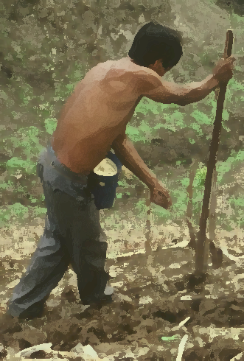

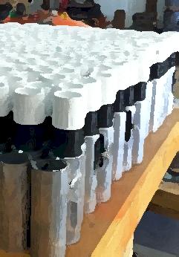
OSU Developing World Hand Planter
Randy Taylor
Nyle Wollenhaupt
Adrian Koller
Bill Raun

Slide 2

Dr. David Waits (Chairman, Cowboy Technologies)
Dr. Richard Gajan (School of Entrepreneurship)
Dr. Amy Dronberger (Cowboy Technologies)
May 28, 2014
david.waits@okstate.edu
rgajan@okstate.edu
amy.dronberger@okstate.edu

Slide 3
OSU Hand Planter
works well over a range of seed sizes (1200 to 2000 seeds/lb)
80,000,000 ac’s of corn planted, weeded, hoed, and harvested by hand
World area planted by hand = corn area in the USA
average farm sizes are 2 ac’s
NGO support, interaction, and ultimate subsidizing of this work is expected
January 2014, conducted an international hand planter workshop whereby on-line-internet attendees included locations in Africa, Asia, Latin America, and the USA
http://nue.okstate.edu/Hand_Planter/osu_hand_planter_workshop.html

Slide 4
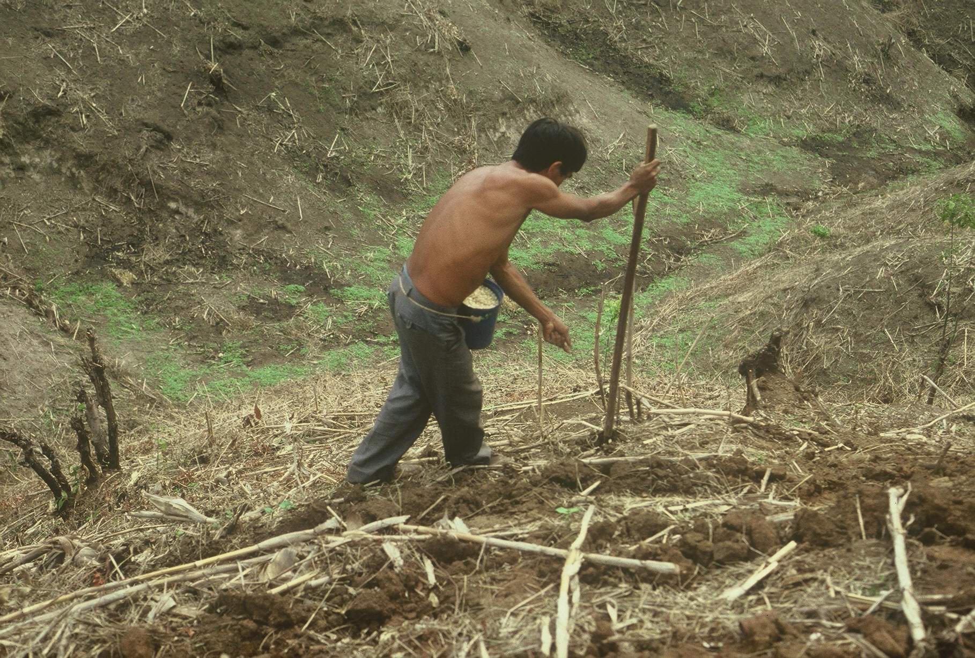


Slide 5
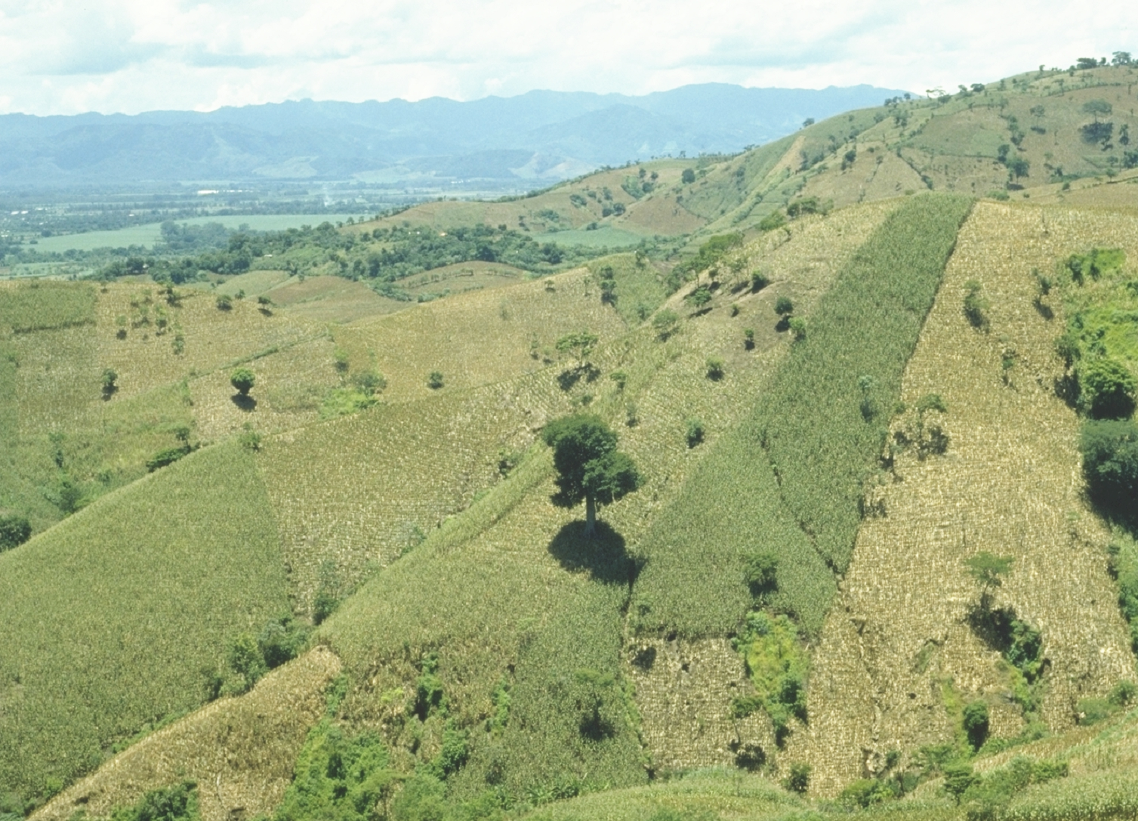
EL SALVADOR

Slide 6
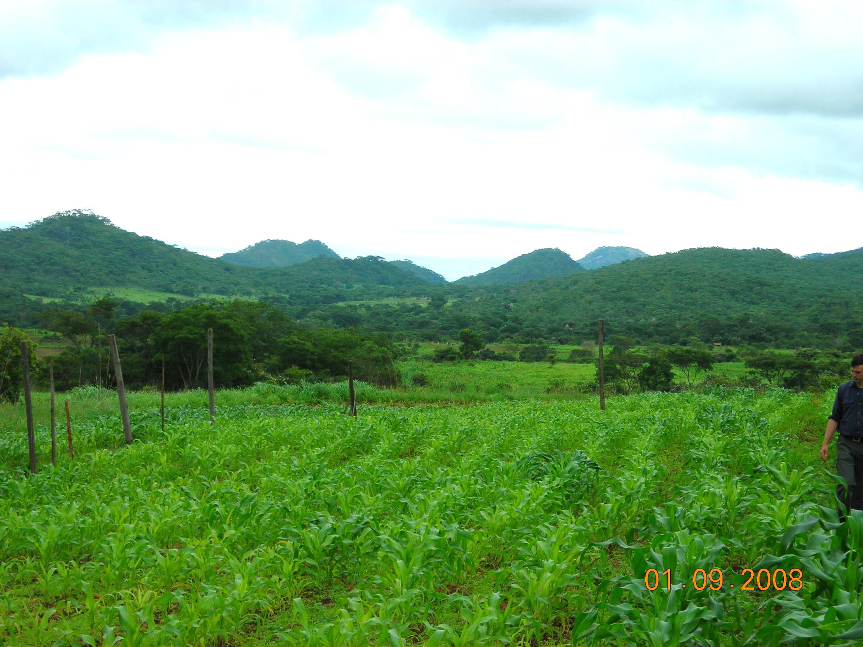
ZIMBABWE

Slide 7
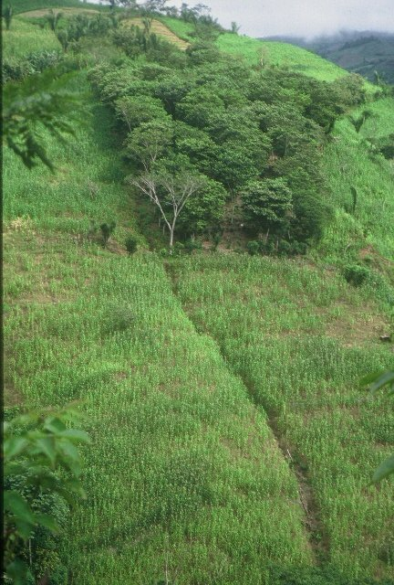
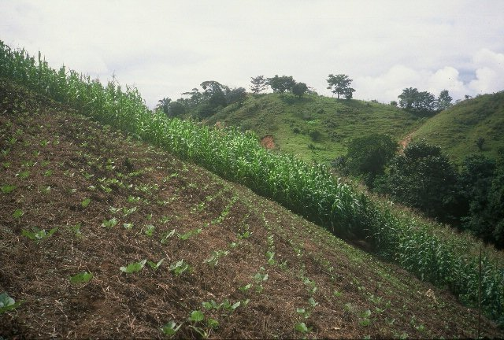
HONDURAS

Slide 8
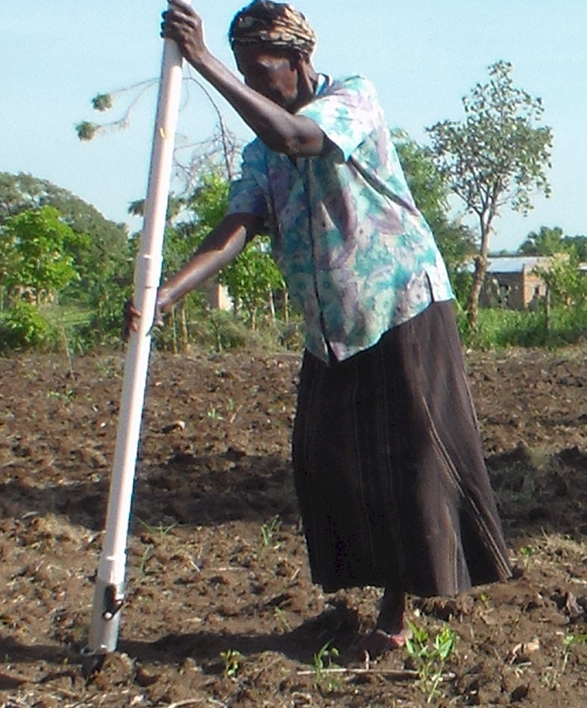
UGANDA

Slide 9
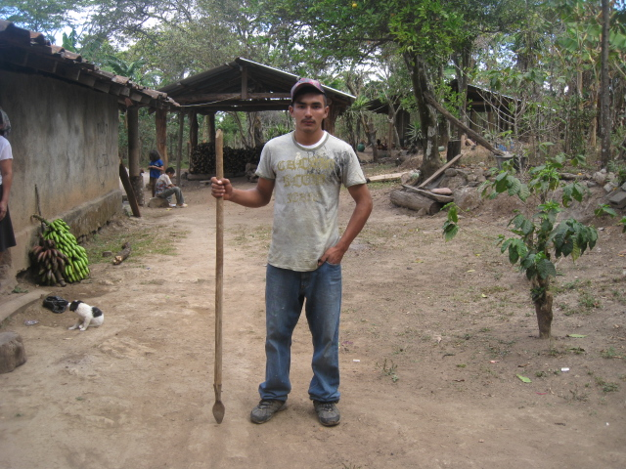
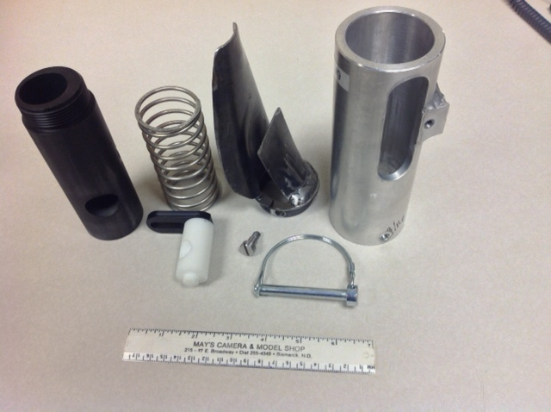
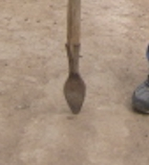
seed size (2653-4344 seeds/kg)
seed type, shape
fertilizer
1,000,000 cycles
0.29g/seed
60,000 seeds/ha
3443 seeds/kg
1.0 kg hopper
17 times refill
http://nue.okstate.edu/Hand_Planter.htm

Slide 10
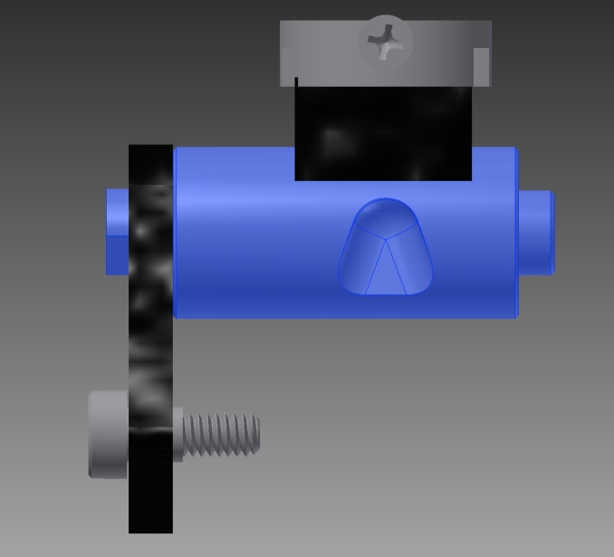
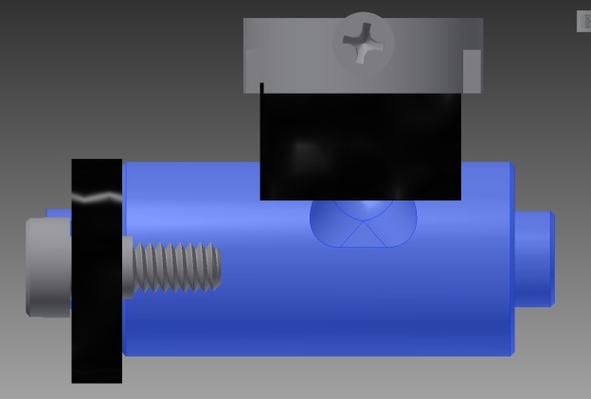
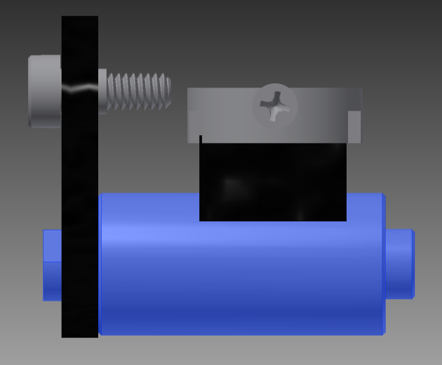
Reciprocating Drum Action
Drum rotates with the cavity moving back into the seed hopper as the spring is compressed.
Spring is fully compressed and the singulation drum cavity is exposed to seed in the hopper
Drum position when planter is relaxed.
As the force on the spring is released, the singulation drum rotates back to the initial ‘relaxed’ position and the seed is dropped.

Slide 11
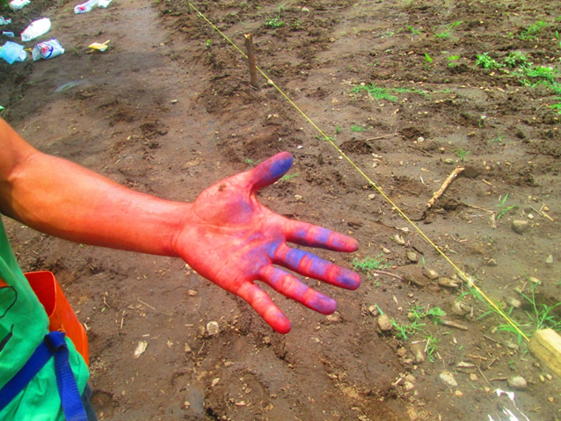
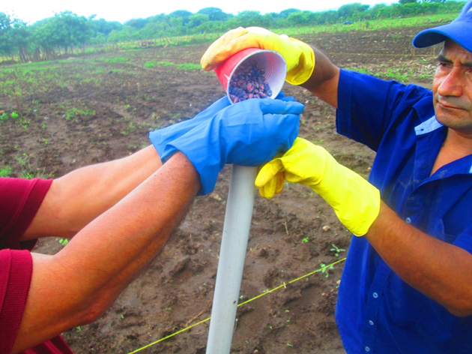
El Salvador, Hand Planter Trials, June, 2014

Slide 12
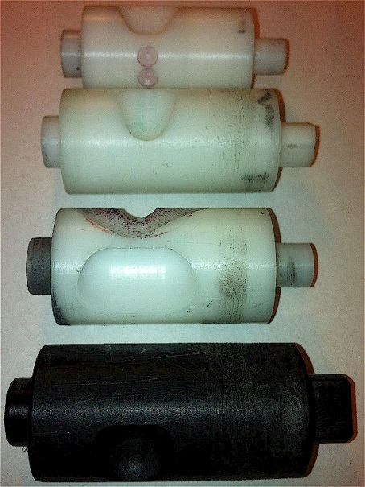
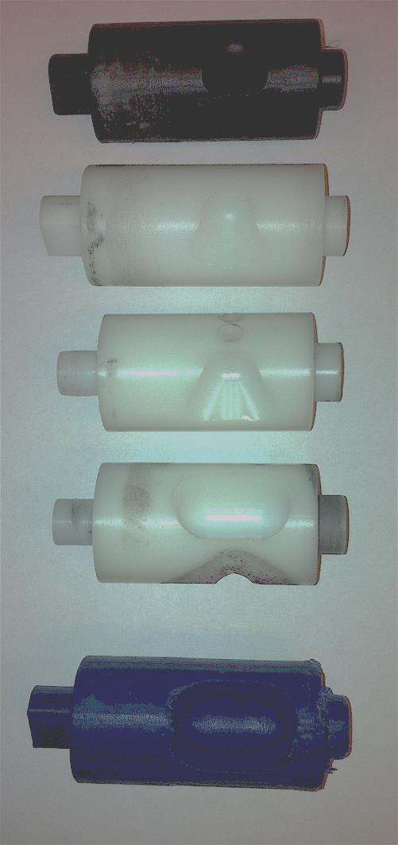
INTERNAL DRUM
Drum | Mass (g) | Volume (cm³)
A | 0.69 | 0.507
B | 0.71 | 0.521
OS | 0.88 | 0.646
OM | 3.36 | 2.468
OC | 3.38 | 2.482

Slide 13


OSU Hand Planter

Slide 14
Nov 13, 2013
SED = 8.6

Slide 15
Options
A. Retain venue where we can get planters into the hands of producers (independent of both smaller and/or large scale agreements with others).
NGO model could end up being a very small facet of the big picture but still needed
B. AGCO licenses planter through OSU.
AGCO delivery to larger markets (gardeners, walmart, food-plot industry) would be entirely up to them
What they call the planter, price, etc., would be under their control
AGCO pays OSU a certain value per planter sold.
TWR would negotiate with OSU so as to allow future research/ownership in the “technology.”
If AGCO takes leadership, our agreement (OSU) would include a research/extension role. if AGCO wants to grant “exclusive” agreements with x-group for “Africa” that would be their decision. Keep us as consultants
C. Indigdev as the Management Team. Joshua Ringer, respected with many good skills. Would need a written agreement
Business model? Use TBDP $30,000 to refine the planter and if this all takes off, it will obviously benefit OSU

Slide 16
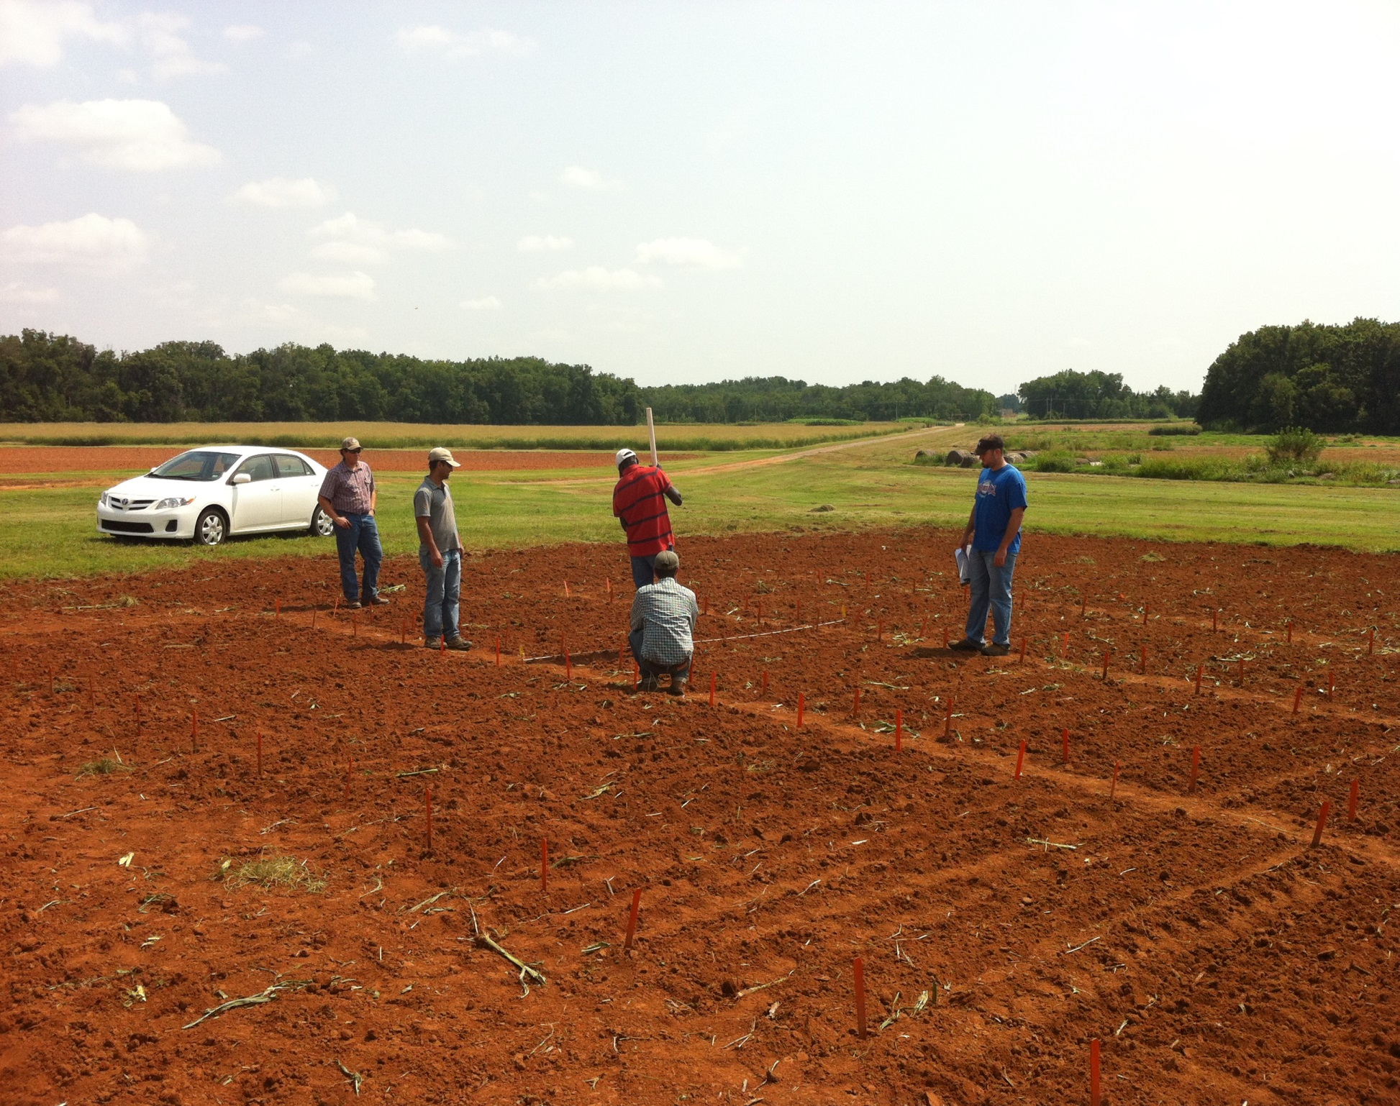

Slide 17
Planning rkt
Is Indigdev the management team?
License technology to Indigdev
Indigdev will have long term role in distribution and support for the planter
Weaknesses: Limited business management skills. Would we invest in them independently?
not Indigdev, then who?
Can Cowboy Technologies provide a management team. This will cost us a share of any LLC that we form (negotiation with Cowboy Technoligies). TWR would be part owners and consultants to the LLC
What is our business model?
-get planters branded to reduce costs
-primary brand for one fee and a secondary brand (approved by the primary brander) for reduced fee
-planter is durable and only real parts to replace or exchange are the metering drum, spring, and tip
-need local, in-country clearing house
-we ship parts and they build custom planters
-helps the local economy and creates ‘local ownership’

Slide 18
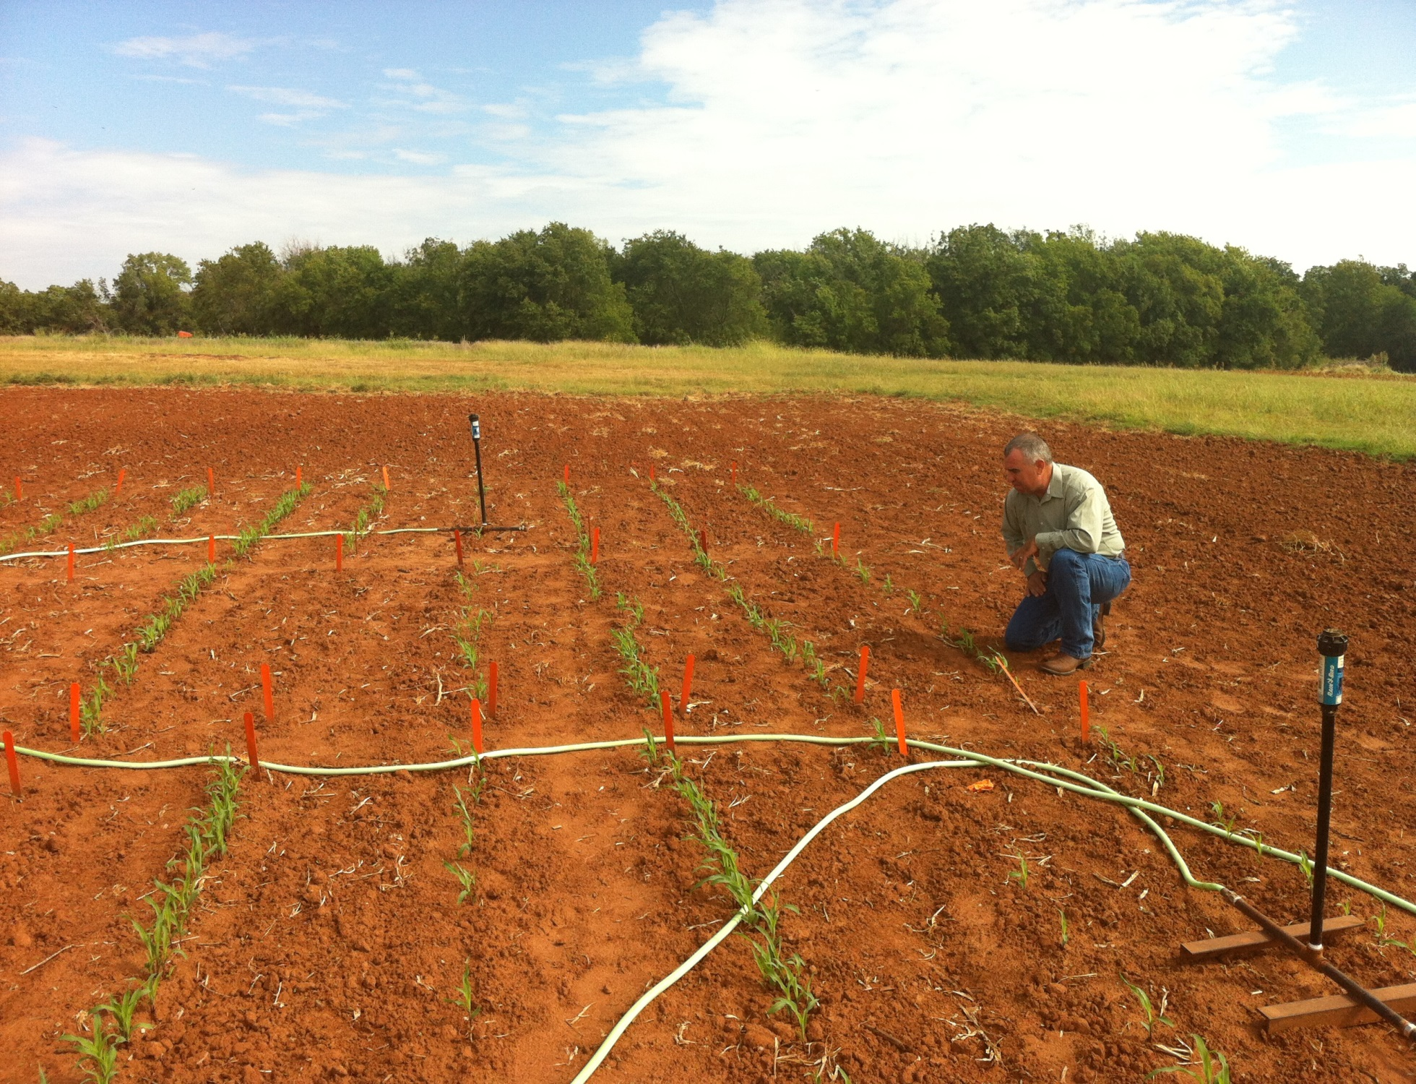
1,000,000 cycles, no failures
1 hectare, 100,000 seeds/ha, 10 years

Slide 19
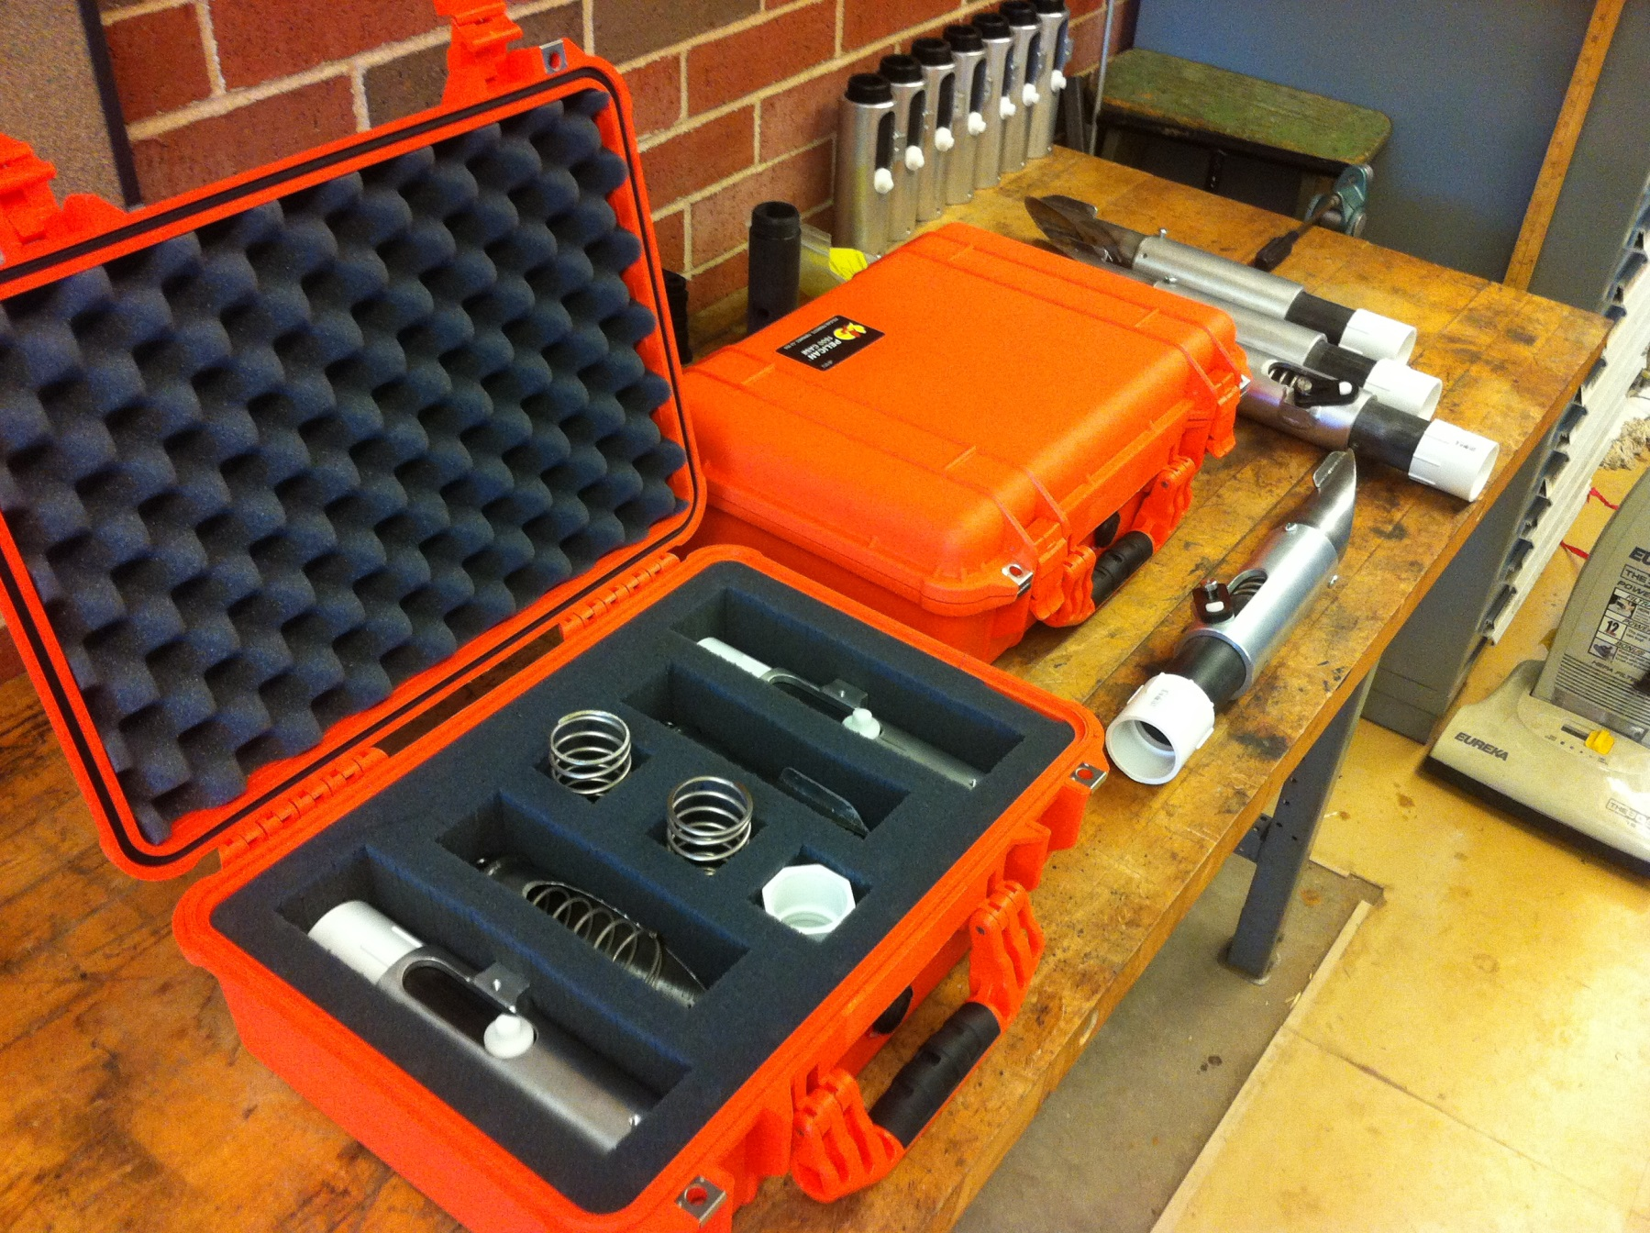
OSU Hand Planter
Thailand Mexico Zambia
El Salvador Guatemala
Regional Trials: El Salvador, Thailand, Colombia, Uganda, Zambia

Slide 20
Grain production is vital because worldwide people get 48% of their calories from eating grain directly. As incomes rise, the percent drops dramatically as diets change to include more meat, milk, eggs and other foods that require more grain to produce. About 48% of grains are eaten directly, 35% fed to animals, and 17% for ethanol and other fuels.
Worldwatch Institute

Slide 21
Bangladesh
Burundi
Belize
Brazil
Colombia
El Salvador
Ethiopia
Guatemala
India
Kenya
Malawi
http://nue.okstate.edu/Hand_Planter/osu_hand_planter_workshop.html
Mexico
Mozambique
Sierra Leone
Nepal
Philippines
Tanzania
Togo
Uganda
USA
Zambia
Zimbabwe

Slide 22
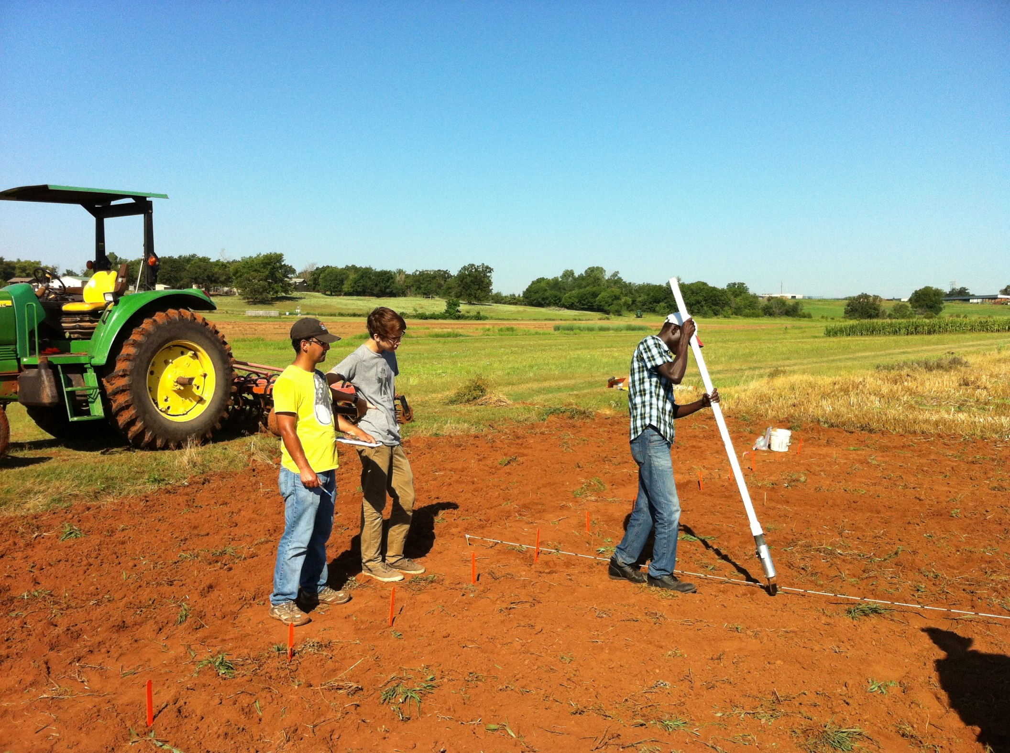



Slide 23
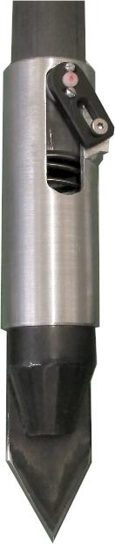
Technology to be commercialized (OSU Hand Planter)
Remove chemically treated seed from the hands of producers
Decrease soil erosion via improved plant spacing
Accommodate mid-season application of urea-N
Place urea below the surface reducing NH₃ losses
Increase corn production and NUE

Slide 24
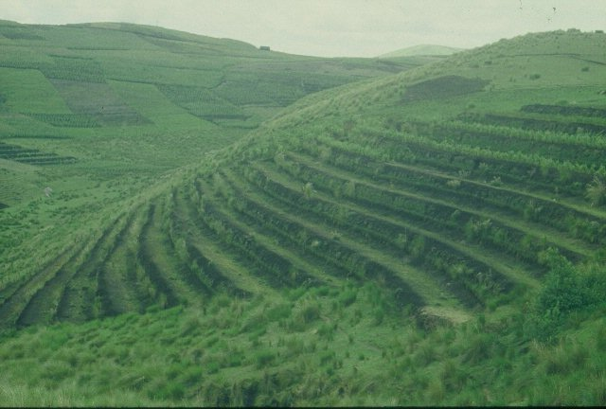
GUATEMALA

