Slide 1

Dr. Shelly Sitton
Dr. Craig Edwards
Dr. Lisa Taylor
The Empowering Aspiring Entrepreneurs for
Economic Success
May 9, 2014

Slide 2
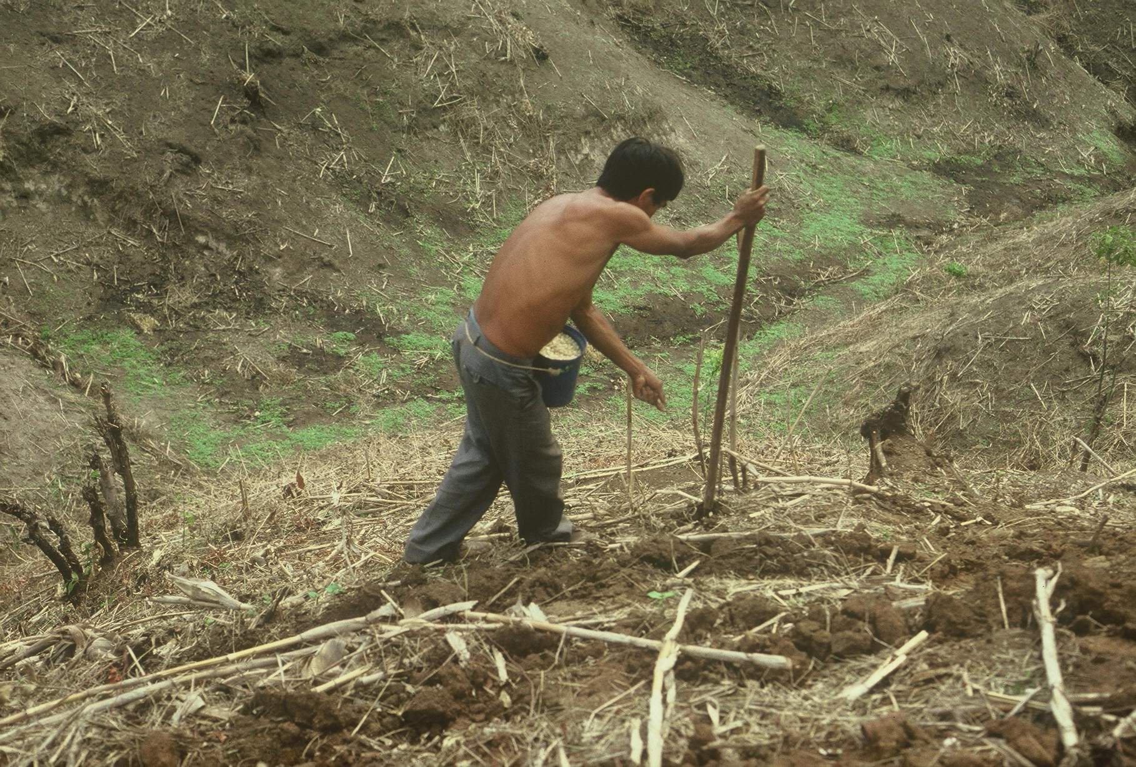


Slide 3

GUATEMALA

Slide 4
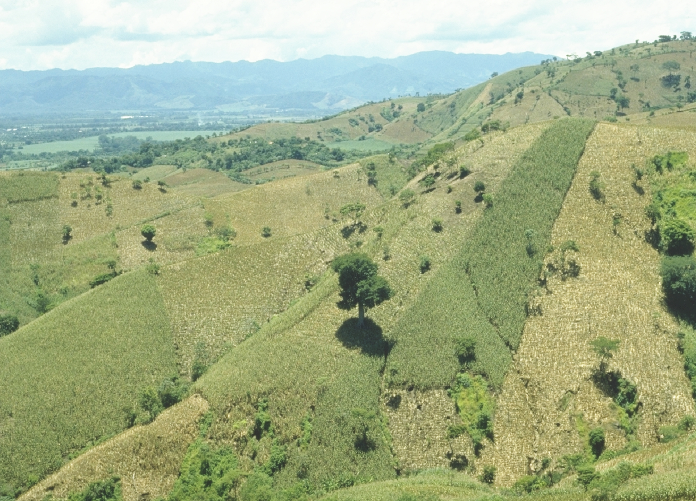
EL SALVADOR

Slide 5
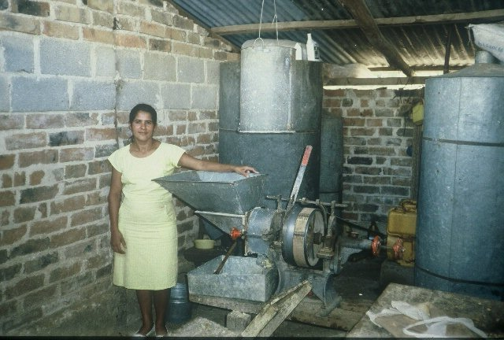
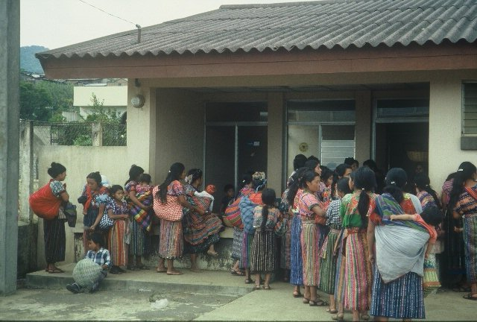
GUATEMALA

Slide 6
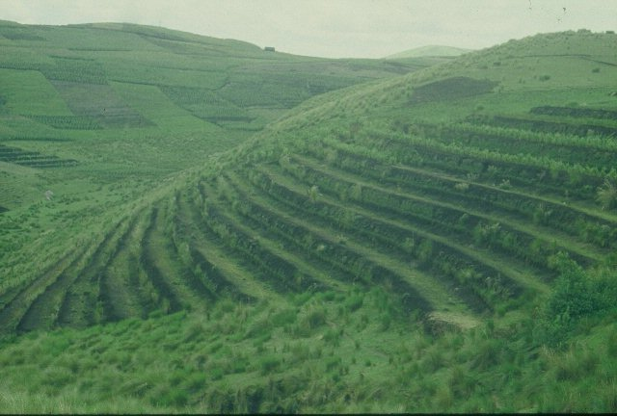
GUATEMALA

Slide 7
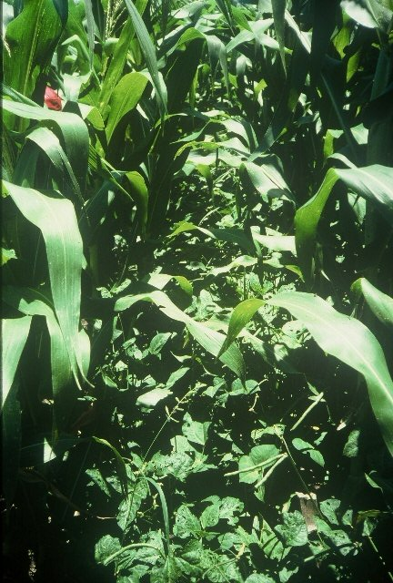
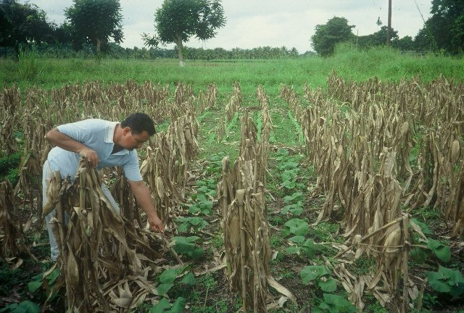

Slide 8
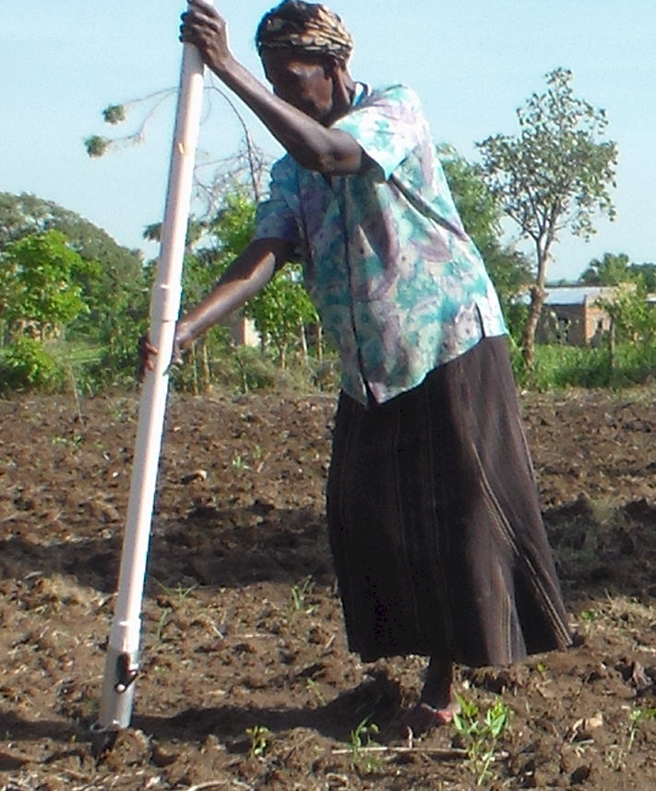
UGANDA

Slide 9

WORLD MAIZE
177,000,000 ha (2012)
4.9 Mg/ha
48,370,000 ha, developing world
60% planted by hand
≈ 29,000,000 ha or 16% of the maize area in the world
 | Area, ha’s |  | Production, Mg
USA | 35,359,790 | 19% | 273,832,130 | 31%
China | 34,966,000 | 19% | 208,234,649 | 24%
Developing (DW) | 48,370,000 | 27% | 97,000,000 | 11%
by hand (60% of DW total) | 29,000,000 | 16% | 58,000,000 | 6%

Slide 10
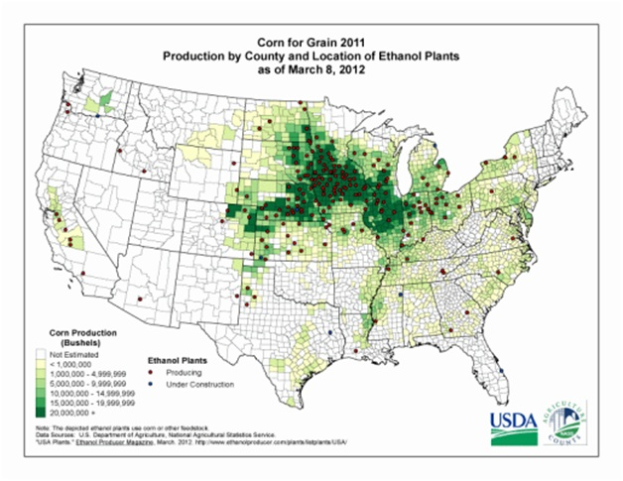
35,359,000 ha’s maize USA
(88,000,000 acres)

Slide 11
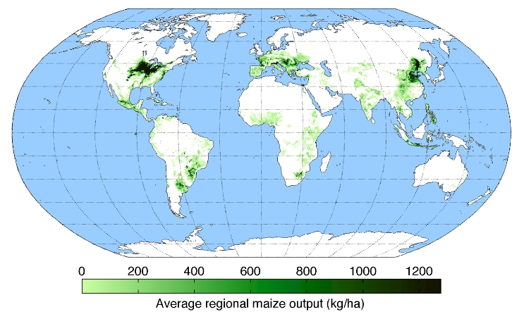
WORLD MAIZE
Global Biogeochemical Cycles 22: GB1022. doi:10.1029/2007GB002947

Slide 12
Hand Planter Need
Homogeneity of plant stands and emergence, decrease plant-to-plant variation and increase grain yields (Martin et al., 2005)
Maize emergence delayed by as little as four days, resulted in a yield depression of 15 percent (Hodgen et al., 2007)
Third world maize yields hover near 2.0 Mg/ha (Dowswell, et al., 1996)

Slide 13


OSU Hand Planter

Slide 14
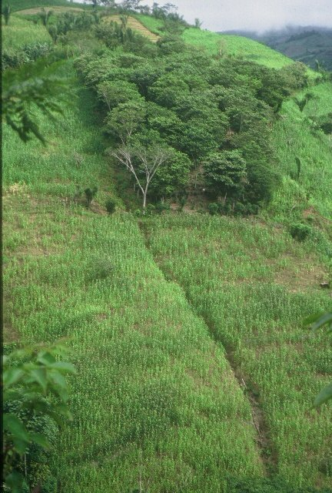
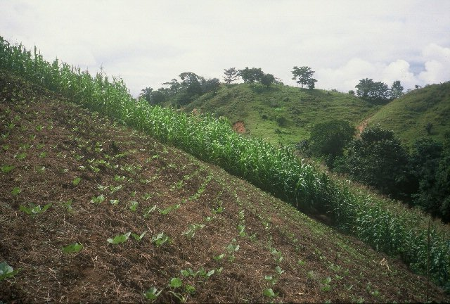
HONDURAS

Slide 15
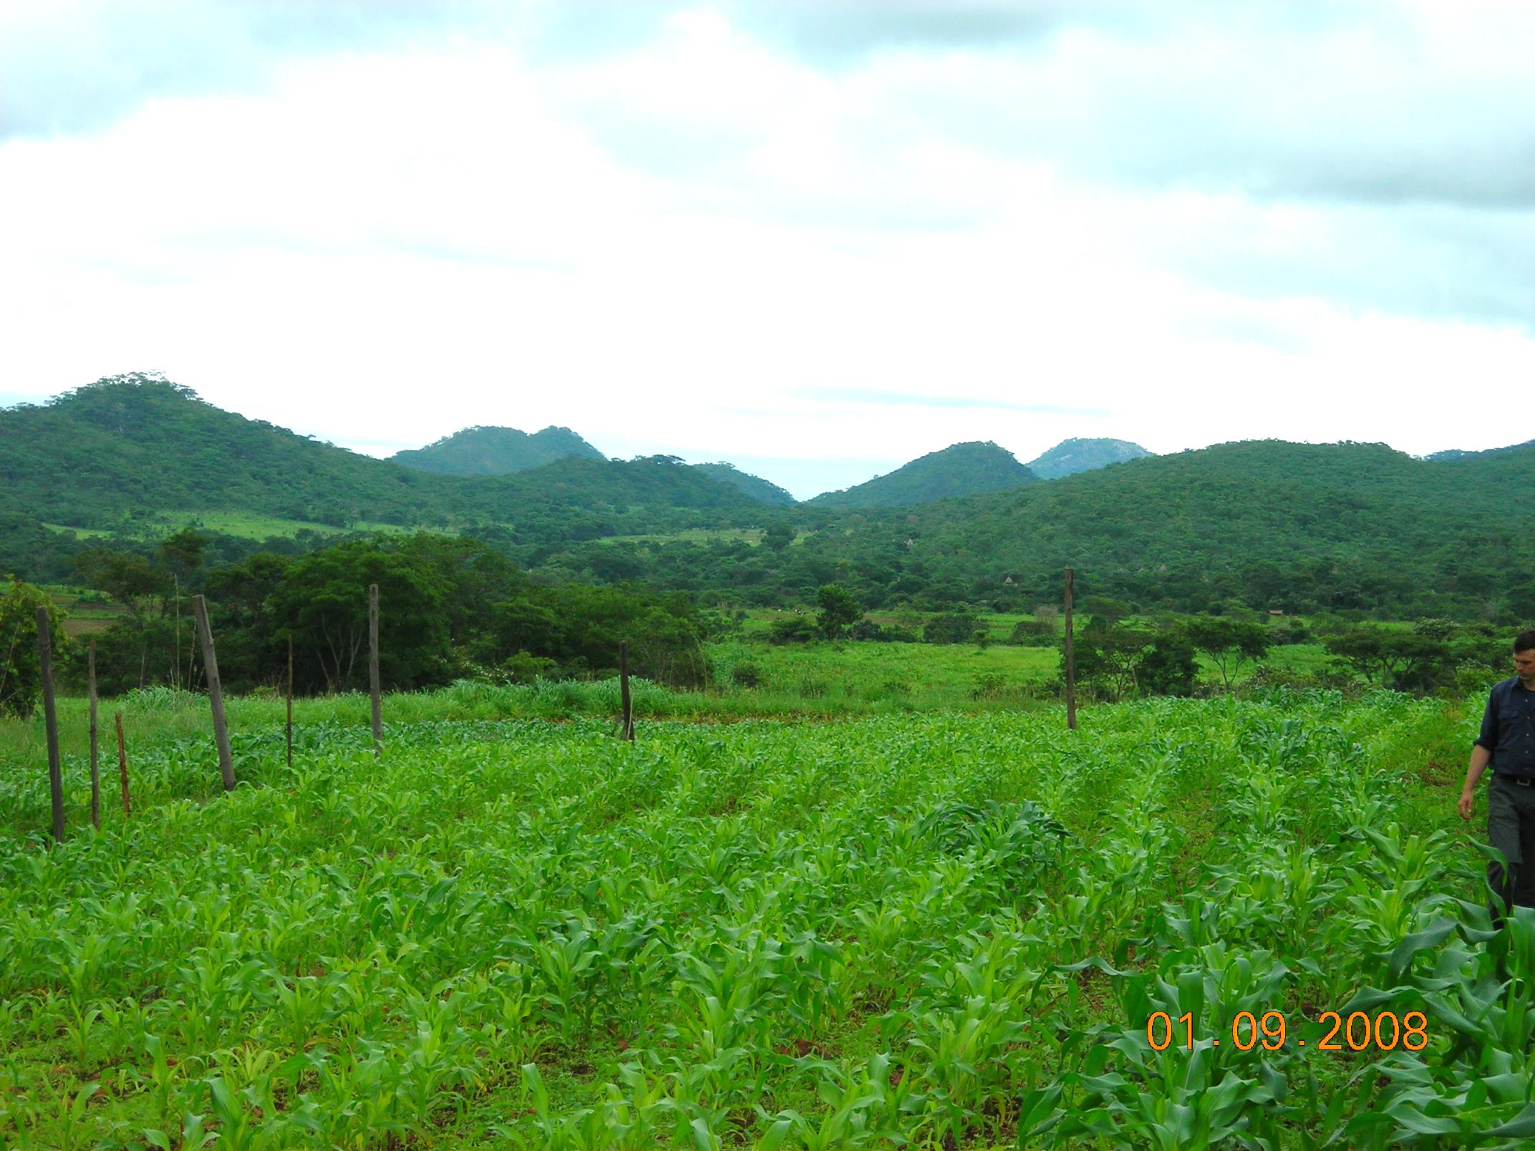
ZIMBABWE

Slide 16
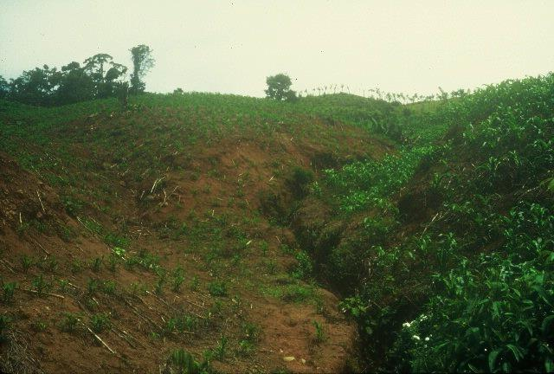
DOMINICAN REPUBLIC

Slide 17
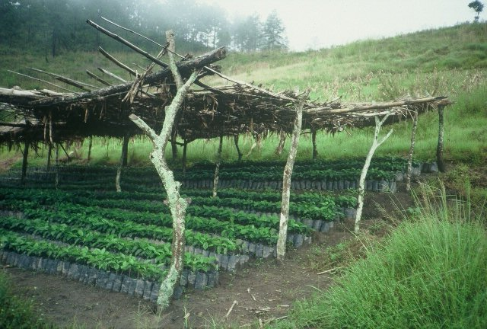
COFFEE

Slide 18
Bangladesh
Burundi
Belize
Brazil
Colombia
El Salvador
Ethiopia
Guatemala
India
Kenya
Malawi
http://nue.okstate.edu/Hand_Planter/osu_hand_planter_workshop.html
Mexico
Mozambique
Sierra Leone
Nepal
Philippines
Tanzania
Togo
Uganda
USA
Zambia
Zimbabwe

Slide 19
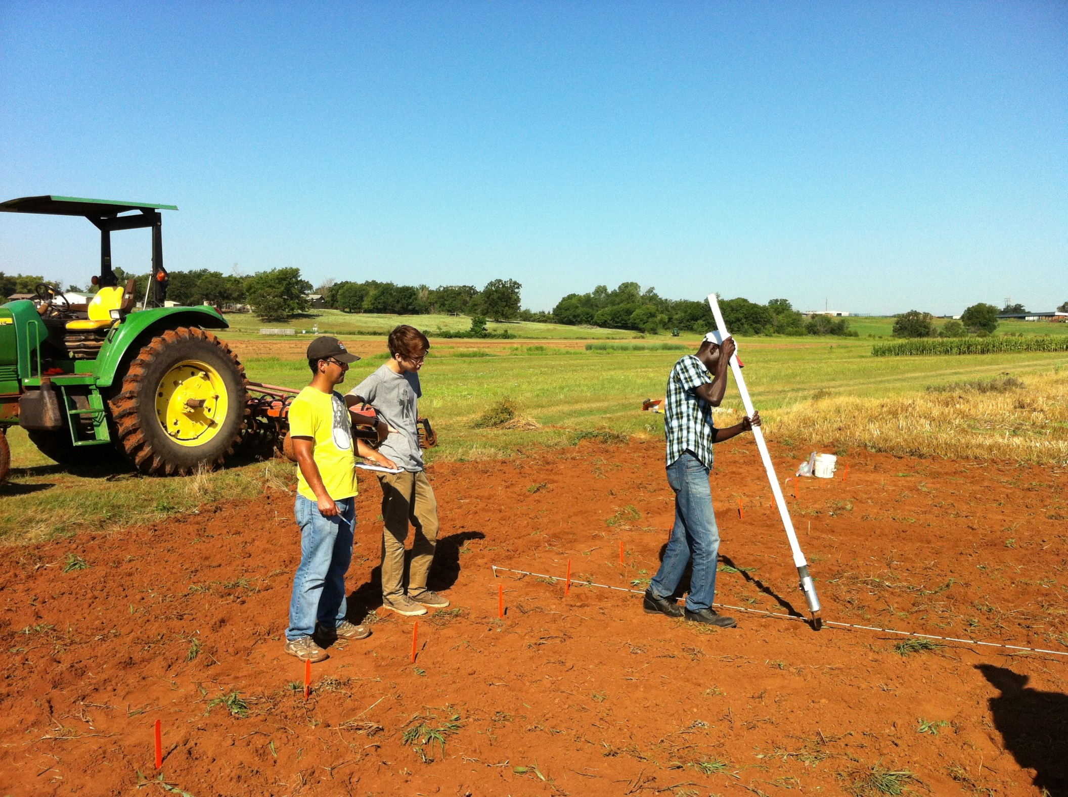



Slide 20
<head>
<meta name="GENERATOR" content="Microsoft FrontPage 12.0">
<title>Nitrogen Use Efficiency, Nitrogen Fertilizers, Wheat Nitrogen Fertilization, Corn Nitrogen Fertilization</title>
<meta NAME="description" CONTENT="Nitrogen Use Efficiency,Nitrogen Fertilizers,RAMP,N Rich Strip,N deficiency,Nitrogen Management,Wheat Nitrogen Fertilization,Maize,Corn Nitrogen Fertilization, pocket sensor, Greenseeder Hand Planter">
<meta NAME="keywords" CONTENT="nitrogen use efficiency,fertilizers,precision nitrogen management,N Rich Strip,N deficiency,ntech, Greenseeker,Greenseeder,Hand Planter, Handplanter, N use efficiency, denitrification, nitrification, NDVI, yield potential, yield prediction, fertilizer recommendations, immobilization, volatilization, agronomy, soil science, plant science, n rich strip, n rich, leaching, tillage, rotation, bedded wheat, ridge-till, foliar N, CIMMYT, plant N use efficiency, nutrient use efficiency, variable rate technology, precision agriculture, maximum uptake, nitrogen fertilizers, nitrogen fertilizer, wheat, corn, rice, sorghum, fertilizers, precision agriculture, crops, sensors, NUE, variable rate technology, Precision Agriculture, Nutrient use efficiency, Nitrogen Sensors, eficiencia del uso de nitrógeno eficiencia del nitrógeno, nitrógeno, nitrogeno, nitrogen fertilization,nitrogen use efficiency defined,definition of nitrogen use efficiency,sensor based,sensor VRT,sufficiency,mobility concept, roger bray, liebig's law of the minimum,pocket sensor,Greenseeder Hand Planter">
<link rel="shortcut icon" href="http://www.nue.okstate.edu/favicon.ico" >

Slide 21
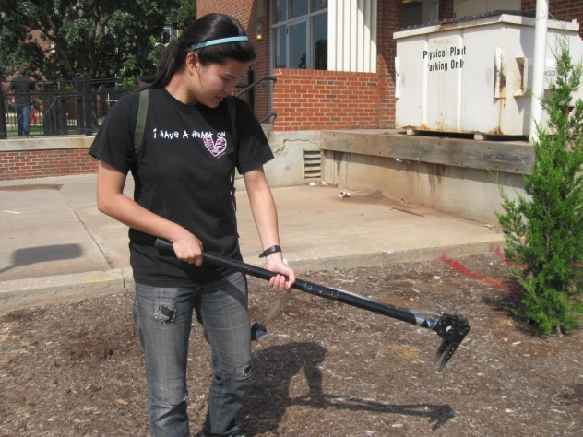
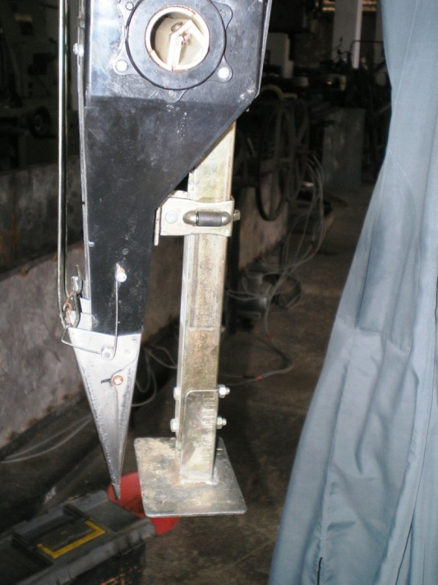
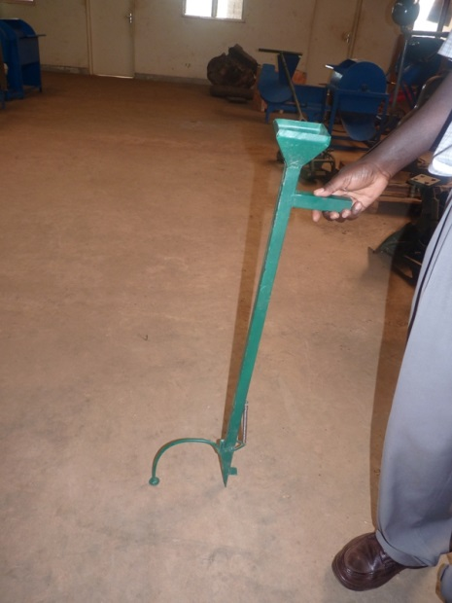
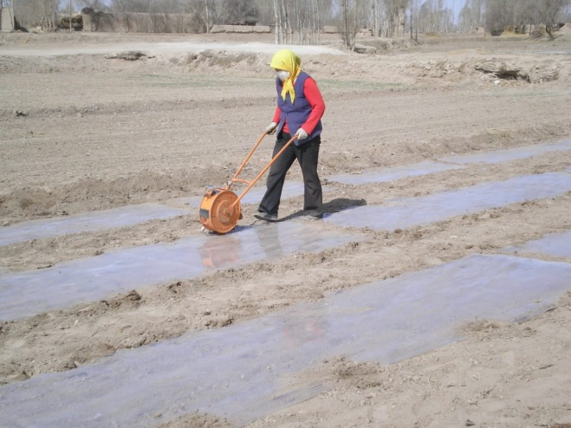
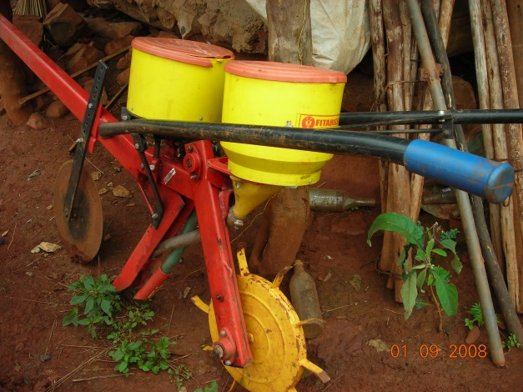
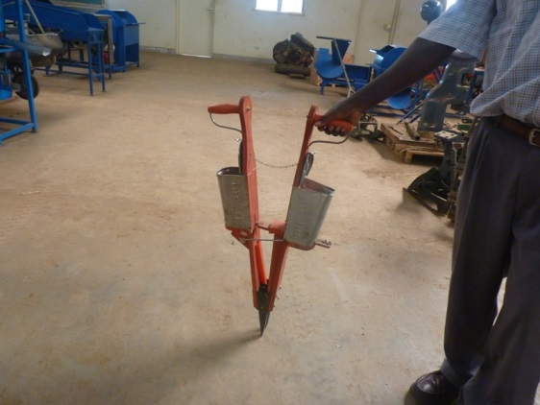
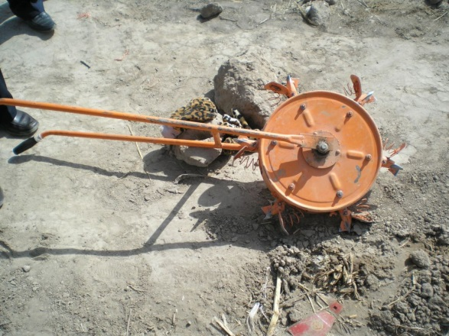

Slide 22
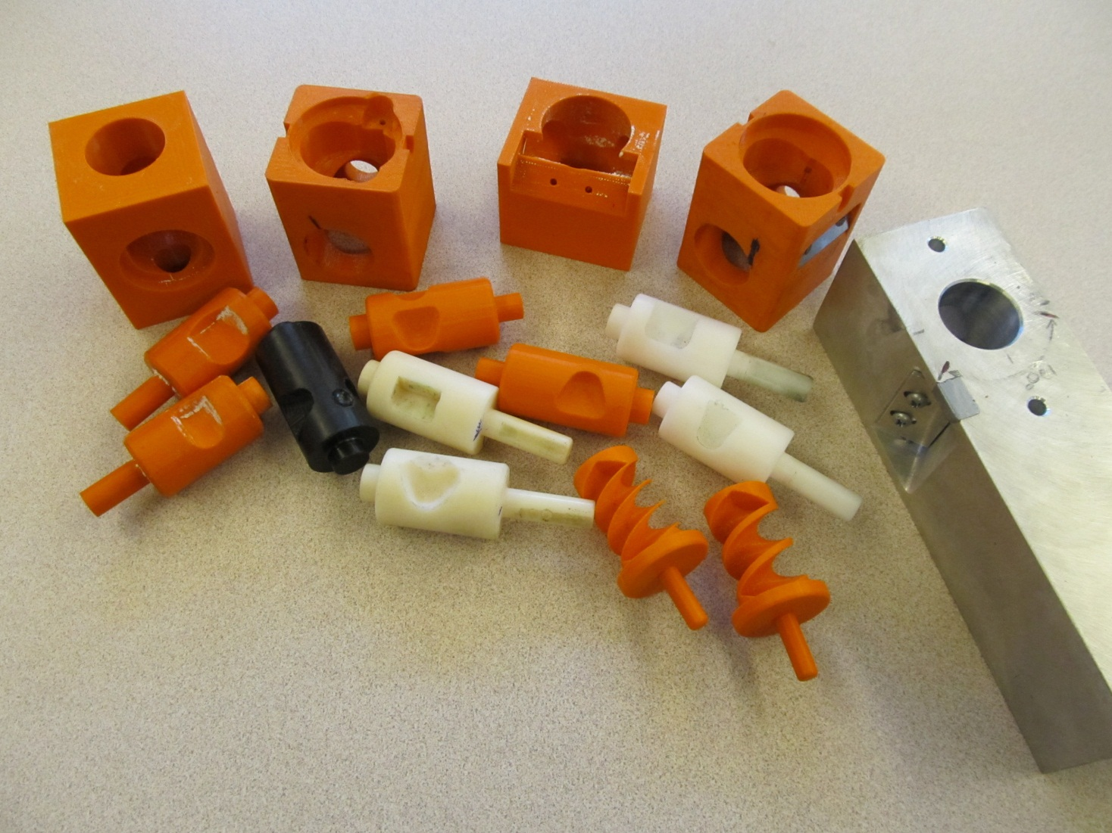
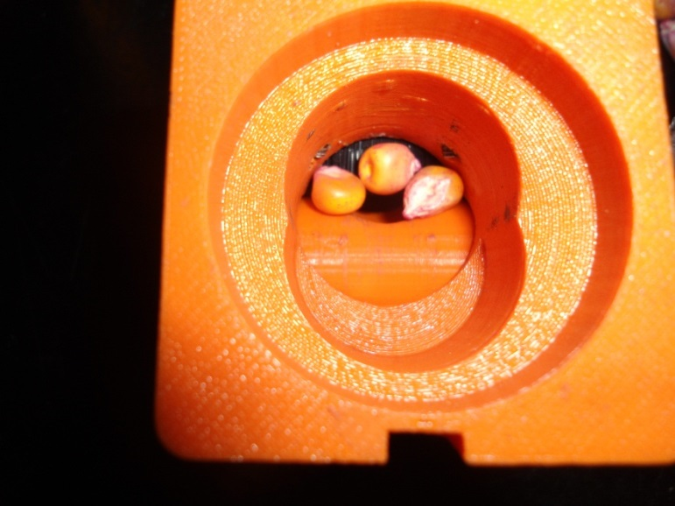
Singulation Design

Slide 23
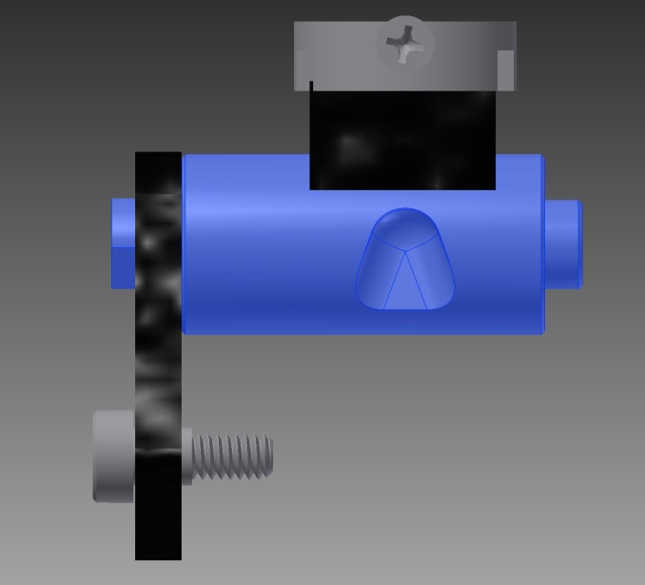
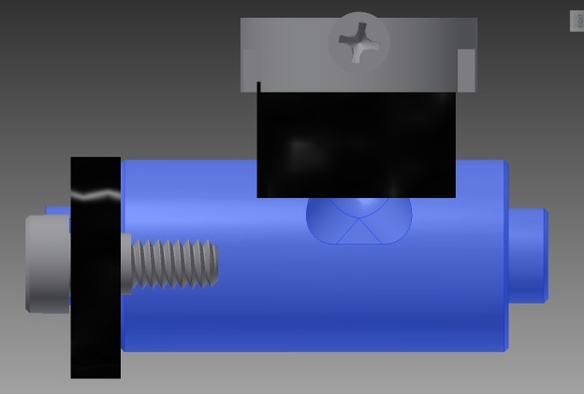
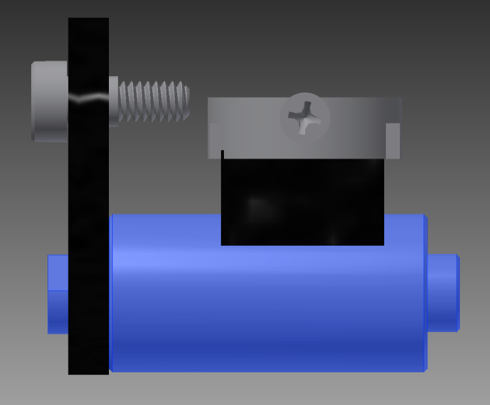
Reciprocating Drum Action
Drum rotates with the cavity moving back into the seed hopper as the spring is compressed.
Spring is fully compressed and the singulation drum cavity is exposed to seed in the hopper
Drum position when planter is relaxed.
As the force on the spring is released, the singulation drum rotates back to the initial ‘relaxed’ position and the seed is dropped.

Slide 24
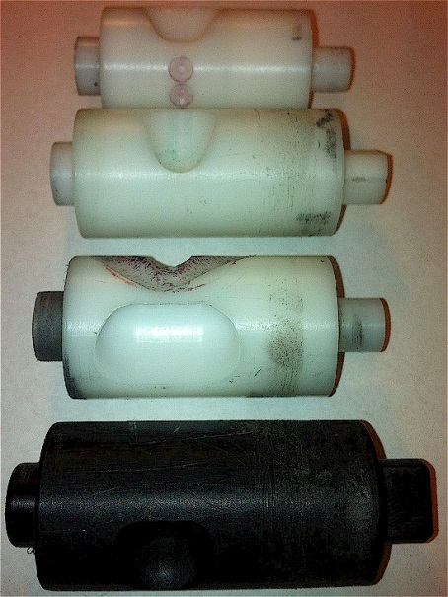
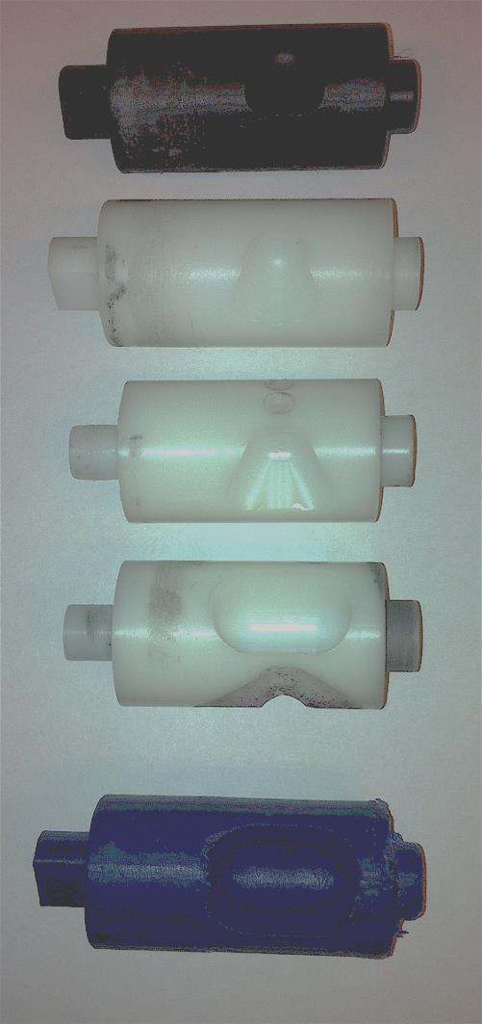
INTERNAL DRUM
Drum | Mass (g) | Volume (cm³)
A | 0.69 | 0.507
B | 0.71 | 0.521
OS | 0.88 | 0.646
OM | 3.36 | 2.468
OC | 3.38 | 2.482

Slide 25
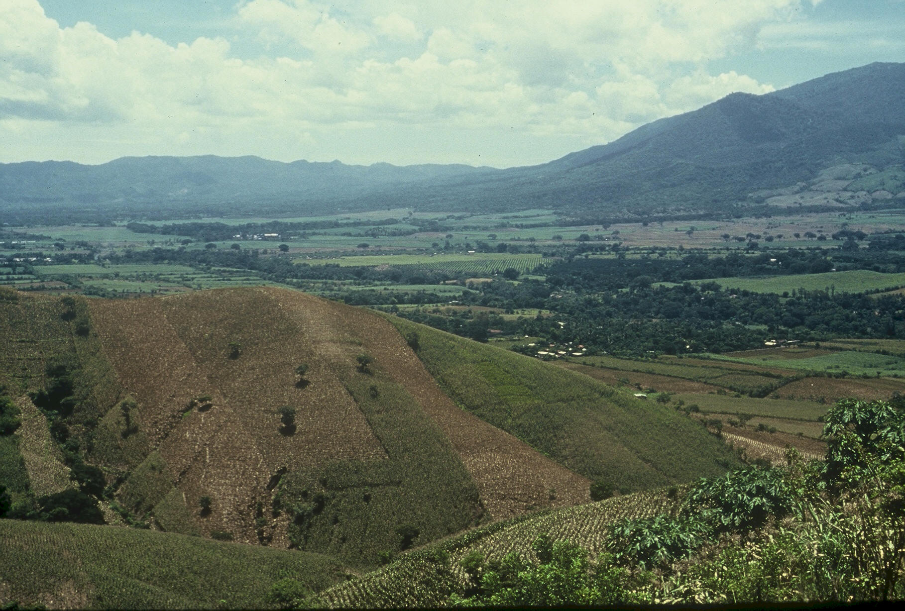
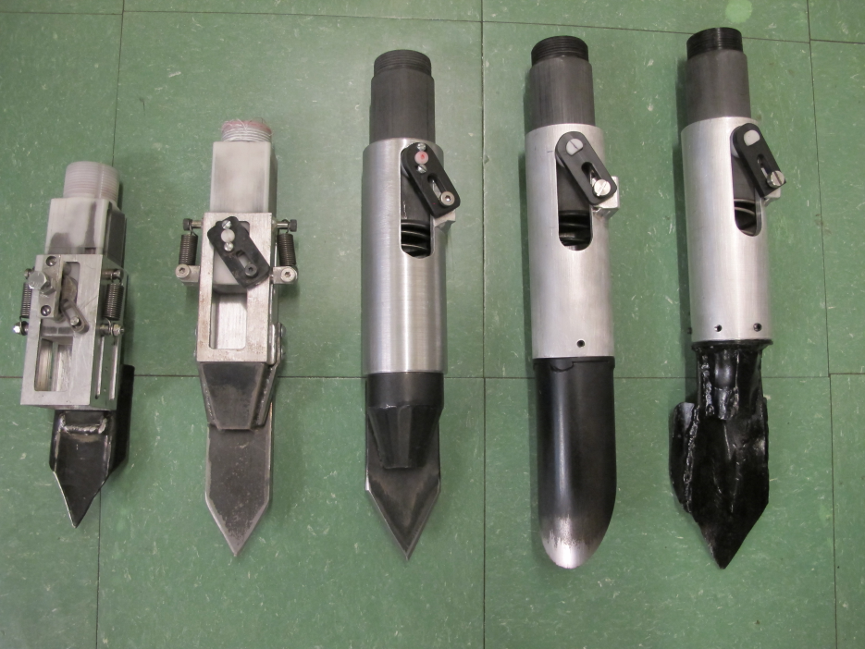

Slide 26
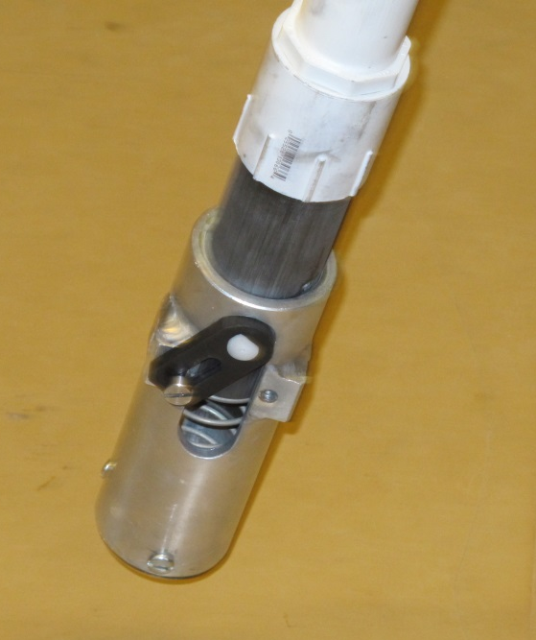
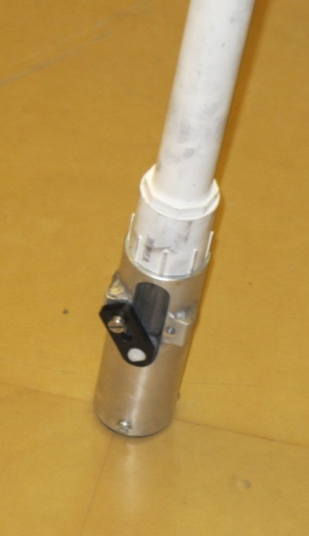
Planter Action
The planter is pressed down and compresses the internal spring.
Singulation drum rotates and seed is released on the down stroke.
The planter is ‘relaxed’ and the spring returns it to the initial position.

Slide 27
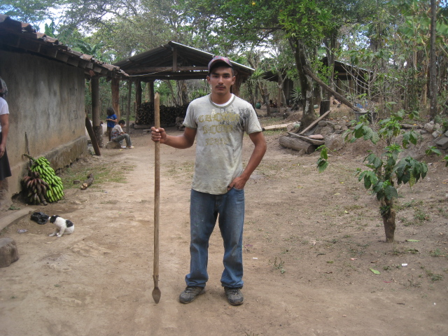
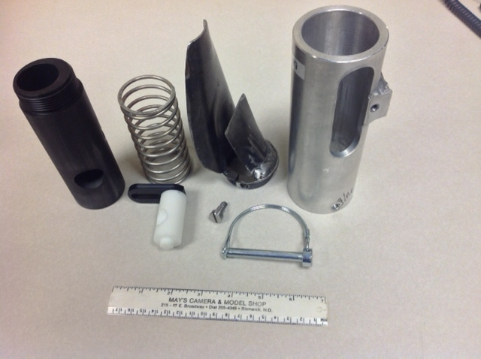
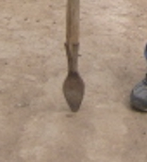
seed size (2653-4344 seeds/kg)
seed type, shape
fertilizer
1,000,000 cycles
0.29g/seed
60,000 seeds/ha
3443 seeds/kg
1.0 kg hopper
17 times refill
http://nue.okstate.edu/Hand_Planter.htm

Slide 28
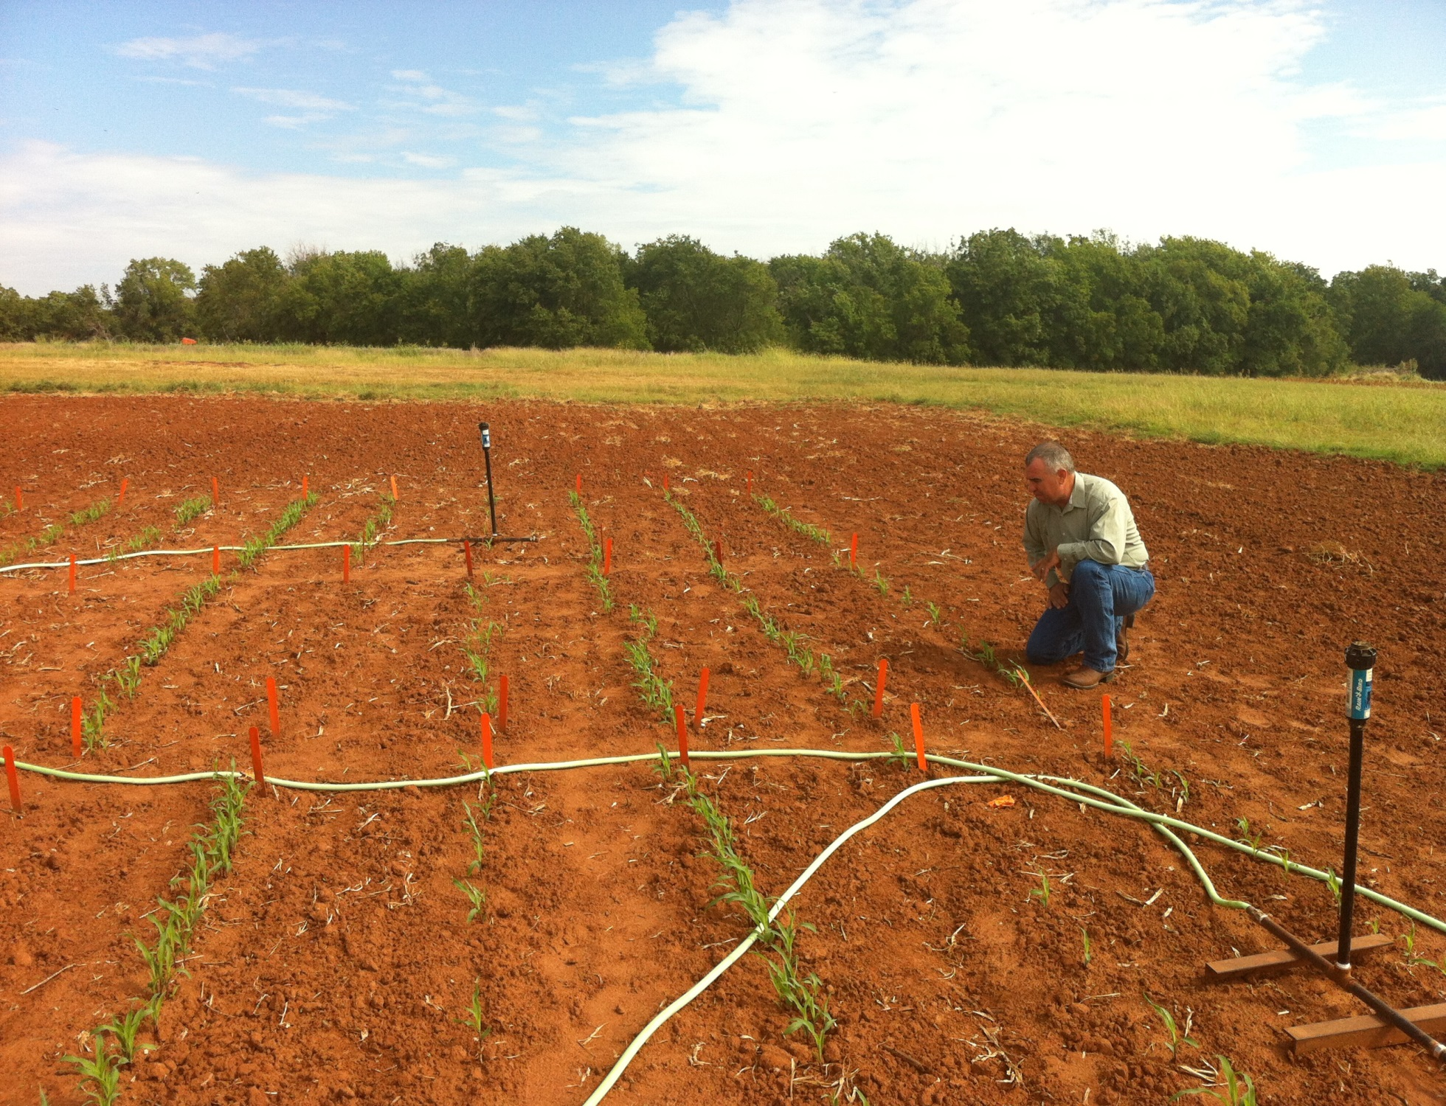
Dr. Randy Taylor
Dr. Nyle Wollenhaupt
1,000,000 cycles, no failures
1 hectare, 100,000 seeds/ha, 10 years

Slide 29
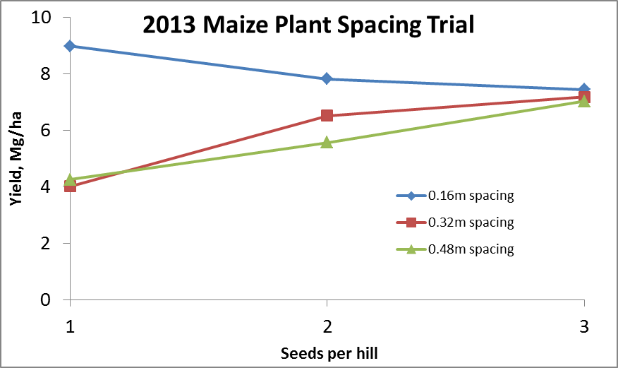
Importance of Singulation
0.76m Row Spacing
Heterogeneity in plant spacing, and plant stands reduce yields
(1997, Nielsen, Purdue)

Slide 30
Nov 13, 2013
SED = 8.6

Slide 31
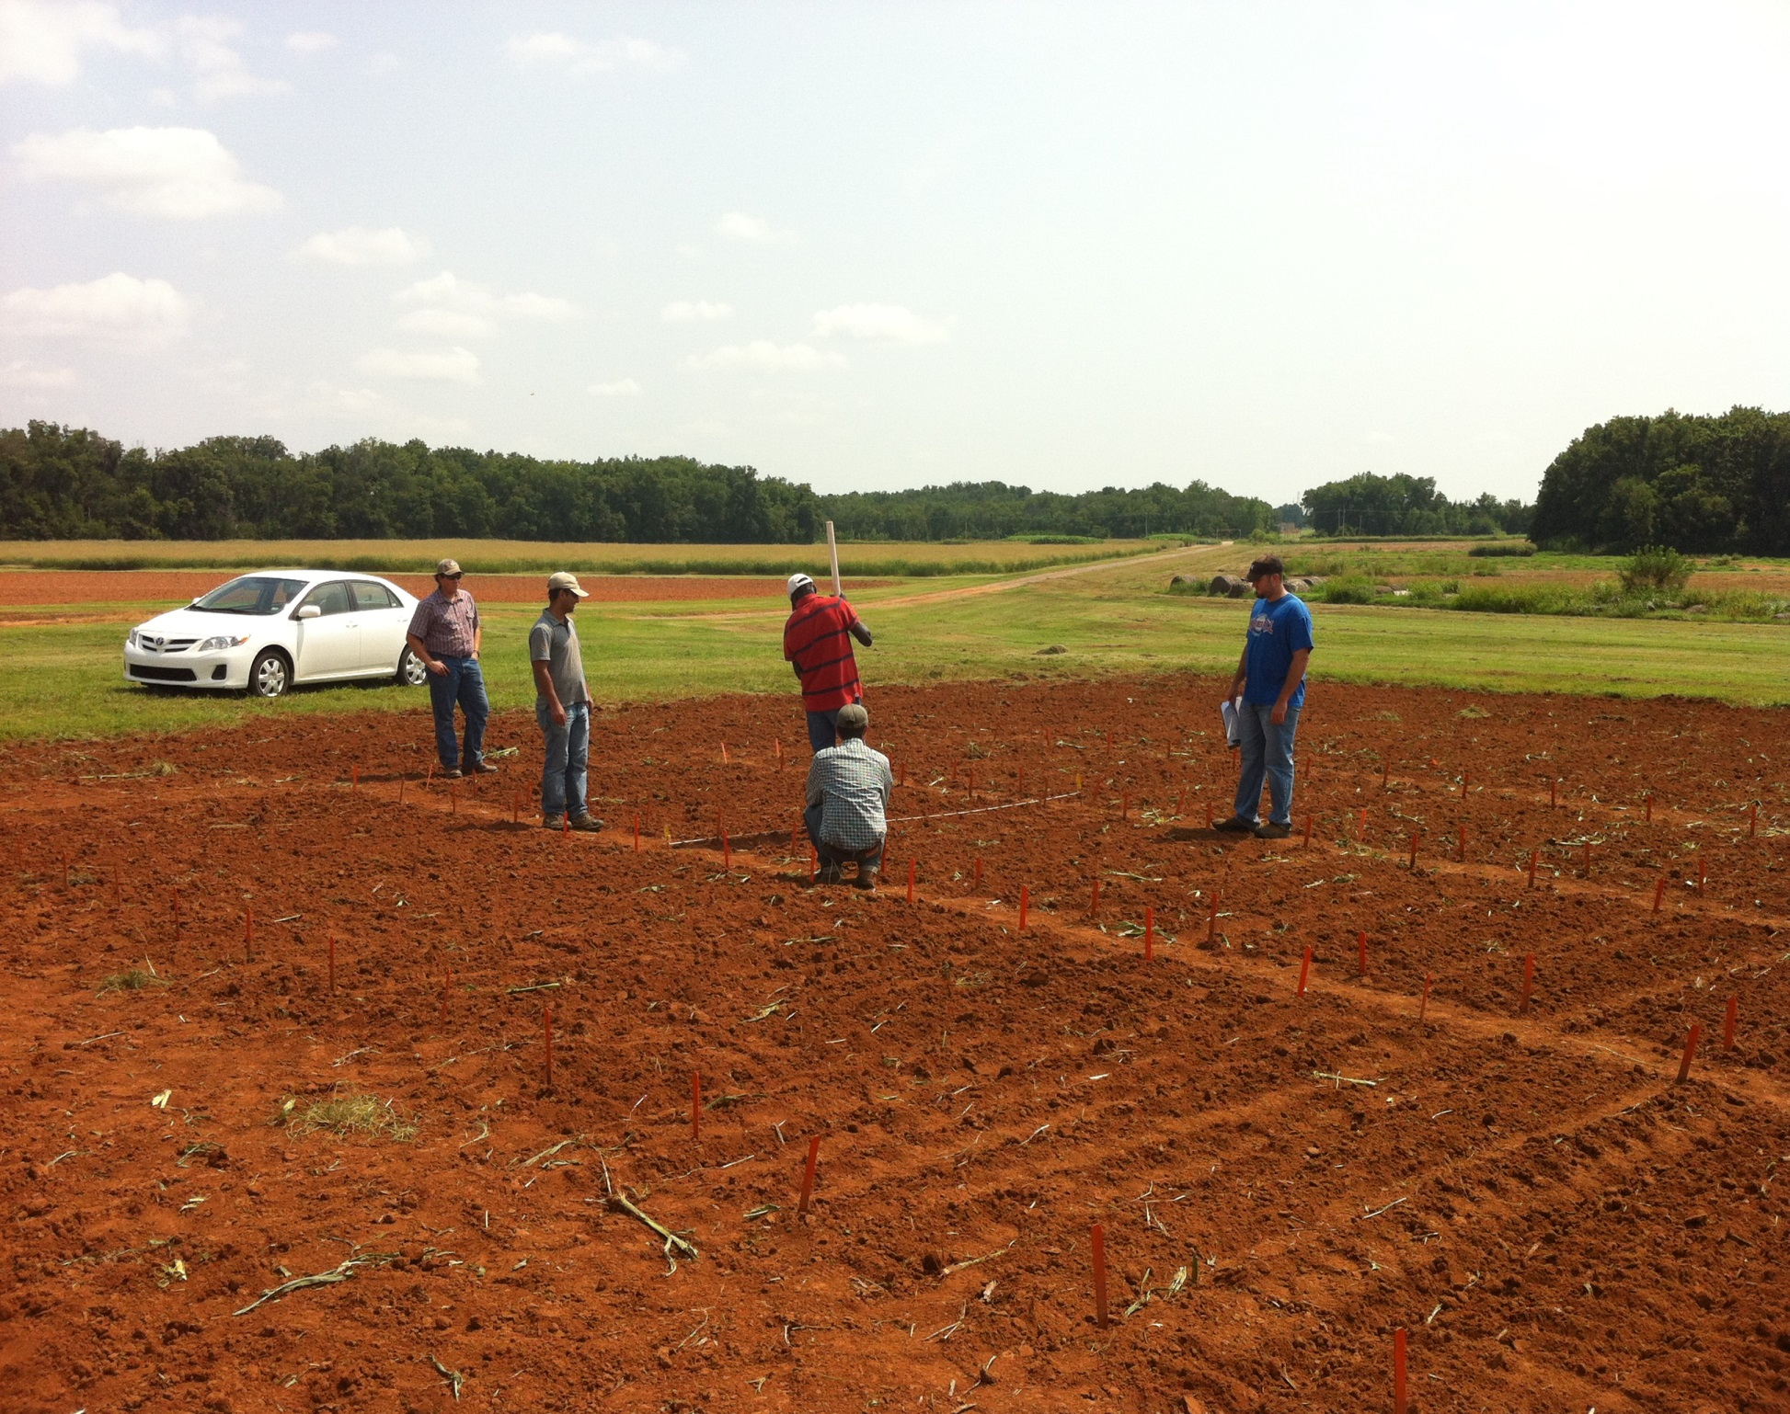

Slide 32
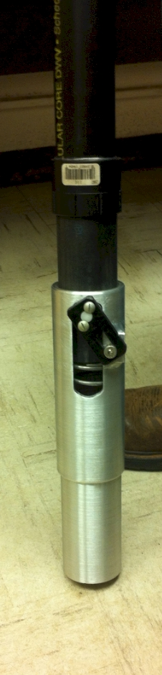
Mid Season Fertilizer N
Efaw and Perkins, 2013
Topdress N, Corn, V12 |  | (70,000 s/ha)
Methods | N, kg/ha | Mg/ha
Check | 0 | 6.6
Hand planter (0.9 g/plant) | 30 | 11.2
Hand planter (1.8 g/plant) | 60 | 10.6
Broadcast | 30 | 6.4
Broadcast | 60 | 7.0
Dribble urea | 30 | 9.3
Dribble urea | 60 | 7.8
Dribble UAN | 30 | 7.3
Dribble UAN | 60 | 10.4
SED = 1.81

Slide 33
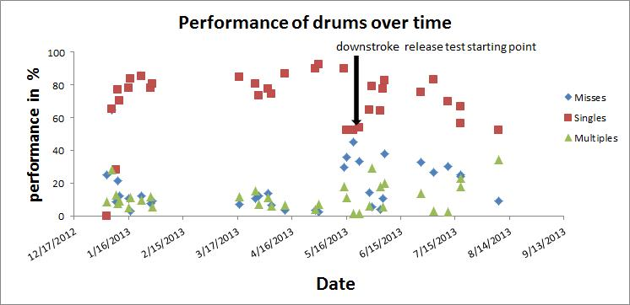

Slide 34
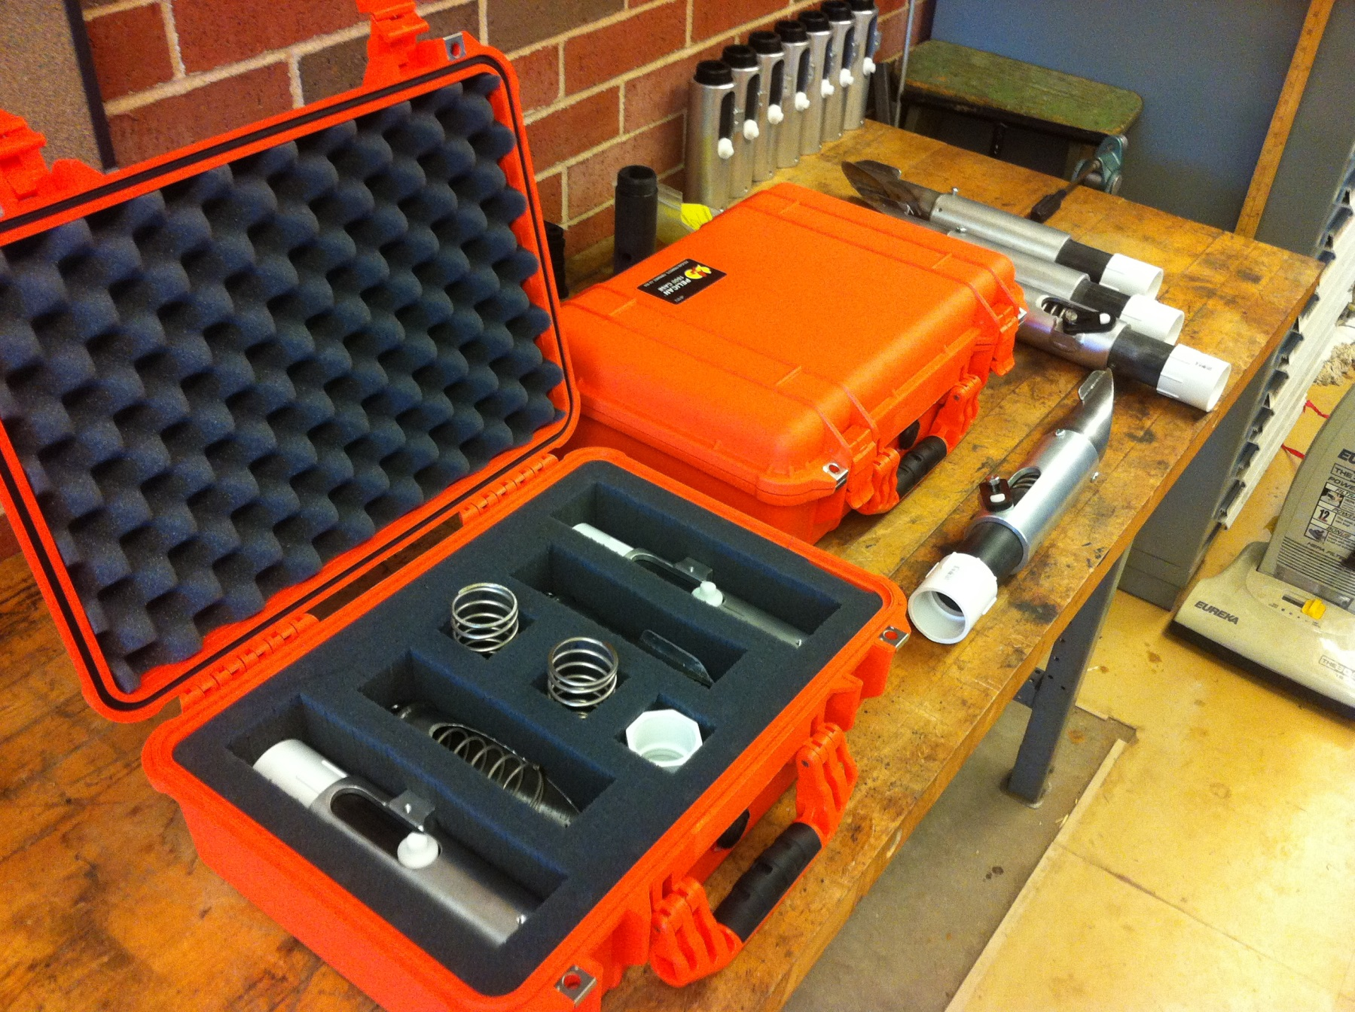
OSU Hand Planter
Thailand Mexico Zambia
El Salvador Guatemala
Regional Trials: El Salvador, Thailand, Colombia, Uganda, Zambia

Slide 35
Increase of 30%
Food production during the same period will have to increase 70%
95% of the increased population will be in the developing world
2050 9.1 Billion

Slide 36
Variables
Brush size, location, stiffness
Drum orientation
Drum cavity size
Drum angle
Internal Housing (1, 2, 3) (brush position)
Seed size, shape (range from 2652 to 4344 seeds/kg)
Operator (many)

Slide 37
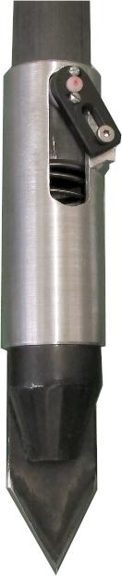
Benefits
Remove chemically treated seeds from the hands of small farmers
Decrease soil erosion via improved plant spacing
Accommodate mid-season application of urea-N
Place urea below the surface reducing NH3 losses
Potential to increase maize production and NUE

Slide 38
Mid Season Fertilizer N
Combined, Efaw and Perkins, 2013
Topdress N, Corn, V12 |  | (70,000 s/ha)
Methods | N, kg/ha | Mg/ha
Check | 0 | 6.6
Hand planter (0.9 g/plant) | 30 | 11.2
Hand planter (1.8 g/plant) | 60 | 10.6
Broadcast | 30 | 6.4
Broadcast | 60 | 7.0
Dribble urea | 30 | 9.3
Dribble urea | 60 | 7.8
Dribble UAN | 30 | 7.3
Dribble UAN | 60 | 10.4
SED = 1.81

Slide 39
Nov 13, 2013
SED = 8.6

Slide 40
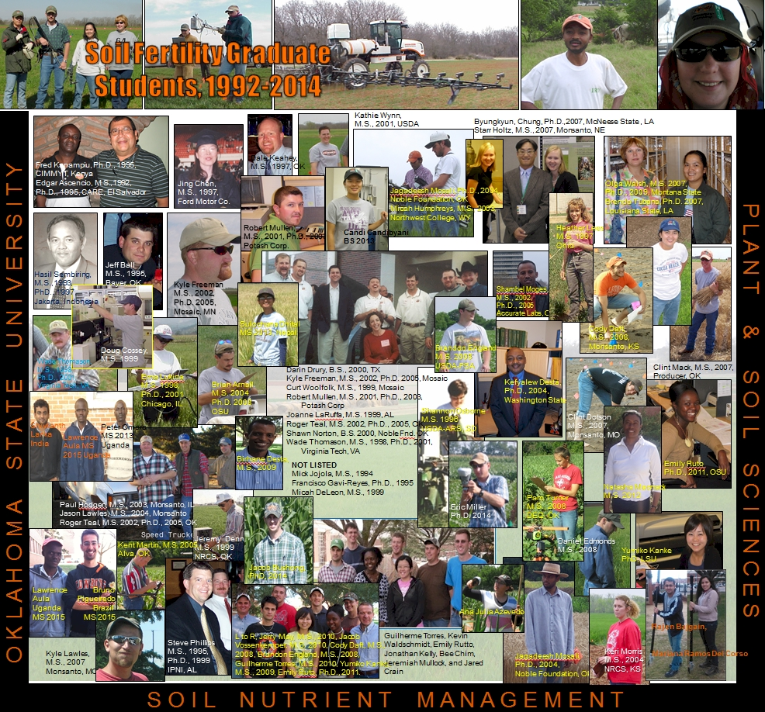

Slide 41
Agriculture and the Environment
Food and Agricultural Organization,
“Livestock's Long Shadow” surveys damage done by sheep, chickens, pigs and goats. But in almost every case, the world's 1.5 billion cattle are most to blame. Livestock are responsible for 18 per cent of the greenhouse gases that cause global warming, more than cars, planes and all other forms of transport put together.
The Independent.co.uk

Slide 42
Grain production is vital because worldwide people get 48% of their calories from eating grain directly. As incomes rise, the percent drops dramatically as diets change to include more meat, milk, eggs and other foods that require more grain to produce. About 48% of grains are eaten directly, 35% fed to animals, and 17% for ethanol and other fuels.
Worldwatch Institute, August 12, 2011 worldwatch.org

