Slide 1

Spring 2014 TBDP Presentation
Dr. Steven Price
Chair, TBDP Committee
Technology and Business Development Program
201 Cordell North
Stillwater, OK 74078 (405)-744-6930
tdc@okstate.edu
Cindy Malayer (405)-744-5361
cindy.malayer@okstate.edu
Angela Cross
Technology Development Center
Oklahoma State University
201 Cordell North
Stillwater, OK 74078 (405)-744-6930
www.tdc.okstate.edu

Slide 2
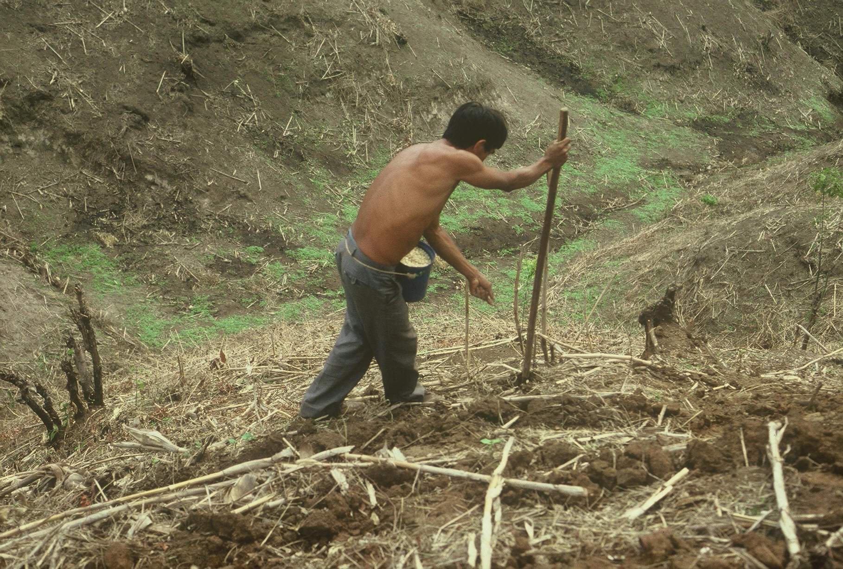


Slide 3
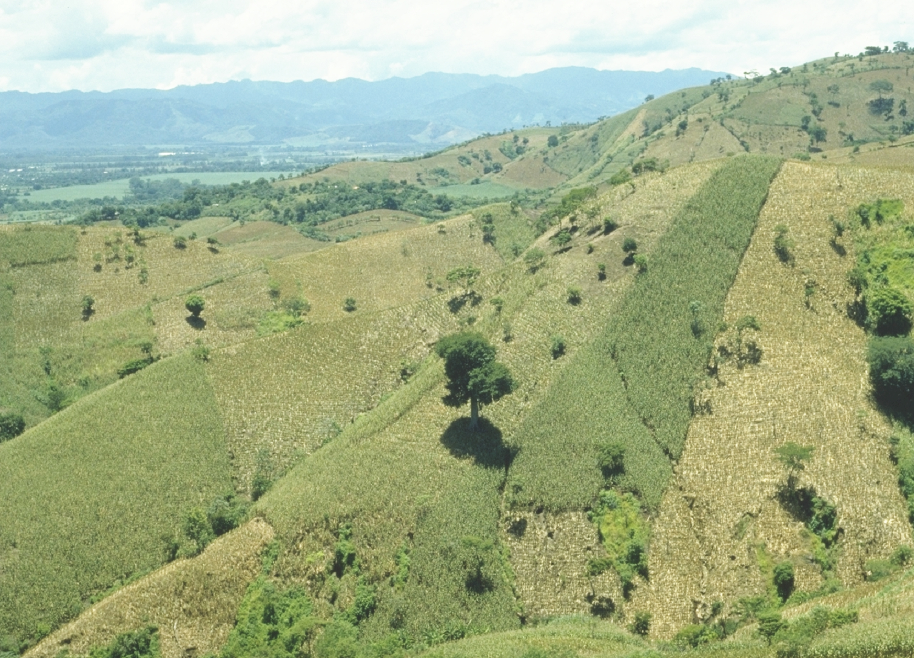

Slide 4
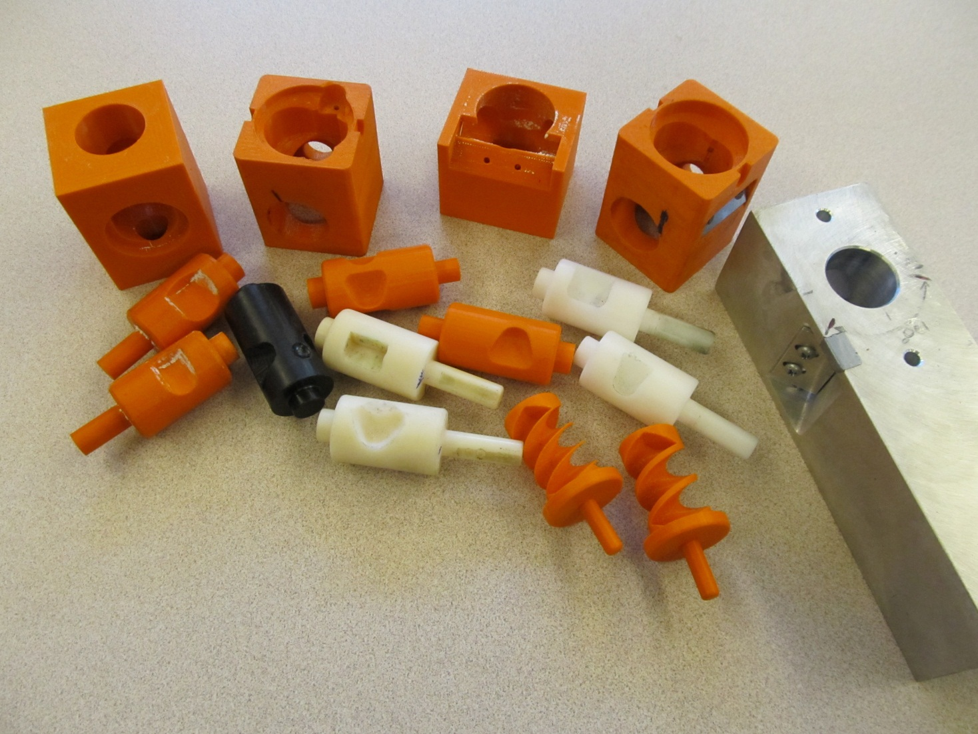
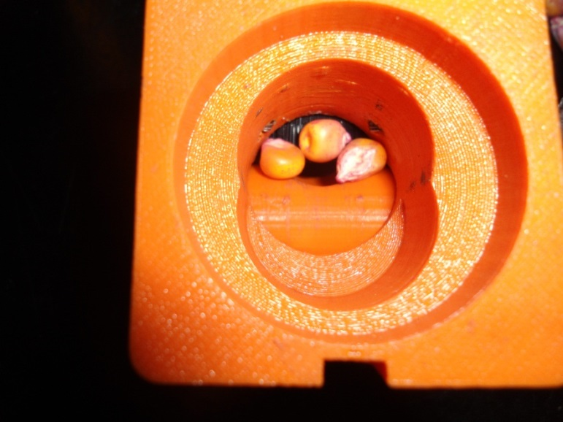
Singulation Design

Slide 5
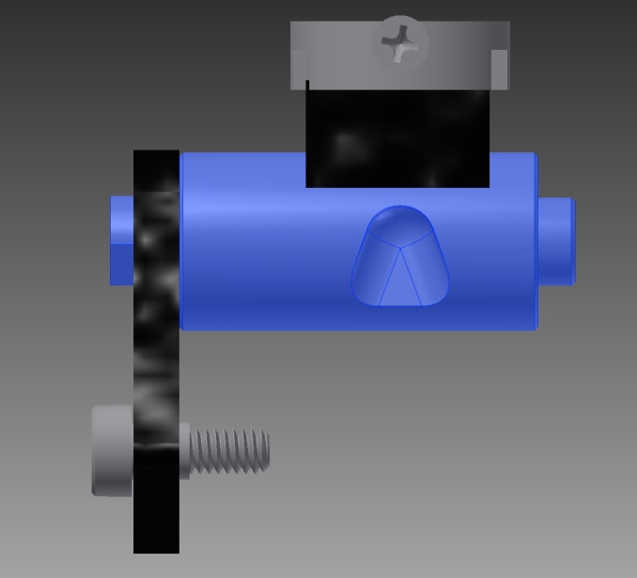
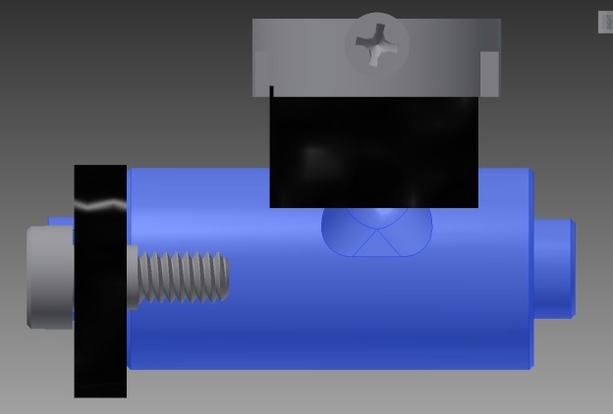
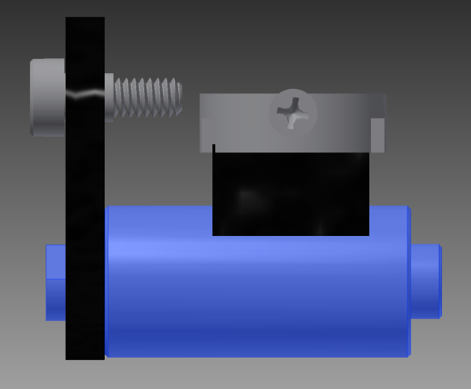
Reciprocating Drum Action
Drum rotates with the cavity moving back into the seed hopper as the spring is compressed.
Spring is fully compressed and the singulation drum cavity is exposed to seed in the hopper
Drum position when planter is relaxed.
As the force on the spring is released, the singulation drum rotates back to the initial ‘relaxed’ position and the seed is dropped.
Koller, A. Adrian, William R. Raun, and Randal K. Taylor. 2012. Singulating hand planter and fertilizer applicator. Serial No. 61/799,338. Disclosure, July 26, 2012.

Slide 6
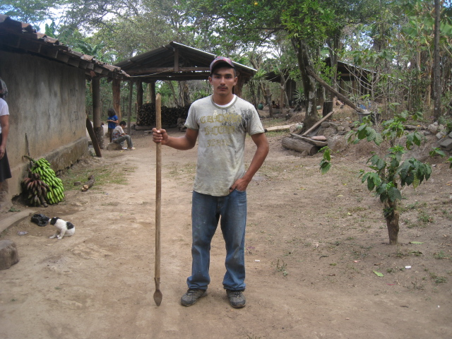
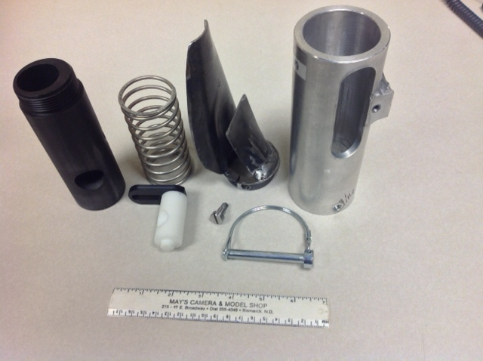
seed size (2653-4344 seeds/kg)
seed type, shape
fertilizer
1,000,000 cycles
0.29g/seed
60,000 seeds/ha
3443 seeds/kg
1.0 kg hopper
17 times refill
http://nue.okstate.edu/Hand_Planter.htm

Slide 7
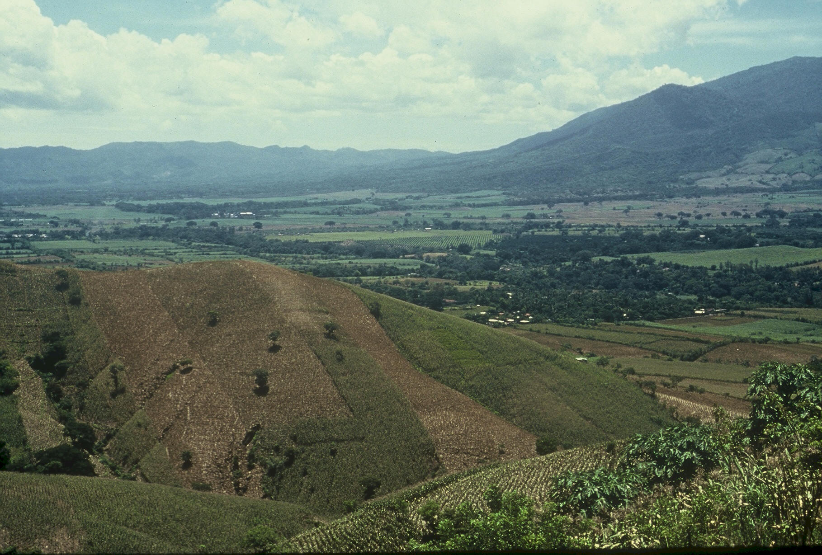
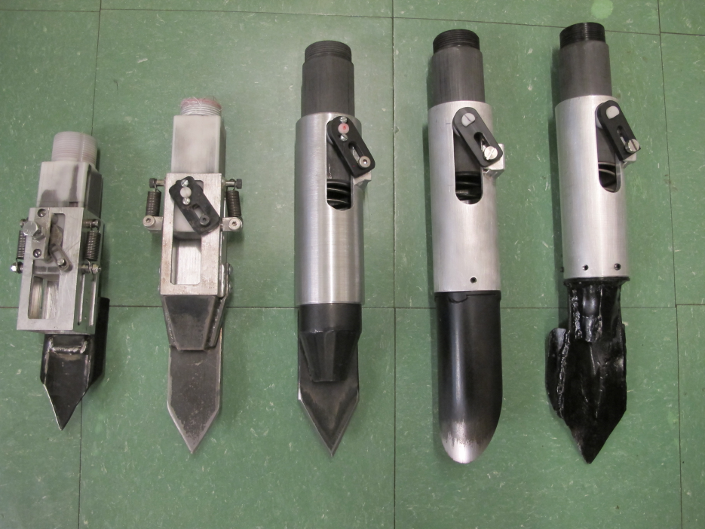

Slide 8
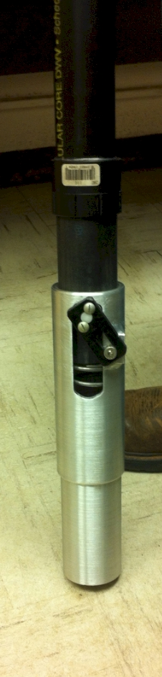
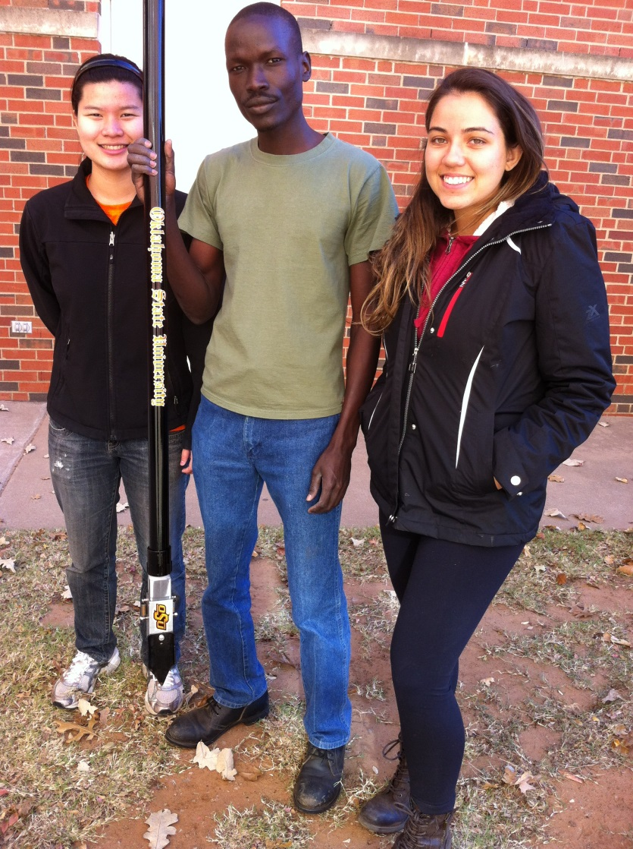
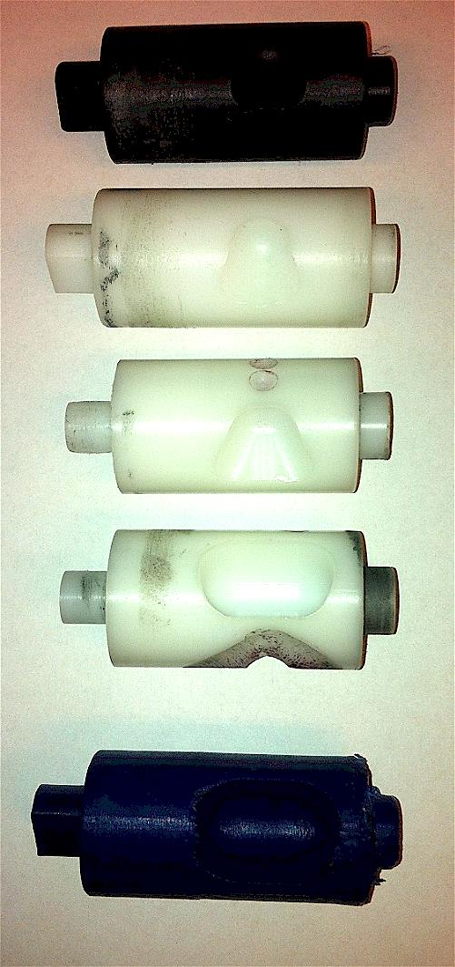

Slide 9
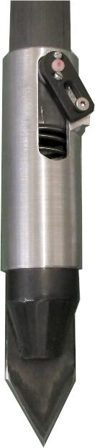
Technology to be commercialized (OSU Hand Planter)
Remove chemically treated seed from the hands of producers
Decrease soil erosion via improved plant spacing
Accommodate mid-season application of urea-N
Place urea below the surface reducing NH₃ losses
Increase corn production and NUE

Slide 10
OSU Hand Planter
works well over a range of seed sizes (1200 to 2000 seeds/lb)
80,000,000 ac’s of corn planted, weeded, hoed, and harvested by hand
World area planted by hand = corn area in the USA
average farm sizes are 2 ac’s
NGO support, interaction, and ultimate subsidizing of this work is expected
January 2014, conducted an international hand planter workshop whereby on-line-internet attendees included locations in Africa, Asia, Latin America, and the USA
http://nue.okstate.edu/Hand_Planter/osu_hand_planter_workshop.html

Slide 11
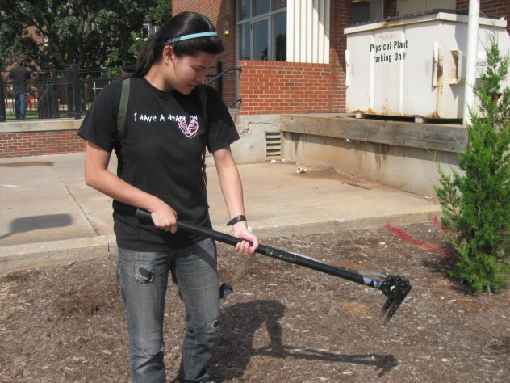
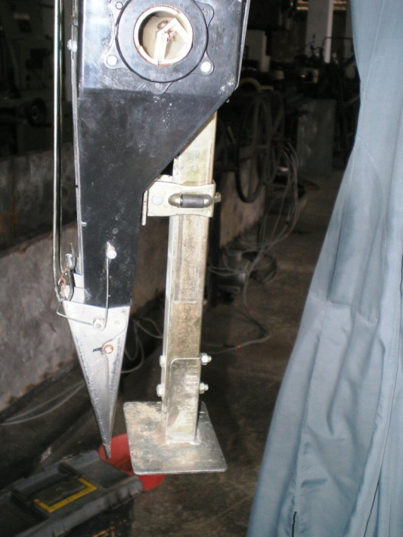
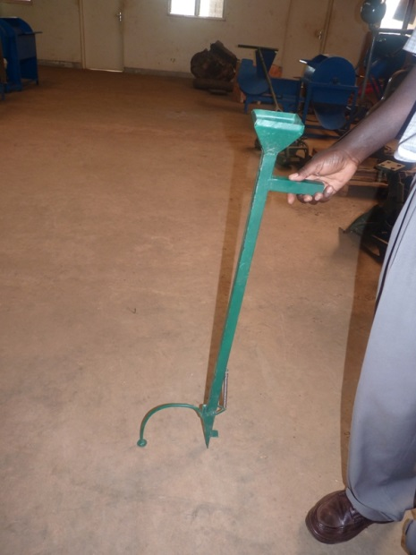
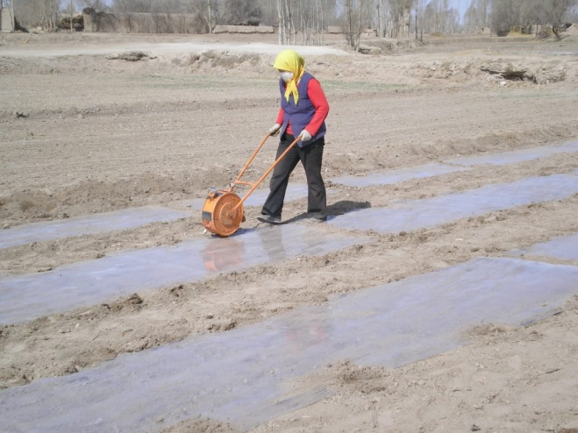
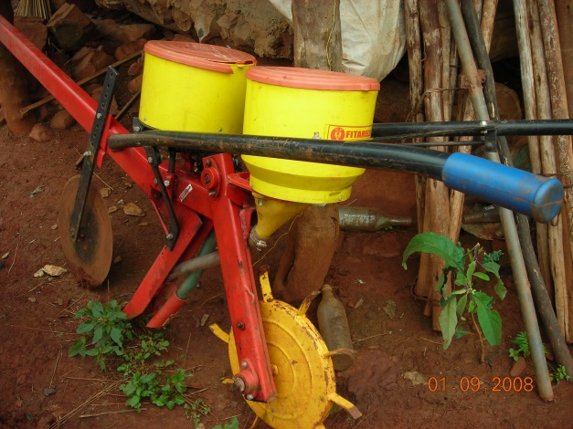
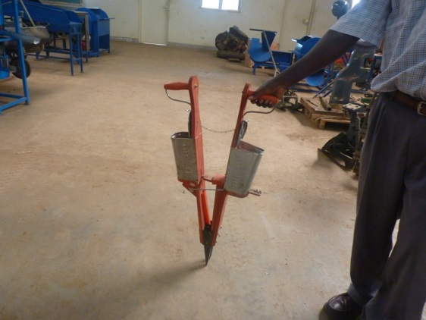
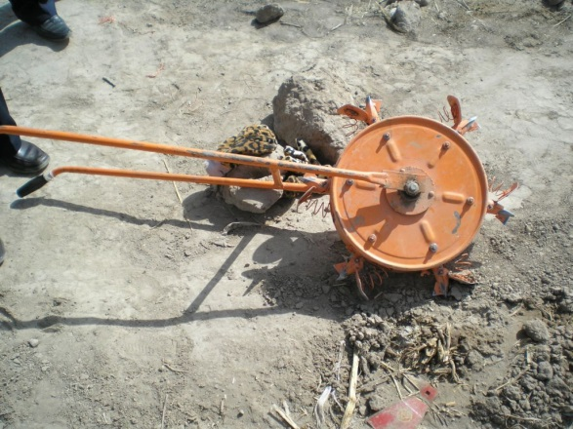

Slide 12
Title: Refinement/Extension of the OSU Singulating Hand Planter
(TBDP II, invention disclosed, need for “gap” funding)
Principal Investigators:
Randy Taylor, BAE randy.taylor@okstate.edu
Bill Raun, PASS bill.raun@okstate.edu
Joshua Ringer
Indigdev LLC (www.indigdev.com)
601 S. Washington PMB 234
Stillwater, OK 74074
joshuaringer@indigdev.org

Slide 13
(http://nue.okstate.edu/Hand_Planter/osu_hand_planter_workshop.html) . Heightened level of demand, now need commercial plan. OSU hand planter close to being on a world stage
OSU Invention Record and Report Form:
IRR submitted, Singulating Hand Planter # 2013-001
Plan for commercialization, patent currently being sought
Actual interest: Indigdev LLC (www.indigdev.com, 601 S. Washington PMB 234, Stillwater, OK 74074) has tentatively committed to license and market OSU hand planters. Local, Oklahoma owned company that presently employs several OSU graduates.
Long-term impact for Oklahoma: OSU hand planter can be adapted to any seed that would be planted by hand. Alternative drums for fertilizer application
Has a broad market in addition to developing world corn, with homeowners for gardens, and food plots for those in the wildlife industry.
Reciprocating drum design includes vested IP interests that belong to OSU

Slide 14
Project timeline
Date, 2014 Activity
March Completion of P-II design
April Production and testing
May-August Prototype testing in Oklahoma, El Salvador, Thailand
Field trials (planting all the way through harvest)
Sep - October Data analysis, re-design, P-III construct
Nov - December Production scale hand planter released
January 2015 Final annual report submitted to TBDP

Slide 15
Proposed budget
n Cost
Local construction of P-II OSU planters 20 ($500 ea) $10,000
By-site support for planter evaluation 20 ($400 ea) $8,000
(includes gas money, misc. expenses)
Data analysis and re-design 1 $3,000
P-III design, manufacture and testing 1 $5,000
Initial manufacturing injection molding 20 ($250 ea) $5,000
Project Reporting 1 $500
Total $31,500

Slide 16
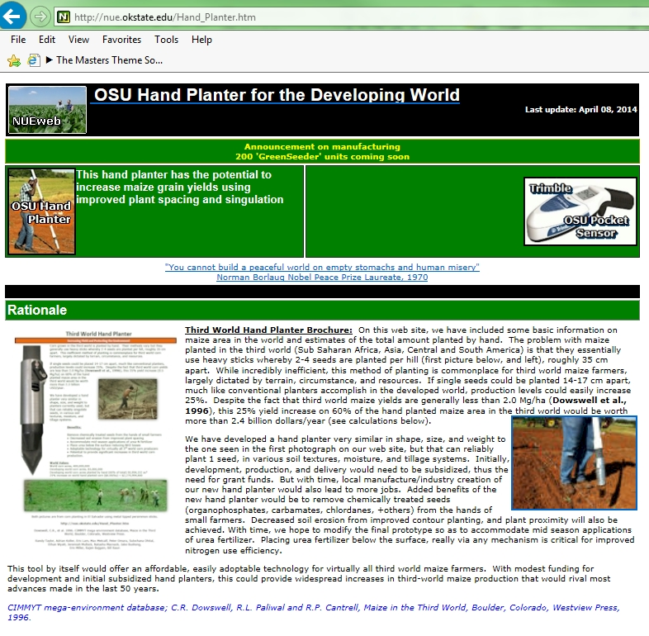
http://nue.okstate.edu/Hand_Planter.htm

Slide 17
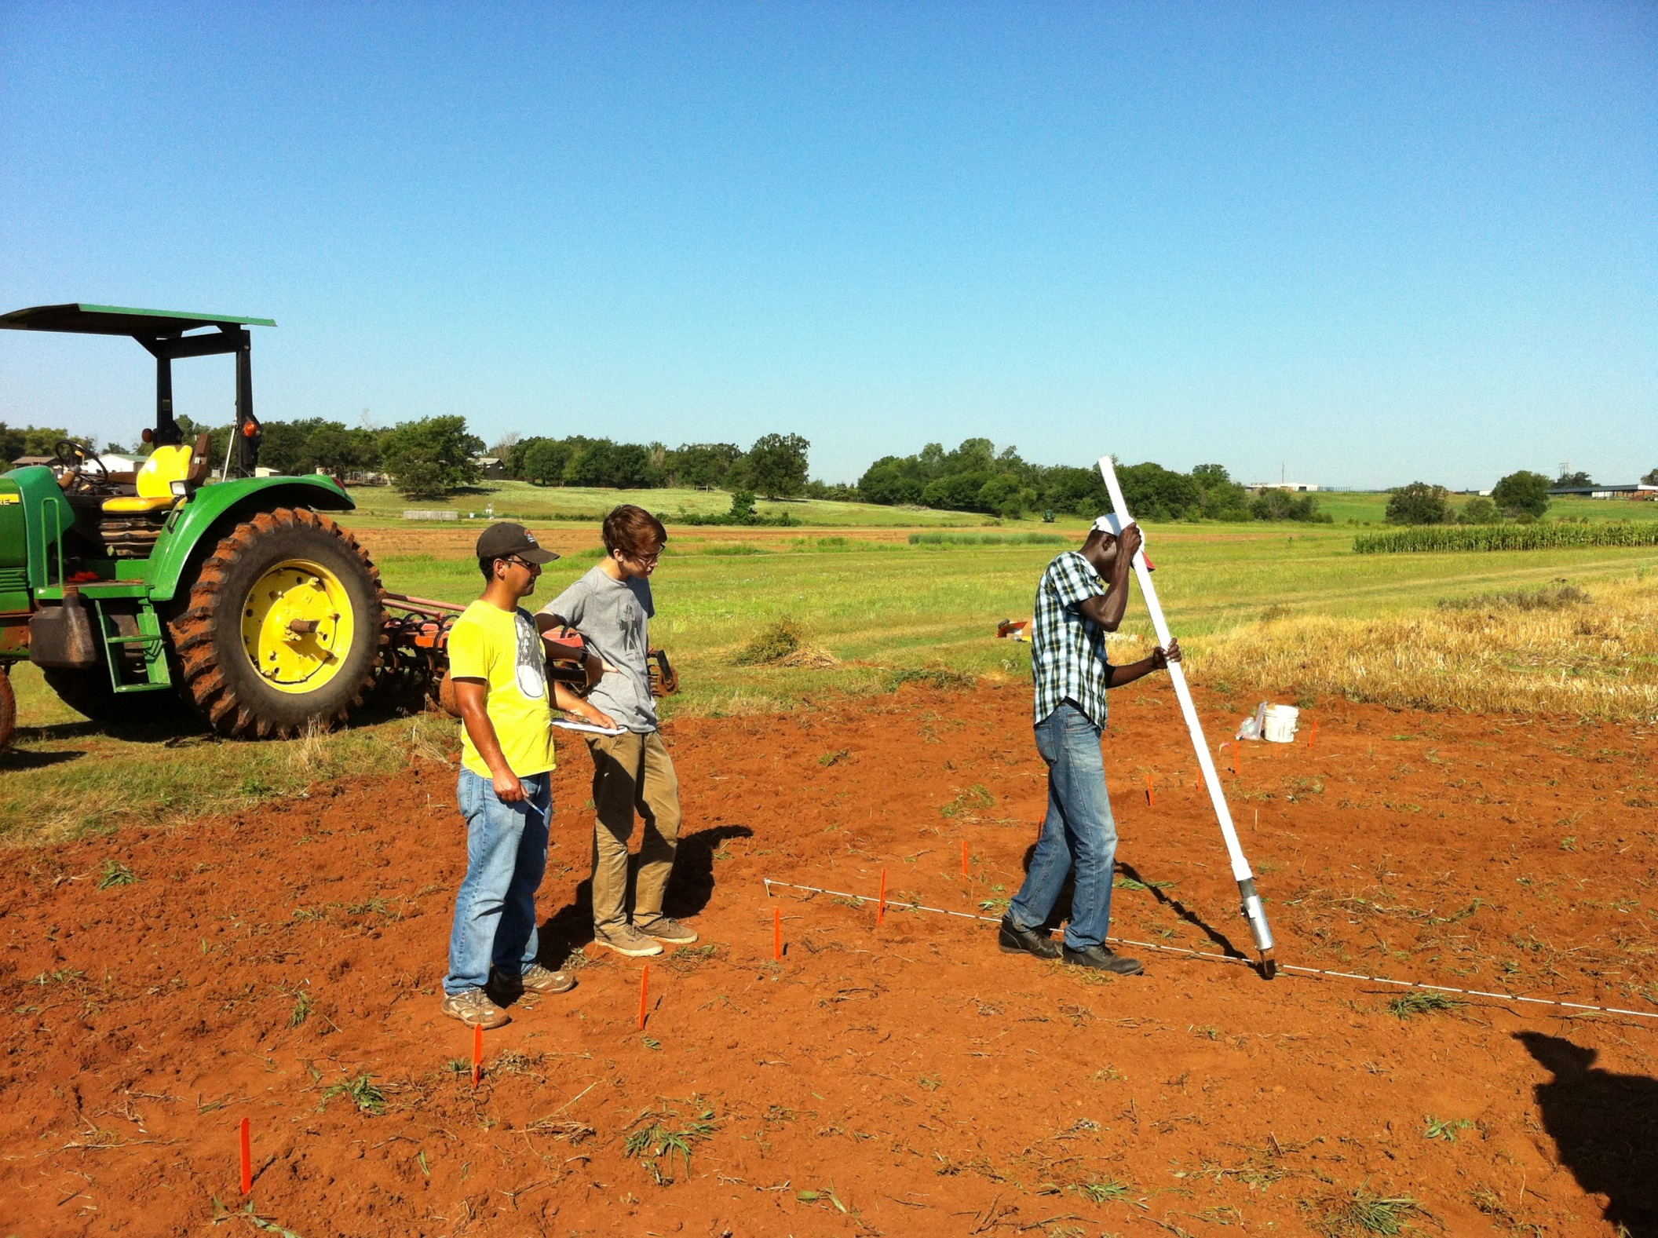


http://nue.okstate.edu/Hand_Planter.htm

Slide 18
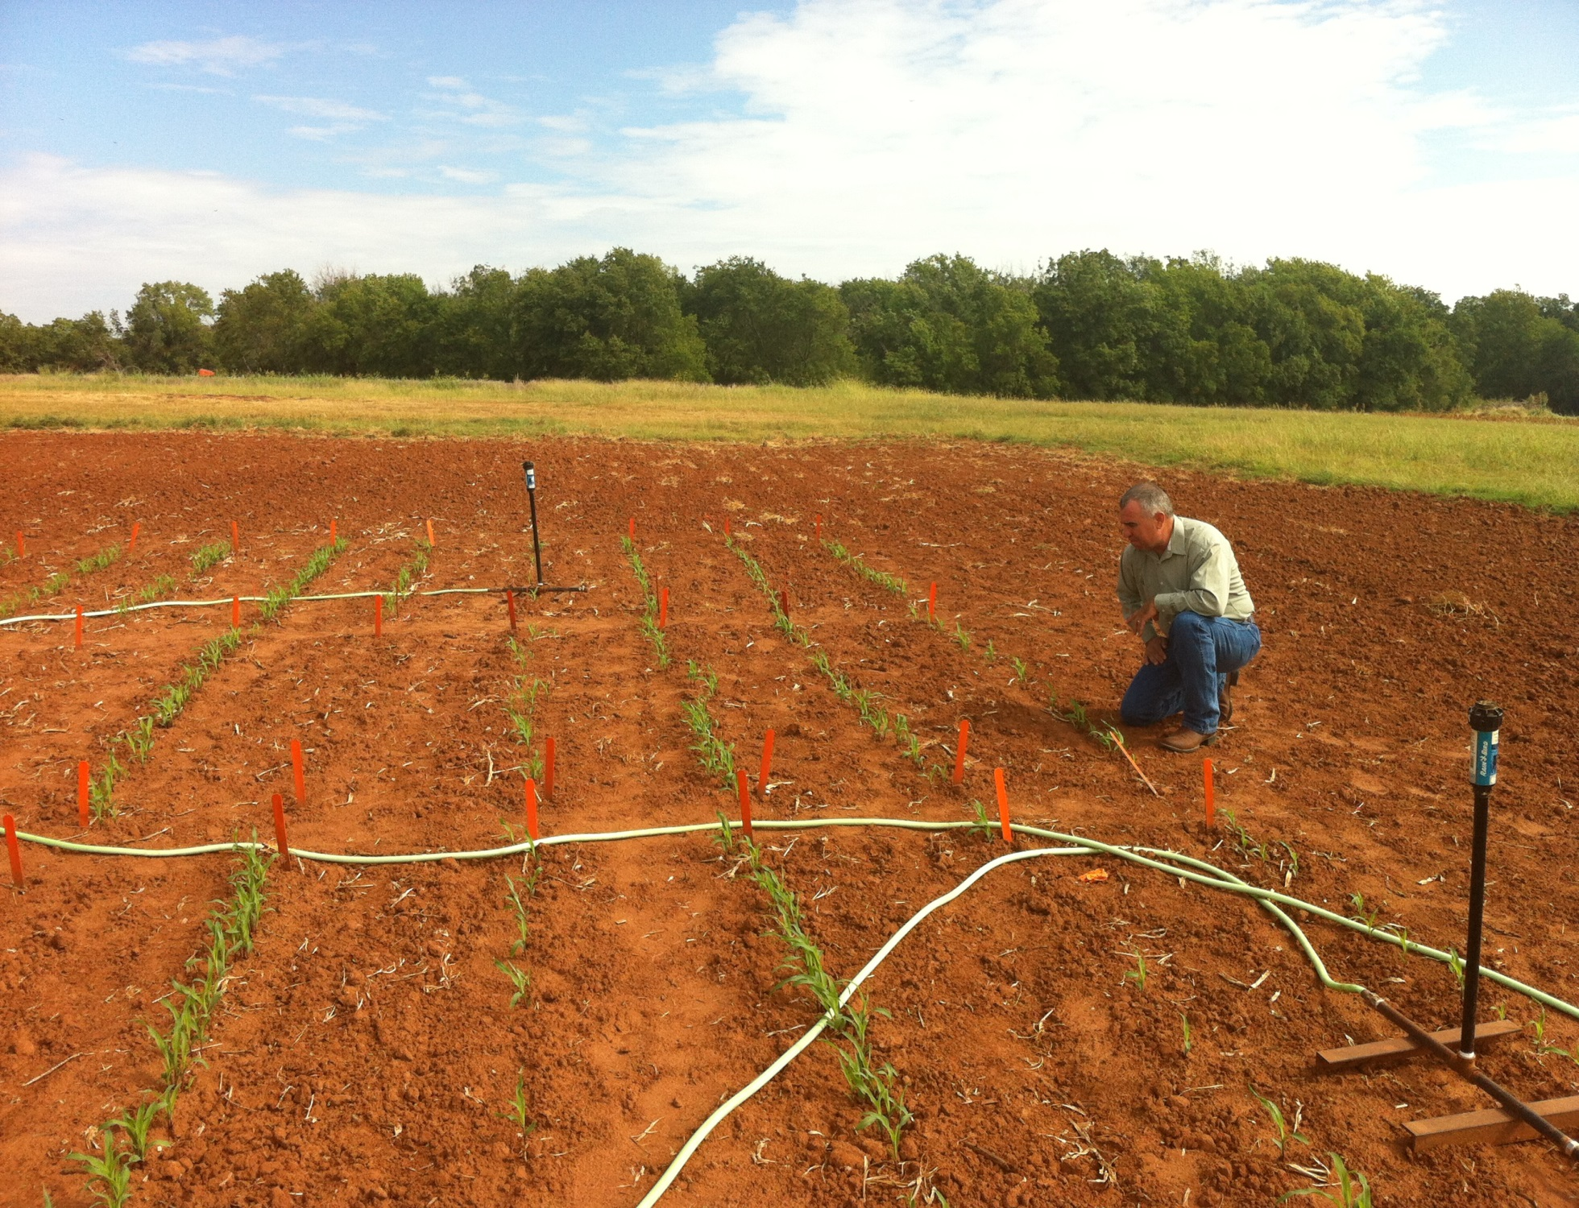

Slide 19
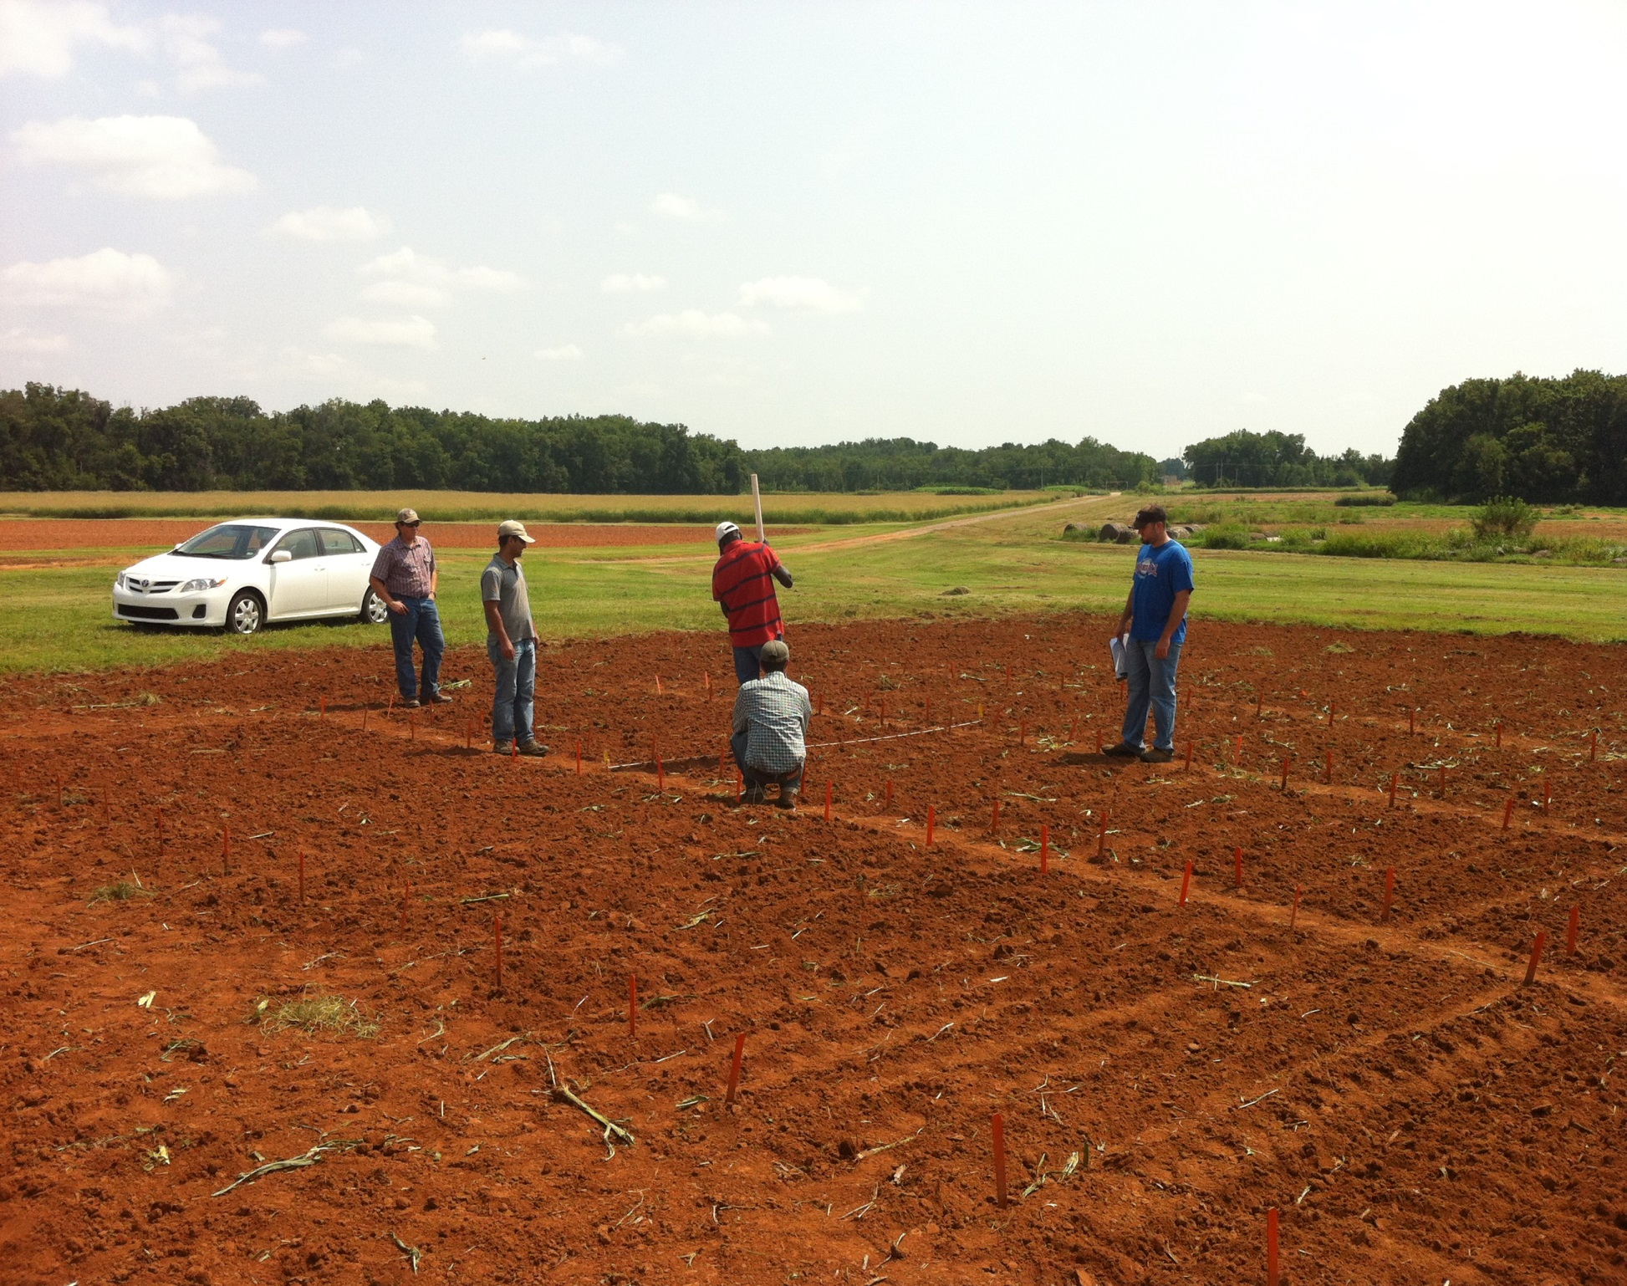
Dr. Randy Taylor
Dr. Nyle Wollenhaupt
1,000,000 cycles, no failures
1 hectare, 100,000 seeds/ha, 10 years
Regional Trials: El Salvador, Honduras, Thailand, Colombia, Uganda, Zambia

Slide 20
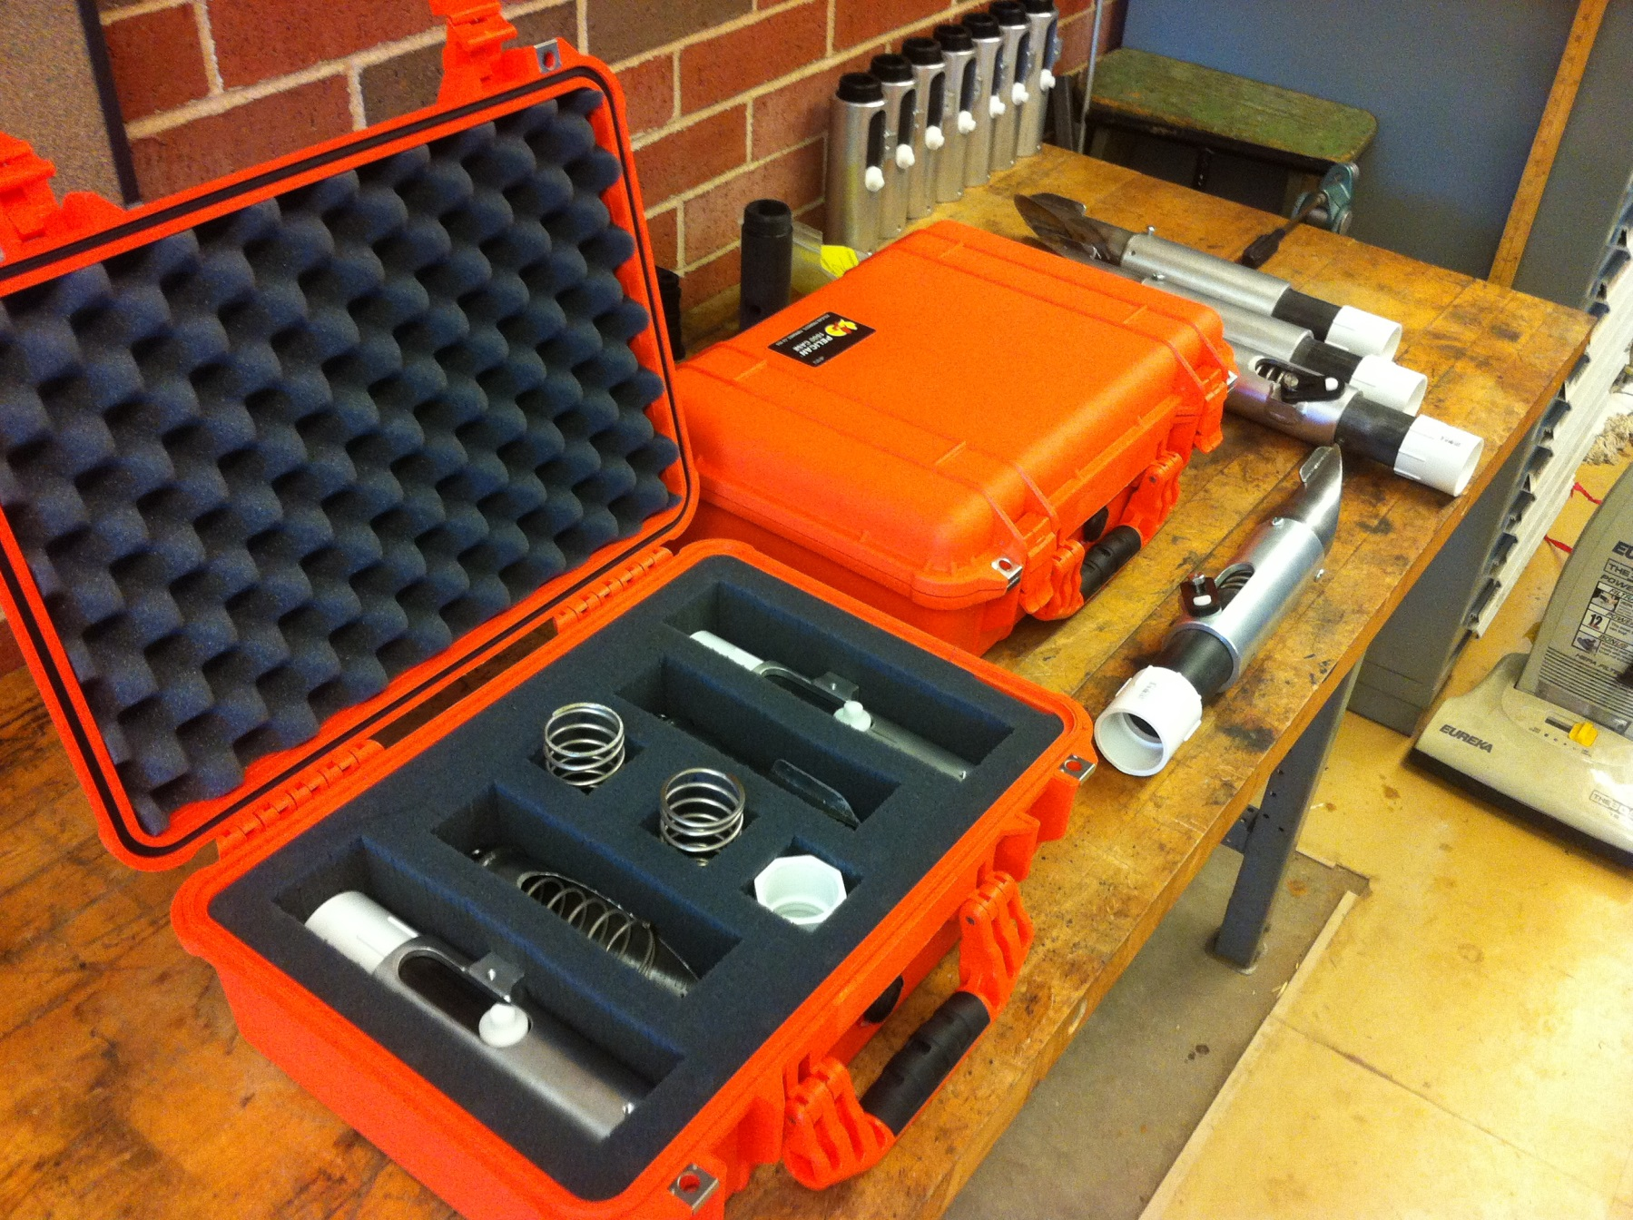
Questions

