Slide 1


Development and Delivery of the OSU Hand Planter
Global Food Security
October 29, 12:30
2019
AGED 4713
Dr. Craig Edwards
nue.okstate.edu

Slide 2
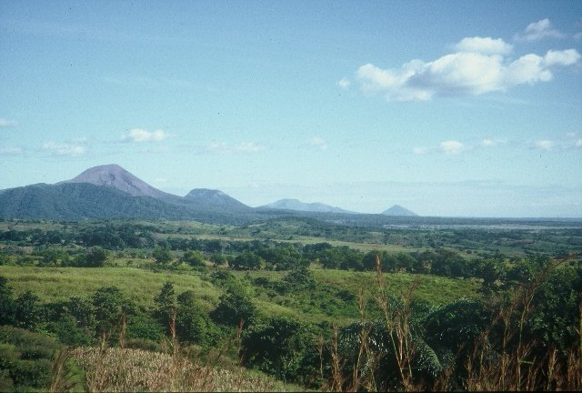
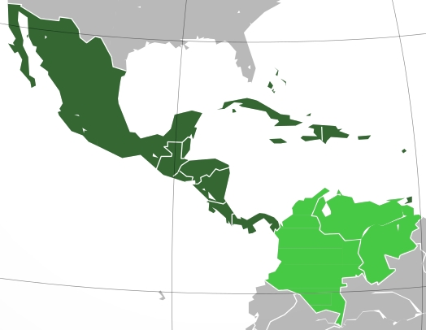
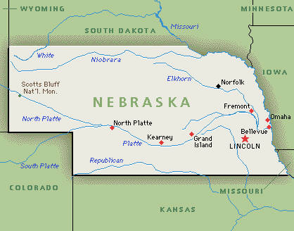
Minden, Nebraska, 1957-1959
Mexico City, Mexico, 1960-1963
Bogota, Colombia, 1964-1967
Cali, Colombia, 1968-1974
Oklahoma State University, 1975-1982
University of Nebraska, 1982-1985
CIMMYT, Mexico, Guatemala, 1985-1991
Oklahoma State University, 1991-present
CaSO₄
DAP, 3-17
Volcan de fuego
Middle America

Slide 3


Global Warming
Global Food Security
Food security is defined as the availability of food and one's access to it. ... The World Food Summit of 1996 defined food security as existing "when all people at all times have access to sufficient, safe, nutritious food to maintain a healthy and active life".Mar 17, 2015
hunger, famine, starvation, epidemic, pandemic
…. ensuring every nation has the ability to feed its population adequate amounts of nutritional foods.
National Institute of Food and Agriculture
Uncomfortable

Slide 4

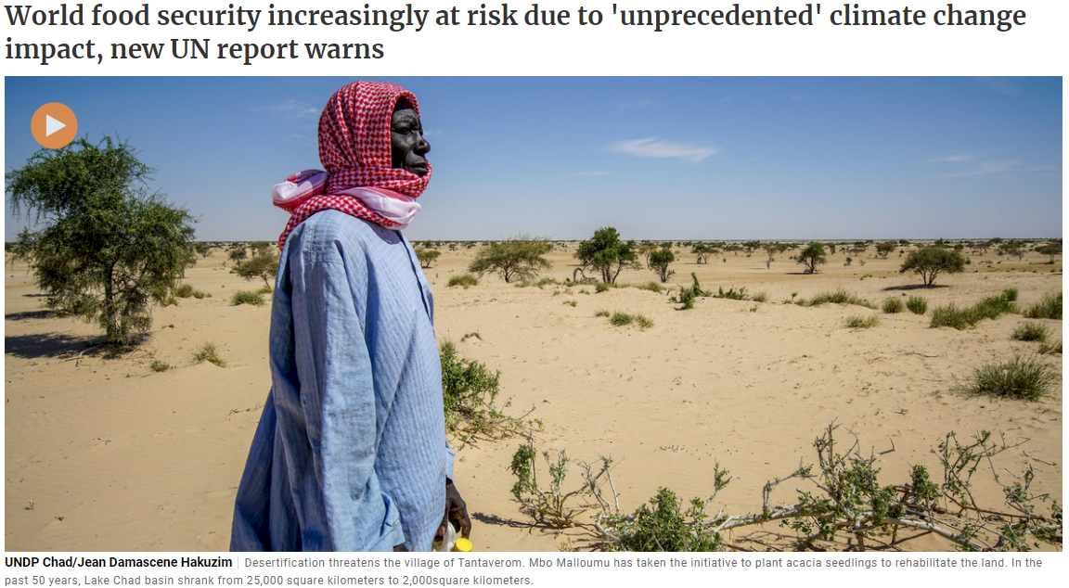
August, 2019

Slide 5

State of the Planet
Earth Institute, Columbia University
World population is expected to grow to 10 billion by 2050
impacts of climate change—higher temperatures, extreme weather, drought, increasing levels of carbon dioxide and sea level rise—threaten to decrease the quantity and jeopardize the quality of our food supplies
If greenhouse gas emissions continue on their current trajectory, yields could fall by 35 percent by 2100 due to water scarcity and increased salinity and ozone
U.S. production of corn (maize) could be cut in half by a 4˚C increase in global temperatures—which could happen by 2100 if we don’t reduce our greenhouse gas emissions
“We already have trouble feeding the world and this additional impact on crop yields will impact the world’s poorest and amplify the rich/poor divide that already exists.”

Slide 6

Global Food Security , Starts with Africa
The detrimental situation of women and children is particularly serious, as well as the situation among female teenagers, who receive less food than their male counterparts in the same households.
On September 14, 2010, the Food and Agriculture Organization of the United Nations (FAO) published its estimates concerning the number of people suffering from hunger, 1,020 billion (2009)

Slide 7

Annual budget, 27.2 billion USD
OSU, 1.33 billion USD
Univ. Nebraska, 0.96 billion USD
MISSION …. to partner to end extreme poverty and to promote resilient, democratic societies while advancing the security and prosperity of the United States."

Slide 8


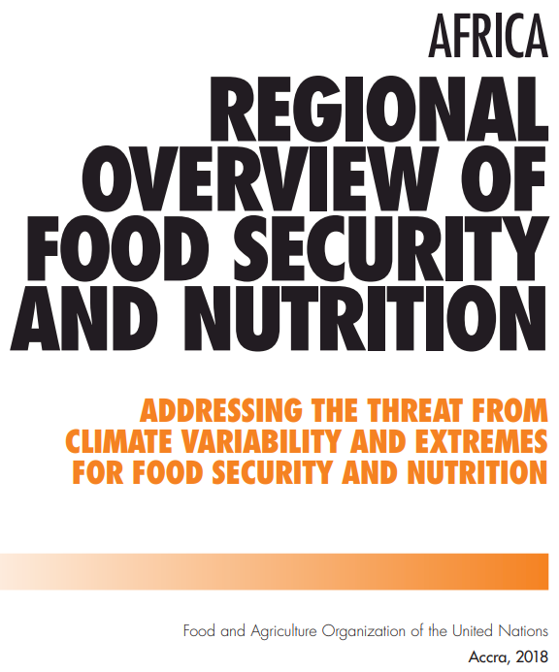

Slide 9

Today, a fifth of Africans are undernourished, representing a staggering 257 million individuals. (USA, 327)
Worsening trend in Africa is due to difficult global economic and worsening environmental conditions, conflict and climate variability.
Food insecurity has worsened in countries affected by conflict, often exacerbated by drought or floods.

Slide 10
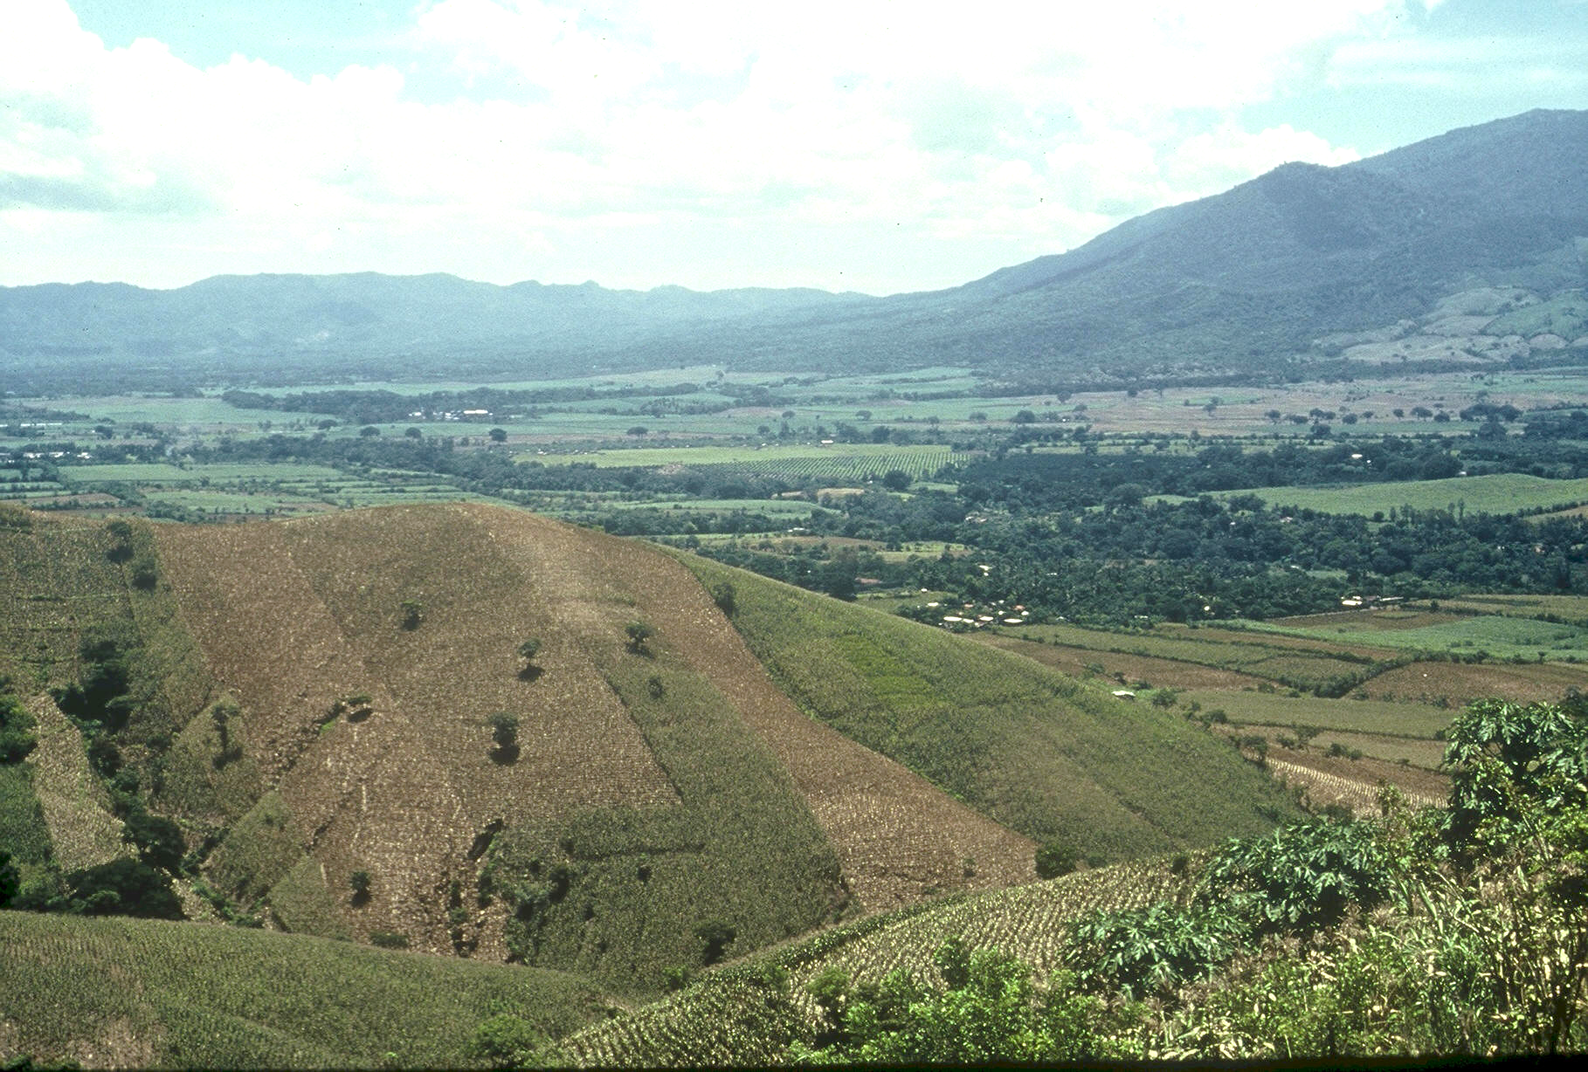

Planter Chronology (34 years)
1985, CIMMYT
1987, Regional Agronomist Central America
1991, Faculty OSU
1999, FP - Hand Planter work
2000, Design/construction started
2013, OSU-MS, Aula, Omara
2019, Planter redesign, Rotary Grant / Importance
Rotary Contributions
(OK, NE, Nigeria)

Slide 11
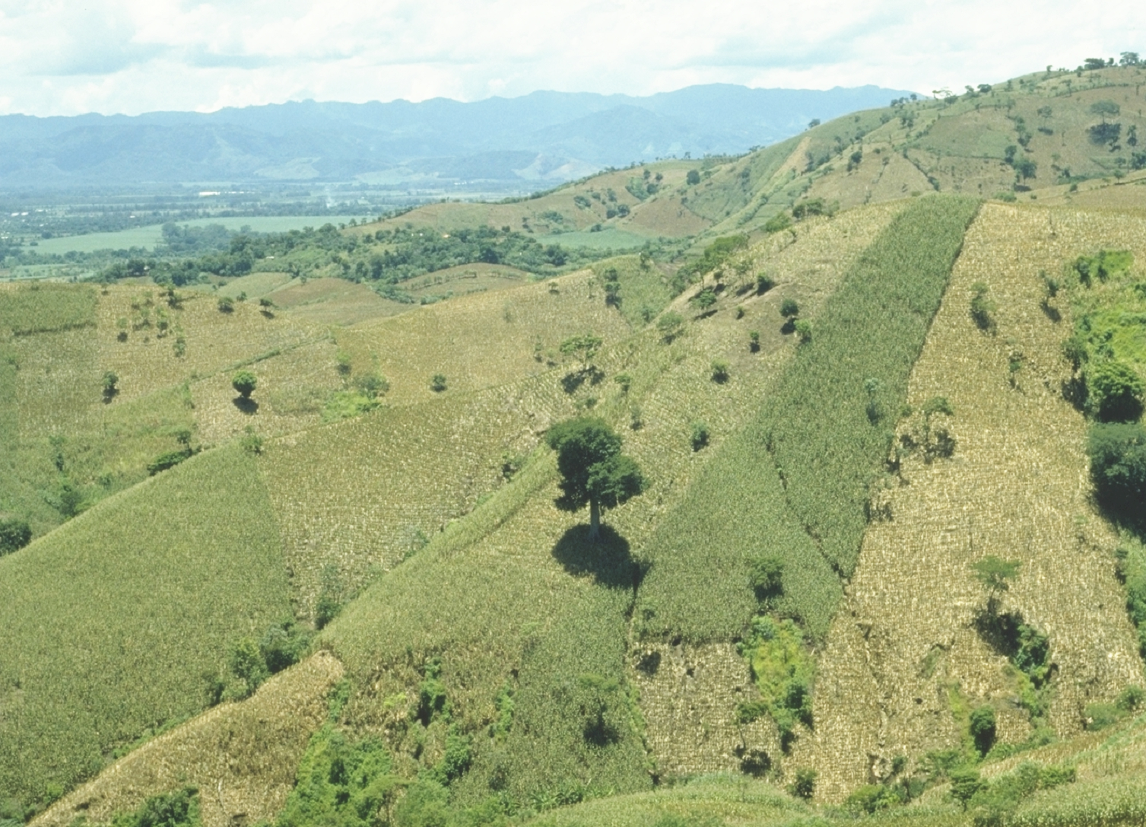
OSU Hand Planter
http://nue.okstate.edu/Hand_Planter/summary_HP1.pdf

Slide 12
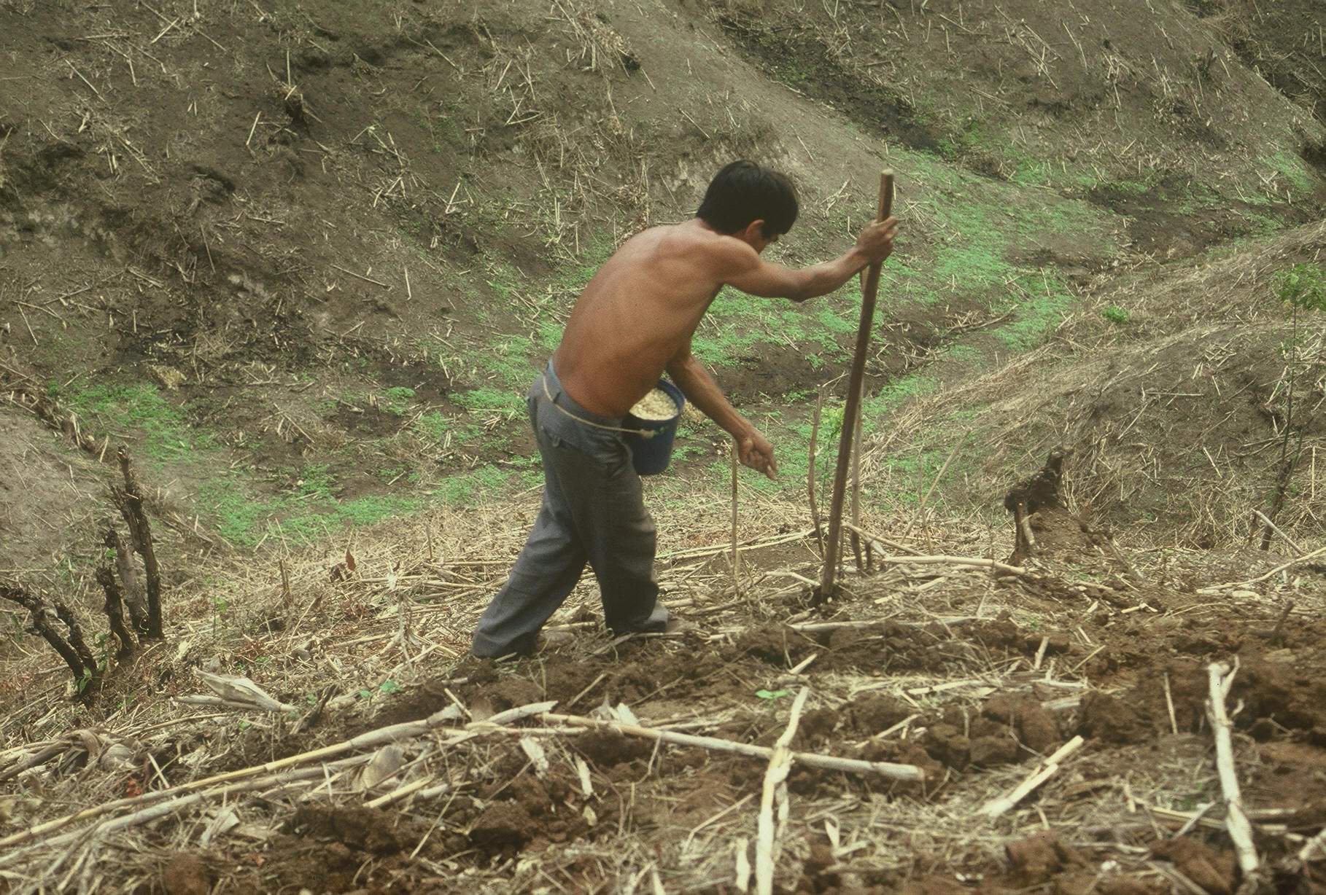

1987 (32)

Slide 13
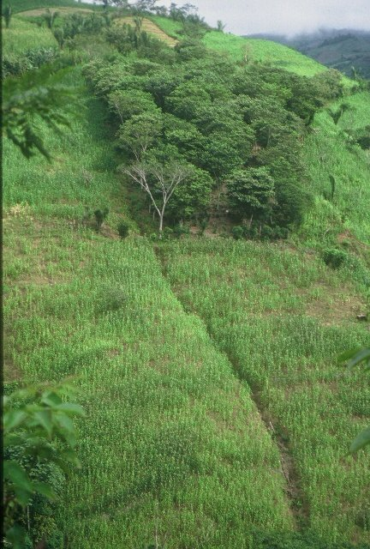
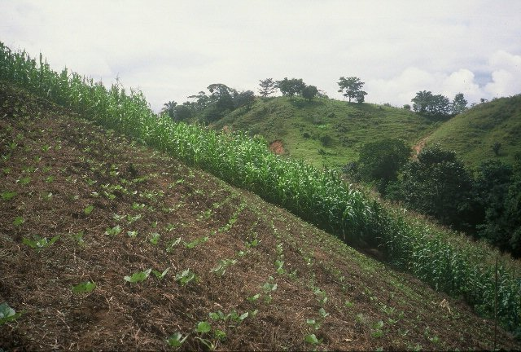
HONDURAS

Slide 14
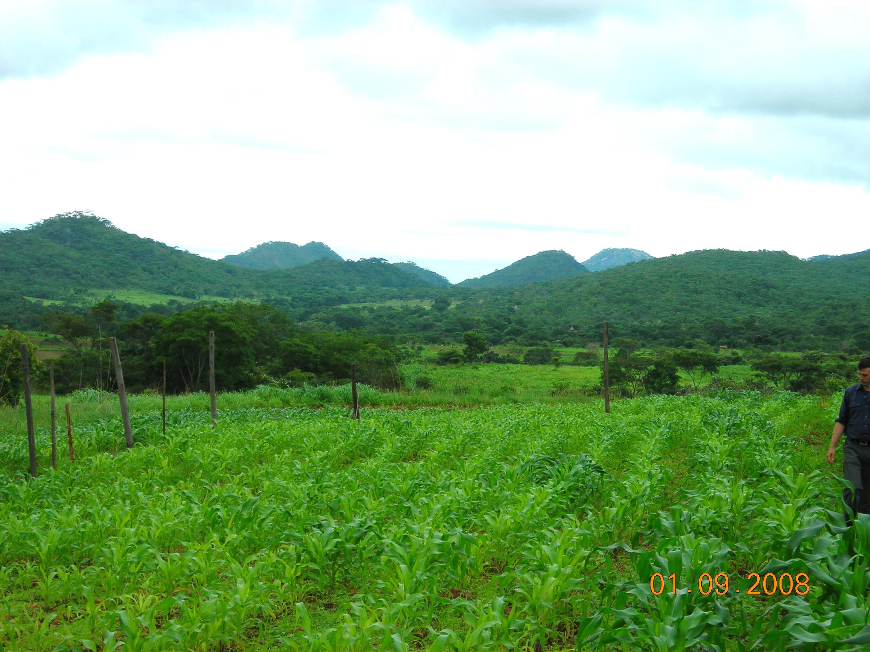
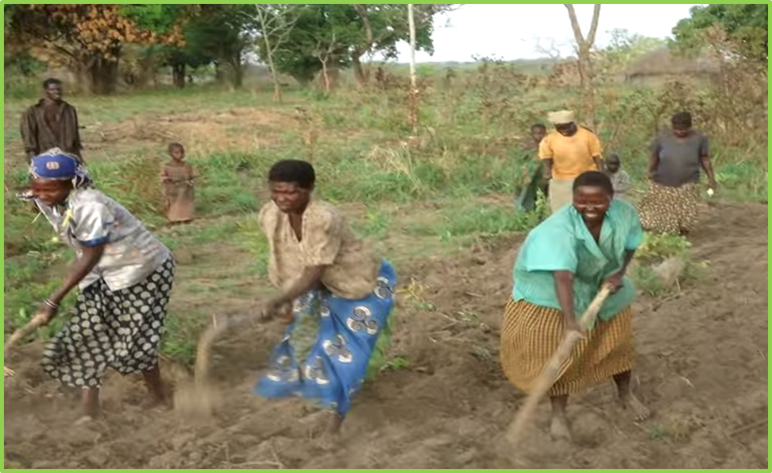
ZIMBABWE, UGANDA
Remote Locations
Surface applications of urea

Slide 15
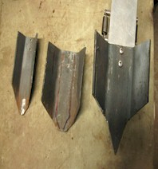
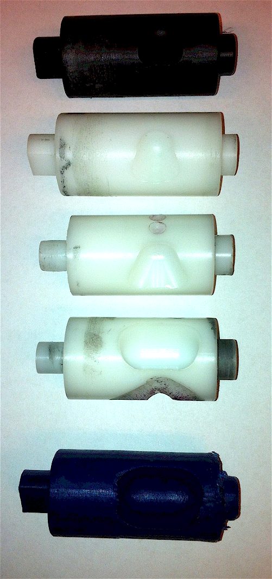
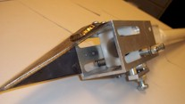
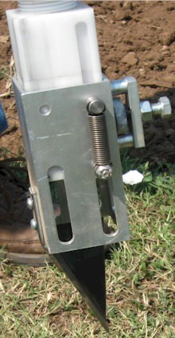
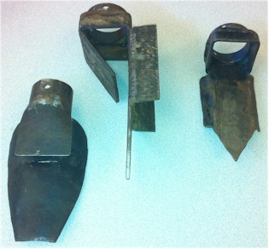
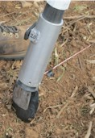
Internal Brush/Strength
Drum size/material
Cavity size/angle
Tip size/design/material
Internal/Ext. spring/tension

Slide 16
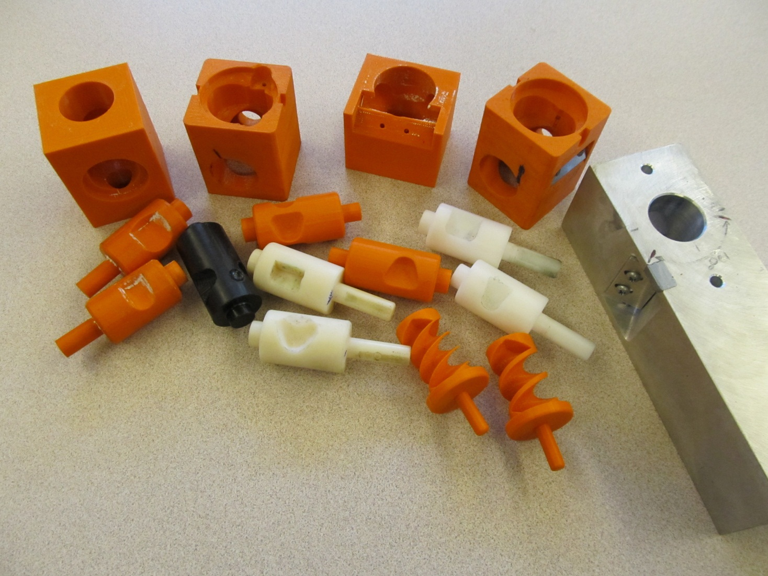
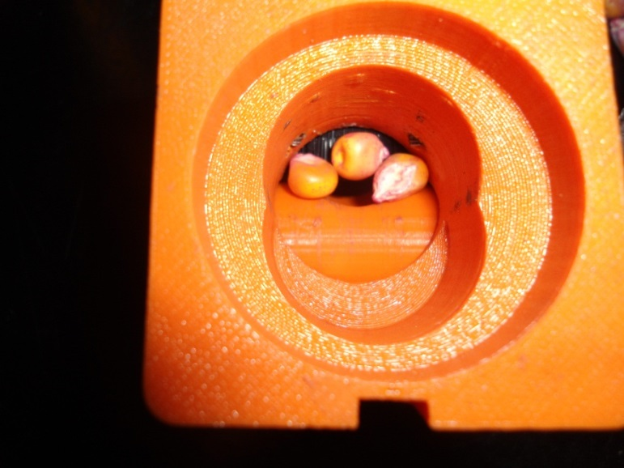
Singulation Design
3D printing
Rotary International
AGCO
Sitlington Chair
ASA Reinvest, Jessica Davis
Tolerances
Materials
Failure analysis/testing

Slide 17
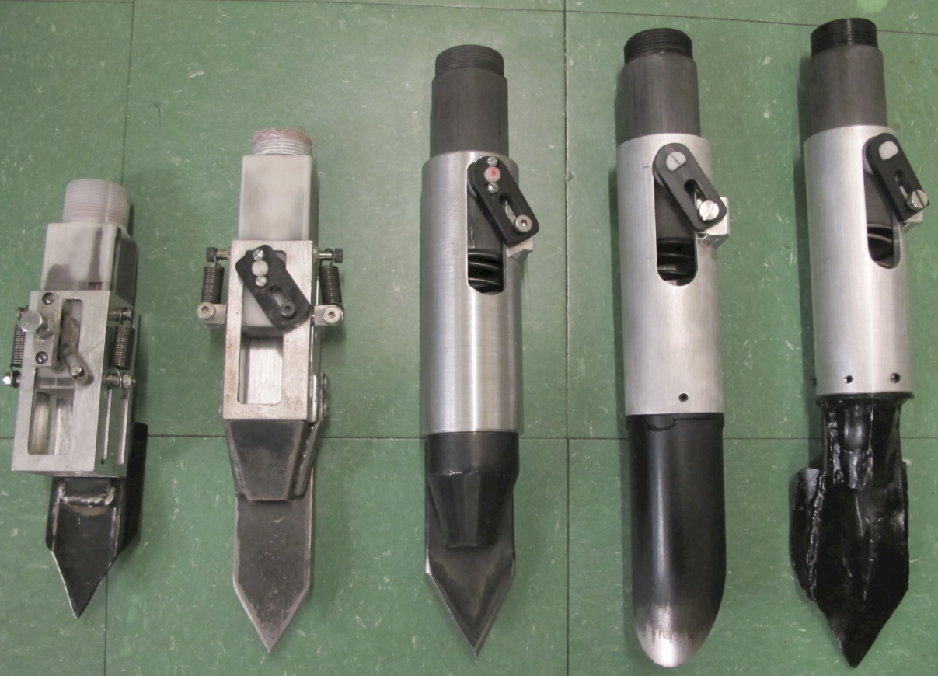

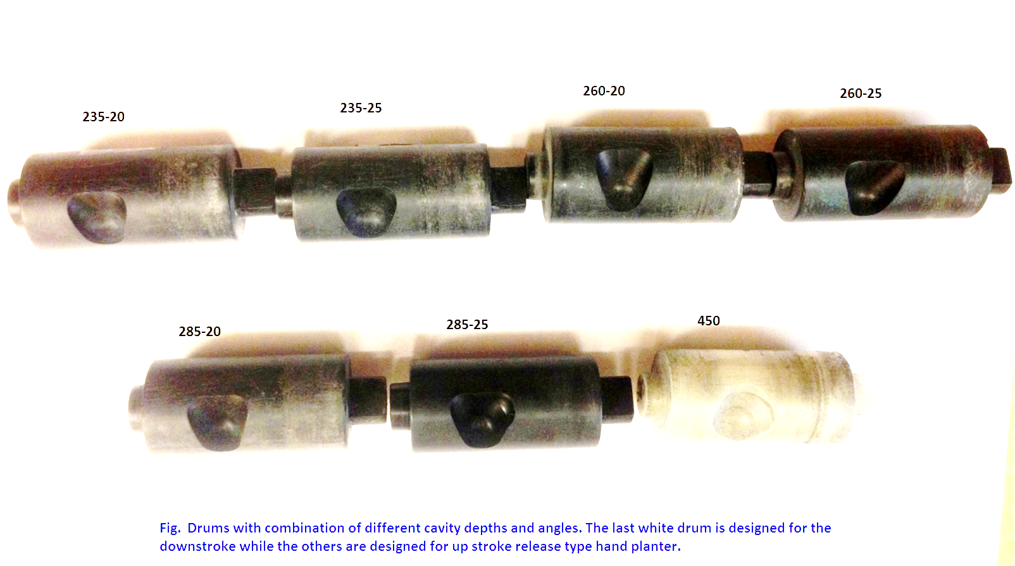
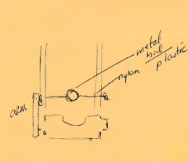

Slide 18
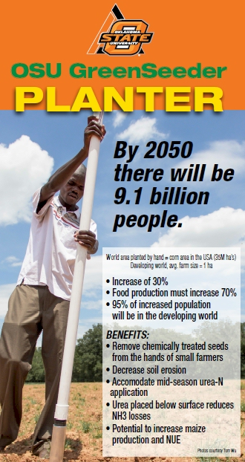
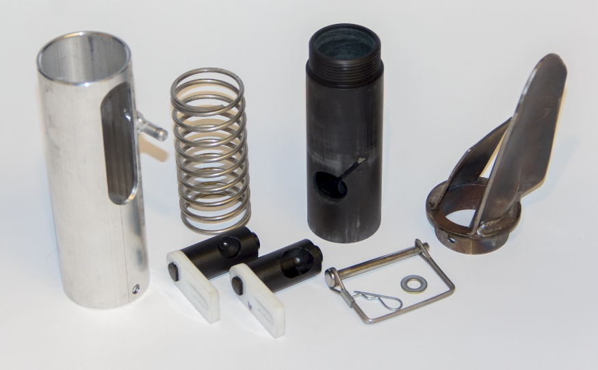
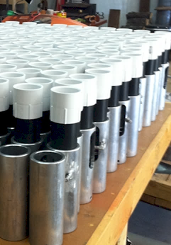

Slide 19
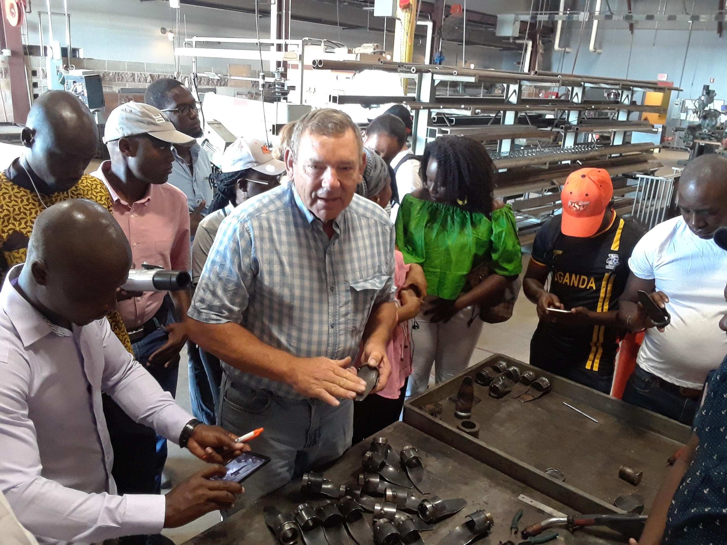
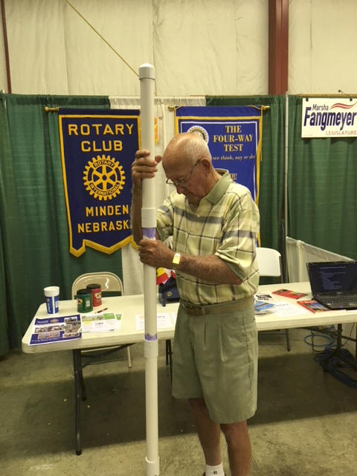
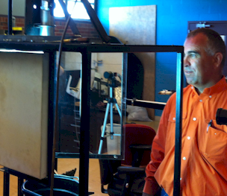

Wayne Kiner
Institutional Memory
Kearney County Fair
Minden, Nebraska
Randy Taylor
tolerance testing
Koemel Law, PLLC
205 W. 7th Ave.
Suite 101-B
Stillwater, OK 74074
http://nue.okstate.edu/Hand_Planter.htm

Slide 20
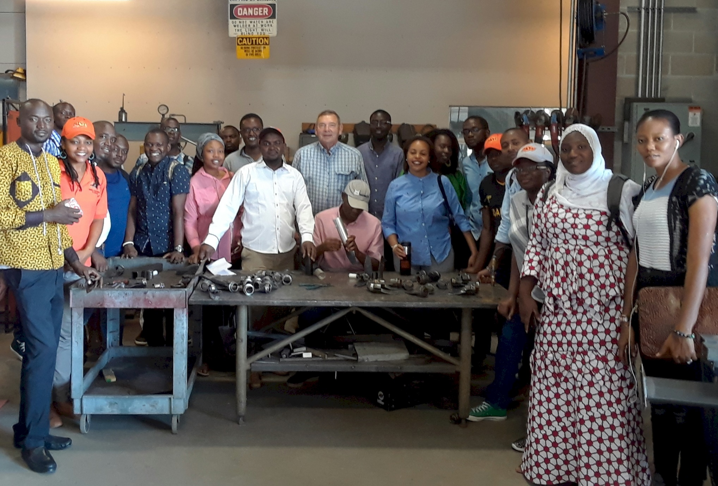
Wayne Kiner, Mandela Fellows 2018

Slide 21

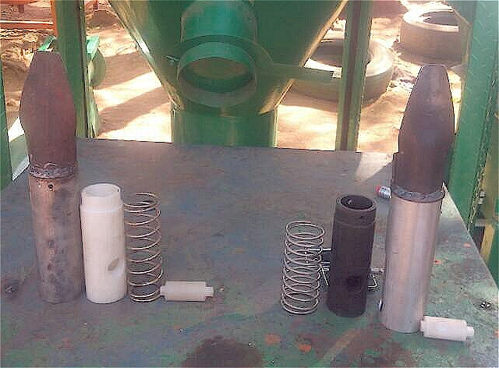
Current Cost Estimates
Grand Victory Ltd
Tsim Sha Tsui Hong Kong
Rm 1604 16/F Lee Wai Coml Bldg
Tsim Sha Tsui
1000, $25 each
Usman Ali, Nigeria, Mandela Fellows
July 11, 2019: Bernard Ato Brown , Kumasi Ghana (Agricultural Engineer)

Slide 22
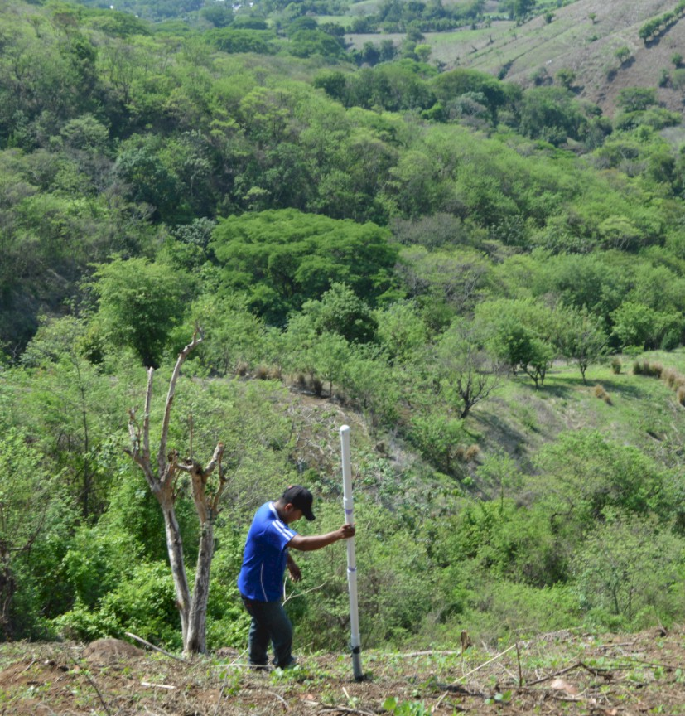
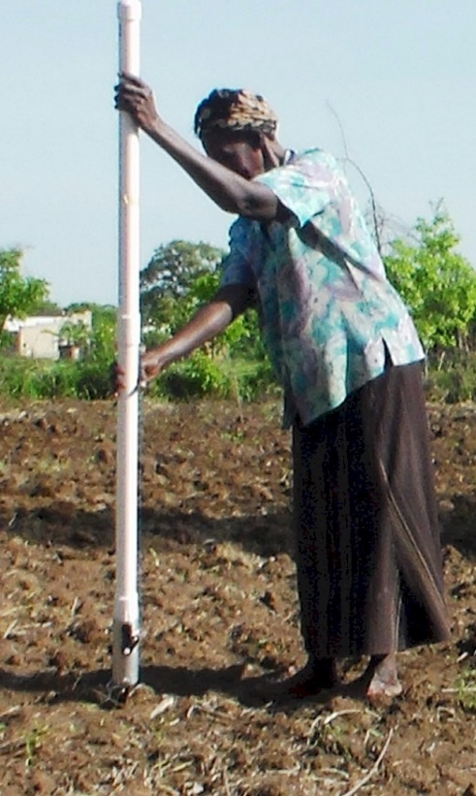
Opico Quezaltepeque, El Salvador
LIRA UGANDA
EL SALVADOR
Peter Omara MS 2013
Worlds Apart
Avg. Farm Size: 1 ha
Avg. Maize Grain Yield, 2 Mg/ha
Maize seed, Hybrids (US, others)
Social aspects/technology transfer

Slide 23
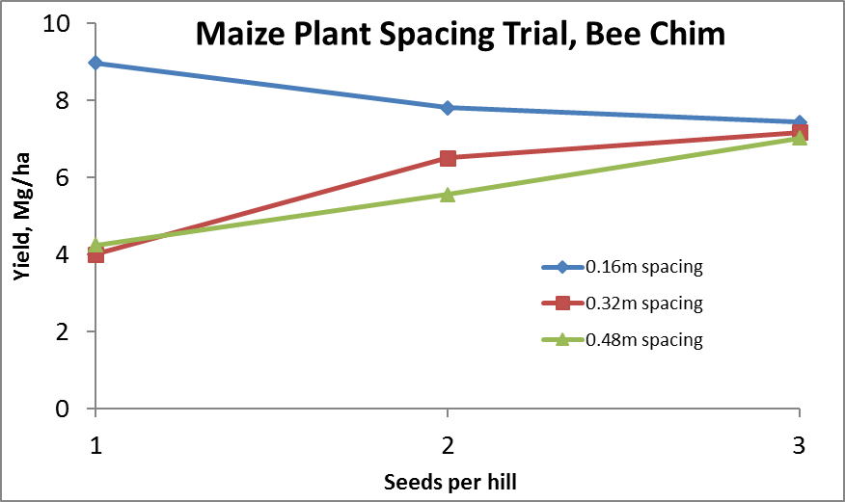
Importance of Singulation
0.76m Row Spacing
Heterogeneity in plant spacing, and plant stands reduce yields
www.agry.purdue.edu/ext/corn/pubs/agry9101.htm

Slide 24
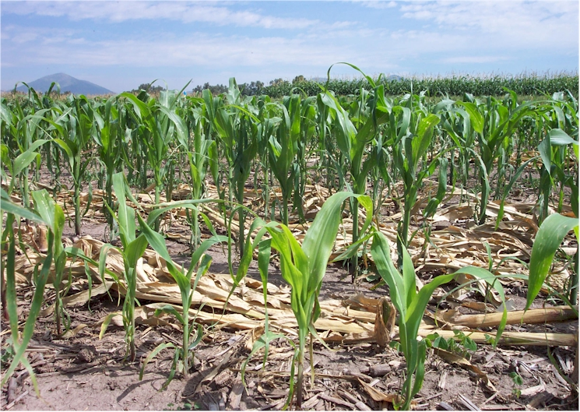
Homogeneity of plant stands

Slide 25
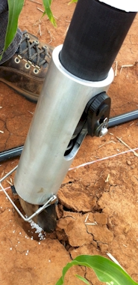
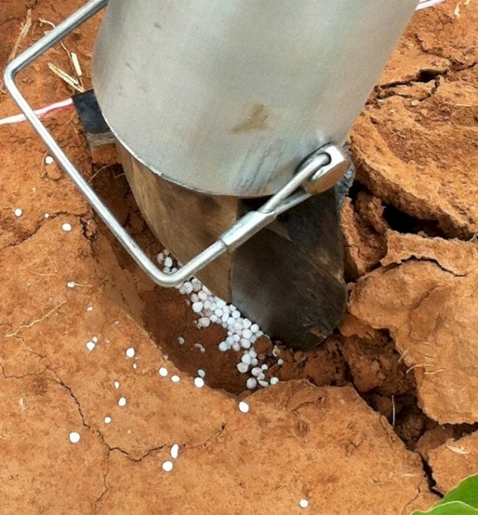
MID Season Fertilizer N
Combined, Efaw and Perkins
Topdress N, Corn, V12 |  | 70,000 plants/ha
Methods | N, kg/ha | Mg/ha
Check | 0 | 6.6
Hand planter (0.9 g/plant) | 30 | 11.2
Hand planter (1.8 g/plant) | 60 | 10.6
Broadcast | 30 | 6.4
Broadcast | 60 | 7.0
Dribble urea | 30 | 9.3
Dribble urea | 60 | 7.8
Dribble UAN | 30 | 7.3
Dribble UAN | 60 | 10.4
SED = 1.81

Slide 26
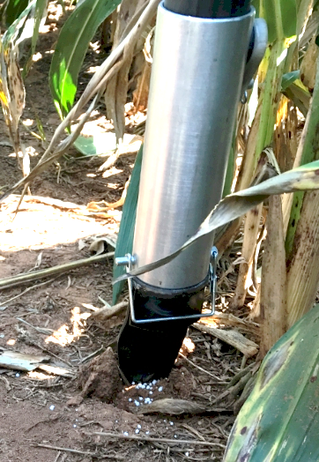
Benefits
Remove chemically treated seeds from the hands of producers
Decrease soil erosion via improved plant spacing
Accommodate mid-season N application
Urea placed below the surface reducing NH₃ loss
Increased production and NUE
Potential Uses
Seed, all types
Alternative chemicals, EPA, mosquito abatement
Food plots/hunters
Gardeners

Slide 27
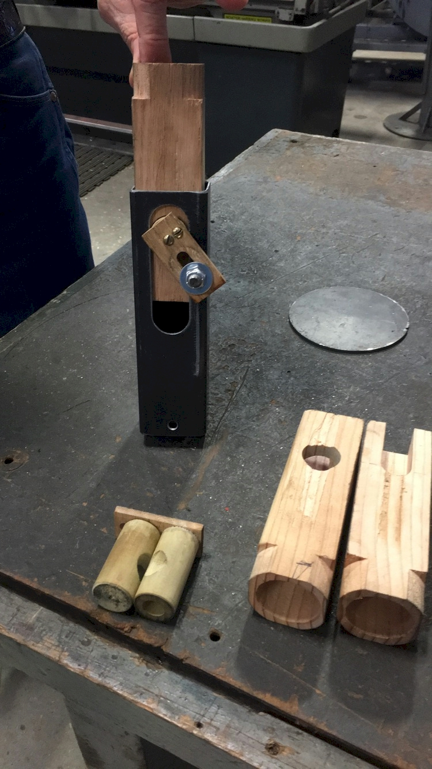
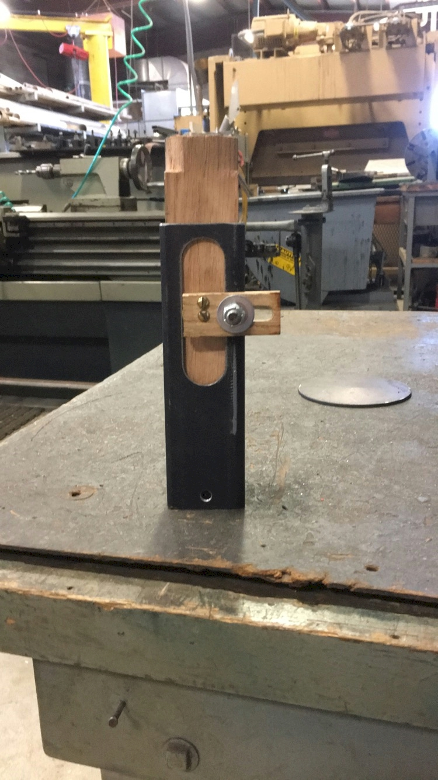
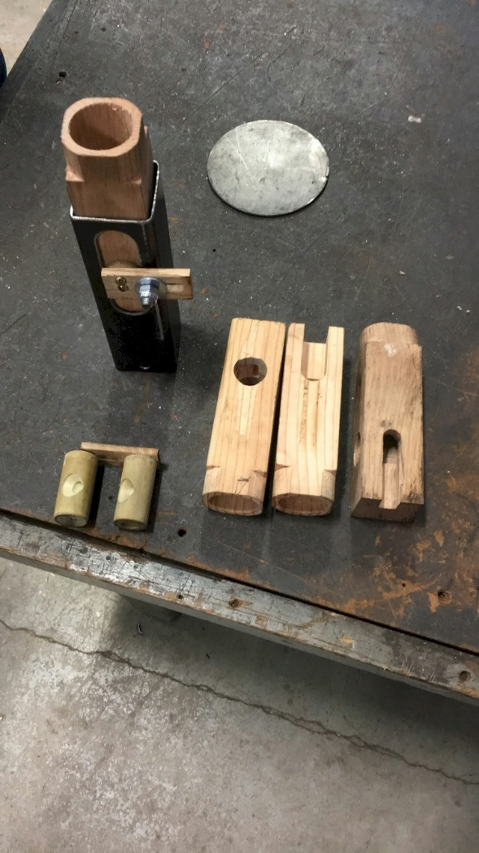
NOT DONE YET
$

Slide 28
MAIZE (FAOSTAT.COM)
Area, ha Production, Mt Avg. Mg/ha
World 183,319,737 1,038,281,035 5.7 (90 bu/ac)
USA 33,644,310 361,091,140 10.9 (174 bu/ac)
China 35,981,005 215,812,100 6.2 (98 bu/ac)
Brazil 15,450,180 80,516,571 5.2 (83 bu/ac)

Slide 29


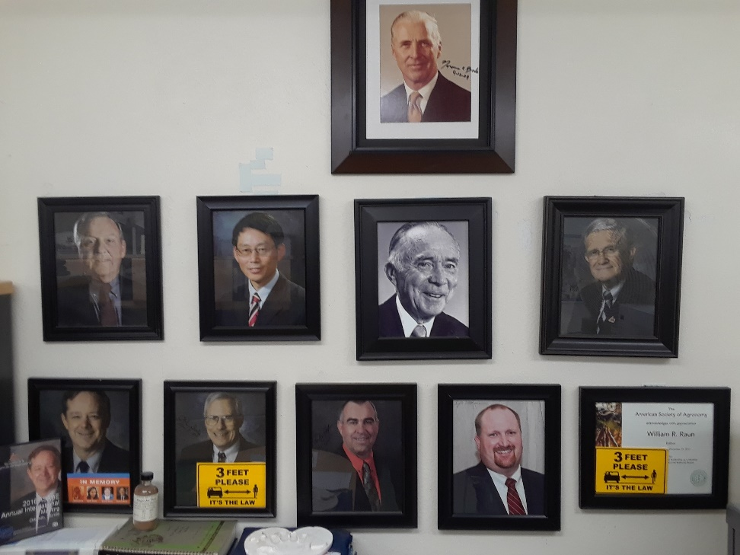
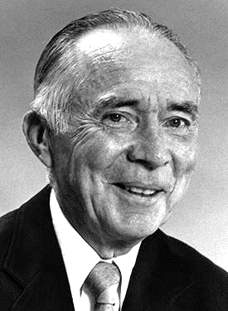

Dr. Robert L. Westerman
Opportunity
Professor R.A. Olson

Slide 30



Norman Borlaug Mother Teresa
1914 – 2009 1910 - 1997

Slide 31
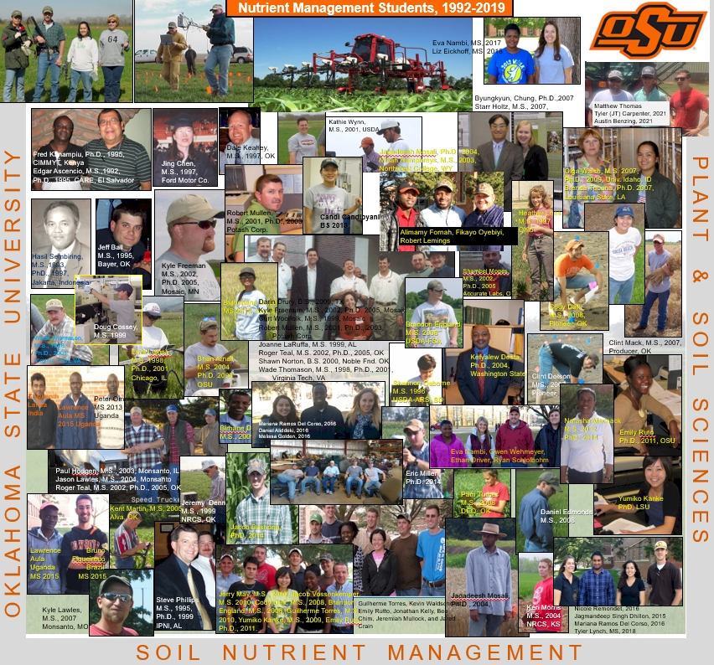

Slide 32
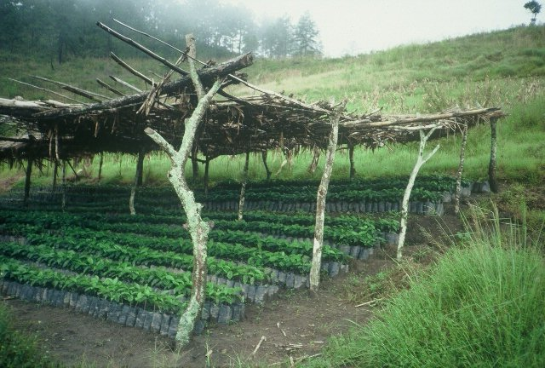
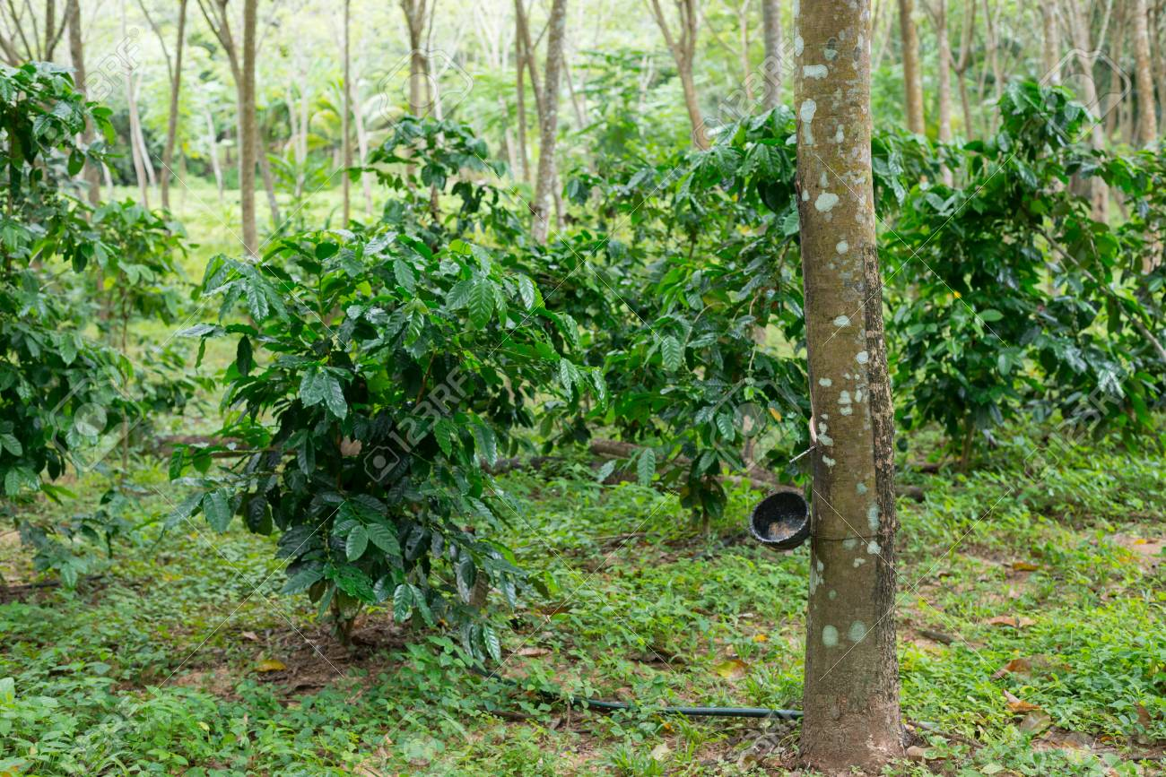
Hemileia vastatrix, leaf rust
(more at lower altitudes)
Coffee Imports to the US (2017)
Colombia $1.3 B
Brazil $1.1 B
Vietnam $541 M
Guatemala $336 M
Indonesia $319 M
Honduras $297 M
Nicaragua $295 M
Peru $227 M
Mexico $225 M
2500-6000 ft asl
Coffee Coffea arabica
Rubber Hevea brasiliensis, 1940 USDA

Slide 33
Population
Nebraska 1.92
Kansas 2.78
Iowa 3.03
Oklahoma 3.93
13.3 million acres of corn IA
9.5 million acres of corn NE (200 bu/ac irrigated, 147 bu/ac dryland)
7.6 million acres of wheat, KS (48 bu/ac) 2017
5.3 million acres of wheat, OK (39 bu/ac) 2015
1.0 million acres of wheat, NE, (46 bu/ac) 2017
5.7 million acres of soybeans, NE (58 bu/ac) 2017
12.6 million cattle (cows + CAFO’s Texas)
6.6 million cattle (cows + CAFO’s Nebraska)
5.1 million cattle (cows + CAFO’s Oklahoma)
John Deere invented the steel plow in 1837, Barbed wire 1874, extensive tillage/first tractor, 1892 (John Froelich, Clayton County IA)
Atmospheric CO2, 1880 (290 ppm)
Atmospheric CO2, 2010 (407 ppm)
Atmospheric CO2, 2016 (411 ppm)
Animal agriculture accounts for 18% of all GHG emissions (CO₂ equivalent, CH₄=20x that of CO₂, N₂O=300x that of CO₂)
Tillage 1890 forward, responsible for 25% of the CO₂ increase

Slide 34
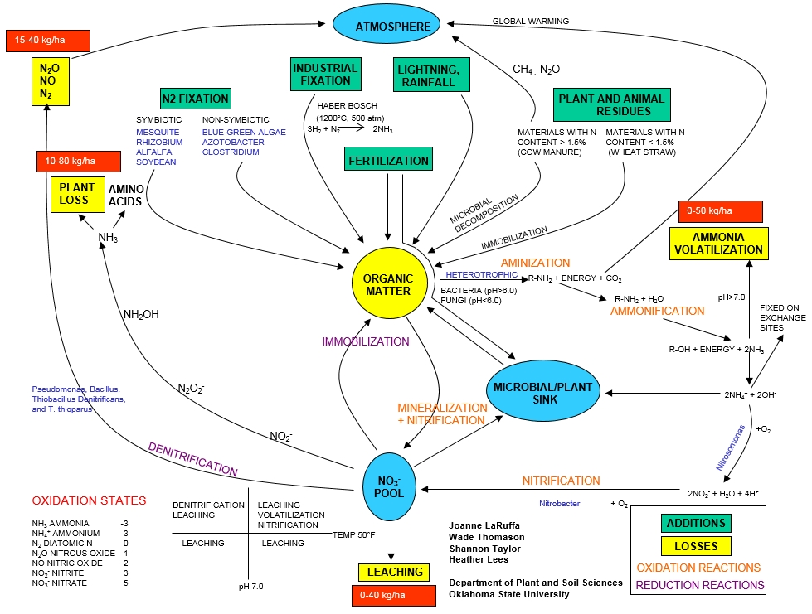

Slide 35





Frontier Rotary, Stillwater Oklahoma
Stillwater Centennial, Stillwater, Oklahoma
Mustang Rotary, Mustang, Oklahoma
Minden Rotary, Minden, Nebraska
Kearney Rotary, Kearney, Nebraska
District 5750, Oklahoma
District 5630, Nebraska
District 9125, Nigeria

Slide 36
