Slide 1



Origin, Development and Delivery of the OSU Hand Planter
Wednesday, September 2, 2020
11:30 am
AGIN 5312
Dr. Shida Henneberry, MIAP
Mikayla Lin Dolch
nue.okstate.edu

Slide 2
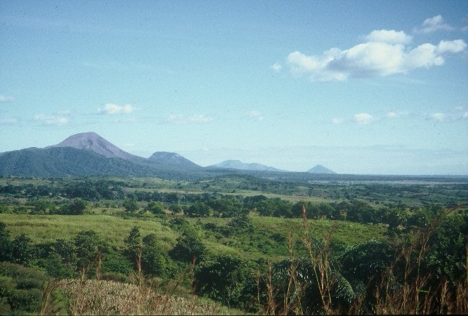
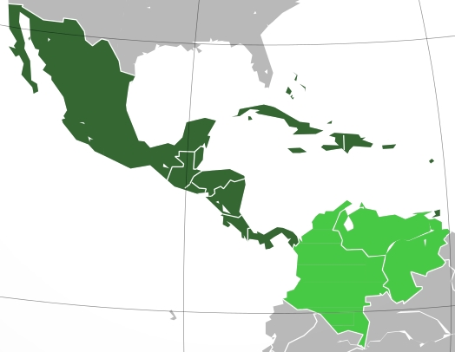
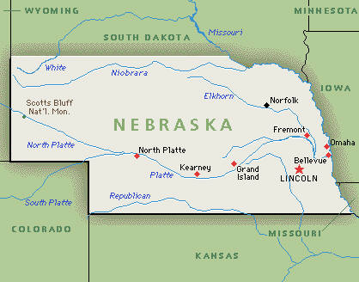
Minden, Nebraska, 1957-1959
Mexico City, Mexico, 1960-1963
Bogota, Colombia, 1964-1967
Cali, Colombia, 1968-1974
Oklahoma State University, 1975-1982
University of Nebraska, 1982-1985
CIMMYT, Mexico, Guatemala, 1985-1991
Oklahoma State University, 1991-present
CaSO₄
DAP, 3-17
Volcan de fuego
Middle America

Slide 3
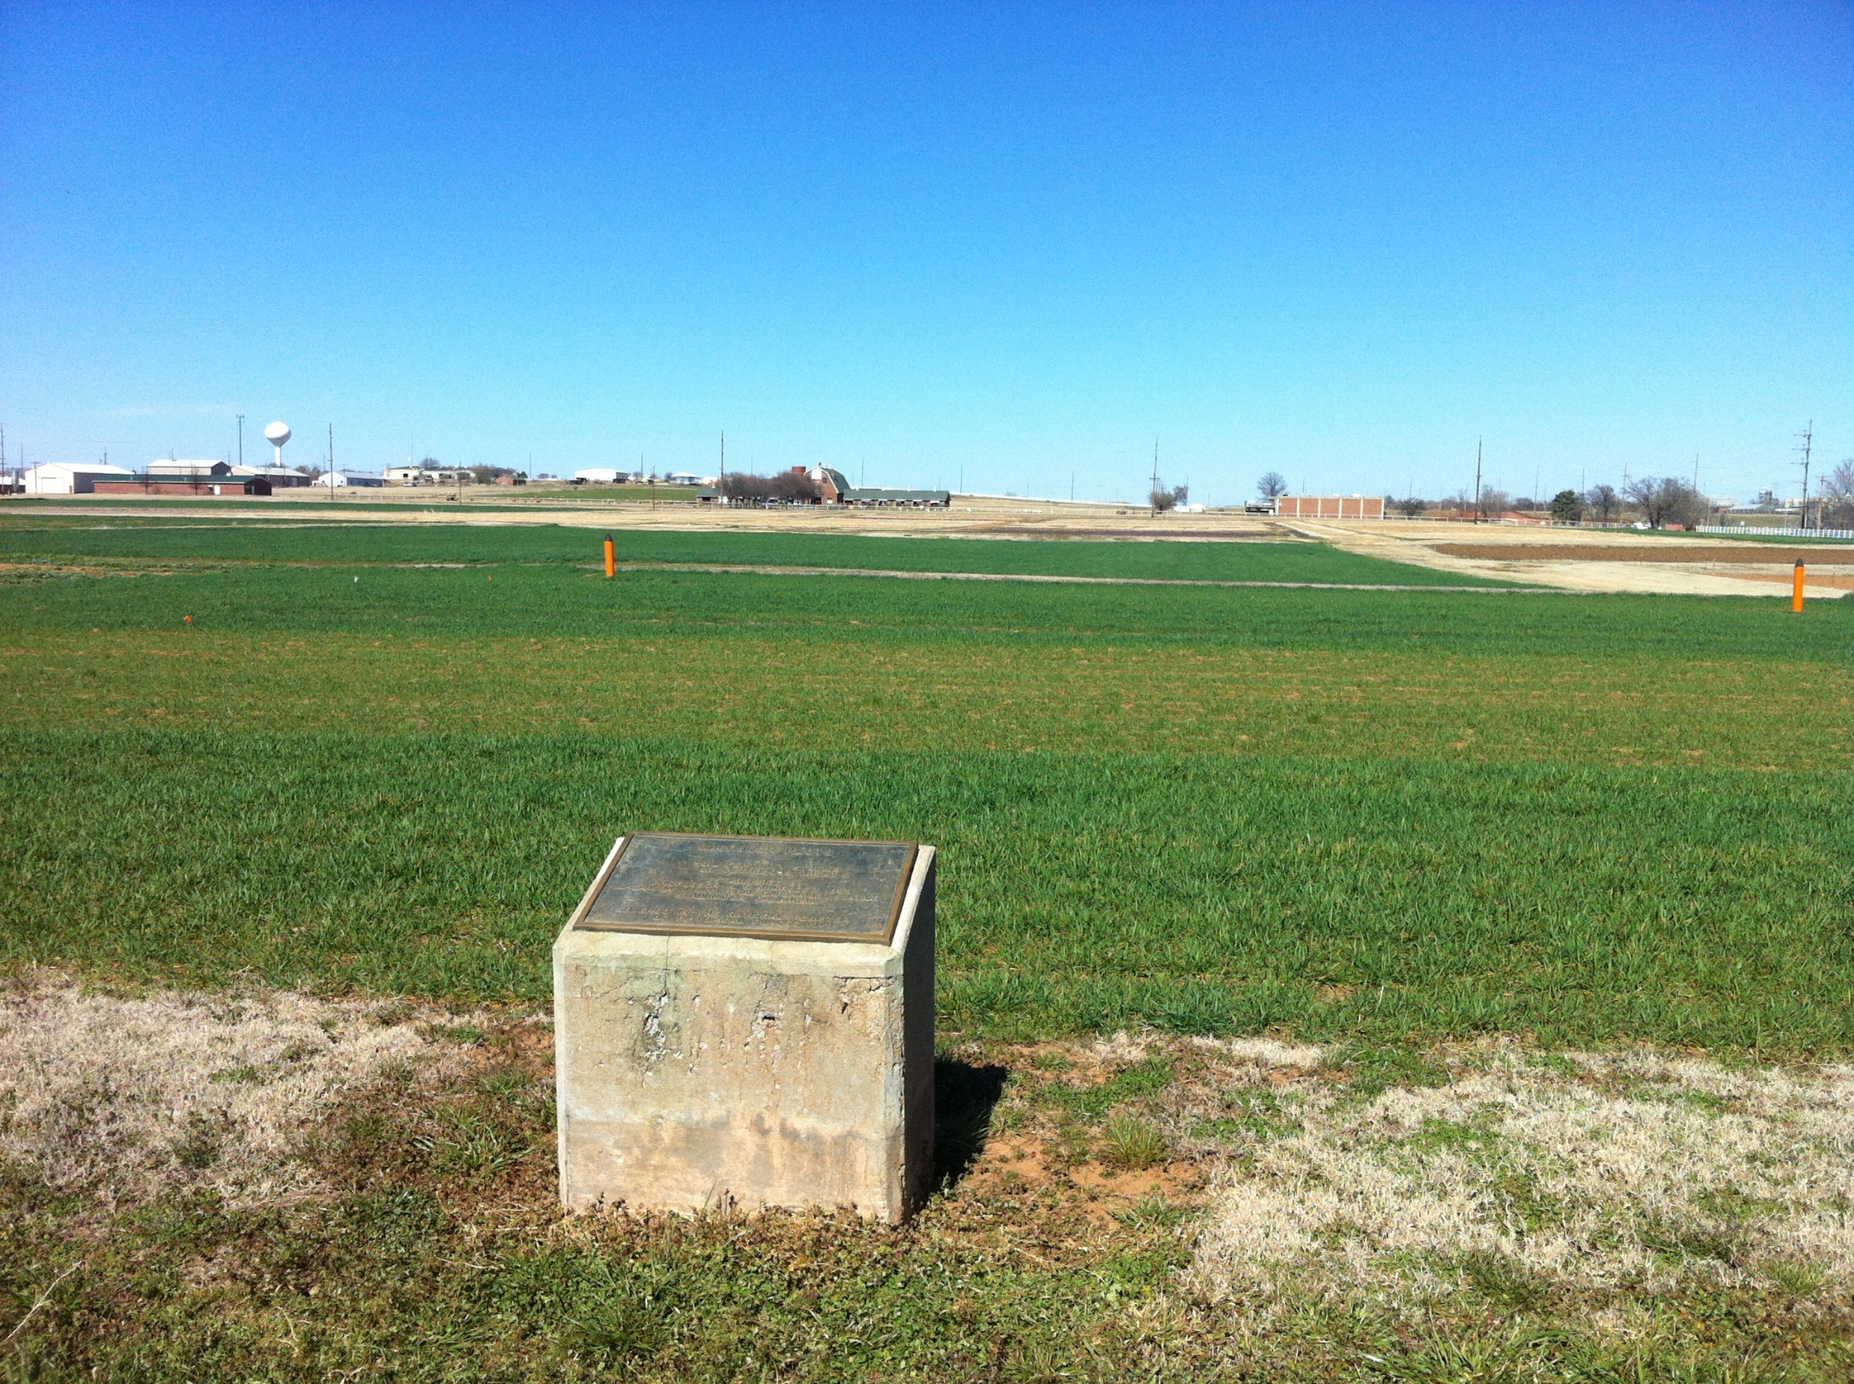
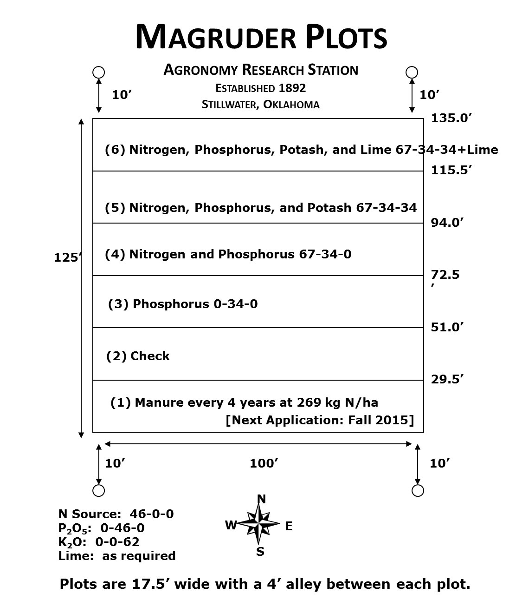
1892
Free living cyanobacteria (blue green algae) found in the check plot.
Sun, et al., 2004. Bacterial community structure and diversity in a century-old manure-treated agroecosystem. Appl. Environ. Micro. 70:5868-5874.

Slide 4
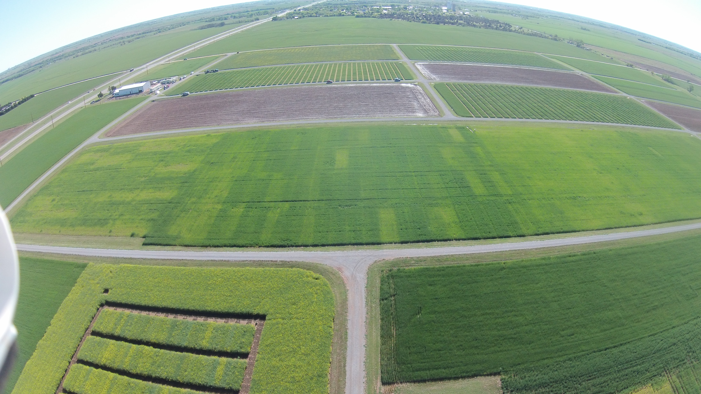

Wheat Fertility Experiment No.502
North Central Experiment Station
Established 1970
Location: Lahoma
TRT | Pre-plant N rate (lb N / ac) | Pre-plant P rate (lb P₂O₅ / ac) | Pre-plant K rate (lb K₂O / ac)
1.* | 0 | 0 | 0
2.* | 0 | 40 | 60
3.* | 20 | 40 | 60
4.* | 40 | 40 | 60
5.* | 60 | 40 | 60
6.* | 80 | 40 | 60
7.* | 100 | 40 | 60
8. | 60 | 0 | 60
9. | 60 | 20 | 60
10. | 60 | 60 | 60
11. | 60 | 80 | 60
12. | 60 | 60 | 0
13. | 100 | 80 | 60
14. | 60 | 40 | 60 (Sul-Po-Mag)
N applied as 46-0-0 (Urea) P applied as 0-46-0 (Triple Super Phosphate) K applied as 0-0-60 (Potash) * - YP plot
Grant silt loam (fine-silty, mixed, superactive, thermic, Udic Argiustoll
Plot size: 16’ x 60’
Alley: 20’
Total Trial Area: 224’ x 300’
W
S
N
E
OBJECTIVE: To study fertilizer nitrogen, phosphorus, and potassium in winter wheat. In recent years, this study has also been used to develop yield potential models and yield predictions through sensor based technologies.
1, 2 – Harvest Sequence Number
1, 2 – Treatment Number
1 , 2 – Soil Sample Sequence Number
 | 300 | 4 | 5 | 12 | 13 | 20 | 21 | 28 | 29 | 36 | 37 | 44 | 45 | 52 | 53
Rep 4 |  | 3 | 5 | 13 | 6 | 10 | 2 | 4 | 7 | 12 | 1 | 8 | 14 | 9 | 11
 | 240 | 43 | 44 | 45 | 46 | 47 | 48 | 49 | 50 | 51 | 52 | 53 | 54 | 55 | 56
 | 220 | 3 | 6 | 11 | 14 | 19 | 22 | 27 | 30 | 35 | 38 | 43 | 46 | 51 | 54
Rep 3 |  | 1 | 14 | 2 | 7 | 11 | 3 | 9 | 12 | 5 | 13 | 4 | 8 | 10 | 6
 | 160 | 29 | 30 | 31 | 32 | 33 | 34 | 35 | 36 | 37 | 38 | 39 | 40 | 41 | 42
 | 140 | 2 | 7 | 10 | 15 | 18 | 23 | 26 | 31 | 34 | 39 | 42 | 47 | 50 | 55
Rep 2 |  | 4 | 8 | 3 | 1 | 11 | 13 | 12 | 7 | 14 | 6 | 9 | 10 | 2 | 5
 | 80 | 15 | 16 | 17 | 18 | 19 | 20 | 21 | 22 | 23 | 24 | 25 | 26 | 27 | 28
 | 60 | 1 | 8 | 9 | 16 | 17 | 24 | 25 | 32 | 33 | 40 | 41 | 48 | 49 | 56
Rep 1 |  | 8 | 2 | 4 | 6 | 14 | 9 | 10 | 5 | 7 | 12 | 1 | 3 | 13 | 11
 |  | 1 | 2 | 3 | 4 | 5 | 6 | 7 | 8 | 9 | 10 | 11 | 12 | 13 | 14
 | 0 | 16 | 32 | 48 | 64 | 80 | 96 | 112 | 128 | 144 | 160 | 176 | 192 | 208 | 224
1970

Slide 6
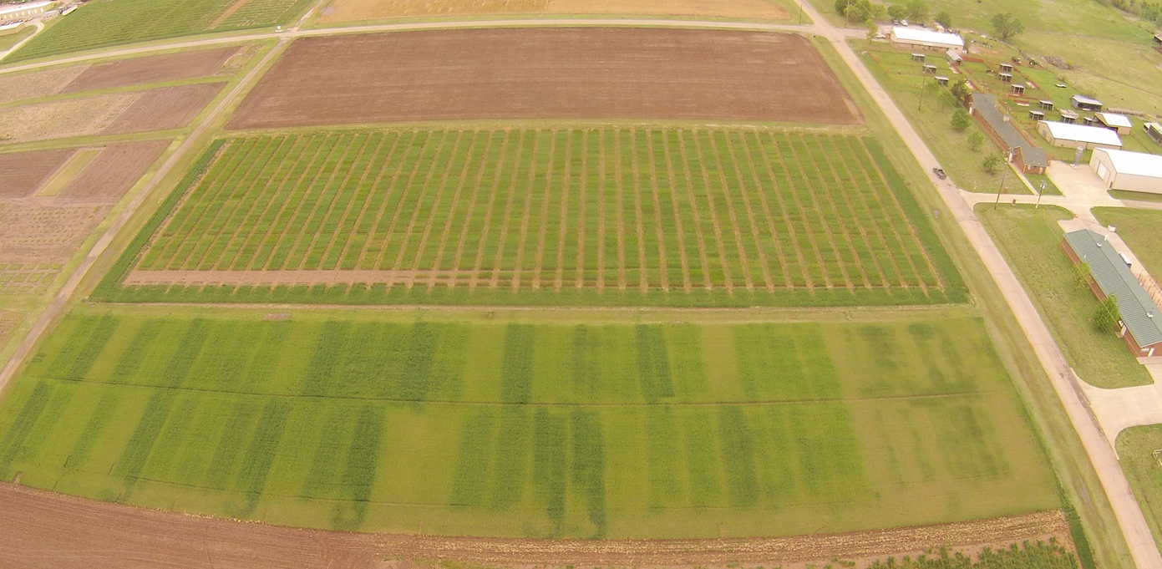
Wheat Fertility Experiment No.222
Agronomy Research Station
Established 1969
Kirkland silt loam (fine, mixed, thermic, Udertic Paleustoll
Location: Stillwater
TRT | Pre-plant N rate (lb N / ac) | Pre-plant P rate (lb P₂O₅ / ac) | Pre-plant K rate (lb K₂O / ac)
1.* | 0 | 60 | 40
2.* | 40 | 60 | 40
3.* | 80 | 60 | 40
4.* | 120 ^ | 60 | 40
5. | 80 | 0 | 40
6. | 80 | 30 | 40
7. | 80 | 90 | 40
8. | 80 | 60 | 0
9. | 80 | 60 | 80
10.* | 0 | 0 | 0
11. | 120 ^ | 90 | 80
12. | 120 ^ | 90 | 0
13. | 80 | 60 | 40 (Sul-Po-Mag)
N applied as 46-0-0 (Urea) P applied as 0-46-0 (Triple Super Phosphate) K applied as 0-0-60 (Potash) * - YP plot ^ - Split 120 lb N rates to 60 lb N (fall) and 60 lb N (spring)
Plot size: 20’ x 60’
Alley: 17’
Total Trial Area: 137’ x 520’
E
N
S
W
OBJECTIVE: To study fertilizer nitrogen, phosphorus, and potassium in winter wheat. In recent years, this study has also been used to develop yield potential models and yield predictions through sensor based technologies.
1, 2 – Harvest Sequence Number
1, 2 – Treatment Number
1 , 2 – Soil Sample Sequence Number
137 | 52 | 49 | 48 | 45 | 44 | 41 | 40 | 37 | 36 | 33 | 32 | 29 | 28 | 25 | 24 | 21 | 20 | 17 | 16 | 13 | 12 | 9 | 8 | 5 | 4 | 1
 | 13 | 13 | 8 | 5 | 7 | 3 | 2 | 11 | 12 | 6 | 9 | 1 | 10 | 4 | 6 | 2 | 11 | 5 | 3 | 8 | 12 | 10 | 9 | 1 | 7 | 4
77 | 26 | 25 | 24 | 23 | 22 | 21 | 20 | 19 | 18 | 17 | 16 | 15 | 14 | 13 | 12 | 11 | 10 | 9 | 8 | 7 | 6 | 5 | 4 | 3 | 2 | 1
 | Rep 2 | Rep 1 | Rep 2 |  |  |  |  |  |  |  |  |  |  |  | Rep 1
60 | 51 | 50 | 47 | 46 | 43 | 42 | 39 | 38 | 35 | 34 | 31 | 30 | 27 | 26 | 23 | 22 | 19 | 18 | 15 | 14 | 11 | 10 | 7 | 6 | 3 | 2
 | 13 | 13 | 8 | 10 | 7 | 12 | 9 | 5 | 2 | 11 | 1 | 3 | 4 | 6 | 3 | 11 | 1 | 8 | 6 | 9 | 12 | 2 | 5 | 10 | 4 | 7
0 | 52 | 51 | 50 | 49 | 48 | 47 | 46 | 45 | 44 | 43 | 42 | 41 | 40 | 39 | 38 | 37 | 36 | 35 | 34 | 33 | 32 | 31 | 30 | 29 | 28 | 27
 | Rep 4 | Rep 3 | 60 | 80 | 100 | 120 | 140 | 160 | 180 | 200 | 220 | 240 | 260 | 280 | 300 | 320 | 340 | 360 | 380 | 400 | 420 | 440 | 460 | 480 | 500 | 520
 |  |  | Rep 4 |  |  |  |  |  |  |  |  |  |  |  | Rep 3
1969

Slide 7
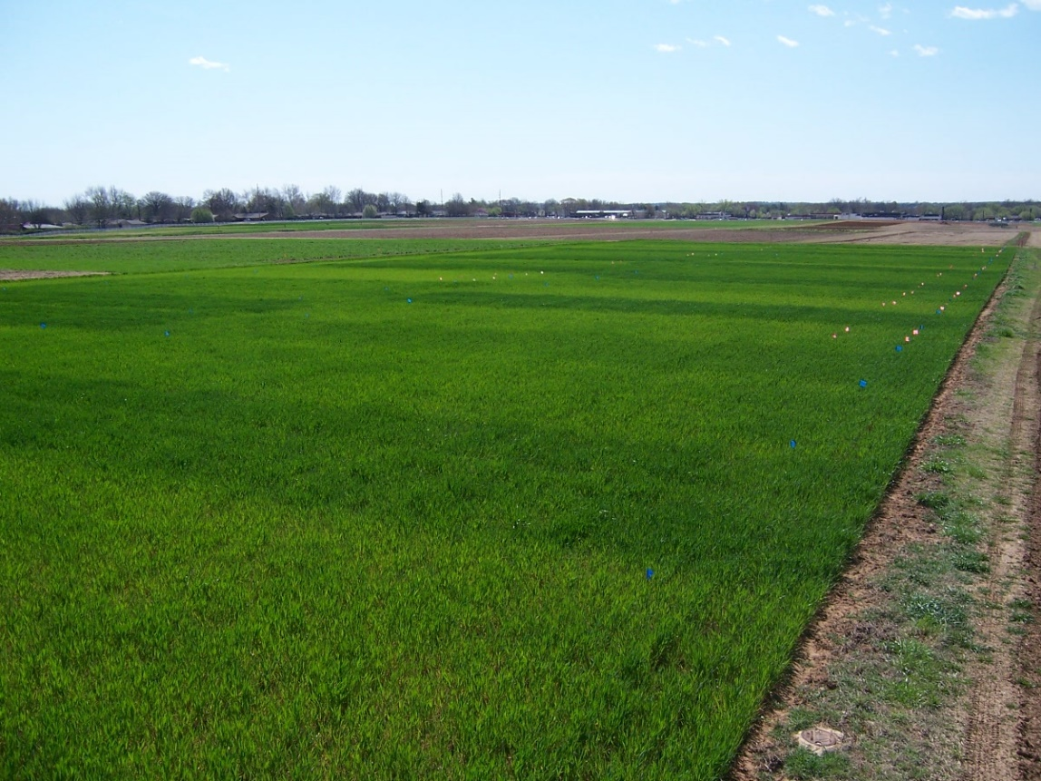

E₂₂₂

Slide 8
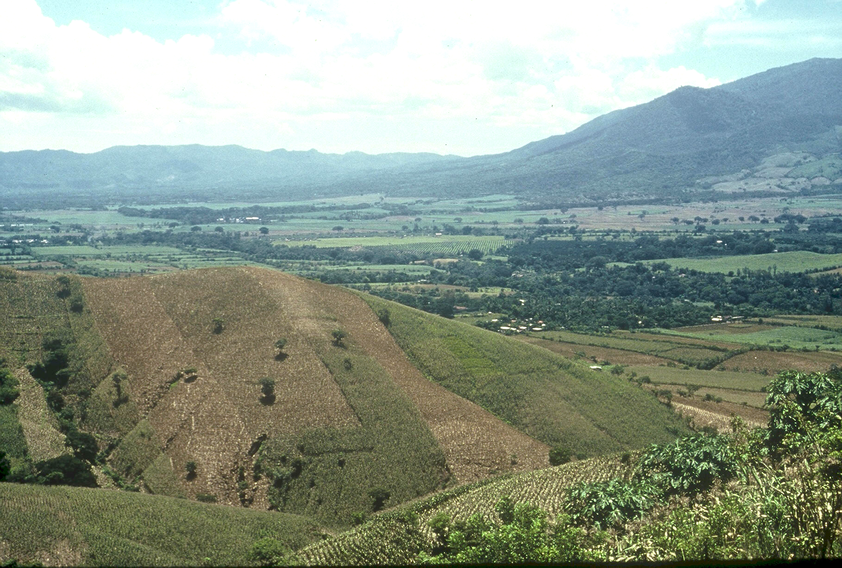

Planter Chronology (35 years)
1985, CIMMYT
1987, Regional Agronomist Central America
1991, Faculty OSU
1999, FP - Hand Planter work
2000, Design/construction started
2013, OSU-MS, Aula, Omara
2019, Planter redesign, Rotary Grant / Importance
Rotary Contributions
(OK, NE, Nigeria)

Slide 9
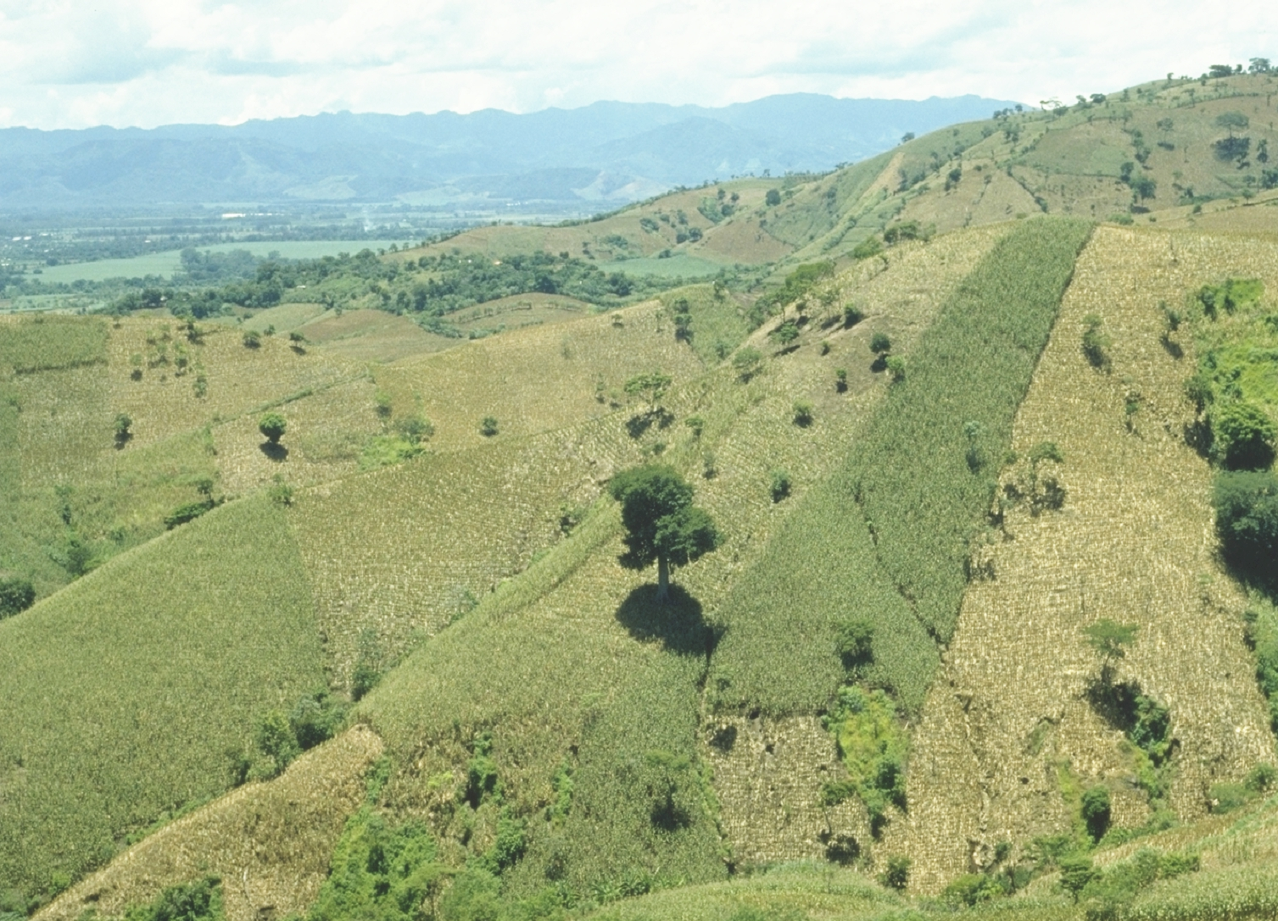
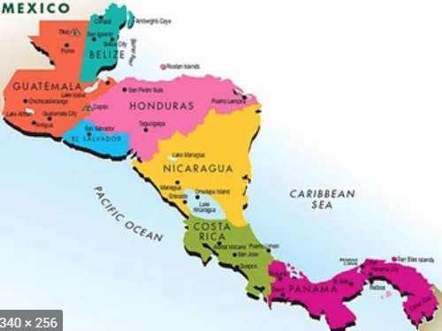

Slide 10
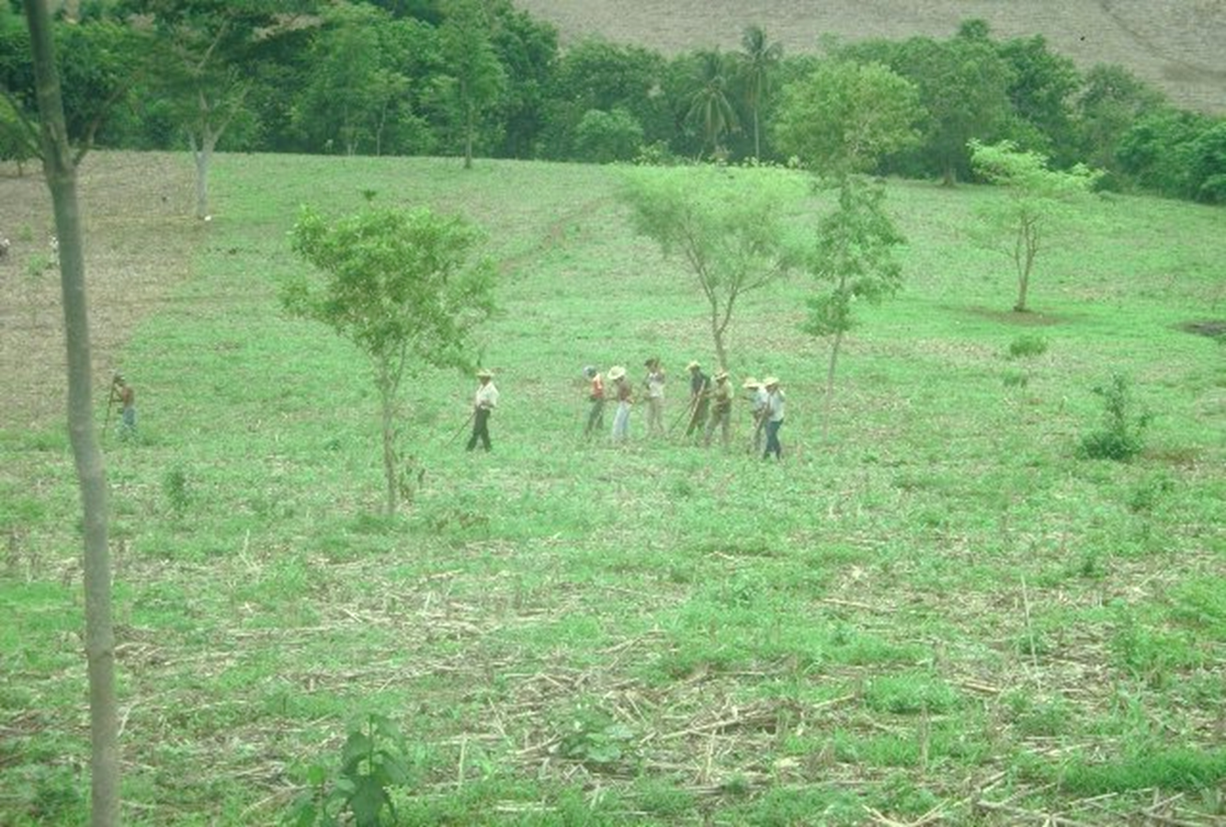

Slide 11
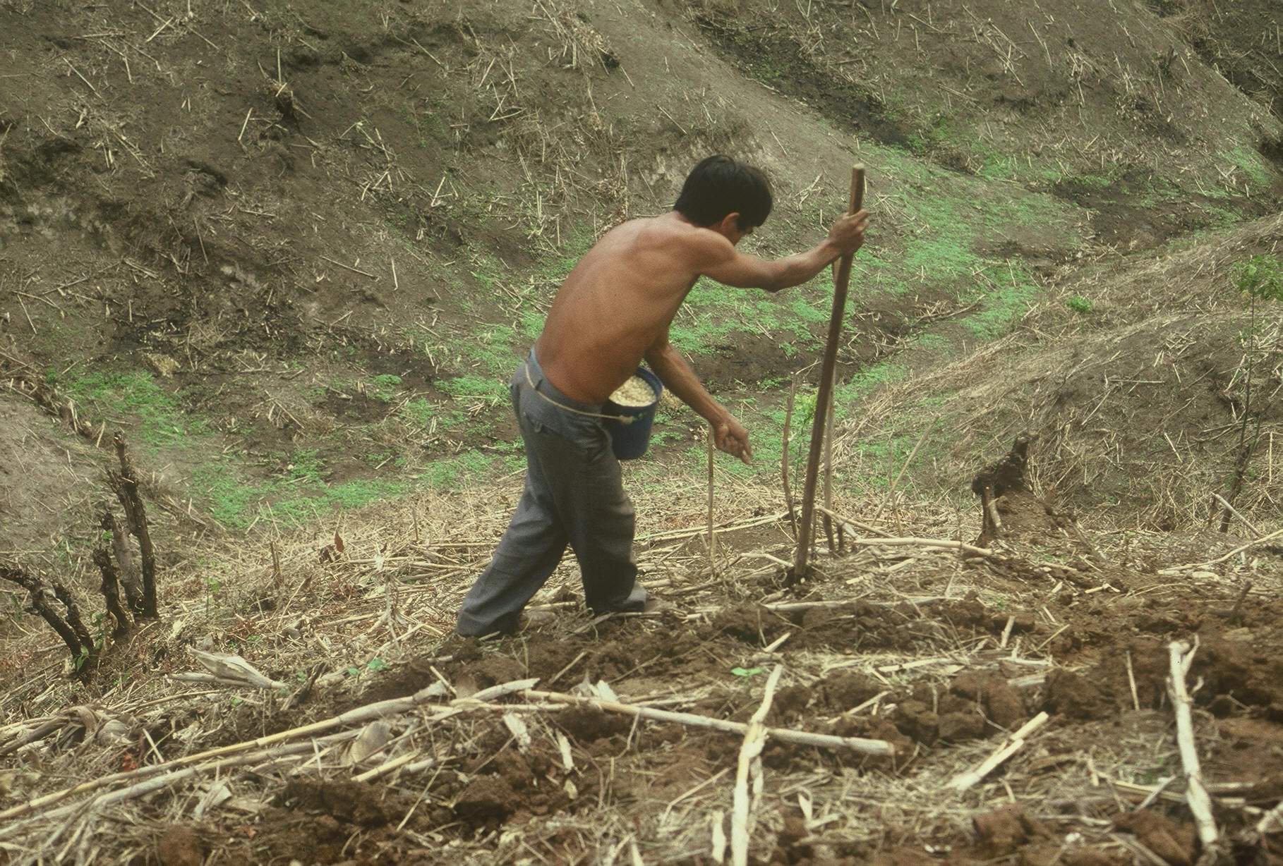

1987 (33)

Slide 12
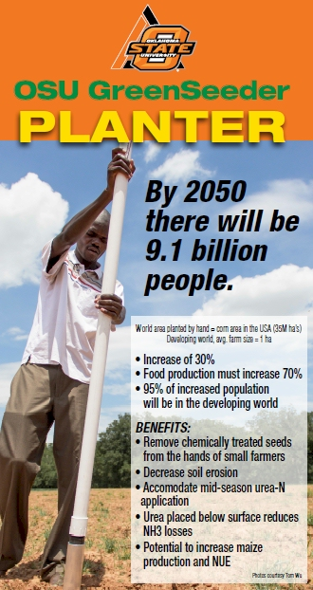
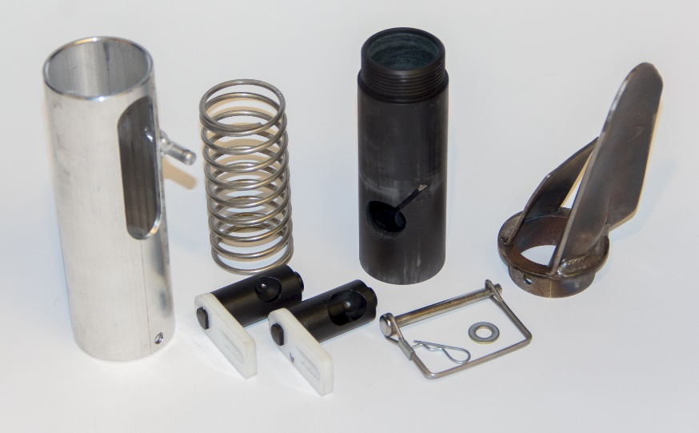
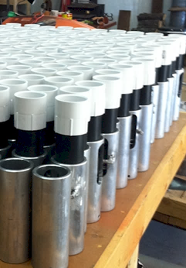

Slide 13
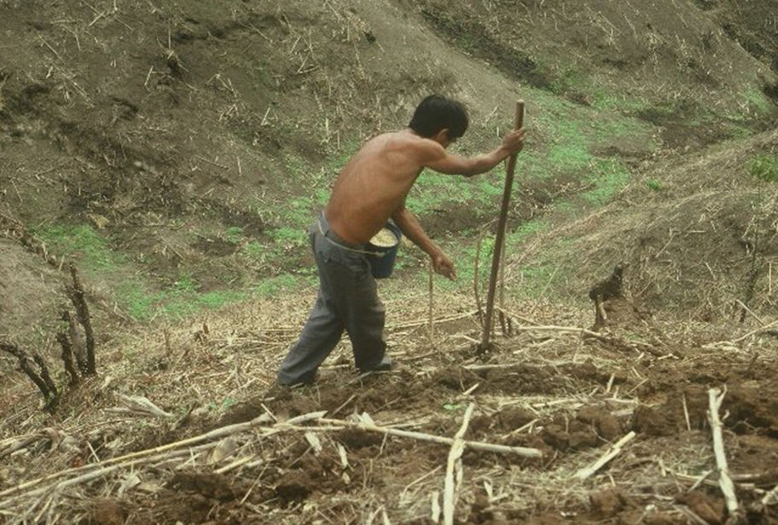
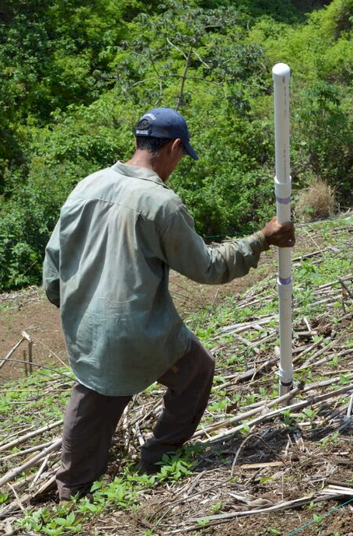


Slide 14
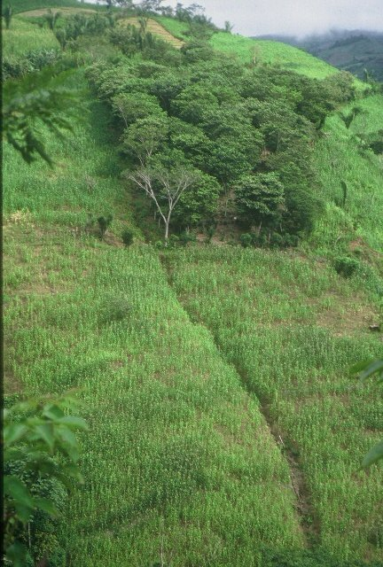
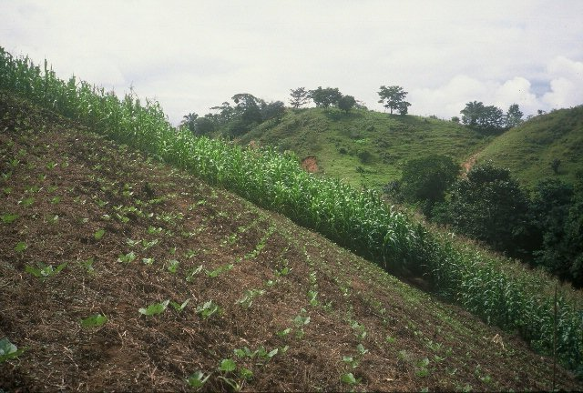

Slide 15
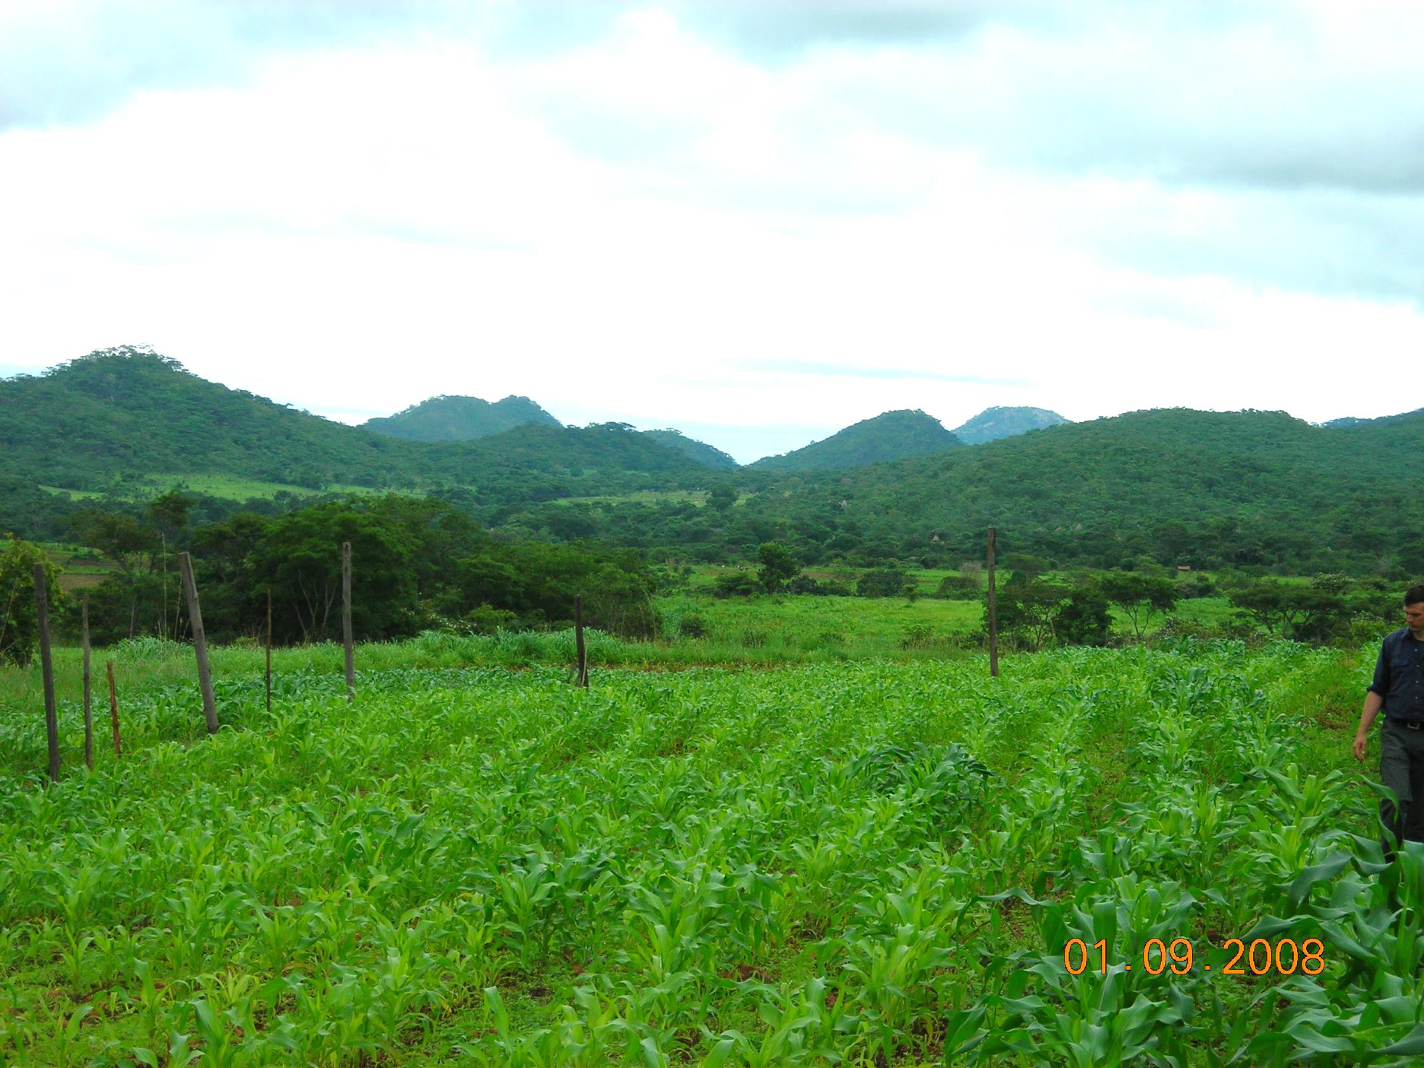
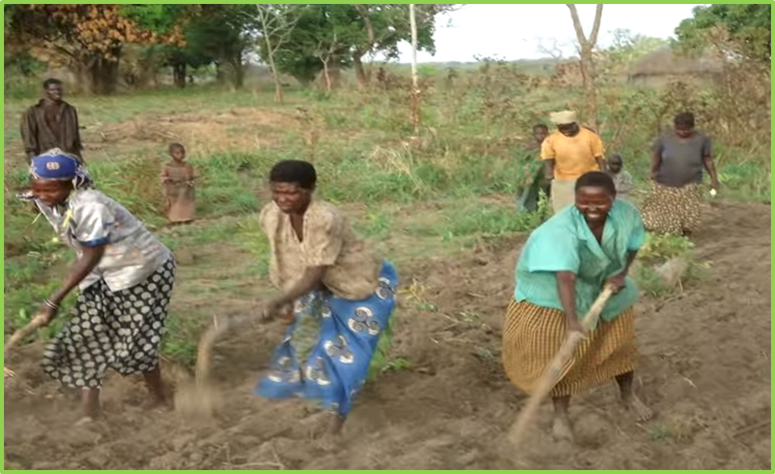
ZIMBABWE, UGANDA
Remote Locations
Surface applications of urea

Slide 16
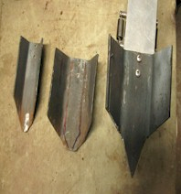
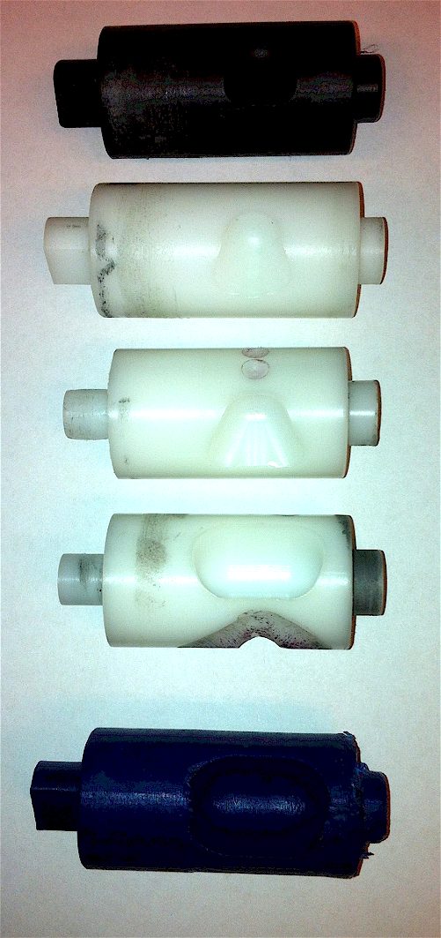
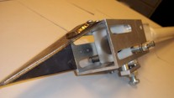
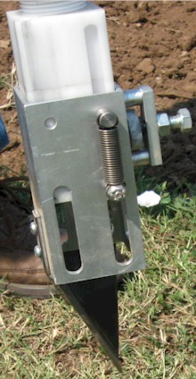
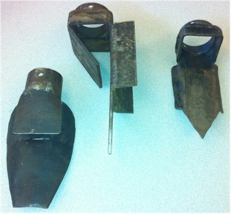
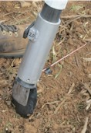
Internal Brush/Strength
Drum size/material
Cavity size/angle
Tip size/design/material
Internal/Ext. spring/tension

Slide 17
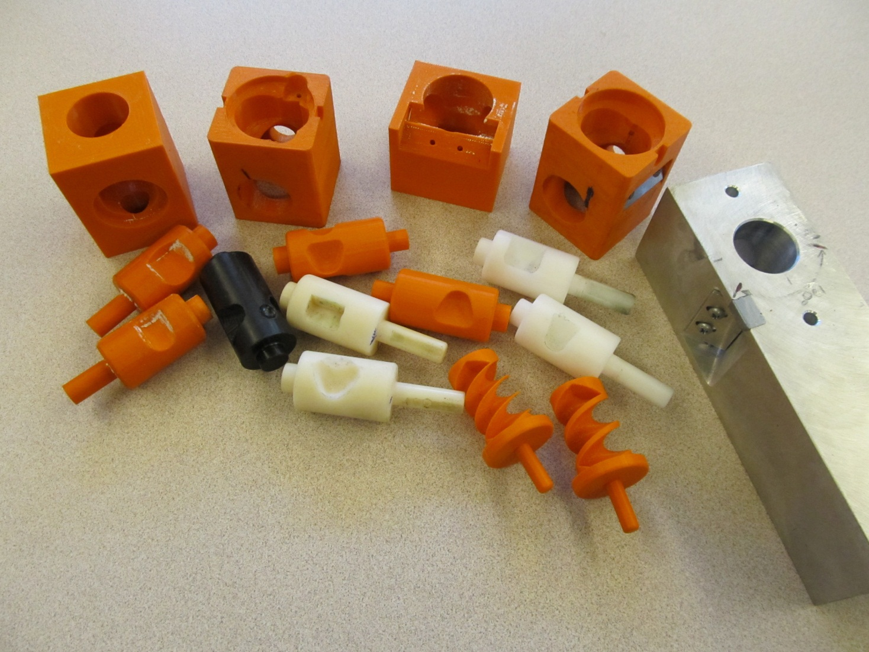
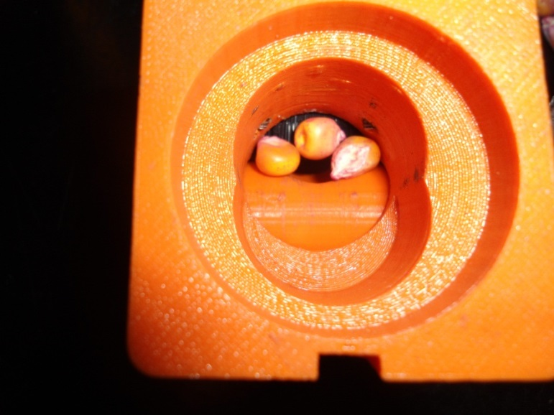
Singulation Design
3D printing
Rotary International
AGCO
Sitlington Chair
ASA Reinvest, Jessica Davis
Tolerances
Materials
Failure analysis/testing

Slide 18
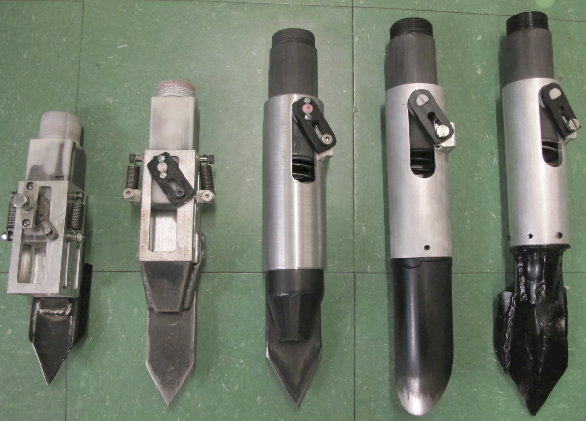

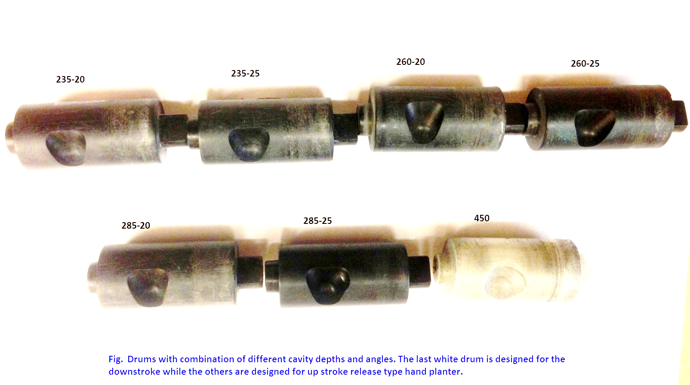
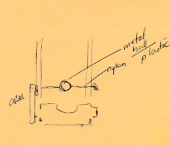

Slide 20
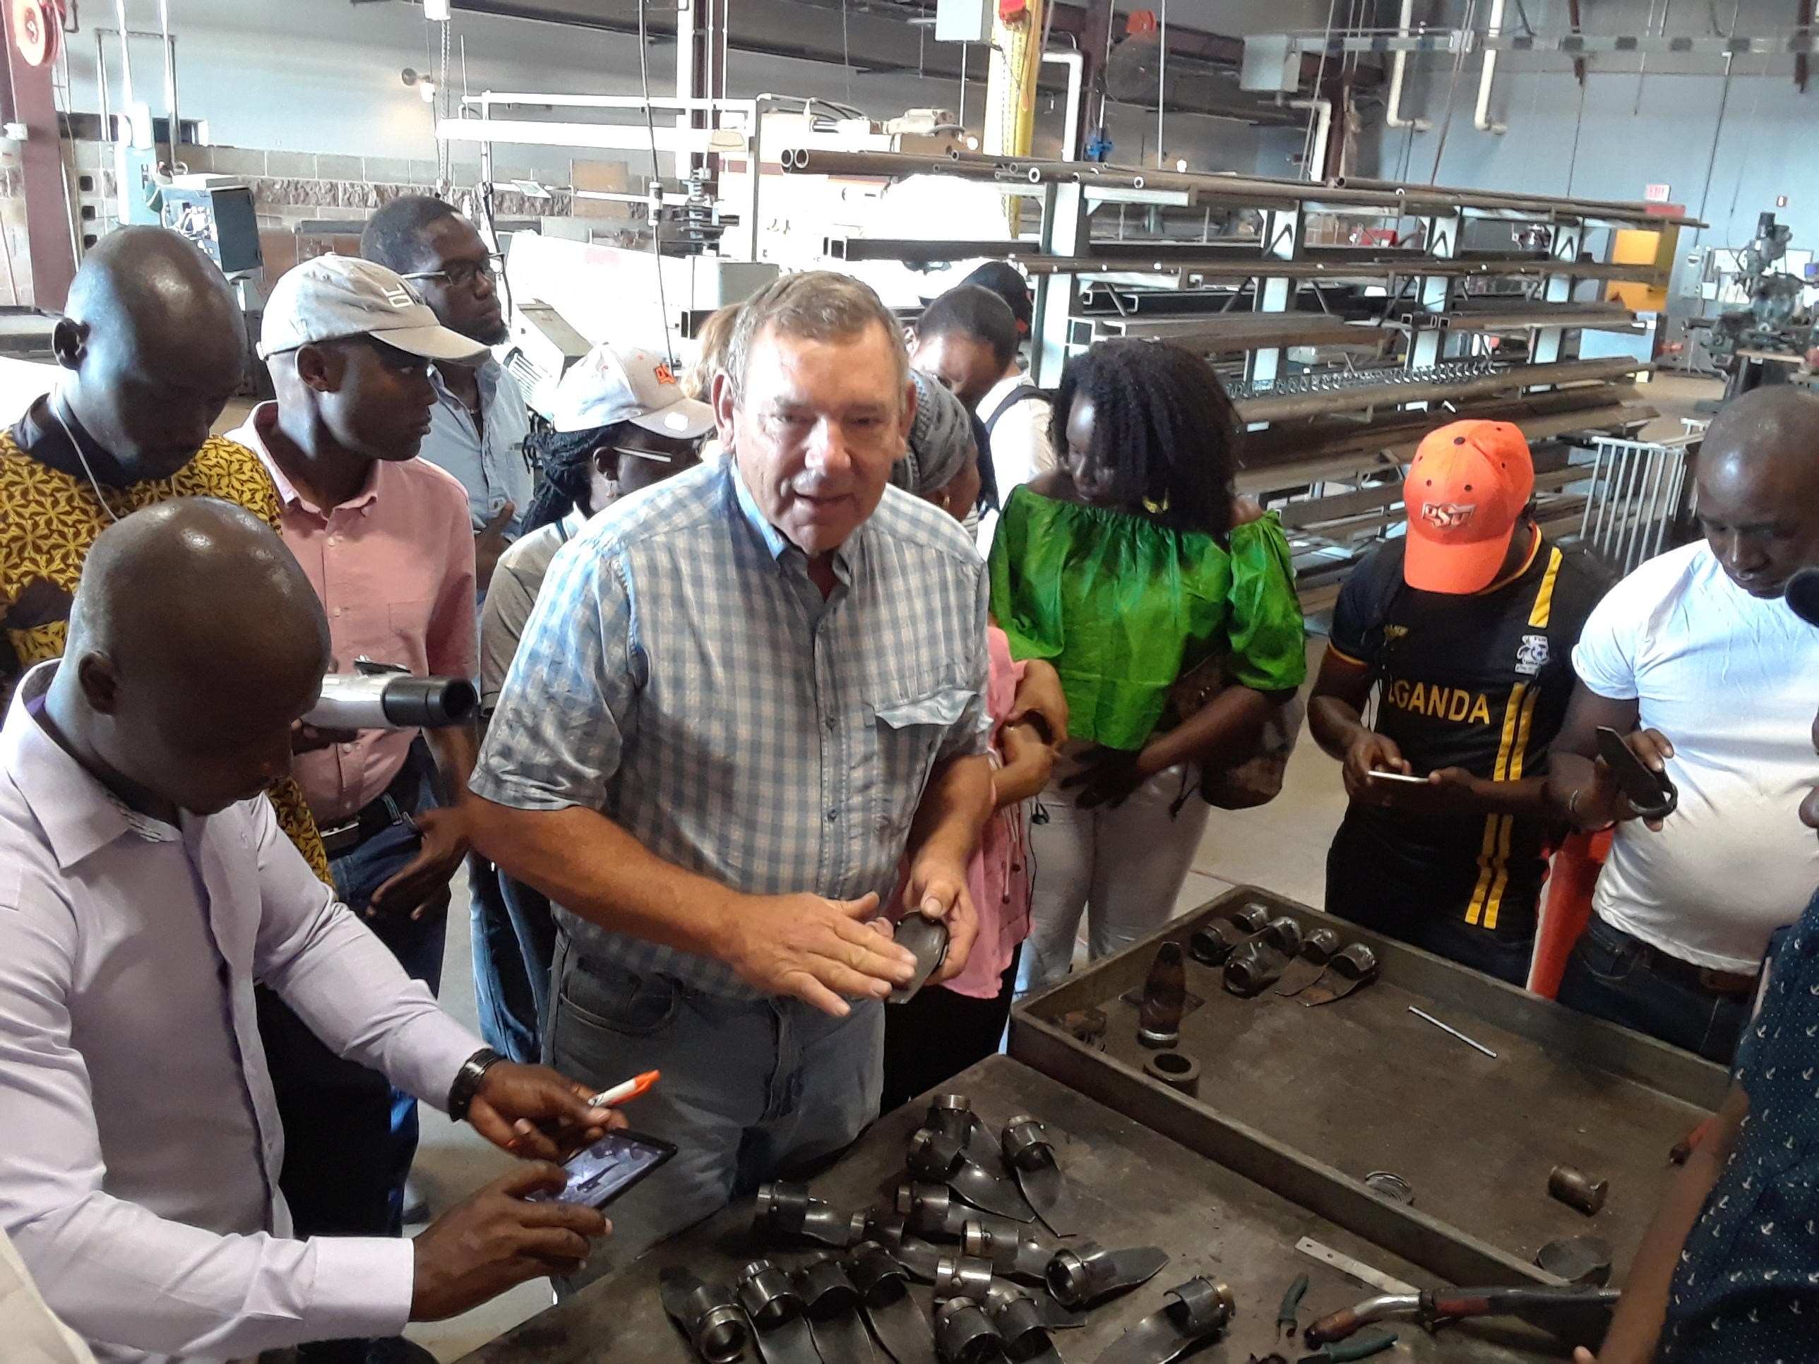
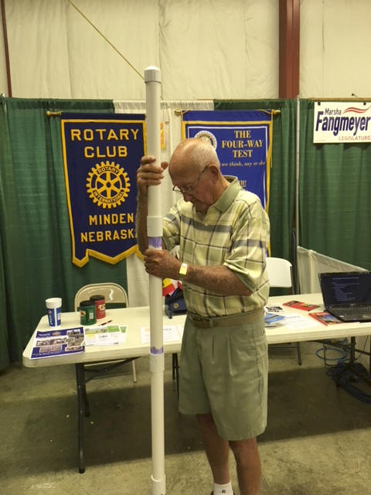
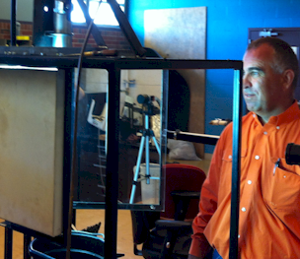

Wayne Kiner
Institutional Memory
Kearney County Fair
Minden, Nebraska
Randy Taylor
tolerance testing
Koemel Law, PLLC
205 W. 7th Ave.
Suite 101-B
Stillwater, OK 74074
http://nue.okstate.edu/Hand_Planter.htm

Slide 21
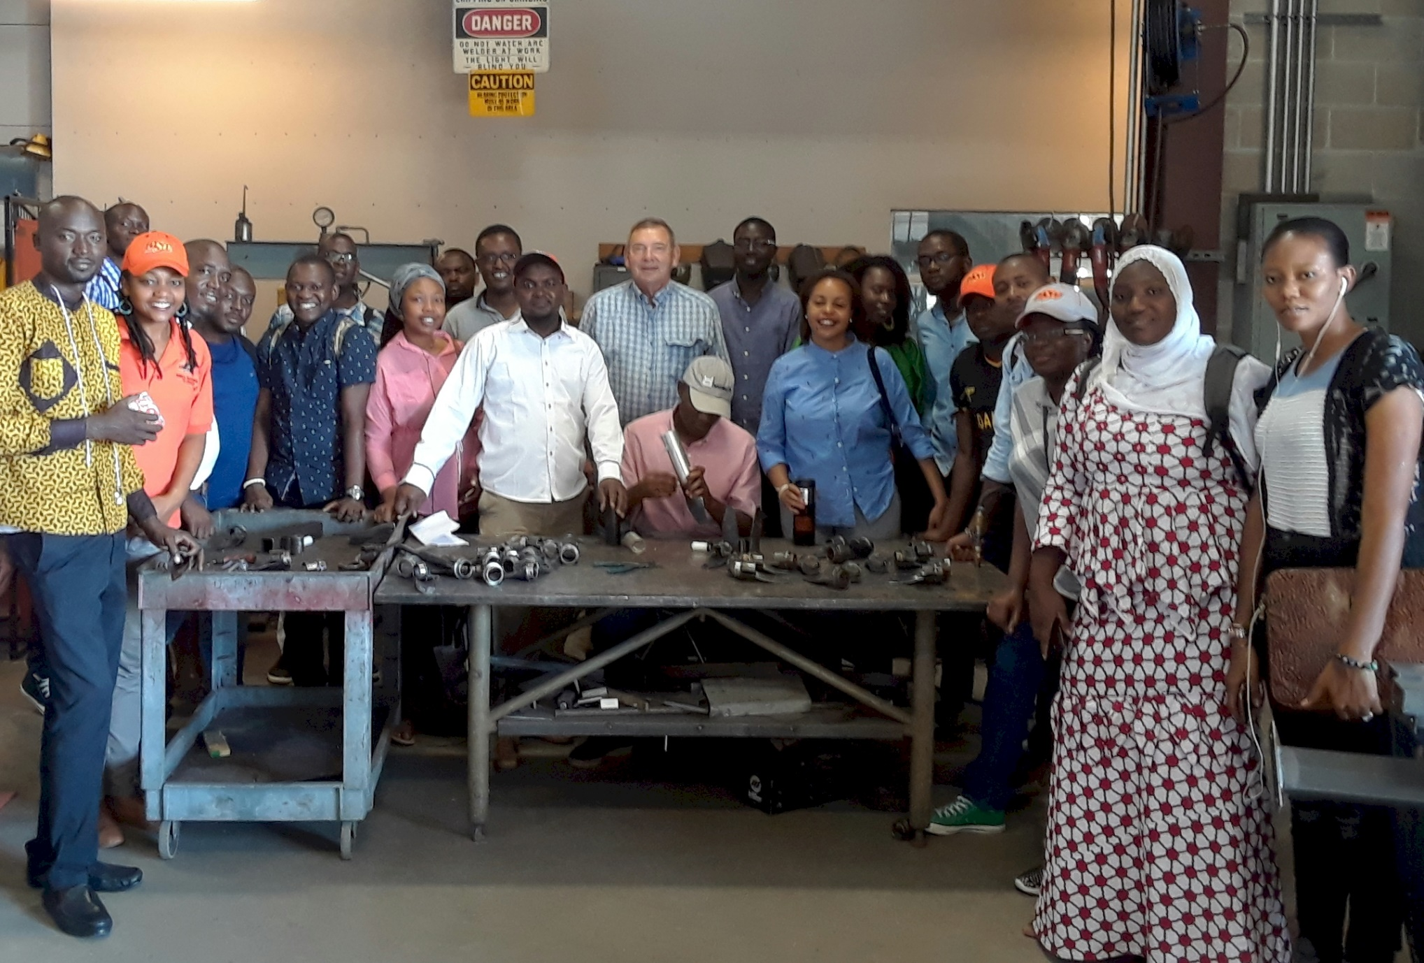
Wayne Kiner, Mandela Fellows 2018

Slide 22
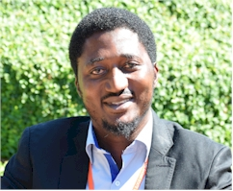
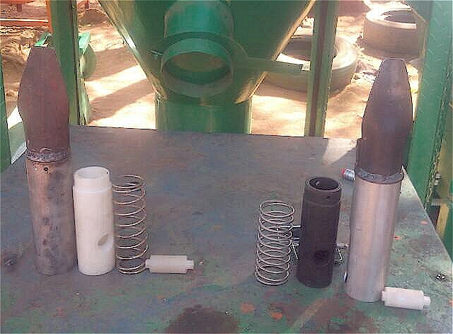
Current Cost Estimates
Grand Victory Ltd
Tsim Sha Tsui Hong Kong
Rm 1604 16/F Lee Wai Coml Bldg
Tsim Sha Tsui
1000, $25 each
Usman Ali, Nigeria, Mandela Fellows
July 11, 2019: Bernard Ato Brown , Kumasi Ghana (Agricultural Engineer)

Slide 23
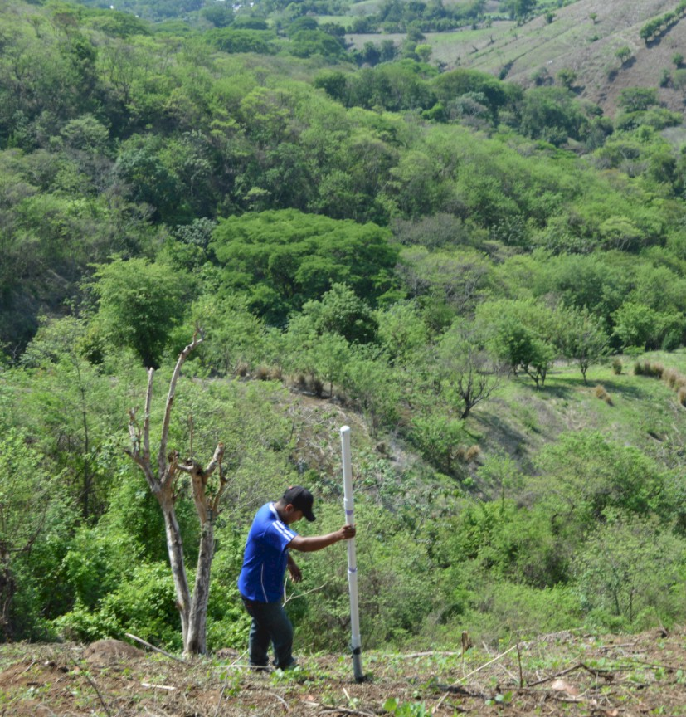
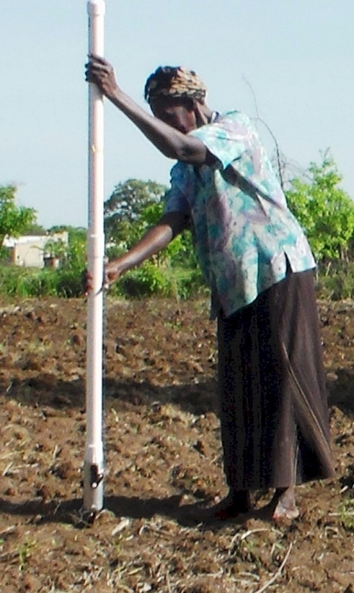
Opico Quezaltepeque, El Salvador
LIRA UGANDA
EL SALVADOR
Peter Omara MS 2013
Worlds Apart
Avg. Farm Size: 1 ha
Avg. Maize Grain Yield, 2 Mg/ha
Maize seed, Hybrids (US, others)
Social aspects/technology transfer

Slide 24
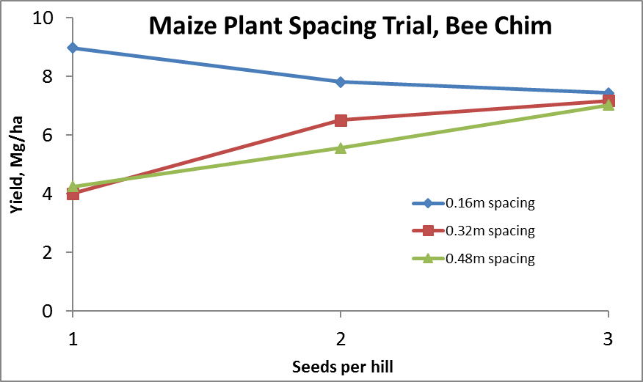
Importance of Singulation
0.76m Row Spacing
Heterogeneity in plant spacing, and plant stands reduce yields
www.agry.purdue.edu/ext/corn/pubs/agry9101.htm

Slide 25
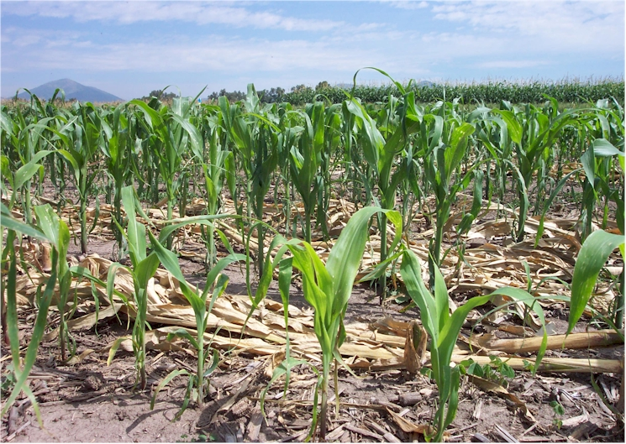
Homogeneity of plant stands

Slide 26
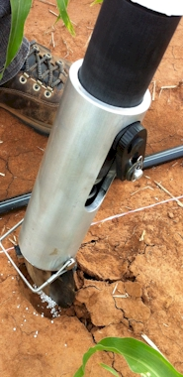
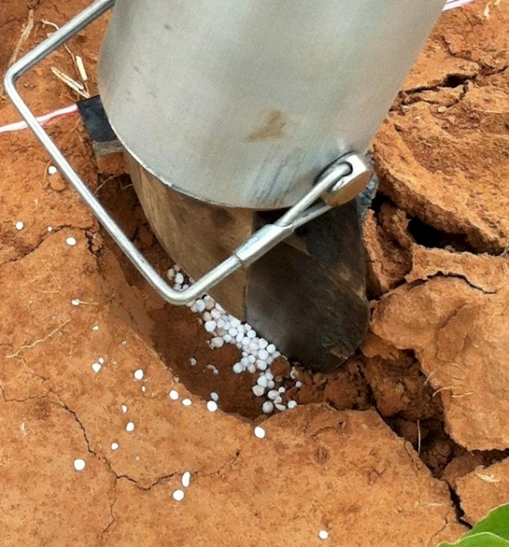
MID Season Fertilizer N
Combined, Efaw and Perkins
Topdress N, Corn, V12 |  | 70,000 plants/ha
Methods | N, kg/ha | Mg/ha
Check | 0 | 6.6
Hand planter (0.9 g/plant) | 30 | 11.2
Hand planter (1.8 g/plant) | 60 | 10.6
Broadcast | 30 | 6.4
Broadcast | 60 | 7.0
Dribble urea | 30 | 9.3
Dribble urea | 60 | 7.8
Dribble UAN | 30 | 7.3
Dribble UAN | 60 | 10.4
SED = 1.81

Slide 27
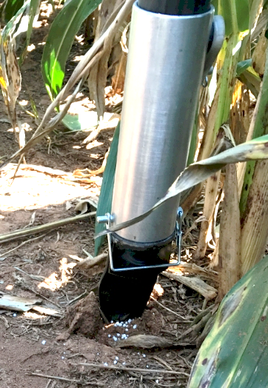
Benefits
Remove chemically treated seeds from the hands of producers
Decrease soil erosion via improved plant spacing
Accommodate mid-season N application
Urea placed below the surface reducing NH₃ loss
Increased production and NUE
Potential Uses
Seed, all types
Alternative chemicals, EPA, mosquito abatement
Food plots/hunters
Gardeners

Slide 28
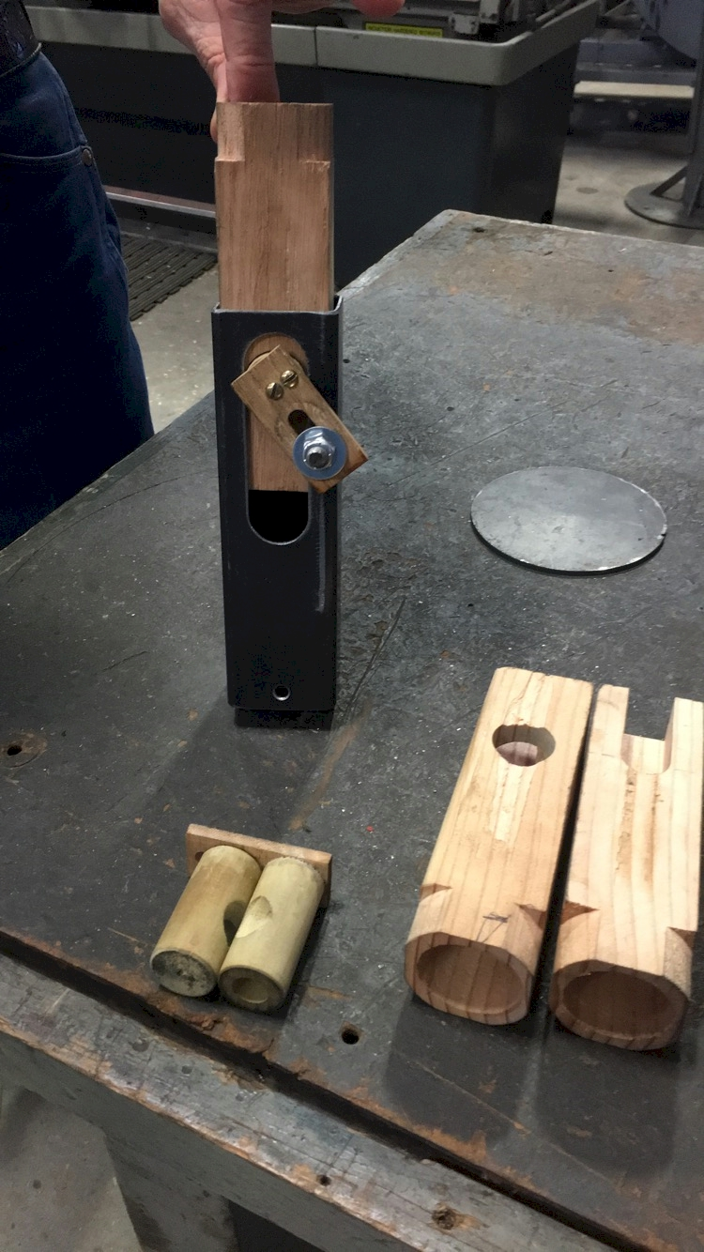
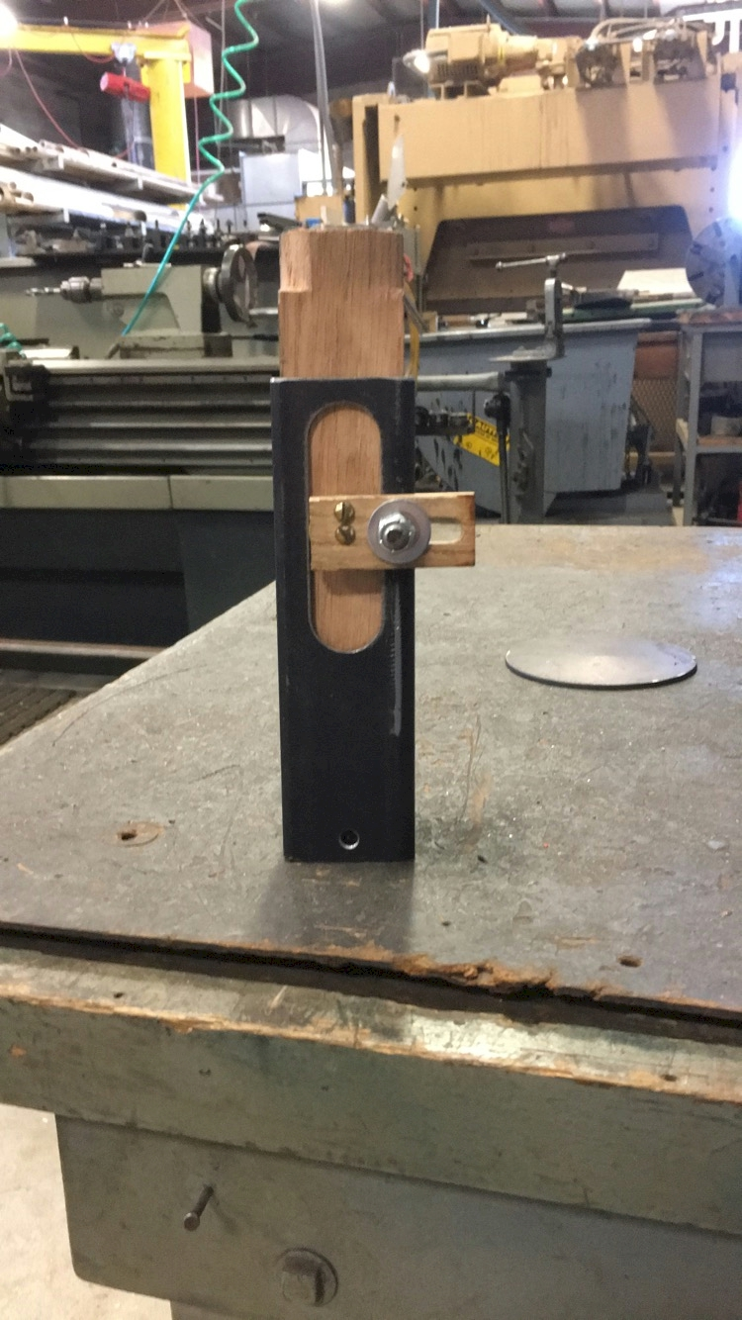
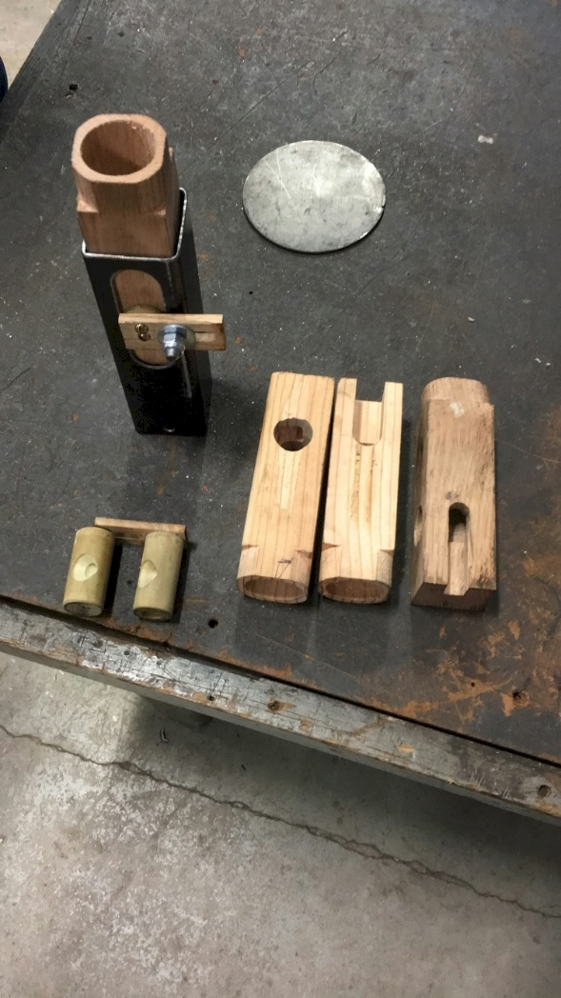
NOT DONE YET
$

Slide 29
MAIZE (FAOSTAT.COM)
Area, ha Production, Mt Avg. Mg/ha
World 183,319,737 1,038,281,035 5.7 (90 bu/ac)
USA 33,644,310 361,091,140 10.9 (174 bu/ac)
China 35,981,005 215,812,100 6.2 (98 bu/ac)
Brazil 15,450,180 80,516,571 5.2 (83 bu/ac)

Slide 30

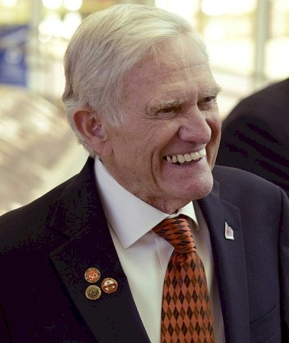



Dr. Robert L. Westerman
Opportunity
Professor R.A. Olson

Slide 31



Norman Borlaug Mother Teresa
1914 – 2009 1910 - 1997

Slide 32


Slide 33


Hemileia vastatrix, leaf rust
(more at lower altitudes)
Coffee Imports to the US (2019)
Colombia $1.14 B
Brazil $1.03 B
Vietnam $300 M
Guatemala $320 M
Indonesia $280 M
Honduras $297 M
Nicaragua $295 M
Costa Rica $140 M
Mexico $160 M
2500-6000 ft asl
Coffee Coffea arabica
Rubber Hevea brasiliensis, 1940 USDA

Slide 34
Population
Nebraska 1.92
Kansas 2.78
Iowa 3.03
Oklahoma 3.93
13.3 million acres of corn IA
9.5 million acres of corn NE (200 bu/ac irrigated, 147 bu/ac dryland)
7.6 million acres of wheat, KS (48 bu/ac) 2017
5.3 million acres of wheat, OK (39 bu/ac) 2015
1.0 million acres of wheat, NE, (46 bu/ac) 2017
5.7 million acres of soybeans, NE (58 bu/ac) 2017
12.6 million cattle (cows + CAFO’s Texas)
6.6 million cattle (cows + CAFO’s Nebraska)
5.1 million cattle (cows + CAFO’s Oklahoma)
John Deere invented the steel plow in 1837, Barbed wire 1874, extensive tillage/first tractor, 1892 (John Froelich, Clayton County IA)
Atmospheric CO2, 1880 (290 ppm)
Atmospheric CO2, 2010 (407 ppm)
Atmospheric CO2, 2016 (411 ppm)
Atmospheric CO2, 2020 (414 ppm)
Animal agriculture accounts for 18% of all GHG emissions (CO₂ equivalent, CH₄=20x that of CO₂, N₂O=300x that of CO₂)
Tillage 1890 forward, responsible for 25% of the CO₂ increase

Slide 35


Slide 36




Frontier Rotary, Stillwater Oklahoma
Stillwater Centennial, Stillwater, Oklahoma
Mustang Rotary, Mustang, Oklahoma
Minden Rotary, Minden, Nebraska
Kearney Rotary, Kearney, Nebraska
District 5750, Oklahoma
District 5630, Nebraska
District 9125, Nigeria

Slide 37
Time, $, Products
post PhD, 1985-present, 34 years
Greenseeker
Years: 1991–2001, 11 years, $4.7M
Delivery, 2002-present
Stone, Solie, students
OSU Hand Planter (Greenseeder)
Years: 1987-2020, 33 years, $175K
Taylor, Koller, many students,
  Delivery, >450, plans for more
OSU graduates, Kenya, Uganda, El Salvador, Mexico, Dr. Joshua Ringer, Dr. Craig Edwards, Mandela Washington Fellows

