Slide 1

Dr. Sergio Abit
Plant and Soil Sciences
February 12, 2020
3:30 pm

Slide 2
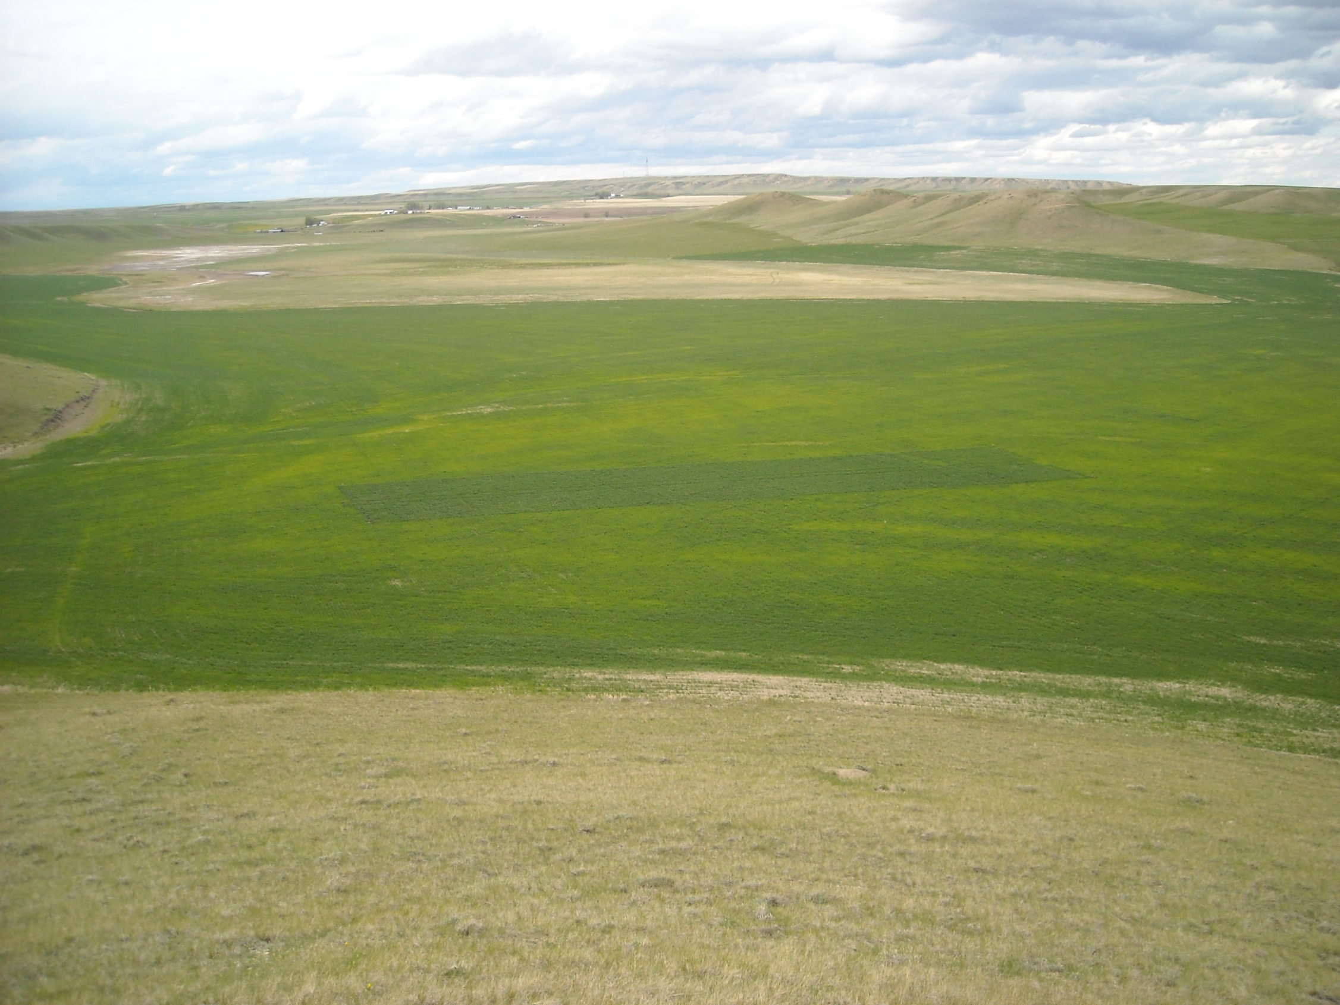

Collaboration
Review Papers
Data mining

Slide 3
Publishing ASA, CSSA, SSSA, JEQ
Mail – manuscripts, paper
Reviewers (30 pages, 3 reviewers)
  Mail time, review time, letters
  https://en.wikipedia.org/wiki/Scholarly_peer_review
  First digital (review via email, 1997)
  Publishing
  Ask good questions
  Manuscript preparation (start with Tables, Figures)
  (http://nue.okstate.edu/Graduate_School/Graduate_School.htm)

Slide 4
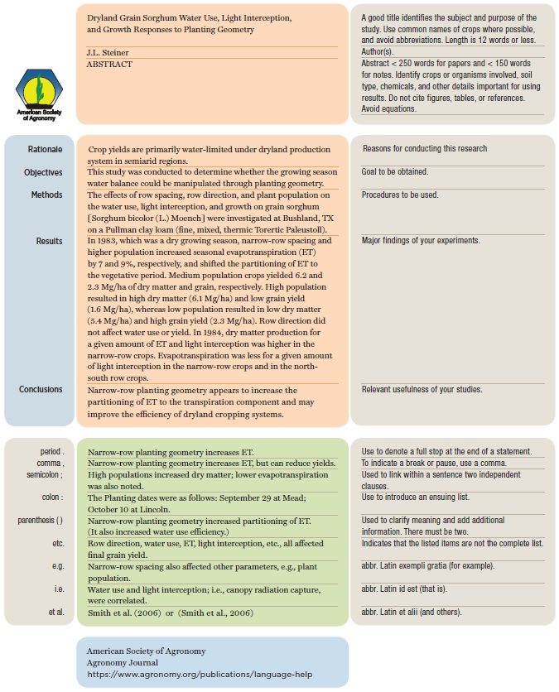
Abstract
Hand Shake
(http://nue.okstate.edu/Graduate_School/Graduate_School.htm)
2019: everyone is saturated with information. cannot take this for granted

Slide 5
Should more be expected of you?
  Literature review (Library vs Google)
  Word vs Typewriter
  Data analysis, SAS, Cards versus Excel
    IBM 370
  Graphs (LEROY versus Excel)

Slide 6
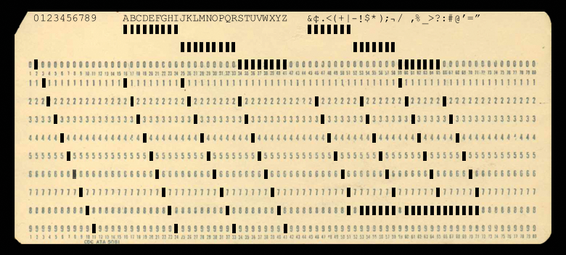
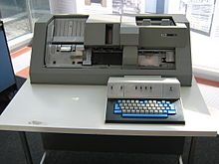

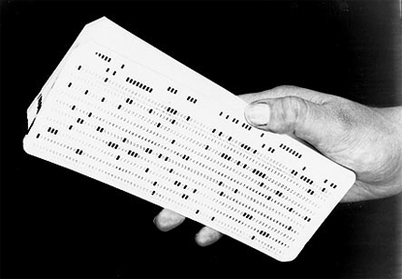
ONE CARD = ONE LINE OF DATA

Slide 7
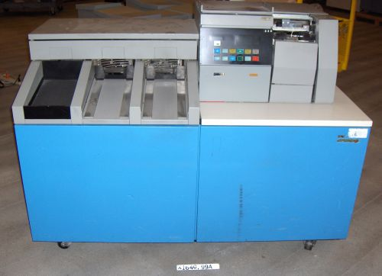

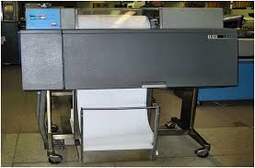
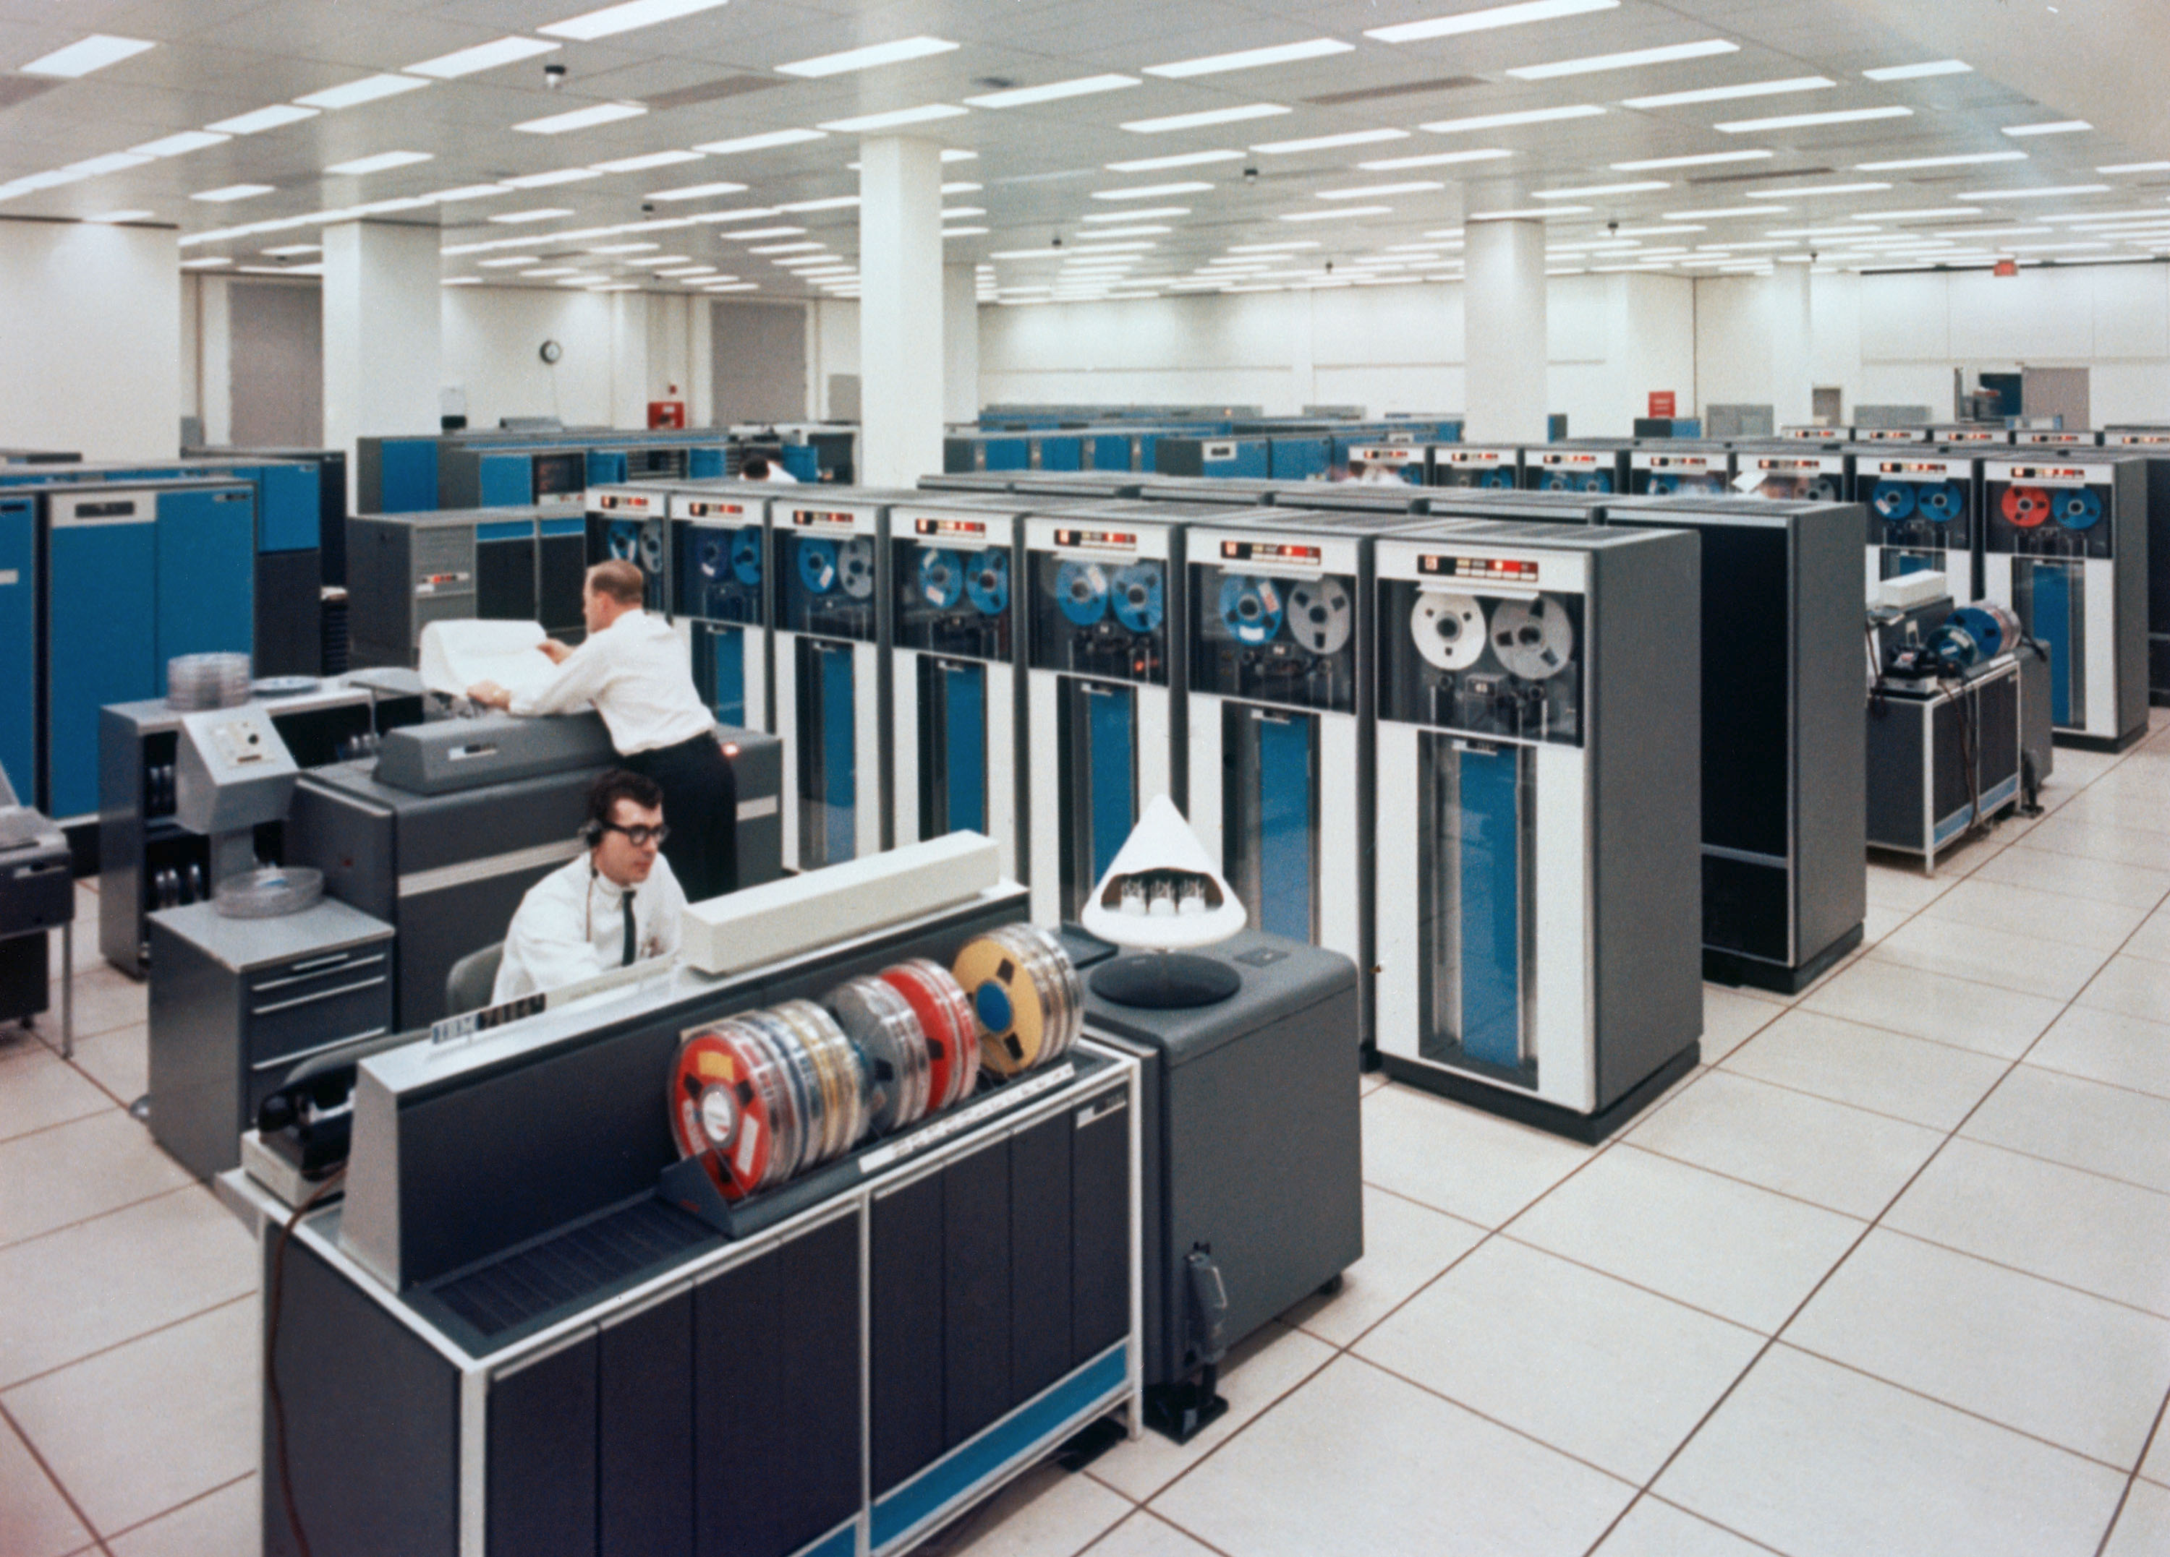
IBM Card Reader
Card pucher (Basement)
Card reader (4th Floor)
IBM 370 (Math Science)
Printer (Math Science)
IBM 370, Main Frame
First 3 cards
IBM JCL (job control language)
id account
where to print
errors ? (printer Math Science)

Slide 8
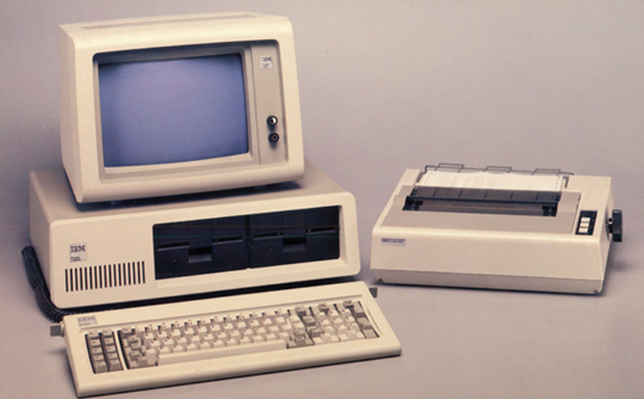
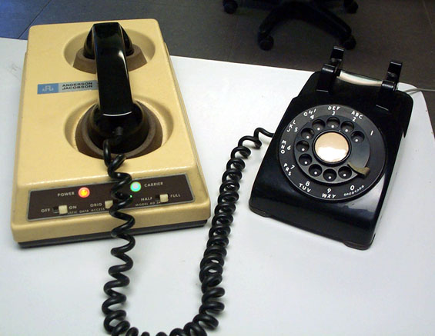
Dial up modem 300 baud
Submit programs to main frame

Slide 9

Agronomy Journal
A

Slide 10

Editor-in-Chief
Editor
Technical Editors (6-7)
Associate Editors (70)
Managing Editor

Slide 11
Double blind review
3 reviewers
Associate Editor makes the final decision
  Accept, Major Revision, Minor Revision, Reject
  Follows through the entire path if accepted
Technical Editor, delivers letter if released

Slide 12
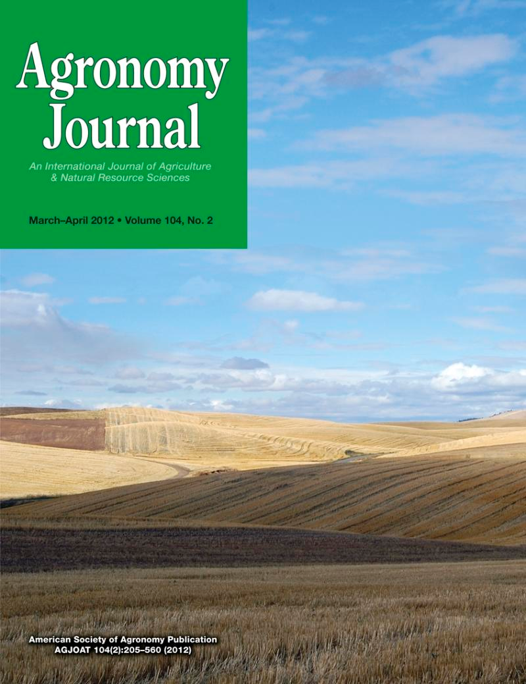

750+ papers/year
60-80 per TE
10-12 per AE
1908, first issue

Slide 13

Agrosystems Geosciences & Environment
https://mc.manuscriptcentral.com/agrosystems

Slide 14


Slide 15
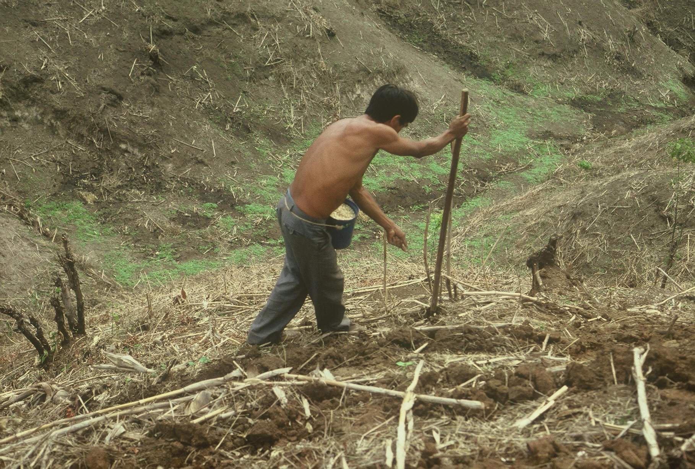



Slide 16
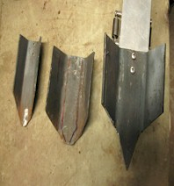
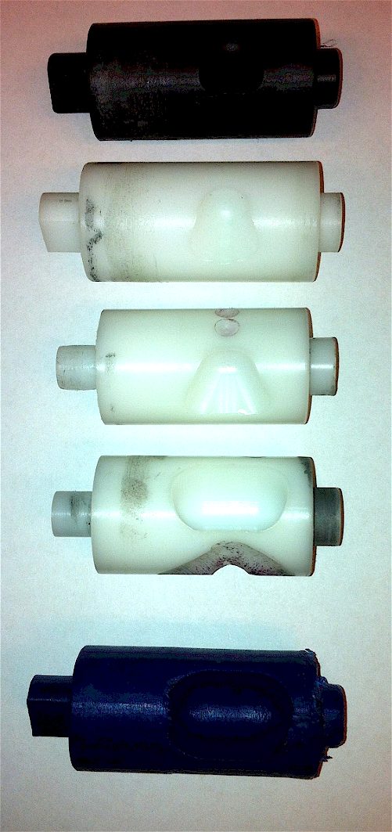
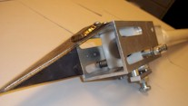
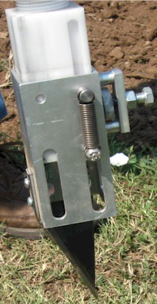
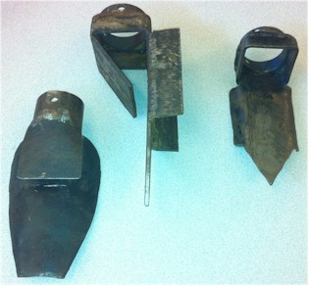
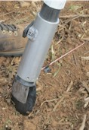
Internal Brush/Strength
Drum size/material
Cavity size/angle
Tip size/design/material
Internal/Ext. spring/tension

Slide 17
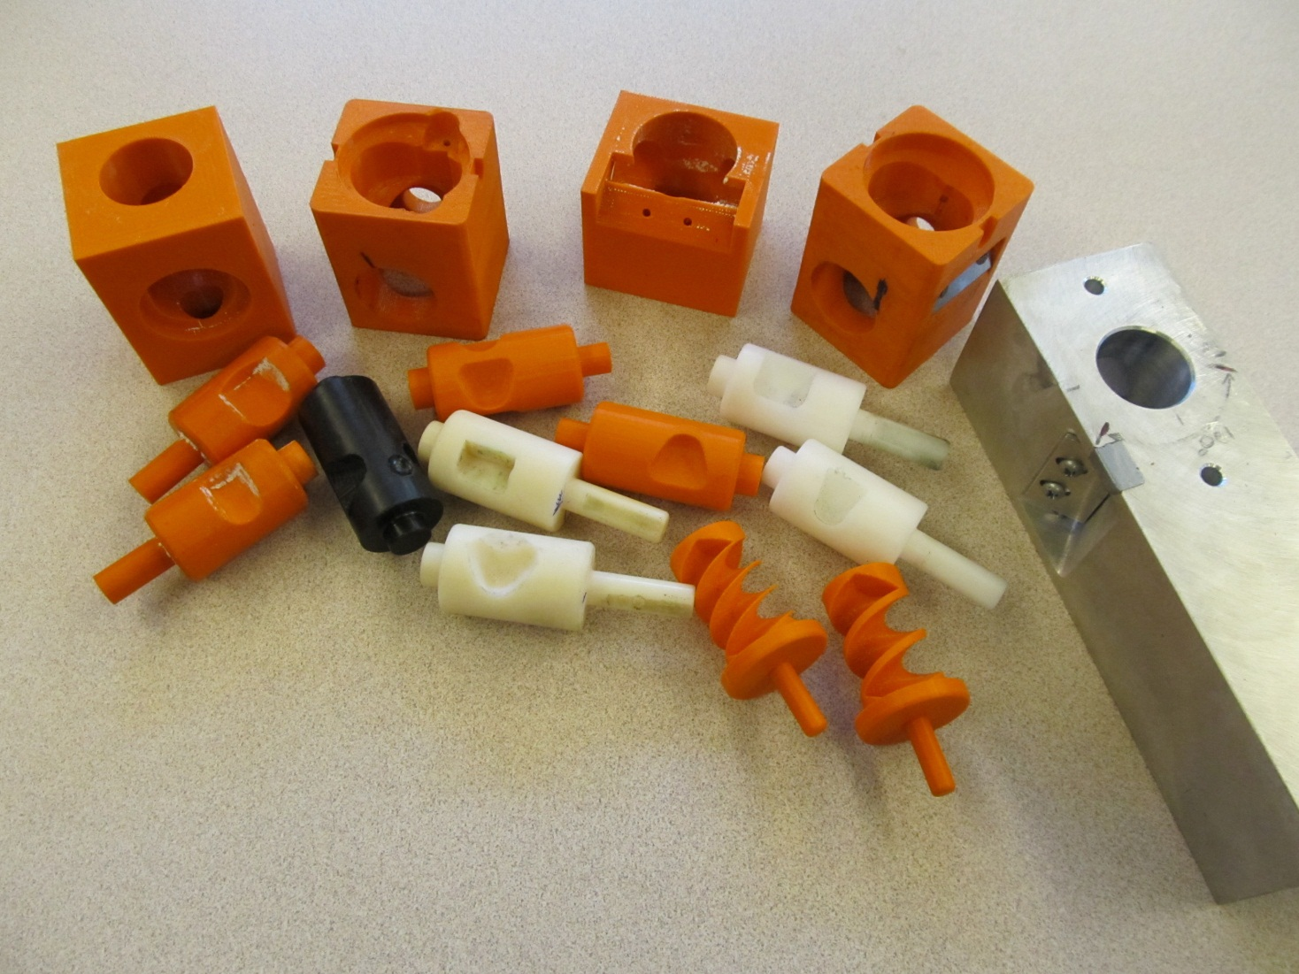
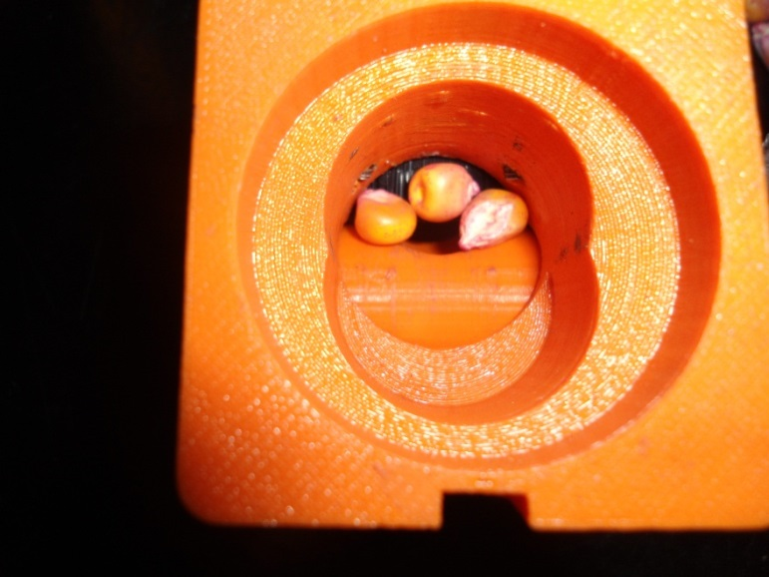
Singulation Design
3D printing
Rotary International
AGCO
Sitlington Chair
ASA Reinvest, Jessica Davis
Tolerances
Materials
Failure analysis/testing

Slide 18
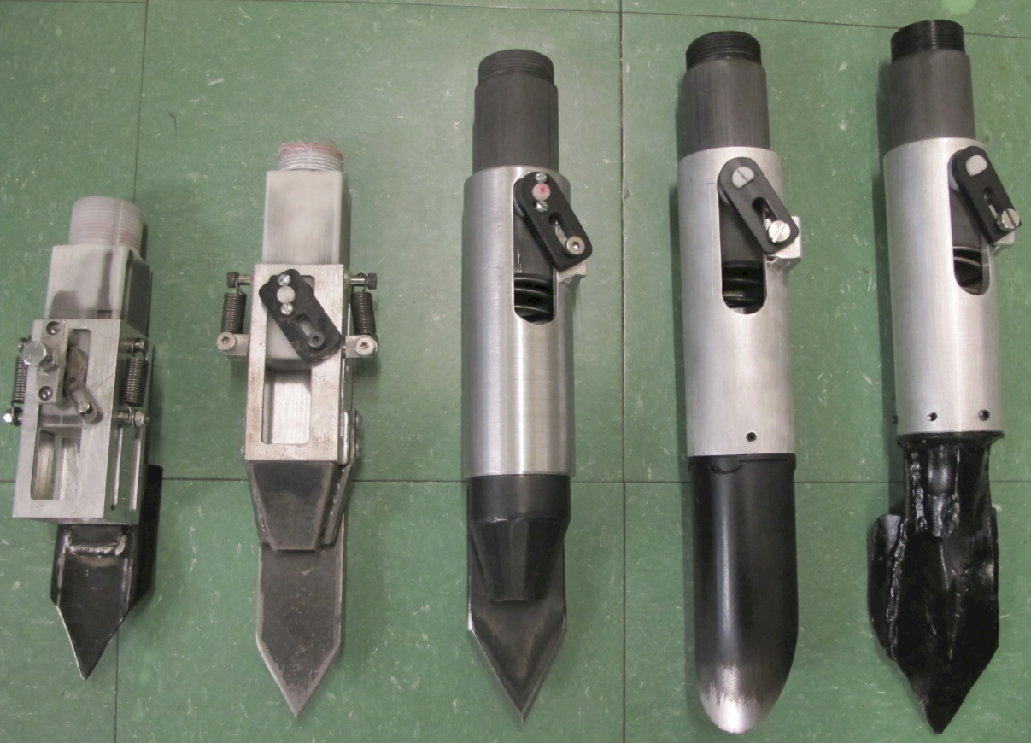

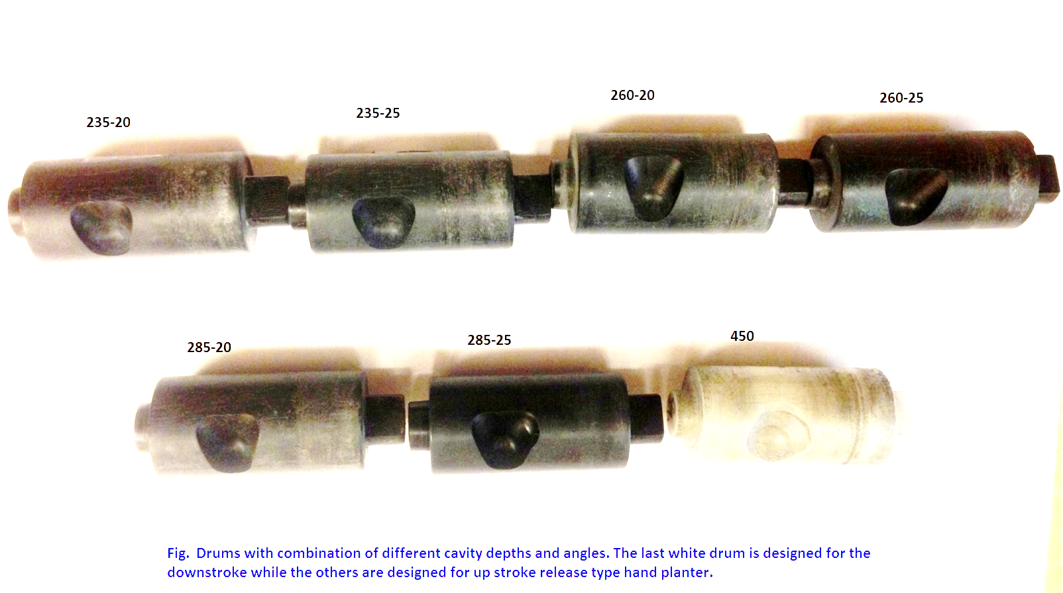
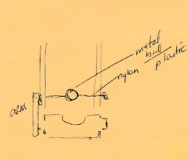

Slide 19
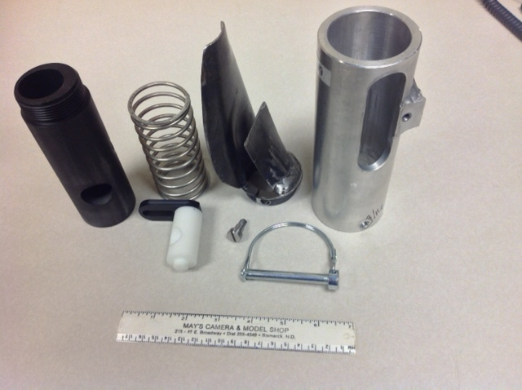
1,000,000 cycles
0.29g/seed
60,000 seeds/ha
3443 seeds/kg
1.0 kg hopper
17 times refill
http://nue.okstate.edu/Hand_Planter.htm

Slide 20
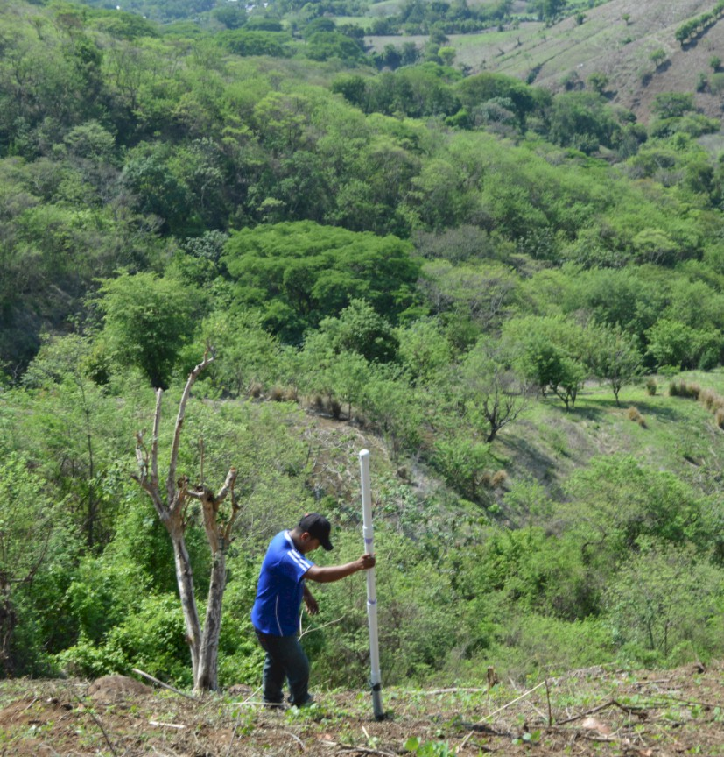
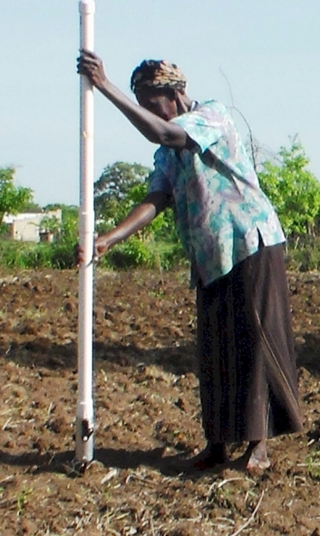
Opico Quezaltepeque, El Salvador
LIRA UGANDA
EL SALVADOR
Peter Omara MS 2013
Worlds Apart
Avg. Farm Size: 1 ha
Avg. Maize Grain Yield, 2 Mg/ha
Maize seed, Hybrids (US, others)
Social aspects/technology transfer

Slide 21
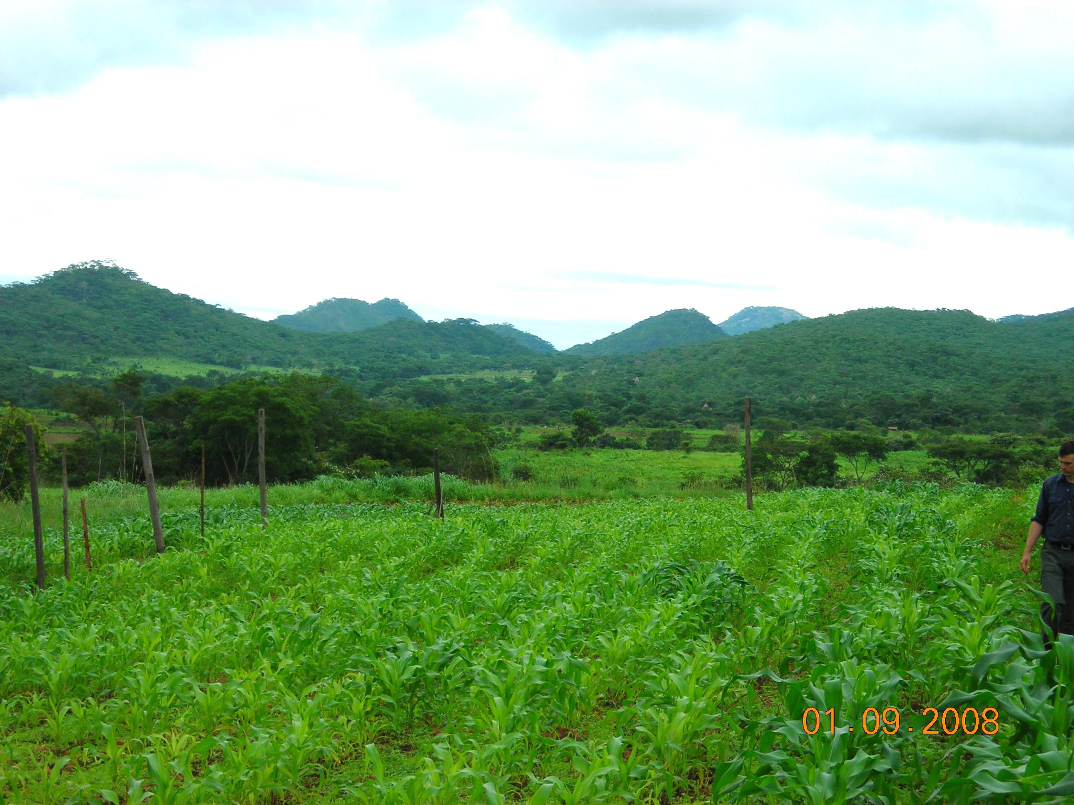
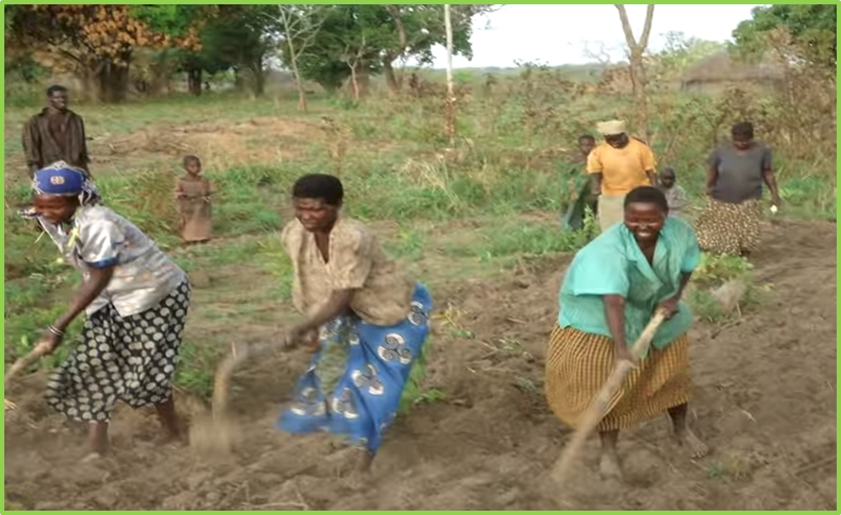
ZIMBABWE, UGANDA
Remote Locations
Surface applications of urea

Slide 22
