Slide 1
Professional Society Membership
Dr. Niels Maness
Horticulture and Landscape Architecture
August 28, 2018
3:30 pm, 304 Ag Hall
# graduate students, # undergraduates
Functions of a Professional Society
Annual Meetings, Division of interest (Turf, C5, CSA)
Publishing
ASA – CSSA – SSSA (tri societies)
Colleagues (go to NUE page, NUE Meetings)

Slide 2
Value of the Tri Societies and Publishing
Staying Current
Staying Connected (society and colleagues)
Service to the society (Associate Editor)
Publishing in society journals
  https://en.wikipedia.org/wiki/Scholarly_peer_review
  Ask good questions
  Manuscript preparation (start with Tables, Figures)
  (http://nue.okstate.edu/Graduate_School/Graduate_School.htm)

Slide 3
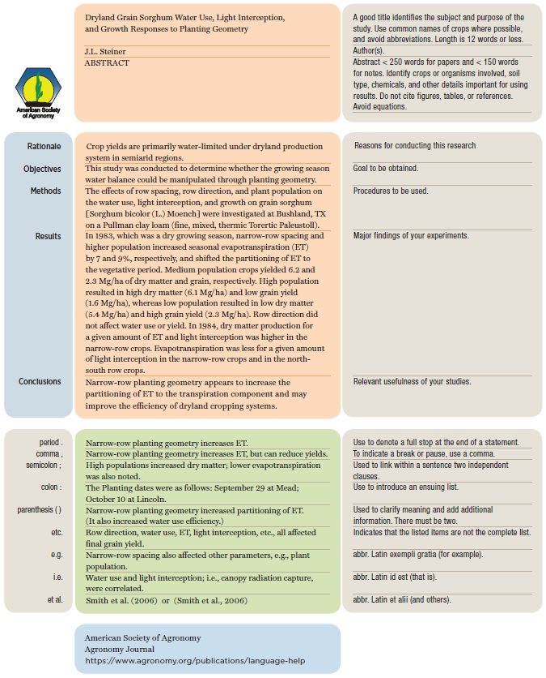
Abstract
eye contact
polite smile
Hand Shake (first Think)
(http://nue.okstate.edu/Graduate_School/Graduate_School.htm)
2018: everyone is saturated with information. cannot take this for granted
http://nue.okstate.edu/Graduate_School/abstract.jpg
other abstracts

Slide 4
Movie “Numbers”
Should more be expected of you?
  Literature review (Library vs Google)
  Word vs Typewriter
  Data analysis, SAS, Cards versus Excel
    IBM 370
  Graphs (LEROY versus Excel)

Slide 5
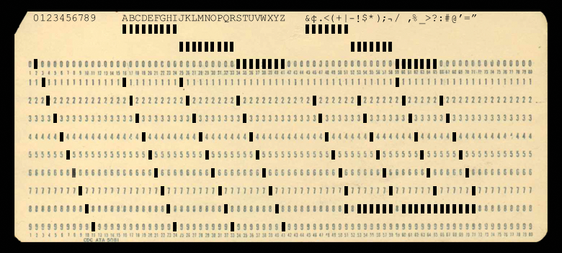
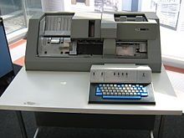

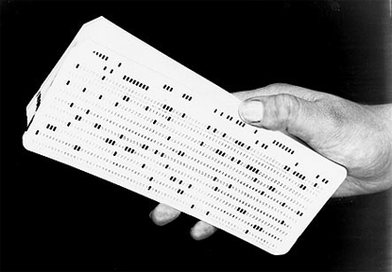
ONE CARD = ONE LINE OF DATA

Slide 6
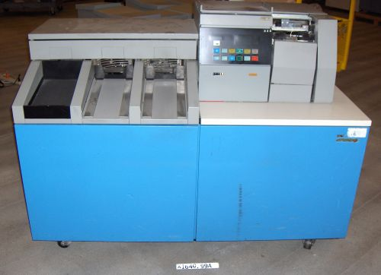

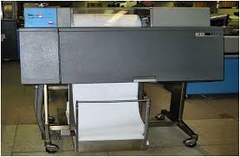
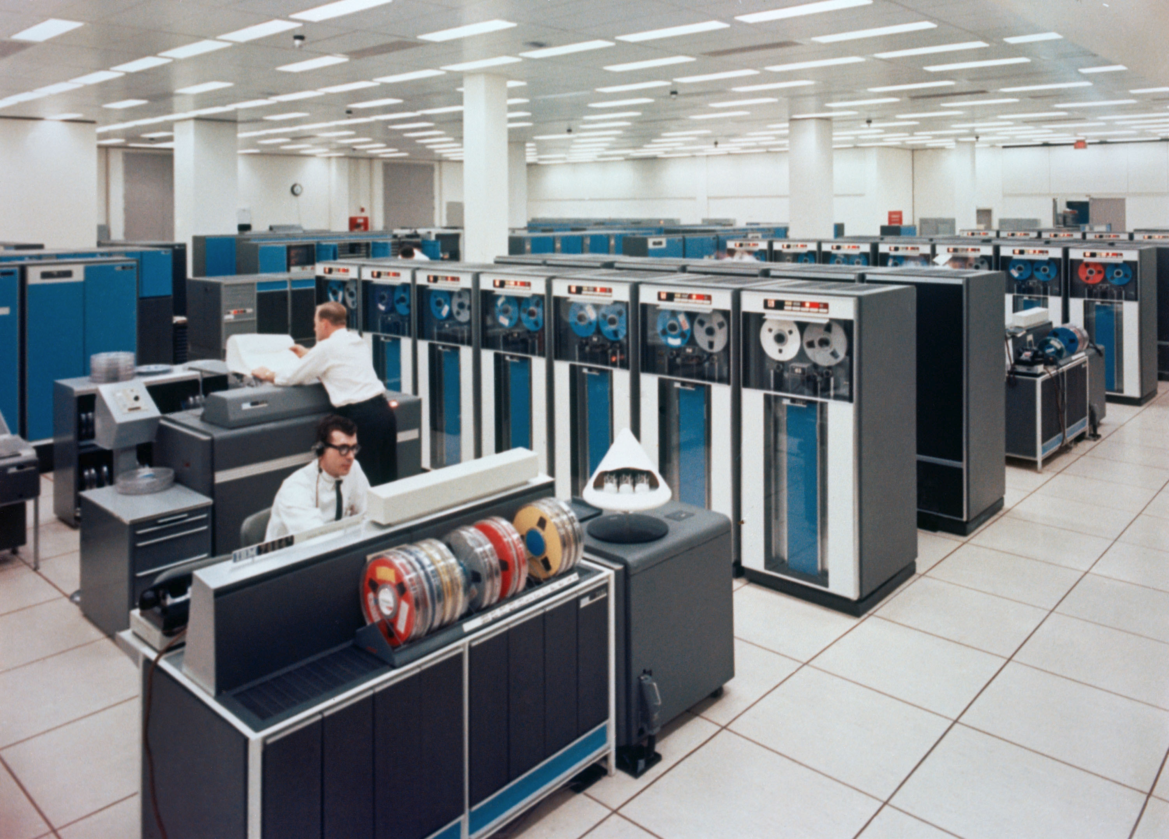
IBM Card Reader
Card pucher (Basement)
Card reader (4th Floor)
IBM 370 (Math Science)
Printer (Math Science)
IBM 370, Main Frame
First 3 cards
IBM JCL (job control language)
id account
where to print
errors ? (printer Math Science)

Slide 7
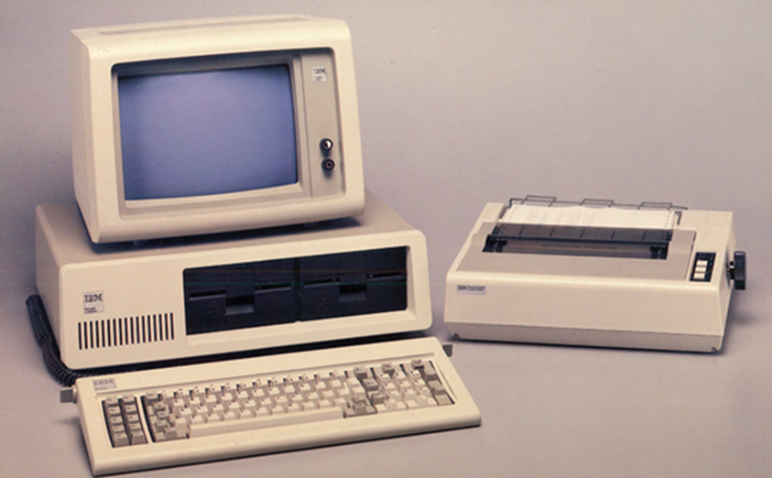
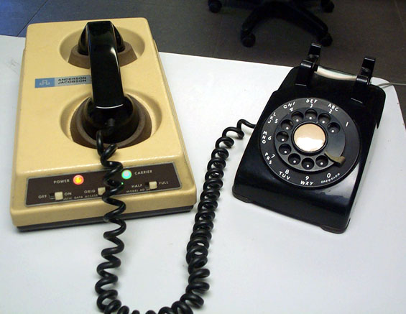
Dial up modem 300 baud
Submit programs to main frame
https://www.youtube.com/watch?v=SBvGaVV4HZs

Slide 8
Agronomy Journal
A

Slide 9
Editor-in-Chief
Editor
Technical Editor (6-7)
Associate Editor (70)
Managing Editor

Slide 10
Double blind review
3 reviewers
Associate Editor makes the final decision
  Accept, Major Revision, Minor Revision, Reject
  Follows through the entire path if accepted
Technical Editor, delivers letter if released

Slide 11
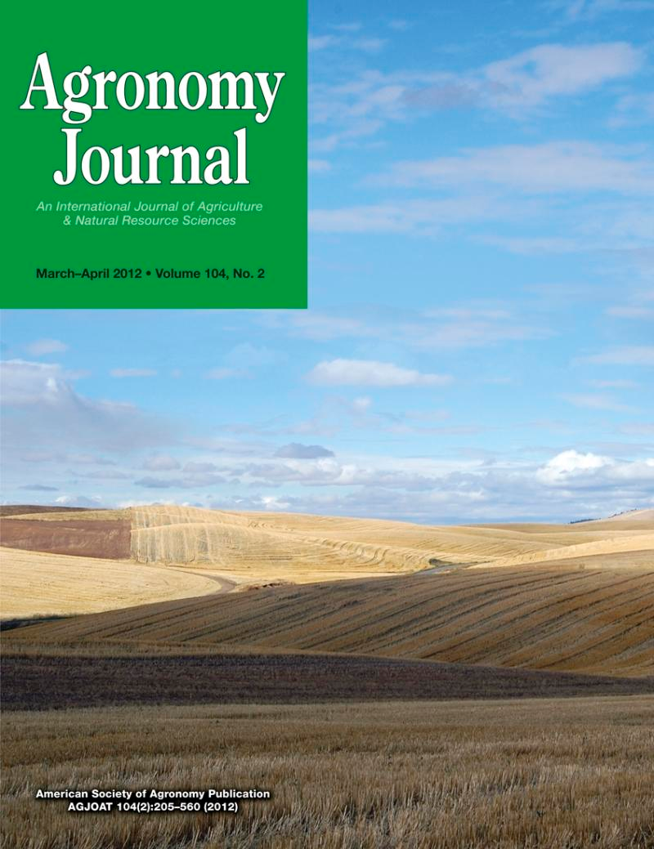
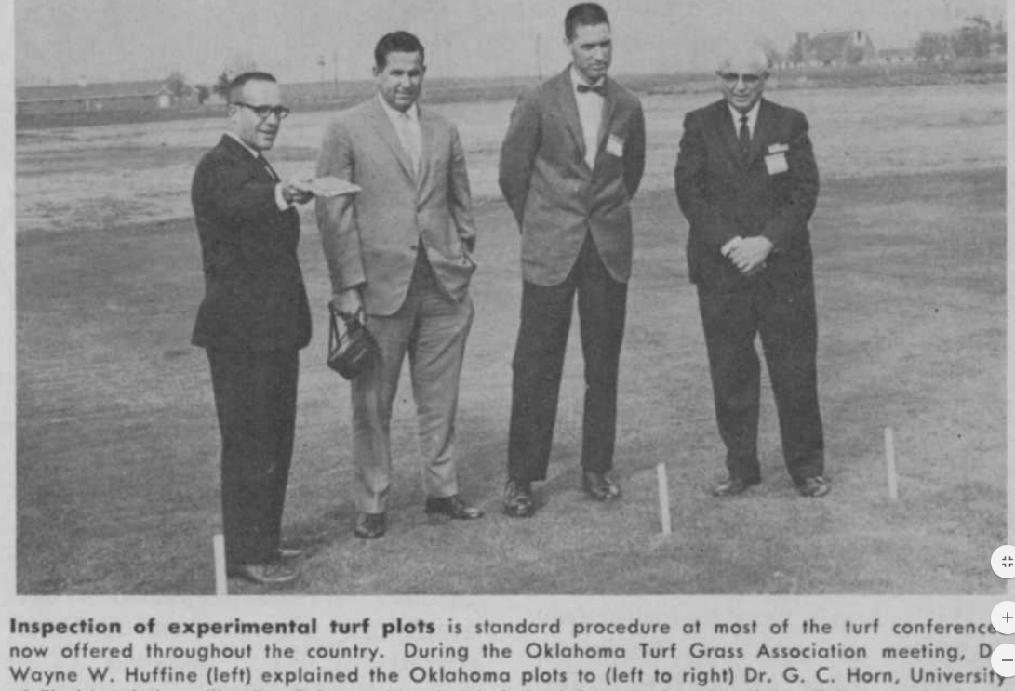

750+ papers/year
60-80 per TE
10-12 per AE
1908, first issue
Dr. Wayne Huffine, OSU

Slide 12
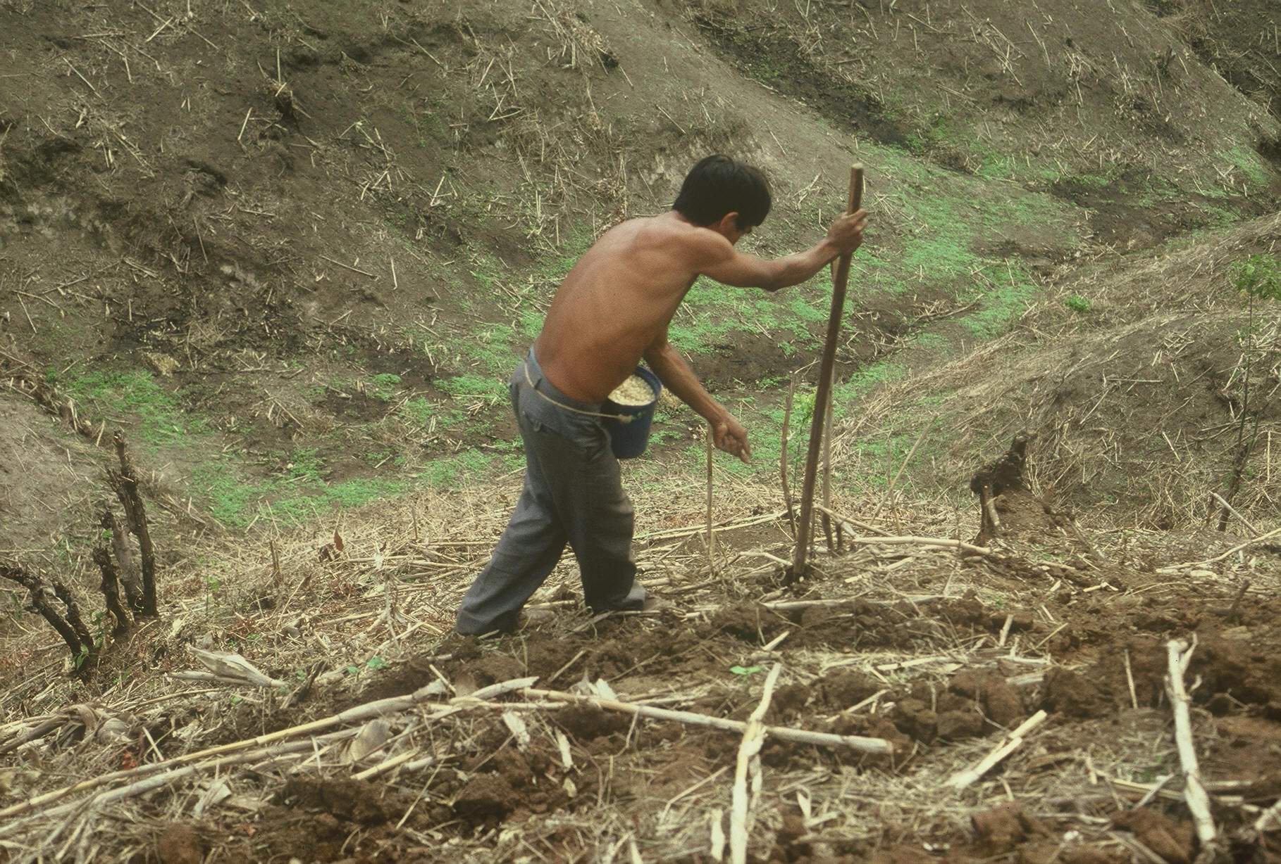



Slide 13
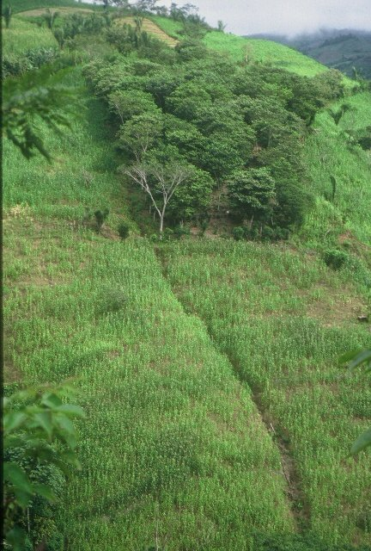
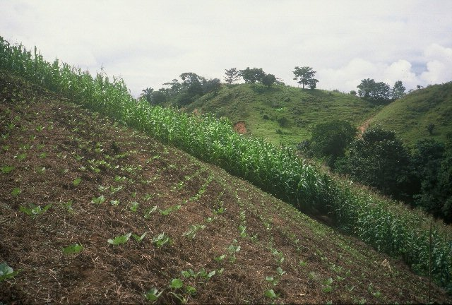
HONDURAS

Slide 14

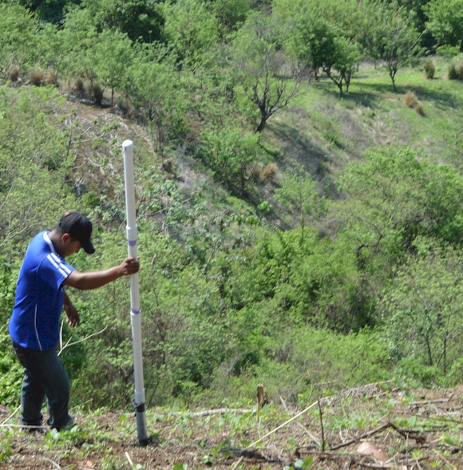
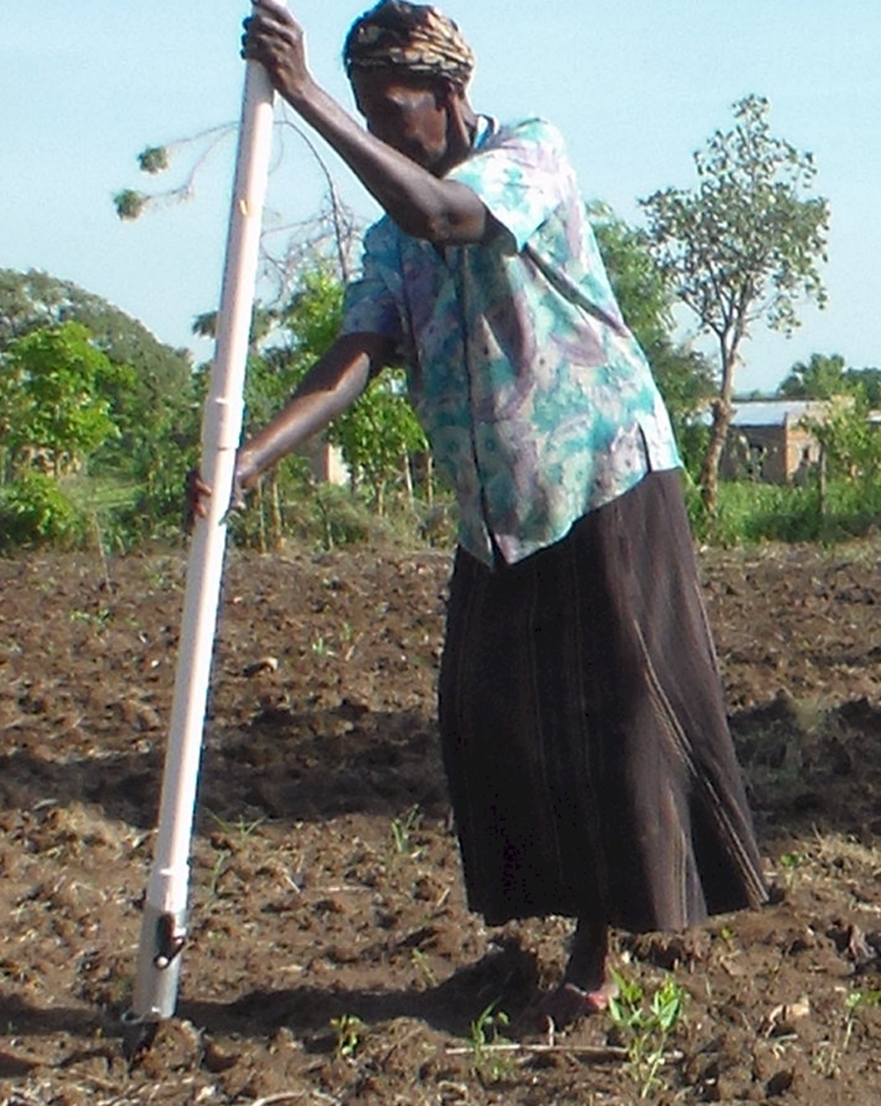
UGANDA
EL SALVADOR

Slide 15
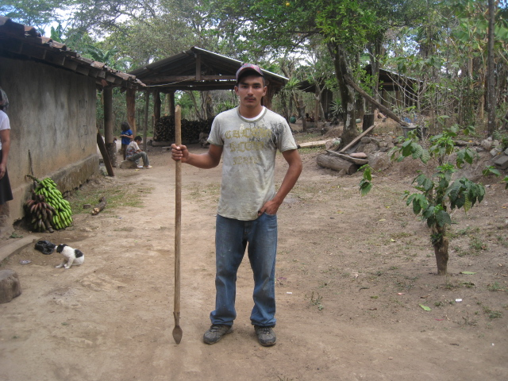
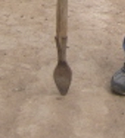
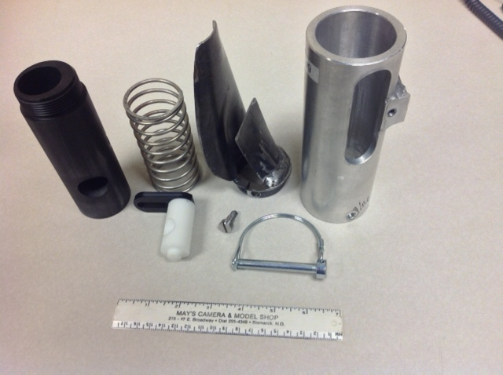
1,000,000 cycles
0.29g/seed
60,000 seeds/ha
3443 seeds/kg
1.0 kg hopper
17 times refill
http://nue.okstate.edu/Hand_Planter.htm

Slide 16
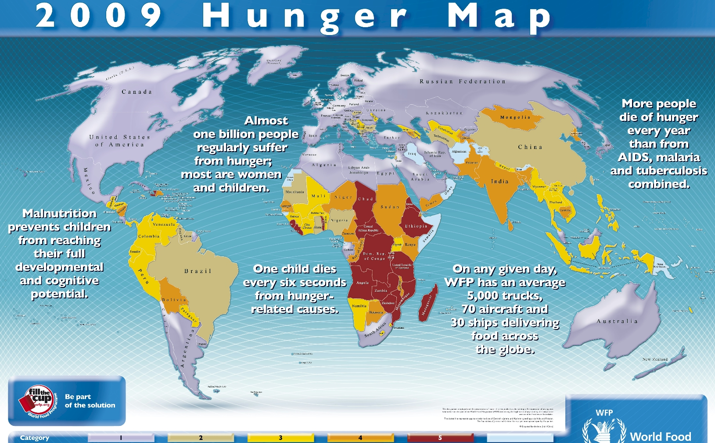

Slide 17
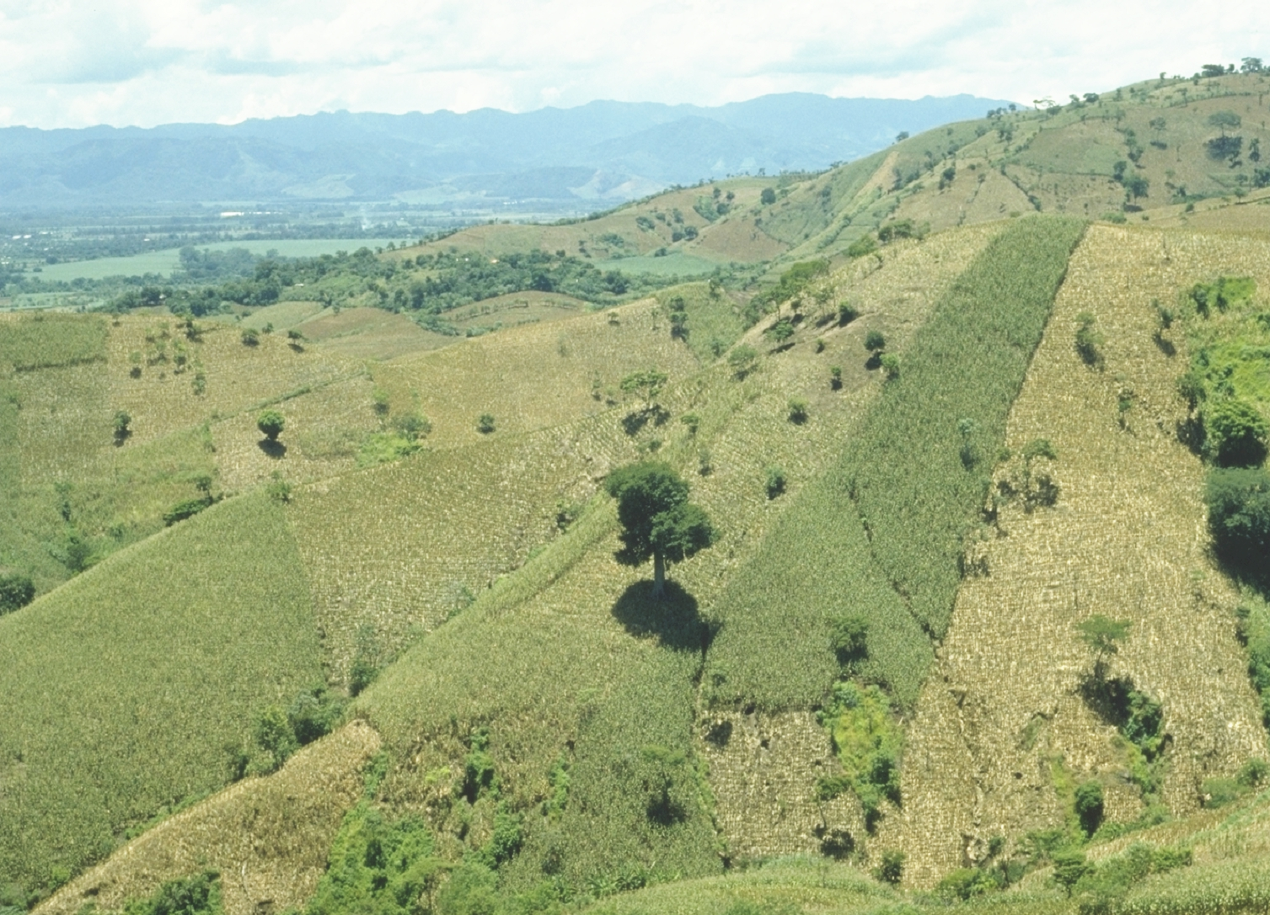

“Food is the moral right of all who are born into this world.”
N.E. Borlaug

Slide 18
