Slide 1
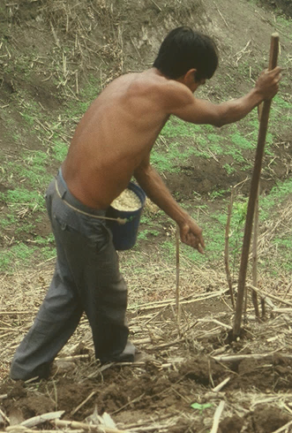
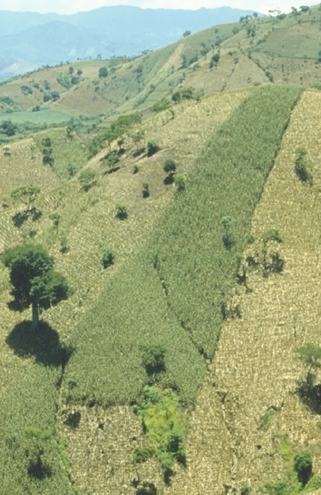
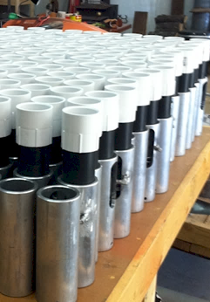
Bill Raun

Slide 2
OSU BS, 1979
OSU MS, 1982
University of Nebraska PHD, 1985
CIMMYT, Mexico, Guatemala, Honduras, El Salvador, Nicaragua, Costa Rica, Panama, Haiti, Dominican Republic, Cuba
OSU, Regents Professor, 1991-present
85 Thesis graduates
205 Refereed Publications
4 Classes Taught
Wife, Tanya Raun
Municipal Judge
Business Law Professor
4 Children
Anne, Notre Dame
Kate, PA School Tulsa
Chris, Freshman OSU
Dana, Sophomore SHS

Slide 3

Hand Planters
Notes:
3

Slide 4
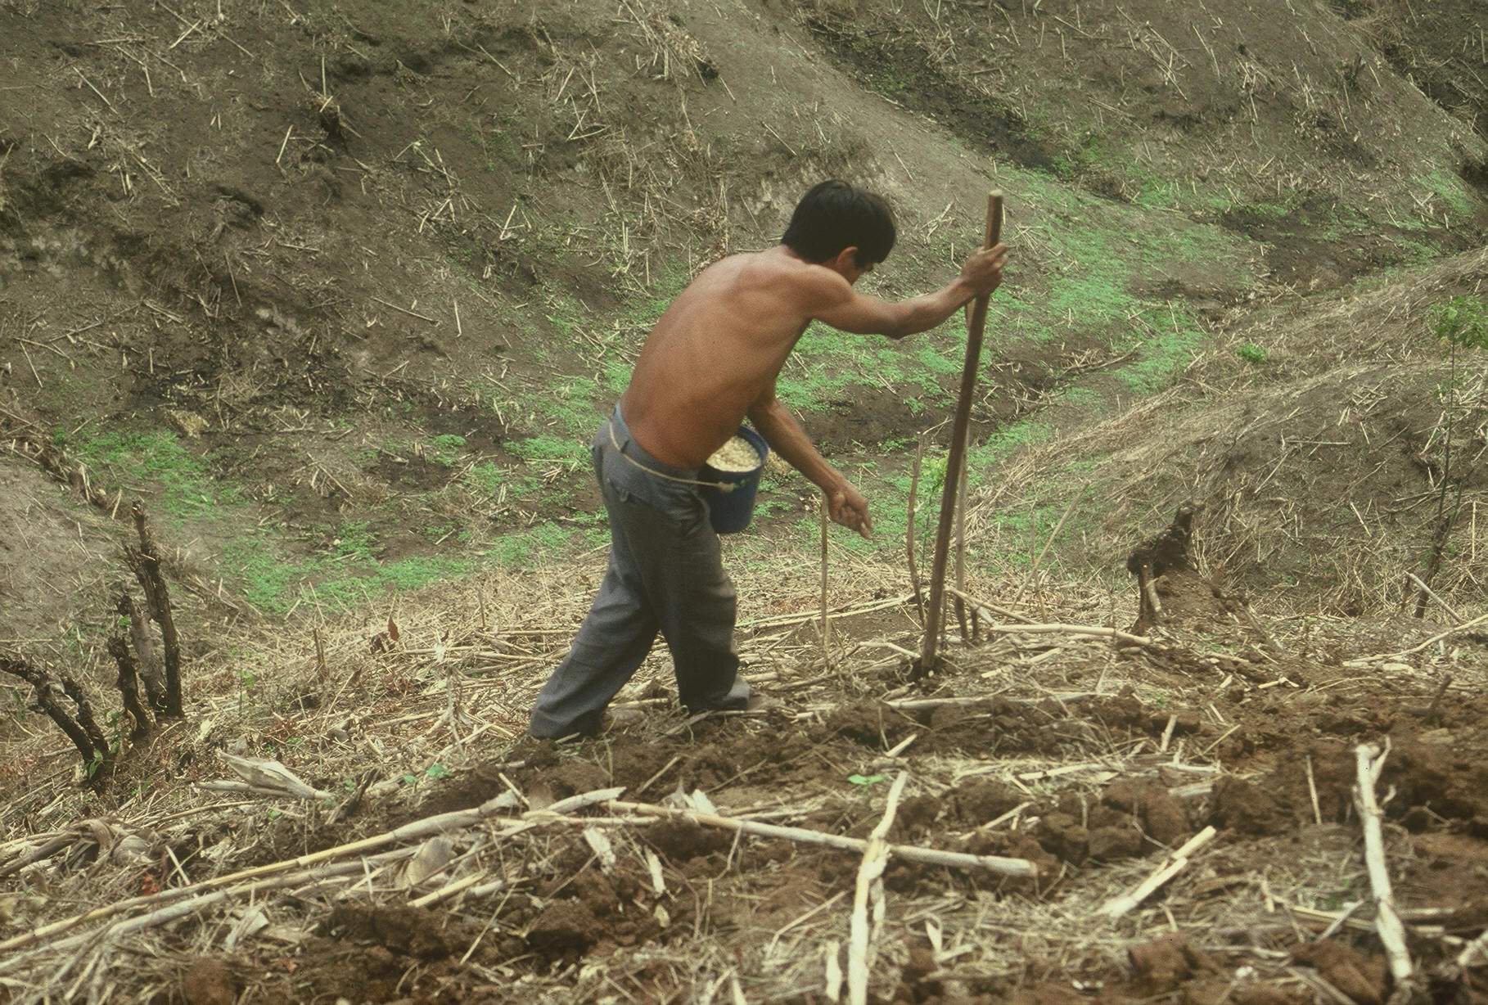



Slide 5
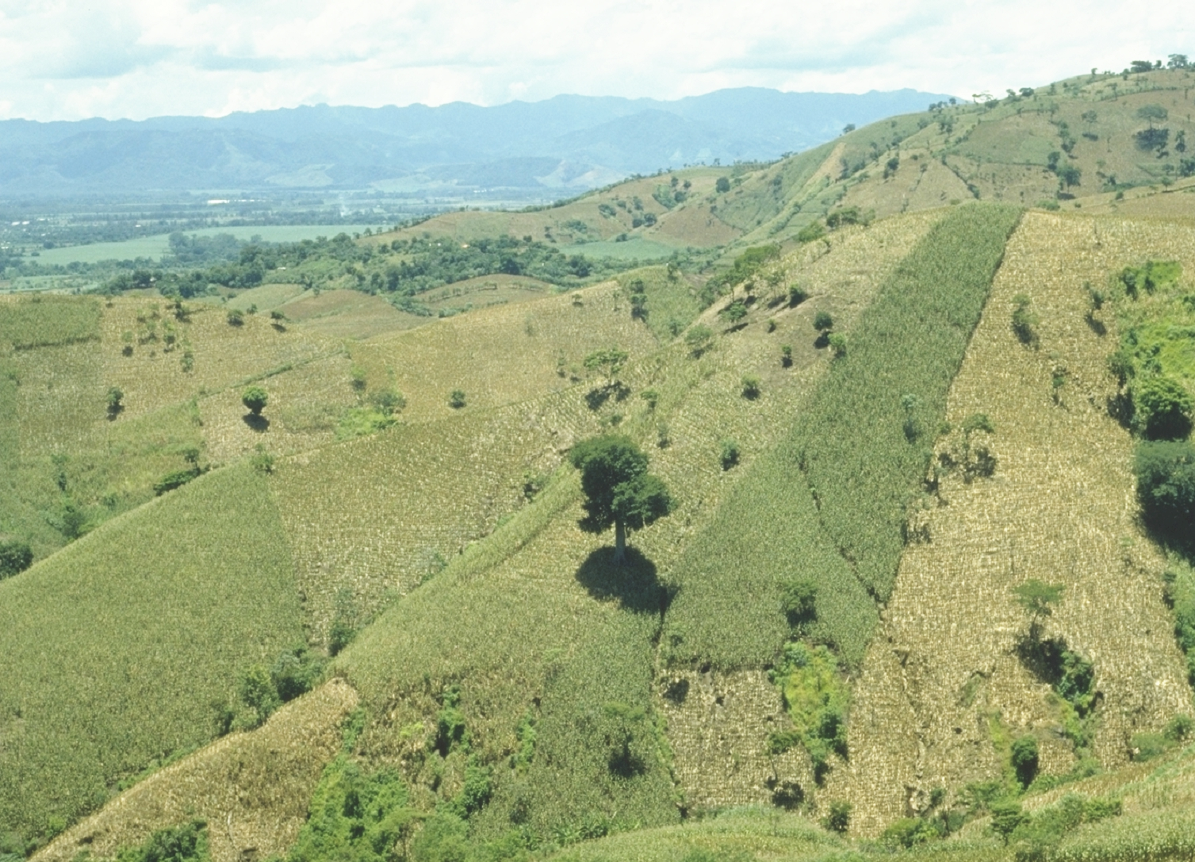
EL SALVADOR

Slide 6
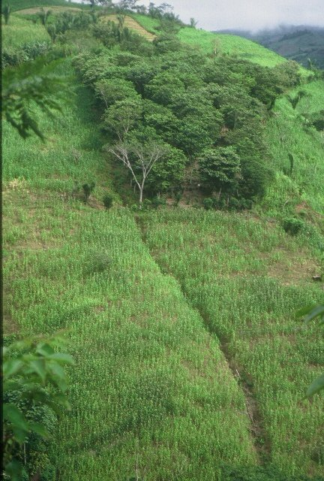
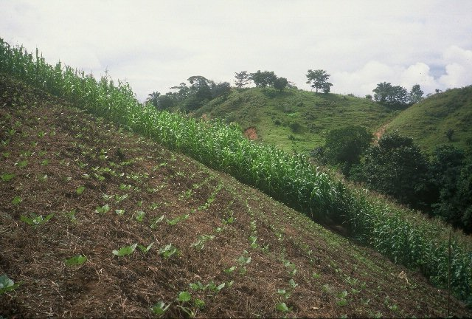
HONDURAS

Slide 7
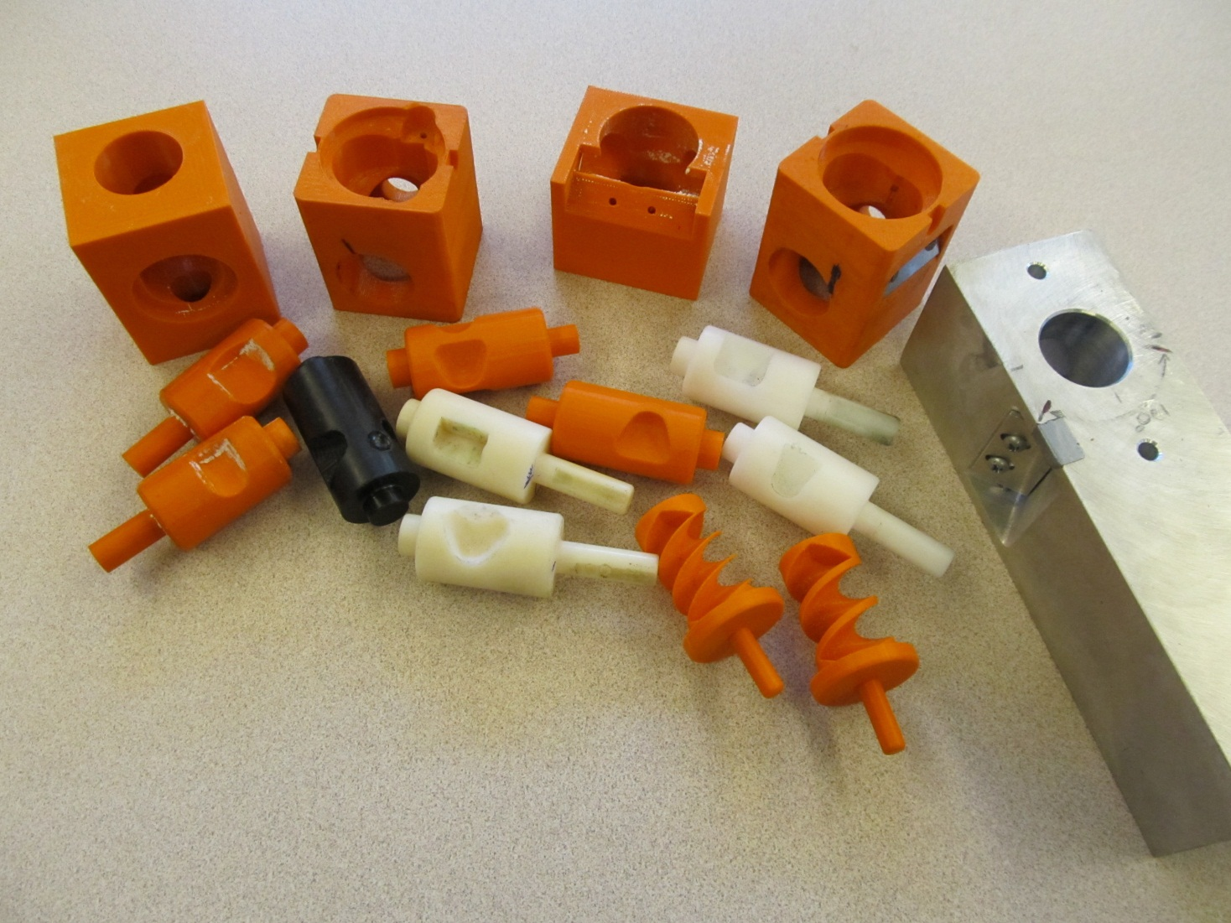
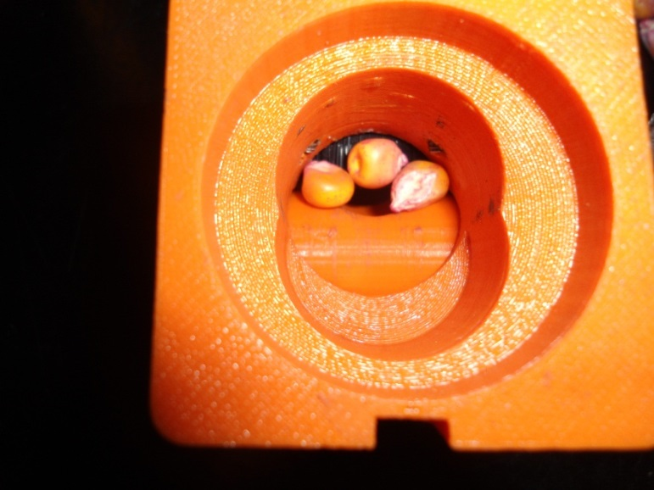
Singulation Design

Slide 8
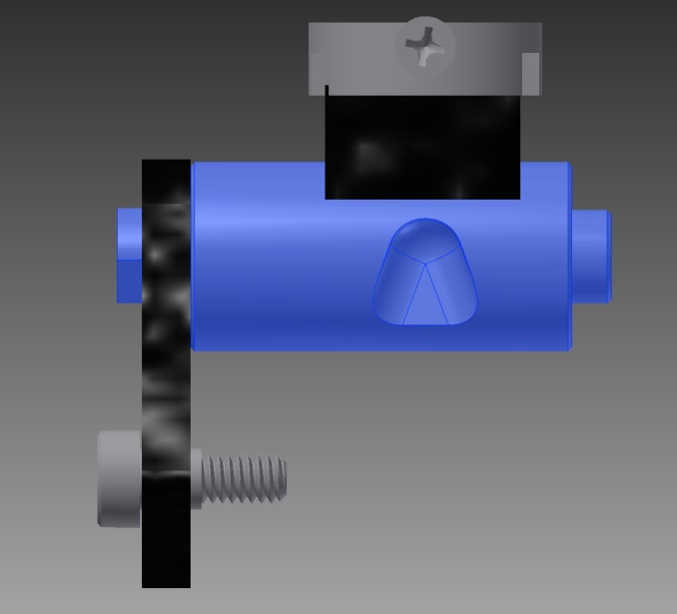
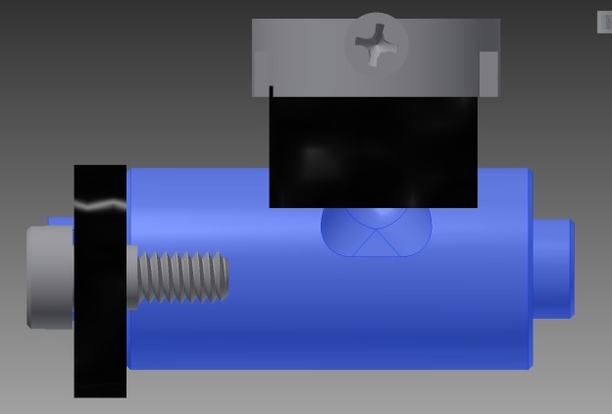
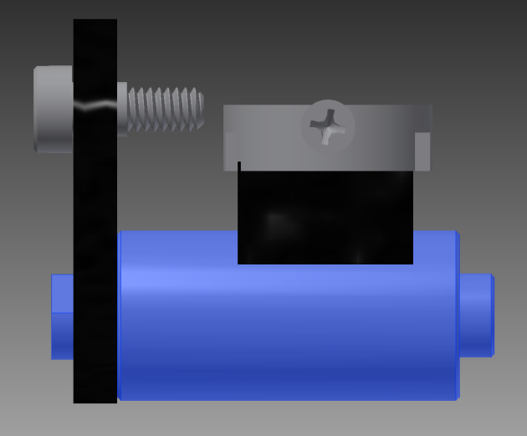
Reciprocating Drum Action
Drum rotates with the cavity moving back into the seed hopper as the spring is compressed.
Spring is fully compressed and the singulation drum cavity is exposed to seed in the hopper
Drum position when planter is relaxed.
As the force on the spring is released, the singulation drum rotates back to the initial ‘relaxed’ position and the seed is dropped.

Slide 9
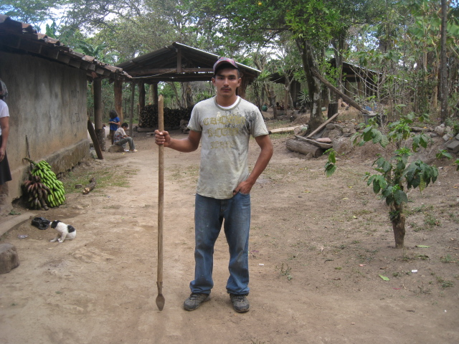
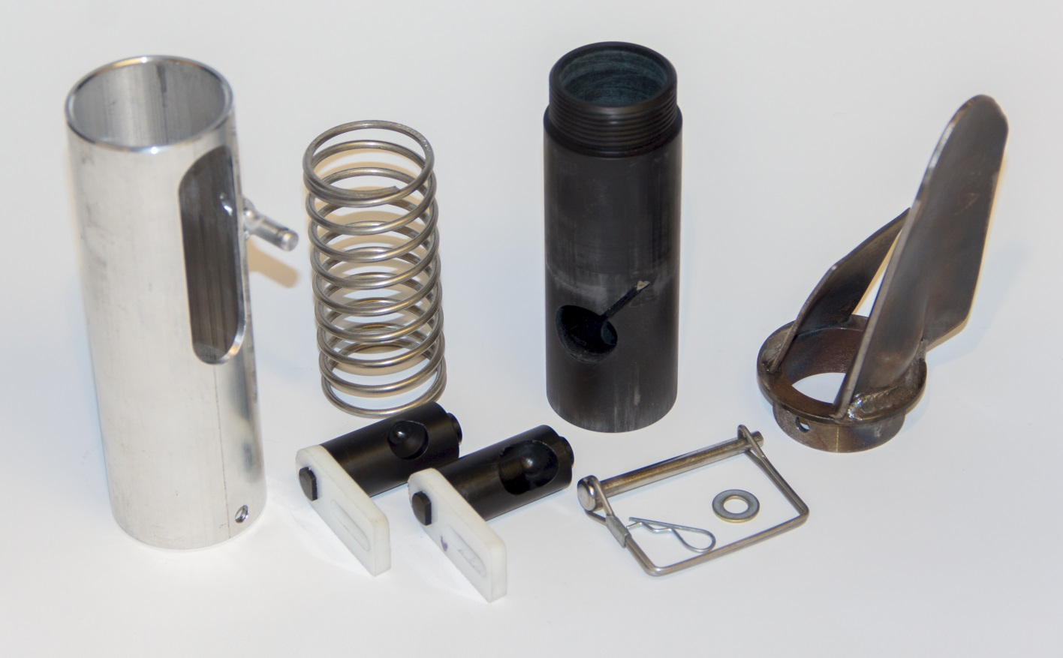
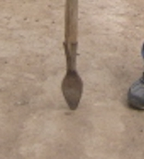
seed size (2653-4344 seeds/kg)
seed type, shape
fertilizer
1,000,000 cycles
0.29g/seed
60,000 seeds/ha
3443 seeds/kg
1.0 kg hopper
17 times refill
http://nue.okstate.edu/Hand_Planter.htm

Slide 10
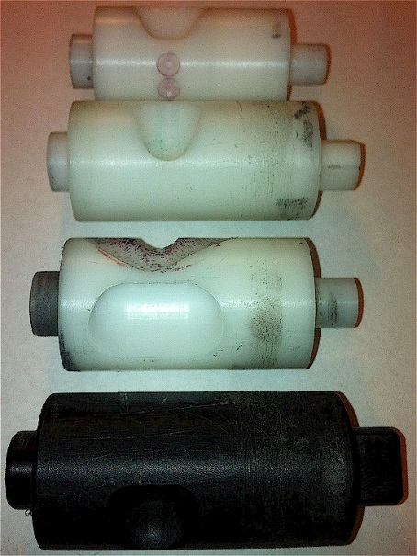
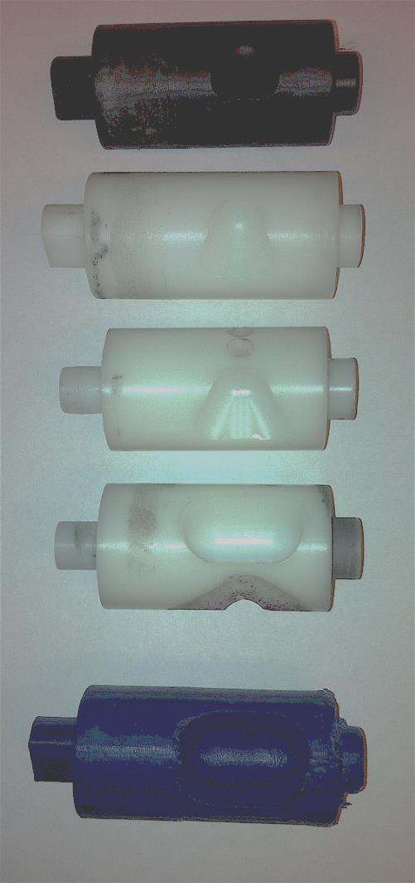
INTERNAL DRUM
Drum | Mass (g) | Volume (cm³)
A | 0.69 | 0.507
B | 0.71 | 0.521
OS | 0.88 | 0.646
OM | 3.36 | 2.468
OC | 3.38 | 2.482

Slide 11
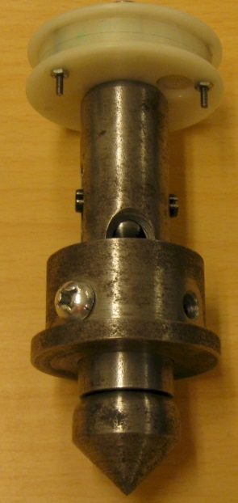
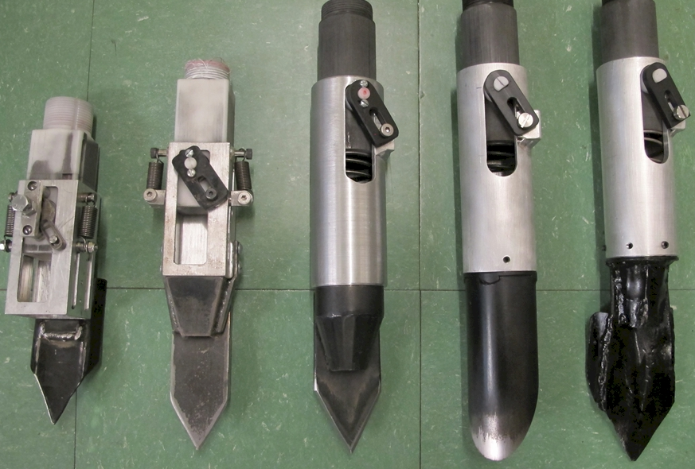
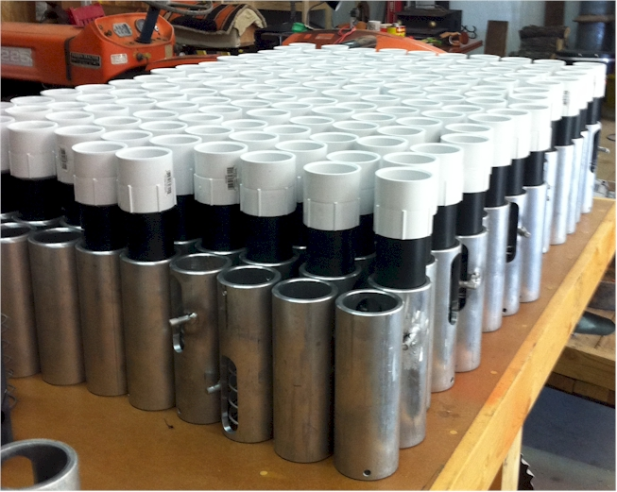

Slide 12
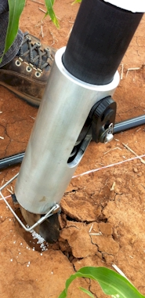
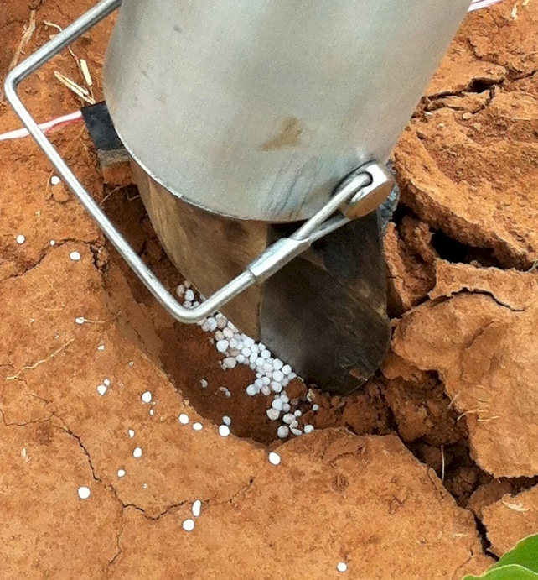
Mid Season Fertilizer N
Combined, Efaw and Perkins, 2013
Topdress N, Corn, V12 |  | 70,000 plants/ha
Methods | N, kg/ha | Mg/ha
Check | 0 | 6.6
Hand planter (0.9 g/plant) | 30 | 11.2
Hand planter (1.8 g/plant) | 60 | 10.6
Broadcast | 30 | 6.4
Broadcast | 60 | 7.0
Dribble urea | 30 | 9.3
Dribble urea | 60 | 7.8
Dribble UAN | 30 | 7.3
Dribble UAN | 60 | 10.4
SED = 1.81

Slide 13
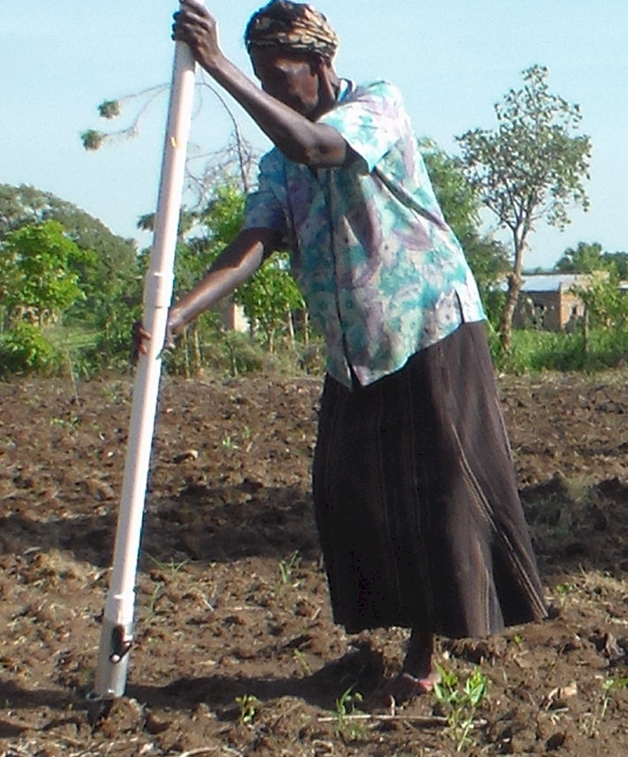
UGANDA

Slide 14
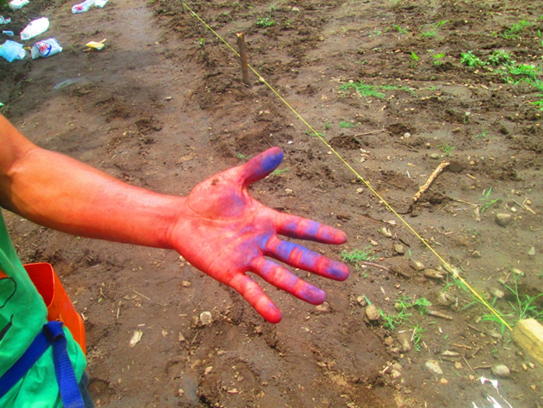
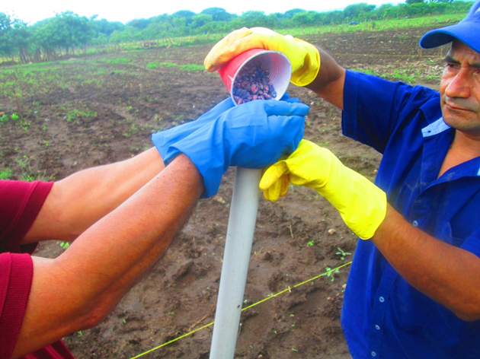
El Salvador, Hand Planter Trials, June, 2014

Slide 15
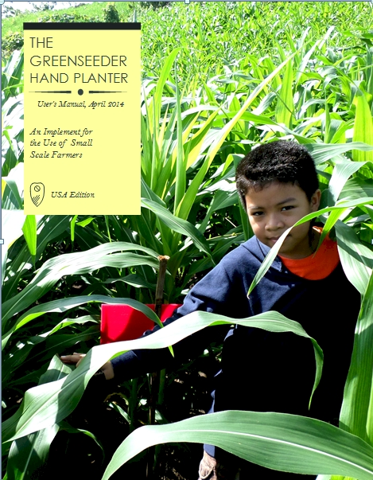
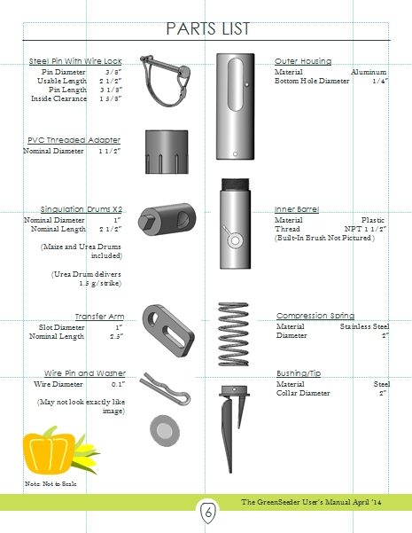
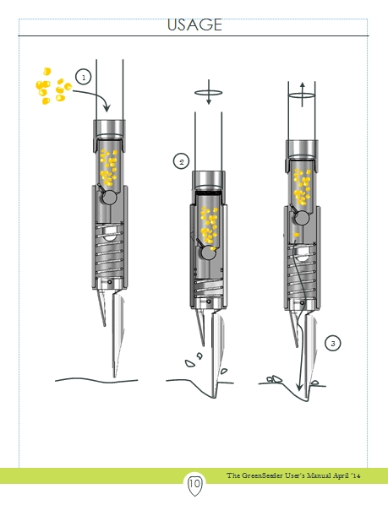
GreenSeeder Manual
http://www.nue.okstate.edu/Hand_Planter/Planter%20User's%20Manual%20EL.pdf

Slide 16
“Food is the moral right of all who are born into this world.”
N.E. Borlaug

Slide 17
