Slide 1
Nitrogen use efficiency
Crop reflectance sensing technology for nutrient management
CSU Plant sensor training
Wednesday, April 10, 2013
Marvin Stone
Regents professor emeritus
Biosystems and Agricultural Engineering
Oklahoma State University
Stillwater, OK
mstone@okstate.edu

Slide 2
Nitrogen use efficiency (NUE)
NUE = N_{Grain} / N_{Fertilizer}
NUE = 1
No loss to environment

Slide 3
Rationale for focus NUE
Crop production practice is heavily dependent on inorganic nitrogen (N) fertilizer
Nitrogen fertilizer costs are one of the most expensive crop inputs
Nitrogen use efficiency is very poor
Nitrogen costs are linked directly to Petroleum energy demand (Natural gas)
Nitrogen loss from crop fertilization has a high potential for environmental degradation

Slide 4
We are dependent on fertilizer for food production
Over 40% of the people on Earth owe their existence to the food production made possible by N fertilizers
C.S. Snyder, International plant nutrition institute,
World Fertilizer N Consumption and Challenges,
Nitrogen Use Efficiency Conference,
Stillwater, Oklahoma August 3, 2010
Notes:
Cliff Snyder presentation at NUE conference

Slide 5
Crop production heavily dependent on inorganic N fertilizer
Organic fertilizers are inadequate to meet needs
“no more than 10-15% of world fertilizer needs could be met by animal manure”
(Wolman and Fournier, SCOPE, 1987)
US Human wastes could supply “about 15% of the amount presently marketed as inorganic fertilizer”
(Wolman and Fournier, SCOPE, 1987)
In China, the proportion of mineral fertilizer to organic fertilizers has gone from 0% in 1949 to 69.7% in 1995
(Portch and Jin, UNESCO-EOLSS 2012)
Notes:
Land Transformation in Agriculture. Ed, Wolman and Fournier, Scientific Committee on Problems of the Environment (SCOPE). Published by John Wiley & Sons Ltd., 1987.
Encyclopedia of Life Support Systems (EOLSS). Agricultural Sciences, Vol II, Sam Portch and Ji-yun Jin, Fertilizer Use in China: Types and Amounts. UNESCO-EOLSS, Eolss Publishers, Oxford ,UK, .
blue-green algae in
fixing nitrogen in the rice paddy. Amounts in the range 10-20 kg/ha are
recognized-not great for the given year's crop but significant over many
years' in nitrogen conservancy. Likewise,the Azolla,anitrogen-fixing fern in China
The dominant influence that inorganic fertilizers are having on agriculture in
the world today is inescapable. They now account for at least 30% of all
agricultural produce of the United States, and probably more of the order of
50% of cereal grain production.

Slide 6
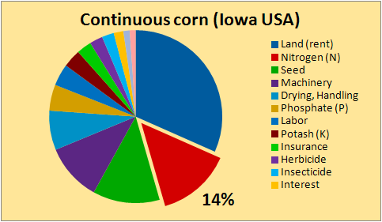
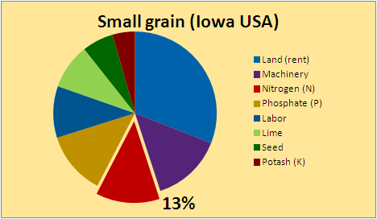
Nitrogen is #1 variable expense in crop production
For US production systems, Land is the most expensive fixed input
Nitrogen fertilizer costs are the most expensive variable input

Slide 7
Nitrogen use efficiency (NUE) is low
World-wide NUE has been estimated at 33%
Raun and Johnson, Agron. J. 91:357–363 (1999)
In North China Plain wheat and corn production, “N fertilizer could be cut in half without loss of yield or grain quality”
Vitousek et al., SCIENCE Vol. 324:19 June 2009.
“Nitrogen use efficiency is declining as nitrogen fertilizer consumption increases faster than grain production.”
Current world fertilizer trends and outlook to 2011/12. FAO, Rome, 2008.
Notes:
Current world fertilizer trends and outlook to 2011/12. FAO, Rome, 2008.
NUE of cereal crops is about 25% in North China Plain (Pan et al., 2001)

Slide 8
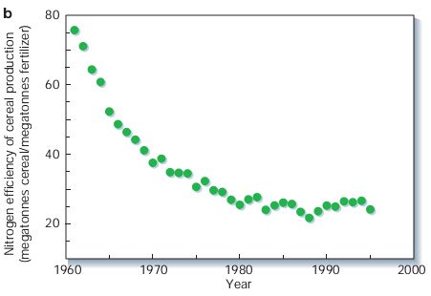
NUE has gone down as N-Rates increased
NUE
33%
Tillman et al. 2002. Nature
Notes:
Agricultural sustainability and intensive production practices, David Tilman, Kenneth G. Cassman, Pamela A. Matson, Rosamond Naylor & Stephen Polasky . Nature 2002, (418) 671-677.

Slide 9
NUE Examples in Cereals (Raun, 2006)
Author Crop Method Year Location NUE (grain)
Varvel Corn 15N 1990 NE 43-53%
Russelle Corn Diff. 1981 NE 46%
Raun Corn Diff. 1989 NE 30-40%
Olson Wheat 15N 1984 KS 27-33%
Bronson Wheat 15N 1991 CO 53%
Raun Wheat 15N 1999 OK 21-32%
Lees Wheat 15N 2000 OK 38-41%
Westerman Sorghum 15N 1972 IL 51%
Varvel Sorghum 15N 1991 NE 48%
DeDatta Rice 15N 1988 Asia 37-47%
Notes:
Global Issues and the Fate of Nitrogen, W. R. Raun, 2006.

Slide 10
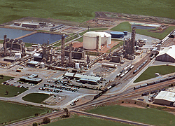
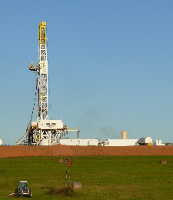
N fertilizer production linked to Energy
One tonne of fertilizer N synthesized through the Haber–Bosch process requires 873 m³ of natural gas
(Vance, 2001)
CO₂
N₂ + 3 H₂ ⇌ 2 NH₃
CH₄
NH₃
Notes:
1090 to 1250 m3 of natural gas to produce 1 metric ton of anhydrous ammonia
[CH_{x}] + H₂O ⇌ CO + H₂ + x/2H₂

Slide 11
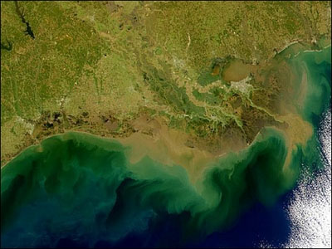
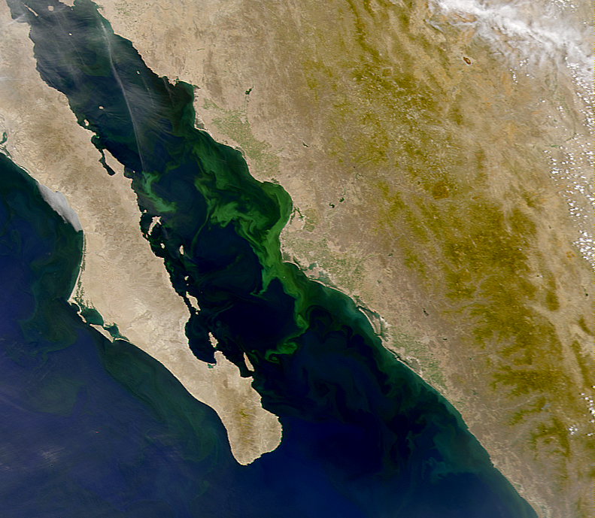
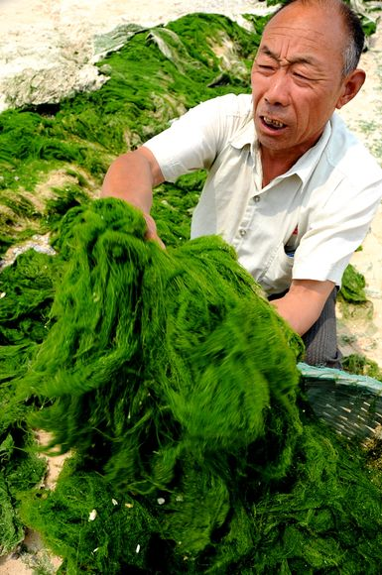
Nitrogen loss has high potential for environmental degradation
Impact of N loss from Agriculture is world-wide news
Mississippi Delta USA
Gulf of California
Mexico
NASA
Michael Beman J, Arrigo KR, Matson PA.
Nature. 2005 Mar 10; 434(7030):211-214
Green Tide Photograph from Imaginechina/AP
Notes:
Green tide photo - http://forum.china.org.cn/redirect.php?tid=14895&goto=lastpost

Slide 12
US GhG Emissions from Agriculture (CO₂ Equivalent)
Notes:
Half of Ag. Nitrous Oxide emissions are derived from cropping

Slide 13
Strategies for improving NUE
Crop rotations with legumes
Genetic improvements focused on NUE
Management of de-nitrification
Source selection
Controlled release
De-nitrification inhibitors
Sensor based management of In-season N application

Slide 14
Most promising opportunity
“we see the greatest gains in NUE and environmental protection accruing from “pre-cision management” in time and space of all production factors to maximize the synchrony between crop-N demand and the supply of mineral N from soil reserves and N inputs” Cassman et al.
Ambio. 2002 Mar;31(2):132-40.
Notes:
Agroecosystems, Nitrogen-use Efficiency, and Nitrogen Management, Cassman, Doberman, and Walters. Univ. of NE. 2002.
Ambio. 2002 Mar;31(2):132-40.

Slide 15
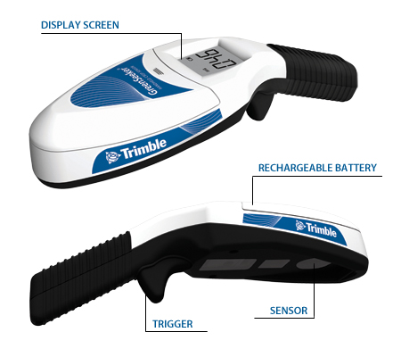
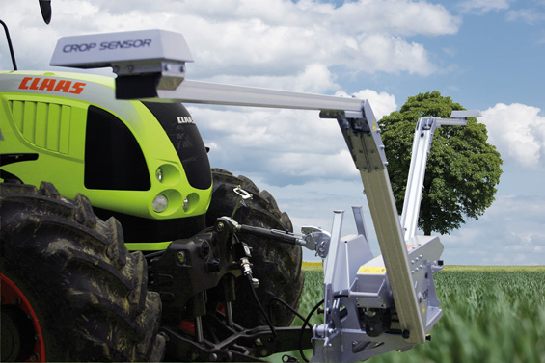
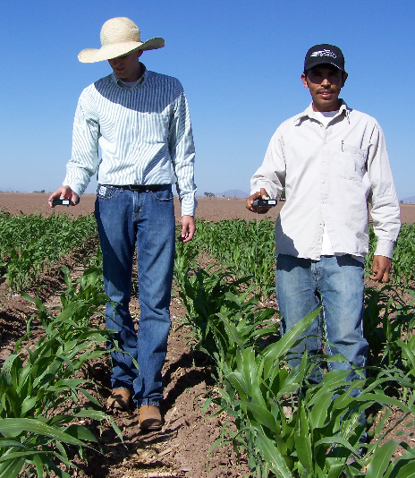
Crop canopy reflectance sensors
Sensors detect optical reflectance based NDVI
CLAAS Agrosystems, http://www.claas.com
Jared Crain, PSS, OSU, CIMMYT Obregon, Mexico

Slide 16
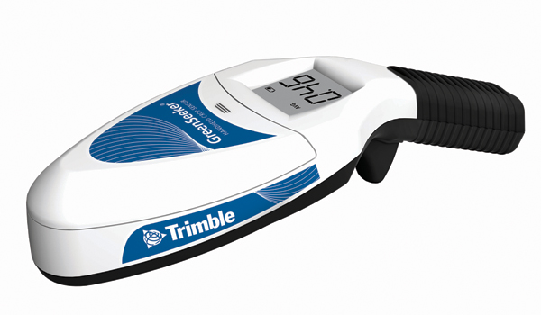
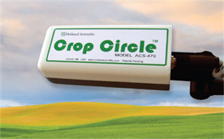
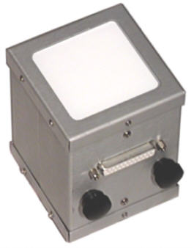
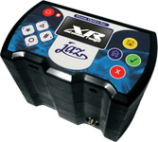
Canopy reflectance sensors (different forms exist)
Greenseeker ™ Handheld
Crop Circle ™ ACS470
Cropscan™ MSR5
Ocean Optics Jaz™

Slide 17
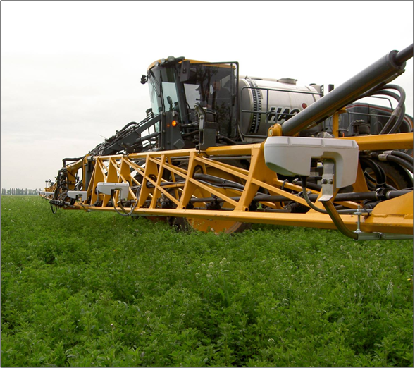
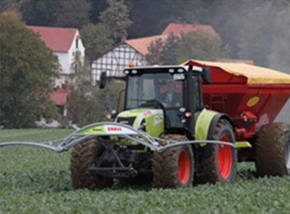
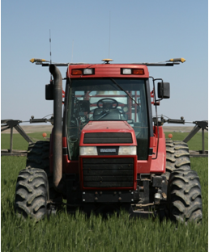
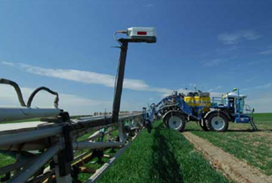
Sensor-based Application Rate Controllers
GreenSeeker ™
CropSpec ™
Crop Sensor ™
OptRx ™

Slide 18
Spectral Response to Nitrogen
Measure of living plant cell’s ability to reflect infrared light
Photosynthetic Potential

Slide 19
Yield Estimation INSEY vs. Wheat Yield (24 locations, 1998-2001)

Slide 20
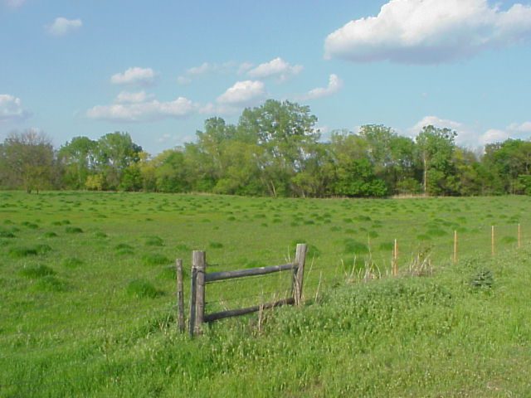
Response Index can allow estimation of in-season mineralization

Slide 21
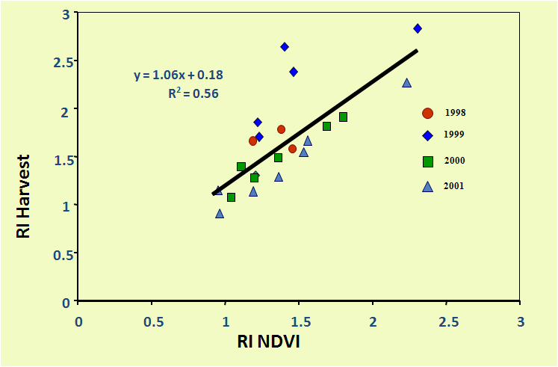
Role of RI in Yield Estimation
Response Index (RI) Estimates yield with added N

Slide 22
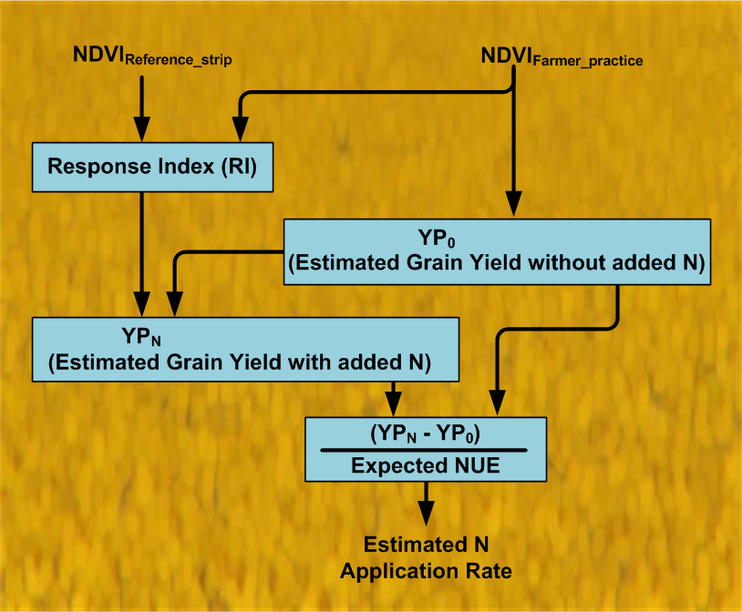
N Fertilization Rate Algorithm
Optical reflectance based yield estimate
Mass balance based N estimate

Slide 23
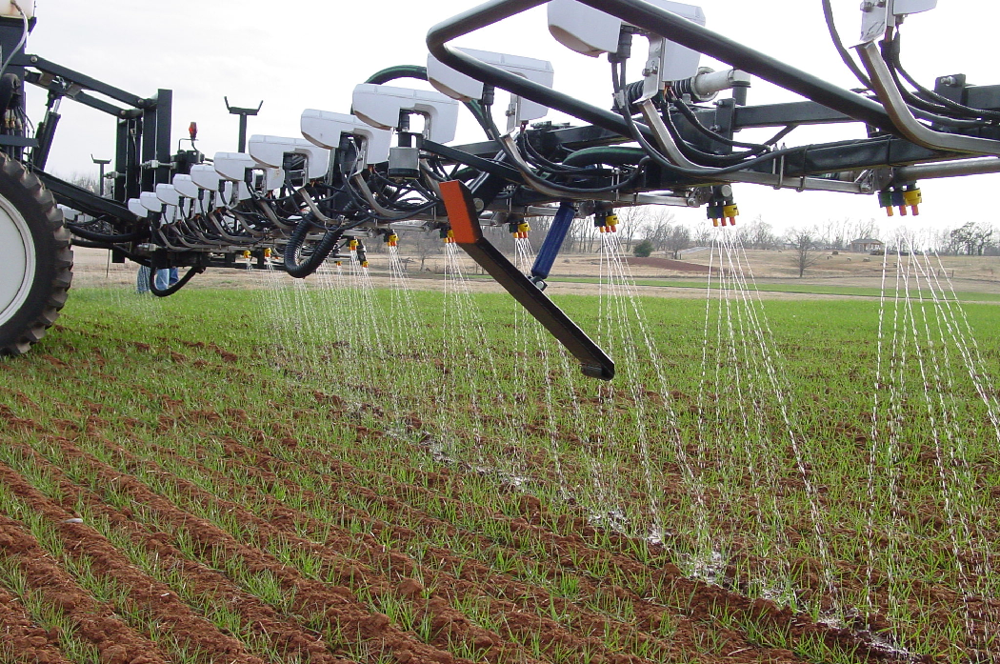
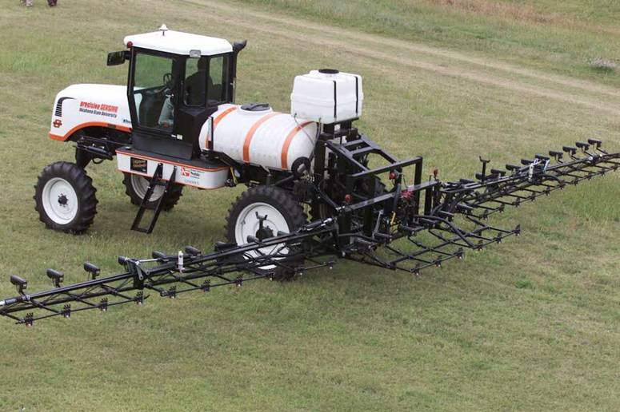
2001 OSU self-propelled applicator

Slide 25
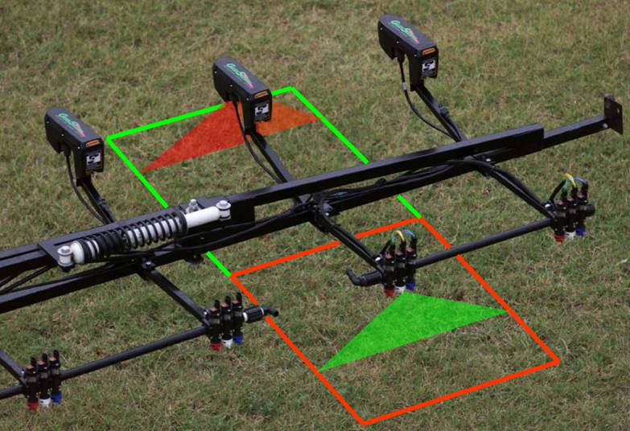
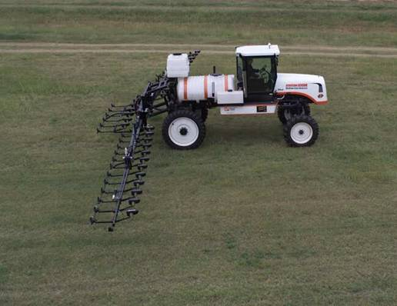
High-resolution not accepted yet
Sense and treat each 0.5 x 1 m spot
Variable nozzle system
Accomplish this while driving 20 mph
Operate day or night

Slide 26
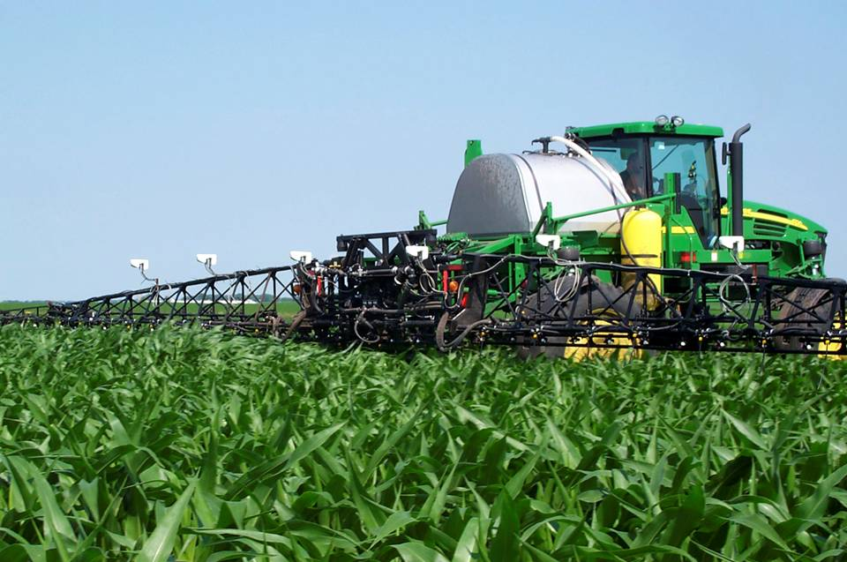
Commercial self-propelled applicator

Slide 27
Adoption of sensor based N management
Local algorithms
Suitable for local crops and cultural practices
Sensor technologies
Adapted to local crops and cultural practices
Cost appropriate for local conditions
Training of farmers and technical support
Manage risk through locally demonstrated results

Slide 28
Classification of sensor types
Illumination source
Active sensors - Self contained illumination
Passive sensors - Use sunlight for an illumination source
Spectral discretization
Multispectral – two or more bands
Spectral – many bands continuous across spectral range
Hyperspectral – wide spectral range, VIS-NIR
Spatial discretization
Single point detector
Imaging
line array
area array

Slide 29
Radiometric sensor geometry
Light reflected from target is focused on the detector
Lens opening to focal length ratio controls detection efficiency and FOV
Illumination field of view is set within the detector view
Target disperses illumination and fraction reaches detector

Slide 30
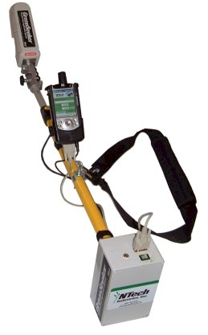
Active sensor - Greenseeker ™

Slide 31
Pocket sensor optical geometry

Slide 32
Reflectance measurement
Based on ratios of
Red and NIR Reflectance
Red Reflectance:
ρ = R_{red} / I_{red}
Example Index:
ρ_{red} / ρ_{nir}
Reflectance is primarily
a function of target

Slide 33
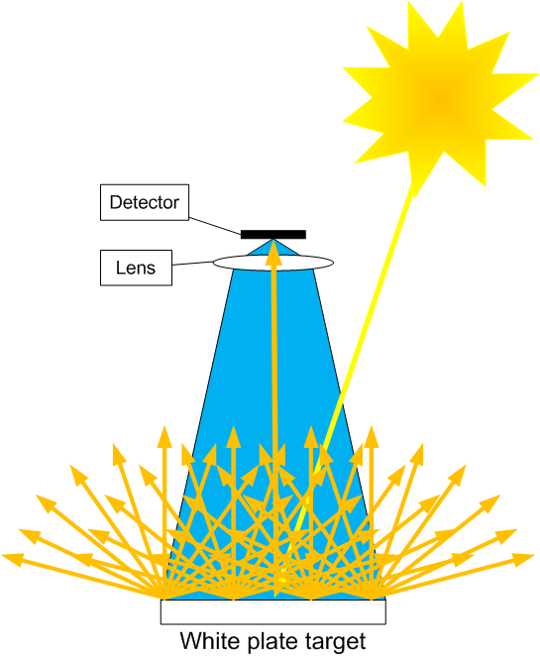
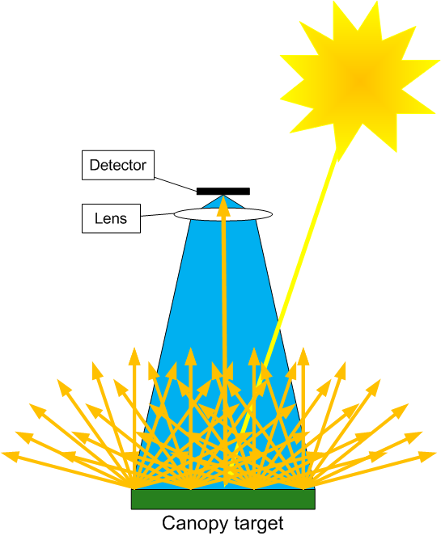
Relectance measurement - calibration
Reflectance is the ratio of canopy irradience to “white plate” reflected irradience
Step 1
Step 2

Slide 34
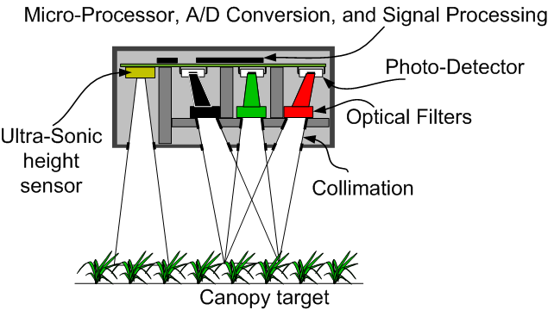
Stored “white reference” sensor
Calibrated to a “white plate” to produce reflectance
“White” values are stored until next calibration
Technique applies to:
multi spectral sensors
fiber optic spectrometers
imaging arrays

Slide 35
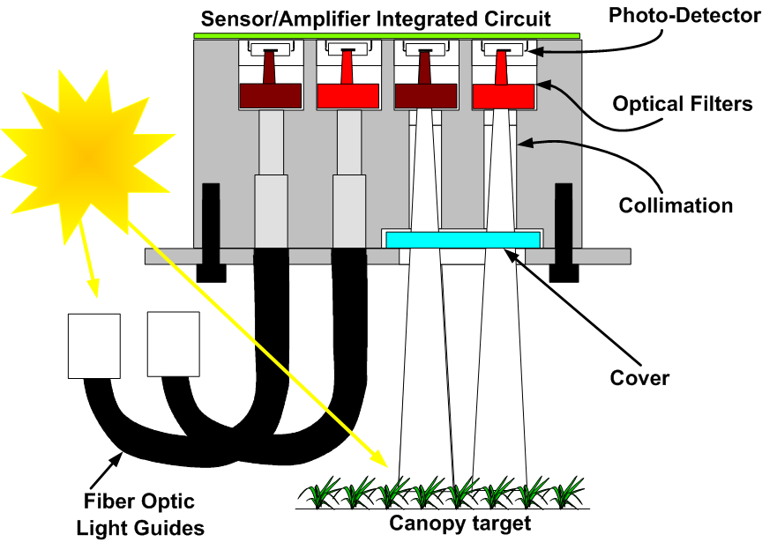
Continuous “White reference” Sensor
“White reference” measured along with light reflected from target

Slide 36
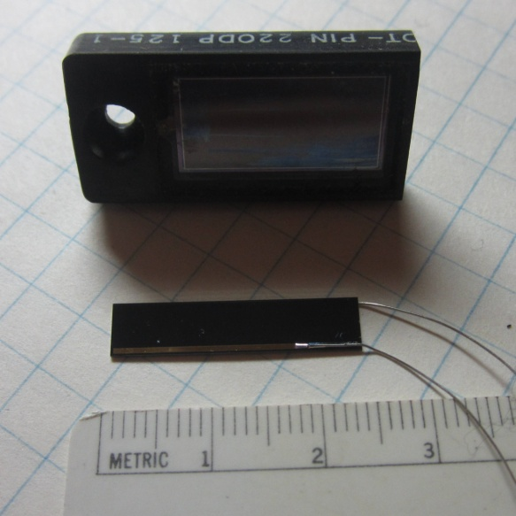
Photometric detection
Photodiode sensor
Dominant or exclusive detector for plant canopy sensors
Incident photons in the depletion region result in conduction and current flow across the region

Slide 37
Detector types / efficiencies

Slide 38
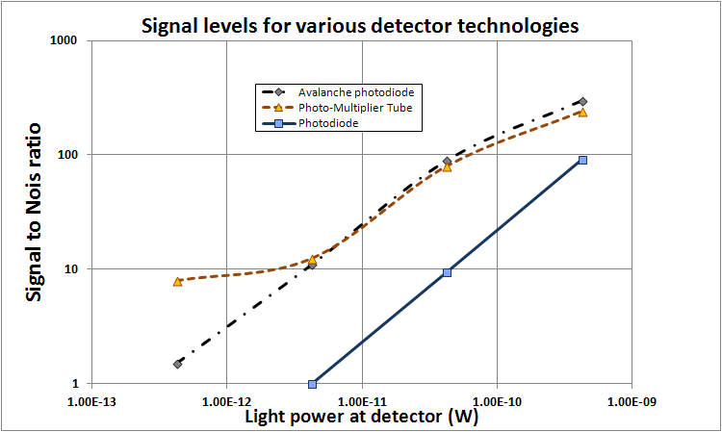
Detector efficiencies
Photodiodes are the primary choice for canopy reflectance measurements
Photodiode are generally linear and cost effective compared to their alternatives
Photodiodes offer long term stability and adequate sensitivity
Photodiodes have predictable thermal characteristics

Slide 39
Photodiode fundamentals
Based on PN or PIN junction diode
photon absorption in the depletion region induces current flow
Spectral sensitivity

Slide 40
Quantum devices
Absorption of a photon of sufficient energy elevates an electron into the conduction band and leaves a hole in the valence band.
Conductivity of semi-conductor is increased.
Current flow in the semi-conductor is induced.

Slide 41
Silicon photodiode spectral response

Slide 42
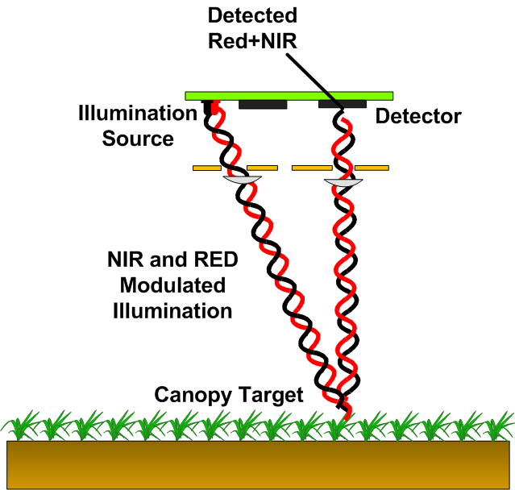
Sunlight rejection in self-illuminated systems
Modulated illumination signals
Used to achieve sunlight rejection
Illumination is modulated in the sub-MHz range
After detection, un-modulated signal is rejected

Slide 43
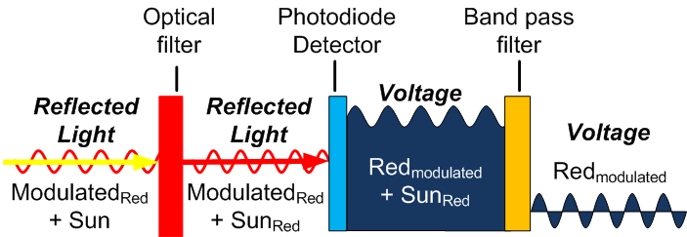
Sunlight invariance
Achieved through filtering
Voltage signal filtering after detection
Band pass filter after detection used to remove sunlight

Slide 44
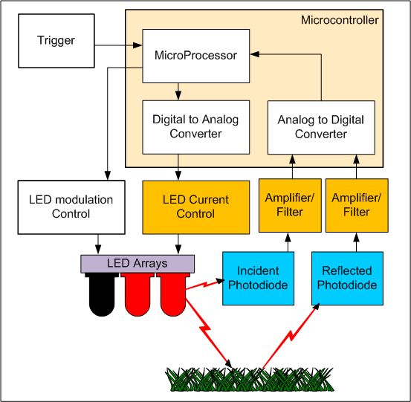
Signal processing in reflectance sensors
Both incident and reflected power are measured
Incident power may be adjusted to suit situation
Matching photodiode characteristics allows compensation for :
Thermal effects
LED aging

Slide 45
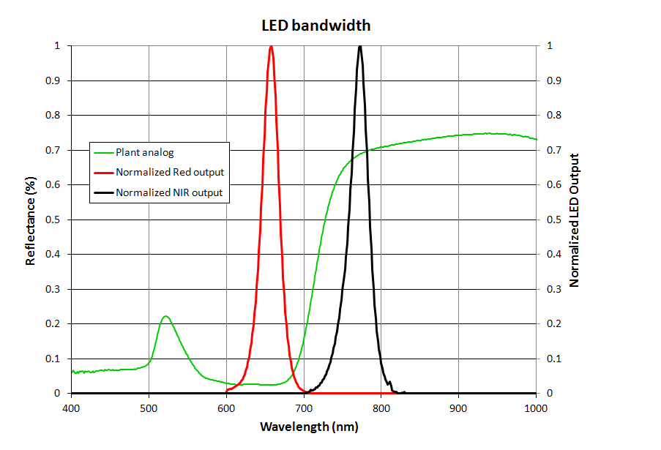
LED based illumination
LEDs
Produce a 25-35 nm wide FWHM signal
Usually current is set to approximately balance detector levels
Band centers may vary significantly between manufacturers for NDVI calculation

Slide 46
Compensation for white plate reflectance
N = Raw A/D value
K_{WhitePlate} – Set to achieve ρ = 1 when white plate is used
White plate calibration must be done at the target distance for active sensors

Slide 47
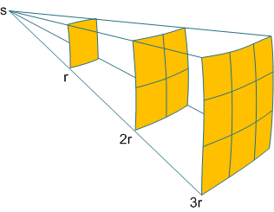
Self –illumination with distance
Inverse square law
power returned to the sensor diminishes as the square of twice the sensor to target distance
Consequences
Much more sensitive to canopy components that are closer to the sensor
Close canopy components may block more distant components

Slide 48
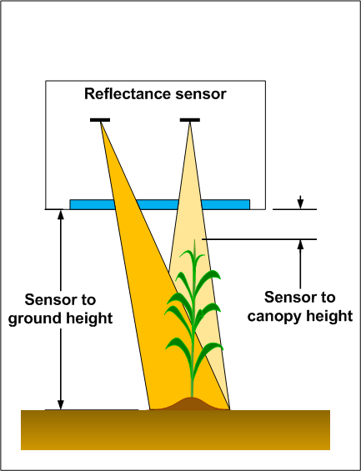
Plant-Sensor geometric interaction
Conical view
Smaller view observed at the top of the canopy than at the bottom
Field of view should be set to capture the top area rather than the bottom

Slide 49
Greenseeker™ geometry
Minimum sensor to canopy distance must be maintained to prevent rejection of close signals

Slide 50
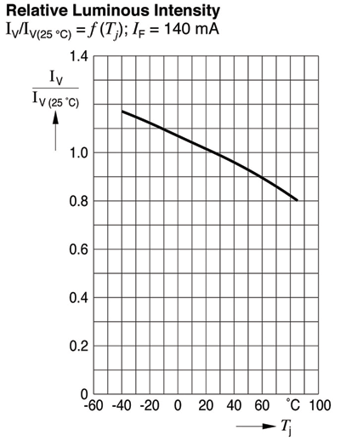
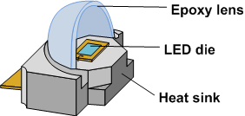
LED intensity vs. junction temperature
LED temperature effects
LED output intensity is a function of temperature
LED epoxy index of refraction is a function of temperature
LED spectral output is a function of temperature
Sensors normally correct for the intensity effect
Osram Opto Semiconductors Santa Clara, CA http://www.osram-os.com
http://www2.electronicproducts.com/Design_considerations_when_backlighting_with_LEDs-article-farc_osram_may2009-html.aspx

