Slide 1




World Phosphorus Use Efficiency (PUE)
Ethan Driver, Jagman Dhillon, & Ryan Bryant-Schlobohm
Objective: To Refine the World estimate of PUE
Current estimate of World PUE in cereal crops is 16%
Guilherme Torres (not pictured), Ethan Driver, Jagman Dhillon, & Ryan Bryant-Schlobohm

Slide 2

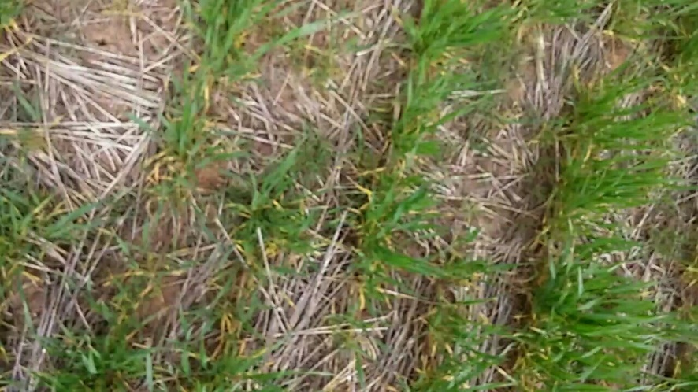




Use of qualitative and quantitative measures of canopy cover to adjust yield for heterogeneous plant stands
Experiment 502, Lahoma, OK
Average Canopy Cover: 32.57%
Average Canopy Cover: 87.59%
Objective: Measured percent canopy cover with the Canopeo mobile application video setting.
Will allow for an analysis of the covariate to be performed in order to make final yield more accurately reflect treatment response independent of heterogeneous plant stands
Original
Original
Processed
Processed
Melissa Golden

Slide 3
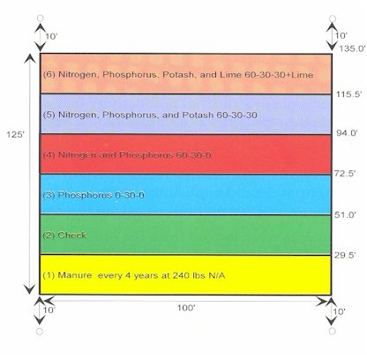
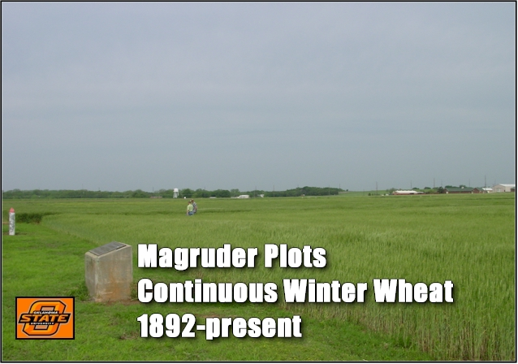

Effects of Climate on Total Organic Carbon (SOC),
Soil pH, and Total Nitrogen in a Long Term Experiment in Oklahoma
Mariana Ramos Del Corso
Objective: to document the relationship between soil organic carbon (OC), total nitrogen (TN), and pH over 24 years.
Mariana Ramos Del Corso

Slide 4
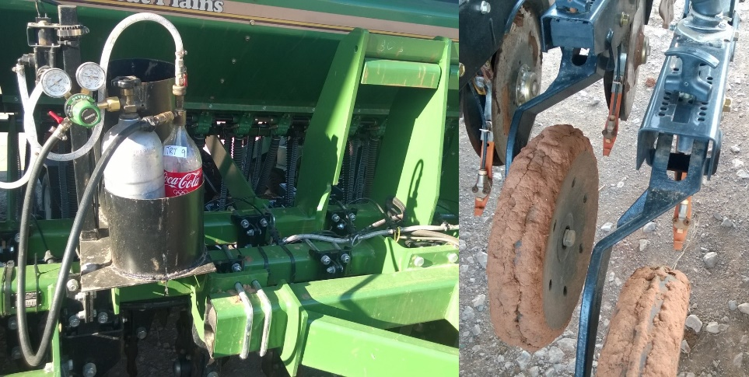

Effect of Micronutrient Fertilizers on Winter Wheat Grain Yield
Bruno Morandin Figueiredo
Table 1. Mean wheat grain yields in bu/ac for growing season 2014-15.
Objective: Evaluate micronutrient fertilization in winter wheat, combined with tillage and method of application.
Treatments | Yields (bu/ac)
 | Perkins | LCB
Check | 40.149* | 37.175*
Check | 47.584 | 43.123
Foliar Calcium | 49.071 | 44.61
Soil Boron | 44.61 | 40.149
Foliar Boron | 43.123 | 40.149
Soil Chlorine | 46.097 | 41.636
Foliar Chlorine | 43.123 | 40.149
Soil Copper | 44.61 | 40.149
Foliar Copper | 52.045 | 47.584
Soil Zinc | 46.097 | 41.636
Foliar Zinc | 47.584 | 43.123
* No significant differences at the 5 % probability level
Figure 1. Great Plains no-till drill adapted with CO₂ system for liquid fertilizer.
Bruno Morandin Figueiredo

Slide 5
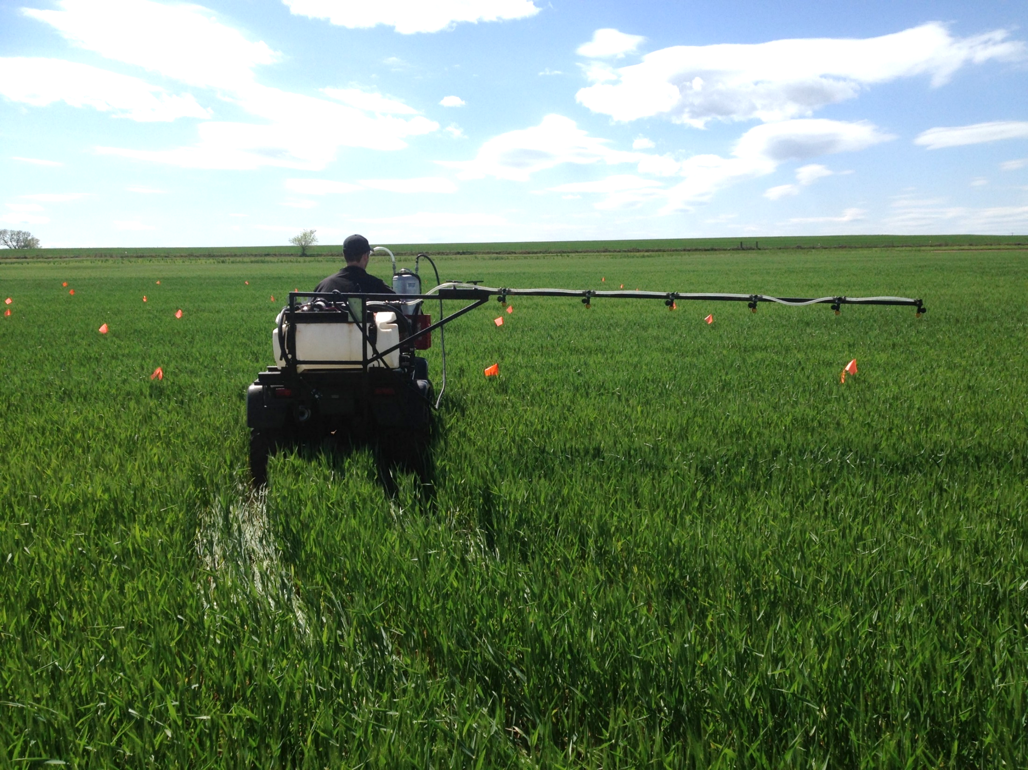
Foliar UAN and Timing on Grain Yield and Nitrogen
Concentration in Winter Wheat (Triticum aestivum L.)
Mariana Ramos Del Corso
  Objective: Determine the amount of UAN that can be applied in foliar form for optimizing yield and grain protein
Treat. | UAN (Ib N/ac) | Timing | Spray nozzle
1 | Check | Feekes 4 | -
2 | 14 | Feekes 4 | 80015 20psi 8mph
3 | 28 | Feekes 4 | 8002 20psi 5mph
4 | 40 | Feekes 4 | 8002 45psi 5mph
5 | 14 | Feekes 10 | 80015 20psi 8mph
Mariana Ramos Del Corso

Slide 6
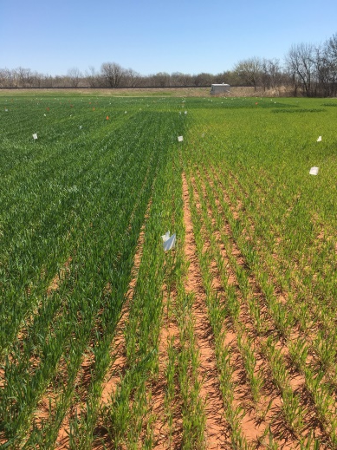

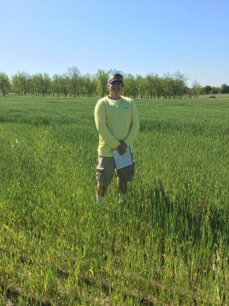
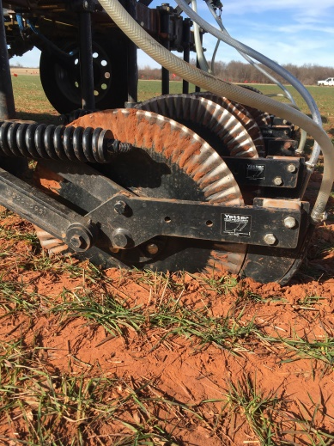

Evaluation of Midseason UAN Application Depth in Winter Wheat
Ryan Bryant-Schlobohm
Department of Plant and Soil Sciences, Oklahoma State University
Objective
Treatment Structure
Objective: Identify midseason application depths of UAN that provide the greatest NUE in corn and winter wheat
Treatment | Midseason N Rate (lbs. N/acre) | Application Depth
1 | 0 | --
2 | 30 | Surface
3 | 30 | 2
4 | 30 | 4
5 | 60 | Surface
6 | 60 | 2
7 | 60 | 4
8 | 90 | Surface
9 | 90 | 2
10 | 90 | 4
11 | 120 | Surface
12 | 120 | 2
13 | 120 | 4
Figure 1. Visible response to fertilized N between treatment 7 (60 lbs. N/acre at 4 inches) and the check (0 lbs. N/acre)
Figure 2. Rolling coulters of the variable rate applicator used to apply subsurface N applications
Ryan Bryant-Schlobohm

Slide 7
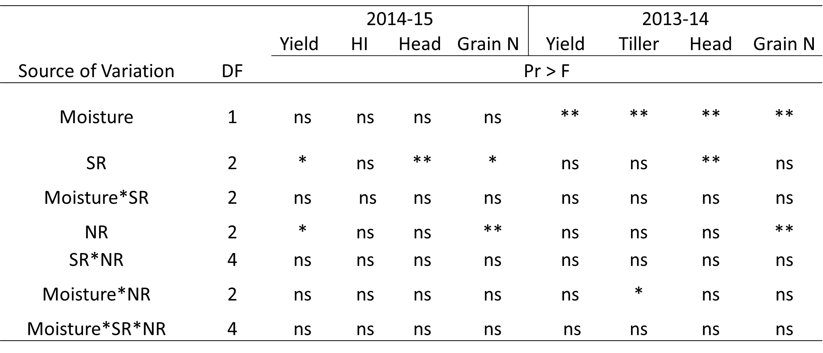

Effect of Irrigation, Nitrogen and Population Rate on Winter Wheat Grain Yield
Sulochana Dhital
Objective:
effect of soil moisture at planting on seeding density and preplant N rate
Data Collection:
Preplant soil moisture, NDVI (F1 – F10; CV), Feekes 5 biomass, head counts at harvest, Grain yield.
*Significant at P = 0.05. ns, not significant at P =0.05
**Significant at P = 0.01.
Conclusions:
Two and three way interaction between seeding rate, N rate and moisture was not significant
Early irrigation had no influence in areas receiving higher rainfall during the growing season
Sulochana Dhital

Slide 8
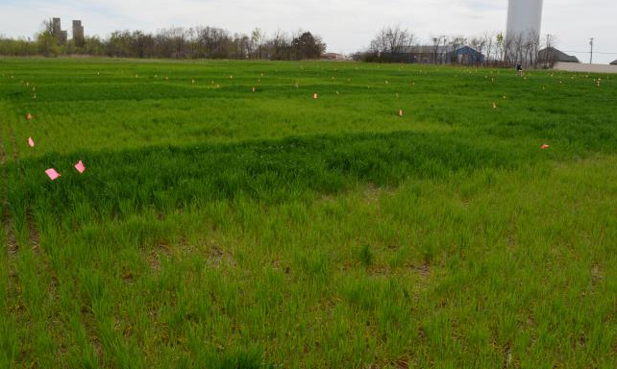

Optimum Preplant N Rate for Winter Wheat
Ethan Driver
Objective: to determine the minimum amount of N that could be applied preplant, and still optimize yields and N use efficiency.
Ethan Driver

Slide 9
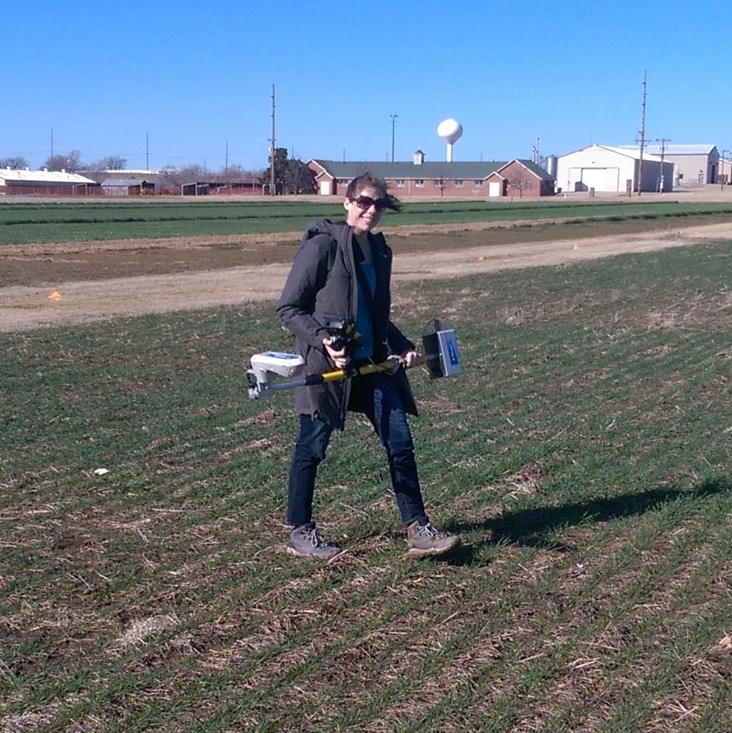

Wheat Response Index Evaluation
Nicole Remondet
Objective: Sequential NDVI measurements from two long-term nutrient management experiments to illustrate growth changes over the life cycle with NDVI. Further evaluation of the response index (RI) over time.
Nicole Remondet

Slide 10
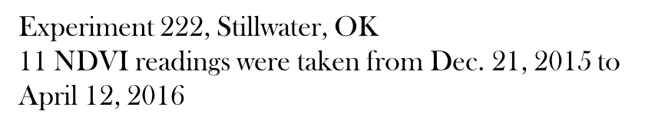
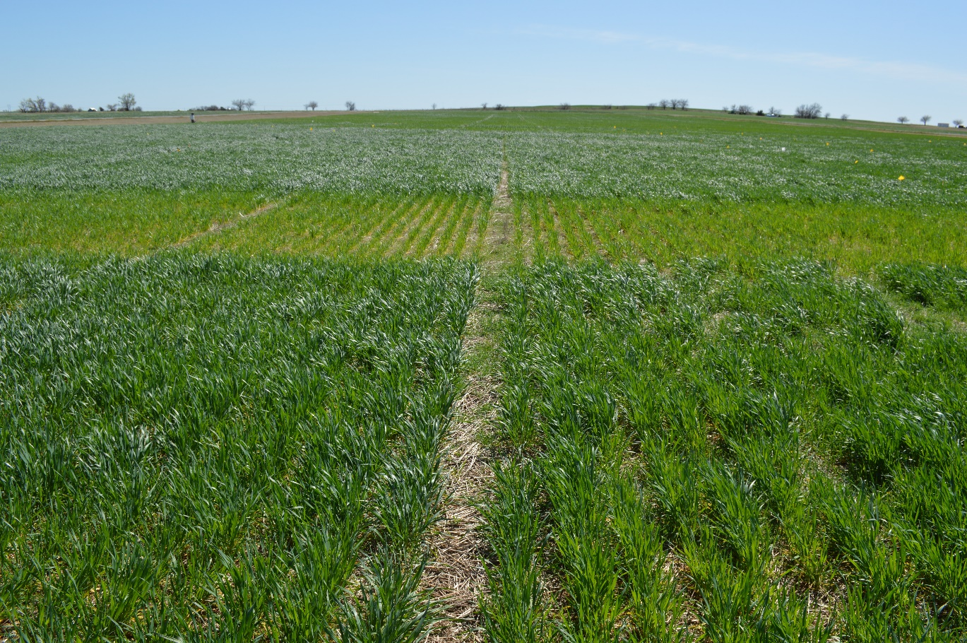
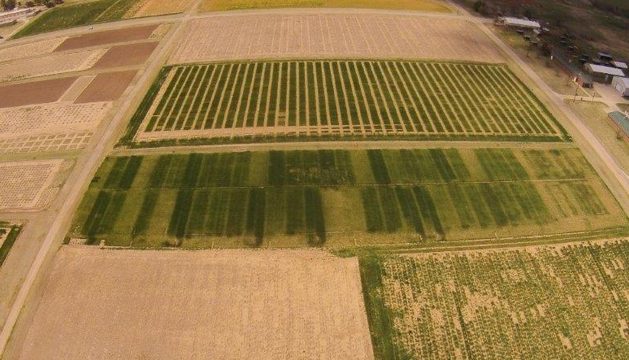


Sequential NDVI Measurements in Winter Wheat for Improved Prediction of
Winter Wheat Grain Yields and Mid-Season Fertilizer Rates
Melissa Golden
Experiment 502, Lahoma, OK
10 NDVI readings were taken from Dec. 18, 2015 to April 07, 2016
Melissa Golden (left)
Nicole Remondet (right)

Slide 11
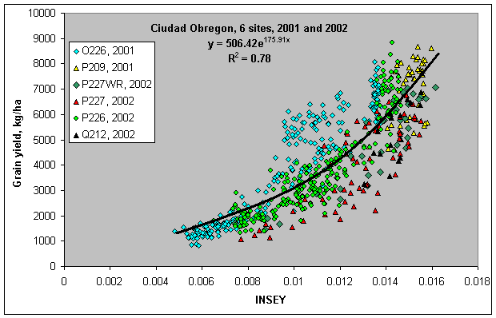
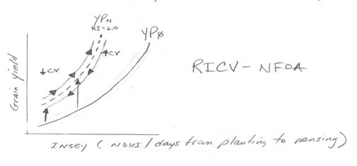
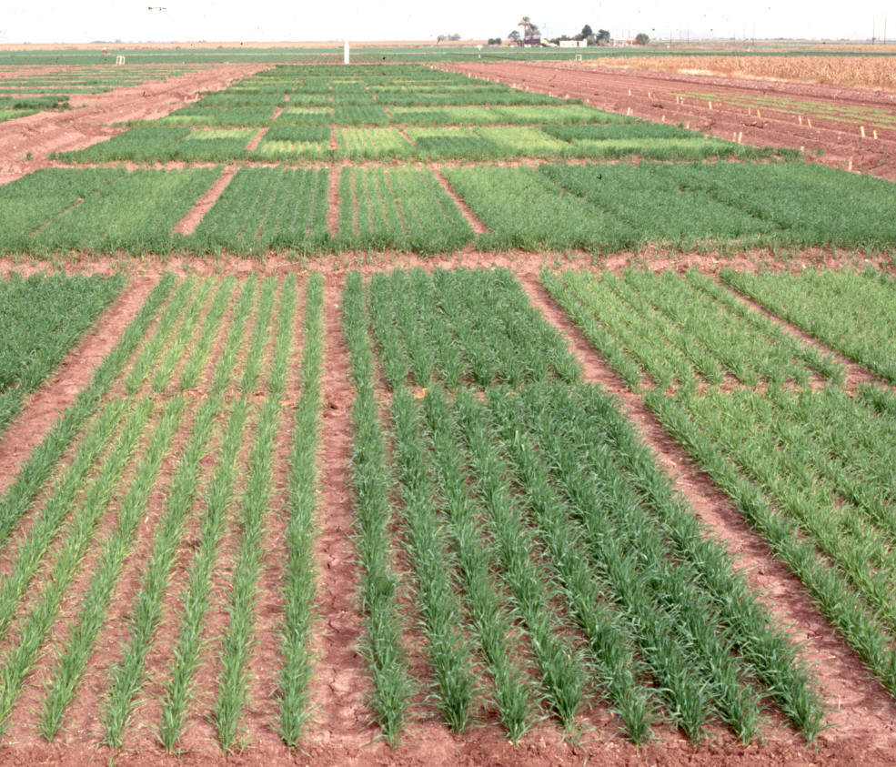


Use of Coefficient Variation (CV) from NDVI, to Improve Yield Prediction
Gwen Wehmeyer and Eva Nambi
Objective: To evaluate the use of coefficient variation (CV) from Normalized Difference Vegetative Index (NDVI) readings for predicting wheat grain yield
Gwen Wehmeyer & Eva Nambi

Slide 12


South Central Great Plains Winter Wheat N Algorithm
Treatment | N - Rate (lb N/ac) | Yield (bu/ac) | Net Return ($/ac)
Split Application | 100 | 35 ± 16 | 154 ± 100
SBNRC | 45 ± 21 | 34 ± 16 | 172 ± 94
Average Difference |  |  | 12 ± 25
 |  |  | Max: 66
 |  |  | Min: -52
Fertilizer Price (28-0-0) = $0.56/lb N
Grain Price = $6.00/bu
http://nue.okstate.edu/SBNRC/mesonet.php
Option 3: Winter Wheat, South Central Great Plains
Tyler Lynch & Bruno Morandin Figueiredo

Slide 13
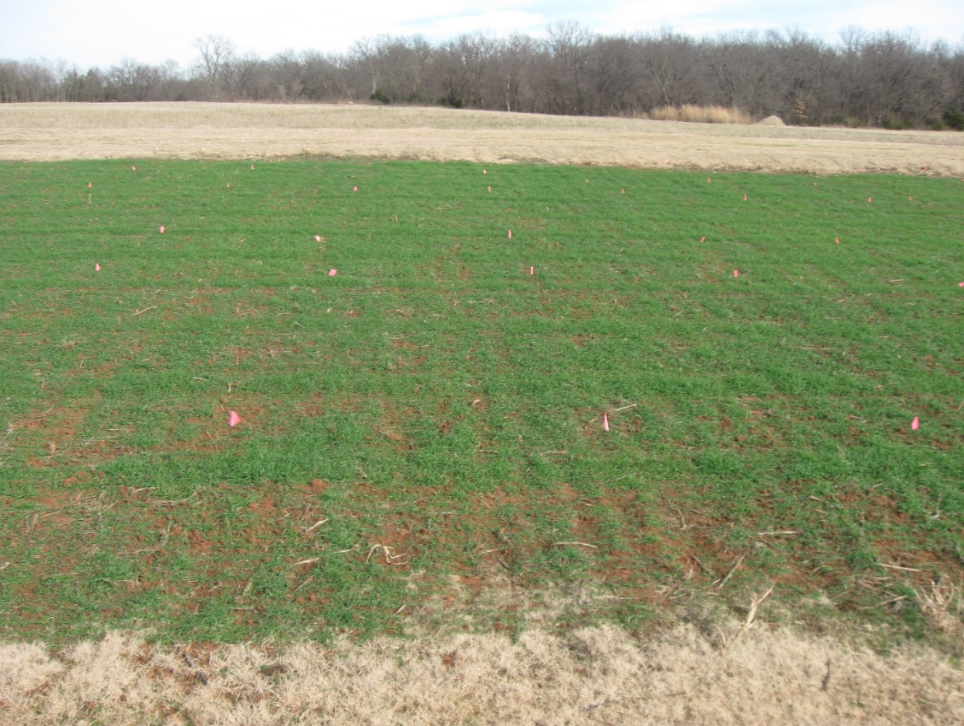
Residual N Availability Following a Failed Crop (Wheat and Sorghum)
Tyler Lynch
Objective: Residual N effect on crop growth following one failed crop cycle
Treatment | Previous Crop | Previous Crop Pre N rate (lb N/ac) | Wheat Pre N Rate (lb N/ac)
1 | Sorghum | 0 | 0
2 | Sorghum | 30 | 0
3 | Sorghum | 60 | 0
4 | Sorghum | 90 | 0
5 | Sorghum | 120 | 0
6 | Sorghum | 150 | 0
7 | Sorghum | 60 | 30
8 | Sorghum | 60 | 60
9 | Sorghum | 60 | 90
10 | Sorghum | 60 | 120
11 | Sorghum | 60 | 150
Tyler Lynch

Slide 14

In Season Prediction of Grain Sorghum Yield Using Red and Red Edge NDVI
Sulochana Dhital
Treatment | Preplant N (lb N/ac) | Sidedress N (lb N/ac) | Method of Application
1 | 0 | 0 | Check
2 | 150 | 0 | N Rich Strip
3 | 30 | 0
4 | 30 | 30
5 | 30 | 60
6 | 30 | 90
7 | 30 | 120
8 | 30 | 150
9 | 30 | 180
10 | 60 | 0
11 | 90 | 0
12 | 120 | 0
Objective:
Use of two different active-optical sensors that employ red and red edge technology, and compare them to estimate the in-season yield potential (YP₀) in grain sorghum
Sulochana Dhital

Slide 15
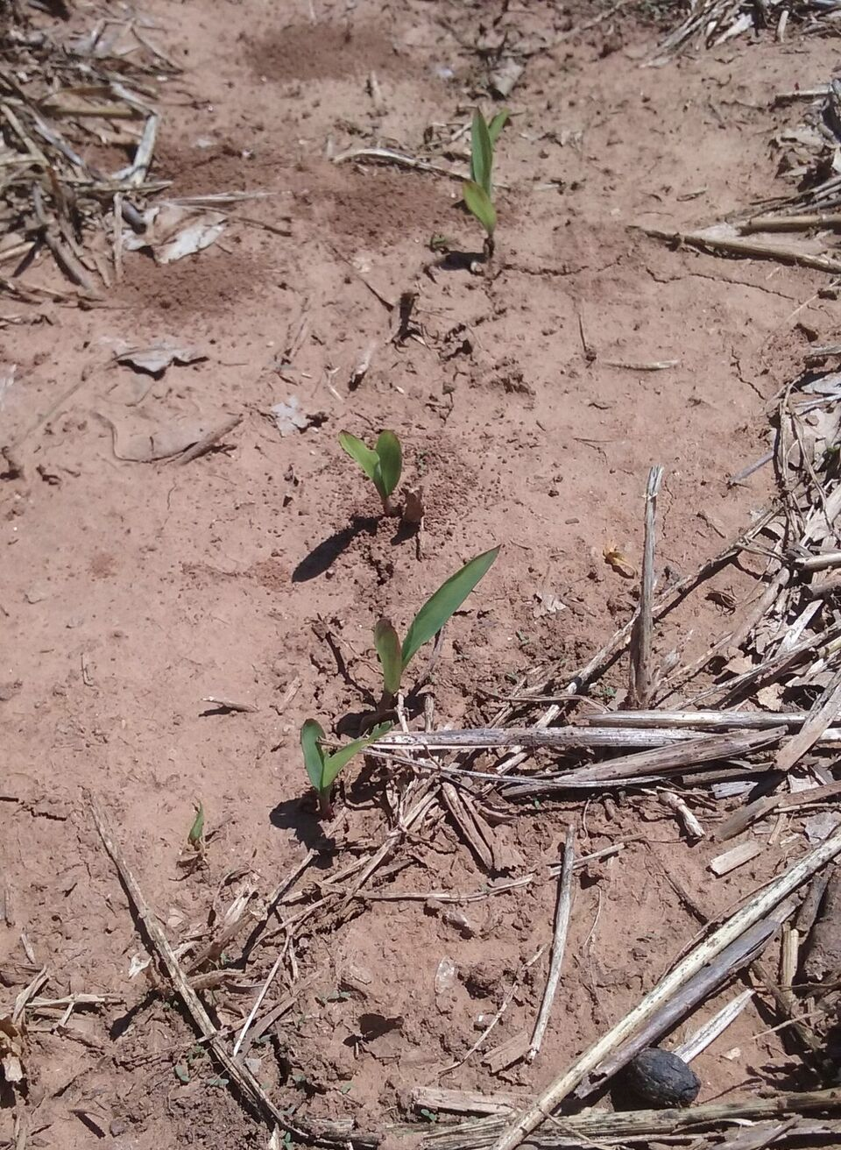
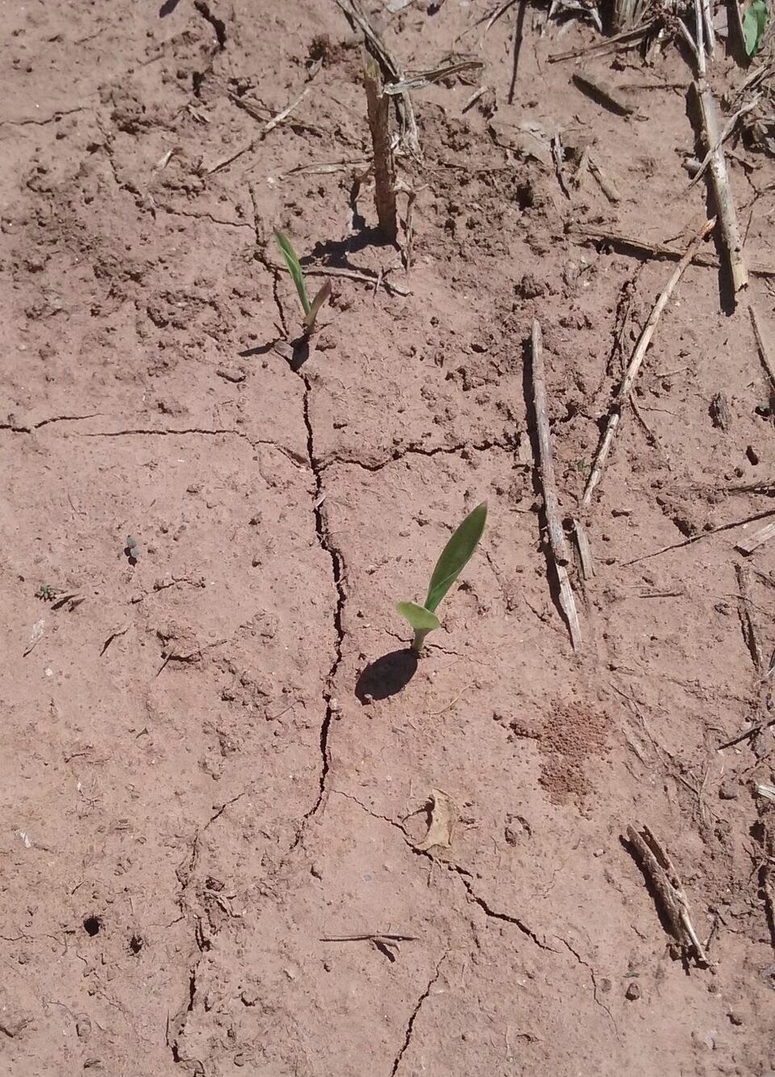
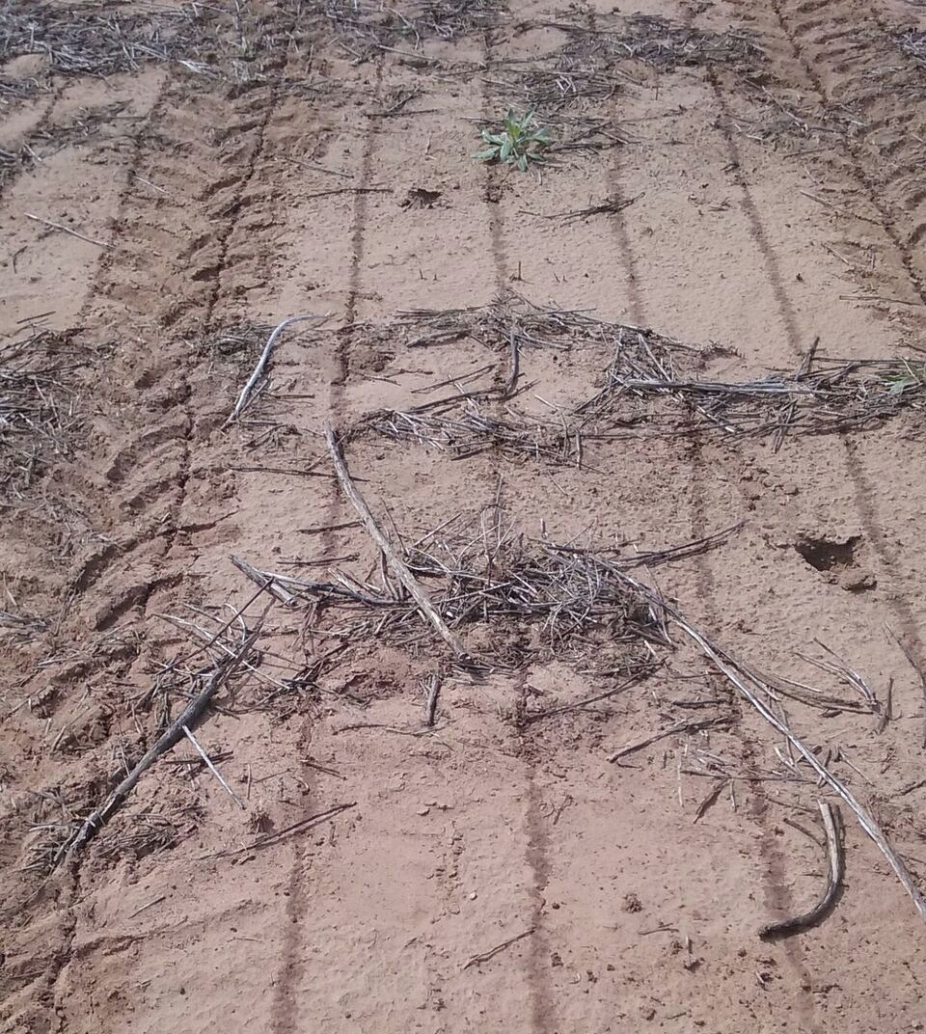

Objective: Determine correct amount of nitrogen that can be applied preplant for optimizing grain yields and NUE
Optimum Preplant Nitrogen (N) Rates in Sorghum
Gwen Wehmeyer
Treatment | Preplant N (lbs/ac) | Sidedress N (lbs/ac)
1 | 0 | 0
2 | 15 | 0
3 | 30 | 0
4 | 45 | 0
5 | 60 | 0
6 | 90 | 0
7 | 0 | 30
8 | 15 | 30
9 | 30 | 30
10 | 45 | 30
11 | 60 | 30
12 | 90 | 30
Gwen Wehmeyer & Ethan Driver

Slide 16
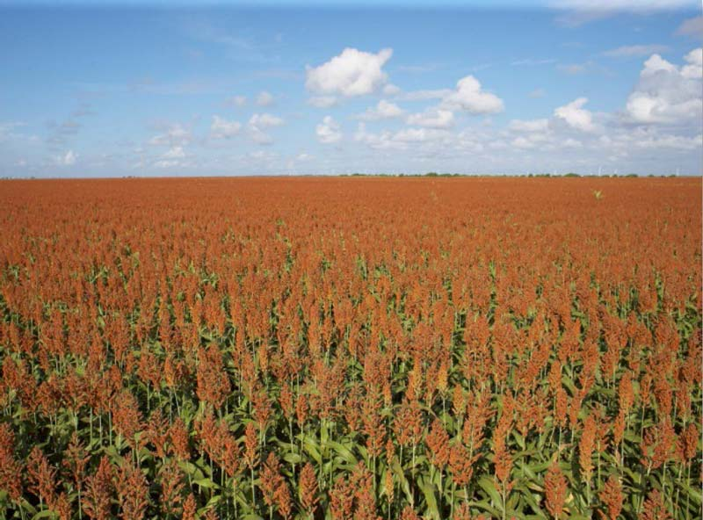
Sulfur Fertilization for Grain Sorghum in Oklahoma
Ryan Bryant-Schlobohm
Department of Plant and Soil Sciences, Oklahoma State University
Objective
Treatment Structure
Treatment | Side-Dress N Rate (lb/acre) | Sulfur Rate (lb/acre)
1 | 0 | 0
2 | 60 | 0
3 | 60 | 10
4 | 60 | 15
5 | 60 | 20
6 | 120 | 0
7 | 120 | 10
8 | 120 | 15
9 | 120 | 20
10 | 60 | Soil SO₄₋ Test Recommendation
11 | 120 | Soil SO₄₋ Test Recommendation
Objective: economic feasibility of applying sulfur for Oklahoma grain sorghum producers
Ryan Bryant-Schlobohm

Slide 17

Variability in Optimum N Rates for Maize in the Central Great Plains
Source | Location | Years | Time period | † (0-N) Yield Range | ‡ High N Yield Range | *Optimum N rate kg ha⁻¹
 |  |  |  | ---- Mg ha⁻¹ ---- |  | Min | Max | Avg. | SD
Bundy et al. (2011) | WI | 21 | 1958-1983 | 1.6-7.6 | 4.3-8.8 | 50 | 233 | 130 | 53
Bundy et al. (2011) | WI | 9 | 1984-1997 | 2.7-5.6 | 5.7-9.96 | 58 | 235 | 179 | 51
Mallarino and Torres (2006) | IA | 20 | 1979-2003 | 0.8-5.9 | 5.1-12.4 | 81 | 237 | 165 | 49
Mallarino and Torres (2006) | IA | 14 | 1985-2010 | 1.4-6.2 | 5.3-12.8 | 134 | 239 | 197 | 32
Varvel et al. (2007) | NE | 5 | 1995-2005 | 6.6-10.9 | 10.4-13.3 | 73 | 193 | 131 | 49
Jokela et al. (1989) Carroll | MN | 3 | 1982-1984 | 5.5-7.3 | 7.1-9.1 | 5 | 131 | 84 | 69
Jokela et al. (1989) Webster | MN | 3 | 1982-1984 | 1.7-5.6 | 1.8-8.7 | 70 | 113 | 91 | 21
Fenster et al. (1976) Waseca | MN | 5 | 1970-1975 | 3.2-7.4 | 7.1-10.6 | 60 | 199 | 135 | 50
Fenster et al. (1976) Martin A | MN | 7 | 1970-1976 | 3.8-8.2 | 4.0-9.6 | 23 | 126 | 69 | 36
Fenster et al. (1976) Martin B | MN | 6 | 1971-1976 | 6.2-11.3 | 6.2-12.0 | 0 | 37 | 18 | 15
Al Kaisi et al. (2003) | CO | 3 | 1998-2000 | 5.6-10.2 | 8.3-10.8 | 66 | 111 | 91 | 23
Ismail et al. (1994) NT | KY | 20 | 1998-2000 | 2.1-7.4 | 5.2-10.9 | 35 | 230 | 128 | 46
Ismail et al. (1994) CT | KY | 20 | 1970-1990 | 1.9-9.5 | 3.5-10.4 | 0 | 203 | 98 | 52
Rice et al. (1986) NT | KY | 15 | 1970-1985 | 3.1-4.9 | 5.7-9.2 | 102 | 178 | 144 | 30
Rice et al. (1986) CT | KY | 15 | 1970-1985 | 1.9-6.1 | 5.0-8.8 | 69 | 204 | 124 | 47
Stecker et al. (1993) Columbia | MO | 3 | 1988-1990 | 3.3-5.6 | 6.0-10.1 | 99 | 194 | 153 | 49
Stecker et al. (1993) Novelty | MO | 3 | 1988-1990 | 4.5-7.2 | 6.7-9.9 | 45 | 182 | 103 | 71
Stecker et al. (1993) Corning | MO | 2 | 1989-1990 | 5.0-6.0 | 8.2-8.5 | 90 | 117 | 104 | 20
Peterson et al. (1989) | NE | 4 | 1983-1986 | 2.1-6.4 | 3.9-10.0 | 11 | 218 | 104 | 88
Eck (1982) | TX | 2 | 1977-1978 | 2.7-4.4 | 5.6-5.9 | 59 | 116 | 88 | 40
Shapiro et al. (2006) RS 51cm | NE | 3 | 1996-1998 | 6.2-8.9 | 9.4-11.1 | 69 | 96 | 83 | 13
Shapiro et al. (2006) RS 76cm | NE | 3 | 1996-1998 | 5.0-8.9 | 7.1-11.0 | 13 | 114 | 75 | 54
Meisinger et al. (1985) MT | MD | 4 | 1974-1977 | 1.8-2.6 | 5.8-8.2 | 127 | 233 | 183 | 45
Meisinger et al. (1985) PT | MD | 4 | 1974-1977 | 2.7-4.2 | 5.1-8.1 | 36 | 196 | 142 | 75
Gehl et al. (2005) Rossville | KS | 2 | 2001-2002 | 6.4-7.9 | 11.3-12.6 | 182 | 204 | 193 | 15
Gehl et al. (2005) Scandia | KS | 2 | 2001-2002 | 2.7-7.4 | 3.8-11.5 | 51 | 160 | 105 | 77
Total |  | 198 |  |  | Average | 62 | 173 | 120 | 45
 |  |  |  |  | SD | 44 | 55 | 43 | 20
Objective: To document the relationship between maize grain yield levels and optimum N rates, over a wide range of locations and years, from published literature.
Conclusions:
Same N rates applied each year on corn do not include accurate accounting for variability in soil N and corn N uptake which are dramatically influenced by the changing growing conditions from one year to the next.
Published results from multiple sites, years revealed extensive variability in optimum nitrogen rates in for maize in the Central Great Plains.
Table 1. Maize grain yield for the zero-N treatment (check plot), high N treatment and a computed optimum N rate in 26 field experiments that encumbered 198 site years of published data in the Central Great Plains, United States 1958-2010.
Sulochana Dhital

Slide 18
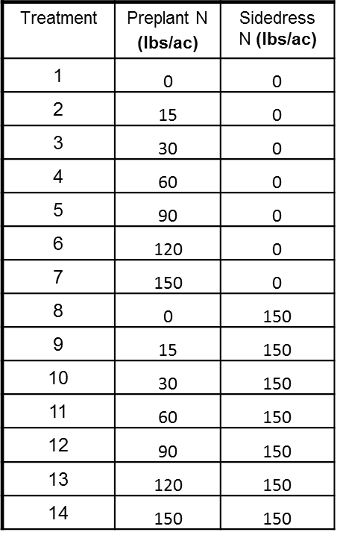
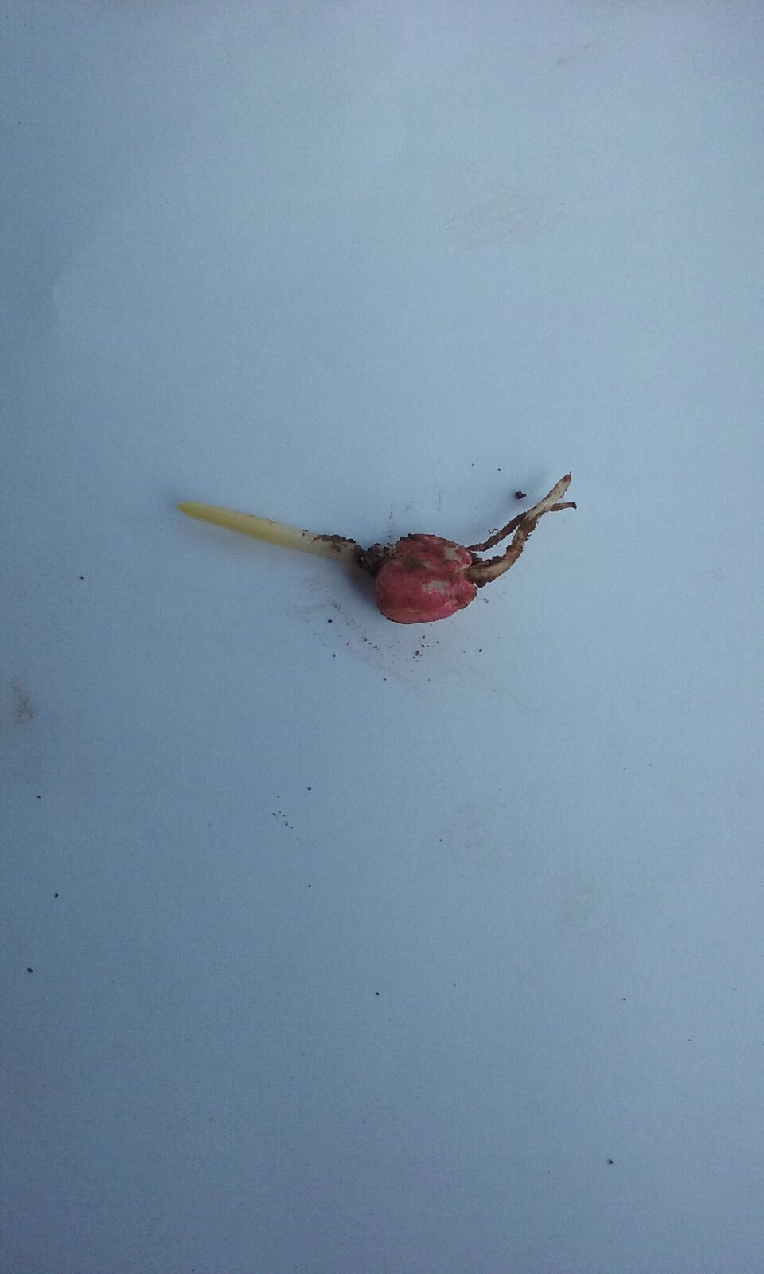
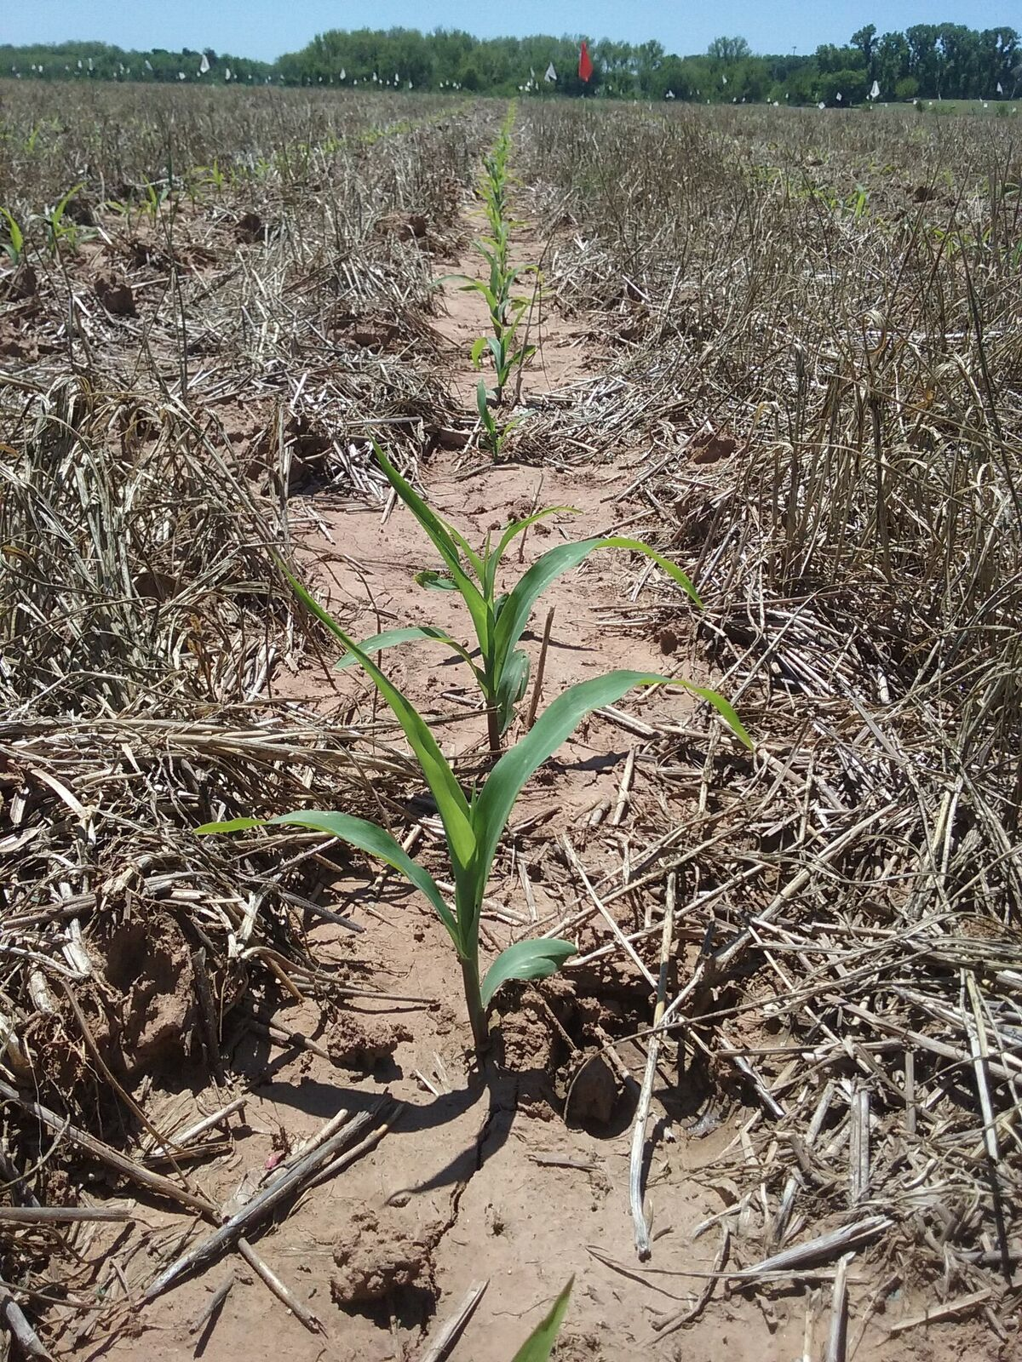

Objective: Determine correct amount of preplant nitrogen that can be applied to optimize grain yields and nitrogen use efficiency
Optimum Preplant Nitrogen (N) Rates in Maize
Gwen Wehmeyer
Gwen Wehmeyer & Ethan Driver

Slide 19
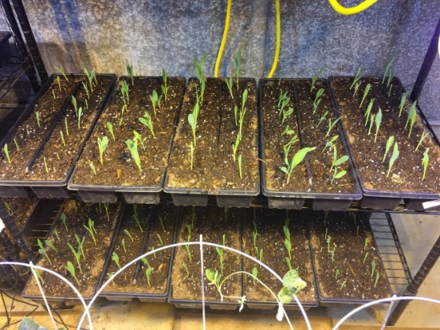
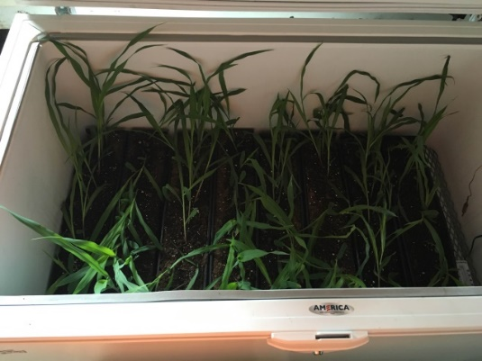
Mitigation of Late Spring Freeze in Maize
Ryan Bryant-Schlobohm
Department of Plant and Soil Sciences, Oklahoma State University
Objective
Treatment Structure
Determine if low rates of foliar applied UAN fertilizer applied prior to an expected freeze can mitigate the damage caused to young corn plants.
Treatment | Temperature | UAN Rate (lbs. N/acre)
1 | No Freeze | 0
2 | No Freeze | 5
3 | No Freeze | 10
4 | 32˚F | 0
5 | 28˚F | 0
6 | 32˚F | 5
7 | 32˚F | 10
8 | 28˚F | 5
9 | 28˚F | 10
Comments
Trial run showed us where to improve current methods
Future trials will be on winter wheat, simulating a late spring freeze after the growing point has moved above ground
Ryan Bryant-Schlobohm

Slide 20
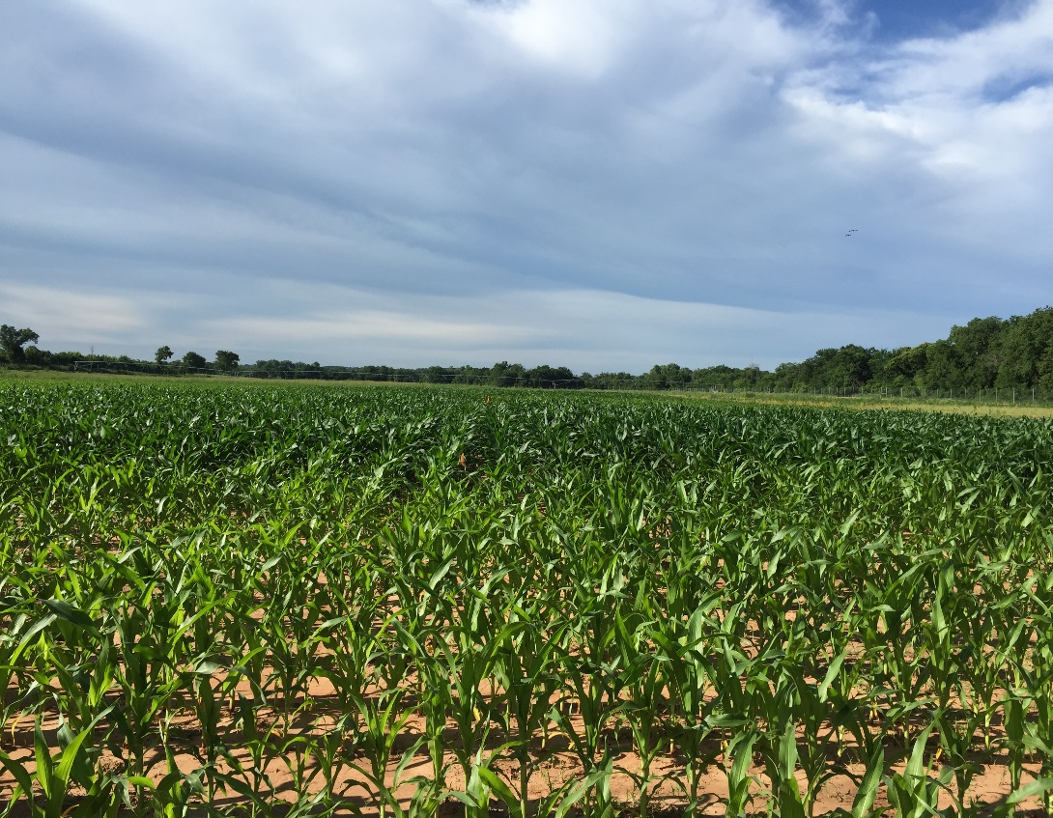

Maize Regional Trial
Jagman Dhillon
Objective: Refinement of the sensor based N rate and optimum N
Treatment | Preplant N (lb N/ac) | Sidedress N (lb N/ac) | Method of Application
1 | 0 | 0 | Check
2 | 200 | 0 | N Rich Strip
3 | 40 | 0
4 | 40 | 30
5 | 40 | 60
6 | 40 | 90
7 | 40 | 120
8 | 40 | 150
9 | 40 | 180
10 | 80 | 0
11 | 120 | 0
12 | 160 | 0
Jagman Dhillon

Slide 21
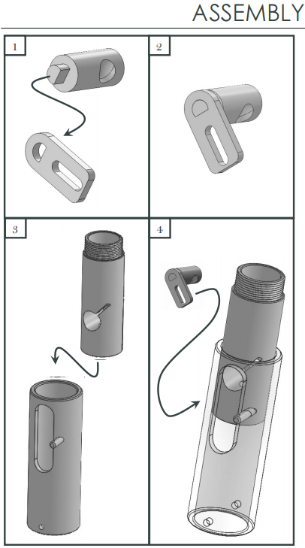
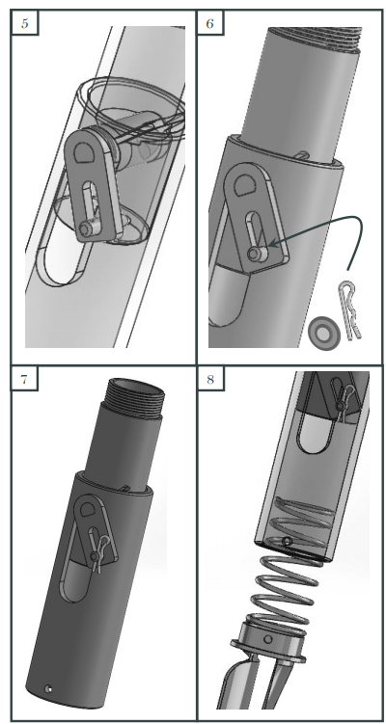

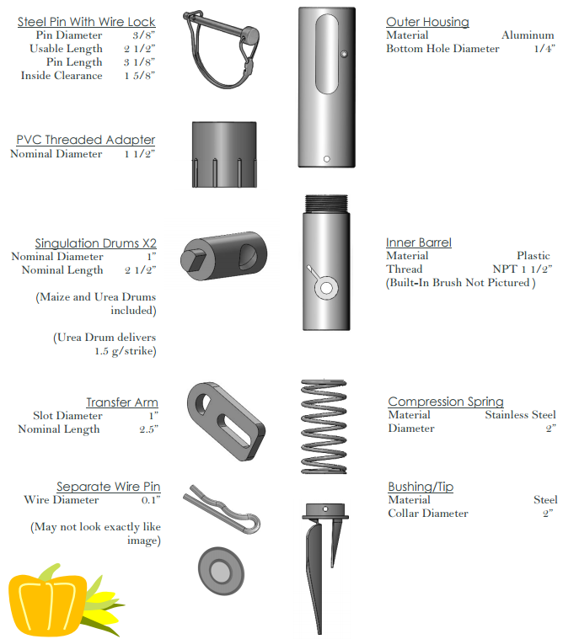
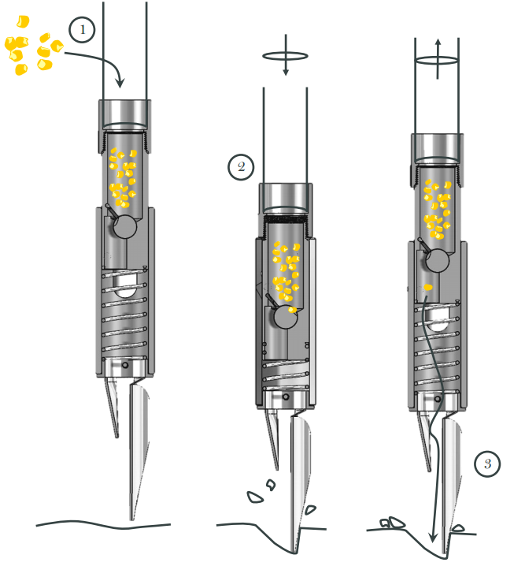
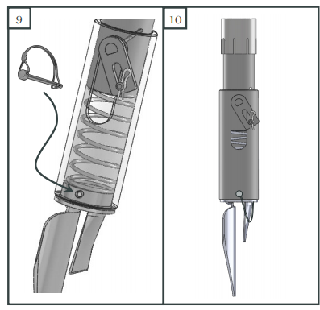

Evaluation of the Inner Housing of the OSU Green Seeder Hand Planter
Daniel K.S. Aliddeki, Jagman Dhillon, Eva Nambi
Objective: Evaluation/Modification of the Inner Housing, OSU Green Seeder Hand Planter
Daniel K.S. Aliddeki, Jagman Dhillon, Eva Nambi

Slide 22
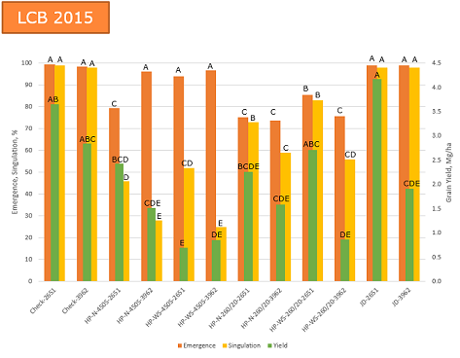
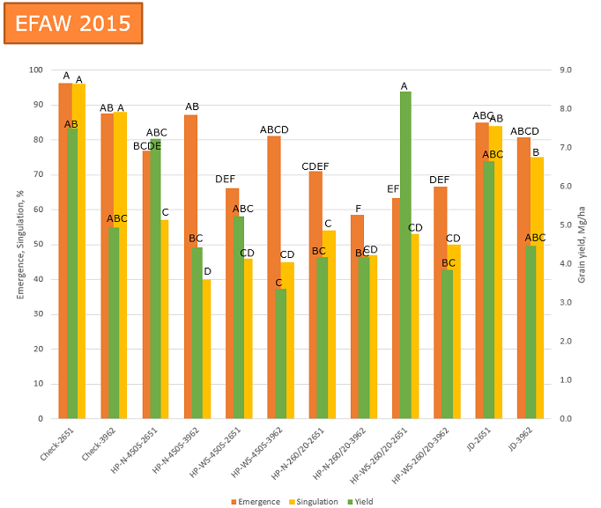
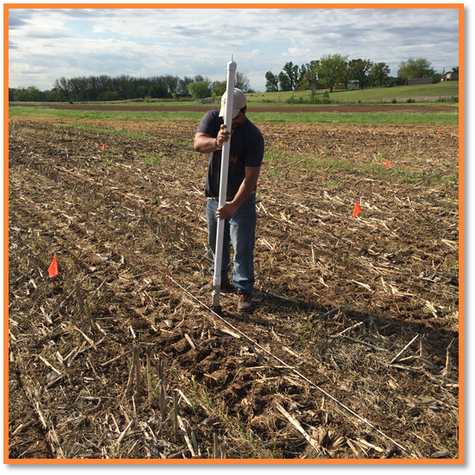
Evaluation of Drum Cavity Size and Planter Tip on
Singulation and Plant Emergence in Maize (Zea mays L.)
Jagman Dhillon
Objective: Evaluation of Drum Cavity Size and Planter-tip on Singulation and Plant Emergence in Maize (Zea mays L.)
Jagman Dhillon

Slide 23
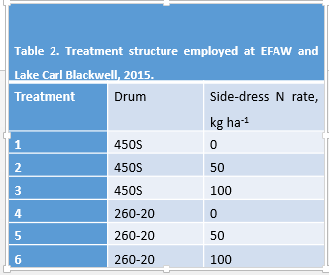
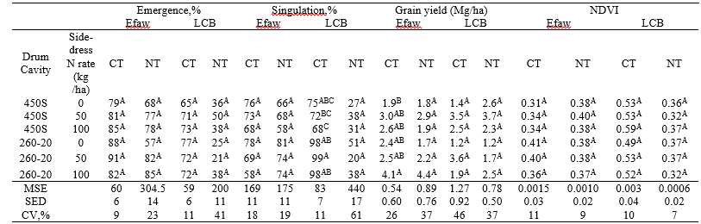
Influence of Tillage and Sidedress N on Maize (Zea mays), Plant Stand, and Grain Yield Using the Green Seeder Hand Planter with Altered Drum Cavity Sizes
Daniel.K.S Aliddeki
Objective : Investigate the influence of tillage (conventional and no-till) and side-dress N on maize plant stands and grain yield using the Green Seeder hand planter with altered drum cavity sizes
Daniel.K.S.Aliddeki
Daniel K.S Aliddeki

Slide 24
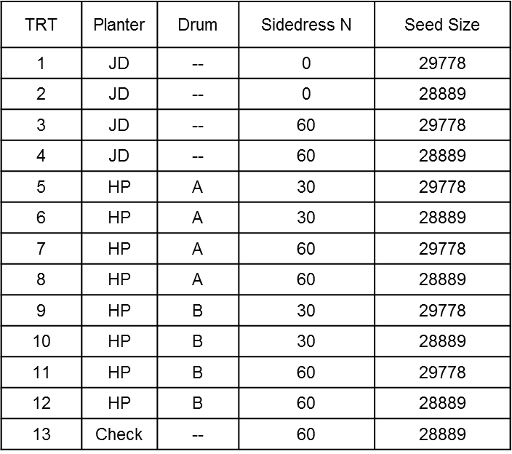
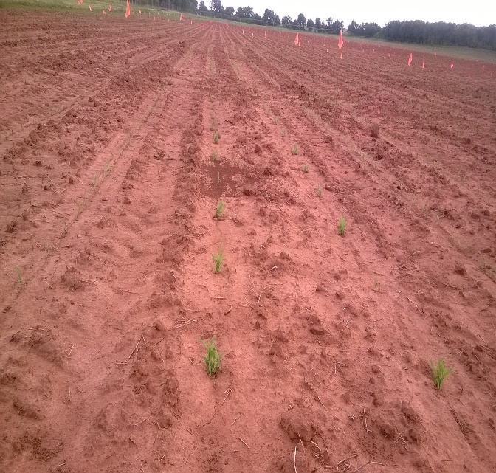

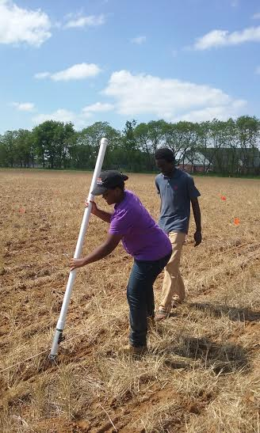


Seeding Density and Plant Spacing on Sorghum Grain Yields
Eva Nambi
Objective: To evaluate the effect of seeding density and plant spacing on sorghum (sorghum bicolor) grain yields using the OSU hand planter
Eva Nambi, Daniel K.S. Aliddeki, & Jagman Dhillon

