Slide 1
Sunday, November 2, 2014: 2:00 PM-5:30 PM Long Beach Convention Center, Room 203A Community Leader: Sarah E. Johnson Beebout Presider: Charles S. Wortmann 2:00 PM Introductory Remarks
2:05 PM 28-1
A Review of Investing Three Years of Agricultural Education, Seed Capital, and Local Staffing in a Haitian Mountain Community. Jason D Streubel, Convoy of Hope/Evangel University/Washington State University; Harold P. Collins, USDA-ARS; Brittni Woods, Convoy of Hope; Chad Kruger, Center for Sustaining Agriculture and Natural Resources, Washington State University
2:20 PM 28-2
Towards Achieving Agricultural Development in Africa: The Case of AGRA’s Capacity Building in Soil Sciences and Agronomy. Marie Rarieya-Midamba, Alliance for a Green Revolution in Africa (AGRA); Bashir A. Jama, Alliance for a Green Revolution in Africa (AGRA)
2:35 PM 28-3
The Pain of Change: Challenges Associated with Mechanizing Rice Production and Harvesting Systems in the Mwea Irrigation Scheme within the Kirinyaga District, Central Province, Kenya. Jill M. Motschenbacher, United States Agency for International Development (USAID) / Catholic Relief Services (CRS) / Farmer-to-Farmer (F2F) Program
2:50 PM 28-4
Effect of Agronomic Management Practices on the Grain Yield of Lowland Rice (Oryza sativa) in Rainforest Agro-Ecology of Nigeria. Akeem Abdulai Oyekanmi, Federal University of Agriculture; Olalekan Suleiman Sakariyawo, Federal University of Agriculture; Sunday Gbenga Aderibigbe, Federal University of Agriculture; Kehinde Adebayo Okeleye, Federal University of Agriculture; Christopher Okonji, Federal University
3:05 PM 28-5
Maize Hand Planter and Fertilizer Applicator for the Developing World. Bill Raun, Oklahoma State University; Randy Taylor, Oklahoma State University; Nyle C. Wollenhaupt, AGCO; Bruno Morandin Figueiredo, Oklahoma State University; Lawrence Aula, Oklahoma State University

Slide 2
Maize hand planter and fertilizer applicator for the developing world
Bill Raun, Randy Taylor, Nyle Wollenhaupt, Bruno Figueiredo, Lawrence Aula, and Joshua Ringer.
The equivalent amount of maize mechanically produced in the USA is planted, managed, and harvested by hand in the developing world. This amounts to almost 36,000,000 hectares of maize produced on marginal landscapes. Planting methods vary but they generally use heavy sticks whereby 2-3 seeds are planted per strike, roughly 35cm apart. This inefficient method of planting is commonplace for subsistence maize farmers, largely dictated by terrain, circumstance, and resources.
When single seeds are placed 14-17cm apart, much like conventional planters, production levels can increase 25%. Because developing world maize yields hover near 2 Mg/ha, a 25% yield increase (+0.5 Mg/ha) on 60% of the hand planted maize area in the developing world would be worth more than 3 billion USD per year. Oklahoma State University has developed a new hand planter that is similar in shape, size, and weight (1.4 kg empty) to planters currently used, but that can reliably singulate seed. Benefits of the OSU hand planter include improved homogeneity of plant stands, removing chemically treated seeds from the hands of producers, accommodate mid-season applications of urea-N fertilizer, function for all kinds of planted crops/seeds, and increased grain yields.

Slide 3
Borlaug: Volume 3, Bread Winner. 1960-1969. Copyright 2004, 2010 by Noel Vietmeyer
…But the technology package was only one aspect. Once we had the package and had checked it for its validity, we still had to harness it to political policies. Otherwise, nothing would have happened and the technology, as good as it was, would never have been applied and food production would have stayed unchanged. We had to see that the credit was available for small farmers to buy the inputs needed to obtain these yields. We also had to see that pricing at the time of harvest was enough to stimulate farmers to adopt this package.
“Then, can man use honest work, God’s best medicine to gain his own livelihood.”
Norman E. Borlaug
“You can’t get him to admit he’s got a Nobel Prize, any other award (he has hundreds), honorary degrees (dozens), or that he’s helped anyone (millions, if not billions).” Noel Vietmeyer

Slide 4
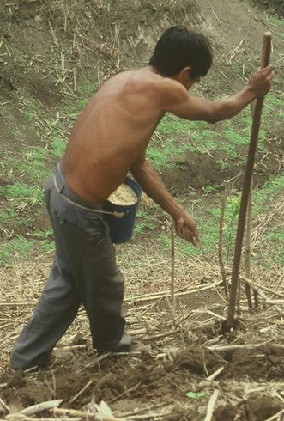
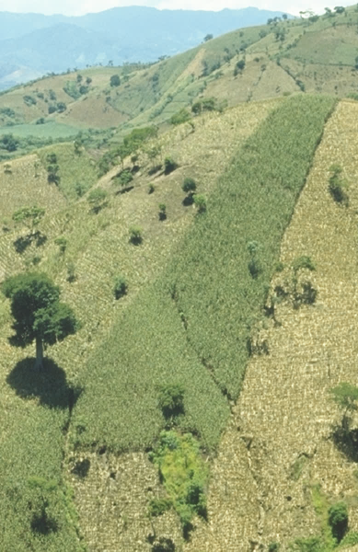
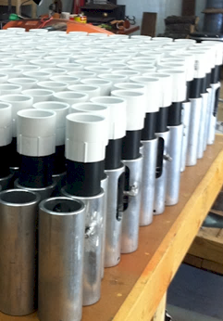
Maize hand planter and fertilizer applicator for the developing world
Bill Raun, Randy Taylor, Nyle Wollenhaupt, Bruno Figueiredo, Lawrence Aula, Joshua Ringer, Edgar Ascencio, Jagmandeep Dhillon

Slide 5
Maize (FAOSTAT, 2013)
Area, ha Production, Mt Avg. Mt/ha
World 184,239,959 1,016,431,783 5.5 (87 bu/ac)
USA 35,478,012 353,699,441 9.9 (157 bu/ac)
China 35,276,500 217,830,000 6.2 (98 bu/ac)
Brazil 15,450,180 80,516,571 5.2 (83 bu/ac)
Low income Food Deficit Countries
49,356,985 117,590,512 2.4 (38 bu/ac)
60% hand planted
29,614,180
USA 2014, 37,125,000 ha’s

Slide 6
World area planted by hand ≈ corn area in the USA
Developing world, avg. farm size = 1 ha
NGO support, interaction, source for subsidizing planters
By 2050 there will be 9.1 billion people.
Increase of 30%
Food production during the same period will have to increase 70%
95% of the increased population will be in the developing world
Alexandratos, N. and J. Bruinsma. 2012. World agriculture towards 2030/2050: the 2012 revision. ESA Working paper No. 12-03. Rome, FAO.

Slide 7
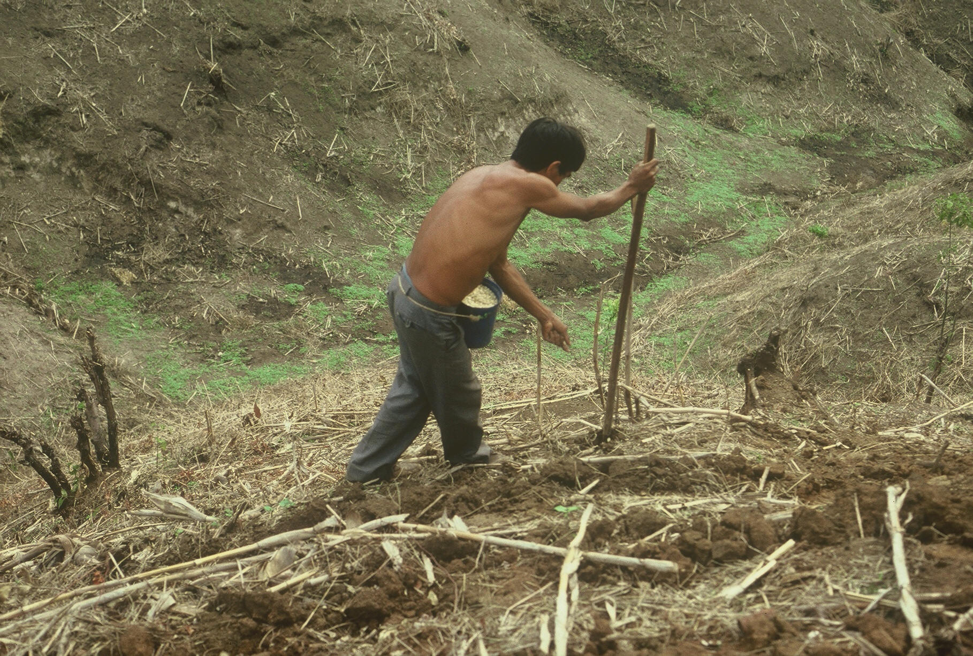

Slide 8
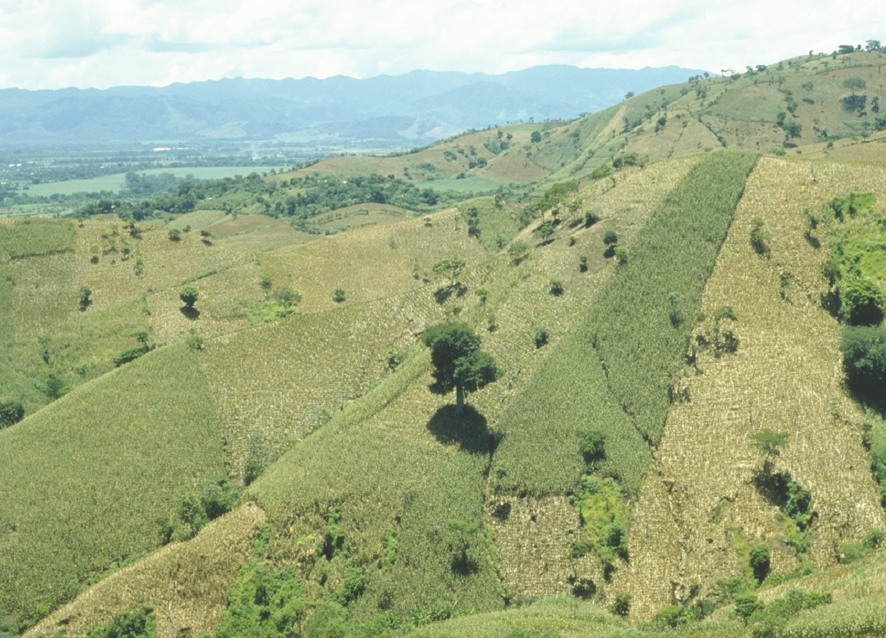
EL SALVADOR

Slide 9
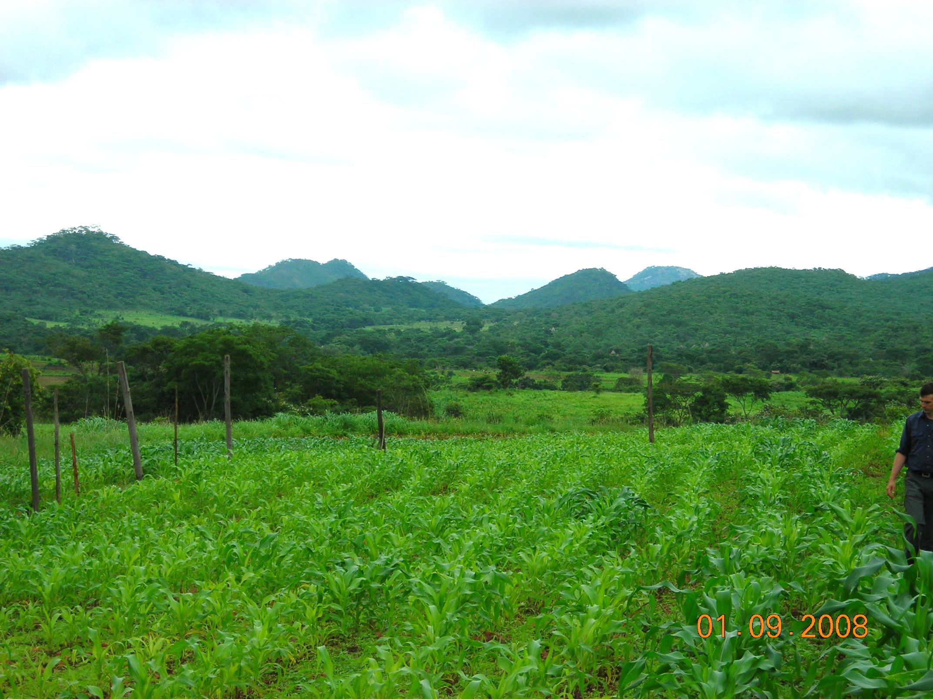
ZIMBABWE

Slide 10
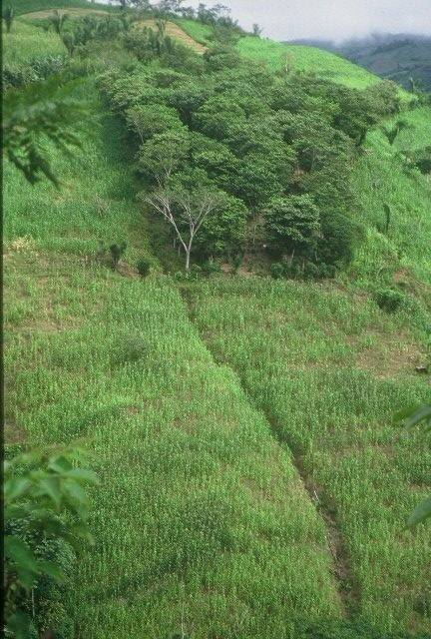
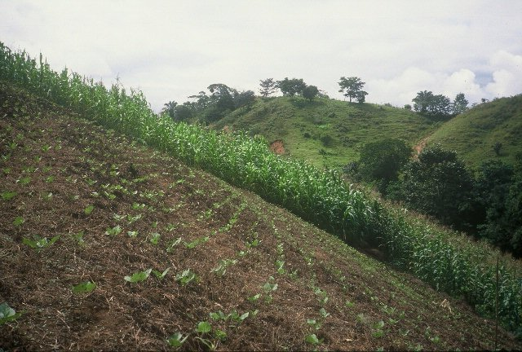
HONDURAS

Slide 11
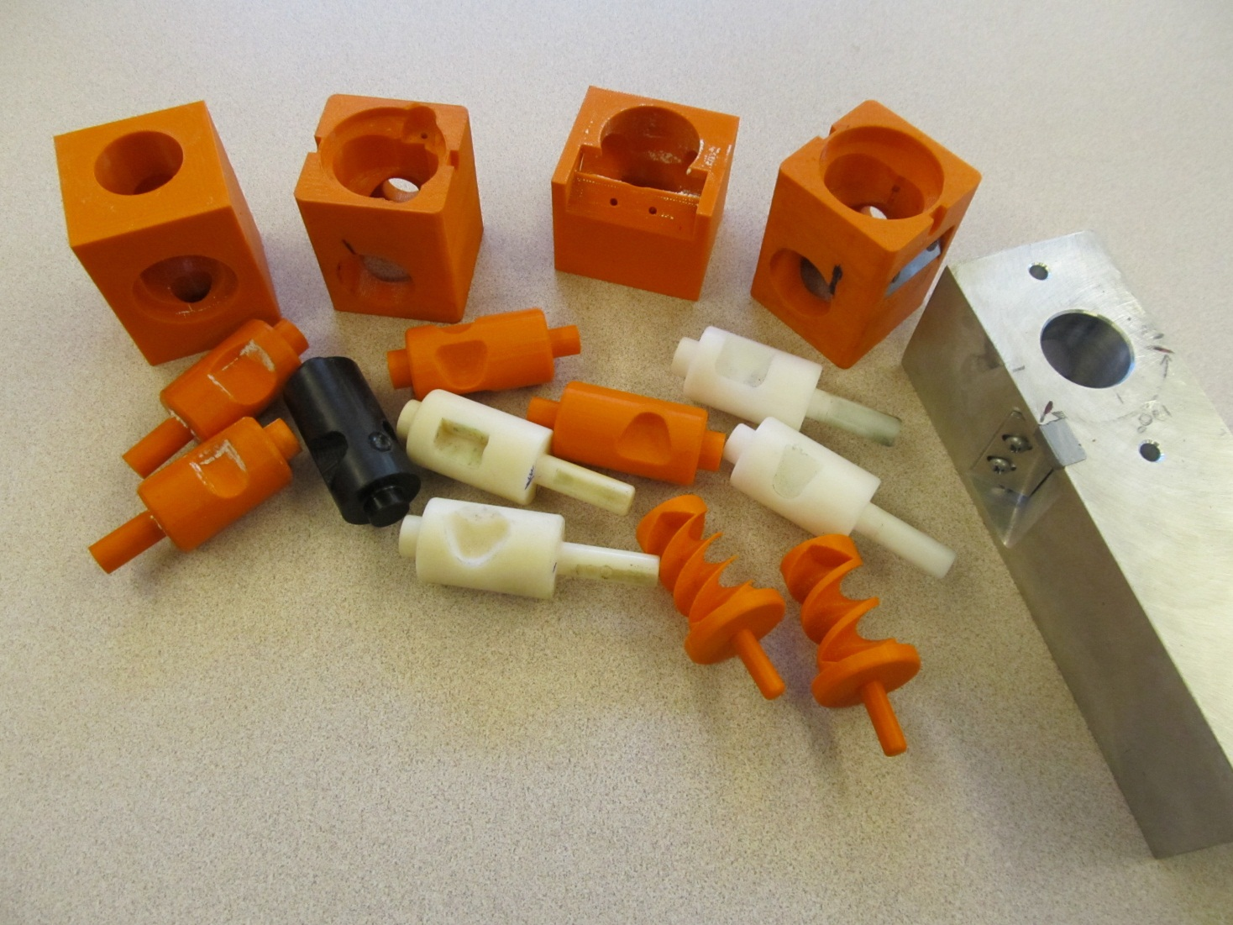
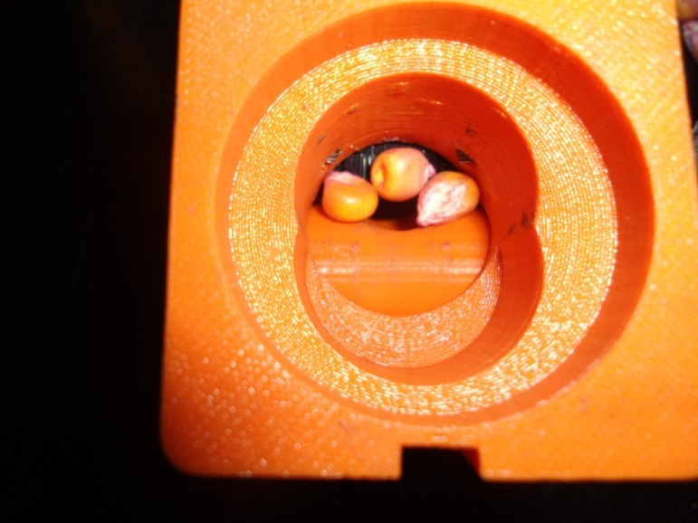
Singulation Design

Slide 12
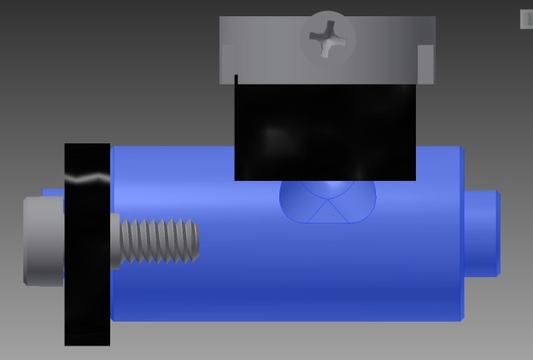
Reciprocating Drum Action
Drum rotates with the cavity moving back into the seed hopper as the spring is compressed.
Spring is fully compressed and the singulation drum cavity is exposed to seed in the hopper
Drum position when planter is relaxed.
As the force on the spring is released, the singulation drum rotates back to the initial ‘relaxed’ position and the seed is dropped.

Slide 13
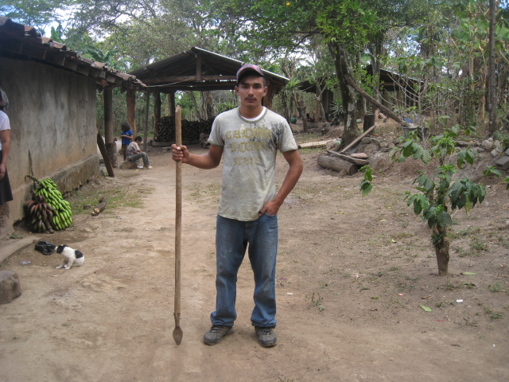
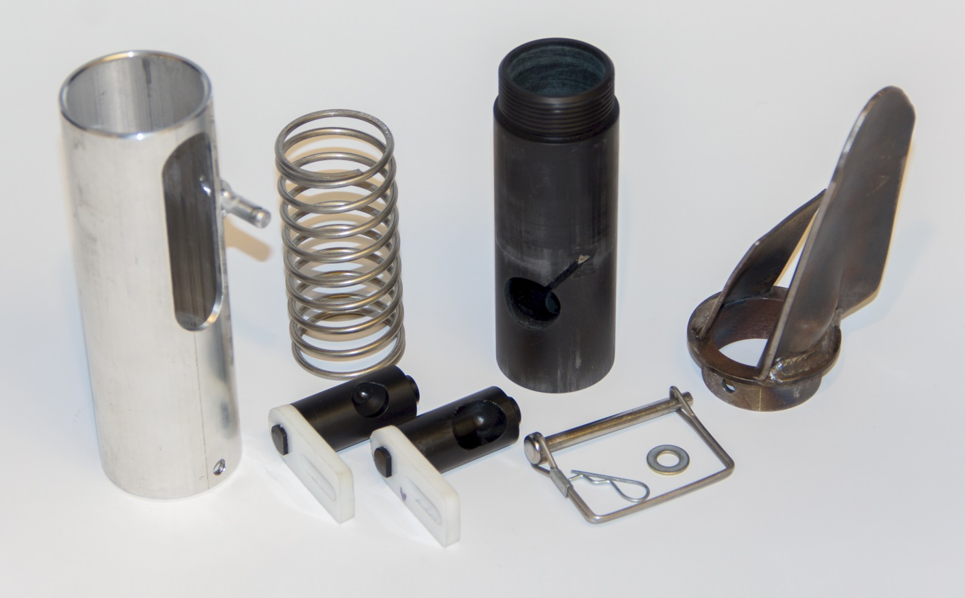
seed size (2653-4344 seeds/kg) seed type, shape
fertilizer
1,000,000 cycles
0.29g/seed
60,000 seeds/ha
3443 seeds/kg
1.0 kg hopper
17 times refill
http://nue.okstate.edu/Hand_Planter.htm

Slide 14
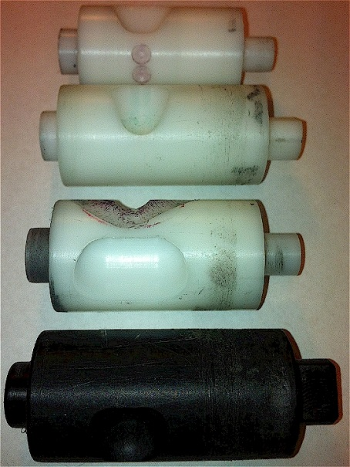
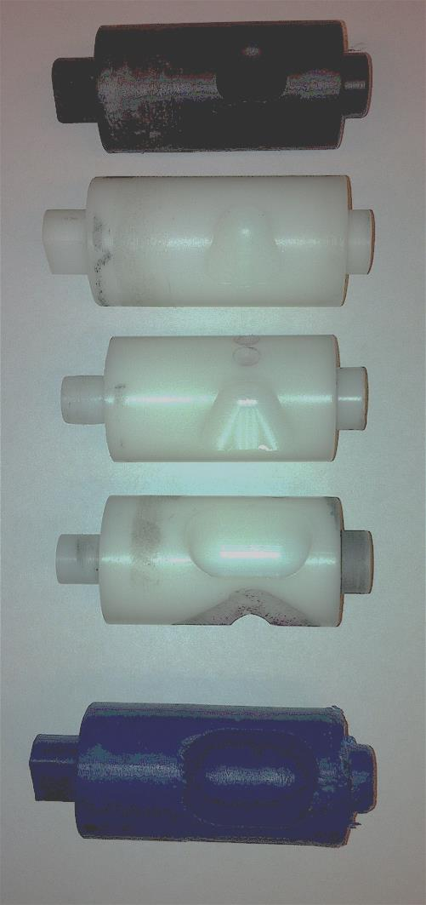
INTERNAL DRUM
Drum | Mass (g) | Volume (cm³)
A | 0.69 | 0.507
B | 0.71 | 0.521
OS | 0.88 | 0.646
OM | 3.36 | 2.468
OC | 3.38 | 2.482

Slide 15
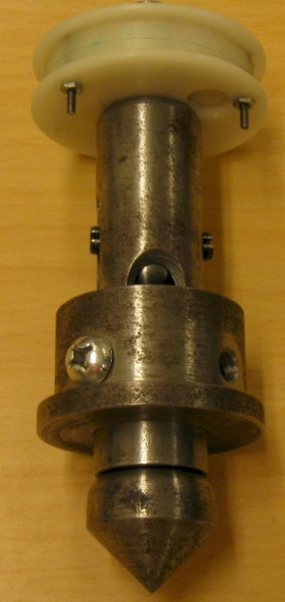
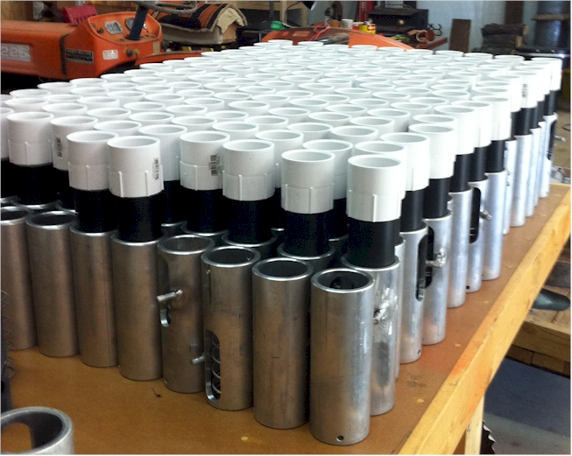

Slide 16
OSU Hand Planter

Slide 17
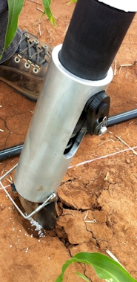
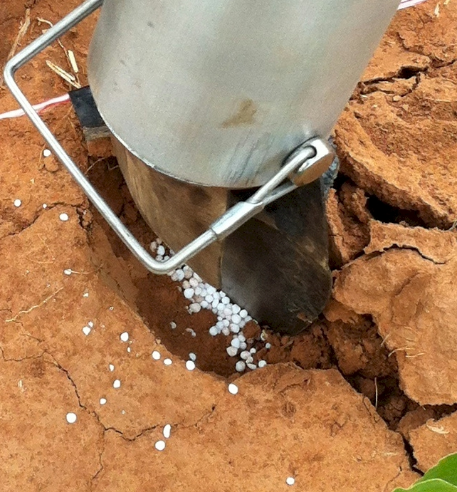
Mid Season Fertilizer N
Combined, Efaw and Perkins, 2013
Topdress N, Corn, V12 |  | 70,000 plants/ha
Methods | N, kg/ha | Mg/ha
Check | 0 | 6.6
Hand planter (0.9 g/plant) | 30 | 11.2
Hand planter (1.8 g/plant) | 60 | 10.6
Broadcast | 30 | 6.4
Broadcast | 60 | 7.0
Dribble urea | 30 | 9.3
Dribble urea | 60 | 7.8
Dribble UAN | 30 | 7.3
Dribble UAN | 60 | 10.4
SED = 1.81

Slide 18
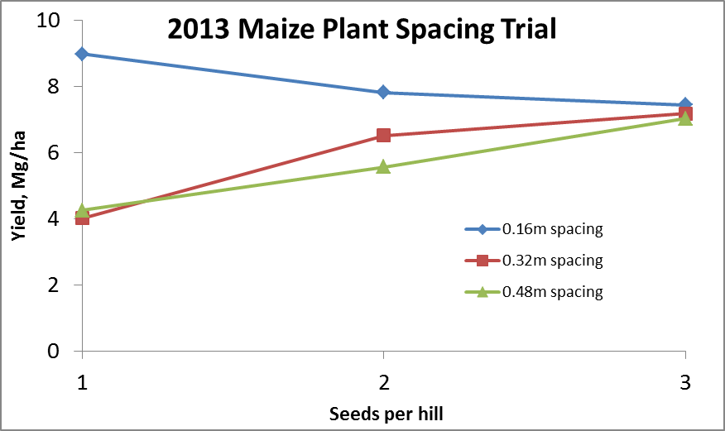
Importance of Singulation
0.76m Row Spacing
Heterogeneity in plant spacing, and plant stands reduce yields (Bob Nielsen, http://www.agry.purdue.edu/ext/corn/pubs/agry9101.htm)

Slide 19
Nov 13, 2013
SED = 8.6

Slide 20
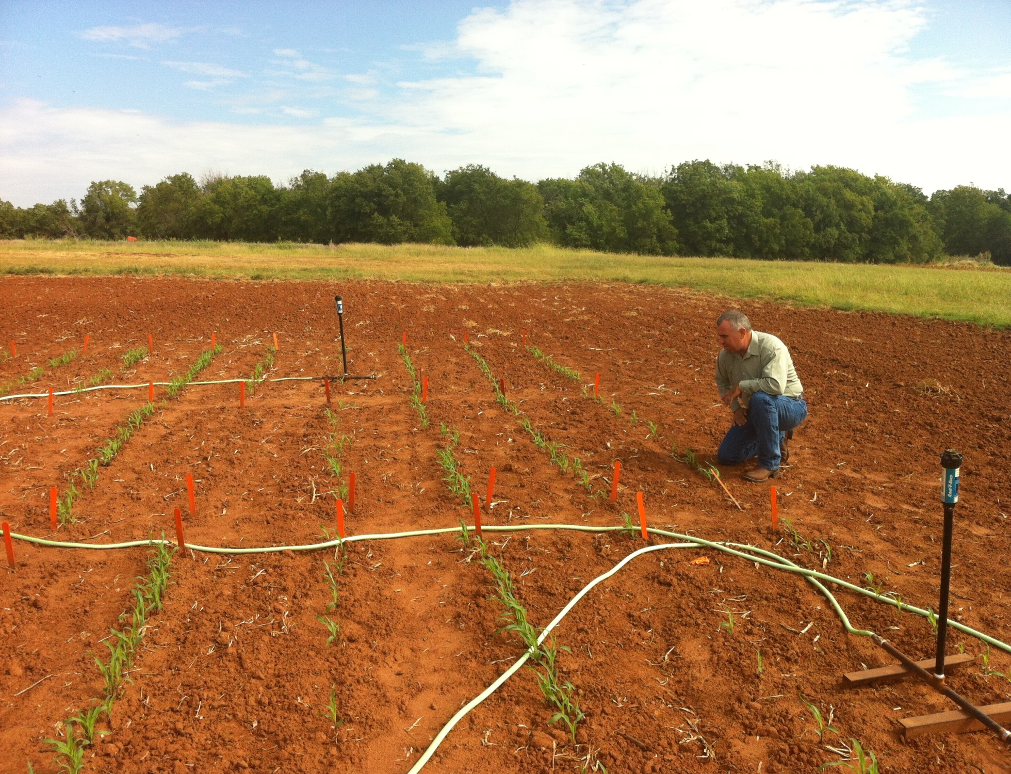
1,000,000 cycles, no failures 1 hectare, 100,000 seeds/ha, 10 years

Slide 21
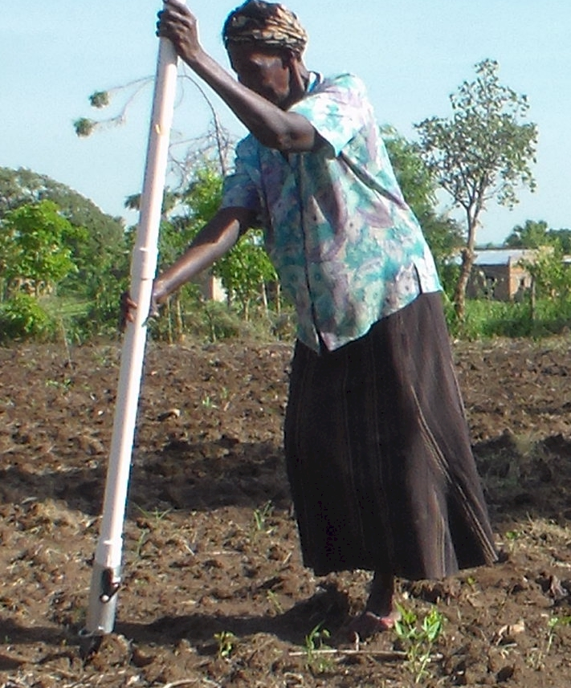
UGANDA

Slide 22
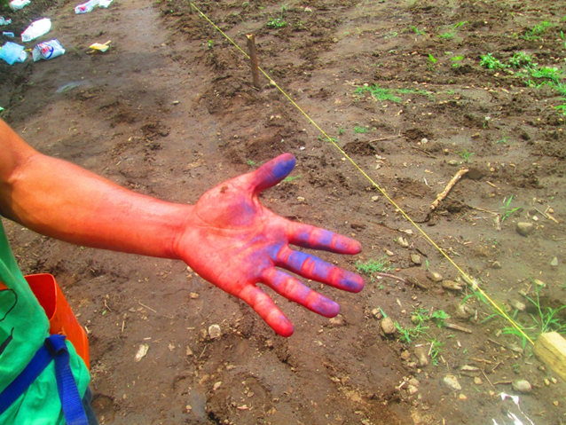
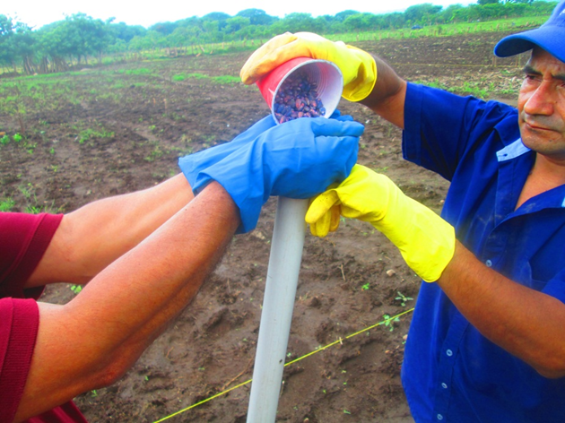
El Salvador, Hand Planter Trials, June, 2014

Slide 23
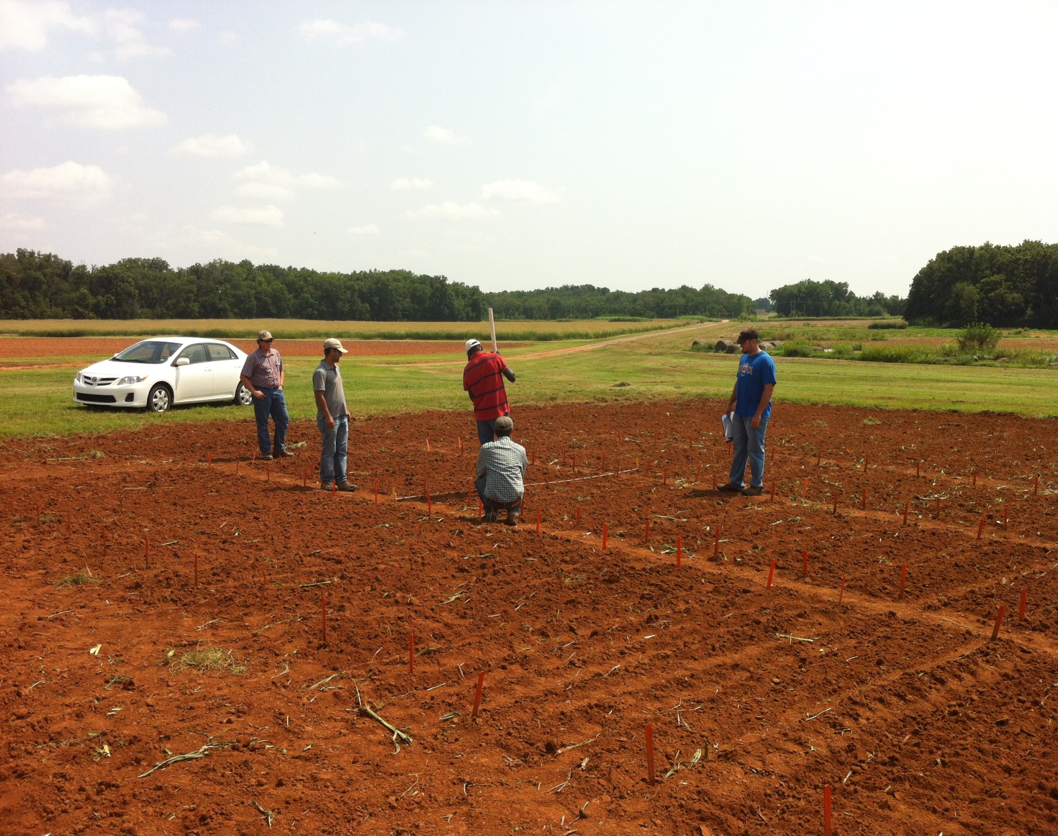

Slide 24
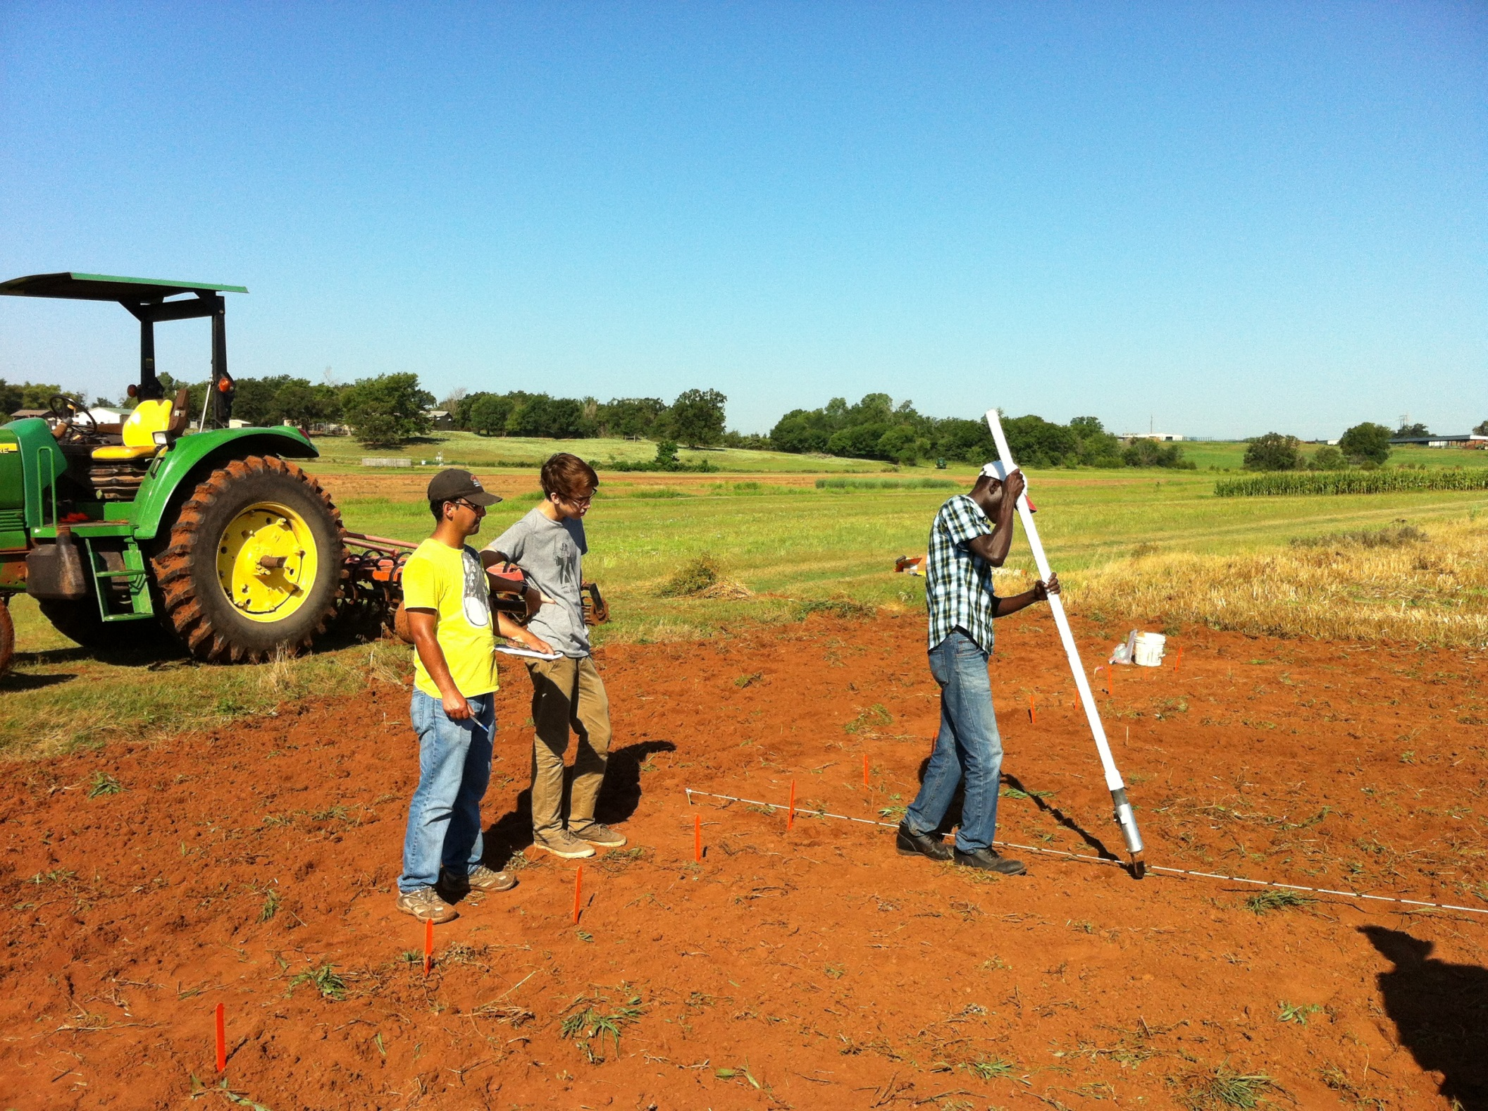

Slide 25
OSU Hand Planter
Thailand Mexico Zambia El Salvador Guatemala

Slide 26
Benefits
Remove chemically treated seeds from the hands of small farmers
Decrease soil erosion via improved plant spacing
Accommodate mid-season application of urea-N
Place urea below the surface reducing NH3 losses
Potential to increase maize production and NUE
Khim et al. (2014). Over three sites, planting 1 seed, every 0.16m increased yields by an average of 1.15 Mg ha⁻¹ (range, 0.33 to 2.46 Mg ha⁻¹) when compared to the farmer practice of placing 2 to 3 seeds per hill, every 0.48 cm.

Slide 27
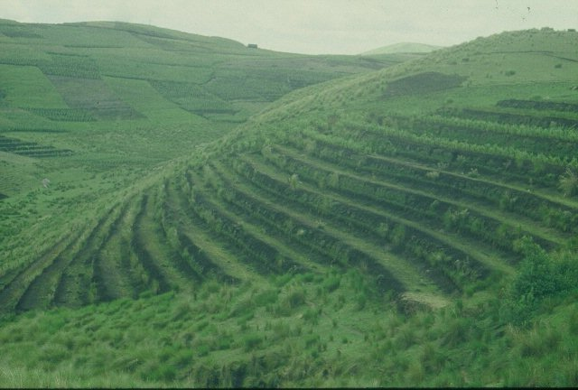
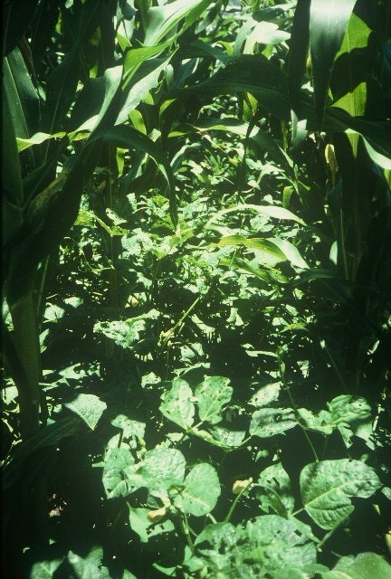
GUATEMALA

Slide 28
“The most conservative man in traditional agriculture is the scientist, and sometimes I am not proud to be one of them. This is most discouraging. The scientist is a privileged person, the man should lead us out of the wilderness of static, underproductive agriculture, and yet by his apathy and failure to exercise his unique vision, he keeps us in the swamp of despair. The scientist fears change because he is in a relatively privileged position in his own society. If there is no breakthrough in yield, he will not be criticized. But if he makes a recommendation and something goes wrong, he may lose his job. “ N.E. Borlaug
“Wheat is an equal opportunity performer, it never discriminates. It grows as well for the poor as for anyone” N.E. Borlaug

Slide 29
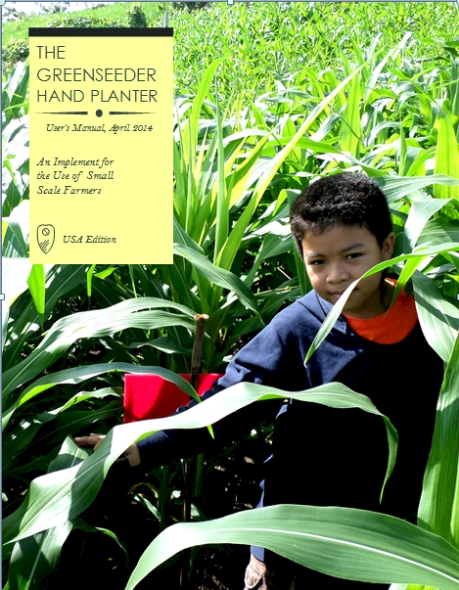
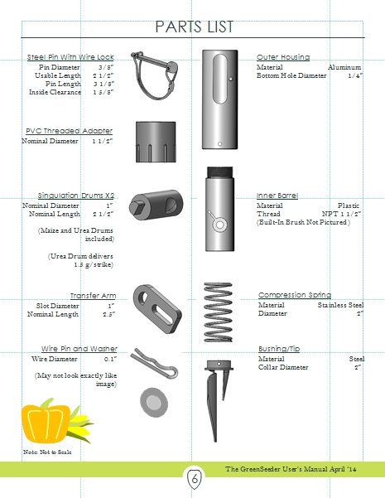
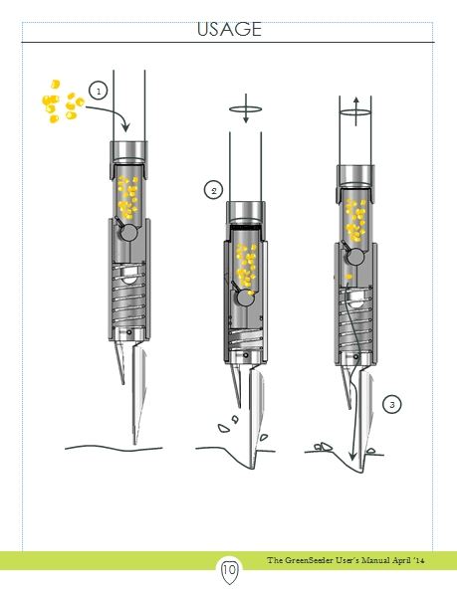
GreenSeeder Manual
http://www.nue.okstate.edu/Hand_Planter/Planter%20User's%20Manual%20EL.pdf

Slide 30
Bangladesh
Burundi
Belize
Brazil
Colombia
El Salvador
Ethiopia
Guatemala
India
Kenya
Malawi Mali
January 2014, on-line hand planter workshop http://nue.okstate.edu/Hand_Planter/osu_hand_planter_workshop.html
Mexico
Mozambique
Sierra Leone
Nepal
Philippines
Tanzania
Togo
Uganda
USA
Zambia
Zimbabwe

Slide 31
Optimum N Rate (over sites)
1. Grain yield * 1.19 (percent grain N) = grain N removed
2. Compute #1 for check
3. Compute #1 for high N yield treatment
4. Estimate of actual N needed (3 – 2)
5. Estimate of optimum fertilizer N = #4/0.33
1.19 (average percent N in corn grain)
0.33 (average for expected fertilizer NUE)

Slide 32
Maize grain yield, high N rate and optimum N rate from 213 site years, Central Great Plains, 1958-2010. (Sulochana Dhital)
Source | Location | Years | Period | High N, yield range | Check plot, yield range | Optimum N rate
 |  |  |  | Mg ha⁻¹ | Mg ha⁻¹ | Min | Max | Avg.
Bundy et al. (2011) | WI | 21 | 1958-1983 | 4.3-8.8 | 1.57-7.59 | 46 | 213 | 119
Bundy et al. (2011) | WI | 24 | 1984-2007 | 5.7-14.1 | 1.67-5.58 | 143 | 334 | 238
Mallarino and Torres (2006) | IA | 32 | 1979-2010 | 5.1-12.5 | 0.75-5.91 | 75 | 314 | 193
Mallarino and Torres (2006) | IA | 26 | 1985-2010 | 5.3-12.8 | 1.4-6.3 | 123 | 332 | 214
Varvel et al. (2007) | NE | 11 | 1995-2005 | 10.4-13.6 | 3.5-10.9 | 67 | 280 | 191
Jokela et al.(1989) Carroll | MN | 3 | 1982-1984 | 7.1-9.1 | 5-7.3 | 5 | 120 | 77
Jokela et al.(1989) Webster | MN | 3 | 1982-1984 | 1.8-8.7 | 1.7-5.6 | 64 | 103 | 84
Fenster et al. (1976) Waseca | MN | 7 | 1970-1976 | 7.12-10.65 | 2.71-7.43 | 55 | 227 | 140
Fenster et al. (1976) Martin | MN | 7 | 1970-1976 | 4-9.6 | 3.8-8.2 | 21 | 116 | 62
Fenster et al. (1976) Martin | MN | 6 | 1971-1976 | 6.2-12 | 6.2-11.3 | 0 | 34 | 15
Al Kaisi et al.(2003) | CO | 3 | 1998-2000 | 5-14.1 | 3.53-12.57 | 24 | 126 | 84
Ismail et al.(1994) NT | KY | 20 | 1998-2000 | 5.2-10.9 | 2.1-7.4 | 32 | 211 | 117
Ismail et al.(1994) CT | KY | 20 | 1970-1990 | 3.5-10.4 | 1.9-9.5 | 0 | 186 | 90
Rice et al.(1986) NT | KY | 16 | 1970-1985 | 5.7-9.2 | 3.1-4.9 | 93 | 163 | 132
Rice et al.(1986) CT | KY | 16 | 1970-1985 | 5-8.8 | 1.9-6.1 | 63 | 187 | 114
Stecker et al.(1993) | MO | 3 | 1988-1990 | 6.04-10.13 | 3.32-5.59 | 91 | 178 | 140
Stecker et al.(1993) | MO | 3 | 1988-1990 | 6.7-9.9 | 4.54-7.2 | 42 | 167 | 94
Stecker et al.(1993) | MO | 2 | 1989-1990 | 8.2-8.5 | 4.95-5.98 | 82 | 108 | 95
Peterson et al.(1989) | NE | 4 | 1983-1986 | 3.9-10 | 2.1-6.4 | 10 | 200 | 96
Woodruff et al.(1983) | SC | 3 | 1974-1976 | 13-20.2 | 1.04-15.6 | 0 | 639 | 302
Eck (1982) | TX | 3 | 1977-1979 | 3.41-13.21 | 1.79-5.03 | 13 | 300 | 146
Total |  | 233 |  |  | average | 50 | 216 | 131
 |  |  |  |  | stdev | 41 | 127 | 66

Slide 33
References
Al-Kaisi, M. M., and X.Yin. 2003. Effects of nitrogen rate, irrigation rate, and plant population on maize yield and water use efficiency. Agron. J. 95(6), 1475-1482.
Bundy, L.G., T.W. Andraski, M.D. Ruark, and A.E. Peterson. 2011. Long-term continuous corn and nitrogen fertilizer effects on productivity and soil properties. Agron. J. 103:1346–1351.
Eck, H. V. (1984). Irrigated corn yield response to nitrogen and water. Agron. J. 76(3), 421-428.
Fenster, W. E., C. J. Overdahl, G.W. Randall, and R. P. Schoper.1978. Effect of nitrogen fertilizer on maize yield and soil nitrates (Vol. 153). Misc. Rept 153-1978. Agr. Exp. Station. U. of Minnesota, St. Paul.
Ismail, I., R.L. Blevins, and W. W. Frye. 1994. Long-term no-tillage effects on soil properties and continuous maize yields. Soil Sc. Soc. Am. J. 58(1), 193-198
Jokela, W. E., and G. W. Randall. 1989. Maize yield and residual soil nitrate as affected by time and rate of nitrogen application. Agron. J. 81(5), 720-726.
Mallarino, A.P., and E. Ortiz-Torres. 2006. A long-term look at crop rotation effects on maize yield and response to N fertilization. In: The Integrated Crop Management Conference Proceedings, Ames, IA. 29–30 Nov. 2006. Iowa State Univ. Ext. Ames. p. 209–213.
Peterson, T. A., and G. E. Varvel. 1989. Crop yield as affected by rotation and nitrogen rate. III. Maize. Agron. J. 81:735-738.
Rice, C. W., M.S. Smith, and R.L. Blevins. 1986. Soil nitrogen availability after long-term continuous no-tillage and conventional tillage maize production. Soil Sc. Soc. Am. J. 50 (5), 1206-1210.
Stecker, J. A., D. D. Buchholz, R.G. Hanson, N.C. Wollenhaupt and K. A. McVay. 1993. Broadcast nitrogen sources for no-till continuous maize and maize following soybean. Agron.J. 85(4), 893-897.
Varvel, G.E., W.W. Wilhelm, J.F. Shanahan, and J.S. Schepers. 2007. An algorithm for maize nitrogen recommendations using a chlorophyll meter based sufficiency index. Agron. J. 99:701-706.
Woodruff, J. R., J.T. Ligon, and B. R. Smith. 1984. Water table depth interaction with nitrogen rates on sub-irrigated corn. Agron. J. 76(2), 280-283.

Slide 34
Agriculture and the Environment
Food and Agricultural Organization, “Livestock's Long Shadow” surveys damage done by sheep, chickens, pigs and goats. But in almost every case, the world's 1.5 billion cattle are most to blame. Livestock are responsible for 18 per cent of the greenhouse gases that cause global warming, more than cars, planes and all other forms of transport put together. The Independent.co.uk
http://www.scientificamerican.com/article/the-greenhouse-hamburger/
http://www.worldwatch.org/files/pdf/Livestock%20and%20Climate%20Change.pdf http://content.time.com/time/health/article/0,8599,1839995,00.html

