Slide 1
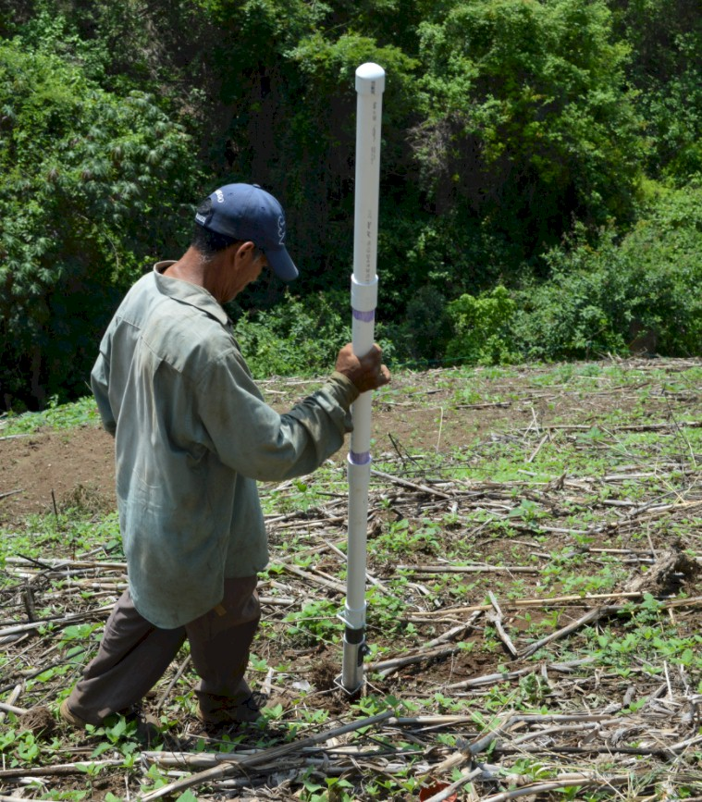


GREEN SEEDER
http://nue.okstate.edu/Hand_Planter.htm

Slide 2

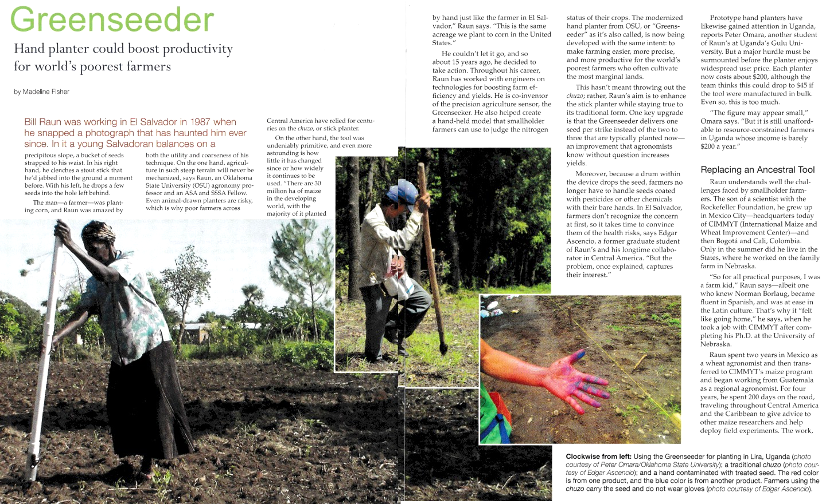
March 2016
Membership, 11,000, views 10,000

Slide 3
Maize (FAOSTAT.com)
Area, ha Production, Mt Avg. Mt/ha
World 183,319,737 1,038,281,035 5.7 (90 bu/ac)
USA 33,644,310 361,091,140 10.9 (174 bu/ac)
China 35,981,005 215,812,100 6.2 (98 bu/ac)
Brazil 15,450,180 80,516,571 5.2 (83 bu/ac)
Low income Food Deficit Countries
49,356,985 117,590,512 2.4 (38 bu/ac)
Developing world maize planted by hand (60% of total)
29,400,000 ha’s (72,618,000 ac)
25% increase on world hand planted maize (avg 2 Mg/ha *0.25 = 0.5 Mg/ha)
29,400,000*(2000kg/ha*0.25%)*$0.23/kg (or $6.00/bu) = $3,381,000,000

Slide 4
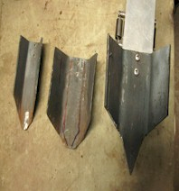
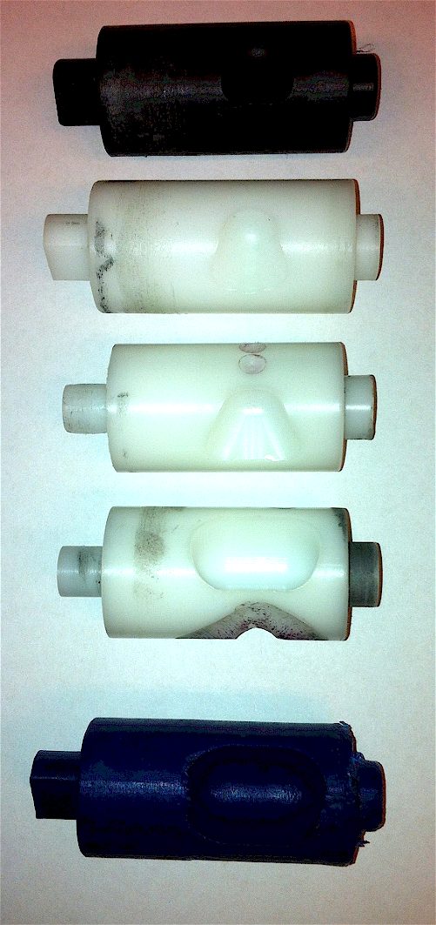
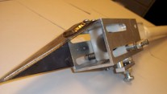
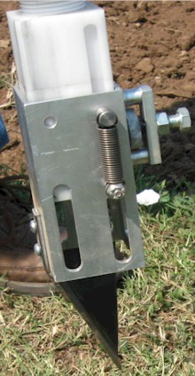
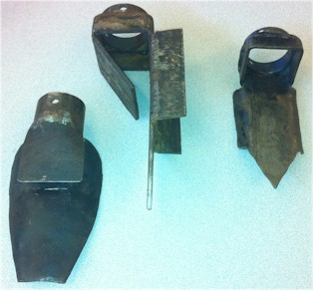
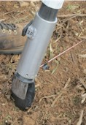
Internal Brush/Strength
Drum size/material
Cavity size/angle
Tip size/design/material
Internal/Ext. spring/tension

Slide 5
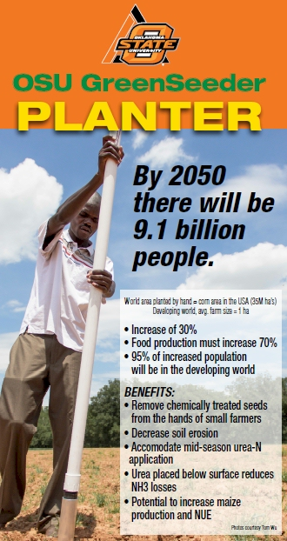
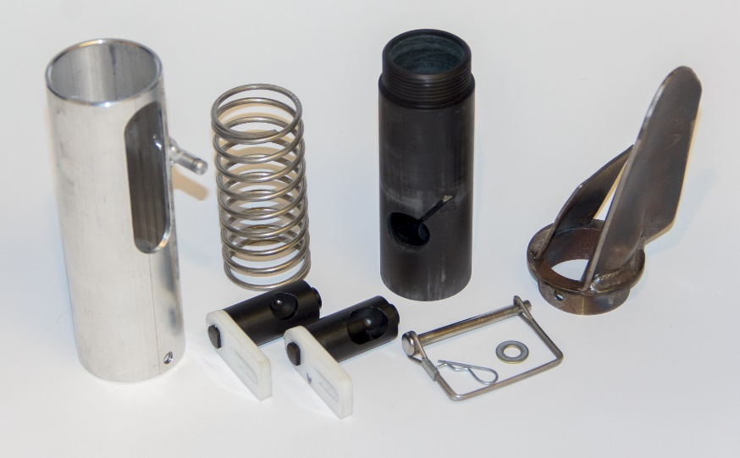
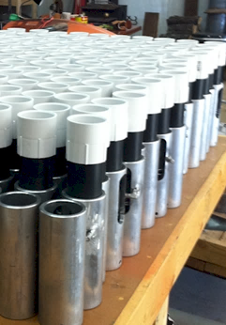
Drums

Slide 6
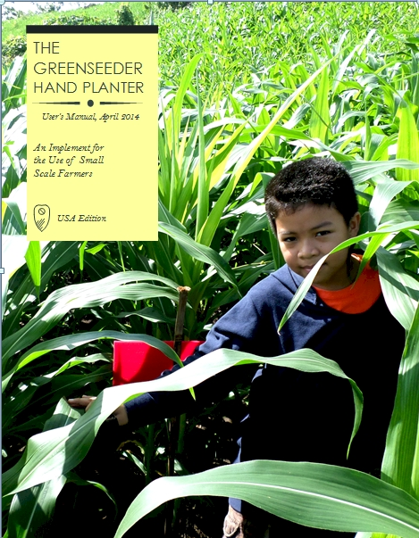
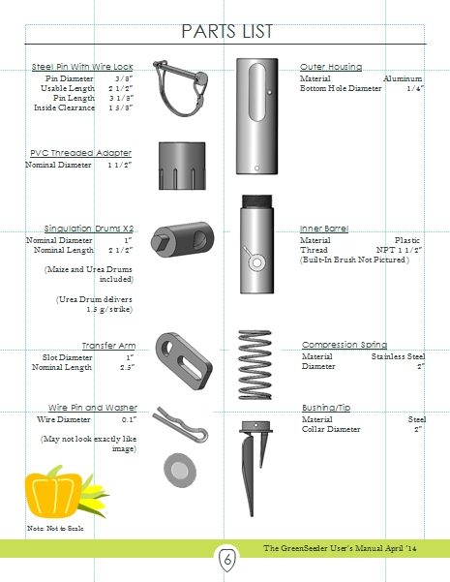
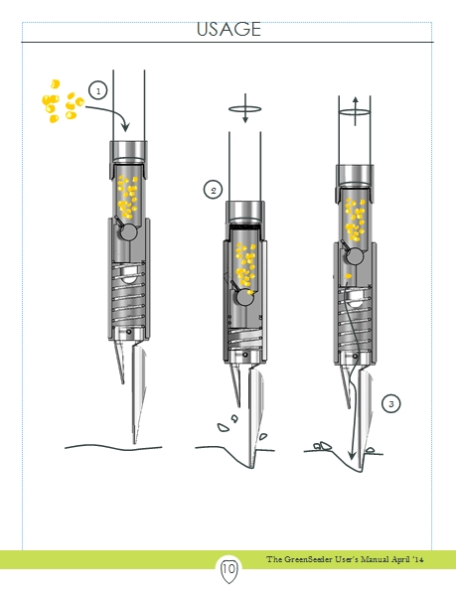
GreenSeeder Manual
http://www.nue.okstate.edu/Hand_Planter/Planter%20User's%20Manual%20EL.pdf

Slide 7


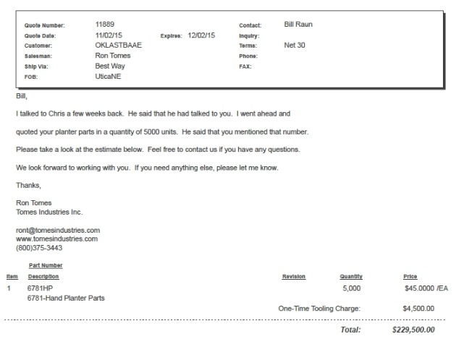
Current Cost Estimates
Grand Victory Ltd
Tsim Sha Tsui Hong Kong
Rm 1604 16/F Lee Wai Coml Bldg
Tsim Sha Tsui
1000
$25 each
5000
$49 each

Slide 8


Technology Adoption
Early stage technology
  Momentum
  Management Team
  Market Size, 100% = 30,000,000 planters
  Financing
Can a large company/industry benefit by developing a product for developed nation farmers?
NGO delivery
https://www.youtube.com/watch?v=VisKBsqcCWA
OSU Hand Planter

Slide 9

nue.okstate.edu/Hand_Planter.htm
1 page PDF (Hand Planter)

Slide 10
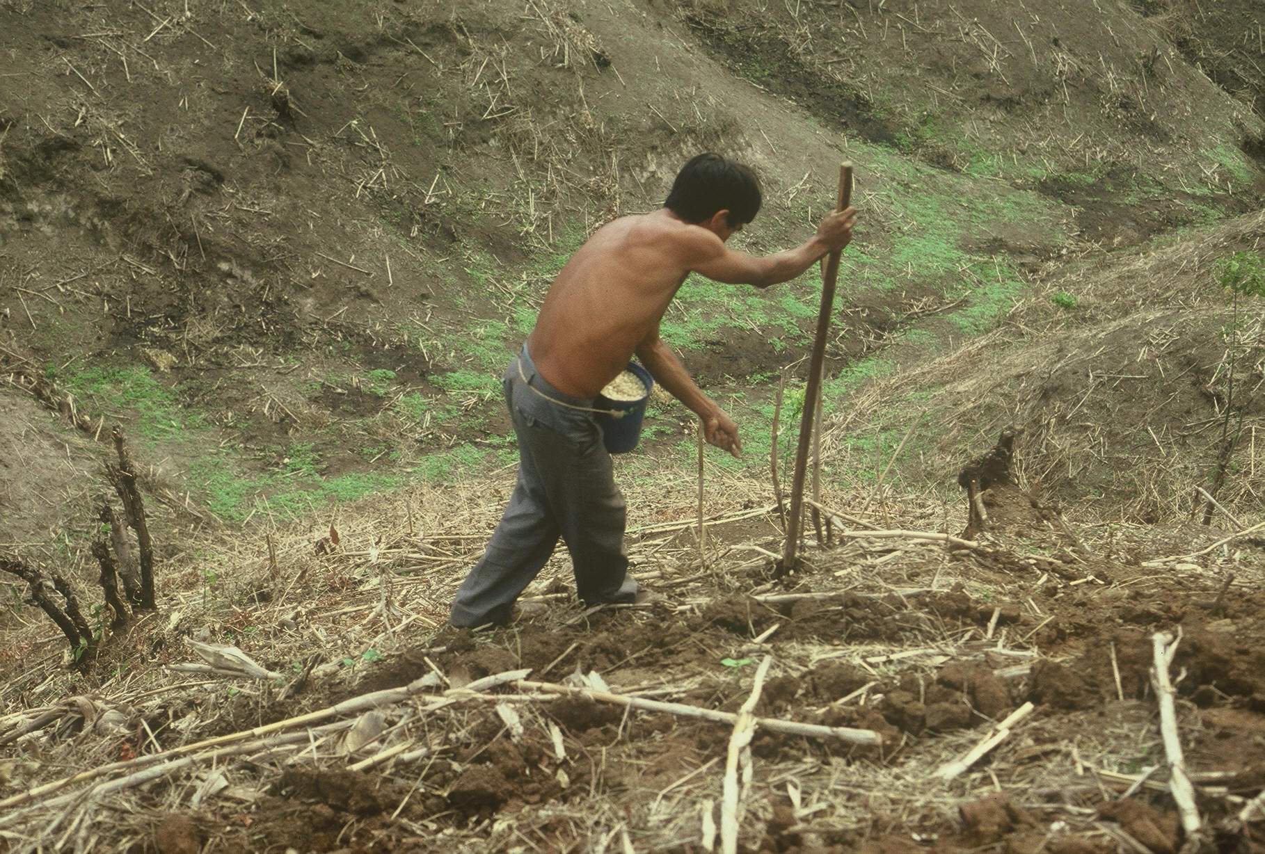

OSU Hand Planter
www.nue.okstate.edu

Slide 11
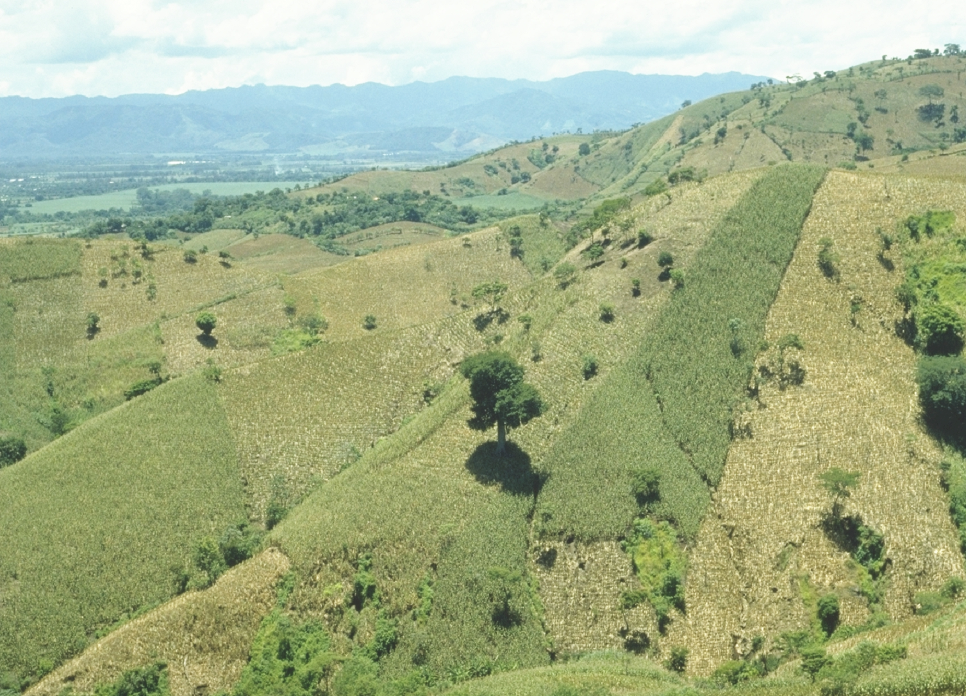
World area planted by hand ≈ corn area in the USA
EL SALVADOR
Alexandratos, N. and J. Bruinsma. 2012. World agriculture towards 2030/2050: the 2012 revision. ESA Working paper No. 12-03. Rome, FAO.

Slide 12
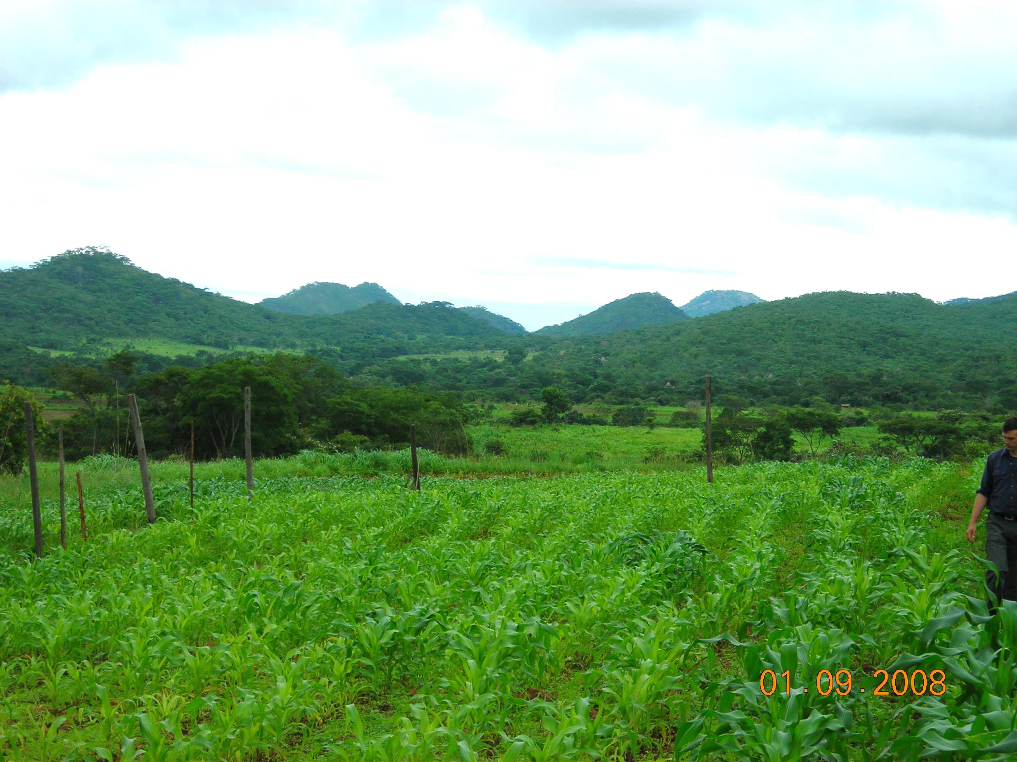
ZIMBABWE
Remote Locations

Slide 13
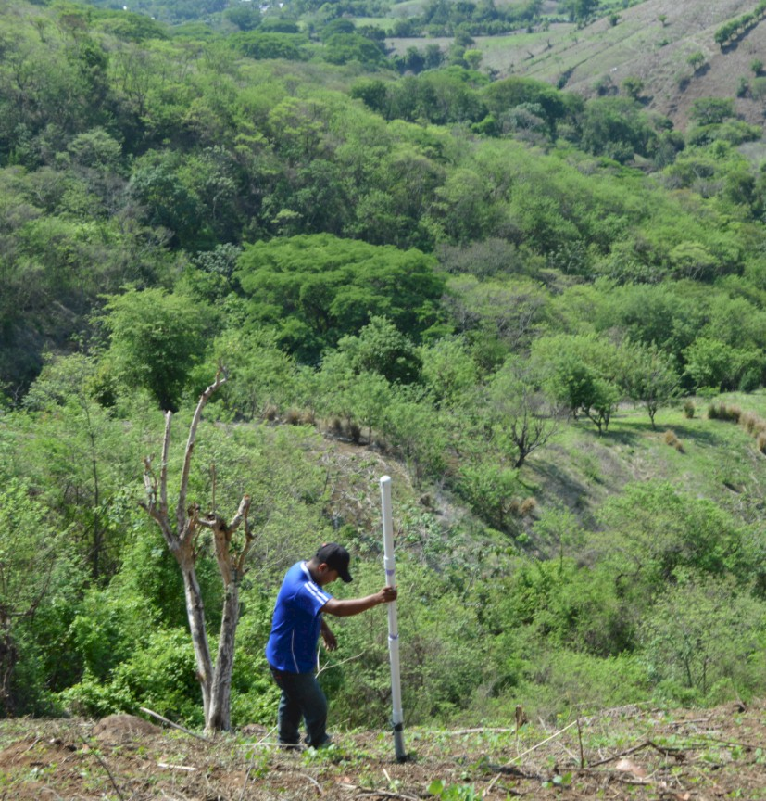
Opico Quezaltepeque, El Salvador
EL SALVADOR
Social aspects/technology transfer

Slide 14
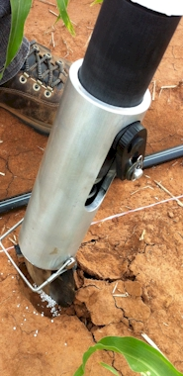
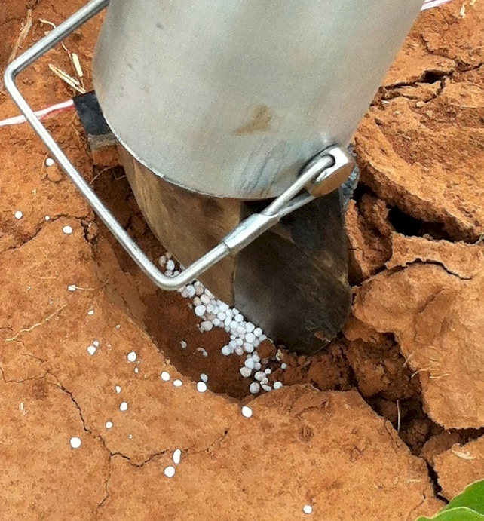
Mid Season Fertilizer N
Combined, Efaw and Perkins
Topdress N, Corn, V12 |  | 70,000 plants/ha
Methods | N, kg/ha | Mg/ha
Check | 0 | 6.6
Hand planter (0.9 g/plant) | 30 | 11.2
Hand planter (1.8 g/plant) | 60 | 10.6
Broadcast | 30 | 6.4
Broadcast | 60 | 7.0
Dribble urea | 30 | 9.3
Dribble urea | 60 | 7.8
Dribble UAN | 30 | 7.3
Dribble UAN | 60 | 10.4
SED = 1.81

Slide 15
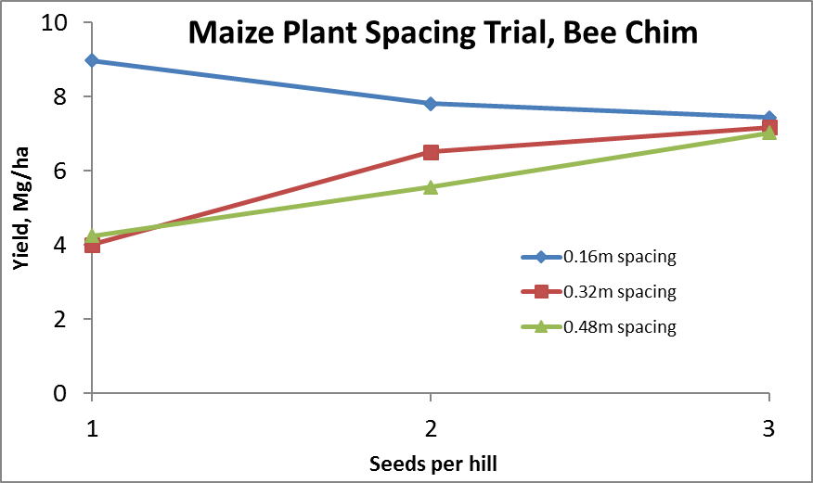
Importance of Singulation
0.76m Row Spacing
Heterogeneity in plant spacing, and plant stands reduce yields
(Bob Nielsen, http://www.agry.purdue.edu/ext/corn/pubs/agry9101.htm)

Slide 16
November 16, 2016
Viability of the OSU planter at $35?
This is a very good milestone. At $35, I think we would be close. We know adoption as a "process" governed by many factors, and cost of the technology plays a great role. Depending on how we approach it, farmers can adopt and use this technology to improve their productivity.
Regards,
Peter Omara
Uganda
___________________
I´m glad the GS team is close to the amount I have heard from local farmers ($25). However, $35 can be a realistic figure for some farmers too.
Cordially
Edgar Ascencio
El Salvador

Slide 17
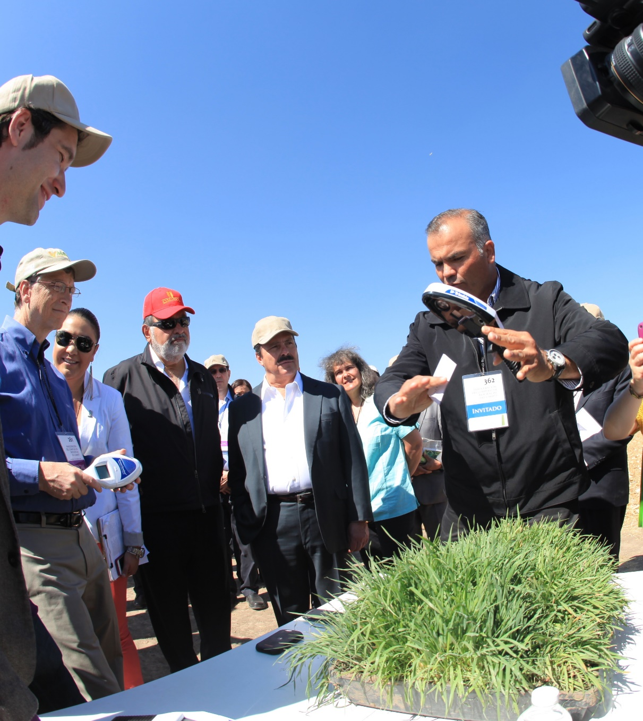
Hand-Held GreenSeeker Sensors

Slide 18
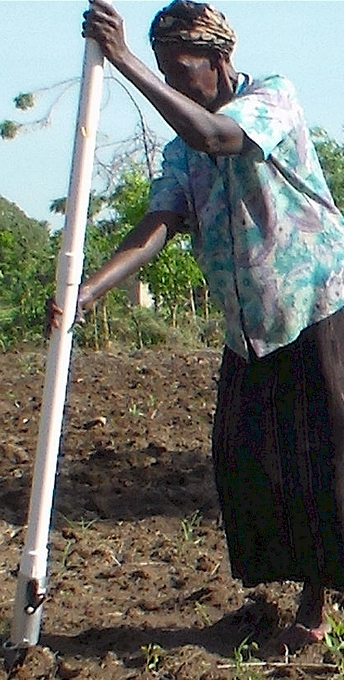
Modern researchers should therefore seek to understand the rationale behind traditional smallholder farmer behavior in technology use. J. Sust. Dev. 2012
Planter Ergonomics

Slide 19
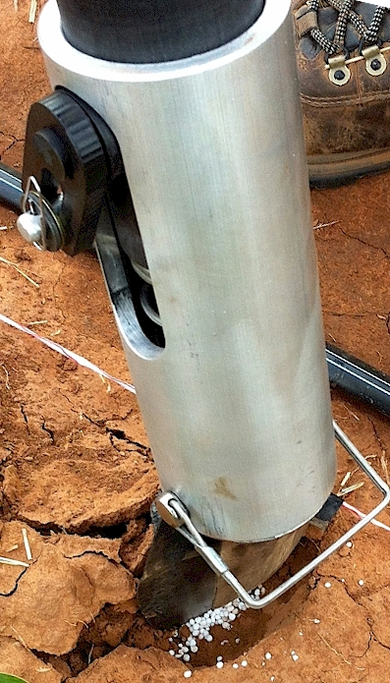
Benefits
Remove chemically treated seeds from the hands of producers
Decrease soil erosion via improved plant spacing
Accommodate mid-season application of urea-N
Place urea below the surface reducing NH3 loss
Potential to increase maize production and NUE
Khim et al. (2014). Planting 1 seed, every 0.16m increased yields by an average of 1.15 Mg ha⁻¹ (range, 0.33 to 2.46 Mg ha⁻¹) when compared to the farmer practice of placing 2 to 3 seeds per hill, every 0.48 cm.

Slide 20



Slide 21

Hand Planters
Person | Organization | Where | No. of Hand Planters
Dr. Isaiah Nyagumbo | CIMMYT, Kenya | Zimbabwe | 4
Dr. Pascal Kaumbutho | KENDAT, Kenya | Kenya | 2
 | Ethiopia | Ethiopia | 1
Dr. Peter Omara | Uganda | Uganda | 8
Dr. Edgar Ascencio | CARE, El Savador | El Salvador | 14
Dr. Fred Kanampiu | IITA, Kenya | Kenya | 2
Dr. Nyle Wollenhaupt | AGCO, Kansas | Kansas | 2
Dr. Ivan Ortiz-Monasterio | CIMMYT, Mexico | Mexico | 1
Kristin Lacy | Semilla Nueva | Guatemala | 2
Nyle Wollenhaupt | AGCO | Lusaka Zambia | 40
Melvin Siwale | AGCO | Lusaka Zambia | 10
Terry Tindall | JR Simplot | Lusaka Zambia | 25
Eric Lam | MAG | Honduras | 2
Eric Lam | CIMMYT | Bangladesh | 1
Roman Gordon | IDIAP | Panama | 2
Dr. Luis Narro | CIAT | Colombia | 6
Dr. Joshua Ringer |  | Thailand | 1
Dr. Assoumane Maiga |  | Mali | 1
Total |  |  | 130
Notes:
21

