Slide 1
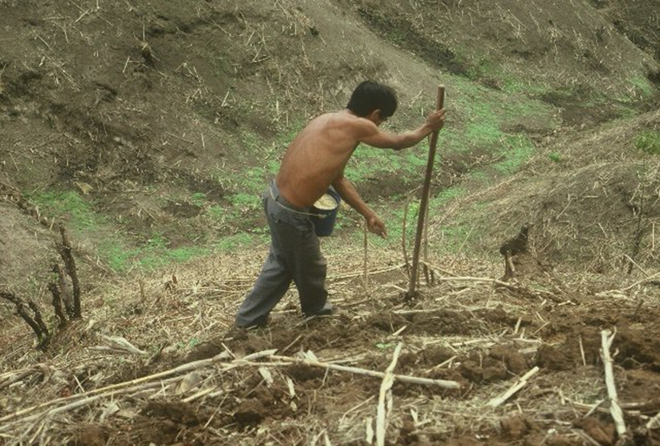
AGIN 5312 Dr. Shida Henneberry, Kaitlyn Ryan September 20, 2017
GREEN SEEDER
OSU Hand Planter
One Minute Video Hand Planter
Jagmandeep Dhillon, Fikayo Oyebiyi, Peter Omara, Tyler Lynch, Bruno Figueiredo, Gwen Wehmeyer, Eva Nambi, Alimamy Fornah, Robert Lemings, Elizabeth Eickhoff, Wayne Kiner, Joshua Ringer, Randy Taylor, Bill Raun

Slide 2
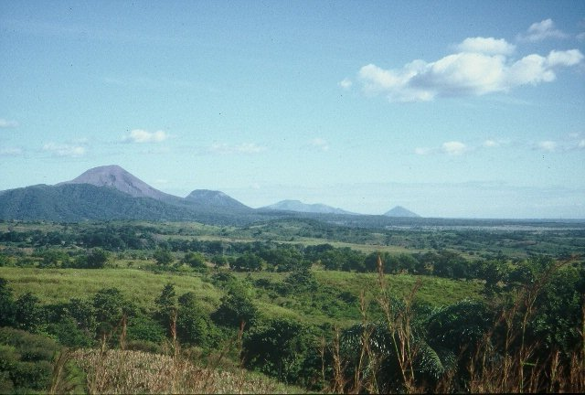
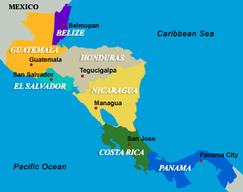
Oklahoma State University, 1976-1982 University of Nebraska, 1982-1985 CIMMYT, 1985-1991 Oklahoma State University, 1991-present

Slide 3
Time, $, Products
post PhD, 1985-present, 32 years
Greenseeker Years: 1991 – 2001
Delivery, 2002-present
11 years, $4.7M
Stone, Solie, many students
OSU Hand Planter (Greenseeder)
1987-2017, 30 years, $175K
Taylor, Koller, many students,
Delivery, >350 plans for more
Former OSU graduates, Uganda, El Salvador, Kenya, Mexico, Dr. Joshua Ringer, Dr. Craig Edwards, Mandela Washington Fellows

Slide 4
Research Template
Agronomy/Engineering Partnership made this possible.
Moving the Hand Planter forward, was because of the success coming from the Greenseeker Project
Allowed direct access to Engineering graduate students, Dr. John Solie, Dr. Marvin Stone
Wayne Kiner, Adrian Koller, Max Metcalf, BAE
Dr. Randy Taylor
Contract on all new hand planters with BAE
Problems have become more complex

Slide 5
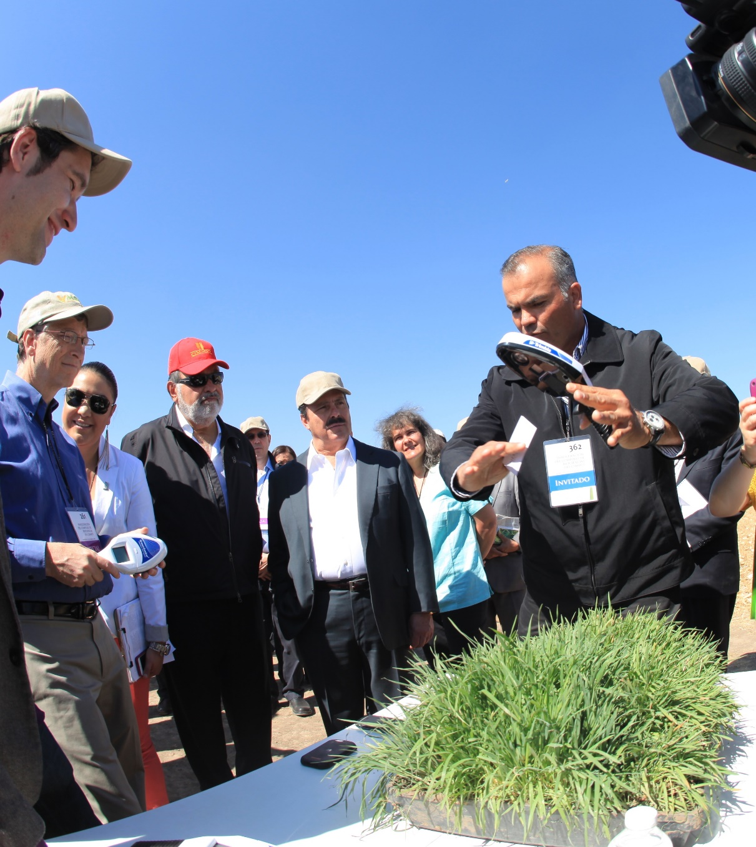
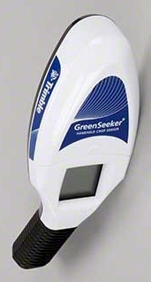
Hand-Held GreenSeeker Sensors

Slide 6
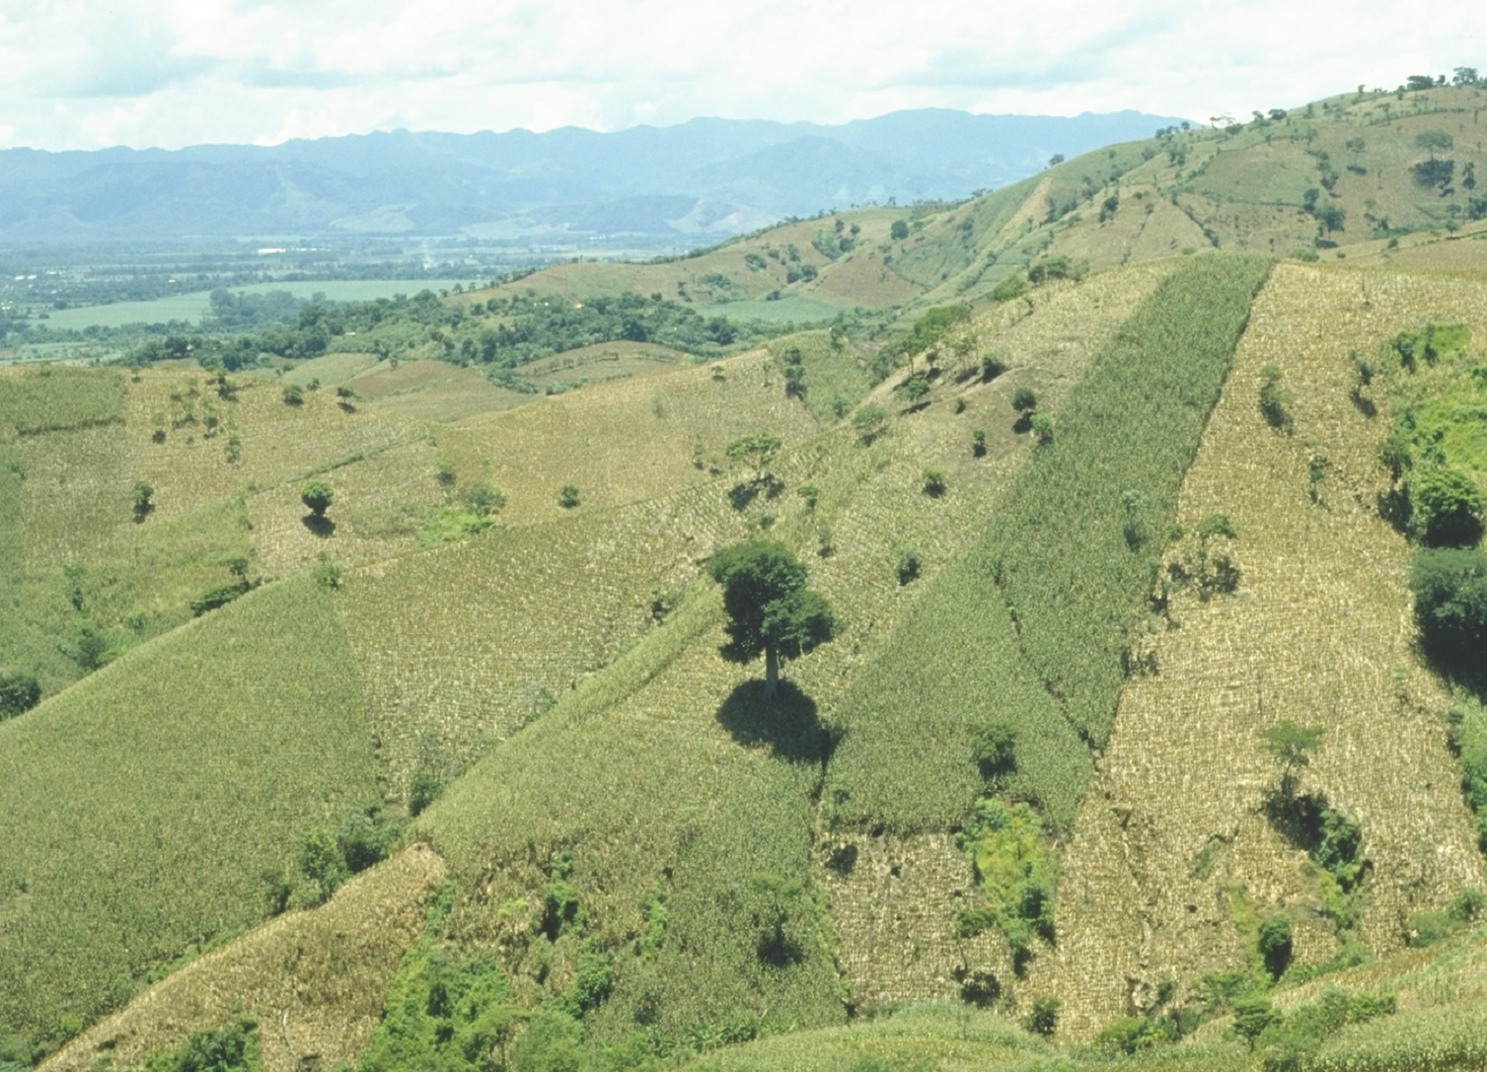
30,000,000 ha’s planted by hand ≈ corn area in the USA USA China Brazil
EL SALVADOR

Slide 7
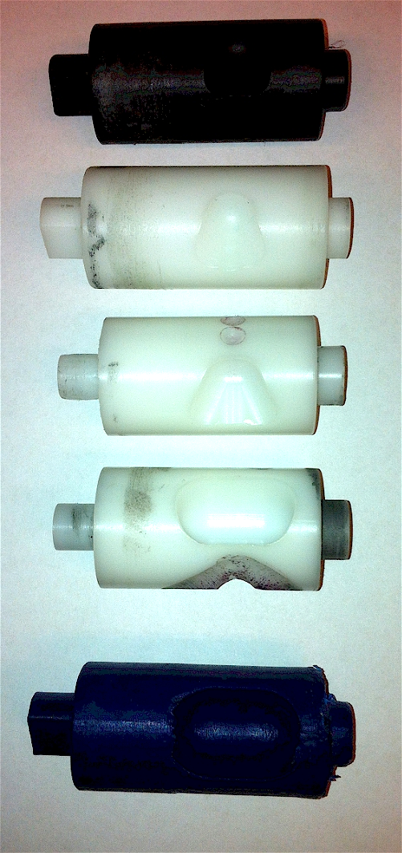
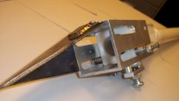
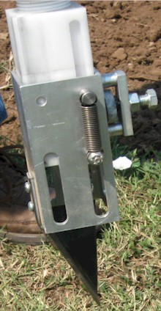
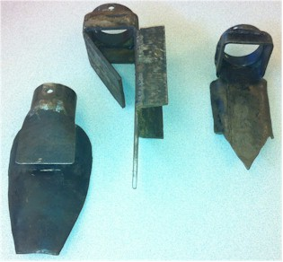
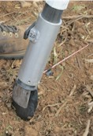
Internal Brush/Strength
Drum size/material
Cavity size/angle
Tip size/design/material
Internal/Ext. spring/tension

Slide 8
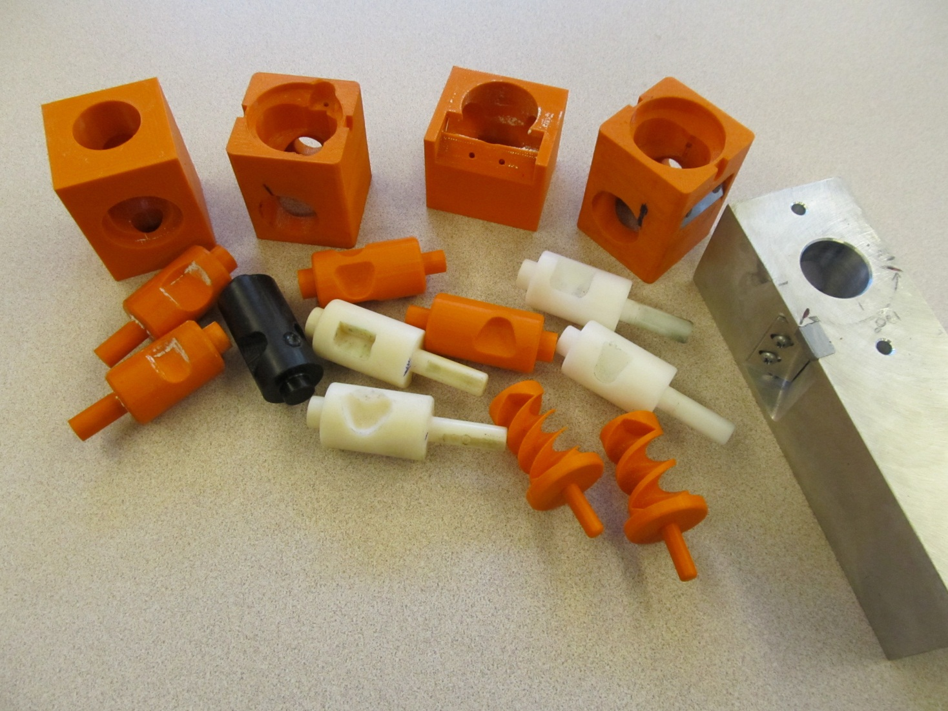
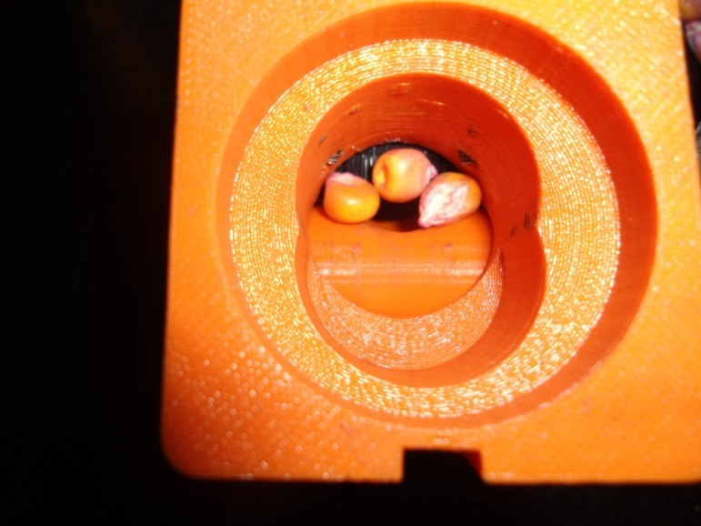
Singulation Design 3D printing

Slide 9
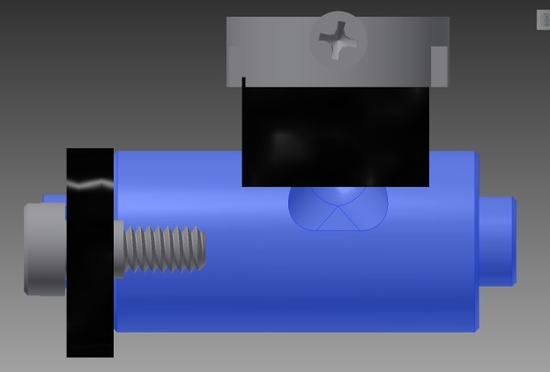
Reciprocating Drum Action
Drum rotates with the cavity moving back into the seed hopper as the spring is compressed.
Spring is fully compressed and the singulation drum cavity is exposed to seed in the hopper
Drum position when planter is relaxed.
As the force on the spring is released, the singulation drum rotates back to the initial ‘relaxed’ position and the seed is dropped.

Slide 10
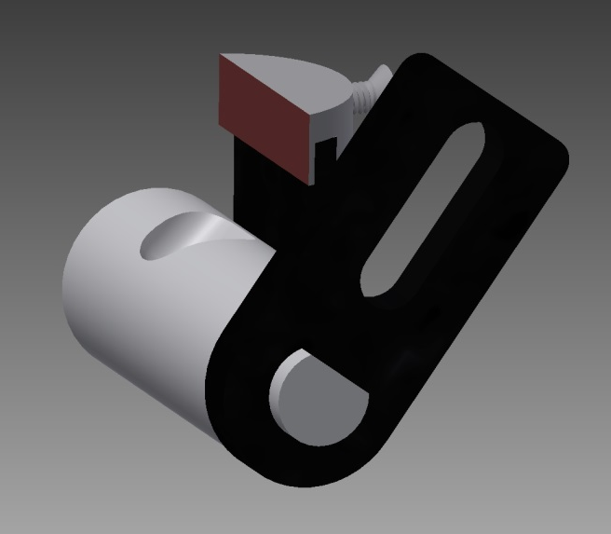
Metering System
Design has gravitated to a reciprocating drum with brush

Slide 11
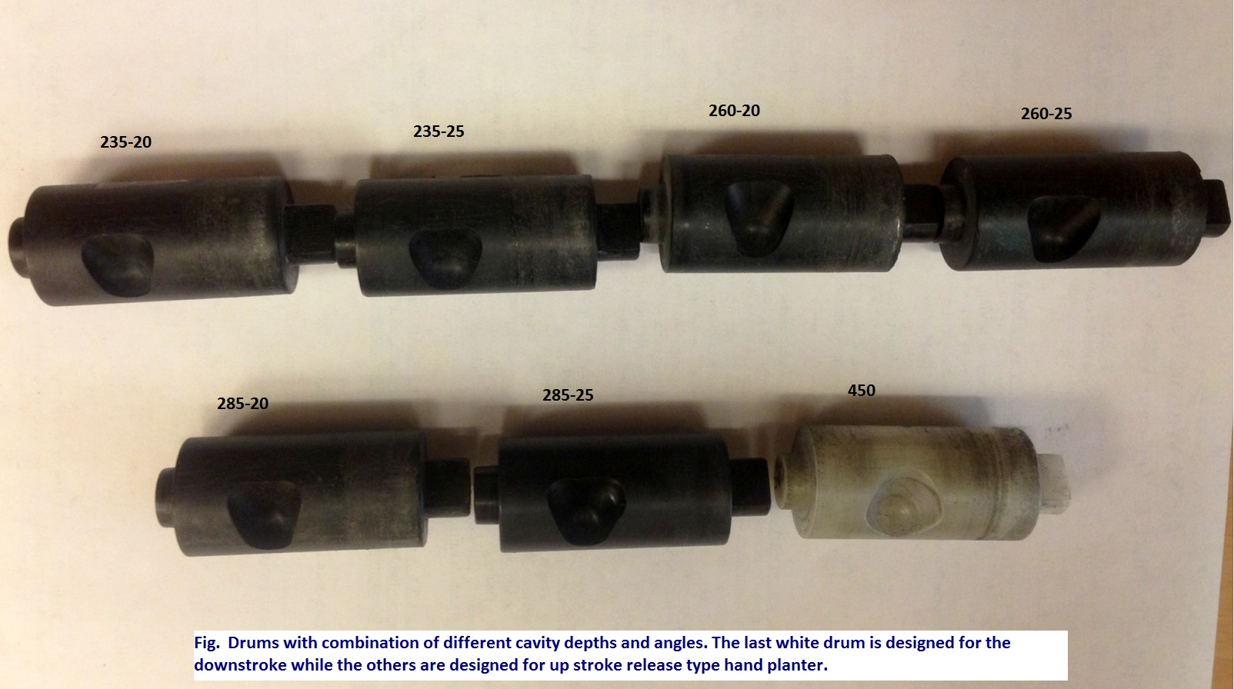
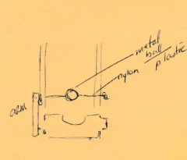

Slide 12
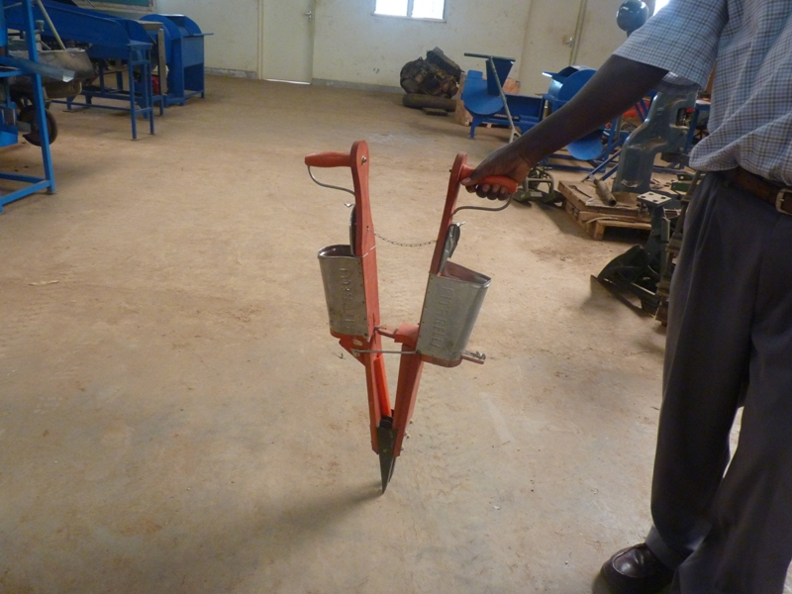
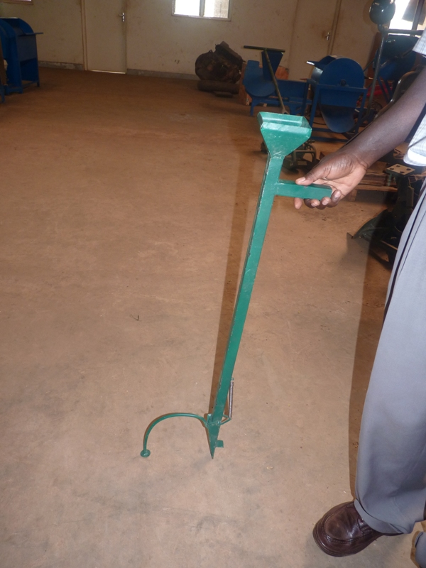
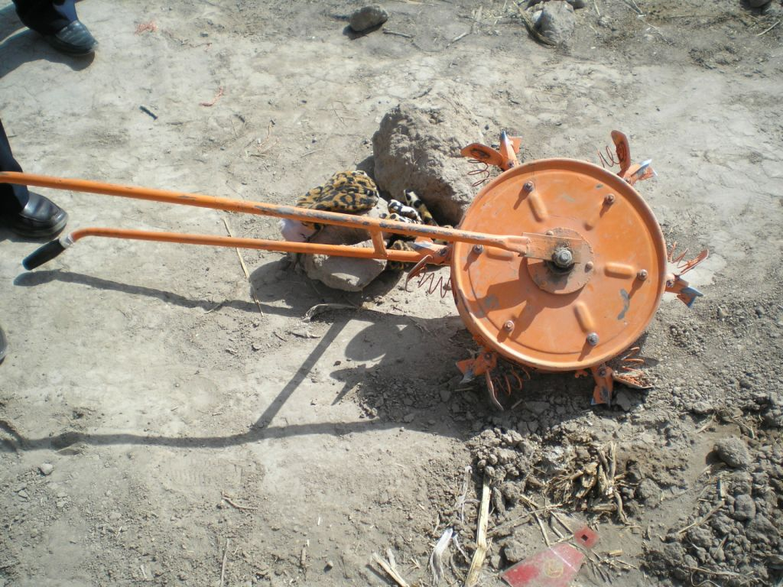
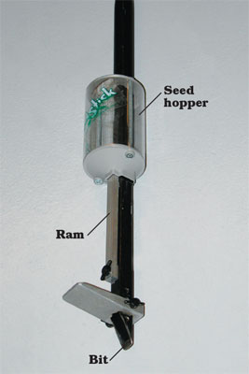
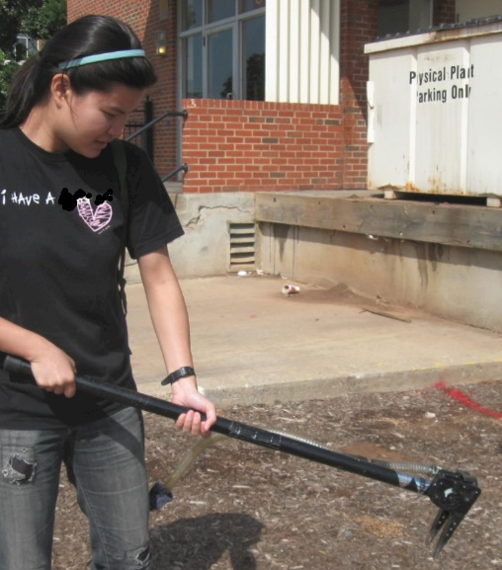
Alternative Designs

Slide 13
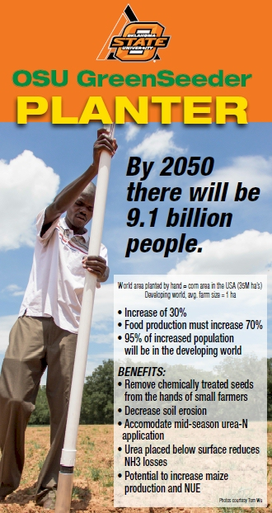
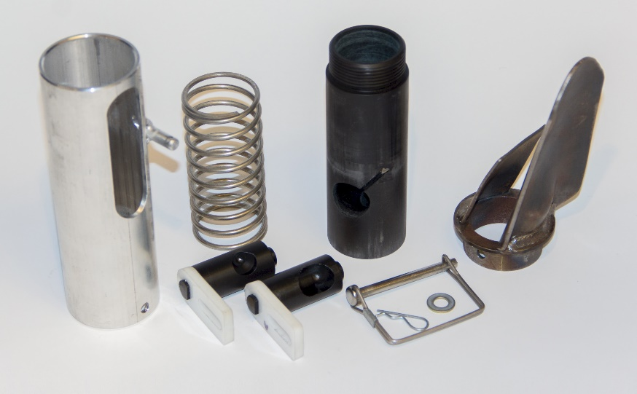
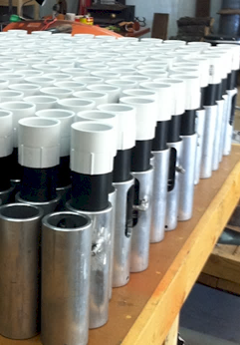
Drums

Slide 14
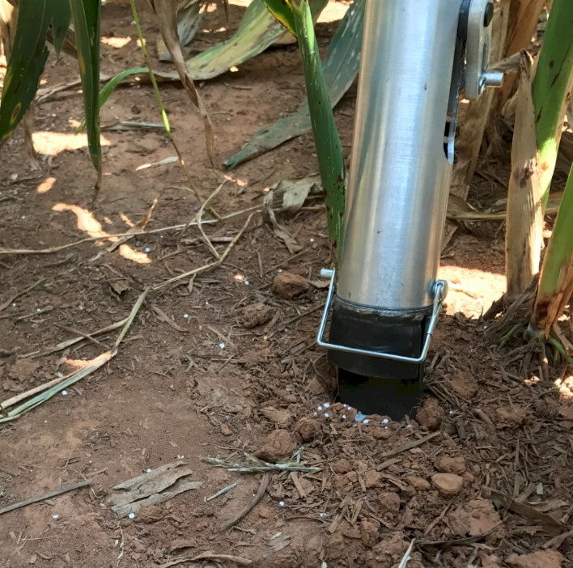
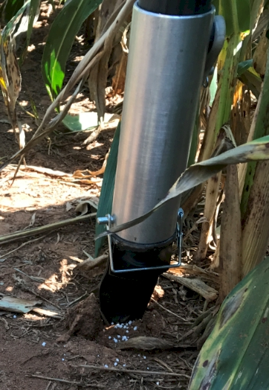
Potential Uses Seed, all types Fertilizer Chemicals, EPA, Mosquito Abatement
Food plots, Hunting industry
Homeowners, gardeners

Slide 15
Opico Quezaltepeque, El Salvador
EL SALVADOR
Social aspects/technology transfer

Slide 16
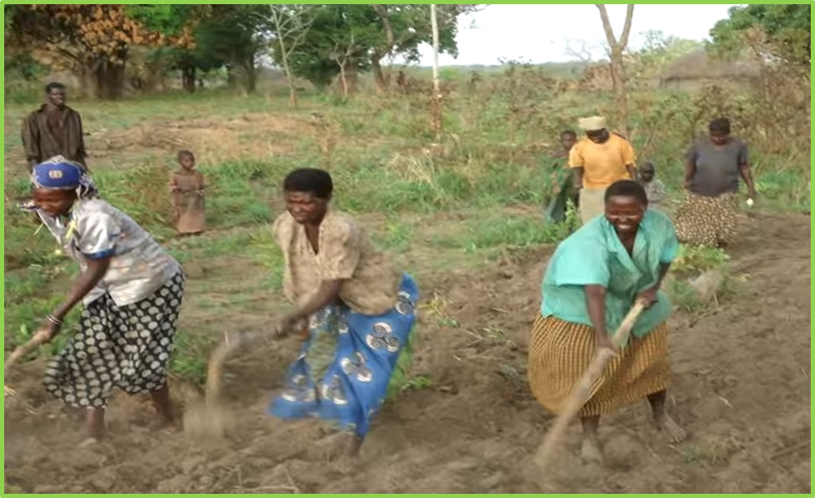
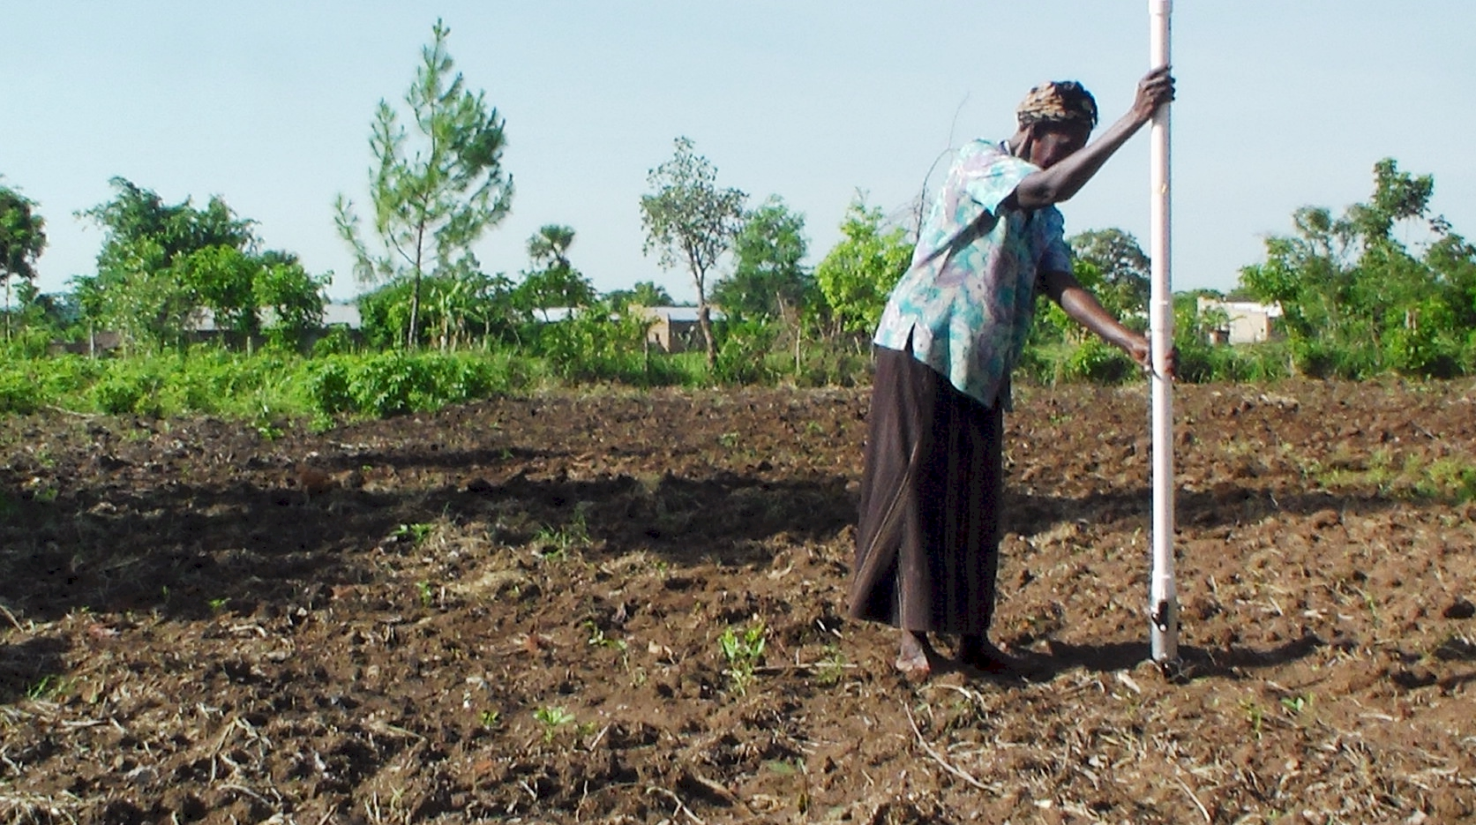
UGANDA

Slide 17
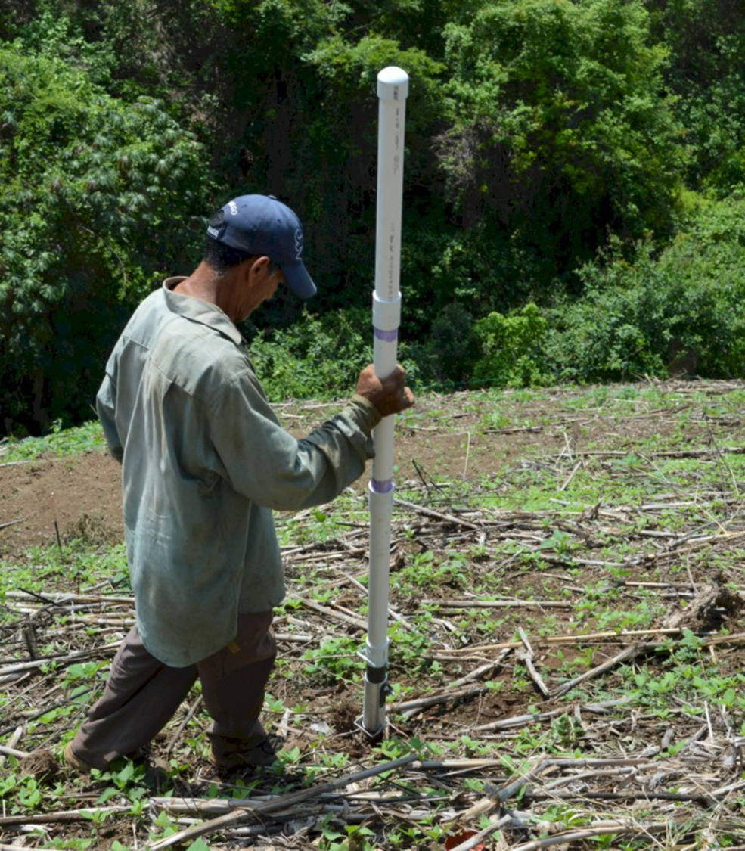
Worlds Apart
(El Salvador, Uganda)
Avg. Farm Size: 1 ha
Avg. Maize Grain Yield, 2 Mg/ha Maize seed, Hybrids (US, others)

Slide 18
Maize (FAOSTAT.com)
Area, ha Production, Mt Avg. Mt/ha
World 183,319,737 1,038,281,035 5.7 (90 bu/ac)
USA 33,644,310 361,091,140 10.9 (174 bu/ac)
China 35,981,005 215,812,100 6.2 (98 bu/ac)
Brazil 15,450,180 80,516,571 5.2 (83 bu/ac)
Low income Food Deficit Countries
49,356,985 117,590,512 2.4 (38 bu/ac)
Developing world maize planted by hand (60% of total) 29,400,000 ha’s (72,618,000 ac) 25% increase on world hand planted maize (avg 2 Mg/ha *0.25 = 0.5 Mg/ha) 29,400,000*(2000kg/ha*0.25%)*$0.23/kg (or $6.00/bu) = $3,381,000,000

Slide 19
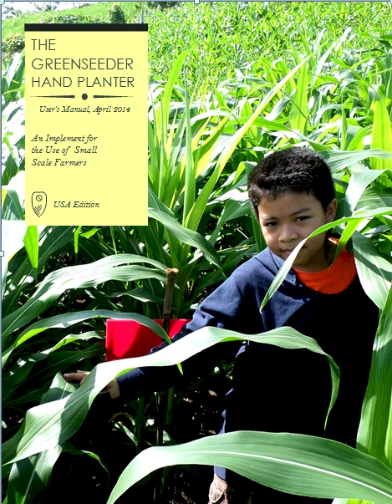
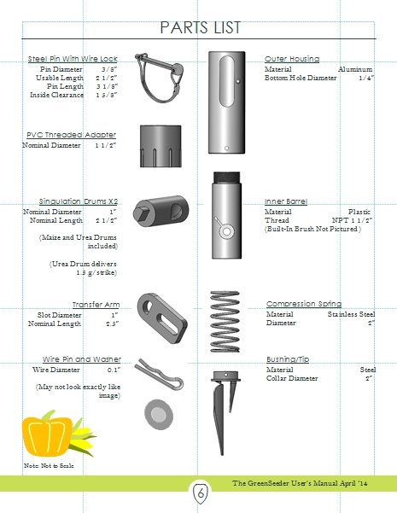
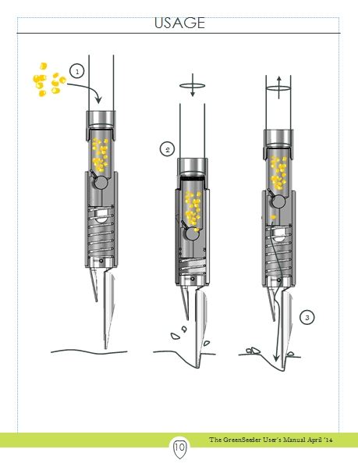
GreenSeeder Manual
http://www.nue.okstate.edu/Hand_Planter/Planter%20User's%20Manual%20EL.pdf

Slide 20
nue.okstate.edu/Hand_Planter.htm
1 page PDF (Hand Planter)

Slide 21
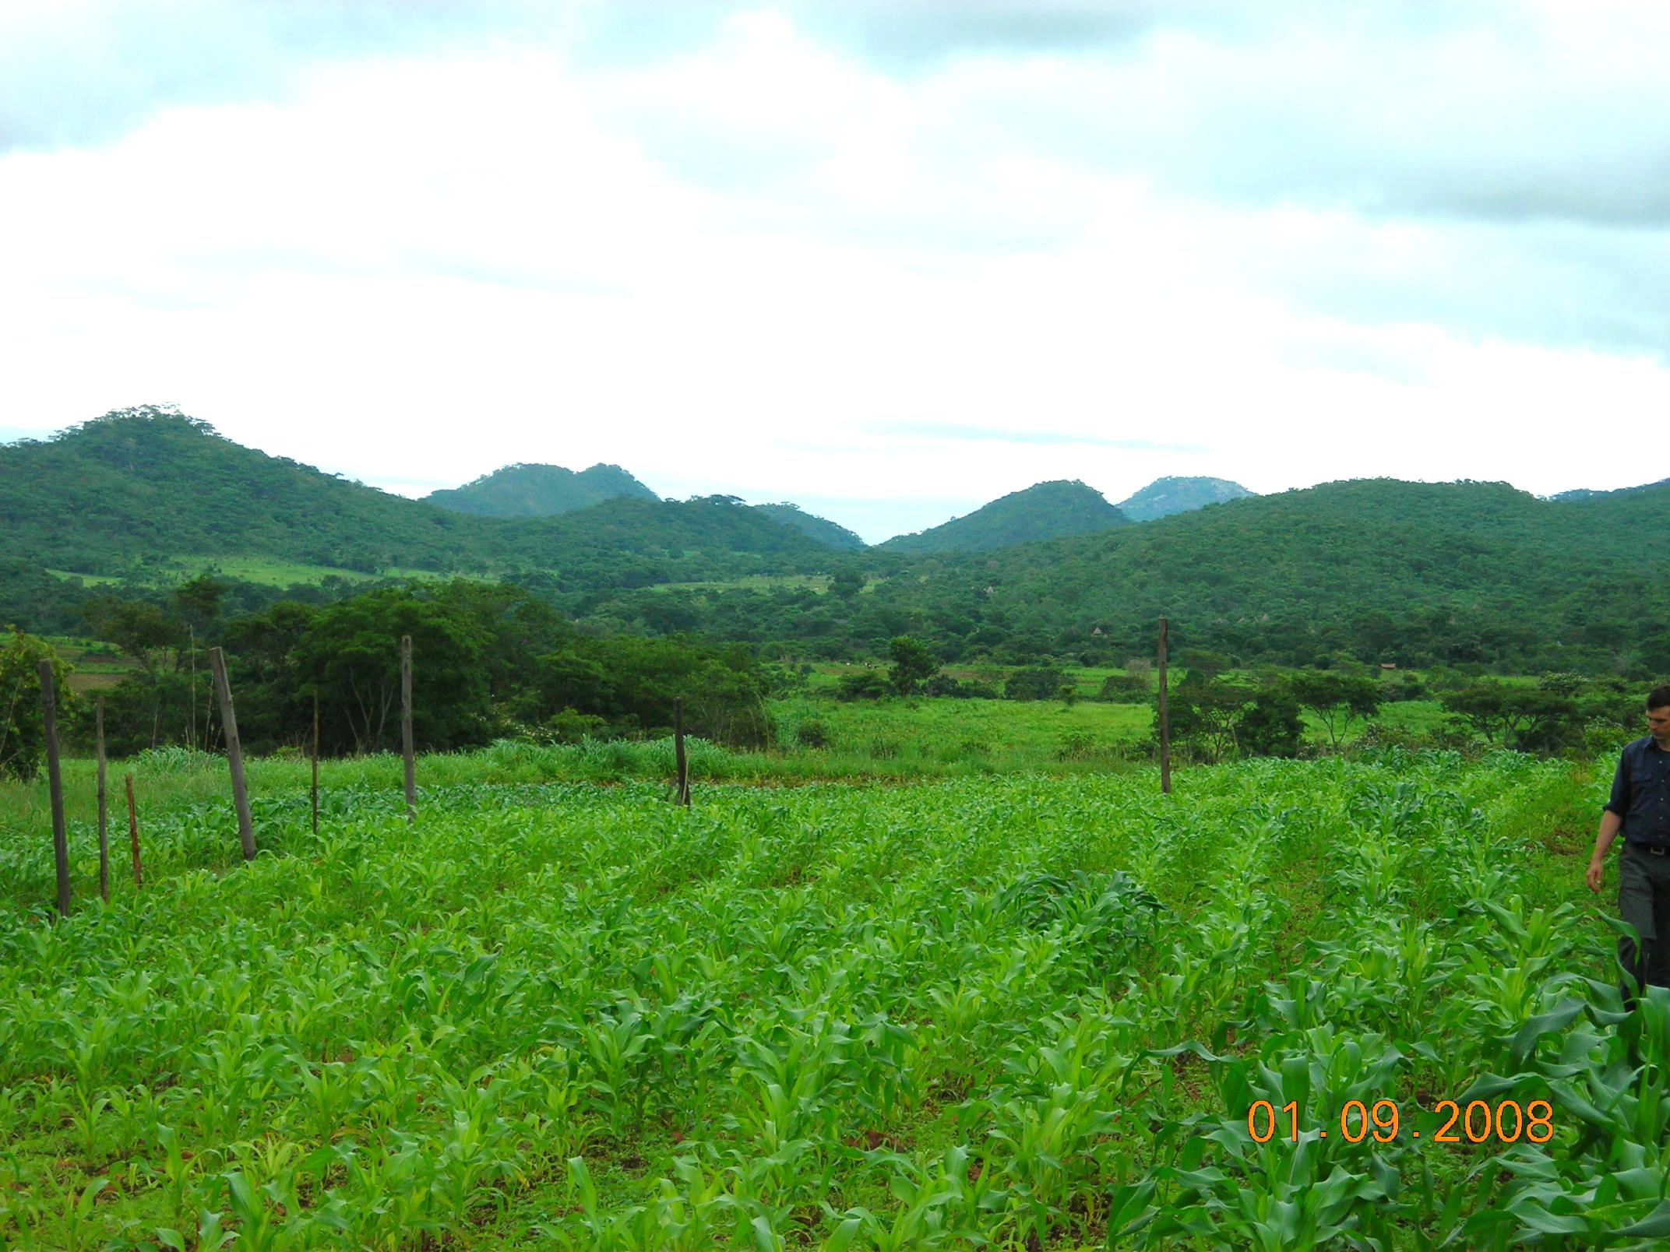
ZIMBABWE
Remote Locations Surface applications of urea

Slide 22
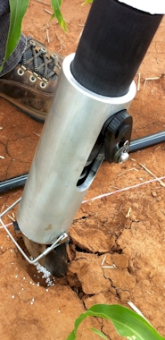
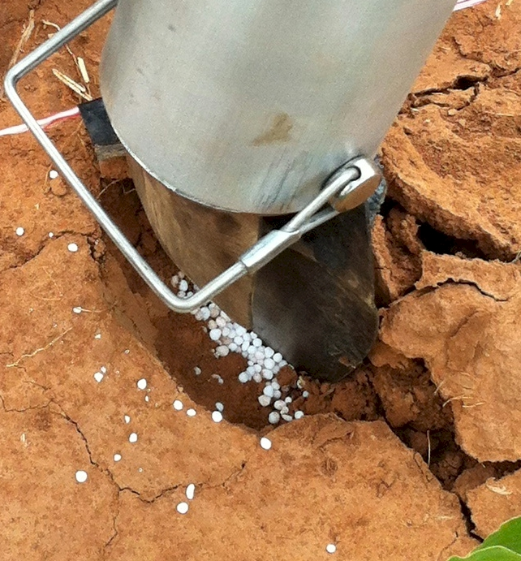
Mid Season Fertilizer N
Combined, Efaw and Perkins
Topdress N, Corn, V12 |  | 70,000 plants/ha
Methods | N, kg/ha | Mg/ha
Check | 0 | 6.6
Hand planter (0.9 g/plant) | 30 | 11.2
Hand planter (1.8 g/plant) | 60 | 10.6
Broadcast | 30 | 6.4
Broadcast | 60 | 7.0
Dribble urea | 30 | 9.3
Dribble urea | 60 | 7.8
Dribble UAN | 30 | 7.3
Dribble UAN | 60 | 10.4
SED = 1.81

Slide 23
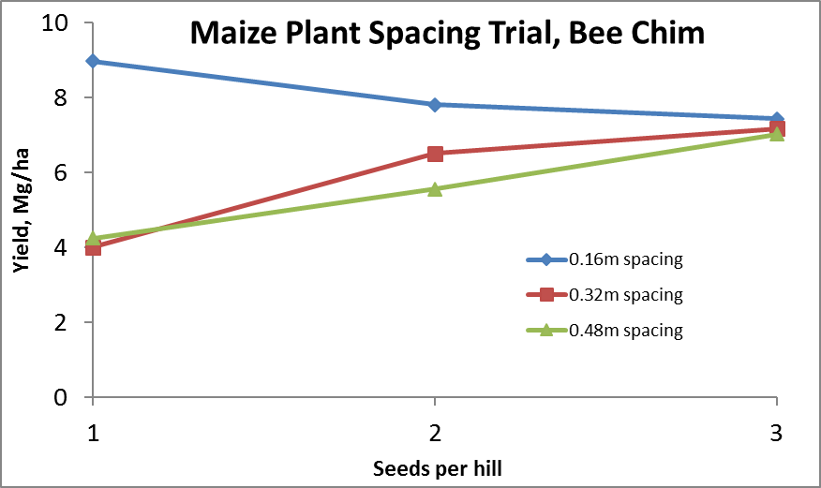
Importance of Singulation
0.76m Row Spacing
Heterogeneity in plant spacing, and plant stands reduce yields (Bob Nielsen, http://www.agry.purdue.edu/ext/corn/pubs/agry9101.htm)

Slide 24
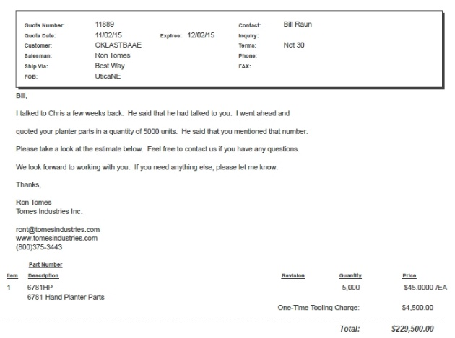
Current Cost Estimates
Grand Victory Ltd Tsim Sha Tsui Hong Kong Rm 1604 16/F Lee Wai Coml Bldg Tsim Sha Tsui
1000 $25 each
5000 $49 each

Slide 25
Viability of the OSU planter at $35?
This is a very good milestone. At $35, I think we would be close. We know adoption as a "process" governed by many factors, and cost of the technology plays a great role. Depending on how we approach it, farmers can adopt and use this technology to improve their productivity.
Regards,
Peter Omara Uganda ___________________
I´m glad the GS team is close to the amount I have heard from local farmers ($35). However, $35 can be a realistic figure for some farmers too.
Cordially
Edgar Ascencio El Salvador

Slide 26
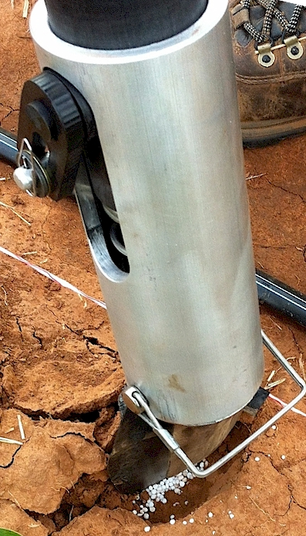
Benefits
Remove chemically treated seeds from the hands of producers
Decrease soil erosion via improved plant spacing
Accommodate mid-season application of urea-N
Place urea below the surface reducing NH3 loss
Potential to increase maize production and NUE
Chim, Bee Khim, Peter Omara, Jeremiah Mullock, Sulochana Dhital, Natasha Macnack, and William Raun. 2014. Effect of seed distribution and population on maize (Zea mays L.) grain yield. Int. J. Agronomy. V2014. . http://dx.doi.org/10.1155/2014/125258.
Omara, Peter, Lawrence, Aula, Bill Raun, Randy Taylor, Adrian Koller, Eric Lam, Joshua Ringer, Jeremiah Mullock, Sulochana Dhital and Natasha Macnack. 2015. Hand planter for maize (Zea mays L.) in the developing world. J. Plant Nutr. DOI:10.1080/01904167.2015.1022186
Dhillon, J.S., B. Figueiredo, L. Aula, T. Lynch, R.K. Taylor, and W.R. Raun. 2017. Evaluation of drum cavity size and planter tip on singulation and plant emergence in maize (Zea mays L.). J. Plant Nutr. DOI:10.1080/01904167.2017.1382532.
Planting 1 seed, every 0.16m increased yields by an average of 1.15 Mg ha⁻¹ (range, 0.33 to 2.46 Mg ha⁻¹) when compared to the farmer practice of placing 2 to 3 seeds per hill, every 0.48 cm.

Slide 27
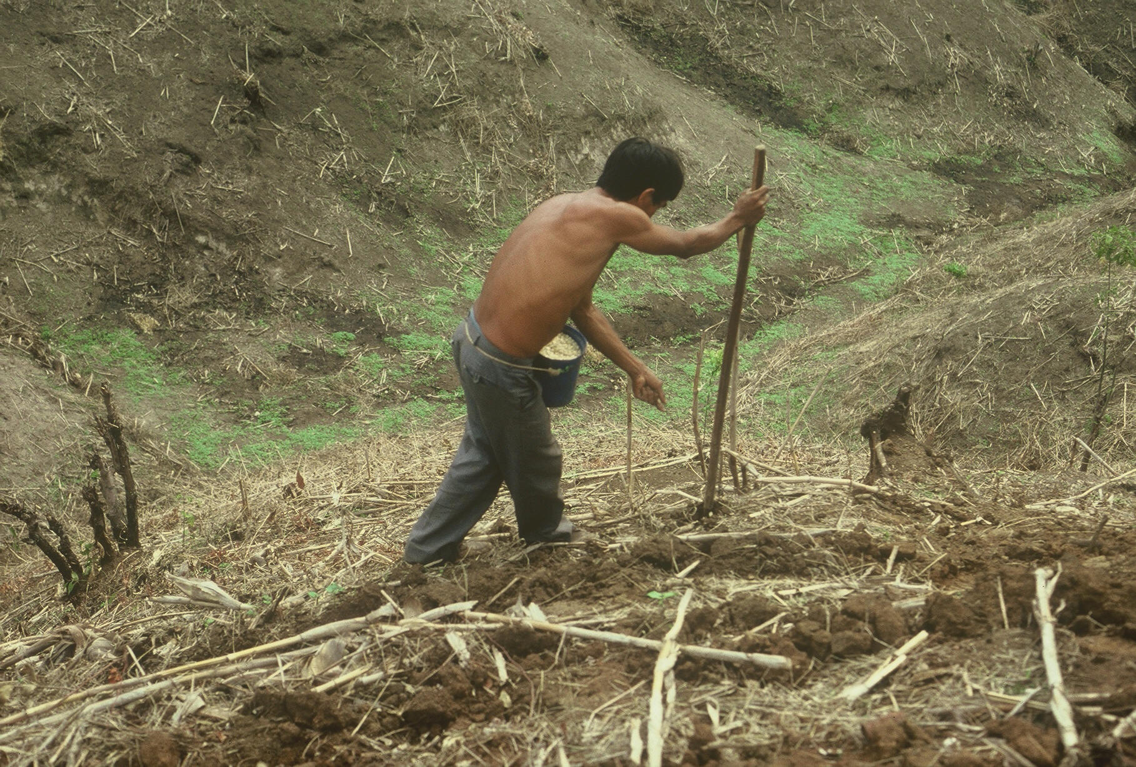
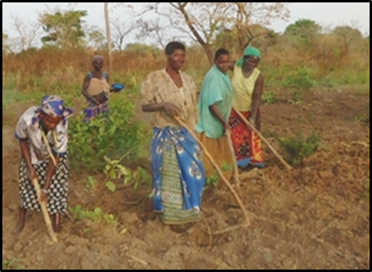
www.nue.okstate.edu

Slide 28
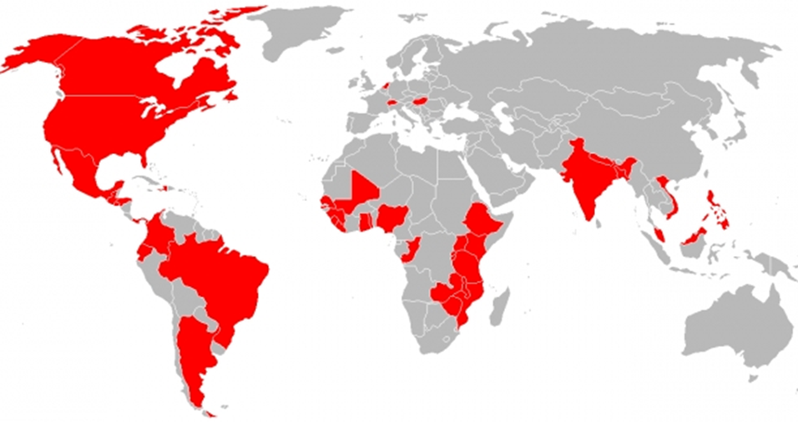
Hand Planters
Person | Organization | Where
Dr. Isaiah Nyagumbo | CIMMYT, Kenya | Zimbabwe
Dr. Pascal Kaumbutho | KENDAT, Kenya | Kenya
 | Ethiopia | Ethiopia
Dr. Peter Omara | Uganda | Uganda
Dr. Edgar Ascencio | CARE, El Savador | El Salvador
Dr. Fred Kanampiu | IITA, Kenya | Kenya
Dr. Nyle Wollenhaupt | AGCO, Kansas | Kansas
Dr. Ivan Ortiz-Monasterio | CIMMYT, Mexico | Mexico
Kristin Lacy | Semilla Nueva | Guatemala
Nyle Wollenhaupt | AGCO | Lusaka Zambia
Melvin Siwale | AGCO | Lusaka Zambia
Terry Tindall | JR Simplot | Lusaka Zambia
Eric Lam | MAG | Honduras
Eric Lam | CIMMYT | Bangladesh
Roman Gordon | IDIAP | Panama
Dr. Luis Narro | CIAT | Colombia
Dr. Joshua Ringer |  | Thailand
Dr. Assoumane Maiga |  | Mali
Notes:
28

Slide 29
March 2016
Membership, 11,000, views 10,000

Slide 30
Who did they invite to speak?
Catholic
Married, Municipal Judge, Business Law Instructor
Four children, Notre Dame, OU PA school, OSU, SHS
Bilingual, Spanish
Colombia, Mexico
Avid Bicycler
Politics? Wall (476-221 BC) education

Slide 32
Technology Adoption
Early stage technology
Momentum
Management Team
Market Size, 100% = 30,000,000 planters
Financing
Can a large company/industry benefit by developing a product for developed nation farmers?
NGO delivery
https://www.youtube.com/watch?v=VisKBsqcCWA
OSU Hand Planter

Slide 33
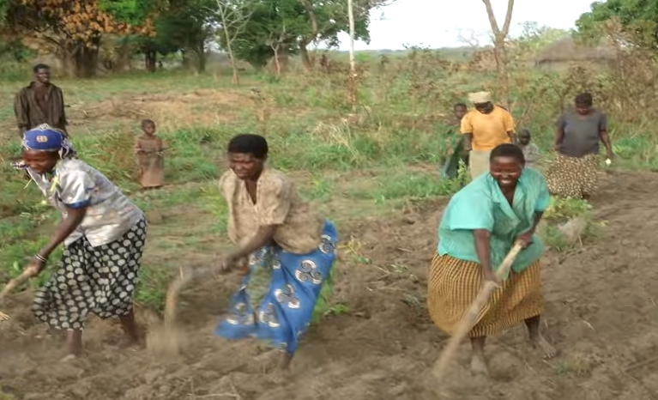
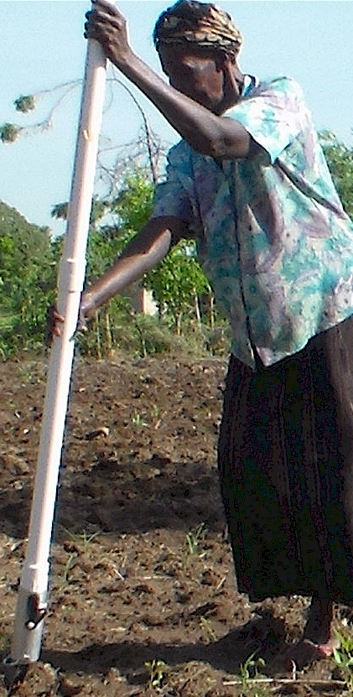
Modern researchers should therefore seek to understand the rationale behind traditional smallholder farmer behavior in technology use. J. Sust. Dev. 2012
Planter Ergonomics

