Slide 1
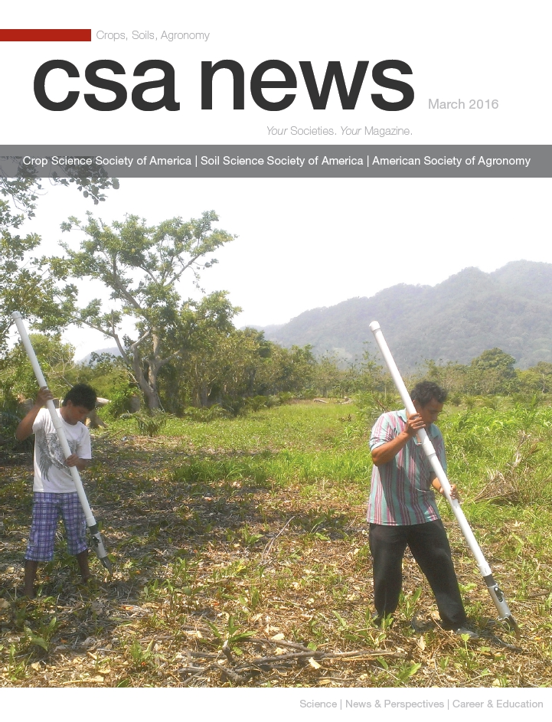
OSU GreenSeeder Hand Planter Thursday, November 17, 2016 11:00-11:30 Wes Watkins Center Jagmandeep Dhillon Joshua Ringer Daniel Aliddeki Wayne Kiner Randy Taylor Bill Raun
CSA News, March 2016
GREEN SEEDER
http://nue.okstate.edu/Hand_Planter.htm

Slide 2
March 2016
Membership, 11,000, views 10,000

Slide 3
Maize (FAOSTAT, 2014)
Area, ha Production, Mt Avg. Mt/ha
World 183,319,737 1,038,281,035 5.7 (90 bu/ac)
USA 33,644,310 361,091,140 10.9 (174 bu/ac)
China 35,981,005 215,812,100 6.2 (98 bu/ac)
Brazil 15,450,180 80,516,571 5.2 (83 bu/ac)
Low income Food Deficit Countries
49,356,985 117,590,512 2.4 (38 bu/ac)
Developing world maize planted by hand (60% of total) 29,400,000 ha’s (72,618,000 ac) 25% increase on world hand planted maize (avg 2 Mg/ha *0.25 = 0.5 Mg/ha) 29,400,000*(2000kg/ha*0.25%)*$0.23/kg (or $6.00/bu) = $3,381,000,000

Slide 4
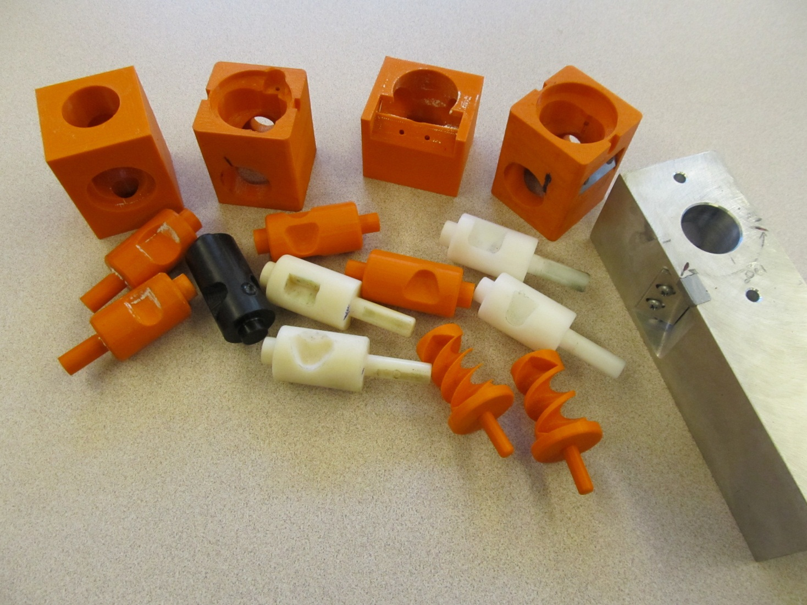
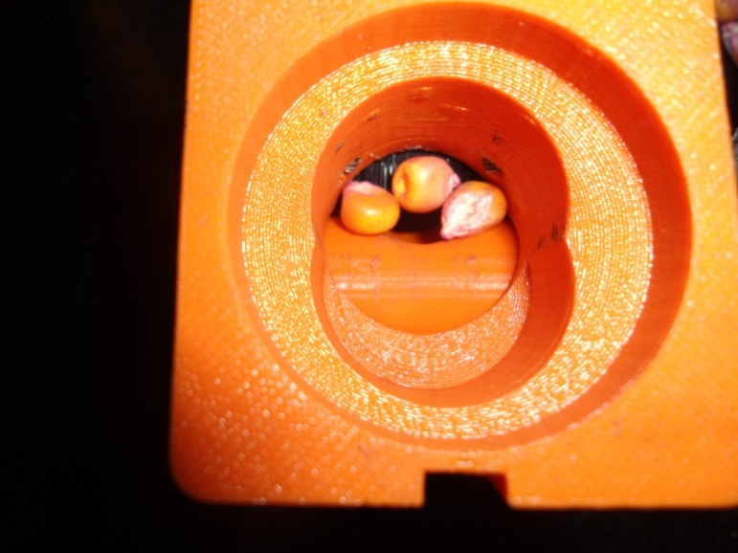
Trial and Error
3D Printing

Slide 5
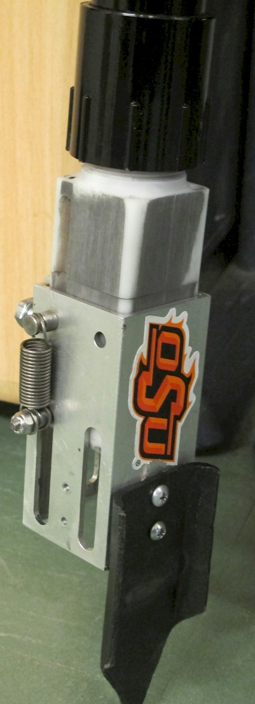
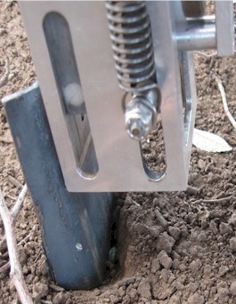
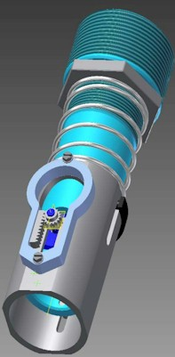
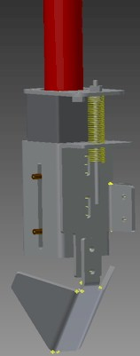

Slide 6
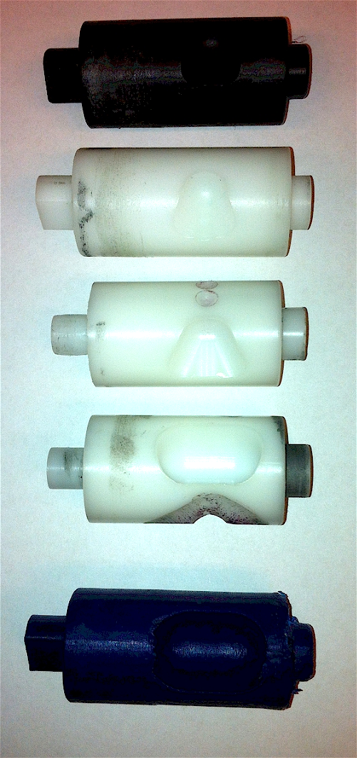
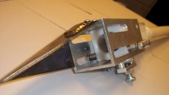
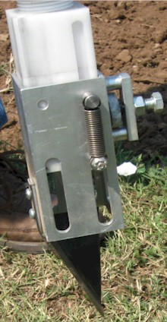
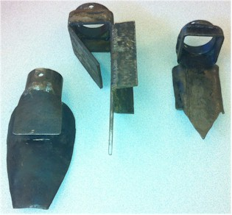
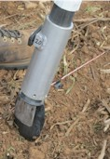
Internal Brush/Strength
Drum size/material
Cavity size/angle
Tip size/design/material
Internal/Ext. spring/tension

Slide 7
Internal drum, cavity size
Design: Fine Tuning
Seed type
Seed size
Fertilizer
amount
source

Slide 8
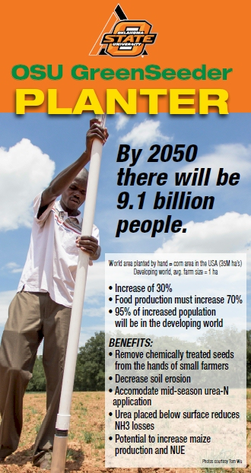
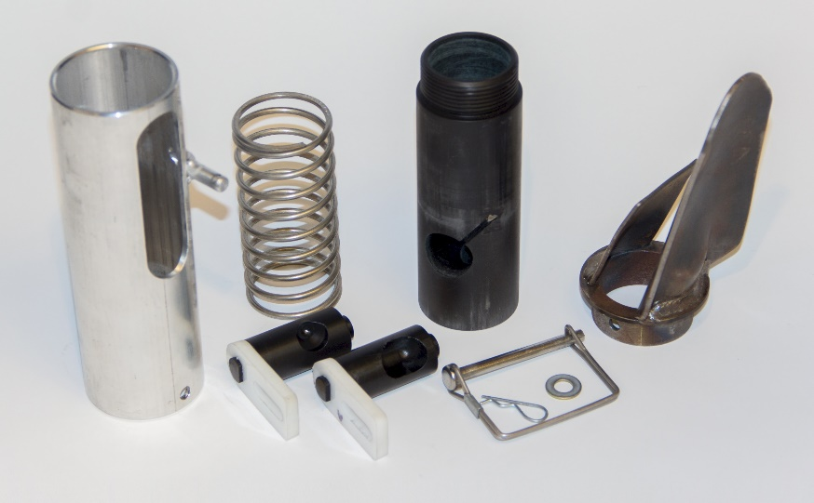
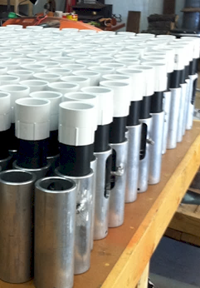
Drums

Slide 9
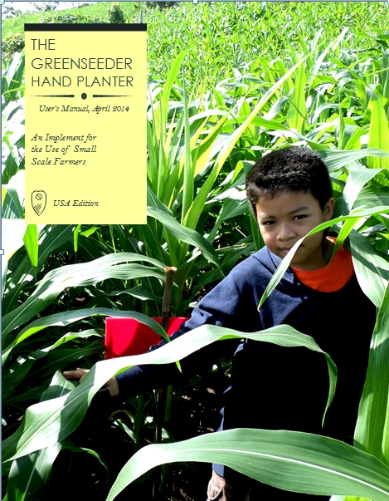
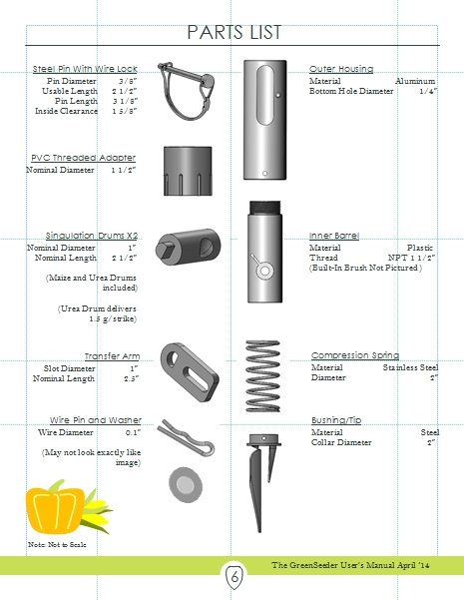
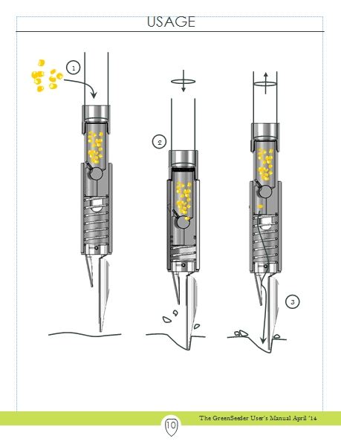
GreenSeeder Manual
http://www.nue.okstate.edu/Hand_Planter/Planter%20User's%20Manual%20EL.pdf

Slide 10
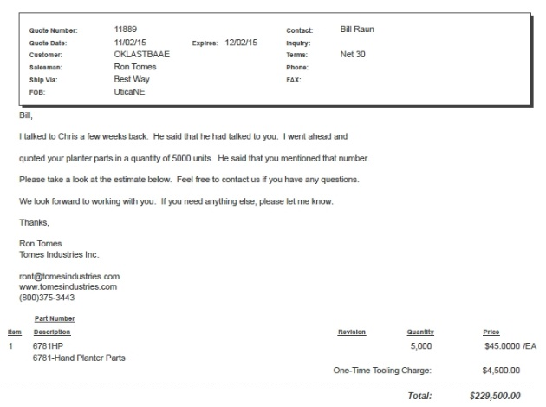
Current Cost Estimates
Grand Victory Ltd Tsim Sha Tsui Hong Kong Rm 1604 16/F Lee Wai Coml Bldg Tsim Sha Tsui
1000 $25 each
5000 $49 each

Slide 11
Technology Adoption
Early stage technology
Momentum
Management Team
Market Size, 100% = 30,000,000 planters
Financing
Can a large company/industry benefit by developing a product for developed nation farmers?
NGO delivery
https://www.youtube.com/watch?v=VisKBsqcCWA
OSU Hand Planter

Slide 12
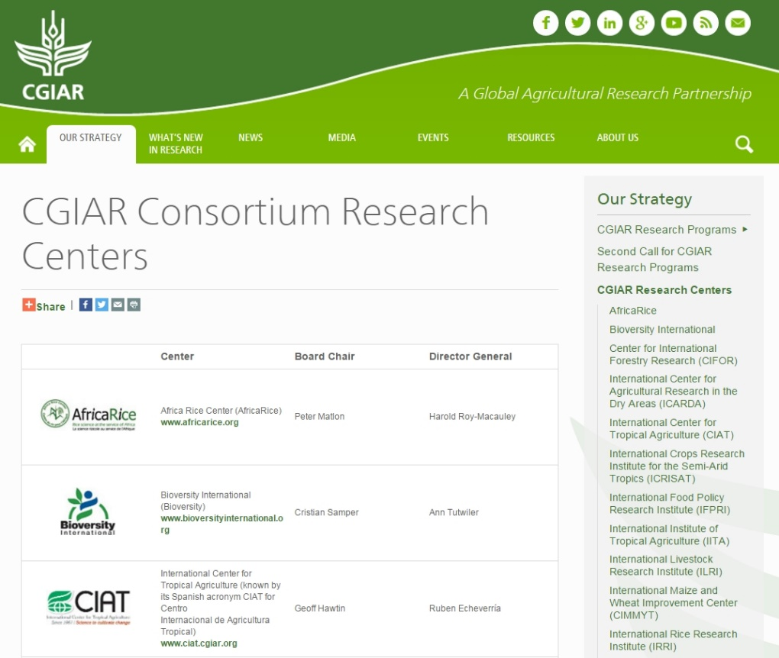
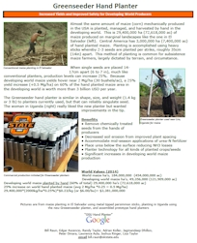
15 International Centers
www.cigar.org
http://www.cgiar.org/ar2013/cgiar-consortium-research-centers/
nue.okstate.edu/Hand_Planter.htm
1 page PDF (Hand Planter)

Slide 13
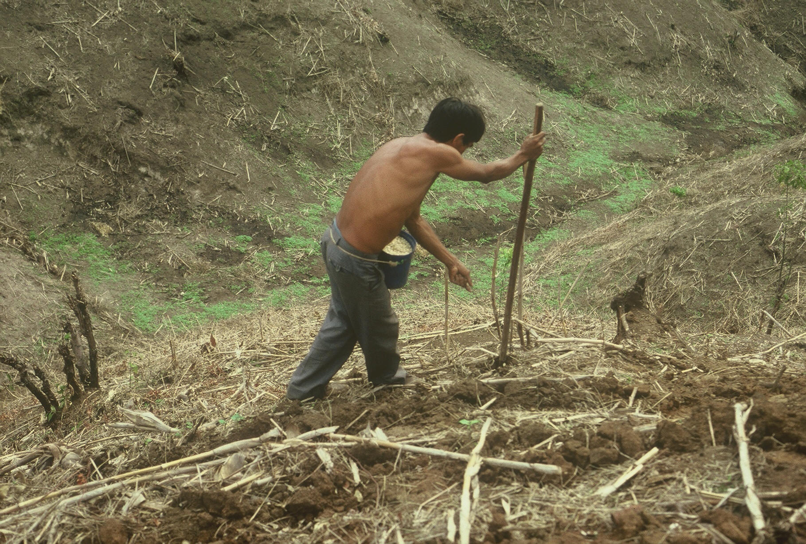
OSU Hand Planter
www.nue.okstate.edu

Slide 14
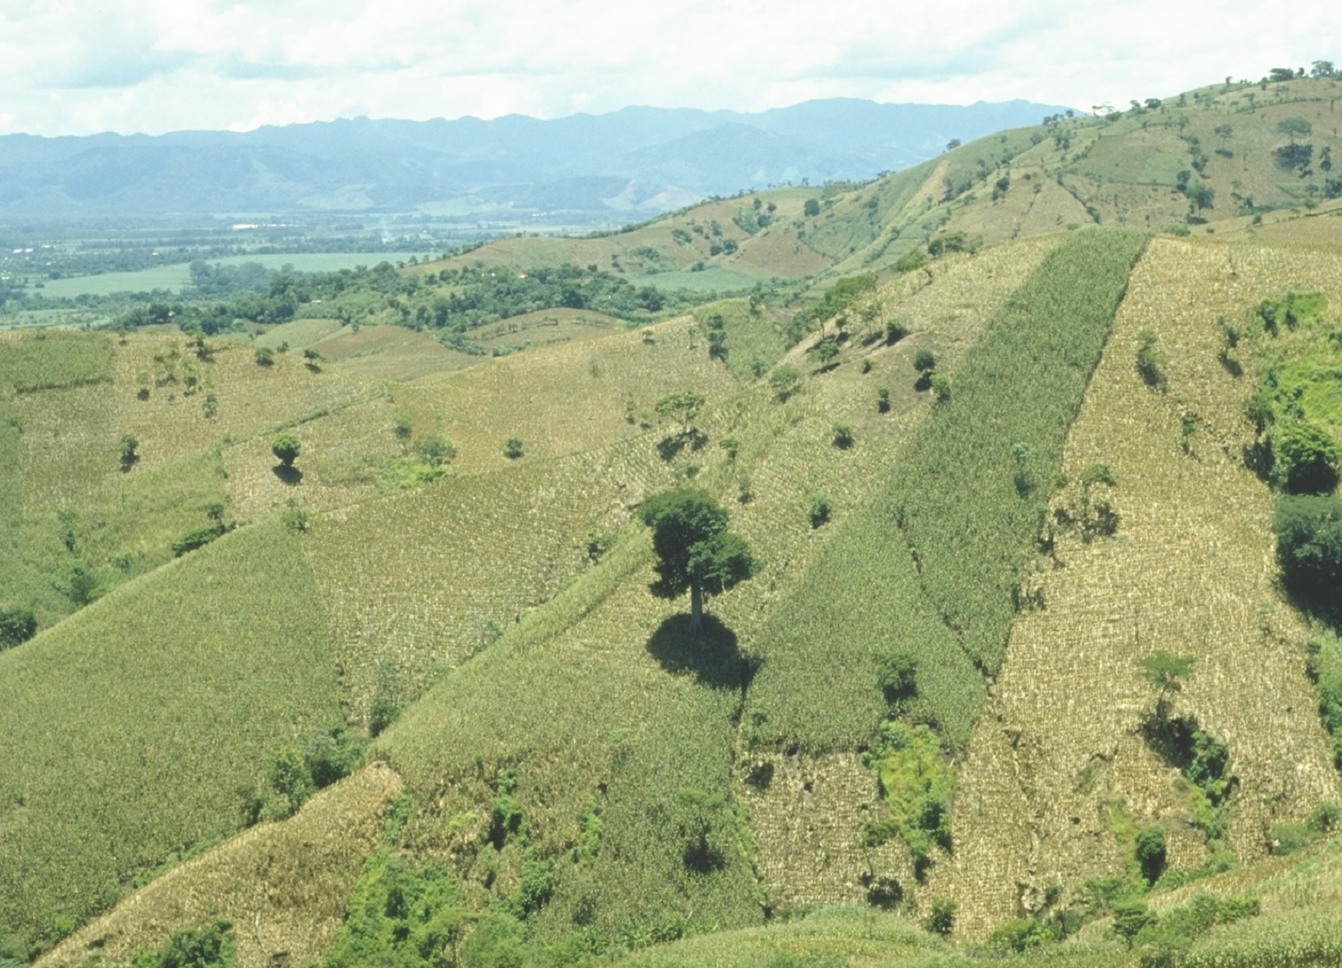
World area planted by hand ≈ corn area in the USA
EL SALVADOR
Alexandratos, N. and J. Bruinsma. 2012. World agriculture towards 2030/2050: the 2012 revision. ESA Working paper No. 12-03. Rome, FAO.

Slide 15
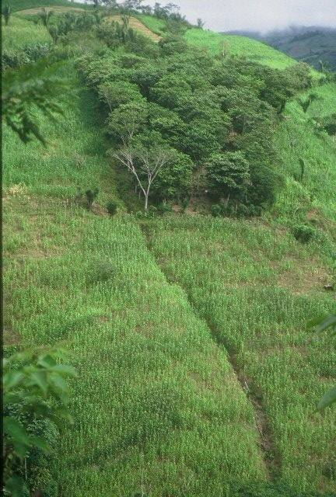
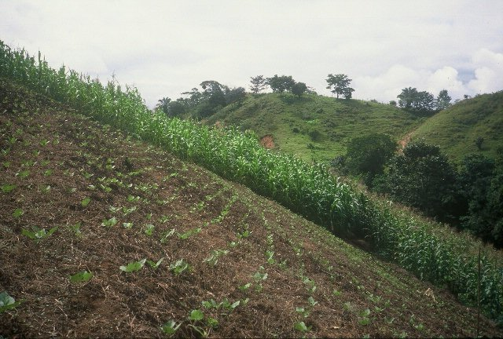
HONDURAS

Slide 16
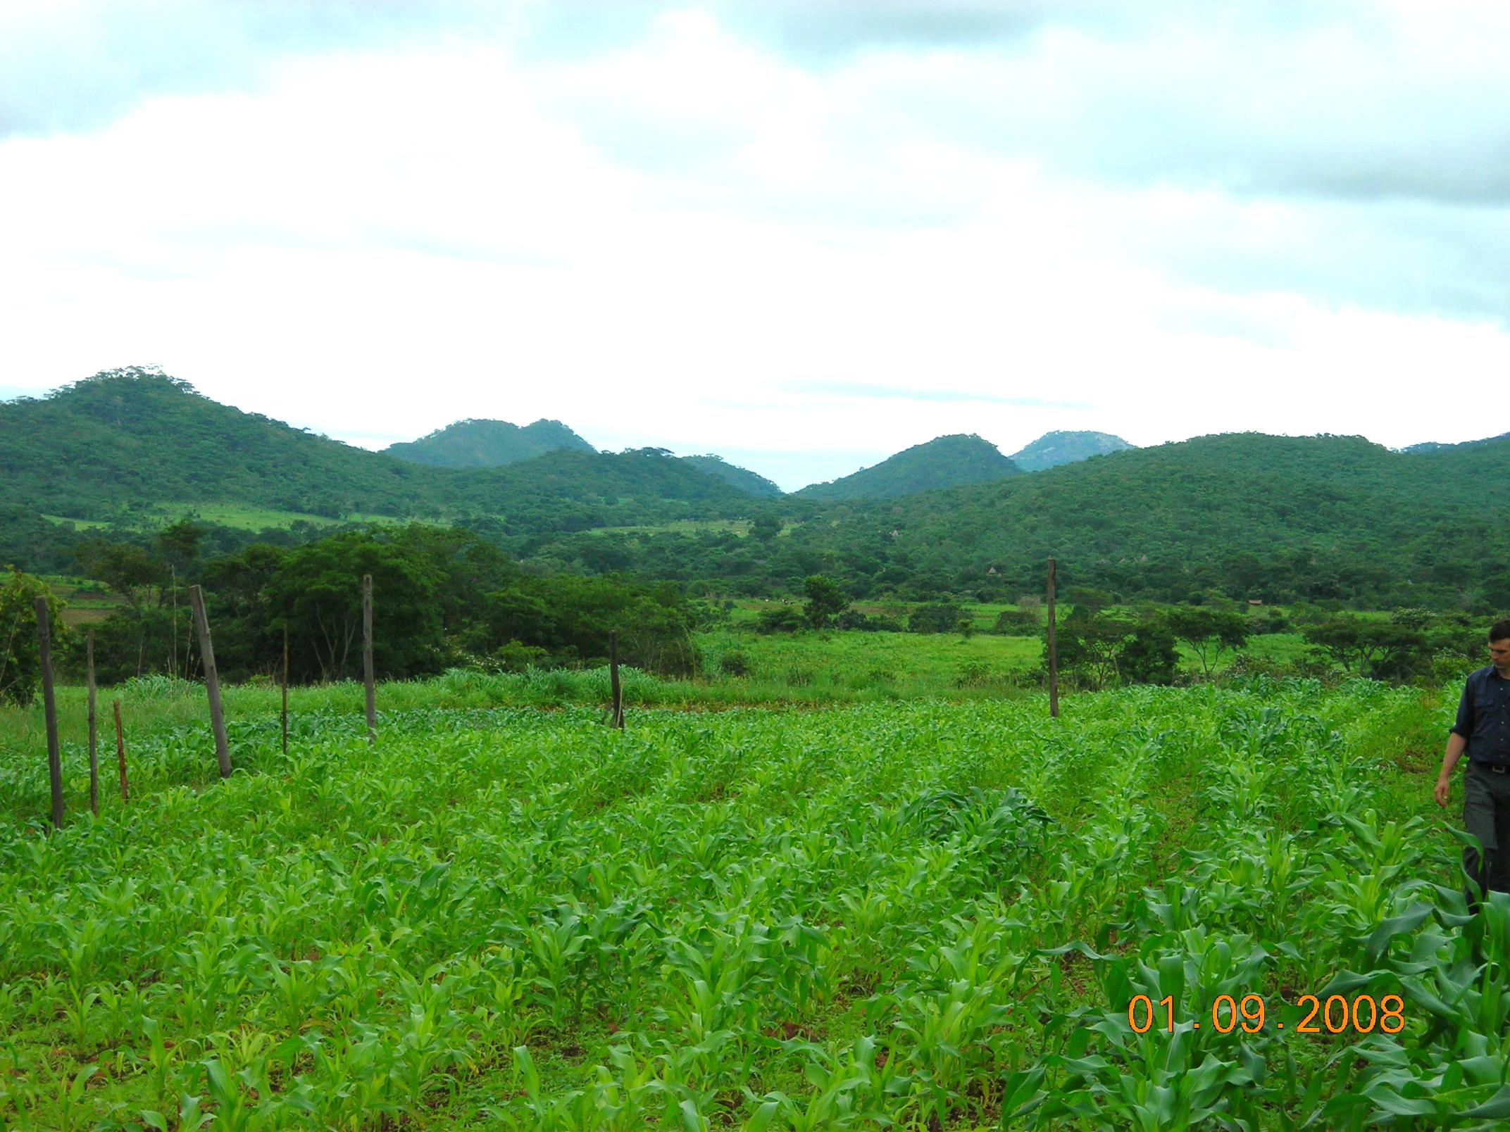
ZIMBABWE
Remote Locations

Slide 17
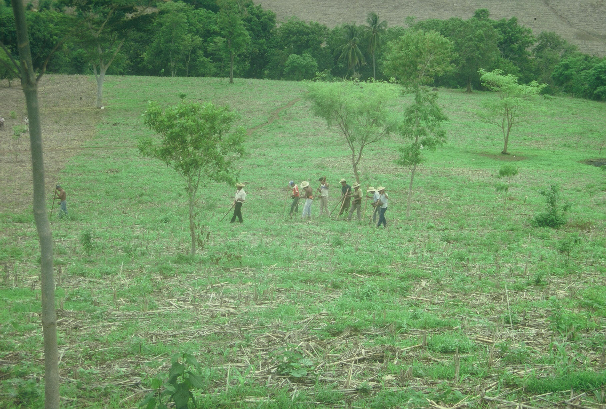
Opico Quezaltepeque, El Salvador
EL SALVADOR
Social aspects/technology transfer

Slide 18
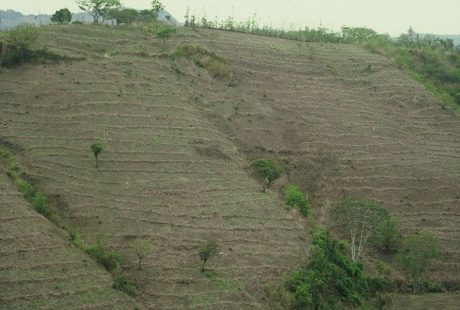
NICARAGUA

Slide 19
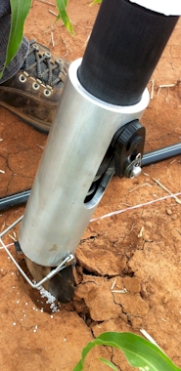
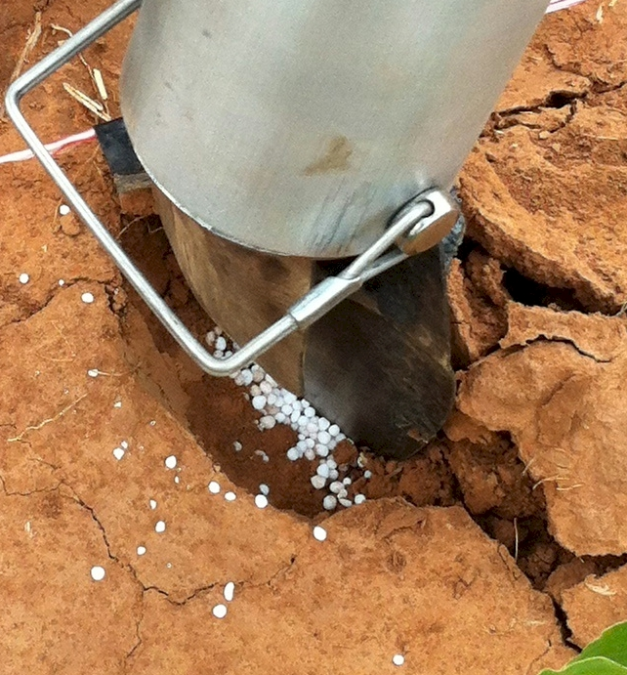
Mid Season Fertilizer N
Combined, Efaw and Perkins
Topdress N, Corn, V12 |  | 70,000 plants/ha
Methods | N, kg/ha | Mg/ha
Check | 0 | 6.6
Hand planter (0.9 g/plant) | 30 | 11.2
Hand planter (1.8 g/plant) | 60 | 10.6
Broadcast | 30 | 6.4
Broadcast | 60 | 7.0
Dribble urea | 30 | 9.3
Dribble urea | 60 | 7.8
Dribble UAN | 30 | 7.3
Dribble UAN | 60 | 10.4
SED = 1.81

Slide 20
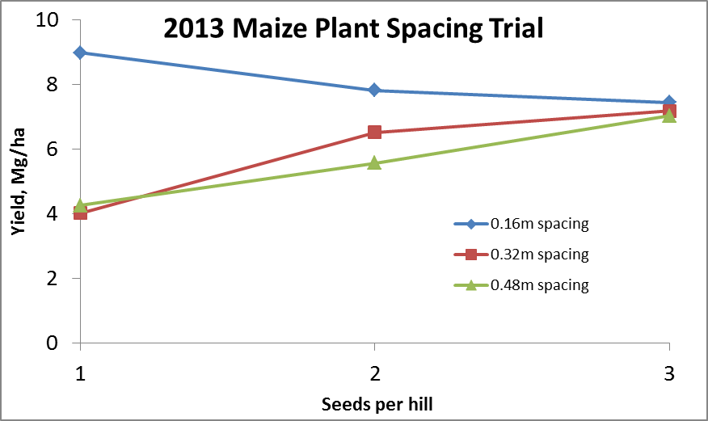
Importance of Singulation
0.76m Row Spacing
Heterogeneity in plant spacing, and plant stands reduce yields (Bob Nielsen, http://www.agry.purdue.edu/ext/corn/pubs/agry9101.htm)

Slide 21
November 16, 2016 Viability of the OSU planter at $35?
This is a very good milestone. At $35, I think we would be close. We know adoption as a "process" governed by many factors, and cost of the technology plays a great role. Depending on how we approach it, farmers can adopt and use this technology to improve their productivity.
Regards,
Peter Omara Uganda ___________________
I´m glad the GS team is close to the amount I have heard from local farmers ($25). However, $35 can be a realistic figure for some farmers too.
Cordially
Edgar Ascencio El Salvador

Slide 22
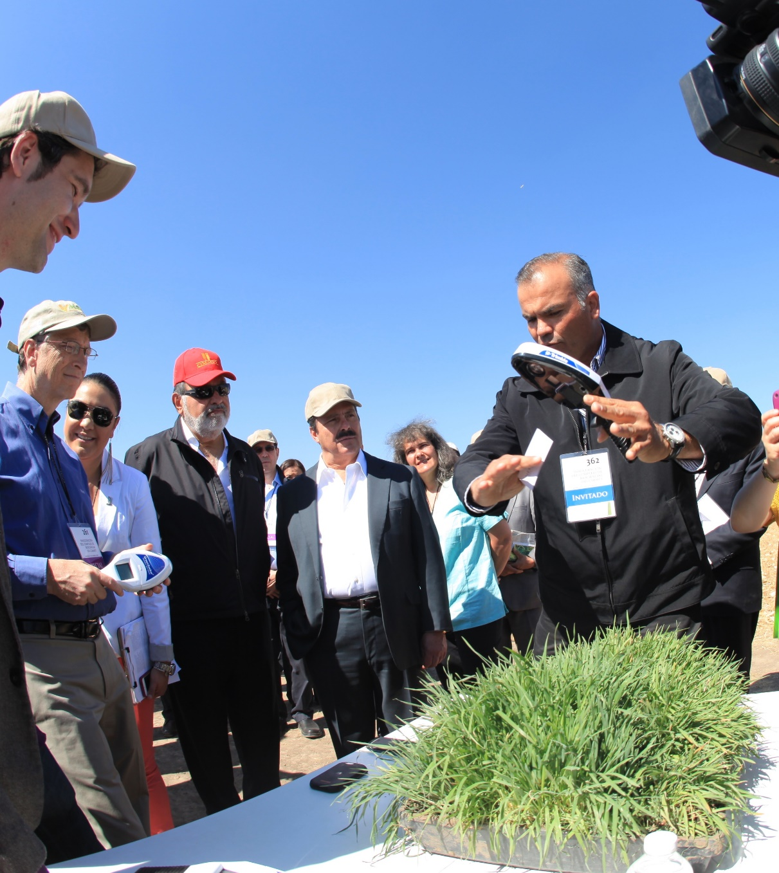
Hand-Held GreenSeeker Sensors
Right Questions Right Time Right Order

Slide 23
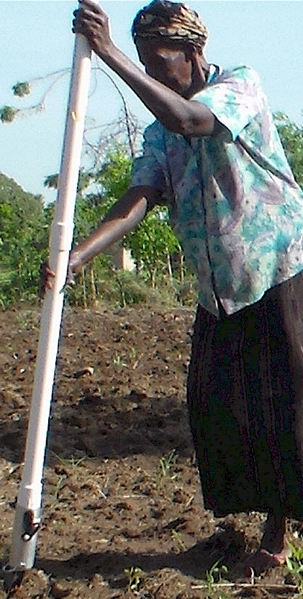
Modern researchers should therefore seek to understand the rationale behind traditional smallholder farmer behavior in technology use. J. Sust. Dev. 2012
Planter Ergonomics

Slide 24
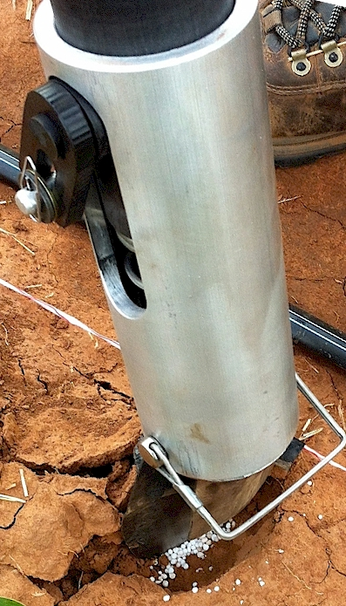
Benefits
Remove chemically treated seeds from the hands of producers
Decrease soil erosion via improved plant spacing
Accommodate mid-season application of urea-N
Place urea below the surface reducing NH3 loss
Potential to increase maize production and NUE
Khim et al. (2014). Planting 1 seed, every 0.16m increased yields by an average of 1.15 Mg ha⁻¹ (range, 0.33 to 2.46 Mg ha⁻¹) when compared to the farmer practice of placing 2 to 3 seeds per hill, every 0.48 cm.

Slide 25
Journey/Puzzle Right questions
Right order
Right product

Slide 27
Hand Planters
Person | Organization | Where | No. of Hand Planters
Dr. Isaiah Nyagumbo | CIMMYT, Kenya | Zimbabwe | 4
Dr. Pascal Kaumbutho | KENDAT, Kenya | Kenya | 2
 | Ethiopia | Ethiopia | 1
Dr. Peter Omara | Uganda | Uganda | 8
Dr. Edgar Ascencio | CARE, El Savador | El Salvador | 14
Dr. Fred Kanampiu | IITA, Kenya | Kenya | 2
Dr. Nyle Wollenhaupt | AGCO, Kansas | Kansas | 2
Dr. Ivan Ortiz-Monasterio | CIMMYT, Mexico | Mexico | 1
Kristin Lacy | Semilla Nueva | Guatemala | 2
Nyle Wollenhaupt | AGCO | Lusaka Zambia | 40
Melvin Siwale | AGCO | Lusaka Zambia | 10
Terry Tindall | JR Simplot | Lusaka Zambia | 25
Eric Lam | MAG | Honduras | 2
Eric Lam | CIMMYT | Bangladesh | 1
Roman Gordon | IDIAP | Panama | 2
Dr. Luis Narro | CIAT | Colombia | 6
Dr. Joshua Ringer |  | Thailand | 1
Dr. Assoumane Maiga |  | Mali | 1
Total |  |  | 130
Notes:
27

Slide 28
Bangladesh
Burundi
Belize
Brazil
Colombia
El Salvador
Ethiopia
Guatemala
India
Kenya
Malawi Mali
January 2014, on-line hand planter workshop http://nue.okstate.edu/Hand_Planter/osu_hand_planter_workshop.html
Mexico
Mozambique
Sierra Leone
Nepal
Philippines
Tanzania
Togo
Uganda
USA
Zambia
Zimbabwe

Slide 29
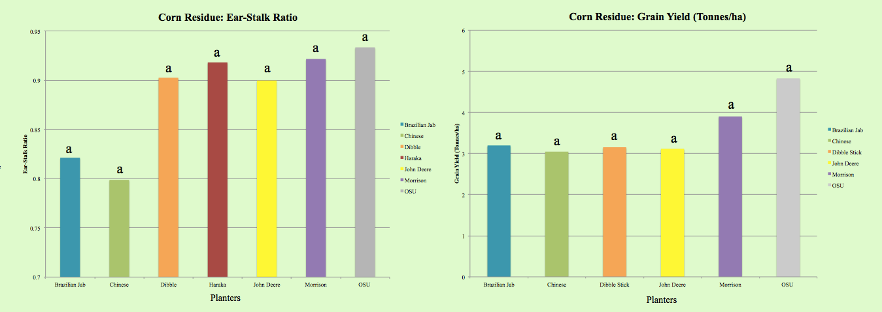
Becca Harman, Univ. Tennessee

Slide 30
“The most conservative man in traditional agriculture is the scientist, and sometimes I am not proud to be one of them. This is most discouraging. The scientist is a privileged person, the man should lead us out of the wilderness of static, underproductive agriculture, and yet by his apathy and failure to exercise his unique vision, he keeps us in the swamp of despair. The scientist fears change because he is in a relatively privileged position in his own society. If there is no breakthrough in yield, he will not be criticized. But if he makes a recommendation and something goes wrong, he may lose his job. “ N.E. Borlaug
“Wheat is an equal opportunity performer, it never discriminates. It grows as well for the poor as for anyone” N.E. Borlaug

Slide 31
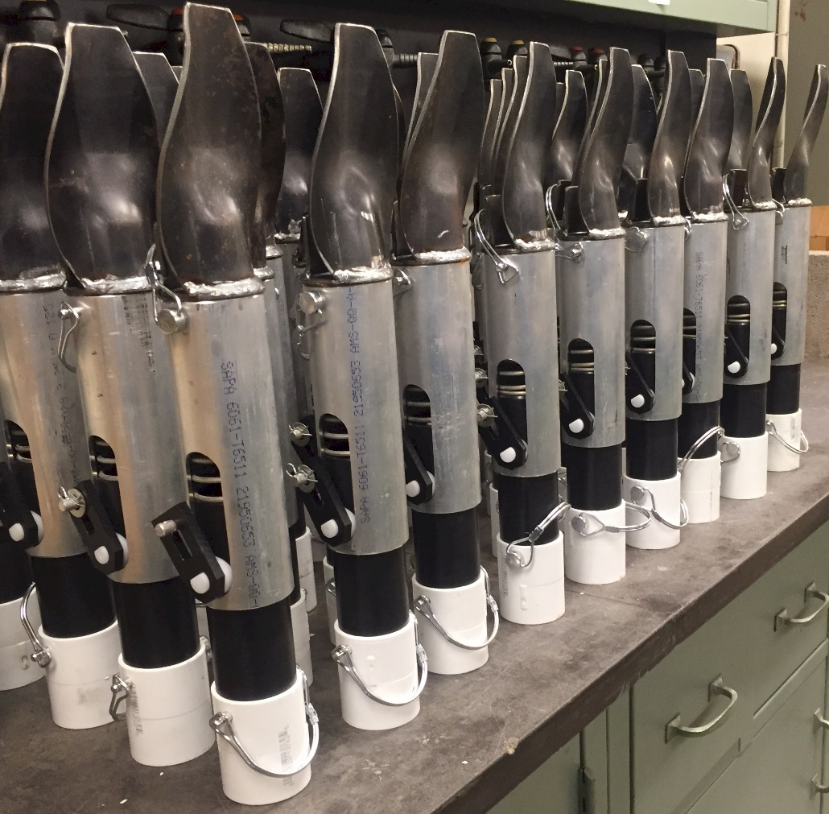

Slide 32
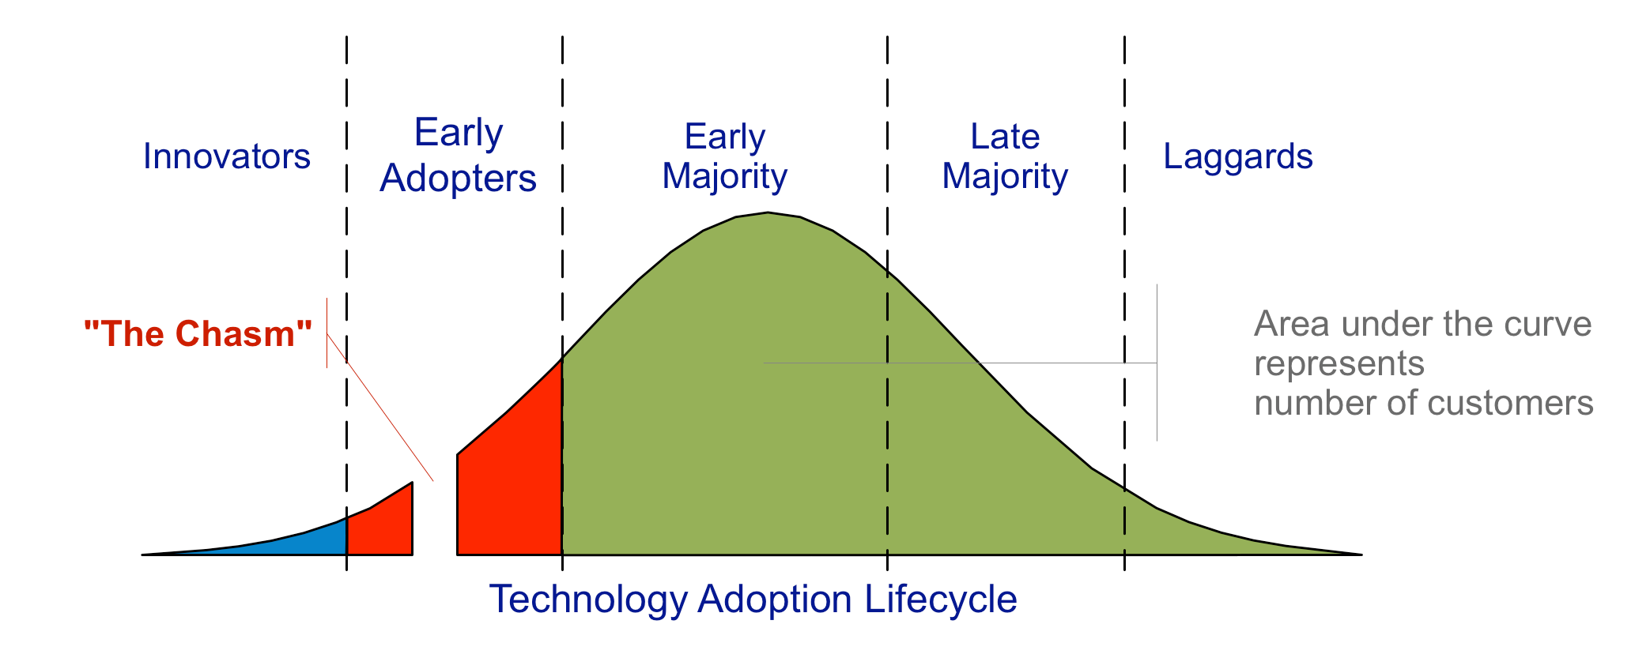
choosing a target market, understanding the whole product concept, positioning the product, building a marketing strategy, choosing the most appropriate distribution channel and pricing.

