Slide 1
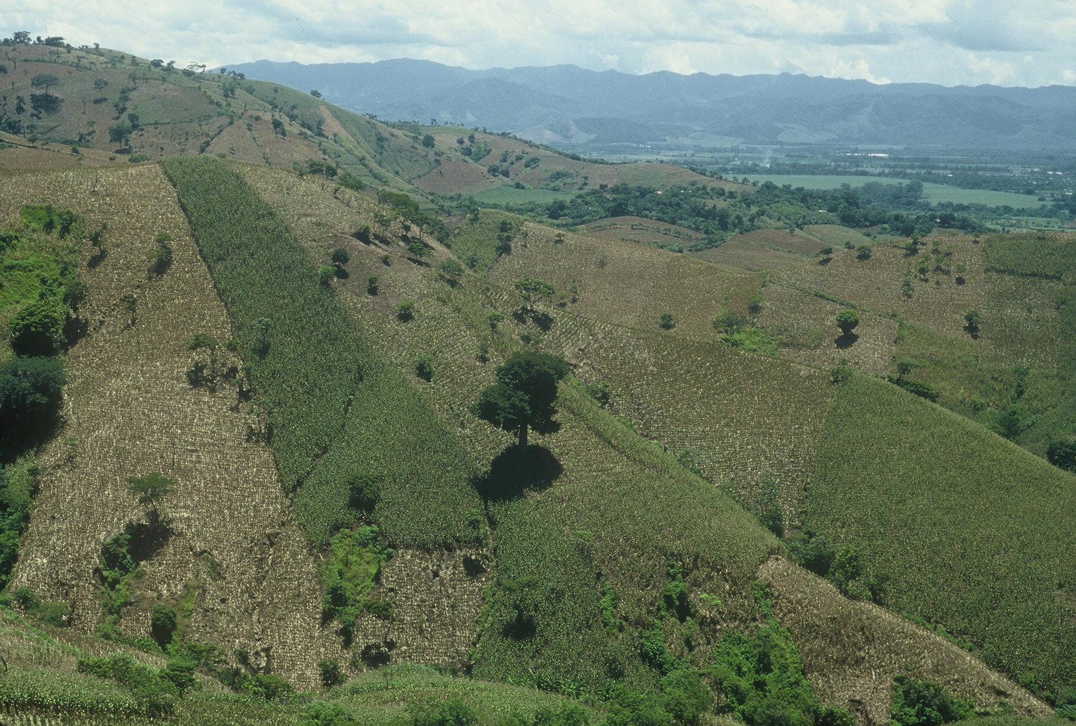
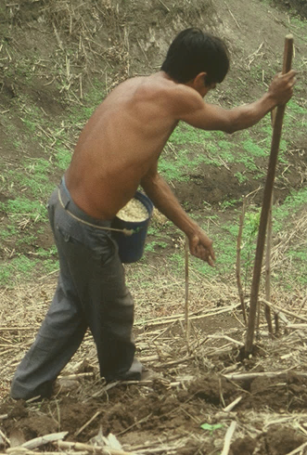
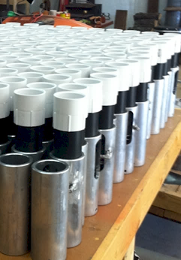
Hand Planter for Emerging Countries
Dr. Barbara Stoecker
Bill Raun, Randy Taylor, Nyle Wollenhaupt,
Bruno Figueiredo, Lawrence Aula,
Joshua Ringer, Edgar Ascencio,
Jagmandeep Dhillon

Slide 2

Hand Planters
Person | Organization | Where | No. of Hand Planters
Dr. Isaiah Nyagumbo | CIMMYT, Kenya | Zimbabwe | 4
Dr. Pascal Kaumbutho | KENDAT, Kenya | Kenya | 2
 | Ethiopia | Ethiopia | 1
Dr. Peter Omara | Uganda | Uganda | 3
Dr. Edgar Ascencio | CARE, El Savador | El Salvador | 4
Dr. Fred Kanampiu | IITA, Kenya | Kenya | 2
Dr. Nyle Wollenhaupt | AGCO, Kansas | Kansas | 2
Dr. Ivan Ortiz-Monasterio | CIMMYT, Mexico | Mexico | 1
Kristin Lacy | Semilla Nueva | Guatemala | 2
Nyle Wollenhaupt | AGCO | Lusaka Zambia | 40
Melvin Siwale | AGCO | Lusaka Zambia | 10
Terry Tindall | JR Simplot | Lusaka Zambia | 25
Eric Lam | MAG | Honduras | 2
Eric Lam | CIMMYT | Bangladesh | 1
Dr. Luis Narro | CIAT | Colombia | 1
Dr. Joshua Ringer |  | Thailand | 1
Dr. Assoumane Maiga |  | Mali | 1
Total |  |  | 101
Notes:
2

Slide 3
Borlaug: Volume 3, Bread Winner. 1960-1969. Copyright 2004, 2010 by Noel Vietmeyer
…But the technology package was only one aspect. Once we had the package and had checked it for its validity, we still had to harness it to political policies. Otherwise, nothing would have happened and the technology, as good as it was, would never have been applied and food production would have stayed unchanged. We had to see that the credit was available for small farmers to buy the inputs needed to obtain these yields. We also had to see that pricing at the time of harvest was enough to stimulate farmers to adopt this package.
“Then, can man use honest work, God’s best medicine to gain his own livelihood.”
Norman E. Borlaug
“You can’t get him to admit he’s got a Nobel Prize, any other award (he has hundreds), honorary degrees (dozens), or that he’s helped anyone (millions, if not billions).” Noel Vietmeyer

Slide 4
Maize (FAOSTAT, 2013)
Area, ha Production, Mt Avg. Mt/ha
World 184,239,959 1,016,431,783 5.5 (87 bu/ac)
USA 35,478,012 353,699,441 9.9 (157 bu/ac)
China 35,276,500 217,830,000 6.2 (98 bu/ac)
Brazil 15,450,180 80,516,571 5.2 (83 bu/ac)
Low income Food Deficit Countries
49,356,985 117,590,512 2.4 (38 bu/ac)
60% hand
planted
29,614,180
USA 2014, 37,125,000 ha’s

Slide 5
World area planted by hand ≈ corn area in the USA
Developing world, avg. farm size = 1 ha
NGO support, interaction, source for subsidizing planters
By 2050 there will be 9.1 billion people.
Increase of 30%
Food production during the same period will have to increase 70%
95% of the increased population will be in the developing world
Alexandratos, N. and J. Bruinsma. 2012. World agriculture towards 2030/2050: the 2012 revision. ESA Working paper No. 12-03. Rome, FAO.

Slide 6
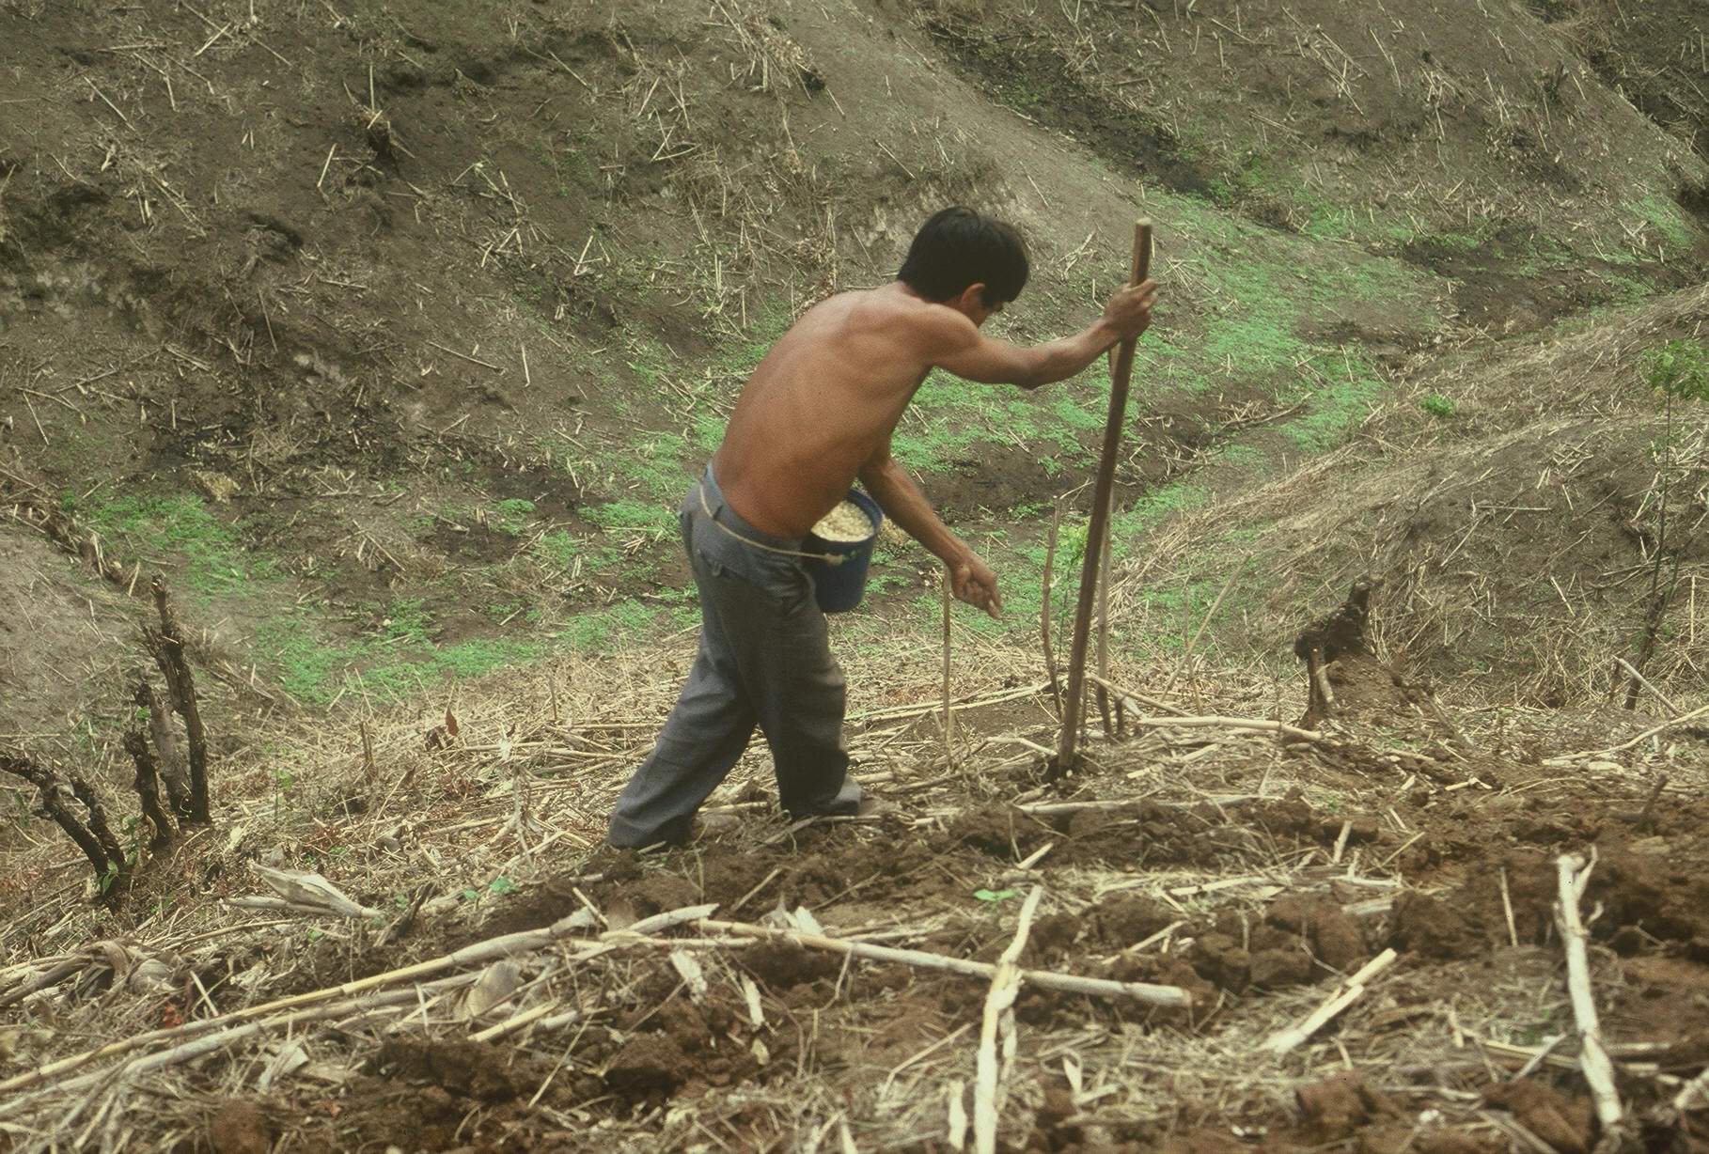



Slide 7
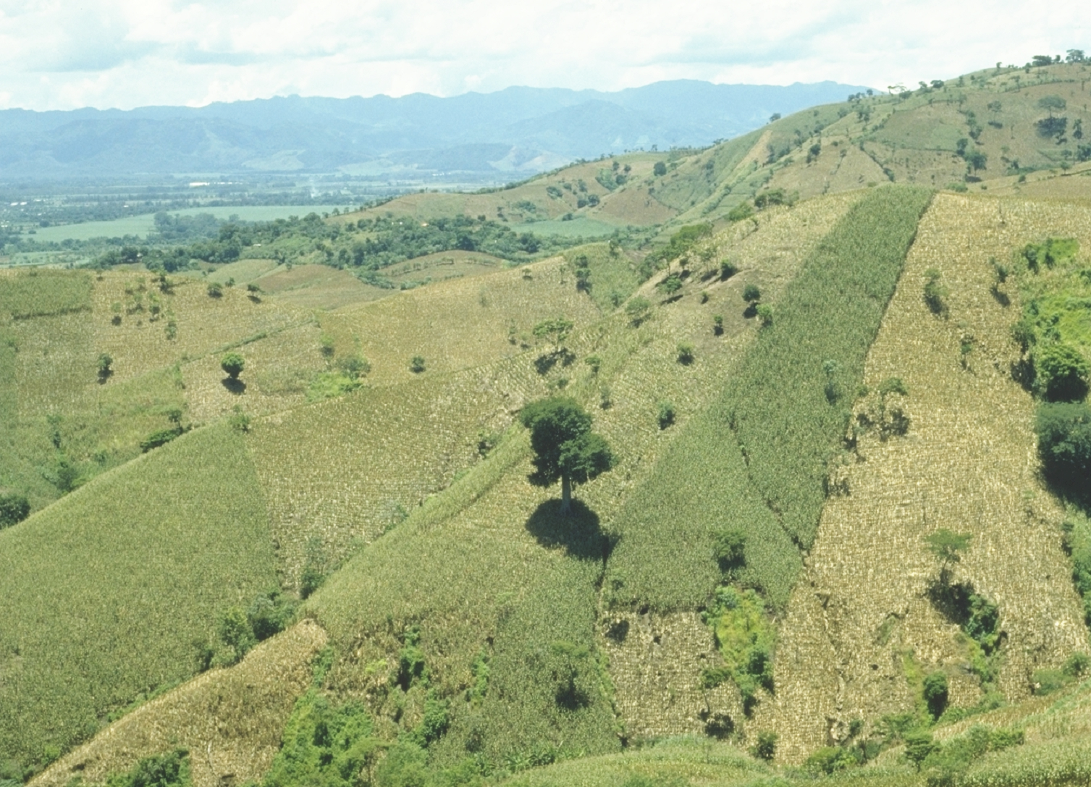
EL SALVADOR

Slide 8
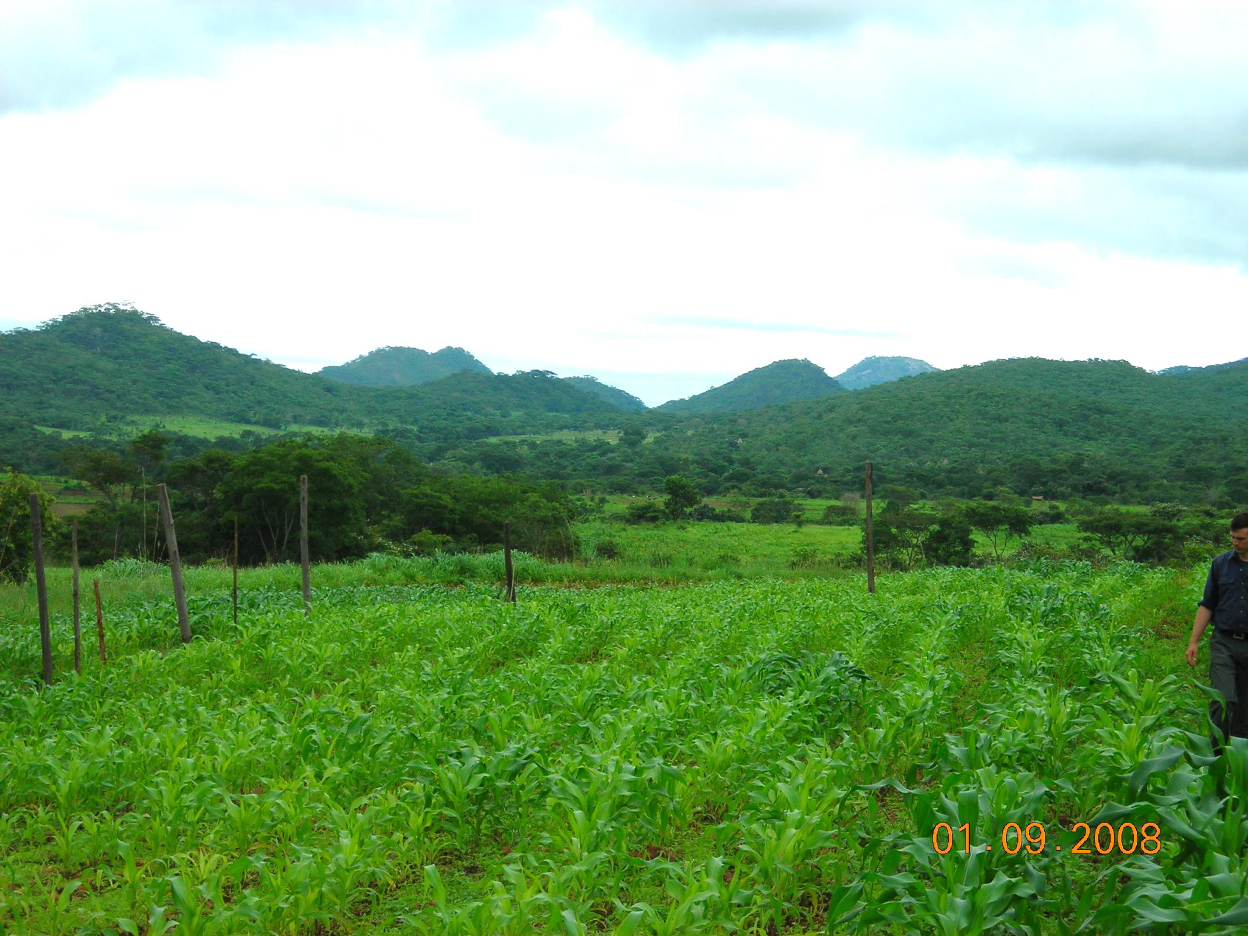
ZIMBABWE

Slide 9
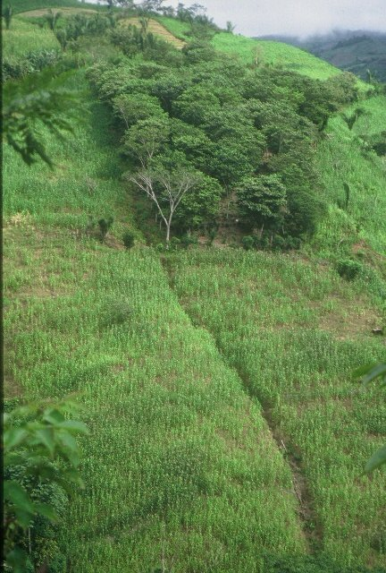
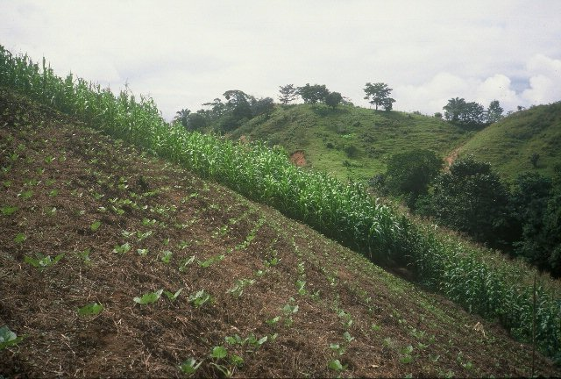
HONDURAS

Slide 10
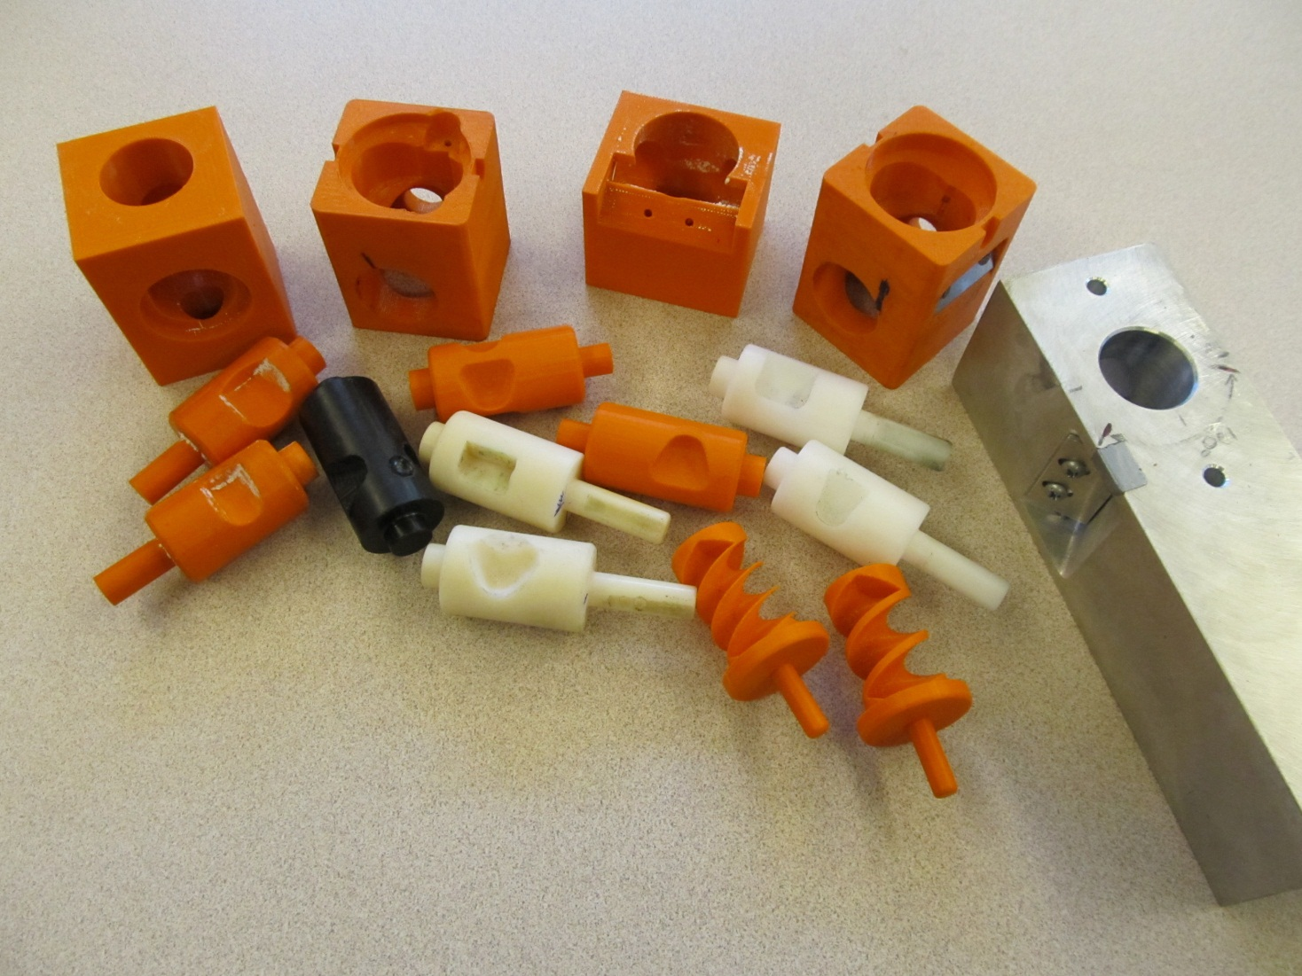
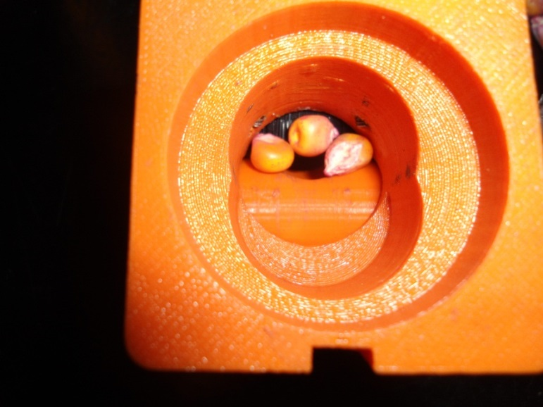
Singulation Design

Slide 11
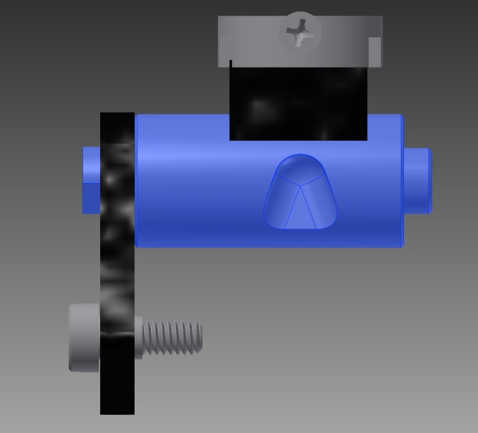
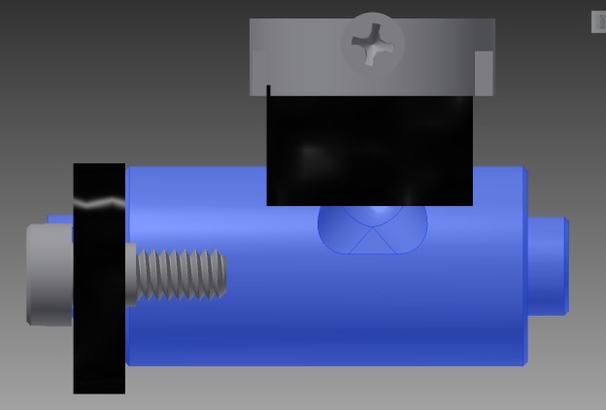
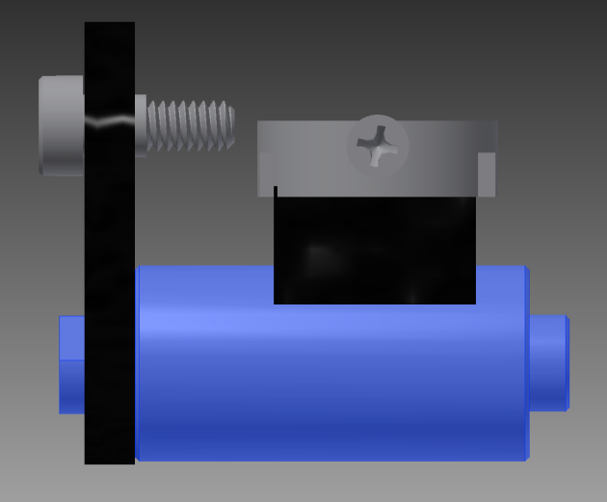
Reciprocating Drum Action
Drum rotates with the cavity moving back into the seed hopper as the spring is compressed.
Spring is fully compressed and the singulation drum cavity is exposed to seed in the hopper
Drum position when planter is relaxed.
As the force on the spring is released, the singulation drum rotates back to the initial ‘relaxed’ position and the seed is dropped.

Slide 12
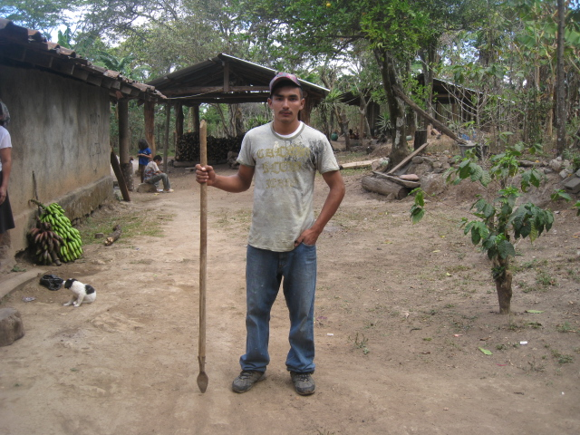
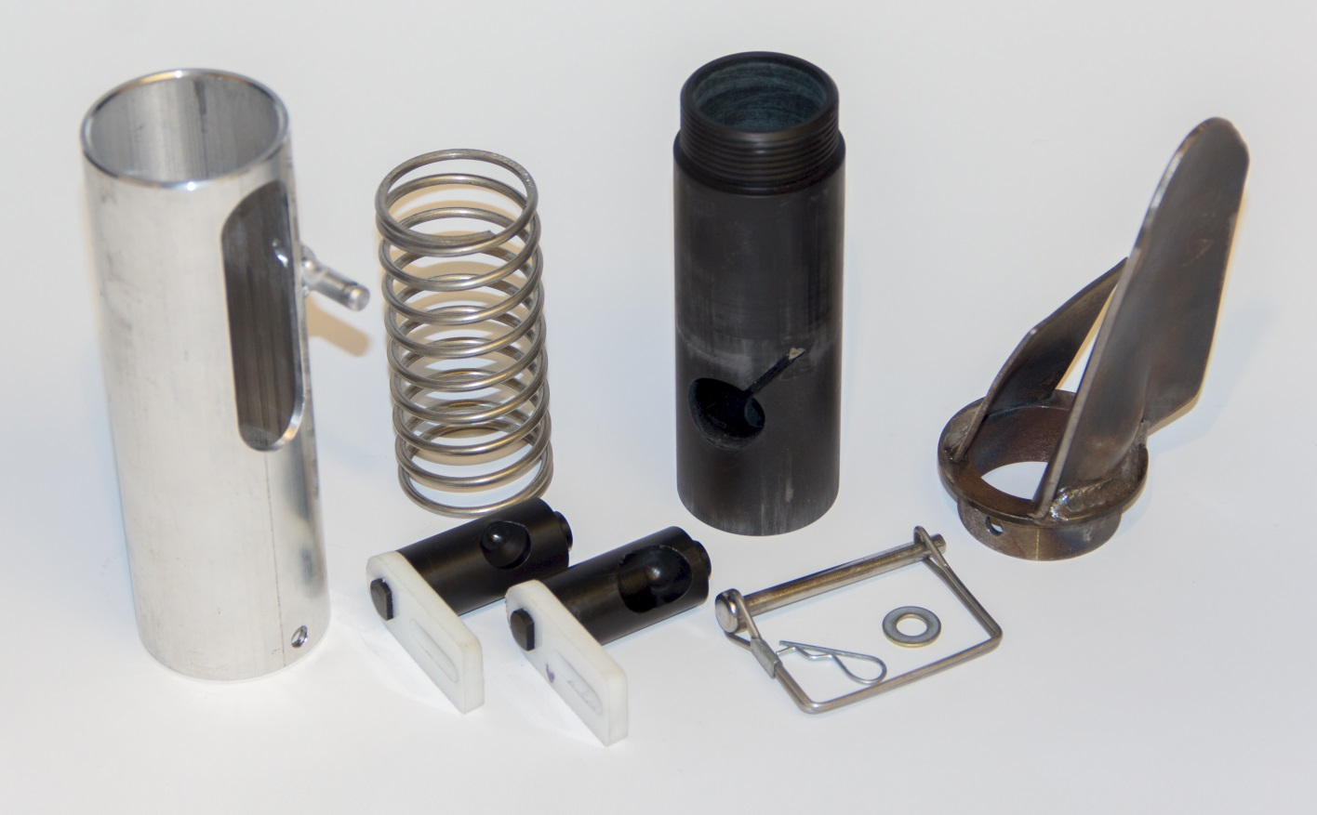
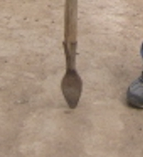
seed size (2653-4344 seeds/kg)
seed type, shape
fertilizer
1,000,000 cycles
0.29g/seed
60,000 seeds/ha
3443 seeds/kg
1.0 kg hopper
17 times refill
http://nue.okstate.edu/Hand_Planter.htm

Slide 13
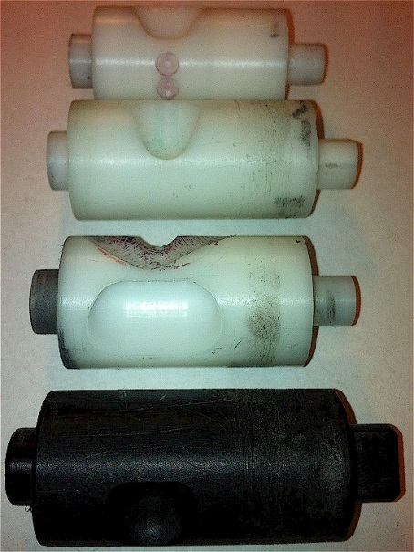
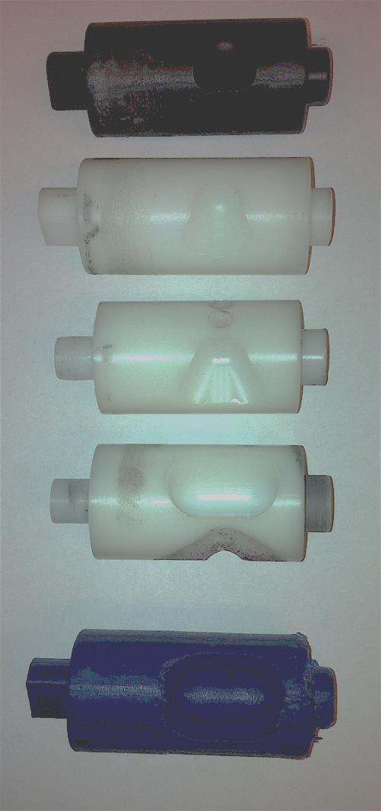
INTERNAL DRUM
Drum | Mass (g) | Volume (cm³)
A | 0.69 | 0.507
B | 0.71 | 0.521
OS | 0.88 | 0.646
OM | 3.36 | 2.468
OC | 3.38 | 2.482

Slide 14
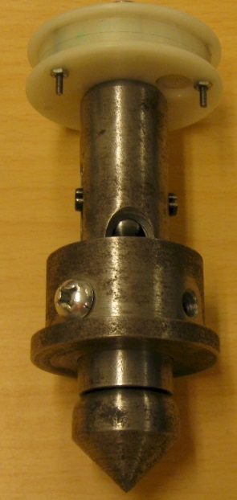
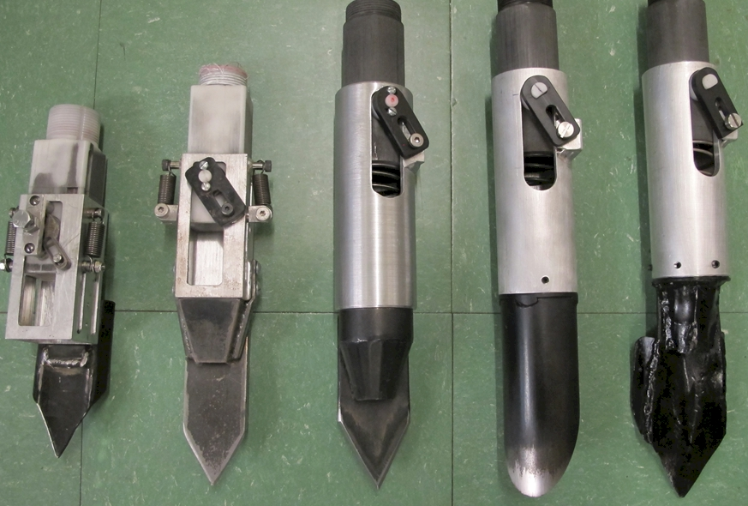
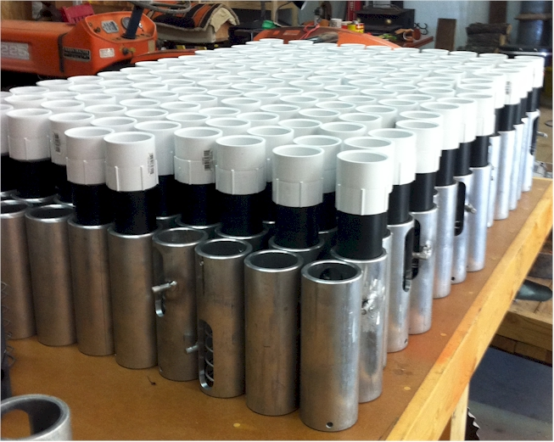

Slide 15
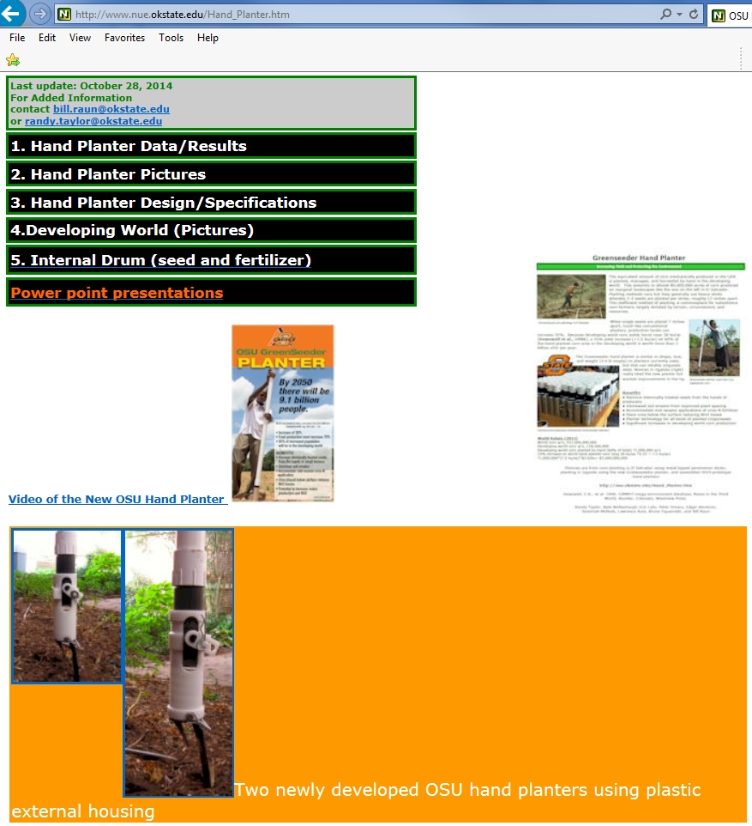

OSU Hand Planter

Slide 16
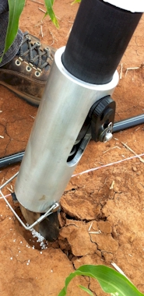
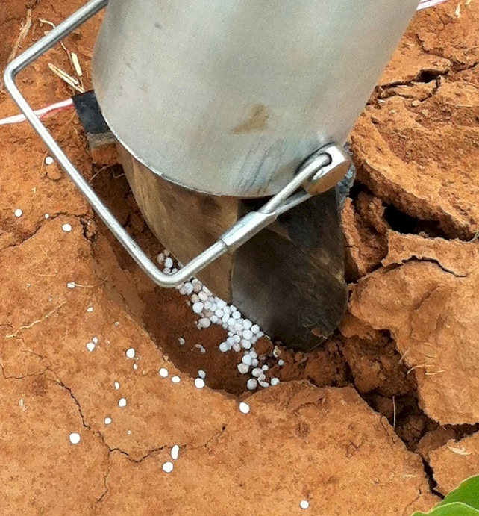
Mid Season Fertilizer N
Combined, Efaw and Perkins, 2013
Topdress N, Corn, V12 |  | 70,000 plants/ha
Methods | N, kg/ha | Mg/ha
Check | 0 | 6.6
Hand planter (0.9 g/plant) | 30 | 11.2
Hand planter (1.8 g/plant) | 60 | 10.6
Broadcast | 30 | 6.4
Broadcast | 60 | 7.0
Dribble urea | 30 | 9.3
Dribble urea | 60 | 7.8
Dribble UAN | 30 | 7.3
Dribble UAN | 60 | 10.4
SED = 1.81

Slide 17
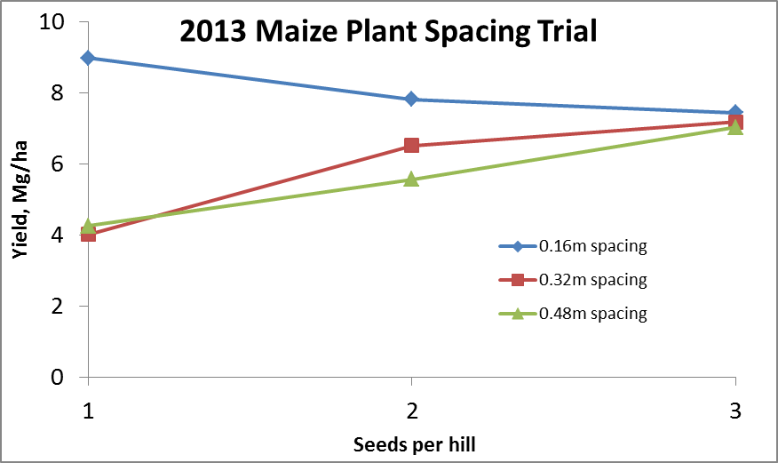
Importance of Singulation
0.76m Row Spacing
Heterogeneity in plant spacing, and plant stands reduce yields
(Bob Nielsen, http://www.agry.purdue.edu/ext/corn/pubs/agry9101.htm)

Slide 18
Nov 13, 2013
SED = 8.6

Slide 19
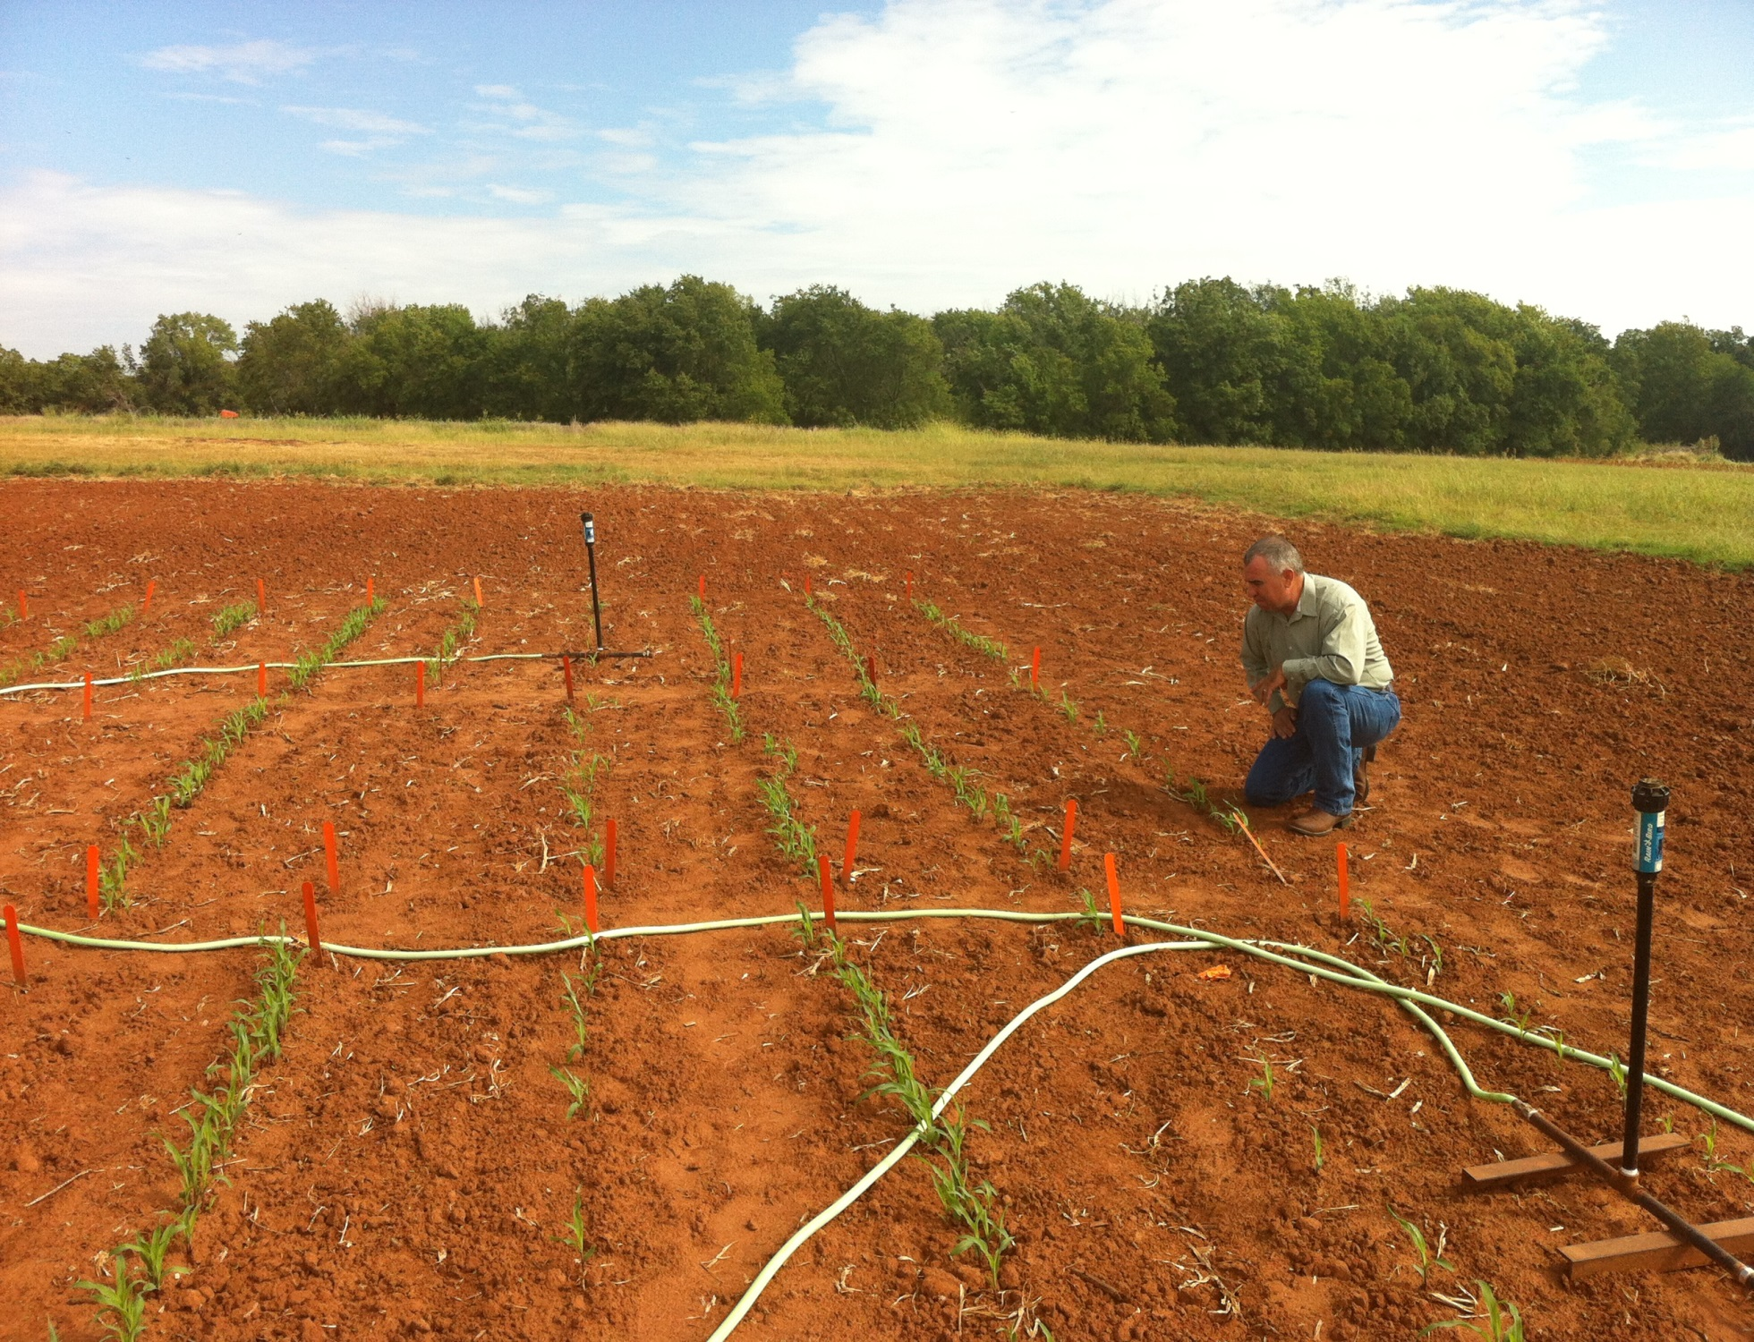
1,000,000 cycles, no failures
1 hectare, 100,000 seeds/ha, 10 years

Slide 20
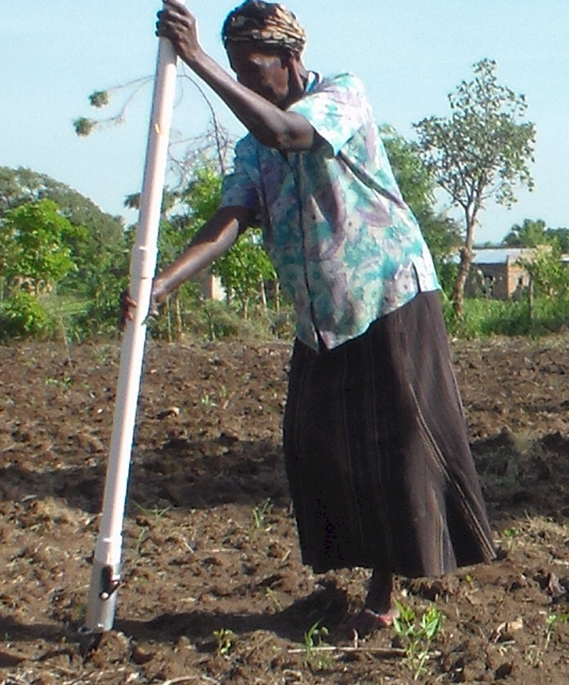
UGANDA

Slide 21
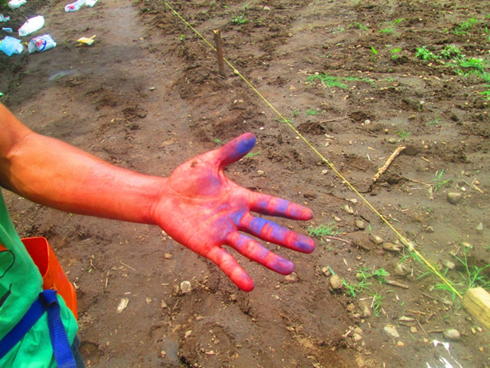
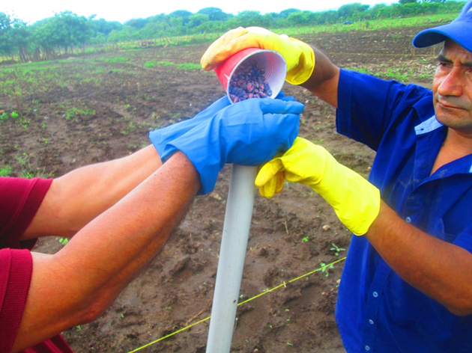
El Salvador, Hand Planter Trials, June, 2014

Slide 22
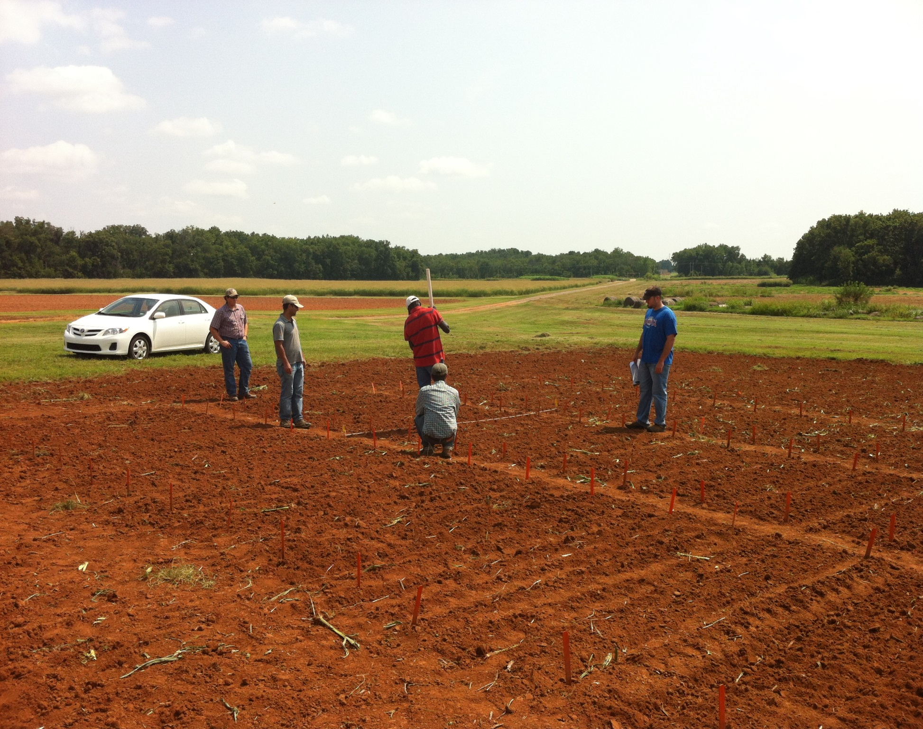

Slide 23
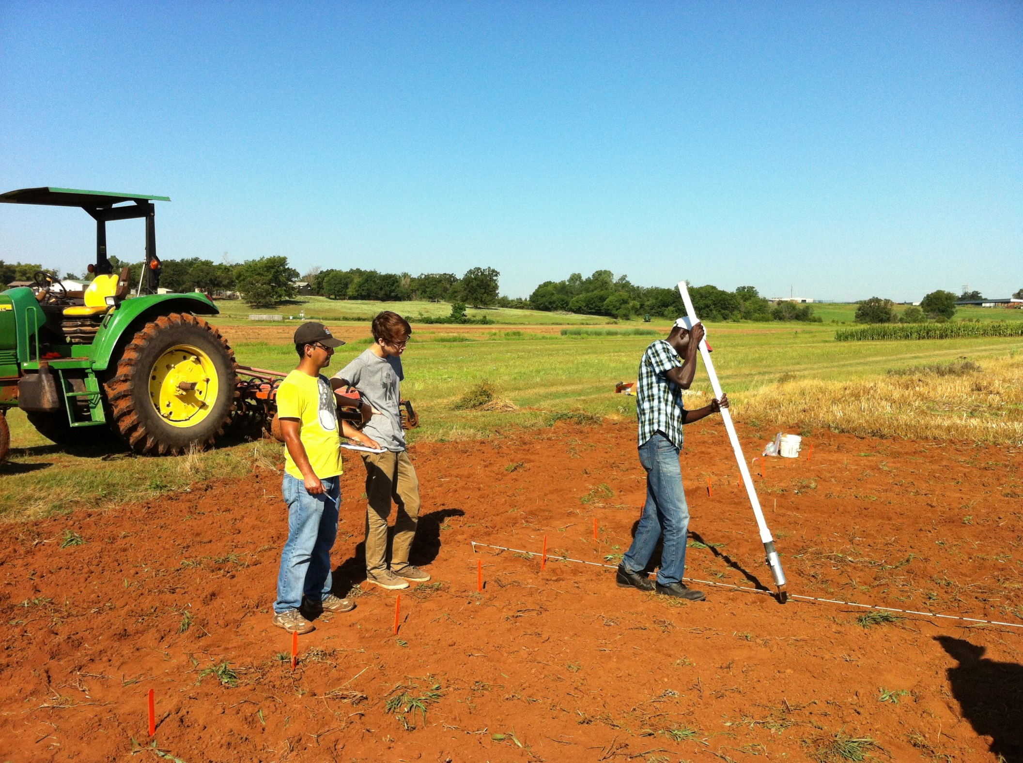



Slide 24
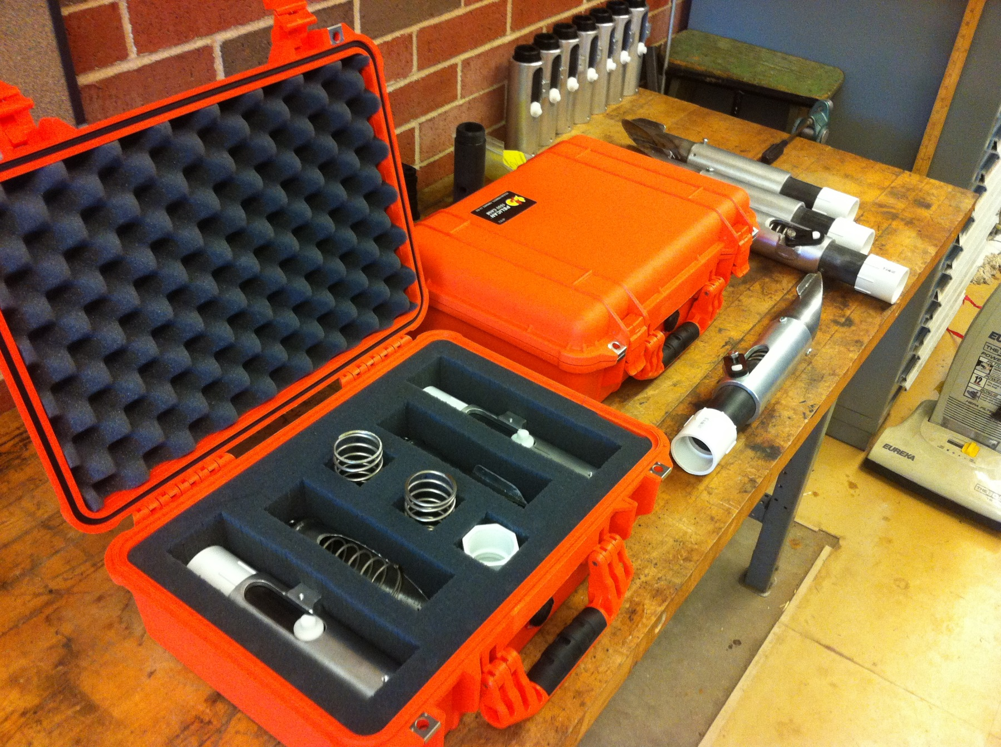
OSU Hand Planter
Thailand Mexico Zambia
El Salvador Guatemala

Slide 25
Benefits
Remove chemically treated seeds from the hands of small farmers
Decrease soil erosion via improved plant spacing
Accommodate mid-season application of urea-N
Place urea below the surface reducing NH3 losses
Potential to increase maize production and NUE
Khim et al. (2014). Over three sites, planting 1 seed, every 0.16m increased yields by an average of 1.15 Mg ha⁻¹ (range, 0.33 to 2.46 Mg ha⁻¹) when compared to the farmer practice of placing 2 to 3 seeds per hill, every 0.48 cm.

Slide 26
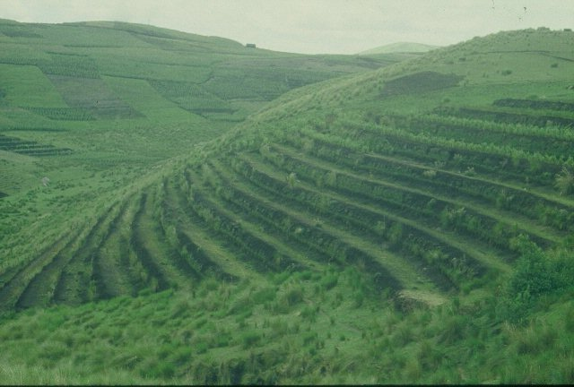
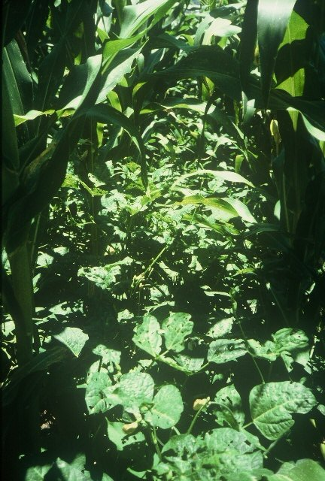
GUATEMALA

Slide 27
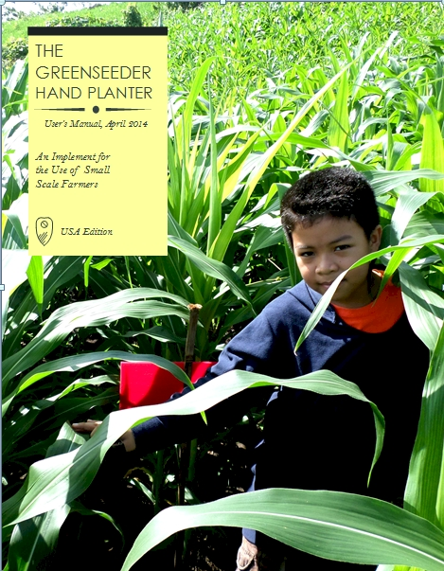
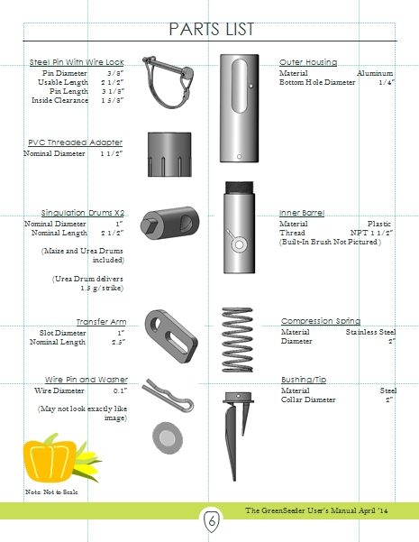
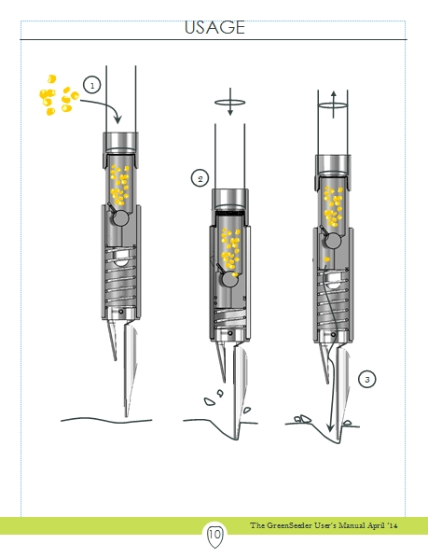
GreenSeeder Manual
http://www.nue.okstate.edu/Hand_Planter/Planter%20User's%20Manual%20EL.pdf

Slide 28
Bangladesh
Burundi
Belize
Brazil
Colombia
El Salvador
Ethiopia
Guatemala
India
Kenya
Malawi Mali
January 2014, on-line hand planter workshop http://nue.okstate.edu/Hand_Planter/osu_hand_planter_workshop.html
Mexico
Mozambique
Sierra Leone
Nepal
Philippines
Tanzania
Togo
Uganda
USA
Zambia
Zimbabwe

Slide 29
“The most conservative man in traditional agriculture is the scientist, and sometimes I am not proud to be one of them. This is most discouraging. The scientist is a privileged person, the man should lead us out of the wilderness of static, underproductive agriculture, and yet by his apathy and failure to exercise his unique vision, he keeps us in the swamp of despair. The scientist fears change because he is in a relatively privileged position in his own society. If there is no breakthrough in yield, he will not be criticized. But if he makes a recommendation and something goes wrong, he may lose his job. “ N.E. Borlaug

