Slide 1

Kansas State University
NUE Meeting,
July 30-August 1, 2018
1996-2018

Slide 2


2018, August, Manhattan, KS (Kansas State Univ.)
2017, August, Baton Rouge, LA (Louisiana State Univ.)
2016, August, Boise, ID (Univ. Idaho)
2015, August, Auburn, AL (Auburn Univ.)
2014, August, Sioux Falls, SD (South Dakota State Univ.)
2013, August, Des Moines, IA (Pioneer Hi Bred)
2012, August, Fargo, ND (North Dakota State Univ.)
2010, August, Stillwater, OK (Oklahoma State Univ.)
2009, August, West Lafayette, IN (Purdue Univ.)
2008, July, Manhattan, KS (Kansas State Univ.)
2007, August, Monmouth IL (Monsanto)
2006, August, Waseca, MN (Univ. Minnesota)
2005, August, Columbia, MO (Univ. Missouri)
2004, August, Lincoln, NE (Univ. Nebraska)
2003, May, Stillwater, OK (Oklahoma State Univ.)
2002, June, Shelton, NE (USDA-ARS, OSU)
2002, January, Lincoln, NE (USDA-ARS, OSU, CIMMYT, Virginia Tech)
2001, July, Stillwater, OK “2X Strip” (USDA-ARS, OSU)
1999, March, Stillwater, OK, Schepers Lecture
1998, June, Lincoln, NE (USDA-ARS, OSU, CIMMYT)
1996, November, Lincoln, NE (USDA-ARS, OSU, CIMMYT)
No registration fee, Jim Schepers
Farmland, 2002

Slide 3
























Objective

Slide 4
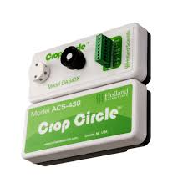
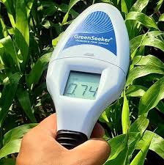

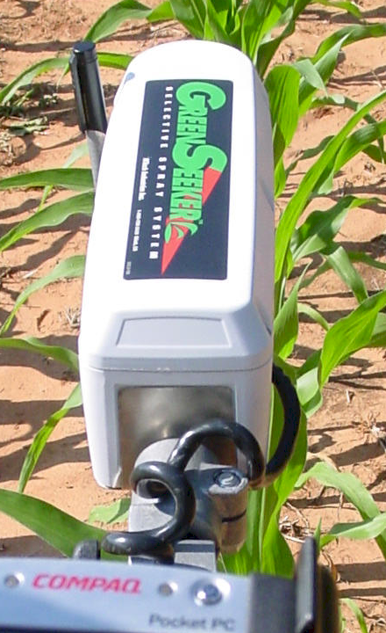



Slide 5
Over 40% of the people on Earth owe their existence to the food production made possible by N fertilizers (Snyder, 2010)
One half of the synthetic N fertilizer used (all time) has been utilized since 1985 (Howarth, 2005)

Slide 6
NUE = (est. grain N removed – est. N from soil/rainfall) / N fertilizer applied
  33% 1999. Agron. J. 91:357–363

Slide 7
http://www.nue.okstate.edu/N_Fertilizers/NUE_definition.html
The Difference Method
= Yield N Fertilized Plot * %N grain – Yield 0N-check * %N grain/Rate of N Fertilizer Applied
2. Macro Statistics Agron J. 91:357-363
= (Yield * %N grain - est. N from soil/rainfall) / N fertilizer applied
3. NUE, Isotopic Recovery (plant N derived from the fertilizer) = (Nu-Nt)/(Nu-(Nf/n))
Nu =atom % 15N in unfertilized plants
Nt = atom % 15N in fertilized plants
Nf = atom % 15N in the fertilizer (example 0.006%) Hauck and Bremner, Adv. Agron. 28:219-266.
4. Percent Fertilizer N Recovery (Varvel and Peterson, Agron. J. 82:935 to 938)
PFR = (NF)-(NC) / R
NF = (Yield * %N grain+stover, fertilized plot)
NC = (Yield * %N grain+stover, unfertilized plots)
R = rate of fertilizer N applied
5. Mass Balance J. Plant Nutr. 26:1561-1580
a. account for N applied,
b. Yield * %N to account for N removed in the grain
c. Yield * estimated plant N loss
d. account for denitrification, nitrate leaching
e. account for non-symbiotic N fixation, N applied in the rainfall,
f. estimate of total soil N (0-30 cm), beginning and end of the experiment
Estimates of NUE

Slide 8
http://www.nue.okstate.edu/N_Fertilizers/NUE_definition.html
The Difference Method
= Yield N Fertilized Plot * %N grain – Yield 0N-check * %N grain/Rate of N Fertilizer Applied
2. Macro Statistics Agron J. 91:357-363
= (Yield * %N grain - est. N from soil/rainfall) / N fertilizer applied
3. NUE, Isotopic Recovery (plant N derived from the fertilizer) = (Nu-Nt)/(Nu-(Nf/n))
Nu =atom % 15N in unfertilized plants
Nt = atom % 15N in fertilized plants
Nf = atom % 15N in the fertilizer (example 0.006%) Hauck and Bremner, Adv. Agron. 28:219-266.
4. Percent Fertilizer N Recovery (Varvel and Peterson, Agron. J. 82:935 to 938)
PFR = (NF)-(NC) / R
NF = (Yield * %N grain+stover, fertilized plot)
NC = (Yield * %N grain+stover, unfertilized plots)
R = rate of fertilizer N applied
5. Mass Balance J. Plant Nutr. 26:1561-1580
a. account for N applied,
b. Yield * %N to account for N removed in the grain
c. Yield * estimated plant N loss
d. account for denitrification, nitrate leaching
e. account for non-symbiotic N fixation, N applied in the rainfall,
f. estimate of total soil N (0-30 cm), beginning and end of the experiment
Estimates of NUE

Slide 9
Variability in Optimum Nitrogen Rates for Maize. Agron. J. 108:2165-2173

Slide 10
Sensor Adoption Motives
Jack Gerhardt, 2006
Rising Price of Nitrogen…Not “cheap” anymore
Falling Relative Price of Corn/Wheat vs. Nitrogen
Diminished Faith in University Recommendations
Growing Acceptance that Mineralization Rates Do Vary
“Greener” Approach… “The right thing to do”
Sensors address seasonal & spatial variability
Producer-friendly technology

Slide 11
2007, The Big Question, Dr. Dave Mengel
Can a N management strategy be developed to:
  Reduce economic risk in bad years?
  Take advantage of the potential of good years?
  Fine-tune N needs in high yielding irrigated crops?
  Reduce environmental risk in sensitive
  environments?
  Enhance profitability in the long run?

Slide 12

Stillwater, OK
2010

Slide 13
Sensor Adoption Barriers
Producer Resistance to Change--Easy to be Sloppy
Present Price of Corn & Wheat—Fear of Yield Loss
Lack of Awareness Regarding Alternative N Strategies
Lack of Clear Direction Among Universities
  pride, lack of funding, insufficient scale, etc.
Inconsistent & Confusing N Management Producer Programs
Equipment Capability and compatibility.
Ag Retailer Business Model.
  Structured around fertilizer volume, soil sampling and low margins—not based on consulting/value/differentiation
Notes:
We have always done it this way… may need 2nd pass of N… fear of giving up yield…never worked with imagery based production before…universities are presently lost when it comes to n rates…ag retailers have to rethink their role.

Slide 14
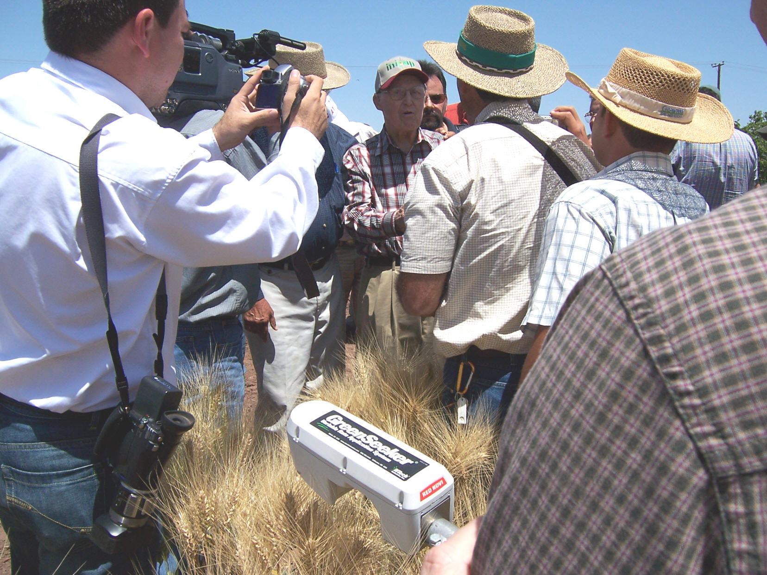
April 16, 2007
Dr. Norman Borlaug
Ciudad Obregon, MX

Slide 15
Plant to Plant Variability in Maize
Minimum, maximum, mean, standard deviation, maximum/minimum and CV for
by-plant maize grain yields from 46 transects in Argentina, Mexico, Iowa, Nebraska, Ohio, Virginia, and Oklahoma, 2002-2004.
________________________________________________________________________________________________________
Location Years Transects Min Yield Max Yield Mean Yield Stdev Max/Min CV
------------------------ kg ha-1----------------------- %
El Batan, Mexico 2002 3 606 9440 4268 1935 22.4 45.3
OK, <6000 kg ha-1 2003-4 12 1128 9169 4652 1724 10.0 37.2
OK, >6000 kg ha-1 2003-4 8 1947 14120 7050 2167 11.6 30.5
Ames, IA, Shelton, NE 2004 4 1872 21173 8320 3660 14.1 46.0
Wooster, OH 2004 1 2066 19458 9759 4367 9.4 50.2
Parana, Argentina 2003 9 2806 28058 11478 4211 15.0 36.8
Painter, VA 2003 4 4753 24552 11943 3171 5.2 26.7
Phillips, NE 2004 5 7098 21492 14383 2926 3.2 20.3
--------------------------------------------------------------------------------------------------------------
All Sites 2002-04 46 2752 17281 8495 2765 11.1 34.3
________________________________________________________________________________________________________
44 bu/ac

Slide 16
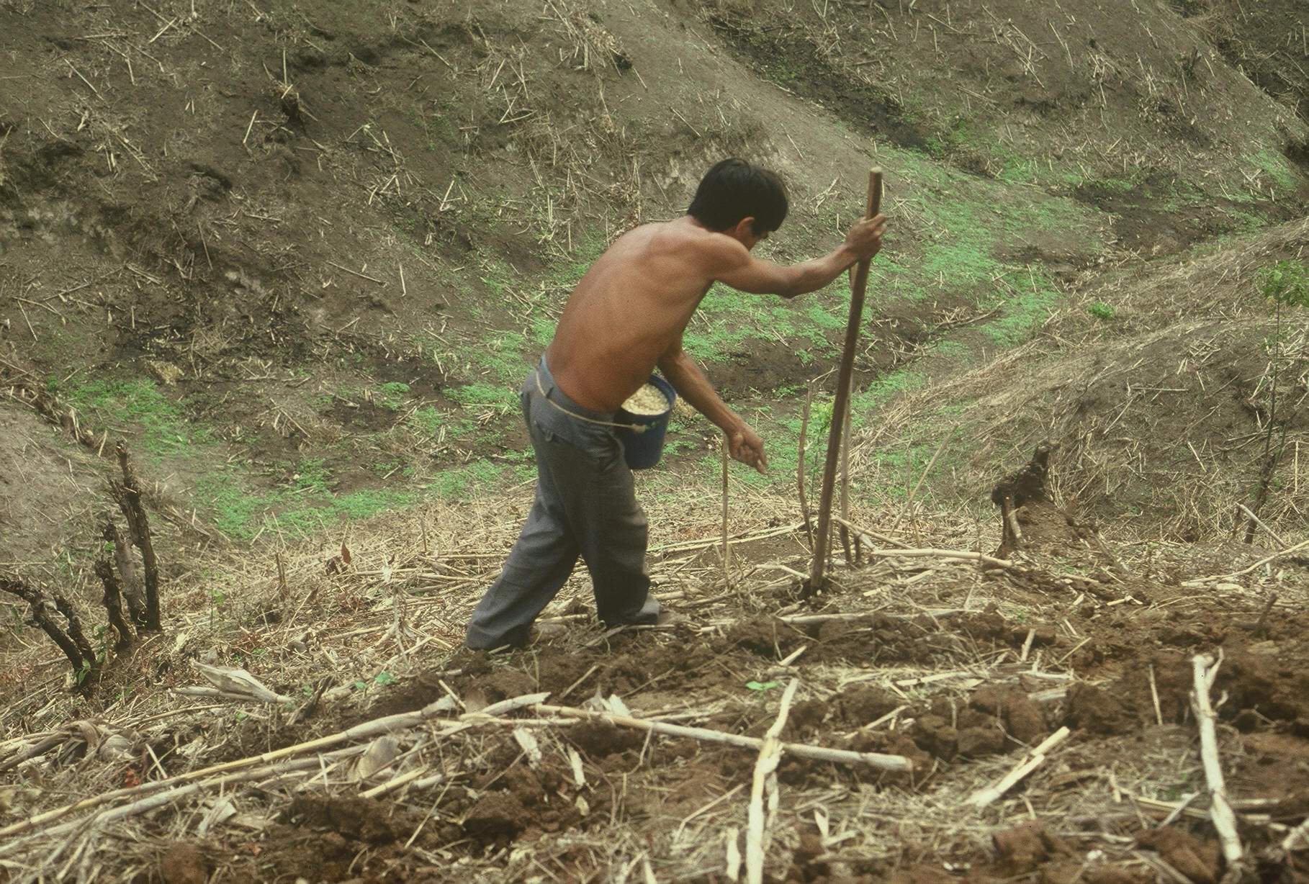

Slide 17
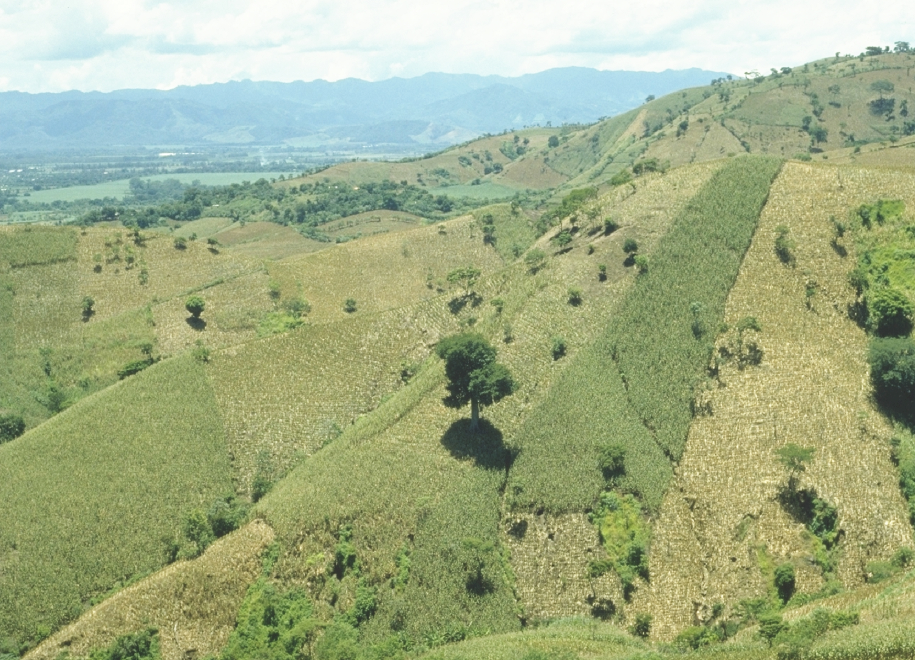

Slide 18
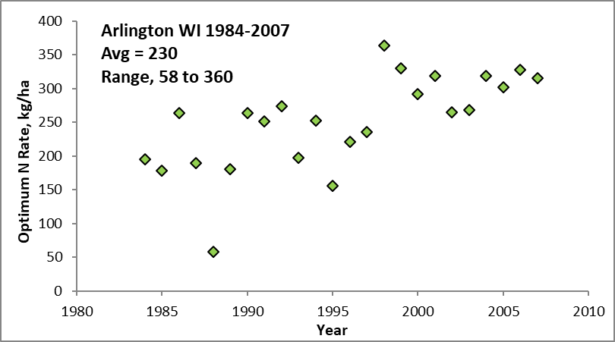
Source | Location | Years | Time period | (0-N) Yield Range | High N Yield Range | Optimum N rate kg ha⁻¹
 |  |  |  | Mg ha⁻¹ | Mg ha⁻¹ | Min | Max | Avg. | SD
Bundy et al. (2011) | WI | 21 | 1958-1983 | 1.6-7.6 | 4.3-8.8 | 50 | 233 | 130 | 53
Bundy et al. (2011) | WI | 9 | 1984-1997 | 2.7-5.6 | 5.7-9.96 | 58 | 235 | 179 | 51
Mallarino and Torres (2006) | IA | 20 | 1979-2003 | 0.8-5.9 | 5.1-12.4 | 81 | 237 | 165 | 49
Mallarino and Torres (2006) | IA | 14 | 1985-2010 | 1.4-6.2 | 5.3-12.8 | 134 | 239 | 197 | 32
Bundy, L.G., T.W. Andraski, M.D. Ruark, and A.E. Peterson. 2011. Long-term continuous maize and nitrogen fertilizer effects on productivity and soil properties. Agron. J. 103:1346–1351. doi:10.2134/agronj2011.0094
Mallarino, A.P., and E. Ortiz-Torres. 2006. A long-term look at crop rotation effects on maize yield and response to N fertilization. In: The Integrated Crop Management Conference Proceedings, Ames, IA. 29–30 Nov. 2006. Iowa State Univ. Ext., Ames. p. 209–213.
Sawyer, J., E. Nafziger, G. Randall, L. Bundy, G. Rehm, and B. Joern. 2006. Concepts and rationale for regional nitrogen rate guidelines for corn. PM 2015. Iowa State Univ. Extension, Ames.

