Slide 1
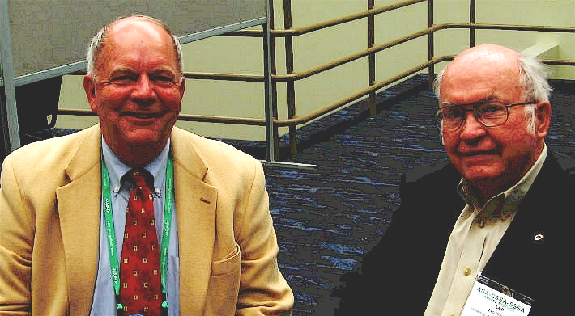

Leo M Walsh Soil Fertility Distinguished Lectureship
Bob Hoeft, Leo M Walsh 2007, New Orleans
Tuesday, November 8, 2016
Josh McGrath, Carrie Laboski
Precision Agriculture for the Developed and Developing World

Slide 2
Leo M. Walsh
L.M. Walsh, M.E. Sumner, D.R. Keeney
Attempts to reduce arsenic toxicity have not been successful, excessive accumulation of As soils should be avoided. Env. Health Perspectives, 1977
K.A. Kelling, L.M. Walsh, D.R. Keeney
Value of sewage sludge. JEQ, 1977
R.G. Hoeft, D.R. Keeney, L.M. Walsh
Atmospheric S deposition 30 kg/ha/yr. Sulfur-deficient alfalfa plants grown in a greenhouse at Madison obtained as much as 73% of their S from the atmosphere. Total N additions ranged from 13 to 30 kg/ha/yr, state average of 20kg/ha/yr. JEQ, 1971

Slide 3
Past Presenters
2015 – William Pan
2014 – Jim Schepers
2013 – Paul Fixen
2012 – Mark Alley
2011 – David Kissel
2010 – Arthur Johnston
2009 – Dave Mengel, Bob Hoeft, Gyles Randall
2008 – Liping Yang
2007 – Mike McLaughlin

Slide 4




Norman Borlaug Mother Teresa
1914 – 2009 1910 - 1997

Slide 5
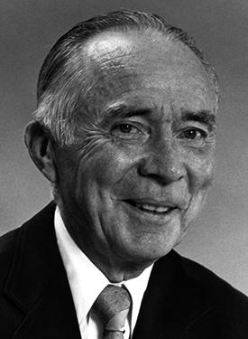
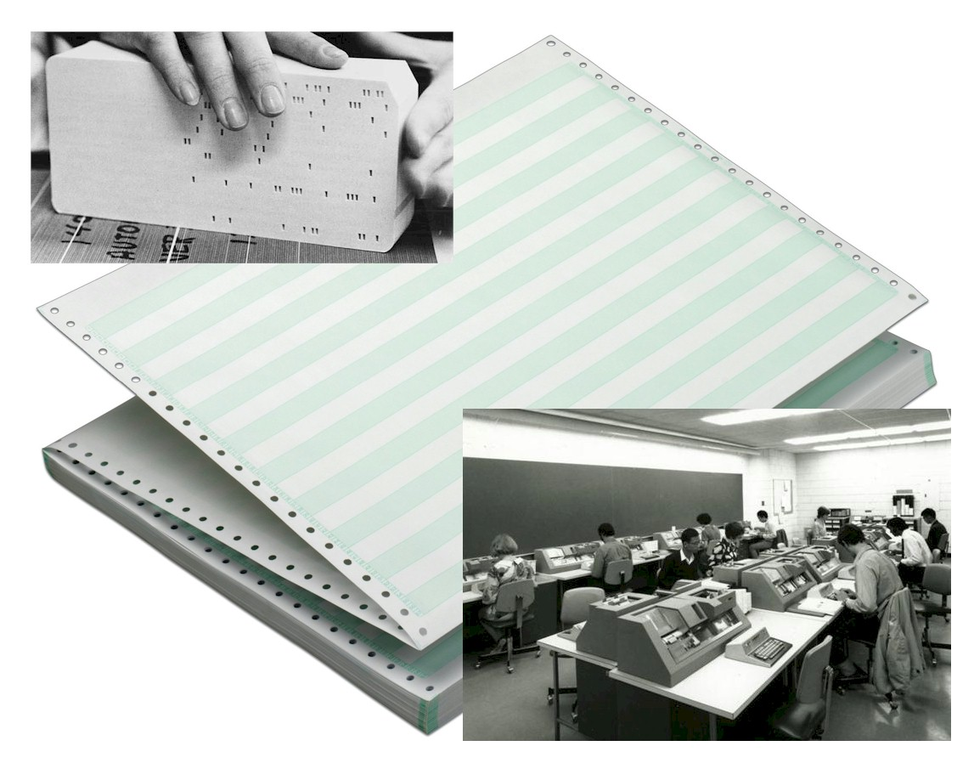

Professor Robert A. Olson
University of Nebraska
Treatment Means, df
Analysis vs Synthesis/Interpretation

Slide 6
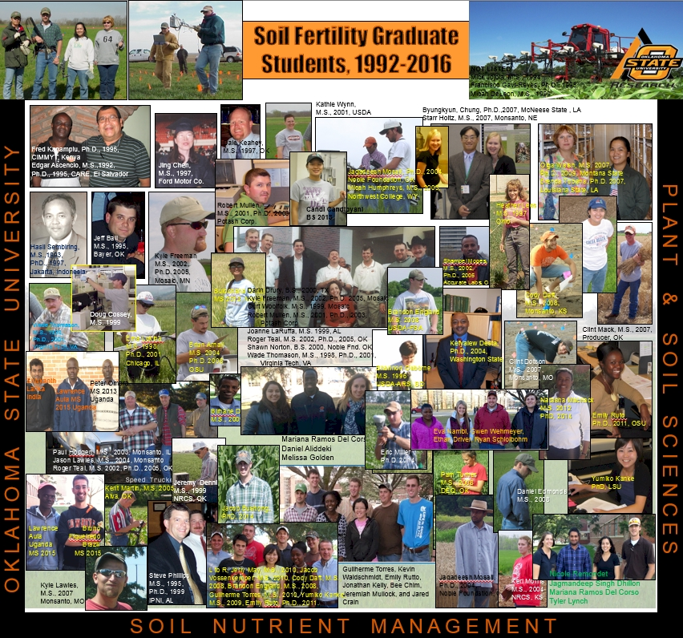
58 MS
26 PhD

Slide 7














PhD Graduates | Year | Location
Edgar Ascencio | 1995 | CARE, El Salvador
Fred Kanampiu | 1995 | IITA, Nigeria
Hasil Sembiring | 1997 | Indonesia
Steve Phillips | 1999 | IPNI, AL
Wade Thomason | 1998 | Virginia Tech, VA
Robert Mullen | 2002 | Potash Corp, OH
Kefyalew Desta | 2004 | Washington State, WA
Kyle Freeman | 2005 | Mosaic, MN
Brenda Tubana | 2007 | LSU, LA
Byungkyun Chung | 2007 | McNeese State, LA
Brian Arnall | 2008 | OSU, OK
Olga Walsh | 2009 | Univ. Idaho, ID
Yesuf Mohammed | 2012 | Montana State, MT
Guilherme Torres | 2012 | Monsanto
Eric Miller | 2014 | Dupont/Pioneer
Jeremiah Mullock | 2014 | Bayer Crop Science
Natasha Macnack | 2014 | Wisconsin
Jake Bushong | 2014 | Private enterprise

Slide 8






MS Graduates | Year | Location
Jeff Ball | 1995 | Bayer Crop Science
Shannon Osborne | 1996 | USDA-ARS, SD
Curt Woolfolk | 2000 | Mosaic, MN
Doug Cossey | 2000 | Servi-Tech, KS
Jason Lawles | 2004 | Monsanto, OK
Keri Morris | 2004 | Hugoton, Kansas
Kyle Lawles | 2006 | Monsanto, OK
Clint Mack | 2006 | Drummond, OK
Clint Dotson | 2007 | Piedmont, OK
Pam Turner | 2008 | Oklahoma City, OK
Cody Daft | 2008 | Oklahoma City, OK
Jake Vossenkemper | 2009 | Univ. Illinois, IL
Yumiko Kanke | 2009 | CA, vertical farming industry, agritecture Precision Agritech Inc.
Jonathan Kelly | 2011 | Sublette, KS
Jared Crain | 2012 | Kansas State Univ. KS
Ethan Wyatt | 2013 | OKC, OK
Peter Omara | 2013 | Gulu University, Uganda
Lawrence Aula | 2014 | Gulu University, Uganda

Slide 9
Journey/Puzzle
Right questions
Right order
Right product

Slide 10
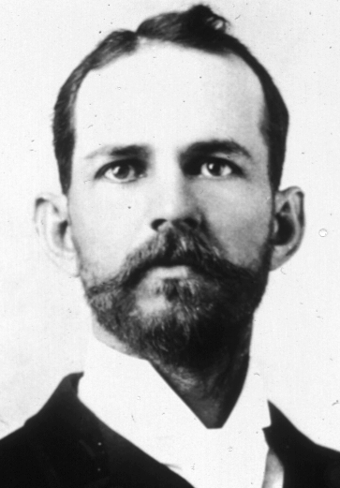
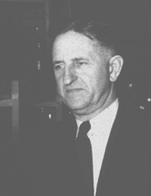
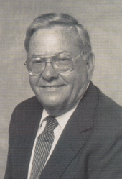


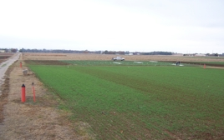
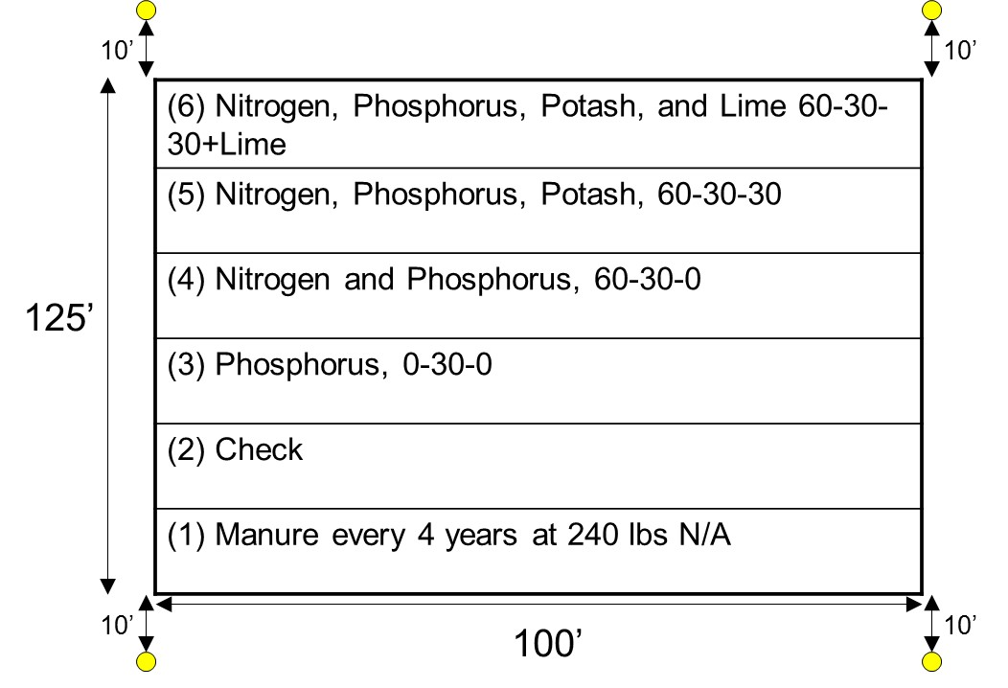
125th Harvest, June 2017
Appl. Environ. Micro. 70:5868-5874. Cyanobacteria
AC Magruder, 1892
Horace Harper, 1926-1951 (25)
Billy Tucker, 1957-1976 (19)
Robert Westerman, 1977-1991 (14)
1991-2016 (25)

Slide 11
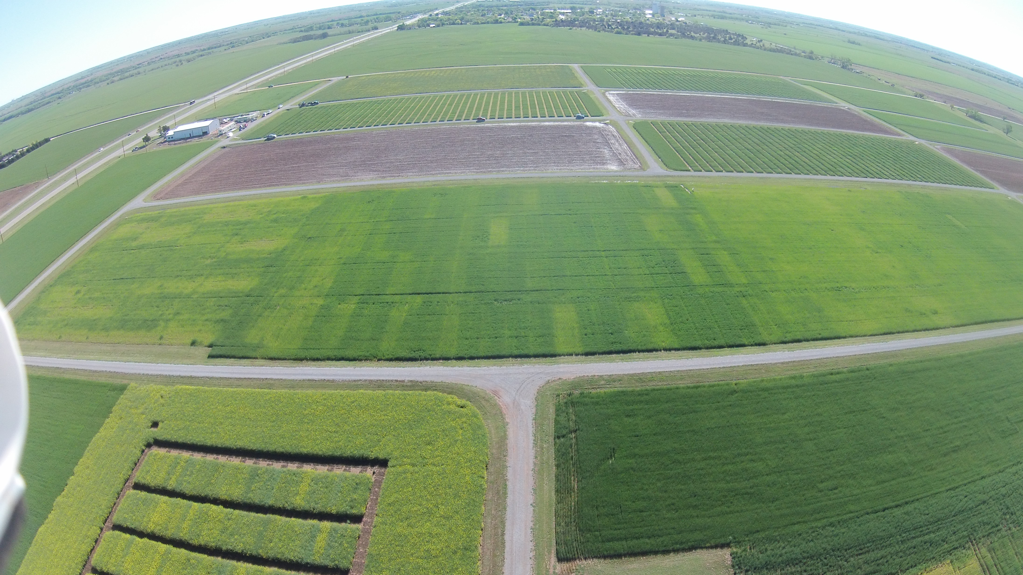
Experiment 502, 1970-present
Lahoma, OK
Work with Engineers
Work with colleagues, Jim Schepers, Newell Kitchen, left, right
Resistance and the right track

Slide 12
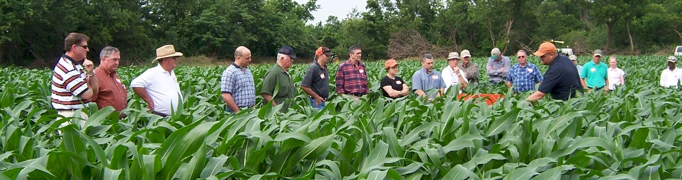

Becoming a Nitrogen Cycle Ninja
Growmark Advanced Agronomy day,
Tuesday, February 3, 2015, Bloomington, IL
Howard Brown
Retention of cyclic information in biological sciences is poor.
Nitrogen cycle is more than just a ‘graphic cycle.’ It is a living cycle that embeds decision and consequence
Nitrogen Cycle Ninja’s have comprehensive understanding of N dynamics, authenticated via this achievement

Slide 13
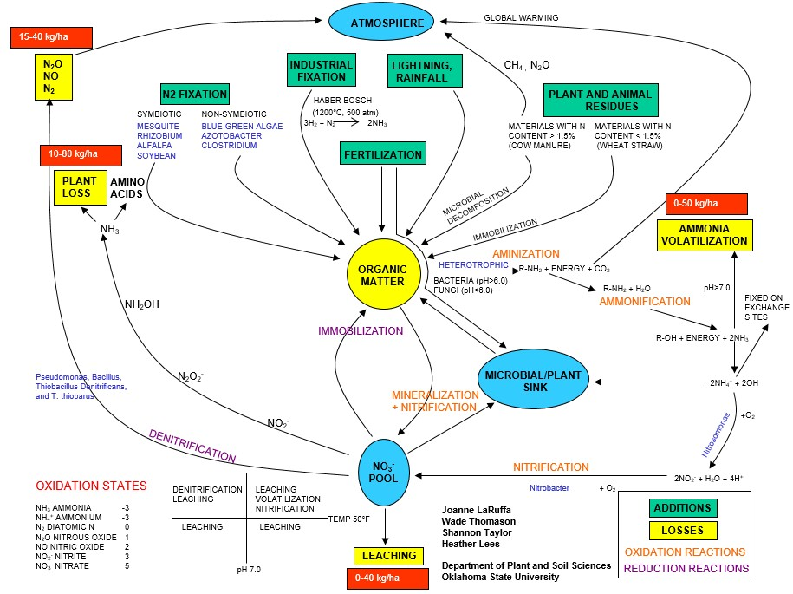

Slide 14

Agron. J. 91:357-363 (pdf)
NUE
NUE for cereal grain production = 33%
Agronomy Journal 91:357-363
Estimated NH3 plant loss, 4-28 kg N/ha
J. Plant Nutr. 20:389-404
Plat loss as NH3 increased at higher N rates
J. Plant Nutr. 23:219-230

Slide 15
NUE Sub-Saharan Africa
100 % NUE
Continued rise in price, elevated economic risk of N fertilization
Existing low yield levels of cereal production
High NUE’s, result of applying so little fertilizer N, at the expense of mining an already depleted soil resource
Edmonds, Daniel E., Silvano L. Abreu, Adelheid West, Donna R. Caasi, Travis O. Conley, Michael C. Daft, Birehane Desta, Brandon B. England, Chelsea D. Farris, Tia J. Nobles, Nehaben K. Patel, Elliott W. Rounds, Brennan H. Sanders, Samar S. Shawaqfeh, Lakmini, Lokuralalage, Roji Manandhar, and W. R. Raun. 2009. Cereal nitrogen use efficiency in Sub Saharan Africa. J. Plant Nutr. 32:2107-2122.
5L 2F 5000

Slide 16
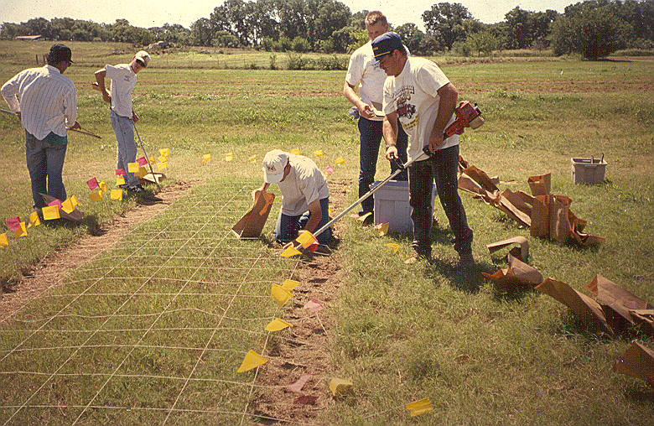
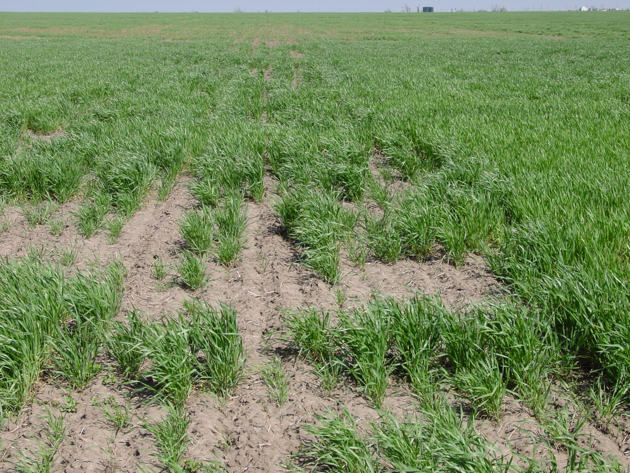
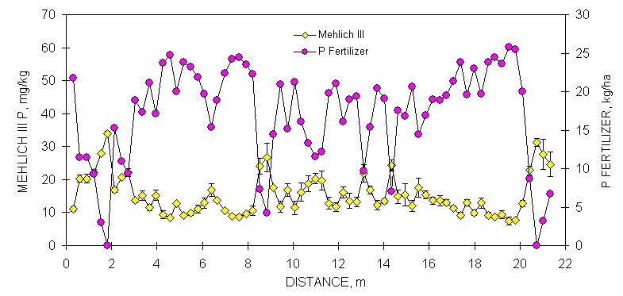
Resolution

Slide 17
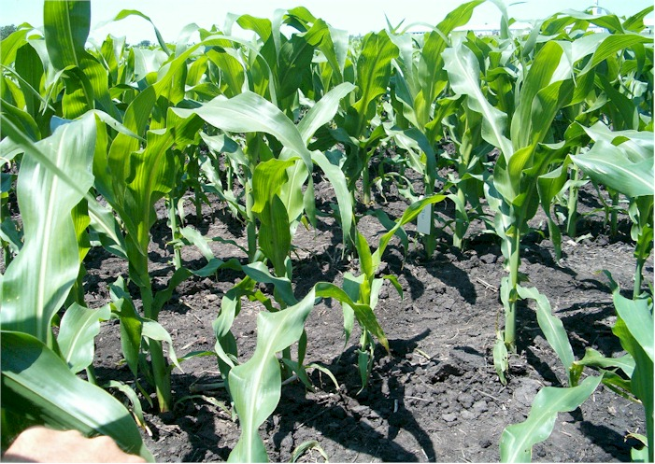
Iowa

Slide 18
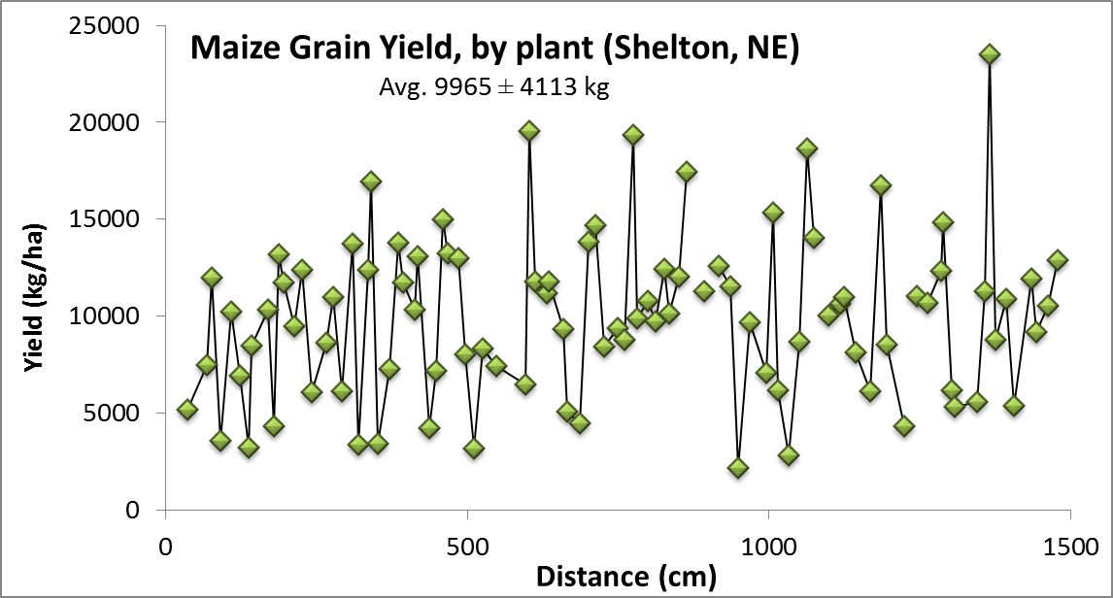
By-plant grain yields
Plant-to-Plant Variability in Corn Production. 2005. Agron. J. 97:1603-1611.

Slide 19
40 transects,
Argentina, Mexico, Iowa, Nebraska, Ohio, and Oklahoma, 2002-2004.
______________________________________________________________________________
Location Years Trans. Min Max Mean Stdev Max/Min CV
------------------------ kg/ha ------------------------ %
Oklahoma, <6000 kg/ha 2003-4 11 1128 9169 4652 1724 10.0 37.2
Oklahoma, >6000 kg/ha 2003-4 8 1947 14120 7050 2167 11.6 30.5
Ames, Iowa, Shelton, NE 2004 4 1872 21173 8320 3660 14.1 46.0
Phillips, NE 2004 5 7098 21492 14383 2926 3.2 20.3
Ohio 2004 1 2066 19458 9759 4367 9.4 50.2
El Batan, MX 2002 3 606 9440 4268 1935 22.4 45.3
Argentina 2003 9 2806 28058 11478 4211 15.0 36.8
All Sites 02-04 40 2410 17034 8173 2746 11.8 35.2
______________________________________________________________________________
Plant-to-plant variability in corn grain yield can be expected, averaged more than 2765 kg/ha (44 bu/ac) over sites and years. Agron. J. 97:1603-1611.

Slide 20
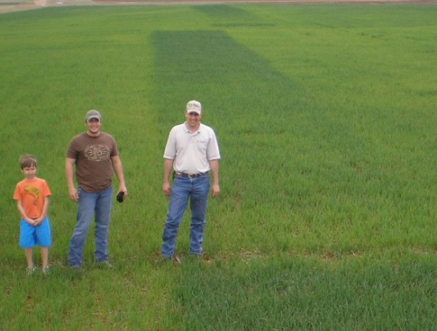
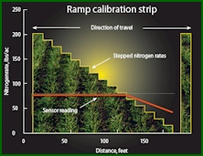
Nitrogen RAMPS
Optimum N rates in the same field vary as do N rates from year to year
2016. Variability in optimum nitrogen rates for maize. Agron. J. 108

Slide 21
Ramp Calibration Strips

Slide 22
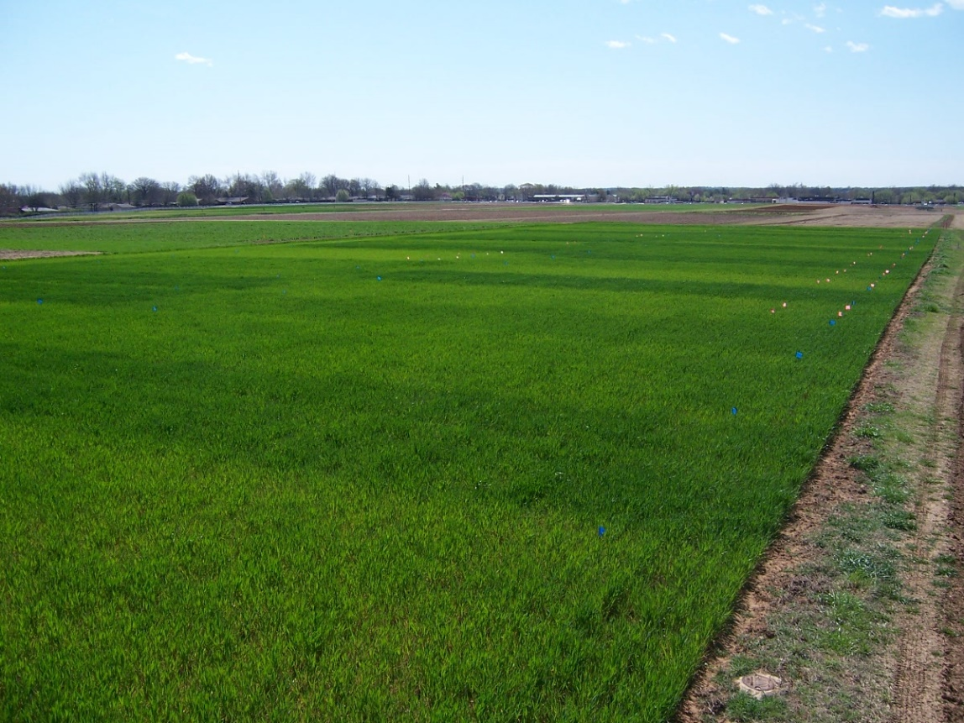
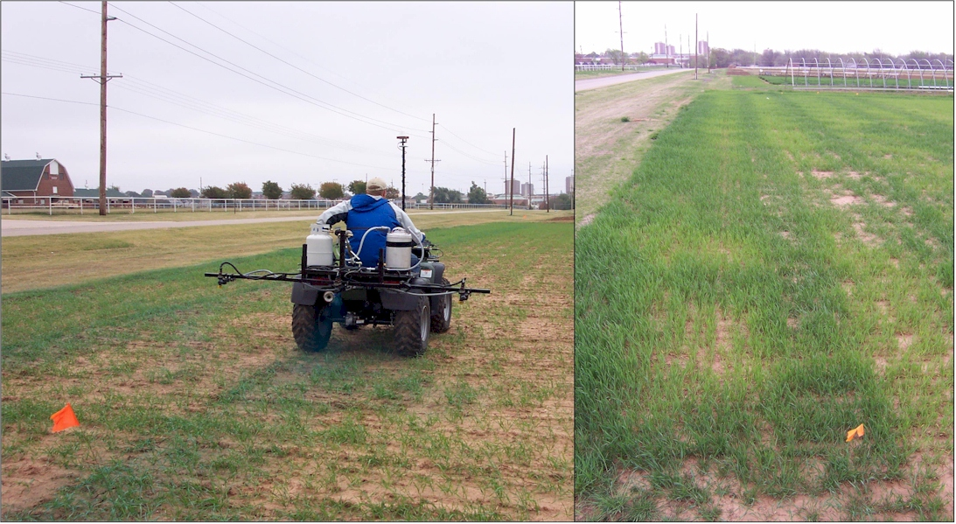
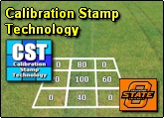
Experiment 222
Stillwater, OK
est. 1969, 48 years, 2016
Calibration Stamps
Optimum N rate changed within each 9 m2

Slide 23
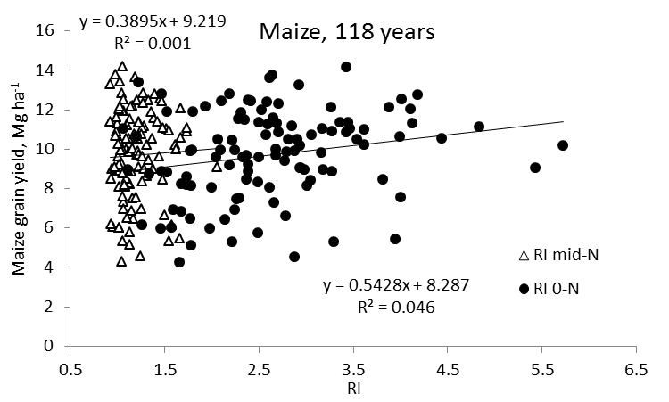
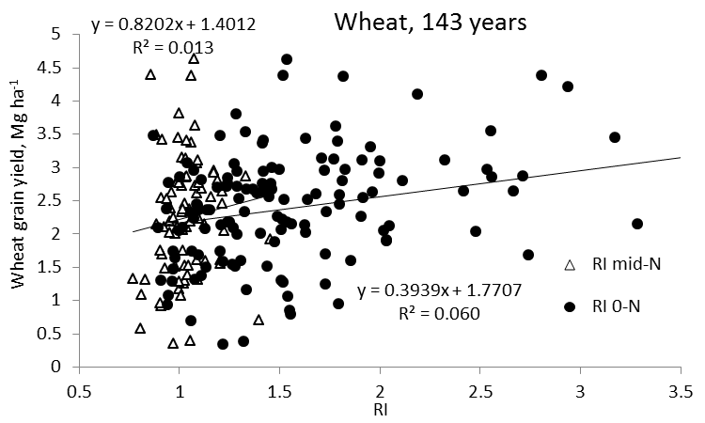
Independence of Yield potential and Nitrogen response
Iowa
Nebraska
Wisconsin
Oklahoma
2013. Relationship between grain crop yield potential and nitrogen response. Agron. J. 105:1335–1344.
Independence of yield potential and crop nitrogen response. Precision Agric. 12:508-518.

Slide 24
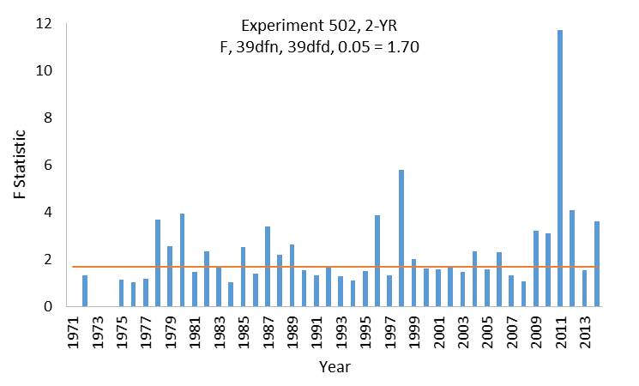
For 83 site years of data, combining any two or three consecutive year-periods was not advisable. Individual years should be analyzed and reported on independently.
2015. Relationship between mean square errors and wheat grain yields in long-term experiments. J. Plant Nutr.

Slide 25
Maize grain yield for the check (0N), high N treatment and optimum N rate in 26 field experiments , 213 site years of published data, 1958-2010.
Source | Location | Years | Time period | † (0-N) Yield Range | ‡ High N Yield Range | *Optimum N rate kg ha⁻¹
 |  |  |  | ---- Mg ha⁻¹ ---- |  | Min | Max | Avg. | SD
Bundy et al. (2011) | WI | 21 | 1958-1983 | 1.6-7.6 | 4.3-8.8 | 50 | 233 | 130 | 53
Bundy et al. (2011) | WI | 9 | 1984-1997 | 2.7-5.6 | 5.7-9.96 | 58 | 235 | 179 | 51
Mallarino and Torres (2006) | IA | 20 | 1979-2003 | 0.8-5.9 | 5.1-12.4 | 81 | 237 | 165 | 49
Mallarino and Torres (2006) | IA | 14 | 1985-2010 | 1.4-6.2 | 5.3-12.8 | 134 | 239 | 197 | 32
Varvel et al. (2007) | NE | 5 | 1995-2005 | 6.6-10.9 | 10.4-13.3 | 73 | 193 | 131 | 49
Jokela et al. (1989) Carroll | MN | 3 | 1982-1984 | 5.5-7.3 | 7.1-9.1 | 5 | 131 | 84 | 69
Jokela et al. (1989) Webster | MN | 3 | 1982-1984 | 1.7-5.6 | 1.8-8.7 | 70 | 113 | 91 | 21
Fenster et al. (1976) Waseca | MN | 5 | 1970-1975 | 3.2-7.4 | 7.1-10.6 | 60 | 199 | 135 | 50
Fenster et al. (1976) Martin A | MN | 7 | 1970-1976 | 3.8-8.2 | 4.0-9.6 | 23 | 126 | 69 | 36
Fenster et al. (1976) Martin B | MN | 6 | 1971-1976 | 6.2-11.3 | 6.2-12.0 | 0 | 37 | 18 | 15
Al Kaisi et al. (2003) | CO | 3 | 1998-2000 | 5.6-10.2 | 8.3-10.8 | 66 | 111 | 91 | 23
Ismail et al. (1994) NT | KY | 20 | 1998-2000 | 2.1-7.4 | 5.2-10.9 | 35 | 230 | 128 | 46
Ismail et al. (1994) CT | KY | 20 | 1970-1990 | 1.9-9.5 | 3.5-10.4 | 0 | 203 | 98 | 52
Rice et al. (1986) NT | KY | 15 | 1970-1985 | 3.1-4.9 | 5.7-9.2 | 102 | 178 | 144 | 30
Rice et al. (1986) CT | KY | 15 | 1970-1985 | 1.9-6.1 | 5.0-8.8 | 69 | 204 | 124 | 47
Stecker et al. (1993) Columbia | MO | 3 | 1988-1990 | 3.3-5.6 | 6.0-10.1 | 99 | 194 | 153 | 49
Stecker et al. (1993) Novelty | MO | 3 | 1988-1990 | 4.5-7.2 | 6.7-9.9 | 45 | 182 | 103 | 71
Stecker et al. (1993) Corning | MO | 2 | 1989-1990 | 5.0-6.0 | 8.2-8.5 | 90 | 117 | 104 | 20
Peterson et al. (1989) | NE | 4 | 1983-1986 | 2.1-6.4 | 3.9-10.0 | 11 | 218 | 104 | 88
Eck (1982) | TX | 2 | 1977-1978 | 2.7-4.4 | 5.6-5.9 | 59 | 116 | 88 | 40
Shapiro et al. (2006) RS 51cm | NE | 3 | 1996-1998 | 6.2-8.9 | 9.4-11.1 | 69 | 96 | 83 | 13
Shapiro et al. (2006) RS 76cm | NE | 3 | 1996-1998 | 5.0-8.9 | 7.1-11.0 | 13 | 114 | 75 | 54
Meisinger et al. (1985) MT | MD | 4 | 1974-1977 | 1.8-2.6 | 5.8-8.2 | 127 | 233 | 183 | 45
Meisinger et al. (1985) PT | MD | 4 | 1974-1977 | 2.7-4.2 | 5.1-8.1 | 36 | 196 | 142 | 75
Gehl et al. (2005) Rossville | KS | 2 | 2001-2002 | 6.4-7.9 | 11.3-12.6 | 182 | 204 | 193 | 15
Gehl et al. (2005) Scandia | KS | 2 | 2001-2002 | 2.7-7.4 | 3.8-11.5 | 51 | 160 | 105 | 77
Total |  | 213 |  |  | Average | 62 | 173 | 120 | 45
 |  |  |  |  | SD | 44 | 55 | 43 | 20

Slide 26
Yield Goals
Average of the last 3 or 5 years + 20% versus observed yield

Slide 28
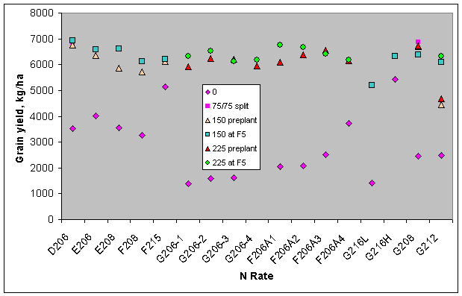
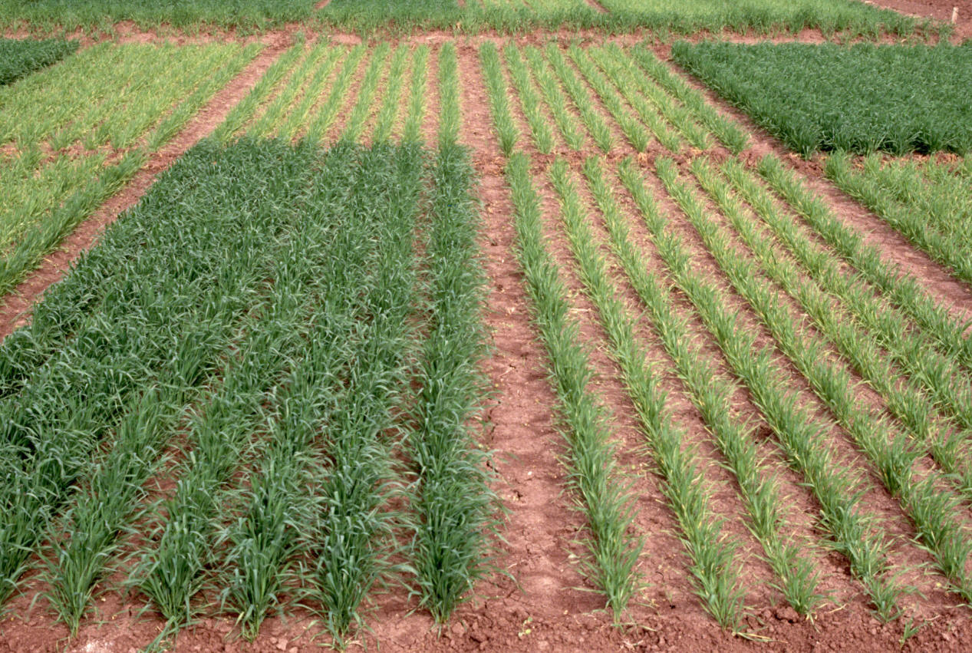

Ortiz-Monasterio, Mexico

Slide 29
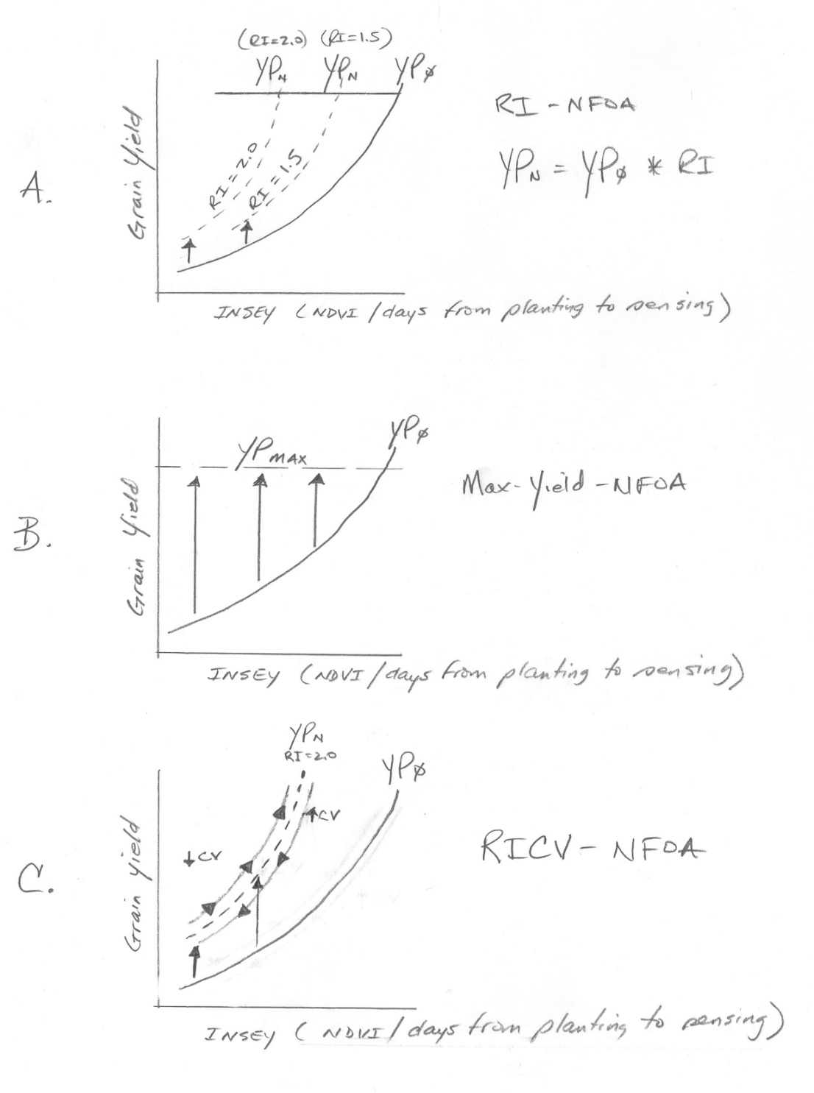
N theory
N algorithm

Slide 30
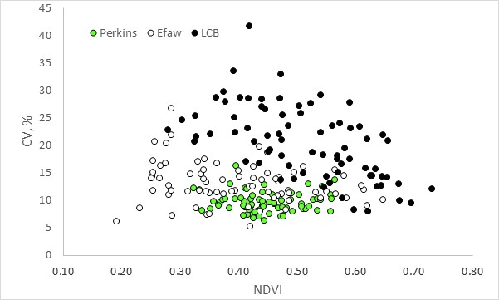
CV Independent of scale
CV Encumbers N Rate risk
Growth Stage, Development, and Spatial Variability in Corn Evaluated Using Optical Sensor Readings J. Plant Nutr. 28:173-182

Slide 31
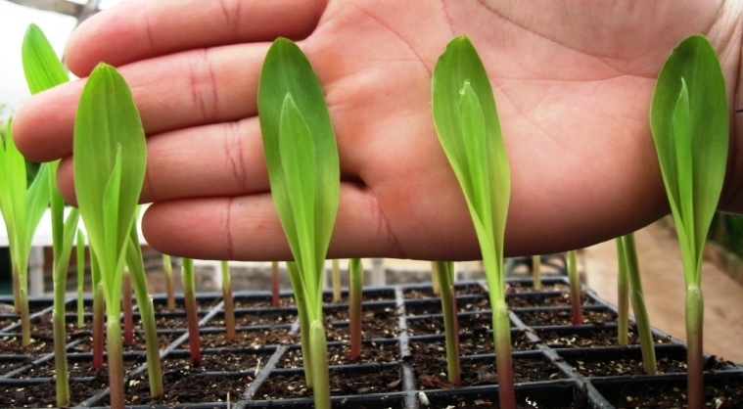
Precision Planting of Corn (Zea mays L.) to Manipulate Leaf Geometry
2011. Maize (Zea mays L.) Leaf Angle and Emergence as Affected by Seed Orientation at Planting. J. Exp. Agric. doi:10.1017/S001447971100038X.

Slide 32
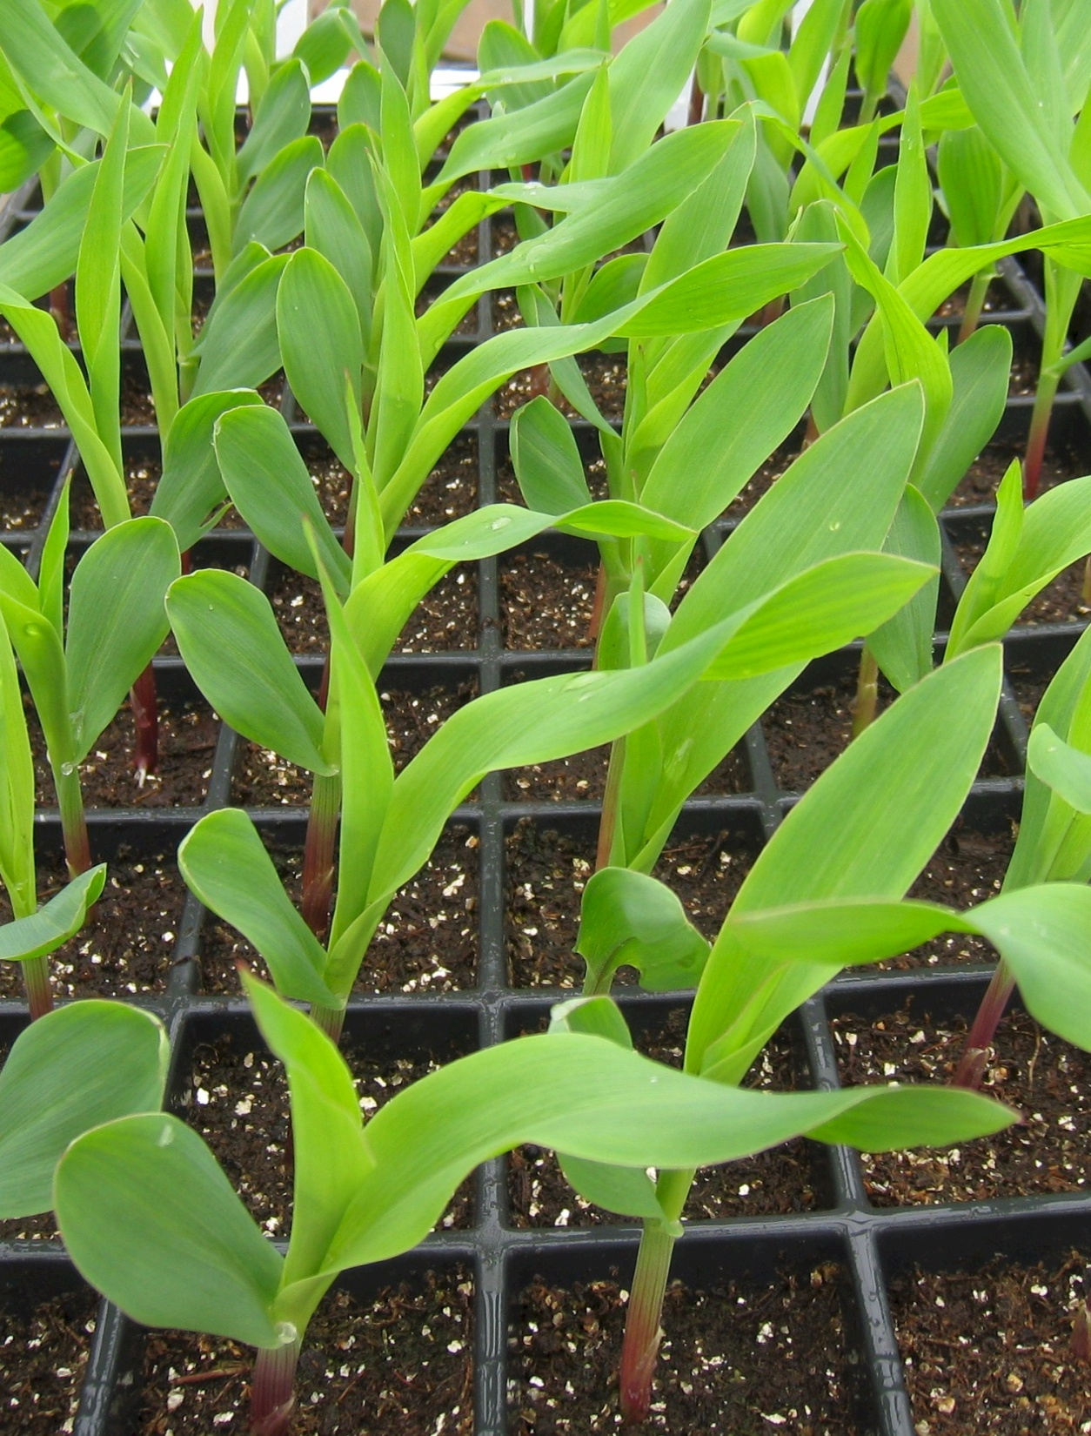
What could be done to better see each plant, Yield Increase

Slide 33
Synthesis
Yield potential and N responsiveness are independent. 0-N check plot yielded the same as the high N rate plot after years of continuous maize production.
Demand for fertilizer N changes every year as do optimum N rates
Static N recommendations do not account for the variability in soil available N and maize N uptake as influenced by environment (temperature/rainfall)
Value of long-term research / sensor CV
32 algorithms/SBNRC

Slide 34
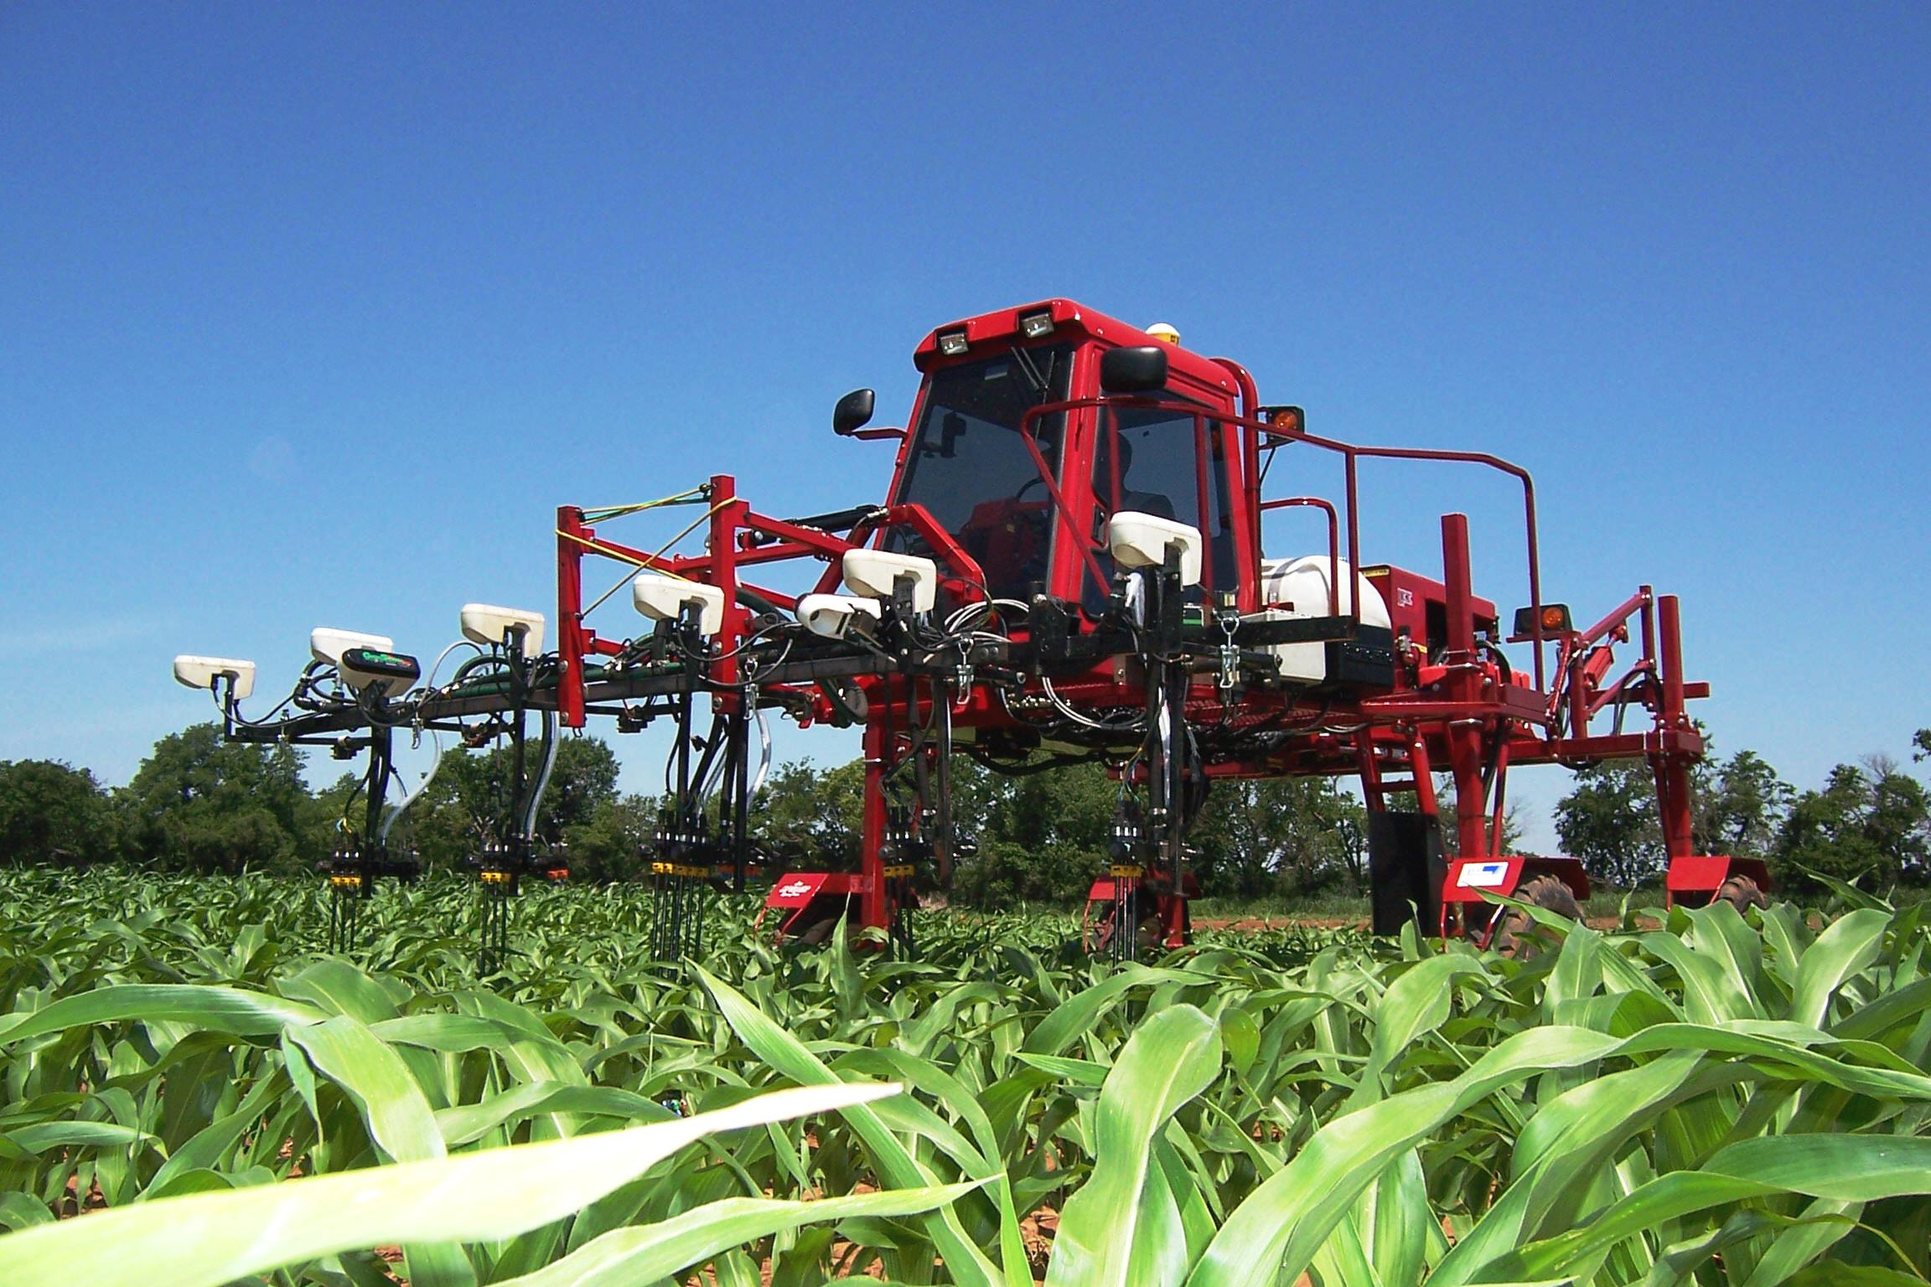
Dr. Marvin Stone, Dr. John Solie, Dr. Randy Taylor
RESOLUTION
Predict yield / yield potential (YP0)
In season estimate of N response (RI)
Estimate N removal (YPN)
CV, weight /sensor-x
Algorithm for N Rate
right order
engineering
wheat/corn

Slide 35
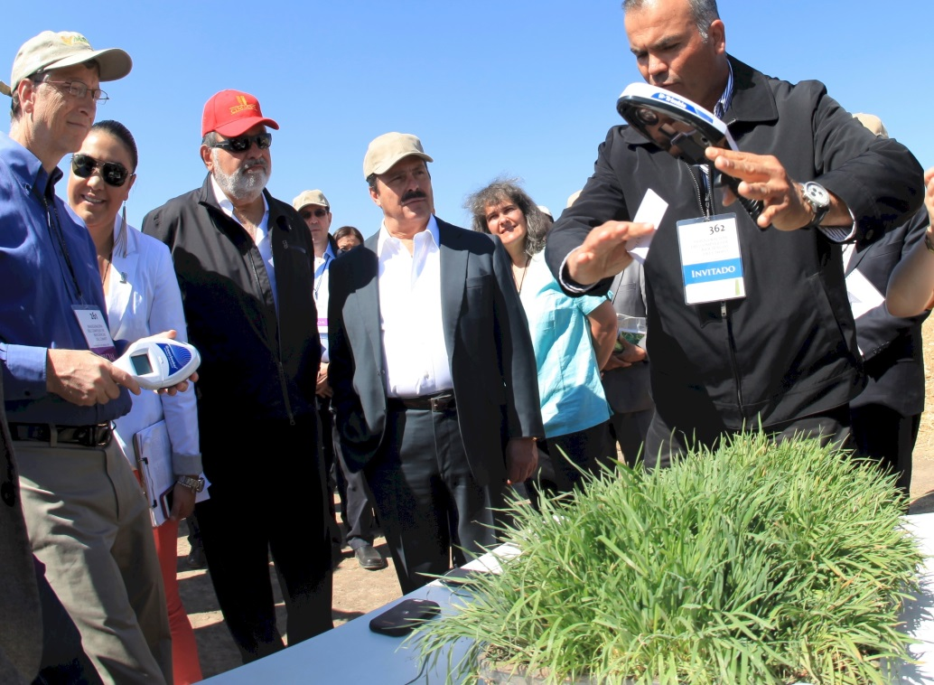
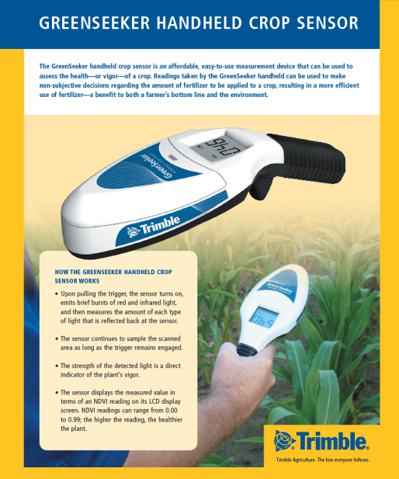
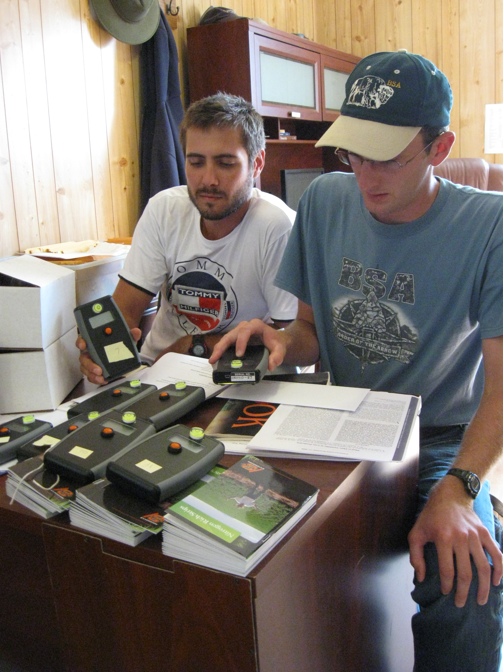


Slide 36
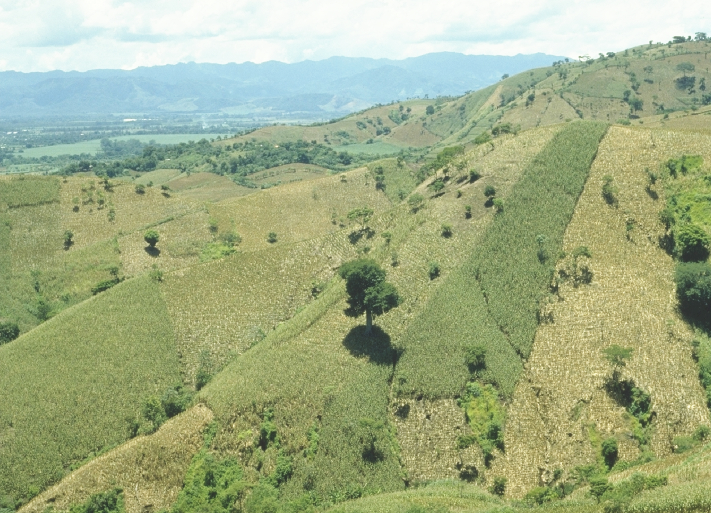
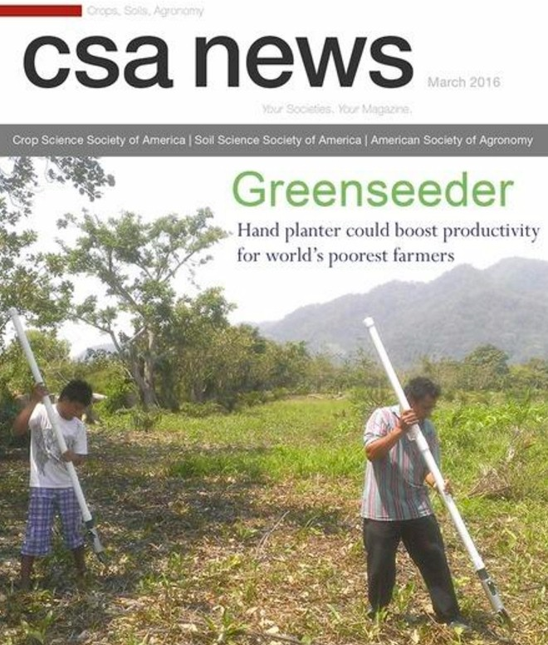
Opico Quezaltepeque, El Salvador

Slide 37
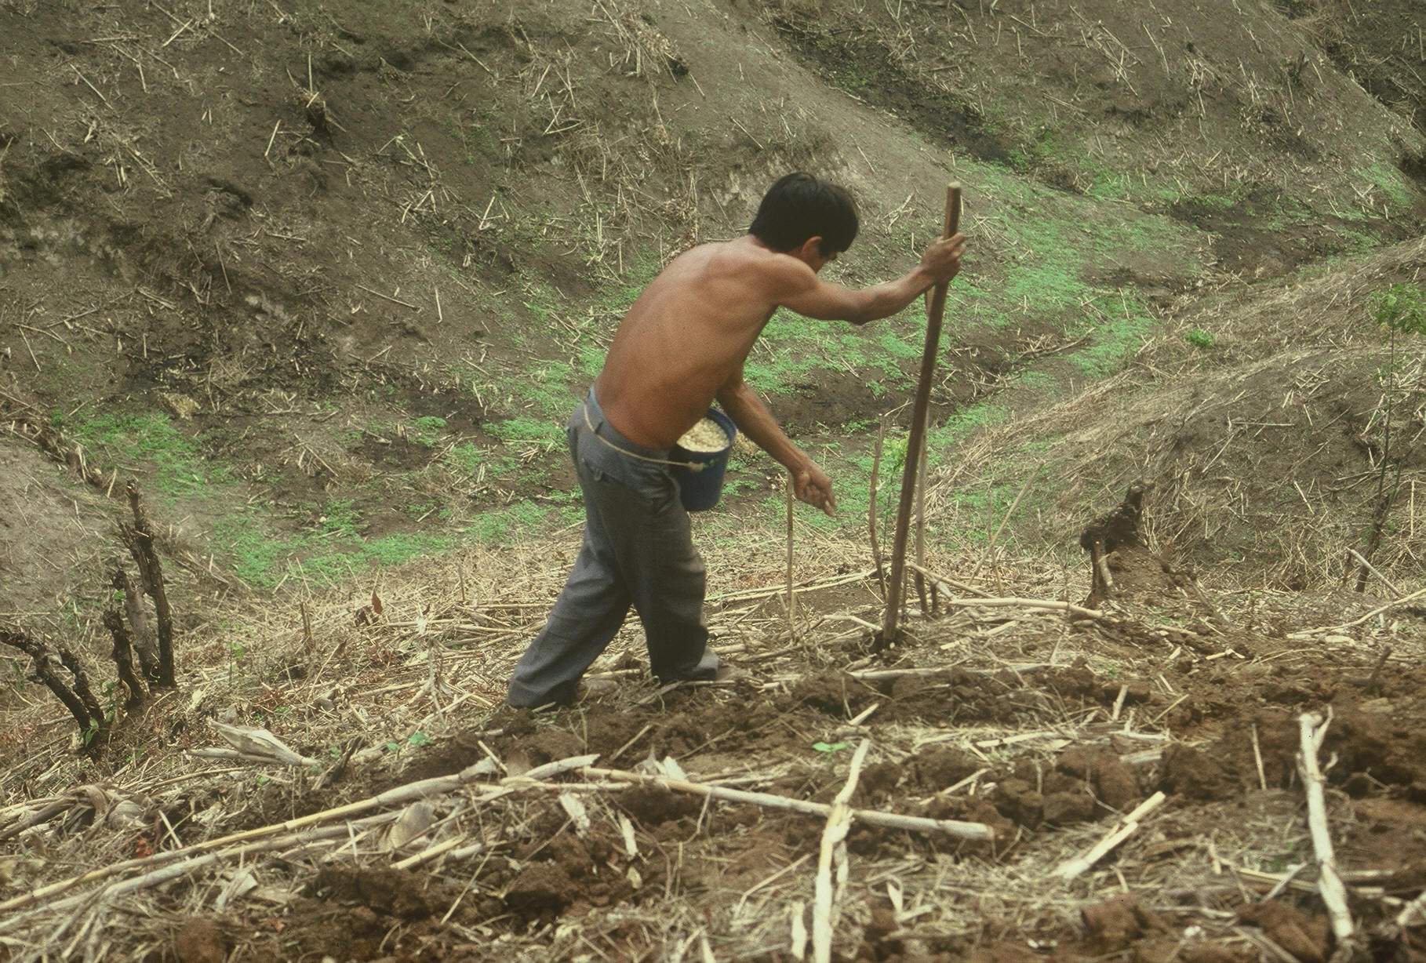

El Salvador
Notes:
22

Slide 38
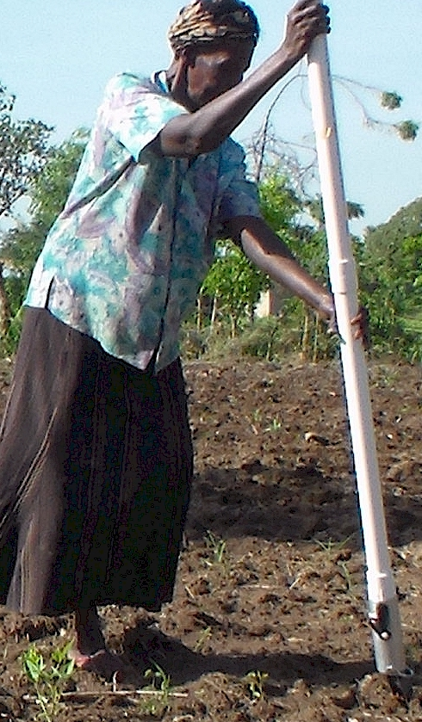
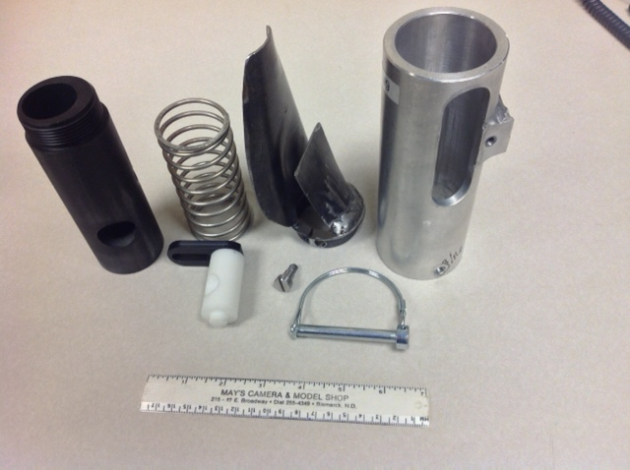
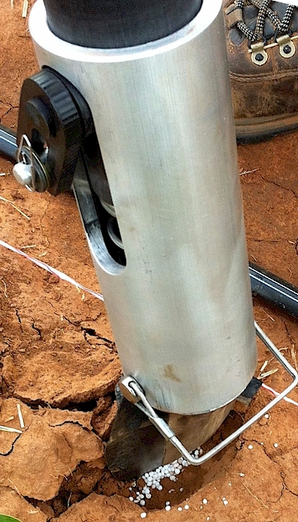
OSU Hand Planter
Dr. Randy Taylor
Wayne Kiner
Lira, Uganda
Peter Omara
Lawrence Aula
Can only be put together one way

Slide 39


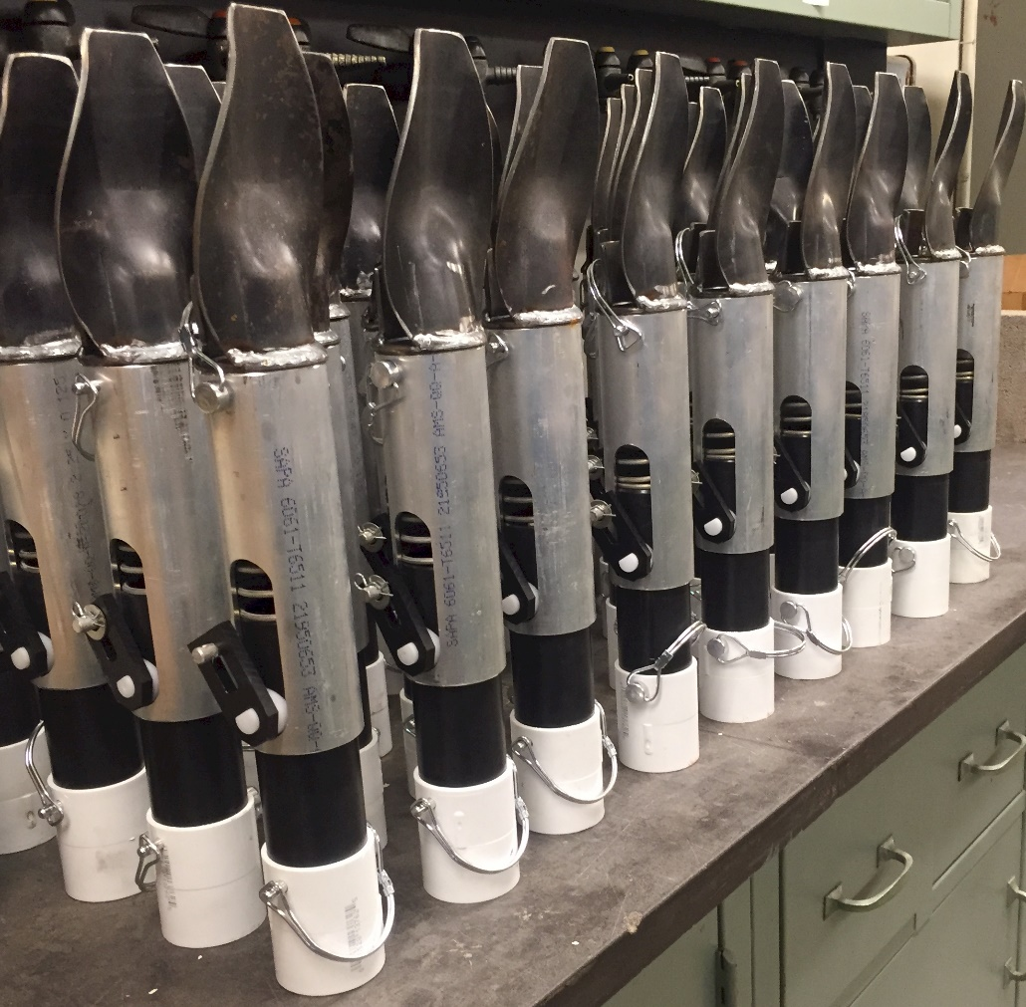
OSU Hand Planter
One Minute Video

Slide 40
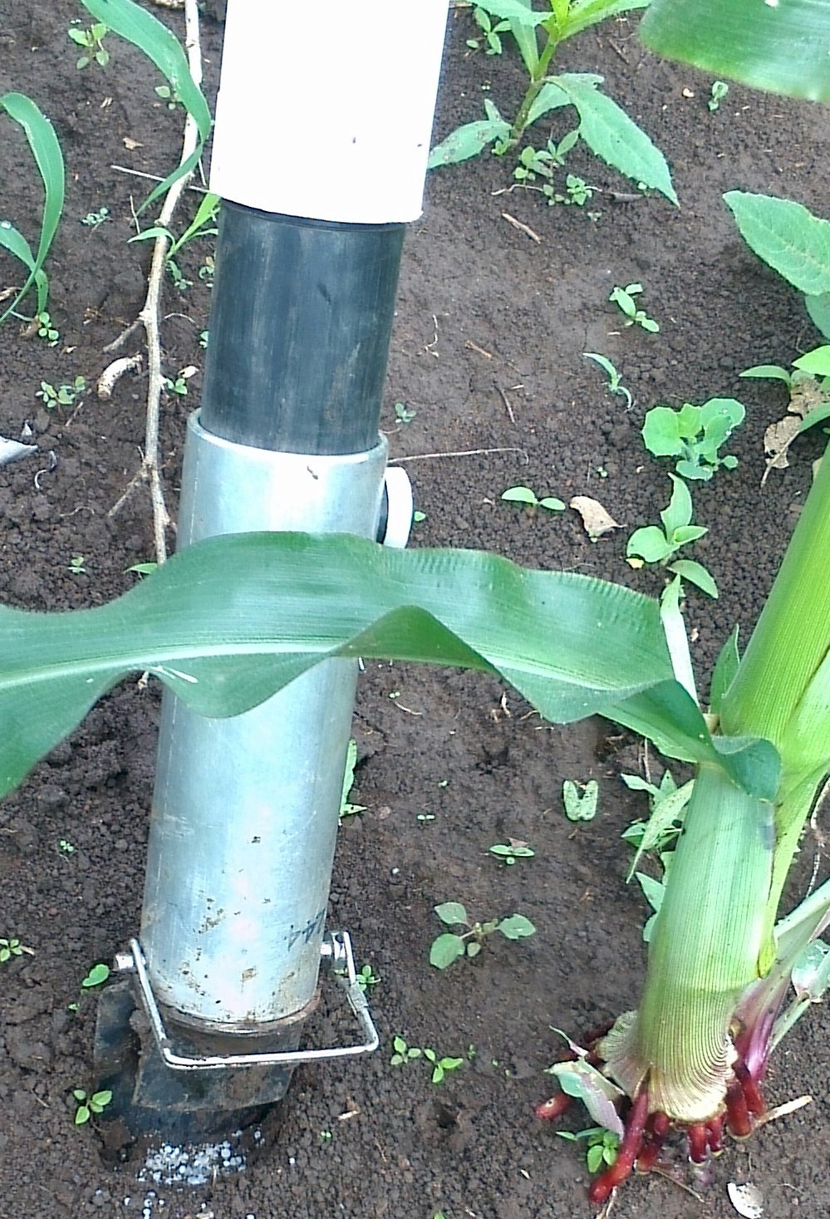
For both the developed and developing world, precision agriculture for maize needs to operate, by plant
2014. Effect of seed distribution and population on maize (Zea mays L.) grain yield. Int. J. Agronomy. V2014. http://dx.doi.org/10.1155/2014/125258.

Slide 41

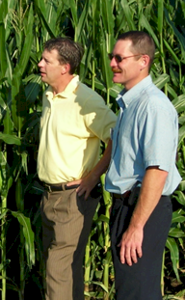
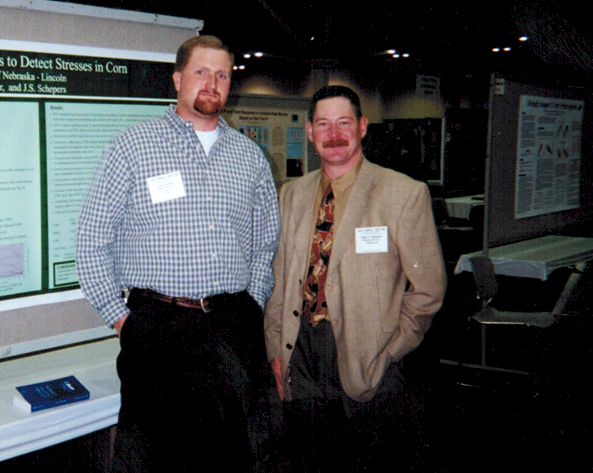
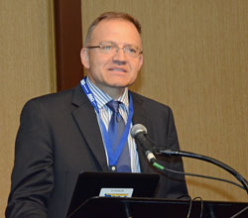
Dr. Steve Phillips
Dr. Wade Thomason
Dr. Brenda Tubana
Dr. Olga Walsh
Dr. Byungkyun Chung
Dr. Newell Kitchen
Dr. Kyle Freeman
Dr. Wade Thomason

Slide 42
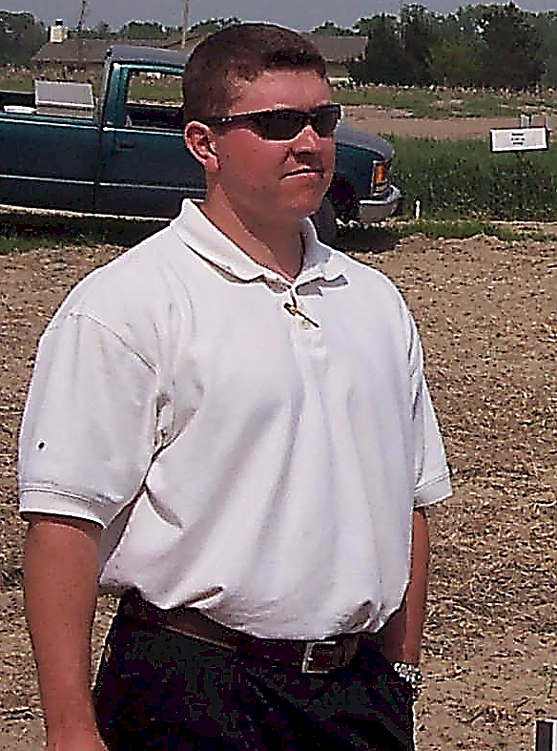
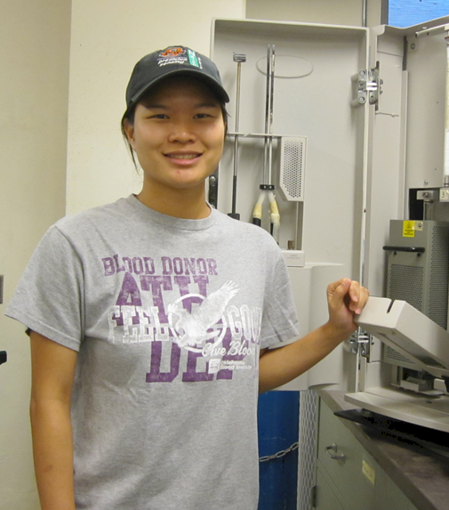
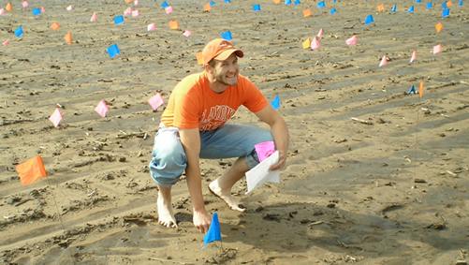
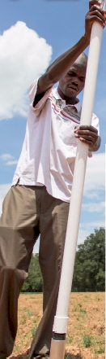


Cody Daft
Candi Candibyani
Lawrence Aula
Dr. Robert Mullen
Dr. Byungkyun Chung
Peter Omara

Slide 43





Dr. Dave Franzen
Dr. Kyle Freeman
Dr. Randy Taylor
Dr. Randy Taylor
Dr. Robert Westerman
Dr. Bee Khim Chim

Slide 44






Dr. Bee Khim Chim
Dr. Yumiko Kanke
Jeff Vetsch
Dr. Brian Arnall, Clint Mack
Dr. Gyles Randall
Dr. Kefyalew Desta
Dr. Matthew Reynolds

Slide 45





Dr. John Shanahan
Ted Mayfield John Mayfield
Dr. Jeremiah Mullock
Dr. Paul Hodgen
Dr. Eric Miller
Dr. Ivan Ortiz-Monasterio
Dr. Matt Ruark

Slide 46






Dr. Norman Borlaug
Dr. Jim Schepers
Dr. John Lamb
sombich
Had S4-S8 stamped on my forehead at the first ASA meeting I went to in Anaheim, 1982
Dr. Antonio
Mallarino
Dr. John Solie
Dr. Marvin Stone
Dr. Shannon Osborne

Slide 47



Distill career/experiences
6 educational/inspiring years with CIMMYT in Mexico and Guatemala
Was with Dr. Borlaug the day he died in Dallas,
3/25/1914 to 9/12/2009 (94.1 years)
Have colleagues that I could never have dreamed of having
Have loved every single day of working in this field

Slide 48

Web site, get started
A lot of really important things we do will never be published (especially pictures)

Slide 49





Slide 50

They ask you stuff like “on a scale of 1 to 10, how much pain do you feel?”
Punch them in the face, that’s how much pain I feel
15th annual 2017 NUE Conference, LSU, Baton Rouge, LA, August
Dr. Brenda Tubana

