Slide 1
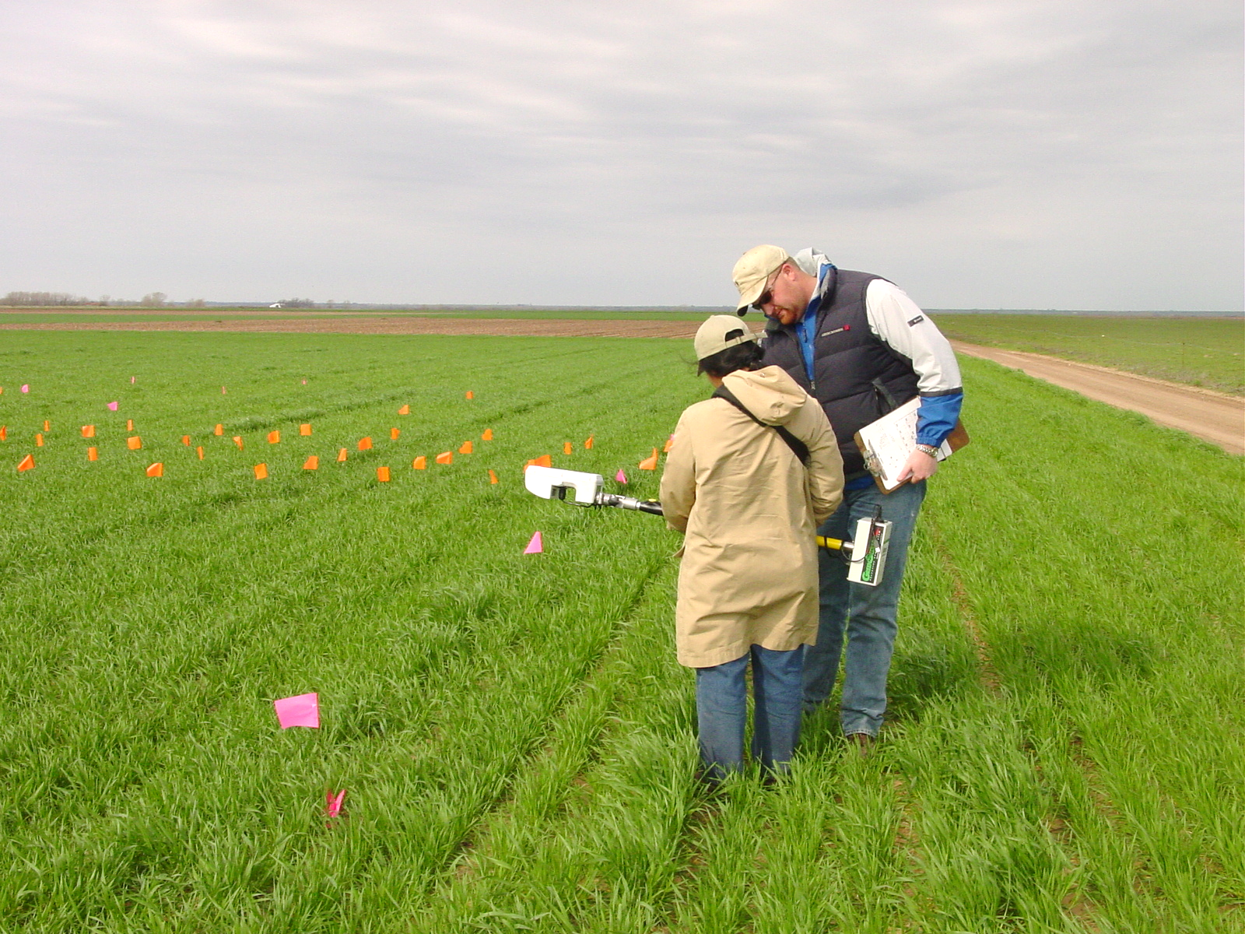
UNIVERSITY OF NEBRASKA
Agronomy and Horticulture Department 2025

Slide 2
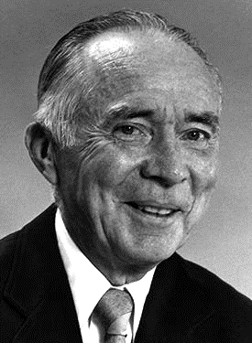
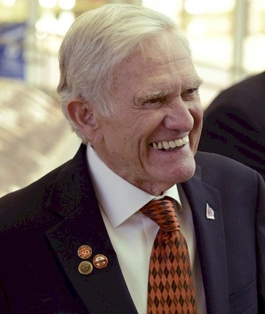


Dr. Robert L. Westerman
Professor Robert A. Olson

Slide 3
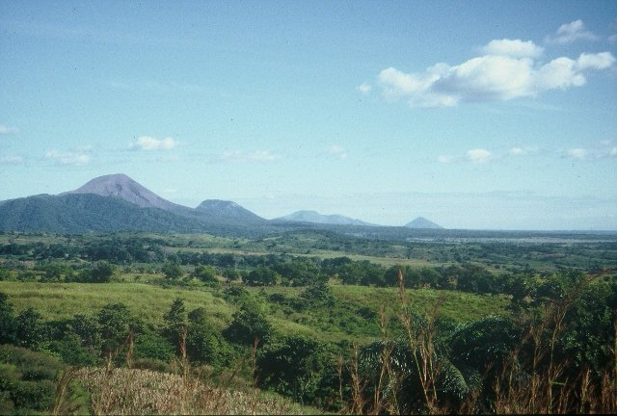
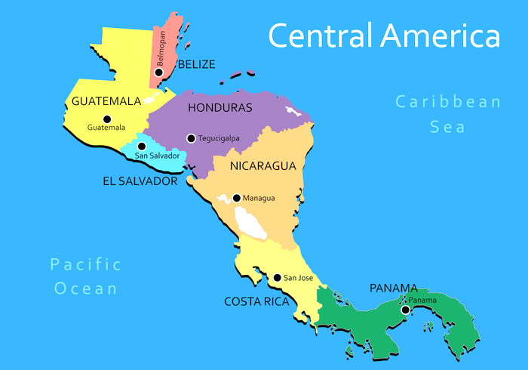
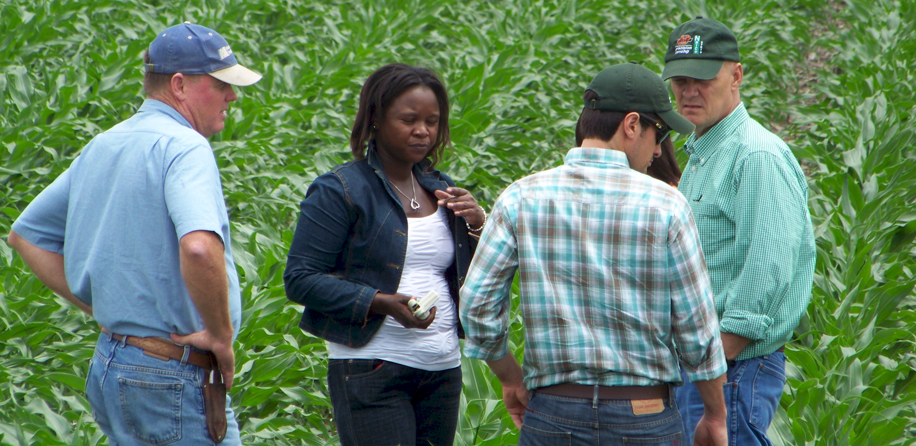
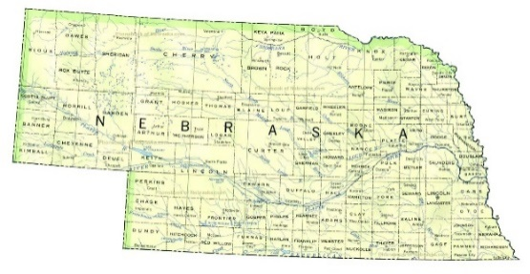
Oklahoma State University, 1976-1982
University of Nebraska, 1982-1985
CIMMYT, Mexico, Guatemala, 1985-1991
Oklahoma State University, 1991-present
CaSO₄
DAP, 3-17
Volcan de fuego

Slide 4
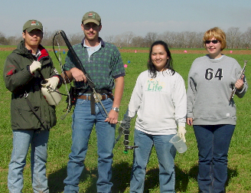
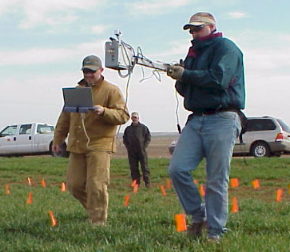
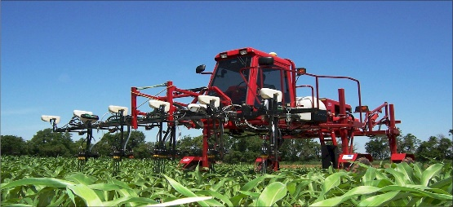
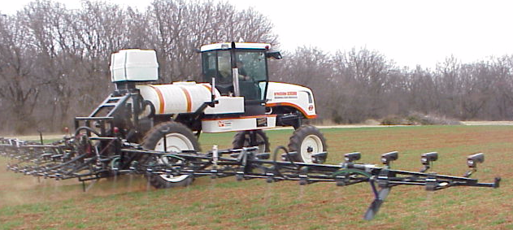

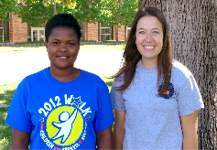
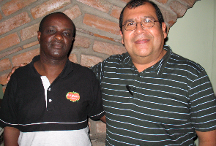


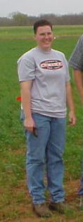
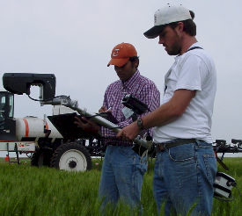
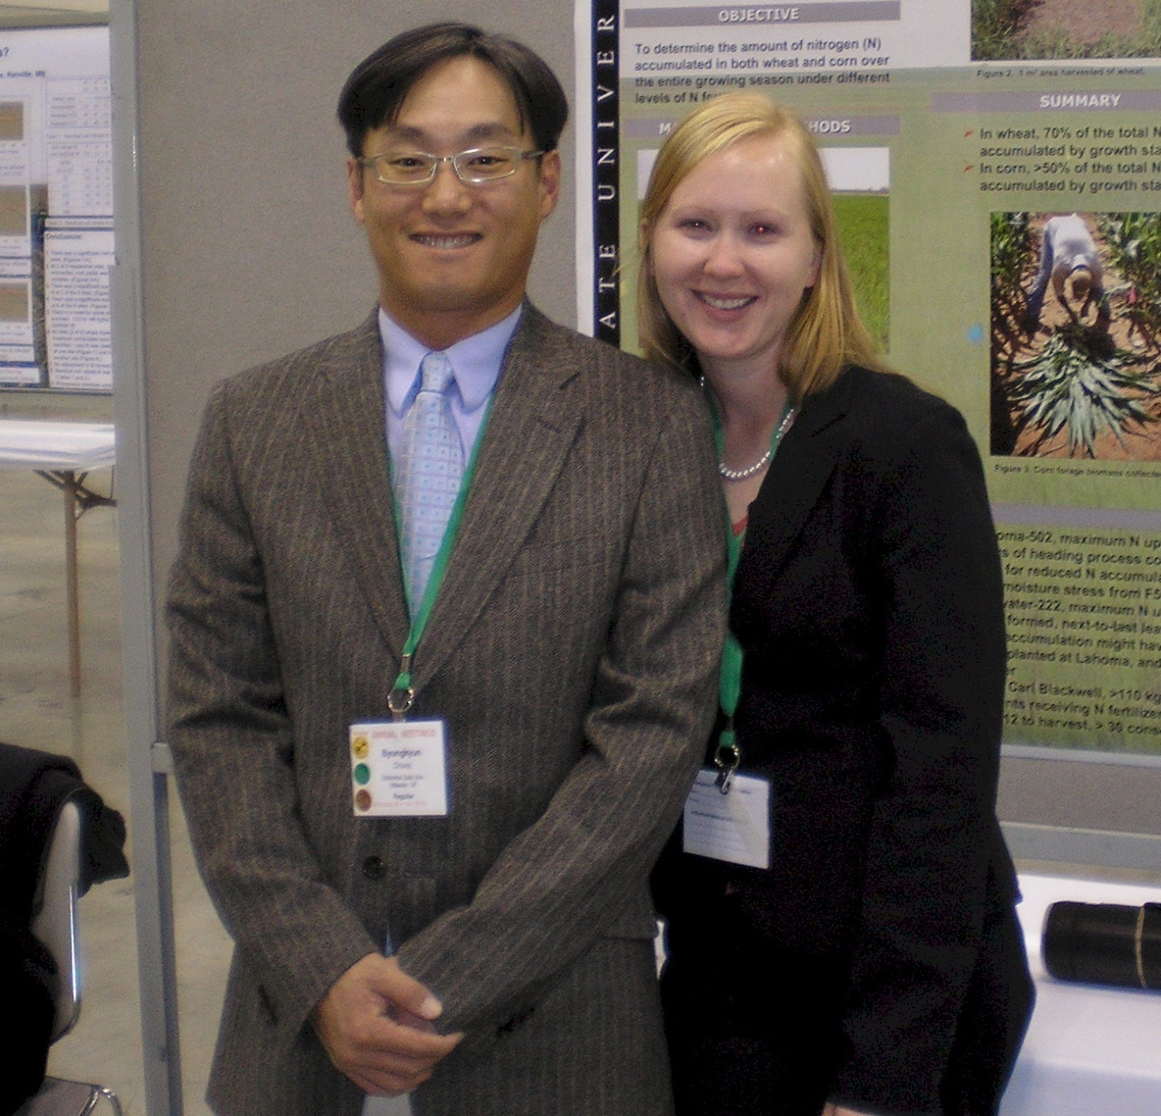
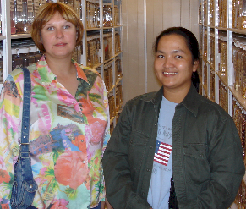

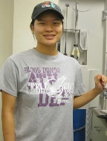
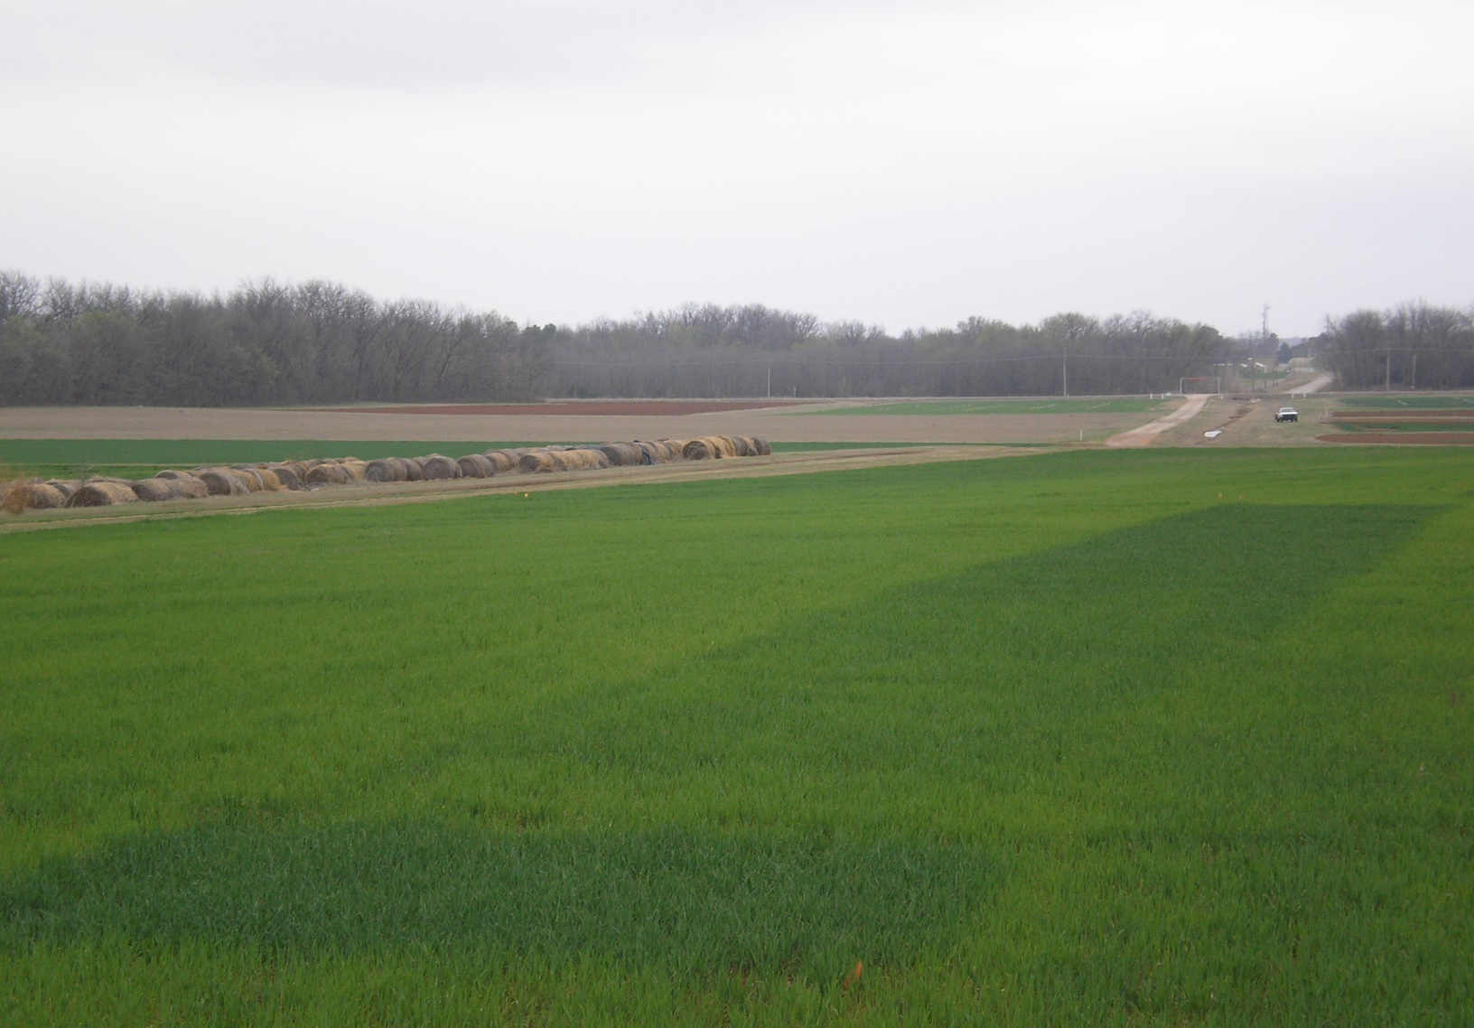
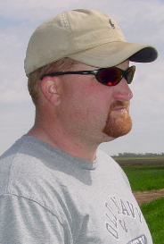
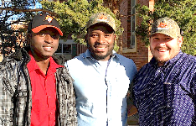
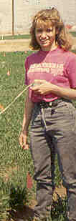
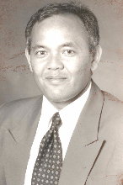


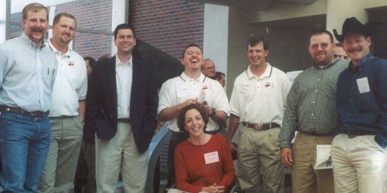

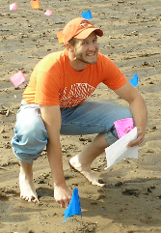
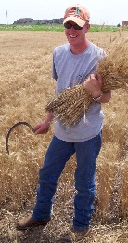
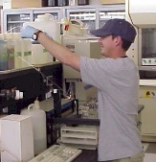
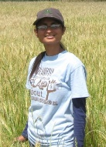
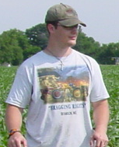
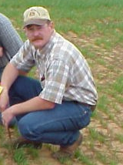
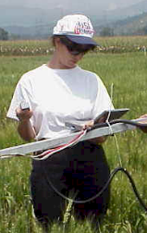
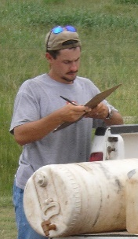


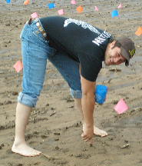
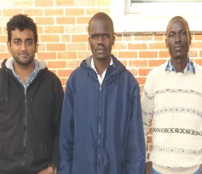




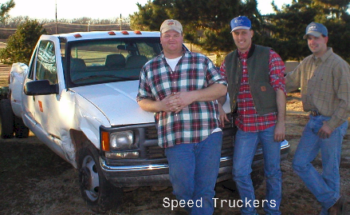
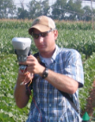
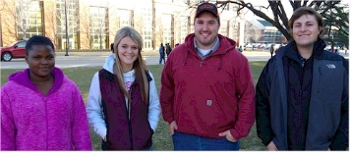
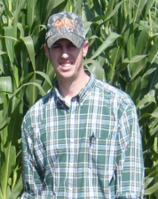
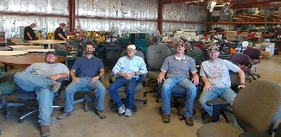

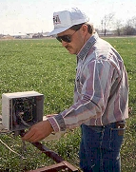
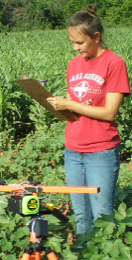
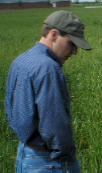
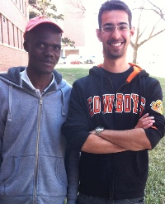
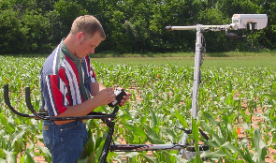
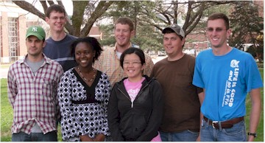
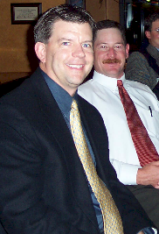
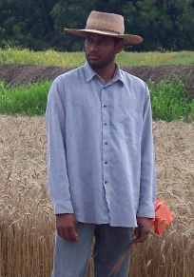
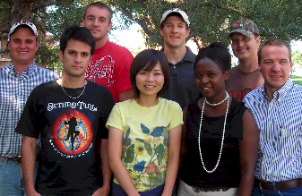
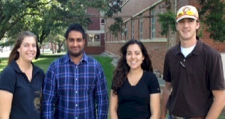
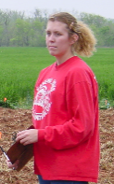

1991 - 2018
NOT LISTED
Mick Jojola, M.S., 1994
Francisco Gavi-Reyes, Ph.D., 1995
Micah DeLeon, M.S., 1999
O K L A H O M A S T A T E U N I V E R S I T Y
Kathie Wynn,
M.S., 2001, USDA
Eva Nambi, MS, 2017
Liz Eickhoff, MS, 2018
Byungkyun, Chung, Ph.D.,2007, McNeese State , LA
Starr Holtz, M.S., 2007, Monsanto, NE
P L A N T & S O I L S C I E N C E S
Fred Kanampiu, Ph.D., 1995,
CIMMYT, Kenya
Edgar Ascencio, M.S.,1992,
Ph.D., 1995, CARE, El Salvador
Dale Keahey,
M.S., 1997, OK
Jing Chen,
M.S., 1997,
Ford Motor Co.
Olga Walsh, M.S. 2007,
Ph.D., 2009, Univ. Idaho, ID
Brenda Tubana, Ph.D. 2007,
Louisiana State, LA
Jagadeesh Mosali, Ph.D., 2004,
Micah Humphreys, M.S., 2003,
Northwest College, WY
Robert Mullen,
M.S., 2001, Ph.D., 2003,
Potash Corp.
Candi Candibyani
BS 2013
Heather Lees
M.S. 1997
Ohio
Alimamy Fornah, Fikayo Oyebiyi, Robert Lemings
Hasil Sembiring,
M.S.,1993,
PhD., 1997,
Jakarta, Indonesia
Jeff Ball
M.S., 1995,
Bayer, OK
Kyle Freeman
M.S., 2002,
Ph.D. 2005,
Mosaic, MN
Shambel Moges,
M.S., 2002,
Ph.D., 2005
Accurate Labs, OK
Darin Drury, B.S., 2000, TX
Kyle Freeman, M.S., 2002, Ph.D. 2005, Mosaic
Curt Woolfolk, M.S., 1999, Mosaic
Robert Mullen, M.S., 2001, Ph.D., 2003,
Potash Corp
Joanne LaRuffa, M.S. 1999, AL
Roger Teal, M.S. 2002, Ph.D., 2005, OK
Shawn Norton, B.S. 2000, Noble Fnd. OK
Wade Thomason, M.S., 1998, Ph.D., 2001,
Virginia Tech, VA
Sulochana Dhital
MS 2013, Nepal
Cody Daft,
M.S., 2008,
Pioneer, OK
Doug Cossey,
M.S. 1999
S O I L N U T R I E N T M A N A G E M E N T
Brandon England
M.S. 2008
USDA-FSA
Wade Thomason,
M.S., 1998,
Ph.D., 2001,
Virginia Tech, VA
Erna Lukina
M.S. 1998,
Ph.D., 2001
Chicago, IL
Clint Mack, M.S., 2007,
Producer, OK
Brian Arnall
M.S. 2004
Ph.D. 2008
OSU
Kefyalew Desta,
Ph.D., 2004,
Washington State
Shannon Osborne
M.S. 1996
USDA-ARS, SD
Clint Dotson
M.S., 2007,
Pioneer, MO
Shivkanth
Lanka
India
Lawrence
Aula MS
2015 Uganda
Peter Omara
MS 2013
Uganda
Mariana Ramos Del Corso, 2016
Daniel Aliddeki, 2016
Melissa Golden, 2016
Natasha Macnack
M.S. 2012
PhD, 2014
Birhane Desta,
M.S., 2009
Emily Ruto
Ph.D., 2011, OSU
Eva Nambi, Gwen Wehmeyer, Ethan Driver, Ryan Schlolbohm
Paul Hodgen, M.S., 2003, Monsanto, IL
Jason Lawles, M.S., 2004, Monsanto
Roger Teal, M.S. 2002, Ph.D., 2005, OK
Eric Miller
Ph.D. 2014
Jeremy Dennis
M.S., 1999
NRCS, OK
Pam Turner
M.S., 2008
DEQ, OK
Yumiko Kanke
PhD, LSU
Kent Martin, M.S. 2005,
Alva, OK
Daniel Edmonds
M.S., 2008
Jacob Bushong,
PhD, 2014
Lawrence Bruno
Aula Figueiredo
Uganda Brazil
MS 2015 MS 2015
Steve Phillips
M.S., 1995,
Ph.D., 1999
IPNI, AL
Jerry May, M.S., 2010, Jacob Vossenkemper, M.S. 2010, Cody Daft, M.S., 2008, Brandon England, M.S., 2008, Guilherme Torres, M.S., 2010, Yumiko Kanke, M.S., 2009, Emily Ruto, Ph.D., 2011.
Jagadeesh Mosali,
Ph.D., 2004,
Kyle Lawles,
M.S., 2007
Monsanto, MO
Guilherme Torres, Kevin Waldschmidt, Emily Rutto, Jonathan Kelly, Bee Chim, Jeremiah Mullock, and Jared Crain
Keri Morris
M.S., 2004
NRCS, KS
Nicole Remondet, 2016
Jagmandeep Singh Dhillon, 2015
Mariana Ramos Del Corso, 2016
Tyler Lynch, MS, 2018

Slide 5








Dr. Marvin Stone, 1950-2015
Dr. John Solie
Dr. Randy Taylor
Biosystems and Agricultural Engineering

Slide 6
Research
Agronomy/Engineering partnership
Hand Planter progress comes from the Greenseeker Project. Trust came from splitting duties (engineering, agronomy, grants)
Allowed direct access to engineering graduate students, Wayne Kiner (Machine shop manager)
Contract on all new hand planters with BAE
Problems are more complex
More time committed to thinking/processing
Ask the right questions

Slide 7






Sustained focus and effort

Slide 8




Spatial Scale
Solie, J.B., W.R. Raun and M.L. Stone. 1999. Submeter spatial variability of selected soil and bermudagrass production variables. Soil Sci. Soc. Am. J. 63:1724-1733.

Slide 9


Plant-to-Plant Variability in Maize Production. 2005.
Agron. J. 97:1603-1611.

Slide 10
40 transects, Argentina, Mexico, Iowa, Nebraska, Ohio, and Oklahoma, 2002-2004.
_____________________________________________________________
Location Years Trans. Min Max Mean Stdev Max/Min CV
------------------------ kg/ha ------------------------ %
OK, <6000 kg/ha 2003-4 11 1128 9169 4652 1724 10.0 37
OK, >6000 kg/ha 2003-4 8 1947 14120 7050 2167 11.6 31
Ames, IA, 2004 4 1872 21173 8320 3660 14.1 46
Shelton, NE
Phillips, NE 2004 5 7098 21492 14383 2926 3.2 20
Ohio 2004 1 2066 19458 9759 4367 9.4 50
El Batan, MX 2002 3 606 9440 4268 1935 22.4 45
Argentina 2003 9 2806 28058 11478 4211 15.0 37
All Sites 02-04 40 2410 17034 8173 2746 11.8 35
Plant-to-plant variability in corn grain yield can be expected, averaged more than 2765 kg/ha (44 bu/ac) over sites and years. Agron. J. 97:1603-1611

Slide 11


Seed Placement and Leaf Orientation
2011. Maize (Zea mays L.) Leaf Angle and Emergence as Affected by Seed Orientation at Planting. J. Exp. Agric. DOI:10.1017/S001447971100038X

Slide 12





2005. Automated calibration stamp technology for improved in-season nitrogen fertilization. Agron. J. 97:338-342.
N Calibration Stamp 2004

Slide 13




2008. Ramp calibration strip technology for determining mid-season N rates in corn and wheat. Agron. J. 100:1088-1093.
Ramp Calibration Strip, 2006

Slide 14




Hand-Held GreenSeeker Sensors

Slide 15

Experiment 502, 1970-present
Lahoma, OK

Slide 16


Independence of Yield potential and Nitrogen response
Random influence
of the environment
Total entropy always increases and the process is irreversible
Iowa
Nebraska
Wisconsin
Oklahoma
2013. Relationship between grain crop yield potential and nitrogen response. Agron. J. 105:1335–1344.
2010. Independence of yield potential and crop nitrogen response. Prec. Agric. 12:508-518.

Slide 17


30,000,000 ha’s planted by hand ≈ corn area in the USA
USA 35 M
China 35 M
Brazil 14 M
EL SALVADOR

Slide 18


Opico quezaltepeque, El Salvador
GREEN SEEDER
2017
1987

Slide 19


Singulation Design
3D printing
Rotary International
AGCO
Sitlington Chair
ASA Reinvest, Jessica Davis
Tolerances
Materials
Failure analysis/testing

Slide 20





Slide 21



GreenSeeder Manual
www.nue.okstate.edu
No failure/1,000,000 cycles
1 ha, 10 years, 100,000 seeds/ha

Slide 22




Slide 23

Person | Organization | Where
Dr. Isaiah Nyagumbo | CIMMYT, Kenya | Zimbabwe
Dr. Pascal Kaumbutho | KENDAT, Kenya | Kenya
Dr. Fred Kanampiu | IITA | Ethiopia
Dr. Peter Omara | Uganda | Uganda
Dr. Edgar Ascencio | CARE, El Savador | El Salvador
Dr. Fred Kanampiu | IITA, Kenya | Kenya
Dr. Nyle Wollenhaupt | AGCO, Kansas | Kansas
Dr. Ivan Ortiz-Monasterio | CIMMYT, Mexico | Mexico
Kristin Lacy | Semilla Nueva | Guatemala
Nyle Wollenhaupt | AGCO | Lusaka Zambia
Melvin Siwale | AGCO | Lusaka Zambia
Terry Tindall | JR Simplot | Lusaka Zambia
Daniel Forestieri | Zamorano | Honduras
Eric Lam | CIMMYT | Bangladesh
Roman Gordon | IDIAP | Panama
Dr. Luis Narro | CIAT | Colombia
Dr. Joshua Ringer |  | Thailand
Dr. Assoumane Maiga |  | Mali
Fikayo Oyebiyi, Usman Ali |  | Nigeria
Hand Planters
Notes:
23

Slide 24


ZIMBABWE, UGANDA
Remote Locations
Surface applications of urea

Slide 25


Opico Quezaltepeque, El Salvador
LIRA UGANDA
EL SALVADOR
Worlds Apart
Avg. Farm Size: 1 ha
Avg. Maize Grain Yield, 2 Mg/ha
Maize seed, Hybrids (US, others)
Social aspects/technology transfer

Slide 26


MID Season Fertilizer N
Combined, Efaw and Perkins
Topdress N, Corn, V12 |  | 70,000 plants/ha
Methods | N, kg/ha | Mg/ha
Check | 0 | 6.6
Hand planter (0.9 g/plant) | 30 | 11.2
Hand planter (1.8 g/plant) | 60 | 10.6
Broadcast | 30 | 6.4
Broadcast | 60 | 7.0
Dribble urea | 30 | 9.3
Dribble urea | 60 | 7.8
Dribble UAN | 30 | 7.3
Dribble UAN | 60 | 10.4
SED = 1.81

Slide 27

Importance of Singulation
0.76m Row Spacing
Heterogeneity in plant spacing, and plant stands reduce yields
www.agry.purdue.edu/ext/corn/pubs/agry9101.htm

Slide 28

Benefits
Remove chemically treated seeds from the hands of producers
Decrease soil erosion via improved plant spacing
Accommodate mid-season N application
Urea placed below the surface reducing NH₃ loss
Increased production and NUE
Potential Uses
Seed, all types
Alternative chemicals, EPA, mosquito abatement
Food plots/hunters
Gardeners

Slide 29





Current Cost Estimates
Grand Victory Ltd
Tsim Sha Tsui Hong Kong
Rm 1604 16/F Lee Wai Coml Bldg
Tsim Sha Tsui
1000, $25 each
5000
$49 each
Usman Ali, Nigeria, Mandela Fellows

Slide 30





Value of the Experimental Method
Minden and Kearney Nebraska

Slide 31


Hemileia vastatrix, leaf rust
(more at lower altitudes)
Coffee Exports
Brazil, $4.6B
Colombia, $2.6B
Honduras, $1.2B
Guatemala, $0.8B
2500-6000 ft asl
Coffee Coffea arabica
Rubber Hevea brasiliensis, 1940 USDA

Slide 32
Teaching
Faculty belief
Most difficult/time consuming
Need to stay current
On-line instruction
Club activity
International relevance
Opportunity for graduate students to experience developing world agriculture (117)
Energy

Slide 33


Data Analysis/Interpretation (SOIL 5112)
Dr. Kent Eskridge, Prof. Robert A. Olson,
Working for CIMMYT Plant Breeders
Stability analysis
Drought tolerance
Stem rust
Understanding “environment”
Homogeneity of error variance
Long-term trials
Obligation, UNL, experimental method
Obligation, El Salvador, Opportunity

Slide 34
Administrative Philosophy
Teamwork
Communication
Attentive awareness of opportunities
Kind, considerate, thoughtful
Facilitator (graduate students, letters, +)
Ask good questions (5813, 10 papers)
BAE, grants, writing

Slide 35
Vision for UNL Agronomy and Horticulture Department 2025
Water should be a central focus for UNL, both in Agronomy and Horticulture. SDI, VRI, weather ready farms, cover crops, deficit irrigation, effluent water/turf
Weather and Climatology, forecasting, air pollution, use of live weather data
Innovation and Creativity thinking differently, social media
Global Yield Gap Atlas, Cassman
F4-F5 (units versus empirical)
Unique funding opportunities, NGO’s Int. Ag.
Administrative support for grant writing
Issues breakfast, Faculty and Students (every lunar orbit)

Slide 36

Research: H-Index (Jorge Hirsch, Physicist, Univ. California, 2005) “measure of both the productivity and citation impact ”
Impact factor (Eugene Garfield, 1925-2017, Columbia, Penn, 1961))
“measure of the frequency with which the average article in a journal has been cited in a particular year”
Publishing, writing-workshop
Sensor Based Nitrogen Rate Calculator
NUE web site
JIF = Citations in 2014 for items published in 2013 + 2012
________________________
Total No. articles published in 2013 + 2012

Slide 37



Awards, faculty
Awards, students
Nominating others, x-Univ.
Student presence, booth, ASA
Student participation in oral competitions, poster competitions
Faculty selection
Agronomy club
UNL, one of the largest Agronomy/Horticulture Dep. in the world
Storied history in International Agriculture
Increased opportunities for students to experience developing world agriculture
Education solves problems, opportunity for “one more” student
Best students are those that work harder

Slide 38


By 2050, there will be more plastic than fish in the world’s oceans
300 million tons of plastics manufactured/year
10 percent recycled
Great Pacific garbage patch
Lignin plastics (Univ. Minnesota), adding Achilles heel to plastic manufacturing that soil microbiology can take advantage of and later degrade

Slide 39





Gonjiro Inazuka, (2 vs 4 ft high), Cecil Salmon 1945, Japan, Orville Vogel (Pilger, NE), UNL, Washington State
Norin 10, Japan, Reyes Vega, Ignacio Narvaez
India
Pakistan
Penjamo 62
Sonora 64
Lerma Rojo 64
Dr. Norman E. Borlaug

Slide 40



























Graduates in Leadership Positions

Slide 41


In 1892, John Froelich invented and built the first gasoline/petrol-powered tractor in Clayton County, Iowa
In 1908, George Harrison Shull, published “The composition of a field of maize”, that marked the beginning of heterosis (hybridization) in plant breeding

Slide 42
13.3 million acres of corn IA
9.5 million acres of corn NE (200 bu/ac irrigated, 147 bu/ac dryland)
7.6 million acres of wheat, KS (48 bu/ac) 2017
5.3 million acres of wheat, OK (39 bu/ac) 2015
1.0 million acres of wheat, NE, (46 bu/ac) 2017
5.7 million acres of soybeans, NE (58 bu/ac) 2017
12.6 million cattle (cows + CAFO’s Texas)
6.6 million cattle (cows + CAFO’s Nebraska)
5.1 million cattle (cows + CAFO’s Oklahoma)
John Deere invented the steel plow in 1837, Barbed wire 1874, extensive tillage/first tractor, 1892 (John Froelich, Clayton County IA)
Atmospheric CO2, 1880 (290 ppm)
Atmospheric CO2, 2018 (408 ppm)
Animal agriculture accounts for 18% of all GHG emissions (CO₂ equivalent, CH₄=20x that of CO₂, N₂O=300x that of CO₂)
Tillage 1890 forward, responsible for 25% of the CO₂ increase
Population
Nebraska 1.92
Kansas 2.78
Iowa 3.03
Oklahoma 3.93

Slide 43






Internal Brush/Strength
Drum size/material
Cavity size/angle
Tip size/design/material
Internal/Ext. spring/tension

Slide 44





Alternative Designs

Slide 45
Similar comments concerning resistance to change in the American Society of Animal Science were made by Oltjen (1983), citing an anonymous source,
“One can stand still in a flowing stream, but not in a world of men.”
Restructuring and name changes within departments should be viewed as evolutionary and not as an abrupt step or change (G.H. Heichel, 1998, personal communication).
Agronomy as a department name has become less common over the past 20 yr. Restructuring, image, visibility, communication, popularity, and increased specialization are some of the factors that have been considered to be important for department and society name changes
Oltjen, R.R. 1983. Significant milestones in the 75 year history of the
American society of animal science. J. Anim. Sci. 57:2–15.
Raun, W.R., N.T. Basta, J.A. Hattey, H. Zhang, and G.V. Johnson. 1998. Changing departmental names from agronomy to plant, crop and soil sciences. J. Nat. Resour. Life Sci. Educ. 27:113-116.

Slide 46
September 28, 2017
There is absolutely no doubt in my mind that the planter is working. As an example which I first wanted to put complete details together but will now share, a farmer supported with one HP in Oyam District reported a slightly higher yield advantage of HP (about 720 kg corn /ac) over conventional hand hoe (about 600kg corn /ac). I gave him the planting tips as well as benefits of Green Seeder & he deliberately said "I'll compare the planter you're praising with the one that I assume your parents used to send you to school".
I visited the field after planting & emergence, and saw a clear deficiency of phosphorus and no N was added plus fall armyworm infestation and I assumed that the yields could have been much higher.
Smallholder producers in Uganda who are the majority may still need a subsidy to acquire the planter perhaps through NGOs.
Thanks,
Lawrence Aula
“The hand planter has saved me from daily struggle to get my husband to support me in planting crops. I don't really need him at planting stage since I can do it alone," Mama Brenda, Uganda

Slide 47


March 2016
Membership, 11,000, views 10,000

Slide 48
MAIZE (FAOSTAT.COM)
Area, ha Production, Mt Avg. Mg/ha
World 183,319,737 1,038,281,035 5.7 (90 bu/ac)
USA 33,644,310 361,091,140 10.9 (174 bu/ac)
China 35,981,005 215,812,100 6.2 (98 bu/ac)
Brazil 15,450,180 80,516,571 5.2 (83 bu/ac)
Low income Food Deficit Countries
49,356,985 117,590,512 2.4 (38 bu/ac)
Developing world maize planted by hand (60% of total)
29,400,000 ha’s (72,618,000 ac)
25% increase on world hand planted maize
(avg 2 Mg/ha *0.25 = 0.5 Mg/ha)
29,400,000*(2000kg/ha*0.25%)*$0.23/kg (or $6.00/bu) = $3,381,000,000

Slide 49
Time, $, Products
post PhD, 1985-present, 33 years
Greenseeker
Years: 1991–2001, 11 years, $4.7M
Delivery, 2002-present
Stone, Solie, students
OSU Hand Planter (Greenseeder)
Years: 1987-2017, 30 years, $175K
Taylor, Koller, many students,
  Delivery, >350, plans for more
OSU graduates, Kenya, Uganda, El Salvador, Mexico, Dr. Joshua Ringer, Dr. Craig Edwards, Mandela Washington Fellows

Slide 50

Benefits
Remove chemically treated seeds from the hands of producers
Decrease soil erosion via improved plant spacing
Accommodate mid-season N application
Urea placed below the surface reducing NH₃ loss
Increased maize production and NUE
Chim, Bee Khim, Peter Omara, Jeremiah Mullock, Sulochana Dhital, Natasha Macnack, and William Raun. 2014. Effect of seed distribution and population on maize (Zea mays L.) grain yield. Int. J. Agronomy. V2014. . http://dx.doi.org/10.1155/2014/125258.
Omara, Peter, Lawrence, Aula, Bill Raun, Randy Taylor, Adrian Koller, Eric Lam, Joshua Ringer, Jeremiah Mullock, Sulochana Dhital and Natasha Macnack. 2015. Hand planter for maize (Zea mays L.) in the developing world. J. Plant Nutr. DOI:10.1080/01904167.2015.1022186
Dhillon, J.S., B. Figueiredo, L. Aula, T. Lynch, R.K. Taylor, and W.R. Raun. 2017. Evaluation of drum cavity size and planter tip on singulation and plant emergence in maize (Zea mays L.). J. Plant Nutr. DOI:10.1080/01904167.2017.1382532.
Planting 1 seed, every 0.16m increased yields by an average of 1.15 Mg ha⁻¹ (range, 0.33 to 2.46 Mg ha⁻¹) when compared to the farmer practice of placing 2 to 3 seeds per hill, every 0.48 cm.

Slide 51



33 Current algorithms, mid-season Sensor Based N recommendations,
Wheat, Corn, Sorghum, Rice, Cotton
120 automated weather stations, 77 counties
OK algorithms tied to live sumGDD, soil moisture

Slide 52


