Slide 1
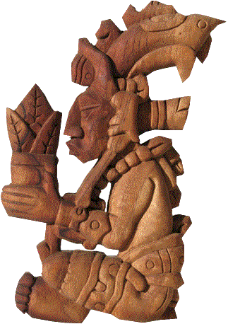


OSU Hand Planter
March 2020
Nigeria
Teosinte
Hun Hunahpu
http://nue.okstate.edu
http://nue.okstate.edu/Hand_Planter.htm

Slide 2
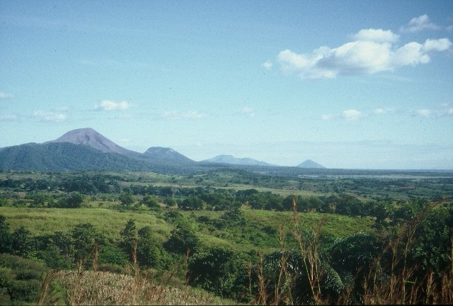
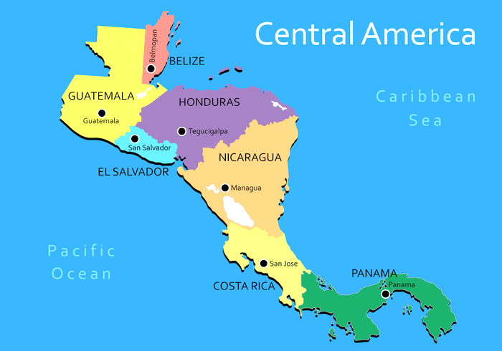
Volcan de fuego

Slide 3
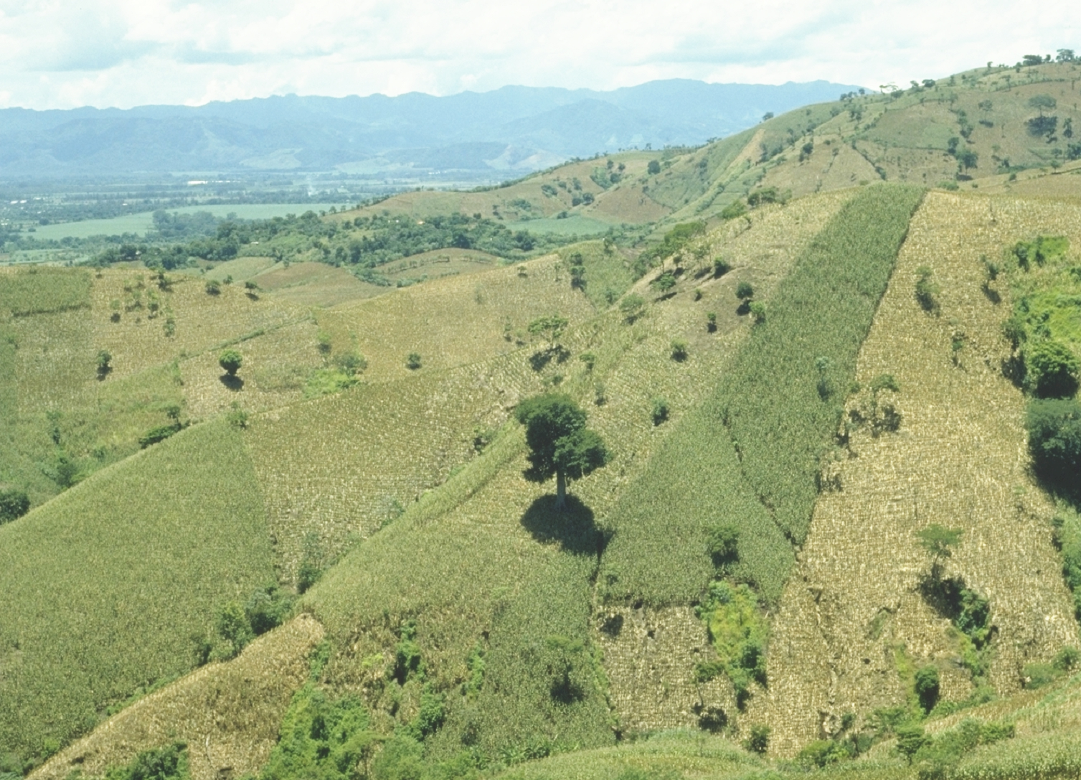
30,000,000 ha’s planted by hand ≈ corn area in the USA
USA 35 M
China 35 M
Brazil 14 M
EL SALVADOR

Slide 4

Person | Organization | Where
Dr. Isaiah Nyagumbo | CIMMYT, Kenya | Zimbabwe
Dr. Pascal Kaumbutho | KENDAT, Kenya | Kenya
Dr. Fred Kanampiu | IITA | Ethiopia
Dr. Peter Omara | Uganda | Uganda
Dr. Edgar Ascencio | CARE, El Savador | El Salvador
Dr. Fred Kanampiu | IITA, Kenya | Kenya
Dr. Nyle Wollenhaupt | AGCO, Kansas | Kansas
Dr. Ivan Ortiz-Monasterio | CIMMYT, Mexico | Mexico
Kristin Lacy | Semilla Nueva | Guatemala
Nyle Wollenhaupt | AGCO | Lusaka Zambia
Melvin Siwale | AGCO | Lusaka Zambia
Terry Tindall | JR Simplot | Lusaka Zambia
Daniel Forestieri | Zamorano | Honduras
Eric Lam | CIMMYT | Bangladesh
Roman Gordon | IDIAP | Panama
Dr. Luis Narro | CIAT | Colombia
Dr. Joshua Ringer |  | Thailand
Dr. Assoumane Maiga |  | Mali
Fikayo Oyebiyi, Usman Ali |  | Nigeria
Hand Planters
Notes:
4

Slide 5
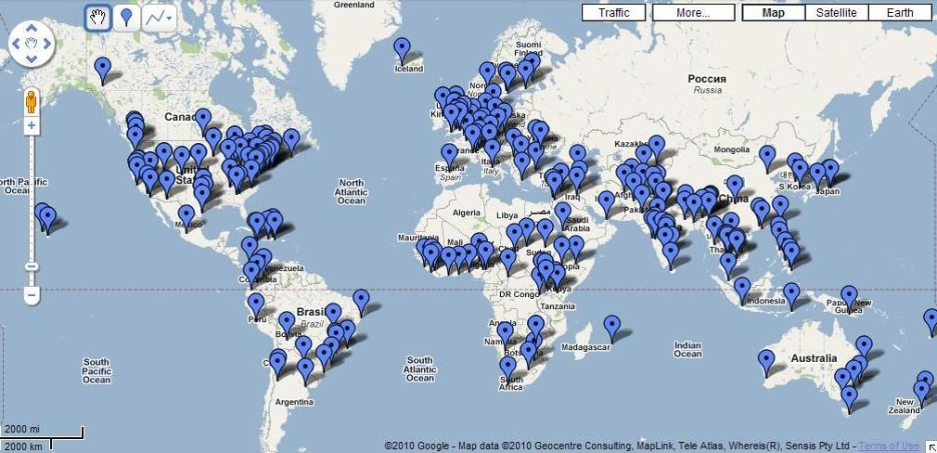

535 Rotary Districts in the world
>35,000 Rotary clubs in 200+ countries
1.2 million members

Slide 6
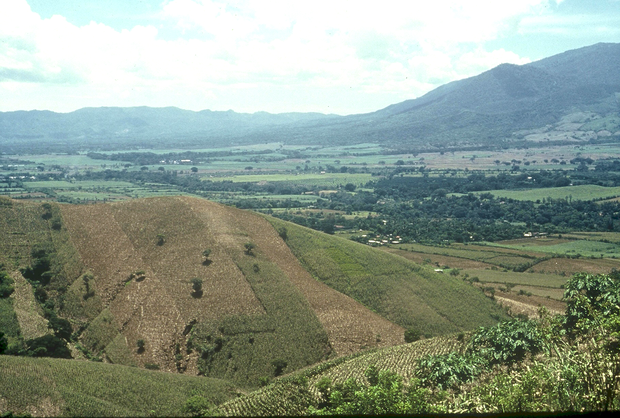

Planter Chronology
1985, CIMMYT
1987, Regional Agronomist Central America
1991, Faculty OSU
1999, FP - Hand Planter work
2000, Working prototype
2013, MS, Aula, Omara
2018, Planter redesign, Rotary Grant / Importance
Rotary Contributions
(Nigeria, Nebraska, Oklahoma, Italy)

Slide 7
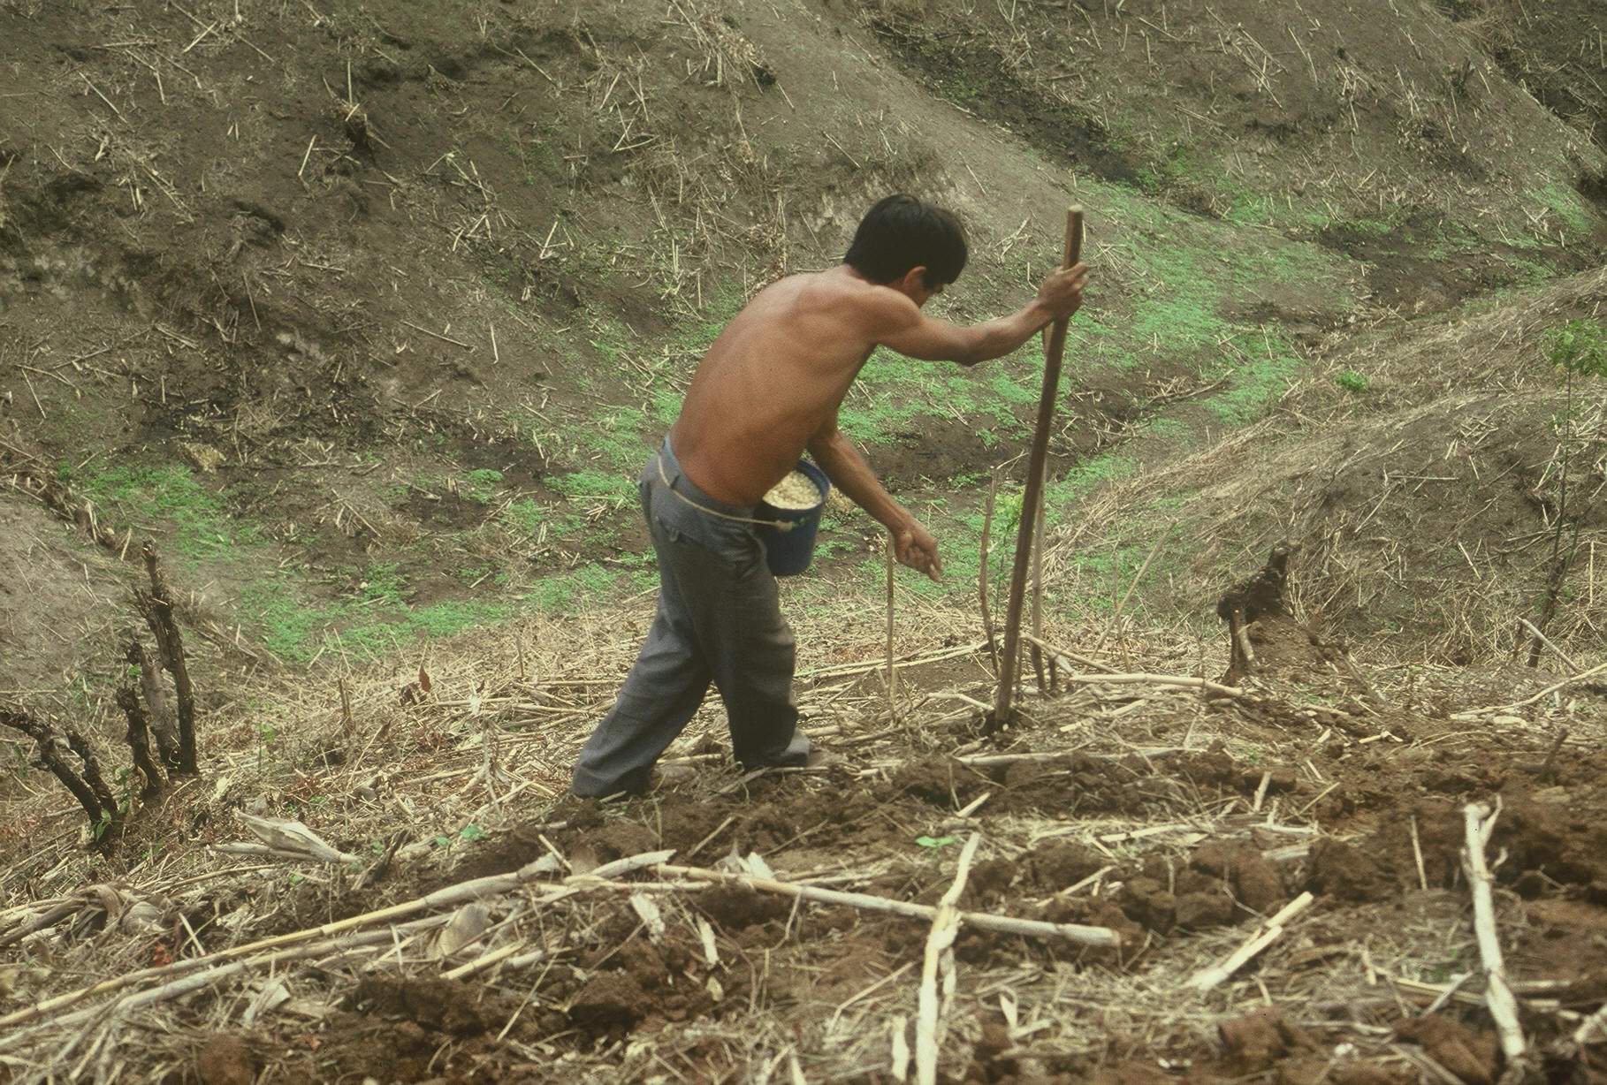


1987
ONE MINUTE VIDEO
OSU Hand Planter
Teosinte, 10,000 years ago, Oaxaca , southern Mexico
Notes:
22

Slide 8
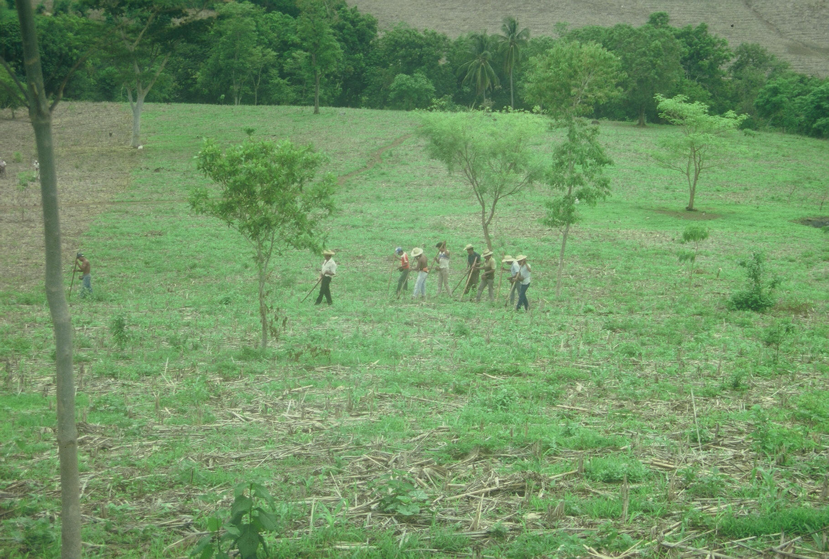
Opico quezaltepeque, El Salvador
Social aspects/technology transfer

Slide 9

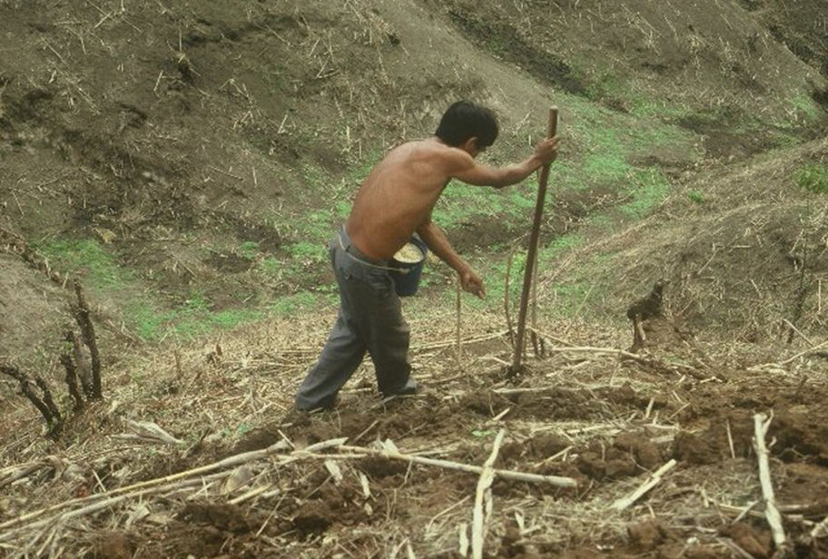
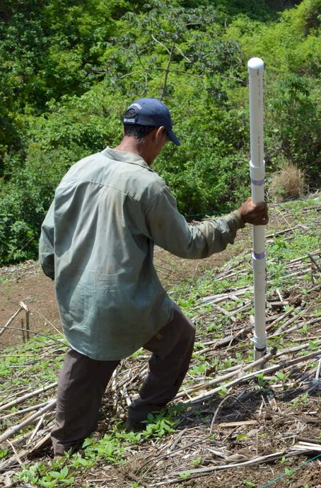

Opico quezaltepeque
EL SALVADOR
2018
1987

Slide 10
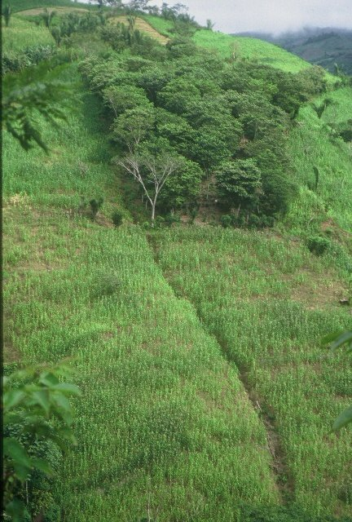
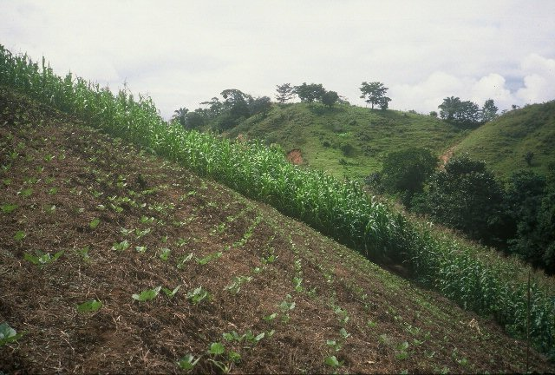
HONDURAS

Slide 11
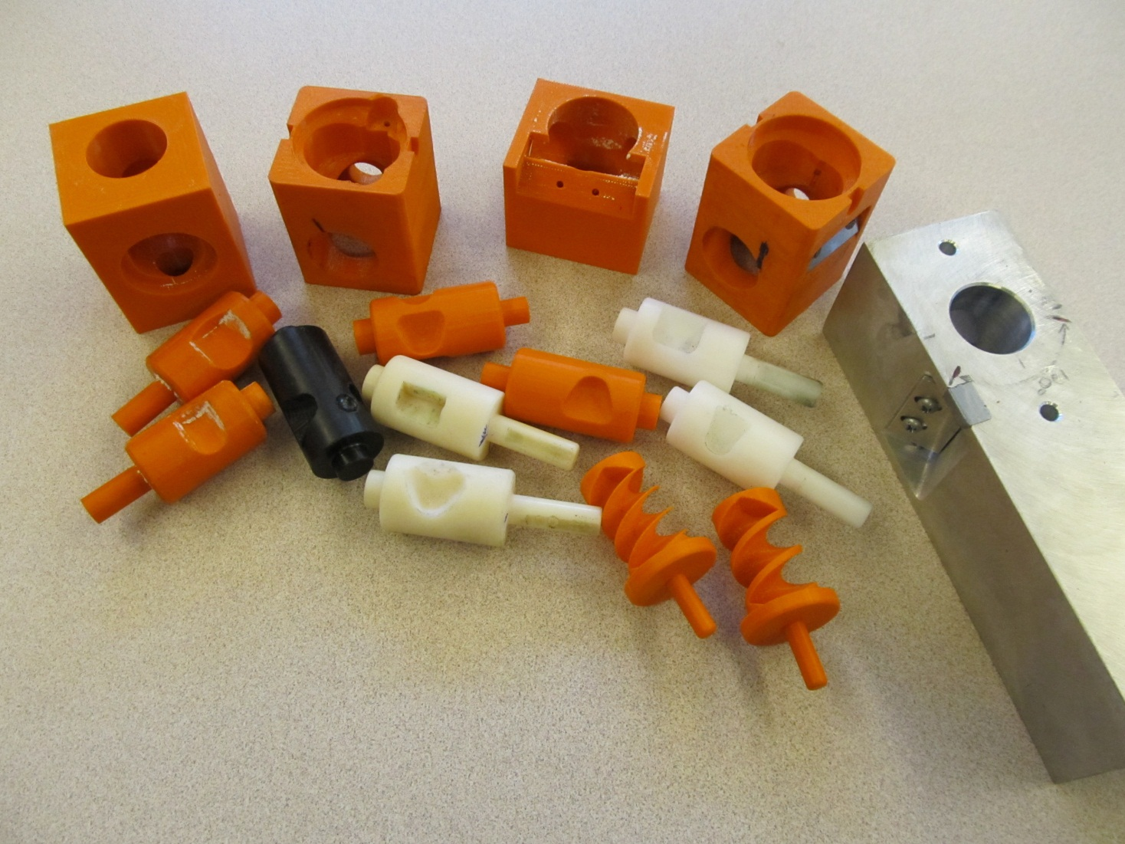
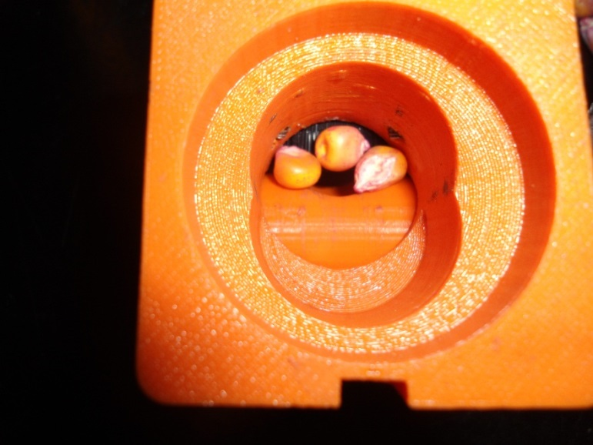
Singulation Design
3D printing
Rotary International
AGCO
Sitlington Chair
ASA Reinvest, Jessica Davis
Max Metcalf
Tolerances
Materials
Failure analysis/testing

Slide 12
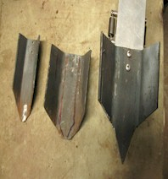
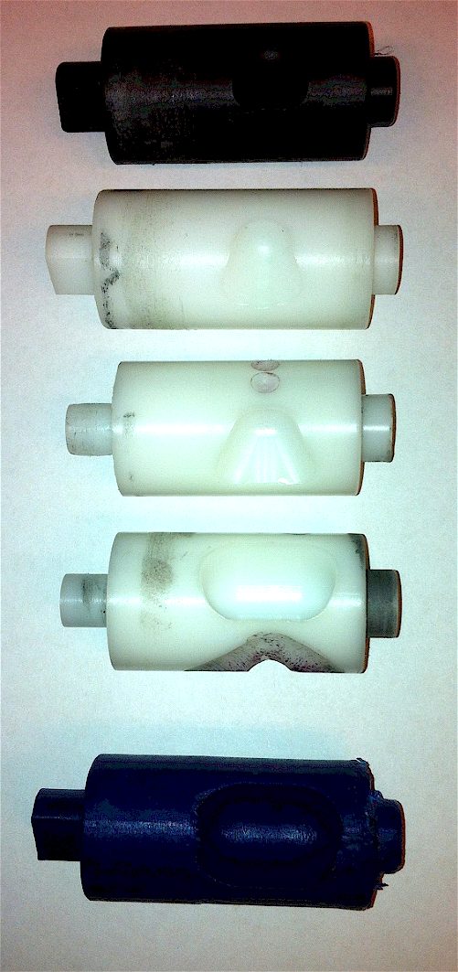
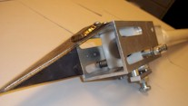
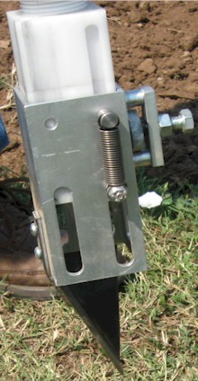
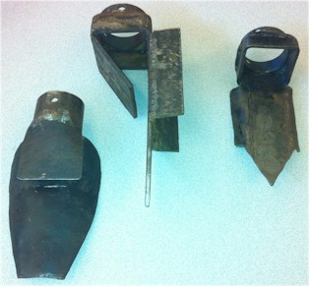
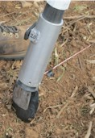
Internal Brush/Strength
Drum size/material
Cavity size/angle
Tip size/design/material
Internal/Ext. spring/tension

Slide 13
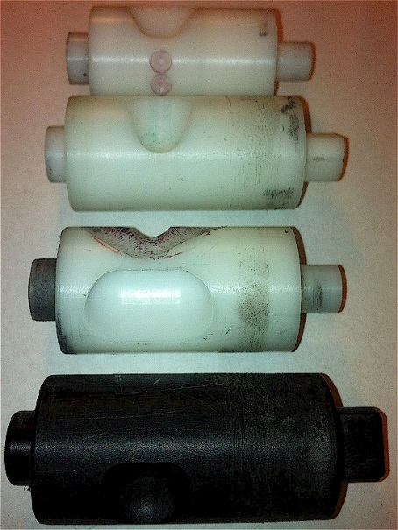
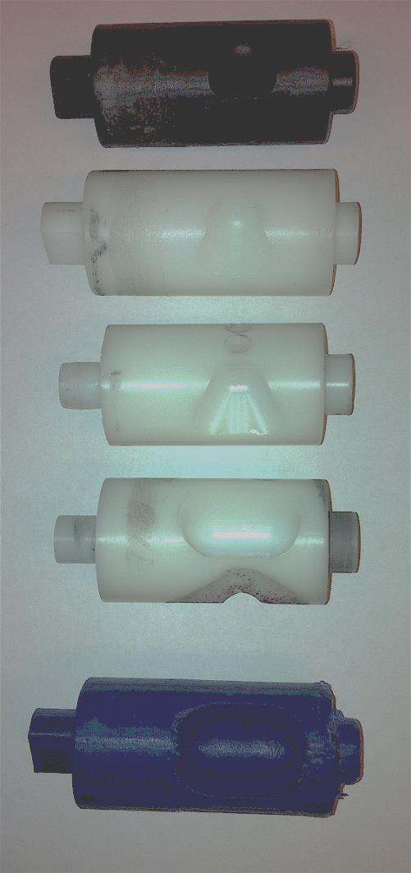
INTERNAL DRUM
Drum | Mass (g) | Volume (cm³)
A | 0.69 | 0.507
B | 0.71 | 0.521
OS | 0.88 | 0.646
OM | 3.36 | 2.468
OC | 3.38 | 2.482

Slide 14
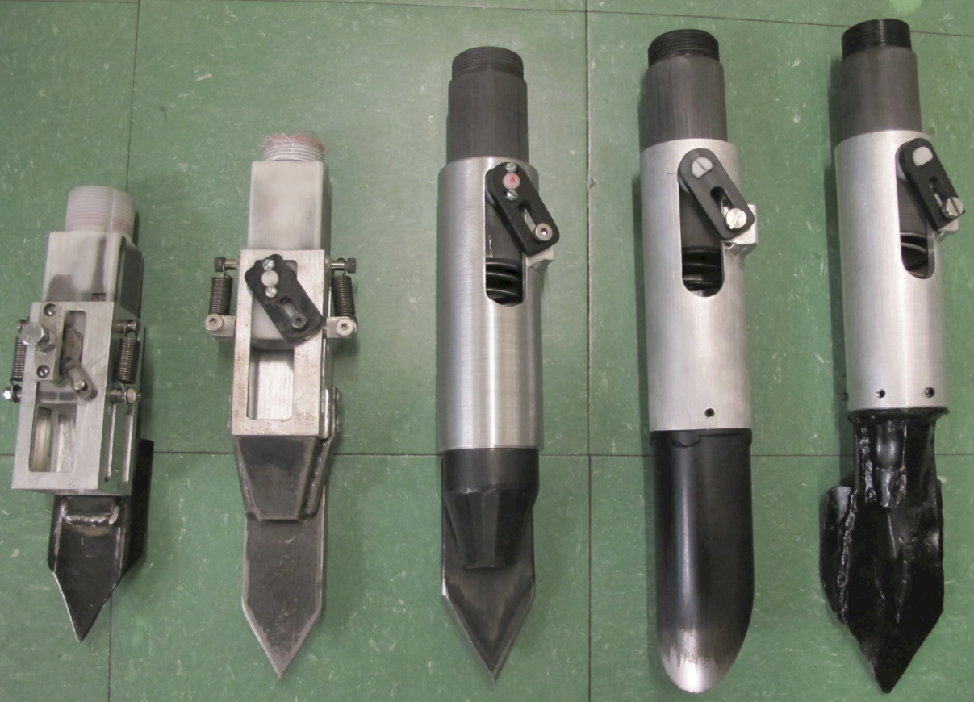

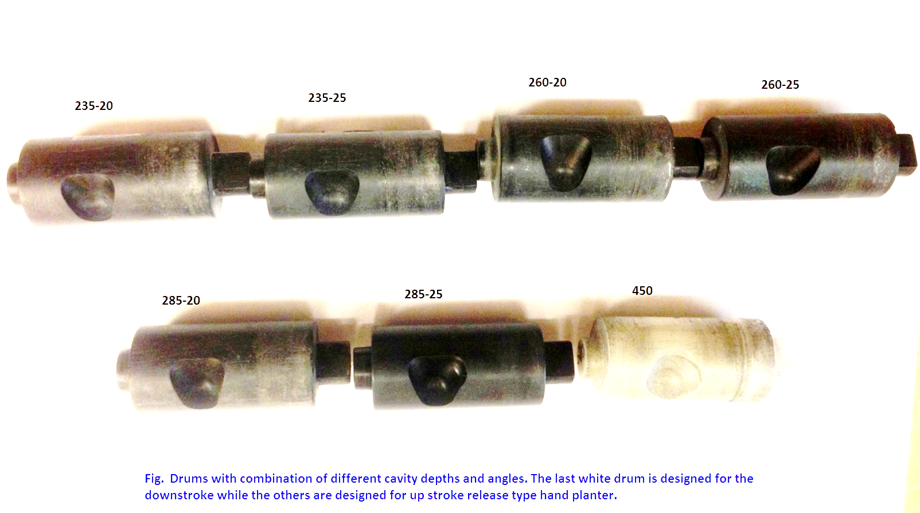
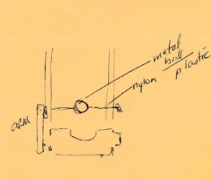

Slide 15
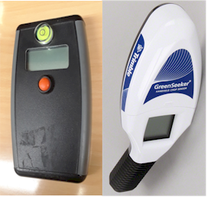
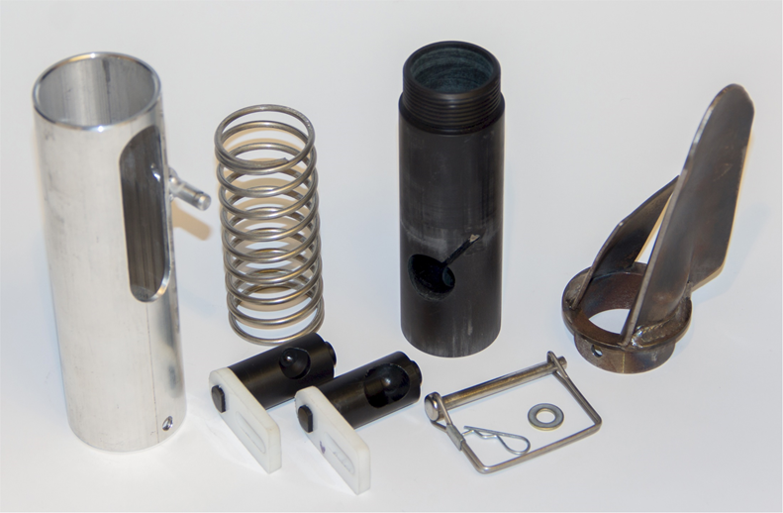
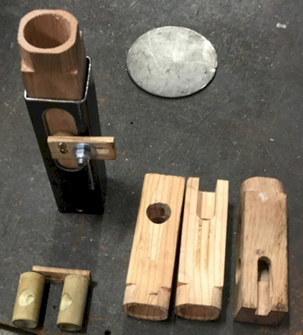
Greenseeker Sensor (basic research)
Greenseeder Planter (applied research)

Slide 16
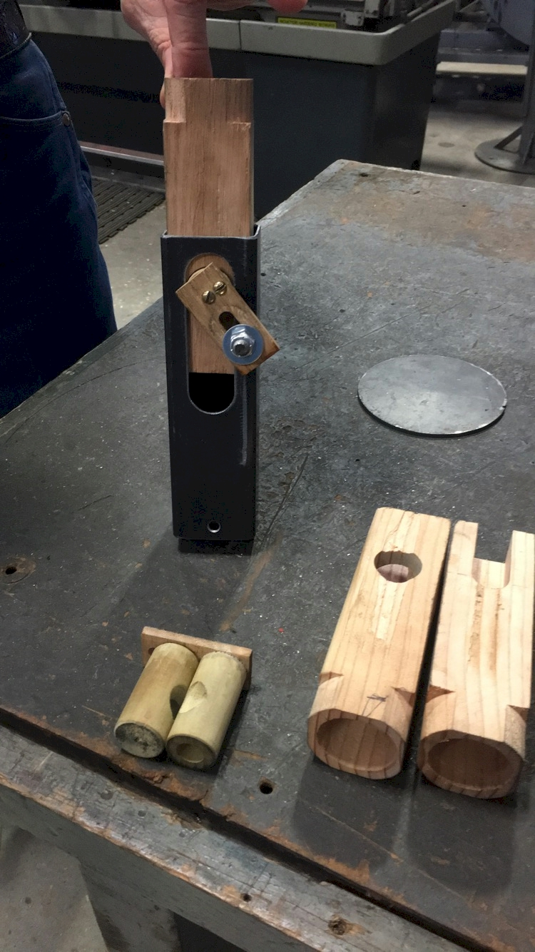
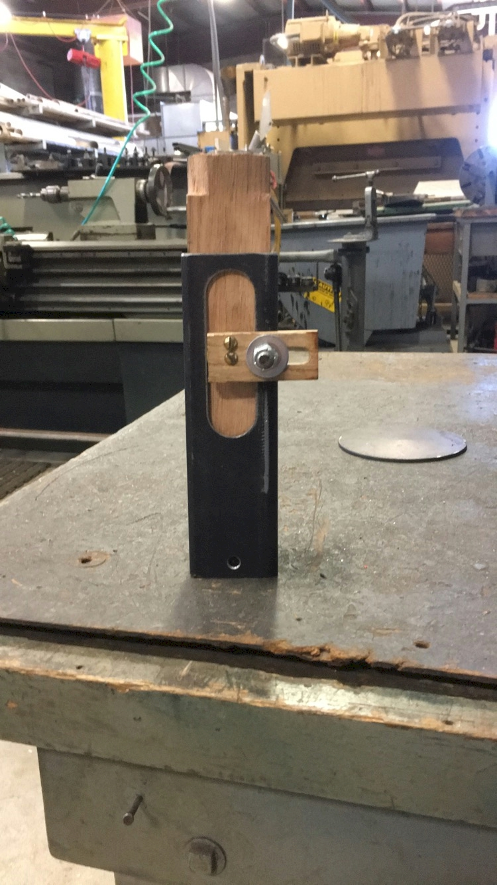
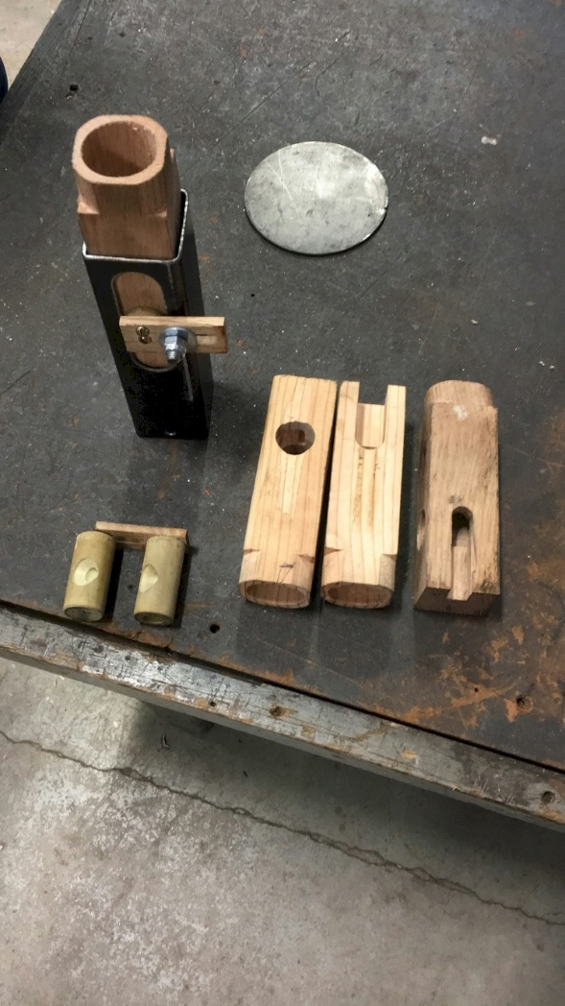

Slide 17
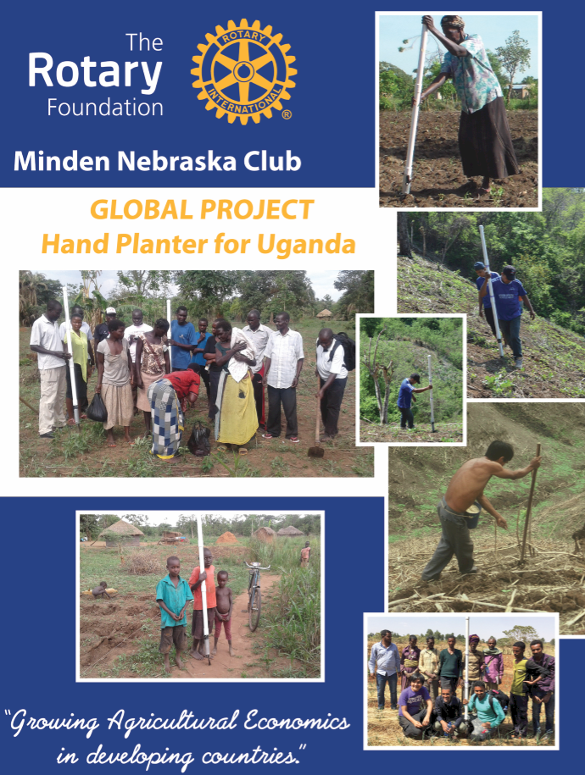

Kevin Raun

Slide 18
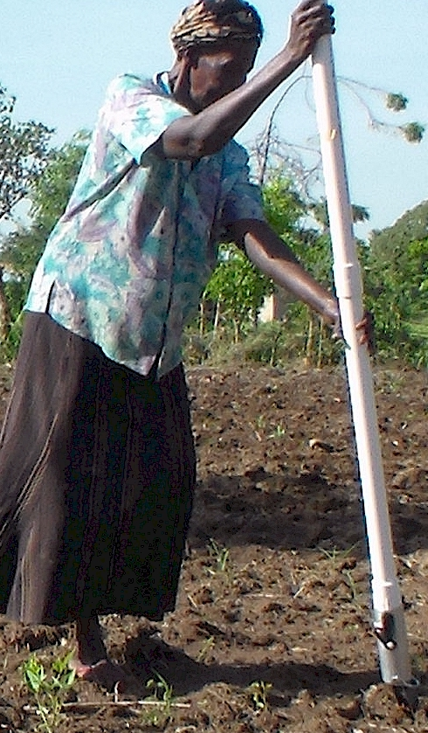
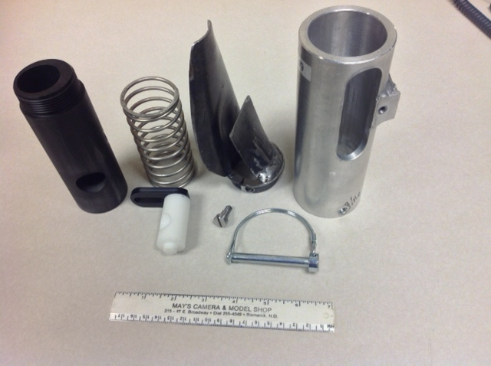

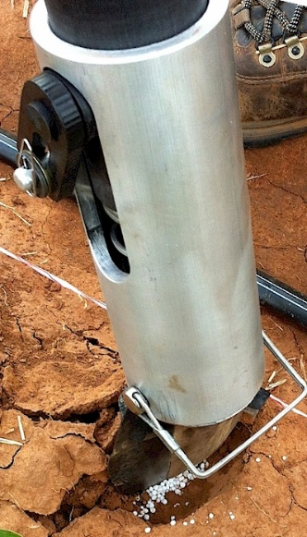
OSU Hand Planter
Plant and Soil Sciences
Biosystems and Agricultural Engineering

Slide 19
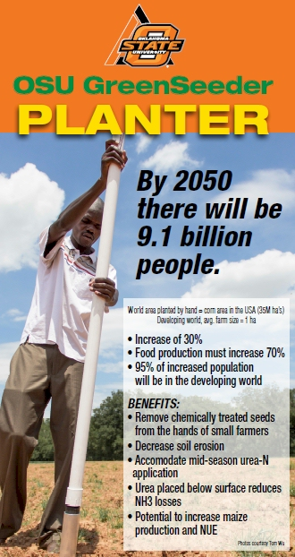
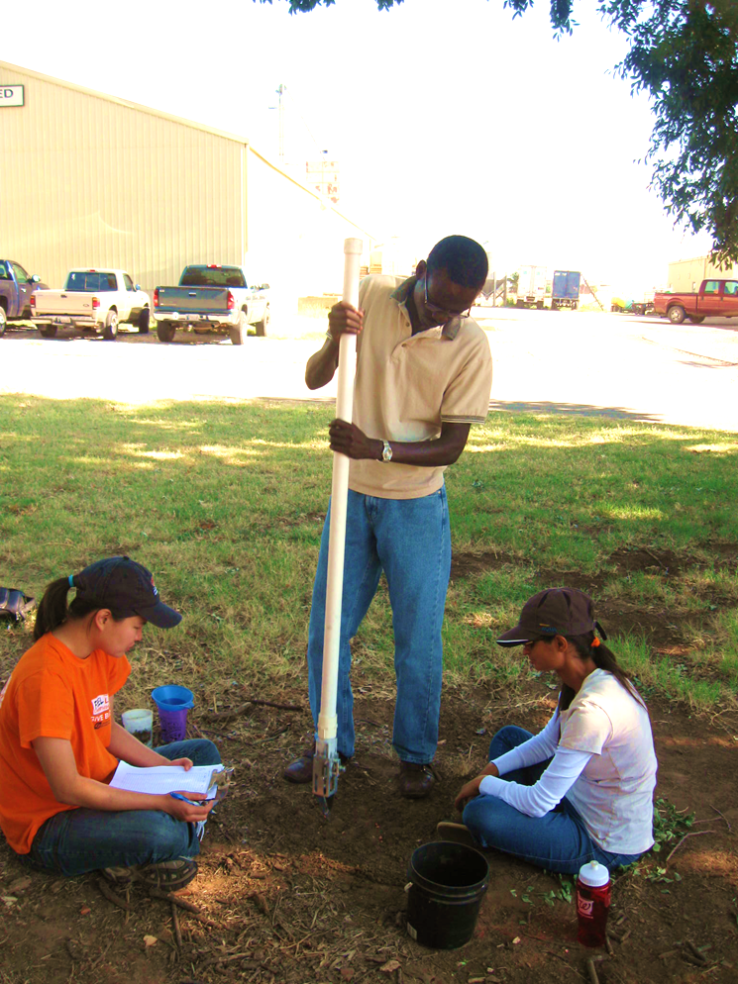
Lawrence Aula
Peter Omara

Slide 20
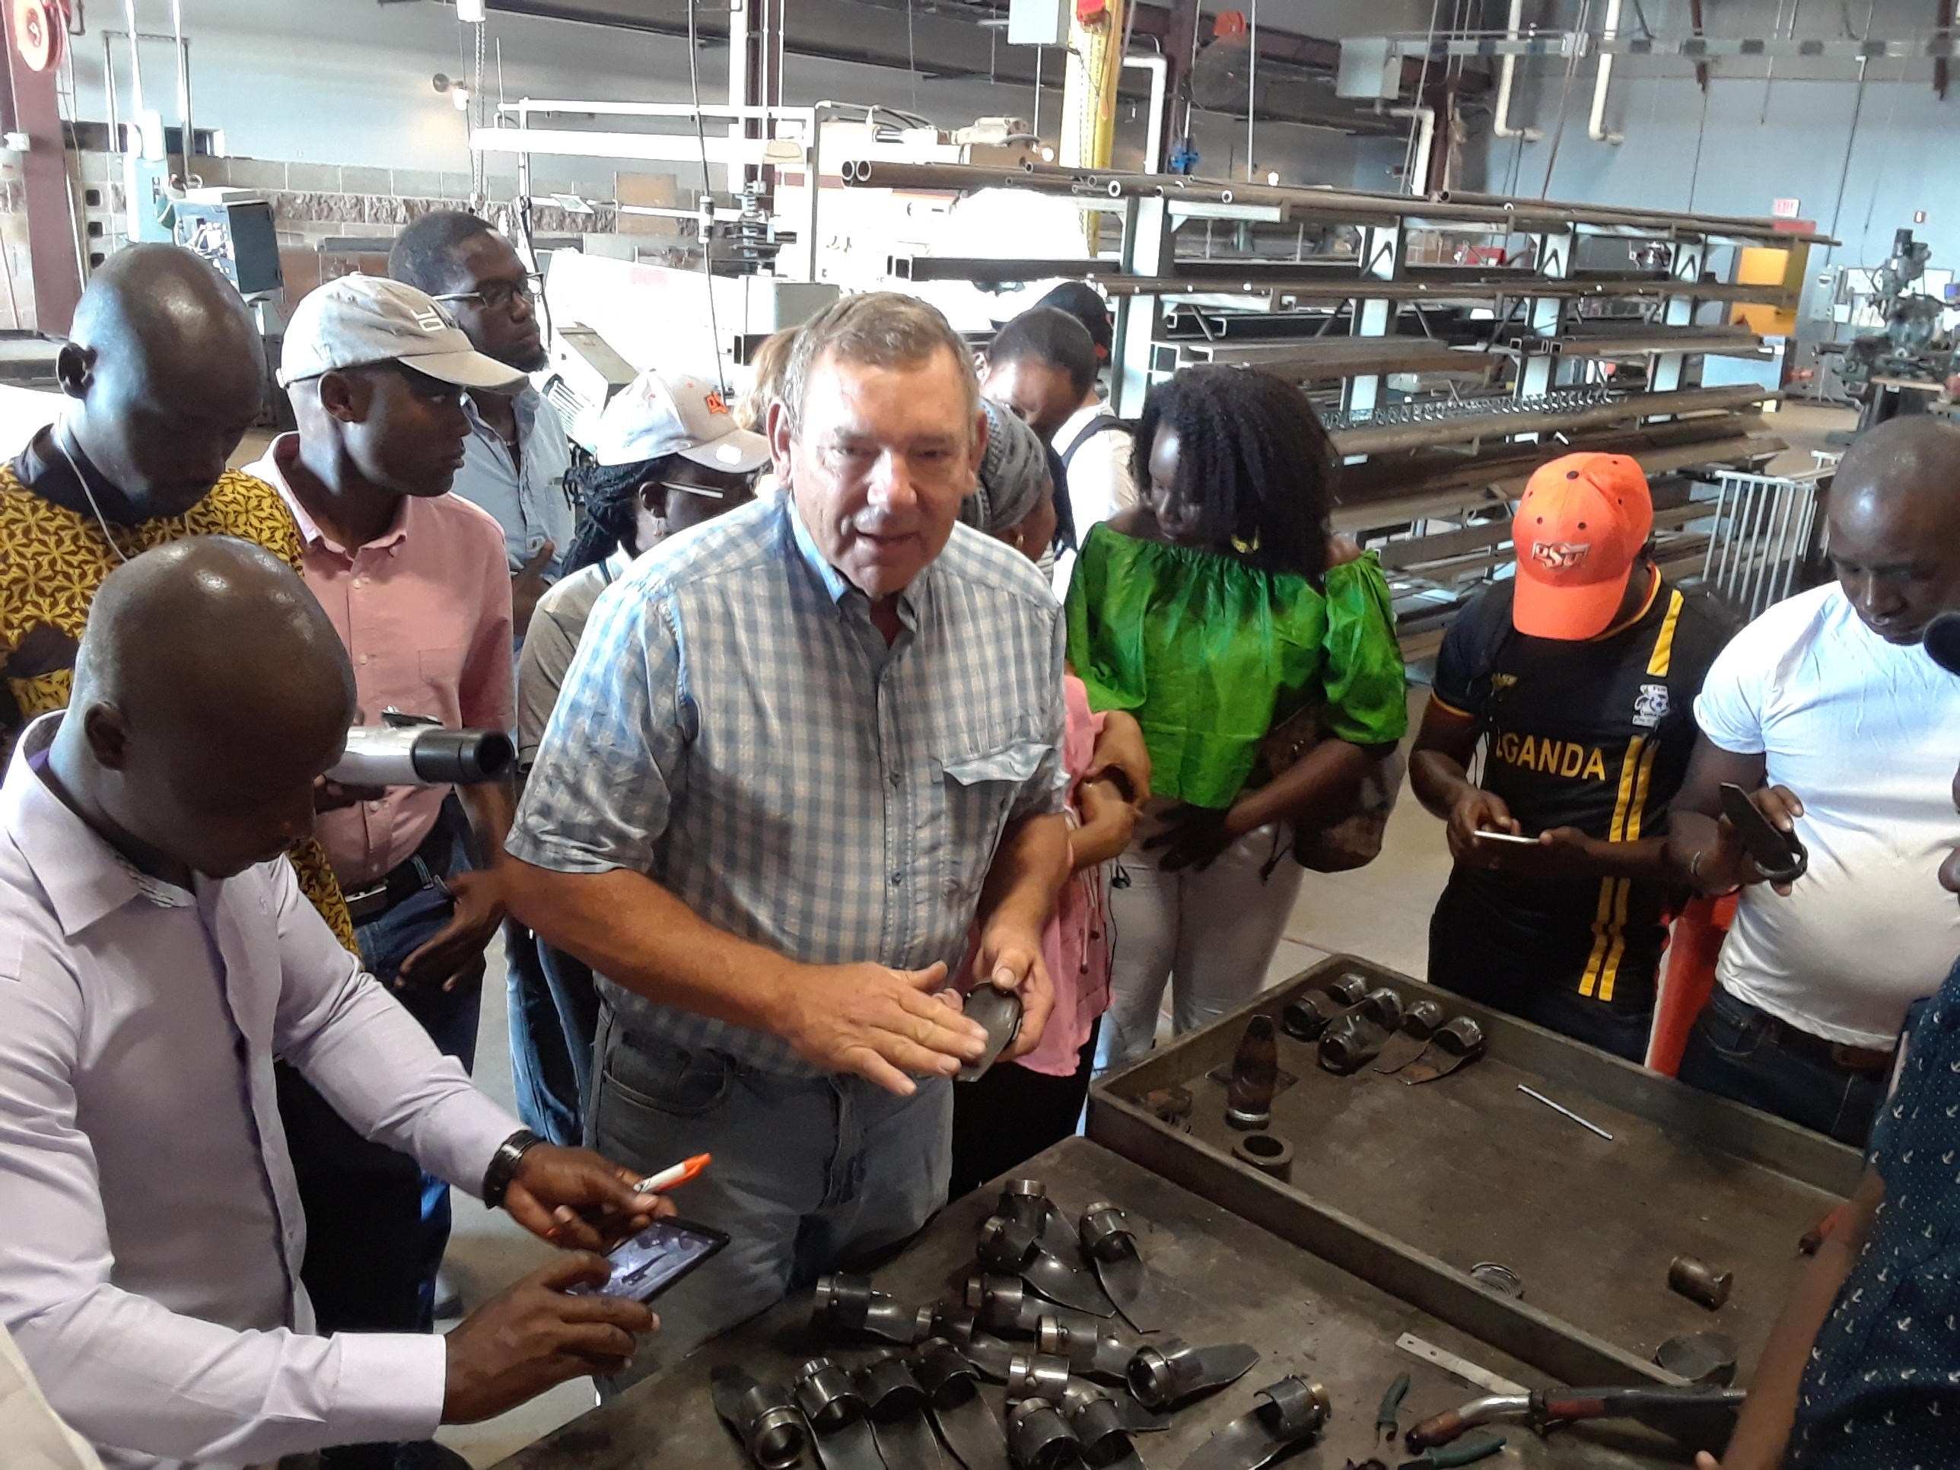
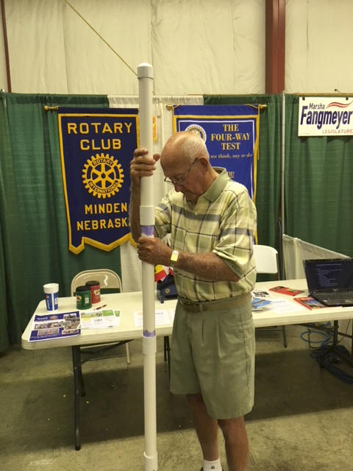

Wayne Kiner
Kearney County Fair
Minden, Nebraska
Koemel Law, PLLC
205 W. 7th Ave.
Suite 101-B
Stillwater, OK 74074
http://nue.okstate.edu/Hand_Planter.htm

Slide 21
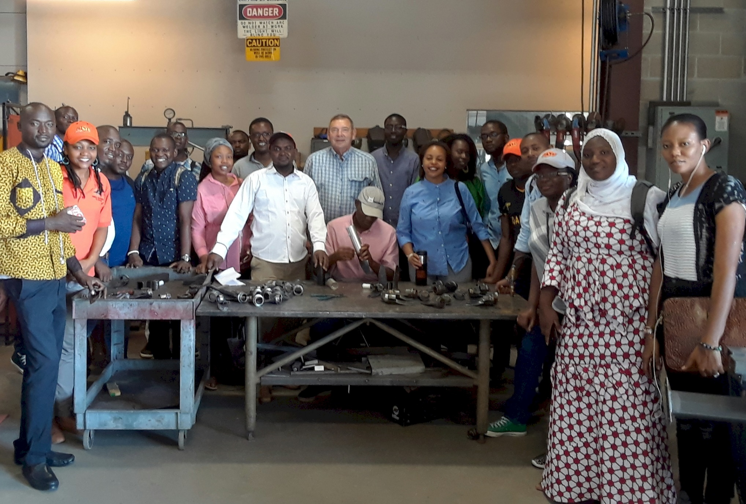
Wayne Kiner, Mandela Fellows 2018

Slide 22
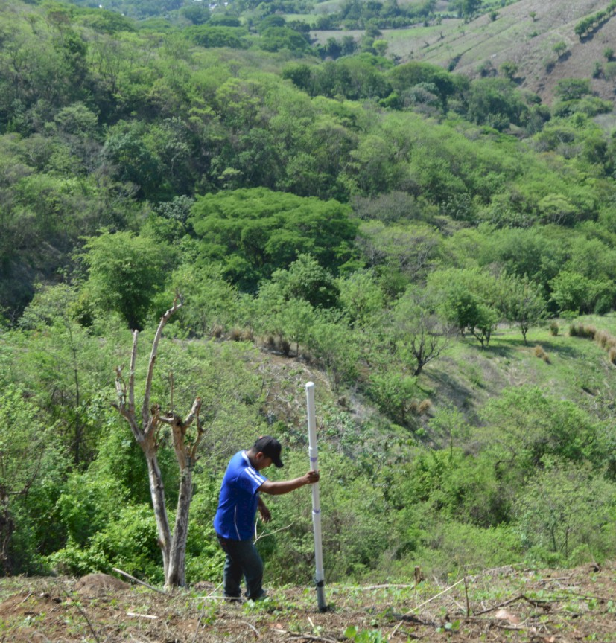
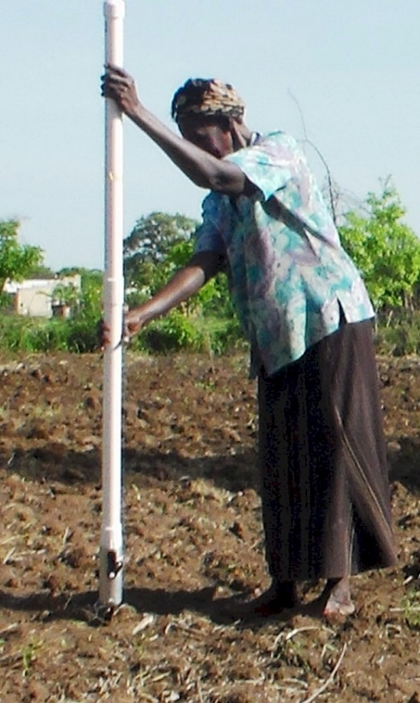
Opico Quezaltepeque, El Salvador
LIRA UGANDA
EL SALVADOR
Peter Omara MS 2013
Worlds Apart
Avg. Farm Size: 1 ha
Avg. Maize Grain Yield, 2 Mg/ha
Maize seed, Hybrids (US, others)
Social aspects/technology transfer

Slide 23
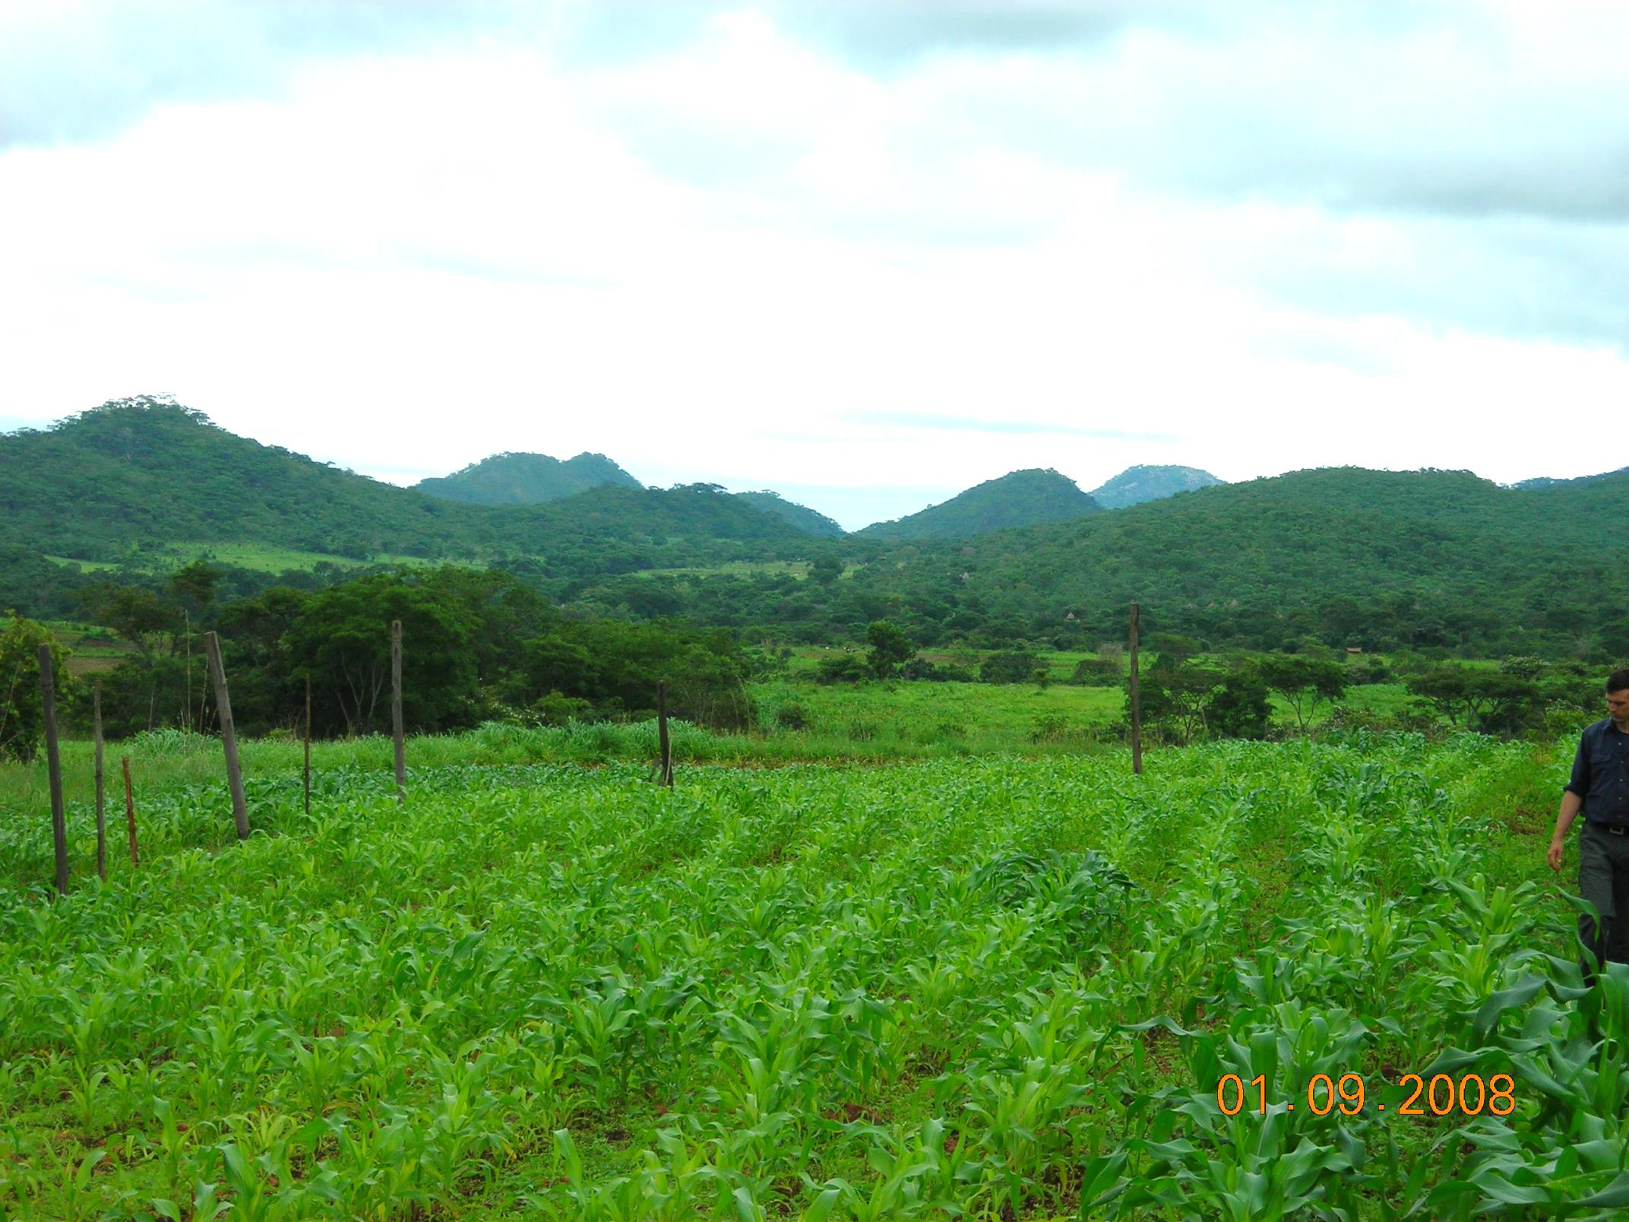
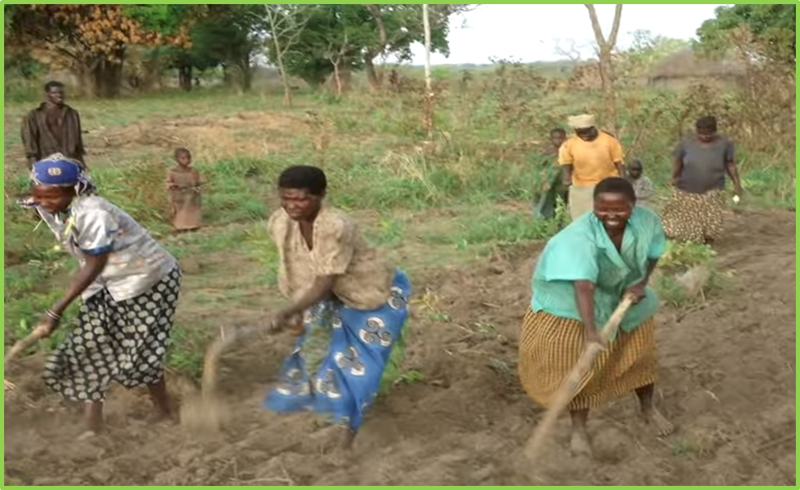
ZIMBABWE, UGANDA
Remote Locations
Surface applications of urea

Slide 24
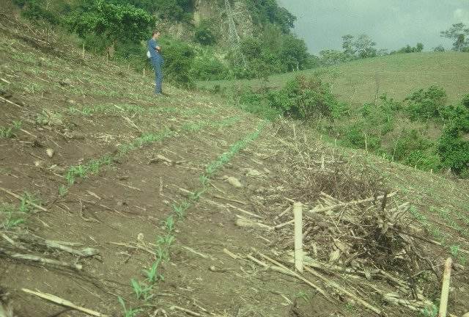
El Salvador

Slide 25
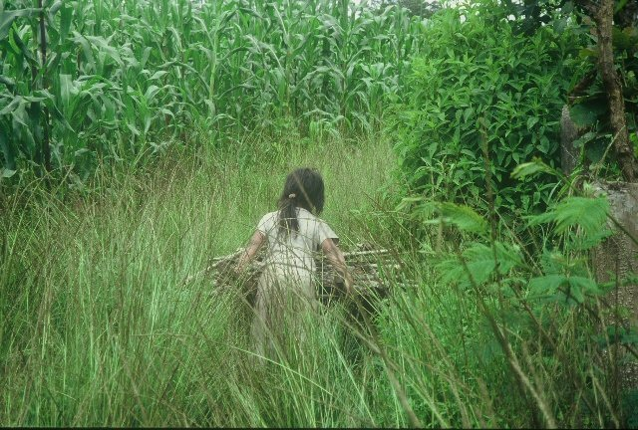
Care

Slide 26
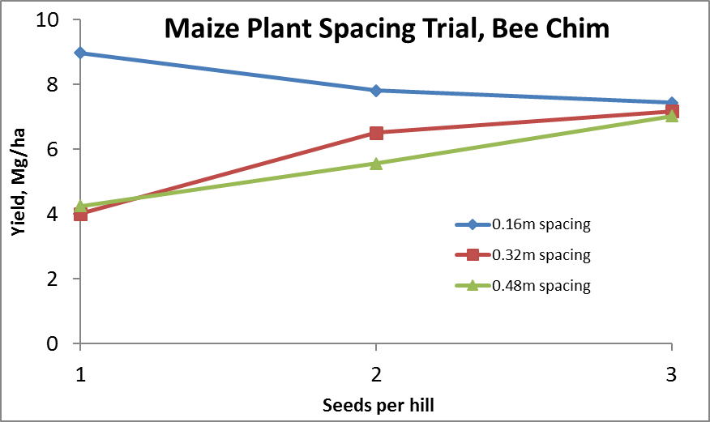
Importance of Singulation
0.76m Row Spacing
Heterogeneity in plant spacing, and plant stands reduce yields
www.agry.purdue.edu/ext/corn/pubs/agry9101.htm

Slide 27
Nov 13, 2013
SED = 8.6

Slide 28
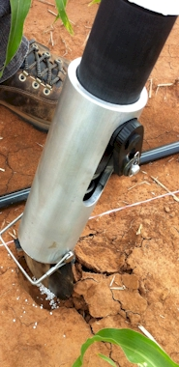
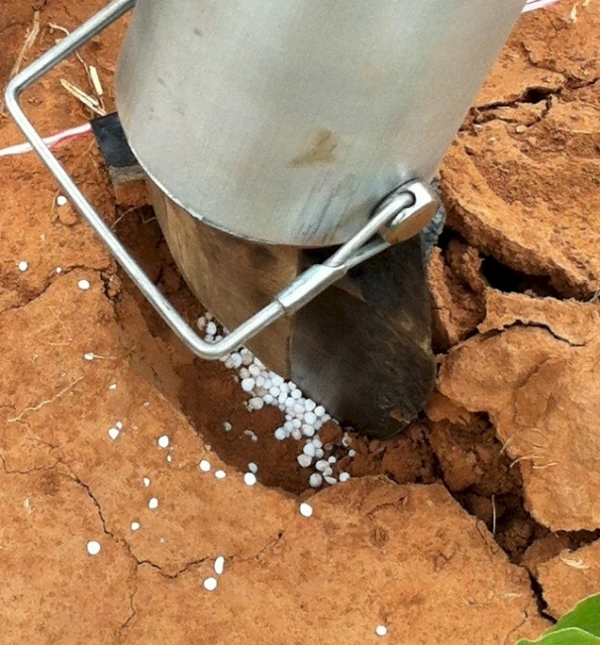
MID Season Fertilizer N
Combined, Efaw and Perkins
Topdress N, Corn, V12 |  | 70,000 plants/ha
Methods | N, kg/ha | Mg/ha
Check | 0 | 6.6
Hand planter (0.9 g/plant) | 30 | 11.2
Hand planter (1.8 g/plant) | 60 | 10.6
Broadcast | 30 | 6.4
Broadcast | 60 | 7.0
Dribble urea | 30 | 9.3
Dribble urea | 60 | 7.8
Dribble UAN | 30 | 7.3
Dribble UAN | 60 | 10.4
SED = 1.81

Slide 29
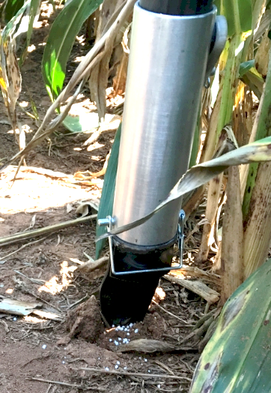
Benefits
Remove chemically treated seeds from the hands of producers
Decrease soil erosion via improved plant spacing
Accommodate mid-season N application
Urea placed below the surface reducing NH₃ loss
Increased production and NUE
Potential Uses
Seed, all types
Alternative chemicals, EPA, mosquito abatement
Food plots/hunters
Gardeners

Slide 30
MAIZE (FAOSTAT.COM)
Area, ha Production, Mt Avg. Mg/ha
World 183,319,737 1,038,281,035 5.7 (90 bu/ac)
USA 33,644,310 361,091,140 10.9 (174 bu/ac)
China 35,981,005 215,812,100 6.2 (98 bu/ac)
Brazil 15,450,180 80,516,571 5.2 (83 bu/ac)

Slide 31





Frontier Rotary, Stillwater Oklahoma
Stillwater Centennial, Stillwater, Oklahoma
Mustang Rotary, Mustang, Oklahoma
Minden Rotary, Minden, Nebraska
Kearney Rotary, Kearney, Nebraska
District 5750, Oklahoma
District 5630, Nebraska
District 9211, Uganda
District 2040, Milan Italy
District 9125, Abuja, Nigeria

Slide 32


Seed Placement and Leaf Orientation
2011. Maize (Zea mays L.) Leaf Angle and Emergence as Affected by Seed Orientation at Planting. J. Exp. Agric. DOI:10.1017/S001447971100038X

Slide 33


Hand-Held GreenSeeker Sensors

Slide 34





Current Cost Estimates
Grand Victory Ltd
Tsim Sha Tsui Hong Kong
Rm 1604 16/F Lee Wai Coml Bldg
Tsim Sha Tsui
1000, $25 each
5000
$49 each
Usman Ali, Nigeria, Mandela Fellows

Slide 35
OSU Hand Planter
http://nue.okstate.edu/Hand_Planter/summary_HP1.pdf

Slide 36

Benefits
Remove chemically treated seeds from the hands of producers
Decrease soil erosion via improved plant spacing
Accommodate mid-season N application
Urea placed below the surface reducing NH₃ loss
Increased maize production and NUE
Chim, Bee Khim, Peter Omara, Jeremiah Mullock, Sulochana Dhital, Natasha Macnack, and William Raun. 2014. Effect of seed distribution and population on maize (Zea mays L.) grain yield. Int. J. Agronomy. V2014. . http://dx.doi.org/10.1155/2014/125258.
Omara, Peter, Lawrence, Aula, Bill Raun, Randy Taylor, Adrian Koller, Eric Lam, Joshua Ringer, Jeremiah Mullock, Sulochana Dhital and Natasha Macnack. 2015. Hand planter for maize (Zea mays L.) in the developing world. J. Plant Nutr. DOI:10.1080/01904167.2015.1022186
Dhillon, J.S., B. Figueiredo, L. Aula, T. Lynch, R.K. Taylor, and W.R. Raun. 2017. Evaluation of drum cavity size and planter tip on singulation and plant emergence in maize (Zea mays L.). J. Plant Nutr. DOI:10.1080/01904167.2017.1382532.
Planting 1 seed, every 0.16m increased yields by an average of 1.15 Mg ha⁻¹ (range, 0.33 to 2.46 Mg ha⁻¹) when compared to the farmer practice of placing 2 to 3 seeds per hill, every 0.48 cm.

Slide 37

Fig 1: worldwide maize area
1 billion metric tons of maize was harvested from 186 million hectares, of which 83% area was located in developing world countries (FAOSTAT 2013).
Almost 19% of area in developing countries is planted by hand.
This production map is based on the SPAM data set from IFPRI (Harvest Choice) but has been aggregated from its original format to better represent important production areas. This fits with national statistics from the year 2005. Datasets: You, L., Z. Guo, J. Koo, W. Ojo, K. Sebastian, M.T. Tenorio, S. Wood, U. Wood-Sichra, 2014. Spatial Production Allocation Model (SPAM) 2005 Beta. http://MapSPAM.info. Accessed , March. 2014)

Slide 38



GreenSeeder Manual
www.nue.okstate.edu
No failure/1,000,000 cycles
1 ha, 10 years, 100,000 seeds/ha

Slide 39



DESIGN
Planter is pressed down and compresses internal spring.
Singulation drum rotates and seed is picked up by drum cavity.
The planter is ‘relaxed’ and while the spring returns to its initial position seed is released from cavity into the soil depression made by planter tip.
GreenSeeder Manual
http://www.nue.okstate.edu/Hand_Planter/Planter%20User's%20Manual%20EL.pdf

Slide 40

Mid Season Fertilizer N
Combined, Efaw and Perkins
Topdress N, Corn, V12 |  | 70,000 plants/ha
Methods | N, kg/ha | Mg/ha
Check | 0 | 6.6
Hand planter (0.9 g/plant) | 30 | 11.2
Hand planter (1.8 g/plant) | 60 | 10.6
Broadcast | 30 | 6.4
Broadcast | 60 | 7.0
Dribble urea | 30 | 9.3
Dribble urea | 60 | 7.8
Dribble UAN | 30 | 7.3
Dribble UAN | 60 | 10.4
SED = 1.81

Slide 41

means for singles, blanks, doubles and triples per 100 strikes
Date | Seed Size | Singles | Blanks | Doubles | Triples | Adjustments
24-Aug | LR | 82 | 17 | 7 | 0 | light spring
 | MR | 76 | 16 | 13 | 0.5 | light and lighter spring
 | MF | 67.5 | 21 | 11.5 | 0
11-Sep | LR | 83 | 8 | 8 | 1 | Light spring, welding done
 | MR | 59 | 6 | 31 | 4
 | MF | 58 | 8.5 | 4 | 2.75
21-Sep | LR | 77 | 6.5 | 16 | 0.5 | Hard spring
 |  | 70.5 | 8 | 19.5 | 2 | lighter spring
23-Sep | LR | 70 | 5.5 | 23 | 1.5 | friction problem fixed, Light spring
Drum and Brush were not changed
Dimensions : Light spring (l=2.1cm,d=1.2cm)
Lighter spring (l=2.9cm,d=0.9cm)
Hard Spring (l=1.5 cm, d=1.5cm)

Slide 42
Maize (FAOSTAT, 2013)
Area, ha Production, Mt Avg. Mt/ha
World 184,239,959 1,016,431,783 5.5 (87 bu/ac)
USA 35,478,012 353,699,441 9.9 (157 bu/ac)
China 35,276,500 217,830,000 6.2 (98 bu/ac)
Brazil 15,450,180 80,516,571 5.2 (83 bu/ac)
Low income Food Deficit Countries
49,356,985 117,590,512 2.4 (38 bu/ac)
60% hand
planted
29,614,180
USA 2014, 37,125,000 ha’s

Slide 43



Variables Evaluated

Slide 44


Shorty’s Machine Shop
7006 E 6th Ave, Stillwater, OK 74074
Dr. Randy Taylor

Slide 45

Biosystems and Agricultural Engineering

Slide 46



Norman Borlaug Mother Teresa
1914 – 2009 1910 - 1997

Slide 47





Alternative Designs

Slide 48


Hemileia vastatrix, leaf rust
(more at lower altitudes)
Coffee Exports
Brazil, $4.6B
Colombia, $2.6B
Honduras, $1.2B
Guatemala, $0.8B
2500-6000 ft asl
Coffee Coffea arabica
Rubber Hevea brasiliensis, 1940 USDA

