Slide 1



NICARAGUA 2016 Ohio State University
Norman Borlaug Mother Teresa
1914 – 2009 1910 - 1997

Slide 2
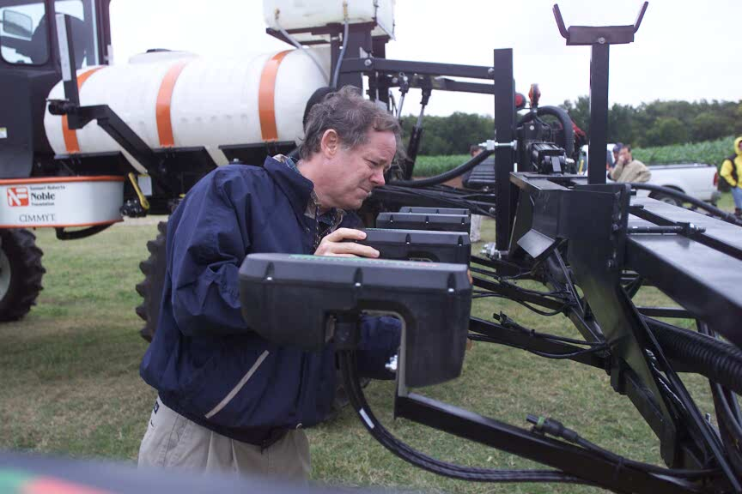
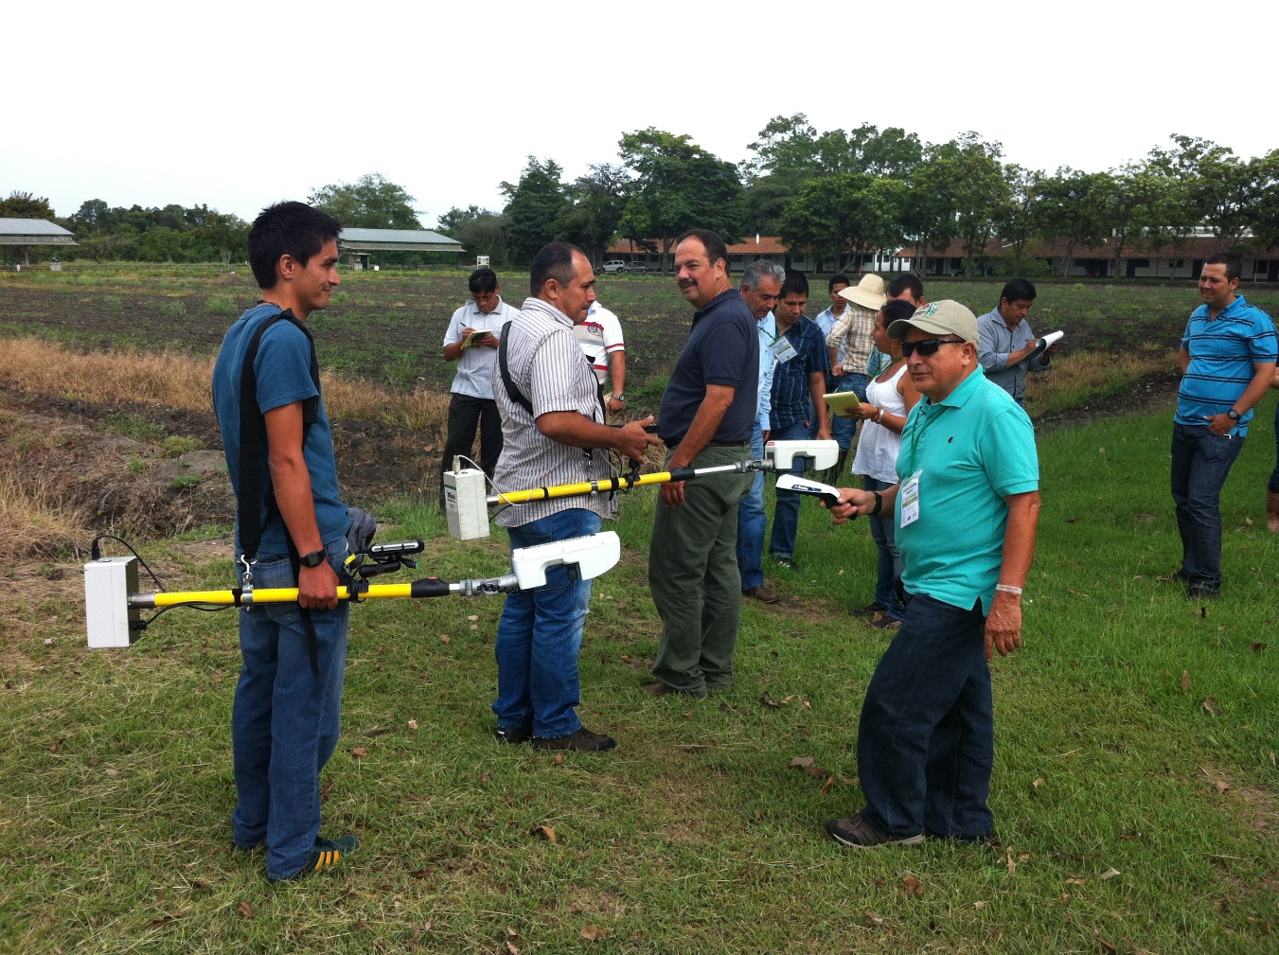
Dr. Marvin Stone
1950-2015

Slide 3
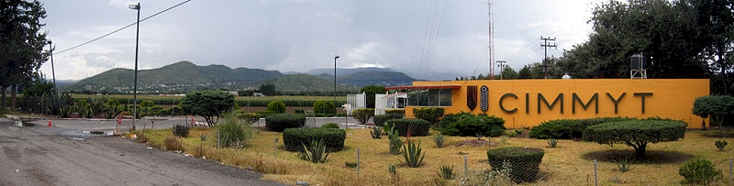

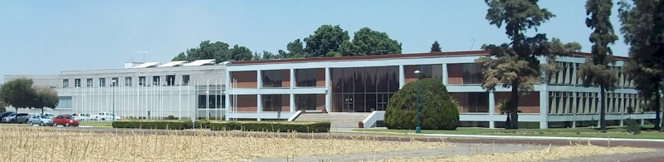
Centro Internacional de Mejoramiento de Maiz y Trigo

Slide 4

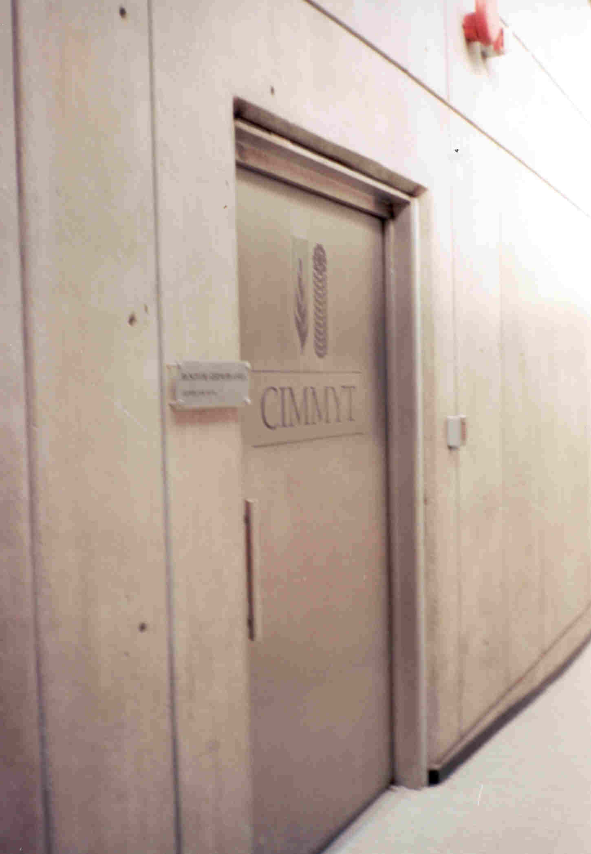
CIMMYT Germplasm Bank
150,000 cereal lines
http://www.cimmyt.org/germplasm-bank/

Slide 5
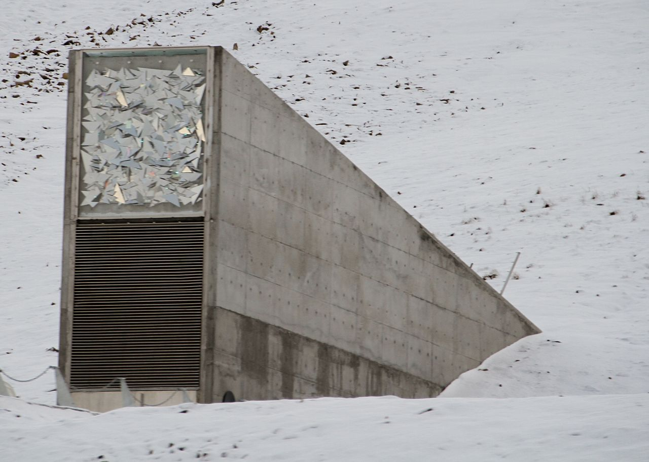
Svalbard Global Seed Vault (Norwegian island of Spitsbergen, 810 miles from the North Pole
Norway, Sweden, Finland, Denmark
Consultative Group on International Agricultural Research (CGIAR)

Slide 6
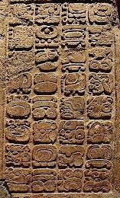



Maize (teosinte) “corn”
- first domesticated in Tehuacan, MX, 3600 BC
- western civilization, discovered in Cuba, 1492
1880 62M ac 25M ha
1900 95M ac 38M ha
1910 100M ac 40M ha 32 bu/ac
1917 111M ac 45M ha
2015 88M ac 54M ha 124 bu/ac

Slide 7
ATMOSPHERE
GLOBAL WARMING
15-40 kg/ha
N₂O
NO
N₂
INDUSTRIAL
FIXATION
LIGHTNING,
RAINFALL
CH_{4 ,} N₂O
N2 FIXATION
HABER BOSCH
PLANT AND ANIMAL
RESIDUES
SYMBIOTIC
NON-SYMBIOTIC
(1200°C, 500 atm)
MESQUITE
RHIZOBIUM
ALFALFA
SOYBEAN
BLUE-GREEN ALGAE
AZOTOBACTER
CLOSTRIDIUM
3H₂ + N₂ 2NH₃
MATERIALS WITH N
CONTENT > 1.5%
(COW MANURE)
MATERIALS WITH N
CONTENT < 1.5%
(WHEAT STRAW)
10-80 kg/ha
FERTILIZATION
PLANT
LOSS
AMINO
ACIDS
MICROBIAL
DECOMPOSITION
0-50 kg/ha
NH₃
IMMOBILIZATION
AMMONIA
VOLATILIZATION
AMINIZATION
ORGANIC
MATTER
HETEROTROPHIC
R-NH₂ + ENERGY + CO₂
BACTERIA (pH>6.0)
FUNGI (pH<6.0)
R-NH₂ + H₂O
pH>7.0
NH₂OH
AMMONIFICATION
FIXED ON
EXCHANGE
SITES
IMMOBILIZATION
R-OH + ENERGY + 2NH₃
Pseudomonas, Bacillus,
Thiobacillus Denitrificans,
and T. thioparus
N₂O₂⁻
MICROBIAL/PLANT
SINK
2NH₄⁺ + 2OH⁻
MINERALIZATION
+ NITRIFICATION
NO₂⁻
+O₂
DENITRIFICATION
Nitrosomonas
NO₃⁻
POOL
NITRIFICATION
OXIDATION STATES
DENITRIFICATION
LEACHING
LEACHING
VOLATILIZATION
NITRIFICATION
Nitrobacter
+ O₂
2NO₂⁻ + H₂O + 4H⁺
NH₃ AMMONIA -3
NH₄⁺ AMMONIUM -3
N₂ DIATOMIC N 0
N₂O NITROUS OXIDE 1
NO NITRIC OXIDE 2
NO₂⁻ NITRITE 3
NO₃⁻ NITRATE 5
TEMP 50°F
Joanne LaRuffa
Wade Thomason
Shannon Taylor
Heather Lees
Department of Plant and Soil Sciences
Oklahoma State University
ADDITIONS
LEACHING
LEACHING
LOSSES
LEACHING
OXIDATION REACTIONS
pH 7.0
0-40 kg/ha
REDUCTION REACTIONS

Slide 8
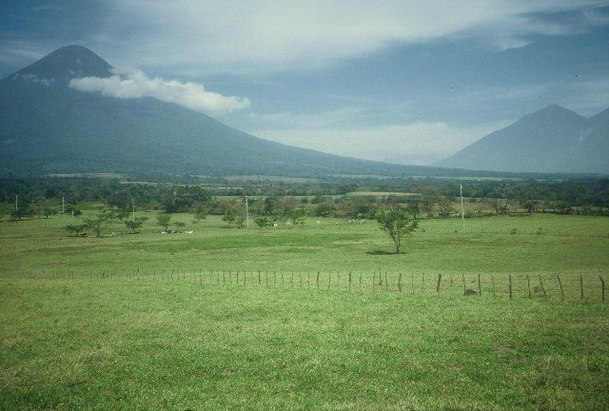
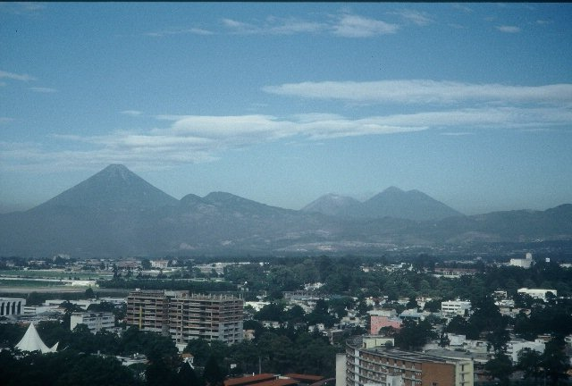
Guatemala
Guatemala

Slide 9
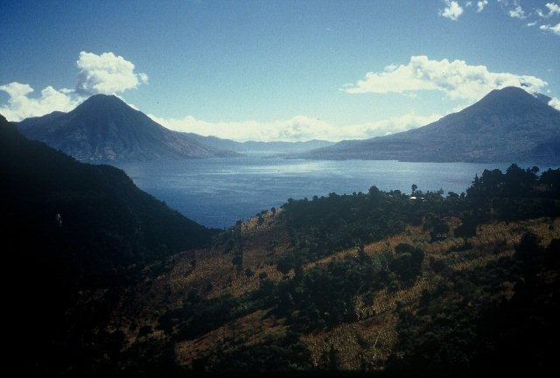
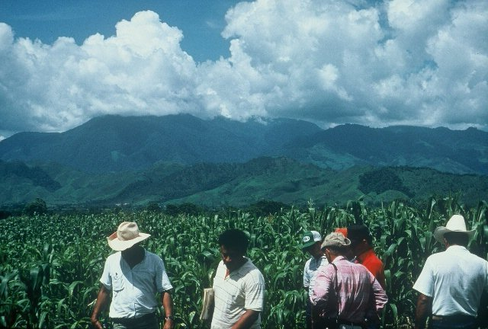
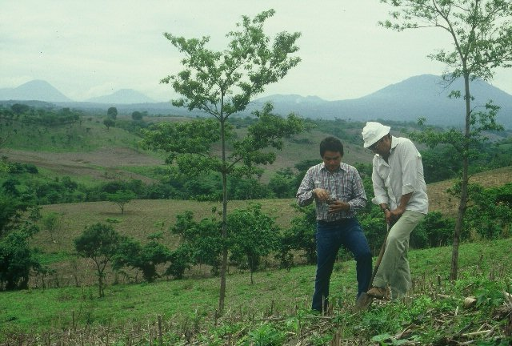
Guatemala
Andisols
Inceptisols
Andept (great group)
Costa Rica
El Salvador

Slide 10
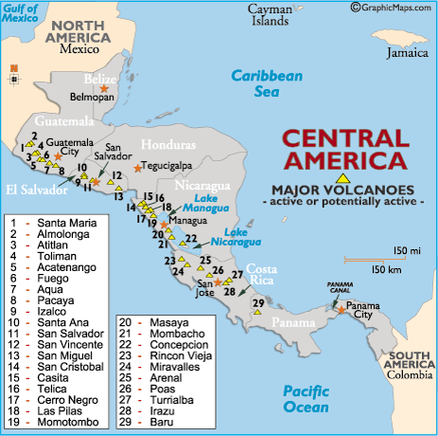

Slide 11
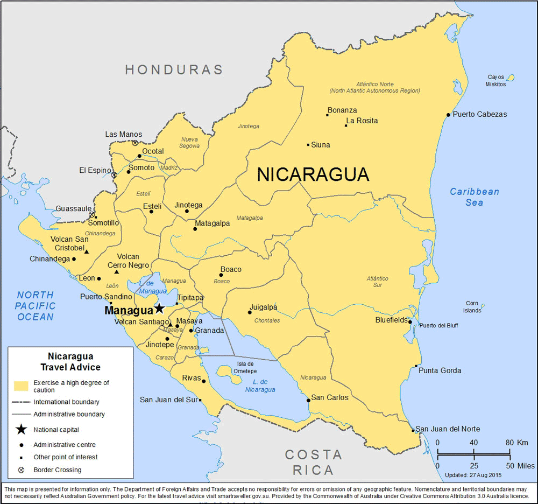
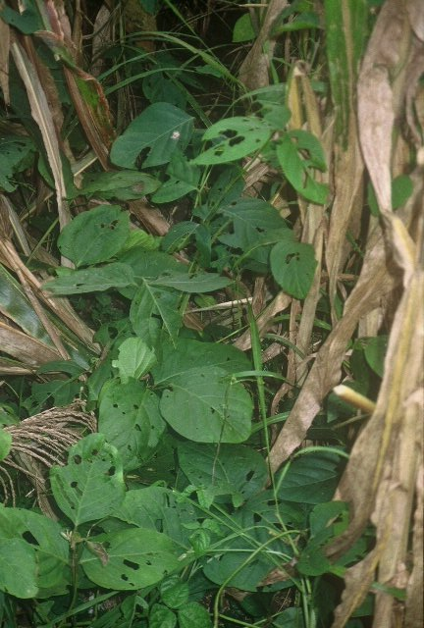
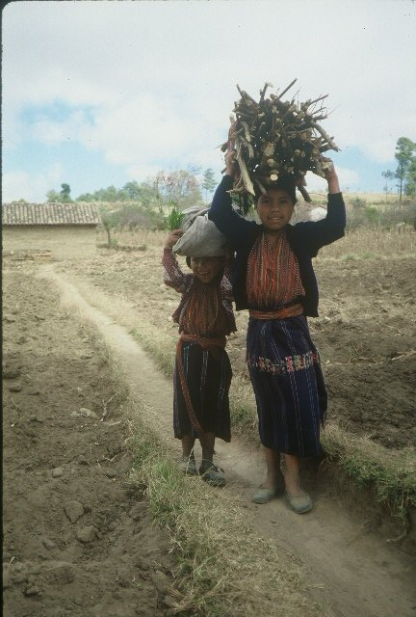
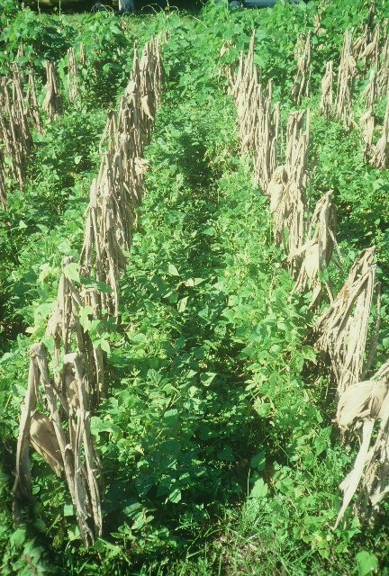
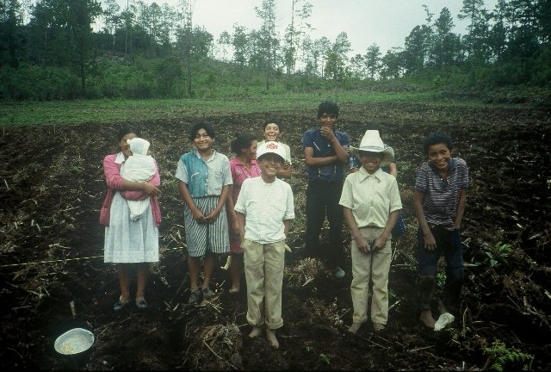
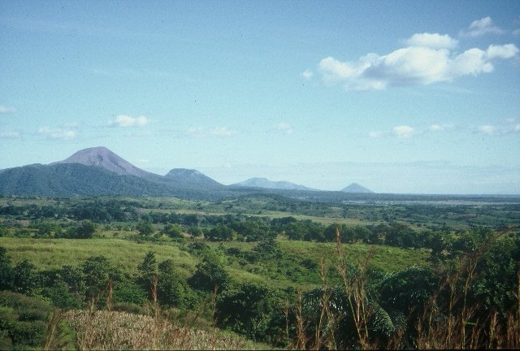


Slide 12
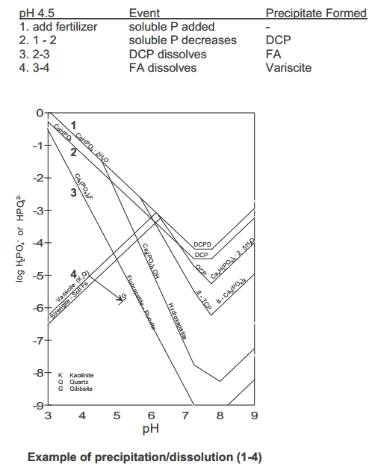
Volcanic Ash Soils
Inceptisols (Great Group, andept)
Andisols (new Soil Order)
allophane (amorphous, poorly crystalline hydrous aluminium silicate clay mineraloid. Al₂O ₃· (SiO₂)
imogolite
What can be done to increase P solubility/availability in volcanic ash soils?
Supersaturation of the band with respect to Ca, and force immediate precipitation as DCPD and DCP

Slide 13
Maize yield response as affected by sulfur, phosphorus and nitrogen as banded applications on a volcanic ash derived tropical soil
Hypothesis: precipitation of dicalcium phosphate dihydrate (DCPD) and dicalcium phosphate (DCP) within the joint N‐P‐S band, reducing the amount of P fixed as Fe or Al hydroxides and/or P complexed with amorphous allophane. Precipitation and subsequent dissolution of DCPD and DCP within the band could have increased P availability with time. Also, SO₄ ⁼ blocking of adsorption sites could have increased P via reduced soil P fixation
Raun, W.R., and H.J. Barreto. 1991. Maize yield response as affected by sulfur, phosphorus and nitrogen as banded applications on a volcanic ash derived tropical soil. Commun. In Soil Sci. and Plant Anal. 22(15-16) 1661-1676.

Slide 14
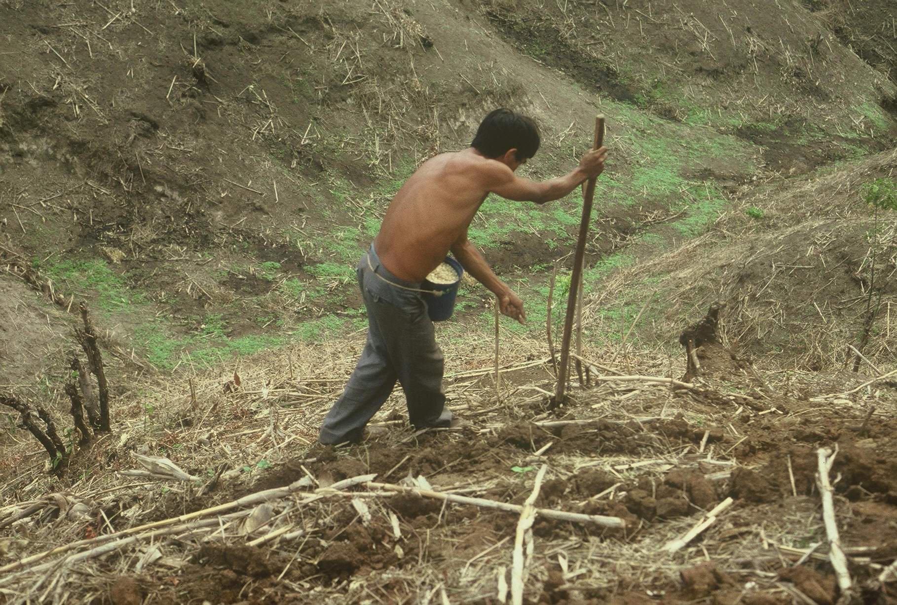

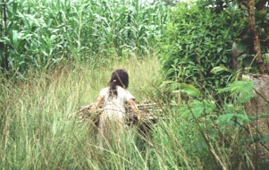

www.nue.okstate.edu

Slide 15
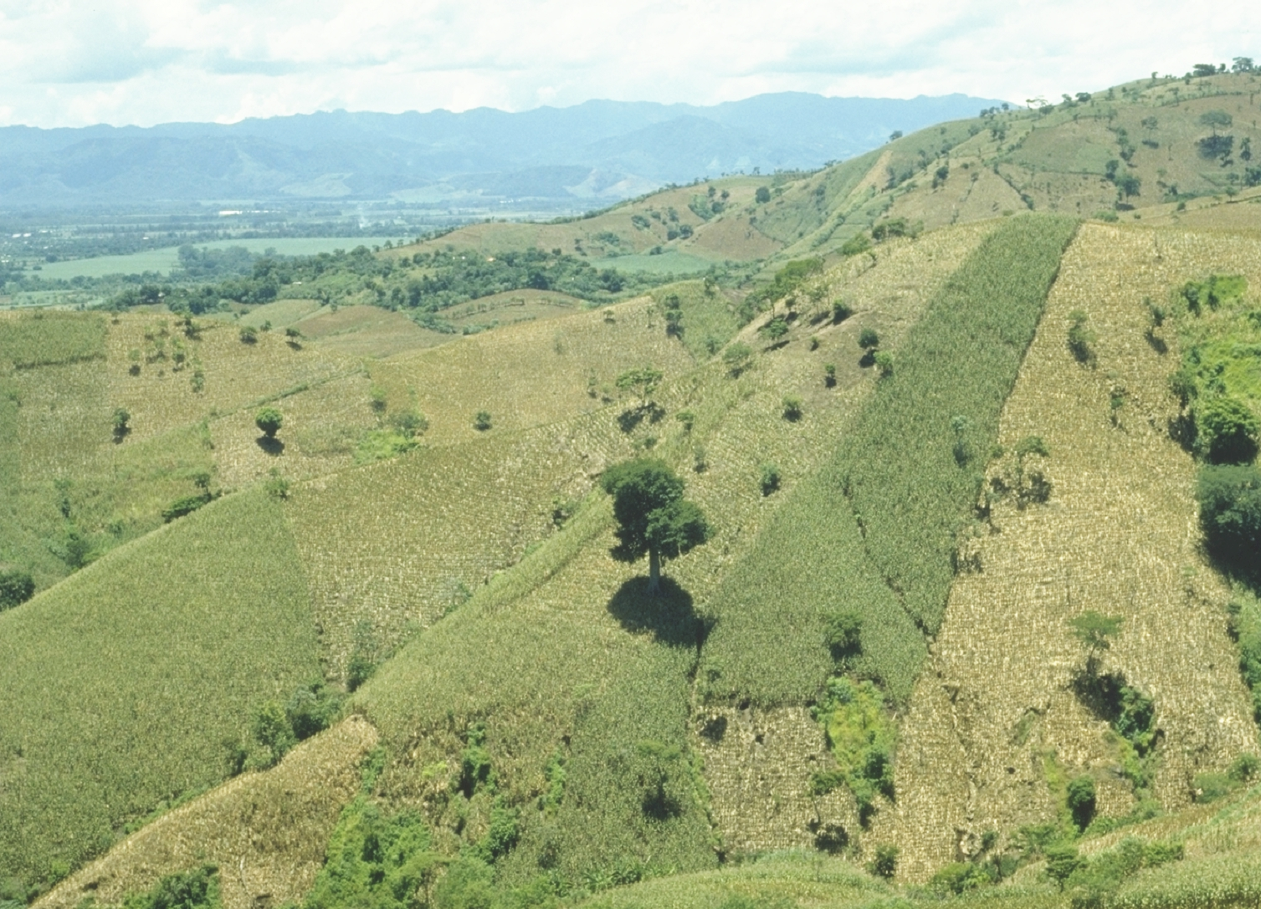
World area planted by hand ≈ corn area in the USA
Developing world, avg. farm size = 1 ha
potential planters ?
By 2050 there will be 9.1 billion people. 95% of the increased population will be in the developing world
EL SALVADOR

Slide 16
Maize Area (FAOSTAT.org) 2015
Country ha‘s ac's bu/ac
China 35,981,005 88,887,307 98
USA 33,644,310 83,101,446 157
----------------------- 29,614,180 ---------------------- (developing world)
Brazil 15,431,709 38,116,321 83
Mexico 7,060,275 17,438,879
Colombia 654,093 1,615,610
Guatemala 871,593 2,152,835
El Salvador 314,343 776,427
Nicaragua 300,000 741,000
Honduras 253,200 625,404
Haiti 377,000 931,190*
Panama 62,860 155,264
Costa Rica 6,224 15,373
TOTAL 2,185,220 5,397,493
OHIO 3,470,000
1 Mg/ha = 15.9 bu/ac (56 lbs/bu)
32 bu/ac, 2 Mg/ha
150 bu/ac

Slide 17


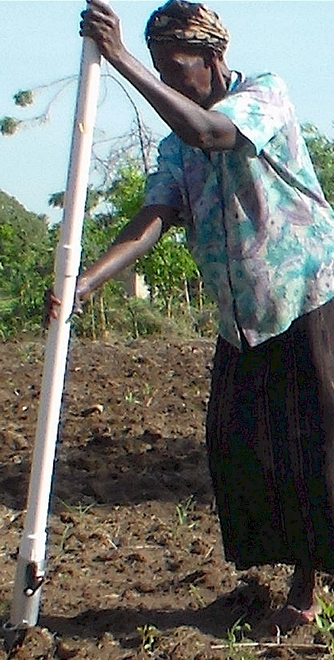
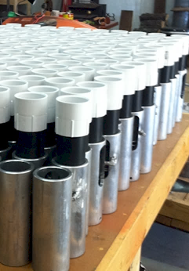
Drums

Slide 18
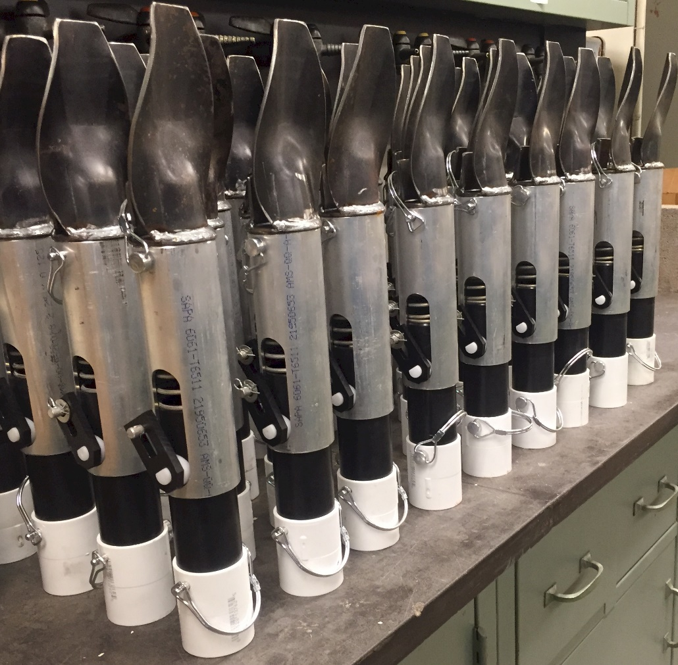

Slide 19
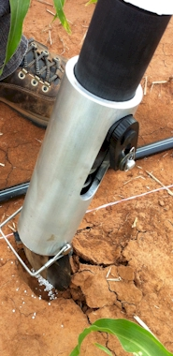
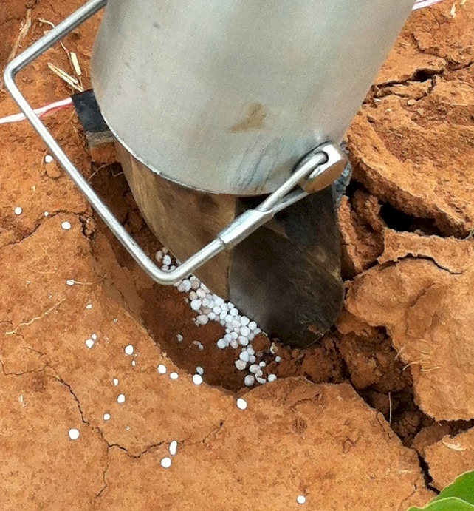
Mid Season Fertilizer N
Combined, Efaw and Perkins, 2013
Topdress N, Corn, V12 |  | 70,000 plants/ha
Methods | N, kg/ha | Mg/ha
Check | 0 | 6.6
Hand planter (0.9 g/plant) | 30 | 11.2
Hand planter (1.8 g/plant) | 60 | 10.6
Broadcast | 30 | 6.4
Broadcast | 60 | 7.0
Dribble urea | 30 | 9.3
Dribble urea | 60 | 7.8
Dribble UAN | 30 | 7.3
Dribble UAN | 60 | 10.4
SED = 1.81

Slide 20
Benefits
Remove chemically treated seeds from the hands of small farmers
Decrease soil erosion via improved plant spacing
Accommodate mid-season application of urea-N
Place urea below the surface reducing NH3 losses
Potential to increase maize production and NUE
Khim et al. (2014). Over three sites, planting 1 seed, every 0.16m increased yields by an average of 1.15 Mg ha⁻¹ (range, 0.33 to 2.46 Mg ha⁻¹) when compared to the farmer practice of placing 2 to 3 seeds per hill, every 0.48 cm.

Slide 21

Hand Planters
Person | Organization | Where | No. of Hand Planters
Dr. Isaiah Nyagumbo | CIMMYT, Kenya | Zimbabwe | 4
Dr. Pascal Kaumbutho | KENDAT, Kenya | Kenya | 2
 | Ethiopia | Ethiopia | 1
Dr. Peter Omara | Uganda | Uganda | 3
Dr. Edgar Ascencio | CARE, El Savador | El Salvador | 4
Dr. Fred Kanampiu | IITA, Kenya | Kenya | 2
Dr. Nyle Wollenhaupt | AGCO, Kansas | Kansas | 2
Dr. Ivan Ortiz-Monasterio | CIMMYT, Mexico | Mexico | 1
Kristin Lacy | Semilla Nueva | Guatemala | 2
Nyle Wollenhaupt | AGCO | Lusaka Zambia | 40
Melvin Siwale | AGCO | Lusaka Zambia | 10
Terry Tindall | JR Simplot | Lusaka Zambia | 25
Eric Lam | MAG | Honduras | 2
Eric Lam | CIMMYT | Bangladesh | 1
Dr. Luis Narro | CIAT | Colombia | 1
Dr. Joshua Ringer |  | Thailand | 1
Dr. Assoumane Maiga |  | Mali | 1
Total |  |  | 101
Notes:
21

Slide 22
World Phosphorus Use Efficiency in Cereal Crops
PUE determined using world cereal harvested area, total grain production, and phosphorus (P) fertilizer consumption from 1961 to 2013.
World PUE of cereals calculated using both difference and balance methods.
Assumed cereal production accounts for 61% of the total agricultural land.
Cereal grain yields increased from 1.35 Mg ha⁻¹ to 3.90 Mg ha⁻¹ between 1961 and 2013.
1961: world fertilizer P consumption 4,770,182 Mg
2013: 16,662,470 Mg
349% increase in 53 years
World PUE of cereal crops are low. Using the difference method, average world PUE from 1961 to 2013 was 16%.
Raun, W.R., and G.V. Johnson. 1999. Improving nitrogen use efficiency for cereal production. Agron. J. 91:357-363.
Torres, G.M., J. Dhillon, E. Driver, and W.R. Raun. 2016. World phosphorus use efficiency in cereal crops. Agron. J.

