Slide 1

Plant & Soil Sciences
Soil Fertility and
Precision Nutrient Management
Graduate Student Orientation
Room 263 AGH
Stillwater, OK
August 12th, 2013

Slide 2
Disclaimer/Introduction
This is an informal meeting
Graduate College can supersede anything covered in this presentation
It is the responsibility of the graduate student to become familiar with and follow the rules of the Graduate College and the Plant and Soil Sciences Department
http://nue.okstate.edu/Graduate_School/Graduate_School.htm

Slide 3
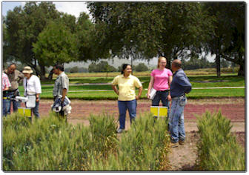
Degree Requirements
Master of Science (pg. 7-9)
Doctor of Philosophy (pg. 15-19)

Slide 4
Advisory Committee
Establish in the first semester
Master of Science
  Three members
  Within or outside the department doesn’t matter
Doctor of Philosophy
  Four members
  At least one member has to be outside of the department
Notes:
Prospective members of the advisory committee are selected by the student in consultation with the major advisor.
Student ascertain the willingness of the prospective members to serve on the committee.

Slide 5
Plan of Study
Master of Science
  Must be submitted to the Graduate College prior to completion of the 17th credit hour of course work.
  Course requirements (pg. 7-8)
Doctor of Philosophy
  Must be submitted to the Graduate College prior to completion of the 28th credit hour of course work.
  Course requirements (pg. 16-17)
Submitted online http://gradcollege.okstate.edu/planofstudy

Slide 6
Research Proposal
Attempt to complete as soon as possible
Contract between you and your advisor what is expected of your research project
Work with your advisor on format
Examples: http://nue.okstate.edu/Graduate_School/Graduate_School.htm

Slide 7
Candidacy Exams
Doctor of Philosophy students only
Students coordinate with advisor and committee to arrange time for exam and defense
Must have an approved plan of study prior to taking
Students must complete at least 10 hours of dissertation (6000) hours after exam
Submit the candidacy form to the graduate college
  http://gradcollege.okstate.edu/forms

Slide 8
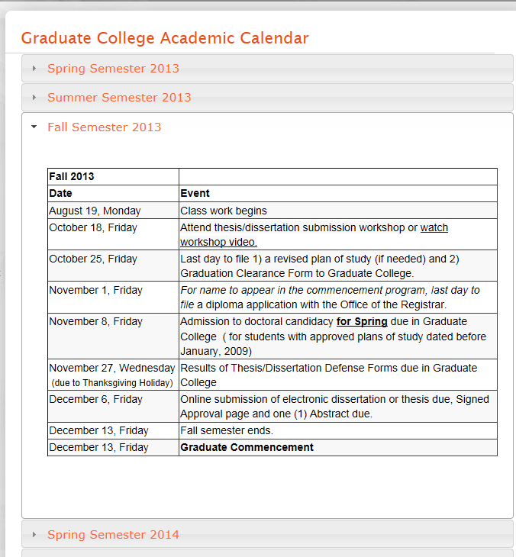
Thesis/Dissertation Defense
Defense must be completed by set dates each semester
Copy of the completed document submitted to the graduate college
WATCH DATES!!!
http://gradcollege.okstate.edu/graduate-college-academic-calendar

Slide 9
Teaching Opportunities
Required for all PhD students to teach one semester
Can receive course credit (consult with professor)
Classes that soil fertility students have helped teach:
  SOIL 2124 (Lab): Dr. Abit
  SOIL 4234 (Lab): Dr. Arnall

Slide 10
Work Hours & Leave Expectations
Consult with major advisor and/or Sr. agriculturalist on schedule.
Pay is for 20 hours/week during the semester
40 hours/week
Be aware of your project responsibilities
Leave, 10 working days/yr
  work with other members of your group to make sure your responsibilities are taken care of while away

Slide 11
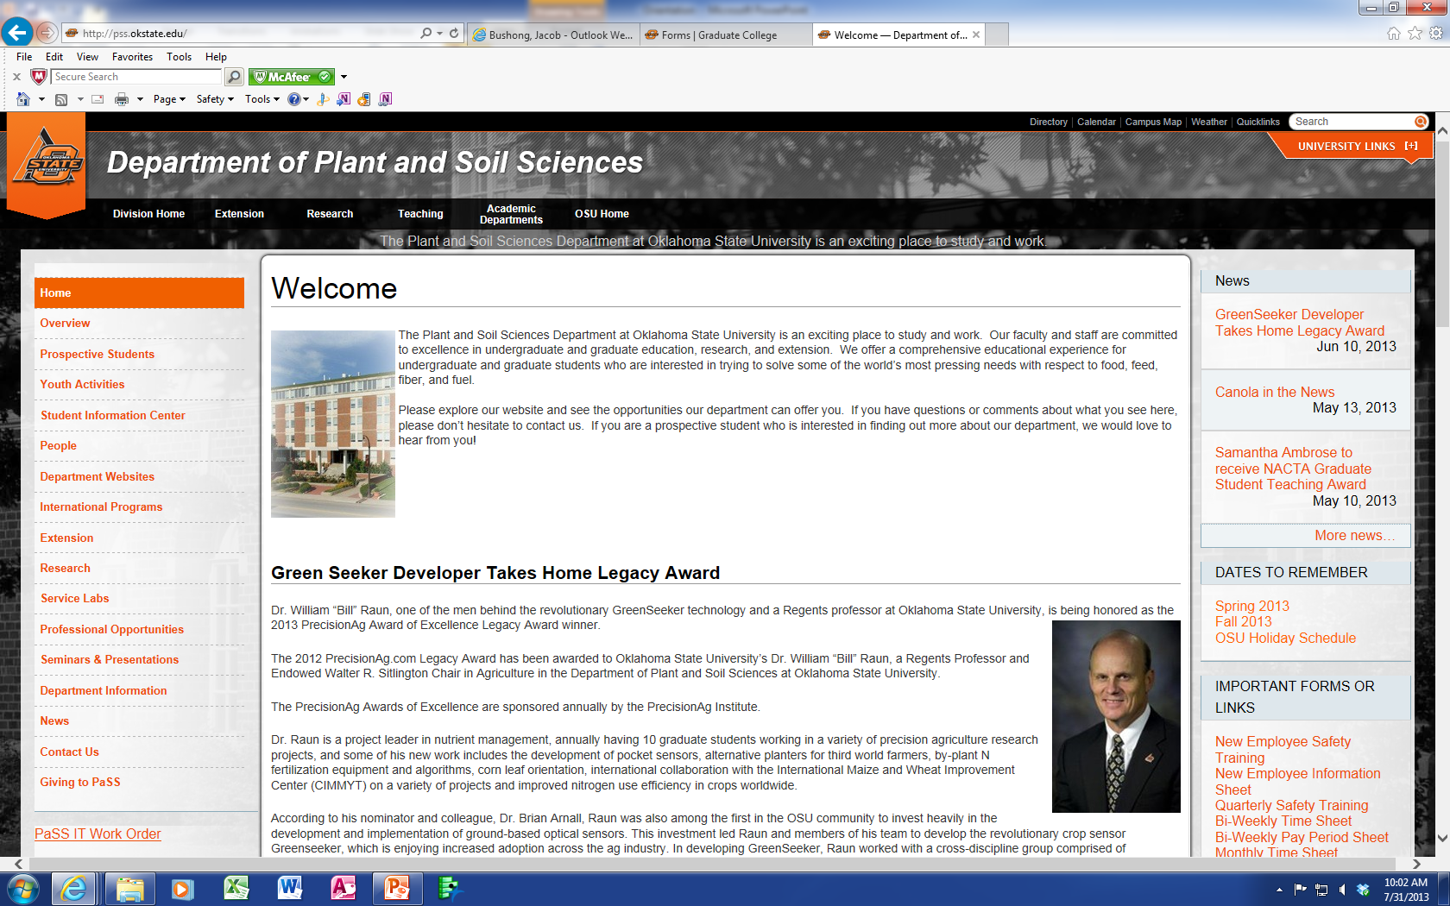
IT Issues
All students should be issued a computer
Common computer labs (AGH 168, 268)
Report problems to departmental IT

Slide 12
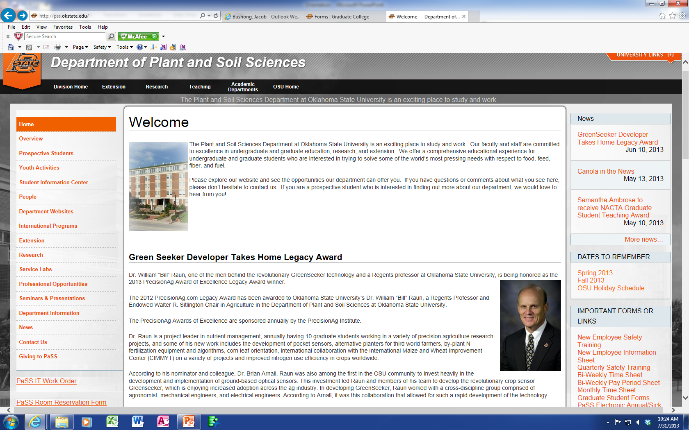
Room Reservations
At some point you will need a room for committee meetings, defenses, etc.
Rooms available are AGH 263, 268, 374

Slide 13
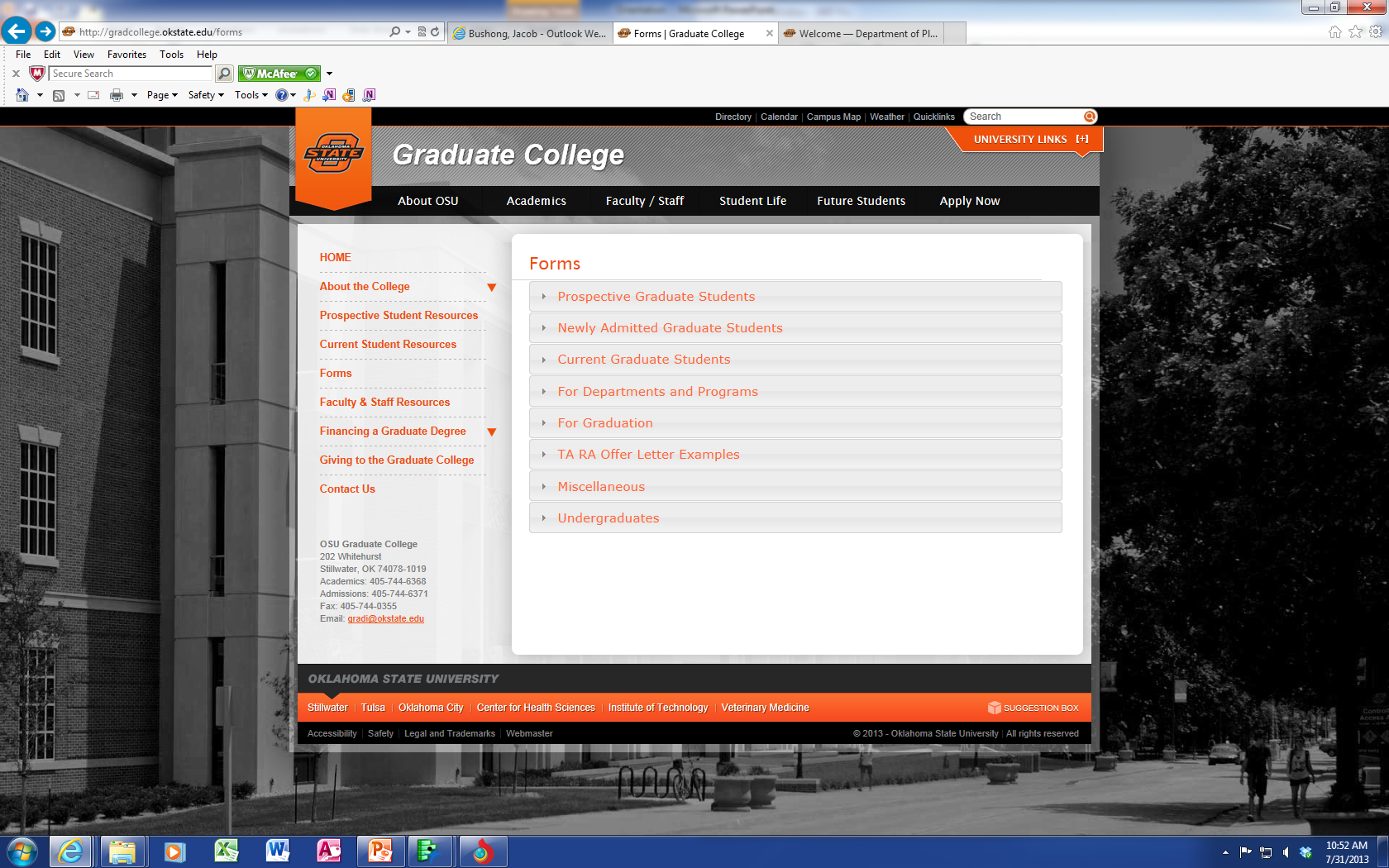
Forms
Forms need to be submitted to the Department and Graduate College every semester

Slide 14
Safety Training
New employees/graduate students need to complete the ‘New Employee Training’ Module
Quarterly safety training is required
  Should receive an email from Vicki Brake

Slide 15
Departmental Scholarships
Email will be sent out in spring with applications

Slide 16
Professional Meetings
Opportunity to showcase your research
Attending meetings is a privilege
You are representing yourself, your research group, and your university
Regularly attended meetings:
  ASA, CSSA, SSSA annual meetings
  NUE conference
  Extension workshops

Slide 17
Etiquette
All professional meetings require business dress
  http://www.career.vt.edu/JobSearchGuide/BusinessCasualAttire.html
Table etiquette remains important
  http://www.career.vt.edu/diningetiquette/diningetiquette.html
Never wrap napkins around your head or use cell phones at the dinner table

Slide 18
Hygiene
Hand washing
  vigilant
Personal hygiene
  Culture in the US is not lenient. Daily use of unscented deodorants/antiperspirants is encouraged
  Daily dental care/mouthwash

