Slide 1



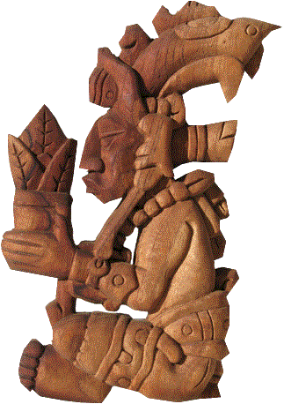
OSU Hand Planter
September 6, 2018
Stillwater Oklahoma Rotarians
“OSU Hand Planter”
http://nue.okstate.edu/Hand_Planter.htm
Hun Hunahpu

Slide 2
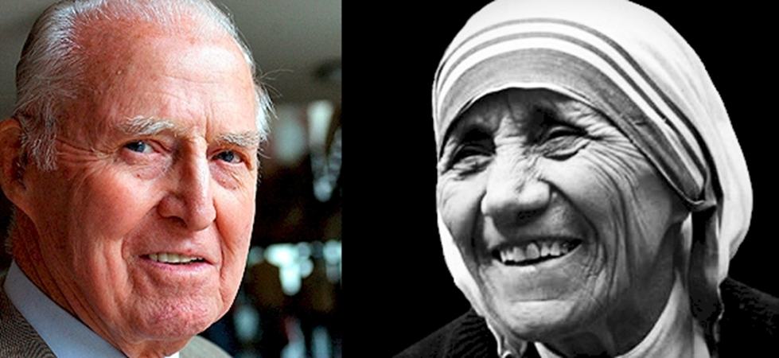



Norman Borlaug Mother Teresa
1914 – 2009 1910 - 1997

Slide 3
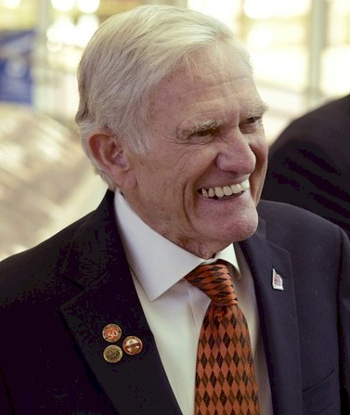

Dr. Robert L. Westerman

Slide 4
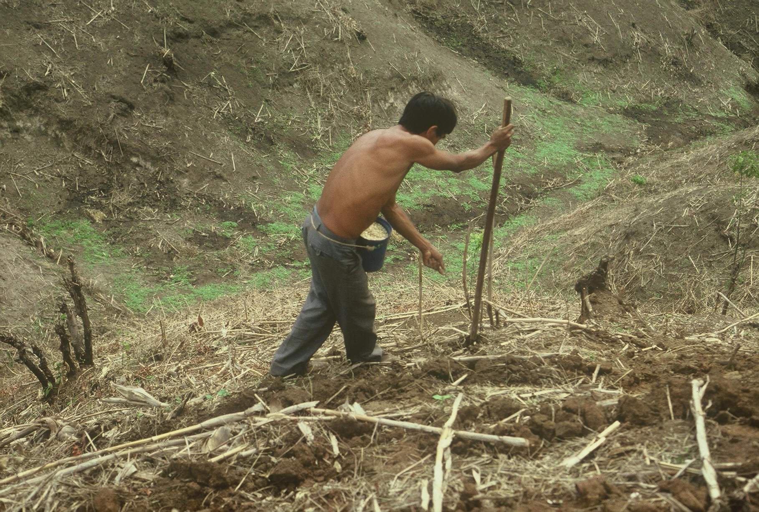
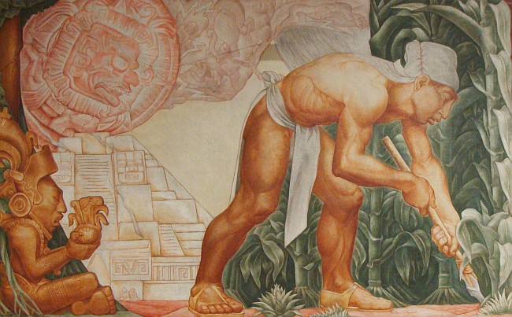
1987
Teosinte, 10,000 years ago, Oaxaca , southern Mexico
Notes:
22

Slide 5
MAIZE (FAOSTAT.COM)
Area, ha Production, Mt Avg. Mg/ha
World 183,319,737 1,038,281,035 5.7 (90 bu/ac)
USA 33,644,310 361,091,140 10.9 (174 bu/ac)
China 35,981,005 215,812,100 6.2 (98 bu/ac)
Brazil 15,450,180 80,516,571 5.2 (83 bu/ac)

Slide 6
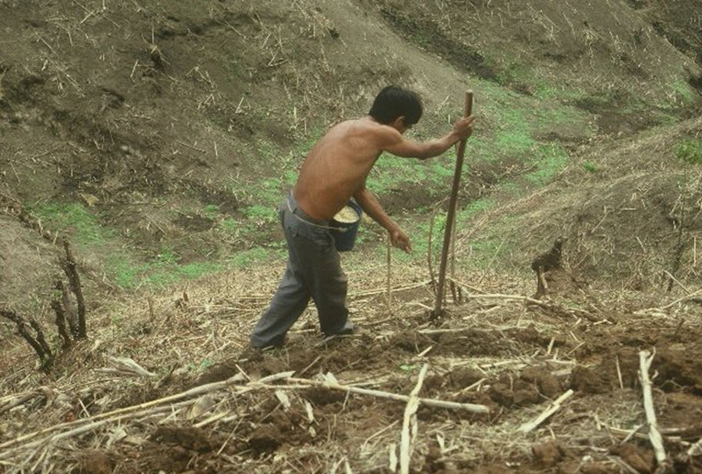
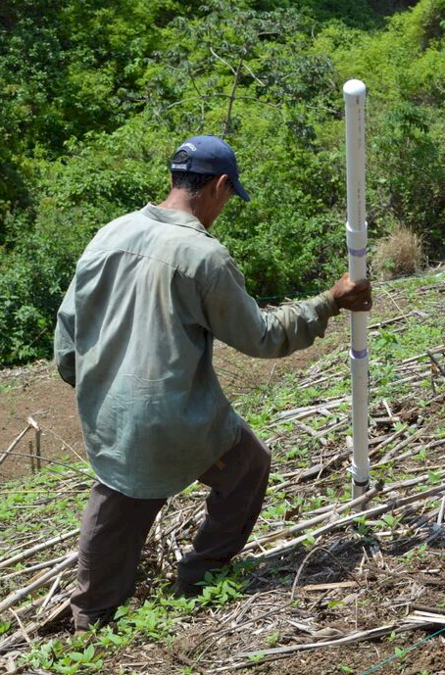

Opico quezaltepeque, El Salvador
GREEN SEEDER
2017
1987

Slide 7
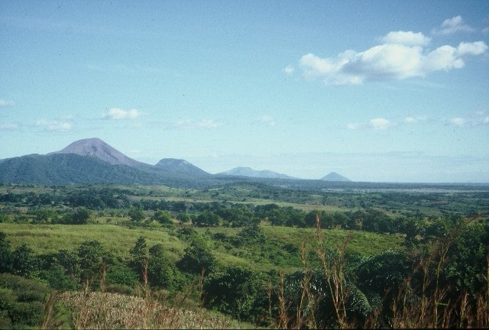
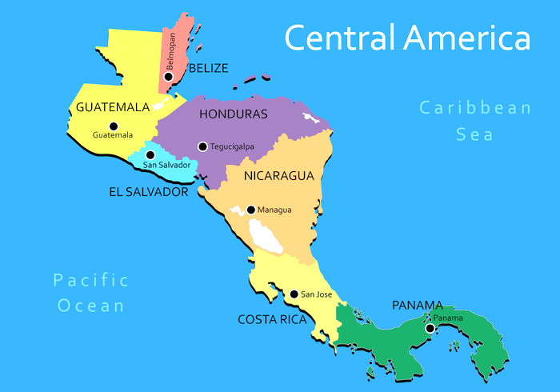
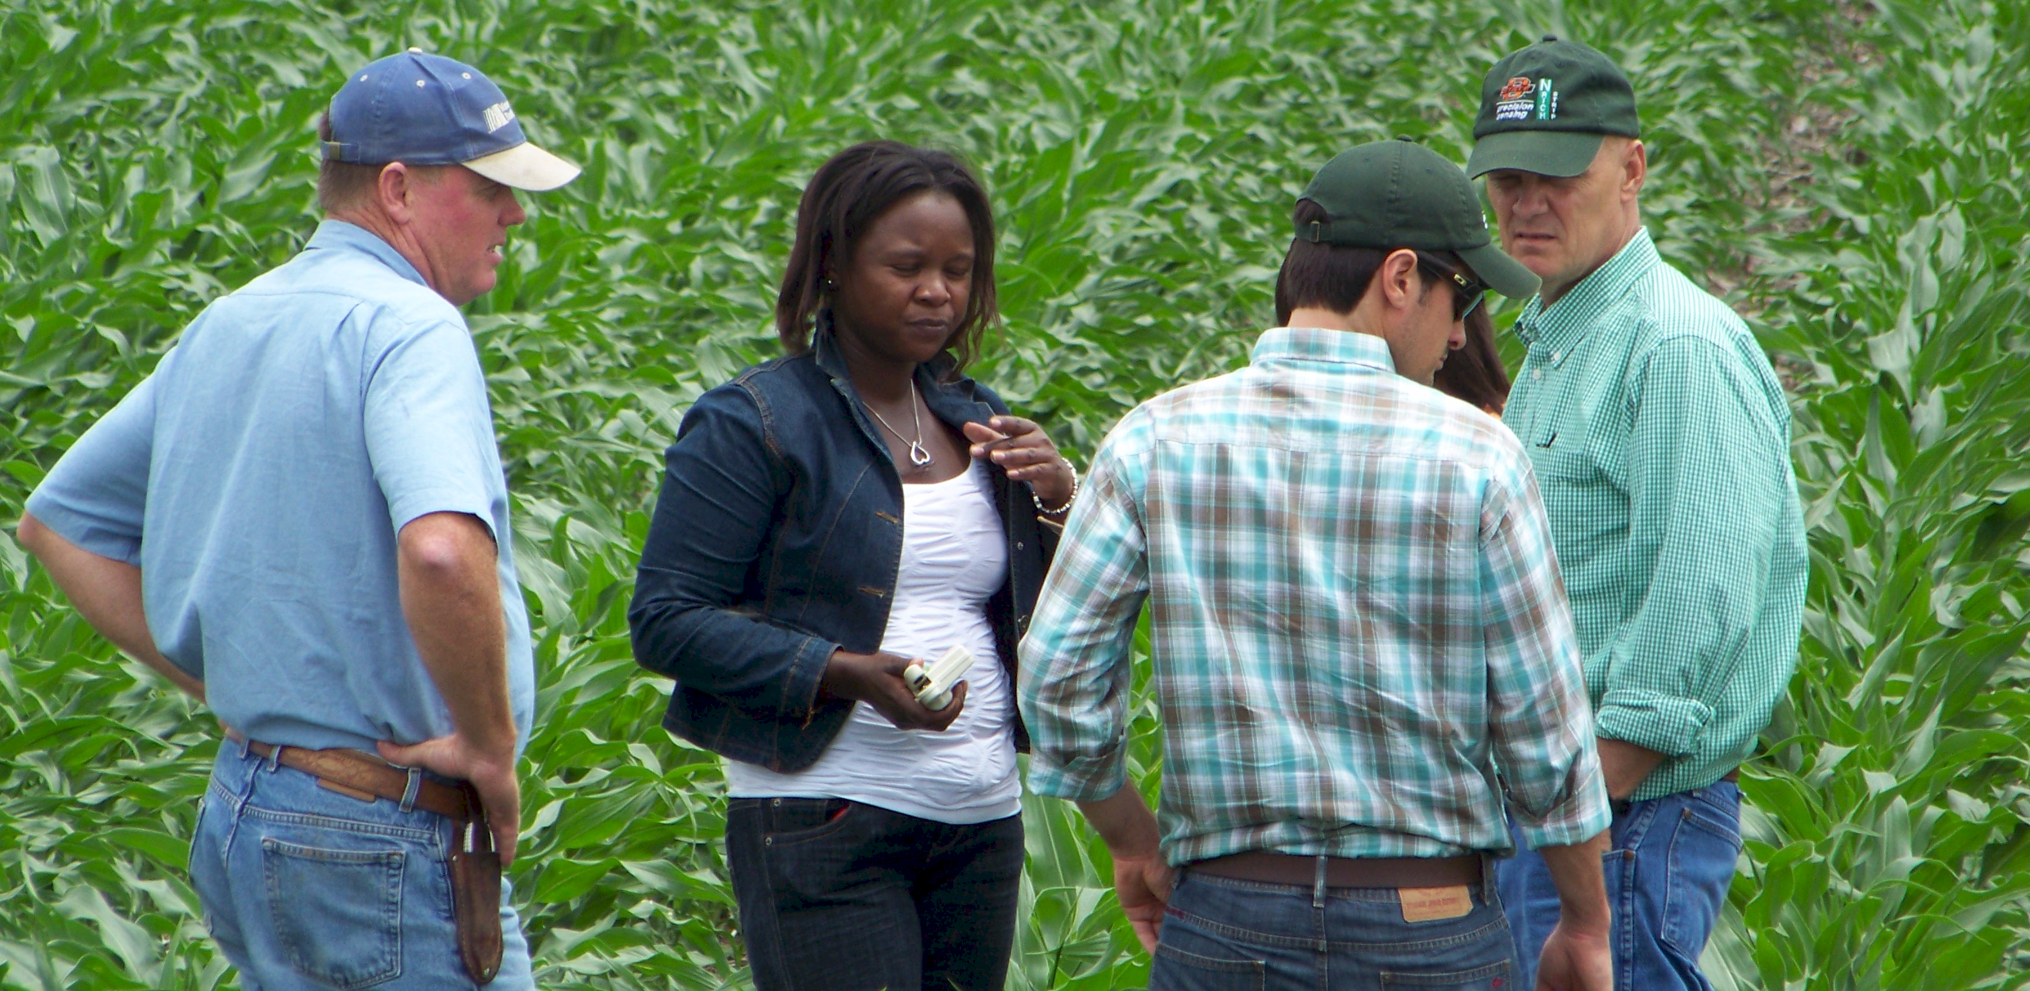
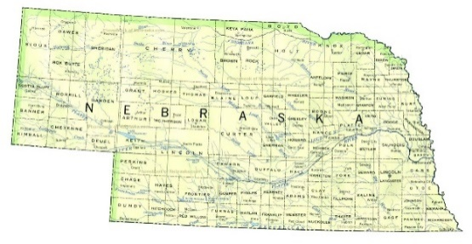
Oklahoma State University, 1976-1982
University of Nebraska, 1982-1985
CIMMYT, Mexico, Guatemala, 1985-1991
Oklahoma State University, 1991-present
CaSO₄
DAP, 3-17
Volcan de fuego

Slide 8
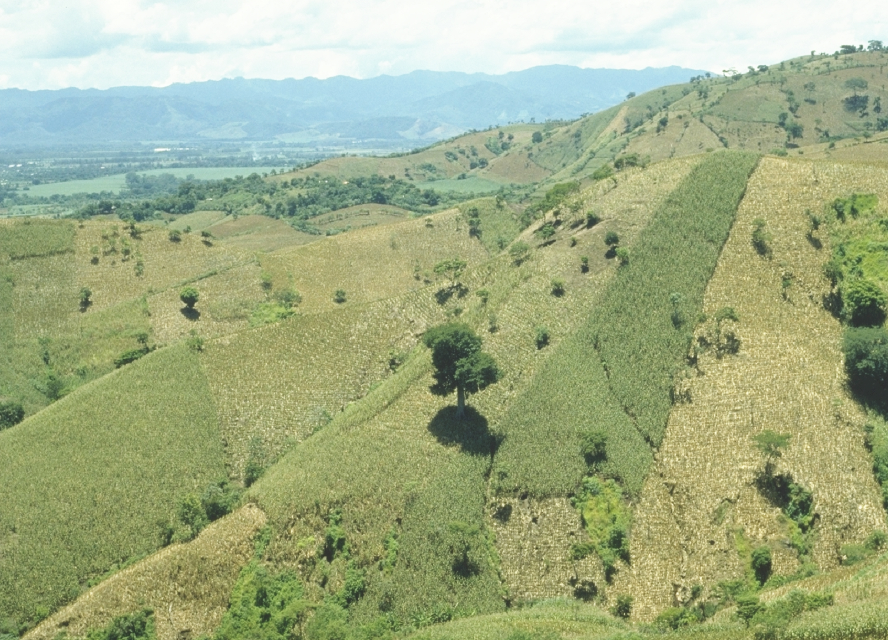
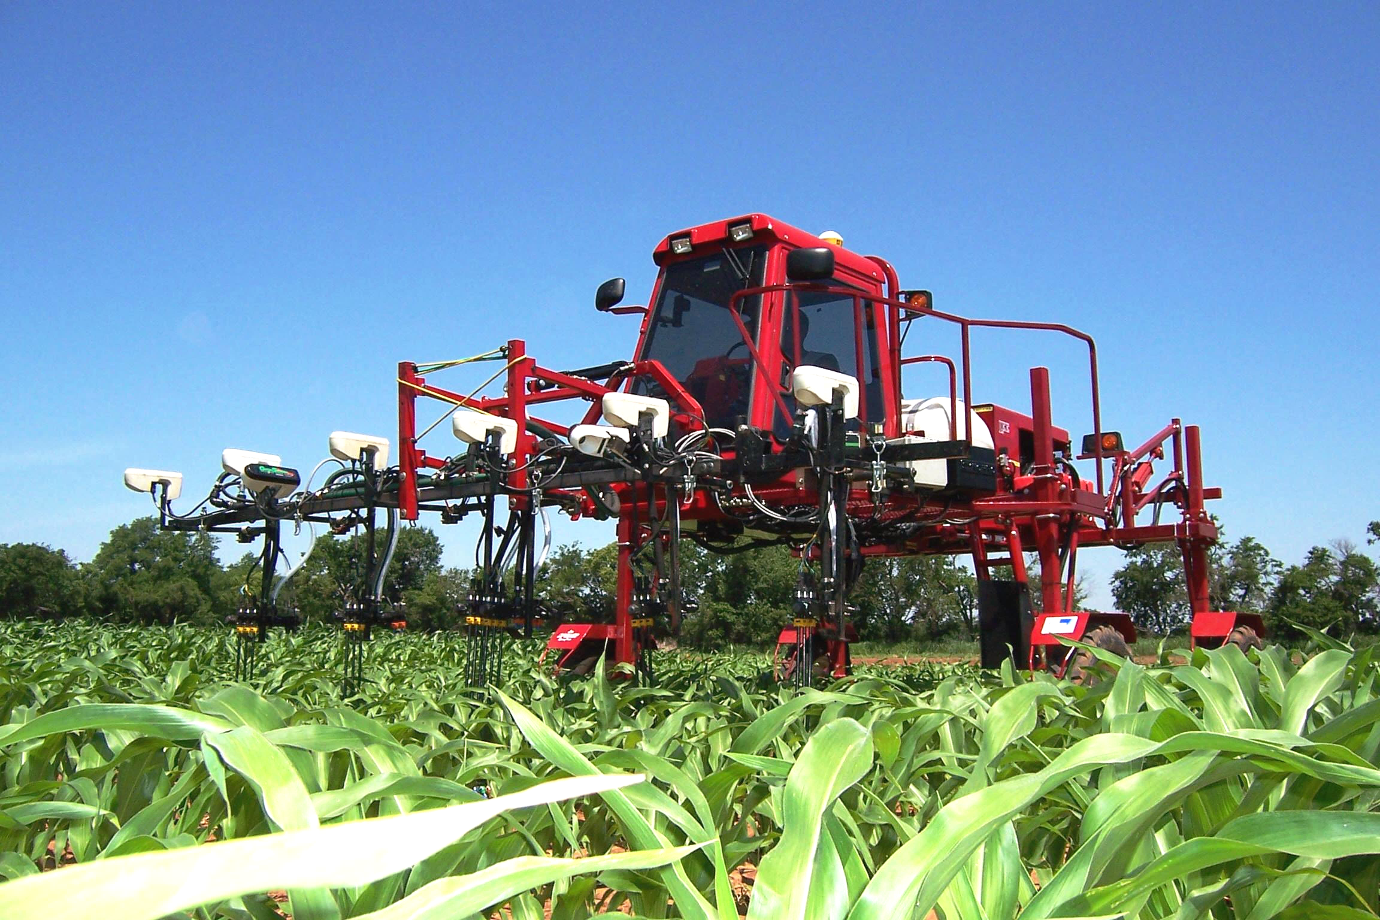
30,000,000 ha’s planted by hand ≈ corn area in the USA
USA 35 M
China 35 M
Brazil 14 M
EL SALVADOR

Slide 9
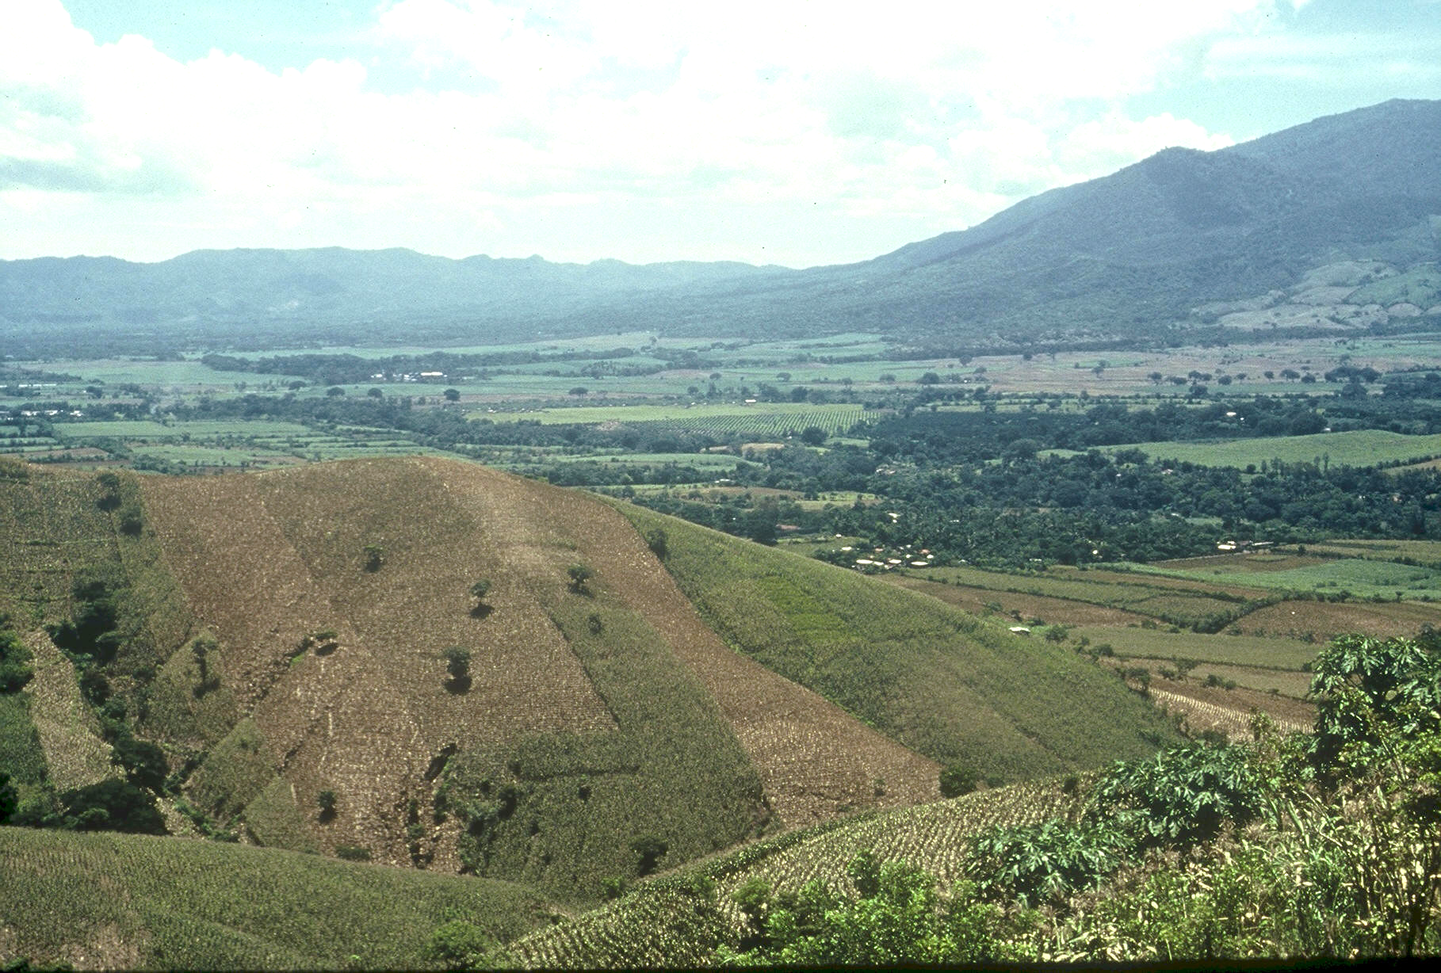

1985, CIMMYT
1987, Regional Agronomist Central America
1991, Faculty OSU
1999, FP - Hand Planter work started
2000, Working prototype
2013, MS, Aula, Omara
2018, Planter redesign, Rotary Grant importance
Rotary Contributions
(OK, NE, Uganda)

Slide 10


Kevin Raun

Slide 11
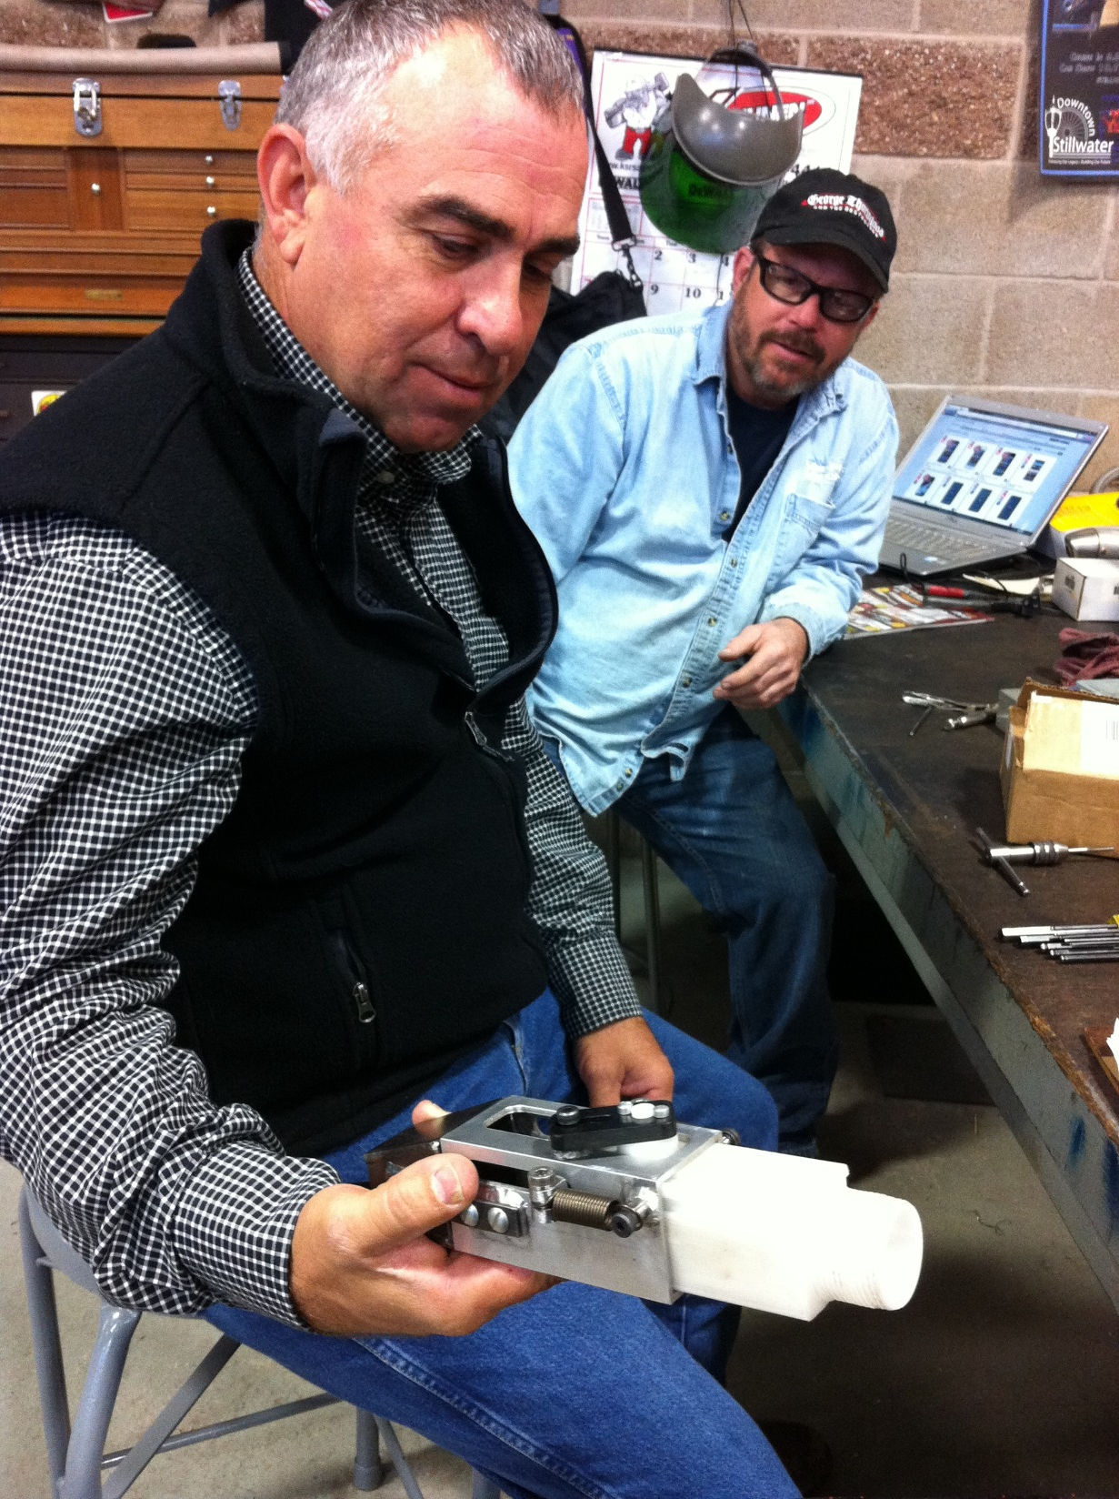
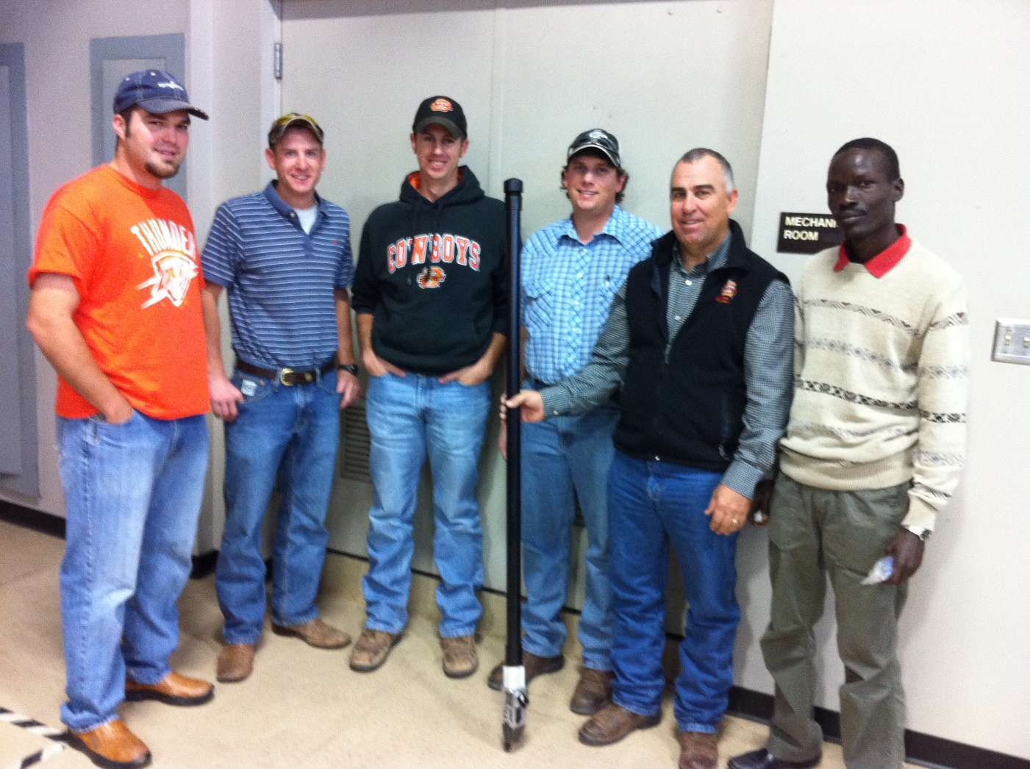
Shorty’s Machine Shop
7006 E 6th Ave, Stillwater, OK 74074
Dr. Randy Taylor

Slide 12
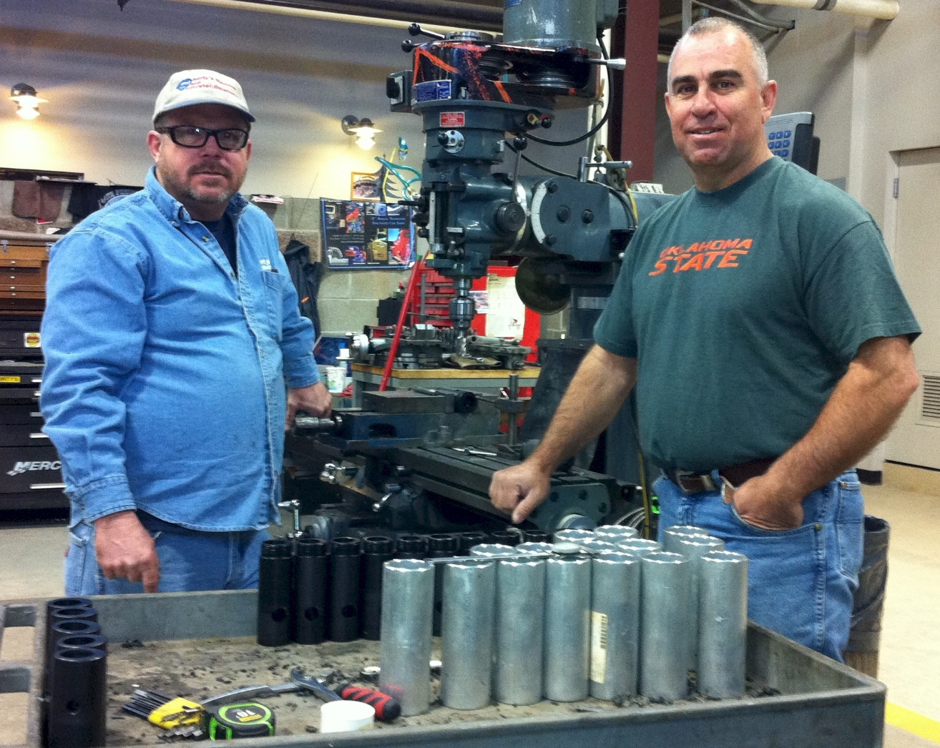
Biosystems and Agricultural Engineering

Slide 13
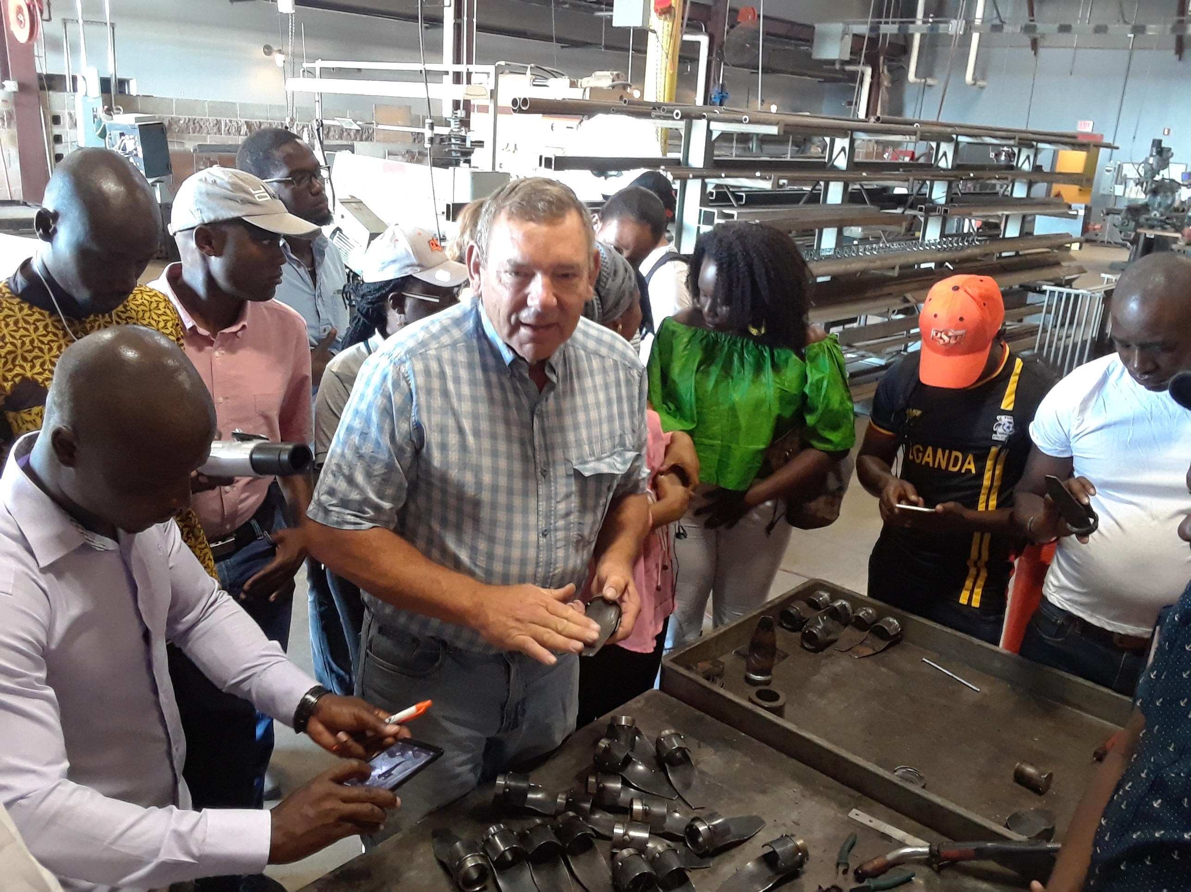
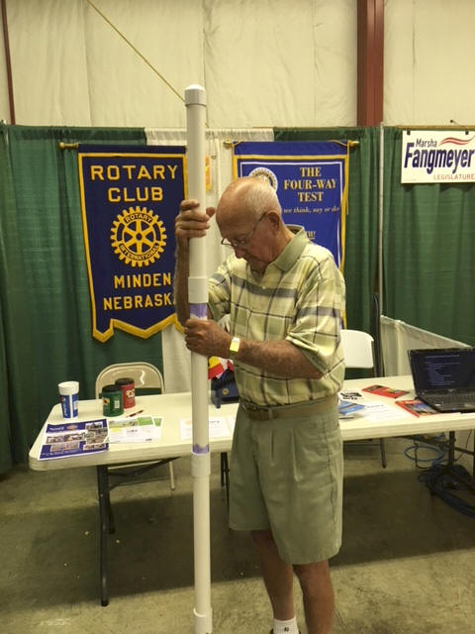

Wayne Kiner
Kearney County Fair
Minden, Nebraska
Koemel Law, PLLC
205 W. 7th Ave.
Suite 101-B
Stillwater, OK 74074
http://nue.okstate.edu/Hand_Planter.htm

Slide 14
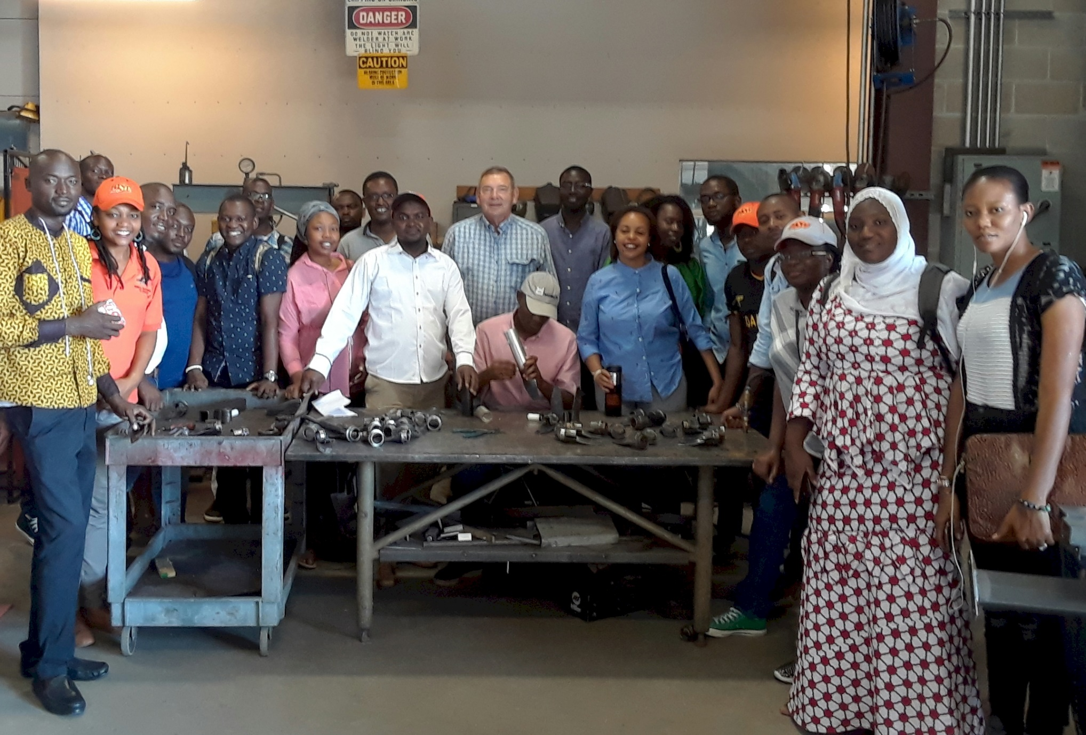
Wayne Kiner, Mandela Fellows 2018

Slide 15
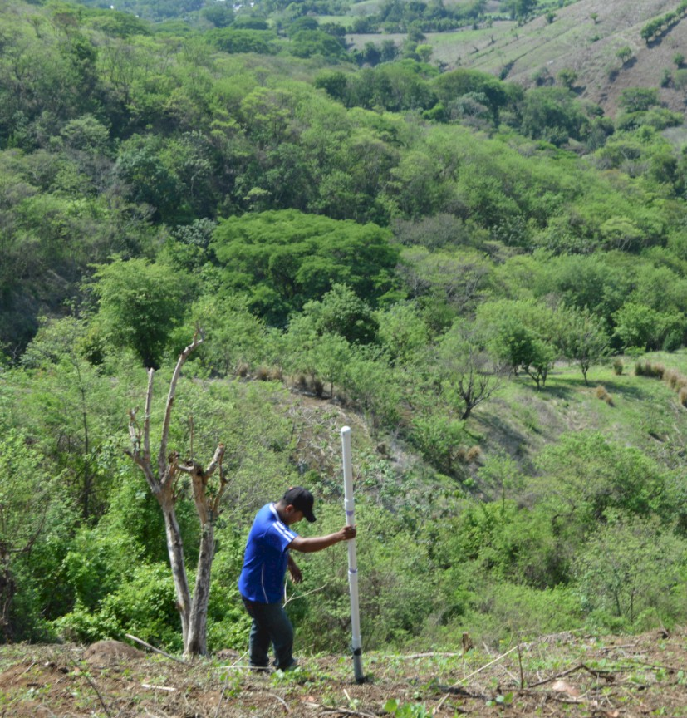
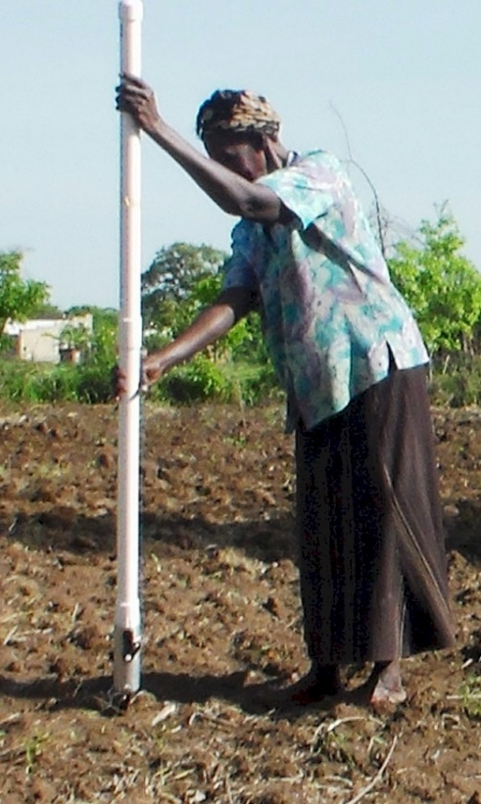
Opico Quezaltepeque, El Salvador
LIRA UGANDA
EL SALVADOR
Peter Omara MS 2013
Worlds Apart
Avg. Farm Size: 1 ha
Avg. Maize Grain Yield, 2 Mg/ha
Maize seed, Hybrids (US, others)
Social aspects/technology transfer

Slide 16
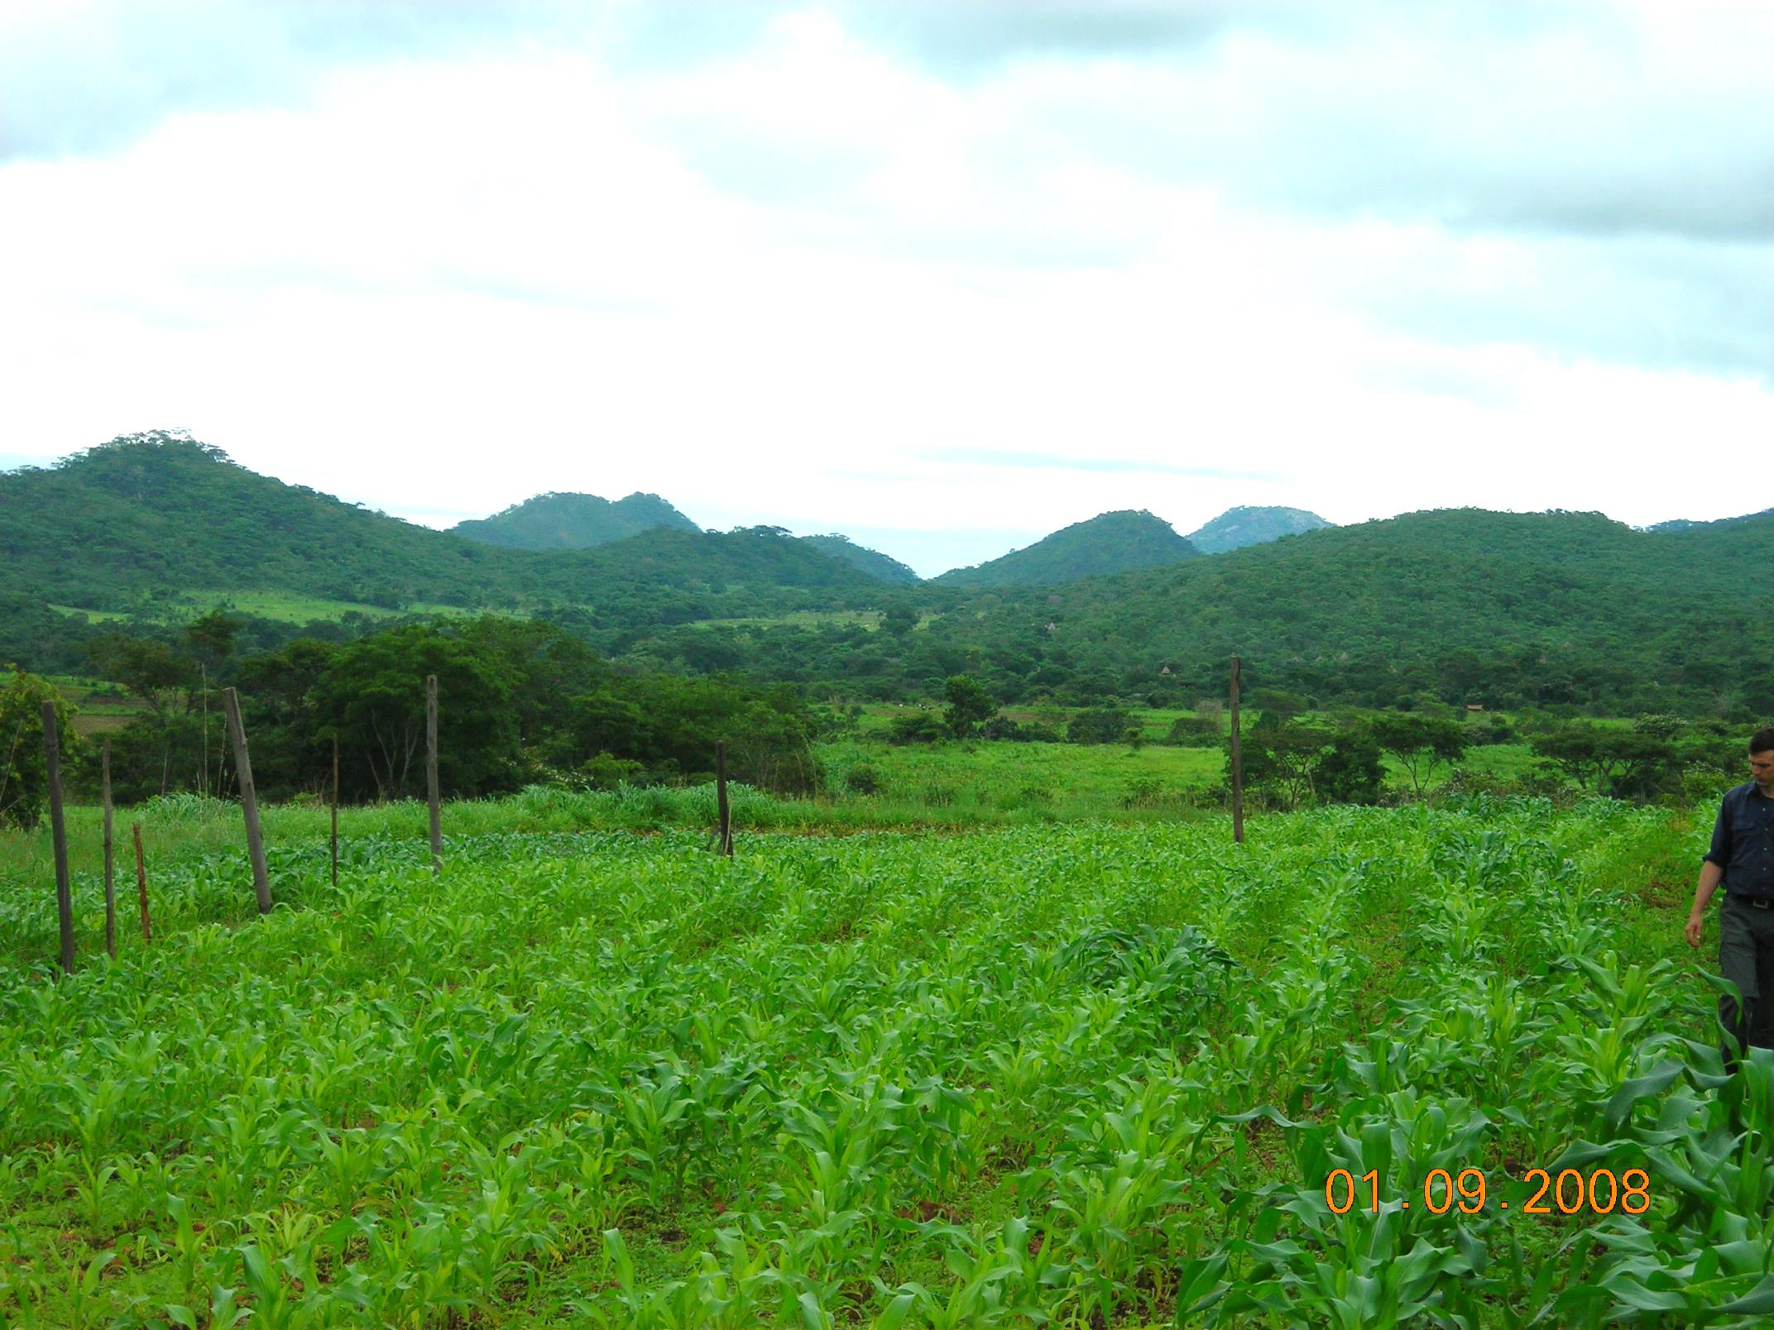
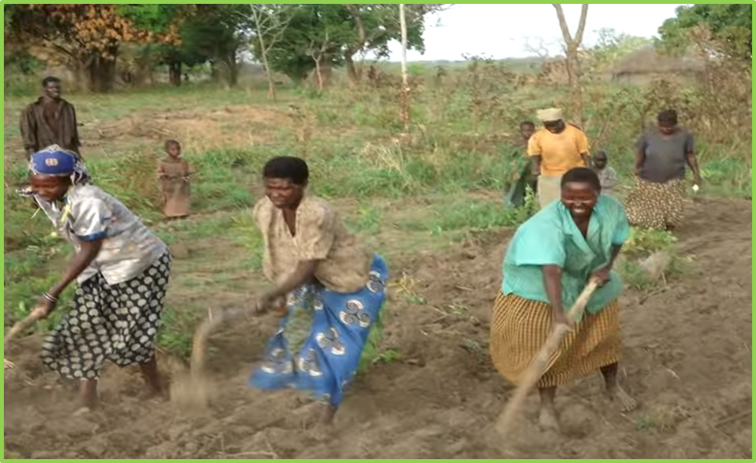
ZIMBABWE, UGANDA
Remote Locations
Surface applications of urea

Slide 17
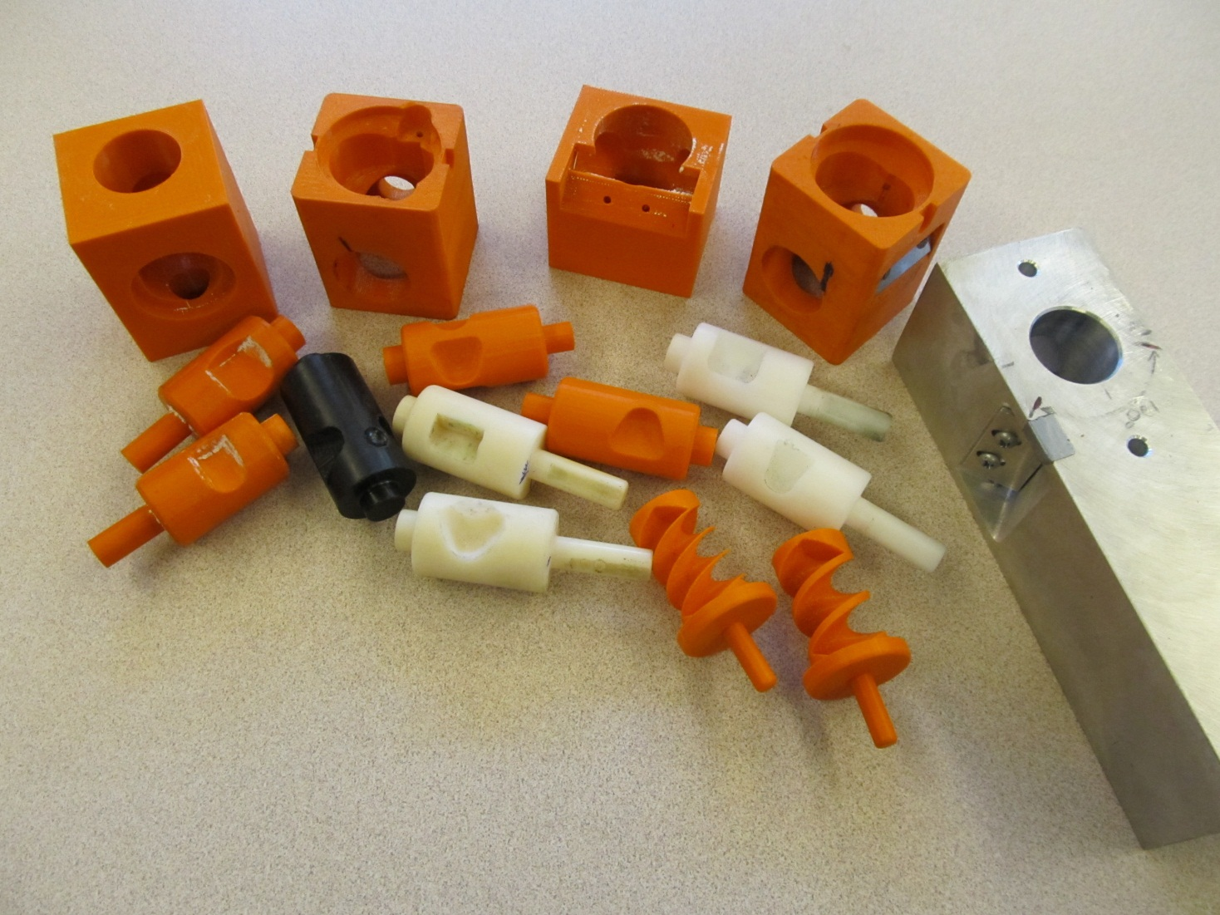
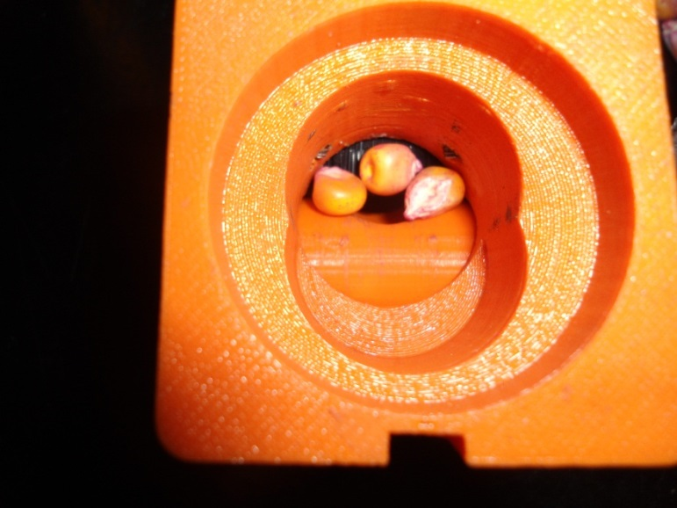
Singulation Design
3D printing
Rotary International
AGCO
Sitlington Chair
ASA Reinvest, Jessica Davis
Max Metcalf
Tolerances
Materials
Failure analysis/testing

Slide 18
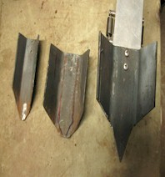
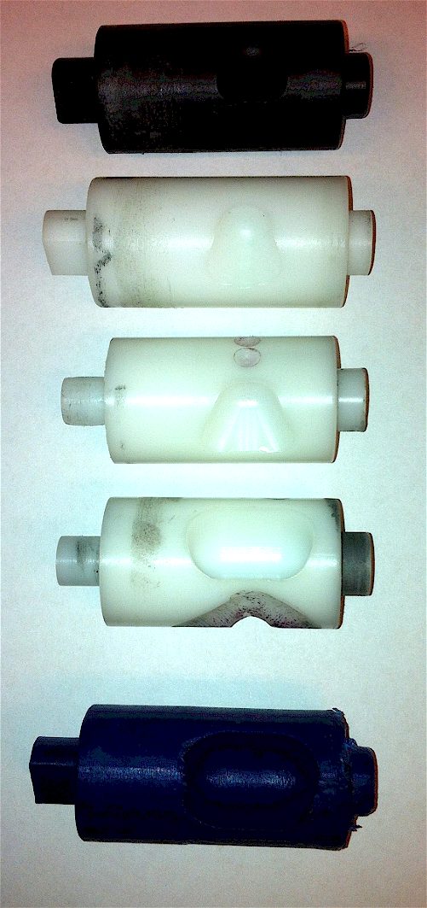
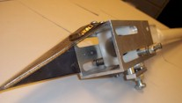
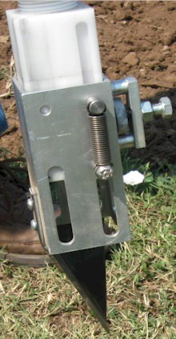
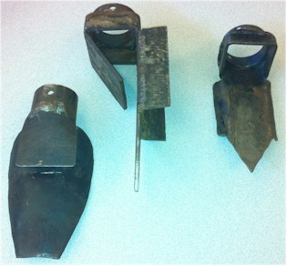
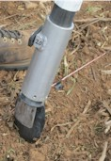
Internal Brush/Strength
Drum size/material
Cavity size/angle
Tip size/design/material
Internal/Ext. spring/tension

Slide 19
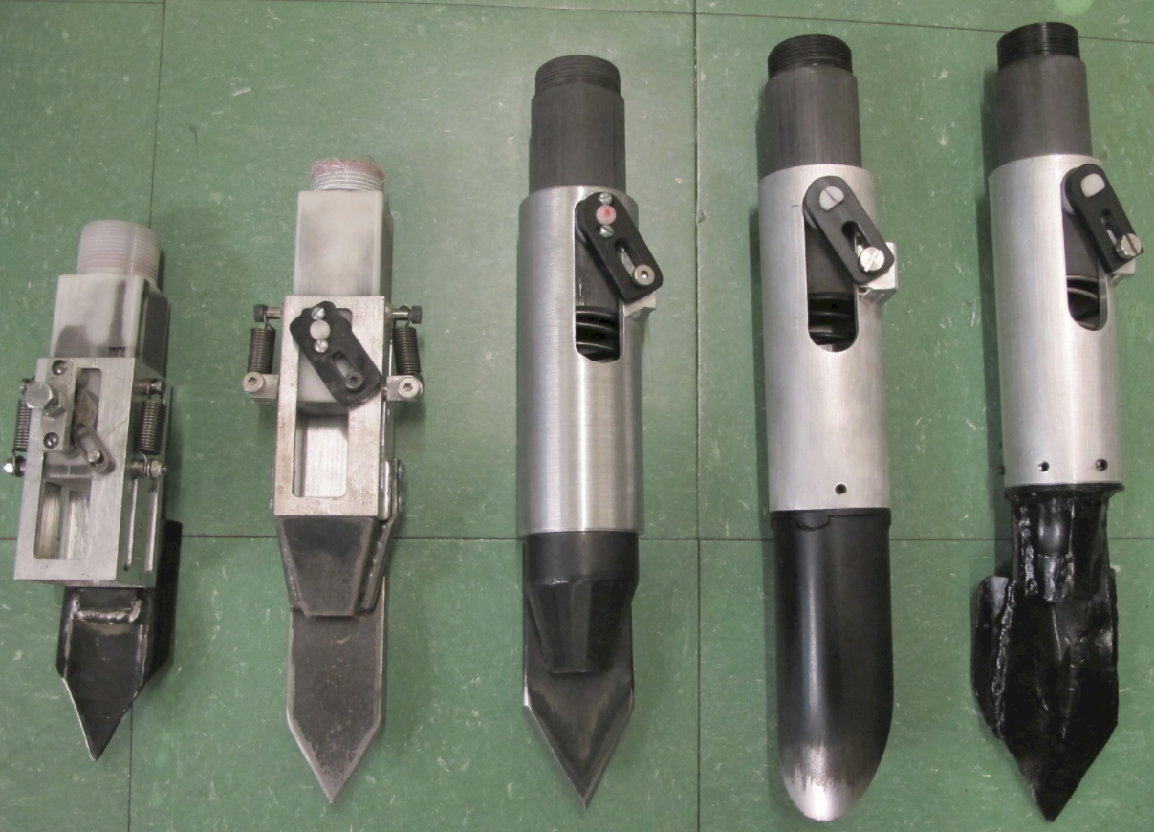

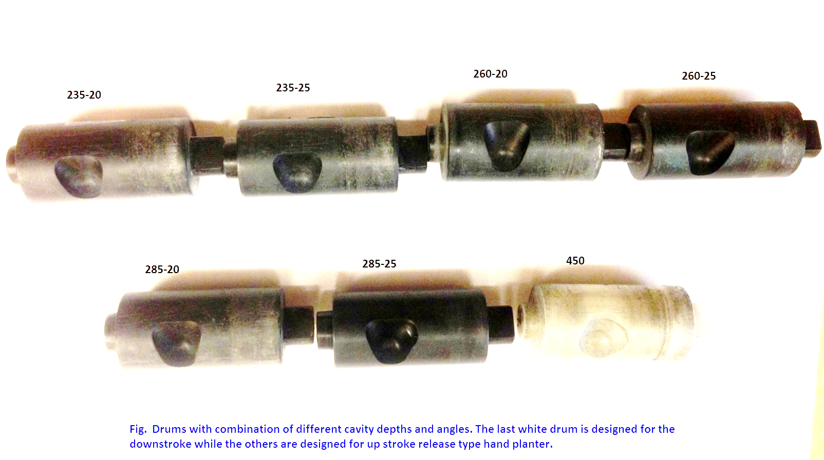
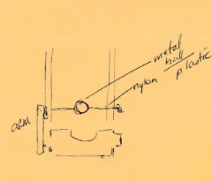

Slide 20
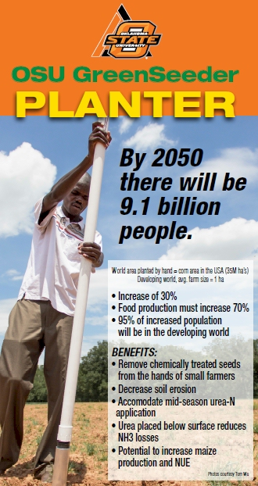
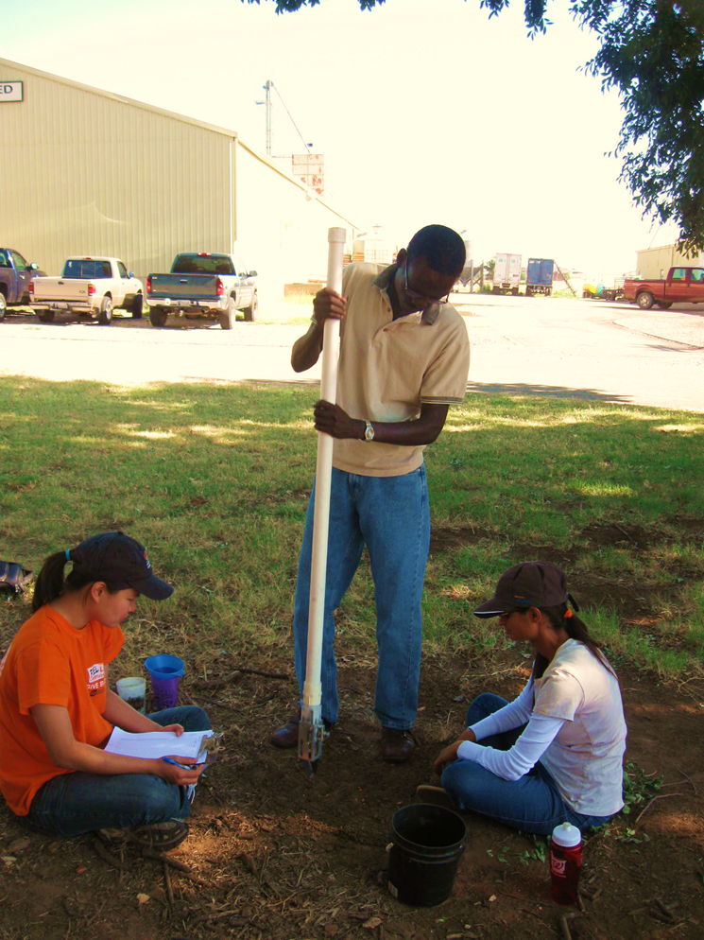
Lawrence Aula
Peter Omara

Slide 21
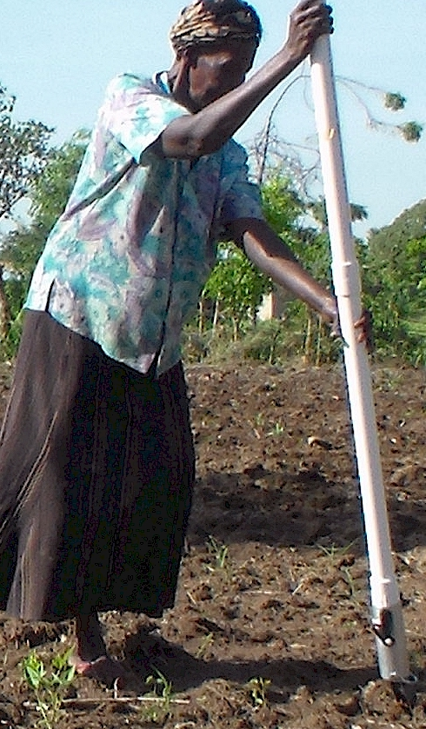
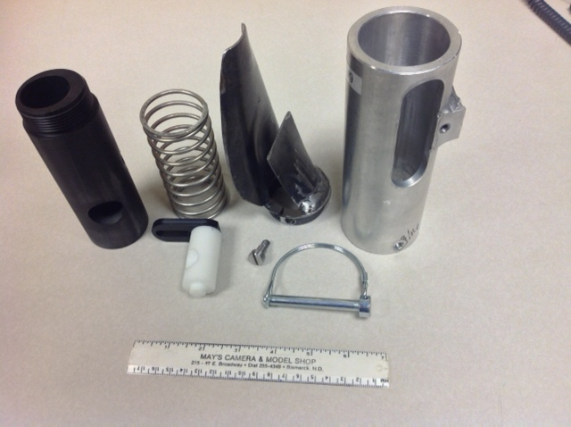

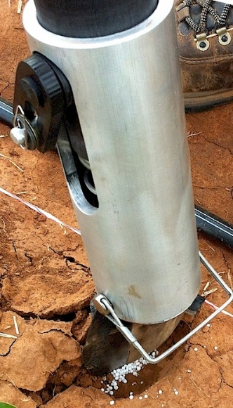
OSU Hand Planter
Dr. Randy Taylor
Wayne Kiner

Slide 22
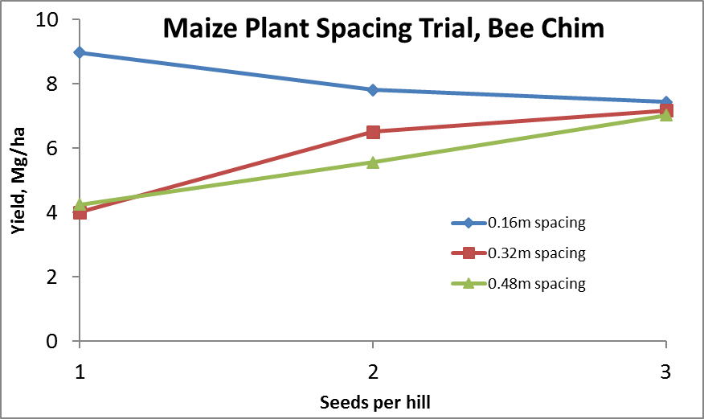
Importance of Singulation
0.76m Row Spacing
Heterogeneity in plant spacing, and plant stands reduce yields
www.agry.purdue.edu/ext/corn/pubs/agry9101.htm

Slide 23
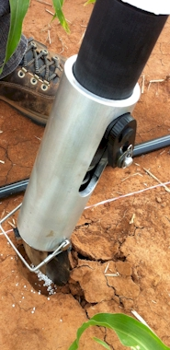
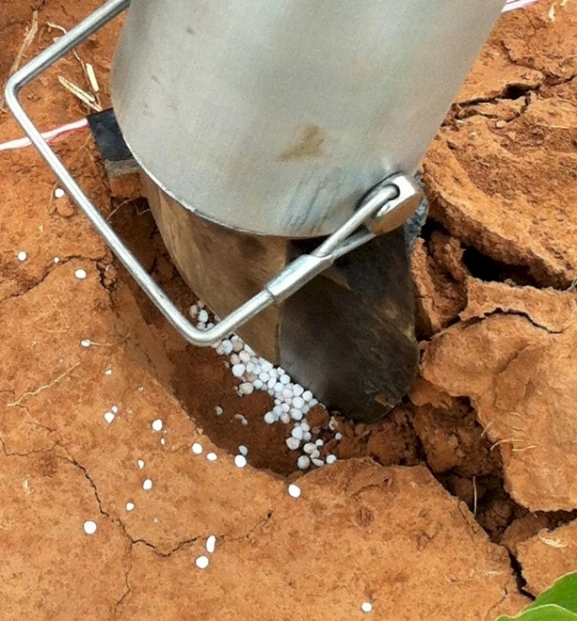
MID Season Fertilizer N
Combined, Efaw and Perkins
Topdress N, Corn, V12 |  | 70,000 plants/ha
Methods | N, kg/ha | Mg/ha
Check | 0 | 6.6
Hand planter (0.9 g/plant) | 30 | 11.2
Hand planter (1.8 g/plant) | 60 | 10.6
Broadcast | 30 | 6.4
Broadcast | 60 | 7.0
Dribble urea | 30 | 9.3
Dribble urea | 60 | 7.8
Dribble UAN | 30 | 7.3
Dribble UAN | 60 | 10.4
SED = 1.81

Slide 24
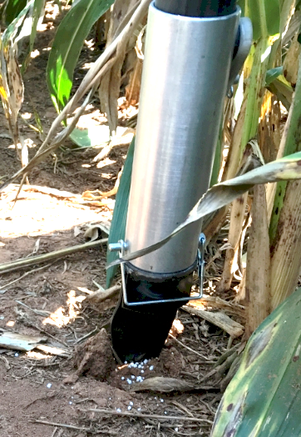
Benefits
Remove chemically treated seeds from the hands of producers
Decrease soil erosion via improved plant spacing
Accommodate mid-season N application
Urea placed below the surface reducing NH₃ loss
Increased production and NUE
Potential Uses
Seed, all types
Alternative chemicals, EPA, mosquito abatement
Food plots/hunters
Gardeners

Slide 25


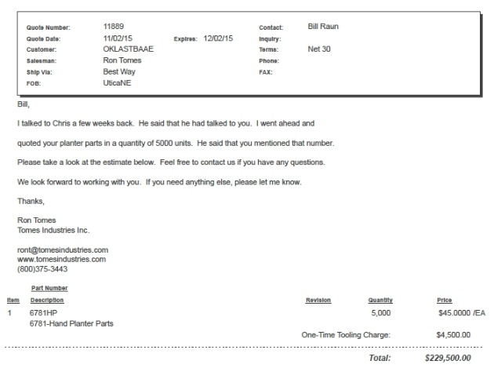
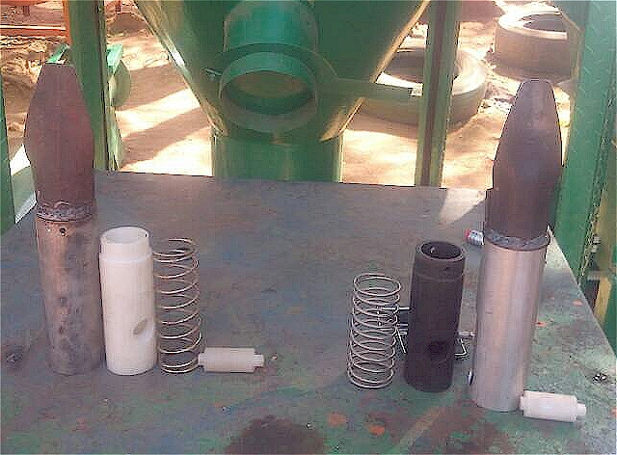
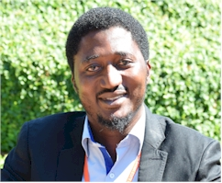
Current Cost Estimates
Grand Victory Ltd
Tsim Sha Tsui Hong Kong
Rm 1604 16/F Lee Wai Coml Bldg
Tsim Sha Tsui
1000, $25 each
5000
$49 each
Usman Ali, Nigeria, Mandela Fellows

Slide 26
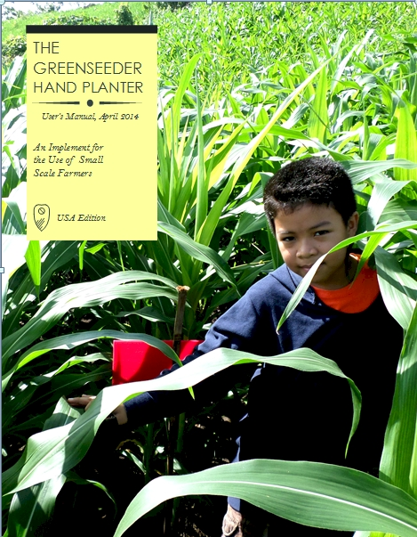
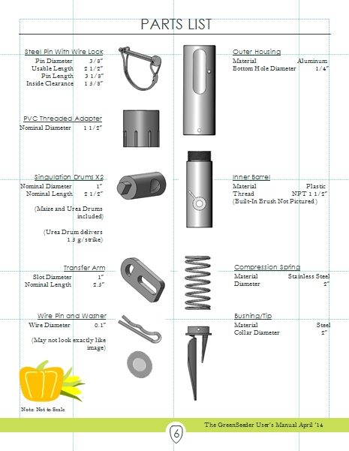
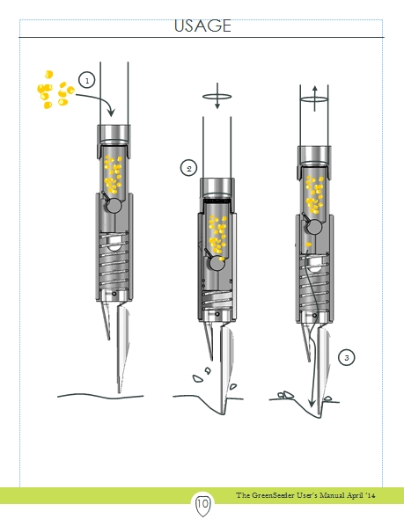
GreenSeeder Manual
www.nue.okstate.edu
No failure/1,000,000 cycles
1 ha, 10 years, 100,000 seeds/ha

Slide 27

Person | Organization | Where
Dr. Isaiah Nyagumbo | CIMMYT, Kenya | Zimbabwe
Dr. Pascal Kaumbutho | KENDAT, Kenya | Kenya
Dr. Fred Kanampiu | IITA | Ethiopia
Dr. Peter Omara | Uganda | Uganda
Dr. Edgar Ascencio | CARE, El Savador | El Salvador
Dr. Fred Kanampiu | IITA, Kenya | Kenya
Dr. Nyle Wollenhaupt | AGCO, Kansas | Kansas
Dr. Ivan Ortiz-Monasterio | CIMMYT, Mexico | Mexico
Kristin Lacy | Semilla Nueva | Guatemala
Nyle Wollenhaupt | AGCO | Lusaka Zambia
Melvin Siwale | AGCO | Lusaka Zambia
Terry Tindall | JR Simplot | Lusaka Zambia
Daniel Forestieri | Zamorano | Honduras
Eric Lam | CIMMYT | Bangladesh
Roman Gordon | IDIAP | Panama
Dr. Luis Narro | CIAT | Colombia
Dr. Joshua Ringer |  | Thailand
Dr. Assoumane Maiga |  | Mali
Fikayo Oyebiyi, Usman Ali |  | Nigeria
Hand Planters
Notes:
27

Slide 28


535 Rotary Districts in the world
>35,000 Rotary clubs in 200+ countries
1.2 million members

Slide 29





Frontier Rotary, Stillwater Oklahoma
Stillwater Centennial, Stillwater, Oklahoma
Mustang Rotary, Mustang, Oklahoma
Minden Rotary, Minden, Nebraska
Kearney Rotary, Kearney, Nebraska
District 5750, Oklahoma
District 5630, Nebraska
District 9211, Uganda

Slide 30


Hemileia vastatrix, leaf rust
(more at lower altitudes)
Coffee Exports
Brazil, $4.6B
Colombia, $2.6B
Honduras, $1.2B
Guatemala, $0.8B
2500-6000 ft asl
Coffee Coffea arabica
Rubber Hevea brasiliensis, 1940 USDA

Slide 31


Seed Placement and Leaf Orientation
2011. Maize (Zea mays L.) Leaf Angle and Emergence as Affected by Seed Orientation at Planting. J. Exp. Agric. DOI:10.1017/S001447971100038X

Slide 32


Hand-Held GreenSeeker Sensors

Slide 33






End Product, By Plant

Slide 34
Time, $, Products
post PhD, 1985-present, 33 years
Greenseeker
Years: 1991–2001, 11 years, $4.7M
Delivery, 2002-present
Stone, Solie, students
OSU Hand Planter (Greenseeder)
Years: 1987-2017, 30 years, $175K
Taylor, Koller, many students,
  Delivery, >350, plans for more
OSU graduates, Kenya, Uganda, El Salvador, Mexico, Dr. Joshua Ringer, Dr. Craig Edwards, Mandela Washington Fellows

Slide 35
OSU Hand Planter
http://nue.okstate.edu/Hand_Planter/summary_HP1.pdf

Slide 36








Dr. Marvin Stone, 1950-2015
Dr. John Solie
Dr. Randy Taylor
Biosystems and Agricultural Engineering

Slide 37




2008. Ramp calibration strip technology for determining mid-season N rates in corn and wheat. Agron. J. 100:1088-1093.
Ramp Calibration Strip, 2006

Slide 38
13.3 million acres of corn IA
9.5 million acres of corn NE (200 bu/ac irrigated, 147 bu/ac dryland)
7.6 million acres of wheat, KS (48 bu/ac) 2017
5.3 million acres of wheat, OK (39 bu/ac) 2015
1.0 million acres of wheat, NE, (46 bu/ac) 2017
5.7 million acres of soybeans, NE (58 bu/ac) 2017
12.6 million cattle (cows + CAFO’s Texas)
6.6 million cattle (cows + CAFO’s Nebraska)
5.1 million cattle (cows + CAFO’s Oklahoma)
John Deere invented the steel plow in 1837, Barbed wire 1874, extensive tillage/first tractor, 1892 (John Froelich, Clayton County IA)
Atmospheric CO2, 1880 (290 ppm)
Atmospheric CO2, 2018 (408 ppm)
Animal agriculture accounts for 18% of all GHG emissions (CO₂ equivalent, CH₄=20x that of CO₂, N₂O=300x that of CO₂)
Tillage 1890 forward, responsible for 25% of the CO₂ increase
Population
Nebraska 1.92
Kansas 2.78
Iowa 3.03
Oklahoma 3.93

Slide 39





Alternative Designs

Slide 40

Benefits
Remove chemically treated seeds from the hands of producers
Decrease soil erosion via improved plant spacing
Accommodate mid-season N application
Urea placed below the surface reducing NH₃ loss
Increased maize production and NUE
Chim, Bee Khim, Peter Omara, Jeremiah Mullock, Sulochana Dhital, Natasha Macnack, and William Raun. 2014. Effect of seed distribution and population on maize (Zea mays L.) grain yield. Int. J. Agronomy. V2014. . http://dx.doi.org/10.1155/2014/125258.
Omara, Peter, Lawrence, Aula, Bill Raun, Randy Taylor, Adrian Koller, Eric Lam, Joshua Ringer, Jeremiah Mullock, Sulochana Dhital and Natasha Macnack. 2015. Hand planter for maize (Zea mays L.) in the developing world. J. Plant Nutr. DOI:10.1080/01904167.2015.1022186
Dhillon, J.S., B. Figueiredo, L. Aula, T. Lynch, R.K. Taylor, and W.R. Raun. 2017. Evaluation of drum cavity size and planter tip on singulation and plant emergence in maize (Zea mays L.). J. Plant Nutr. DOI:10.1080/01904167.2017.1382532.
Planting 1 seed, every 0.16m increased yields by an average of 1.15 Mg ha⁻¹ (range, 0.33 to 2.46 Mg ha⁻¹) when compared to the farmer practice of placing 2 to 3 seeds per hill, every 0.48 cm.

Slide 41

Experiment 502, 1970-present
Lahoma, OK

