Slide 1
Corn (Zea mays L.) Leaf Angle, Emergence, Light Interception and Yield as Affected by Seed Orientation at Planting.
Guilherme Torres
Department of Plant and Soil Sciences
Oklahoma State University

Slide 2
Increasing Yield
  Plant population (Cox 2001).
    80,000 and 116,000 plants/ha
  Reducing row spacing (Lutz et al. 1971).
    40, 30, and 15 inches
  Homogenous corn plant stands and even emergence (Martin et al. 2005)
    May decrease plant-to-plant variation and could lead to increased grain yields.
  Leaf architectures of modern corn hybrids (Stewart et al. 2003).

Slide 3
Rationale
Stinson and Moss (1960)
  When soil moisture and nutrients are satisfactory light can be the primary ecological factor limiting grain yields
  Peters (1961)
    Systematic orientation of corn leaves using seed planting techniques provides means for capturing more sunlight and more efficient soil shading.
Donald (1963)
  Leaf geometry and its effects on light distribution with crop and levels of photosynthesis offer potential strategies for improving production efficiency.
Stewart et al. (2003)
  Leaf architecture of modern corn hybrids can optimize light interception to increase grain yield.

Slide 4
Rationale cont.
More homogenous corn stands have…
Less interplant competition, increased light interception, reduced weed pressure, (quicker canopy closure).
Ability to potentially increase seeding rates while substantially increasing corn grain yields.
Reduce seeding rates and maintain grain yields.

Slide 5
Emergence, Light Interception and Yield
Reichert et al. (1958) and Stinson and Moss (1960)
  Reductions in grain yield when artificial shading was used to reduce available light.
Hodgen et al. (2007)
  Found that if corn plants are delayed by as little as four days, the yield depression of that individual delayed plant was as much as 15 percent.
Sujatha et al. (2004)
  Found that in irrigated production systems, prostate leaf architectures from the corn hybrids could assist in integrated weed management with the potential to decrease herbicide rates.

Slide 6
Research Questions
Can corn leaf orientation be manipulated by controlling seed position at planting?
Which seed position can result in across-row leaf orientation and what is the effect on emergence?
What is the effect of leaf orientation on light interception and grain yield ?
Across-row
Leaf orientation
With-row
Leaf orientation

Slide 7
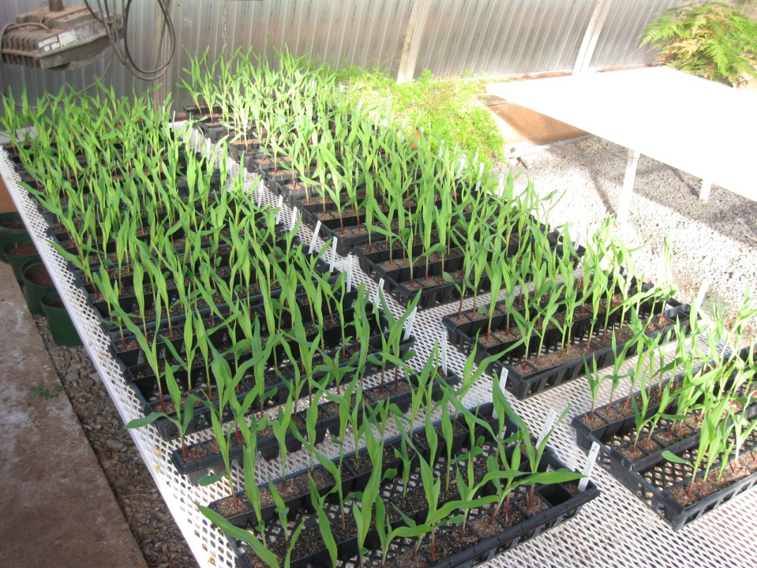
Greenhouse Trials
Materials and Methods
Planted 2.5 cm deep
Medium flats
10 seeds per treatment
Redi-earth
Adobe Illustrator CS4 software
Emergence
Leaf angle
Analysis of variance
Frequency distribution
Angle ranges (%)

Slide 8
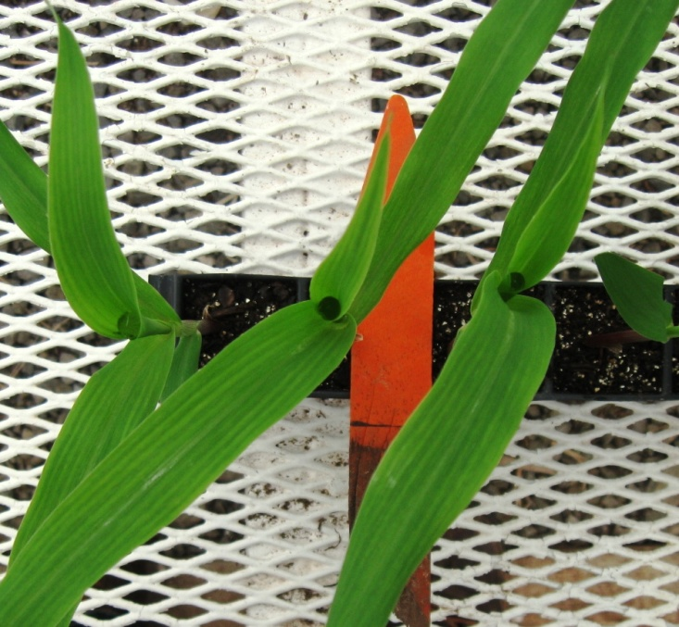
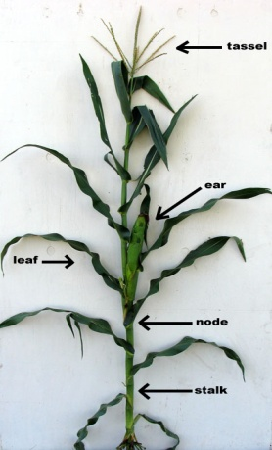
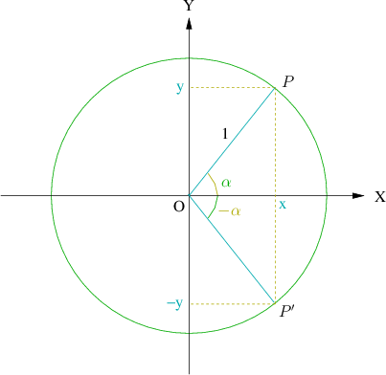
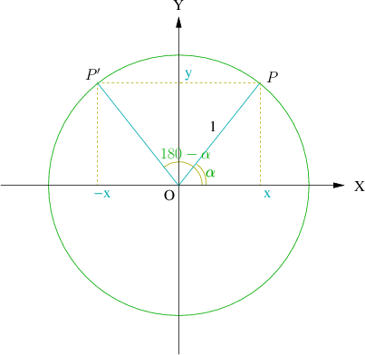
Leaf angle
Deviation from the corn row
Between 0° and 90°
Angle ranges
  0 ° to 30 ° (with-row)
  30 ° to 60 °
  60 ° to 90 ° (across-row)
Leaf symmetry

Slide 9
Experiment #1 (E1)
Pioneer 33B54
6 treatments
3 leaf stage
Experiment #2 (E2)
Pioneer 33B54
13 treatments
4 leaf stage

Slide 10
Experiment #3 (E3)
5 Dekalb hybrids
  DKC6122RR2
  DKC6172RR2
  DKC6346RR2
  DKC6342VT3
  DKC6169VT3
8 treatments
4 leaf stage
400 seeds

Slide 11
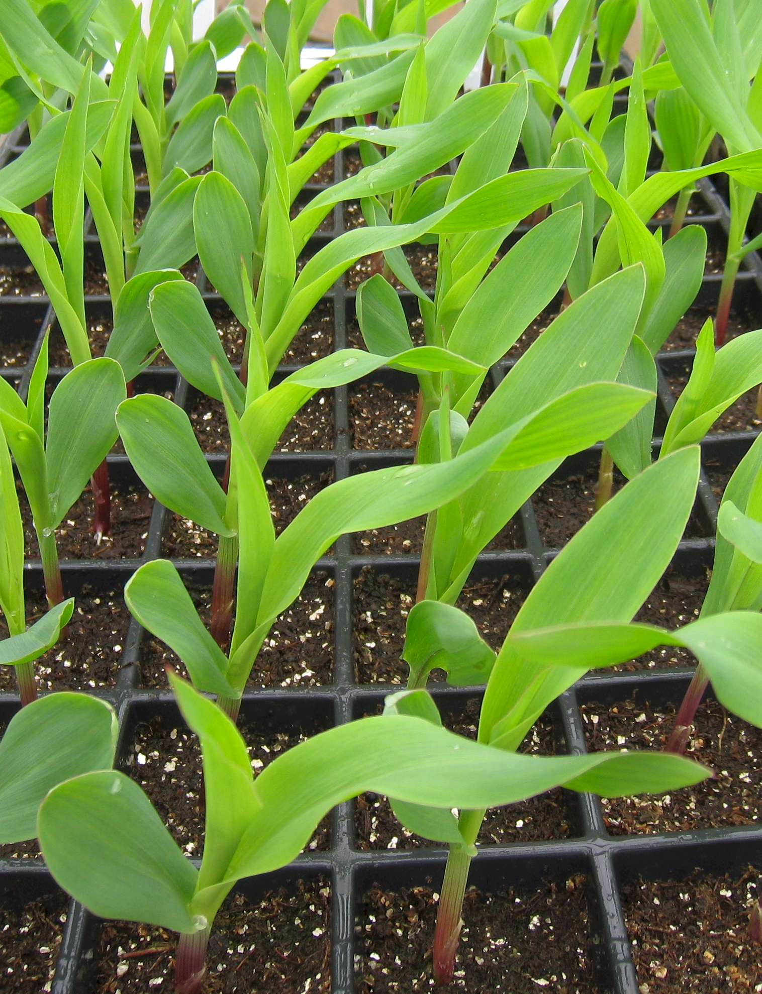






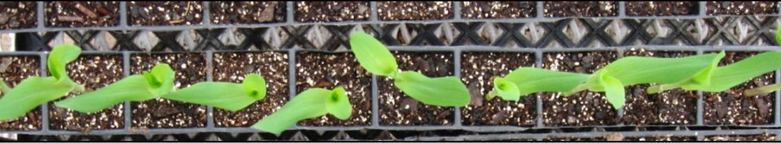
Results (E1)
Source of Variation |  | df | Leaf Angle |  | Emergence |  | Frequency distribution
Replication |  | 9 | ** |  | NS
Treatment |  | 5 | ** |  | ** |  | plants with leaf angle between 0° and 30° degrees | plants with leaf angle between 60° and 90° degrees
MSE |  | 58 | 313.58 |  | 0.12
Treatment means |  | N | Mean | Standard deviation | Mean | Standard deviation
 |  |  | Degrees |  |  |  | %
1 |  | 9 | 57.0 | 28.2 | 4.3 | 0.50 | 22.2 | 66.7
2 |  | 10 | 66.7 | 18.7 | 4.8 | 0.42 | 0.0 | 70.0
3 |  | 10 | 67.8 | 14.4 | 5.0 | 0.00 | 10.0 | 90.0
4 |  | 10 | 67.2 | 18.4 | 5.0 | 0.00 | 0.0 | 70.0
5 |  | 10 | 18.8 | 19.7 | 4.4 | 0.51 | 80.0 | 10.0
6 |  | 10 | 20.6 | 16.9 | 5.0 | 0.00 | 80.0 | 0.0
SED |  |  | 7.92 |  | 0.15
C.V. |  |  | 36 |  | 7

Slide 12









Results (E2)
Source of Variation |  | df | Leaf Angle |  | Emergence |  | Frequency distribution
Replication |  | 9 | NS |  | **
Treatment |  | 12 | ** |  | ** |  | plants with leaf angle between 0° and 30° degrees | plants with leaf angle between 60° and 90° degrees
MSE |  | 105 | 413.65 |  | 0.12
Treatment means |  | N | Mean | Standard deviation | Mean | Standard deviation
 |  |  | Degrees |  |  |  | %
1 |  | 9 | 51.0 | 18.0 | 6.6 | 0.51 | 22.2 | 44.4
2 |  | 10 | 65.6 | 16.8 | 6.7 | 0.48 | 0.0 | 80.0
3 |  | 10 | 47.4 | 19.3 | 7.3 | 0.48 | 20.0 | 70.0
4 |  | 10 | 62.4 | 27.8 | 6.3 | 0.48 | 30.0 | 40.0
5 |  | 10 | 29.0 | 13.0 | 3.0 | 0.00 | 80.0 | 10.0
6 |  | 10 | 31.5 | 17.3 | 6.1 | 0.31 | 60.0 | 10.0
7 |  | 10 | 45.6 | 23.1 | 6.9 | 0.31 | 60.0 | 30.0
8 |  | 10 | 48.0 | 23.7 | 7.1 | 0.31 | 30.0 | 30.0
9 |  | 9 | 62.0 | 14.9 | 6.1 | 0..31 | 22.2 | 77.8
10 |  | 10 | 68.9 | 19.4 | 6.3 | 0.48 | 10.0 | 90.0
11 |  | 9 | 57.0 | 19.7 | 7.0 | 0.00 | 22.2 | 55.6
12 |  | 10 | 54.8 | 22.4 | 7.0 | 0.00 | 20.0 | 50
13 | RANDOM | 10 | 54.9 | 21.8 | 7.1 | 0.31 | 20.0 | 60.0
SED |  |  | 9.09 |  | 0.15
C.V. |  |  | 39 |  | 5

Slide 13








Results (E3)
Source of Variation |  | df | Leaf Angle |  | Emergence |  | Frequency distribution
Replication |  | 9 | NS |  | NS
Treatment |  | 7 | ** |  | **
Hybrid |  | 4 | * |  | ** |  | plants with leaf angle between 0° and 30° degrees | plants with leaf angle between 60° and 90° degrees
MSE |  | 309 | 311.77 |  | 0.26
Treatment means |  | N | Mean | Standard deviation | Mean | Standard deviation
 |  |  | Degrees |  |  |  | %
1 |  | 50 | 62.6 | 17.2 | 6.4 | 1.05 | 8.0 | 72.0
2 |  | 45 | 51.4 | 18.4 | 8.3 | 1.11 | 22.2 | 60.0
3 |  | 50 | 64.7 | 15.4 | 6.1 | 0.68 | 4.0 | 76.0
4 |  | 49 | 38.8 | 17.0 | 6.8 | 1.10 | 46.9 | 20.4
5 |  | 50 | 47.8 | 18.1 | 7.0 | 0.55 | 32.0 | 38.0
6 |  | 50 | 66.3 | 14.17 | 6.8 | 0.75 | 4.0 | 86.0
7 |  | 50 | 51.4 | 20.8 | 6.8 | 0.72 | 32.0 | 50.0
8 | RANDOM | 50 | 48.8 | 17.8 | 7.0 | 0.99 | 28 | 48.0
SED |  |  | 7.89 |  | 0.23
C.V. |  |  | 33 |  | 7

Slide 14
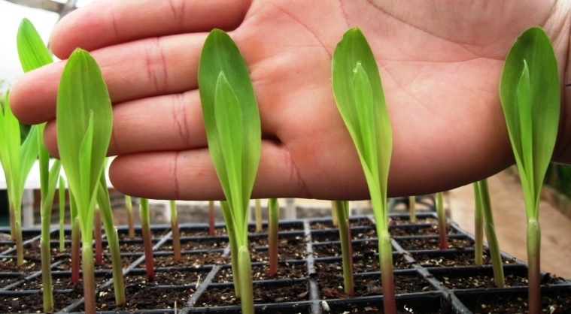
Discussion
Fortin and Pierce (1996)
  Found that random orientation of seed resulted in random ear leaf azimuths
Bowers and Hayden (1972)
  Flat orientation (hypocotyl up) consistently had better emergence (beans)
Patten and Van Doren Jr. (1970)
  Proximal end of the seed down resulted in earlier more complete emergence with more seedling growth

Slide 15
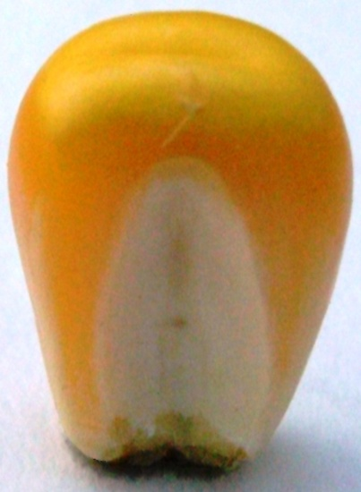
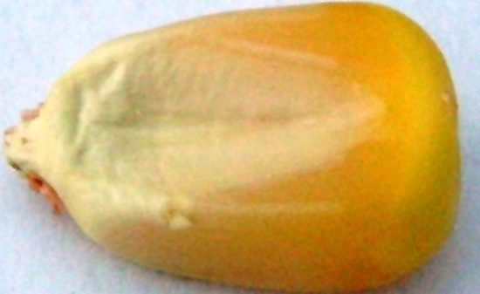
Field Trial – Materials and Methods
RCBD
Row Orientation: North-South
Row spacing: 75 cm
Light interception, at V10 and R1
  (LI-1400)
Grain yield at harvest
Corn Hybrids
  Prostate leaf pattern - P0902HR
  Erect leaf pattern - P1173HR
  (within incomplete factorial arrangement)
Seed Orientation
  Upright, caryopsis pointed down, parallel to the row
  Laying flat, embryo up, caryopsis pointed perpendicular to the row
  Random
Plant Population (in thousands of plants/ha)
  49.4 , 74.1 and 98.8
Upright
Flat
Flat
Row orientation

Slide 16
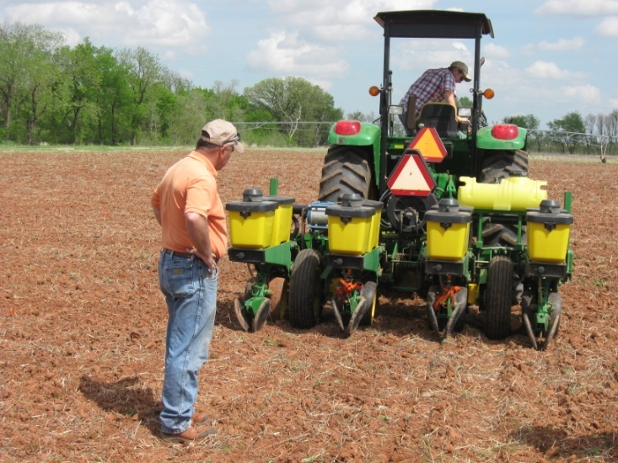
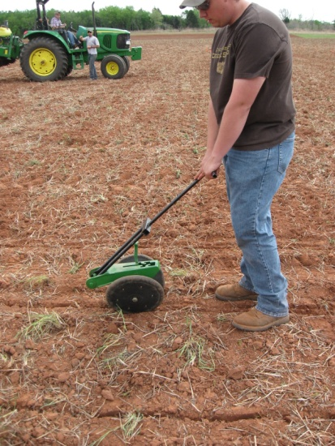
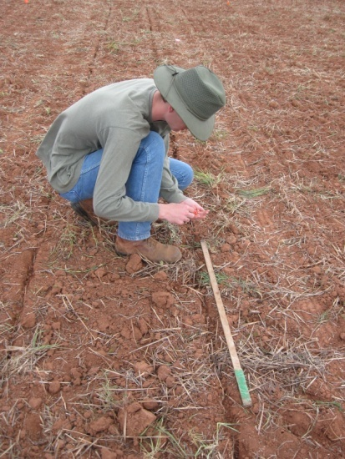

Slide 17
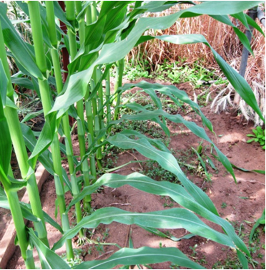
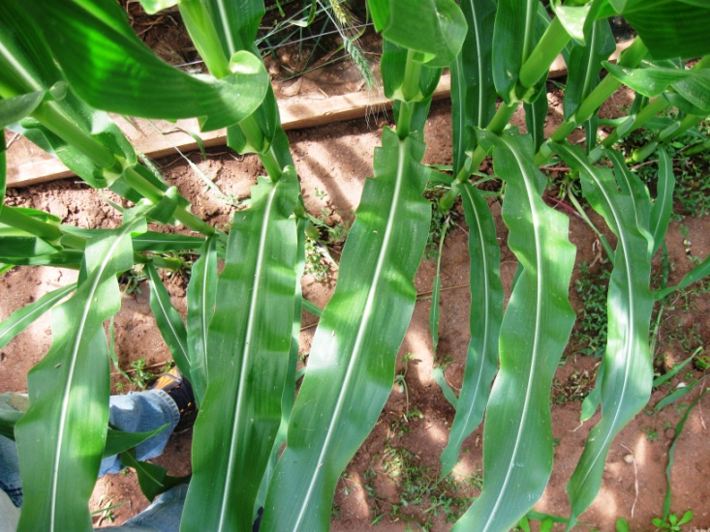
Results (Field Trial)

Slide 18
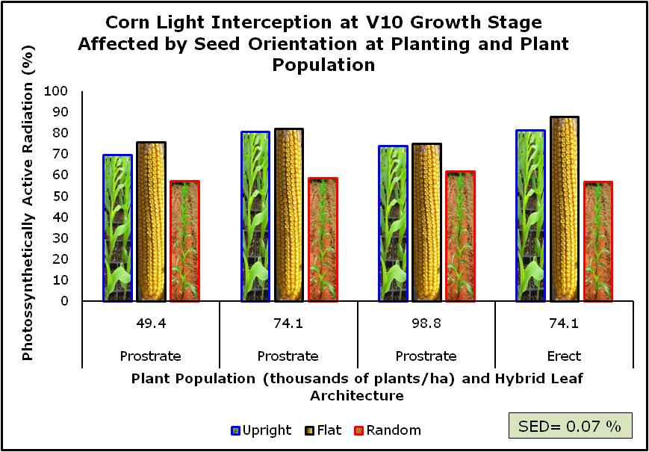
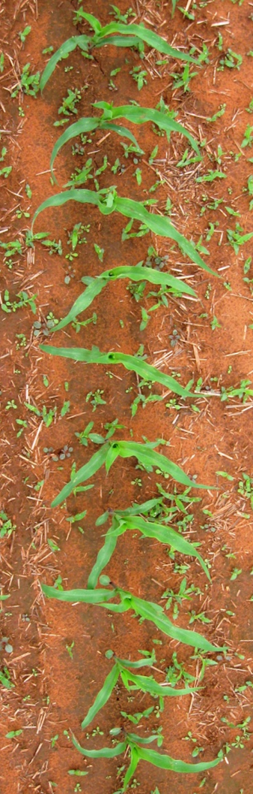

Slide 19
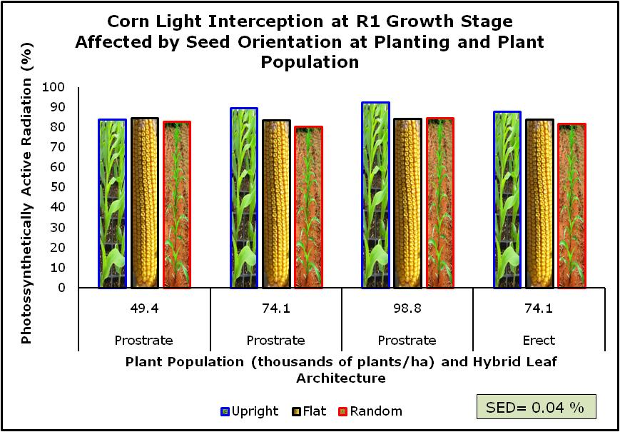

Slide 20
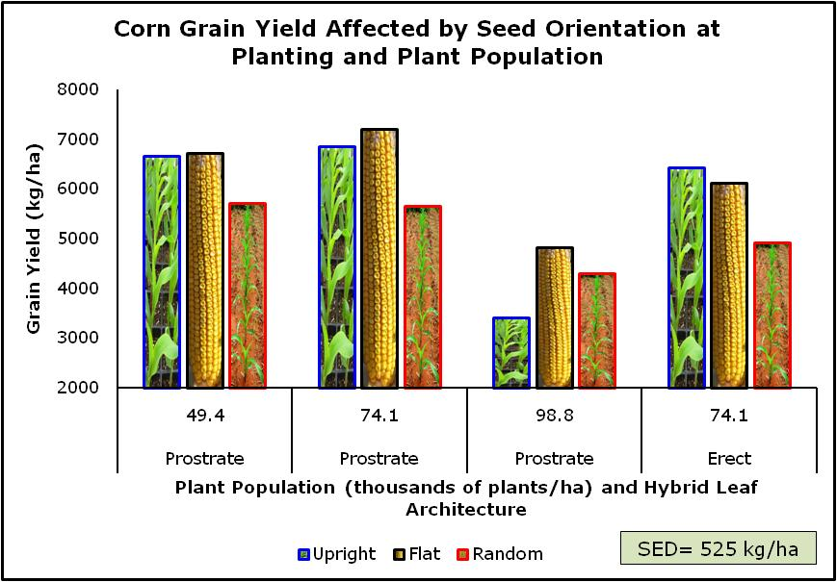
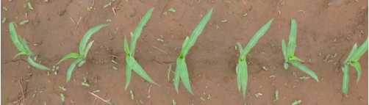

Slide 21
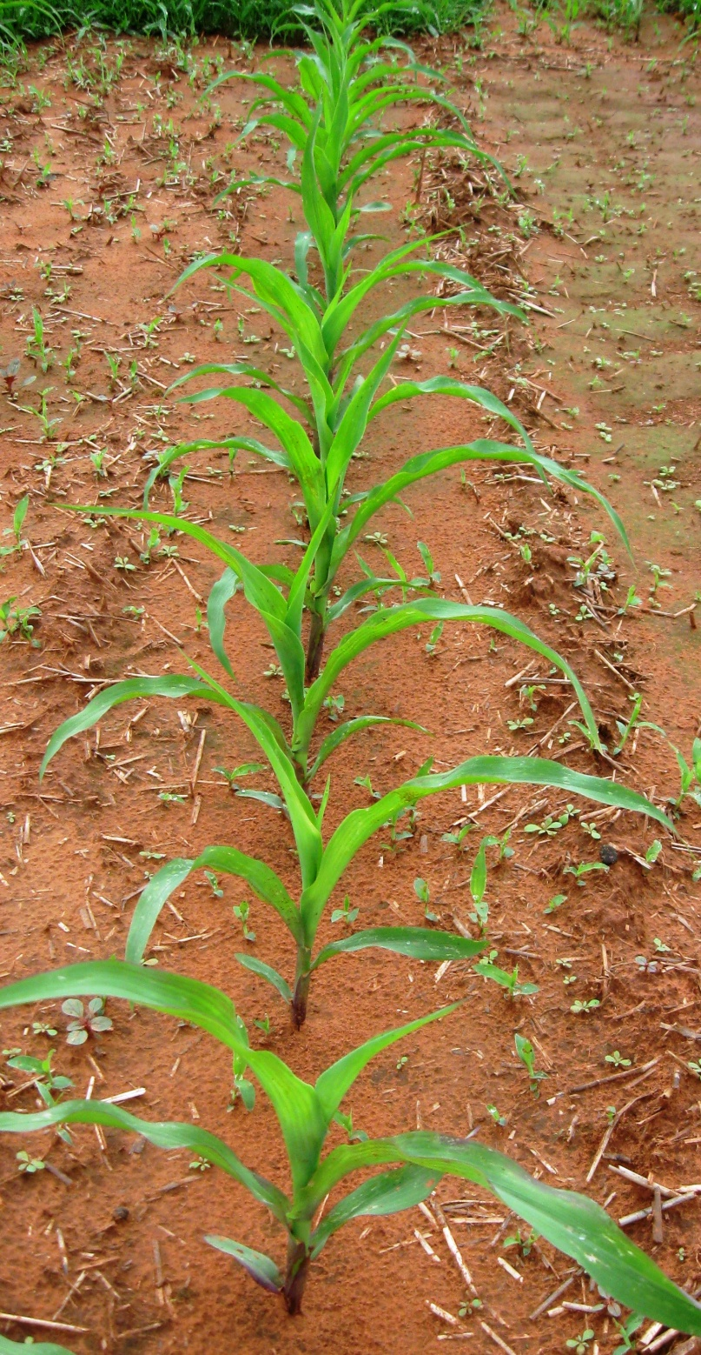
Discussion
Pendlenton et al. (1967)
  35 % yield increase in corn when aluminum reflectors were used to provide additional light to the middle and lower leaves.
Toler et al. (1999)
  Differences in light interception between leaf orientations decrease with maturity.
  No differences were found in plant population.
  Across row: 10% higher corn yields than the random leaf orientation.
Sujatha et al. (2004)
  50% less light reached the ground between rows of horizontal leaf hybrid compared with upright leaf in both years.

Slide 22
Conclusions
Placement and arrangement of corn seed can influence rate of emergence and leaf orientation.
At V10 fixed seed planting intercept more light than random seed planting.
Difference in light interception decreases with maturity.
Effect of seed orientation on light interception was independent of plant population and hybrid.
When seeds were planted in an upright or flat position (versus random placement);
  There was 12.5% yield increase for the flat but no benefits were realized for upright at the high population (98,000 plants/ha).
  Seeds planted upright or flat resulted in increased yields up to 17.4% (pop 49,400 plants/ha).
  Yield increase up to 27.1% and 30.6% (prostrate and erect hybrids respectively at pop 74,100 plants/ha) when compared to random placement.

Slide 23
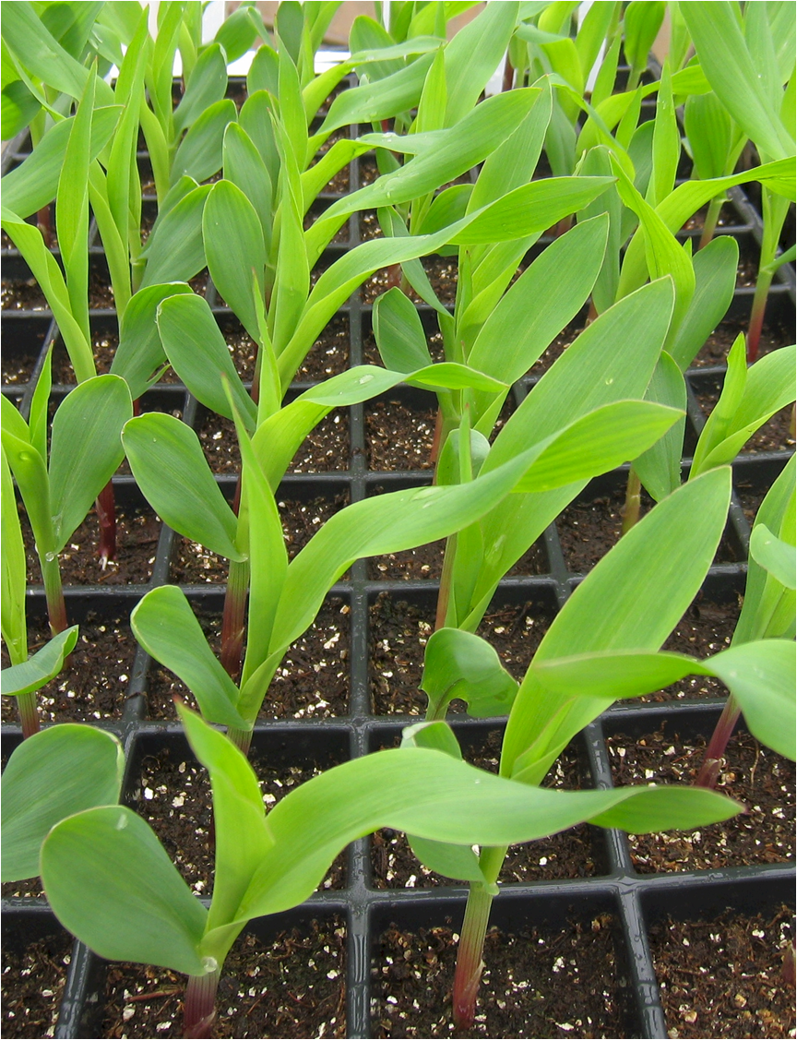
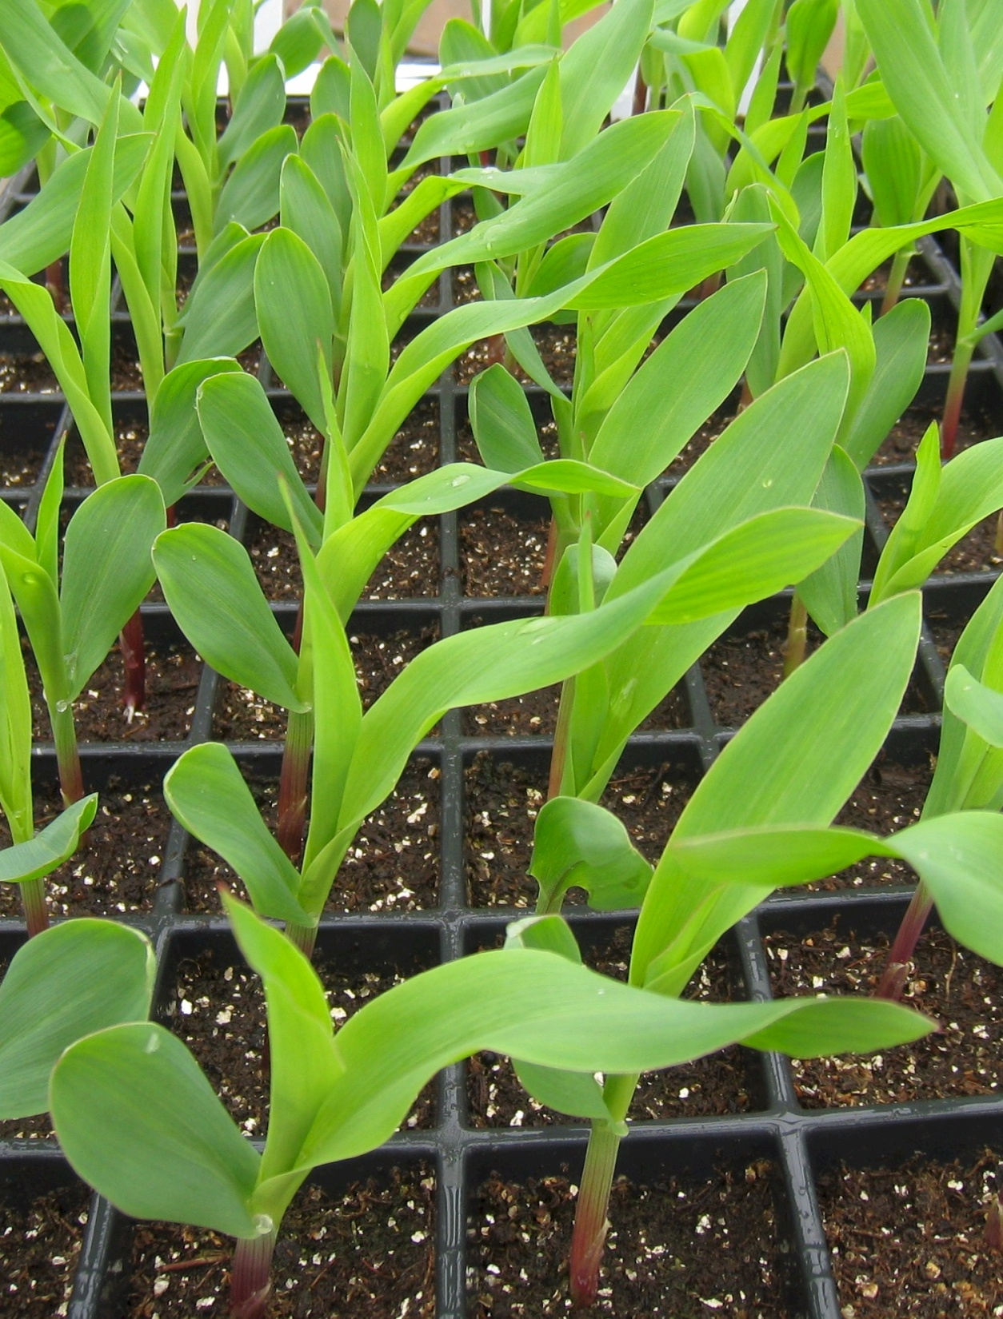
Thank You!
Questions?

