Slide 1

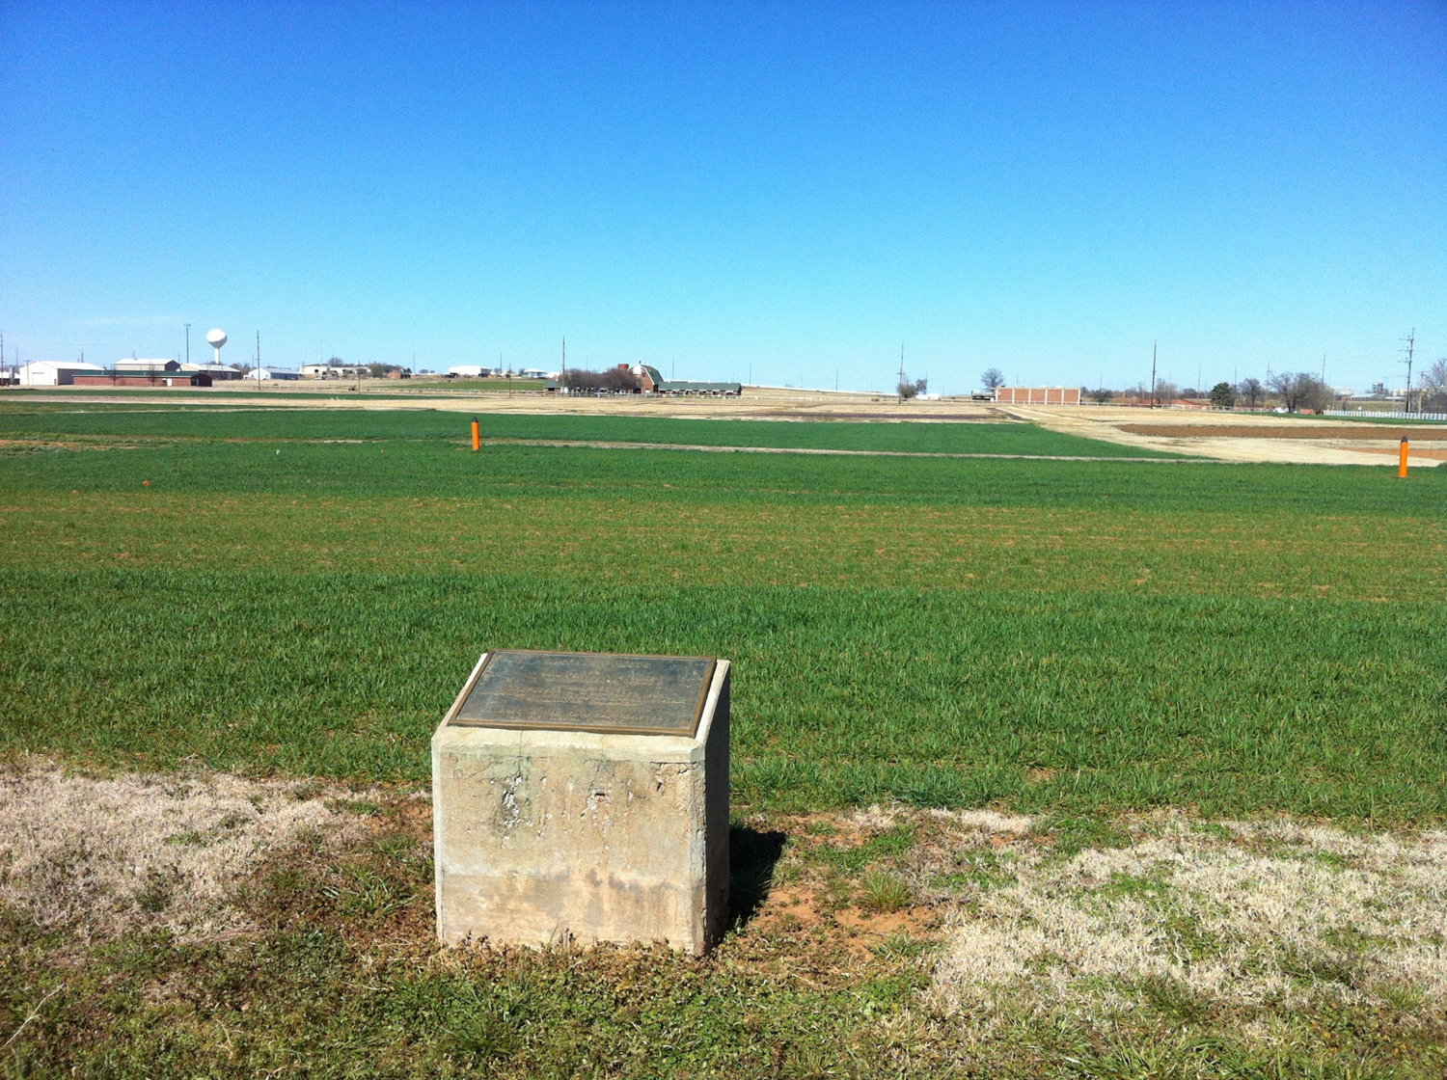
The Importance of Long-Term Trials: What Have We Learned?
Department Seminar – Spring 2019
Bruno Morandin Figueiredo

Slide 2
The Importance of Long-Term Trials: What Have We Learned?
Introduction
To determine treatment differences as a function of the environment
Application of new methodologies can be used/tested as they are developed (Greenseeker)
Novel analysis/biometry evaluated using substantive data sets

Slide 3

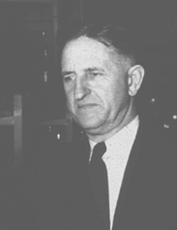


The Importance of Long-Term Trials: What Have We Learned?
How to maintain trial longevity?
Alexander C. Magruder, Horace J. Harper, Billy B. Tucker, Robert L. Westerman
Institutional Memory

Slide 4
The Importance of Long-Term Trials: What Have We Learned?
Introduction
OSU Long Term Experiments
Experiment | Location | Focus | Crop | Year Est.
222 | Stillwater | NPK | wheat | 1968
301 | Efaw | Municipal wastes | wheat | 1993
302 | Efaw | Animal wastes | wheat | 2000
406 | Altus | NPK irrigated | wheat | 1965
407 | Altus | NPK dryland | wheat | 1965
439 | Altus | NPK | cotton | 1971
501 | Lahoma | NPK | sorghum (1970-2004) canola (2005-present) | 1970
502 | Lahoma | NPK | wheat | 1970
503 | Lahoma | P Source Method | wheat | 1970
504 | Lahoma | P Source | wheat | 1970
505 | Lahoma | N Source | wheat | 1970
601 | LCB | Zero-Till Topdress | wheat | 2001
702 | Perkins | N and P Rates | wheat | 1998
Magruder Plots | Stillwater | NPK-lime | wheat | 1892
Source: http://nue.okstate.edu/Long_Term_Experiments.htm

Slide 5
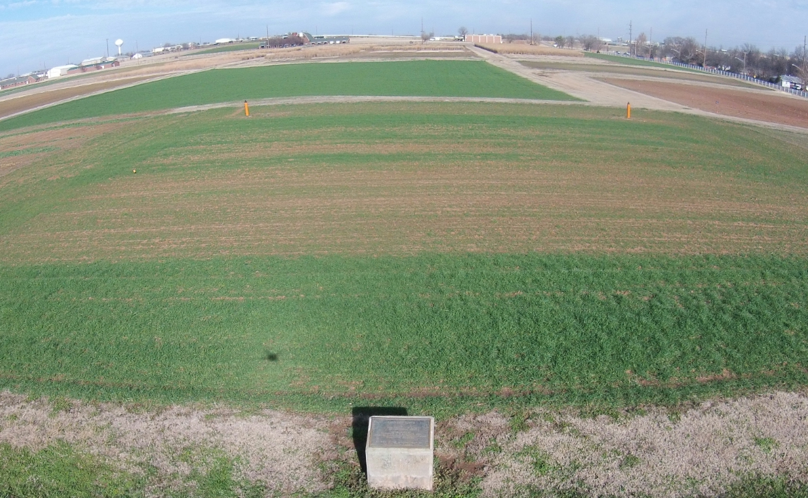
The Importance of Long-Term Trials: What Have We Learned?
The Magruder Plots

Slide 6
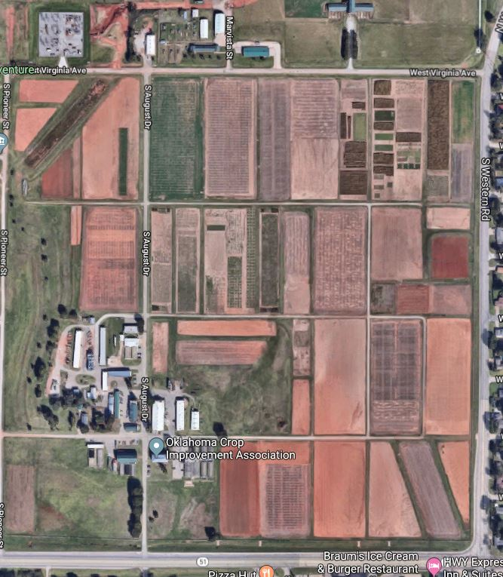
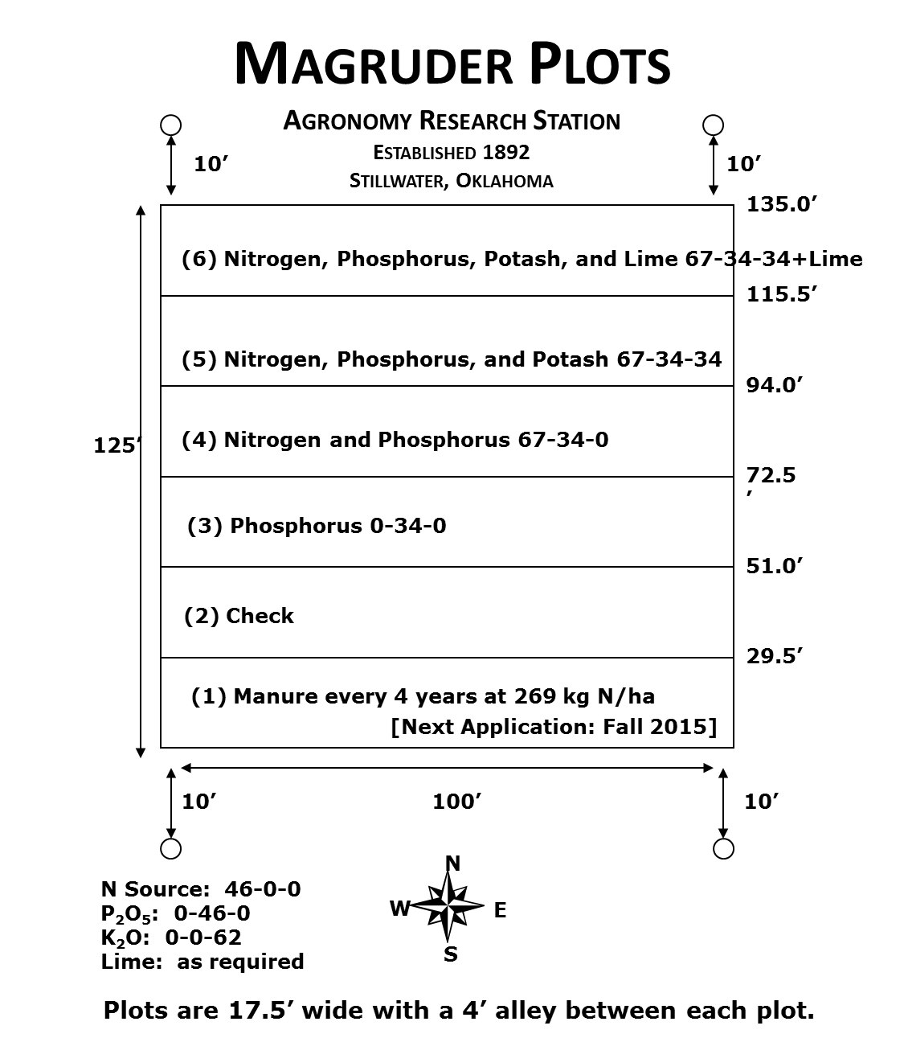
The Importance of Long-Term Trials: What Have We Learned?
The Magruder Plots

Slide 7
The Importance of Long-Term Trials: What Have We Learned?
Stability Analysis
First used to test yield stability of different genotypes across multiple environments
Effect of different environments on treatment response
Linear regression of yield (by treatment) on the environment mean (average yield of all treatments in a given year)

Slide 8
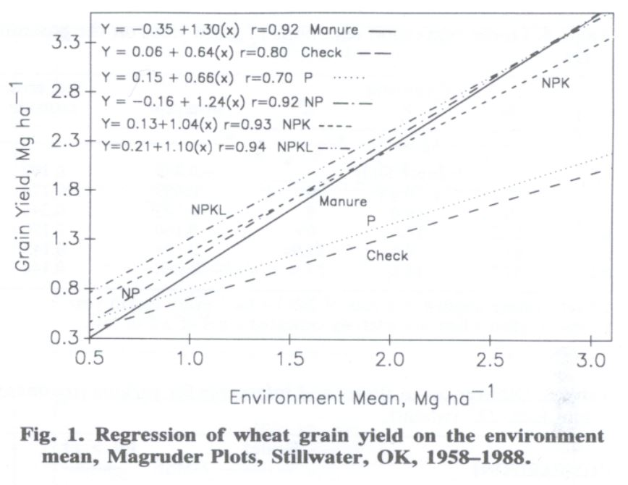
The Importance of Long-Term Trials: What Have We Learned?
Stability Analysis
Source: 1993, Agronomy Journal, 85(1), pp.159-167.

Slide 9
The Importance of Long-Term Trials: What Have We Learned?
Check Plot Yields
Conventional tillage has decreased soil organic matter from 4 to 1% (1892 – present)
Declining yield levels following years of continuous winter wheat without fertilization?

Slide 10
The Importance of Long-Term Trials: What Have We Learned?
Check Plot Yields
Source: 2007, The Magruder Plots: untangling the puzzle. Agron J. 99:1191-1198.

Slide 11
The Importance of Long-Term Trials: What Have We Learned?
Check Plot Yields
Extensive variability in plots with/without N
Source: 2016, Variability in Optimum Nitrogen Rates for Maize. Agron. J. 108:2165-2173
Improved varieties over time assimilate
more N
Highly variable environments
  N mineralization
  N from rainfall

Slide 12
The Importance of Long-Term Trials: What Have We Learned?
Should sites be combined over years?
Two and three year combinations
F- Statistic applied to each combination
Resulting F - value plot over time

Slide 13
The Importance of Long-Term Trials: What Have We Learned?
Should sites be combined over years?
Source: 2017, Relationship between mean square errors and wheat grain yields in long-term experiments. Journal of Plant Nutrition, 40(9), pp.1243-1249.

Slide 14
The Importance of Long-Term Trials: What Have We Learned?
Should sites be combined over years?
Source: 2017, Relationship between mean square errors and wheat grain yields in long-term experiments. Journal of Plant Nutrition, 40(9), pp.1243-1249.

Slide 15
The Importance of Long-Term Trials: What Have We Learned?
Should sites be combined over years?
For 2 year combinations, 43% should not be combined
For 3 year combinations, 73% should not be combined
Combining data over years ignores the highly variable effect of environment

Slide 16
The Importance of Long-Term Trials: What Have We Learned?
Impendence of Nitrogen Response and Yield
Nitrogen response calculated for check and medium nitrogen rates:
    RI = Yield High N plot
    Check or Mid N
Wheat: Stillwater and Altus – OK (143 years)
Maize: Arlington – WI, Shelton – NE, Nashua and Kanawha – IA (118 years)

Slide 17
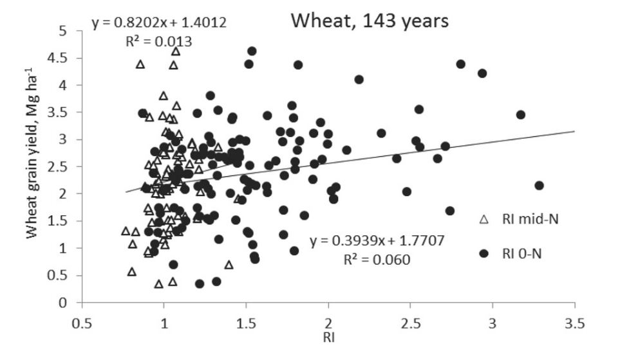
The Importance of Long-Term Trials: What Have We Learned?
Impendence of Nitrogen Response and Yield
Source: 2010, Agronomy Journal, 105(5), pp.1335-1344

Slide 18
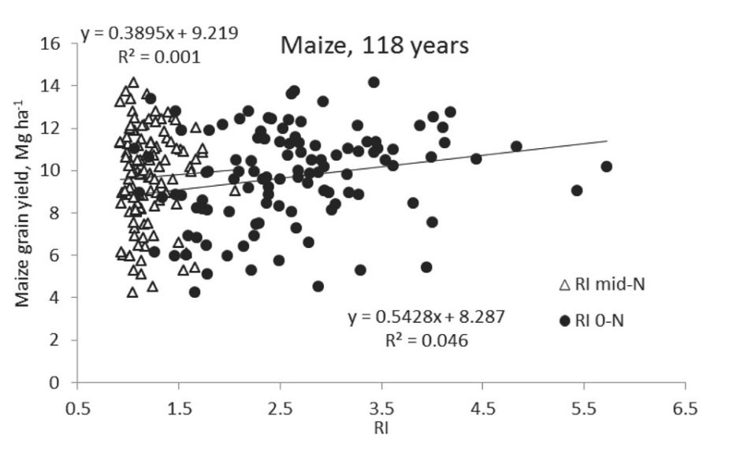
The Importance of Long-Term Trials: What Have We Learned?
Impendence of Nitrogen Response and Yield
Source: 2010, Agronomy Journal, 105(5), pp.1335-1344

Slide 19
The Importance of Long-Term Trials: What Have We Learned?
Impendence of Nitrogen Response and Yield
No significant relationship between RI and Yield level
Must account for both RI and Yield (YP0) to determine accurate N rate recommendations

Slide 20
The Importance of Long-Term Trials: What Have We Learned?
Research history
Raun, W. R., H. J. Barreto, and R. L. Westerman. 1993. Use of stability analysis for long-term soil fertility experiments. Agron. J. 85:159-167.
Guertal, E.A., W.R. Raun, R.L. Westerman and R.K. Boman. 1994. Applications of stability analysis for single-site, long-term experiments. Agron. J. 86:1016-1019.
Raun, W.R., and G.V. Johnson. 1995. Soil-plant buffering of inorganic nitrogen in continuous winter wheat. Agron. J. 87:827-834.
Stone, M.L., J.B. Solie, W.R. Raun, R.W. Whitney, S.L. Taylor and J.D. Ringer. 1996. Use of spectral radiance for correcting in-season fertilizer nitrogen deficiencies in winter wheat. Trans. ASAE 39(5):1623-1631.
Raun, W.R., G.V. Johnson, S.B. Phillips and R.L. Westerman. 1998. Effect of long-term nitrogen fertilization on soil organic C and total N in continuous wheat under conventional tillage in Oklahoma. Soil & Tillage Res. 47:323-330.
Raun, W.R., G.V. Johnson, H. Sembiring, E.V. Lukina, J.M. LaRuffa, W.E. Thomason, S.B. Phillips, J.B. Solie, M.L. Stone and R.W. Whitney. 1998. Indirect measures of plant nutrients. Commun. In Soil Sci. Plant Anal. 29:1571-1581.
Raun, W.R., G.V. Johnson, and R.L. Westerman. 1999. Fertilizer nitrogen recovery in long-term continuous winter wheat. Soil Sci. Soc. Am. J. 63:645-650.
Lees, H.L., W.R. Raun and G.V. Johnson. 2000. Increased plant N loss with increasing nitrogen applied in winter wheat observed with ¹⁵N. J. Plant Nutr. 23:219-230.
Thomason, W.E., W.R. Raun and G.V. Johnson. 2000. Winter wheat fertilizer nitrogen use efficiency in grain and forage production systems. J. Plant Nutr. 23:1505-1516.
Raun, W.R., G.V. Johnson, M.L. Stone, J.B. Solie, E.V. Lukina, W.E. Thomason and J.S. Schepers. 2001. In-season prediction of potential grain yield in winter wheat using canopy reflectance. Agron. J. 93:131-138.
Lukina, E.V., K.W. Freeman, K.J. Wynn, W.E. Thomason, R.W. Mullen, A.R. Klatt, G.V. Johnson, R.L. Elliott, M.L. Stone, J.B. Solie, and W.R. Raun. 2001. Nitrogen fertilization optimization algorithm based on in-season estimates of yield and plant nitrogen uptake. J. Plant Nutr. 24:885-898.
Raun, W.R., J.B. Solie, G.V. Johnson, M.L. Stone, R.W. Mullen, K.W. Freeman, W.E. Thomason, and E.V. Lukina. 2002. Improving nitrogen use efficiency in cereal grain production with optical sensing and variable rate application. Agron. J. 94:815-820.
Mullen, R.W., Kyle W. Freeman, William R. Raun, G.V. Johnson, M.L. Stone, and J.B. Solie. 2003. Identifying an in-season response index and the potential to increase wheat yield with nitrogen. Agron. J. 95:347-351.
Davis, R.L., J.J. Patton, R.K. Teal, Y. Tang, M.T. Humphreys, J. Mosali, K. Girma, J.W. Lawles, S.M. Moges, A. Malapati, J.Si, H. Zhang, S. Deng, G.V. Johnson, R.W. Mullen, and W.R. Raun. 2003. Nitrogen balance in the Magruder Plots following 109 years in continuous winter wheat. J. Plant Nutr. 26(8):1561-1580.
Moges, S.M., W.R. Raun, R.W. Mullen, K.W. Freeman, G.V. Johnson, and J.B. Solie. 2004. Evaluation of green, red and near infrared bands for predicting winter wheat biomass, nitrogen uptake, and final grain yield. J. Plant Nutr. 27: 1431-1414.
Sun, H.Y., S.P. Deng, and W.R. Raun. 2004. Bacterial community structure and diversity in a century-old manure-treated agroecosystem. Appl. Environ. Micro. 70:5868-5874.
Macnack, Natasha, Bee Chim Khim, Jeremiah Mullock, and William Raun. 2014. In season prediction of nitrogen use efficiency and grain protein in winter wheat, Triticum aestivum L.. Commun. Soil Sci. Plant Anal. 00:1-15. DOI:10.1080/00103624.2014.904337.

Slide 21
The Importance of Long-Term Trials: What Have We Learned?
Research history
Raun, W.R., J.B. Solie, M.L. Stone, K.L. Martin, K.W. Freeman, R.W. Mullen, H. Zhang J.S. Schepers, and G.V. Johnson. 2005. Optical sensor based algorithm for crop nitrogen fertilization. Commun. Soil Sci. Plant Anal. 36:2759-2781.
Girma, Kefyalew, K.L. Martin, R.H. Anderson, D.B. Arnall, K.D. Brixey, M.A. Casillas, B. Chung, B.C. Dobey, S.K. Kamenidou, S.K. Kariuki, E.E. Katsalirou, J.C. Morris, J.Q. Moss, C.T. Rohla, B.J. Sudbury, B.S. Tubana, and W.R. Raun. 2006. Mid-Season Prediction of Wheat Grain Yield Potential Using Plant, Soil, and Sensor Measurements. J. Plant Nutr. 29:873-897.
Arnall, D.B., W.R. Raun, J.B. Solie, M.L. Stone, G.V. Johnson, K. Desta, K.W. Freeman, R.K. Teal, and K.L. Martin. 2006. Relationship between coefficient of variation measured by spectral reflectance and plant density at early growth stages in winter wheat. J. Plant. Nutr. 29:1983-1997.
Girma, Kefyalew, R.K. Teal, K.W. Freeman, R.K. Boman, and W.R. Raun. 2007. Cotton lint yield and quality as affected by cultivar and long-term applications of N, P, and K fertilizers. J. Cotton Sci. 11:12-19.
Girma, Kefyalew, Starr L. Holtz, Daryl B. Arnall, Brenda S. Tubana, and William R. Raun. 2007. The Magruder Plots: untangling the puzzle. Agron J. 99:1191-1198.
Arnall, Daryl B., Brenda S. Tubaña, Starr L. Holtz, Kefyalew Girma and William R. Raun. 2009. Relationship between nitrogen use efficiency and response index in winter wheat. J. Plant Nutr. 32:502-515.
Raun, William R., John B. Solie, and Marvin L. Stone. 2011. Independence of yield potential and crop nitrogen response. Precision Agric. 12:508-518.
Solie, J.B., A.D. Monroe, W.R. Raun, and M.L. Stone. 2012. Generalized algorithm for variable nitrogen rate application in cereal grains. Agron. J. 104:378-387.
Arnall, D.B., A.P. Mallarino, M.D. Ruark, G.E. Varvel, J.B. Solie, M.L. Stone, J. L. Mullock, R.K. Taylor, and W.R. Raun*. 2013. Relationship between grain crop yield potential and nitrogen response. Agron. J. 105:1335–1344. doi:10.2134/agronj2013.0034
Raun, W.R., J.B. Solie, M.L. Stone, K.L. Martin, K.W. Freeman, R.W. Mullen, H. Zhang J.S. Schepers, and G.V. Johnson. 2005. Optical sensor based algorithm for crop nitrogen fertilization. Commun. Soil Sci. Plant Anal. 36:2759-2781.
Raun, William, Melissa Golden, Bruno Figueiredo, Jagmandeep Dhillon, Mariana Ramos Del Corso, Nicole Remondet, Mame Diatite-Koumba, Shawntel Ervin, Daniel Alidekki, Ethan Driver, Bill Jones, James Lasquites, Samuel Zoca, Patrick Watkins, and Jeremiah Mullock. 2015. Relationship between mean square errors and wheat grain yields in long-term experiments. J. Plant Nutr.
Bushong, J.T., J.L. Mullock, E.C. Miller, W.R. Raun, and D.B. Arnall. 2015. Evaluation of mid-season sensor based nitrogen fertilizer recommendations for winter wheat using different estimates of yield potential. J. Prec. Agric.
Macnack, N., and W.R. Raun. 2015. Effect of long-term beef manure application on soil test phosphorus, organic carbon and winter wheat yield. J. Plant Nutr.

Slide 22
The Importance of Long-Term Trials: What Have We Learned?
Summary
Valuable publications have originated from the same plots over the years
Treatment response highly dependent on the environment
Dissemination of data and collaboration (Kansas State, CSIRO, others)
Trials continue to provide relative/timely information (CO₂, soil OC, cyanobacteria, +)

Slide 23
The Importance of Long-Term Trials: What Have We Learned?
  Acknowledgements
Committee members.
  Dr. Zhang, Dr. Arnall, Dr. Weckler, Dr. Raun
Graduate student group
Department of Plant and Soil Sciences
Agricultural Experiment Station

Slide 24
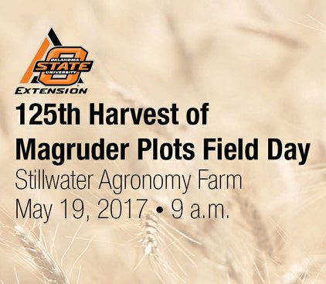
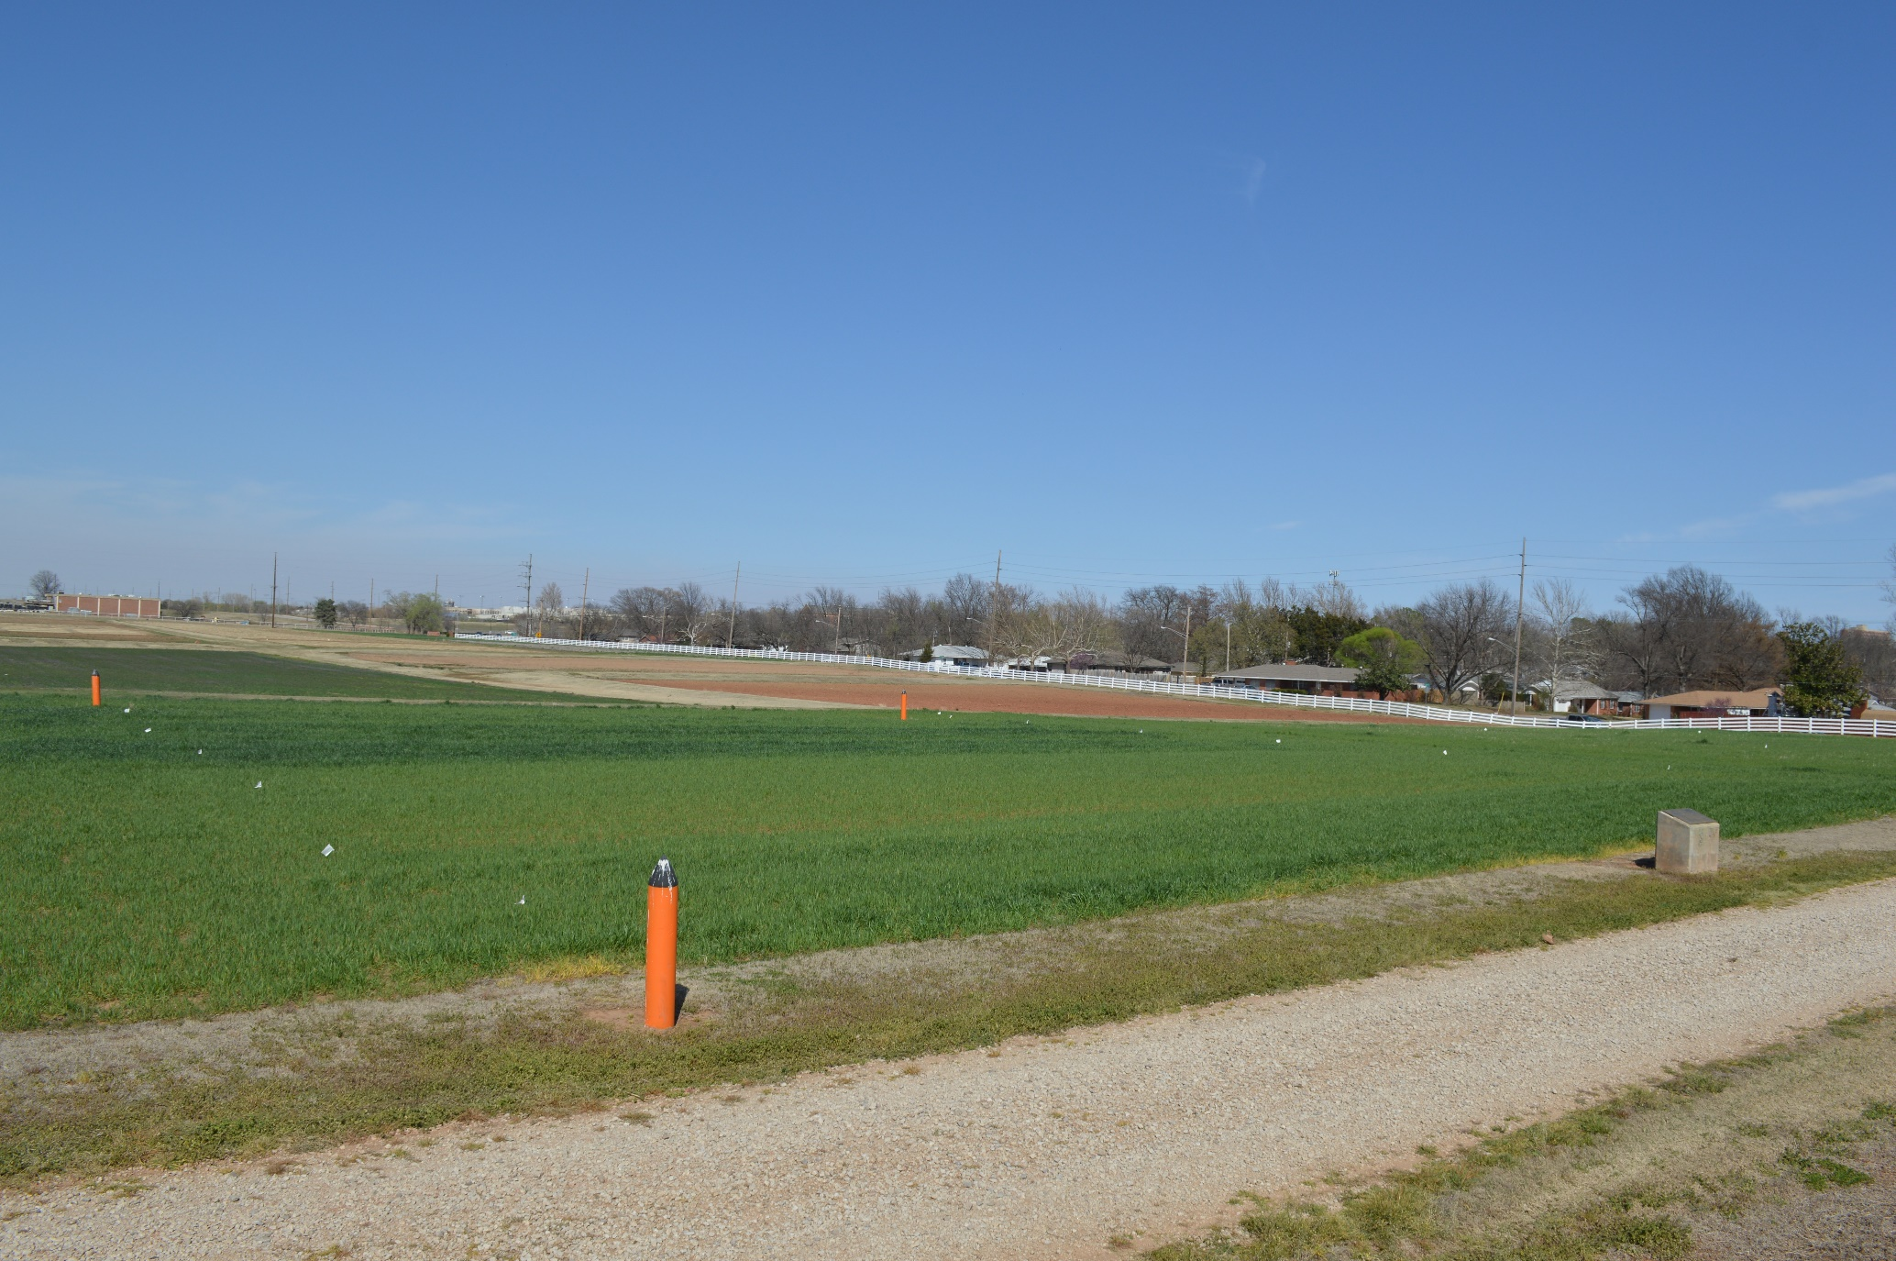
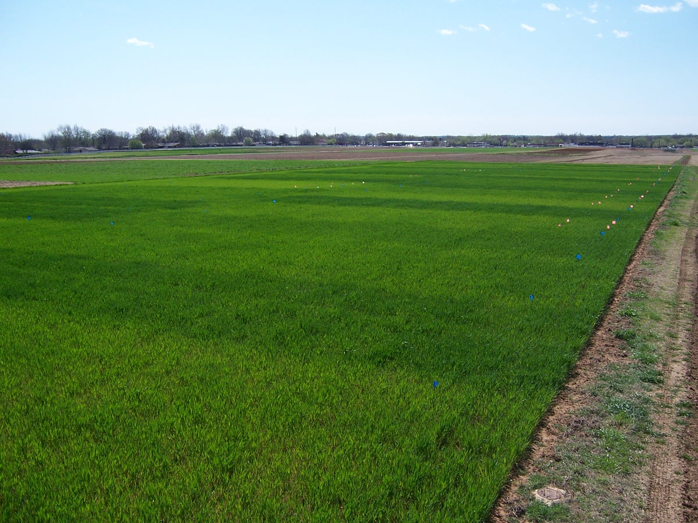
The Importance of Long-Term Trials: What Have We Learned?
Thank you!
Email me at brunom@okstate.edu
Or visit me at 054 AgHall
E222

