Slide 1
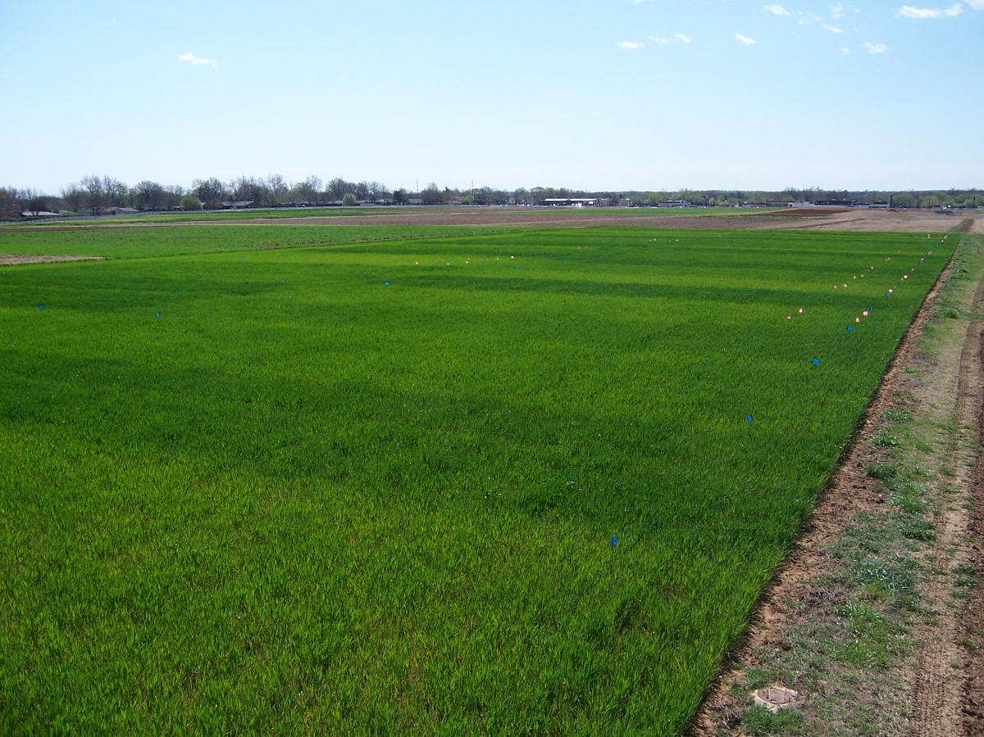

OSU Winter Crops School
December 12, 2018
nue.okstate.edu
NDVI, sensor calibration
Value of the OSU Long Term Experiments

Slide 2
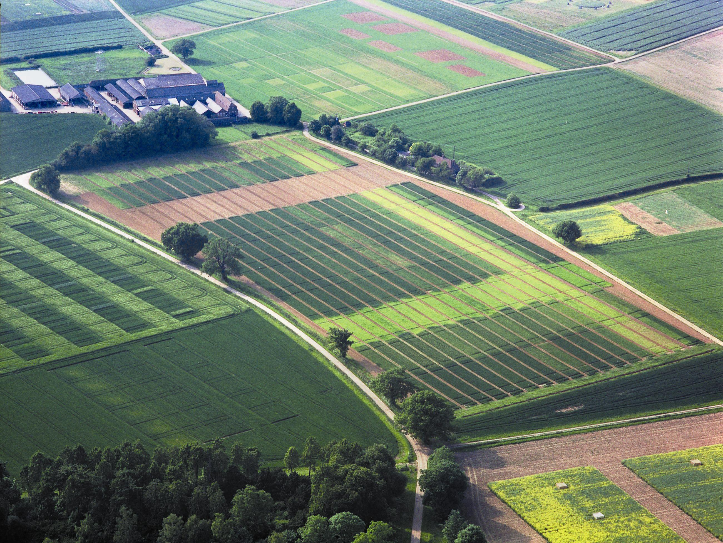
1843 Broadbalk experiment at Rothamsted Research in Hertfordshire, UK

Slide 3

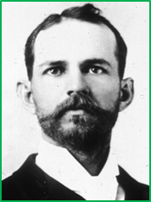
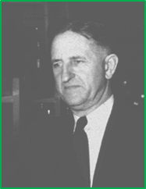


Long Term Nutrient Management/Tillage Experiments
American Society of Agronomy Centennial, 2007
PDF file ASA Centennial Calendar
1843 Rothamsted Broadbalk, UK
1876 The Morrow Plots, Illinois, Corn, Soybeans
1888 Sanborn Fields, Missouri, Corn, Soybeans
1892 The Magruder Plots, Oklahoma, Wheat
1911 The Cullars Rotation, Alabama, Cotton
1914 Topdressing Experiment, Australia
1931 Crop Residue Experiment, Oregon
1961 NPK Fertility, Kansas
1962 Long Term Manure, Michigan
1963 Long Term Tillage/Rotation, Ohio
1970 Continuous N Tillage, Kentucky
1974 Wheat/Soybean Tillage, Argentina
Boman, R.K., S.L. Taylor, W.R. Raun, G.V. Johnson, D.J. Bernardo and L.L. Singleton. 1996. The Magruder plots, a century of wheat research in Oklahoma. Okla. Agric. Exp. Sta., Agronomy 96-1. 69 pages.
Davis, R.L., J.J. Patton, R.K. Teal, Y. Tang, M.T. Humphreys, J. Mosali, K. Girma, J.W. Lawles, S.M. Moges, A. Malapati, J.Si, H. Zhang, S. Deng, G.V. Johnson, R.W. Mullen, and W.R. Raun. 2003. Nitrogen balance in the Magruder Plots following 109 years in continuous winter wheat. J. Plant Nutr. 26(8):1561-1580.
Girma, Kefyalew, Starr L. Holtz, Daryl B. Arnall, Brenda S. Tubana, and William R. Raun. 2007. The Magruder Plots: untangling the puzzle. Agron J. 99:1191-1198.

Slide 4
http://nue.okstate.edu/Long_Term_Experiments.htm
OSU Ongoing Long Term Experiments
Experiment | Location | Focus | Crop | Year Est.
222 | Stillwater (DATA) | NPK | wheat | 1968
301 | Efaw | Municipal wastes | wheat | 1993
302 | Efaw | Animal wastes | wheat | 2000
406 | Altus (DATA) | NPK irrigated | wheat | 1965
407 | Altus (DATA) | NPK dryland | wheat | 1965
439 | Altus | NPK | cotton | 1971
501 | Lahoma | NPK | sorghum (1970-2004) canola (2005-present) | 1970
502 | Lahoma (DATA) (Pictures) | NPK | wheat | 1970
503 | Lahoma | P Source Method | wheat | 1970
504 | Lahoma | P Source | wheat | 1970
505 | Lahoma | N Source | wheat | 1970
701 | LCB | Zero-Till Topdress | wheat | 2001
Magruder Plots | Stillwater (DATA) | NPK-lime | wheat | 1892

Slide 5
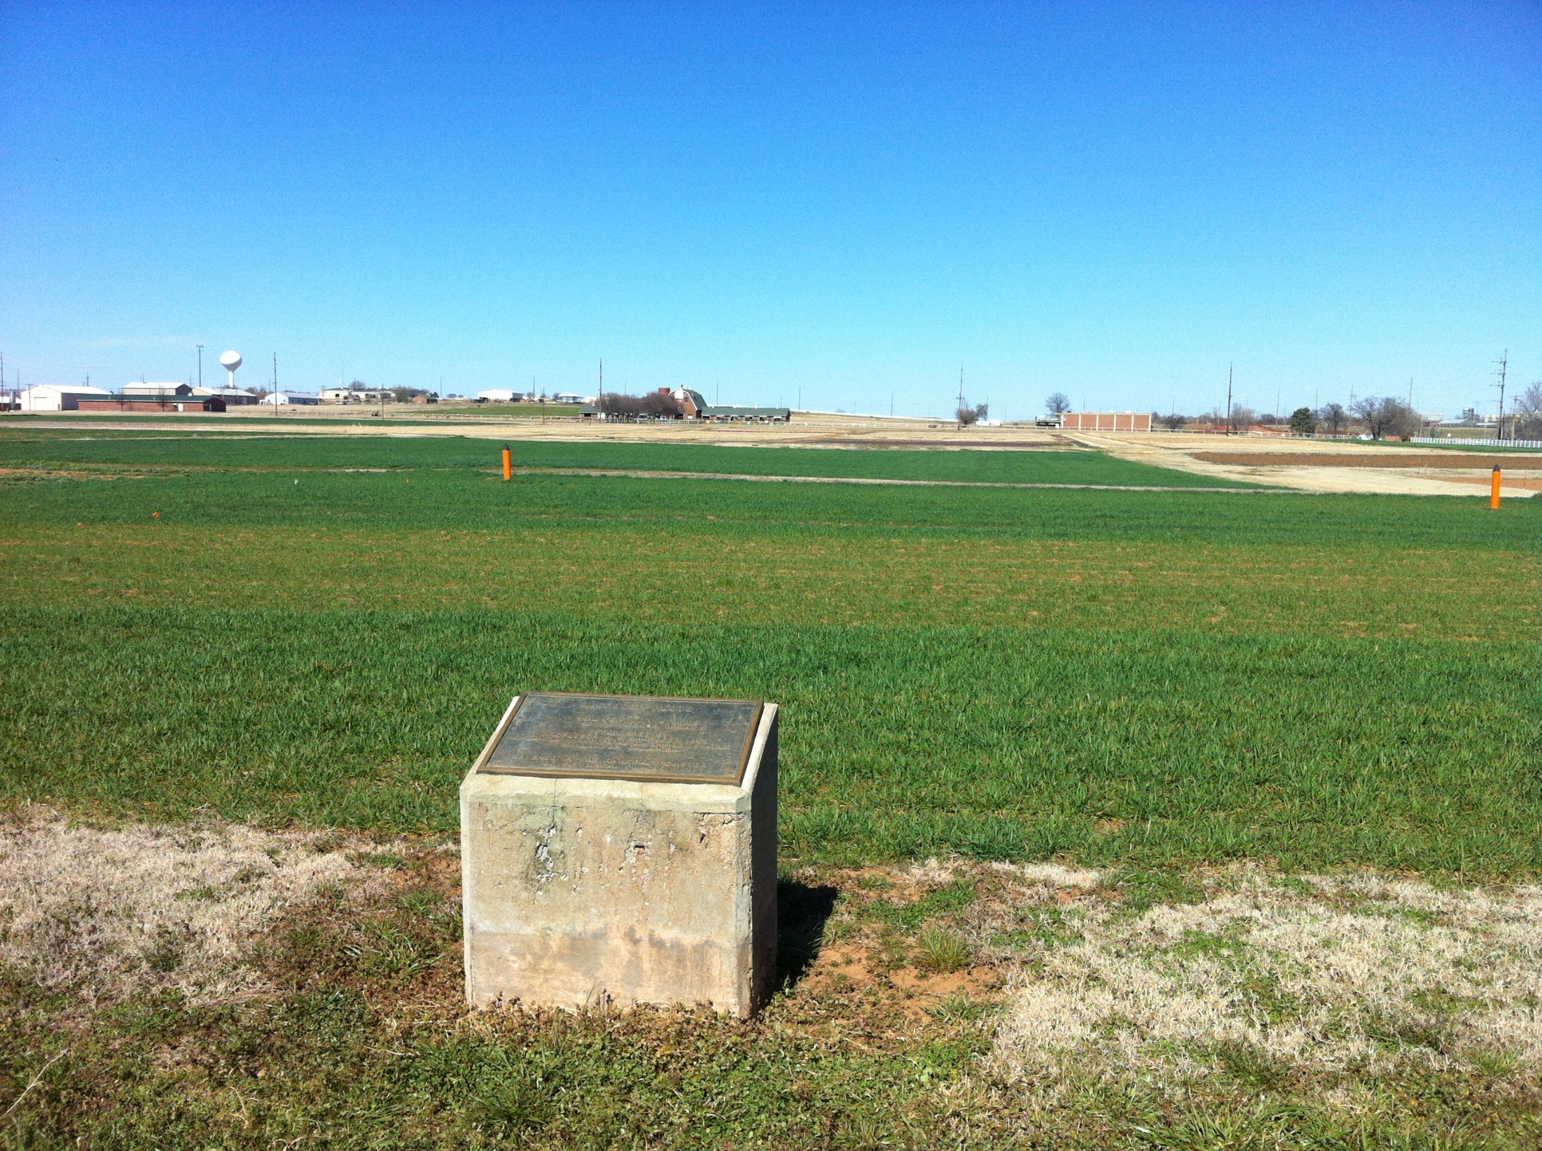

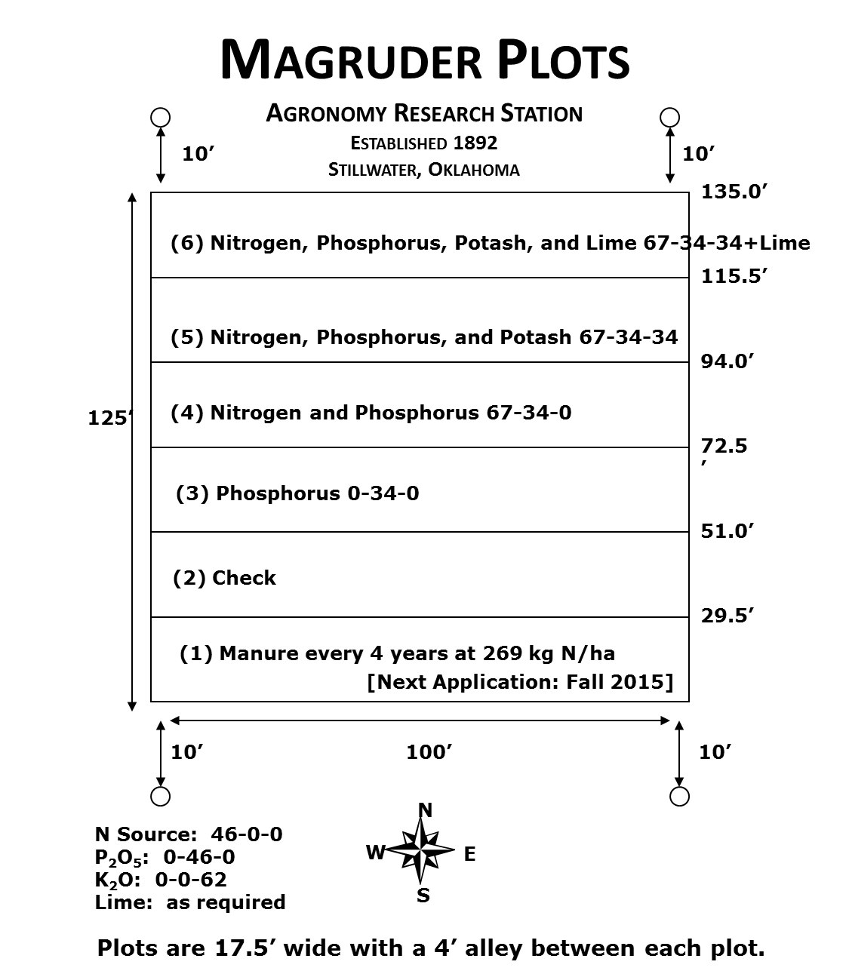
1892

Slide 6
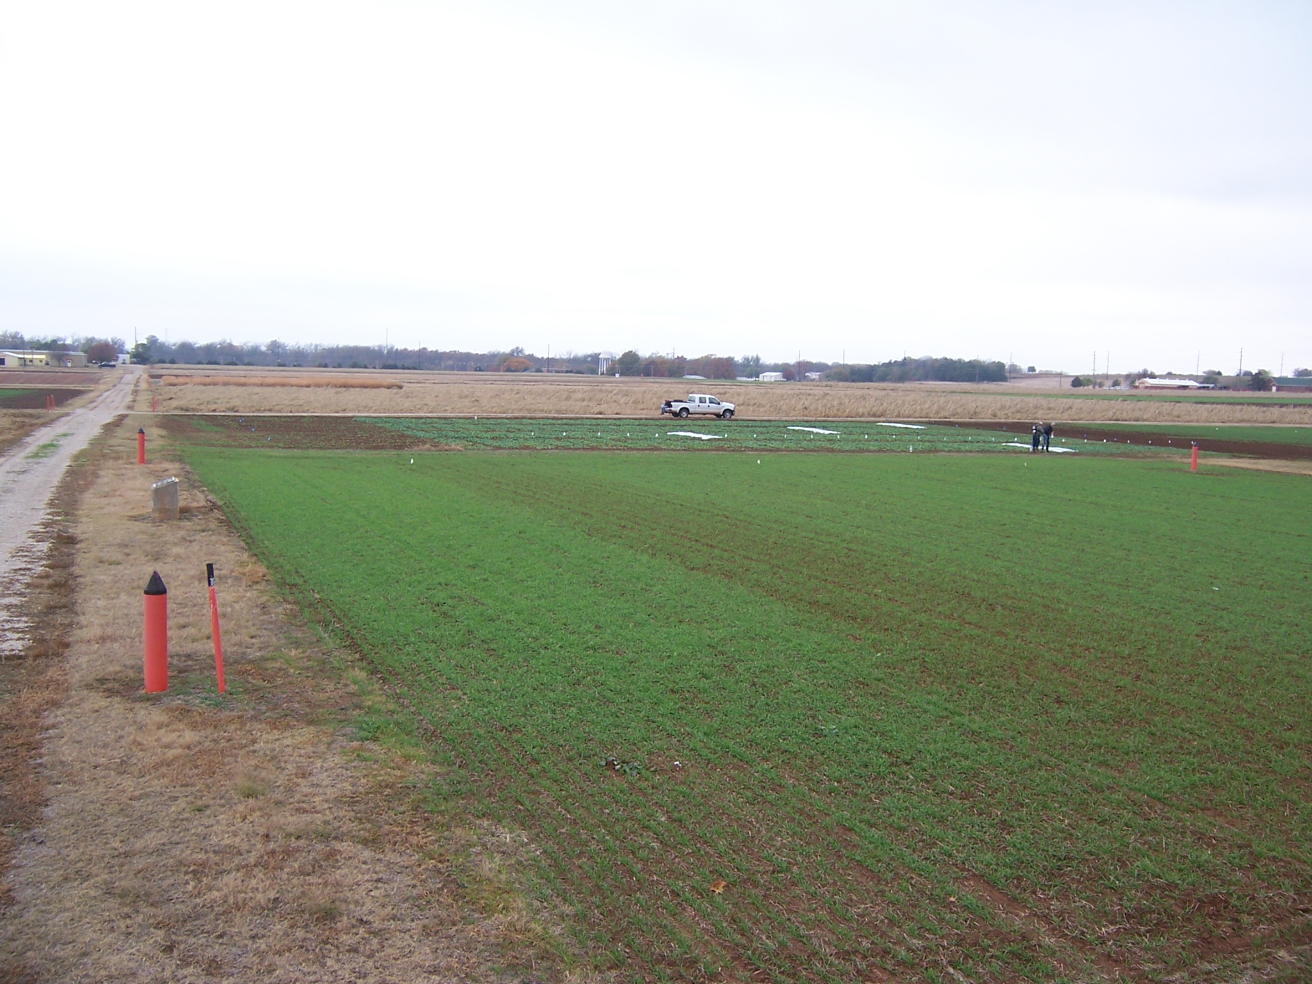
Magruder Plots
Free living cyanobacteria (blue green algae) found in the check plot.
Sun, et al., 2004. Bacterial community structure and diversity in a century-old manure-treated agroecosystem. Appl. Environ. Micro. 70:5868-5874.
1892

Slide 7
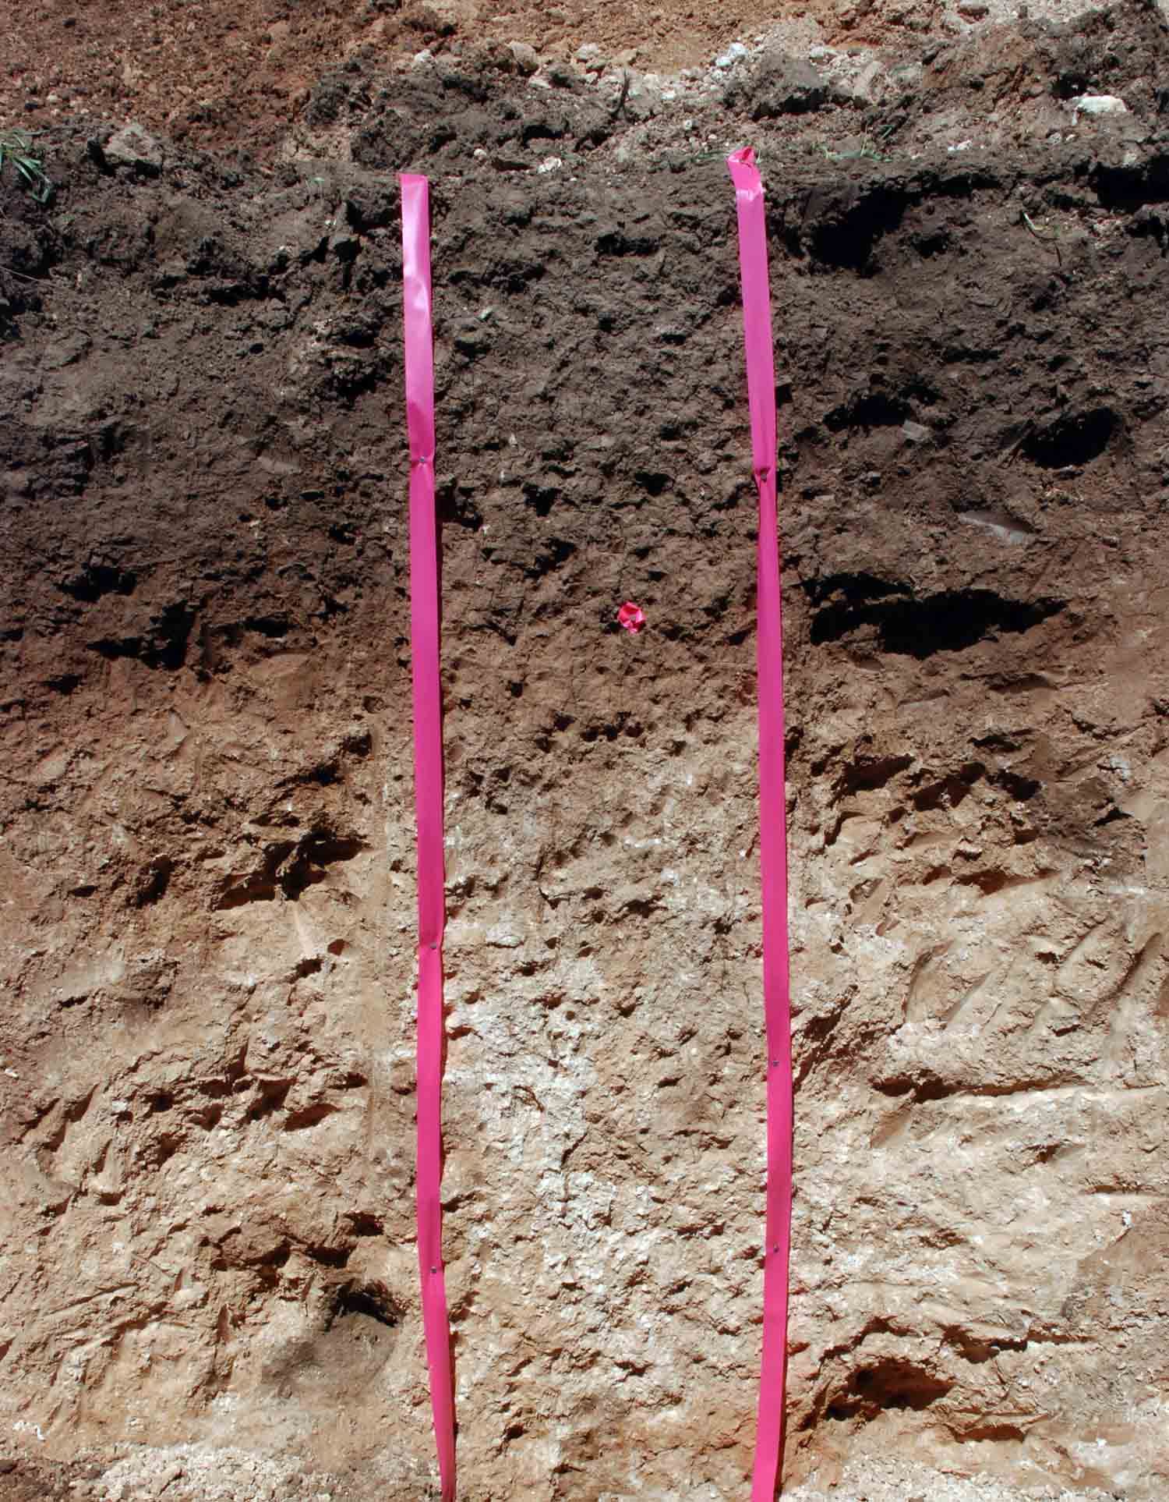
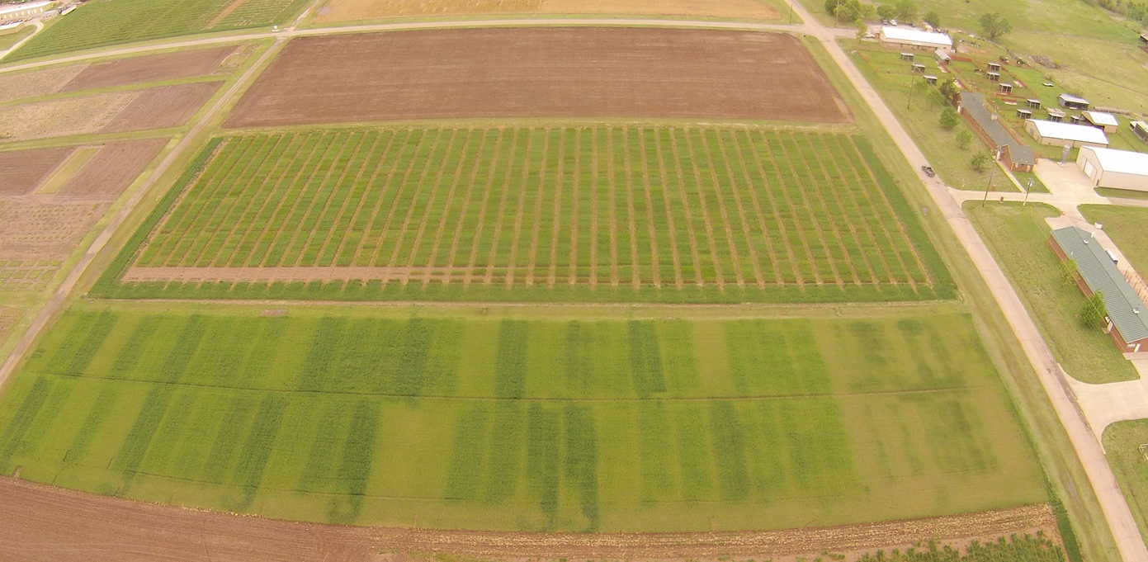
Wheat Fertility Experiment No.222
Agronomy Research Station
Established 1969
Kirkland silt loam (fine, mixed, thermic, Udertic Paleustoll
Location: Stillwater
TRT | Pre-plant N rate (lb N / ac) | Pre-plant P rate (lb P₂O₅ / ac) | Pre-plant K rate (lb K₂O / ac)
1.* | 0 | 60 | 40
2.* | 40 | 60 | 40
3.* | 80 | 60 | 40
4.* | 120 ^ | 60 | 40
5. | 80 | 0 | 40
6. | 80 | 30 | 40
7. | 80 | 90 | 40
8. | 80 | 60 | 0
9. | 80 | 60 | 80
10.* | 0 | 0 | 0
11. | 120 ^ | 90 | 80
12. | 120 ^ | 90 | 0
13. | 80 | 60 | 40 (Sul-Po-Mag)
N applied as 46-0-0 (Urea) P applied as 0-46-0 (Triple Super Phosphate) K applied as 0-0-60 (Potash) * - YP plot ^ - Split 120 lb N rates to 60 lb N (fall) and 60 lb N (spring)
Plot size: 20’ x 60’
Alley: 17’
Total Trial Area: 137’ x 520’
E
N
S
W
OBJECTIVE: To study fertilizer nitrogen, phosphorus, and potassium in winter wheat. In recent years, this study has also been used to develop yield potential models and yield predictions through sensor based technologies.
1, 2 – Harvest Sequence Number
1, 2 – Treatment Number
1 , 2 – Soil Sample Sequence Number
137 | 52 | 49 | 48 | 45 | 44 | 41 | 40 | 37 | 36 | 33 | 32 | 29 | 28 | 25 | 24 | 21 | 20 | 17 | 16 | 13 | 12 | 9 | 8 | 5 | 4 | 1
 | 13 | 13 | 8 | 5 | 7 | 3 | 2 | 11 | 12 | 6 | 9 | 1 | 10 | 4 | 6 | 2 | 11 | 5 | 3 | 8 | 12 | 10 | 9 | 1 | 7 | 4
77 | 26 | 25 | 24 | 23 | 22 | 21 | 20 | 19 | 18 | 17 | 16 | 15 | 14 | 13 | 12 | 11 | 10 | 9 | 8 | 7 | 6 | 5 | 4 | 3 | 2 | 1
 | Rep 2 | Rep 1 | Rep 2 |  |  |  |  |  |  |  |  |  |  |  | Rep 1
60 | 51 | 50 | 47 | 46 | 43 | 42 | 39 | 38 | 35 | 34 | 31 | 30 | 27 | 26 | 23 | 22 | 19 | 18 | 15 | 14 | 11 | 10 | 7 | 6 | 3 | 2
 | 13 | 13 | 8 | 10 | 7 | 12 | 9 | 5 | 2 | 11 | 1 | 3 | 4 | 6 | 3 | 11 | 1 | 8 | 6 | 9 | 12 | 2 | 5 | 10 | 4 | 7
0 | 52 | 51 | 50 | 49 | 48 | 47 | 46 | 45 | 44 | 43 | 42 | 41 | 40 | 39 | 38 | 37 | 36 | 35 | 34 | 33 | 32 | 31 | 30 | 29 | 28 | 27
 | Rep 4 | Rep 3 | 60 | 80 | 100 | 120 | 140 | 160 | 180 | 200 | 220 | 240 | 260 | 280 | 300 | 320 | 340 | 360 | 380 | 400 | 420 | 440 | 460 | 480 | 500 | 520
 |  |  | Rep 4 |  |  |  |  |  |  |  |  |  |  |  | Rep 3
1969

Slide 8
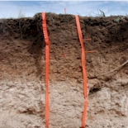
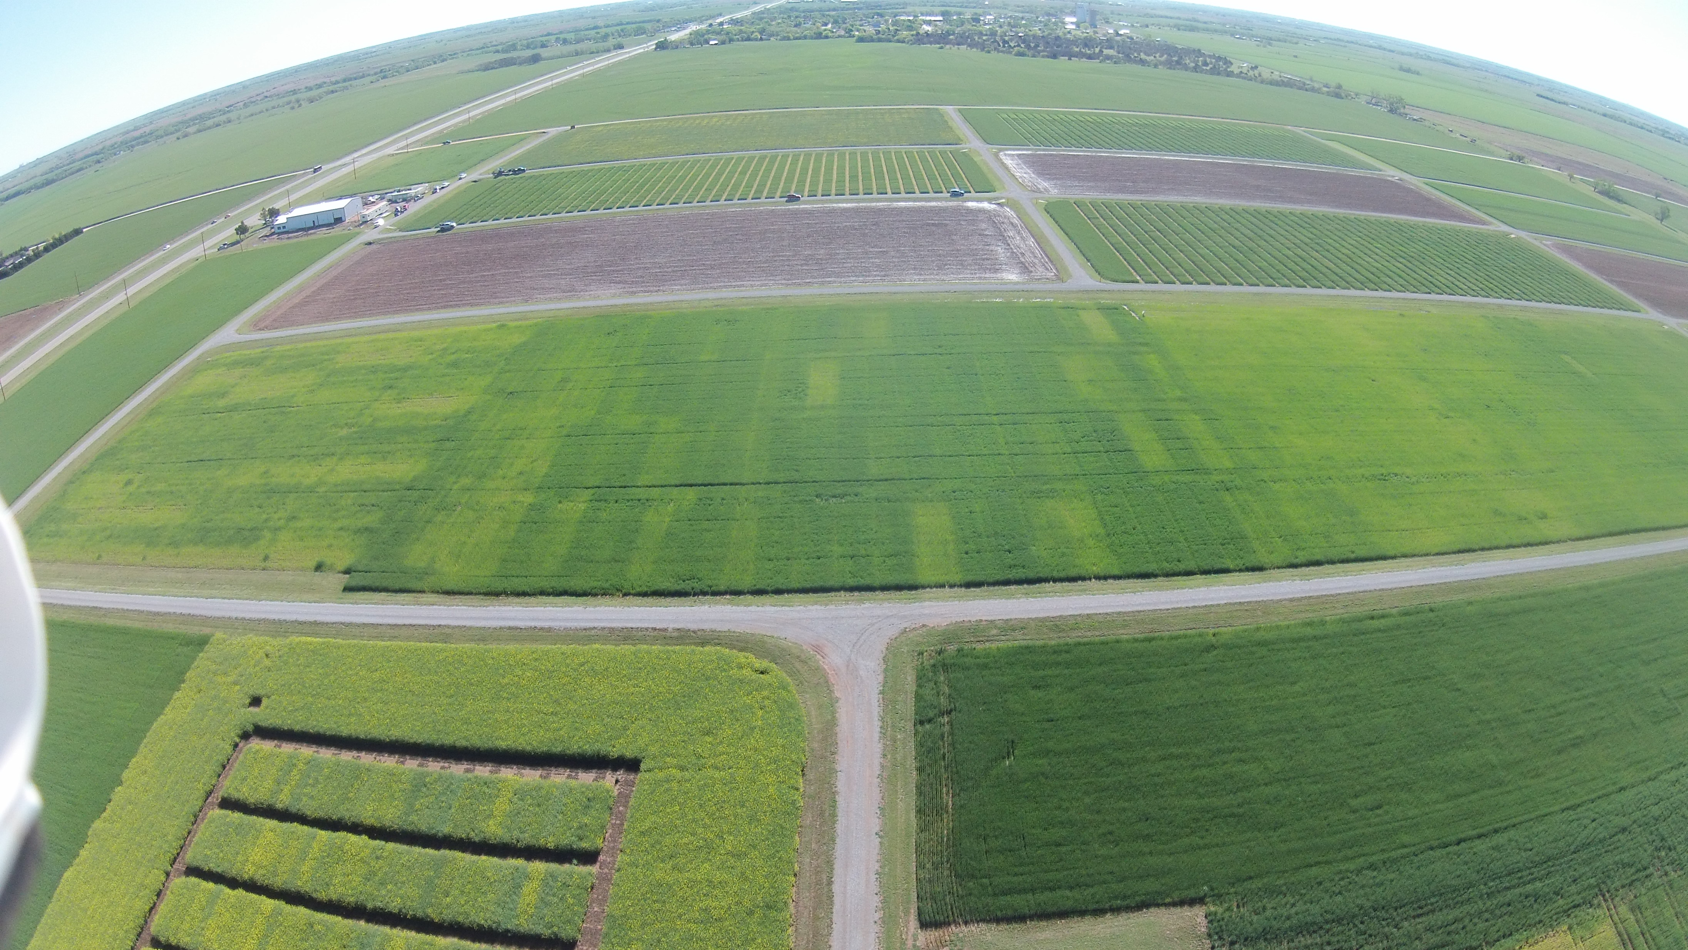
Wheat Fertility Experiment No.502
North Central Experiment Station
Established 1970
Location: Lahoma
TRT | Pre-plant N rate (lb N / ac) | Pre-plant P rate (lb P₂O₅ / ac) | Pre-plant K rate (lb K₂O / ac)
1.* | 0 | 0 | 0
2.* | 0 | 40 | 60
3.* | 20 | 40 | 60
4.* | 40 | 40 | 60
5.* | 60 | 40 | 60
6.* | 80 | 40 | 60
7.* | 100 | 40 | 60
8. | 60 | 0 | 60
9. | 60 | 20 | 60
10. | 60 | 60 | 60
11. | 60 | 80 | 60
12. | 60 | 60 | 0
13. | 100 | 80 | 60
14. | 60 | 40 | 60 (Sul-Po-Mag)
N applied as 46-0-0 (Urea) P applied as 0-46-0 (Triple Super Phosphate) K applied as 0-0-60 (Potash) * - YP plot
Grant silt loam (fine-silty, mixed, superactive, thermic, Udic Argiustoll
Plot size: 16’ x 60’
Alley: 20’
Total Trial Area: 224’ x 300’
W
S
N
E
OBJECTIVE: To study fertilizer nitrogen, phosphorus, and potassium in winter wheat. In recent years, this study has also been used to develop yield potential models and yield predictions through sensor based technologies.
1, 2 – Harvest Sequence Number
1, 2 – Treatment Number
1 , 2 – Soil Sample Sequence Number
 | 300 | 4 | 5 | 12 | 13 | 20 | 21 | 28 | 29 | 36 | 37 | 44 | 45 | 52 | 53
Rep 4 |  | 3 | 5 | 13 | 6 | 10 | 2 | 4 | 7 | 12 | 1 | 8 | 14 | 9 | 11
 | 240 | 43 | 44 | 45 | 46 | 47 | 48 | 49 | 50 | 51 | 52 | 53 | 54 | 55 | 56
 | 220 | 3 | 6 | 11 | 14 | 19 | 22 | 27 | 30 | 35 | 38 | 43 | 46 | 51 | 54
Rep 3 |  | 1 | 14 | 2 | 7 | 11 | 3 | 9 | 12 | 5 | 13 | 4 | 8 | 10 | 6
 | 160 | 29 | 30 | 31 | 32 | 33 | 34 | 35 | 36 | 37 | 38 | 39 | 40 | 41 | 42
 | 140 | 2 | 7 | 10 | 15 | 18 | 23 | 26 | 31 | 34 | 39 | 42 | 47 | 50 | 55
Rep 2 |  | 4 | 8 | 3 | 1 | 11 | 13 | 12 | 7 | 14 | 6 | 9 | 10 | 2 | 5
 | 80 | 15 | 16 | 17 | 18 | 19 | 20 | 21 | 22 | 23 | 24 | 25 | 26 | 27 | 28
 | 60 | 1 | 8 | 9 | 16 | 17 | 24 | 25 | 32 | 33 | 40 | 41 | 48 | 49 | 56
Rep 1 |  | 8 | 2 | 4 | 6 | 14 | 9 | 10 | 5 | 7 | 12 | 1 | 3 | 13 | 11
 |  | 1 | 2 | 3 | 4 | 5 | 6 | 7 | 8 | 9 | 10 | 11 | 12 | 13 | 14
 | 0 | 16 | 32 | 48 | 64 | 80 | 96 | 112 | 128 | 144 | 160 | 176 | 192 | 208 | 224
1970

Slide 9
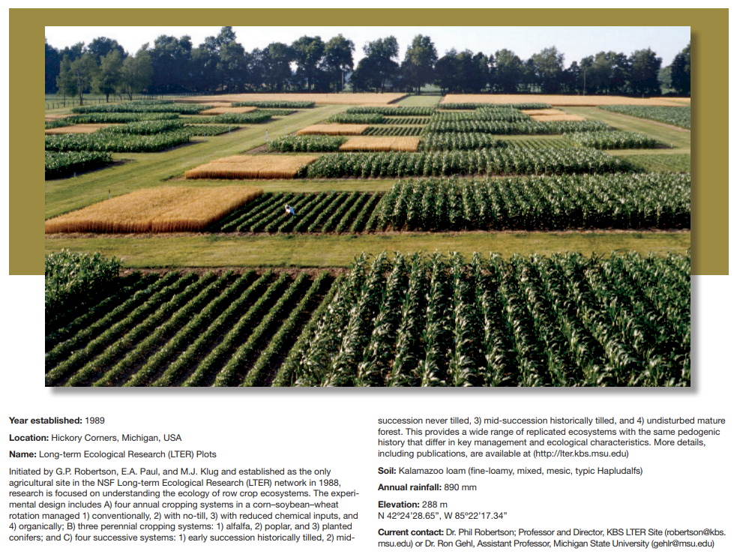

1962

Slide 10
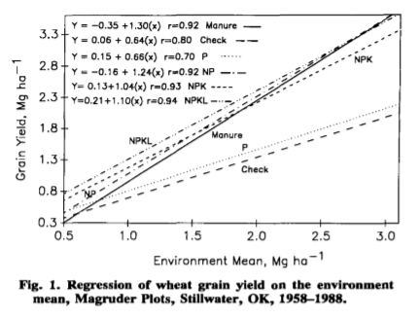
Raun, W. R., H. J. Barreto, and R. L. Westerman. 1993. Use of stability analysis for long-term soil fertility experiments. Agron. J. 85:159-167.
Benefit of K fertilization in stress years
1988, Stability Analysis

Slide 11
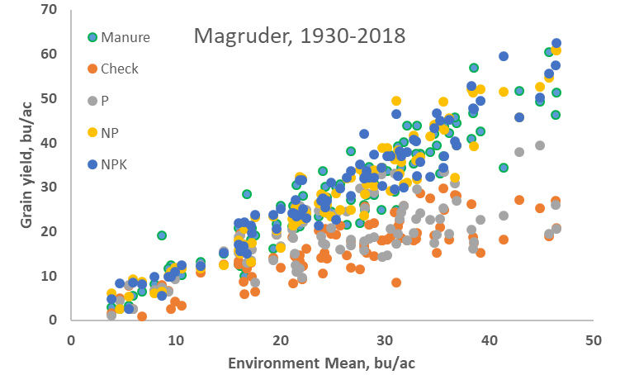
Stability Analysis

Slide 12
Yield Goals
Average of the last 3 or 5 years + 20% versus observed yield

Slide 13
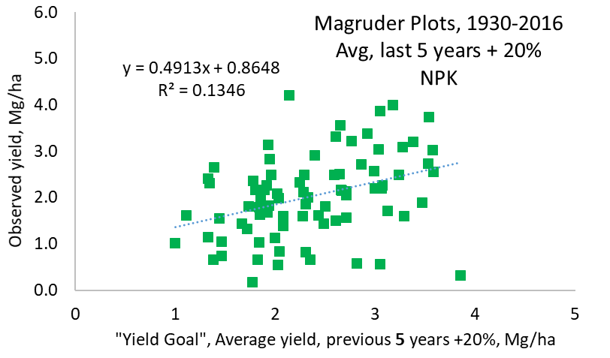
Value of yield goals

Slide 14
Linear relationship between avg. yield for the previous 3, 4, and 5 yr (yield goal or YG), versus grain yield for the next year
Location Treatment, Linear Years to r² Root MSE n Yield goal error,
N-P-K, kg ha⁻¹ Equation Estimate YG Mg ha⁻¹
Magruder 0-0-0 y=0.76+0.24x 3 0.03 0.456 84 0.46
Magruder 0-0-0 y=0.77+0.23x 4 0.03 0.459 83 0.45
Magruder 0-0-0 y=0.821+0.20x 5 0.02 0.464 82 0.45
Magruder 67-14.6-28.8 y=0.90+0.47x 3 0.16 0.659 84 0.75
Magruder 67-14.6-28.8 y=0.89+0.48x 4 0.14 0.826 83 0.73
Magruder 67-14.6-28.8 y=0.86+0.49x 5 0.13 0.834 82 0.72
Exp. 222 0-29-37 y=0.82+0.29x 3 0.05 0.647 42 0.58
Exp. 222 0-29-37 y=0.58+0.46x 4 0.09 0.637 41 0.52
Exp. 222 0-29-37 y=0.71+0.33x 5 0.06 0.553 40 0.50
Exp. 222 135-29-37 y=2.07-0.02x 3 <0.01 0.899 42 0.93
Exp. 222 135-29-37 y=2.05-0.01x 4 <0.01 0.957 41 0.85
Exp. 222 135-29-37 y=2.19-0.09x 5 <0.01 0.941 40 0.84
Exp. 502 0-20-55 y=1.45+0.14x 3 0.01 0.524 42 0.55
Exp. 502 0-22-55 y=1.21+0.26x 4 0.03 0.526 41 0.55
Exp. 502 0-20-55 y=1.13+0.30x 5 0.03 0.531 40 0.55
Exp. 502 112-20-55 y=3.70-0.16x 3 0.02 1.024 42 1.08
Exp. 502 112-20-55 y=2.72+0.10x 4 0.01 1.042 41 1.03
Exp. 502 112-20-55 y=1.78+0.36x 5 0.04 1.037 40 0.97
Yield averages for the prior 3, 4, and/or 5 yr were not correlated with ensuing season yields (all trials)
Yield goal estimates were off by up to 3.69 Mg ha^{–1} (51 bu/ac)
Yield goals faill due to the unpredictable influence of environment.
Mid-season prediction of yield potential (NDVI) can improved in-season cereal fertilizer N recommendations.
Raun, W.R., B. Figueiredo, J. Dhillon, J.T. Bushong, R.K. Taylor, H. Zhang, A. Fornah. 2017. Can yield goals be predicted? Agron. J. 109(5) DOI: 10.2134/agronj2017.05.0279

Slide 15
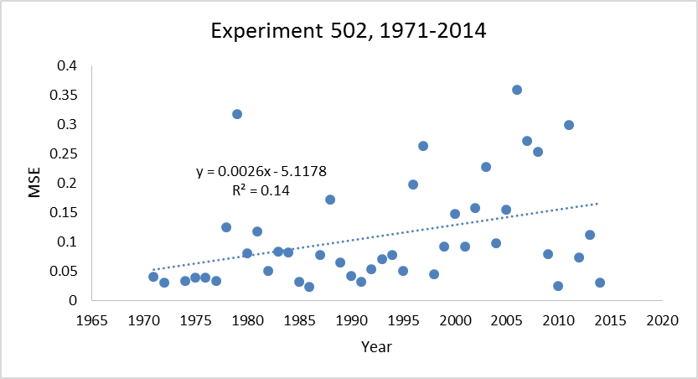
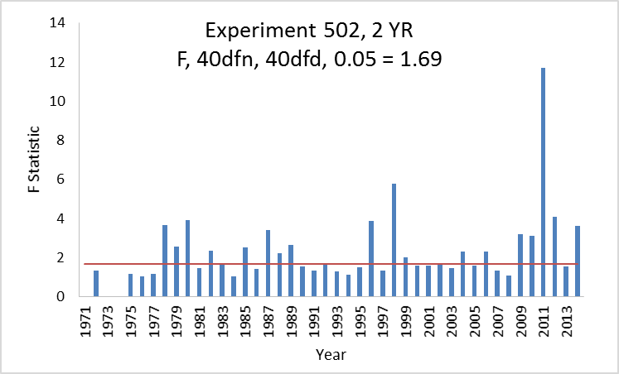
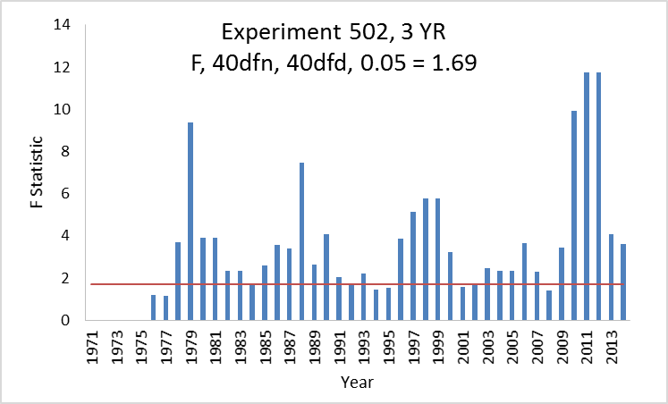
SOIL 5112
Student Paper
spring 2015
Relationship between Mean Square Errors and Wheat Grain Yields in Long-Term Experiments. J. Plant Nutr. doi:10.1080/01904167.2016.1257638.

Slide 16
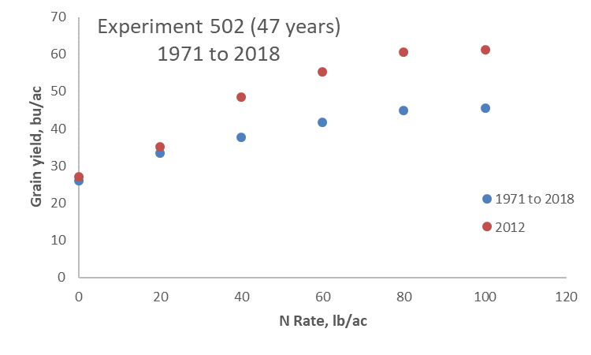
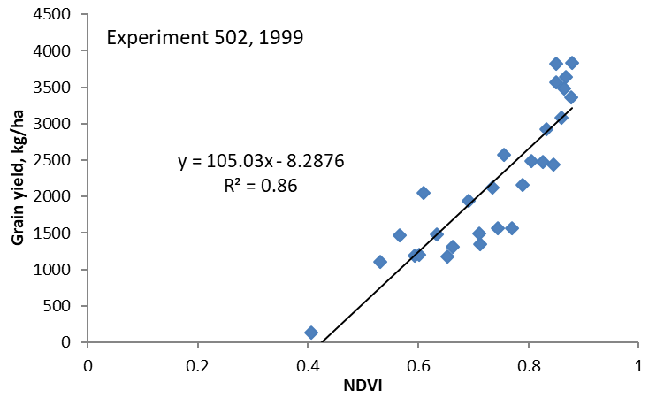
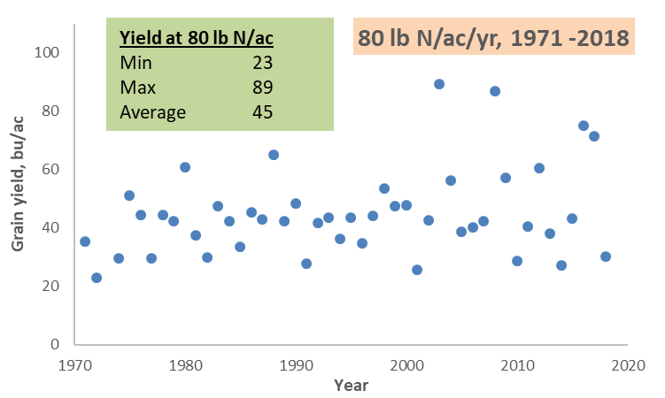
Experiment 502, 1970-2018

Slide 17
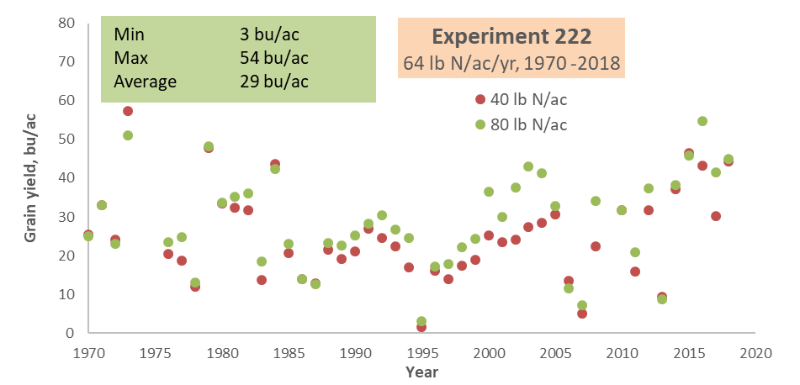
Experiment 222 1969-2018
Averages inappropriate
for predictive tools

Slide 18
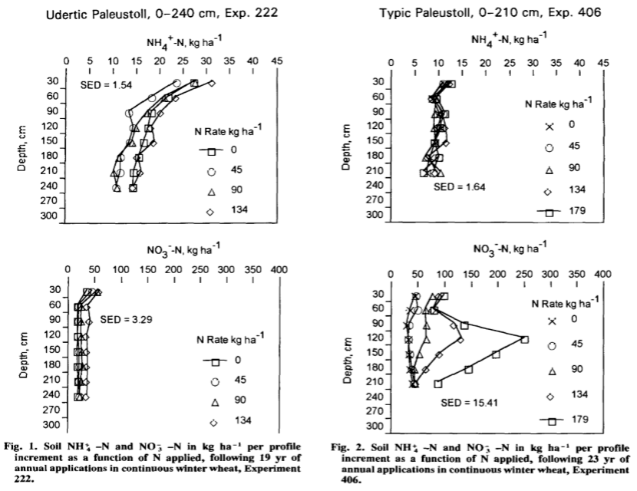
Westerman, R.L, R.K. Boman, W.R. Raun and G.V. Johnson. 1994. Ammonium and nitrate nitrogen in soil profiles of long-term winter wheat fertilization experiments. Agron. J. 86:94-99.

Slide 19
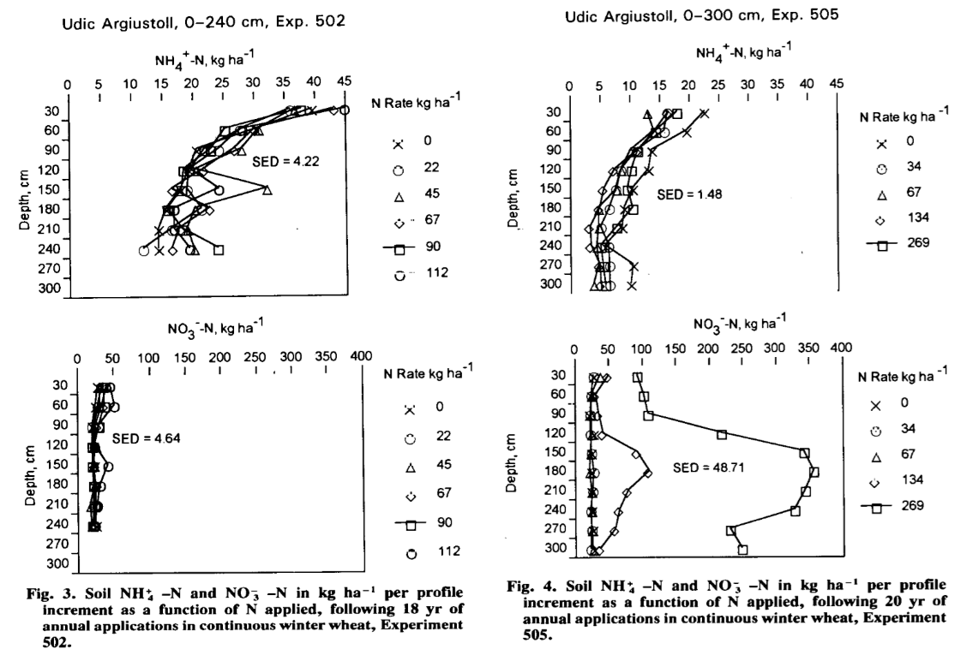
Westerman, R.L, R.K. Boman, W.R. Raun and G.V. Johnson. 1994. Ammonium and nitrate nitrogen in soil profiles of long-term winter wheat fertilization experiments. Agron. J. 86:94-99.

Slide 20
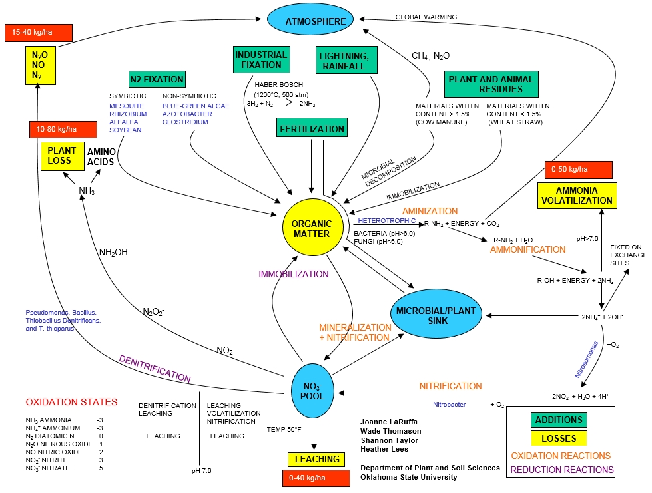

Slide 21
Raun, W. R., H. J. Barreto, and R. L. Westerman. 1993. Use of stability analysis for long-term soil fertility experiments. Agron. J. 85:159-167.
Guertal, E.A., W.R. Raun, R.L. Westerman and R.K. Boman. 1994. Applications of stability analysis for single-site, long-term experiments. Agron. J. 86:1016-1019.
Raun, W.R., and G.V. Johnson. 1995. Soil-plant buffering of inorganic nitrogen in continuous winter wheat. Agron. J. 87:827-834.
Stone, M.L., J.B. Solie, W.R. Raun, R.W. Whitney, S.L. Taylor and J.D. Ringer. 1996. Use of spectral radiance for correcting in-season fertilizer nitrogen deficiencies in winter wheat. Trans. ASAE 39(5):1623-1631.
Raun, W.R., G.V. Johnson, S.B. Phillips and R.L. Westerman. 1998. Effect of long-term nitrogen fertilization on soil organic C and total N in continuous wheat under conventional tillage in Oklahoma. Soil & Tillage Res. 47:323-330.
Raun, W.R., G.V. Johnson, H. Sembiring, E.V. Lukina, J.M. LaRuffa, W.E. Thomason, S.B. Phillips, J.B. Solie, M.L. Stone and R.W. Whitney. 1998. Indirect measures of plant nutrients. Commun. In Soil Sci. Plant Anal. 29:1571-1581.
Raun, W.R., G.V. Johnson, and R.L. Westerman. 1999. Fertilizer nitrogen recovery in long-term continuous winter wheat. Soil Sci. Soc. Am. J. 63:645-650.
Lees, H.L., W.R. Raun and G.V. Johnson. 2000. Increased plant N loss with increasing nitrogen applied in winter wheat observed with ¹⁵N. J. Plant Nutr. 23:219-230. (up to 42 Kg N/ha)
Thomason, W.E., W.R. Raun and G.V. Johnson. 2000. Winter wheat fertilizer nitrogen use efficiency in grain and forage production systems. J. Plant Nutr. 23:1505-1516. (82 versus 30)
NH₄ and NO₃ accumulation
Increase in soil organic C with Applied N
Plant N loss as NH₃ (42 kg N/ha)
NUE, (33%)
Grain versus forage production
(30 vs. 82%)
Predicting yields and yield goals, NDVI, Greenseeker

Slide 22
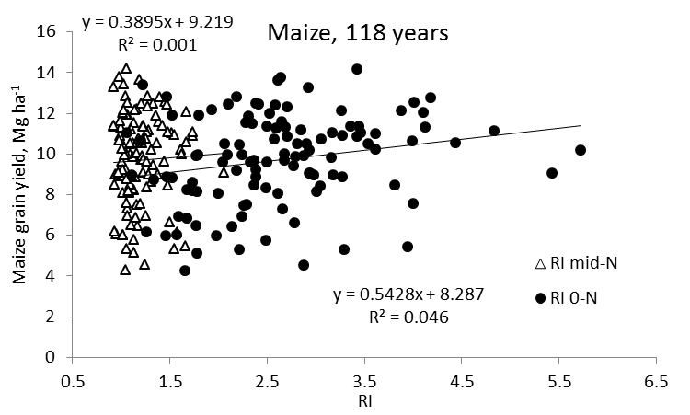
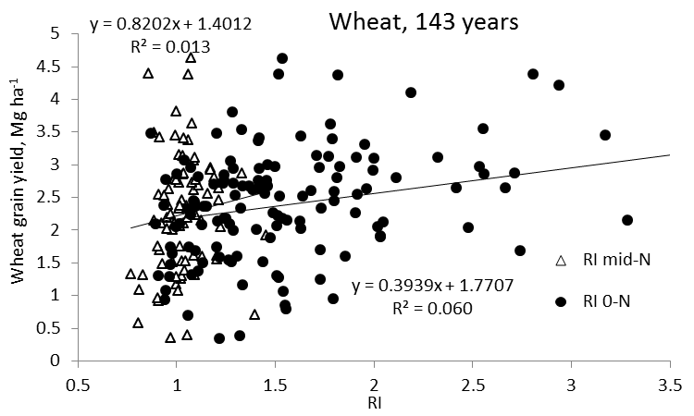
Independence of Yield potential and Nitrogen response
Iowa
Nebraska
Wisconsin
Oklahoma
2011. Independence of yield potential and crop nitrogen response. Precision Agric. 12:508-518.
2013. Relationship between grain crop yield potential and nitrogen response. Agron. J. 105:1335–1344.

Slide 23
Dr. Westerman
Value of the Long Term Experiments UNL
Independence of Biological Processes in Agriculture
Biodiversity and randomness will increase.
More and more processes found to be independent.
Each year, residual N in the soil following crop harvest is different
Yield levels change radically from year to year, a product of an ever changing and unpredictable/random environment
Contribution of residual soil N for next years’ growing crop, randomly influences N response or the response index (RI)
2nd law of thermodynamics total entropy or orderliness increases with time and is irreversible
Biological systems are expected to become more and more random with time.
Unpredictable nature that environment has on N demand, and the unpredictable nature that environment has on final grain yield, dictate the need for independent estimation of multiple random variables

Slide 24
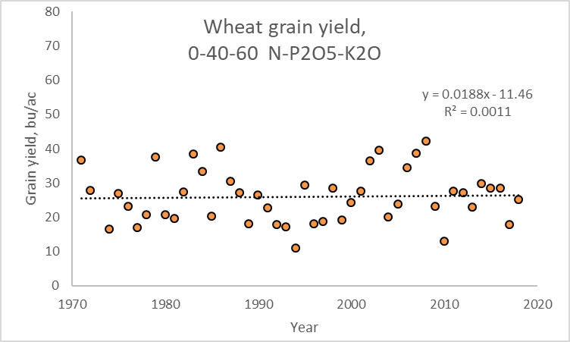
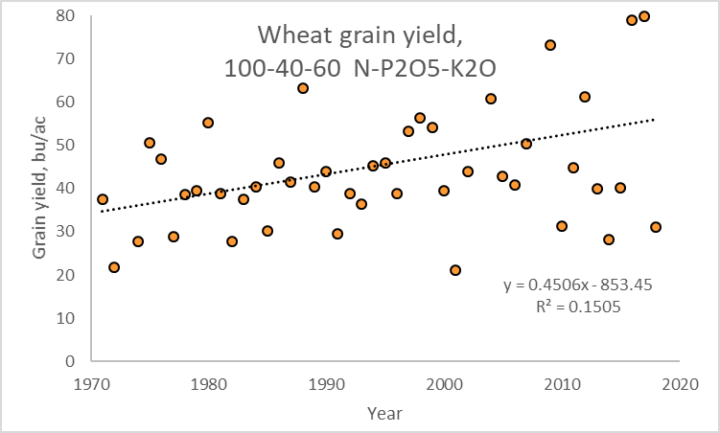

Varieties (14), Lahoma 502
Years Variety
1971-1974 Nicoma
1975-1976 Triumph 64
1977 Osage
1978 Trimph 64
1979-1992 TAM W-101
1993-1994 Karl
1995-1999 Tonkawa
2000-2004 Custer
2005-2008 Overley
2009 Endurance
2010-2011 Bullet
2012-2013 Billings
2014 Ruby Lee
2015-2017 Iba
2018 Bentley
CIMMYT
Selection Environment
N Rich Strip, 2X Strip

Slide 25
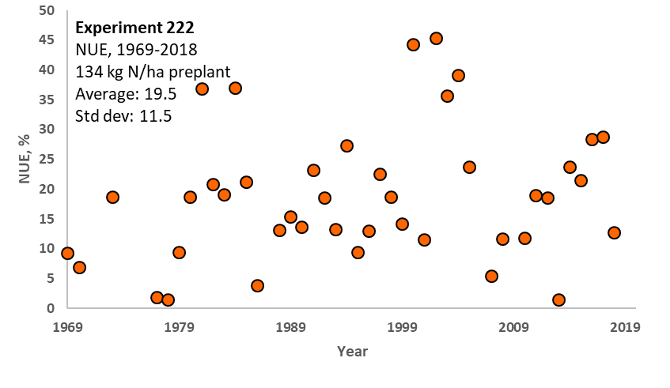
NUE
Exp. 222,1969-2015
(N uptake treated - N uptake check)/N rate
(#4 and #1) 120-60-40 0-60-40 (N-P2O5-K2O)

Slide 26
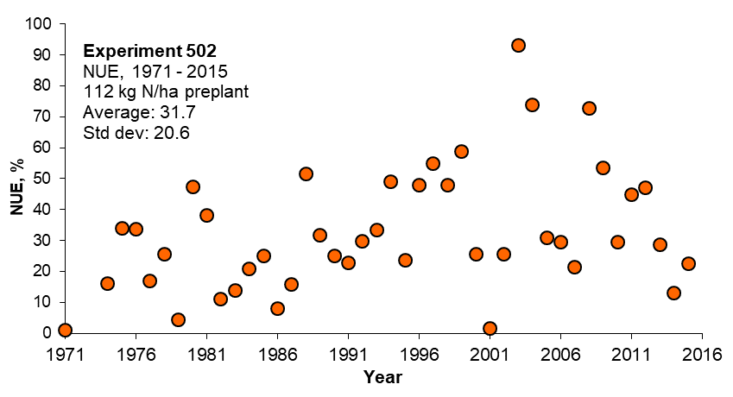
NUE
Exp. 502,1971-2015
(N uptake treated - N uptake check)/N rate
(#7 and #2) 100-40-60 and 0-40-60 (N-P2O5-K2O)

Slide 27
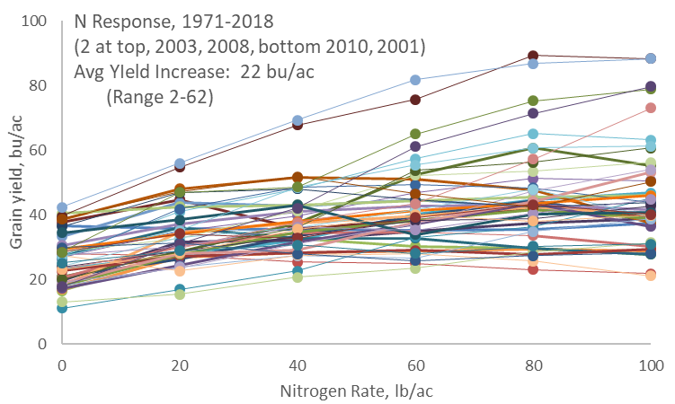
Nitrogen Response from Year to Year is Random

Slide 28
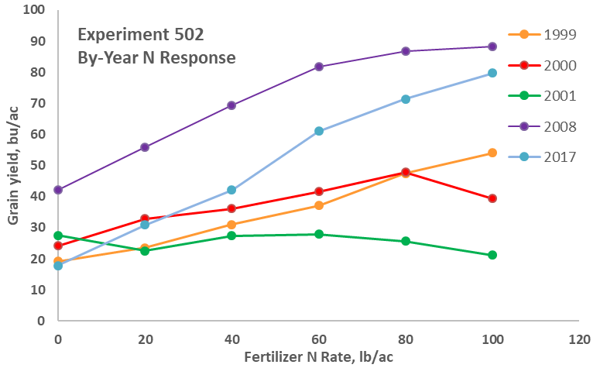
SBNRC, Inclusion of SOIL MOISTURE at Sensing

Slide 29
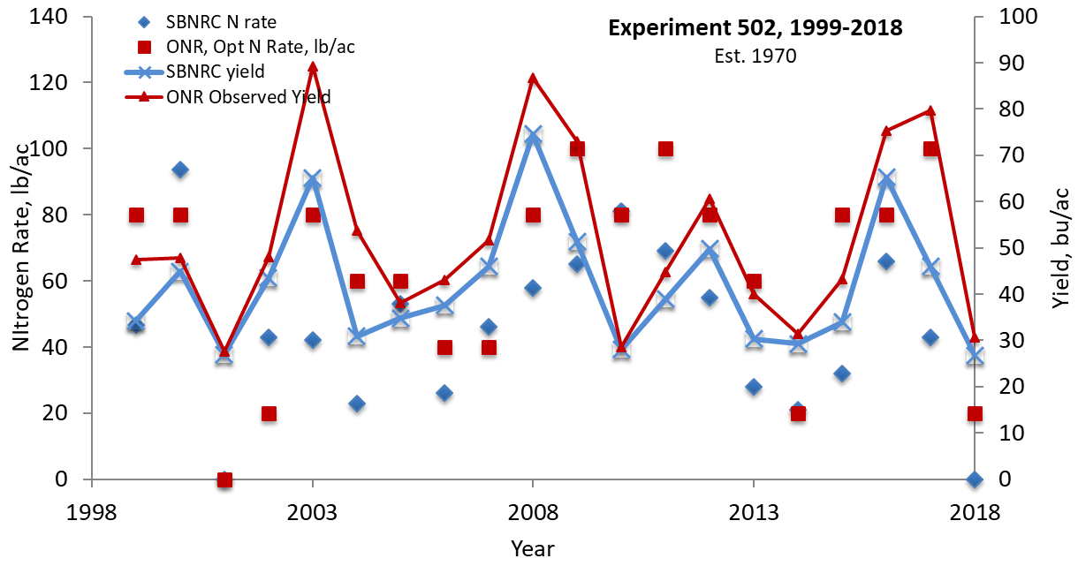
REVENUE: When there was very limited response to fertilizer N, the SBNRC did very well. Why? NDVI readings early, when there are limited differences, are incredibly valuable. When you cannot see the N rich strip early, these are the years where applying added fertilizer N do not pay. If the readings show up early, using the calculator is OFF??
When the RI was below 2, the SBNRC did well

Slide 30

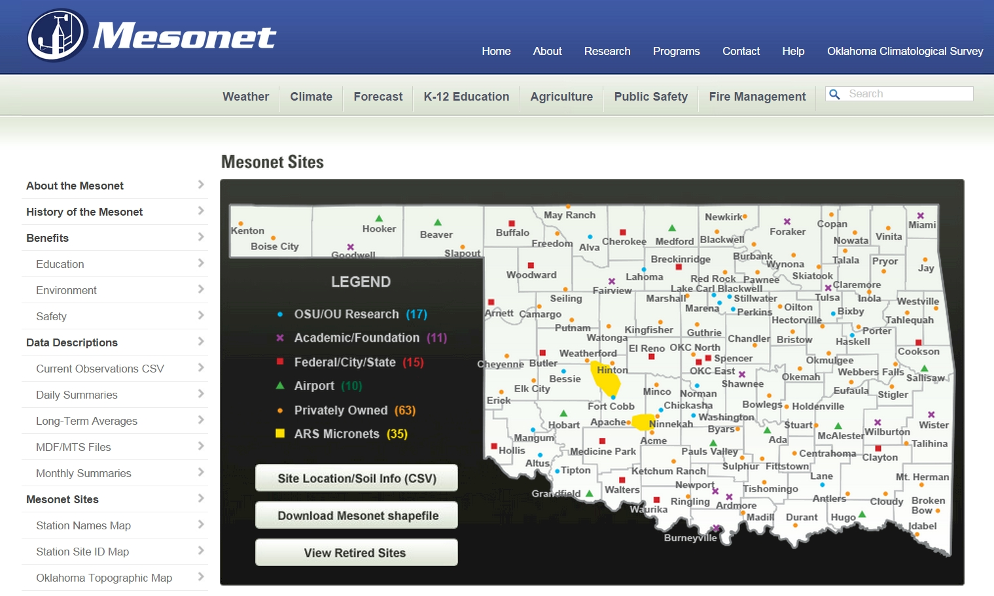

www.nue.okstate.edu
120 Automated Stations, in 77 counties

Slide 31
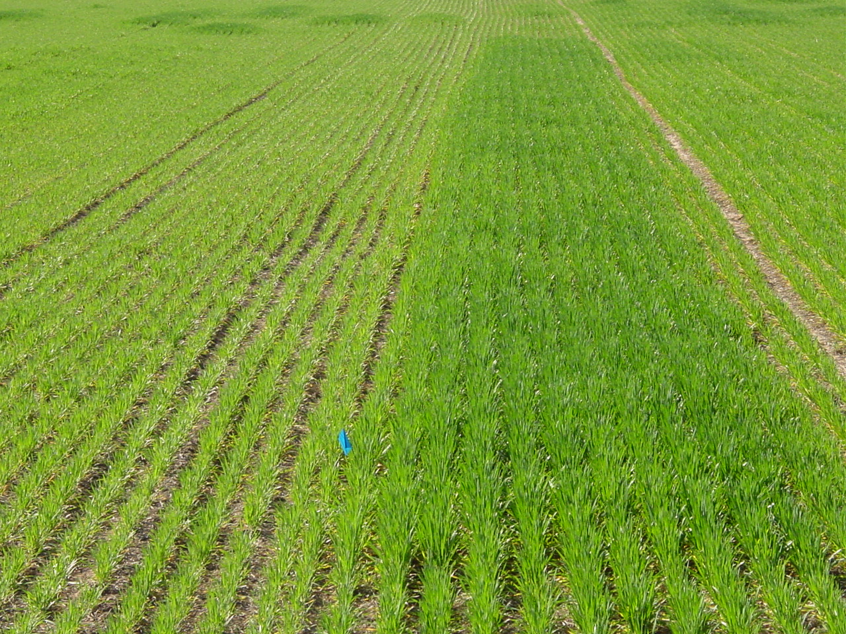

Chim, Bee Khim, Peter Omara, Jeremiah Mullock, Sulochana Dhital, Natasha Macnack, and William Raun. 2014. Effect of seed distribution and population on maize (Zea mays L.) grain yield. Int. J. Agronomy. V2014. http://dx.doi.org/10.1155/2014/125258.
Ortiz-Monasterio, J.I., and W. Raun. 2007. Reduced nitrogen for improved farm income for irrigated spring wheat in the Yaqui Valley, Mexico, using sensor based nitrogen management. J. of Agric. Sci. 145:215-222.

Slide 32
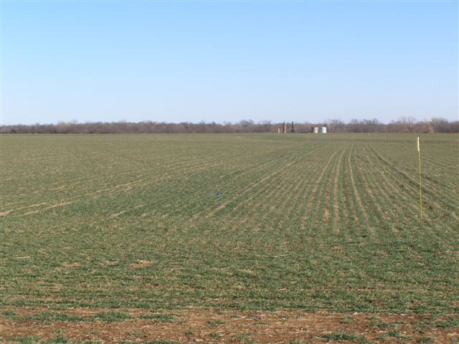
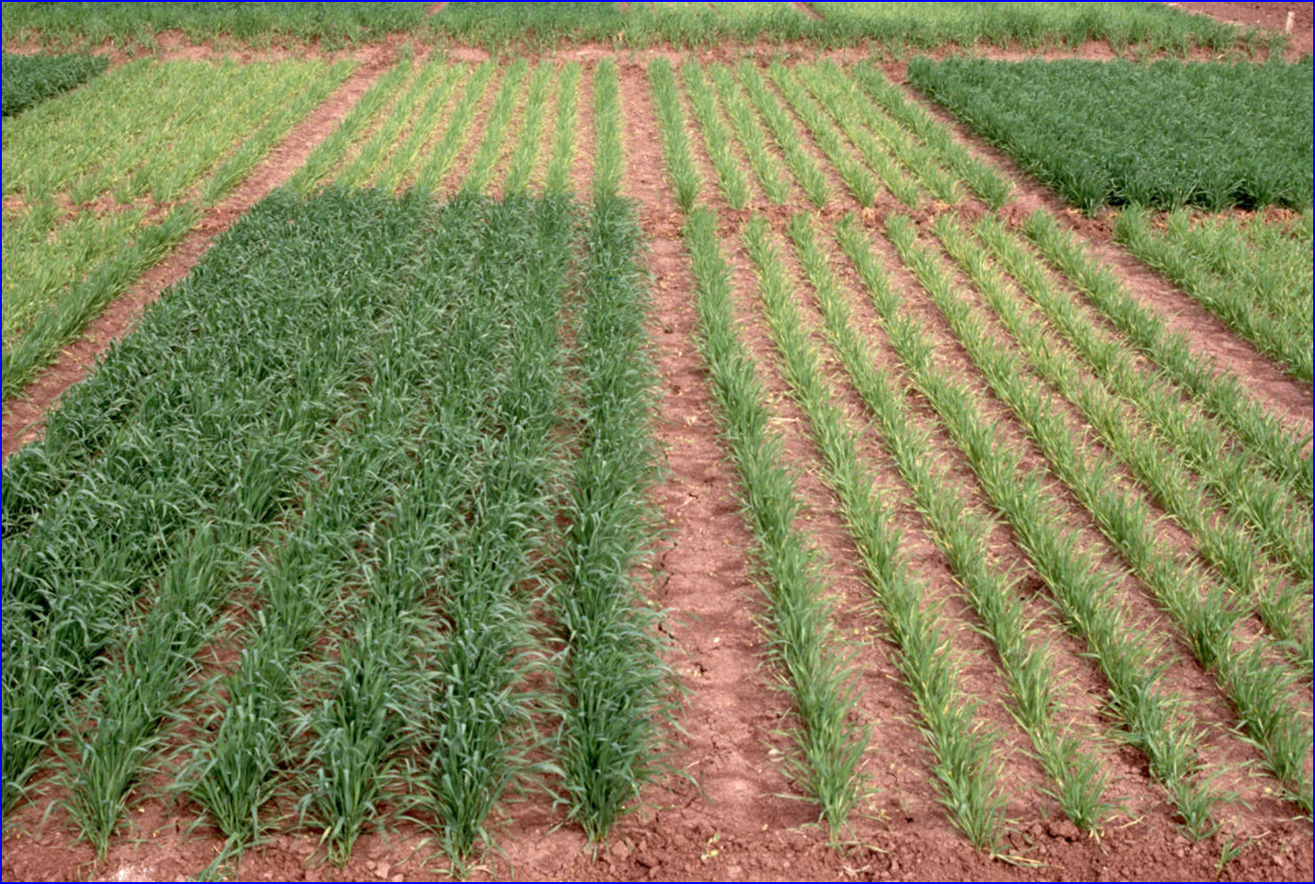
Estimate of Plant Stand Homogeneity

Slide 33
Dhital, Sulochana. 2015. Do nitrogen rates change every year. Precision Agric.
Source | Location | Years | Years | High N Yield Range | Check plot Yield Range | Optimum N rate
 |  |  |  | Mg ha⁻¹ | Mg ha⁻¹ | Min | Max | Avg.
Bundy et al. (2011) | Wisconsin | 21 | 1958-1983 | 4.3-8.8 | 1.57-7.59 | 46 | 213 | 119
Bundy et al. (2011) | Wisconsin | 24 | 1984-2007 | 5.7-14.1 | 1.67-5.58 | 143 | 334 | 238
Mallarino and Torres (2006) | Iowa | 32 | 1979-2010 | 5.1-12.5 | 0.75-5.91 | 75 | 314 | 193
Mallarino and Torres (2006) | Iowa | 26 | 1985-2010 | 5.3-12.8 | 1.4-6.3 | 123 | 332 | 214
Varvel et al. (2007) | Nebraska | 11 | 1995-2005 | 10.4-13.6 | 3.5-10.9 | 67 | 280 | 191
Jokela et al.(1989) Carroll | Minnesota | 3 | 1982-1984 | 7.1-9.1 | 5-7.3 | 5 | 120 | 77
Jokela et al.(1989) Webster | Minnesota | 3 | 1982-1984 | 1.8-8.7 | 1.7-5.6 | 64 | 103 | 84
Fenster et al. (1976) Waseca | Minnesota | 7 | 1970-1976 | 7.12-10.65 | 2.71-7.43 | 55 | 227 | 140
Fenster et al. (1976) Martin | Minnesota | 7 | 1970-1976 | 4-9.6 | 3.8-8.2 | 21 | 116 | 62
Fenster et al. (1976) Martin | Minnesota | 6 | 1971-1976 | 6.2-12 | 6.2-11.3 | 0 | 34 | 15
Al Kaisi et al.(2003) | Colorado | 3 | 1998-2000 | 5-14.1 | 3.53-12.57 | 24 | 126 | 84
Ismail et al.(1994) NT | Kentucky | 20 | 1998-2000 | 5.2-10.9 | 2.1-7.4 | 32 | 211 | 117
Ismail et al.(1994) CT | Kentucky | 20 | 1970-1990 | 3.5-10.4 | 1.9-9.5 | 0 | 186 | 90
Rice et al.(1986) NT | Kentucky | 16 | 1970-1985 | 5.7-9.2 | 3.1-4.9 | 93 | 163 | 132
Rice et al.(1986) CT | Kentucky | 16 | 1970-1985 | 5-8.8 | 1.9-6.1 | 63 | 187 | 114
Stecker et al.(1993) | Missouri | 3 | 1988-1990 | 6.04-10.13 | 3.32-5.59 | 91 | 178 | 140
Stecker et al.(1993) | Missouri | 3 | 1988-1990 | 6.7-9.9 | 4.54-7.2 | 42 | 167 | 94
Stecker et al.(1993) | Missouri | 2 | 1989-1990 | 8.2-8.5 | 4.95-5.98 | 82 | 108 | 95
Peterson et al.(1989) | Nebraska | 4 | 1983-1986 | 3.9-10 | 2.1-6.4 | 10 | 200 | 96
Woodruff et al.(1983) | South Car. | 3 | 1974-1976 | 13-20.2 | 1.04-15.6 | 0 | 639 | 302
Eck (1982) | Texas | 3 | 1977-1979 | 3.41-13.21 | 1.79-5.03 | 13 | 300 | 146
Shapiro et al.(2006) RS 51cm | Nebraska | 3 | 1996-1998 | 9.4-11.14 | 6.24-8.93 | 64 | 88 | 76
Shapiro et al.(2006) RS76cm | Nebraska | 3 | 1996-1998 | 7.12-11.04 | 5.02-8.88 | 12 | 105 | 69
Meisinger et al. (1985) MT | Maryland | 4 | 1974-1977 | 5.8-8.2 | 1.8-2.6 | 117 | 213 | 168
Meisinger et al. (1985) MT | Maryland | 4 | 1974-1977 | 5.1-8.1 | 2.7-4.2 | 33 | 180 | 130
Gehl et al.(2005) Ellinwood | Kansas | 4 | 2001-2002 | 9-11.9 | 2.7-7.2 | 147 | 307 | 220
Gehl et al.(2005) Rossville | Kansas | 2 | 2001-2002 | 11.3-12.6 | 6.4-7.9 | 167 | 187 | 177
Gehl et al.(2005) scandia | Kansas | 2 | 2001-2002 | 3.8-11.5 | 2.7-7.4 | 47 | 147 | 97
Gehl et al.(2005) Manhattan | Kansas | 2 | 2001-2002 | 10.5-10.7 | 2.8-6.4 | 143 | 260 | 202
Total |  | 257 |  |  | average | 61 | 208 | 134
 |  |  |  |  | stdev | 50 | 114 | 63
CV=47

Slide 34
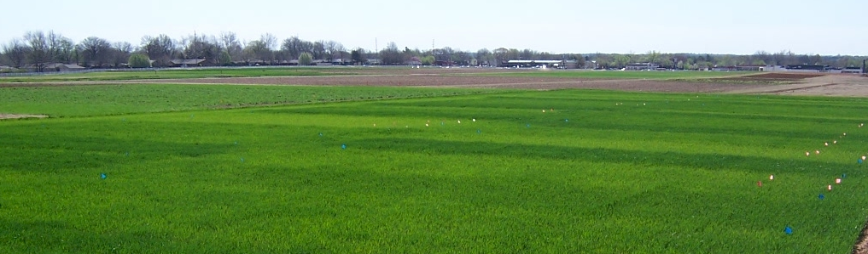
Lessons Learned
Faculty Importance
ID cyanobacteria, 0-N
Stability, K
Genetics, high N
Yield goal value
Variability ONR (all studies)
Exp. errors year to year prevent combining sites
Excess N ends up the groundwater
Plants lose N as NH3 through the leaves
Yield potential and N response are independent
Biological systems are random (N response year to year is random)
SBNRC delivers accurate mid-season N rates
Homogenous plant stands can lead to maximum yields

Slide 35
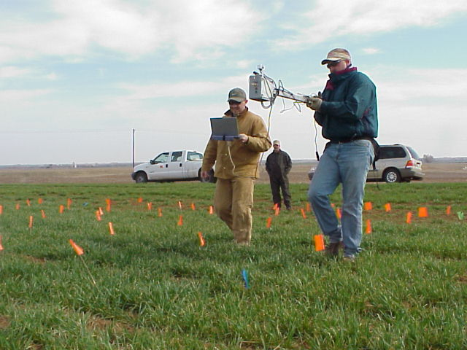
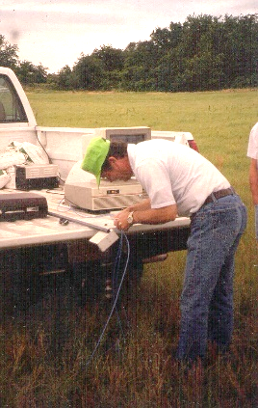
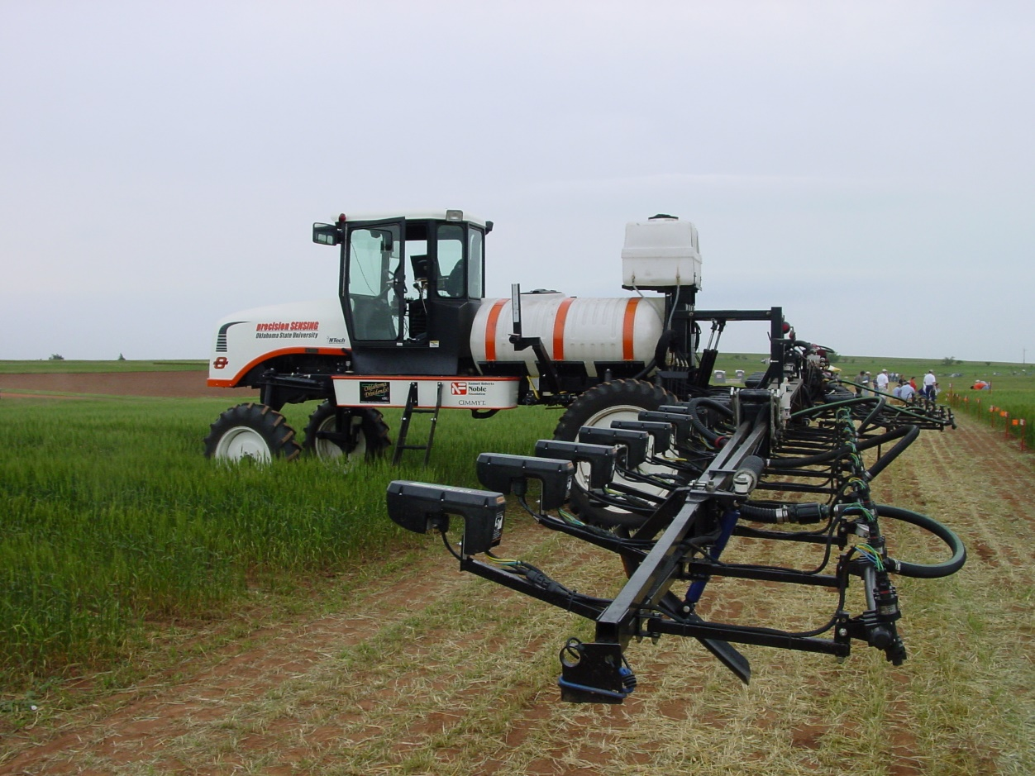
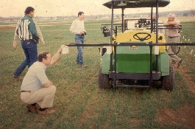
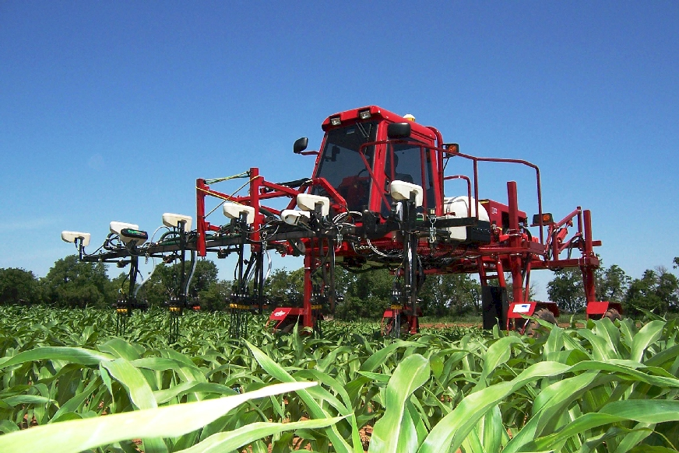
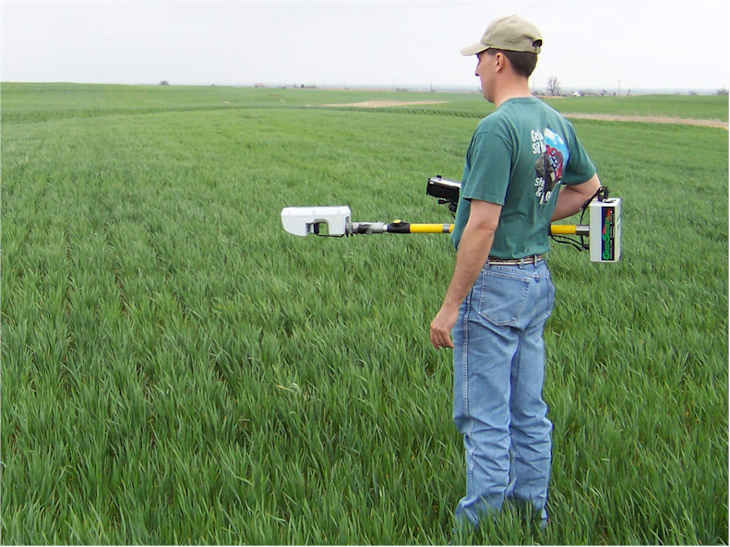
End Product, By Plant

Slide 36




Norman Borlaug Mother Teresa
1914 – 2009 1910 - 1997

Slide 37



Dr. Robert L. Westerman
Opportunity

