Slide 1
Salt/Freeze Mitigation Trial
Efaw
N
W
E
Treatment | UAN (gal/ac)
1 | Check
2 | 10
3 | 20
4 | 10 + Adjuvant
S
Plot size: 10’ x 15’
Alley: 10’
(4/14)- 15 leaves/plot sampled prior to application
(4/14) – UAN applications made with CO₂ sprayer from 1:35-1:50pm
(4/15) – freezing conditions for 6 hours
  Low temperature of 28 F
(4/15) – 8:30 am – visually more dew/frost on untreated plots. See pictures.
(4/15) 1:00pm – fertlilized plots showing signs of burn; more burn in TRT 3 and 4.
  Fertilizer spray still on leaves on treated plots
  Larger decreases in NDVI in treated plots compared to check
Rep 1 |  | 2 | 3 | 1 | 4
Rep 2 |  | 4 | 3 | 1 | 2
Rep 3 |  | 3 | 4 | 2 | 1

Slide 2
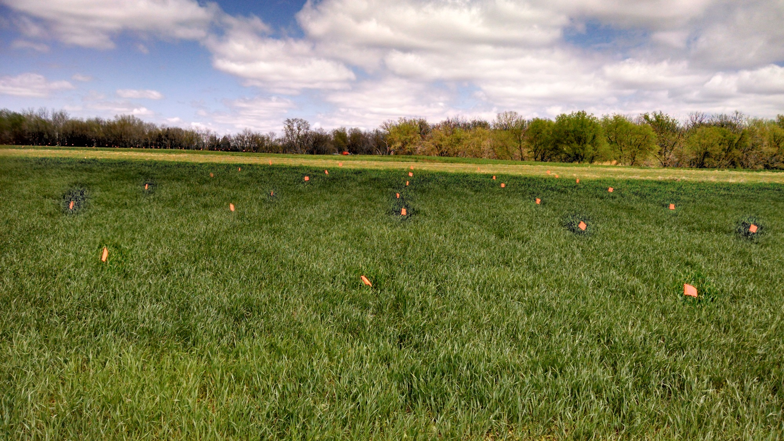
Day Prior to Freeze following application of UAN

Slide 3
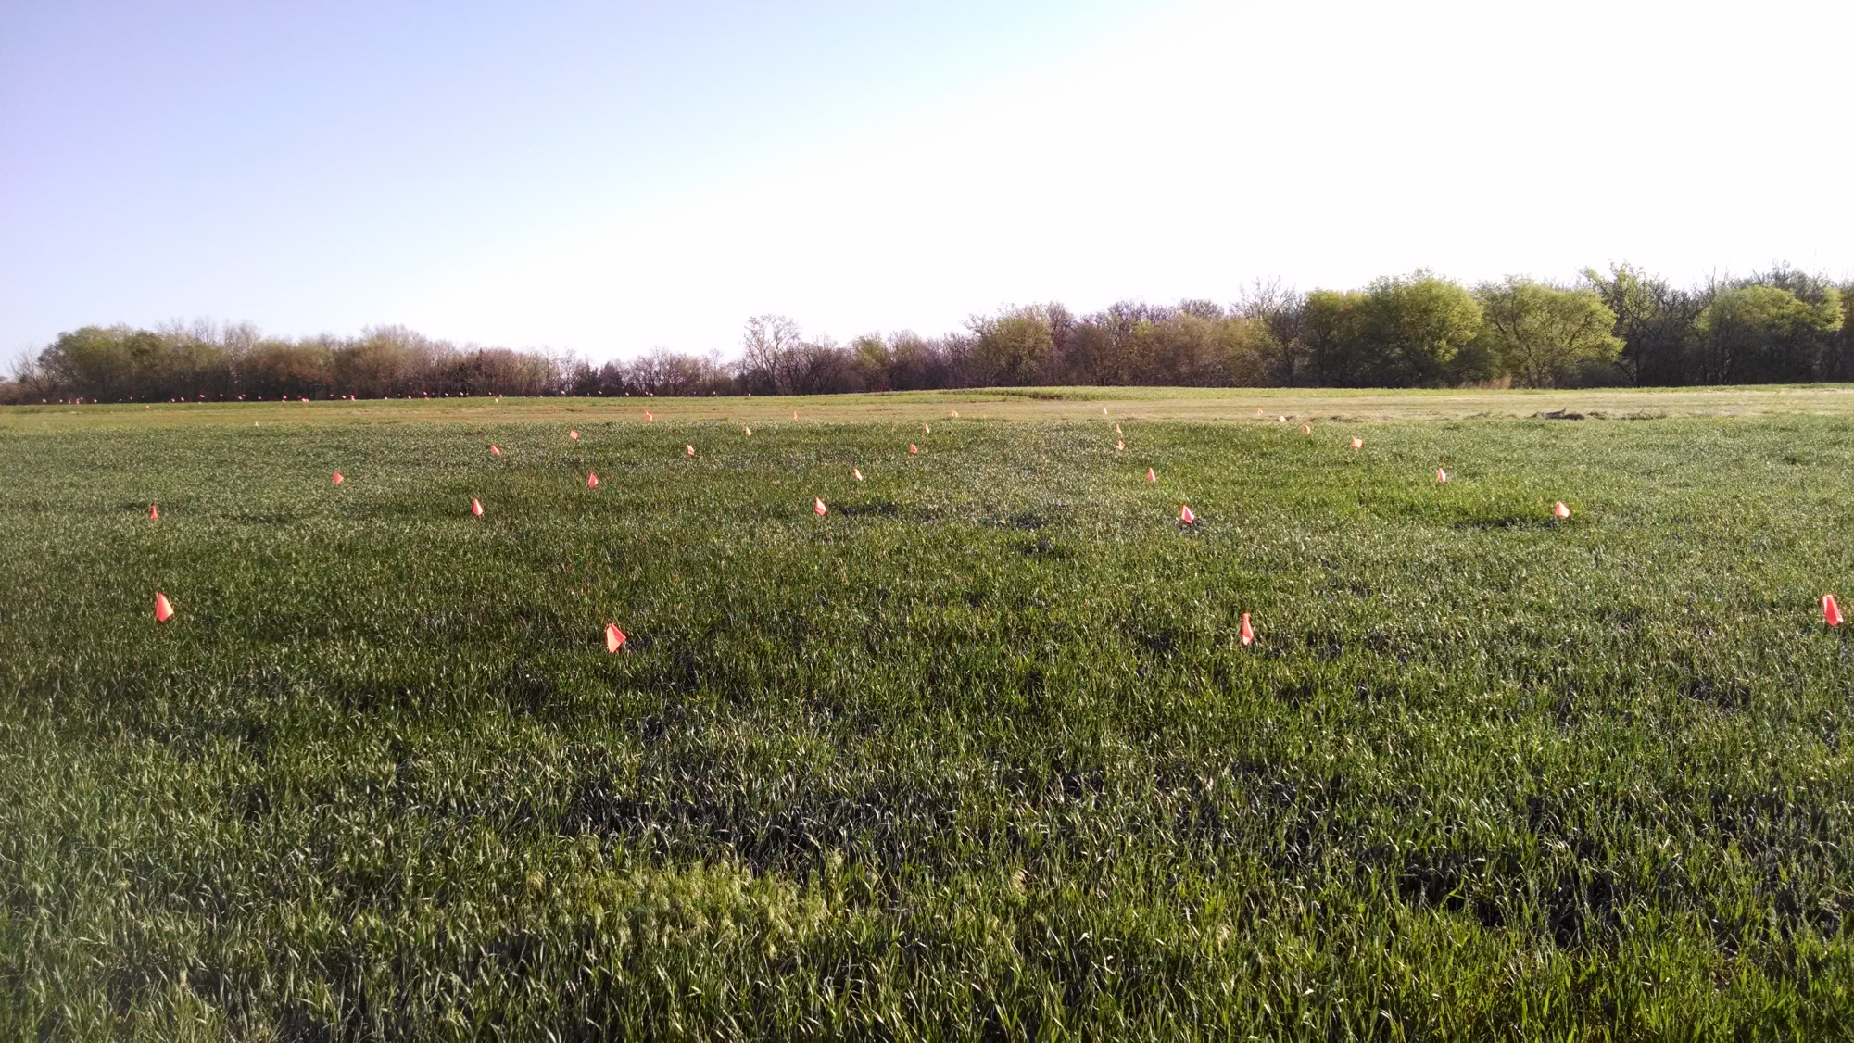
Day following Freeze – 830am

Slide 4
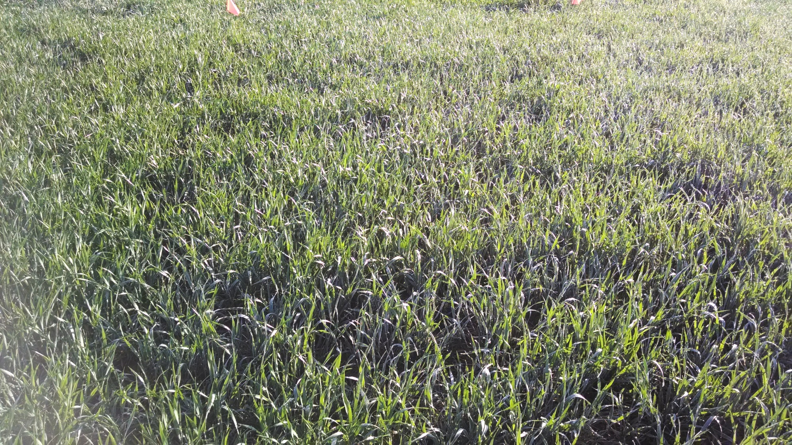
Check – 830am

Slide 5
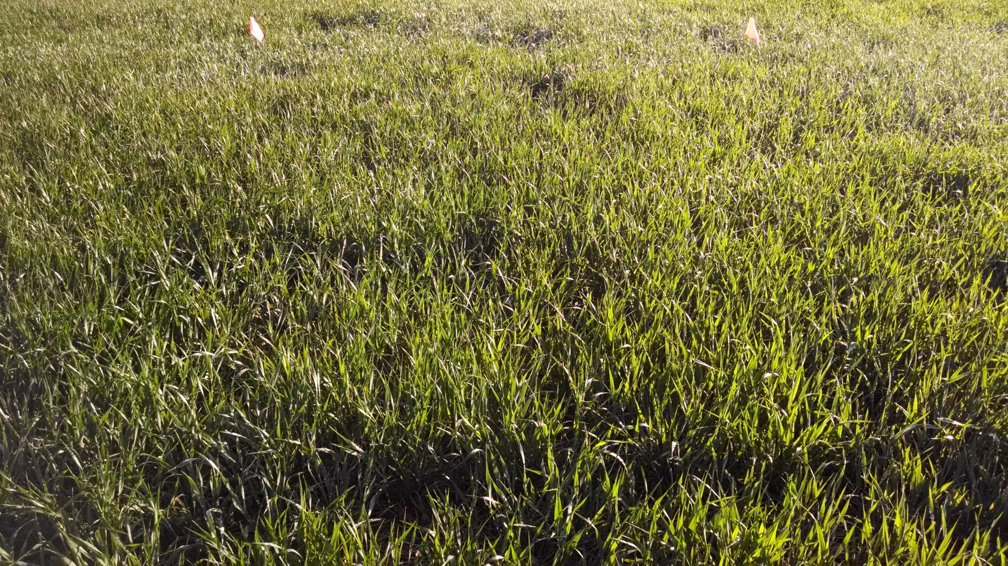
10 gallon UAN/ac -830am

Slide 6
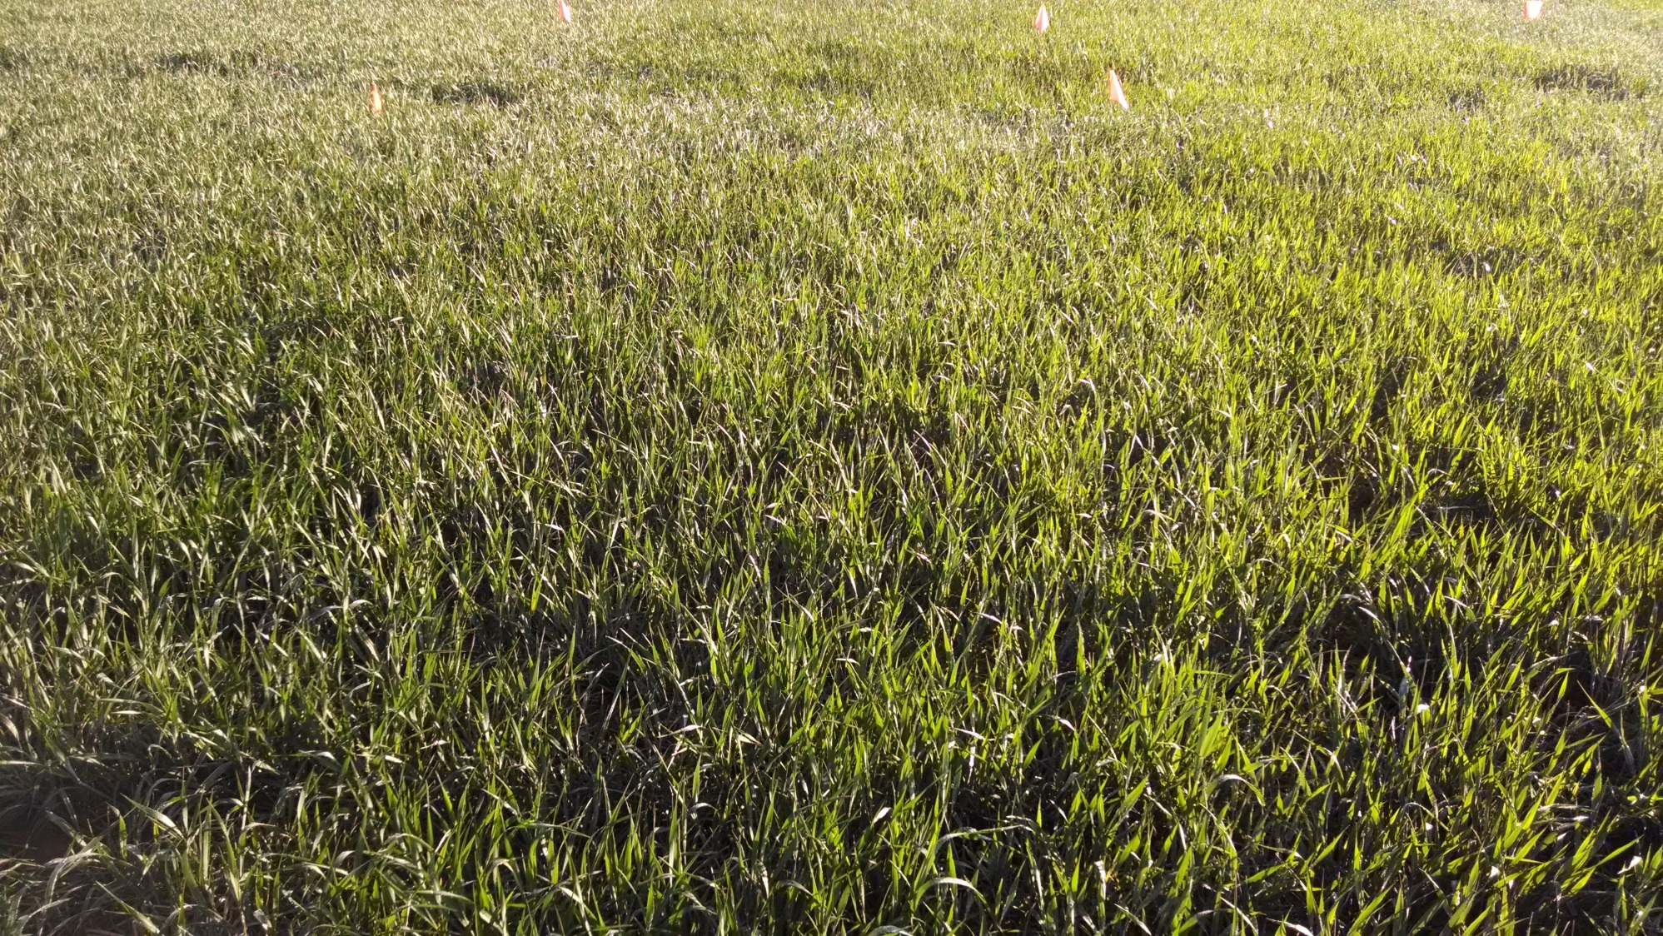
20 gallon UAN/ac – 830am

Slide 7
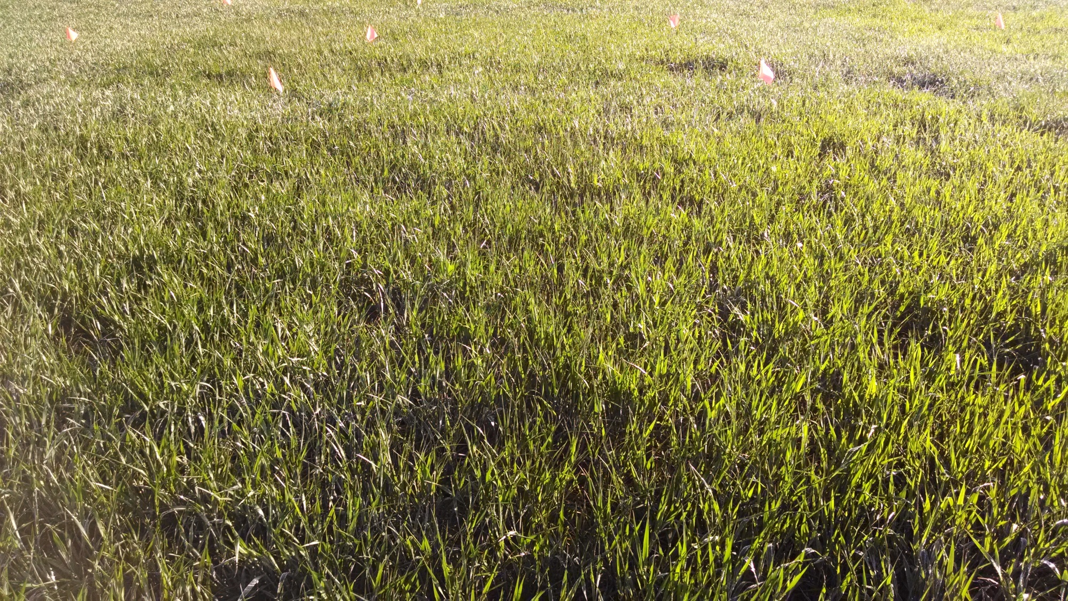
10 gallon UAN/ac + adjuvant – 830am

Slide 8
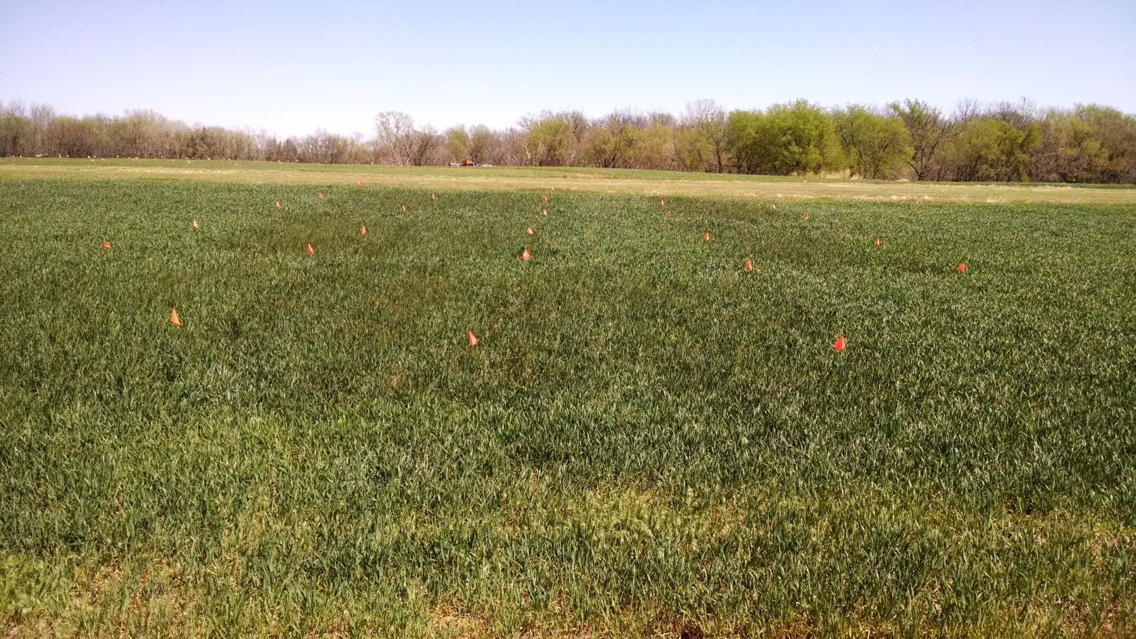
Day following Freeze – 1pm

Slide 9
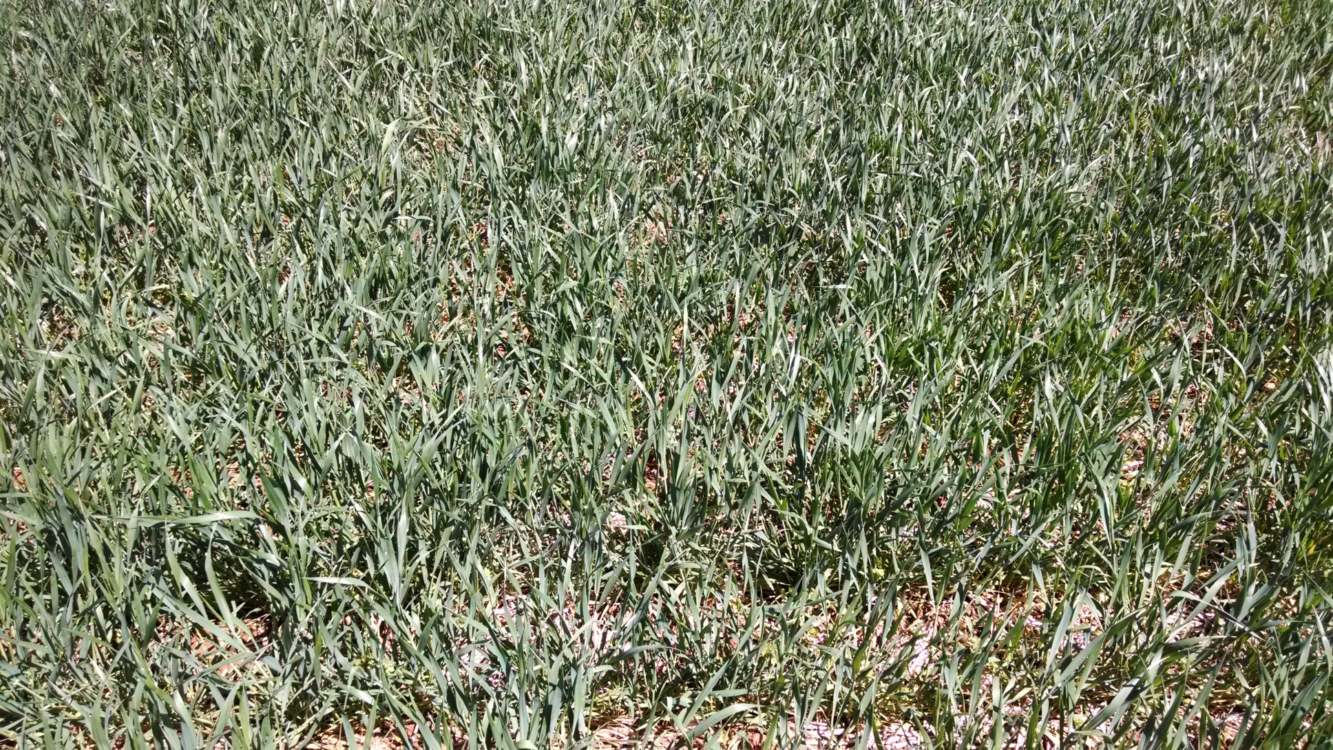
Check – 1pm

Slide 10
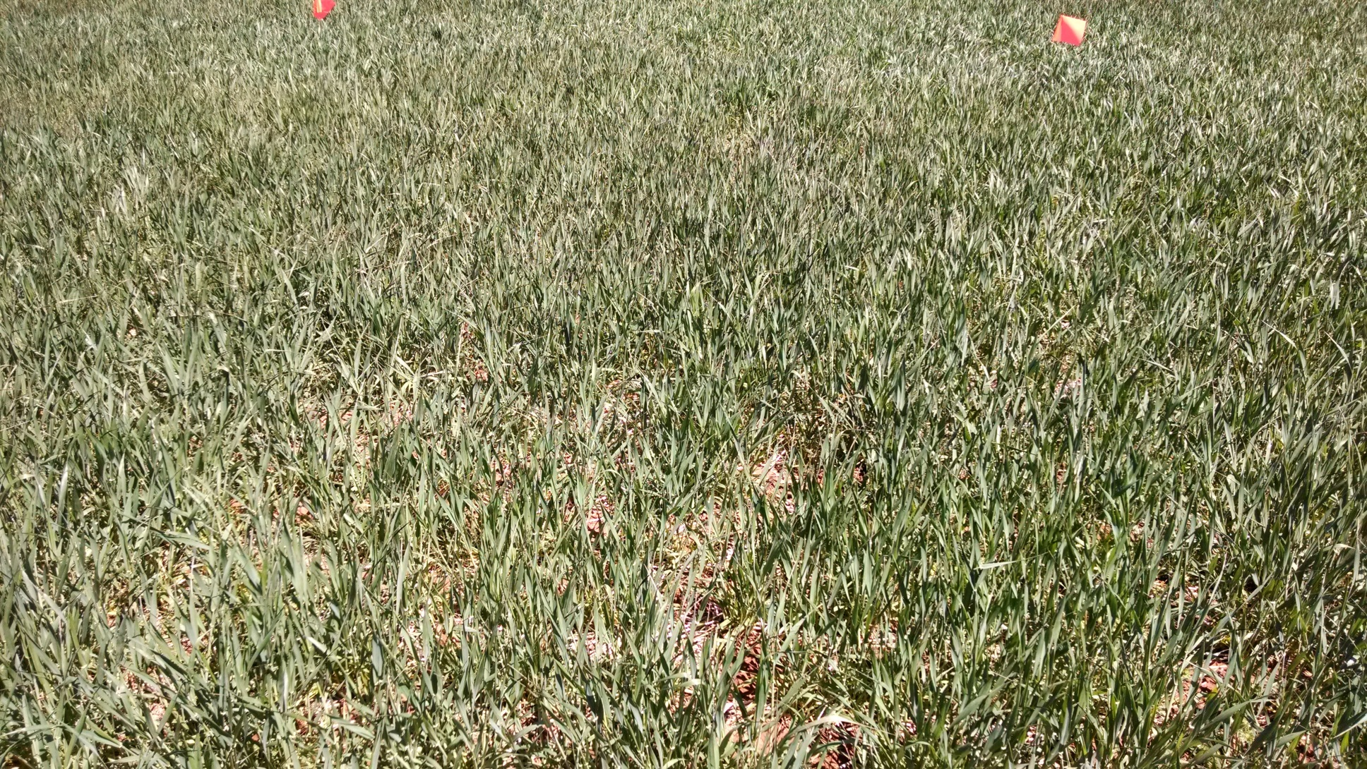
10 gallon UAN/ac -1pm

Slide 11
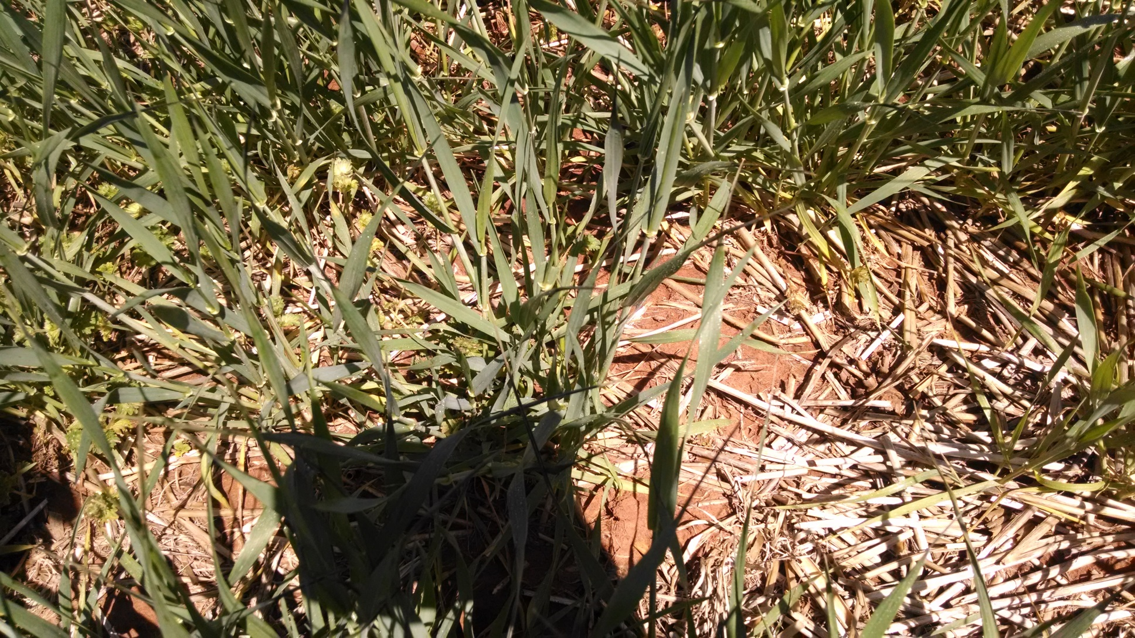
10 gallon UAN/ac -1pm

Slide 12
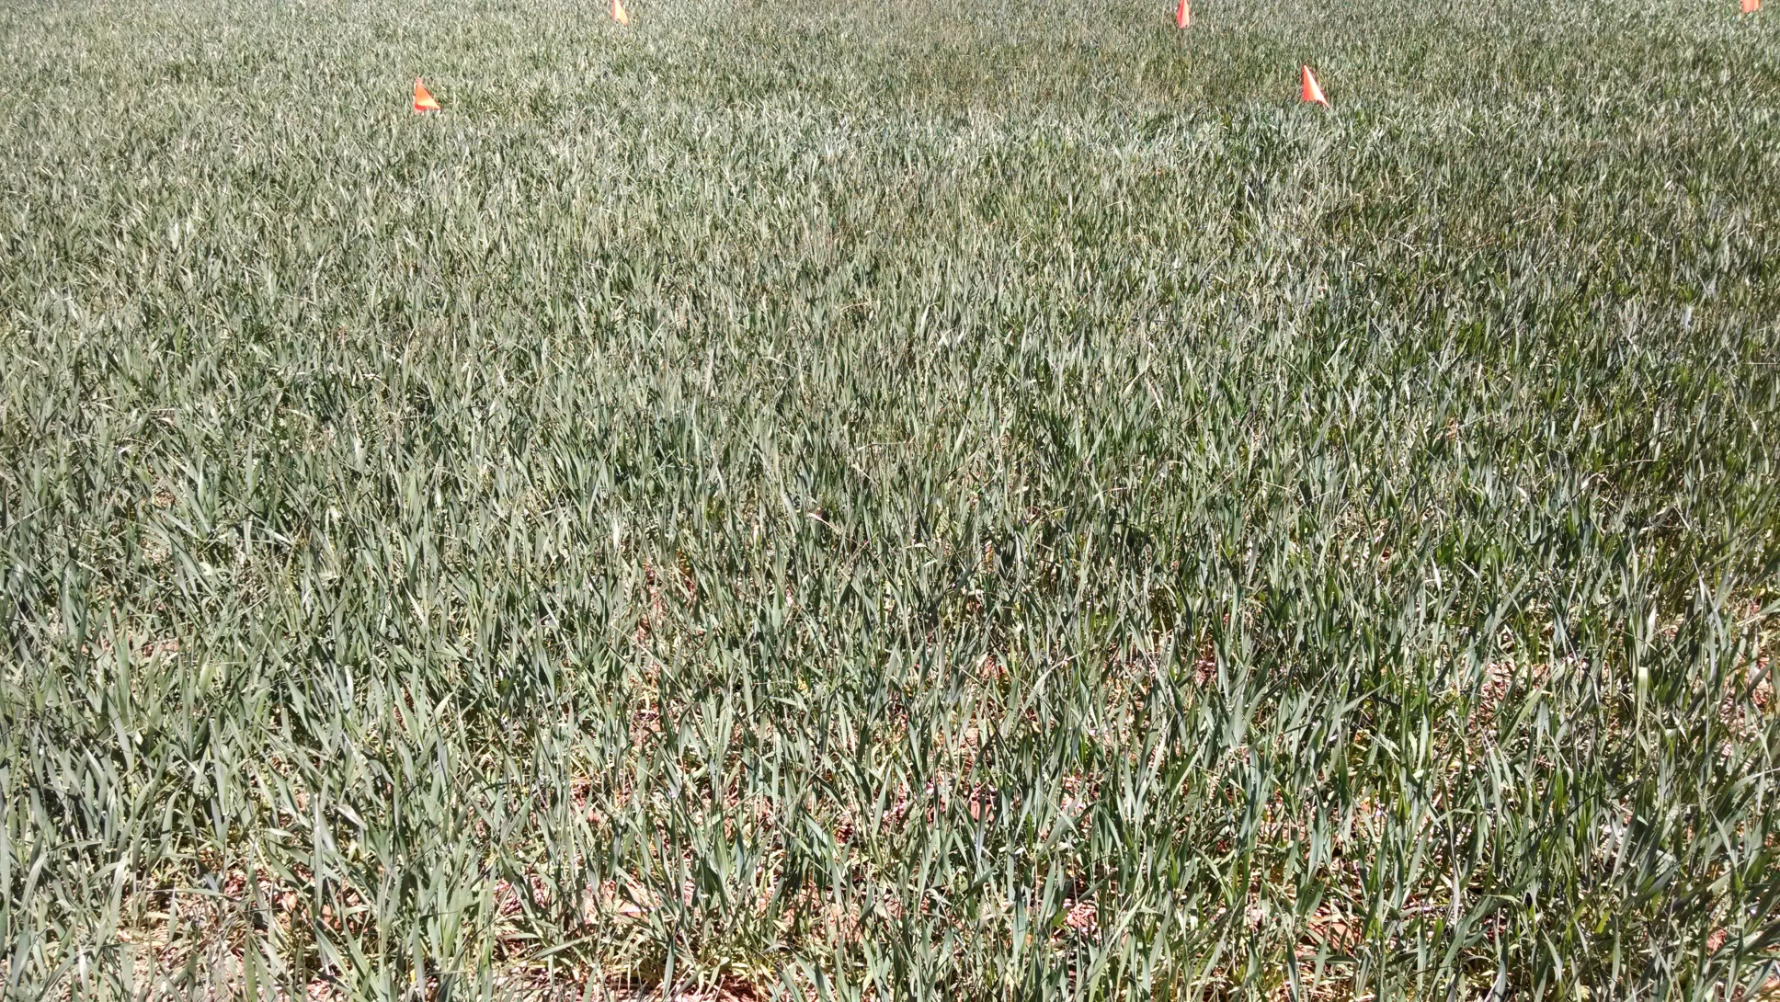
20 gallon UAN/ac – 1pm

Slide 13
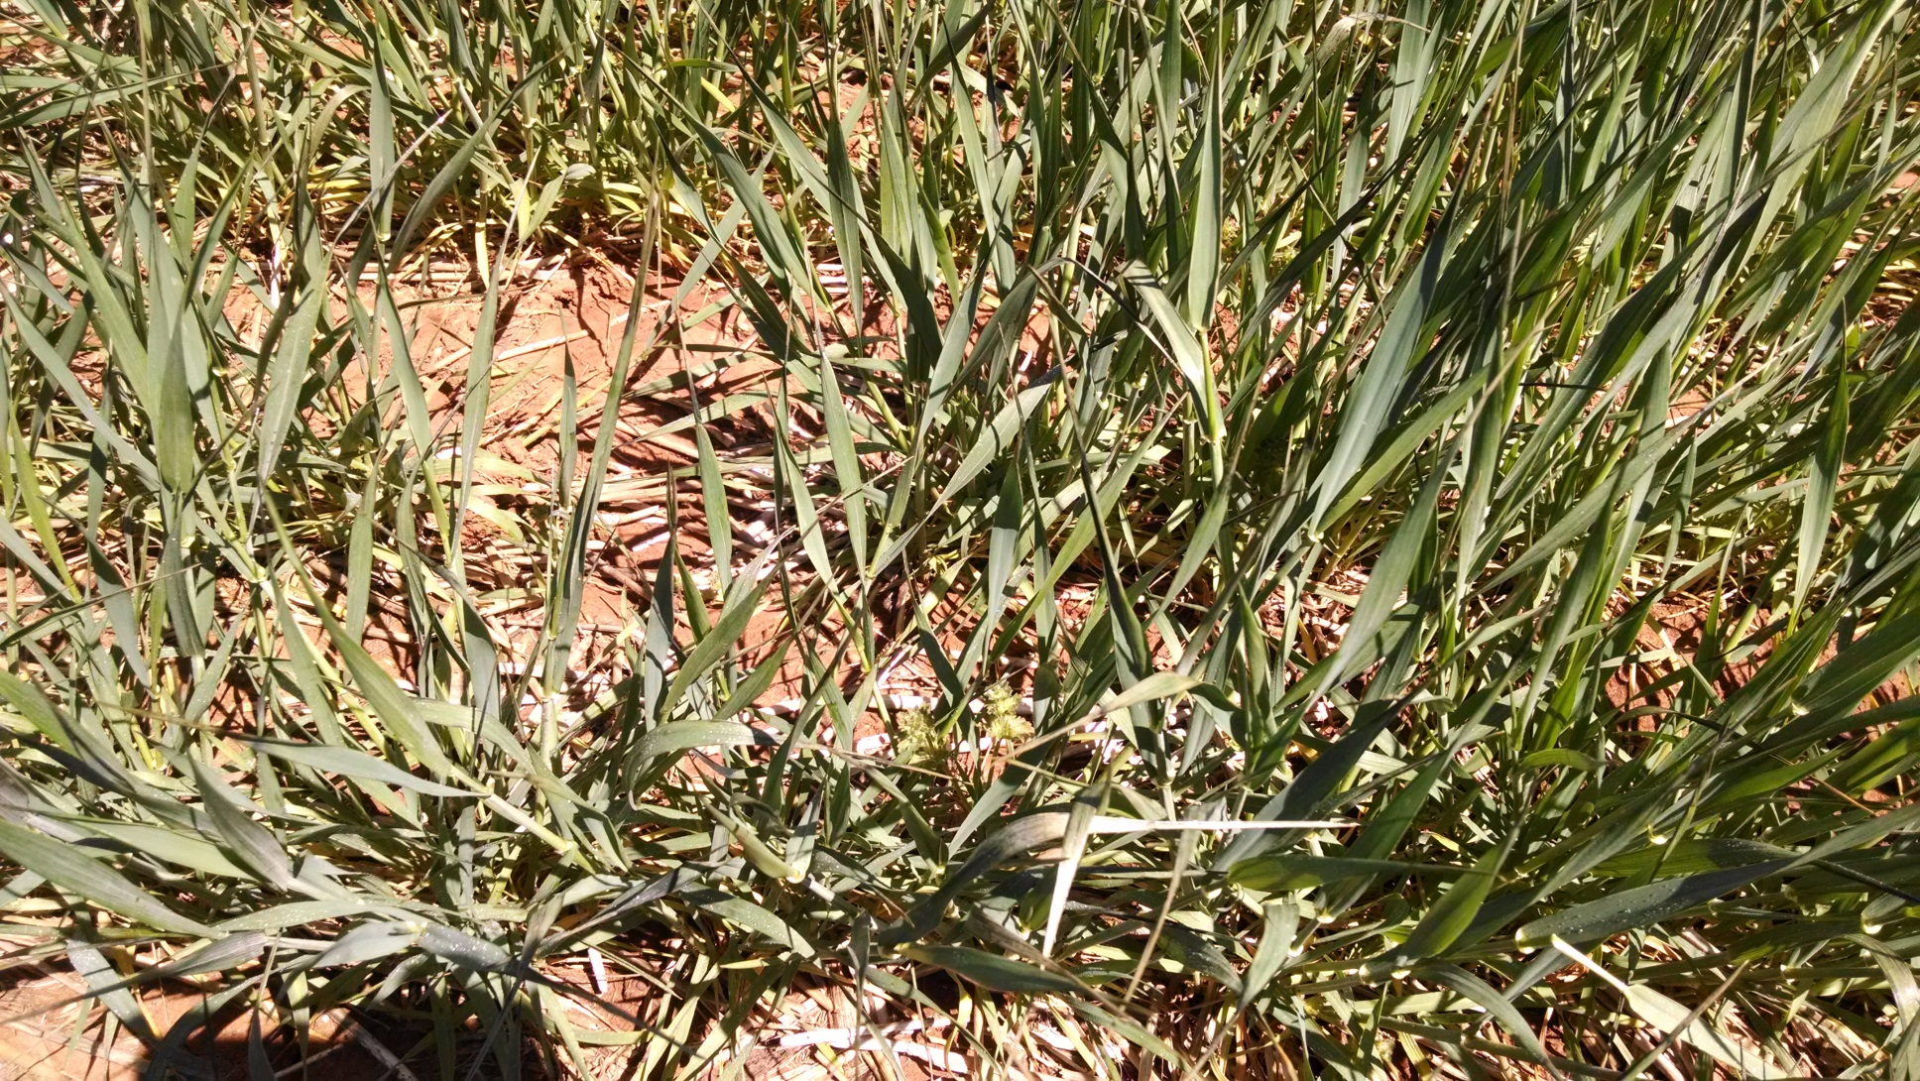
20 gallon UAN/ac – 1pm

Slide 14
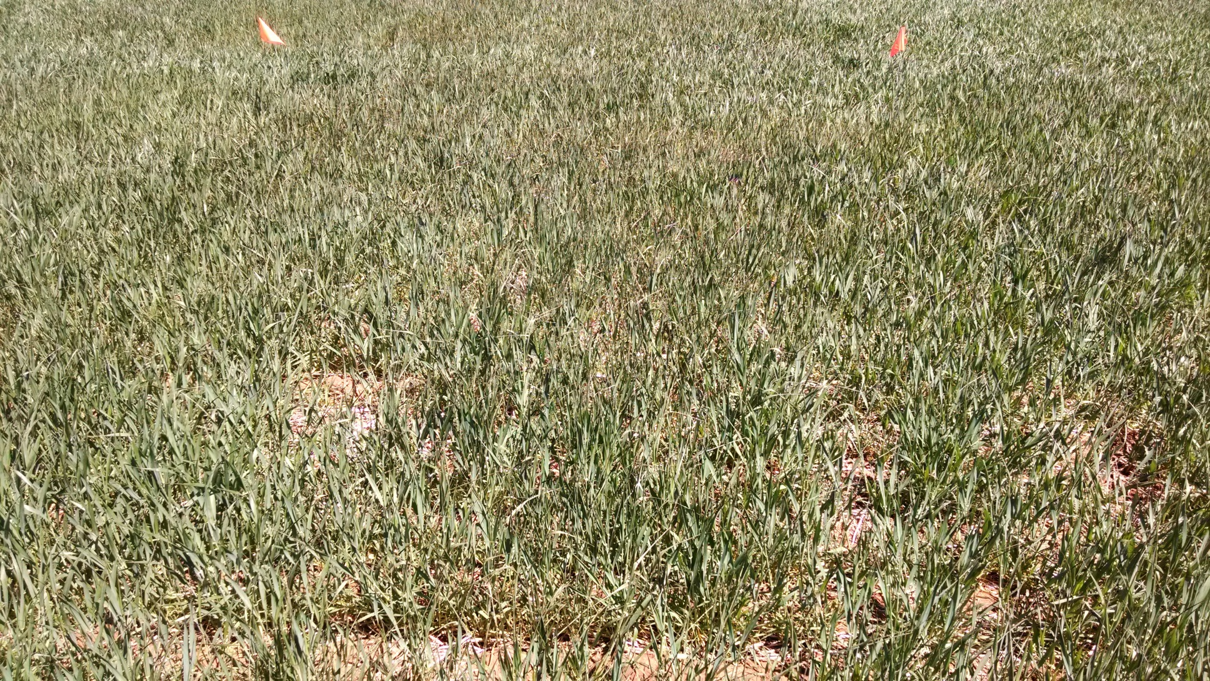
10 gallon UAN/ac + adjuvant – 1pm

Slide 15
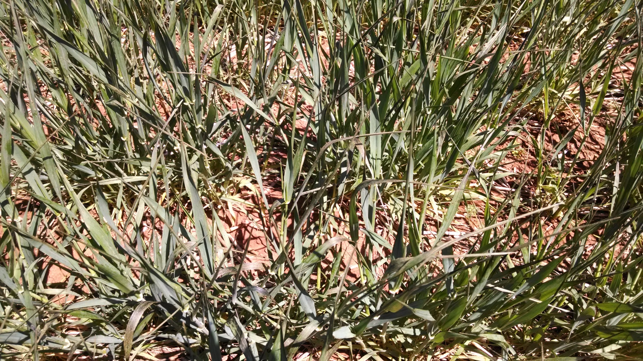
10 gallon UAN/ac + adjuvant – 1pm

