Slide 1
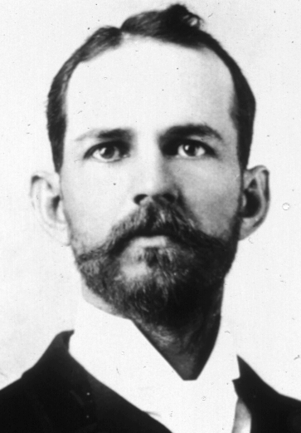
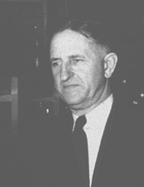



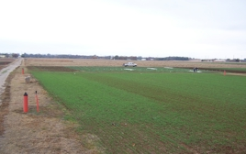
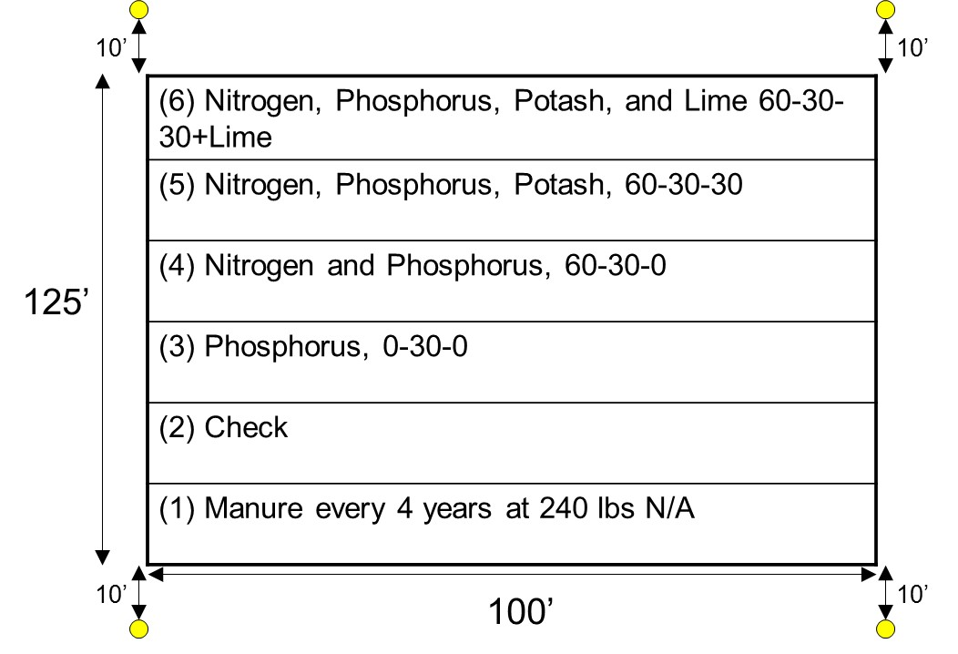

AC Magruder, 1892
Horace J. Harper, 1926-1951 (25)
Billy Tucker, 1957-1976 (19)
Robert L. Westerman, 1977-1991 (14)
William R. Raun, 1992-present (28)
Continuity

Slide 2
http://nue.okstate.edu/Long_Term_Experiments.htm
OSU Ongoing Long Term Experiments
Experiment | Location | Focus | Crop | Year Est.
222 | Stillwater (DATA) | NPK | wheat | 1968
301 | Efaw | Municipal wastes | wheat | 1993
302 | Efaw | Animal wastes | wheat | 2000
406 | Altus (DATA) | NPK irrigated | wheat | 1965
407 | Altus (DATA) | NPK dryland | wheat | 1965
439 | Altus | NPK | cotton | 1971
501 | Lahoma | NPK | sorghum (1970-2004) canola (2005-present) | 1970
502 | Lahoma (DATA) (Pictures) | NPK | wheat | 1970
503 | Lahoma | P Source Method | wheat | 1970
504 | Lahoma | P Source | wheat | 1970
505 | Lahoma | N Source | wheat | 1970
701 | LCB | Zero-Till Topdress | wheat | 2001
Magruder Plots | Stillwater (DATA) | NPK-lime | wheat | 1892

Slide 3
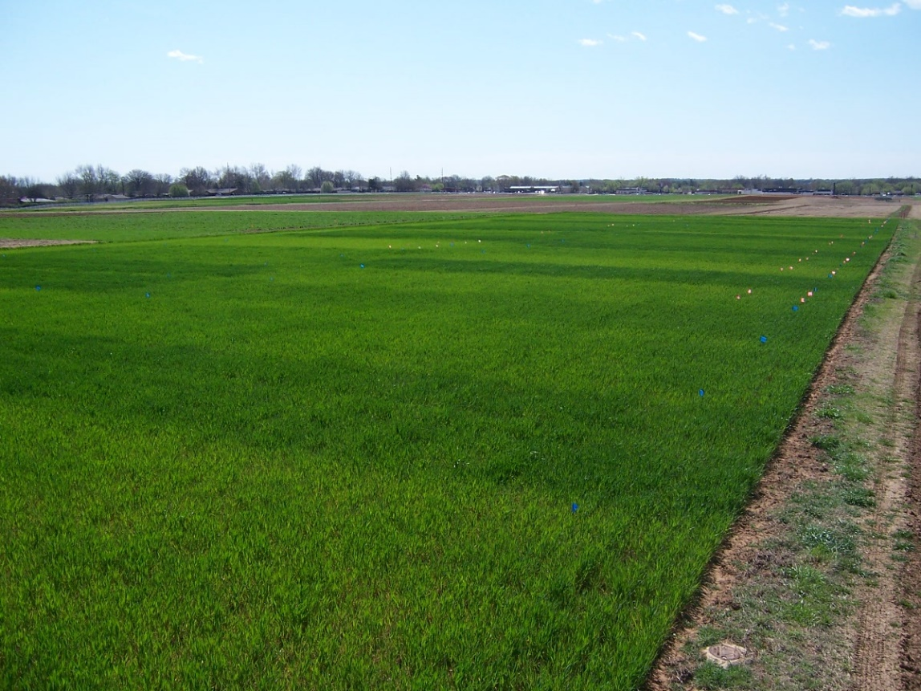

http://nue.okstate.edu/Long_Term_Experiments.htm

Slide 4
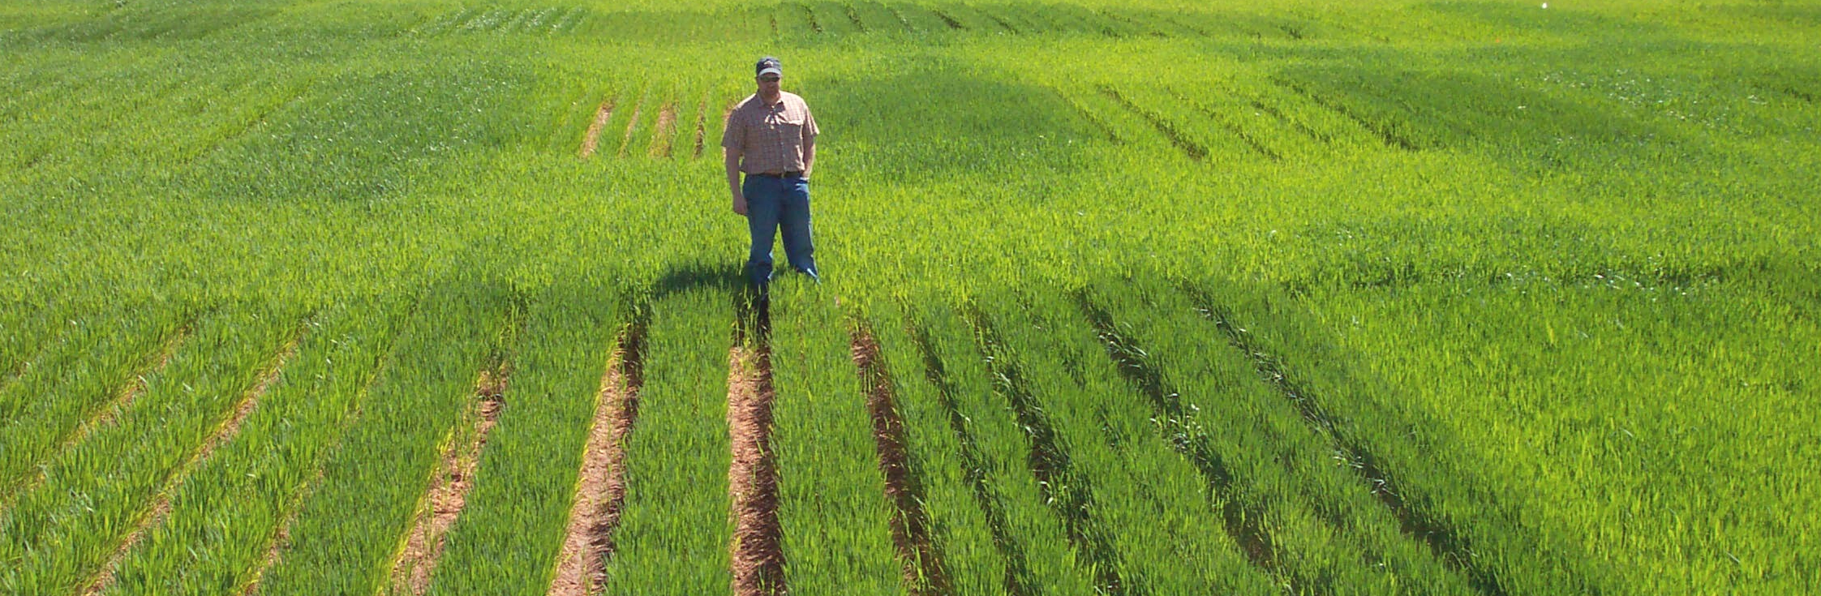
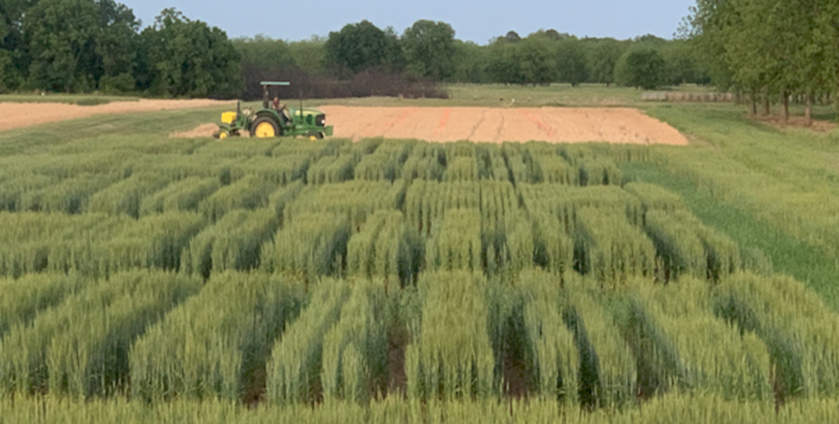
E_{nue}
E_{beds}
Dr. Kyle Freeman,
Office Chérifien des Phosphates (OCP)

Slide 5
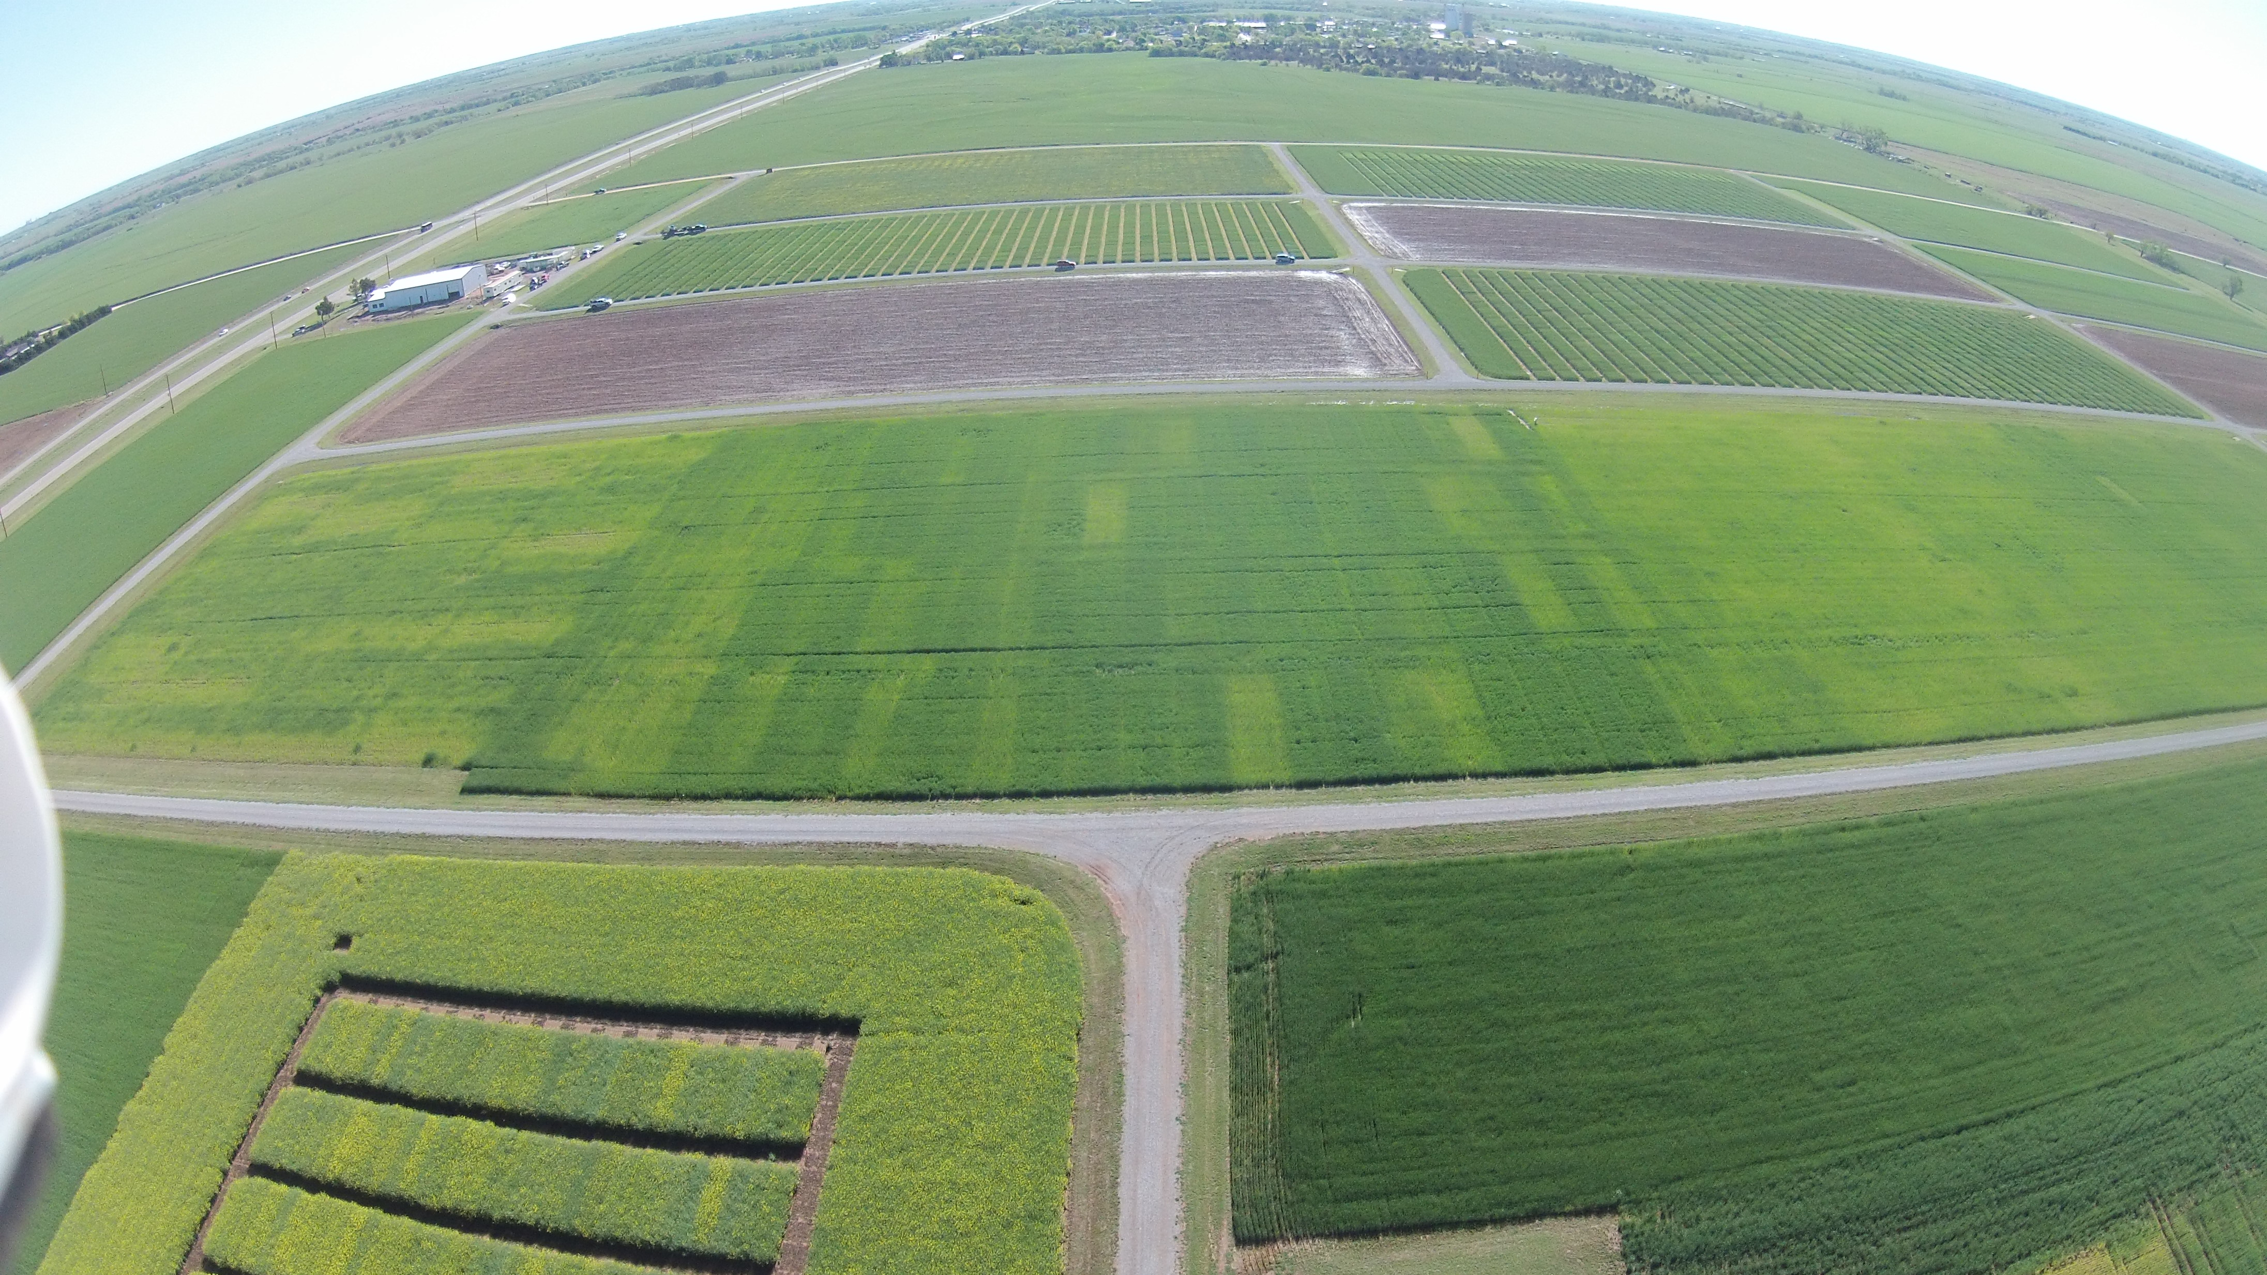
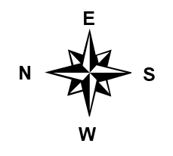
E₅₀₂

Slide 6

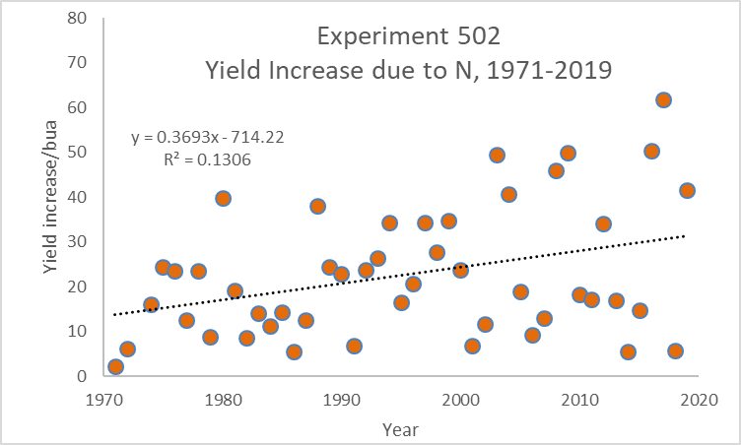

Slide 7
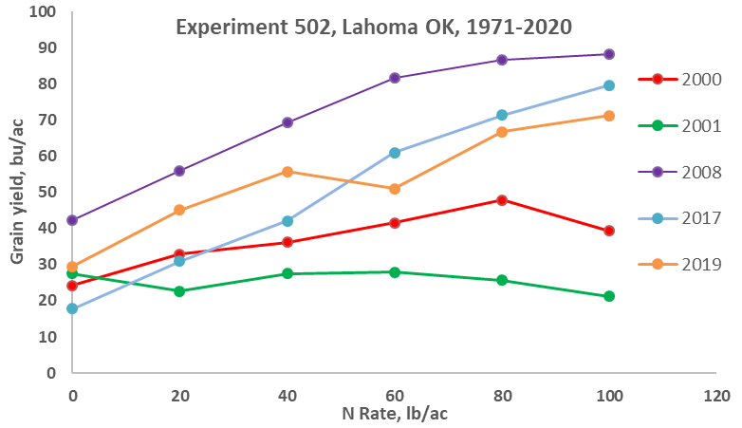

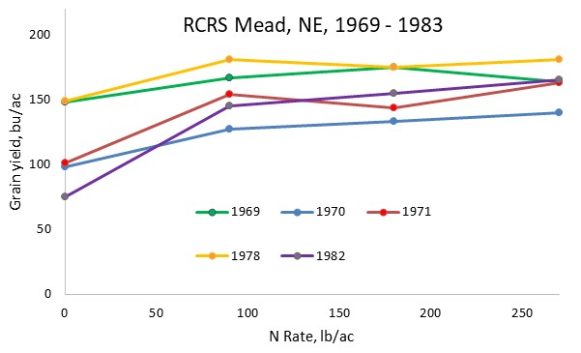
49 years Later
E_{RCRS}

Slide 8
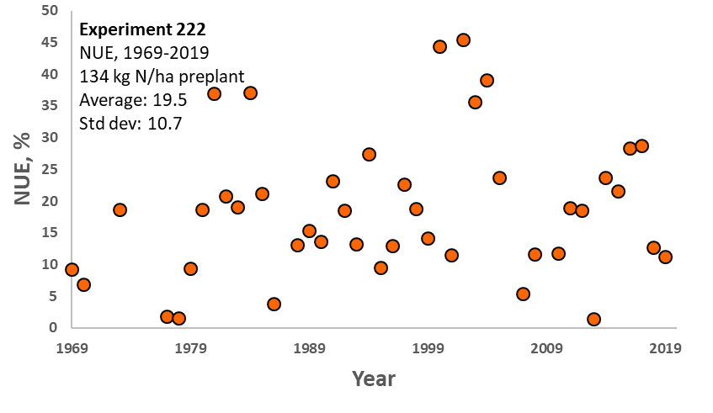
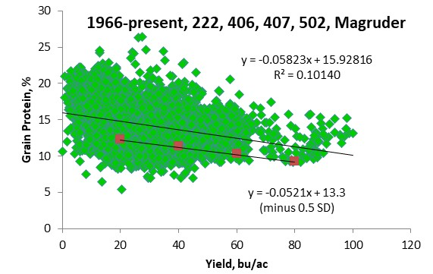

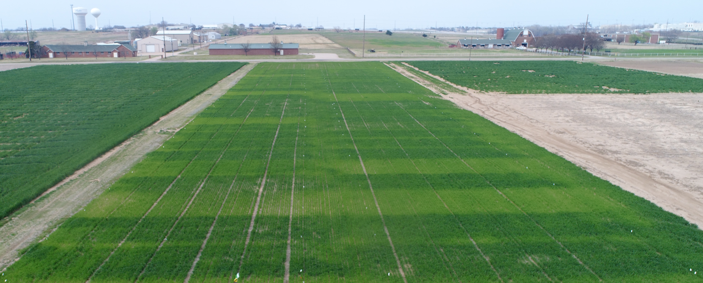
E₂₂₂

Slide 9
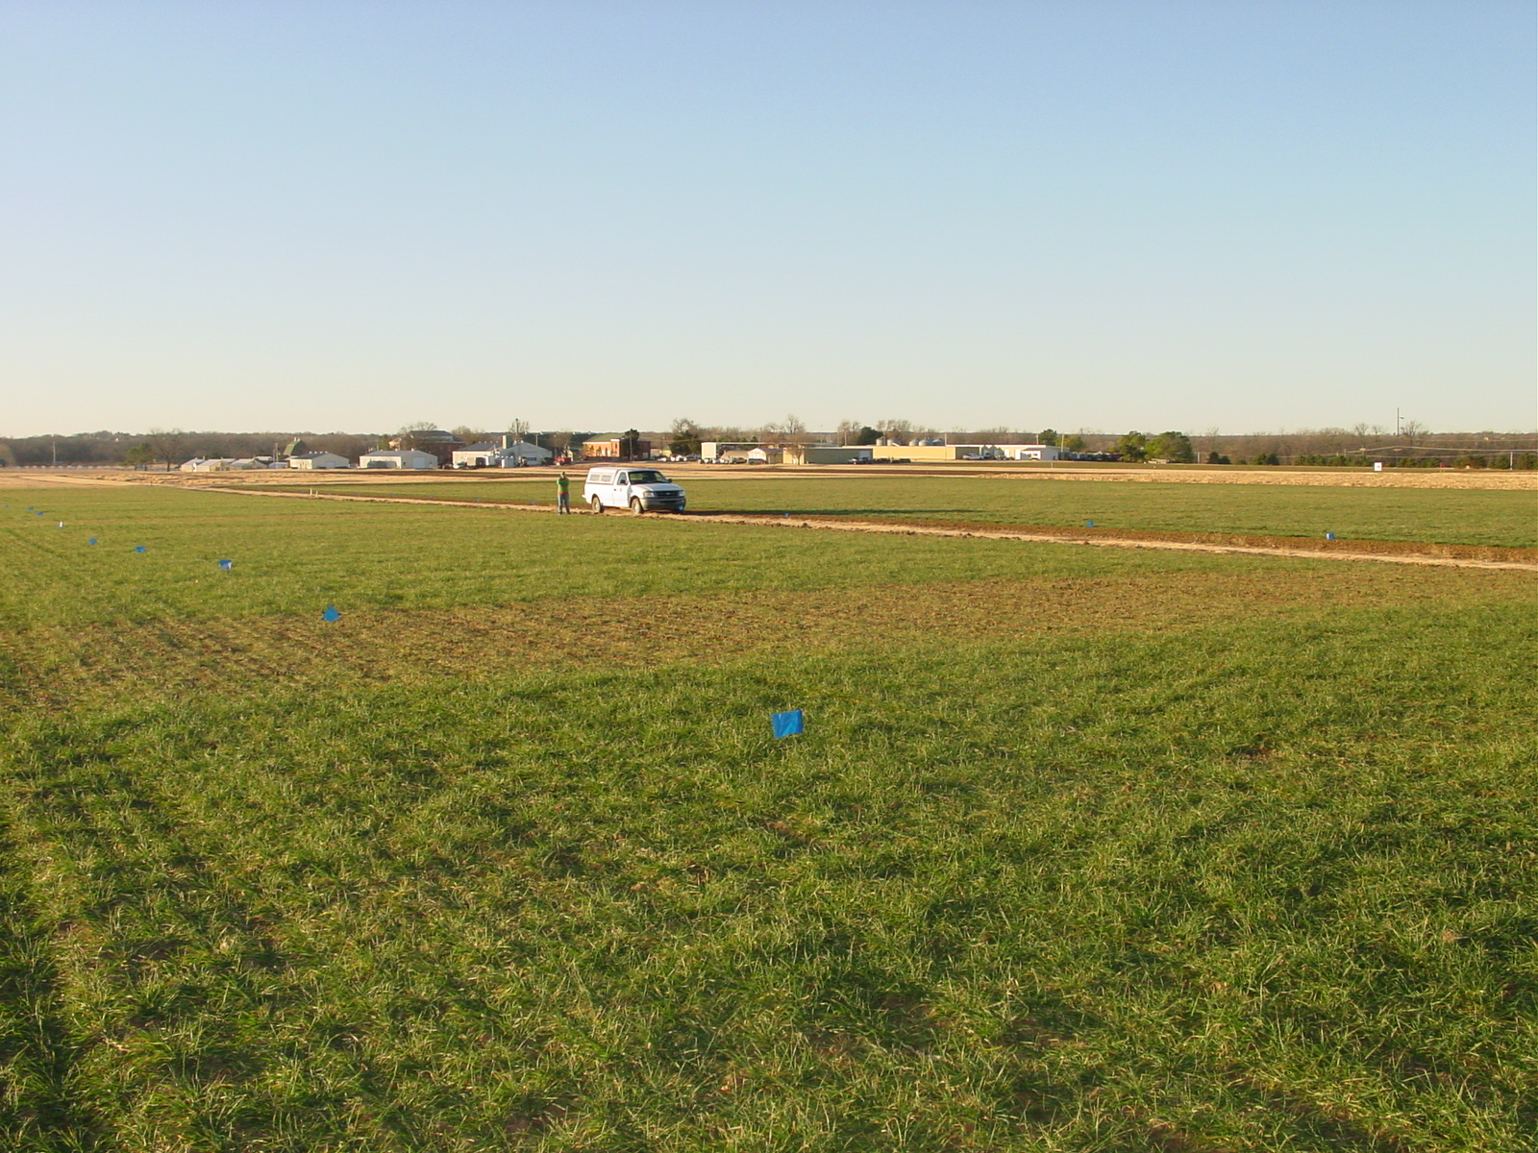
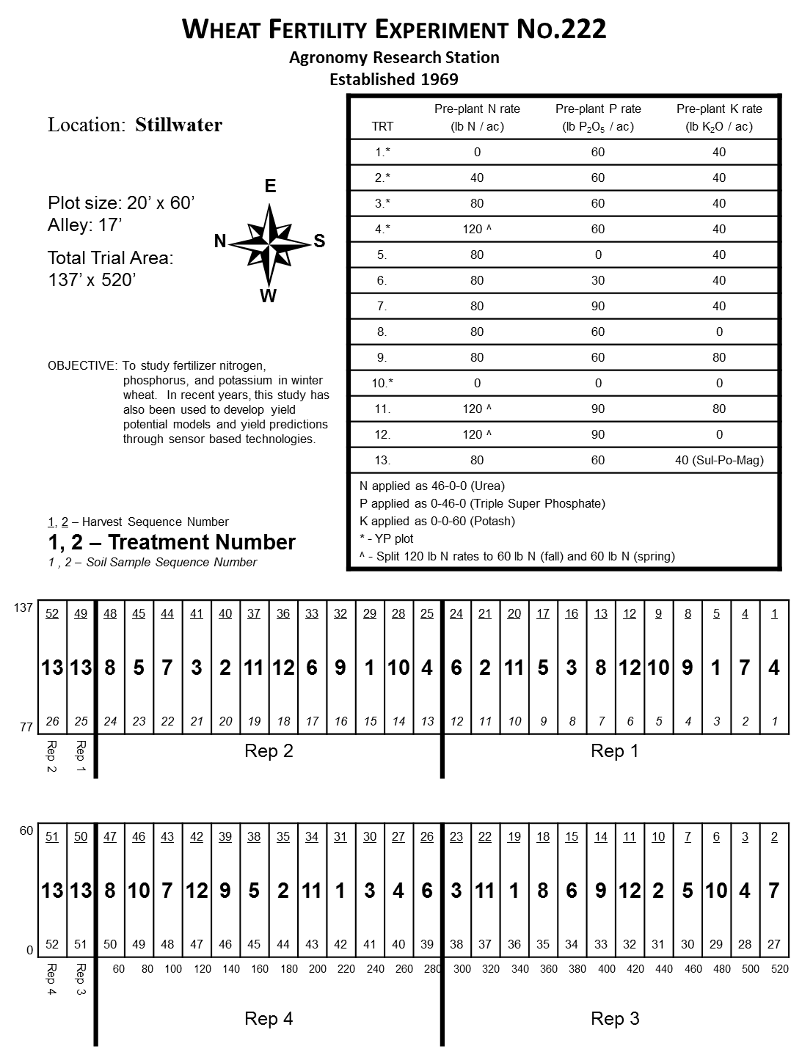


Slide 10


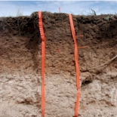


Wheat Fertility Experiment No.502
North Central Experiment Station
Established 1970
Location: Lahoma
TRT | Pre-plant N rate (lb N / ac) | Pre-plant P rate (lb P₂O₅ / ac) | Pre-plant K rate (lb K₂O / ac)
1.* | 0 | 0 | 0
2.* | 0 | 40 | 60
3.* | 20 | 40 | 60
4.* | 40 | 40 | 60
5.* | 60 | 40 | 60
6.* | 80 | 40 | 60
7.* | 100 | 40 | 60
8. | 60 | 0 | 60
9. | 60 | 20 | 60
10. | 60 | 60 | 60
11. | 60 | 80 | 60
12. | 60 | 60 | 0
13. | 100 | 80 | 60
14. | 60 | 40 | 60 (Sul-Po-Mag)
N applied as 46-0-0 (Urea) P applied as 0-46-0 (Triple Super Phosphate) K applied as 0-0-60 (Potash) * - YP plot
Grant silt loam (fine-silty, mixed, superactive, thermic, Udic Argiustoll
Plot size: 16’ x 60’
Alley: 20’
Total Trial Area: 224’ x 300’
W
S
N
E
OBJECTIVE: To study fertilizer nitrogen, phosphorus, and potassium in winter wheat. In recent years, this study has also been used to develop yield potential models and yield predictions through sensor based technologies.
1, 2 – Harvest Sequence Number
1, 2 – Treatment Number
1 , 2 – Soil Sample Sequence Number
 | 300 | 4 | 5 | 12 | 13 | 20 | 21 | 28 | 29 | 36 | 37 | 44 | 45 | 52 | 53
Rep 4 |  | 3 | 5 | 13 | 6 | 10 | 2 | 4 | 7 | 12 | 1 | 8 | 14 | 9 | 11
 | 240 | 43 | 44 | 45 | 46 | 47 | 48 | 49 | 50 | 51 | 52 | 53 | 54 | 55 | 56
 | 220 | 3 | 6 | 11 | 14 | 19 | 22 | 27 | 30 | 35 | 38 | 43 | 46 | 51 | 54
Rep 3 |  | 1 | 14 | 2 | 7 | 11 | 3 | 9 | 12 | 5 | 13 | 4 | 8 | 10 | 6
 | 160 | 29 | 30 | 31 | 32 | 33 | 34 | 35 | 36 | 37 | 38 | 39 | 40 | 41 | 42
 | 140 | 2 | 7 | 10 | 15 | 18 | 23 | 26 | 31 | 34 | 39 | 42 | 47 | 50 | 55
Rep 2 |  | 4 | 8 | 3 | 1 | 11 | 13 | 12 | 7 | 14 | 6 | 9 | 10 | 2 | 5
 | 80 | 15 | 16 | 17 | 18 | 19 | 20 | 21 | 22 | 23 | 24 | 25 | 26 | 27 | 28
 | 60 | 1 | 8 | 9 | 16 | 17 | 24 | 25 | 32 | 33 | 40 | 41 | 48 | 49 | 56
Rep 1 |  | 8 | 2 | 4 | 6 | 14 | 9 | 10 | 5 | 7 | 12 | 1 | 3 | 13 | 11
 |  | 1 | 2 | 3 | 4 | 5 | 6 | 7 | 8 | 9 | 10 | 11 | 12 | 13 | 14
 | 0 | 16 | 32 | 48 | 64 | 80 | 96 | 112 | 128 | 144 | 160 | 176 | 192 | 208 | 224

Slide 11
Refereed Journal Publications coming from Experiment 502

Slide 12

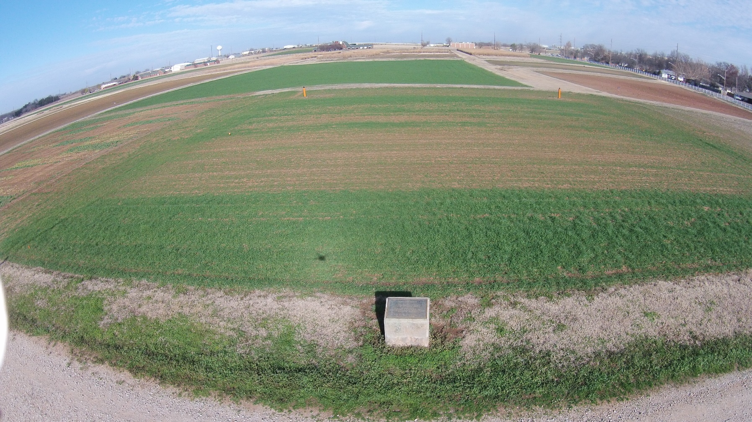
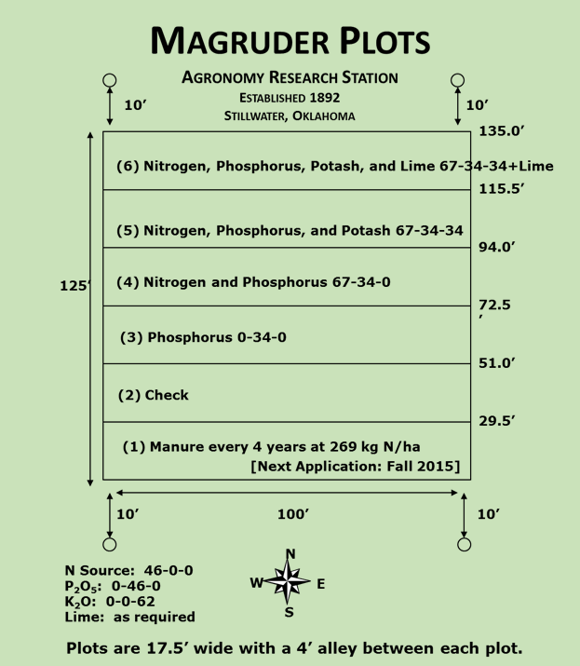
Magruder Plots
National Register of Historic Places
August, 1979
E_{Magruder}

Slide 13
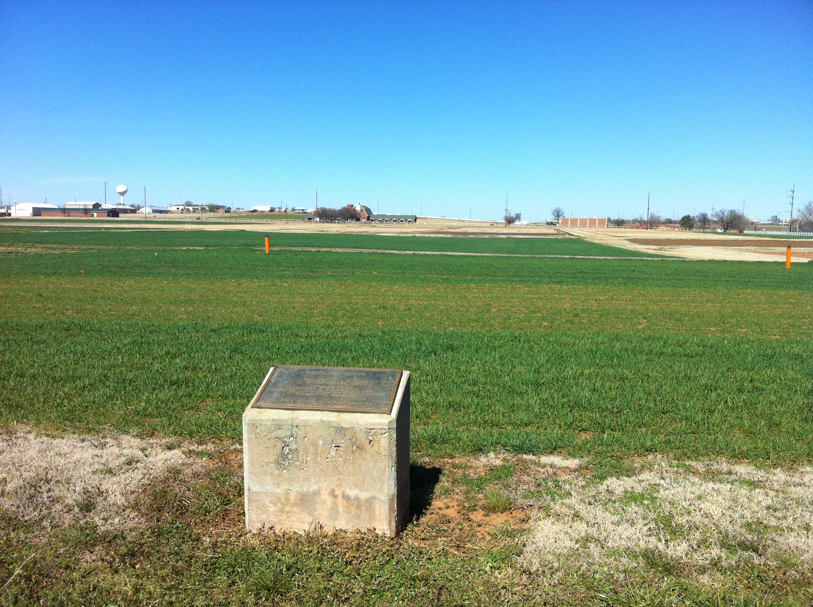

Slide 14
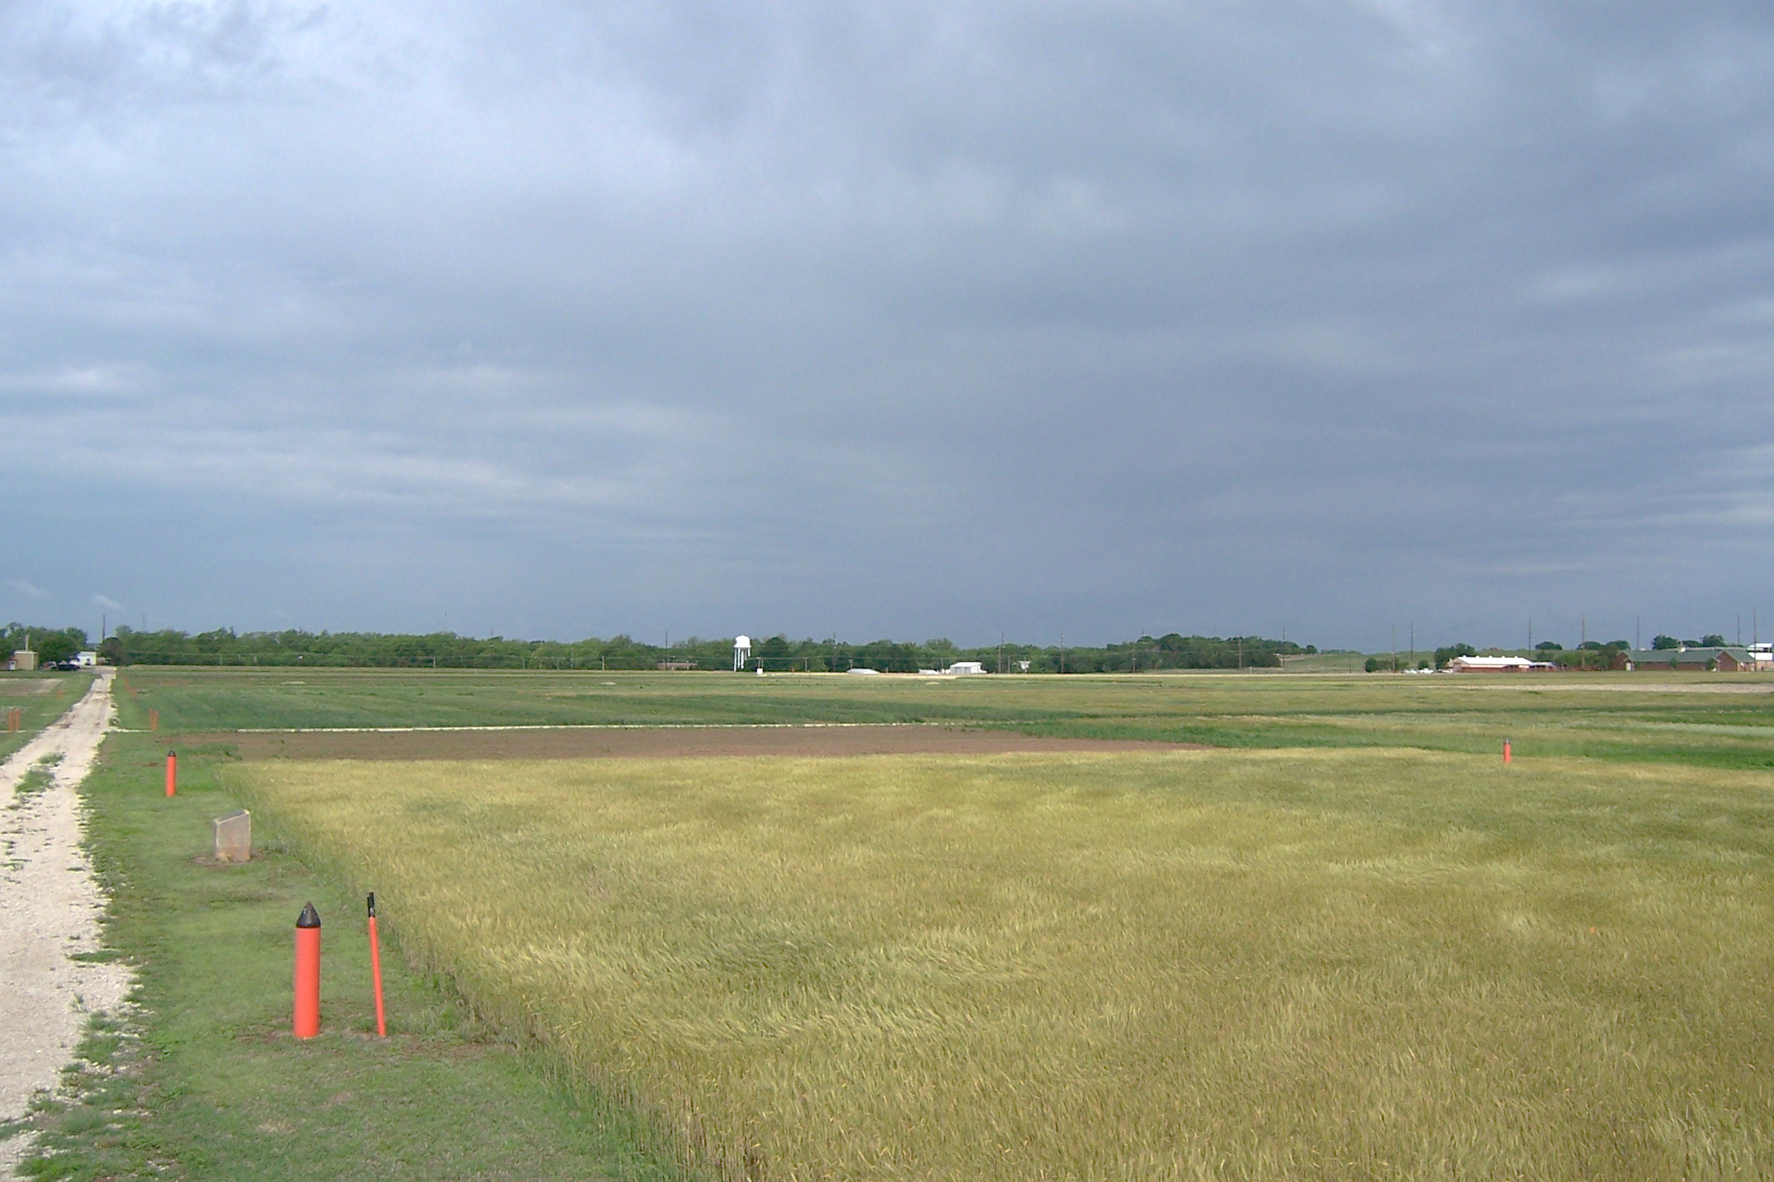

Slide 15
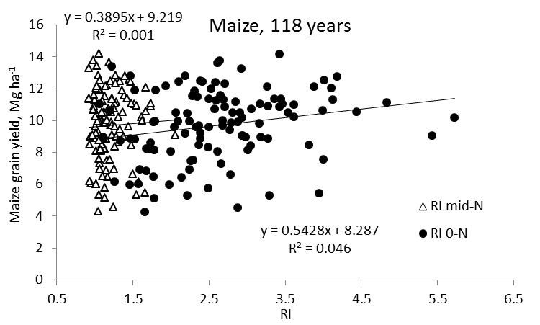
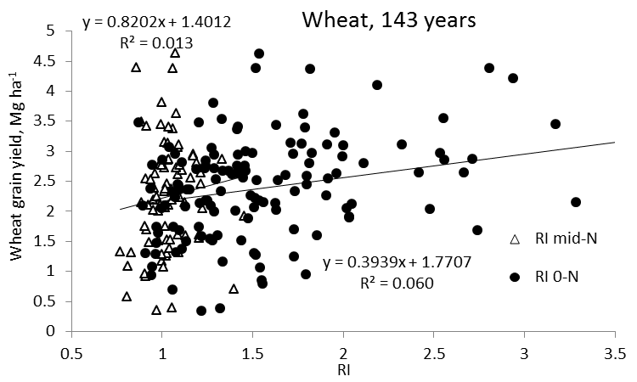
Independence of Yield potential and Nitrogen response
Iowa
Nebraska
Wisconsin
Oklahoma
Arnall, D.B., A.P. Mallarino, M.D. Ruark, G.E. Varvel, J.B. Solie, M.L. Stone, J. L. Mullock, R.K. Taylor, and W.R. Raun*. 2013. Relationship between grain crop yield potential and nitrogen response. Agron. J. 105:1335–1344.
Raun, W.R., John B. Solie, and Marvin L. Stone. 2011. Independence of yield potential and crop nitrogen response. Precision Agric. 12:508-518.

Slide 16
Girma, Kefyalew, Starr L. Holtz, Daryl B. Arnall, Brenda S. Tubana, and William R. Raun. 2007. The Magruder Plots: untangling the puzzle. Agron J. 99:1191-1198.

Slide 17
Question: should sites be combined over years?
For 83 site years of data, combining any two or three consecutive year-periods was not advisable. Individual years should be analyzed and reported on independently due to the unpredictable influence of the environment

Slide 19
Replication data over time

Slide 20
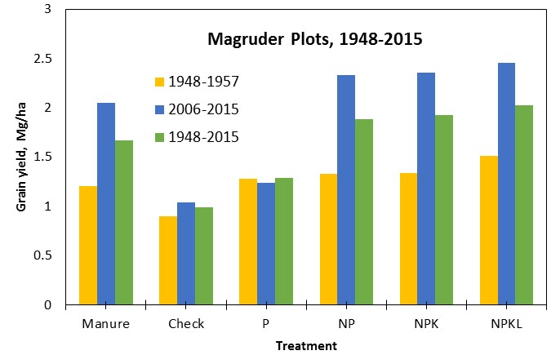

Slide 21
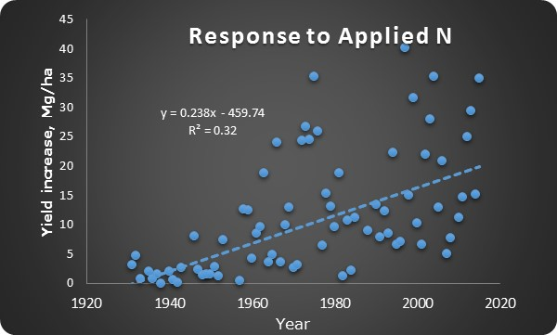
NP versus P

Slide 22
Raun, W. R., H. J. Barreto, and R. L. Westerman. 1993. Use of stability analysis for long-term soil fertility experiments. Agron. J. 85:159-167.
Guertal, E.A., W.R. Raun, R.L. Westerman and R.K. Boman. 1994. Applications of stability analysis for single-site, long-term experiments. Agron. J. 86:1016-1019.
Raun, W.R., and G.V. Johnson. 1995. Soil-plant buffering of inorganic nitrogen in continuous winter wheat. Agron. J. 87:827-834.
Stone, M.L., J.B. Solie, W.R. Raun, R.W. Whitney, S.L. Taylor and J.D. Ringer. 1996. Use of spectral radiance for correcting in-season fertilizer nitrogen deficiencies in winter wheat. Trans. ASAE 39(5):1623-1631.
Raun, W.R., G.V. Johnson, S.B. Phillips and R.L. Westerman. 1998. Effect of long-term nitrogen fertilization on soil organic C and total N in continuous wheat under conventional tillage in Oklahoma. Soil & Tillage Res. 47:323-330.
Raun, W.R., G.V. Johnson, H. Sembiring, E.V. Lukina, J.M. LaRuffa, W.E. Thomason, S.B. Phillips, J.B. Solie, M.L. Stone and R.W. Whitney. 1998. Indirect measures of plant nutrients. Commun. In Soil Sci. Plant Anal. 29:1571-1581.
Raun, W.R., G.V. Johnson, and R.L. Westerman. 1999. Fertilizer nitrogen recovery in long-term continuous winter wheat. Soil Sci. Soc. Am. J. 63:645-650.
Lees, H.L., W.R. Raun and G.V. Johnson. 2000. Increased plant N loss with increasing nitrogen applied in winter wheat observed with ¹⁵N. J. Plant Nutr. 23:219-230. (up to 42 Kg N/ha)
Thomason, W.E., W.R. Raun and G.V. Johnson. 2000. Winter wheat fertilizer nitrogen use efficiency in grain and forage production systems. J. Plant Nutr. 23:1505-1516. (82 versus 30)
NH4 and NO3 accumulation
Increase in soil organic C with Applied N
Plant N loss as NH₃ (42 kg N/ha)
NUE, (32.8%)
Grain versus forage production
(30 vs. 82%)
Predicting yields and yield goals, NDVI, Greenseeker
Stability Analysis

Slide 23
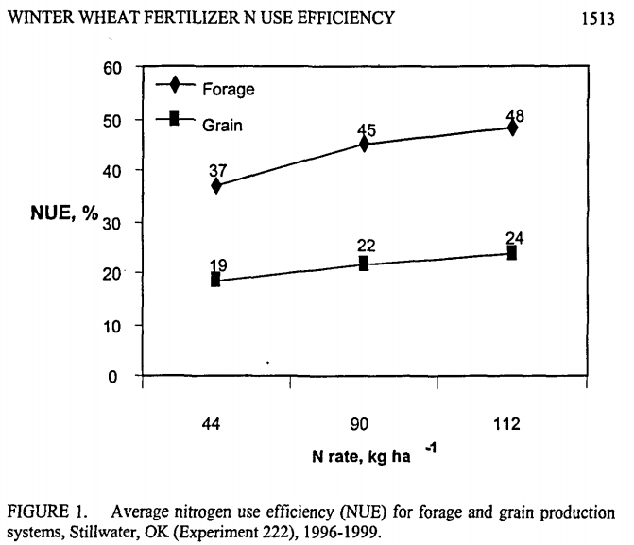
NUE Grain only versus Forage
80%, 2001

Slide 24
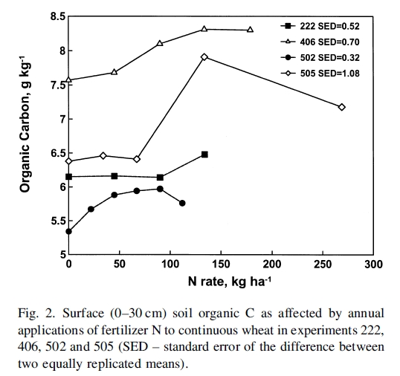
Long term N applied versus soil organic Carbon
1998
222: 1969
406: 1965
502: 1970
505: 1970

Slide 25
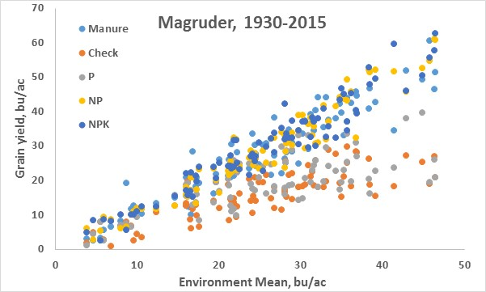
Stability Analysis
benefit of K in stress environments

Slide 26
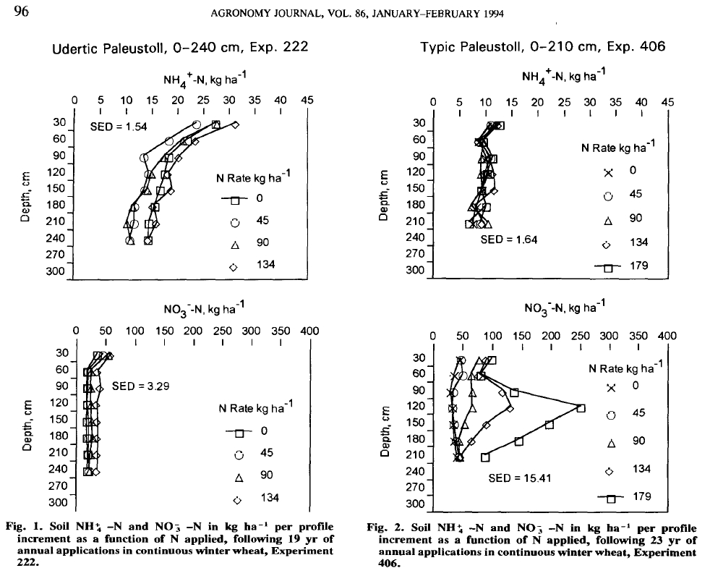

Slide 27

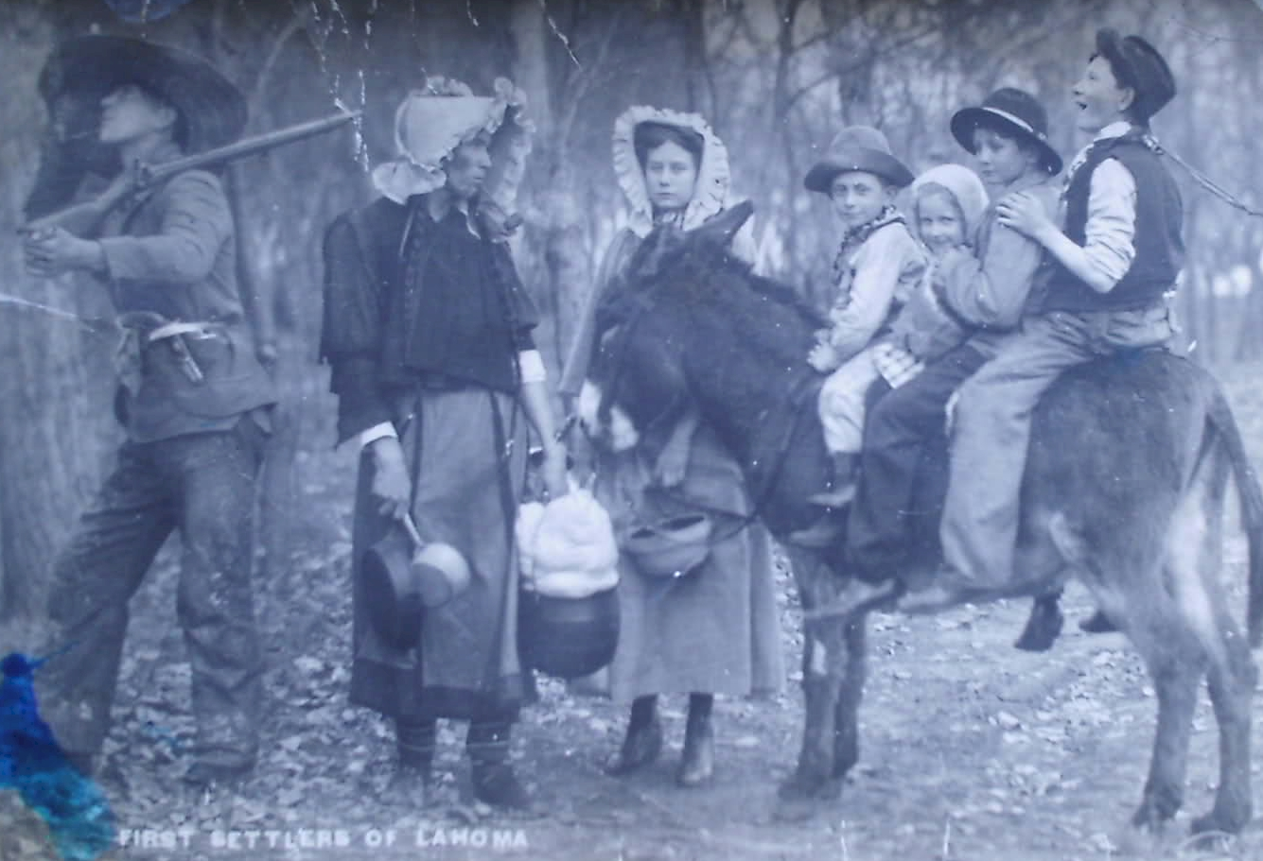
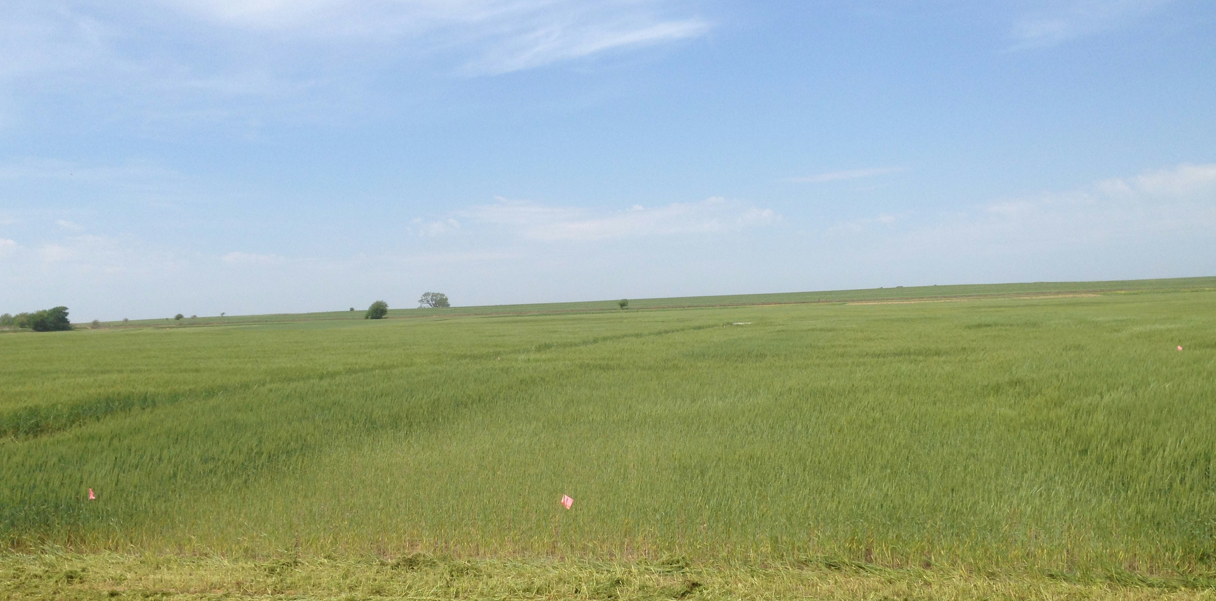
Experiment 502,
Lahoma, OK
1970-2015
83 cm (33 in) rainfall
36°23′17″N 98°5′20″W

Slide 28


AG-FS-3873 1989 Setting Realistic Crop Yield Goals
George Rehm and Michael Schmitt, University of Minnesota
Yield Goals
With favorable soil moisture and a good long range forecast, it would be smart to aim for a 10% to 20% increase over the recent average. This method allows for maximum flexibility in the establishment of yield goals.
Set your yield goal 5 to 10 percent above your average yield of the past five years. That way, if it's a good year, the crop will have enough nutrients to become a bumper crop. If it's an off year, the amount of excess nitrogen in the soil will be kept to a minimum.
Set Realistic Yield Goals
University of Illinois,

Slide 29
Yield Goals
Average of the last 3 or 5 years + 20% versus observed yield

Slide 32
Raun, W.R., G.V. Johnson, M.L. Stone, J.B. Solie, E.V. Lukina, W.E. Thomason and J.S. Schepers. 2001. In-season prediction of potential grain yield in winter wheat using canopy reflectance. Agron. J. 93:131-138.
Lukina, E.V., K.W. Freeman, K.J. Wynn, W.E. Thomason, R.W. Mullen, A.R. Klatt, G.V. Johnson, R.L. Elliott, M.L. Stone, J.B. Solie, and W.R. Raun. 2001. Nitrogen fertilization optimization algorithm based on in-season estimates of yield and plant nitrogen uptake. J. Plant Nutr. 24:885-898.
Raun, W.R., J.B. Solie, G.V. Johnson, M.L. Stone, R.W. Mullen, K.W. Freeman, W.E. Thomason, and E.V. Lukina. 2002. Improving nitrogen use efficiency in cereal grain production with optical sensing and variable rate application. Agron. J. 94:815-820.
Mullen, R.W., Kyle W. Freeman, William R. Raun, G.V. Johnson, M.L. Stone, and J.B. Solie. 2003. Identifying an in-season response index and the potential to increase wheat yield with nitrogen. Agron. J. 95:347-351.
Davis, R.L., J.J. Patton, R.K. Teal, Y. Tang, M.T. Humphreys, J. Mosali, K. Girma, J.W. Lawles, S.M. Moges, A. Malapati, J.Si, H. Zhang, S. Deng, G.V. Johnson, R.W. Mullen, and W.R. Raun. 2003. Nitrogen balance in the Magruder Plots following 109 years in continuous winter wheat. J. Plant Nutr. 26(8):1561-1580.
Moges, S.M., W.R. Raun, R.W. Mullen, K.W. Freeman, G.V. Johnson, and J.B. Solie. 2004. Evaluation of green, red and near infrared bands for predicting winter wheat biomass, nitrogen uptake, and final grain yield. J. Plant Nutr. 27: 1431-1414.
Sun, H.Y., S.P. Deng, and W.R. Raun. 2004. Bacterial community structure and diversity in a century-old manure-treated agroecosystem. Appl. Environ. Micro. 70:5868-5874.
Macnack, Natasha, Bee Chim Khim, Jeremiah Mullock, and William Raun. 2014. In season prediction of nitrogen use efficiency and grain protein in winter wheat, Triticum aestivum L.. Commun. Soil Sci. Plant Anal. 00:1-15. DOI:10.1080/00103624.2014.904337.
Variability in optimum N rates
Variability in N demand
NOx emissions
Response Index
Cyanobacteria, LT check plots
Prediction of grain protein%
Independence of YP0 and RI

Slide 33
Raun, W.R., J.B. Solie, M.L. Stone, K.L. Martin, K.W. Freeman, R.W. Mullen, H. Zhang J.S. Schepers, and G.V. Johnson. 2005. Optical sensor based algorithm for crop nitrogen fertilization. Commun. Soil Sci. Plant Anal. 36:2759-2781.
Girma, Kefyalew, K.L. Martin, R.H. Anderson, D.B. Arnall, K.D. Brixey, M.A. Casillas, B. Chung, B.C. Dobey, S.K. Kamenidou, S.K. Kariuki, E.E. Katsalirou, J.C. Morris, J.Q. Moss, C.T. Rohla, B.J. Sudbury, B.S. Tubana, and W.R. Raun. 2006. Mid-Season Prediction of Wheat Grain Yield Potential Using Plant, Soil, and Sensor Measurements. J. Plant Nutr. 29:873-897.
Arnall, D.B., W.R. Raun, J.B. Solie, M.L. Stone, G.V. Johnson, K. Desta, K.W. Freeman, R.K. Teal, and K.L. Martin. 2006. Relationship between coefficient of variation measured by spectral reflectance and plant density at early growth stages in winter wheat. J. Plant. Nutr. 29:1983-1997.
Girma, Kefyalew, R.K. Teal, K.W. Freeman, R.K. Boman, and W.R. Raun. 2007. Cotton lint yield and quality as affected by cultivar and long-term applications of N, P, and K fertilizers. J. Cotton Sci. 11:12-19.
Girma, Kefyalew, Starr L. Holtz, Daryl B. Arnall, Brenda S. Tubana, and William R. Raun. 2007. The Magruder Plots: untangling the puzzle. Agron J. 99:1191-1198.
Arnall, Daryl B., Brenda S. Tubaña, Starr L. Holtz, Kefyalew Girma and William R. Raun. 2009. Relationship between nitrogen use efficiency and response index in winter wheat. J. Plant Nutr. 32:502-515.
Raun, William R., John B. Solie, and Marvin L. Stone. 2011. Independence of yield potential and crop nitrogen response. Precision Agric. 12:508-518.
Solie, J.B., A.D. Monroe, W.R. Raun, and M.L. Stone. 2012. Generalized algorithm for variable nitrogen rate application in cereal grains. Agron. J. 104:378-387.
Arnall, D.B., A.P. Mallarino, M.D. Ruark, G.E. Varvel, J.B. Solie, M.L. Stone, J. L. Mullock, R.K. Taylor, and W.R. Raun*. 2013. Relationship between grain crop yield potential and nitrogen response. Agron. J. 105:1335–1344. doi:10.2134/agronj2013.0034
Yield prediction, NDVI
Nitrogen balance,
Within plot CV’s and NDVI to predict yield
MSE’s over years (combining sites)
Generalized algorithm

Slide 34
Raun, W.R., J.B. Solie, M.L. Stone, K.L. Martin, K.W. Freeman, R.W. Mullen, H. Zhang J.S. Schepers, and G.V. Johnson. 2005. Optical sensor based algorithm for crop nitrogen fertilization. Commun. Soil Sci. Plant Anal. 36:2759-2781.
Raun, William, Melissa Golden, Bruno Figueiredo, Jagmandeep Dhillon, Mariana Ramos Del Corso, Nicole Remondet, Mame Diatite-Koumba, Shawntel Ervin, Daniel Alidekki, Ethan Driver, Bill Jones, James Lasquites, Samuel Zoca, Patrick Watkins, and Jeremiah Mullock. 2015. Relationship between mean square errors and wheat grain yields in long-term experiments. J. Plant Nutr.
Bushong, J.T., J.L. Mullock, E.C. Miller, W.R. Raun, and D.B. Arnall. 2015. Evaluation of mid-season sensor based nitrogen fertilizer recommendations for winter wheat using different estimates of yield potential. J. Prec. Agric.
Macnack, N., and W.R. Raun. 2015. Effect of long-term beef manure application on soil test phosphorus, organic carbon and winter wheat yield. J. Plant Nutr.
National, International, multi crop Sensor Based N Algorithms (32)
Long-term Manure application

Slide 35
Source | Location | Years | Time period | (0-N) Yield Range | High N Yield Range | Opt. N rate kg ha⁻¹
 |  |  |  | Mg ha⁻¹ | Mg ha⁻¹ | Min | Max | Avg. | SD
Bundy et al. (2011) | WI | 21 | 1958-1983 | 1.6-7.6 | 4.3-8.8 | 50 | 233 | 130 | 53
Bundy et al. (2011) | WI | 9 | 1984-1997 | 2.7-5.6 | 5.7-9.96 | 58 | 235 | 179 | 51
Mallarino and Torres (2006) | IA | 20 | 1979-2003 | 0.8-5.9 | 5.1-12.4 | 81 | 237 | 165 | 49
Mallarino and Torres (2006) | IA | 14 | 1985-2010 | 1.4-6.2 | 5.3-12.8 | 134 | 239 | 197 | 32
Varvel et al. (2007) | NE | 5 | 1995-2005 | 6.6-10.9 | 10.4-13.3 | 73 | 193 | 131 | 49
Jokela et al.(1989) Carroll | MN | 3 | 1982-1984 | 5.5-7.3 | 7.1-9.1 | 5 | 131 | 84 | 69
Jokela et al.(1989) Webster | MN | 3 | 1982-1984 | 1.7-5.6 | 1.8-8.7 | 70 | 113 | 91 | 21
Fenster et al. (1976) Waseca | MN | 5 | 1970-1975 | 3.2-7.4 | 7.1-10.6 | 60 | 199 | 135 | 50
Fenster et al. (1976) Martin | MN | 7 | 1970-1976 | 3.8-8.2 | 4.0-9.6 | 23 | 126 | 69 | 36
Fenster et al. (1976) Martin | MN | 6 | 1971-1976 | 6.2-11.3 | 6.2-12.0 | 0 | 37 | 18 | 15
Al Kaisi et al.(2003) | CO | 3 | 1998-2000 | 5.6-10.2 | 8.3-10.8 | 66 | 111 | 91 | 23
Ismail et al.(1994) NT | KY | 20 | 1998-2000 | 2.1-7.4 | 5.2-10.9 | 35 | 230 | 128 | 46
Ismail et al.(1994) CT | KY | 20 | 1970-1990 | 1.9-9.5 | 3.5-10.4 | 0 | 203 | 98 | 52
Rice et al.(1986) NT | KY | 15 | 1970-1985 | 3.1-4.9 | 5.7-9.2 | 102 | 178 | 144 | 30
Rice et al.(1986) CT | KY | 15 | 1970-1985 | 1.9-6.1 | 5.0-8.8 | 69 | 204 | 124 | 47
Stecker et al.(1993)Columbia | MO | 3 | 1988-1990 | 3.3-5.6 | 6.0-10.1 | 99 | 194 | 153 | 49
Stecker et al.(1993)Novelty | MO | 3 | 1988-1990 | 4.5-7.2 | 6.7-9.9 | 45 | 182 | 103 | 71
Stecker et al.(1993) Corning | MO | 2 | 1989-1990 | 5.0-6.0 | 8.2-8.5 | 90 | 117 | 104 | 20
Peterson et al.(1989) | NE | 4 | 1983-1986 | 2.1-6.4 | 3.9-10.0 | 11 | 218 | 104 | 88
Eck (1982) | TX | 2 | 1977-1978 | 2.7-4.4 | 5.6-5.9 | 59 | 116 | 88 | 40
Shapiro et al.(2006) RS 51cm | NE | 3 | 1996-1998 | 6.2-8.9 | 9.4-11.1 | 69 | 96 | 83 | 13
Shapiro et al.(2006) RS76cm | NE | 3 | 1996-1998 | 5.0-8.9 | 7.1-11.0 | 13 | 114 | 75 | 54
Meisinger et al. (1985) MT | MD | 4 | 1974-1977 | 1.8-2.6 | 5.8-8.2 | 127 | 233 | 183 | 45
Meisinger et al. (1985) PT | MD | 4 | 1974-1977 | 2.7-4.2 | 5.1-8.1 | 36 | 196 | 142 | 75
Gehl et al.(2005) Rossville | KS | 2 | 2001-2002 | 6.4-7.9 | 11.3-12.6 | 182 | 204 | 193 | 15
Gehl et al.(2005) Scandia | KS | 2 | 2001-2002 | 2.7-7.4 | 3.8-11.5 | 51 | 160 | 105 | 77
Olson et al. (1986) | NE | 15 | 1969-1983 | 2.6-9.4 | 7.3-11.4 | 90 | 270 | 174 | 79
Total |  | 213 |  |  | average | 63 | 177 | 122 | 46
 |  |  |  |  | stdev | 43 | 57 | 43 | 21

Slide 36
Do Nitrogen Rates Change Every Year?
Source | Location | Years | Years | High N Yield Range | Check plot Yield Range | Optimum N rate
 |  |  |  | Mg ha⁻¹ | Mg ha⁻¹ | Min | Max | Avg.
Bundy et al. (2011) | WI | 21 | 1958-1983 | 4.3-8.8 | 1.57-7.59 | 46 | 213 | 119
Bundy et al. (2011) | WI | 24 | 1984-2007 | 5.7-14.1 | 1.67-5.58 | 143 | 334 | 238
Mallarino and Torres (2006) | IA | 32 | 1979-2010 | 5.1-12.5 | 0.75-5.91 | 75 | 314 | 193
Mallarino and Torres (2006) | IA | 26 | 1985-2010 | 5.3-12.8 | 1.4-6.3 | 123 | 332 | 214
Varvel et al. (2007) | NE | 11 | 1995-2005 | 10.4-13.6 | 3.5-10.9 | 67 | 280 | 191
Jokela et al.(1989) Carroll | MN | 3 | 1982-1984 | 7.1-9.1 | 5-7.3 | 5 | 120 | 77
Jokela et al.(1989) Webster | MN | 3 | 1982-1984 | 1.8-8.7 | 1.7-5.6 | 64 | 103 | 84
Fenster et al. (1976) Waseca | MN | 7 | 1970-1976 | 7.12-10.65 | 2.71-7.43 | 55 | 227 | 140
Fenster et al. (1976) Martin | MN | 7 | 1970-1976 | 4-9.6 | 3.8-8.2 | 21 | 116 | 62
Fenster et al. (1976) Martin | MN | 6 | 1971-1976 | 6.2-12 | 6.2-11.3 | 0 | 34 | 15
Al Kaisi et al.(2003) | CO | 3 | 1998-2000 | 5-14.1 | 3.53-12.57 | 24 | 126 | 84
Ismail et al.(1994) NT | KY | 20 | 1998-2000 | 5.2-10.9 | 2.1-7.4 | 32 | 211 | 117
Ismail et al.(1994) CT | KY | 20 | 1970-1990 | 3.5-10.4 | 1.9-9.5 | 0 | 186 | 90
Rice et al.(1986) NT | KY | 16 | 1970-1985 | 5.7-9.2 | 3.1-4.9 | 93 | 163 | 132
Rice et al.(1986) CT | KY | 16 | 1970-1985 | 5-8.8 | 1.9-6.1 | 63 | 187 | 114
Stecker et al.(1993) | MO | 3 | 1988-1990 | 6.04-10.13 | 3.32-5.59 | 91 | 178 | 140
Stecker et al.(1993) | MO | 3 | 1988-1990 | 6.7-9.9 | 4.54-7.2 | 42 | 167 | 94
Stecker et al.(1993) | MO | 2 | 1989-1990 | 8.2-8.5 | 4.95-5.98 | 82 | 108 | 95
Peterson et al.(1989) | NE | 4 | 1983-1986 | 3.9-10 | 2.1-6.4 | 10 | 200 | 96
Woodruff et al.(1983) | SC | 3 | 1974-1976 | 13-20.2 | 1.04-15.6 | 0 | 639 | 302
Eck (1982) | TX | 3 | 1977-1979 | 3.41-13.21 | 1.79-5.03 | 13 | 300 | 146
Shapiro et al.(2006) RS 51cm | NE | 3 | 1996-1998 | 9.4-11.14 | 6.24-8.93 | 64 | 88 | 76
Shapiro et al.(2006) RS76cm | NE | 3 | 1996-1998 | 7.12-11.04 | 5.02-8.88 | 12 | 105 | 69
Meisinger et al. (1985) MT | MD | 4 | 1974-1977 | 5.8-8.2 | 1.8-2.6 | 117 | 213 | 168
Meisinger et al. (1985) MT | MD | 4 | 1974-1977 | 5.1-8.1 | 2.7-4.2 | 33 | 180 | 130
Gehl et al.(2005) Ellinwood | KS | 4 | 2001-2002 | 9-11.9 | 2.7-7.2 | 147 | 307 | 220
Gehl et al.(2005) Rossville | KS | 2 | 2001-2002 | 11.3-12.6 | 6.4-7.9 | 167 | 187 | 177
Gehl et al.(2005) scandia | KS | 2 | 2001-2002 | 3.8-11.5 | 2.7-7.4 | 47 | 147 | 97
Gehl et al.(2005) Manhattan | KS | 2 | 2001-2002 | 10.5-10.7 | 2.8-6.4 | 143 | 260 | 202
Total |  | 257 |  |  | average | 61 | 208 | 134
 |  |  |  |  | stdev | 50 | 114 | 63

Slide 38
Thought/Theory
Yield potential and N responsiveness are independent. 0-N check plot yielded the same as the high N rate plot after years of continuous maize production.
Demand for fertilizer N changes every year as does the optimum N rate
Static N recommendations do not account for the variability in soil available N and maize N uptake as influenced by environment (temperature/rainfall)
Investment in long-term research continues to be needed

Slide 39
“Again, the results provide no clear indication of a change in N rates over time” (Page 11, Concepts and Rationale for Regional Nitrogen Rate Guidelines for Corn, ISU Extension, 2006)

Slide 40
Fertilizer recommendations that ignore yield entirely are limited to explaining less than 50% of the variation in the economic optimum N rate for maize (Lory and Scharf, 2003, Agron. J. 95:994-999)
Research conducted over locations and years in Missouri noted that economically optimum fertilizer N rates vary widely from year to year, field to field, and from place to place within a field (Scharf et al., 2005, Agron J. 97:452-461)
Because yield level and N responsiveness are independent, and both impact N demand, using both will assist in formulating more accurate fertilizer N recommendations (Arnall et al., 2013, Agron J. 105:1335-1344)

Slide 41
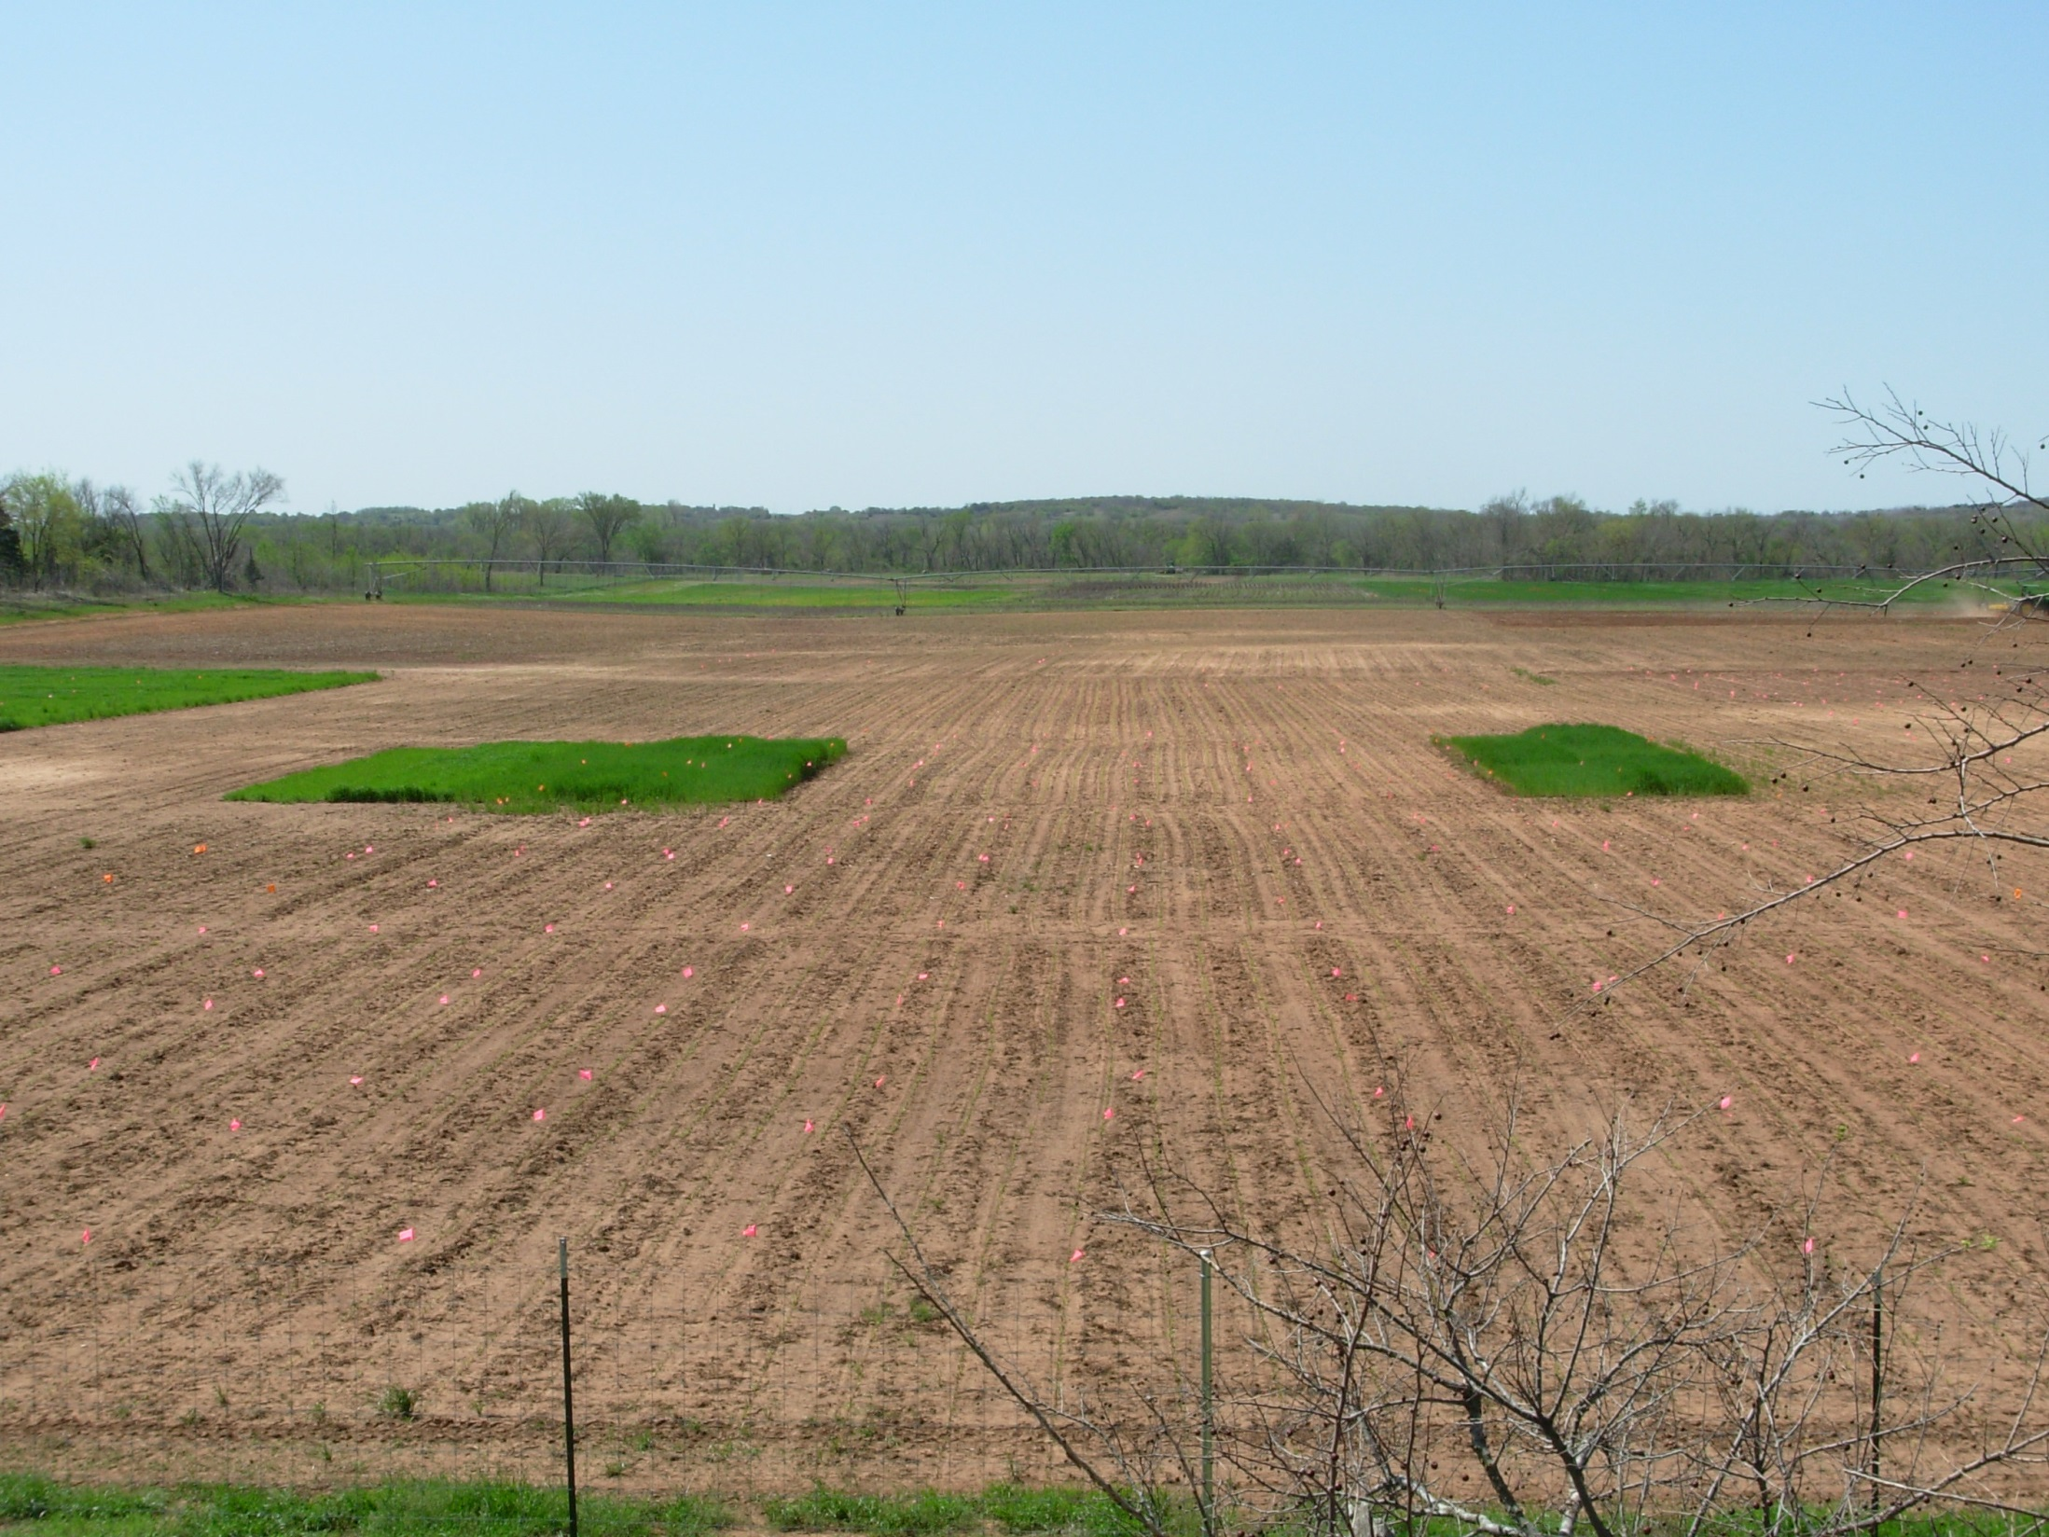
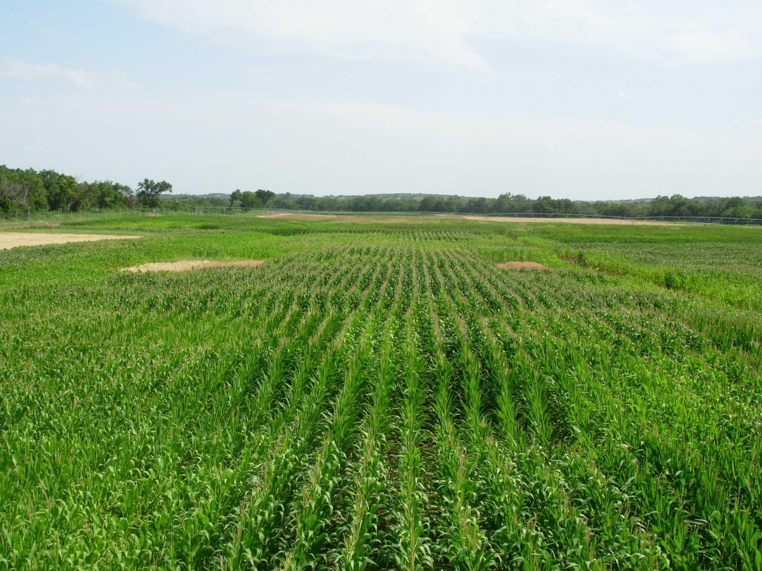
Indicator Crops, Eric Miller

Slide 42
Magruder Plots
 | N | P₂O₅ | K₂O
 | ---------- | lb/ac | --------
Manure | 240 lbs N/ac, every 4th year
Check | 0 | 0 | 0
P | 0 | 30 | 0
NP | 60 | 30 | 0
NPK | 60 | 30 | 30
NPKL * | 60 | 30 | 30
*, pH <5.5, 3T/ac

Slide 43
