Slide 1
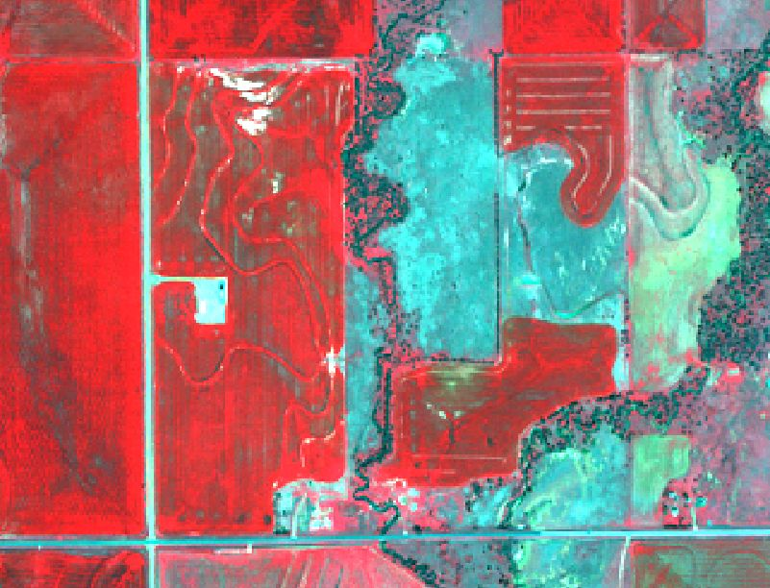
Theory of Predicting Crop Response to Non-Limiting Nitrogen

Slide 2
What do N Rich Strips Say About N Rate Algorithms? + Quite a Bit of Geostatistics

Slide 3
What do N Rich Strips Say About N Rate Algorithms? – Part II, with a little geostatistics

Slide 4
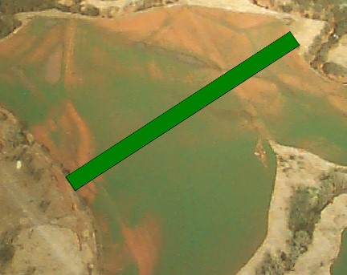
Nitrogen Rich Strip
Apply one Non-Limiting Nitrogen strip across the field between preplant fertilization and shortly after emergence. Use this as a reference strip to determine N rate.
Concept first proposed in 1994 by Dr. James Schepers

Slide 5
NRich (N Reference) Strip Enables Paired Comparison of Field Practice N Fertility and Non-Limiting N Fertility
Paired sampling of N Rich and Field Rate NDVI from either IKONIS or GreenSeeker imagery
Measure Nrich NDVI and calculate expected yield
Measure Field Rate NDVI

Slide 6
How Should We Interpret RINDVI
In 2007, we examined RI_{NDVI} indirectly by transforming the data to potential yield
This year, I will examine R_{INDVI} directly and compare measured RI to RI predicted by the OSU algorithm
The goal of this is to:
Better understand the relationship between FpNDVI and RI_{NDVI}
provide a method for evaluating algorithms based on measured paired comparisons of vegetative growth through part of the season

Slide 7
Model of R_{INDV} for three crops and 6,216 data points

Slide 8
RI Model for Wheat

Slide 9
Wheat RI Model from Experimental Data

Slide 10
Location and Year Effects on RI

Slide 11
Comparison of RI Curves Constructed from NRich Strips and Field Experiments

Slide 12
RI NDVI Corn Model Calculated from Field Averages of FpNDVI and NRich NDVI

Slide 13
Yield Potential Model for All Crops Wheat Data Shown in Graph

Slide 14
Response Index Theory for Fertilizer N Response

Slide 15
Comparing RI NDVI Model to OSU Model
?

Slide 16
Comparison of OSU Topdress Rate to RI NDVI Model Topdress Rate
?

Slide 17
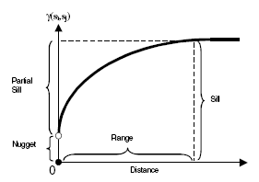
Semivariogram
Region where samples remain correlated (i.e. integral scale) or region of high relatedness
Indication of spatial strength.
Integral Scale
Overall sample variance.
Measure of undetermined small scale variability and sampling error.
Distance “range” where data is spatially related.

Slide 18
Results Intermediate Scale Sensing or Sampling
Data Type | Date | Nugget | Nugget:Sill | Range (m) | Lag Size (m) | Lag No. | Integral Scale (m) | Model Error (RMSS) | Model Error (SME)
Yield (bu/acre) | 2005 | 4.636 | 0.06 | 24 | 3.5 | 7 | 5.4 | 1.02 | 0.00381
Yield (bu/acre) | 2006 | 0 | 0 | 24 | 3.5 | 7 | 5.6 | 0.77 | 0.00243
Yield (bu/acre) | 2007 | 0 | 0 | 22 | 3.4 | 7 | 5.3 | 1.08 | 0.00543
NDVI_{GreenSeeker™} | 18-Dec-04 | 0 | 0 | 12 | 0.7 | 17 | 3.8 | 1.91 | 0.00028
NDVI_{GreenSeeker™} | 17-Mar-06 | 0.001 | 0.62 | 43 | 5.4 | 8 | 4.5 | 0.97 | -0.00540
NDVI_{GreenSeeker™} | 6-Apr-06 | 0.005 | 0.58 | 72 | 8.1 | 9 | 6.2 | 0.92 | -0.00381
NDVI_{GreenSeeker™} | 4-Mar-07 | 0.003 | 0.26 | 9 | 1.2 | 8 | 3.0 | 0.95 | -0.00021
NDVI_{GreenSeeker™} | 1-Mar-08 | 0.006 | 0.58 | 30 | 4.7 | 8 | 4.0 | 0.87 | -0.00121
NDVI_{GreenSeeker™} | 16-Mar-08 | 0.010 | 0.57 | 30 | 4.7 | 7 | 4.0 | 0.91 | -0.00250
Soil Test NO₃-N_{0-15cm} | 15-Aug-06 | 1.200 | 0.85 | 181 | 26.0 | 7 | 5.9 | 1.00 | 0.00069
Soil Test NO₃-N_{15-30cm} | 15-Aug-06 | 0.191 | 0.82 | 174 | 22.0 | 8 | 6.3 | 1.00 | -0.00975
Soil Test P | 15-Aug-06 | 0.041 | 0.48 | 168 | 19.0 | 9 | 10.5 | 1.01 | -0.01894
Soil Test K | 15-Aug-06 | 0.011 | 0.46 | 150 | 19.0 | 8 | 10.1 | 1.01 | 0.00416
Soil Test pH | 15-Aug-06 | 0.147 | 0.36 | 168 | 19.0 | 9 | 11.7 | 0.98 | 0.01491
Soil Test TSS | 15-Aug-06 | 0.068 | 0.84 | 158 | 20.0 | 8 | 5.7 | 1.00 | 0.00475
Soil Test OM | 15-Aug-06 | 0.012 | 0.36 | 158 | 20.0 | 8 | 11.3 | 0.92 | 0.00010
Soil EC_{Veris 0-30cm} | 2005 | 0.002 | 0.04 | 35 | 5.0 | 7 | 6.5 | 0.79 | -0.00004
Soil EC_{Veris 0-91cm} | 2005 | 0 | 0 | 42 | 6.0 | 7 | 7.3 | 0.80 | -0.00005

Slide 19
Recommendations for Measuring RI NDVI
Pair your farmer practice treatment and your NRich treatments in your experiment design or (in the case of statistical purists) insert an extra farmer practice treatment which is paired with your NRich treatments.
To maximize spatial relatedness, your sensor measurements from the two treatments should be spaced no more than three to four meters apart.
At greater distances, relatedness declines and variability (error) in the value of RI increases.
Remember that beyond the range measurements can be highly related by chance. Between the integral scale and the range, the odds of the measurements being highly related declines rapidly.

Slide 20
Conclusions
Paired comparisions between field N rate and non-limiting N rate along an NRich strip define the relationship between the existing and optimum N application rate.
All algorithms purporting to determine N application rate must account for the relationships between FpNDVI and NRich NDVI defined by the NRich strip.
These relationships vary from year to year and location to location.
The Power/Cosh model appears to accurately predict the NDVI Response Index as a function of FpNDVI.

