Slide 1
An update on Kansas sensor based N recommendations
Drew Tucker and Dave Mengel
KSU Agronomy

Slide 2
Background:
Our program was started in 2005 with a visit to OSU.
  Visited Bill Raun and John Soley that summer
  Bill gave us a GreenSeeker red handheld unit to use
  Hired Drew Tucker as a GRA to work on the project
We began taking measurements with the GreenSeeker red sensor on an existing sorghum experiment that summer with the intent of seeing how it worked, and if it did, develop K-State N rec’s for wheat, and sorghum.

Slide 3
Background:
We put out our first field trials in 2006:
  Focus was on sorghum and wheat as those crops were where we felt we could make the greatest impact.
Purchased a Crop Circle amber sensor in 2006.
  Setting between OSU and UNL-ARS, we wanted to understand the differences between the two sensors and the different approaches the two groups were taking
  We wanted to determine if we needed different algorithms for different sensors.

Slide 4
Where we’re at today
Initial downloadable algorithms (GreenSeeker based) were made available to the public for wheat and sorghum through the K-State Soil Testing Lab website in January 2009.
K-State algorithm options were added to the menu of the GreenSeeker control unit for wheat and sorghum for the 2009 crop year.
Corn algorithms for use at V-8/9 will be available for 2010.

Slide 5
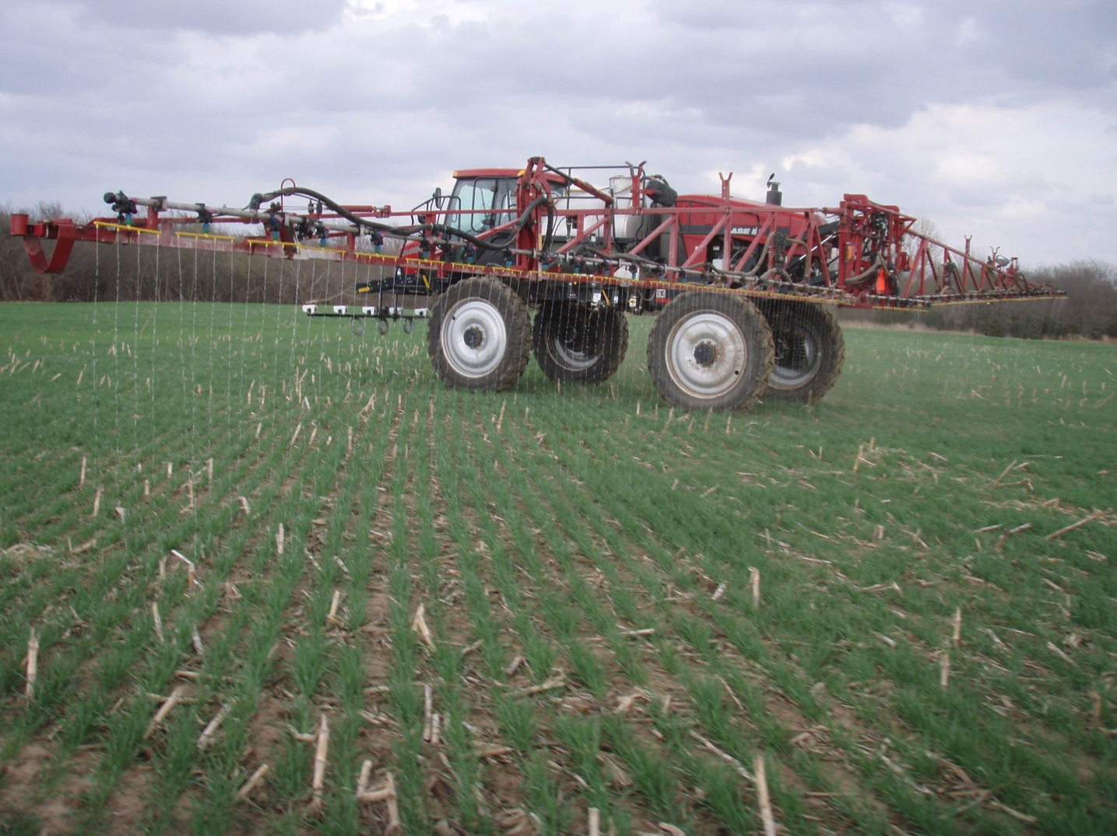
General Approach

Slide 6
Our General Approach to Algorithms and Rate Calculators
Our approach to developing rate calculators is based on:
  An in-field reference strip; calculated RI; relationship of RI at sensing to RI at harvest; expected N uptake; and NUE.
  Yield potential is estimated from reference strip.
  Yield response to additional N is based on the expected RI at harvest based on RI at sensing and yield potential of reference.
  Additional N need to optimize yield is estimated from N uptake data across a range of yield levels,
  Estimated NUE is used to covert N uptake need to fertilizer N need. Base is 50%, but can be adjusted up or down based on soils, climate or management practice.

Slide 7
K-State Grain Sorghum Nitrogen Rate Calculator

Slide 8
Grain sorghum yield relationship used to estimate yield potential of the field.
Notes:
DAP is days from planting to sensing when average temperature is greater than 63 degrees F which is the min. temperature for seed germination.

Slide 9
Grain Sorghum Yields vs. NDVI 2006-2008
Notes:
9
This is just using the pre-plant data only from the main experiments from 2006-2008. There are 10 site years represented here.

Slide 10
Grain Sorghum Yields vs. NDVI/GDU’s 2006-2008
Notes:
10
If we got to a Gdd’s approach we can do a better job than just a straight NDVI. Due to the approach of being a little bit more difficult for farmer’s to calculate, and sorghum’s growing nature, we plan on sticking with just a NDVI/DAP or INSEY approach.

Slide 11
RI at GS-3 vs. RI Grain Yield at Harvest used to calculate yield response to added N (delta yld)
Notes:
11
This graph is what we use to correct RI at GS-3 to a RI of grain yield so we can calculate a delta yield approach.

Slide 12
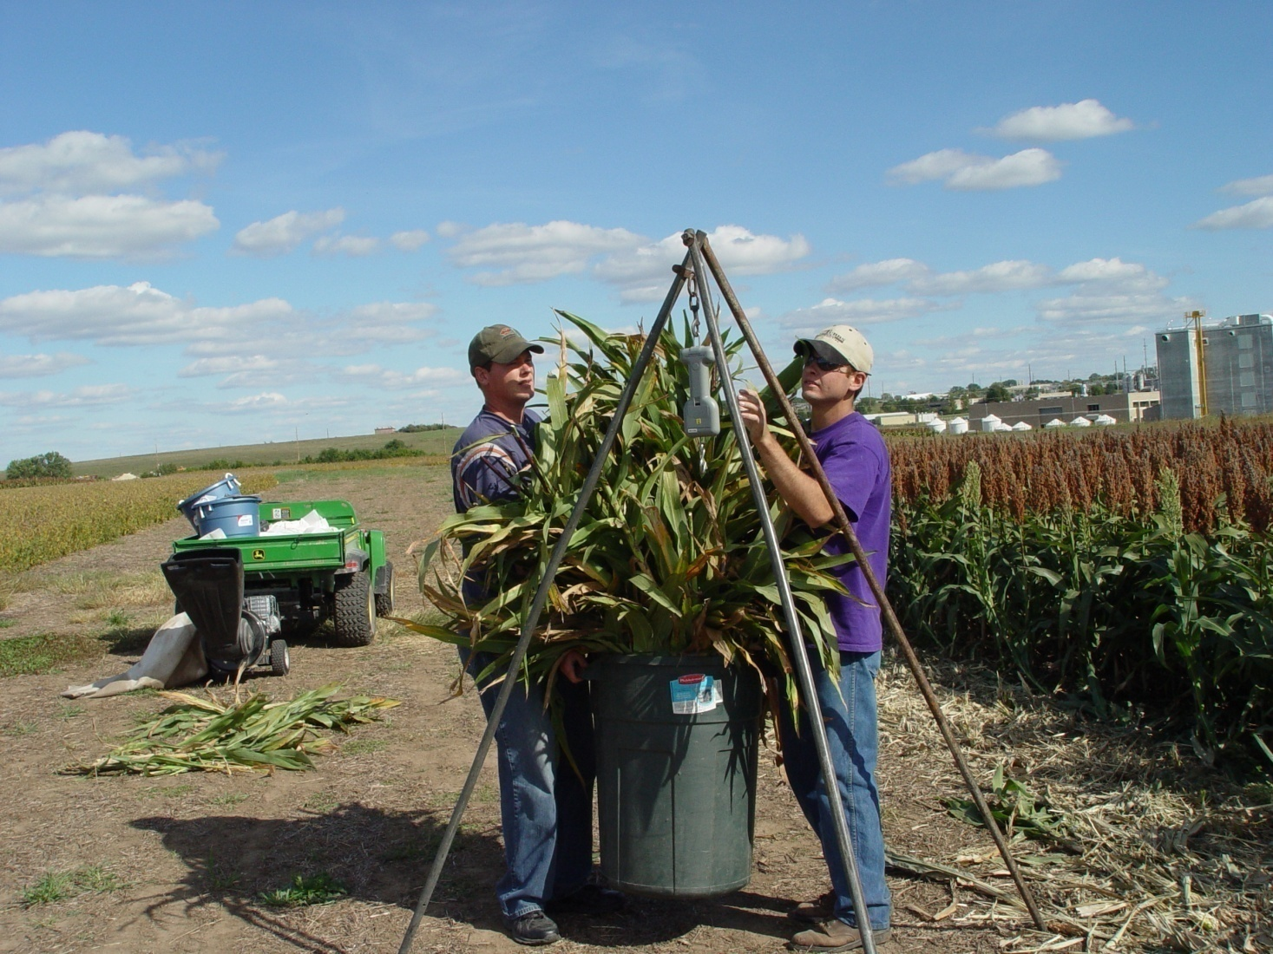
Measuring biomass and uptake

Slide 13
Sorghum N Uptake (grain+stover) vs. Yield
Notes:
If you solve for lbs N/bu at 100 bushel yield level you will get .95 lbs N/bushel increase.

Slide 14
Example calculation
Reference strip NDVI = 0.60 @ 35 DAP, INSEY = 0.0171
Farmer Practice NDVI = 0.57, INSEY = 0.0163
  RI vegetation = 1.05, RI grain = 1.26
  Yield potential of fertilized reference strip, 100 bu/ac
    For farmer practice without additional fertilizer, 80 bu/ac
    Calculated from reference yield potential and RI grain
    N uptake needed to gain additional 20bu yield to realize potential
      20 bushels x 0.95 lbs N/bu = 19 lbs N uptake per acre
      Adjusted for NUE or recovery 19/0.5 = 38 lbs N fert/ac

Slide 15
Grain Sorghum Nitrogen Sensor Calculator Performance 2006-2008
Notes:
Our best soil based system had a mean difference of 26 lbs/ac.

Slide 16
Comparison of Sensor Based N Rec’s to Soil Test Based Rec’s, 2006-2008
Notes:
This is the new summary table when using the table listed in the previous slide and using efficiency factors of .4 for below 60, .5 if it was between 60-100, .55 if it was between 100-120, and .60 for 120-140, and .65 for above. One important thing to remember is if we get within 10 pounds one way or the other is we are really only trading dollars once you get that close due to the nature of the N responsiveness curve. In years where the price of grain is low compared to the price of fertilizer, we want to be 10 pounds on the negative side, and vice versa. A yield goal of 120 was used at Manhattan, and 80 at all other sites.

Slide 17
Notes:
This shows how well the two sensors correlate when it comes to NDVI, notice that this relationship isn’t one to one though.

Slide 18
Notes:
This shows how the two RI’s relate to each other, once again this relationship isn’t one to one, therefore the two sensors would need two different sensor recommendations.

Slide 19
Notes:
This shows you how the recommendations would differ based on their RI at the 120 bushel yield level, this difference is primarily due to the sensors differences in wavelength, wavelength intensity, and wavelength width.

Slide 20
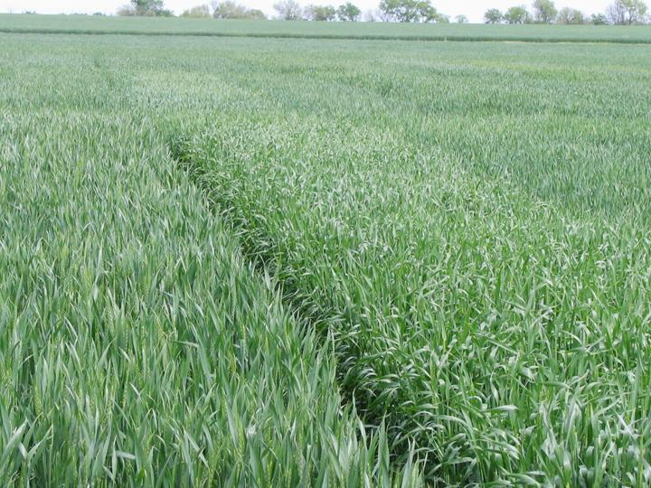

Slide 21
Winter Wheat N Rate Calculator

Slide 22
Winter Wheat Yield Prediction 2006-2008
Notes:
INSEY is NDVI/DAP where the average temp is greater than 40 degrees F. This is the min. temperature for wheat growth.

Slide 23
Winter Wheat Nitrogen Sensor Calculator Performance 2006-2009
Notes:
Johnson 2009 was abnormally dry after N application, which resulted in lower NUE, and in Partridge heavy weed pressure induced a higher N response than what was expected.

Slide 24
Issues with sensing wheat
Planting date and spring vegetation
  In western KS (and I assume OK) more 2nd year and cont wheat is grown, it’s planted early, more fall-early spring growth, and the sensor can be used successfully at earlier growth stages (Feekes 3?)
    With the very early planting common in W Kansas can actually use the sensor before dormancy in the fall in many fields.
  In eastern Kansas, wheat is planted later (after soybeans), barely emerges prior to winter and you don’t get adequate levels of vegetation for sensing until much later in the spring (Feekes 4/5).
    Problem is multiplied with no-till wheat.

Slide 25
Future work on sorghum and wheat
Testing on farmers fields to confirm the rate calculators work in the real world.
  Started in 2009, but will be the primary focus of our wheat and sorghum work in 2010.
  Algorithms seem to work well when little or no N is applied at or near planting.
    But what about fields where 50% of the expected need was applied preplant?
    Or a rescue situation where large amounts of preplant N was lost very early?

Slide 26
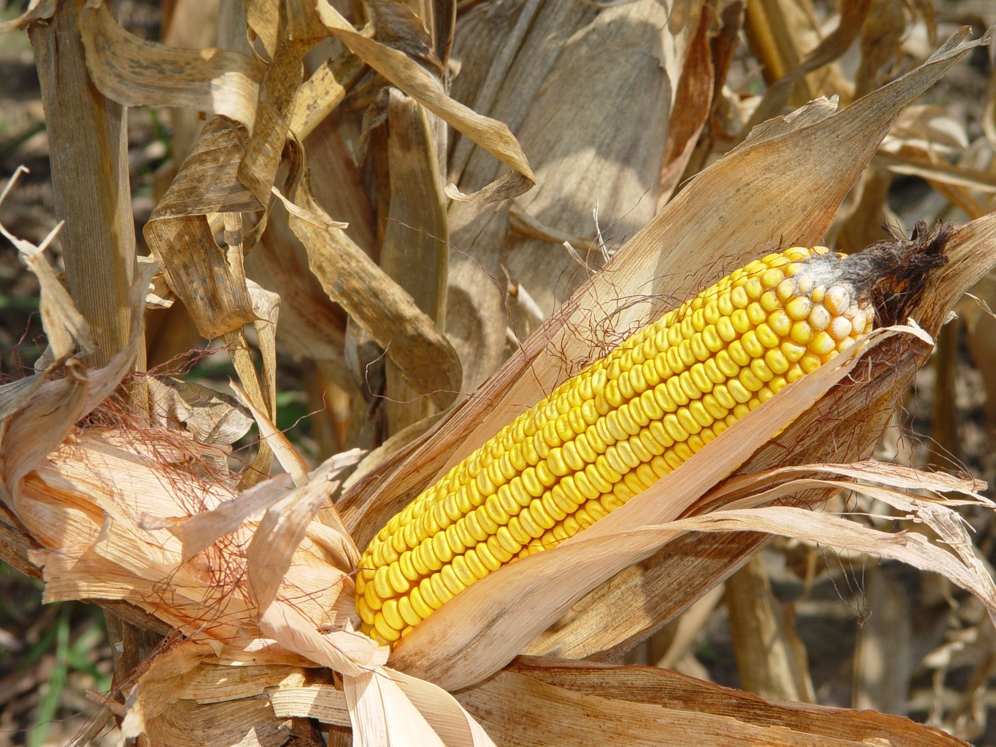

Slide 27
Corn work
In 2007 we initiated a corn study focused on using the GS and CC at the V-8/9 growth stage. This study was initiated at Rossville (NE) and Tribune (WC) under sprinkler irrigation.
In 2008 added a flood irrigated site at Colby (NW), and a high yielding dryland site at Manhattan.

Slide 28
Results from corn work at Rossville, KS 2007&8
Treatment | Total N Applied |  | Grain Yield |  | Total N Uptake
 | 2007 | 2008 | 2007 | 2008 | 2007 | 2008
Starter Only | 20 | 20 | 135 | 82 | 88 | 51
120 S+ pre | 120 | 120 | 219 | 213 | 168 | 146
160 | 160 | 160 | 218 | 228 | 154 | 163
200 | 200 | 200 | 227 | 234 | 183 | 186
120 split | 120 | 120 | 223 | 201 | 182 | 141
160 split | 160 | 160 | 224 | 222 | 172 | 152
200 split | 200 | 200 | 219 | 226 | 176 | 162
120 + GS | 125 | 163 | 224 | 224 | 166 | 155
120 + CC | 125 | 178 | 224 | 222 | 163 | 153
120 + Spad | 130 | 143 | 215 | 210 | 167 | 140
GS + Spad | 120 | 130 | 214 | 227 | 174 | 148
CC + Spad | 120 | 175 | 212 | 230 | 156 | 166

Slide 29
Corn Yield Prediction 2006-2008

Slide 30
Corn Sensor Based N Rate Calculator
Will be finished after this years field work is finished.
Will be similar to other calculators.
Hopefully the performance will be as good as the other two.

Slide 31
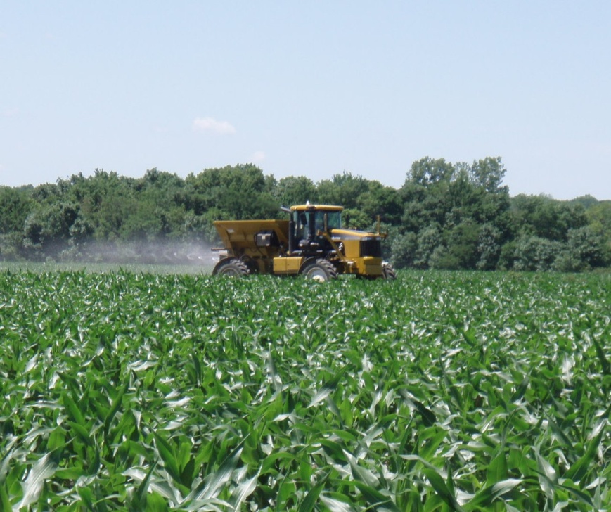
Additional work on corn
Late season rescue N applications to corn at V-12 to 16 using high clearance sprayers.
  Work started in 2009, both on research farms and with cooperative farmers and dealers/custom applicators

Slide 32
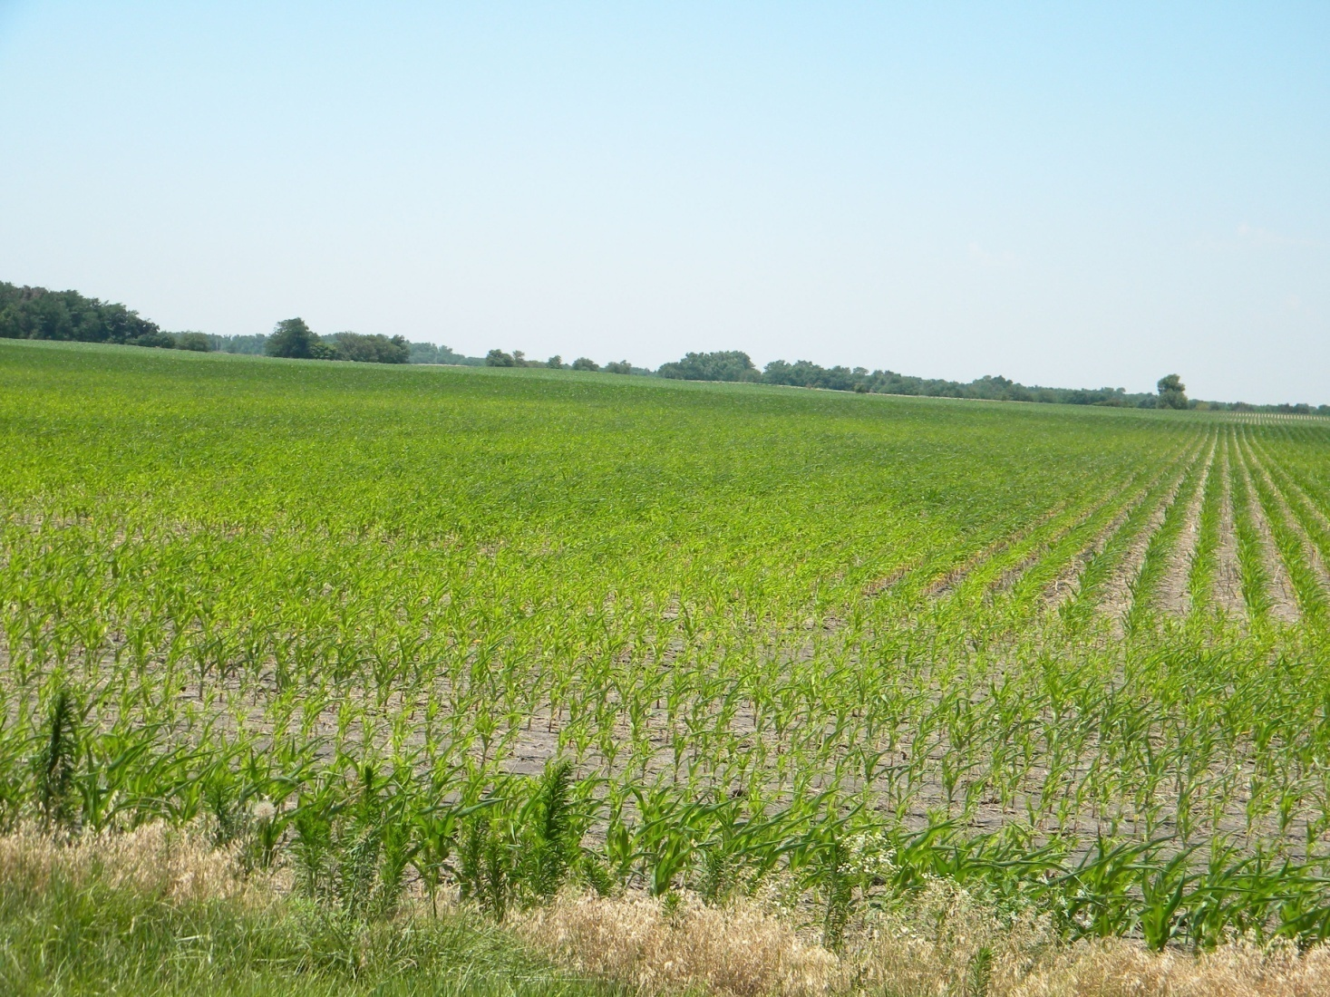
Loss of preplant N, KS 2009

Slide 33
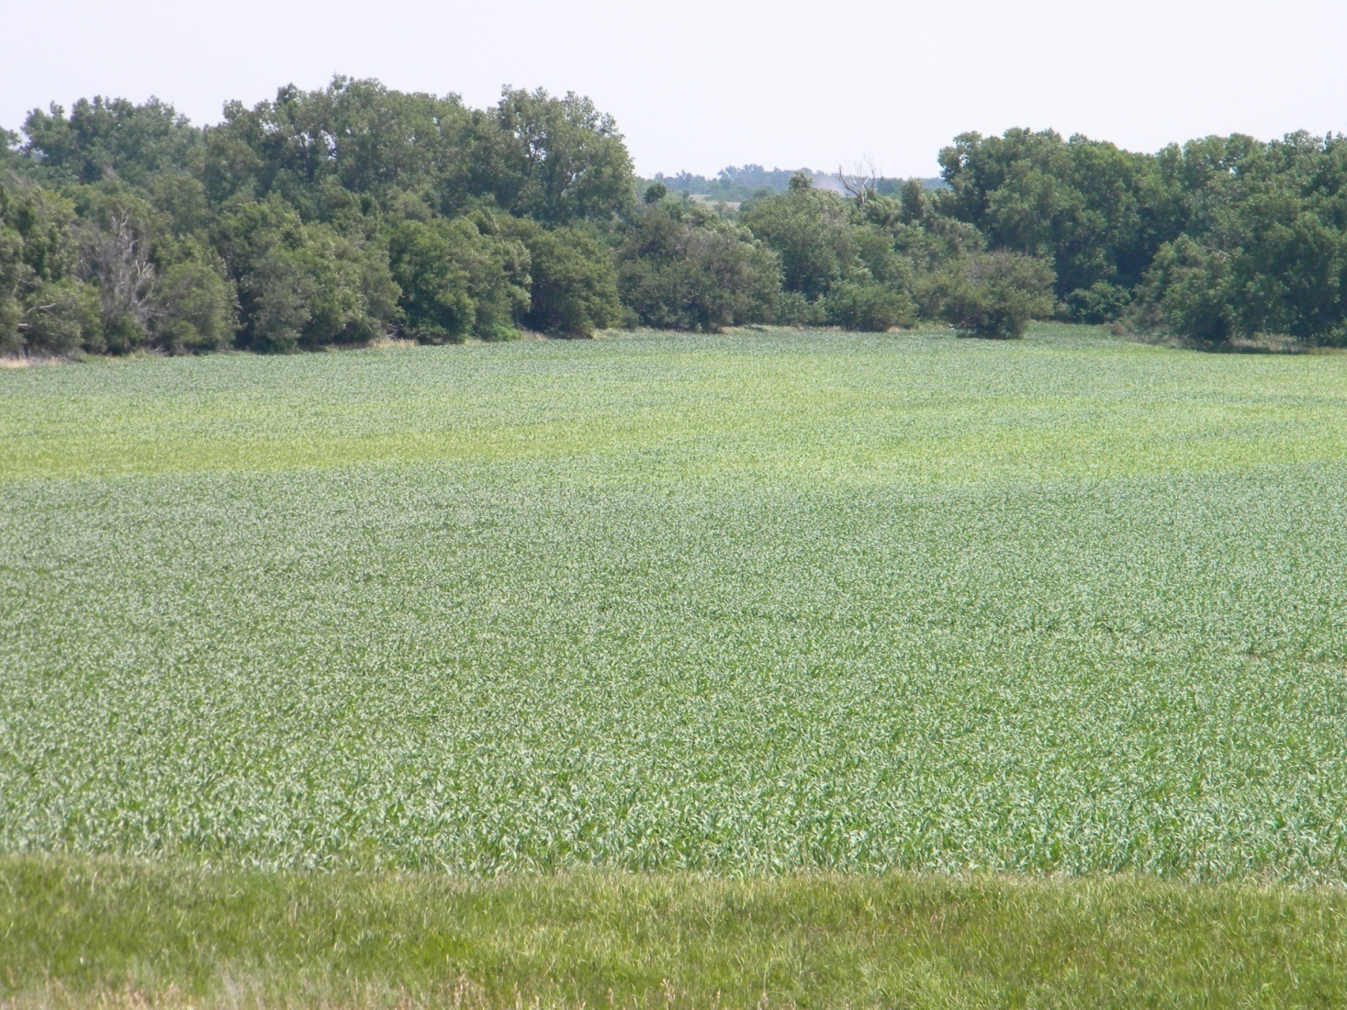
Denitrification N loss in corn, KS 2009

Slide 34
Issues with corn
Biomass/sensor saturation
  Purchased a Crop Circle ACS470 to look at the “red edge”
  Working in the row middle to reduce biomass in the sensor footprint.

Slide 35
Red Edge NDVI vs. Red NDVI from GreenSeeker and Crop Circle Sensors
Notes:
35
This graph is what we use to correct RI at GS-3 to a RI of grain yield so we can calculate a delta yield approach.

Slide 36
Estimating NUE
Can we estimate expected NUE/Recovery based on soil, climate and crop-fertilizer management?
Project initiated in 2008
  Includes both a “data mining” and field component
  Intent is to provide quantitative estimates of the expected NUE from different management practices as impacted by soils and climate.
  Using standard practices as base and providing/developing adjustment coefficients up or down.

Slide 37
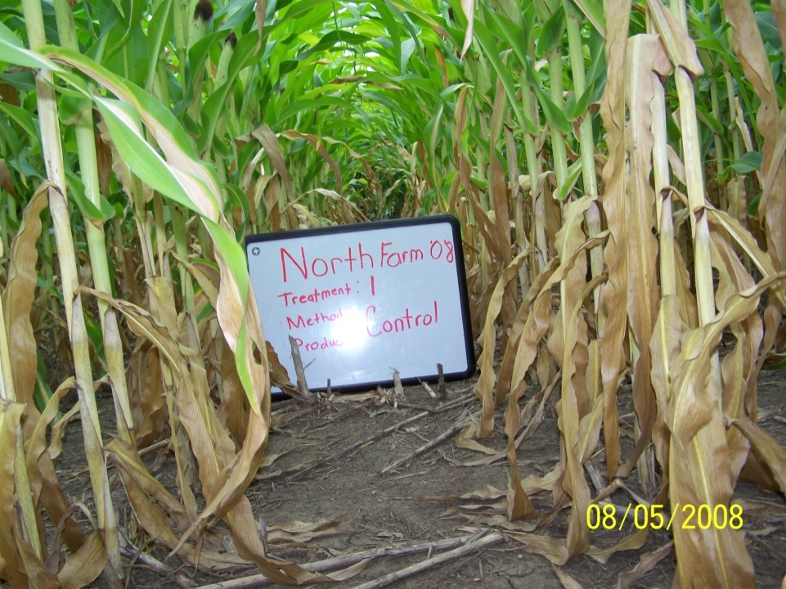
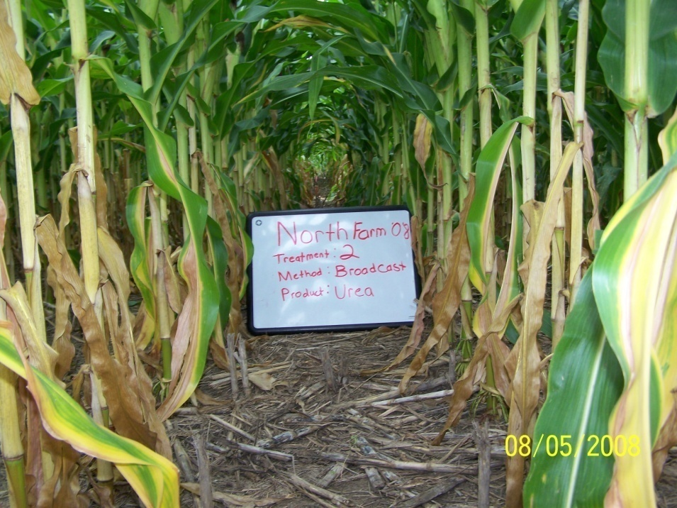
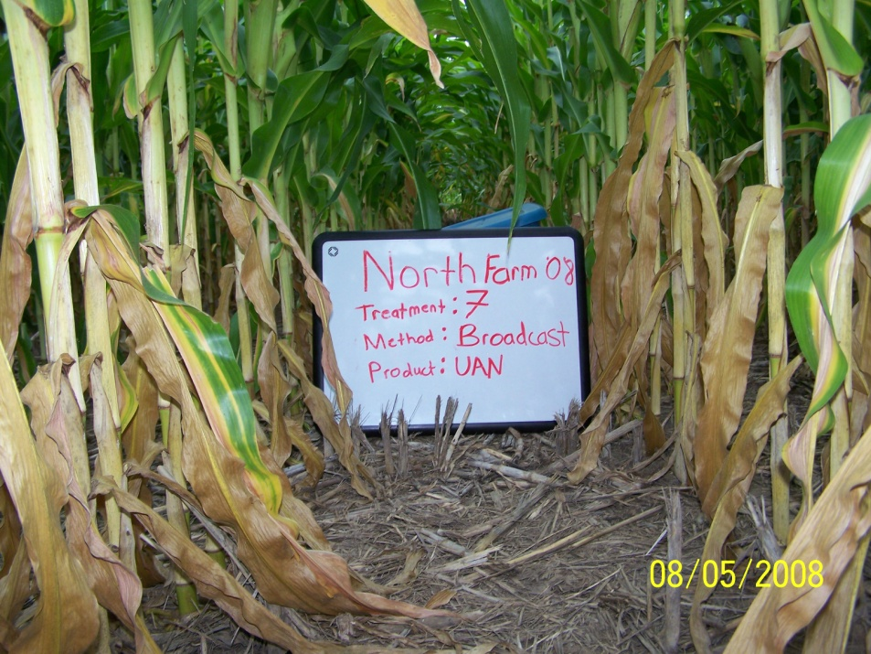
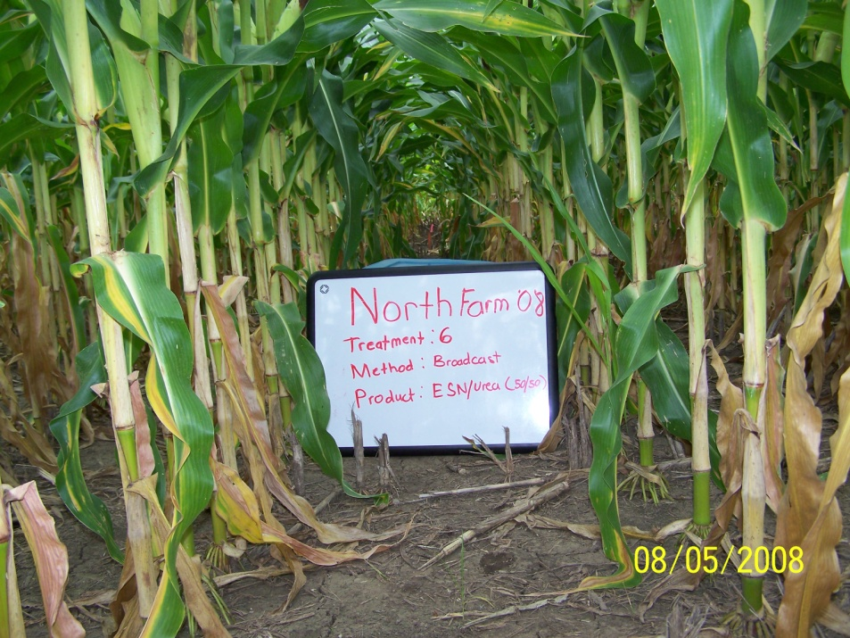

Slide 38
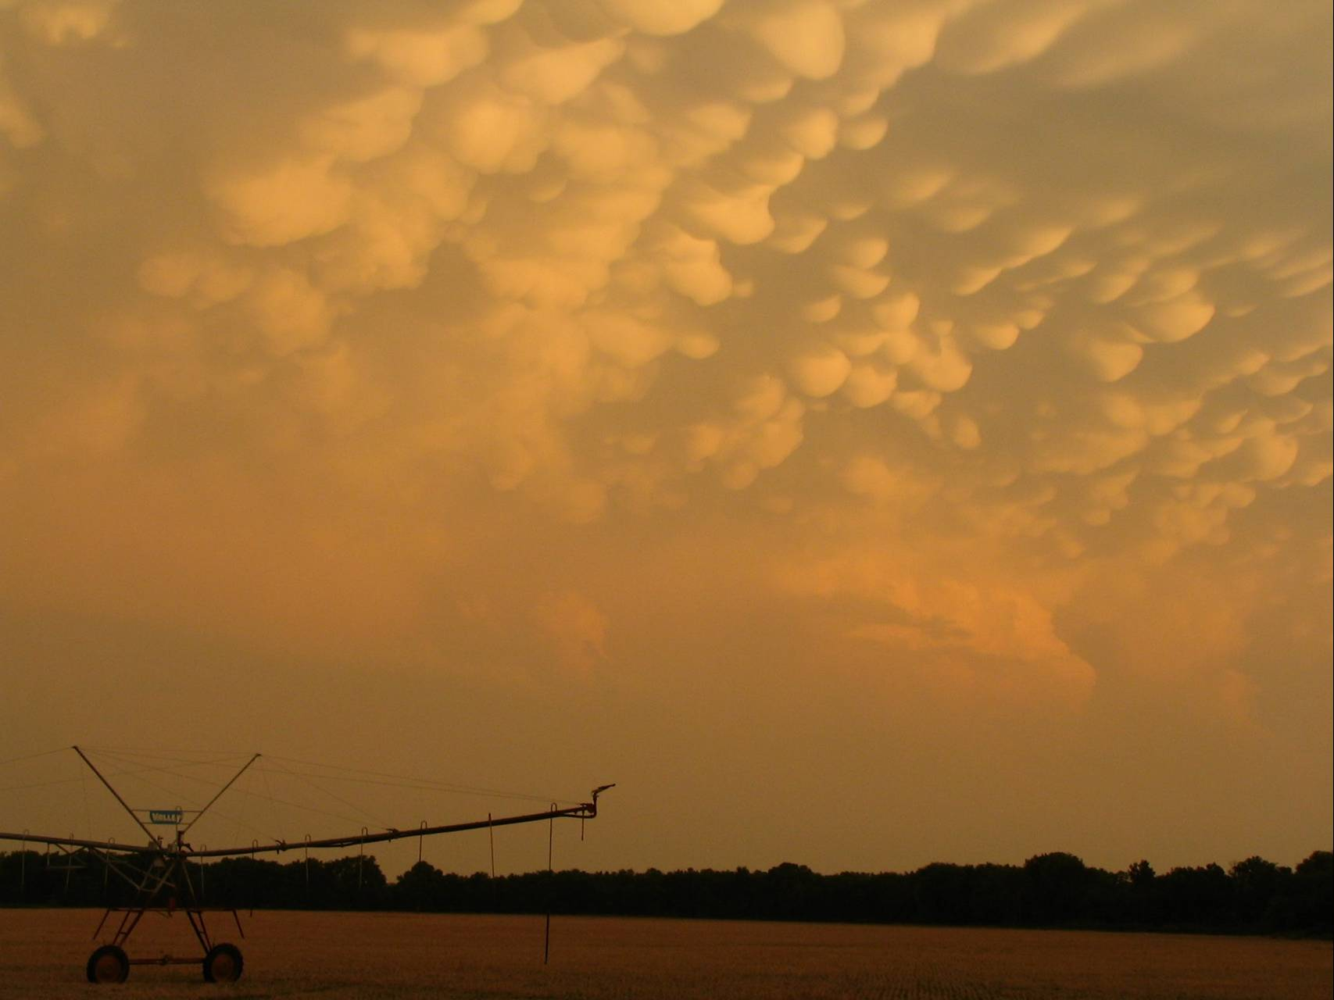
Questions?

