Slide 1
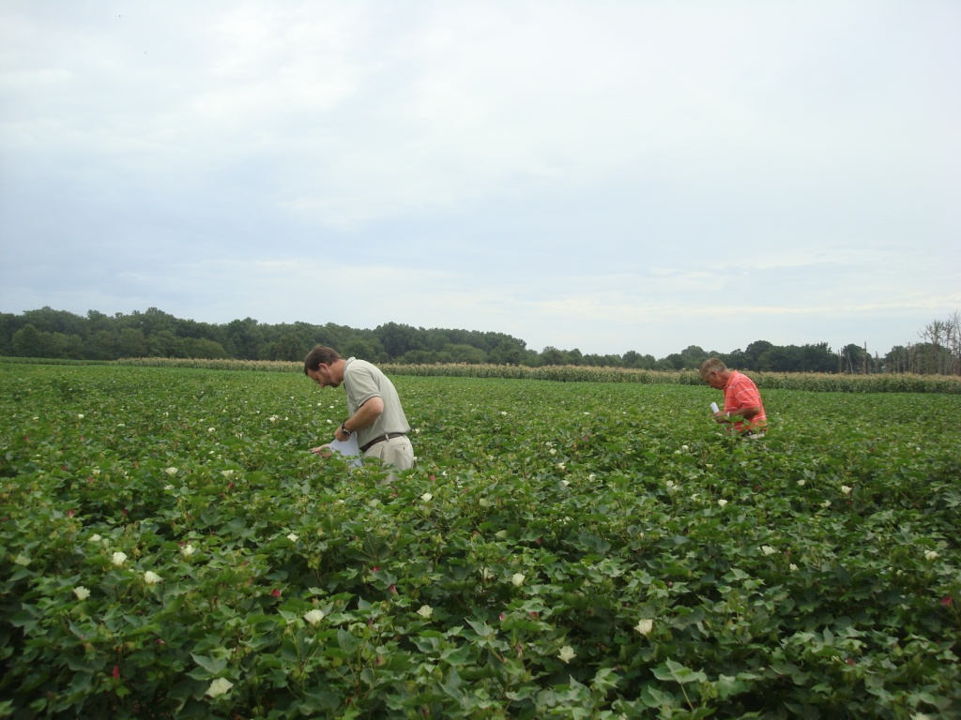










Sensor-Based Approaches for Cotton Nitrogen Management

Slide 2
Outline
Introduction
2008 Sensor Projects
Sensor-based approaches to manage nitrogen
Core data collection

Slide 3
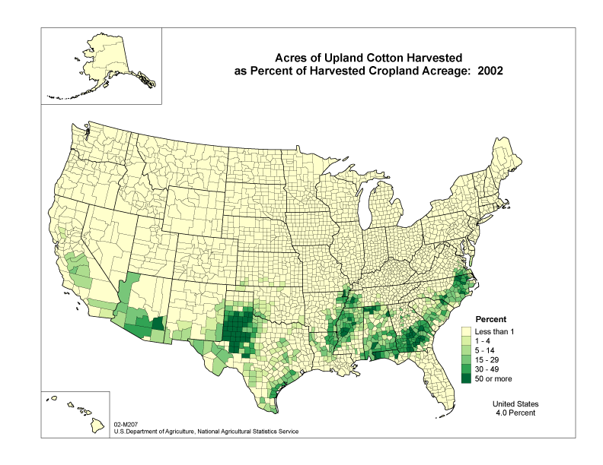

Slide 4
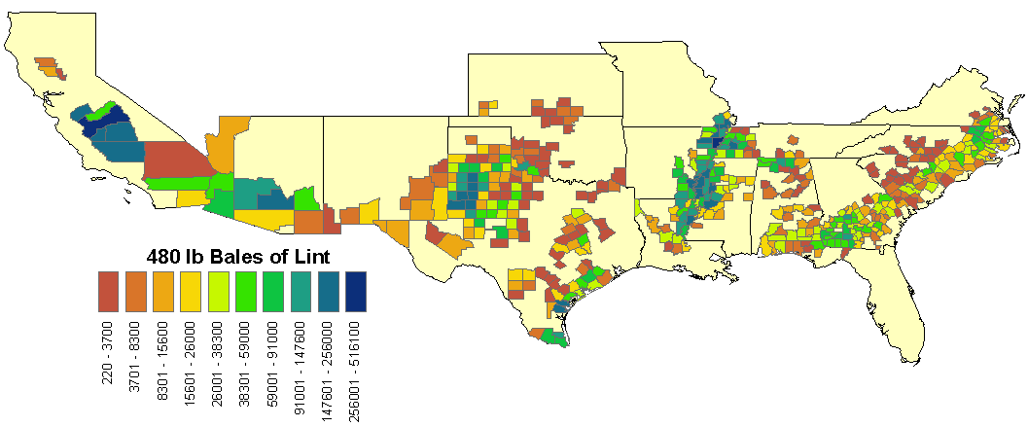
Cotton Belt
USDA, NASS

Slide 5
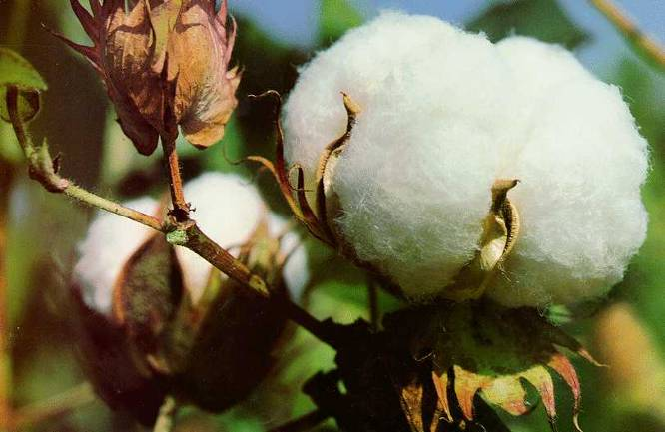
Cotton and Nitrogen
Perennial plant managed as annual
  Indeterminate flowering pattern
50 lbs N – per lint bale (1 bale = 480 lbs)
Over-application of N:
  Energy partition to vegetative vs. reproductive development
  Large plants prevent efficient harvest
  Growth regulators applied to control vegetative development

Slide 6



2008 Sensor Projects
State | Investigators | Inputs Managed Based on Modulated Active Light Sensors
 |  | PGR | Defoliant | Nitrogen | Insecticide | Plant Map | Irrigation
Alabama | S. Norwood, A. Winstead, J. Fulton
 | K. Balkcom
Arizona | T. Clarke, D. Hunsaker
Arkansas | M. Mozaffarri
Georgia | G. Vellidis, C. Perry
 | H. Schomberg
Louisiana | R. Leonard
 | B. Tubana, D. Boquet, E. Clawson
Mississippi | J. Varco
Missouri | G. Stevens, P. Scharf, E. Vories
New Mexico | T. Carrillo, J. Ellington
North Carolina | G. Robinson
Oklahoma | R. Taylor, T. Sharp, S. Osborne, J. Banks, B. Arnall, B. Raun
South Carolina | M. Jones, P. Bauer
 | A. Khalilian, W. Henderson
Tennessee | J. Wilkerson
 | O. Gwathmey
 | J. Larson (Economics)
Texas | K. Bronson
 | D. Martin
 | A. Thomasson, R. Sui
+ other
sensor
+ other
sensor
+ other
sensor
+ other
sensor
custom
sensor

Slide 7
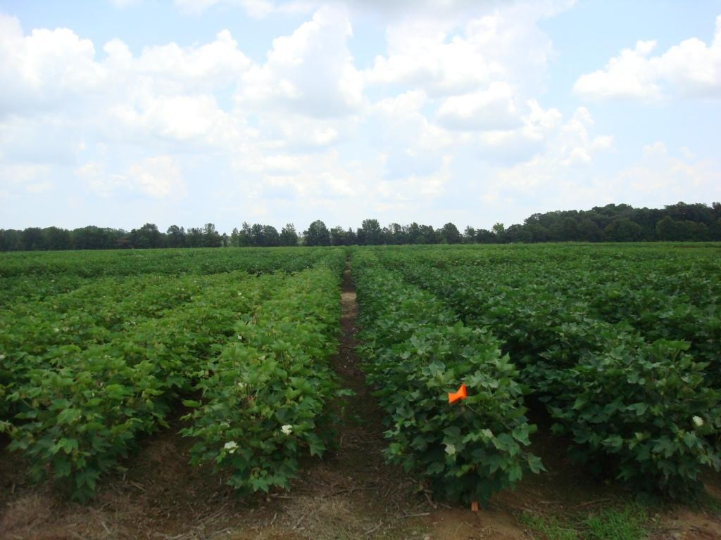
Sensor-Based Approaches
Relate yield potential with sensor readings and a well fertilized nitrogen plot
Direct regression relationship between sensor reading compared to a reference nitrogen plot
A growth stage specific relationship between the sensor reading and N rate
Relationship between historic yield, soil type and the sensor reading

Slide 8
Relate yield potential with sensor readings and a well fertilized N plot

Slide 9
Nitrogen Recommendation
Variables that determine crop N requirements | Estimation Procedures
Crop yield level | Yield goal; history (Yield potential predictive equation)
Available soil N organic matter mineralization residual N atmospheric deposition legumes credit nitrate in irrigation water manure | Soil and tissue analyses (Estimates of increase in yield due to N using early-season canopy reflectance- response index)

Slide 10
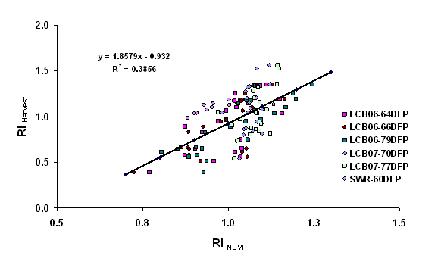
SBNRC Algorithm
OSU – Arnall et al.
N Rate = (YP0 * RI – YP0) * %N / NUE
potential cotton lint yield, kg/ha = 235.96 e ^{2216.2 * INSEY}
cotton lint yield, kg/ha = 177.41 e ^{2216.2 * INSEY}
Where:
  Yield Prediction Model: YP0 = 235.96 e ^{2216.2 * INSEY}
  Response Index: RI = 1.8579 * RINDVI – 0.932
  %N = 0.09
  Nitrogen Use Efficiency: NUE = 0.50
Notes:
10

Slide 11
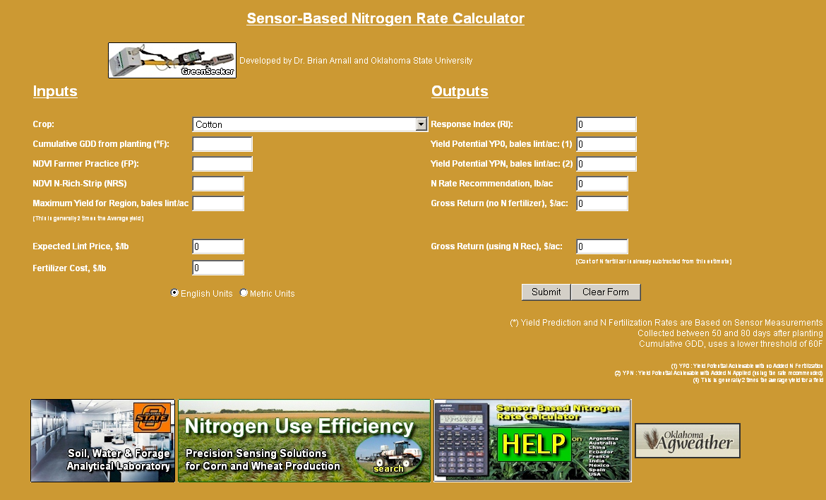
SBNRC Algorithm
OSU – Arnall et al.
Notes:
11

Slide 12
LSU AgCenter Implementation of OSU approach (Tubana et al.)
Initiated in 2008, 3 sites in North Louisiana
Growth stage: two weeks after early bloom
INSEY is defined as NDVI divided by the number of days from planting to sensing

Slide 13
LSU AgCenter Implementation of OSU approach (Tubana et al.)
This study also consider the impact of PGR (applied at early bloom) on the yield relationship.

Slide 14
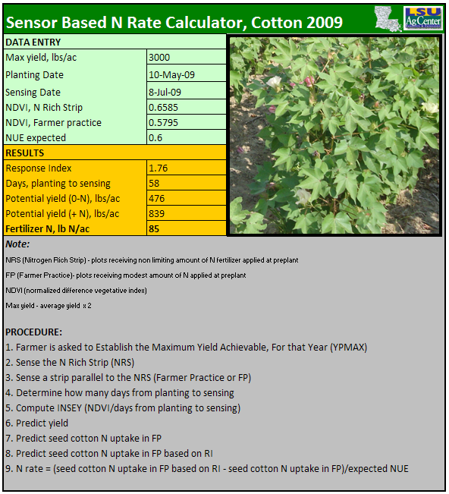
LSU AgCenter Implementation of OSU approach (Tubana et al.)

Slide 15
Clemson Modification of OSU Approach (Khalilian et al.)
Soil specific yield by INSEY relationships (soil electrical conductivity categories)
Coastal plain soils of South Carolina
INSEY was calculated as days from emergence to date of sensing.

Slide 16
Direct regression relationship between sensor reading compared to a reference nitrogen plot

Slide 17
Missouri (Scharf et al.)
Best-band-ratio predictor of economically optimal nitrogen rate

Slide 18
Missouri (Scharf et al.)
Calculating N rate based on NDVI and refNDVI:
  Crop Circle 210: N rate (lb/ac) = 573 - [549 x (NDVI/refNDVI)]
  GreenSeeker: N rate (lb/ac) = 760 - [732 x (NDVI/refNDVI)]
  Cropscan: N rate (lb/ac) = 691 - [673 x (NDVI/refNDVI)]
Ceilings on total N rate are use:
  200 lbs N/ac for heavy soils (clay, clay loam)
  150 for other soils
Farmers decide on lowest and highest N rates for the system (within the ceiling)

Slide 19
A growth stage specific relationship between sensor readings and N rate

Slide 20
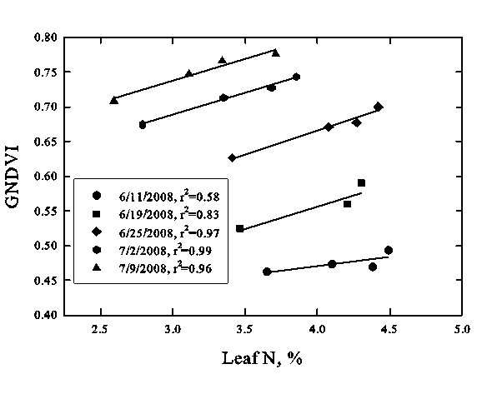
Mississippi (Varco et al.)
Relationship between GNDVI or NDVI at a specific stage of growth and fertilizer N rate
Leaf N approach (graph): Utilize N rates to that produce leaf N values at various physiological stages

Slide 21
Mississippi (Varco et al.)
Example of established relationship at the third week of squaring (experimental data):
Fertilizer N rate equivalence (FNRE) = -999.562 + 1584.984(GNDVI or NDVI on-the-go value)
Variable N rate = FNRE (experimental data) – target rate
Ceilings on total N rate (cutoff values)

Slide 22
Relationship between historic yield, soil type, and sensor readings

Slide 23
Tennessee (Wilkerson et al.)
 | Historic Yield Potential
NDVI | Low | Average | High
High | R-- | R- | R
Average | R- | R | R+
Low | R | R+ | R++
Where: R is the average recommended rate, R+ and R++ are positively incremented, and R- and R-- are decremented from the recommended rate.
Bracket the response of real-time nitrogen prescription algorithms
Incorporate a map of historic information: identify areas within a field as historically low or high yielding and increment/decrement the N prescription accordingly
Additional agronomic data to determine the size of increment or decrement in response to yield potential is needed.

Slide 24
Texas (Sui et al.)
Canopy chlorophyll content index (CCCI) – relative estimate of the chlorophyll content in a crop canopy
CCCI accounts for variation in canopy density and less likely to give false indications of low chlorophyll content (vs. simple ratio or NDVI)
Well-suited for the three-band sensor (Crop Circle)

Slide 25
Core Data Collection
Develop a simplified yield potential nitrogen rate estimate – under discussion.
Producer usable approach - 2010

Slide 26
Core Data Collection
Growth stages for plant data collection:
  Early squaring: 3 to 7 squares
  Early bloom: 2 to 3 blooms
  Mid bloom
  Peak bloom
Nitrogen rates: 0, 90, and 120 lb N/ac

Slide 27
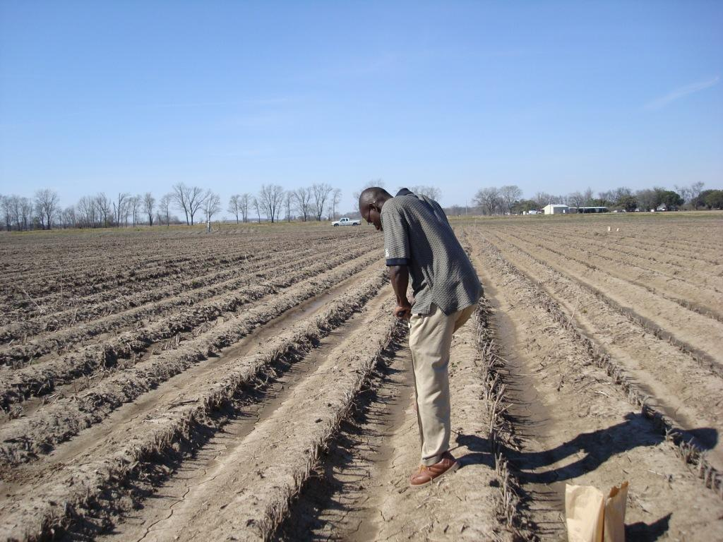
Core Data Collection
Soils data set (Mehlich-3 P & K, soil NO₃)
  Preplant samples
  Post-harvest samples

Slide 28
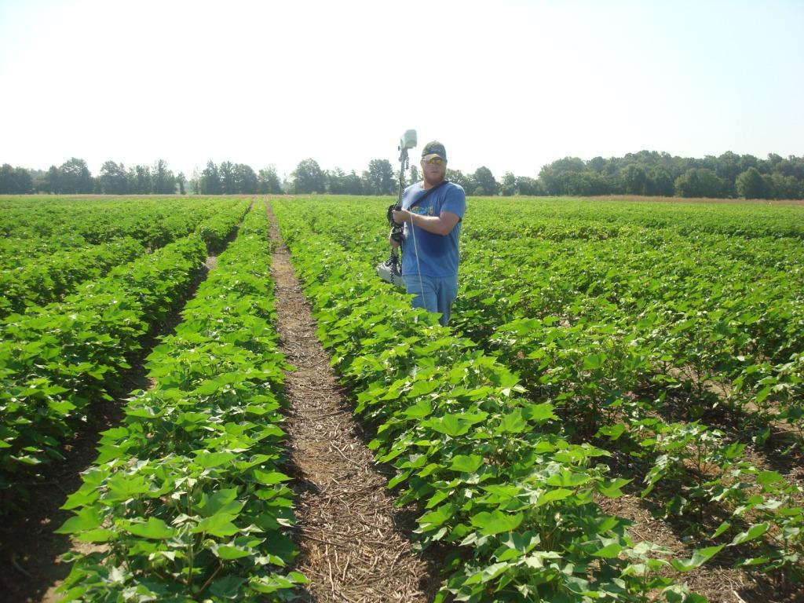
Core Data Collection
Within season plant information:
  Sensor readings

Slide 29
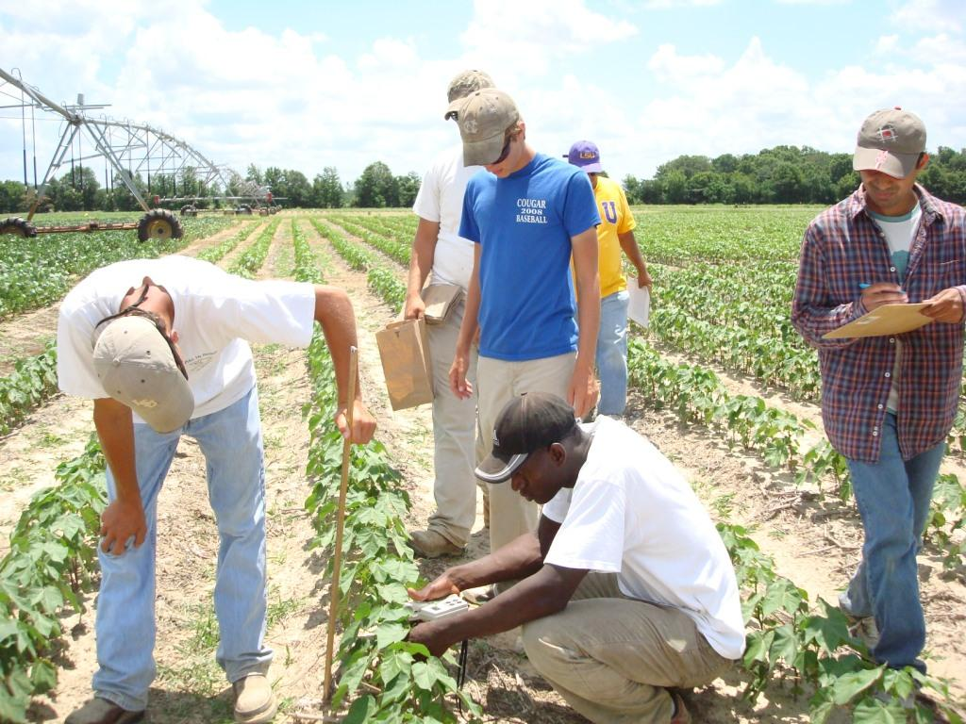
Core Data Collection
Within season plant information:
  SPAD readings and plant height
  Tissue samples for leaf N

Slide 30
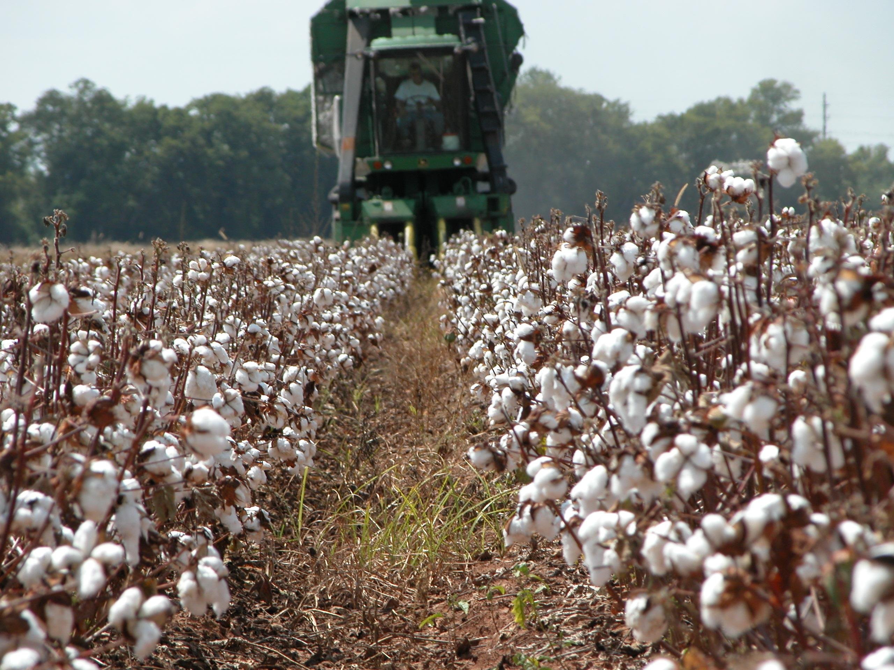
Yield Data Collection
Hand harvest – 13.3 ft of row
Machine – 40 feet of 2 rows
Determine seed cotton and lint weight
Seed N content

Slide 31
Other Record Keeping
Varieties
Planting and harvest dates
Nitrogen rates, timing, application methods and N sources
PIX rates and dates (if applicable)
Irrigation amounts (indicate in furrow, pivot, drip)
Rainfall

Slide 32
Take Home Notes
One or more of these approaches should be ready for extended on-farm evaluation in 2010.
Will this end with one concept: analysis of core data:
  correction procedures (thermal time, days from planting to sensing etc.)
  components (yield potential, response index, simple ratio)

Slide 33

Questions!!!

