Slide 1
Generalized Algorithm for Variable Rate Nitrogen Application on Cereal Grains
John B. Solie, Regents Professor Biosystems and Agri. Engineering Dept.
William R. Raun, Regents Professor, Plant and Soil Sciences Department
Dean Monroe, PhD, Formerly Biosystems and Agri. Engineering Department
Randall K. Taylor, Professor, Biosystems and Agri. Engineering Department
D. Brian Arnall, Assistant Professor, Plant and Soil Sciences Department

Slide 2
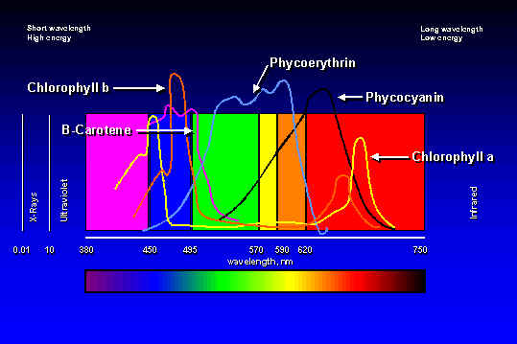
Physiological Basis for Spectral Sensing
Reflectance (%)
0.25
Wavelength (nm)

Slide 3
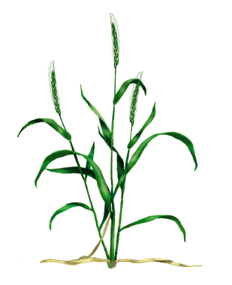
Normalized Difference Vegetative Index - NDVI
Calculated from the red and near-infrared bands
Equivalent to a plant physical examination
Correlated with:
  Plant biomass
  Crop yield
  Plant nitrogen
  Plant chlorophyll
  Water stress
  Plant diseases
  Insect damage

Slide 4
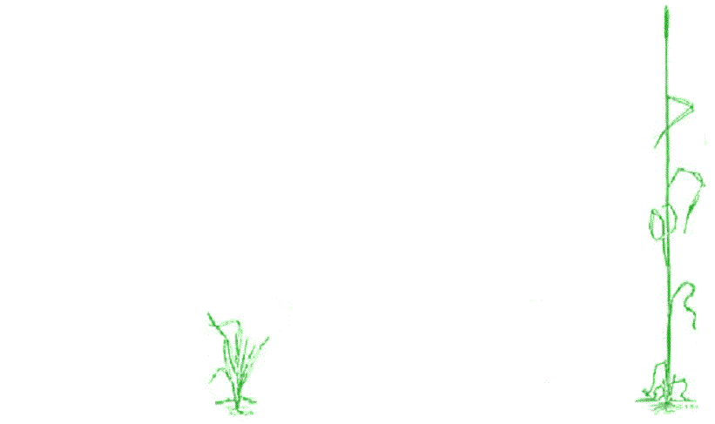
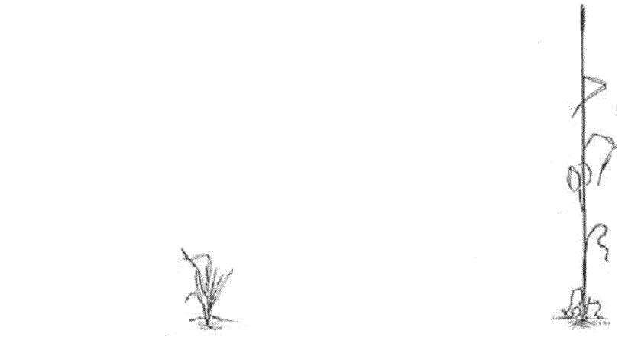
OSU Original N Rate Algorithm
Bill’s Postulates
Crop yield potential can be predicted from NDVI
A maximum potential yield exists that is a function of the weather and soil type
A fertilizer response index exists that defines the response to additional fertilizer and varies from year to year and site to site.
Response to N fertilizer is independent of potential yield.
YPN = f(YP0, RI)
1. Measure
2. Predict YP₀
3. Predict YP_{N}
4.
3
2
1
4

Slide 5
Problems with OSU Original Algorithm
Discontinuities in yield & response index models
Yield model dos not satisfy boundary conditions
  zero yield on bare soil (FpNDVI =0,
  Maximum potential yield at F_{P}NDVI=1,
Failure to account for bare soil NDVI.
Inability to fully account for crop growth stage and varying biomass levels.
Lack of a scientifically based procedure to determine maximum potential yield.
Inability to account for interaction between Nrich NDVI and yield model

Slide 6
Proposed Generalized Algorithm
Fix maximum value of potential yield curve with best estimate of maximum potential yield, YPmax.
Use bounded (sigmoid) model to predict grain yield as function of NDVI.
Incorporate RI_{Fert} into YP0 yield prediction to calculate YPN
Calculate potential yields with and without additional fertilizer with bounded yield model, response index, and maximum estimated yield.
Calculated N application rate based on difference between potential yield.
Improve methodology for mid-season prediction of maximum yield

Slide 7
Potential Yield Models
(8)
(8)
Straight Line
Exponential
Sigmoid

Slide 8
Unit Sigmoid Model
Radius of Curvature

Slide 9
Max. Yield and Inflection Point

Slide 10
Curvature Change with Unit Max. Yield And Variable Inflection NDVI

Slide 11
Corn Sigmoid Model Parameters

Slide 12
Optimization & Sensitivity Analysis Sigmoid Model Parameters for Corn

Slide 13
Sigmoid Yield Model Parameters
 |  |  | Coeficient of Determination R² |  | Absolute Error
Model Factor | Crop | Optimum Value | TC NLIN Regression | Sigmoid Yield Model | TC NLIN Regression | Sigmoid Yield Model
"K" | Corn | 0.123 | 0.429 | 0.402 | 0.582 | 0.680
 | Wheat | 0.124 | 0.537 | 0.502 | 0.423 | 0.523
"BSF" | Corn | 0.045 | 0.429 | 0.402 | 0.582 | 0.665
 | Wheat | 0.077 | 0.537 | 0.502 | 0.423 | 0.524

Slide 14
Corn Zero Intercept Sigmoid Model: Measured and Predicted Values

Slide 15
Corn Zero Intercept Sigmoid Model: Measured and Predicted Values

Slide 16
Wheat Perkins 2006

Slide 17
Step 1 Estimate maximum potential yield within field for current year
Field yield records
Farmer and/or consultant’s informed opinion
Growth models
Other
Winter Wheat Yield of Cumulative Pot. Etos 10 days before to 30 days after planting

Slide 18
Fully Bounded Sigmoid Yield Model Parameters

Slide 19
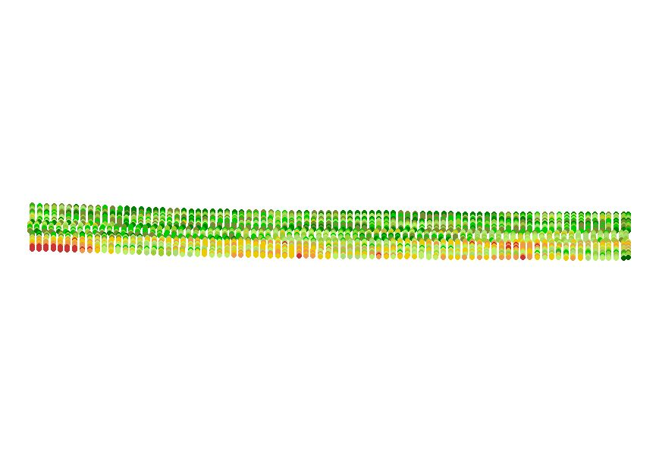
NRich Strip
Sense NDVI from NRich and adjacent farmer practice strip in a portion of the field exhibiting the highest response to pre-plant fertilizer.

Slide 20
Potential Yield Calculations

Slide 21
Fertilizer Application Rate

Slide 22
Conclusions
With the possible exception of winter wheat, the process for estimating crop yield in-season is more art than science.
Research is needed to improve maximum yield estimates for crop, year, and location.
The proposed sigmoid yield model for calculating yield accounts for location, year, and crop growth prior to sensing.
Model parameters are the same for corn and wheat (NUE and % N in grain are crop specific).
Seven years of tests confirm that the model for calculating N application rate from yield estimates works well.

Slide 23
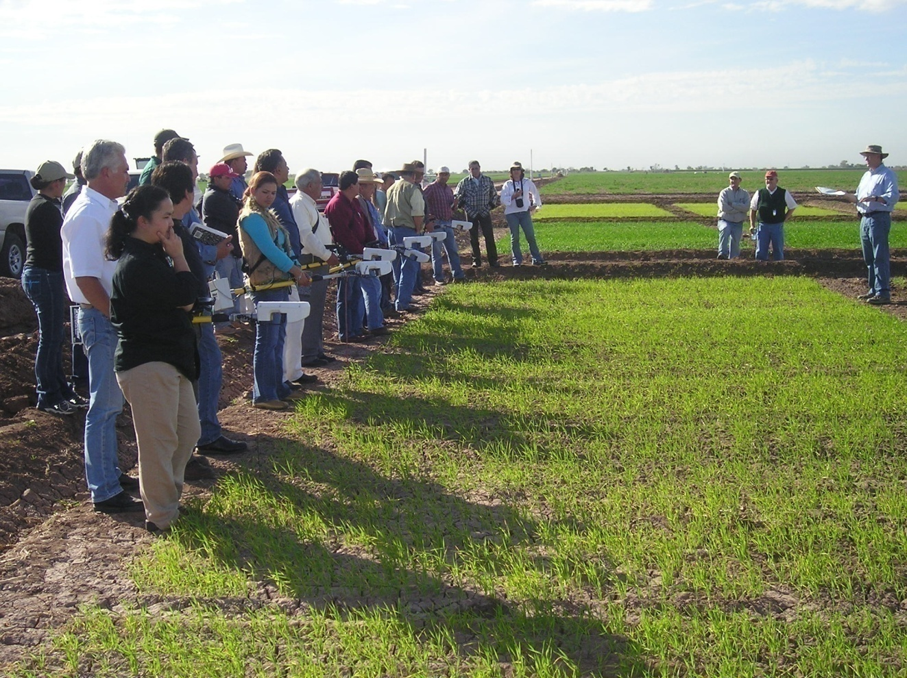
Questions
Ivan Ortiz-Monasterio Farmer training,
Ciudad Obregon, Mexico, January 2007

Slide 24
50
Reflectance (%)
25
Wavelength (nm)

Slide 25
Spectral Signature: Two N Levels

Slide 26
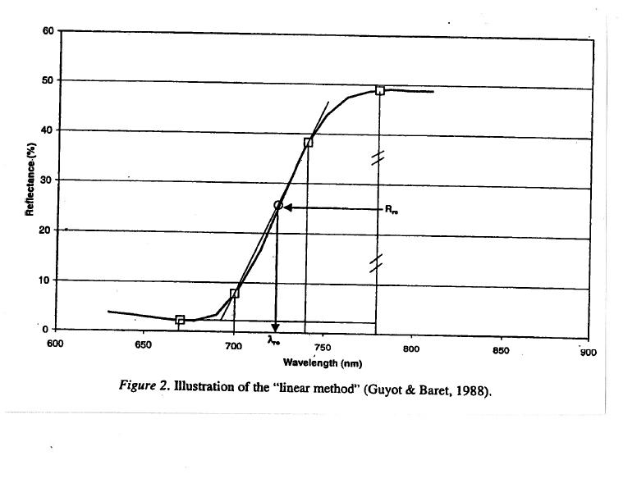
Red Edge

Slide 27
Red Edge High and No N Rates
Curves are Shift and Normalized

Slide 28
Comparisons of Various Indices

Slide 29
N Concentration (Minolta SPAD)

