Slide 1
Corn (Zea mays L.) Leaf Angle and Emergence as Affected by Seed Orientation at Planting
Guilherme Torres, Jacob Vossenkemper, William Raun, John Solie and Randy Taylor
Department of Plant and Soil Sciences
Department of Biosystems and Agricultural Engineering
Oklahoma State University

Slide 2
Introduction
Increasing Yield
  Plant population (Cox 2001).
    80,000 and 116,000 plants/ha
  Reducing row spacing (Lutz et al. 1971).
    40, 30, and 15 inches
  Leaf architectures of modern corn hybrids (Stewart et al. 2003).

Slide 3
Rationale
Stinson and Moss (1960)
  When soil moisture and nutrients are satisfactory light can be the primary ecological factor limiting grain yields.
  Peters (1961)
    Systematic orientation of corn leaves using seed planting techniques provides means for capturing more sunlight and more efficient soil shading.
Donald (1963)
  Leaf geometry and its effects on light distribution with crop and levels of photosynthesis offer potential strategies for improving production efficiency.
Stewart et al. (2003)
  Leaf architecture of modern corn hybrids can optimize light interception to increase grain yield.

Slide 4
Rationale cont.
More homogenous corn stands have
1. Less interplant competition, increased light interception, reduced weed pressure, (quicker canopy closure).
2. Ability to potentially increase seeding rates while substantially increasing corn grain yields.
3. Reduce seeding rates and maintain grain yields.

Slide 5
Light Interception
Pendlenton et al. (1967)
  35 % yield increase in corn when aluminum reflectors were used to provide additional light to the middle and lower leaves
Reichert et al. (1958) and Stinson and Moss (1960)
  Reductions in grain yield when artificial shading was used to reduce available light
Sujatha et al. (2004)
  Found that in irrigated production systems, prostate leaf architectures from the corn hybrids could assist in integrated weed management with the potential to decrease herbicide rates.

Slide 6
Emergence
Hodgen et al. (2007)
  Found that if corn plants are delayed by as little as four days, the yield depression of that individual delayed plant was as much as 15 percent.
Daft et al. (2008)
  Heterogeneous corn plant stands can lead to over application of fertilizers, pesticides and supplemental irrigation because these late emerging plants compete for nutrients, and produce little to no yield.
Martin et al. (2005)
  Homogenous corn plant stands and emergence may decrease plant-to-plant variation and could lead to increased grain yields.

Slide 7
Objective
Identify which seed placement and arrangement could result in plant architecture with leaves orientated perpendicularly to the row and understand the effect of seed position on emergence.
With-row
Leaf orientation
Across-row
Leaf orientation

Slide 8
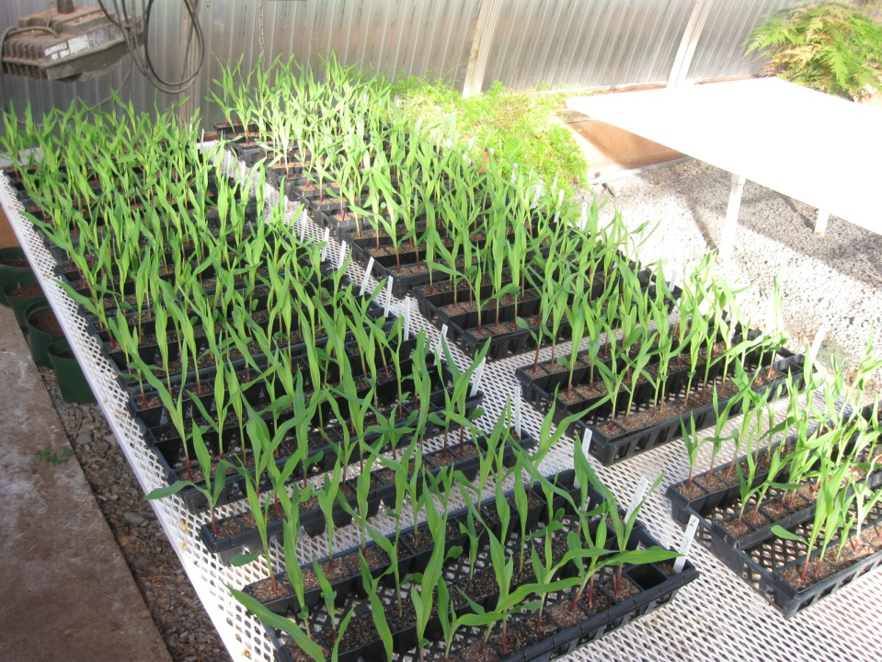
Greenhouse Trials
Materials and Methods
Planted 2.5 cm deep
Medium flats
10 seeds per treatment
Redi-earth
Adobe Illustrator CS4 software
Emergence
Leaf angle
Analysis of variance
Frequency distribution
Angle ranges (%)

Slide 9
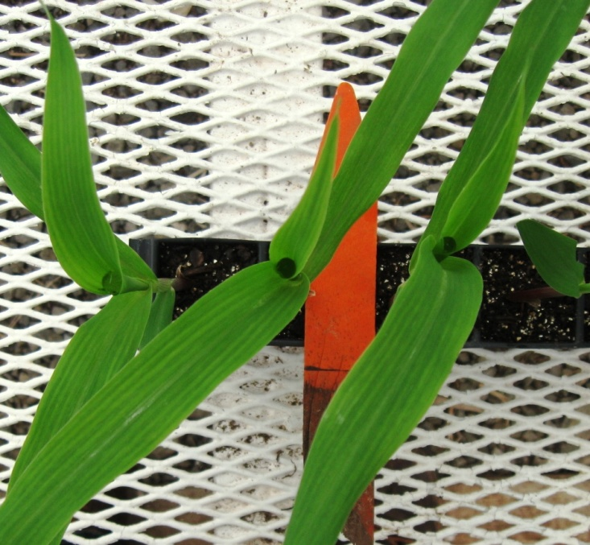
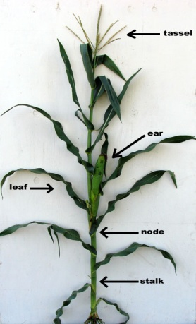
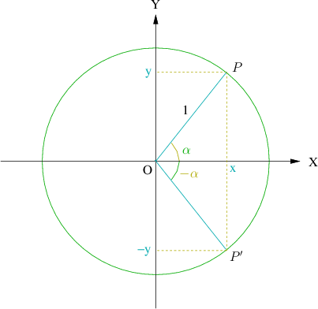
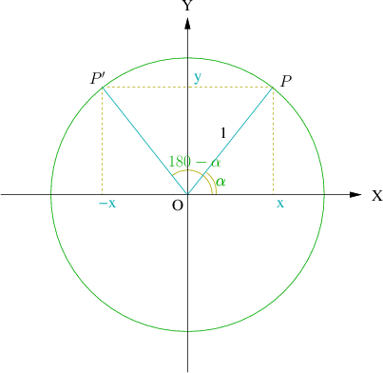
Leaf angle
Deviation from the corn row
Between 0° and 90°
Angle ranges
  0 ° to 30 ° (with-row)
  30 ° to 60 °
  60 ° to 90 ° (across-row)
Leaf symmetry

Slide 10
Experiment #1 (E1)
Pioneer 33B54
6 treatments
3 leaf stage
Experiment #2 (E2)
Pioneer 33B54
13 treatments
4 leaf stage

Slide 11
Experiment #3 (E3)
5 Dekalb hybrids
  DKC6122RR2
  DKC6172RR2
  DKC6346RR2
  DKC6342VT3
  DKC6169VT3
8 treatments
4 leaf stage
400 seeds

Slide 12
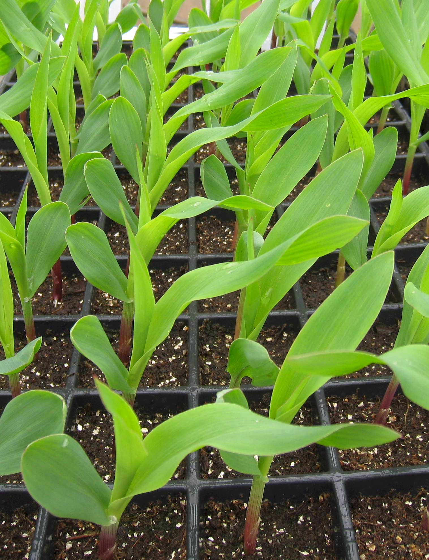






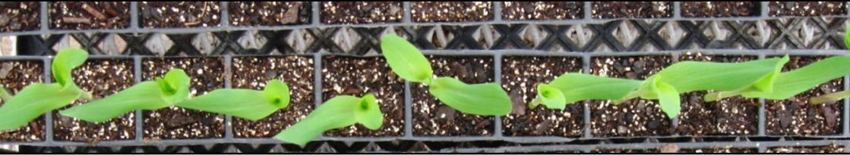
Results (E1)
Source of variation |  | df | Leaf Angle |  | Emergence |  | Frequency distribution
Replication |  | 9 | ** |  | NS
Treatment |  | 5 | ** |  | ** |  | plants with leaf angle between 0° and 30° degrees | plants with leaf angle between 60° and 90° degrees
MSE |  | 58 | 313.58 |  | 0.12
Treatment means |  | N | Mean | Standard deviation | Mean | Standard deviation
 |  |  | Degrees |  |  |  | %
1 |  | 9 | 57.0 | 28.2 | 4.3 | 0.50 | 22.2 | 66.7
2 |  | 10 | 66.7 | 18.7 | 4.8 | 0.42 | 0.0 | 70.0
3 |  | 10 | 67.8 | 14.4 | 5.0 | 0.00 | 10.0 | 90.0
4 |  | 10 | 67.2 | 18.4 | 5.0 | 0.00 | 0.0 | 70.0
5 |  | 10 | 18.8 | 19.7 | 4.4 | 0.51 | 80.0 | 10.0
6 |  | 10 | 20.6 | 16.9 | 5.0 | 0.00 | 80.0 | 0.0
SED |  |  | 7.92 |  | 0.15
C.V. |  |  | 36 |  | 7

Slide 13









Results (E2)
Source of variation |  |  | df | Leaf Angle |  | Emergence |  | Frequency distribution
Replication |  |  | 9 | NS |  | **
Treatment |  |  | 12 | ** |  | ** |  | plants with leaf angle between 0° and 30° degrees | plants with leaf angle between 60° and 90° degrees
MSE |  |  | 105 | 413.65 |  | 0.12
Treatment means |  |  | N | Mean | Standard deviation | Mean | Standard deviation
 |  |  |  | Degrees |  |  |  | %
1 |  |  | 9 | 51.0 | 18.0 | 6.6 | 0.51 | 22.2 | 44.4
2 |  |  | 10 | 65.6 | 16.8 | 6.7 | 0.48 | 0.0 | 80.0
3 |  |  | 10 | 47.4 | 19.3 | 7.3 | 0.48 | 20.0 | 70.0
4 |  |  | 10 | 62.4 | 27.8 | 6.3 | 0.48 | 30.0 | 40.0
5 |  |  | 10 | 29.0 | 13.0 | 6.0 | 0.00 | 80.0 | 10.0
6 |  |  | 10 | 31.5 | 17.3 | 6.1 | 0.31 | 60.0 | 10.0
7 |  |  | 10 | 45.6 | 23.1 | 6.9 | 0.31 | 60.0 | 30.0
8 |  |  | 10 | 48.0 | 23.7 | 7.1 | 0.31 | 30.0 | 30.0
9 |  |  | 9 | 62.0 | 14.9 | 6.1 | 0..31 | 22.2 | 77.8
10 |  |  | 10 | 68.9 | 19.4 | 6.3 | 0.48 | 10.0 | 90.0
11 |  |  | 9 | 57.0 | 19.7 | 7.0 | 0.00 | 22.2 | 55.6
12 |  |  | 10 | 54.8 | 22.4 | 7.0 | 0.00 | 20.0 | 50
13 | RANDOM |  | 10 | 54.9 | 21.8 | 7.1 | 0.31 | 20.0 | 60.0
SED |  |  |  | 9.09 |  | 0.15
C.V. |  |  |  | 39 |  | 5

Slide 14








Results (E3)
Source of variation |  |  | df | Leaf Angle |  | Emergence |  | Frequency distribution
Replication |  |  | 9 | NS |  | NS
Treatment |  |  | 7 | ** |  | **
Hybrid |  |  | 4 | * |  | ** |  | plants with leaf angle between 0° and 30° degrees | plants with leaf angle between 60° and 90° degrees
MSE |  |  | 309 | 311.77 |  | 0.26
Treatment means |  |  | N | Mean | Standard deviation | Mean | Standard deviation
 |  |  |  | Degrees |  |  |  | %
1 |  |  | 50 | 62.6 | 17.2 | 6.4 | 1.05 | 8.0 | 72.0
2 |  |  | 45 | 51.4 | 18.4 | 8.3 | 1.11 | 22.2 | 60.0
3 |  |  | 50 | 64.7 | 15.4 | 6.1 | 0.68 | 4.0 | 76.0
4 |  |  | 49 | 38.8 | 17.0 | 6.8 | 1.10 | 46.9 | 20.4
5 |  |  | 50 | 47.8 | 18.1 | 7.0 | 0.55 | 32.0 | 38.0
6 |  |  | 50 | 66.3 | 14.17 | 6.8 | 0.75 | 4.0 | 86.0
7 |  |  | 50 | 51.4 | 20.8 | 6.8 | 0.72 | 32.0 | 50.0
8 | RANDOM |  | 50 | 48.8 | 17.8 | 7.0 | 0.99 | 28 | 48.0
SED |  |  |  | 7.89 |  | 0.23
C.V. |  |  |  | 33 |  | 7

Slide 15

Discussion
Fortin and Pierce (1996)
  Found that random orientation of seed resulted in random ear leaf azimuths
Bowers and Hayden (1972)
  Flat orientation (hypocotyl up) consistently had better emergence (beans)
Patten and Van Doren Jr. (1970)
  Proximal end of the seed down resulted in earlier more complete emergence with more seedling growth

Slide 16
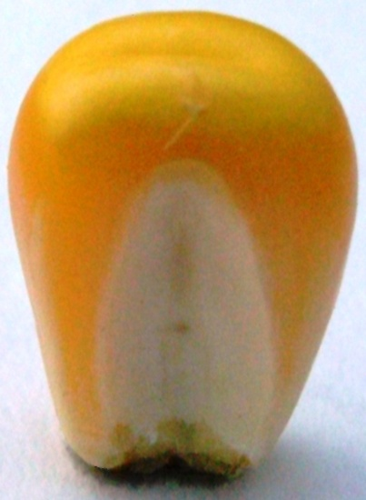
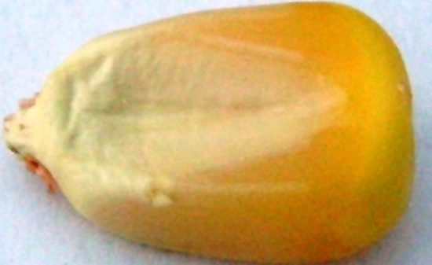
Field Trial – Materials and Methods
RCBD
Row Orientation: North-South
Row spacing: 30 inches
Light interception, V10 and R1
  (LI-1400)
Grain yield at harvest
Corn Hybrids
  Prostate leaf pattern - P0902HR
  Upright leaf pattern - P1173HR
  (within incomplete factorial arrangement)
Seed Orientation
  Upright, caryopsis pointed down, parallel to the row
  Laying flat, embryo up, caryopsis pointed perpendicular to the row
  Random
Plant Population (in thousands of seeds / acre
  Irrigated trial – 20, 30 and 40
  Dry land trial -15, 20 and 25
Row orientation

Slide 17
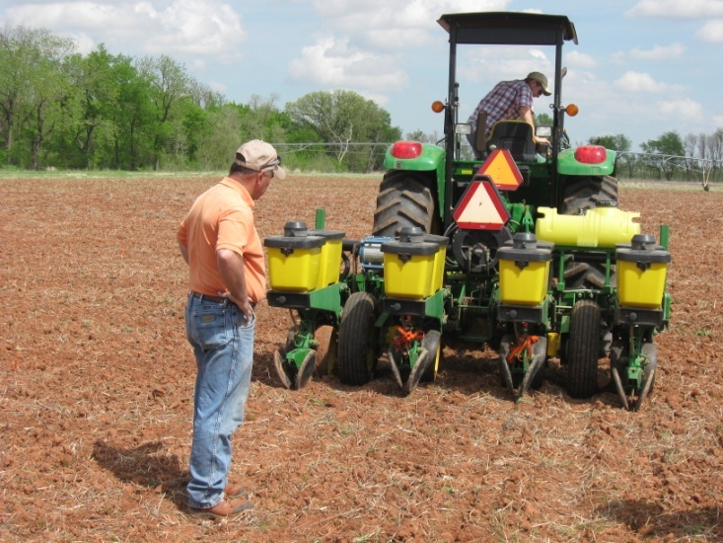
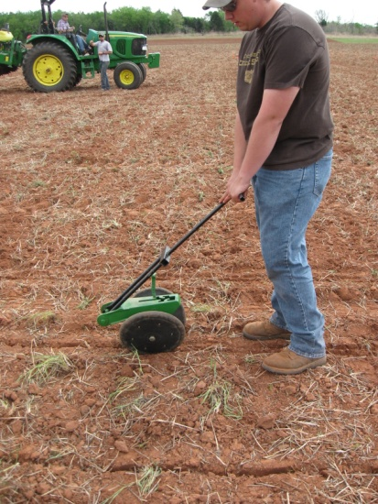
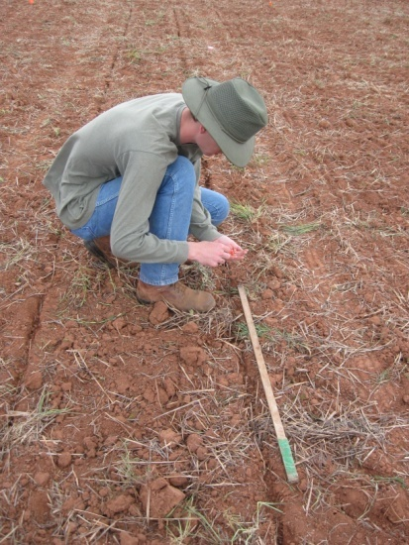

Slide 18
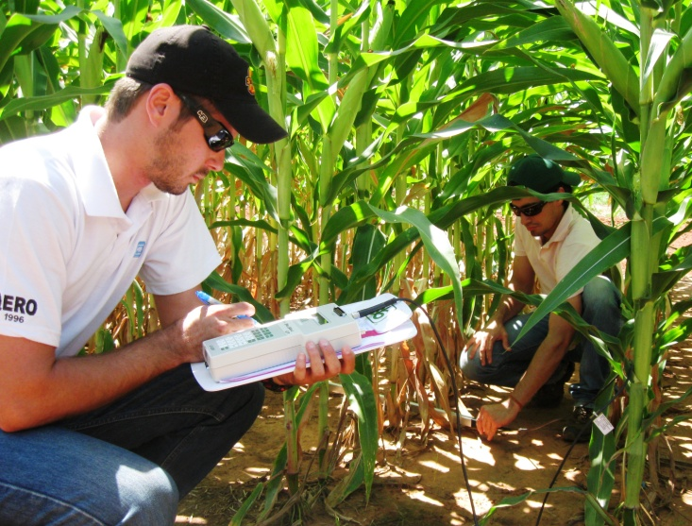
Objective
  Development of innovative crop management to improve/maintain yields (reduce pesticides and fertilizer rates).
2 fixed seed orientations and random
3 populations
2 corn hybrids (differing leaf structure)
  Prostrate and erect
Dry-land and irrigated conditions
Light interception
Grain yield

Slide 19
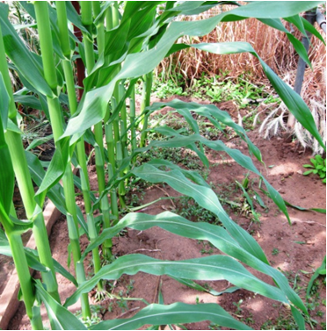
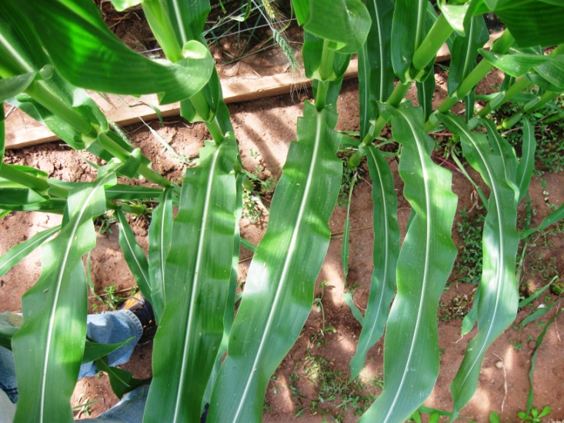

Slide 20
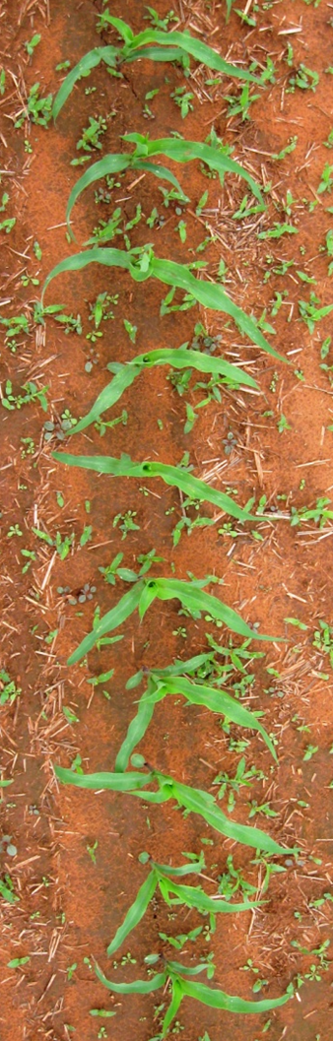
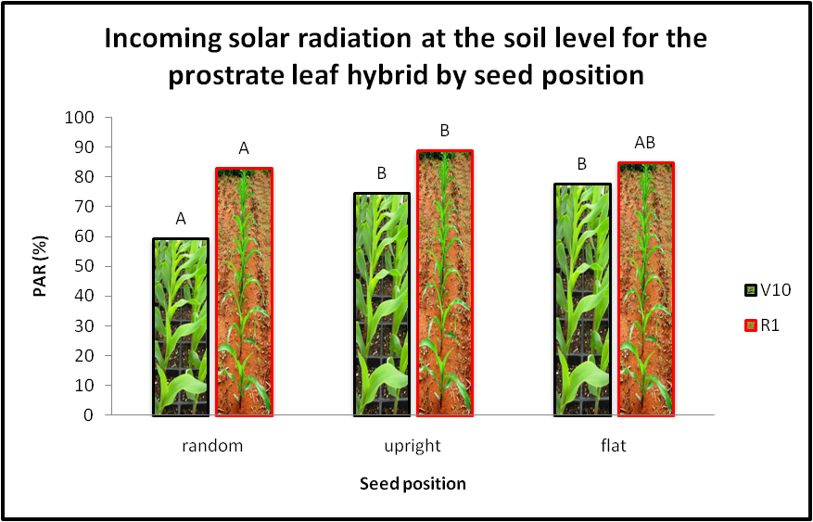
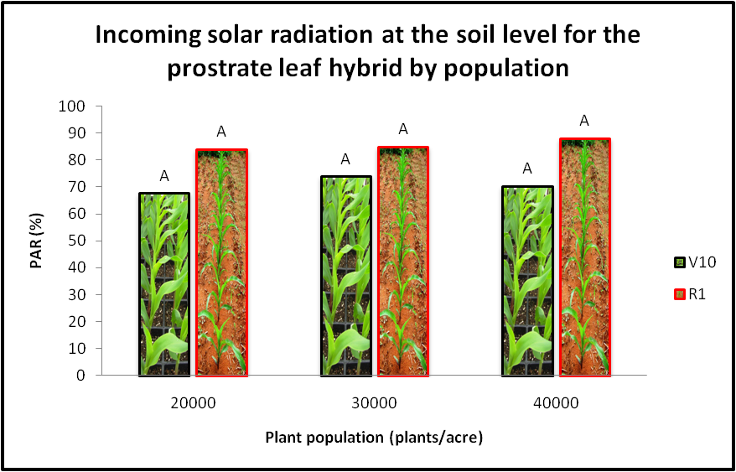

Slide 21
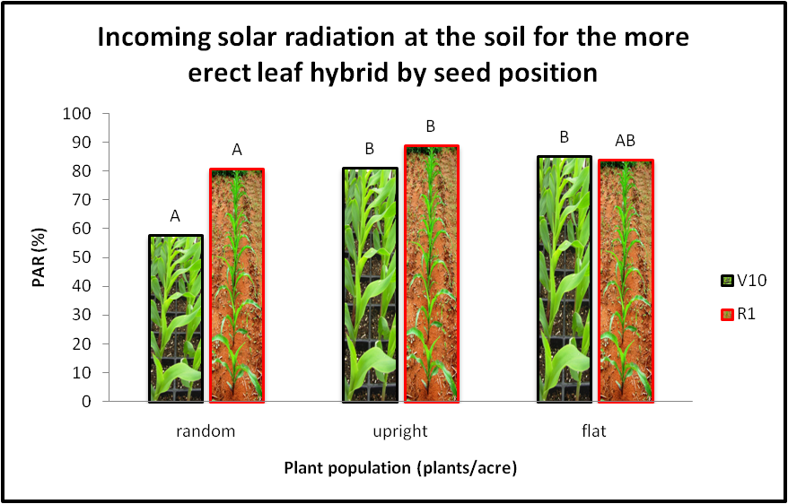
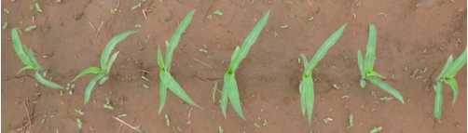
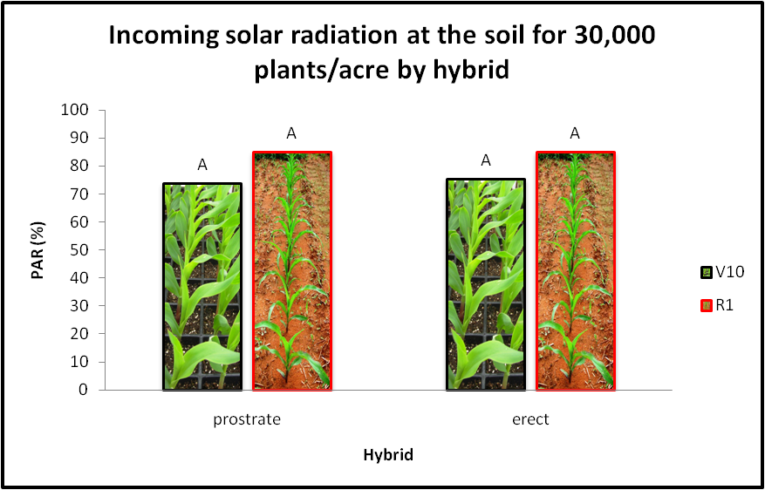

Slide 22
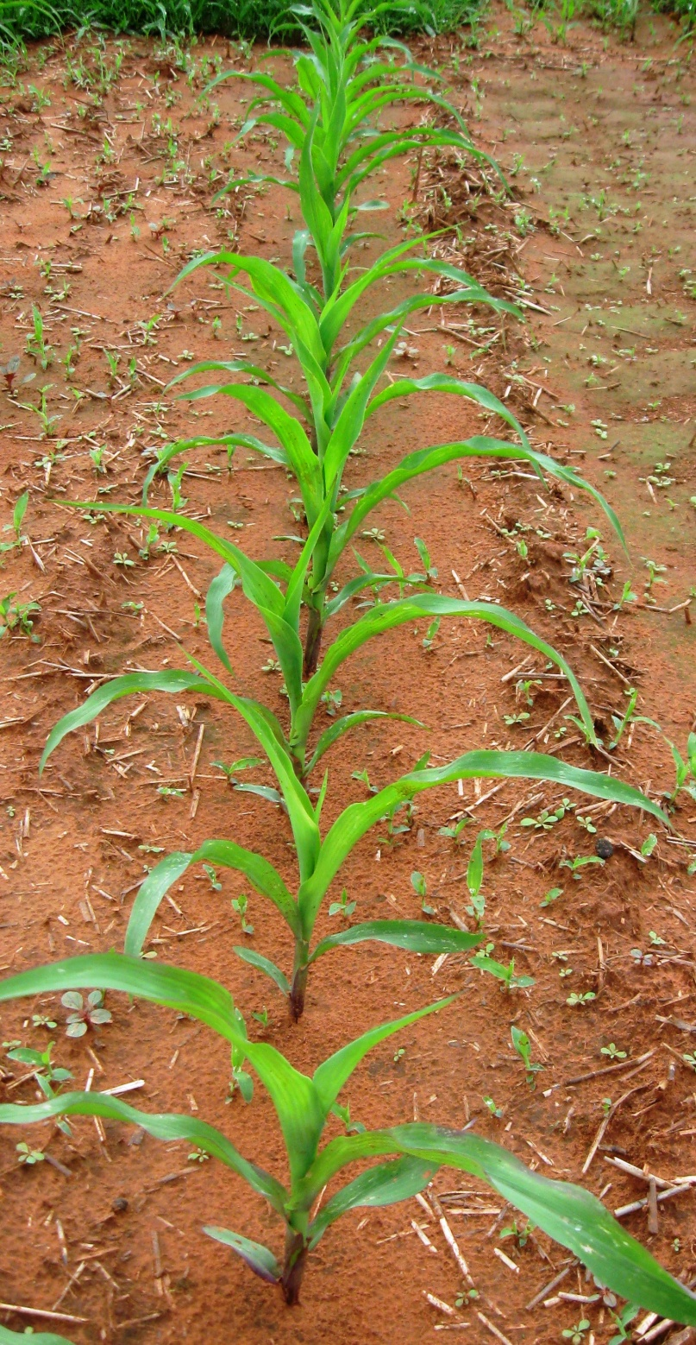
Discussion
Toler et al. (1999)
  Differences in light interception between leaf orientations decrease with maturity.
  No differences were found in plant population.
  Across row -10% to 20 % higher corn yields than the random and with-row leaf orientation.
Sujatha et al. (2004)
  50% less light reached the ground between rows of horizontal leaf hybrid compared with upright leaf in both years.

Slide 23
Conclusions
Placement and arrangement of corn seed can influence rate of emergence and leaf orientation.
At V10 fixed seed planting intercept more light than random seed planting.
At R1upright seed position intercept more light than random.
Effect of seed orientation on light interception was independent of plant population and hybrid.
Difference in light interception decreases with maturity.
Controlled leaf geometry could facilitate planting higher populations with the potential for increasing grain yield or permit the preservation of yields with reduced plant populations.

Slide 24
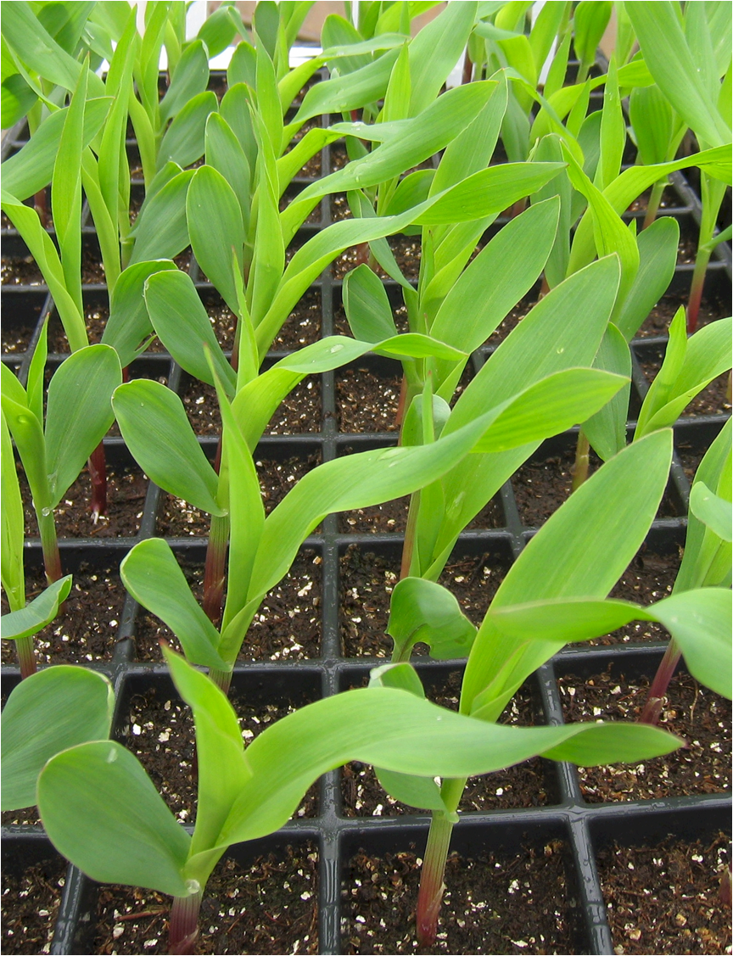
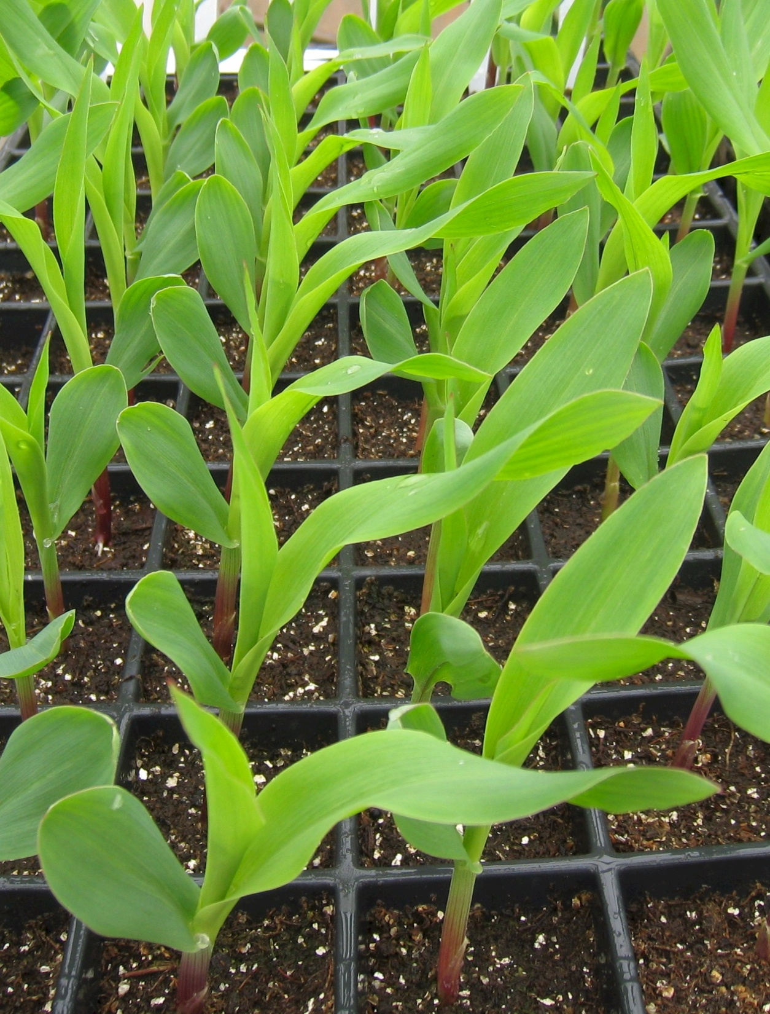
Questions
guilherme.torres@okstate.edu

