Slide 1
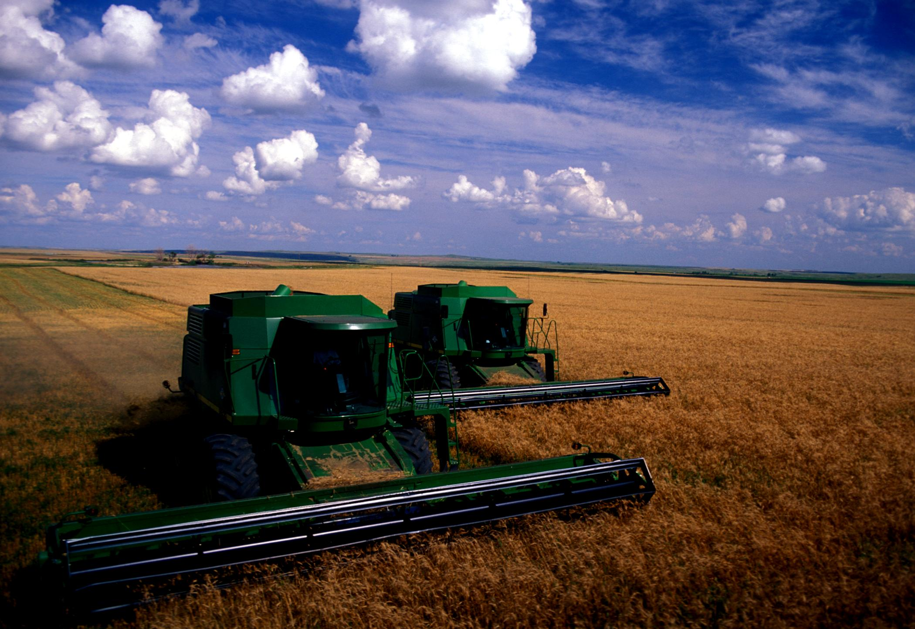
CANOPY REFLECTANCE (HRWW AND HRSW) IN SOUTH DAKOTA
ECONOMIC OPTIMUM NITROGEN RATE FOR HRSW IN SOUTH DAKOTA
Nitrogen Use Efficiency Meeting
Cheryl Reese*, David Clay*, Dwayne Beck*, John Lukuch‡, Tulsi Kharel*, Sharon Clay*, Dan Long†, and Gregg Carlson*
*South Dakota State University, Brookings, SD
‡ North Dakota State University, Langdon, ND
†USDA-ARS, Pendleton, Oregon
August 3rd, 2010
Stillwater, Oklahoma
Notes:
1

Slide 2
Objectives
Improve N fertilizer recommendations for South Dakota Wheat
Evaluate canopy reflectance to predict N
EONR and impact of protein premium / discount

Slide 3
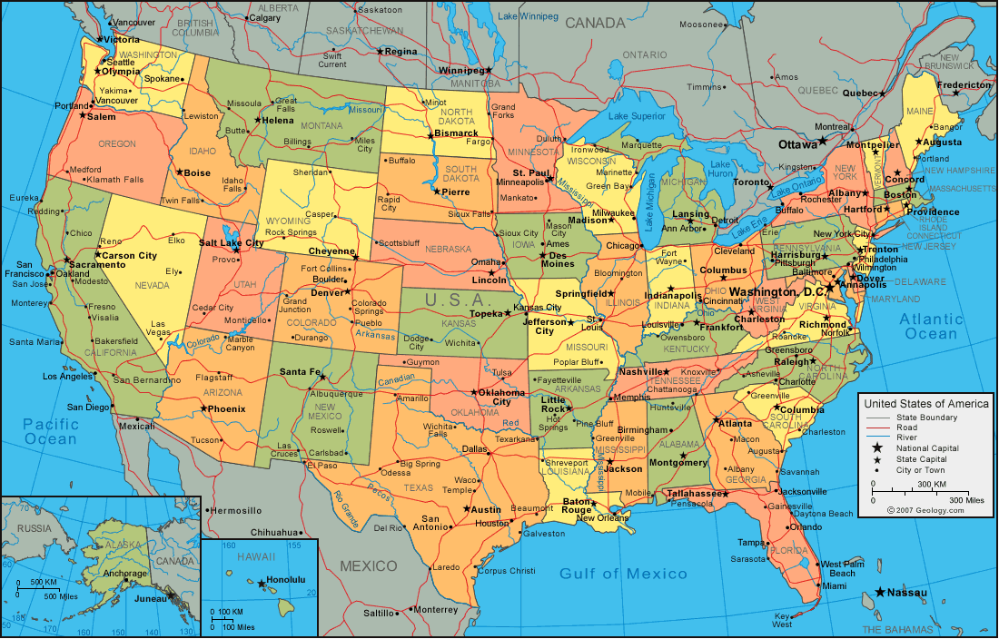
Study Location
Study Location

Slide 4
Hard Red Winter Wheat
Canopy Reflectance

Slide 5
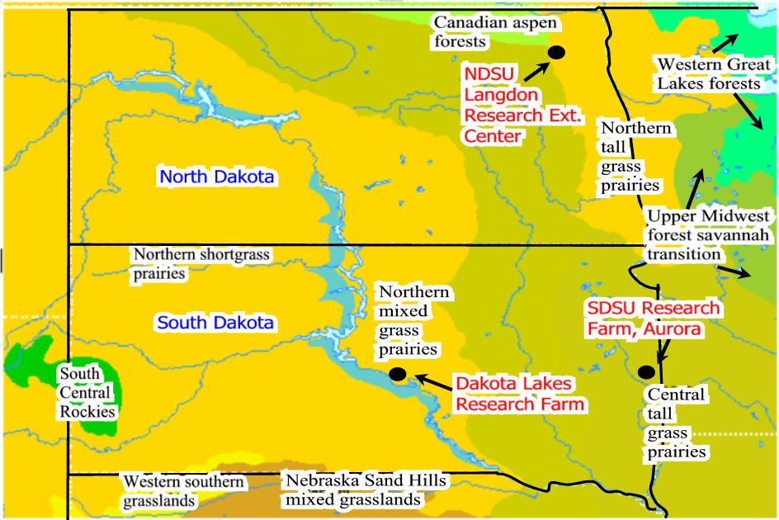
Field Locations
HRWW Study Locations
Winner, SD

Slide 6
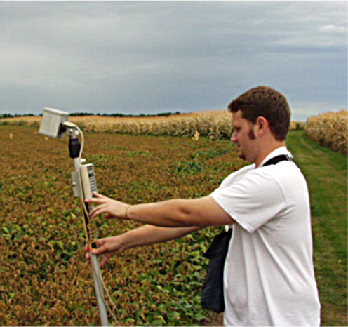
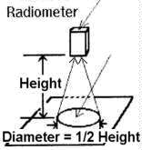
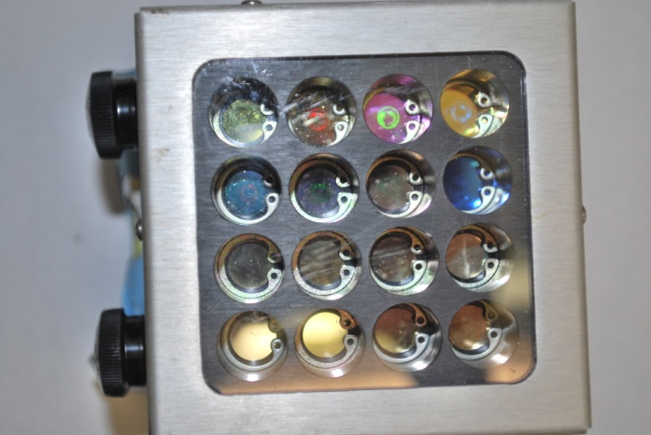
Remote Sensing Equipment:
CropScan, Passive 16 Band Radiometer
Passive Sensor
Depend on sunlight
Trade-off: collect over wide range, ability to select wavelengths, and wavebands

Slide 7
Indices
Description | Index | Cropscan Bands Used to Calculate Index | Measurement | Authors
Normalized Difference Vegetation Index | NDVI_{w} | (R₈₃₀ - R₆₆₀) (R₈₃₀ + R₆₆₀) | Healthy vegetation reflects more NIR and less visible light. | Rouse, 1973
 | NDVI_{n} | (R₇₆₀ - R₆₆₀) (R₇₆₀ + R₆₆₀)
Green Normalized Difference Vegetation Index | GNDVI_{w} | (R₈₃₀ - R₅₆₀) (R₈₃₀ + R₅₆₀) | More sensitive to chlorophyll-a than NDVI. | Gitelson et al., 1996
 | GNDVI_{n} | (R₈₇₀ - R₅₆₈) (R₈₇₀ + R₅₆₈)
CRedEdge | CRedEdge | [R₈₁₀ / R₇₁₀]-1 | Canopy chlorophyll | Gitelson et al., 2005

Slide 8
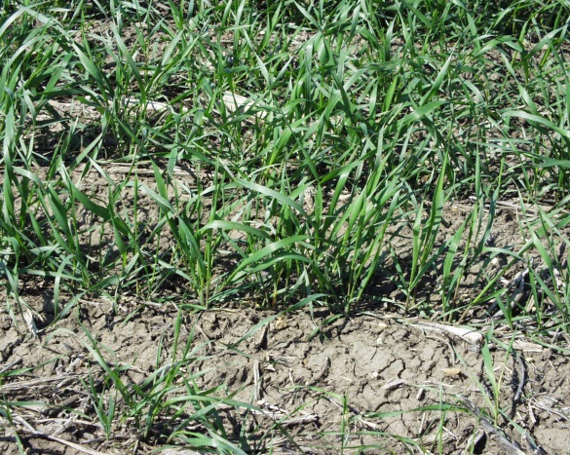
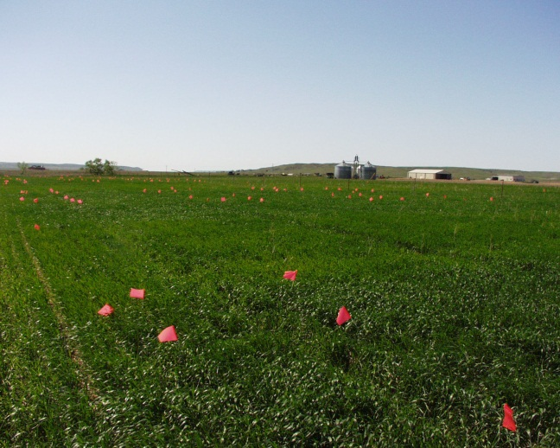
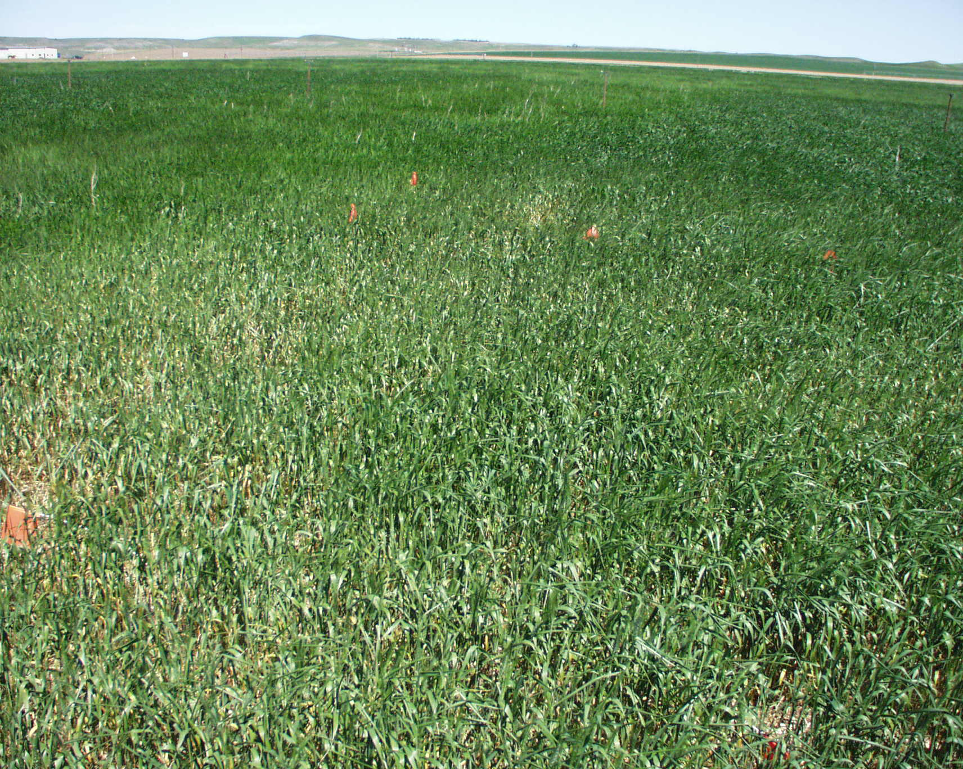
Dakota Lakes, HRWW 2006:
Good year for line source irrigation
05/11/06
04/26/06:
  3-4 leaf, tillering
05/11/06:
  Jointing
05/26
  Boot,
  Some awns visible
04/26/06

Slide 9
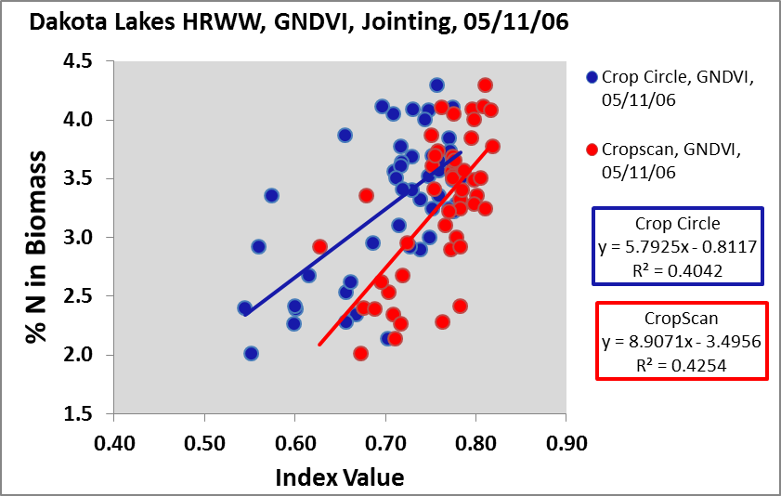
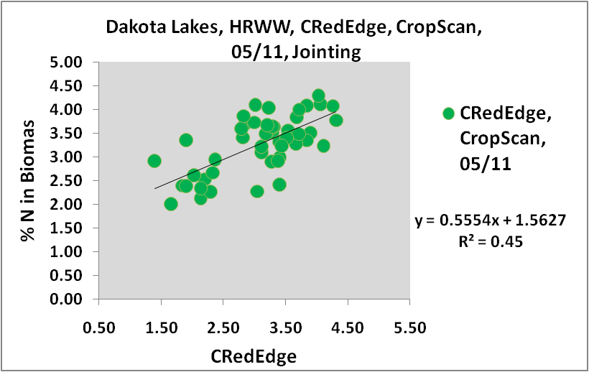
Dakota Lakes, Canopy Reflectance

Slide 10
HRWW Yield and Protein

Slide 11
HRSW,
Dakota Lakes,
2003-2004
Canopy Reflectance, Yield, and Protein

Slide 12
Field Cultural Practices
No-Till for 20+ years
Wide variety of rotations
  Beneficial soil / mycorrhyzial interactions
Average spring soil test NO3
  60 kg-N ha⁻¹
Previous crop
  2003: Soybeans
  2004: Pinto beans and cowpeas

Slide 13
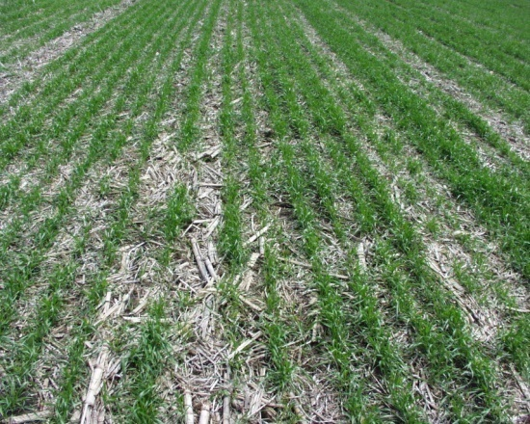
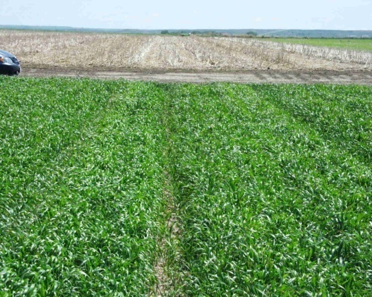
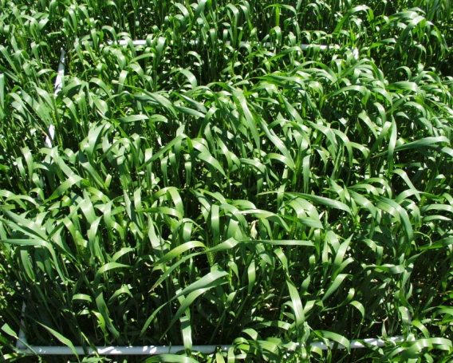
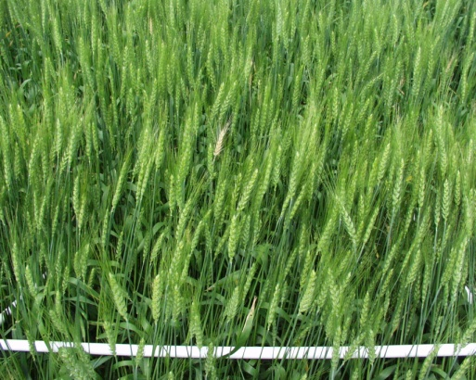
Growth Stages
May 15th
  3-4 leaf, tillering
June 4th
  6 leaf, end of tillering
June 14th
  Flag leaf, some awns
June 26th
  Flowering

Slide 14
Saturation Issues

Slide 15
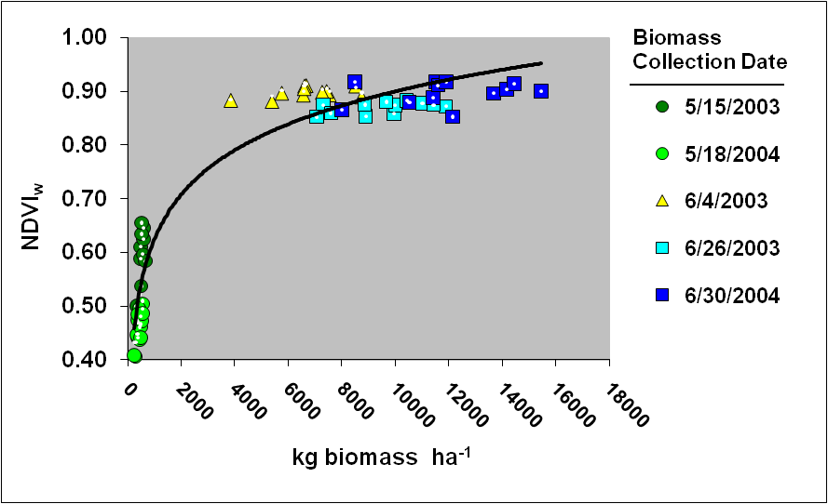
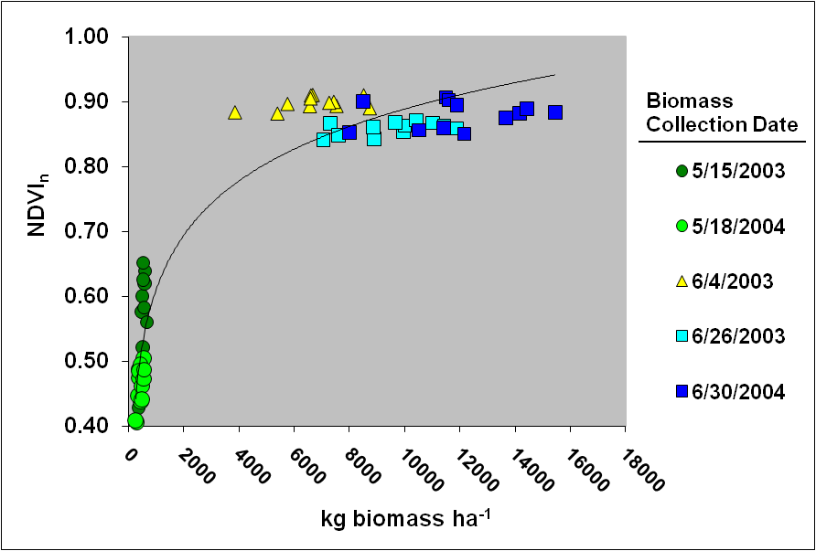
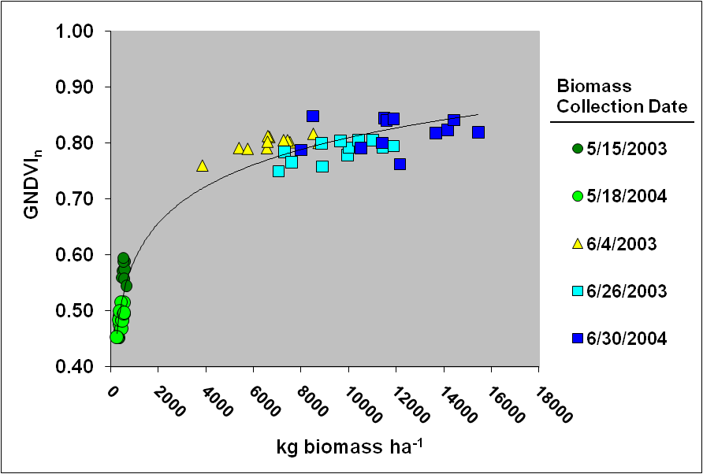
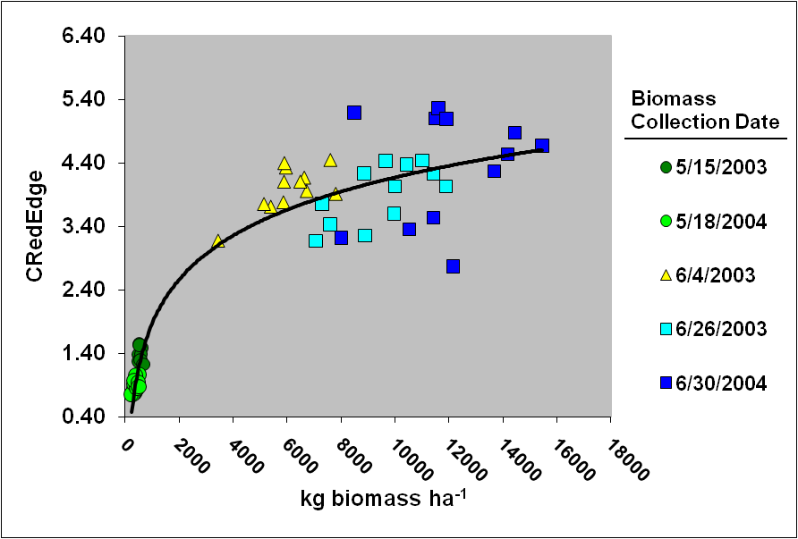
Results
Which would you select?
NDVIw
NDVIn
GNDVIn
CRedEdge
15
Notes:
15

Slide 16
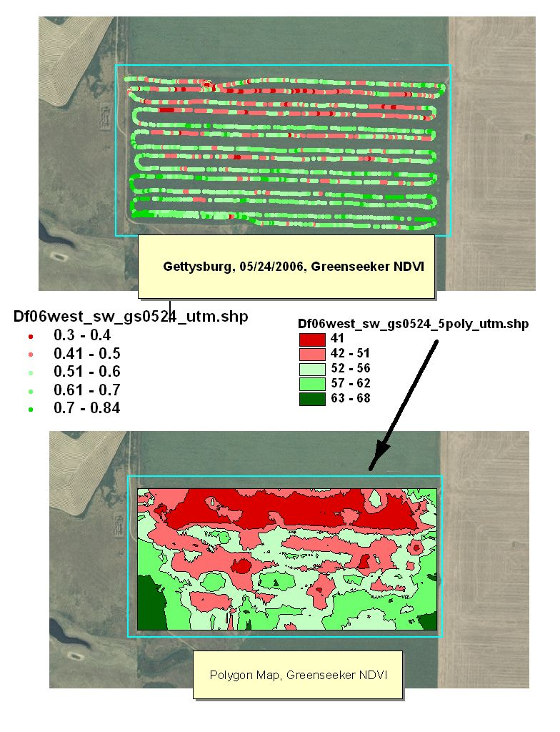
NDVI in SD, HRSW
Monitor growth stage carefully,
Collect NDVI before canopy closure to avoid saturation issues
Around Memorial Day Weekend (End of May, Beginning of June)

Slide 17
Harvest Parameters

Slide 18
Summary: HRSW
NDVI values should be collected before 5-6 leaf on HRSW (~May 28th or Memorial Day in South Dakota).
If N is to be applied after 5-6 leaf, CRedEdge appeared to be a
This study suggests when soil NO₃-N is ~60 kg-N ha⁻¹, 130 kg-N ha⁻¹applied 5-6 leaf increases yield, grain protein, and reduces lodging.

Slide 19
How Much N Fertilizer to Apply on HRSW?
What Pays?
What Does Not Pay?

Slide 20
What Farmers Know at Planting
N Fertilizer Cost
In SD, with HRSW, some indication of yield and quality in Kansas, Oklahoma, Texas
When they have lost $ in the past due to discount on low protein wheat
When they have made $ with a premium
Fertilize for protein @ 12% HRWW, @ 14% HRSW

Slide 21
Field Locations
Study Locations

Slide 22
HRSW grain market value in SD based on protein premium or discount.

Slide 23
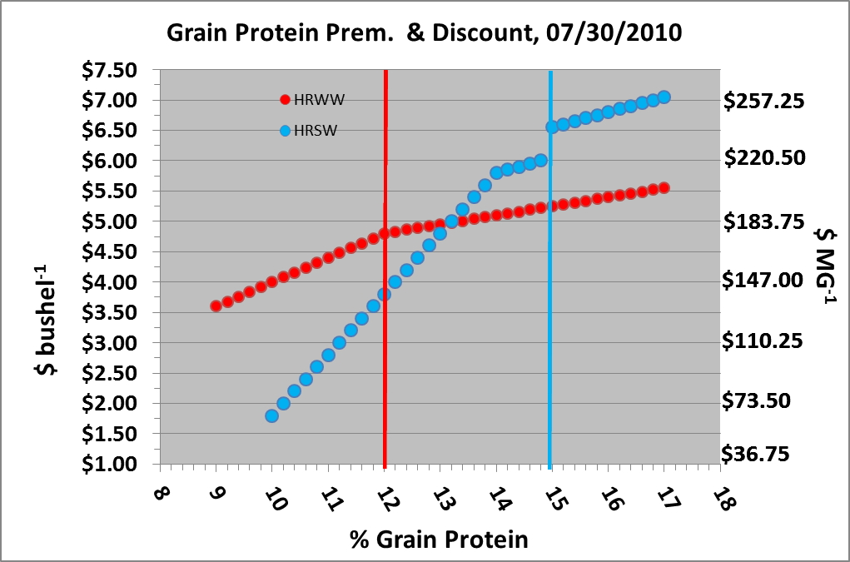
South Dakota, July 30th, 2010
Commodity Prices & Premium/Discount
Notes:
HRSW: ~$5.80 / bu ($213/Mg)
Protein Scale:
+$0.05 each 1/5 above 14%
+$0.50 @ 15%,
-$0.20 each 1/5 below 14 to 10%
HRWW
Protein Scales:
$0.03 each 1/5 above 12%
-$0.08 cents each 1/5 12% to 10

Slide 24
Experimental Design
RCB Design, Each Site, 4 Blocks.
N Treatments:
Determined Apparent Return and EONR

Slide 25
Calculating Return on N Investment
Apparent Return ($ ha⁻¹)
Two grain selling price
  $129 or $258 Mg⁻¹ ($3.50 or 7.00 bushel⁻¹)
Three N fertilizer costs
  $0.62, $1.25, or $1.90 kg-N⁻¹ or
  ($0.28, $0.57, or $0.86 lb-N⁻¹)
Six Protein Premium / Discount Scenarios
N applied Pre-Emergence or In-Season

Slide 27
EONR Using Excel SolverTM

Slide 28
Results:
Apparent Return, and Economic Optimum N Rate
(EONR),Yield, and Protein

Slide 29
Nitrogen Treatment Impact for
Different Protein Premium / Discount Scenarios on
Apparent Return ($ ha⁻¹)
Notes:
Not double more because of N cost.
Low discount, $1.90 cost, split app. $215 for $129 Mg-1; $747 for $258 Mg-1;
4393 kg-grain ha-1; 14.6%.
Cost of N $286.9. Grain value: $0.129 @ $129 Mg-1 or $567 w/out N; $0.257 at $258 Mg-1 or $1129 w/out N;
Subtract 567-287=280 ($129 Mg-1 )1129-287 = 842 ($258 Mg-1 ) OR
51% cost when grain is $129 Mg-1 OR
23% of cost when grain is $258 Mg-1

Slide 30
EONR: Application Time
Pre-Emergence or In-Season?
Tested 36 scenarios:
  Six Sites
  Three fertilizer prices
  Two grain selling prices
Out of these:
  EONR In-S or Pre-emergence the same: 22 scenarios
  In-S EONR Higher: 10
  Pre-emergence EONR Higher: 4

Slide 31
Fertilizer Cost and EONR:
% N Fertilizer Reduction

Slide 32
EONR at Langdon and Rainfall
$129 Mg⁻¹

Slide 33
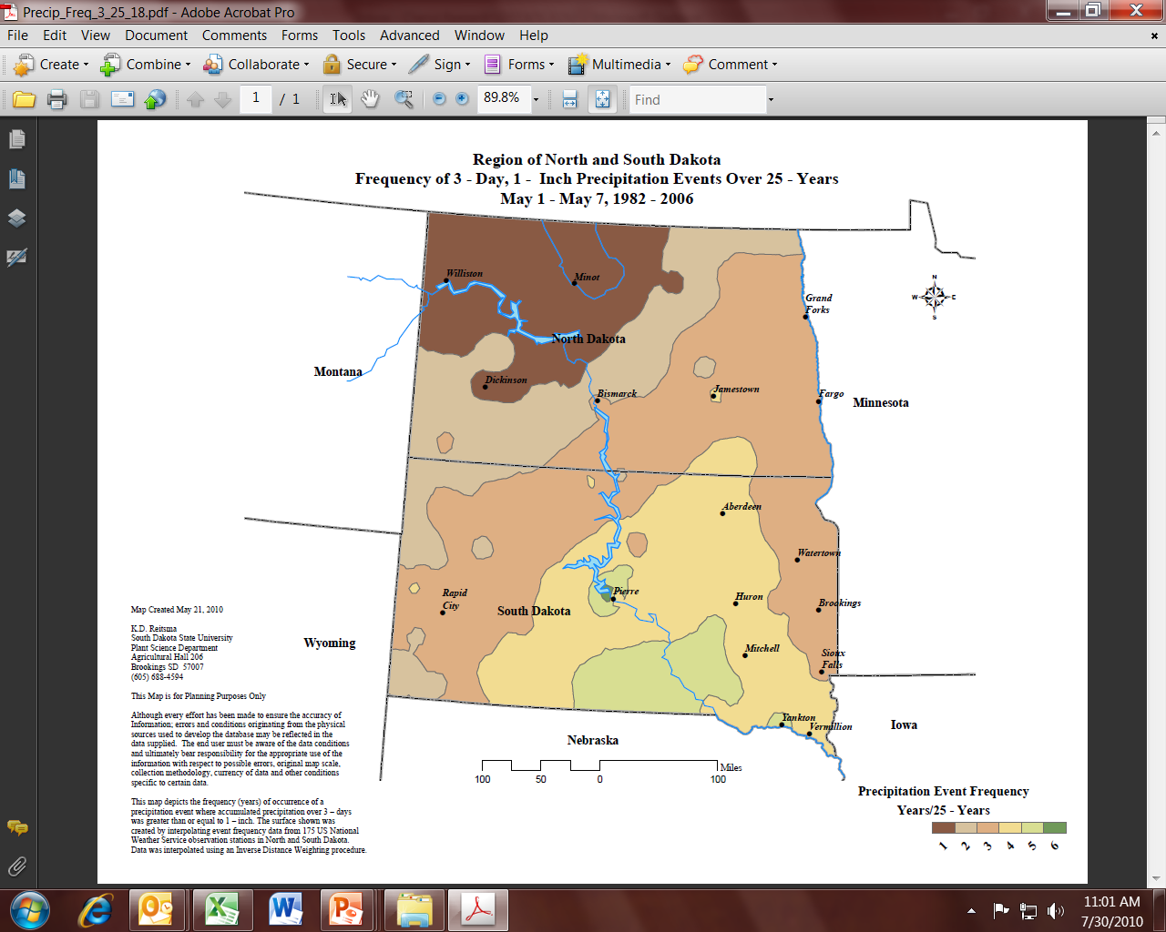
Need Rain for
in-season N

Slide 34
Conclusions
Indices show great promise in SD to manage in-season N for both HRWW and HRSW; need more fields.
N fertilizer price affects wheat EONR.
Development of a online EONR prediction model for wheat incorporating:
  N fertilizer cost options
  Value of grain
  Different protein premium/discounts scenarios
  Tillage / Climate Impacts on N mineralization:
    Microorganism competition for N
    Mycorrhizal colonization and contributions

Slide 35
EONR Calculator for Wheat

Slide 36






Questions / Thank you!
South Dakota State University
Farmers and Support Staff at SDSU
Dan Forgey (Farmer)
Ralph Holzwarth (Farmer)
Ryan Patterson (Farmer)
Steph Hansen (SDSU)
Jon Kleinjan (SDSU)
Ryan Brunner (SDSU)
Tulsi Kharel (SDSU)
Scientists:
David Clay (SDSU)
Sharon Clay (SDSU)
Dwayne Beck (SDSU)
Gregg Carlson (SDSU)
Dan Long (USDA-ARS)
36

Slide 37
Yield, Lodging, and Grain Protein

Slide 38
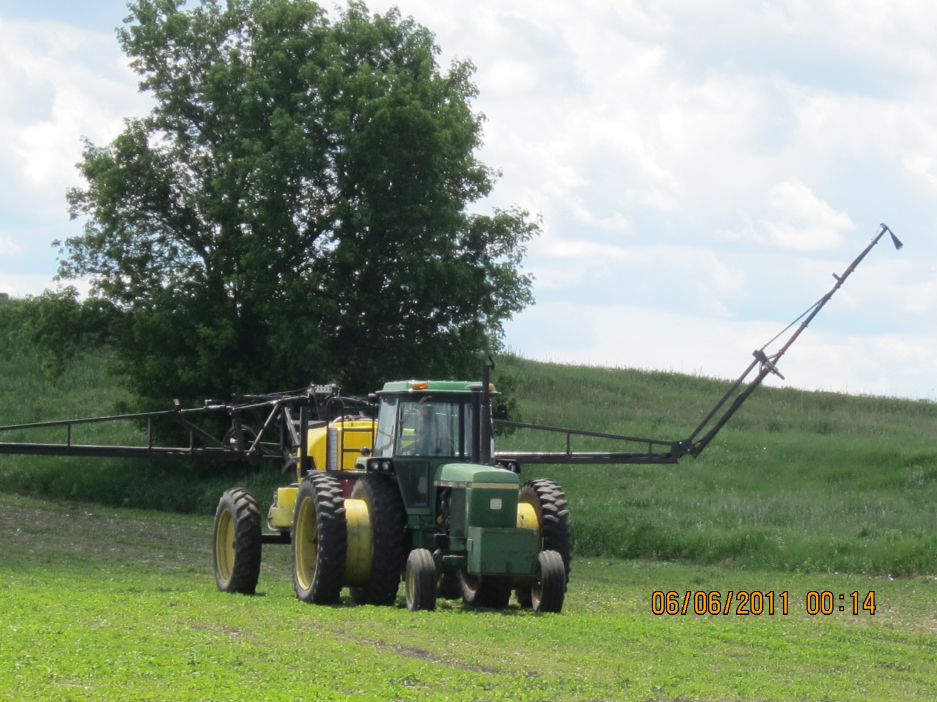

Slide 39
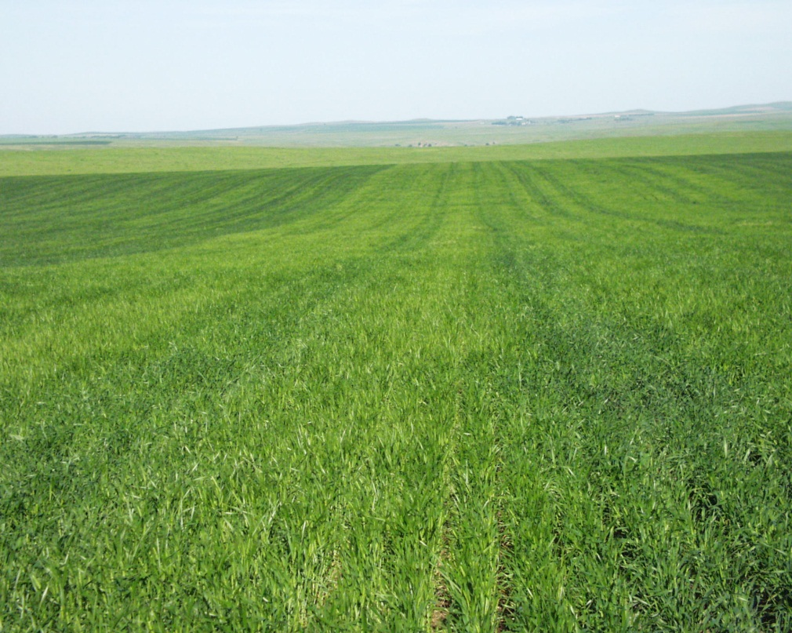
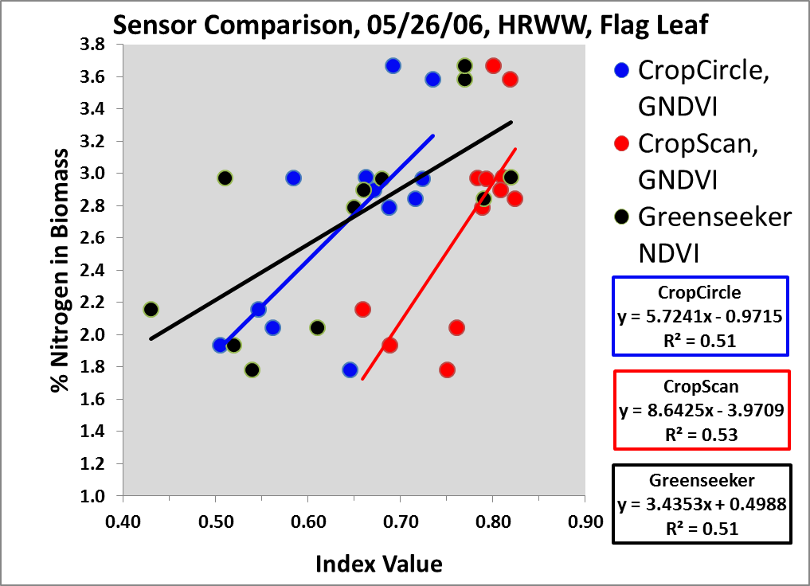
Winner Field, 2006:
A Challenging Field
05/26/2006

