Slide 1
Generalized Algorithm for Variable Rate Nitrogen Application on Cereal Grains
John B. Solie, Regents Professor Biosystems and Agri. Engineering Dept.
William R. Raun, Regents Professor, Plant and Soil Sciences Department
Dean Monroe, PhD, Formerly Biosystems and Agri. Engineering Department

Slide 2
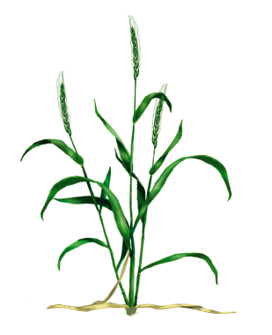
Normalized Difference Vegetative Index - NDVI
Calculated from the red and near-infrared bands
Equivalent to a plant physical examination
Correlated with:
  Plant biomass
  Crop yield
  Plant nitrogen
  Plant chlorophyll
  Water stress
  Plant diseases
  Insect damage

Slide 3
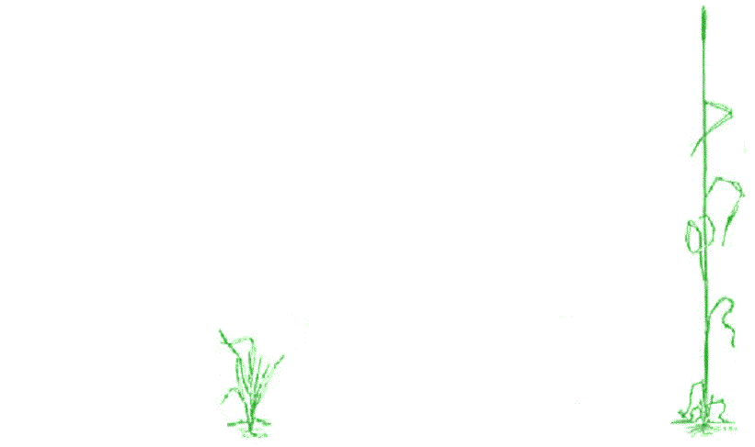
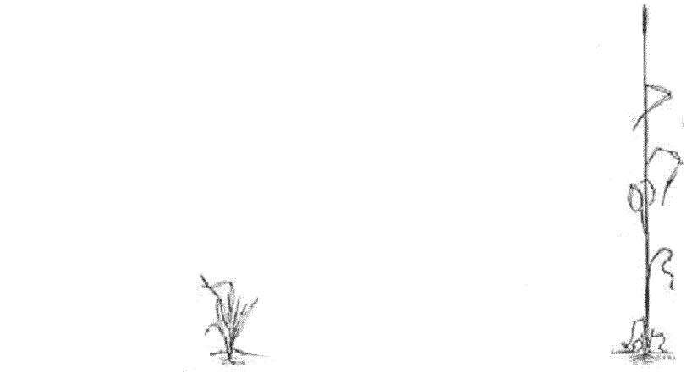
OSU Original N Rate Algorithm
Bill’s Postulates
Crop yield potential can be predicted from NDVI
A maximum potential yield exists that is a function of the weather and soil type
A fertilizer response index exists that defines the response to additional fertilizer and varies from year to year and site to site.
Response to N fertilizer is independent of potential yield.
YPN = f(YP0, RI)
1. Measure
2. Predict YP₀
3. Predict YP_{N}
4.
3
2
1
4

Slide 4
Agronomic Justification for Sigmoid Yield Model

Slide 5
Sigmoid Yield Model with Transitions
How Do We Locate the “Curve?

Slide 6
Locate by 1) NDVINRICH and Max. Potential Yield 2) NDVIBareSoil and Zero Yield

Slide 7
Sigmoid Model Shift from Change in Growth Stage (Biomass)
Maximum
Potential
Yield
NRich NDVI

Slide 8
Unit Sigmoid Model
Radius of Curvature

Slide 9
Potential Yield Calculations
Variables & Parameters
YPmax
NDVINRich
NDVIFP
RINDVI = NDVINRich/NDVIFP
Inf – Parameter Function of NDVINRich
“K” – Parameter Function of NDVINRich

Slide 10
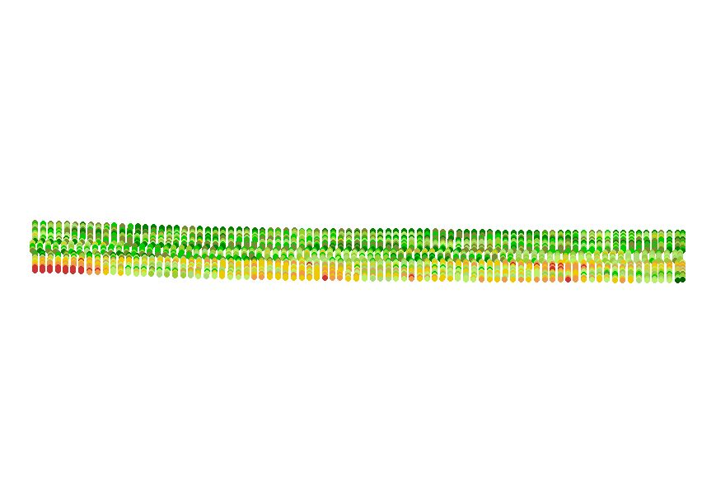
NRich Strip & Potential Yield
NDVI NRICH, NDVIFP NDVIBS:
Sense NDVI from NRich strip and adjacent farmer practice strip in a portion of the field exhibiting the highest response to pre-plant fertilizer. Also collect NDVI measurement from bare soil. Calculate RINDVI
POTENTIAL YIELD:
Field history, yield trend, farmer’s and agronomist’s knowledge, experience, and intuition, crop models, soils map, etc.

Slide 11
Inflection Point Location

Slide 12
Curvature “K”

Slide 13
OSU Algorithm Prediction of Yield Compared with Nonlinear Regression of Individual Data Sets

Slide 14
Fertilizer Application Rate

Slide 15
Field Test Results
Dr. Bill Raun
Eminent Professor and Regents Professor
Oklahoma State University

Slide 16
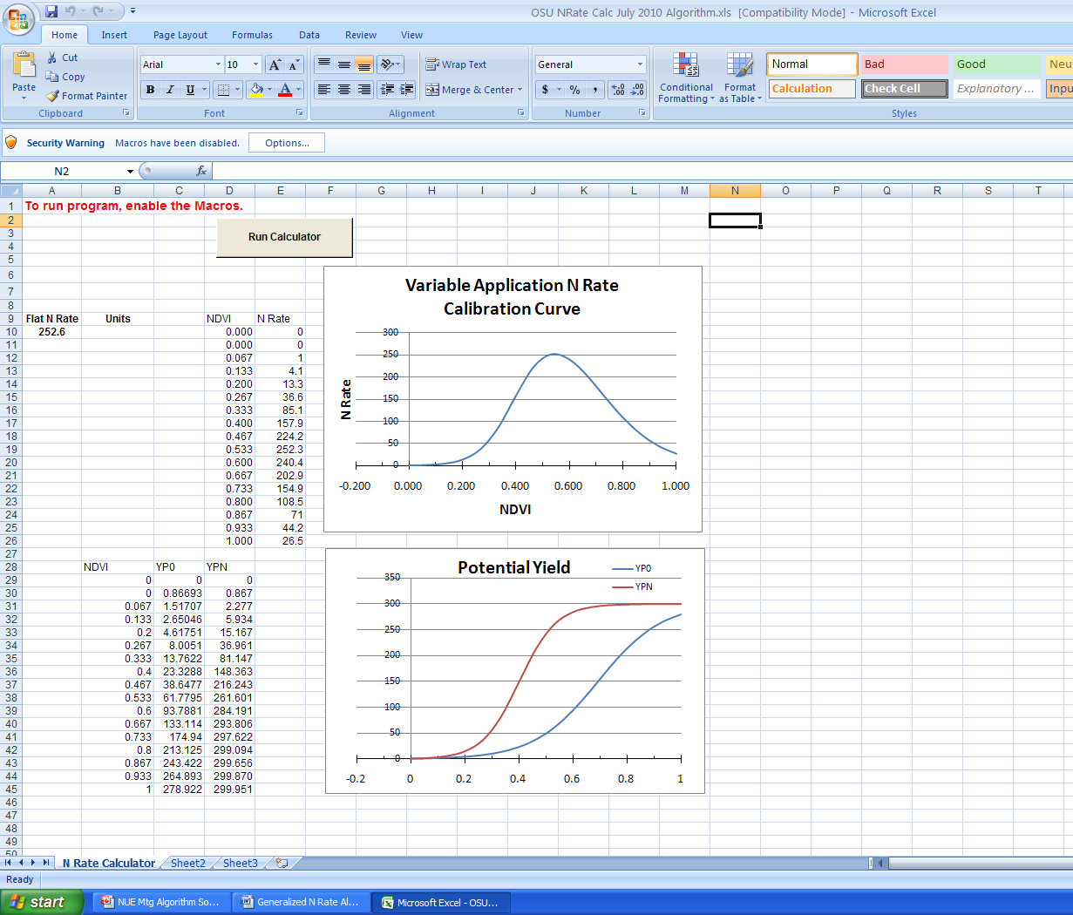
Spread Sheet Macro for Calculating N Rate

