Slide 1
Variable Rate Fertilizer at Reduced Scales
Randy Taylor
Biosystems and Agricultural Engineering
Oklahoma State University
2010 NUE Conference
Stillwater, OK

Slide 2
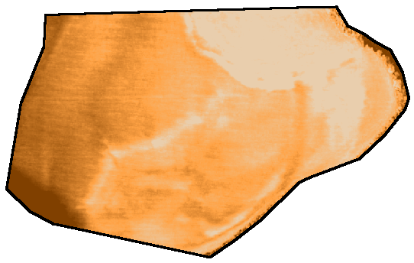
Field Scale Variability
Macro-variability
  Likely tied to soil type, landscape position, or something else
Micro-variability

Slide 3
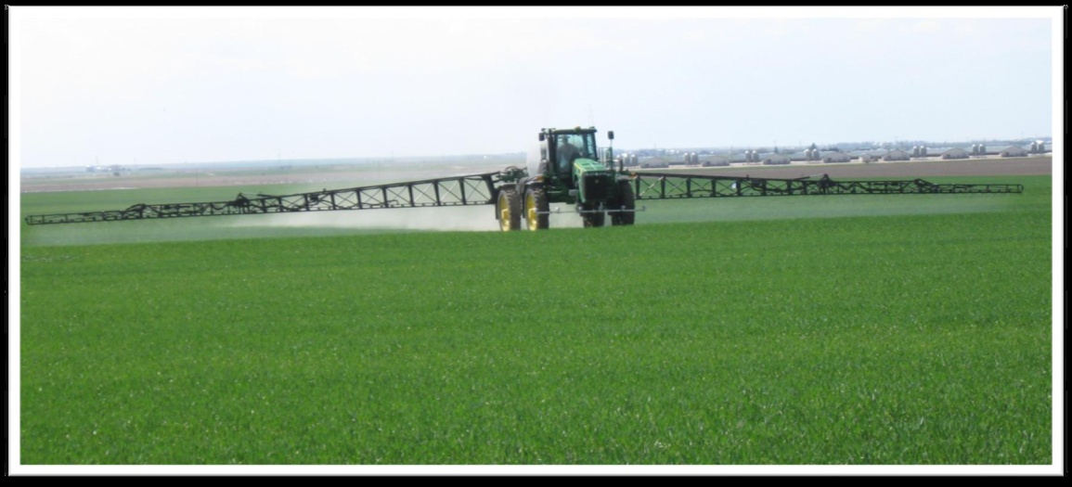
Variability View from Equipment
Longitudinal
  Down-the-row
  Response time issues
Lateral
  Across the boom
  Boom divisions
A greater distance between the control and delivery points means a lower resolution and increased scale.

Slide 4
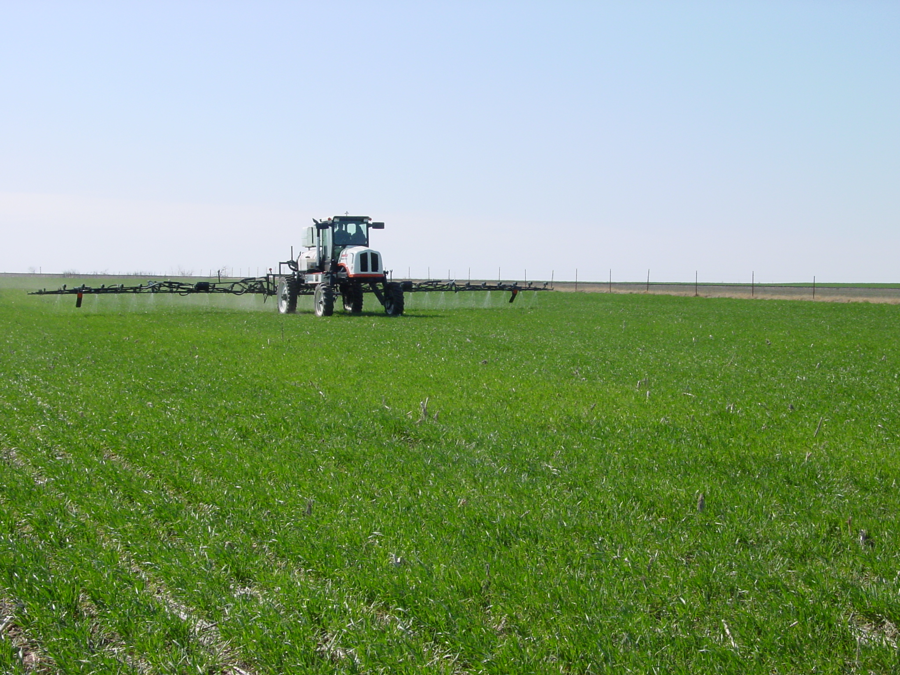
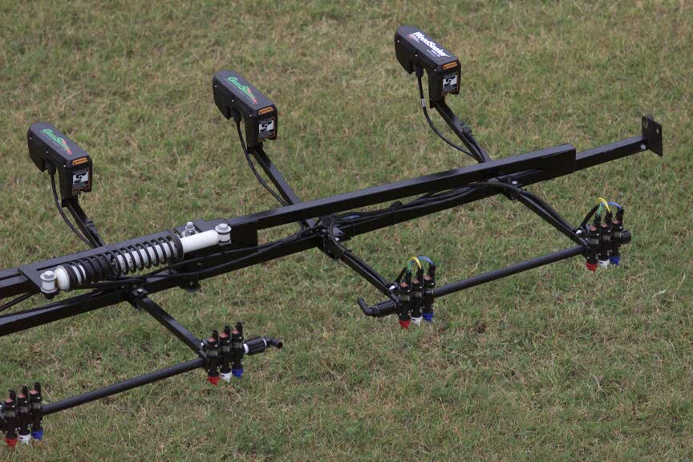
Sub-Meter Application System is a Proven Concept

Slide 5
Liquid Systems
The initial sub-meter application system met market resistance
However, sensor based VRA has found commercial success
Section control systems have also renewed the interest in sub-boom width application

Slide 6
Accepted Resolution

Slide 7
Reduced Scale

Slide 8
Liquid Systems
Most commercial rate controllers can be set to about a 2 second response time.
Multiple control sections will require multiple control valves and possibly flow meters.
Pulse width modulation and binary valve systems have promise.

Slide 9
Granular VRT
Granular distribution/delivery systems follow two basic designs
  Gate/belt or chain/spinner
  Metering wheel/air boom
While both systems can be used for variable rate application, reducing the application scale to a partially width is really not feasible

Slide 10
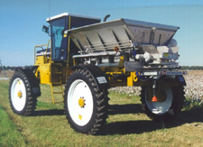
Spinner Spreaders
Reducing application scales with spinner spreaders is really not feasible.
The material is centrally metered and distributed.
Furthermore, VRA with spinner spreaders is a challenge.
  Spread distribution patterns are typically a function of flow rate onto the spinner

Slide 11
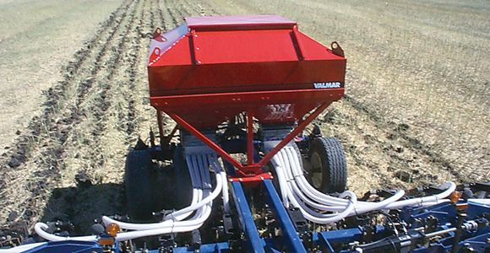
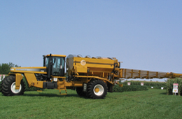
Air Boom Systems
The material is centrally metered, but patterns are created locally.
The primary challenge is lag time from the metering system to the point of application

Slide 12
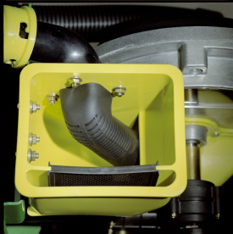
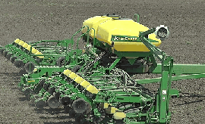
Potential Solutions
The central hopper/conveying system might be a good model to follow

Slide 13
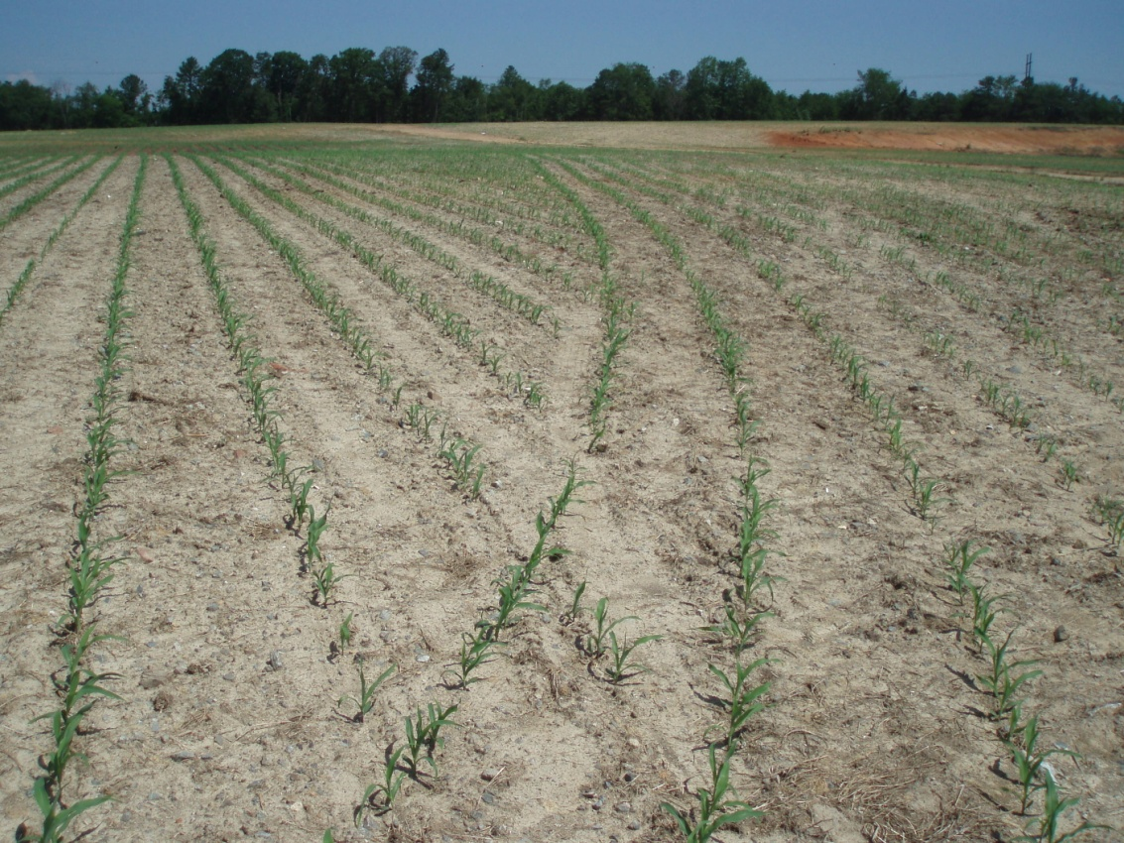
Section Control System Speed

Slide 14
Rate Controllers and Tuning
Prescriptions should not be developed without considering rate controller performance.
Worry about the macro variability within the field.
Are you capturing the general trend?

Slide 15
Questions
Randy Taylor
Randy.Taylor@okstate.edu
405-744-5431

