Slide 1
Sensor-based Nitrogen Application – Converting Research to Practicality
Brent Rendel
Rendel Farms
Miami, Oklahoma

Slide 2
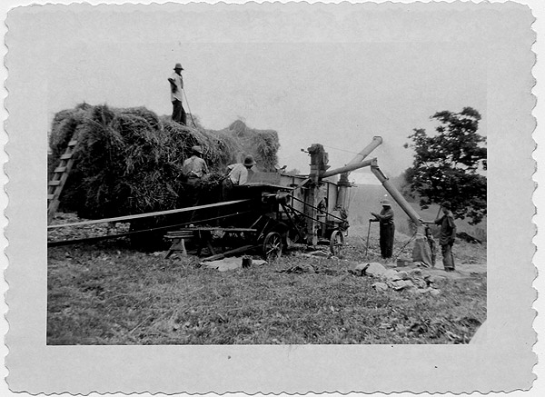
If it was good enough for my dad…

Slide 3
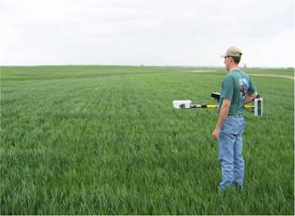
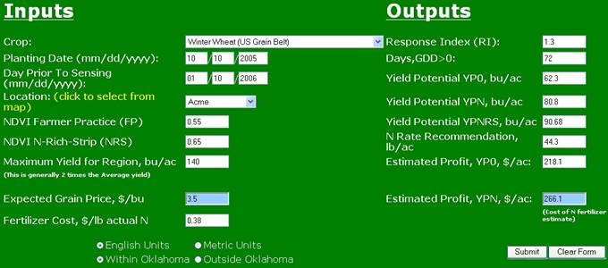
N Strip Approach

Slide 4
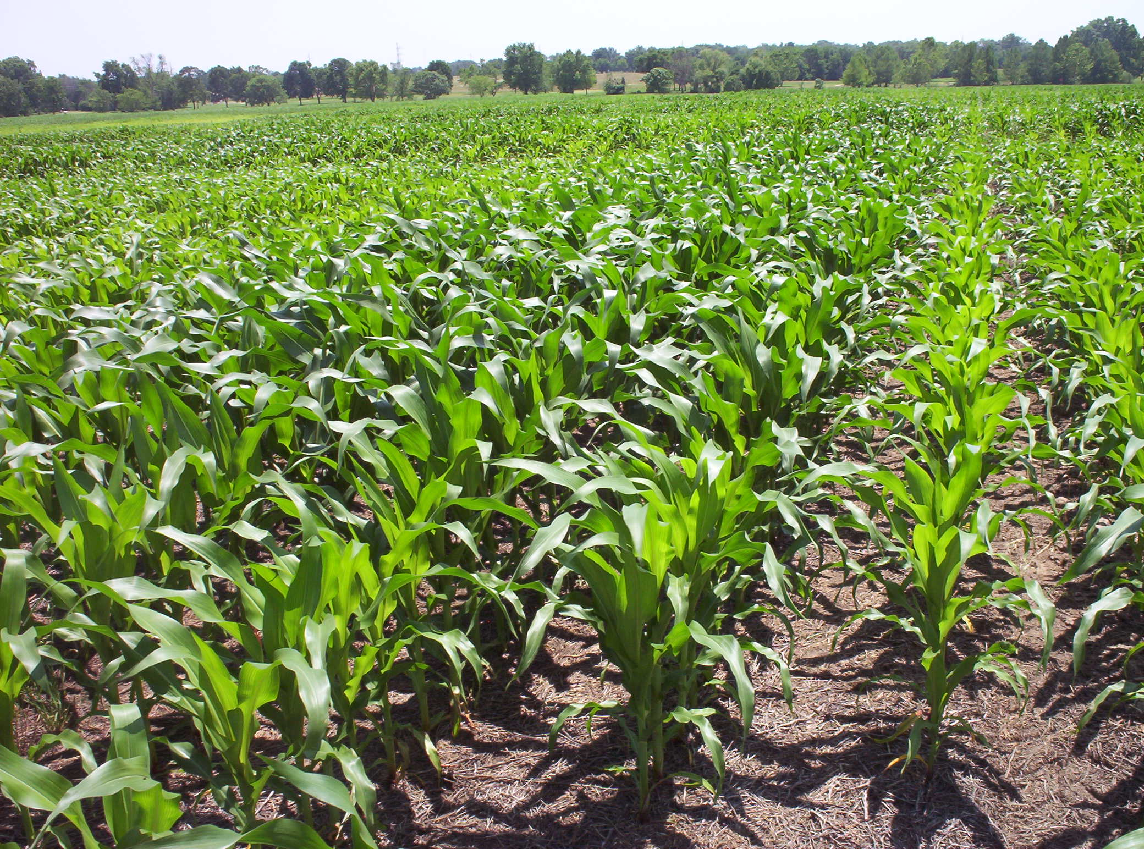
N Ramp Approach

Slide 5
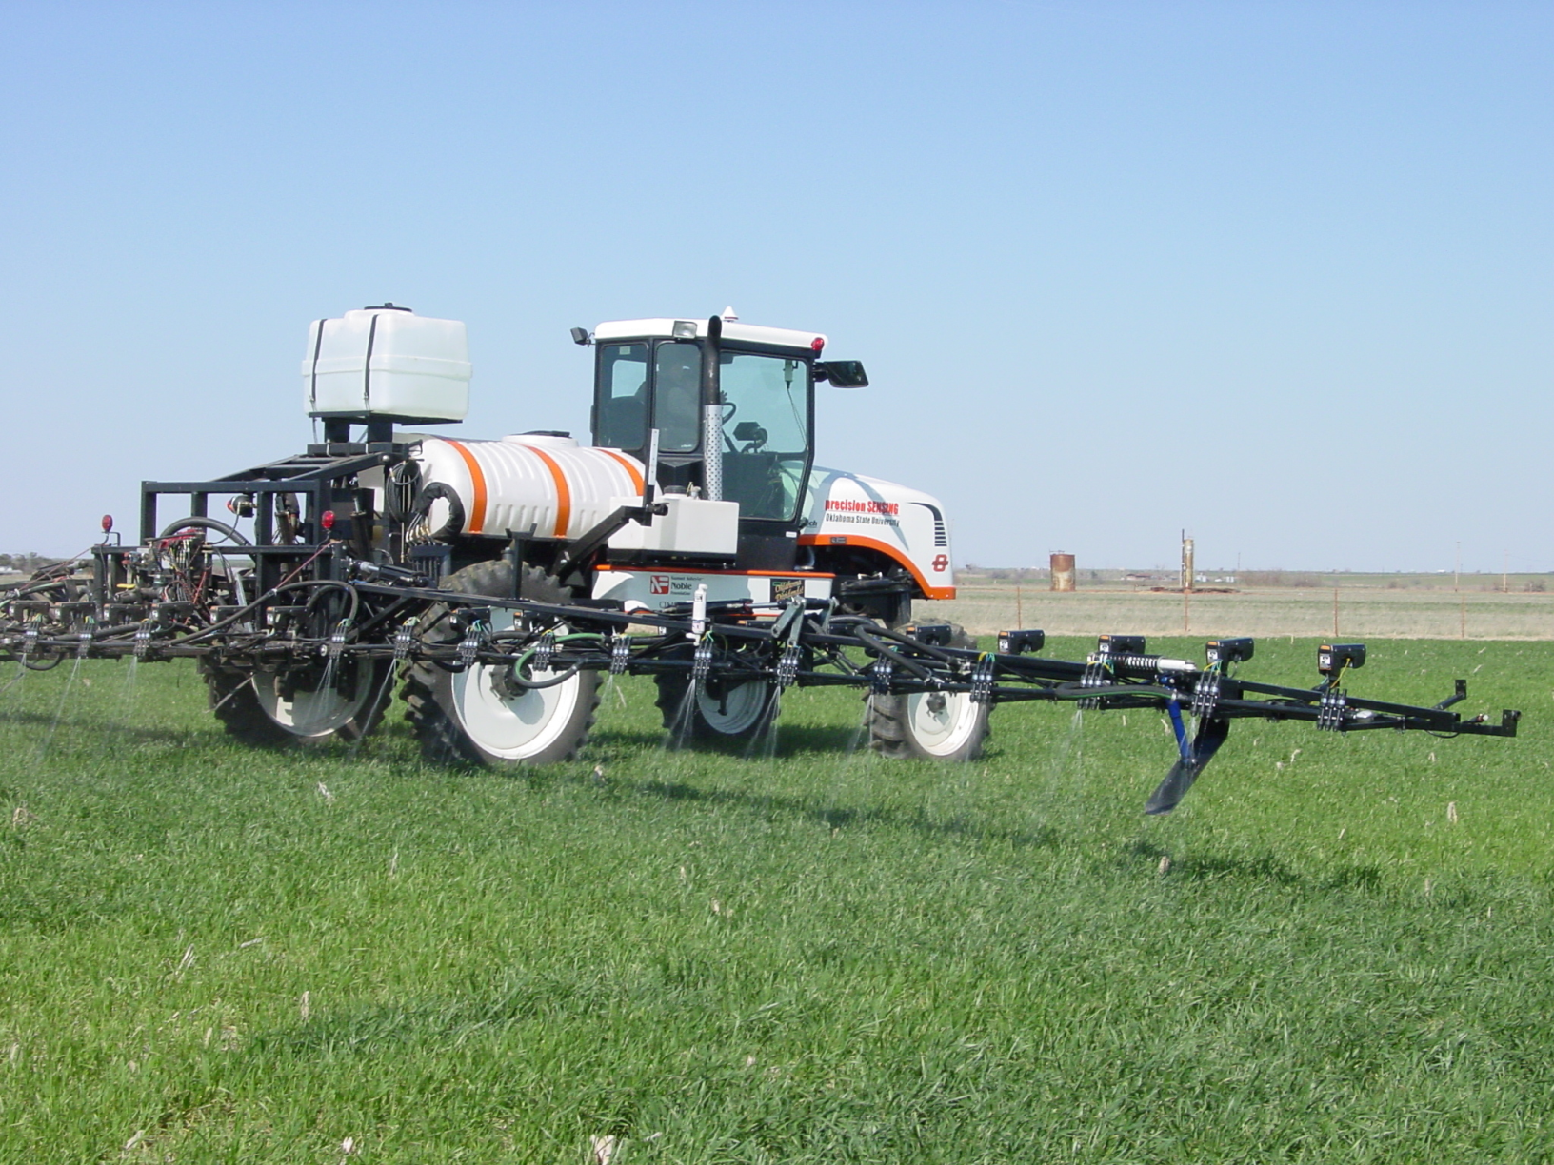
On-the-go Zone Approach

Slide 6

My Approach

Slide 7
2005 Crop Year
Wheat:
  OSU placed 3-level nitrogen strips in 1 wheat field
  ZERO additional nitrogen called for by GreenSeeker
  All other fields received 36 # N/ac as topdress
  Farm avg: 33.0 bu/ac vs GreenSeeker avg: 33.9 bu/ac
Corn:
  OSU placed Corn nitrogen test in one field using various nitrogen levels as part of statewide research
  Highest profit/acre obtained was on check, closely followed by GreenSeeker
Notes:
Relate story of telling Stan to call in Bob Woods to confirm results after another week of growing

Slide 8
Precision Nitrogen Applicator
Mark I

Slide 9
2006 Crop Year
Wheat:
  Placed 3-level N strips in all wheat fields
  Topdressed at GreenSeeker rate plus 10 lb/ac of N
  Farm avg yield: 24.4 bu/ac (consistent with county yields for the year)
Corn:
  OSU placed Corn nitrogen test in one field using various nitrogen levels as part of statewide research
  Highest profit/acre obtained was on check, closely followed by GreenSeeker

Slide 10
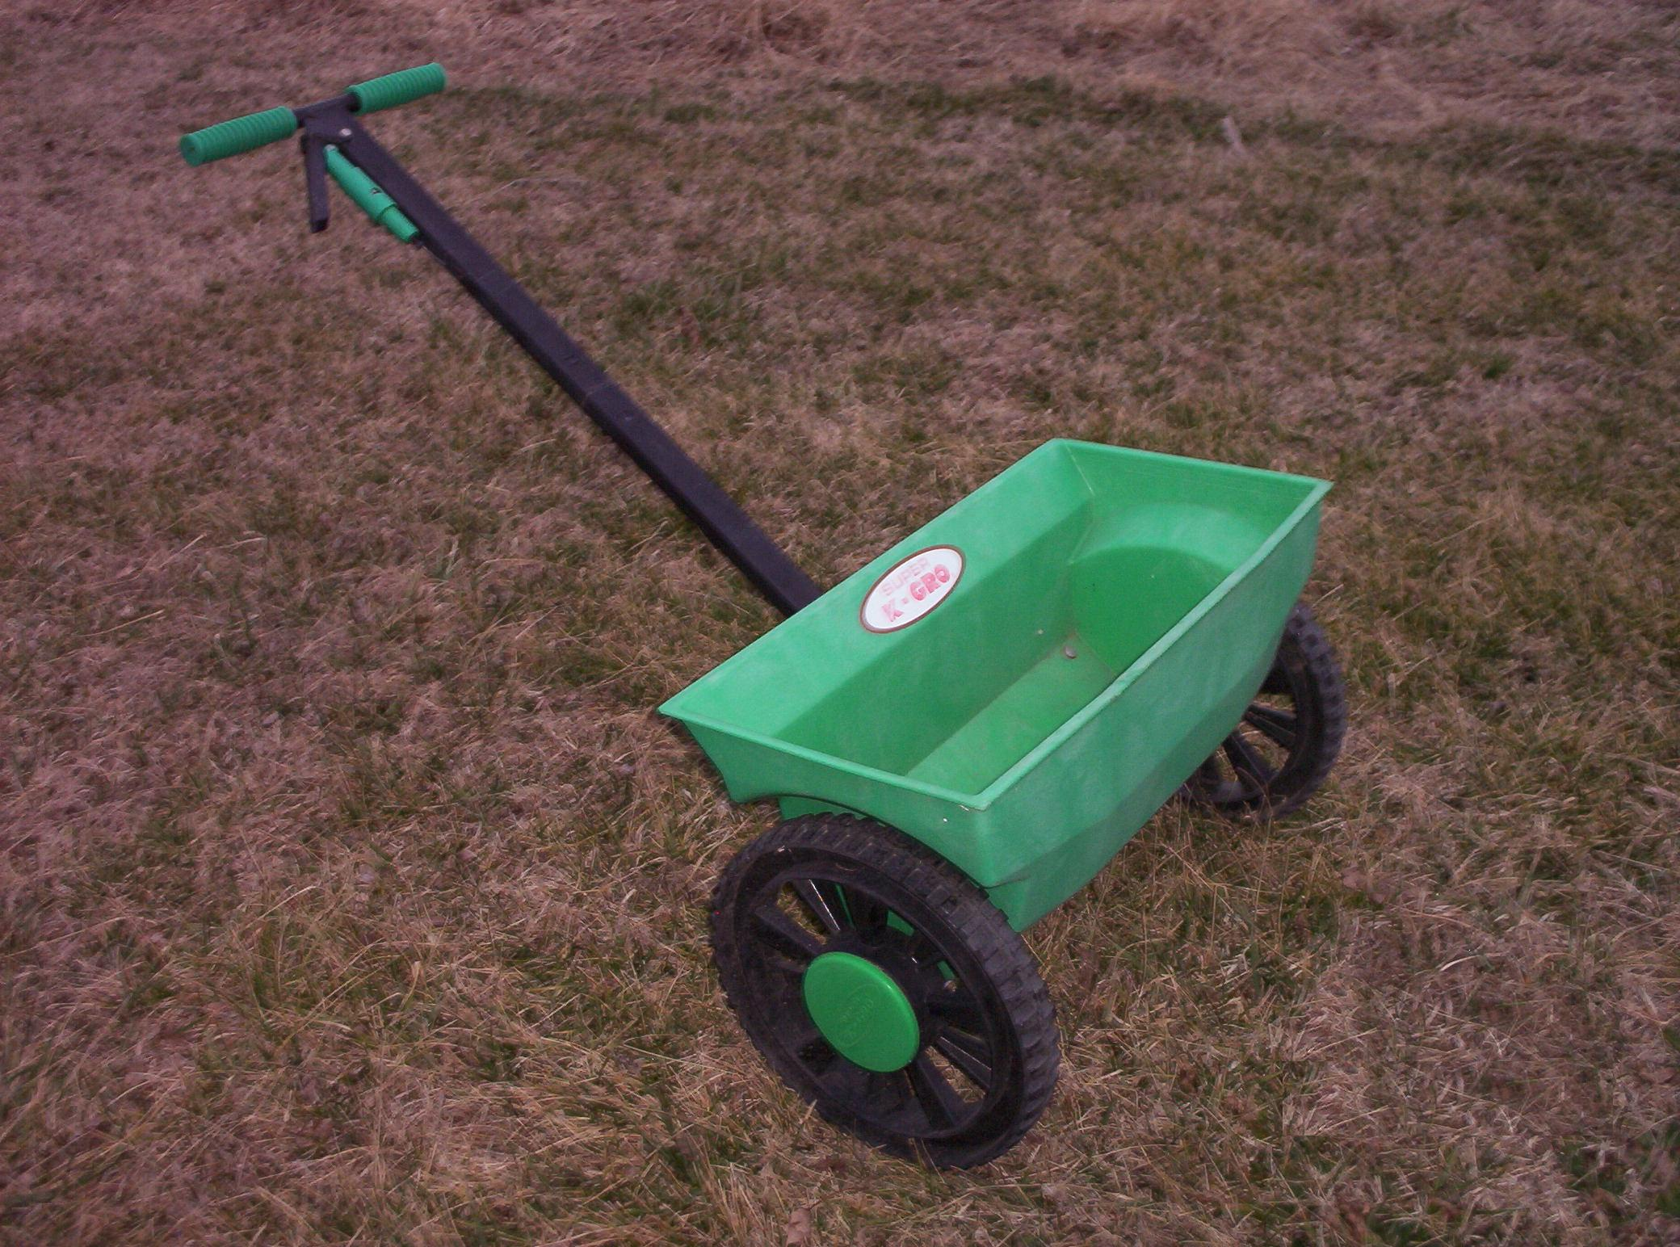
Precision Nitrogen Applicator
Mark II

Slide 11
2007 Crop Year
Wheat:
  OSU placed N Ramps on 7 fields
  I placed single-rate High N strips on all fields
  Topdress well below traditional levels (0-30#/ac)
  Late spring freeze destroyed 90% of the crop

Slide 12
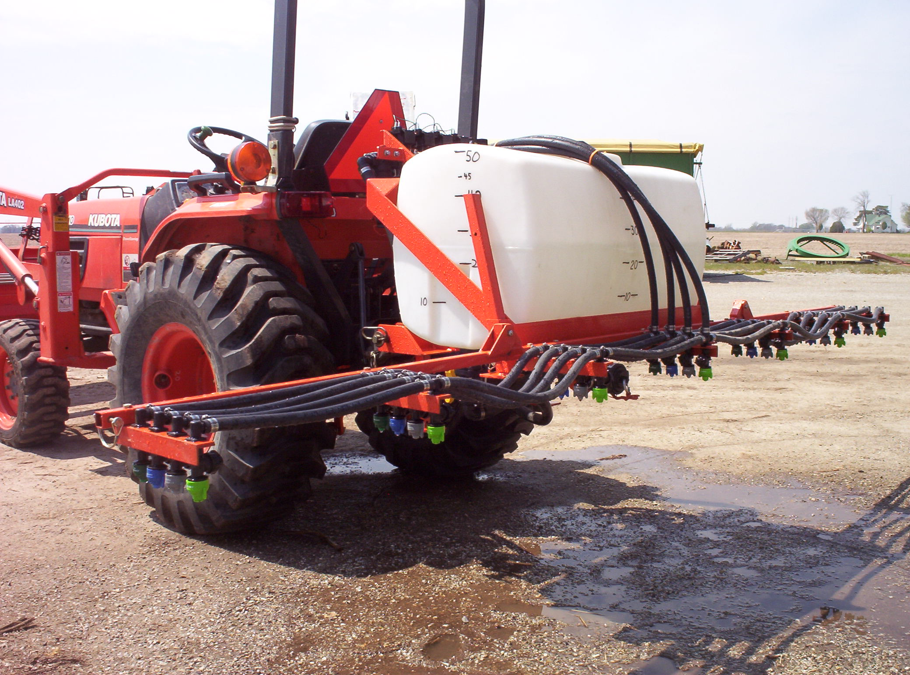
Precision Nitrogen Applicator
Mark III
Notes:
Show Rendel Ramp Applicator
Discuss current corn crop lessons
Need to get ramps down ASAP
Be prepared to make judgment calls
GPS marking almost a necessity
You really do need to wait until V7+ before a good reading can be obtained

Slide 13
2007 Crop Year
Corn:
  20 N Ramps in 9 fields
  Late Spring freeze destroyed or severely damaged earliest planted fields
  Some ramps adversely affected by “wet holes”
  Average GS side dress rate – 35 # N/ac
  Placed full-rate (75# n/ac side dress) check in 1 field – out-yielded GS check (25# N/ac side dress) by 21.2 bu/ac

Slide 14
2008 Crop Year
Wheat:
  Placed N ramps in all fields
  Topdressed at GreenSeeker rate and placed full-rate (75 #N/ac) topdress strips in 3 fields
  Checks confirmed highest profit with GS.
Corn:
  Placed N ramps in all fields
  Extended length of high N section of ramp
  Top dressed by GS strips and farmer “eye” estimates
  No checks

Slide 15
2009 Crop Year
Wheat:
  Placed N ramps in all fields
  Winter conditions dictated topdressing early (GDD<70)
  Used past experience, visual ramp estimates and GS
  Placed High N checks in 2 fields
  No added profit on High N checks
Corn:
  Placed Single-rate High N strips in 4 of 14 fields
  Used past experience and strips to determine rates
  Corn grew too tall to sidedress in some areas

Slide 16
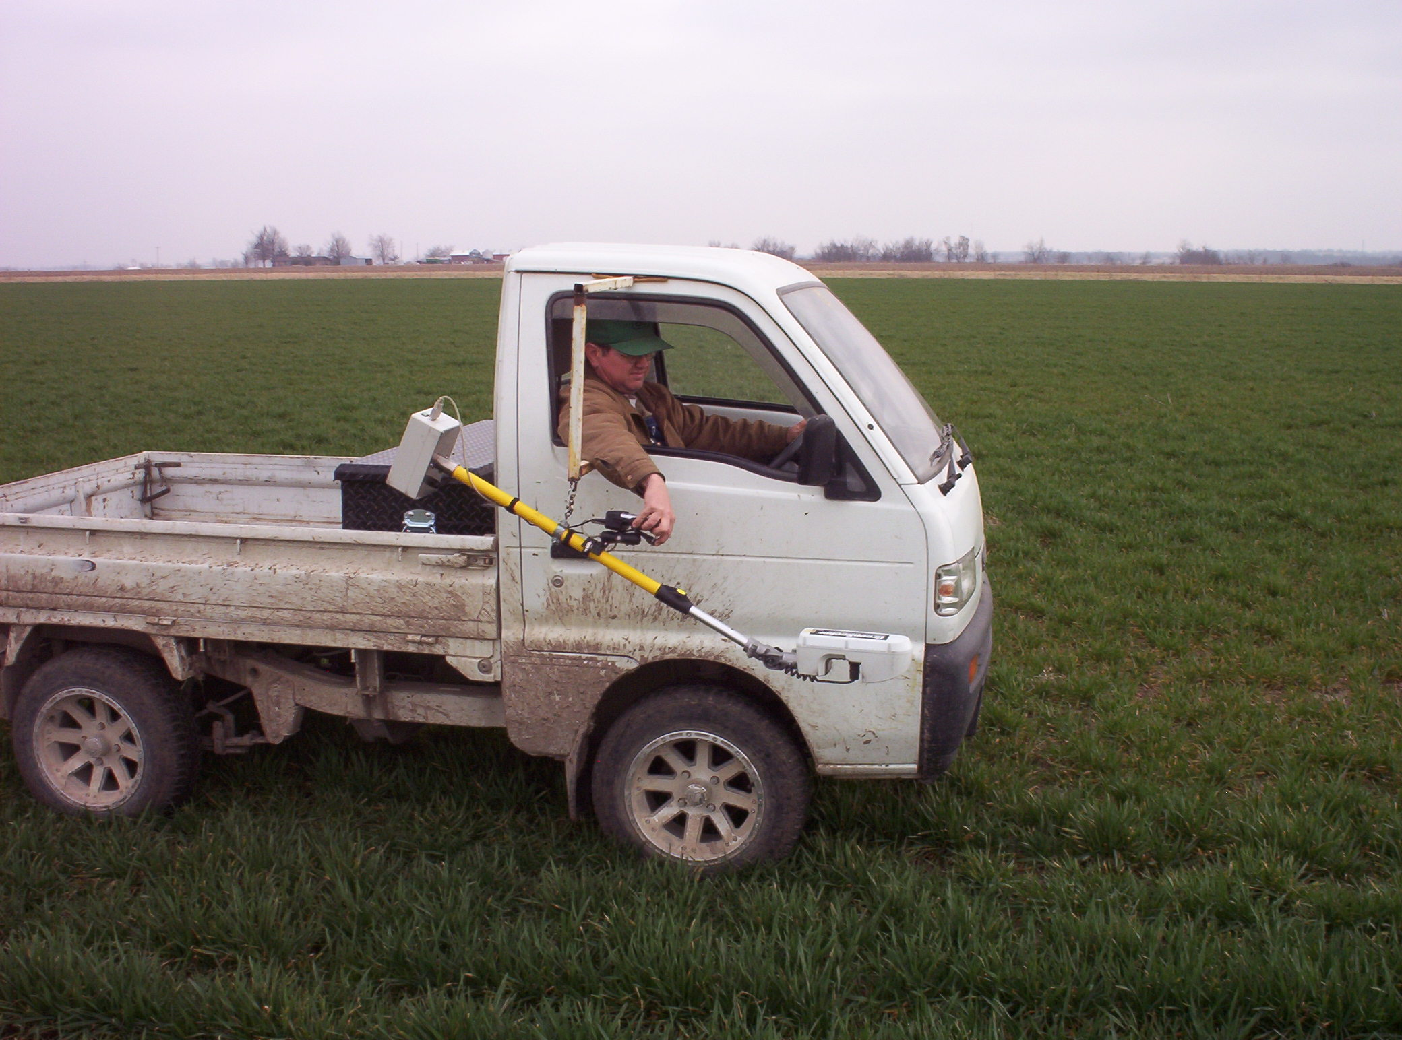
Ramp Sensing Upgrade

Slide 17
2010 Crop Year
Wheat:
  Wet fall prevented planting until November 30th
  Limited acres and growth = zero top dress
Corn:
  Switched to bedded corn system
  No ramps or strips placed this year (weather, schedule)
  Targeted fields for 50# N/ac side dress at V6-V8
  Weather prevented sidedress on 70% of acres (tasseled before N could be placed)
  No visual N stress in most fields

Slide 18
Lessons Learned
Start slow but be persistent
Don’t adjust your farm to the technology…adjust the technology to your farm
Question everything and believe your results
NUE is an approach…not a system!
Wheat is a “No-brainer”
Corn is still a work in progress
A 50% solution is better than a 30% solution
Communication
Communication
Communication

Slide 19
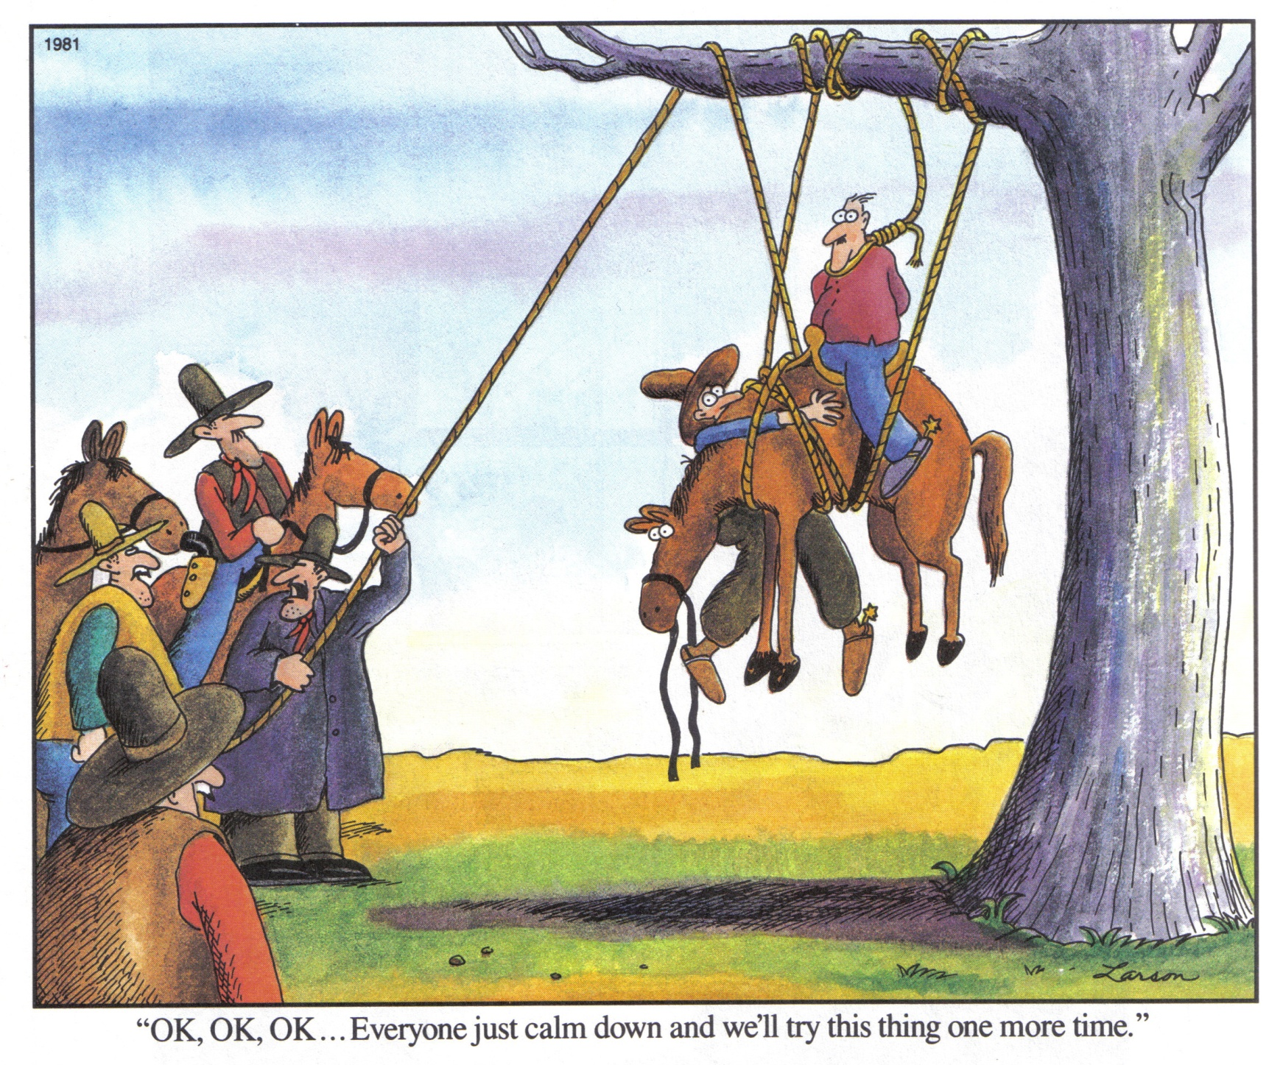
Agriculture “Beta Testers”

Slide 20
Since I began speaking about 20 minutes ago...
The world has 2900 more mouths to feed (U.S. Census Bureau)
Nearly a quarter-section of productive U.S. farmland has been converted to urban use (2002 / 2007 U.S. Census of Agriculture)
Runoff from applied nitrogen fertilizer sources have sent the equivalent of 2 semi truck loads of urea fertilizer out the mouth of the Mississippi River (U.S. EPA Draft Gulf Hypoxia Action Plan 2008)

Slide 21
Contact
Brent Rendel
okiefarmer@yahoo.com
918-533-4081 (cell)

