Slide 1
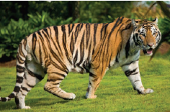


Louisiana State University
Sensor Research Updates
Yumiko Kanke, Dr. Brenda Tubana, Dr. Jasper Teboh, and Josh Lofton

Slide 2
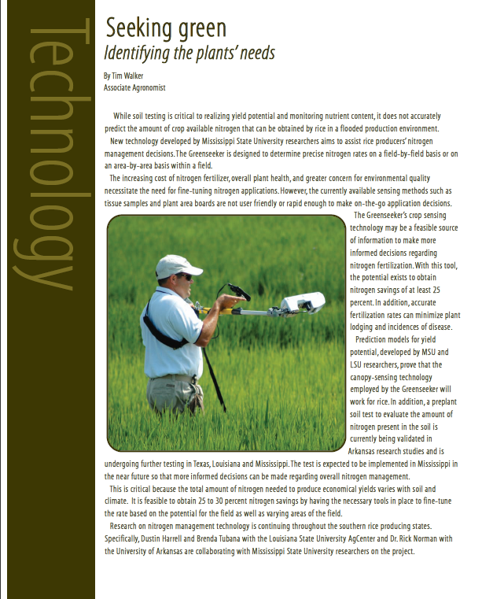
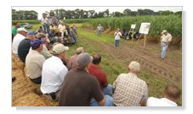
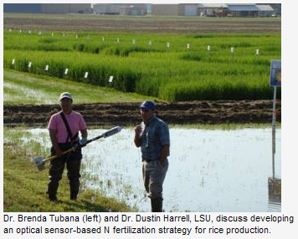
Remote Sensor Studies
Crops: sugarcane, rice, cotton and corn
Application: improve midseason N fertilizer recommendations
Activities
  Update database
  Refinement algorithms
  Validation/calibration

Slide 3
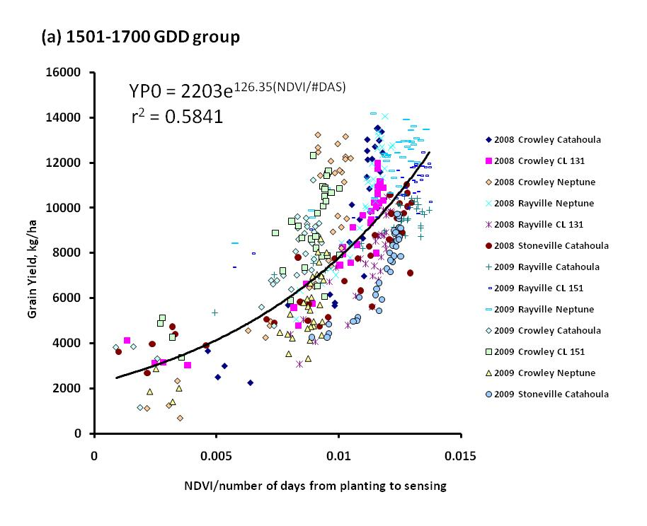
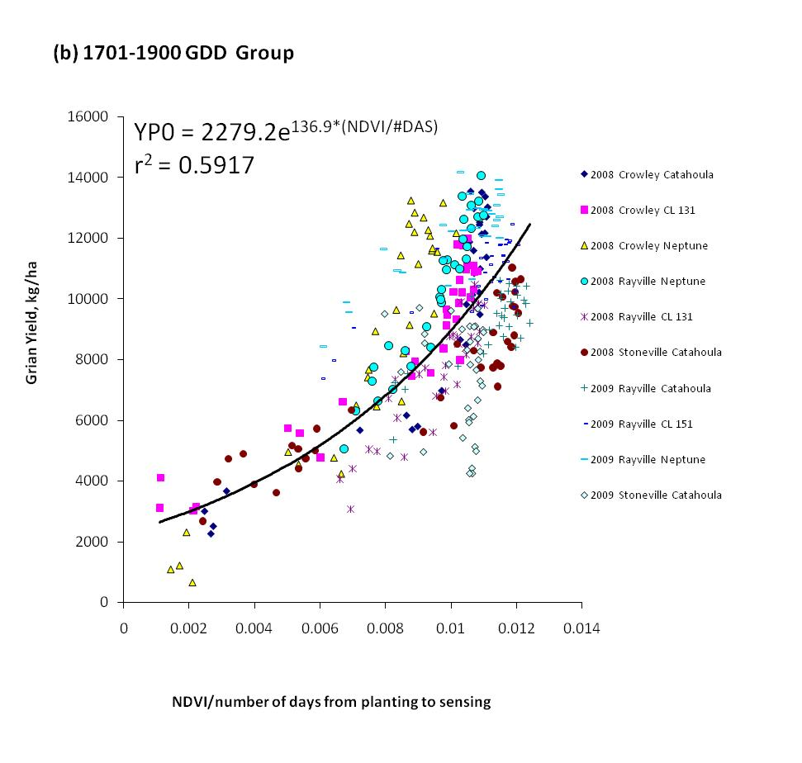
Rice Updates
Grain yield potential can be predicted at panicle differentiation (1501-1900 cumulative GDD).
Research in on-going
  To evaluate the impact of water reflectance
  To refine the algorithm

Slide 4
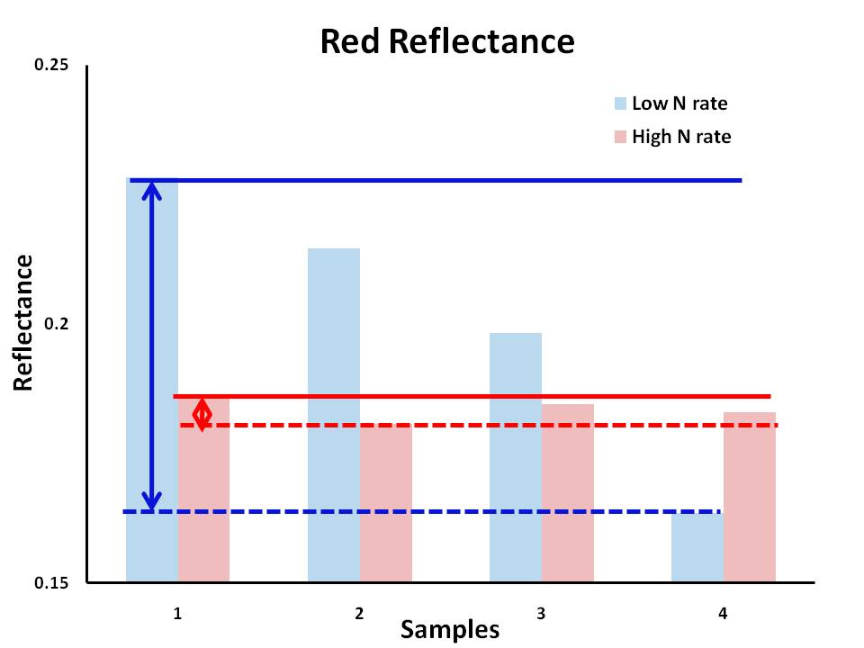
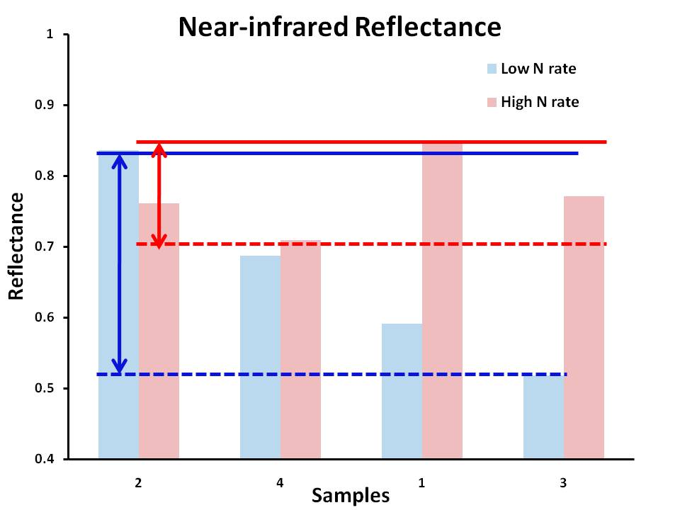
Rice Updates
  The water as a background may alter canopy reflectance readings. This is most significant when plant biomass is small and the stand is thin.
  Low N rate, NDVI could be from 0.44 to 0.58
  High N rate, NDVI could be from 0.62 to 0.66

Slide 5
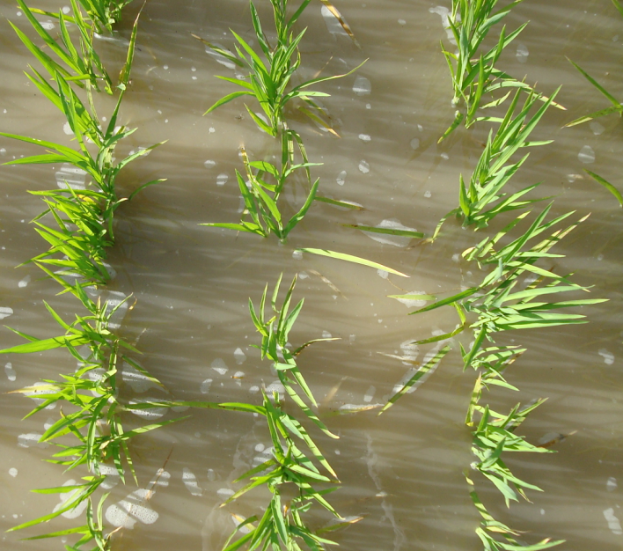
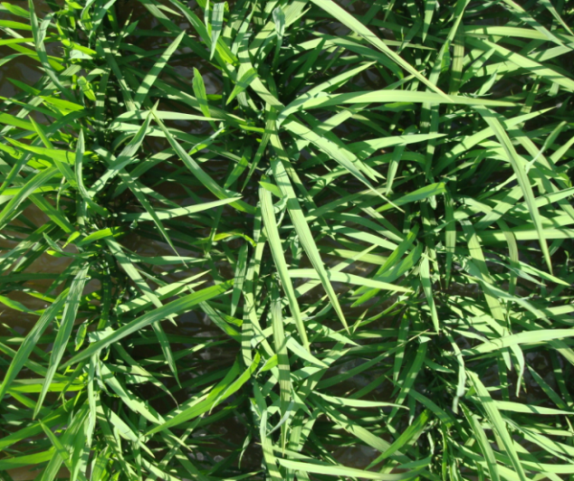
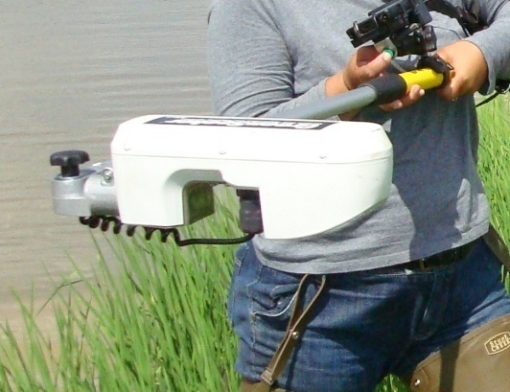
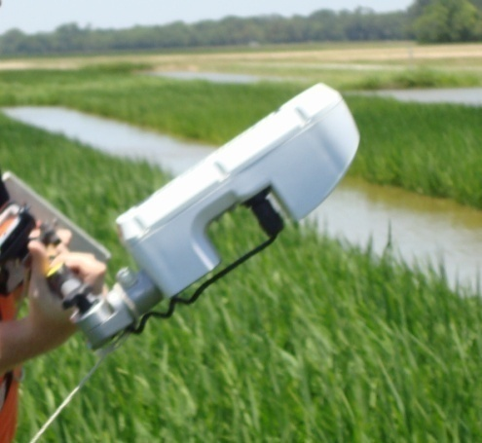
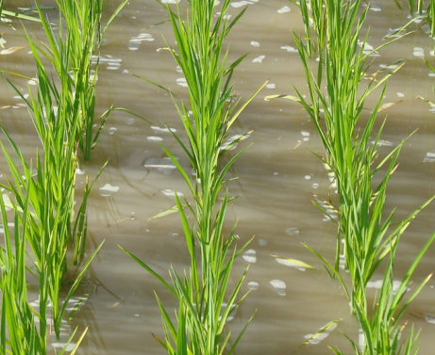
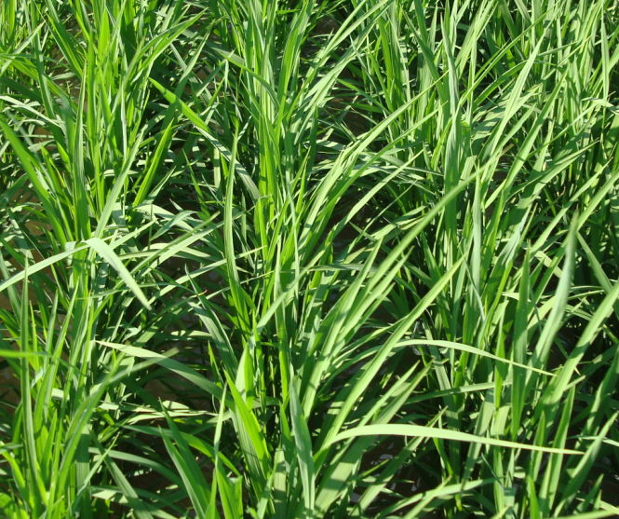
Rice Updates
Nadir
Check Plot
210 lbs/A
NDVI =0.168
0.725
Tilted (45º angle)
0.438
0.757
Poster Presentation

Slide 6
Sugarcane Updates
Estimated optimal N rates for cane yield production fell within or below (majority of the site-years) the recommended rates . *Sugarcane is a perennial crop. Plant cane is fist year plant, stubble cane is 2nd or 3 rd year plant.
Recommended N for stubble cane:
80-120 lbs N ac⁻¹
Recommended N for plant cane:
60-100 lbs N ac⁻¹
No response
No response
No response
No response
No response
No response
No response
No response

Slide 7
Sugarcane: Research Focus 1
Sugarcane is a perennial crop. It re-grows after each harvest for multiple years (4 years) without annual reseeding.
Crop age effect
Refinement procedure
  cumulative growing degree days
  Number of days from __ to sensing

Slide 8
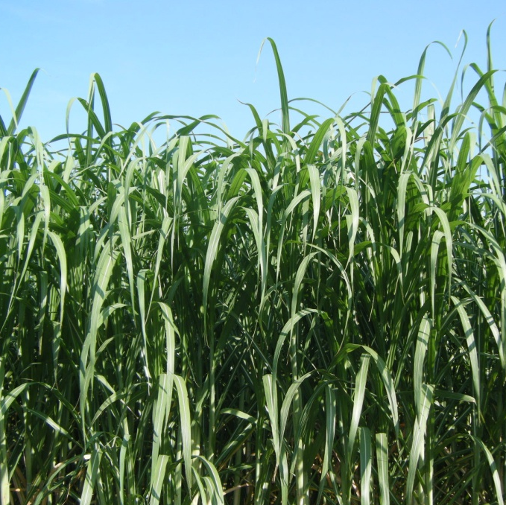
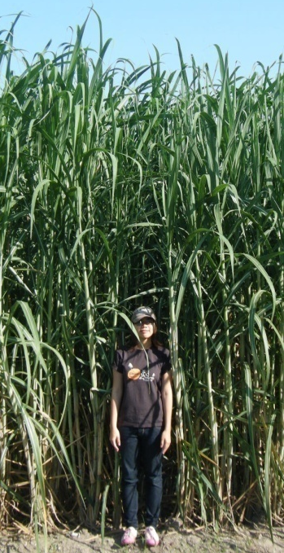
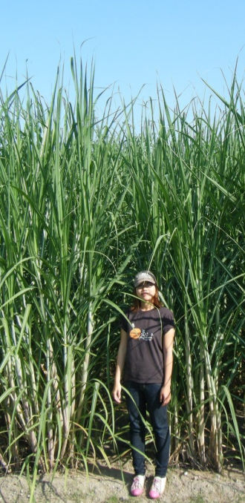
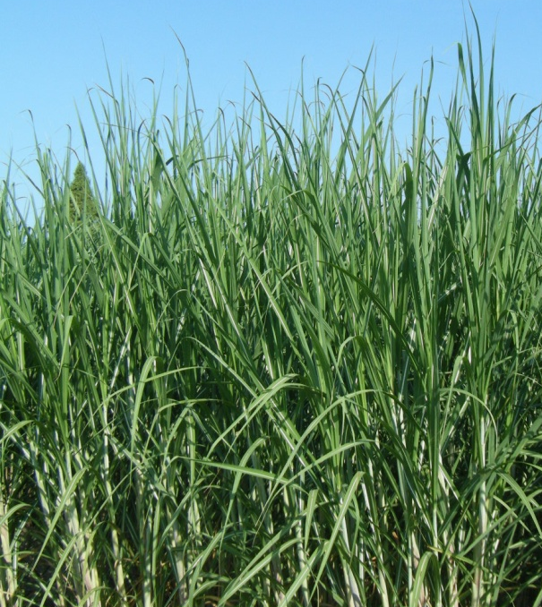
Sugarcane: Research Focus 2
Varietal diversification is an essential program in Louisiana’s sugarcane industry.
Canopy structure effect
Refinement procedure
-categorize by canopy structure (droopy and erect leaf)
or plant height

Slide 9
Sugarcane: Research Focus 2
Categorize by canopy structure (droopy and erect leaves)

Slide 10
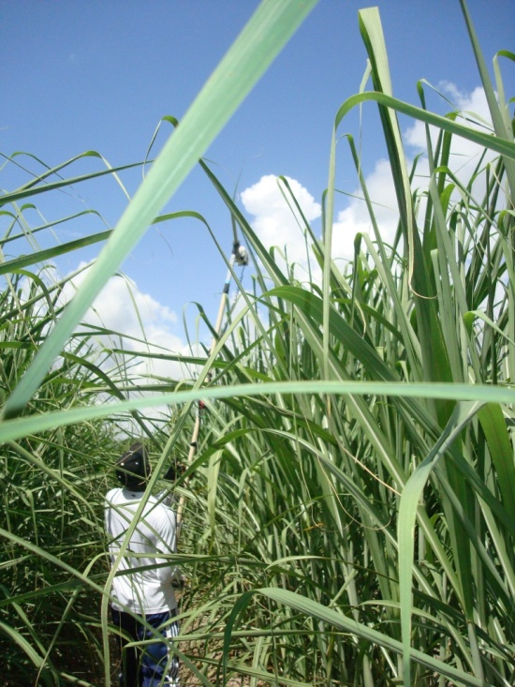
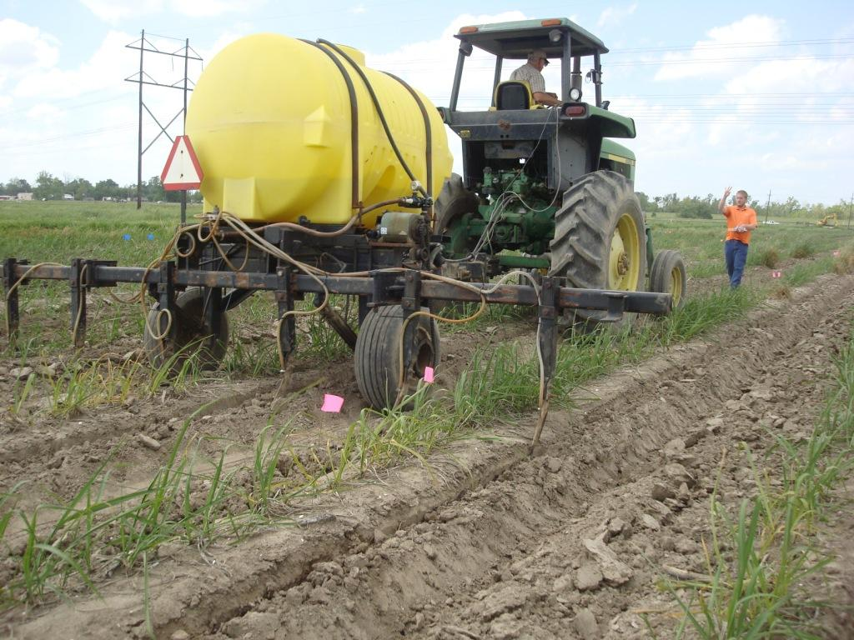
Sugarcane: Research Focus 3
Nitrogen fertilization is done early in spring (one time application)
Tall stature – challenge when collecting data
How early we can put our N reference strip?
How late can we apply N fertilizer?
Small biomass is an issue early in the spring. Three weeks after growth recommenced in spring, height may become an issue.

Slide 11
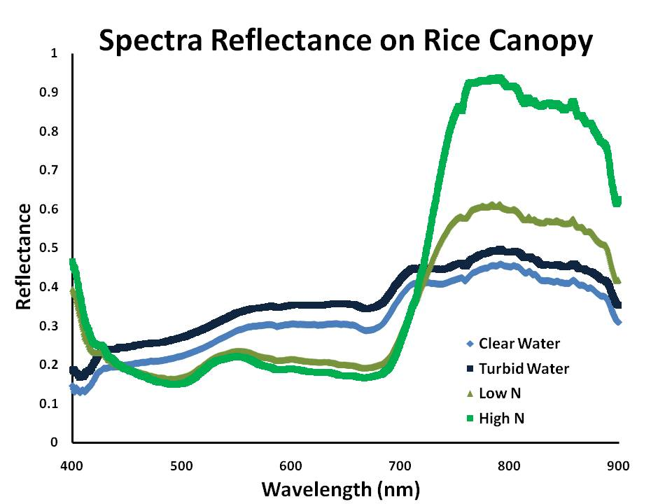
Rice and Sugarcane: Research Focus 4
Evaluate spectral reflectance based on leaf element and plant canopy structure using red-edge.

Slide 12
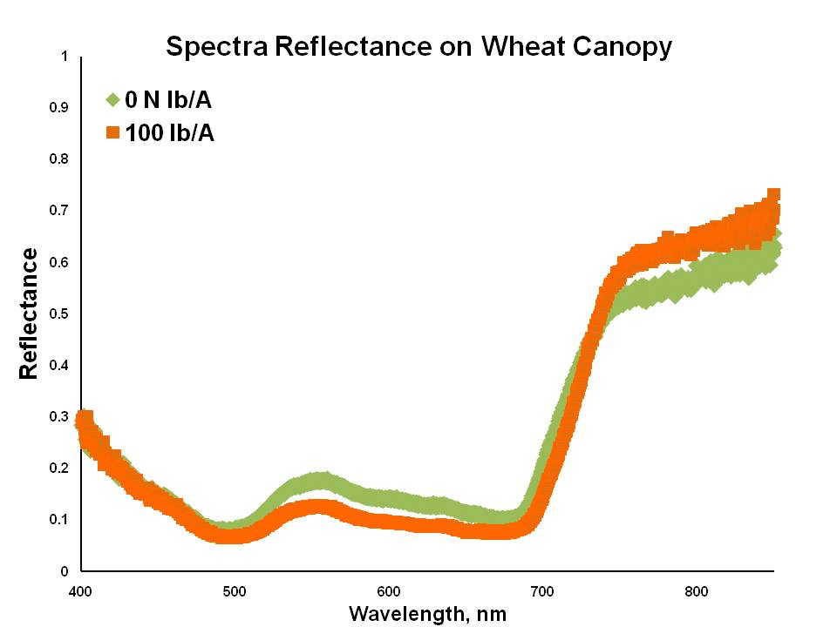
Red-edge
Wavelength between RED and NIR wavelengths
  670 nm to 780 nm (Meer and Jong, 2006)
  700 and 750 nm (Seager, 2005)
The first or second derivative of reflectance between 690 to 740 nm, depending on the sensor (Dixit, 1985)

Slide 13
Index
Reflectance
Reflectance between 680-740 nm. Index could be described as ratio of reflectance.
Derivative analysis (Red-edge position)
The wavelength of maximum slope in the red edge reflectance . The wavelength which has a maximum point of the first derivative reflectance. Index could be described as the specific wavelength . (Cho and Skidmore)

Slide 14
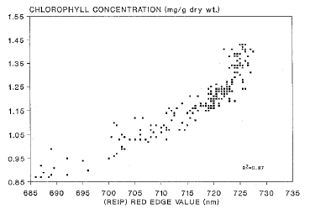
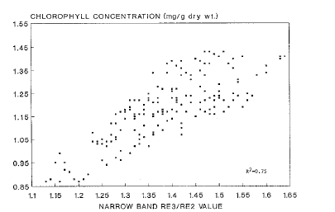
For example
- Chlorophyll content can be explained by red-edge index
Red Edge Position
The maximum point of the first derivative reflectance
Red-Edge (Reflectance Ratio)
(R734-747nm)/(R715-726nm)
(Moss, 1991)

Slide 15
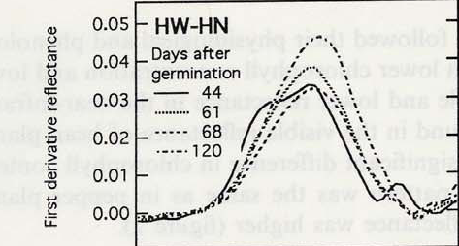
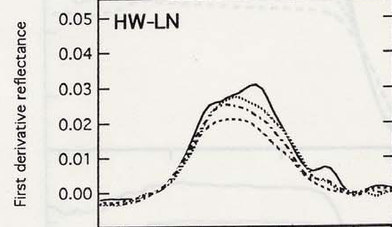

Derivative Analysis
Not only points but area and shape
High N rate
Low N rate
Maximum point
  Longer wavelength (approx. 750 nm)
  Peak of the reflectance pattern
Large total area
Maximum point
  -Shorter wavelength
  -Between 720 to 740 nm
Small total area
(Filella, 1994)

Slide 16
Red-Edge Points
Highly correlated with
- chlorophyll content (Meer, 2007)
- plant biomass (Mutanga, 2004)
Less affected by soil background (Jong, 2007)
Very narrow bands needed to be observed
Complicated method to determine REP
-The simple maximum derivatie
-Linear interpolation (Guyot and Baret, 1988)
-Inverted Gaussianmodelling (Miller et al., 1990)
-High orderpolynomial fitting (Pu et al., 2003)
-Linear extrapolation techniques (Cho and Skidmore )
-Lagrangian interpolation technique (Dawson and Curran, 1998)

Slide 17
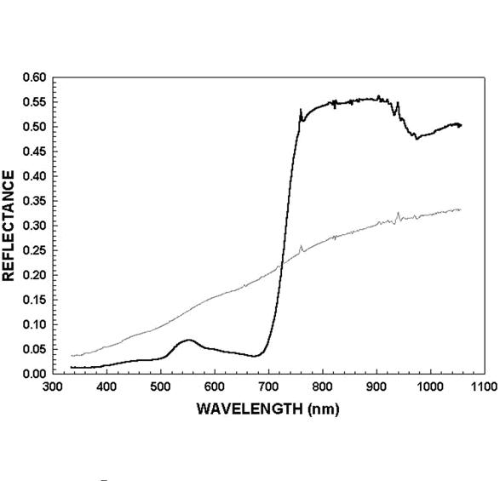
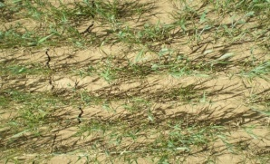
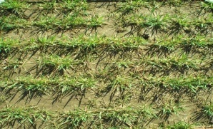
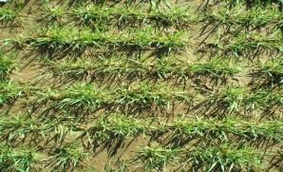
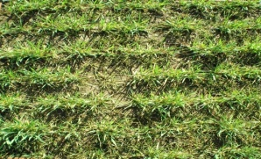
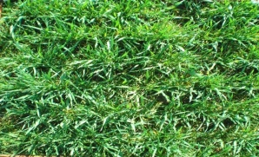
Potential to be a new index for determine N rate?
Yes, especially biomass completely covers ground
NIR
780nm
Red
650nm
However, need to be discussed
- Red-edge, What are you looking for? Red-edge reflectance, point, shape, or area?
- Looking at very narrow bands, work in practical fields?

Slide 18
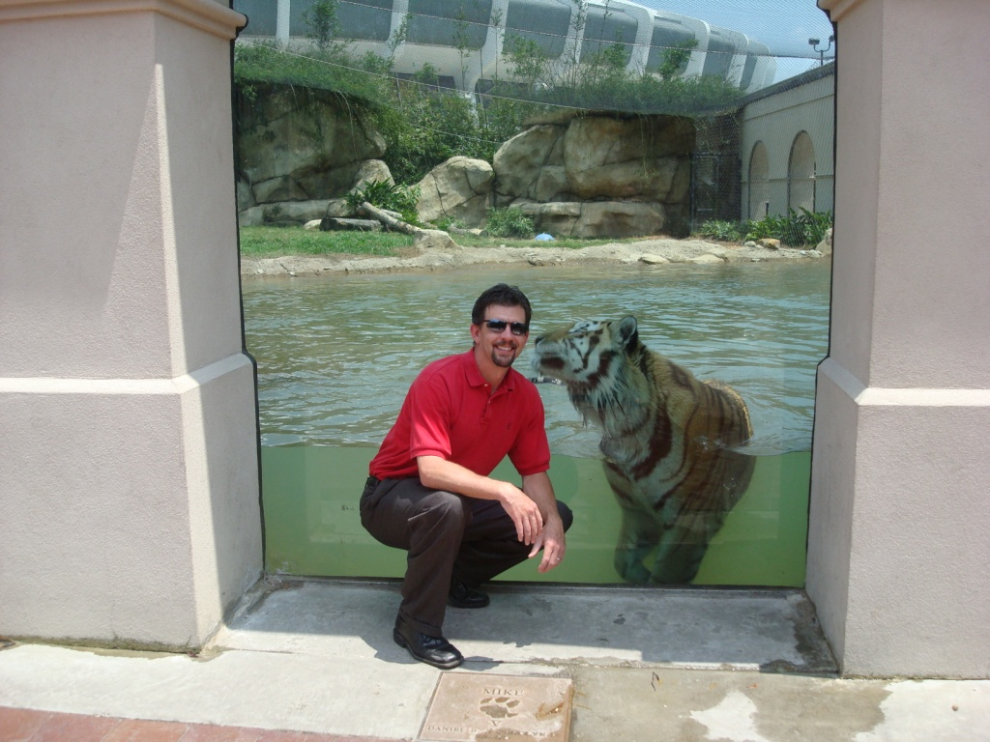
Thank you

Slide 19
References
Meer, F.V.D., and S.M. de Jong. 2006. Imaging spectrometry for agriculture applications. In: Imaging spectrometry: Basic principal and prospective application, eds. Clevers, J. G. P. W. and R. Jongschaap, pp.157-197. Dordrecht, Netherlands : Springer.
Seager, S., E.L. Turner, J. Schafer, and E.B. Ford. 2005. Vegetation’s Red edge: a possible spectroscopic biosignature of extraterrestrial plants. Astrophysics. 5: 372-390.
Dixit, L. and S. Ram. 1985. Quantitative analysis by derivative electronic spectroscopy. Appl. Spectr. Rev. 21:311-418.
Cho, M.A, A.K. Skidmore, C. Atzberger.. Towards red-edge positions less sensitive to canopy biophysical parameters using prospect-sailh simulated data. http://www.isprs.org/proceedings/XXXVI/part7/PDF/115.pdf
Cho, M.A. and Skidmore, A.K., In Press. A new technique for extracting the red edge position from hyperspectral data: The linear extrapolation method. Remote Sensing of Environment.
Guyot, G. and Baret, F., 1988. Utilisation de la haute resolution spectrale pour suivre l'etat des couverts vegetaux, Proceedings of the 4th International colloquim on spectral signatures of objects in remote sensing. ESA SP-287, Assois, France, pp. 279-286.
Miller, J.R., Hare, E.W. and Wu, J., 1990. Quantitative characterization of the red edge reflectance. An inverted- Gaussian reflectance model. International Journal of Remote Sensing, 11(10): 1755-1773.
Pu, R., Gong, P., Biging, G.S. and Larrieu, M.R., 2003. Extraction of red edge optical parameters from Hyperion
data for estimation of forest leaf area index. IEEE Transactions on Geoscience and Remote Sensing, 41(4): 916-921.
Dawson, T.P. and Curran, P.J., 1998. A new technique for interpolating red edge position. International Journal of Remote Sensing, 19(11): 2133-2139.

