Slide 1
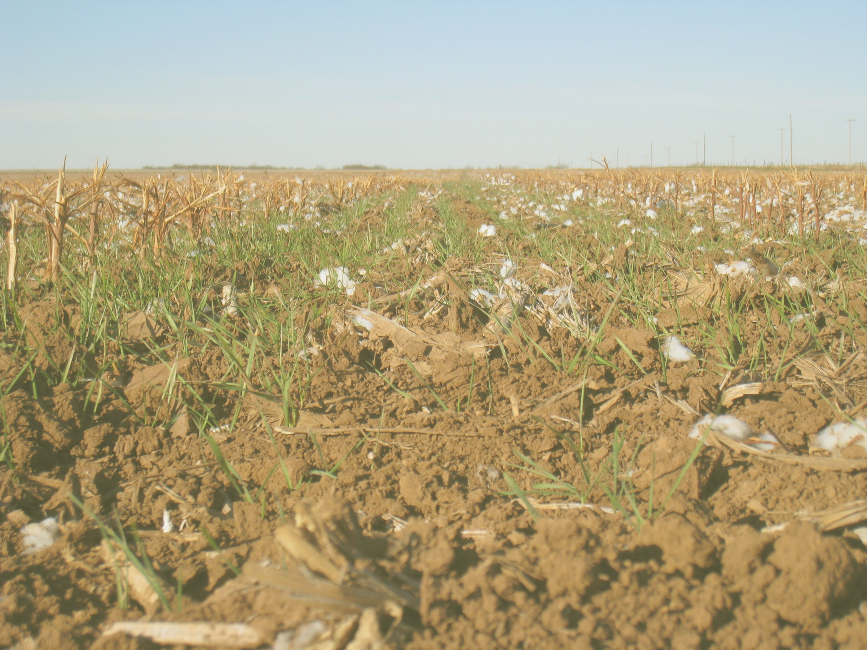
Development of Cotton N Fertilization Algorithms, Southern USA
Kevin Bronson
Brenda Tubana
Brian Arnall

Slide 2
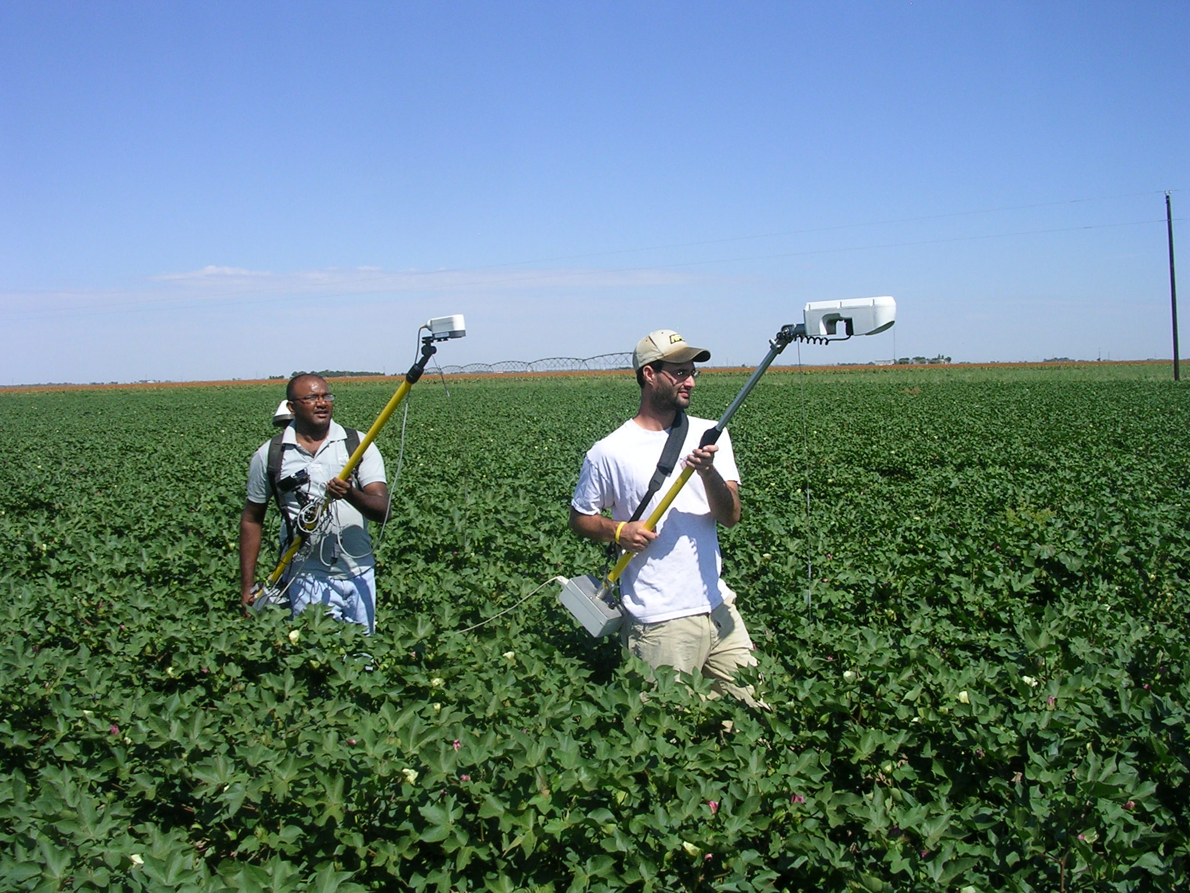


Improved Strategies for Nitrogen Management in Subsurface Drip Irrigated Cotton
Kevin F. Bronson, Adi Malapati
Jason Nusz, Jeff Johnson
Texas A & M AgriLife Res, and Texas Tech Univ. Lubbock, TX

Slide 3
Treatments
Soil test based N mgt (STB) 32-0-0 injected early square to mid bloom for 2.5 bale/ac yield goal (125 lb N/ac – 0-24 in soil test NO₃-N – irrigation water NO₃)
0.5 X Soil test based (0.5 STB)
1.5 X Soil test based (1.5 STB)
Zero-N (1 plot/station/rep)
Reflectance-based mgt 1: initially 0.5 STB N rate, N injection rate adjusted upwards to STB rate when NDVI REF1 is statistically < NDVI REF1.
Reflectance-based mgt 2 : initially STB N rate, N injection rate adjusted upwards to 1.5 STB rate when NDVI REF2 is statistically < NDVI 1.5 STB.

Slide 4
First open boll biomass, N accumulation, N fertilizer recovery efficiency, seed and lint yields as affected by nitrogen management, Lubbock, TX, 2007.
N treatment | N fertilizer injectedª | Total N uptake | Recovery efficiency | Biomass |  | Seed yield | Lint yield
 | ---- lb N/ac ----- |  | % | --------------- lb/ac --------------
1.5*STB | 120 | - | - | - | 2379 a |  | 1347 a
Refl- strategy 2 | 90 | 131 a* | 62 a | 7666 a | 2253 a |  | 1330 a
STB | 80 | 128 a | 65 a | 7704 a | 2241 a |  | 1326 a
Refl.strategy 1 | 62 | 120 a | 72 a | 7561 a | 2350 a |  | 1372 a
0.5*STB | 40 | - | - | - | 2270 a |  | 1365 a
Zero-N | 0 | 76 | - | 5362 | 1692 |  | 1062
ª Injected from 11 July to 11 August
*Means in a column followed by the same letter are not significantly different at P = 0.05

Slide 5
First open boll biomass, N accumulation, N fertilizer recovery efficiency, seed and lint yields as affected by nitrogen management, Lubbock, TX, 2008.
N treatment | N fertilizer injected¹ |  | Total N uptake | Recovery efficiency | Biomass | Seed yield | Lint yield
 | --------- lb N/ac ------ |  |  | % | --------------- lb/ac -------------
1.5*STB | 94 | 138 a |  | 75 a | 7993 a | 2553 a | 1532 a
Refl.strategy 2 | 62 | - |  | - | - | 2572 a | 1586 a
STB | 62 | 130 a |  | 101 a | 7546 a | 2455 a | 1495 a
Refl.strategy 1 | 46 | 110 b |  | 94 a | 6587 b | 2542 a | 1538 a
0.5*STB | 31 | - |  | - | - | 2129 b | 1283 b
Zero-N | 0 | 67 |  | - | 4968 | 1640 | 1006
ª Injected from 26 June to 16 July and 5 to 8 August
*Means in a column followed by the same letter are not significantly different at P = 0.05

Slide 6
First open boll biomass, N accumulation, N fertilizer recovery efficiency, seed and lint yields as affected by nitrogen management, Lubbock, TX, 2009
N treatment | N fertilizer injected¹ | Total N uptake | Recovery Efficiency | Biomass |  | Seed yield | Lint yield
 | ---------- lb N/ac ------- |  | % | --------------- lb/ac -------------
1.5*STB | 72 | 124 a | 47 a | 7761 a | 2526 a |  | 1527 a
Refl.strategy 2 | 48 | - | - | - | 2487 ab |  | 1509 a
STB | 48 | 114 a | 49 a | 7670 a | 2471 ab |  | 1522 a
Refl.strategy 1 | 24 | 109 a | 77a | 8058 a | 2581 a |  | 1610 a
0.5*STB | 24 | - | - | - | 2326 b |  | 1487 a
Zero-N | 0 | 90 | - | 6962 | 2029 |  | 1336

Slide 7
Summary of three years of Refl. Strategy 1 N fertilizer management in SDI cotton, Lubbock, TX, 2007-2009
 | Units | 2007 | 2008 | 2009
0-24 inch NO₃ | lb /ac | 17 | 30 | 18
Starter N fertilizer | lb N/ac | 0 | 10 | 22
Irrigation NO₃ | lb N/ac | 20 | 30 | 22
Injected fertilizer | lb N/ac | 62 | 46 | 24
Recovery efficiency | % | 72 | 94 | 77
Lint yield | lb /ac | 1372 | 1538 | 1610

Slide 8
Summary of three years of soil test based strategy for N fertilizer management in SDI cotton, Lubbock, TX, 2007-2009
 | Units | 2007 | 2008 | 2009
0-24 inch NO₃ | lb /ac | 24 | 35 | 21
Starter N fertilizer | lb N/ac | 0 | 10 | 22
Irrigation NO₃ | lb N/ac | 20 | 30 | 22
Injected fertilizer | lb N/ac | 80 | 62 | 48
Recovery efficiency | % | 65 | 101 | 49
Lint yield | lb /ac | 1326 | 1495 | 1522

Slide 9
Conclusions
Recovery efficiency of daily injection of N between early square and mid bloom was 62 to 94 %.
Reflectance-based N management strategy1 saved 22, 26, and 50 % N compared to soil test based management during 2007, 2008, and 2009, respectively.
EONRs ranged from 22 to 68 lb N/ac for lint.

Slide 10
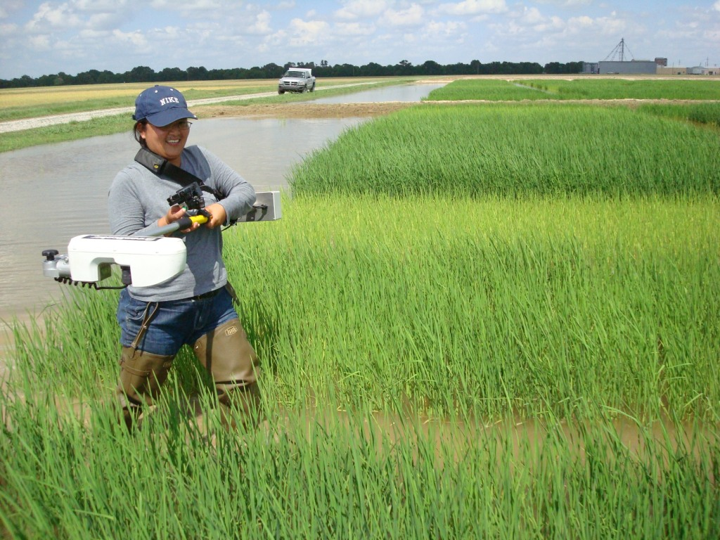

LSU

Slide 11
2009
  NDVI and Yield best correlated at later stage. 4 weeks after first bloom
  RI NDVI and RI yield best correlated at 2 weeks after first bloom
Tested 08 algorithm

Slide 13

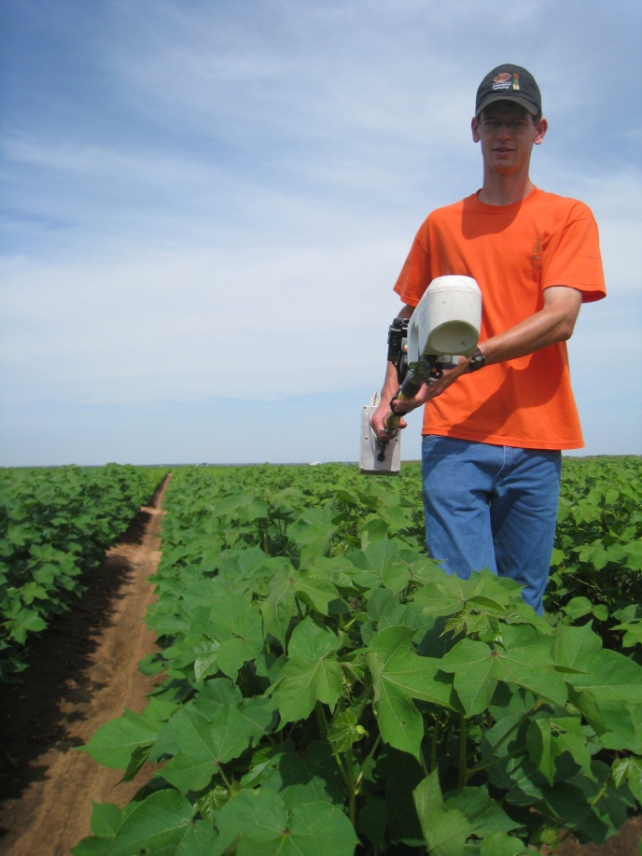
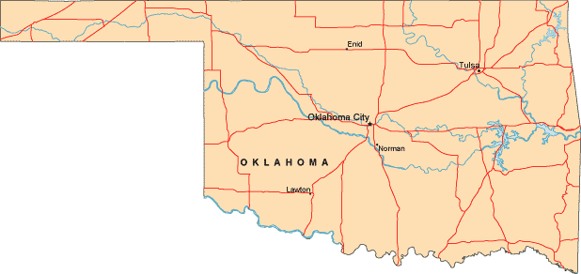
Ok State
4 years of Data
  Stillwater and Altus
NDVI and Cumulative GDD’s
First White Flower
Environment

Slide 14
Yield Prediction

Slide 15
YP Models

Slide 16
Response Index

Slide 17
2010
Continue Catch-up and YP trials (long-term).
SBNRC trts.
Altus
  30 lb pre 62 lbs applied (42-96)
  60 lb pre 26 lbs applied (17-42)
LCB
  0 lb pre 28 lbs applied ( 17-45)
  40 lb pre 16 lbs applied (4-27)

Slide 18
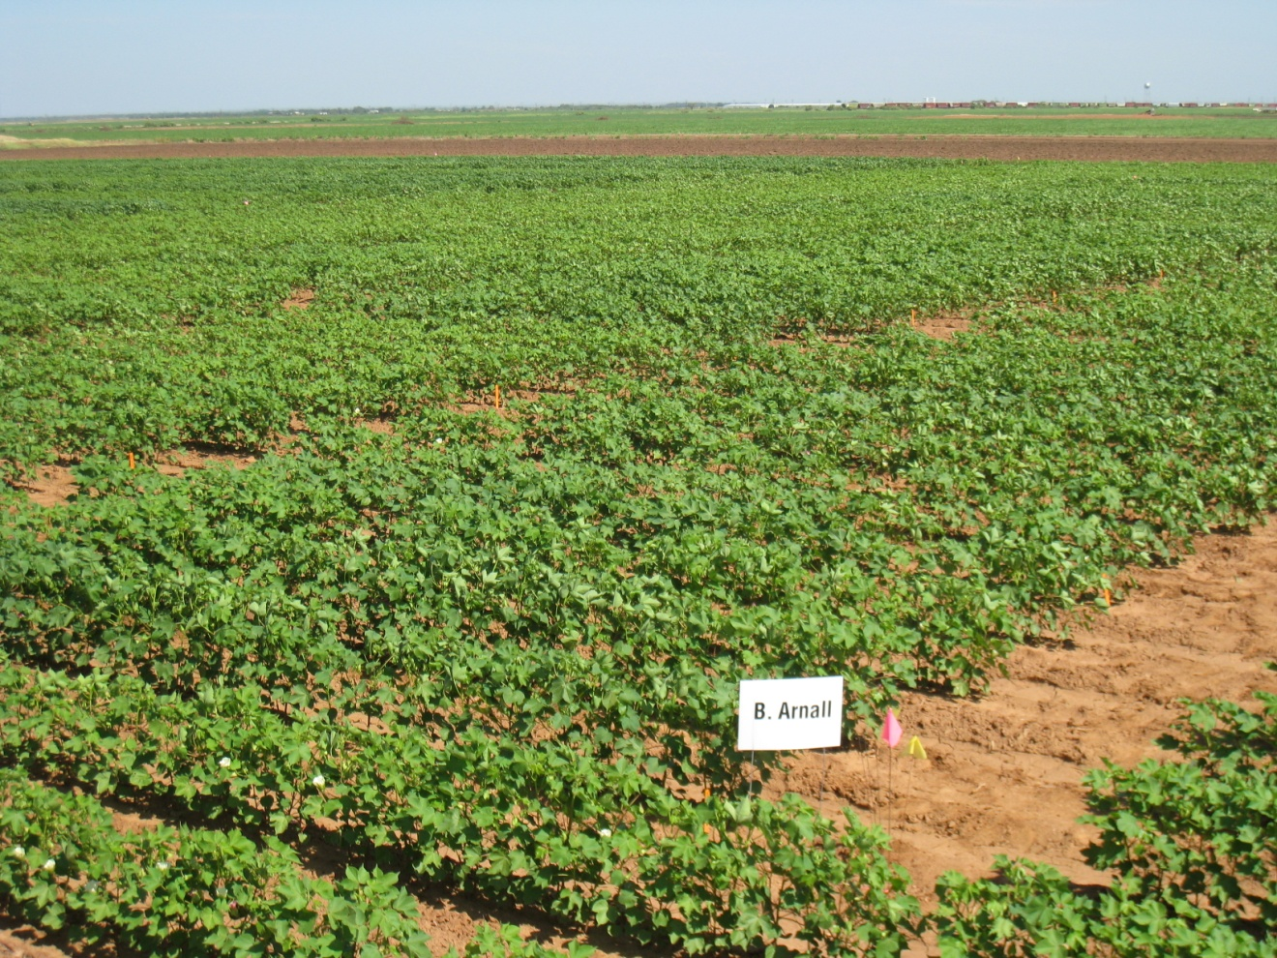
Thank you

