Slide 1
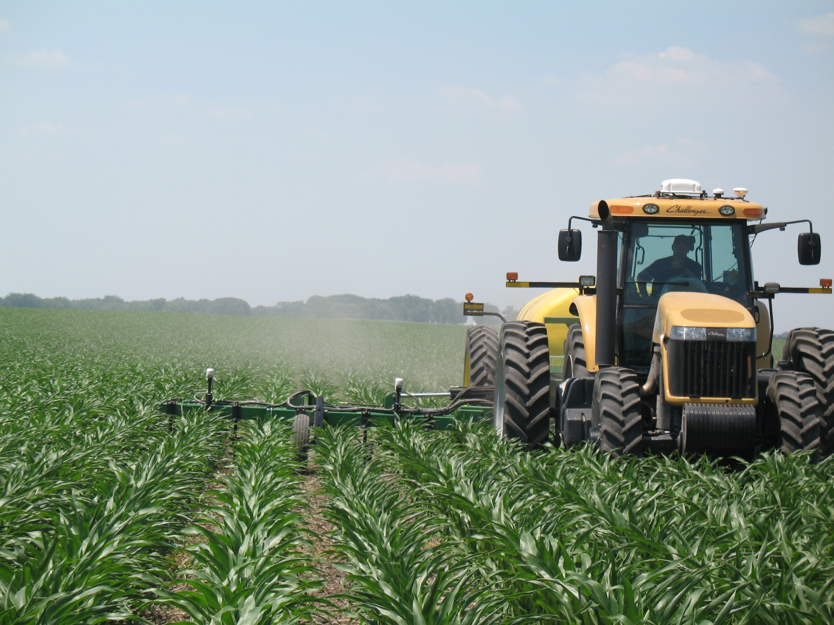
Sensor Based Results in Kansas
*Drew Tucker and Dave Mengel
e-mail: drew.tucker@okstate.edu
Oklahoma State University
Field & Research Service Unit
Chickasha, OK

Slide 2
Background:
We put out our first field trials in 2006:
Focus was on sorghum and wheat as those crops were where we felt we could make the greatest impact.
Purchased a Crop Circle amber sensor in 2006.
Setting between OSU and UNL-ARS, we wanted to understand the differences between the two sensors and the different approaches the two groups were taking
We wanted to determine if we needed different algorithms for different sensors.

Slide 3
Where we’re at today
Initial downloadable algorithms (GreenSeeker based) were made available to the public for wheat and sorghum through the K-State Soil Testing Lab website in January 2009.
K-State algorithm options were added to the menu of the GreenSeeker control unit for wheat and sorghum for the 2009 crop year.
Corn algorithms for use at V-8/9 and V-15/16 will be available for 2011.

Slide 4
Our General Approach to Algorithms and Rate Calculators
Our approach to developing rate calculators is based on:
An in-field reference strip; calculated RI; relationship of RI at sensing to RI at harvest; expected N uptake; and NUE.
Yield potential is estimated from reference strip.
Yield response to additional N is based on the expected RI at harvest based on RI at sensing and yield potential of reference.
Additional N need to optimize yield is estimated from N uptake data across a range of yield levels,
Estimated NUE is used to convert N uptake need to fertilizer N need. Base is 50%, but can be adjusted up or down based on soils, climate, or management practice.

Slide 5
KSU Grain Sorghum Nitrogen Rate Calc.

Slide 6
Grain Sorghum Nitrogen Sensor Calculator Performance 2006-2009
Notes:
Our best soil based system had a mean difference of 26 lbs/ac.

Slide 7
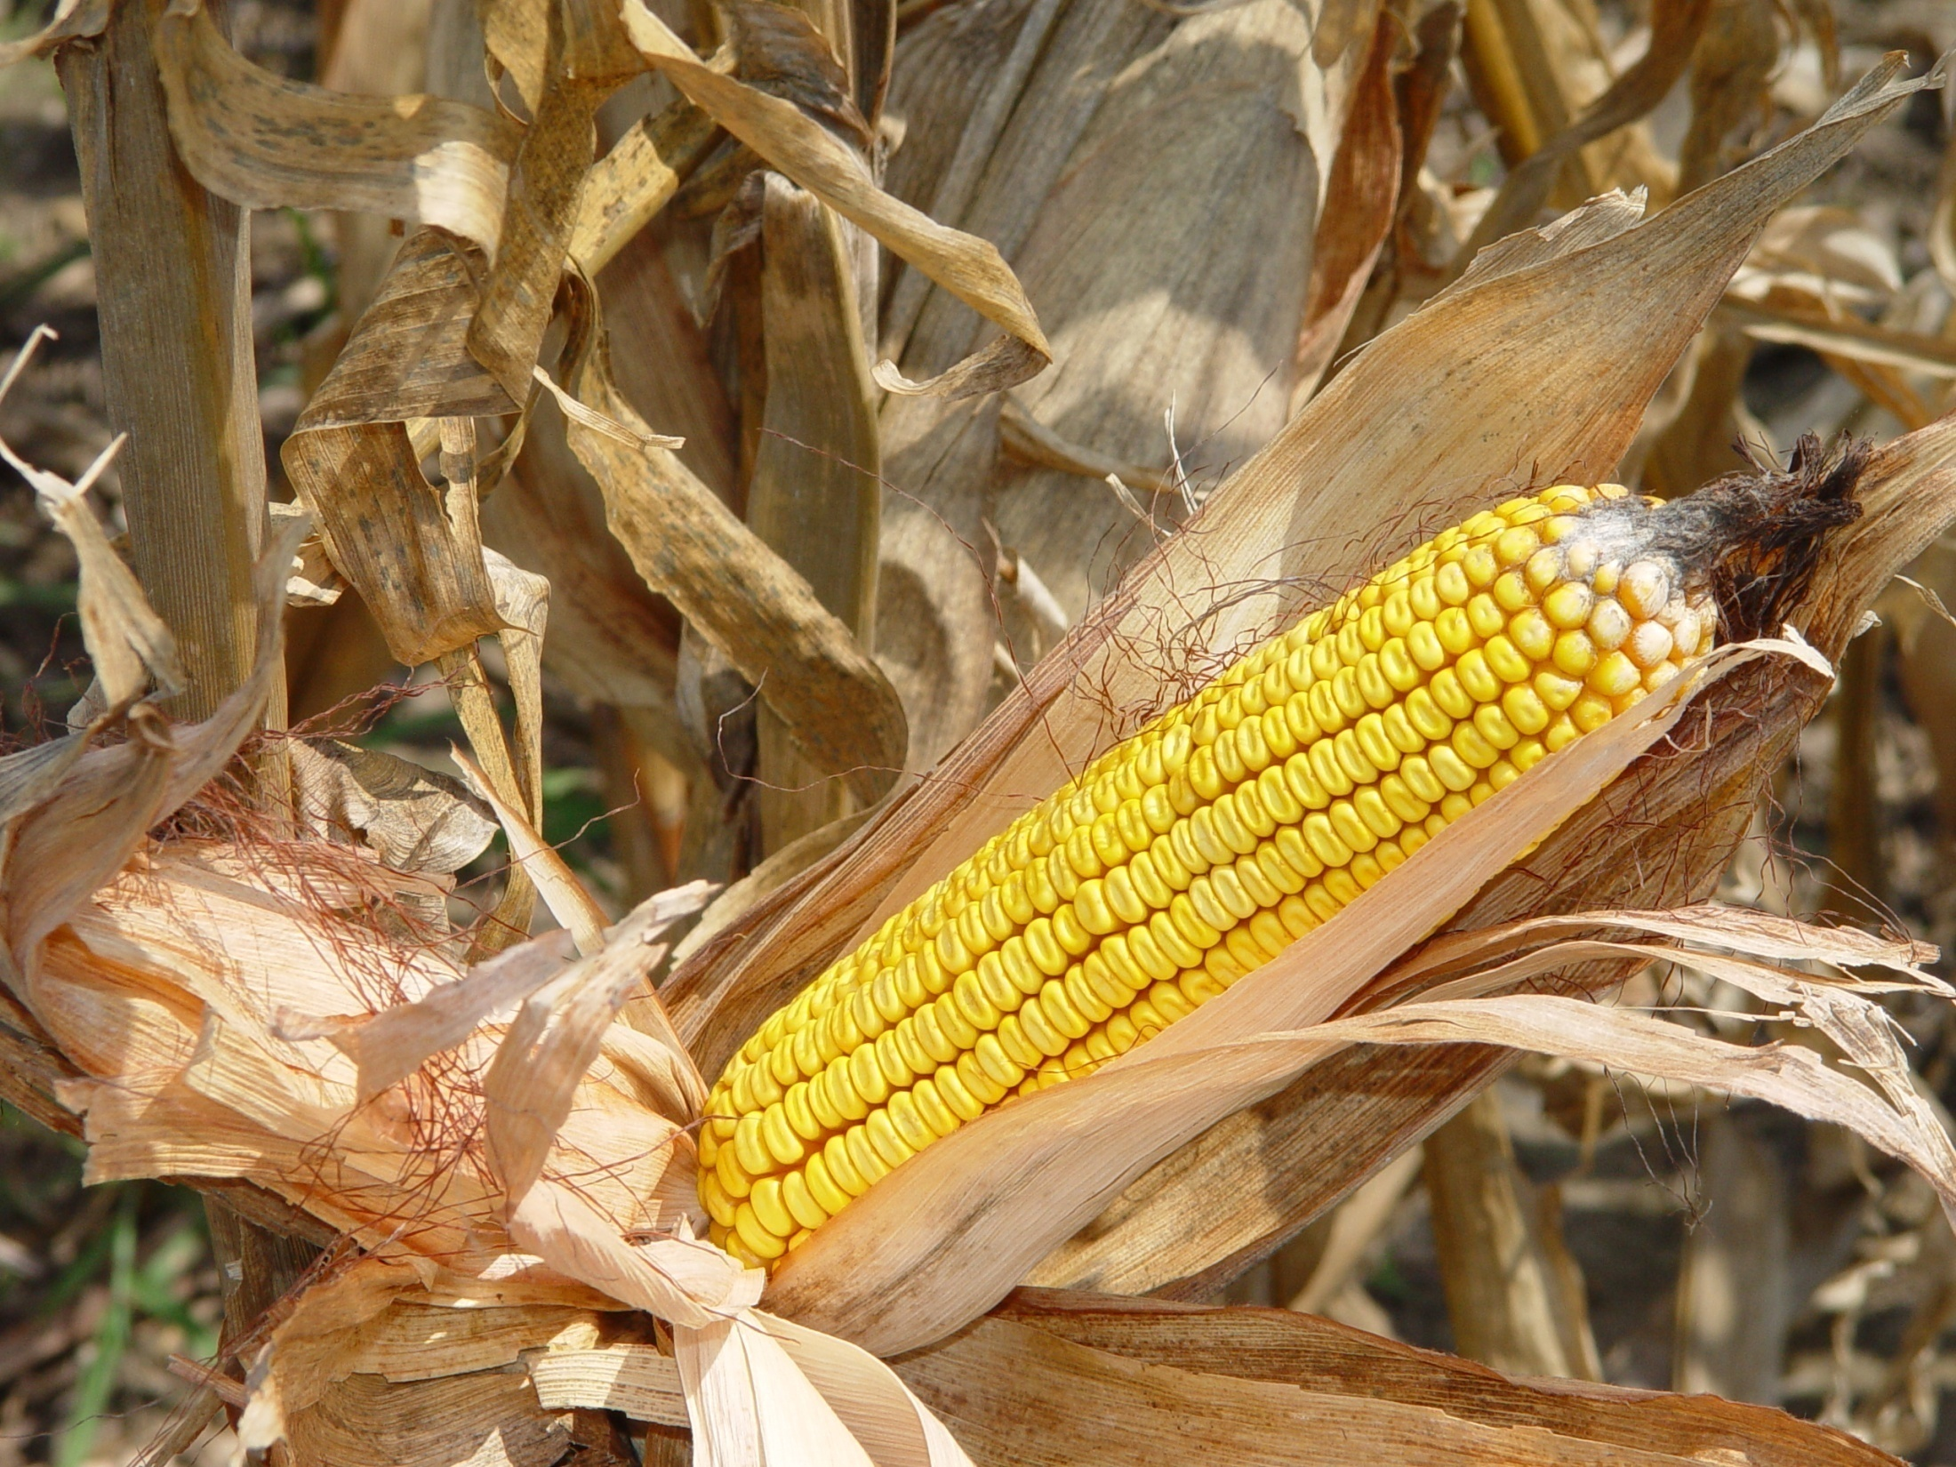

Slide 8
Corn work
In 2007 we initiated a corn study focused on using the GS and CC at the V-8/9 growth stage. This study was initiated at Rossville (NE) and Tribune (WC) under sprinkler irrigation.
In 2008 added a flood irrigated site at Colby (NW), and a high yielding dry land site at Manhattan.

Slide 9
Irrigated Results 2007-2009
Pre-Plant N | Side-dress N | Total N |  |  | Grain Yield
Location |  | Rossville | Tribune | Colby | Rossville | Tribune | Colby
------------------------------lbs N ac⁻¹ ------------------------------ |  |  |  |  | -------------bu ac⁻¹-------------
0 | 0 | 20 | 20 | 20 | 101 d | 139 f | 130
100 | 0 | 100 | 100 | 100 | 214 c | 190 de | 171
140 | 0 | 160 | 160 | 160 | 218 bc | 221 a | 178
180 | 0 | 200 | 200 | 200 | 230 ab | 195 cde | 175
40 | 60 | 120 | 120 | 120 | 219 bc | 180 e | 169
60 | 80 | 160 | 160 | 160 | 229 ab | 208 abc | 172
80 | 100 | 200 | 200 | 200 | 229 ab | 212 ab | 186
100 | GS | 145 | 133 | 135 | 222 abc | 197 bcd | 170
120 | CC | 149 | na | 133 | 235 a |  | 175
120 | CH | 137 | 144 | 128 | 215 bc | 202 bcd | 166
120 | GS+CH | 123 | 125 | 148 | 225 abc | 191 de | 167
120 | CC + CH | 146 | na | 140 | 225 abc |  | 167

Slide 10
Dry Land Results 2008
Pre-Plant N | Side-dress N | Total N | Grain Yield
-------------------------lbs N ac⁻¹ ------------------------- |  |  | bu ac⁻¹
0 | 0 | 0 | 55 f
0 | 0 | 40 | 67 f
0 | 30 | 70 | 98 e
0 | 60 | 100 | 108 de
0 | 90 | 130 | 129 cd
0 | 120 | 160 | 161 ab
0 | 150 | 190 | 163 ab
0 | 180 | 220 | 186 a
200 | 0 | 200 | 141 bc
80 | GS | 120 | 107 de
80 | CC | 120 | 106 de
80 | CH | 120 | 146 bc

Slide 11
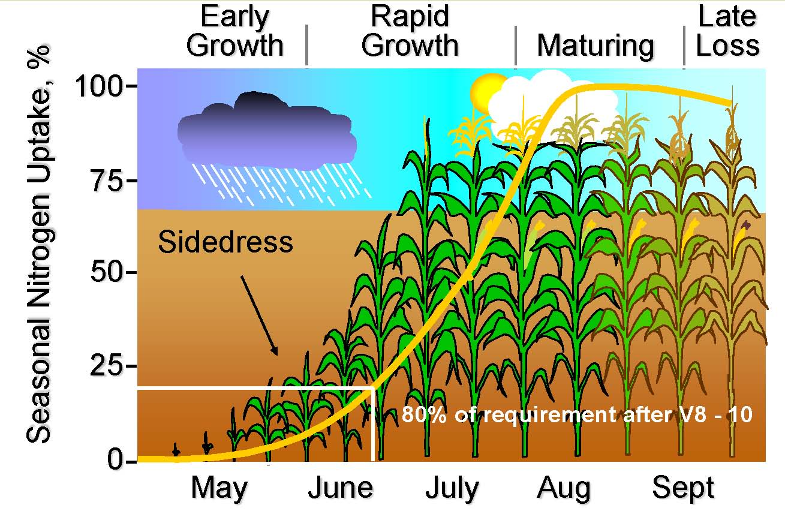
Corn Growth and N-Uptake

Slide 12
Loss of preplant N, KS 2009

Slide 13
Denitrification N loss in corn, KS 2009

Slide 14
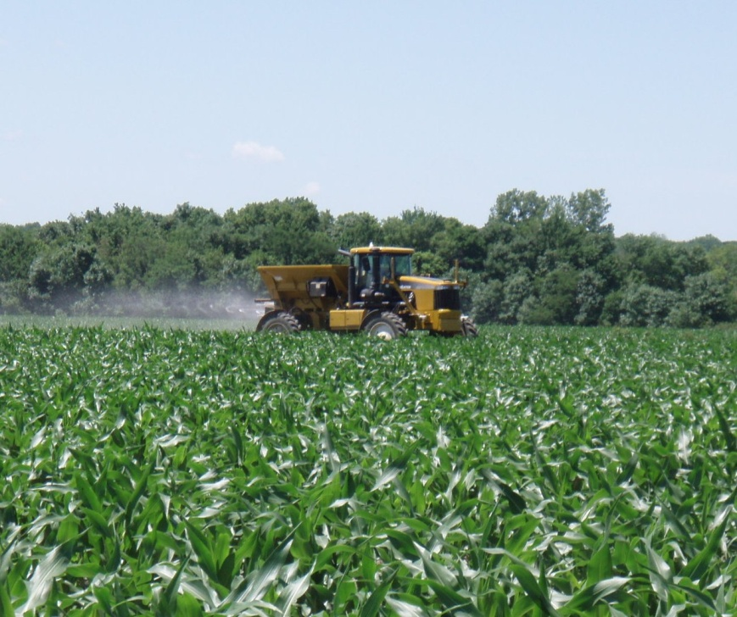
Additional work on corn
Late season rescue N applications to corn at V-12 to 16 using high clearance sprayers.
Work started in 2009, both on research farms and with cooperative farmers and dealers/custom applicators

Slide 15
Agronomy North Farm, 2009
Treatment | N Rate lbs ac⁻¹ | Grain Yield bu ac⁻¹
Pre-plant N | 60 | 149 e
Pre-plant N + 30 at V-8 | 90 | 158 d
Pre-plant N + 60 at V-8 | 120 | 173 c
Pre-plant N + 90 at V-8 | 150 | 185 bc
Pre-plant N + 30 at V-16 | 90 | 166 cd
Pre-plant N + 60 at V-16 | 120 | 192 b
Pre-plant N + 90 at V-16 | 150 | 206 a

Slide 16
Farmer fields near St. Marys KS, 2009
Treatment | N Rate lb/ac | Grain Yield bu/ac
Pre-plant N | 70 | 177 a
Pre-plant N + 30 at V-16 | 100 | 178 a
Pre-plant N + 60 at V-16 | 130 | 185 a
Pre-plant N + 90 at V-16 | 160 | 177 a
Sensor rates at these fields applied by JB Pearl with a high clearance applicator averaged less than 30 lb/ac at V-16. The producer’s normal rate would have been 160 lb N/ac applied as anhydrous ammonia pre-plant.

Slide 17
Rossville Experiment Field, 2009
Treatment | N Rate lbs ac⁻¹ | Grain Yield bu ac ⁻¹
Pre-plant N | 60 | 102 d
Pre-plant N + 30 at V-16 | 90 | 131 c
Pre-plant N + 60 at V-16 | 120 | 158 b
Pre-plant N + 90 at V-16 | 150 | 196 a
A sensor based N recommendation for the V-16 timing would have been 84 kg N ha⁻¹

Slide 18
KSU Future Sensor Based N Rec. V-8,9?

Slide 19
KSU Future Sensor Based N Rec. V-15/16?

Slide 20
Final Remarks
Sensor based nitrogen management for corn may have the most potential for making rescue N applications or “top off” N applications during late vegetative growth.
Further research on how, when, and how much to apply is still required.
Technology will require a good reference strip to be successful.
Further research may be required to decide what a “good” reference strip is.
Industry is currently marketing sensor technology, thus there is a need for future research in this topic.
Future topic areas may include biofuel crops, forage crops, and grain crops.

Slide 21
Estimating NUE, Future Research
Can we estimate expected NUE/Recovery based on soil, climate and crop-fertilizer management?
Project initiated in 2008
Includes both a “data mining” and field component
Intent is to provide quantitative estimates of the expected NUE from different management practices as impacted by soils and climate.
Using standard practices as base and providing/developing adjustment coefficients up or down.

Slide 22
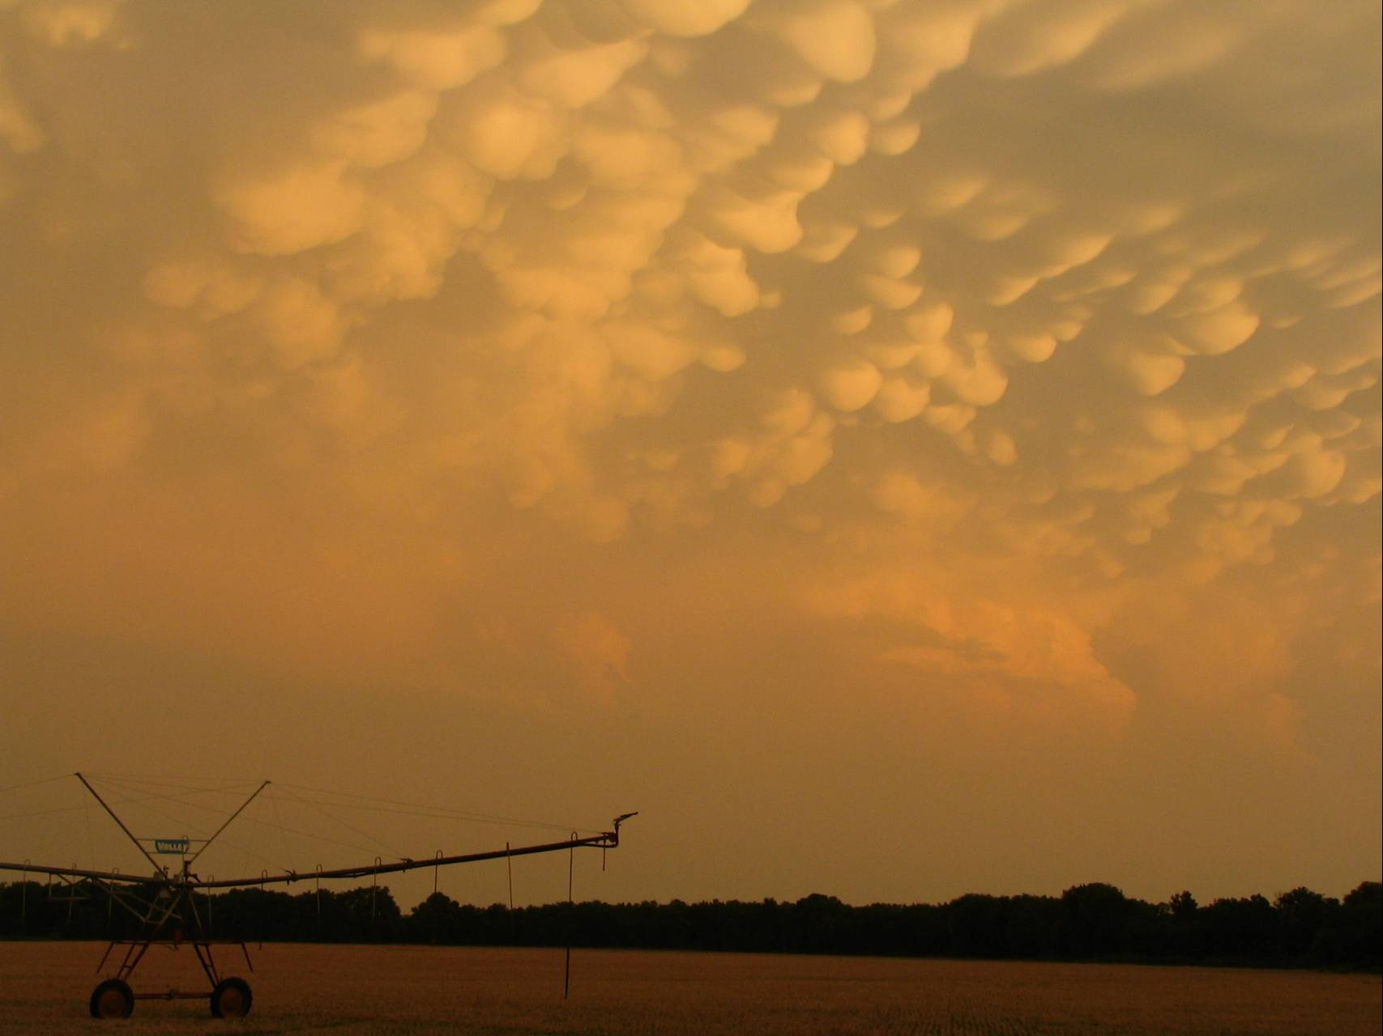
Questions?

