Slide 1
Agronomy Trial Manager Jacob Vossenkemper
Career Opportunities at Pioneer Hi-Bred

Slide 2
“Investments in Science”
Pioneer and DuPont are making substantial investment in research and development
400 new scientists will be added in the remainder of 2010 and 2011
Molecular biologist
Plant physiologist
Statisticians: phenotypic analysis
Entomologist
Plant Breeders
Many more………..
Agronomy Sciences and Product Advancement (Sales and Marketing)
IMPACT leads
Field Trial Managers
Research Associates
Agronomist
Technical Product Managers

Slide 3
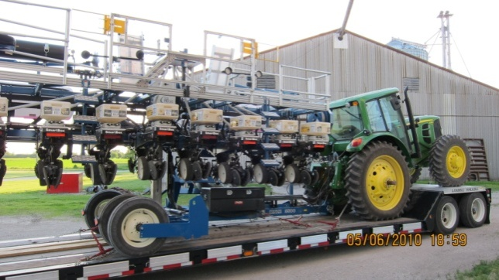
Product Advancement and Characterization
IMPACT Lead
What is IMPACT?
(Intensively Managed Product Advancement , Characterization and Training Trials)
Responsible for………
On farm Corn hybrid and soybean variety testing activities
Identify appropriate testing environments (not the best, the most appropriate for the region)
Collaborate with producers to insure timely in season field activities
Maintains, organizes and summarizes results of experiments

Slide 4
Product Advancement and Characterization
Qualifications and experience:
Bachelor’s degree in an agriculture or scientific related field and minimum of 4 years of industry related experience
Master’s degree in an agriculture or scientific related field and 0 to 2 years of industry related experience
Experience in field testing, including planting and harvesting
Relevant experience with scientific methodologies and how they apply to field testing
Experience with product advancement procedures
Excellent personal interaction skills required for fostering and enhancing a team building environment with a diverse group of individuals.

Slide 5
Agronomy Sciences
Field Trial Manger
Strive to provide helpful management suggestions to our customers to assist them in making the greatest possible profit from our products
Expected to be the technical problem solver in your area of study or specialization (My area of specialization being soil fertility and nutrient management)

Slide 6
Agronomy Sciences (Field Trial Manager)
How do we achieve this?
Through on farm experimentation and demonstrations (small plot, field scale, strip trials)
Highlight technology and techniques that improve agronomic practices as well as foster ideas of economic, trait and environmental sustainability
Variable rate seeding
Nutrient management (timing, placement, form)
Row spacing (population x hi-bred x environment)
Water and or drought management
Optimize placement of Pioneer products and technologies
Traits, and genetics
Seed treatments
New refuge concepts

Slide 7
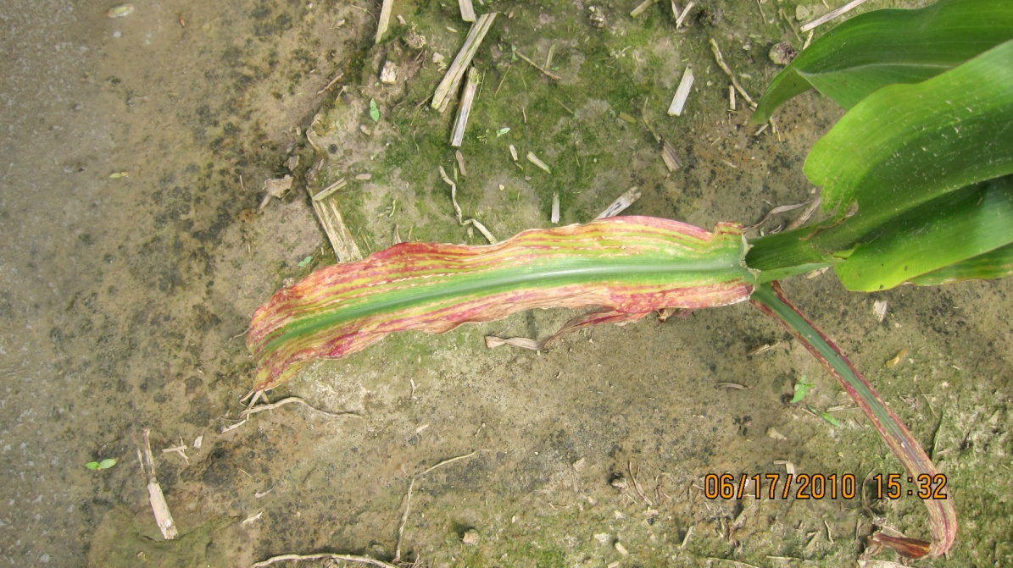
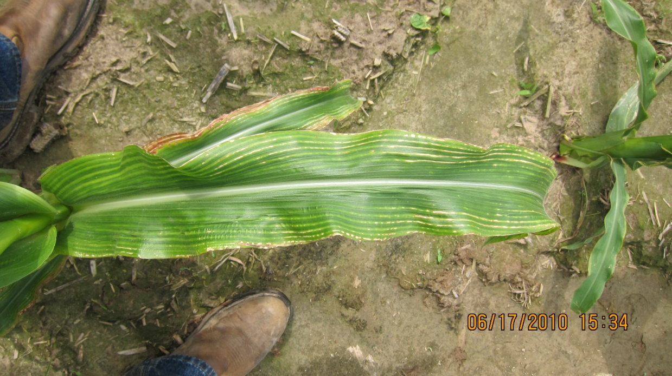
Technical Problem Solving: Example
Magnesium Deficiency
Low CEC soil
High Potassium
pH 6.4 – 6.8
Deficiency persisted in different levels of severity across appox 1000 acres
The question: is this problem hi-bred specific
Or is the deficiency just being expressed more severely in some hi-brid’s

Slide 8
Technical Problem Solving, New Canton, IL
Mg SO4 (Epsom Salt) Trial 2010
Legend
Mg SO4 Harvest Strips
(1 header width)
Check Harvest Strips
(1 header width)
Mg SO4 Application Rates =
20 lbs product diluted in 100 gallons water
Mg S04 Treatment | Check | Mg S04 Treatment | Check | Mg S04 Treatment
800- 1000 ft ?
600 ft

Slide 9
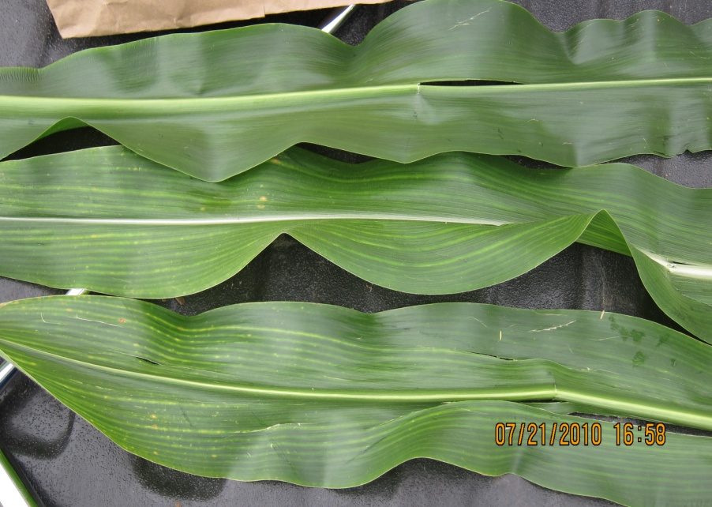
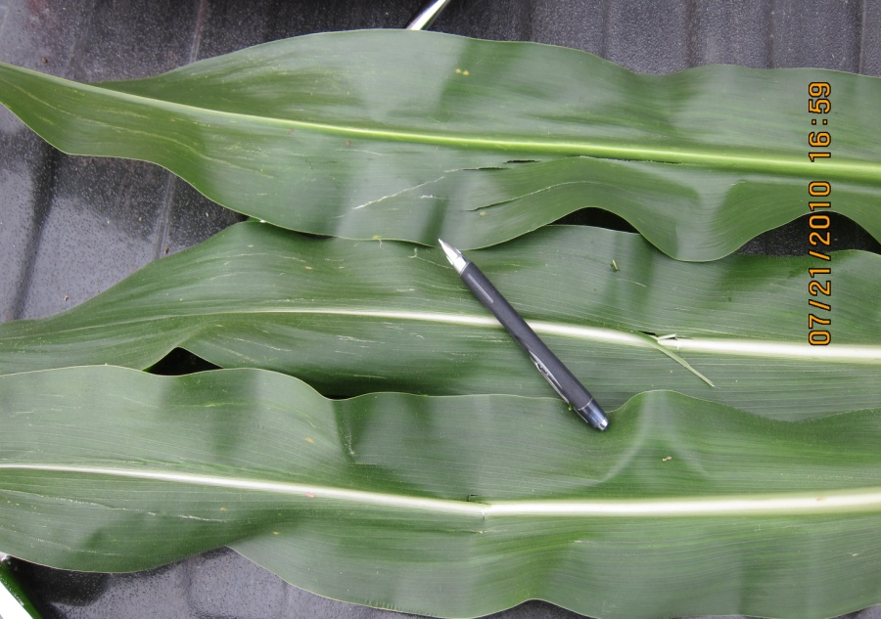
Technical Problem Solving
Check
Mg Treatment

Slide 10
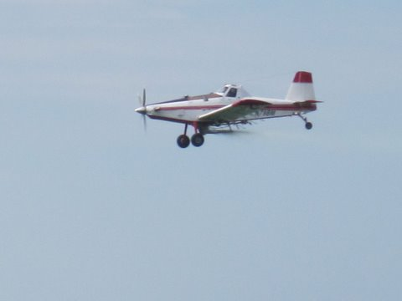
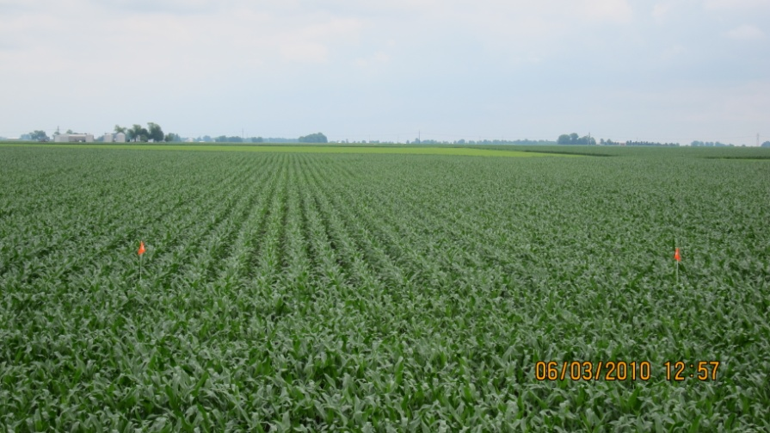
Highlighting Technology: Sensor Based N Recommendation

Slide 12
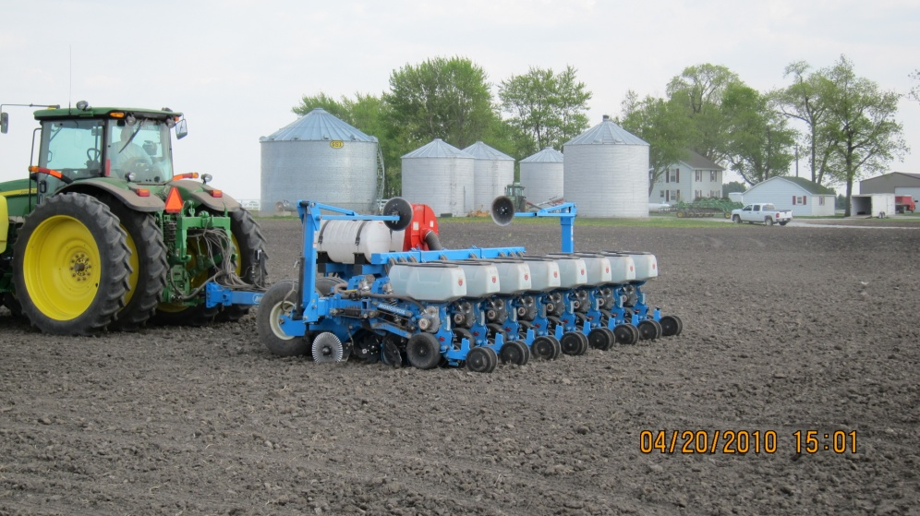
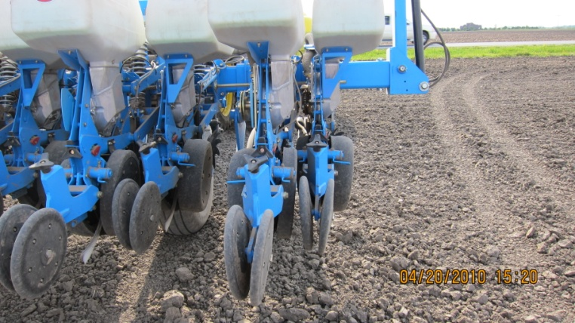
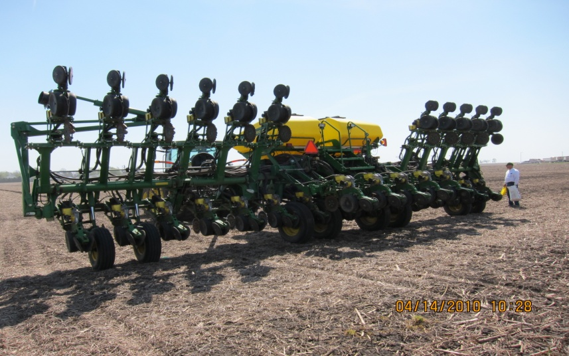
Row Spacing x Population x Hi-bred
Heartland Business Unit 2010
Working with a number of
equipment manufactures
Northern, IL
East Central, IL
South West, IN

Slide 13
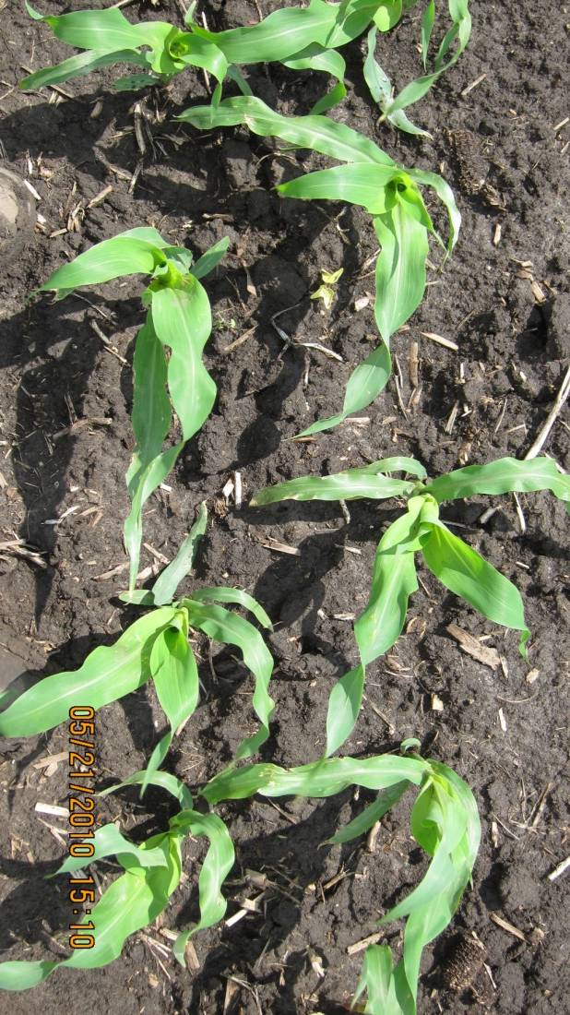
Equidistant Plant Spacing Evaluation
What we want! What we get!

Slide 14
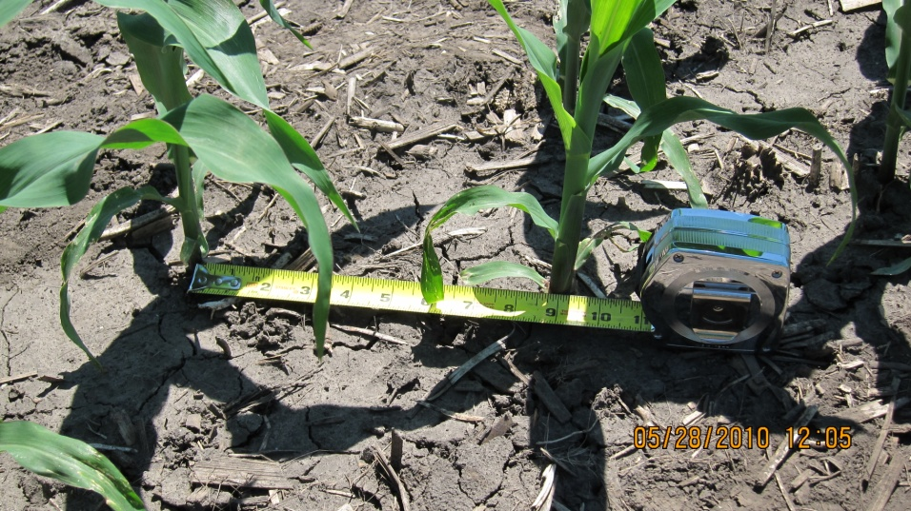
Equidistant plant spacing evaluation
What we want! What we get!
Planter | # of Measurements | Standard Deviation
Planter X | n = 1184 | 2.22
Planter Y | n = 6048 | 1.59

Slide 15
Agronomy Sciences
Qualifications and experience:
Field-research based Bachelors or Masters degree in Agronomy, Weed Science, Soil Science, Plant Pathology, or Entomology
2-4 years field research management experience with an agricultural company or university in conceiving, coordinating, executing, analyzing, interpreting, and reporting results from field research trials in writing and oral presentations is required
Apply at: http://www.pioneer.com/employment/openings/search.asp

