Slide 1
Crop Spec OTG
High Plains Desert

Slide 2
Study area – High Plains Desert
North Central Montana
High elevation located on Rocky Mountain Front
4,000 Acre Wheat/Barley/Pea/Fallow
200 Angus Beef Cows
11” annual precipitation
High protein wheat growing region
2/3 of MT wheat ships to Asian Rim

Slide 3
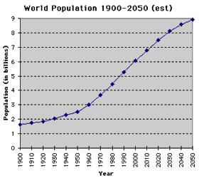
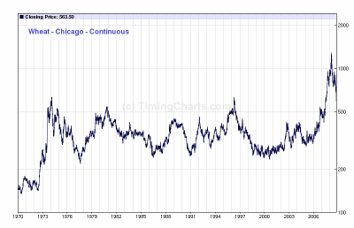
Food, Fertilizer and people

Slide 4
K.I.S.S Keep It Simple Stupid
Provide a tool to measure in season variability
Provide simple index
Provide simple user interface
Technical and Agronomic support
Measure results
Set realistic expectations, be conservative
Not everyone has a yield or quality monitor
If its not easy, most end users don’t want it unless it has large capital advantages

Slide 5
Knowledge vs Data
Old farmers might not be able to tell you what they had for breakfast, but they can all tell you how a field performed 30 years ago and why.
The best current data sets do not have knowledge, only data. The need for local knowledge is critical to the success of a precision ag program. Every farming operation is different, every field is different, treat them accordingly.

Slide 6
Variable Rate follies
Nitrogen is the most difficult nutrient to apply accurately and timely
Previous crop
Organic Matter
Moisture
Temperature
Current Crop
Price
P and K are much easier to deal with using traditional zoning/sampling techniques based on historic trends

Slide 7
Why topcon Crop Specs
The need for real time nitrogen sensing
Oblique view of crop
Use of Red Edge Band
Simple Ratio Index
Dynamic Reference Strip Calibration
4 Simple modes of use
On / OFF
Single Point/Slope
Two Point
Target rate

Slide 8
Nadir vs Oblique - Dense

Slide 9
Nadir vs Oblique - Thin

Slide 10
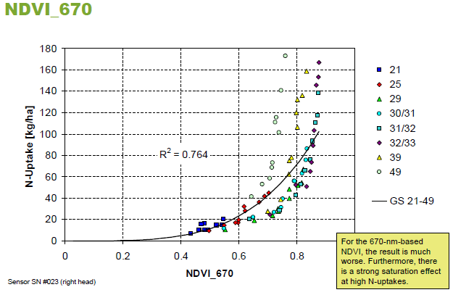
NDVI – using red

Slide 11
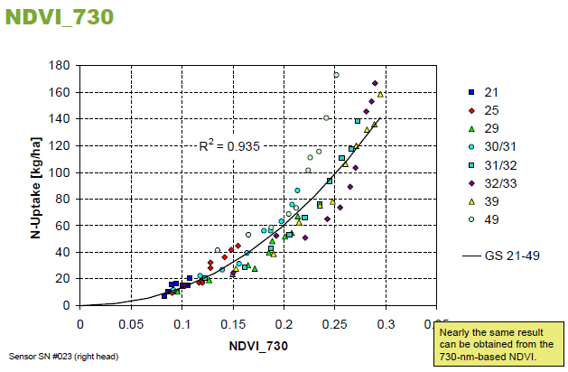
NDVI – using Red Edge

Slide 12
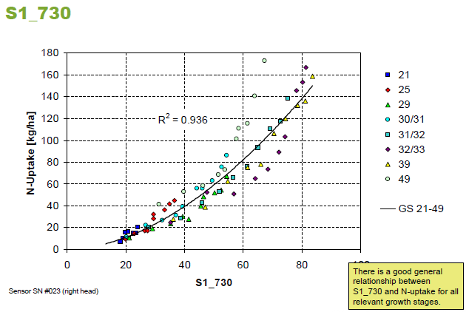
S1 Parameter– using Red Edge

Slide 13
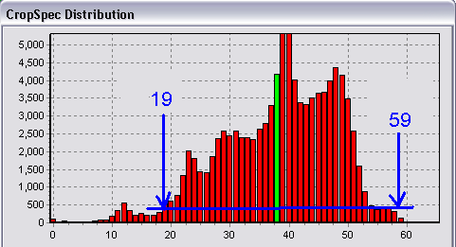
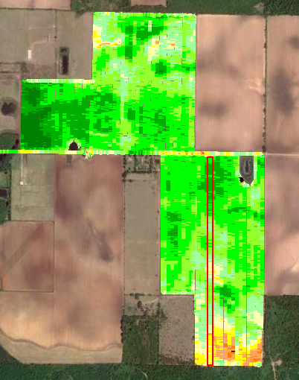
Two Point Calibration
Drive Strip and Apply at Normal Rate
Select min and max CropSpec from cutoff line
Associate two rates => slope factor
Select two point or target rate mode

Slide 14
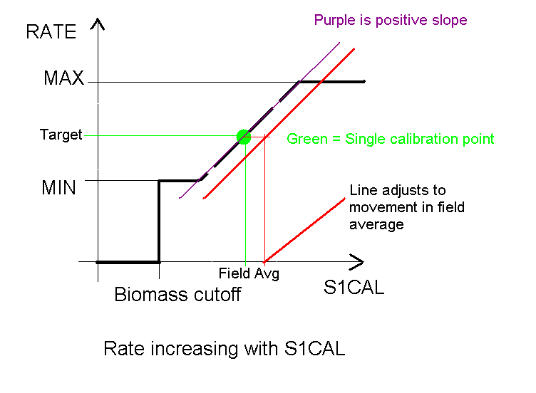
Target Rate

Slide 15
Importance to Montana Wheat Producers
Protein premiums at all time highs
As much as $.30 per .25% protein down/up
50 bushel spring wheat crop
1% below Ordinary = Loss of $60/acre
1% above Ordinary = Gain of $60/acre
1500 acre farm = $90,000/year
5.5 Million Acres of wheat in Montana
$160 million added to Montana’s revenue
60 Million Acres of Wheat in US
Quality premiums not the same across US
Need and expectation will be different

Slide 16
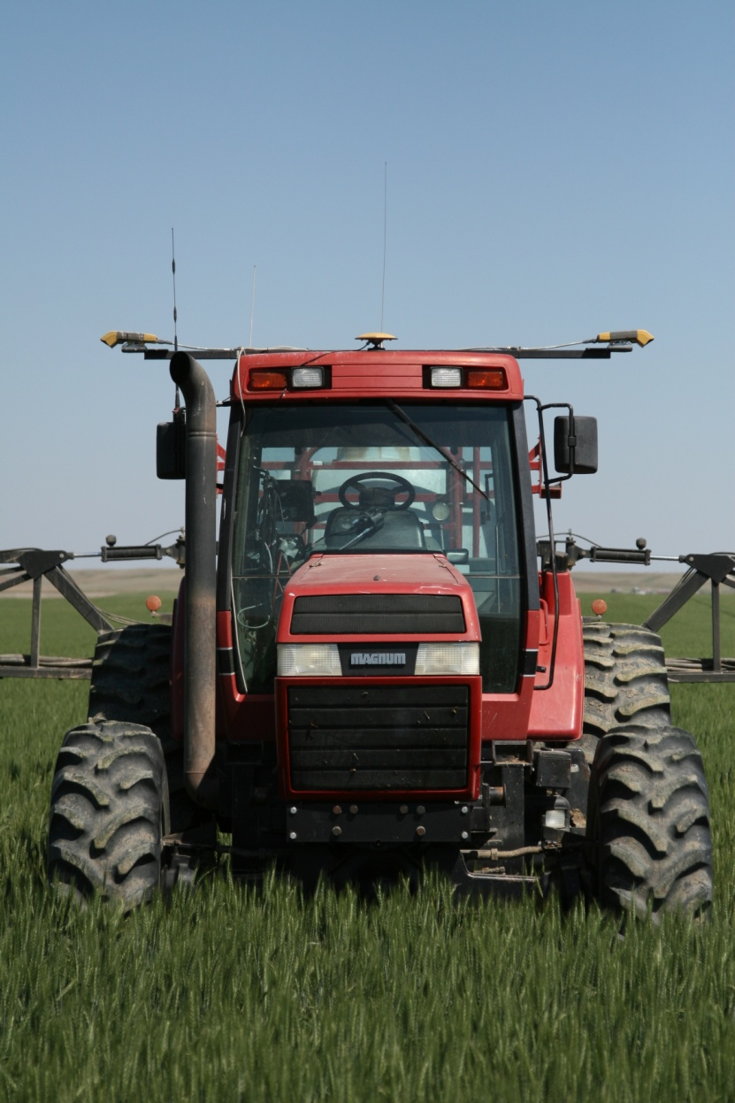
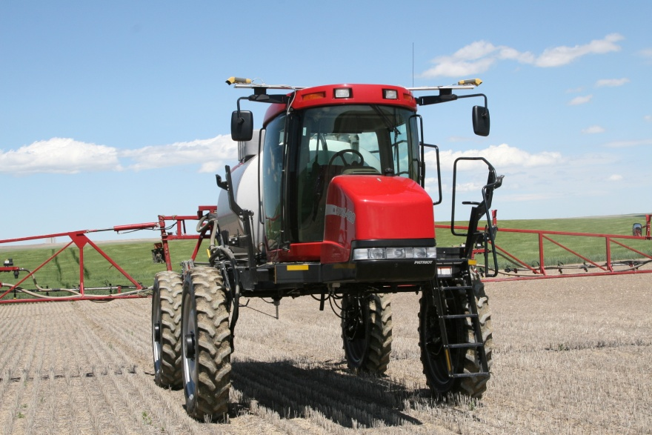
Crop Specs in Montana

Slide 17
Equipment Specs
1993 CaseIH 7220 (150 HP)
2007 CaseIH SRX160
1600 gallon solution tank
120 foot boom width
6 sections
Topcon X20 for full machine control
Topcon Legacy E GPS for RTK
Freewave HTplus radios for data broadcast
Verijet Nozzles (flat fan and banding)

Slide 18
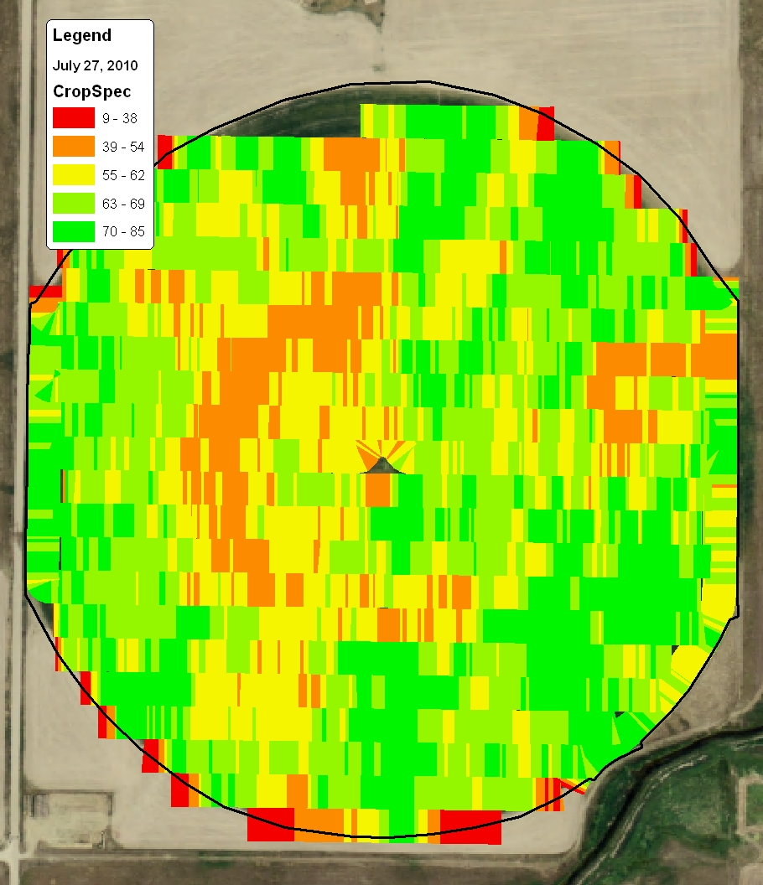
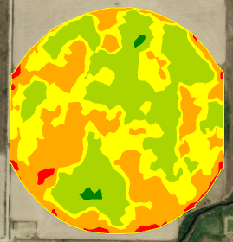
Crop Spec and Long Term Yield

Slide 19
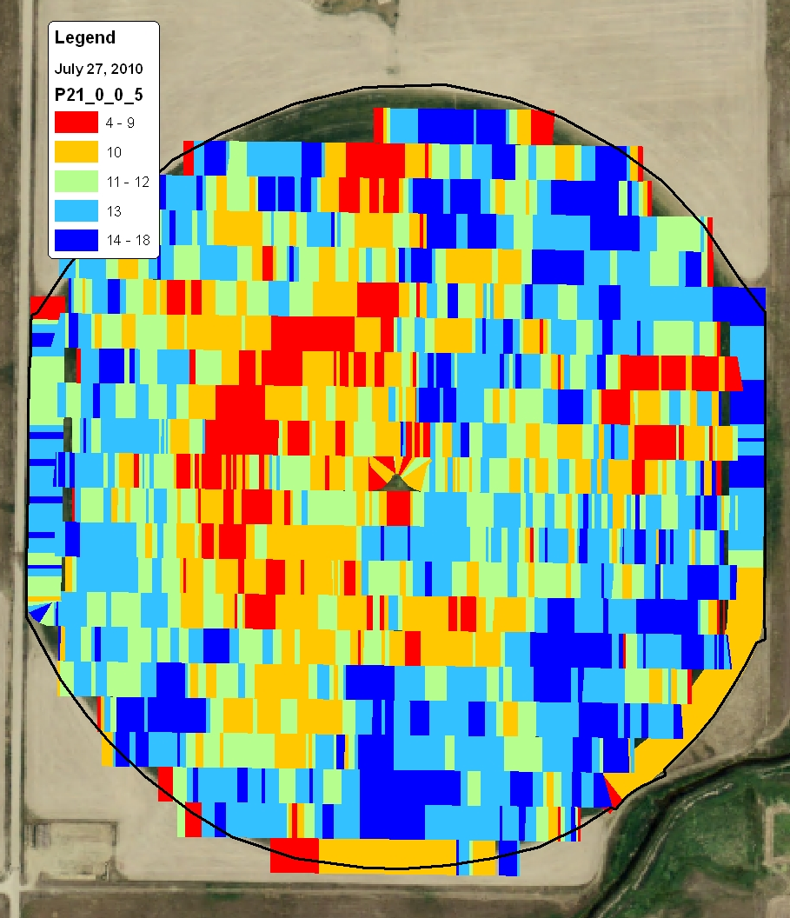
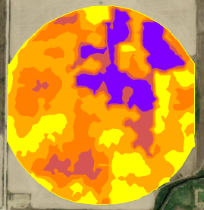
Historic Trends or seasonal effects?
Non Water Limiting Environment

Slide 21
June 12, 2010

Slide 23
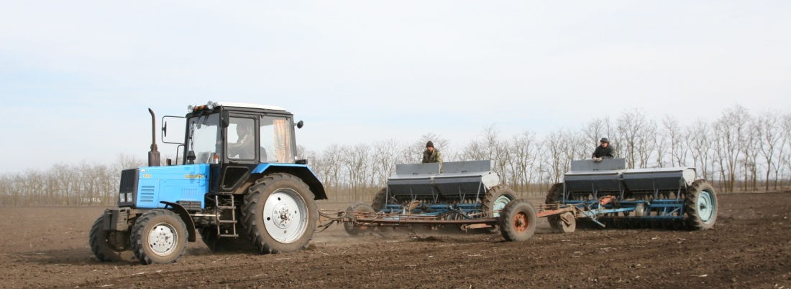
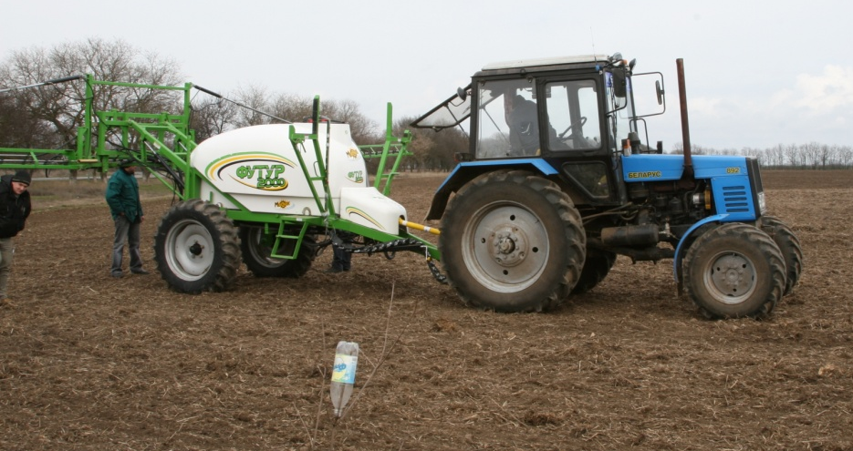
Ukraine Precision Farming System

Slide 24
Take Home
Need for in season Nitrogen adjustments is critical not only in rain-fed production, but also irrigation
All other agronomic factors need to be addressed before actively using a crop sensor
Local knowledge is required to fully use the technology to its potential
Red Edge is more sensitive than Red
The simpler, the better
Try, try, and try again.

Slide 25
NO Fear!
Analysis Paralysis
If you do what you’ve always done, you’ll get what you’ve always got
The definition of insanity is doing the same thing, expecting different results

