Slide 1
Beyond Sensor Technologies
Where Do We Go ?
What’s Next ?
Where Others Have Been

Slide 2
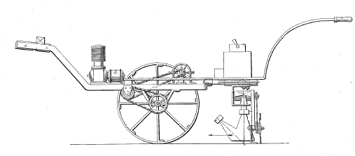
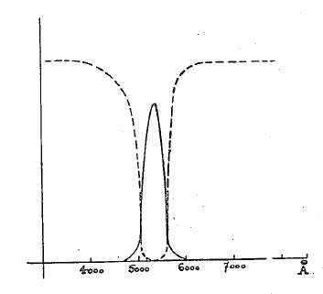
Real-time Active Sensor History
1930
’40
‘50
‘60
‘70
‘80
‘90
2000
Ferte and Balp 1937
Optical Weeder

Slide 3
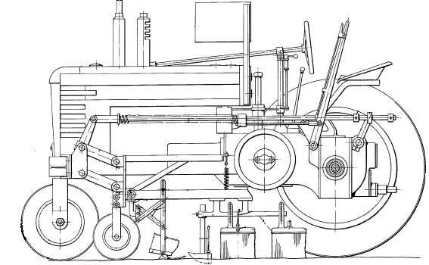
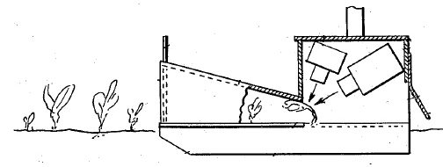
Real-time Active Sensor History
1930
’40
‘50
‘60
‘70
‘80
‘90
2000
Marihart 1943
Variable rate nutrient, fungicide and herbicide

Slide 4
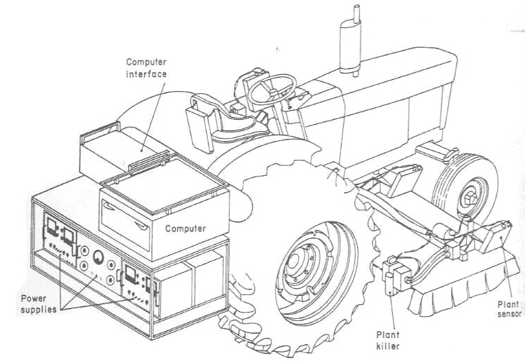
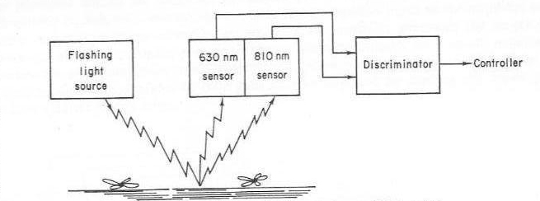
Real-time Active Sensor History
1930
’40
‘50
‘60
‘70
‘80
‘90
2000
Palmer and Owens 1969
Chemcial weeder first to use digital computer

Slide 5
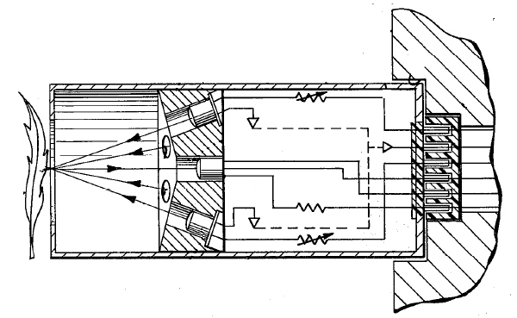
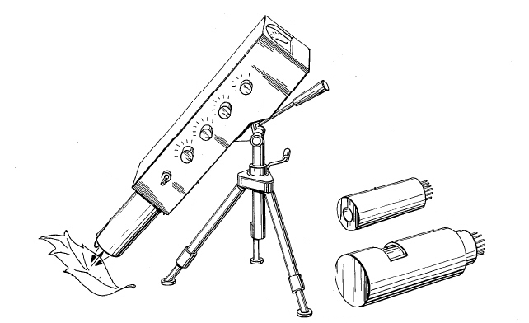
Real-time Active Sensor History
1930
’40
‘50
‘60
‘70
‘80
‘90
2000
Henderson and Grafton 1975
First solid-state (LED) plant sensor

Slide 6
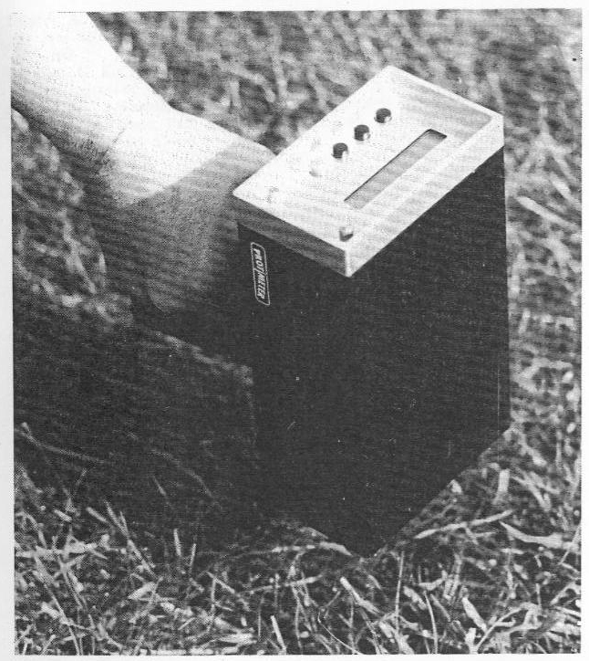
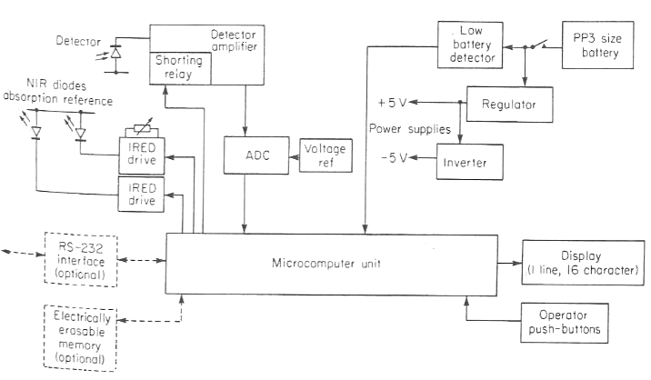
Real-time Active Sensor History
1930
’40
‘50
‘60
‘70
‘80
‘90
2000
Stafford et al. 1988
Handheld turf sensor

Slide 7
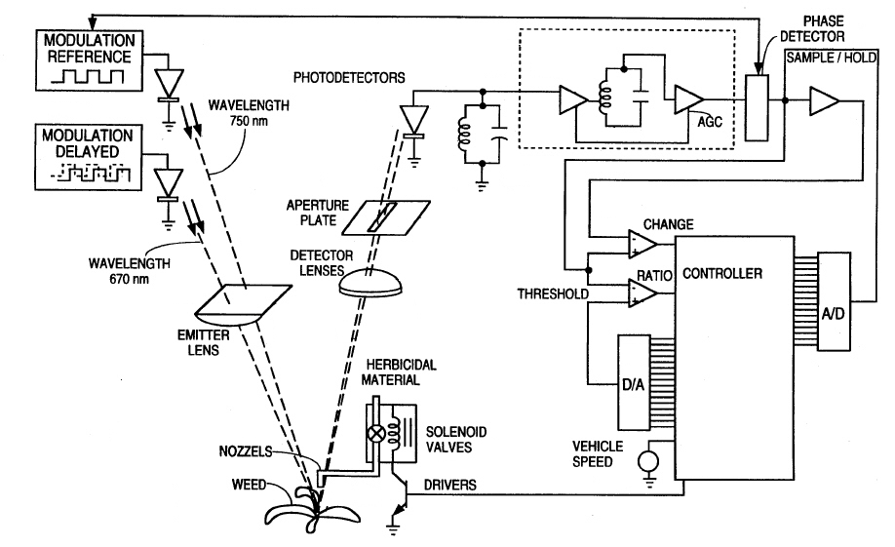
Real-time Active Sensor History
1930
’40
‘50
‘60
‘70
‘80
‘90
2000
Beck and Vyse 1992
Solid state weeder

Slide 8
Prof. Robert Olson Warned about Nitrate Leaching
1930
’40
‘50
‘60
‘70
‘80
‘90
2000
Producers had “discovered” the merits of N fertilizer on corn yields and “assumed” that:
If a little is good, more would be better !
Graduate Students : Curt Clausen, Bill Raun, Albert Simms

Slide 9
High – Nitrate Groundwater in Nebraska
> 10 mg/L NO₃-N
1930
’40
‘50
‘60
‘70
‘80
‘90
2000
Deep soil cores showed nitrate leaching toward groundwater.
Causes : Too much N fertilizer and water
Producers said - “If you want us to apply less N fertilizer, you will have to come up with a practical way to detect a pending deficiency and fix it before it reduces yield ! ! !

Slide 10
Hageman Enlightenment Regarding C & N
1930
’40
‘50
‘60
‘70
‘80
‘90
2000
Schepers takes sabbatical leave with Dick Hageman and works with Fred Below to explore ways to monitor corn N status.
Leaf chlorophyll is key to high yields !

Slide 11
Concern over Nitrate and Pesticide Leaching
1930
’40
‘50
‘60
‘70
‘80
‘90
2000
Burlington Northern Railroad funds project to protect groundwater quality.
Nitrification inhibitor
Realistic N fertilizer rates and timing
Richard Ferguson
Raun Lohry (Nutra-Flo)
Developed leaf N vs. chlorophyll concentration relationships for corn at different growth stages

Slide 12
Problem – Variability in Yield Responses to N
1930
’40
‘50
‘60
‘70
‘80
‘90
2000
How to compare corn yield responses to N fertilizer rates across years, hybrids, and locations ?
Pioneer HiBred studies (Curt Clausen)
Schuyler, Page, ???? Nebraska
Used Relative Yield to evaluate N fertilizer effects across studies

Slide 13
What portion of corn-yield variability should realistically be attributed to climatic conditions after silking ?
Question
<5%
5%
10%
15%
20%
25%
30%
35%
>40%
?

Slide 14
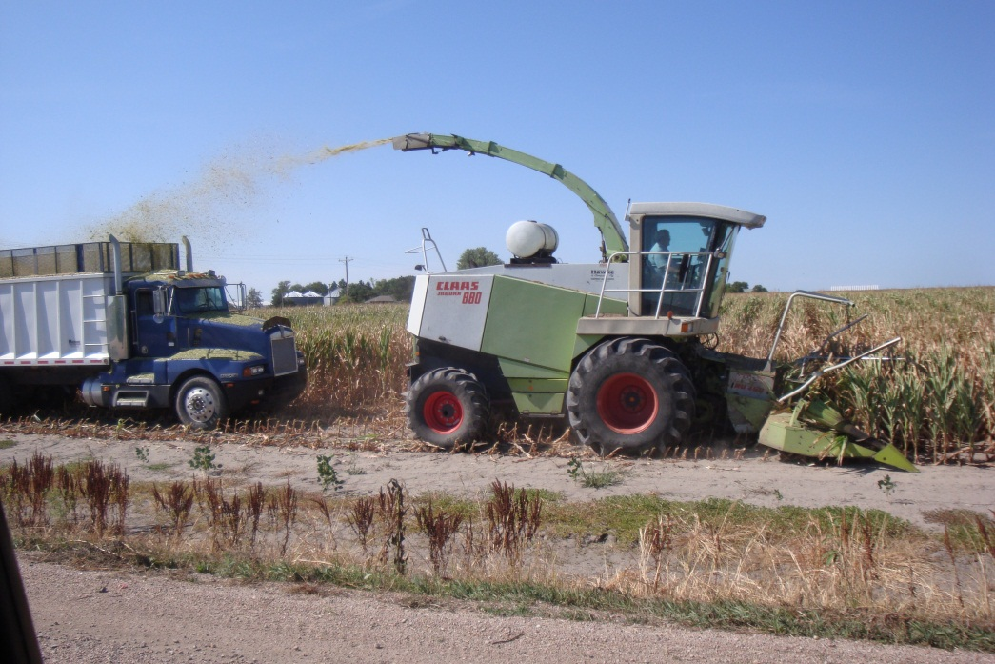
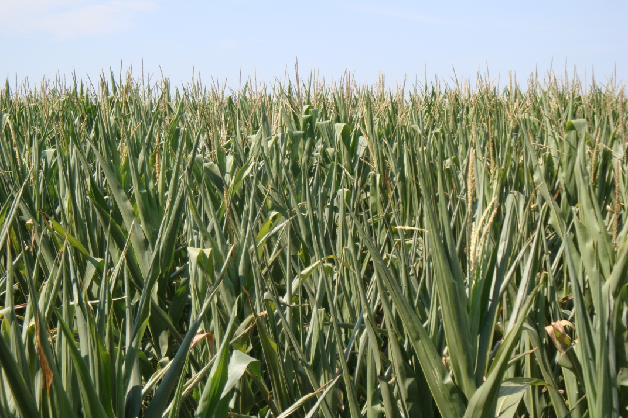
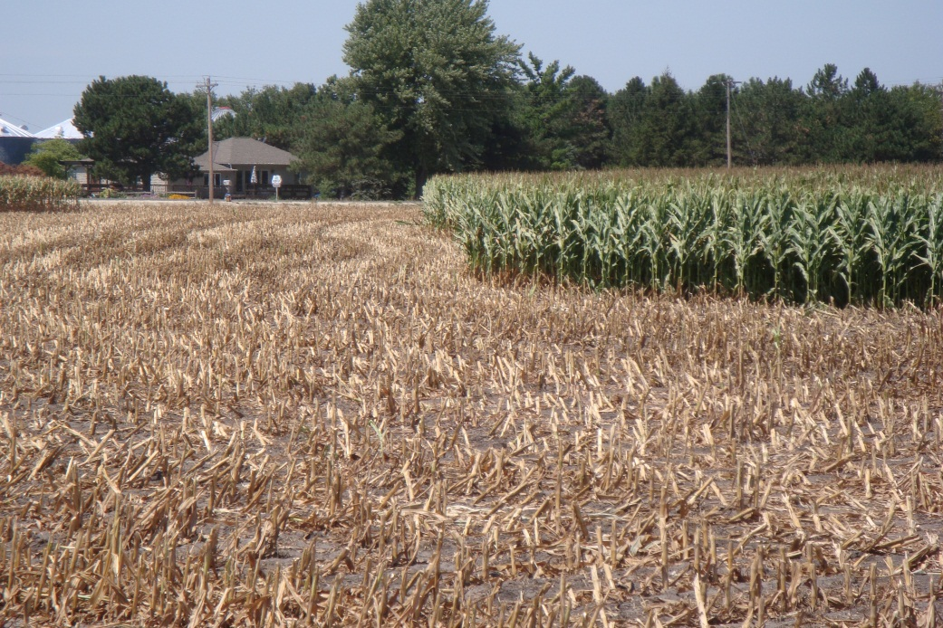
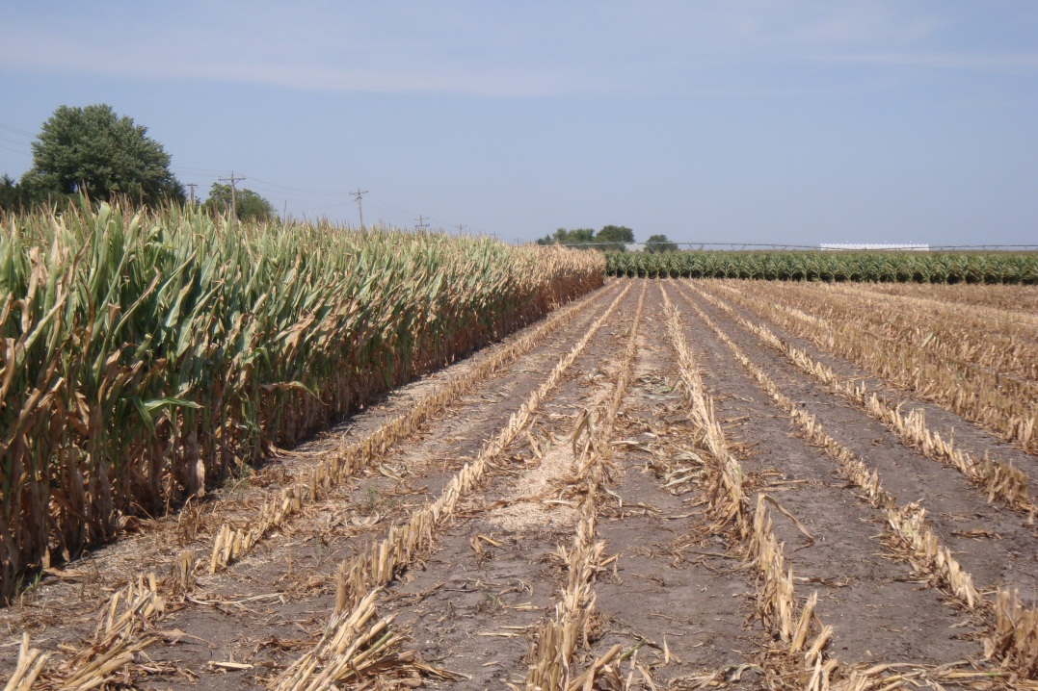
August 11, 2012
July 12, 2012
Value of Irrigation

Slide 15
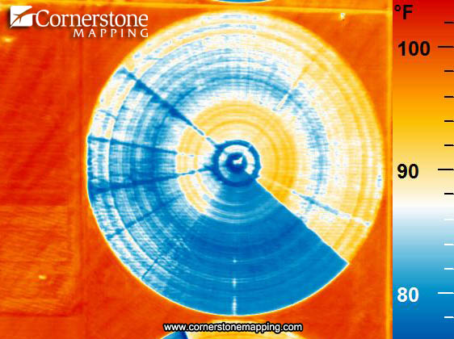
Water Distribution Problems
Someplace
in Kansas
2011
Thermal IR image

Slide 16
Minolta Introduces SPAD Meter
1930
’40
‘50
‘60
‘70
‘80
‘90
2000
SPAD meters used to make spoon-feeding decisions for fertigation in MSEA studies
Project manager (Todd Peterson)
Graduate student (Tracy Blackmer)
“Sufficiency Index” concept is published

Slide 17
Canopy sensors can not quantify excess N
Similar
N Status

Slide 18
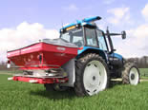
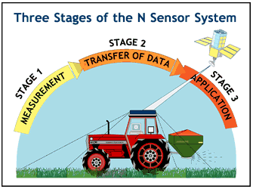
Real-time Active Sensor History
1930
’40
‘50
‘60
‘70
‘80
‘90
2000
Heege and Reusch 1995
First commercial variable rate applicator

Slide 19
When?
How much?
How much early?
In season?
N uptake
Sensor based
In-season N
Early N
Planting
V6
V9
Tasseling

Slide 20
Building Block
Early
Growth
Rapid
Growth
Late
Loss
Maturing
100
75
Seasonal Nitrogen Uptake, %
50
40% of requirement after silking
25
70-80% of requirement after V8 - 10
0
May
June
July
Aug
Sept

Slide 21
Irrigated Corn - 1993
Silking

Slide 22
“Nitrogen Use Efficiency”
Corn Yield
NUE
EONR = 176 kg/ha
Economic Optimum N Rate
Total N Effect
Fertilizer Effect
All Yield
FREE yield
Fertilizer
Only Yield

Slide 23
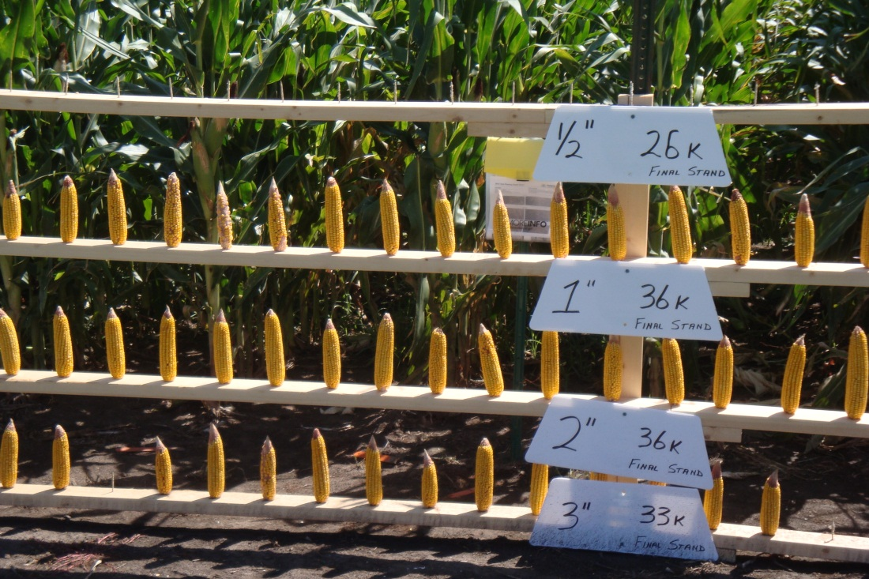
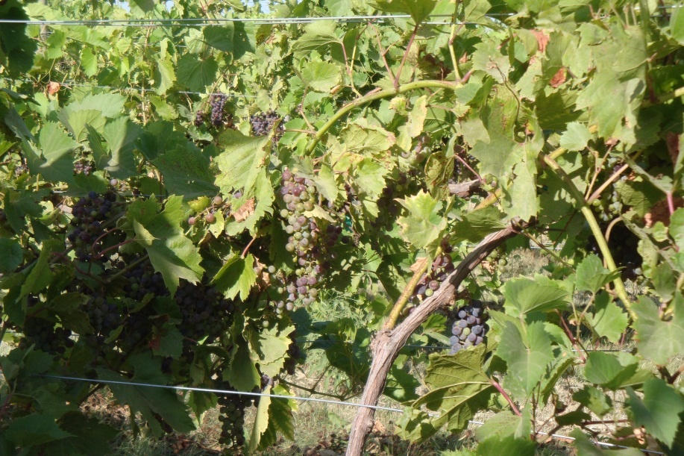
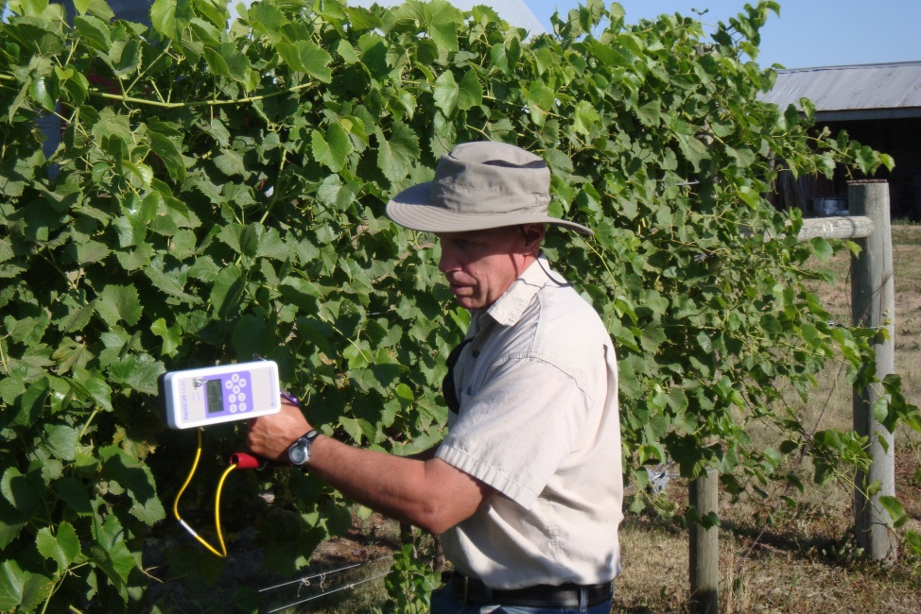
Pay More Attention to Cultural Practices ?
Corn is the Wrong Crop ?
Data Interpretation ?
Algorithm Development ?
Product Quality Issues ?

Slide 24
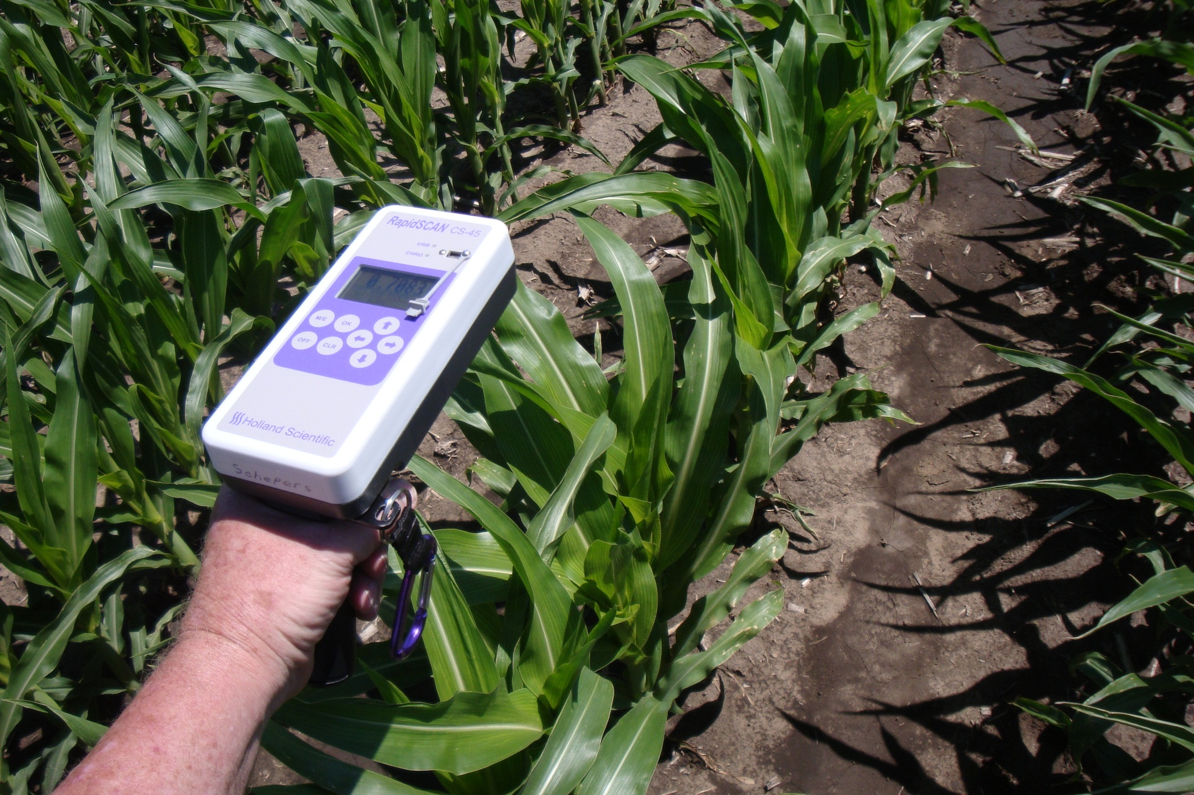
Seed Corn - 2012
Male
Female

Slide 25
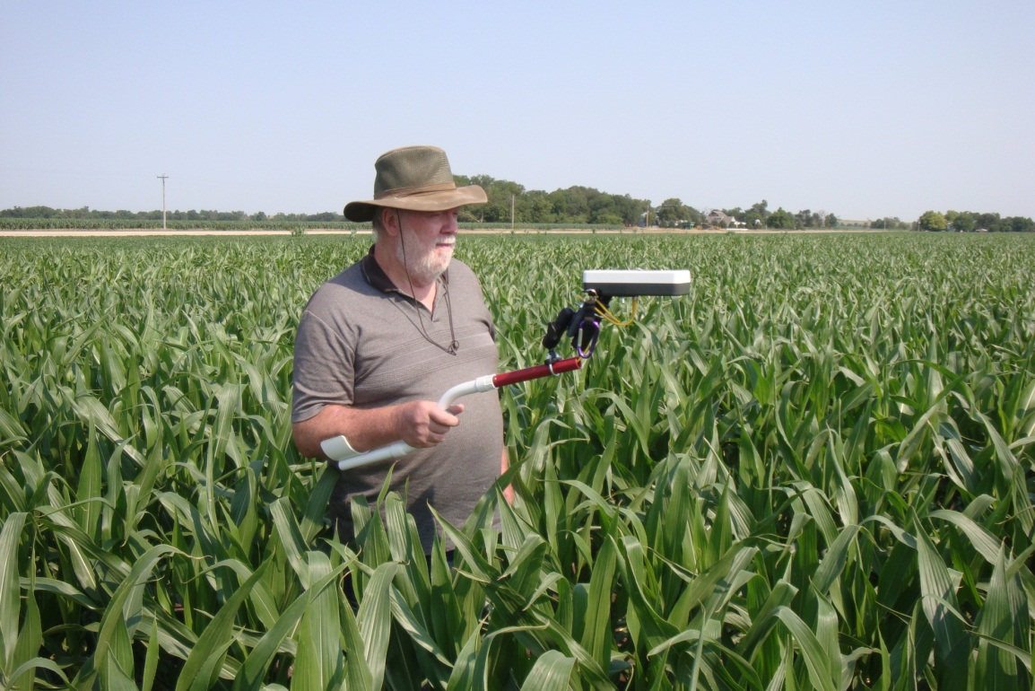
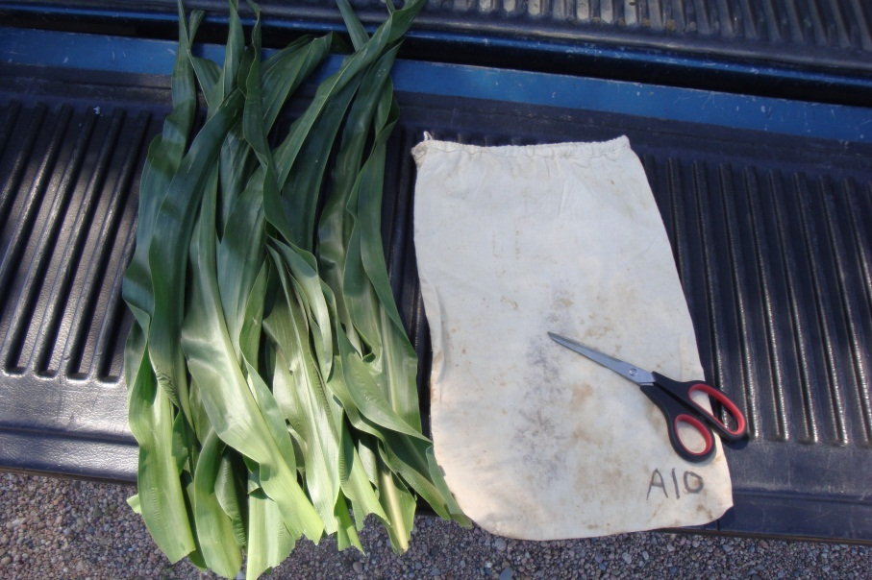
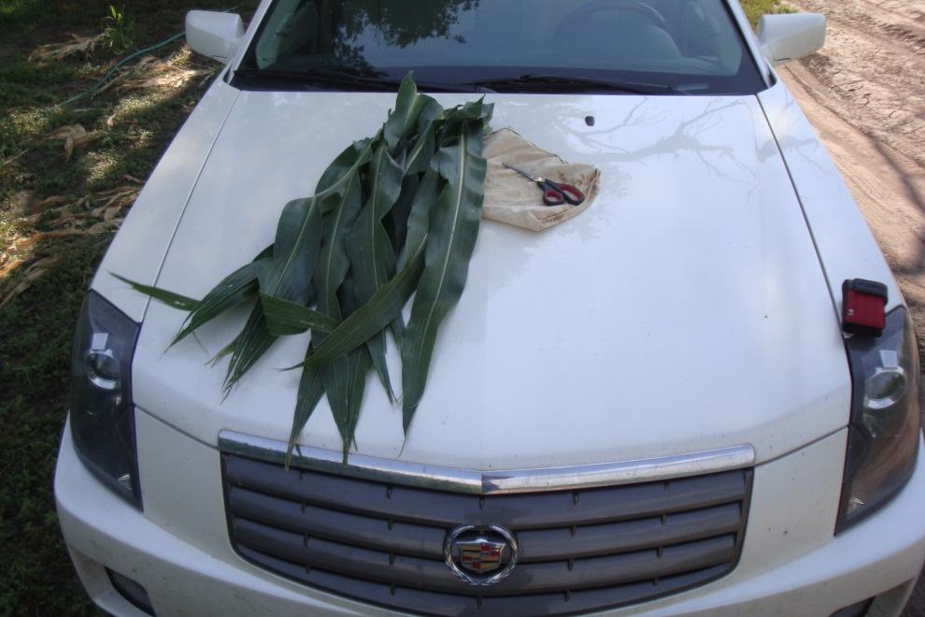
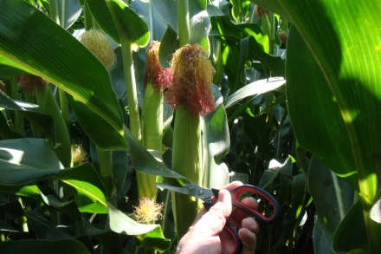
V8
RapidSCAN
Do high yielding hybrids have the same nutrient uptake patterns as older hybrids ?
….similar nutrient balance ?

Slide 26
Silking

Slide 27
Harvest

Slide 28
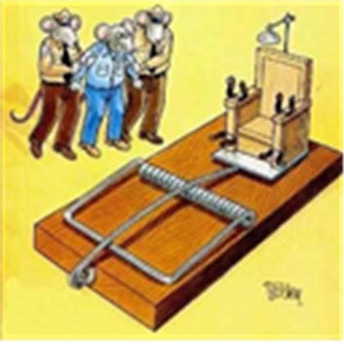
Forget about -
building a better mouse trap ?
Rather
Start by working with farmers to -
catch 50 – 75% of the mice
with existing technologies ?
Drive and Fly Safely

Slide 29
Thank You
Jim Schepers
402-310-6150
james.schepers@gmail.com

