Slide 1
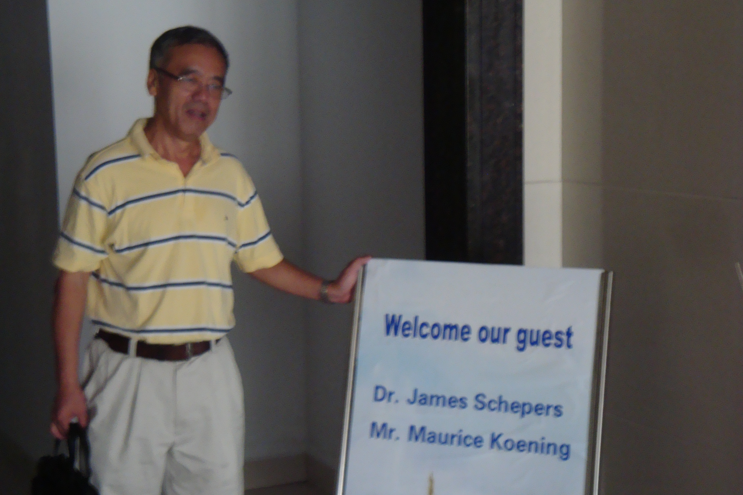
Impressions of China and More
Dr. Chuanguo Xu

Slide 2
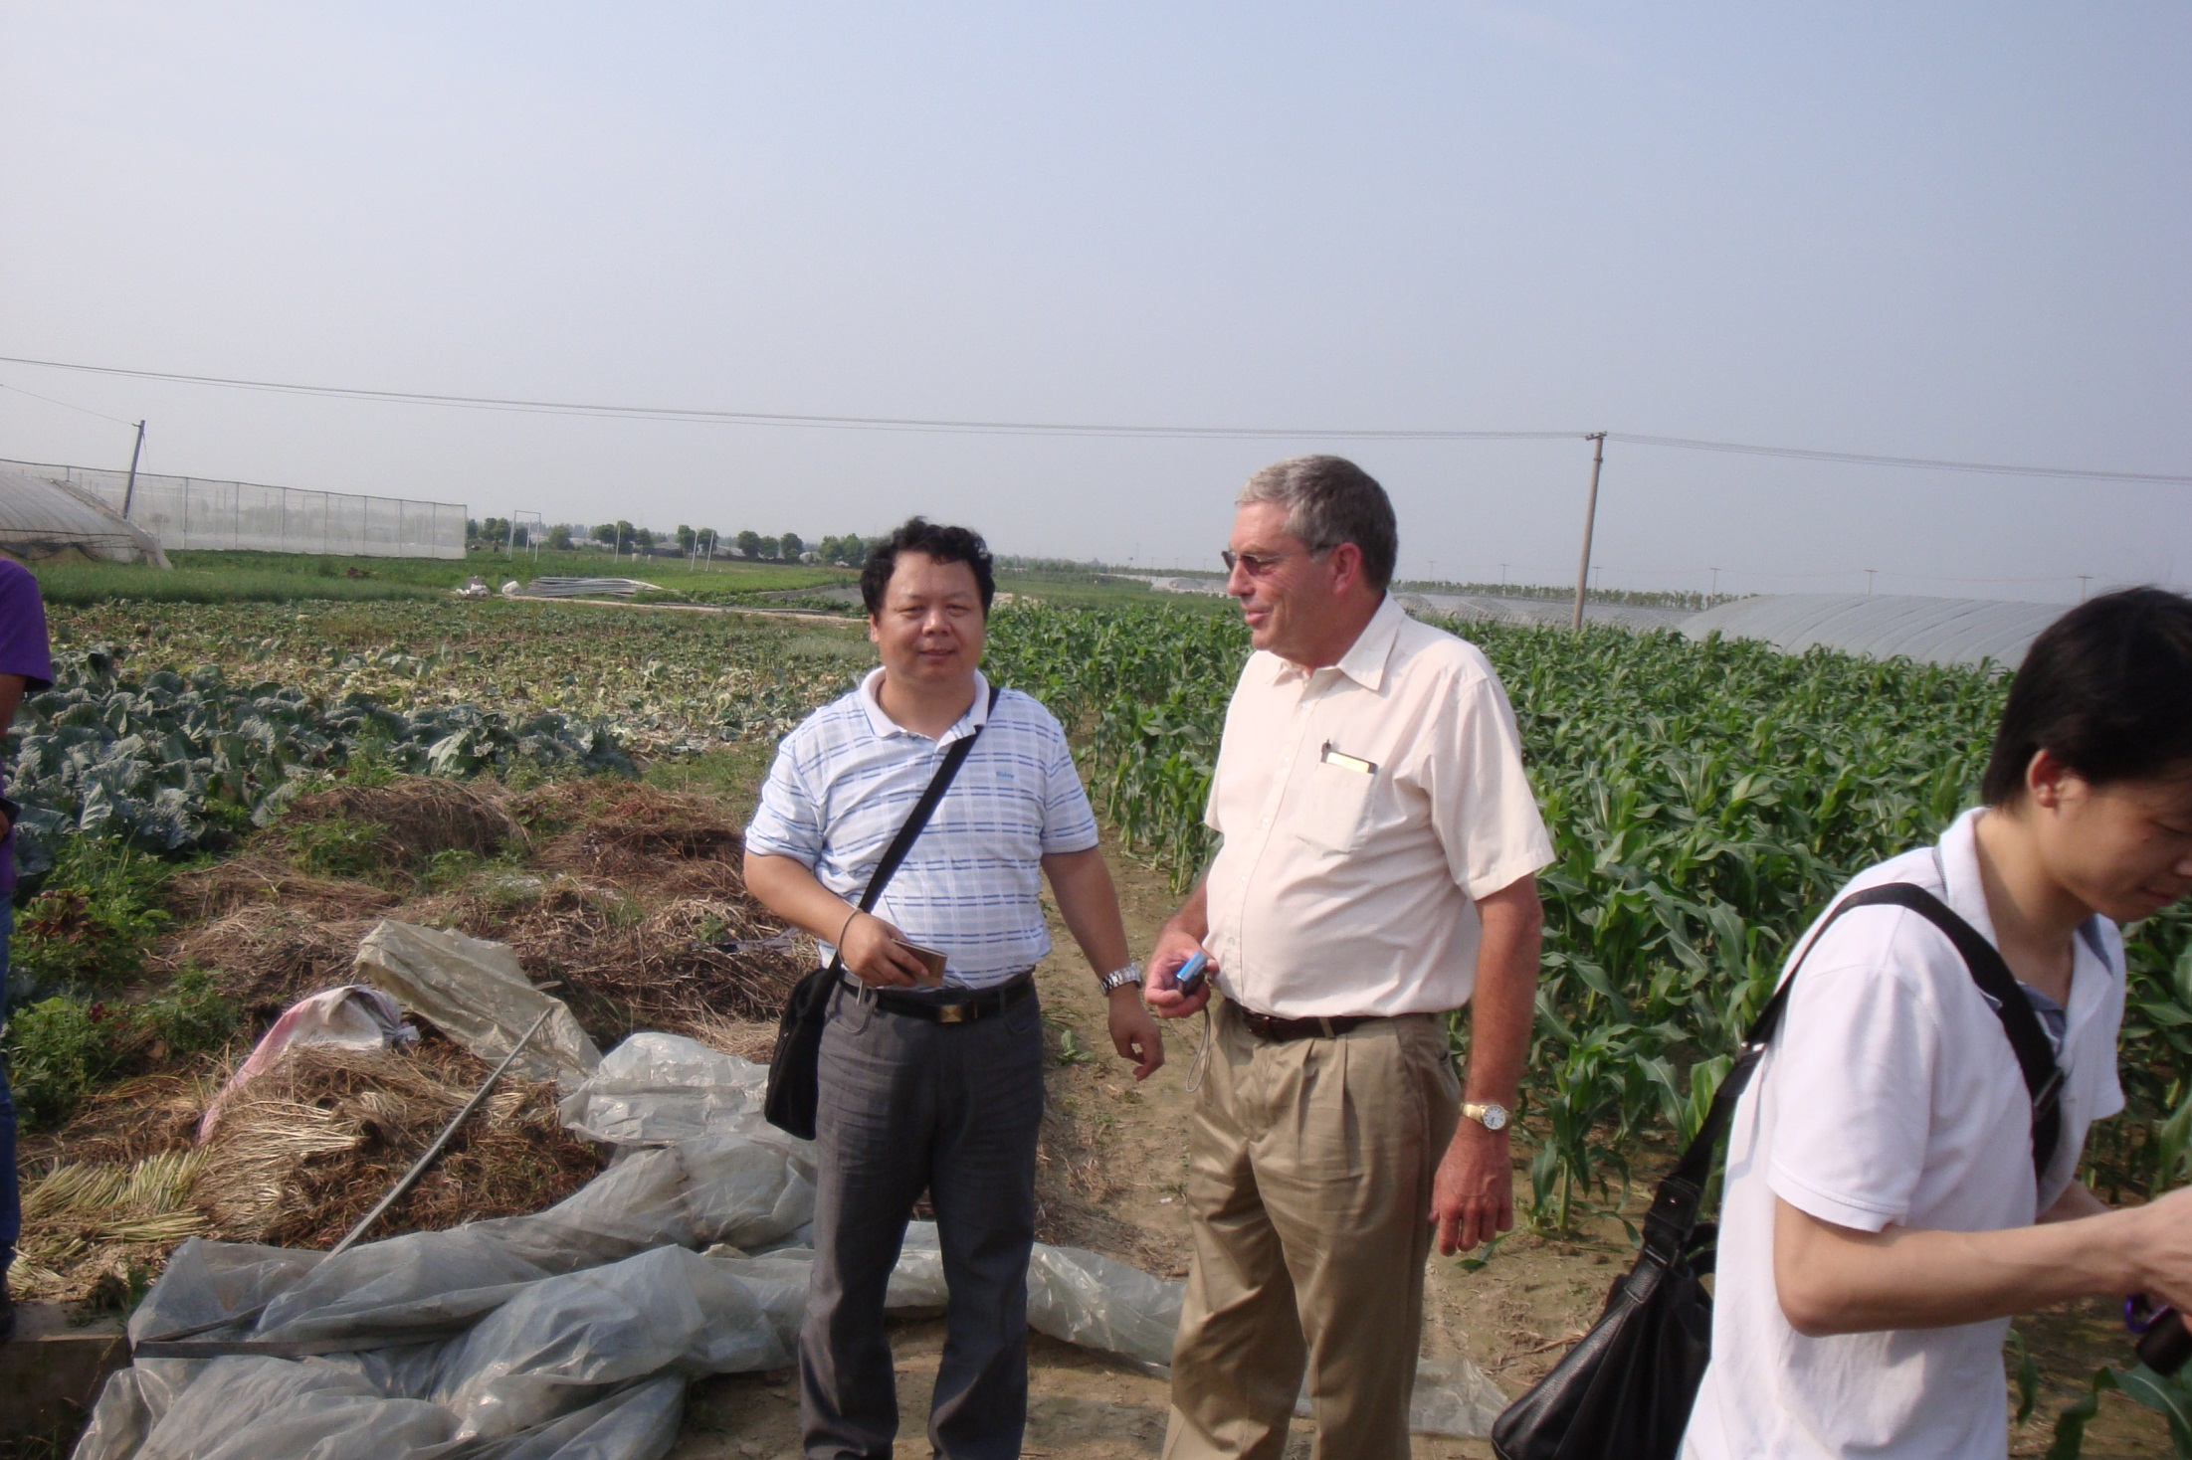
Mr. Maury Keonig
Vice-President Ag Services
Dr. Fang Chen
Regional Director IPNI

Slide 3
What Do You Want from Us ?
“Tell us about recent in-season N management technologies and strategies AND how to effectively convey management information to farmers”
Xu, Chuanguo
Where to Start ?

Slide 4
Photosynthesis
Reflects NIR
Chlorophyll
Biomass
Visible
Wavebands
Near Infrared
Wavebands
(NIR)
Sensors Measure
● Disappearance of red light
● Abundance of reflected NIR
e l d
Chlorophyll captures BLUE and RED light

Slide 5
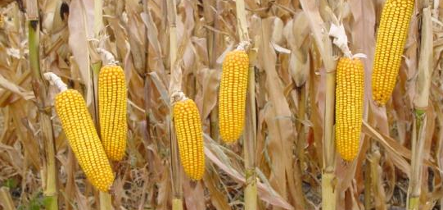
Photosynthesis
Chlorophyll Biomass
Visible
Wavebands
Near Infrared
Wavebands
(NIR)
Vegetation Index
“VIGOR”
Nutrient Status
Y i e l d

Slide 6

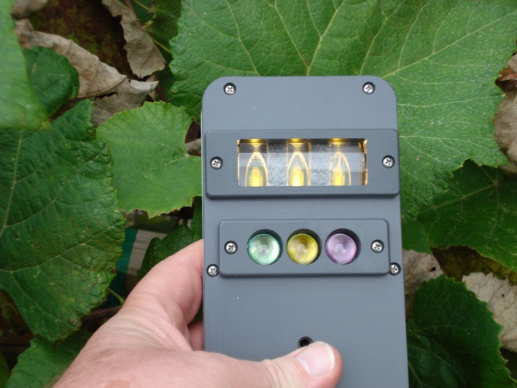
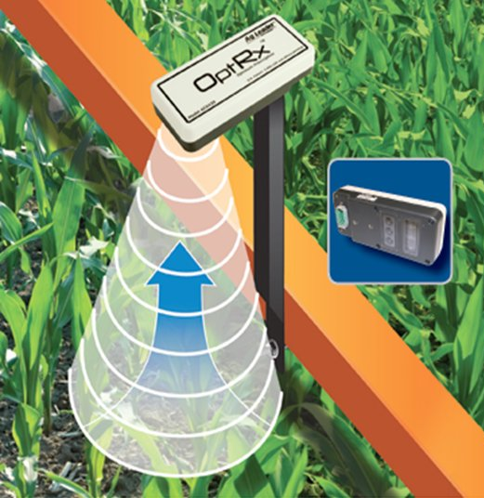
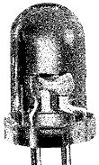
Modulation/Demodulation Using Polychromatic LEDs
Features
Select 3 wavebands
Mapping
External GPS
External power
Waveband output
Output to data logger
Continuous data (10 Hz)
Real-time applications
TARGET
User Selected
Filters
PD1
PD2
PD3
LED
ACS-470
SENSOR

Slide 7
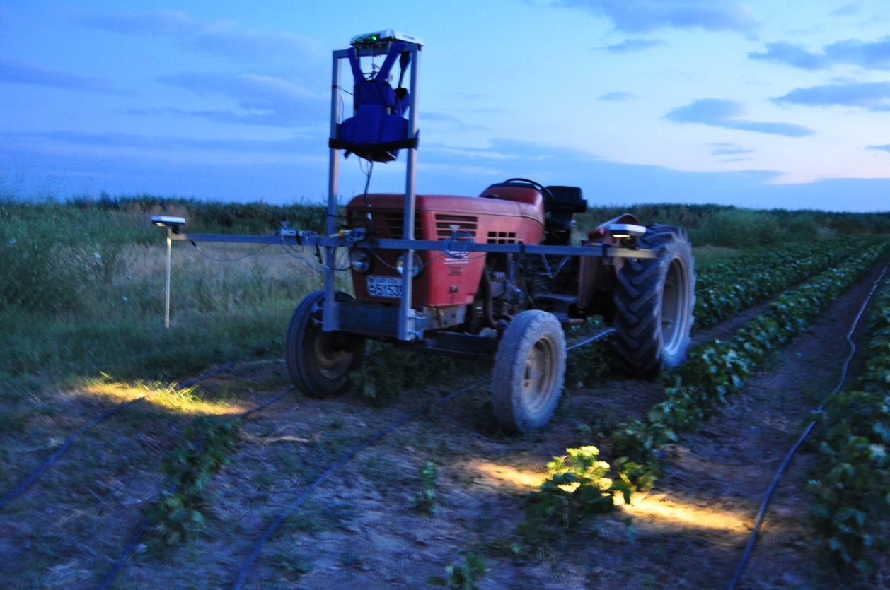
Crop Circle ACS-430
or
AgLeader OptRx
Cotton
Greece - 2010

Slide 8
Instrumentation in Chinese Laboratory
ASD sensor (hyper-spectral)
CropSCAN sensor (16 wavebands)
Minolta SPAD meters
Li-Cor light bar
EM 38 (map electrical conductivity)
Trimble DGPS
Hach portable chemistry kit (pH, EC, more)
Canister-type passive sensors (up and down)
Wave-band specific sensors (Chinese built)
Spectralon reference panels (several)
Grey-scale calibration panels (several sets of 4)
GreenSeeker
Circuit boards being developed and tested

Slide 9
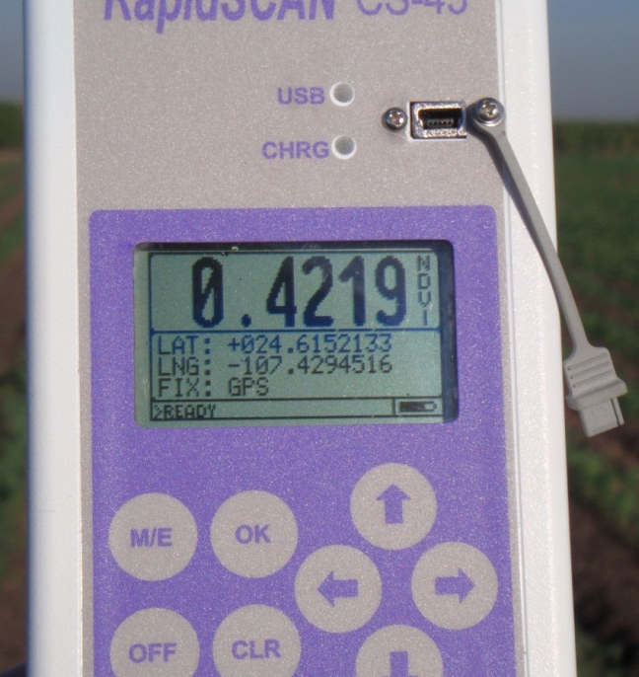
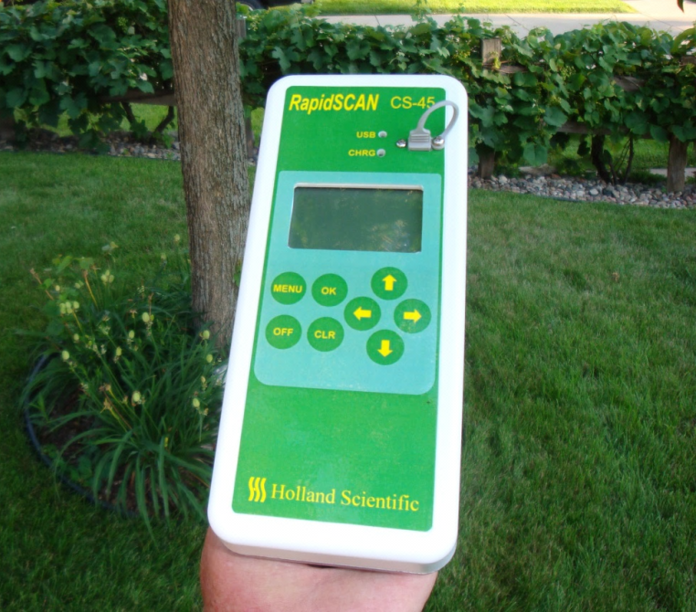
Modulation/Demodulation Using Polychromatic LEDs
TARGET
Built-In
GPS
Lithium battery
Waveband output
3 Meg memory
Averages data @ 10 Hz
Statistics
Start – Stop switch
Red, Red-edge and
NIR Filters
Collects data @ 40,000 Hz
PD1
PD2
PD3
LED
RapidSCAN
SENSOR

Slide 10


Photosynthesis
Chlorophyll Biomass
Visible
Wavebands
Near Infrared
Wavebands
(NIR)
Vegetation Index
Growth stage
Cultivar (variety)
Previous crop
Water stress
Soil properties
Affected By :

Slide 11

Relative “Vigor”
(i.e., 92% adequate)
Sufficiency Index
“ X “
Reference
=
“Managed Crop”
=
S I
“Happy Crop”
Note : Reference value - - - remains constant
i.e., 100%

Slide 14
SI =
4.47
5.21
= 0.85

Slide 15
Basic Algorithm
Holland K.H. and J.S. Schepers. 2010. Derivation of a variable rate nitrogen application model for in-season fertilization of corn. Agronomy Journal 102:1415-1424.
√
√
(1 – SI)
∆ SI
N_{appl} = ( N_{opt} – N_{cred} )
Farmer Rate
or N_{EONR}

Slide 16
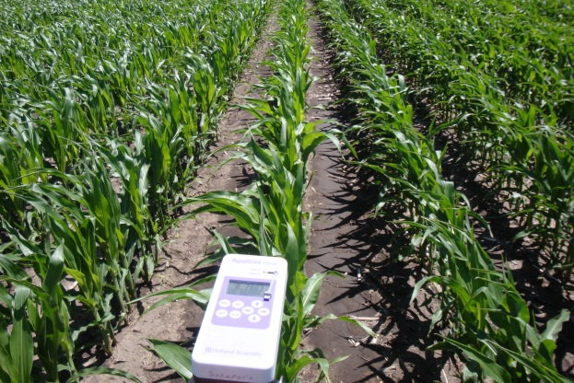
Fertilizer N Rates influence crop vigor
(sufficiency index)
Crop Sufficiency Index is directly related to Relative Yield

Slide 17
Why Some Precision Agriculture Tools Have Slow Adoption ?
Time
Expense
Intimidated by the technology
Inconvenient
Lack of support after the sale
Not appropriate for the situation
Profits are already adequate
Requires different equipment
Needs technical assistance and guidance

Slide 18
Smoke Test
Producer Services
Charges 5-7% more
for products
Grid soil samples
Review yield maps
Generate zone maps for VRT
VRT fertilizer and lime
Check preplant uniformity and deliver materials
Check and calibrate starter fertilizer equipment
Planter uniformity and depth
Sidedress nutrient deliveries
Herbicide applications (high clearance sprayers)
Calibrate fertigation pumps and schedule applications
Field scouting (irrigation, weeds, insects, disease)
Remote sensing (color imagery out the window)
Yield monitor calibration
Help clean up yield maps
Frequent contacts
Demonstrates concern
Near real-time feedback

Slide 19
Appropriate Early-Season N
Problems
Excess N
Courtesy: Fred Below

Slide 20
Should we be working to -
build a better mouse trap ?
OR
Convincing farmers that they should try to -
catch the mouse ?
Get Involved with Producers

Slide 21
Thank You
Jim Schepers
402-310-6150
james.schepers@gmail.com

