Slide 1
Remote sensing based in-season N recommendations
David Clay and Cheryl Reese

Slide 2
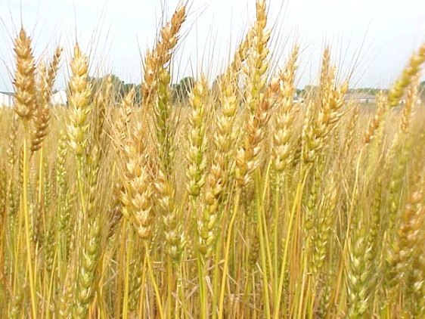
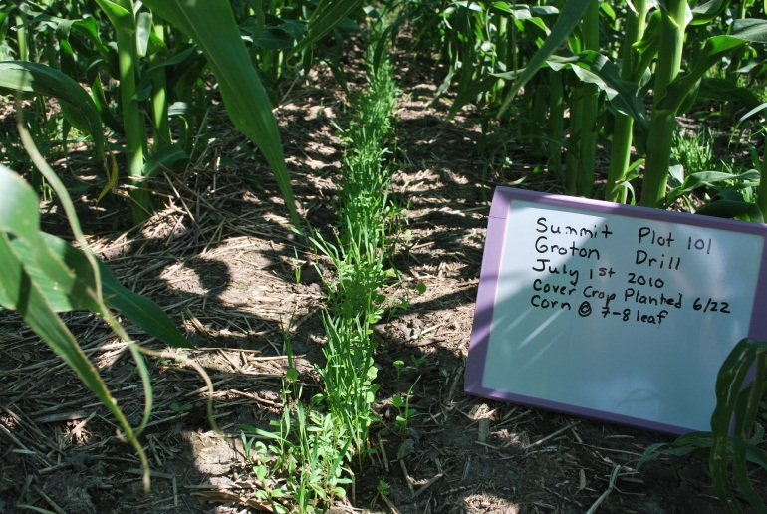
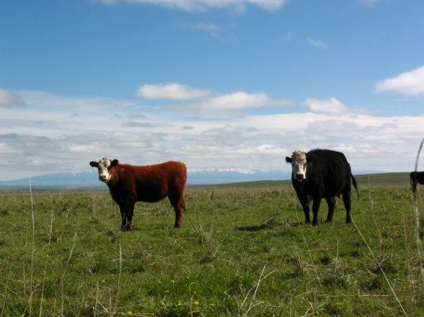
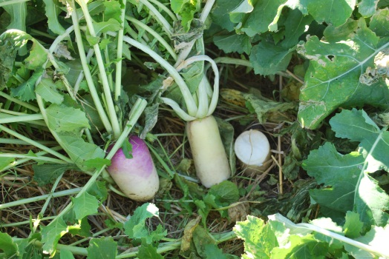
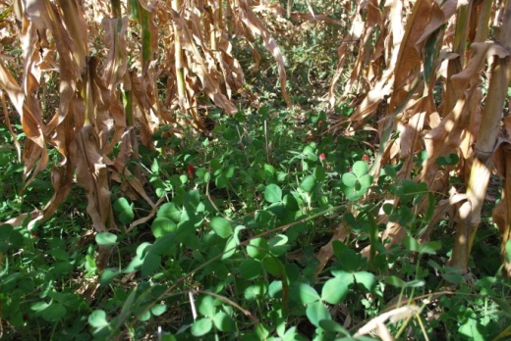
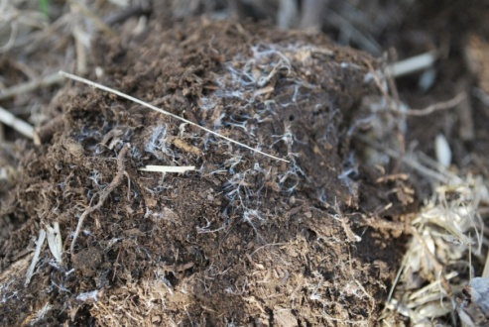
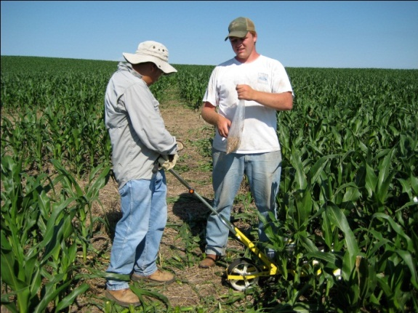
Dryland wheat systems
2
N and P recommendations
Mycorrhizae, carbon footprints, salinity
Copyright 2010, Cheryl Reese SDSU Plant Science Dept.

Slide 3
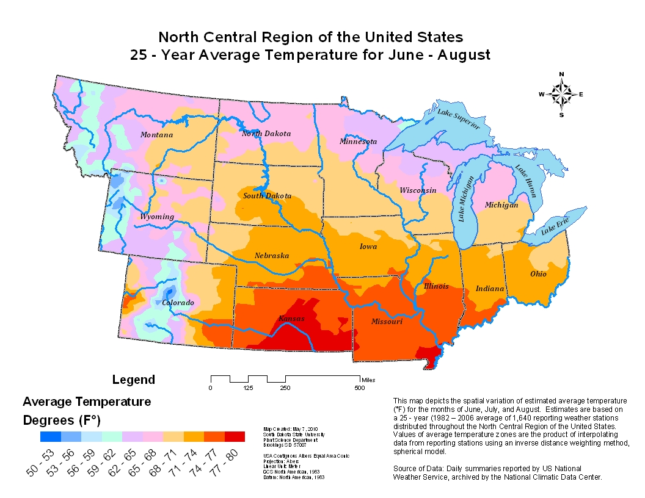

Slide 4
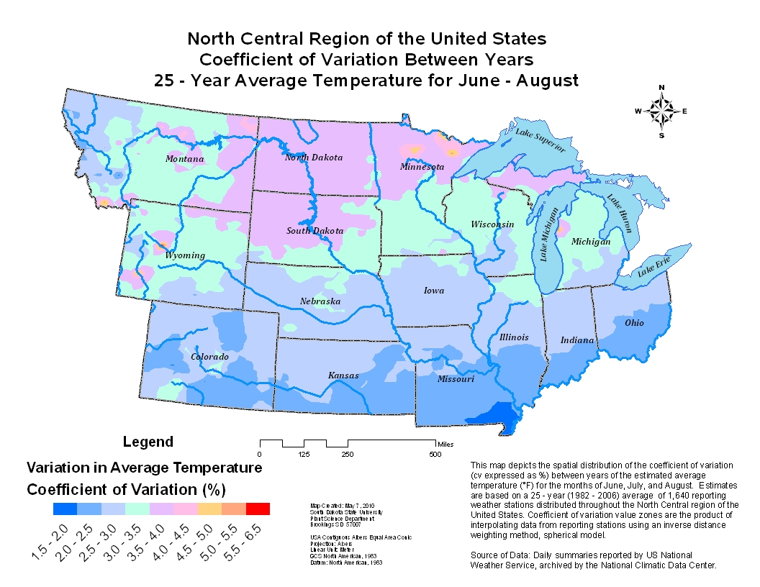

Slide 5
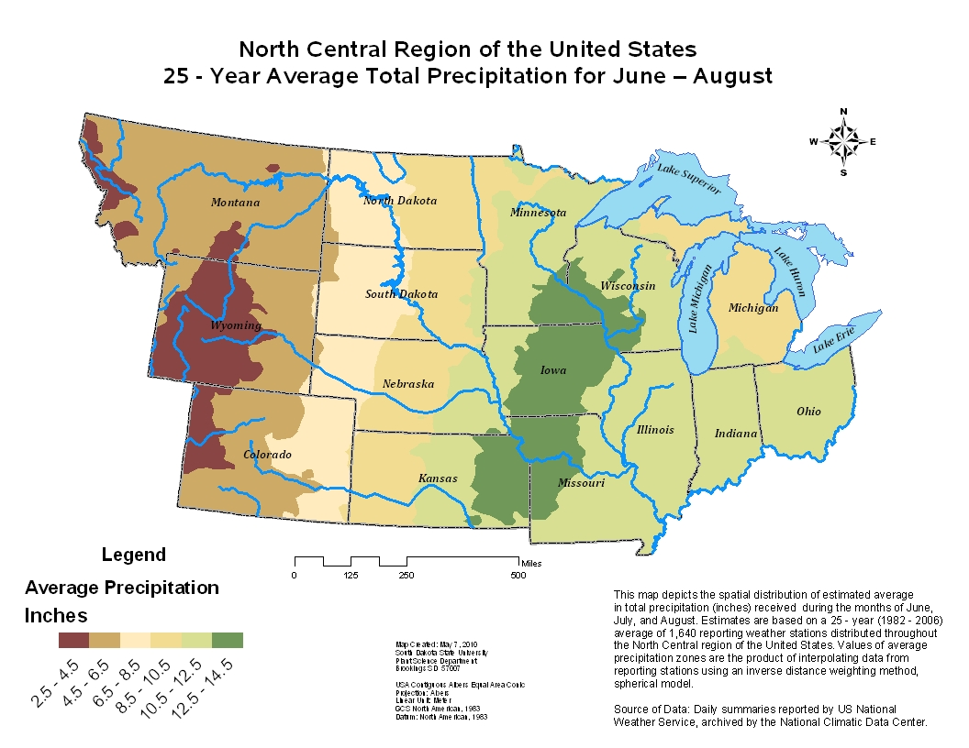

Slide 6
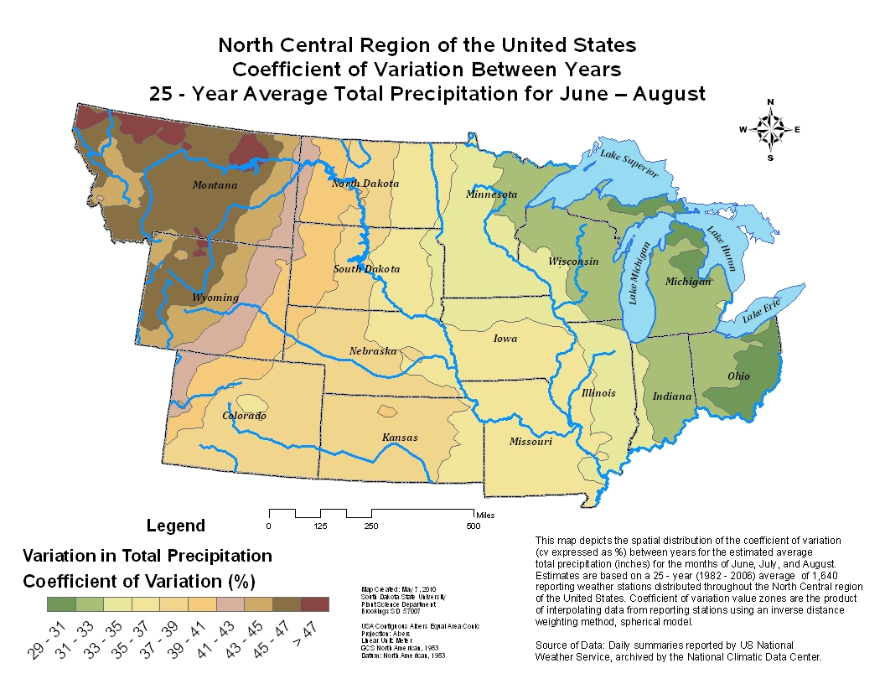

Slide 7
The northern Great Plains has some of the highest climate variability in the United States.
Develop a sustainable system that increases soil and crop resilience.
Cover crops, were estimated by NRCS to be implemented in over 140,000 acres in South Dakota last year.
In-season N rates based on remote sensing may be a tool that can be used to help manage this variability.

Slide 8
Changes in our cultural practices and soil quality. Is soil carbon increasing the need for sensors.

Slide 9
What has happened to soil carbon

Slide 11
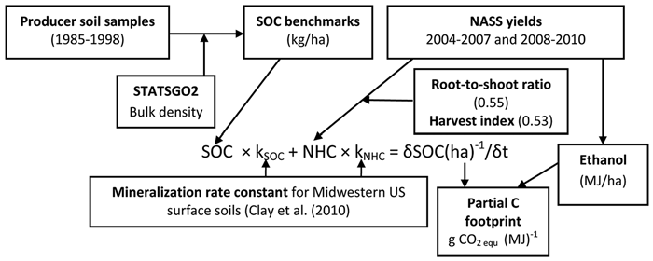
Carbon footprint (Corn)

Slide 12
Carbon footprints
Product | gCO2 equivalent
Hamburger (burger) | 3,600-6,100
Light bulb (4 hour day for 1 year) | 11,000
Nebraska (bu corn) (Liska et al.) | 7,640
North Dakota (bu corn) | 6,630
South Dakota | 5,840
Minnesota | 5,968
Gal of gasoline | 12,600

Slide 13
Carbon footprints (g CO2 eq/MJ) (Greet model)
SD Region | Footprint w/o soil | Soil (g CO2 eq/MJ) | Adjusted footprint
Gasoline |  |  | 95.86
NC | 39.61 | -23.6 | 16.4
C | 39.67 | -15.9 | 23.0
NE | 39.63 | -6.6 | 33.0
EC | 39.67 | -13.1 | 26.6
SE | 39.6 | -17.1 | 22.4
Relative to gasoline there is a 65 to 83% reduction in the footprint

Slide 14
Soil carbon
Changes in our soil carbon values may be producing changes in our fertility requirements,
Data from our soil testing laboratories can provide important information,
A good way to account for OM differences is to include organic matter content in the N recommendation.
Remote sensing-based recommendation may help account for differences as well.

Slide 15
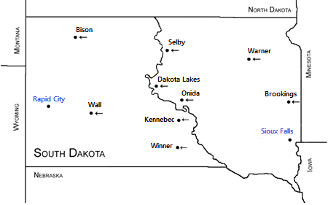
Sensor use in wheat grown in a semi-arid environment

Slide 16
N rate impact on yield and wheat quality
Research conducted in 2007 and 2008
5 N rates (0, 25%, 50%, 100%, and 150% of recommended rate,
2 water rates (adequate and deficit),
N and water budgets developed,
YLNS and YLWS determined using 13C isotopic discrimination,
Protein and dough stability measured.

Slide 17
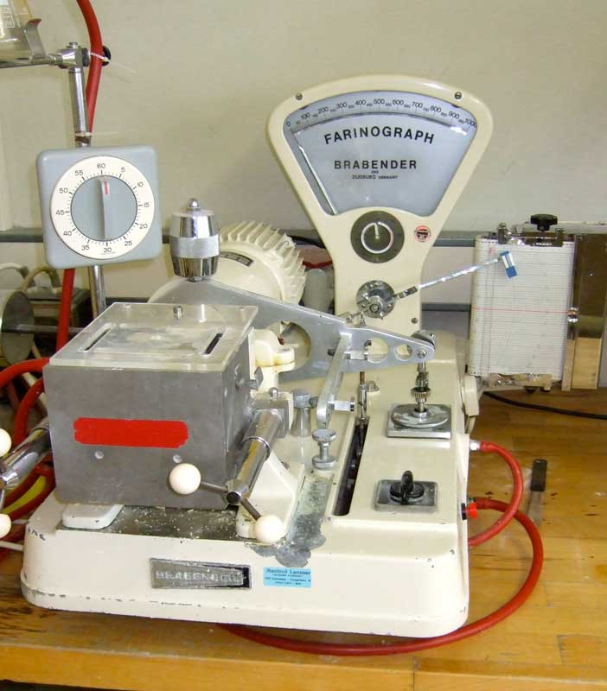
Farinograph

Slide 18
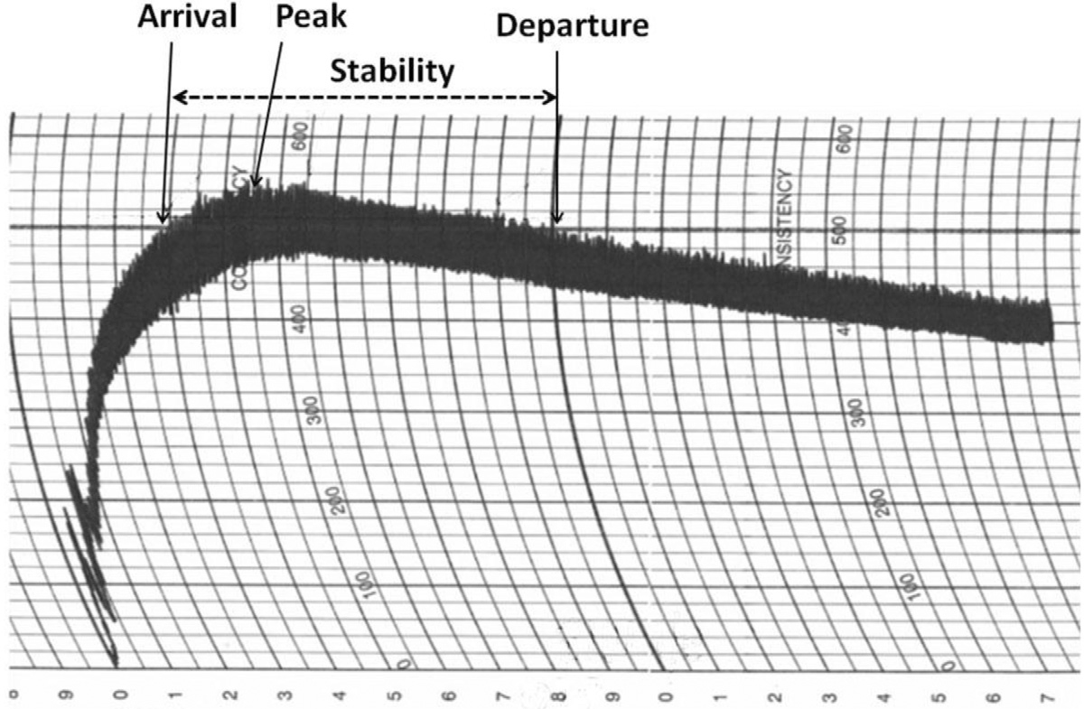

Slide 19
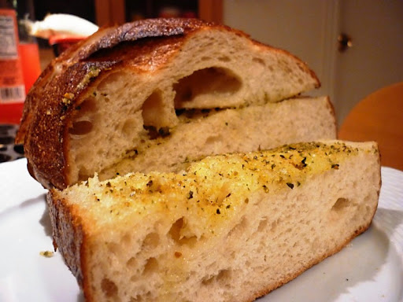
Poor quality bread

Slide 20
N rate influenced water use and N use efficiency (Dakota Lakes, Overly 2007)
N rate | Yield bu | WUE Bu/in | NUE % fert | Protein % | Stability min
0 | 55 | 8.52 |  | 12.4 | 5.2
¼ | 61.6 | 9.55 | 42 | 13.5 | 8.0
½ | 63.9 | 9.83 | 33 | 14.6 | 9.9
1 | 66.2 | 10.3 | 22 | 15.4 | 10.0
1.5 | 64.2 | 9.93 | 14 | 15.8 | 11.3

Slide 21
Yields
Treatment | 2007 (Mg/ha) | 2008 (mg/ha)
0 | 3.69 | 4.48
25% | 4.13 | 5.05
50% | 4.29 | 5.04
100% | 4.44 | 5.54
150% | 4.31 | 5.73
p | 0.001 | 0.001
LSD | 0.2 | 0.28
Water
Not | 4.52 | 5.32
Stressed | 3.82 | 5.02
p | 0.005 | 0.1

Slide 22
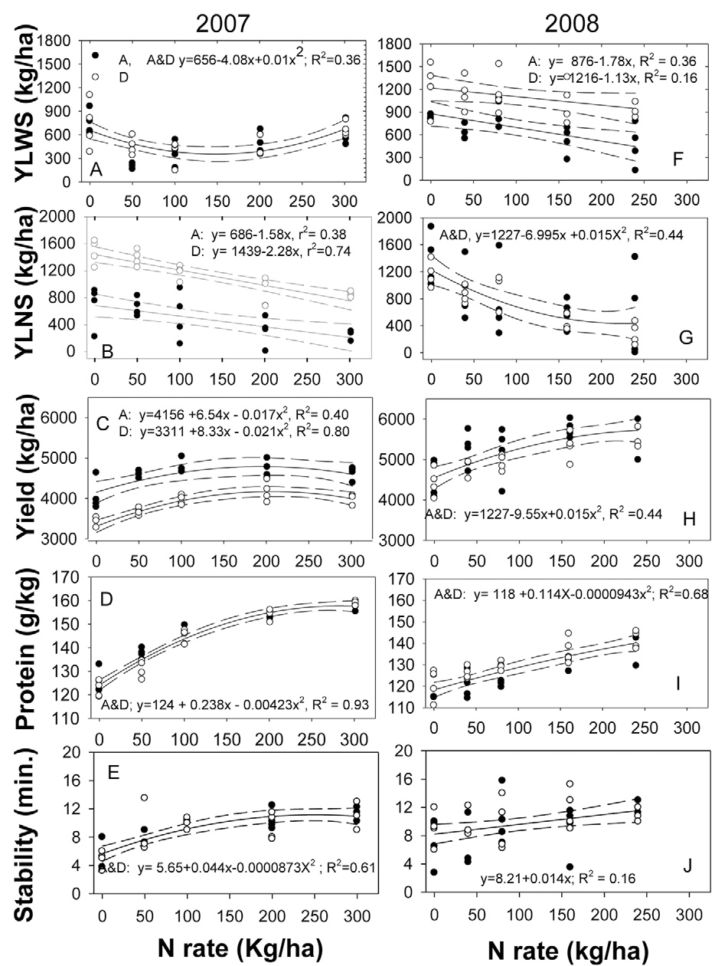

Slide 23
Protein vs fert + min N

Slide 24
We may see cultivar differences in dough quality

Slide 25
Reflectance calculations
NDVI = (NIR-red) / (NIR+red)
SI-NDVI_{wf} = NDVI / NDVI_{wf}
SI-NDVI_{mz} = NDVI / NDVI_{mz}

Slide 26
Stress impacts on reflectance
Treat | Blue | Green | Red | Red | nir | NDVI | SI-NDVI Wf | SI-NDVI MZ
0 | 3.24 | 5.68 | 4.62 | 9.95 | 36.3 | 0.81 | 0.91 | 0.94
0.25 | 3.01 | 5.35 | 4.20 | 9.43 | 38.7 | 0.85 | 0.96 | 0.98
0.5 | 2.96 | 5.25 | 4.08 | 9.28 | 40.3 | 0.86 | 0.97 | 0.99
1.0 | 2.95 | 5.19 | 4.03 | 9.16 | 40 | 0.87 | 0.97 | 1
1.5 | 2.92 | 5.06 | 3.91 | 8.9 | 41.3 | 0.87 | 0.97 | 1
P | 0.001 | 0.001 | 0.001 | 0.001 | 0.001 | 0.001 | 0.001 | 0.01
lsd | 0.16 | 0.23 | 0.26 | 0.40 | 1.87 | 0.01 | 0.01 | 0.02
Water
Not | 2.64 | 4.91 | 3.84 | 9.13 | 39.9 | 0.88 | 0.99 | 0.99
Stressed | 3.39 | 5.71 | 4.49 | 9.56 | 38.8 | 0.83 | 0.93 | 0.98
P | 0.001 | 0.001 | 0.001 | 0.03 | 0.09 | 0.002 | 0.002 | 0.36

Slide 29
Summary
Reference areas can be used to reduce variety and water stress impacts on sufficiency index values.
Reference areas can be placed in a strip or within different management zones.
Using a reference area in high yielding areas can result in diagnosing water stress as N stress.
In low yielding areas N stress can be diagnosed as water stress.

