Slide 1
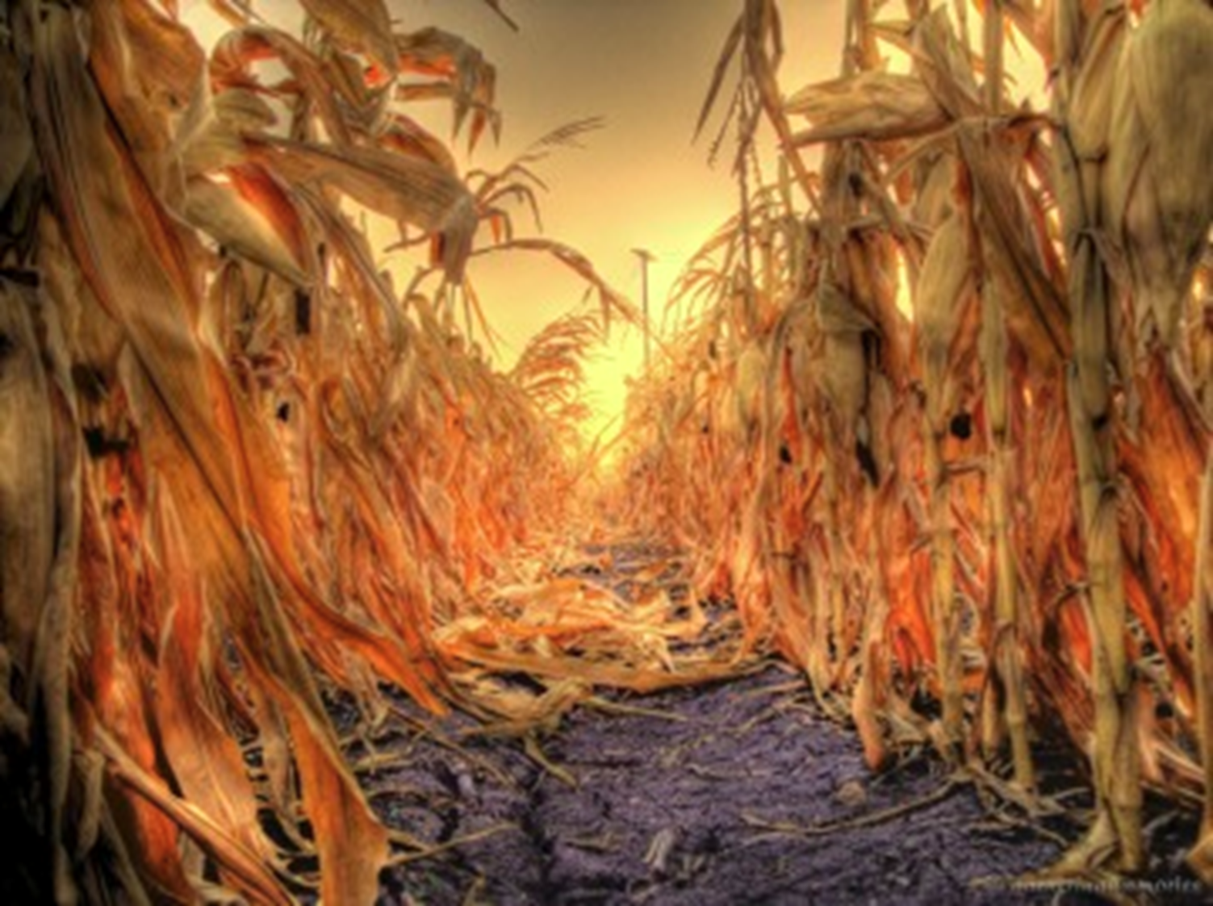
Crops and Crop Production in North Dakota
Joel Ransom

Slide 2
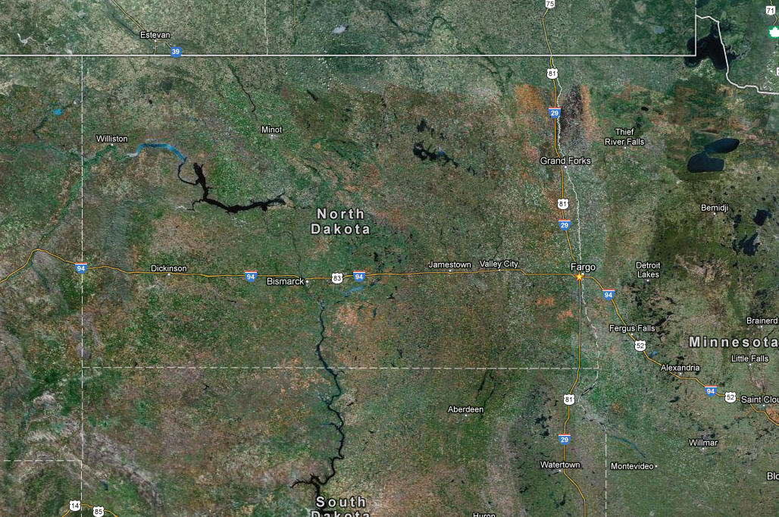
North Dakota Ag Overview ~90% of land mass is farmed

Slide 3
Basic agricultural statistics
Land in farms = 39,600,000 acres
Number of farms = 31,910
Average farm size = 1,241
Crop dominates livestock related agriculture in most counties
Few dairies remain in the state
Five ethanol plants consume ~40% of the corn produced in the state

Slide 4
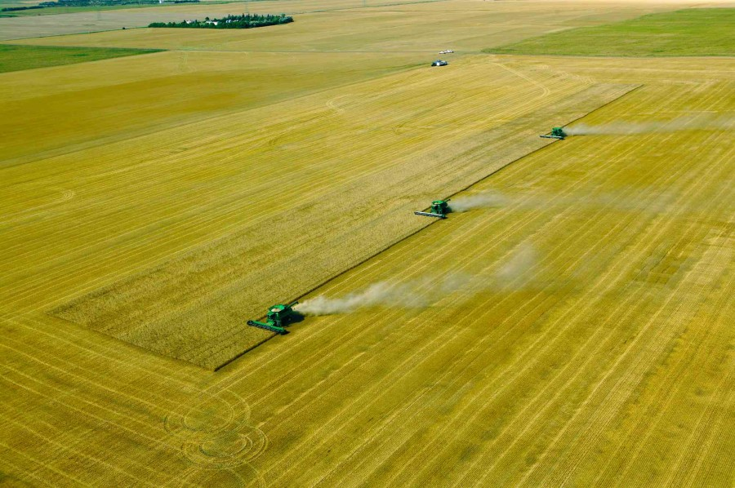
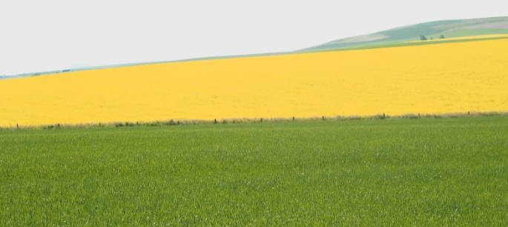
Major crops produced
Spring wheat = 5.5 million acres
Soybeans = 4.6 million acres
Corn = 3.4 million acres
Durum = 1.4 million acres
Canola = 1.3 million acres
Barley = 1.1 million acres
Winter wheat = 750,000 acres
Sunflowers = 740,000 acres
Dry edible beans = 660,000 acres
Flax = 260,000 acres
Peas = 250,000 acres
Sugar beets = 220,000 acres
Lentil = 180,000
Oats = 110,000 acres

Slide 5
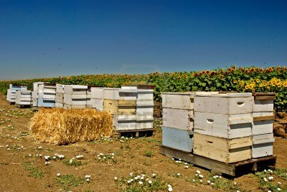
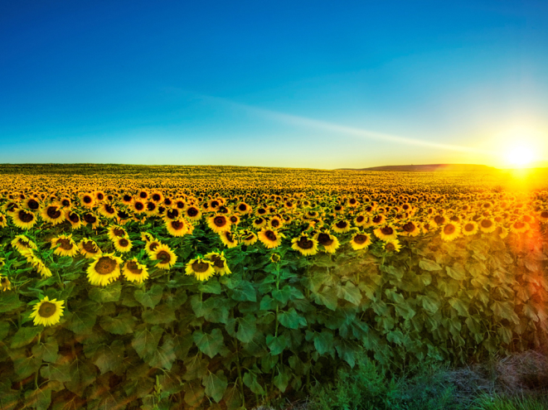
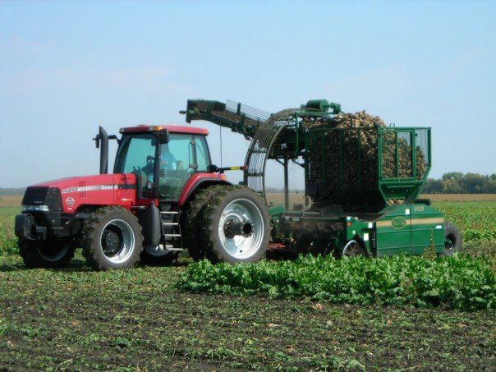
2011 rank
in the U.S. Commodity Percent of Nation’s production
1 Beans, dry edible, all 25%
1 Beans, navy 35%
1 Beans, pinto 46%
1 Canola 83%
1 Flaxseed 87%
1 Honey 22%
1 Sunflower, oil 40%
1 Wheat, Durum 36%
1 Wheat, spring 37%
2 Sunflower, all 38%
2 Sunflower, non-oil 24%
2 Wheat, all 10%
3 Barley 11%
3 Lentils 17%
3 Oats 8%
3 Peas, dry edible 21%
3 Sugarbeets 16%
4 Safflower 1%
6 Hay, alfalfa 6%
6 Potatoes 5%
9 Hay, all 4%
10 Soybeans 4%
12 Corn for grain 2%
17 Hay, other 2%
26 Wheat, winter 1%

Slide 6
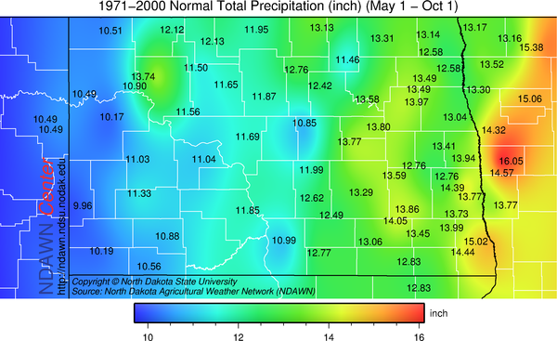

Slide 7
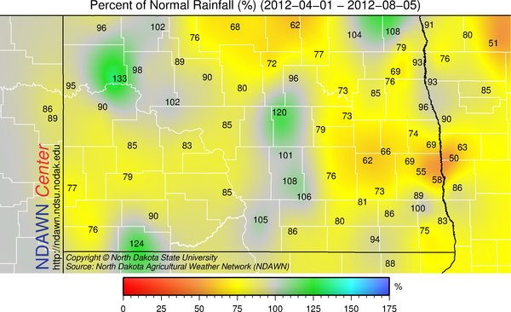

Slide 8
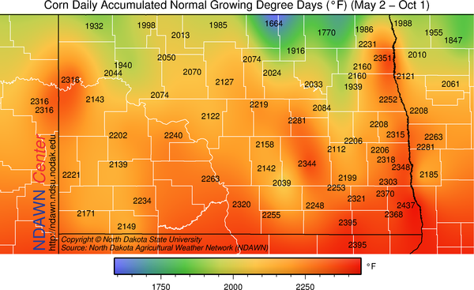

Slide 9
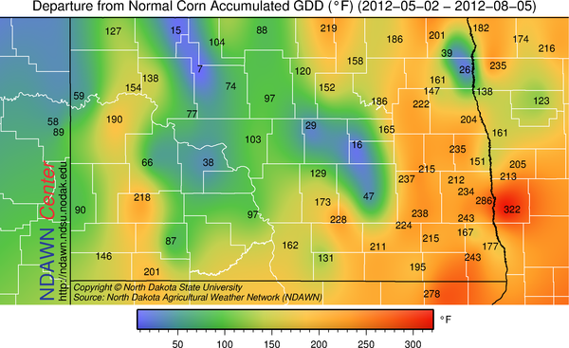

Slide 11
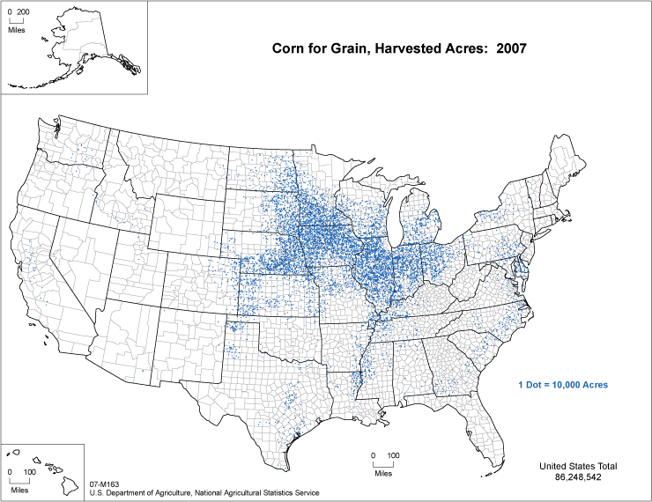

Slide 12
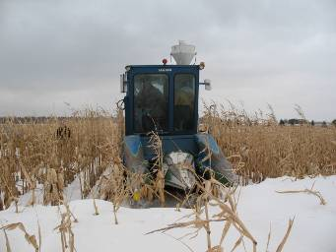
Challenges of growing corn in ND
Drought – corn is a high water user
Short growing season
Getting corn dry enough to bin in the fall without drying is difficult because of low temperatures after maturity

Slide 13
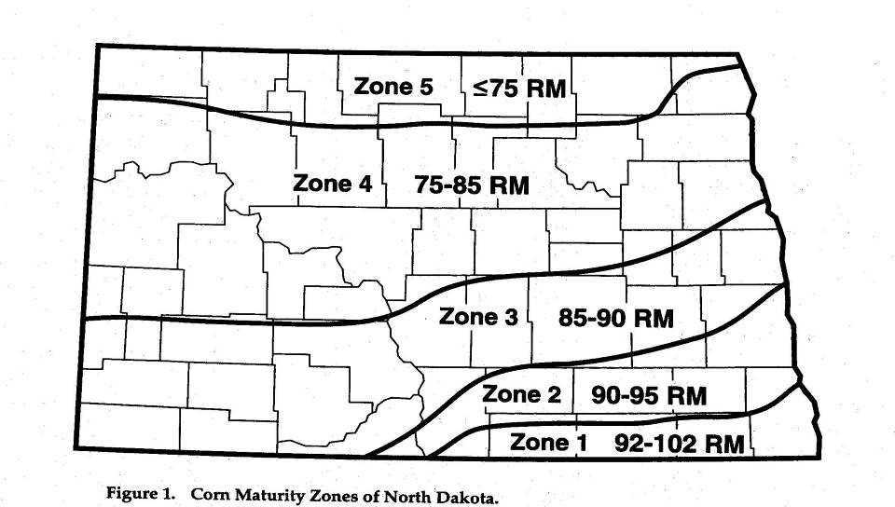
Relative Maturity Recommendations for North Dakota.

Slide 14
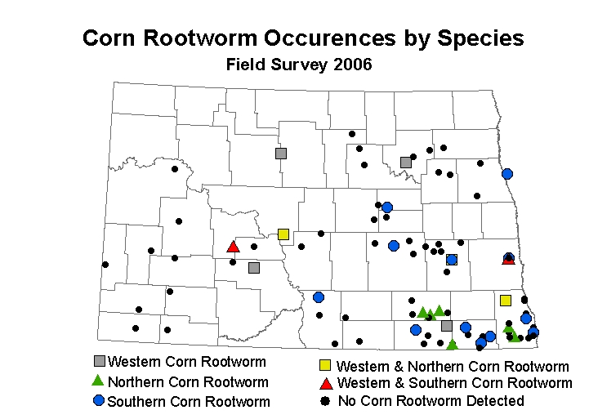
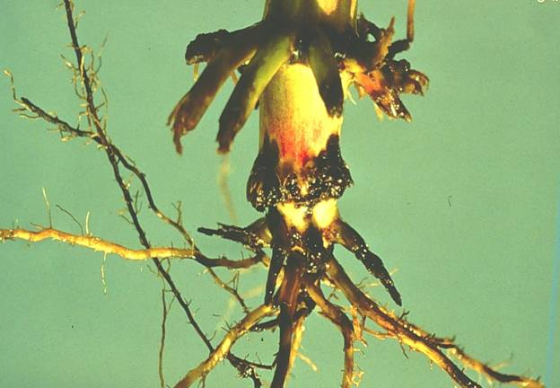

Slide 15
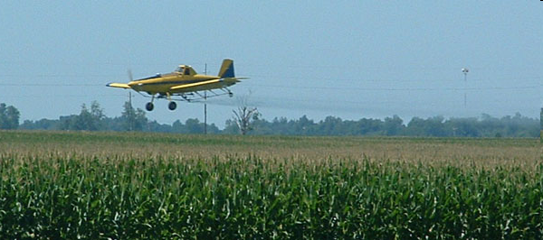
Does Using Fungicides on Corn in the Northern Plains Pay?

Slide 17
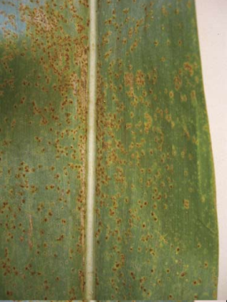
Disease response to fungicides, Prosper & Carrington, 2008.
 | Disease Severity (%)
Treatment | Prosper | Carrington
Untreated | 3.9 | 3.5
Headline | 2.5 | 1.6

Slide 18
Plant on or before 1 May
Effect of planting date on yield, moisture and test wt, Carrington, ND, 2003

Slide 19
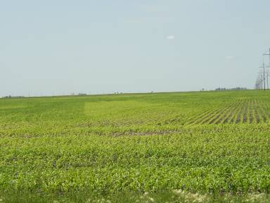
N fertilization strategies
Minimize fall applications due to potential losses
Rate = 1.0 to 1.2 x yield goal
Apply bulk pre-plant or at planting
Splits should be applied before tasseling
Highest N demand V12 to VT

Slide 20
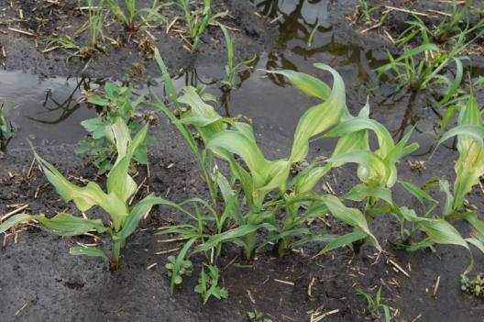
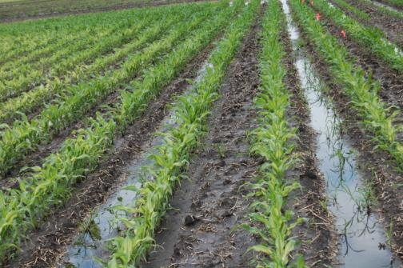
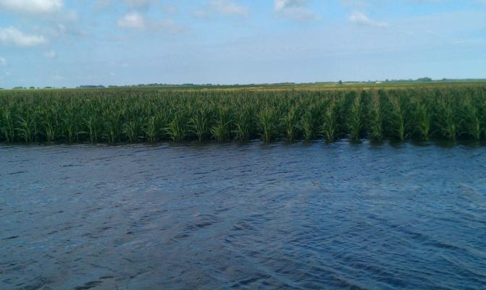
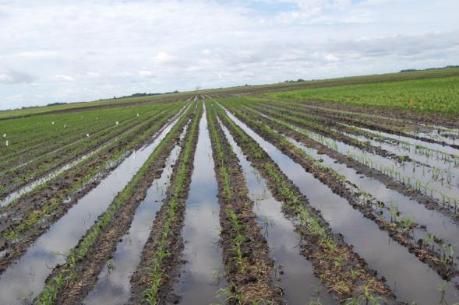

Slide 21
Effect of tile drainage and additive at the 112 N rate on yield of corn, NW22, 2011.

Slide 22
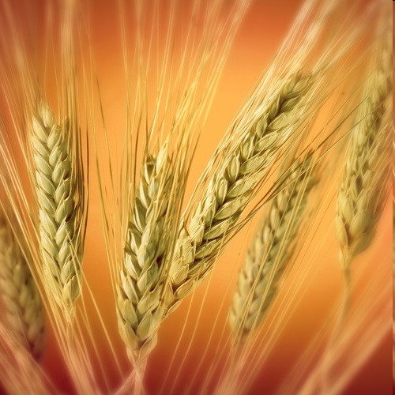
Production issues in wheat

Slide 23
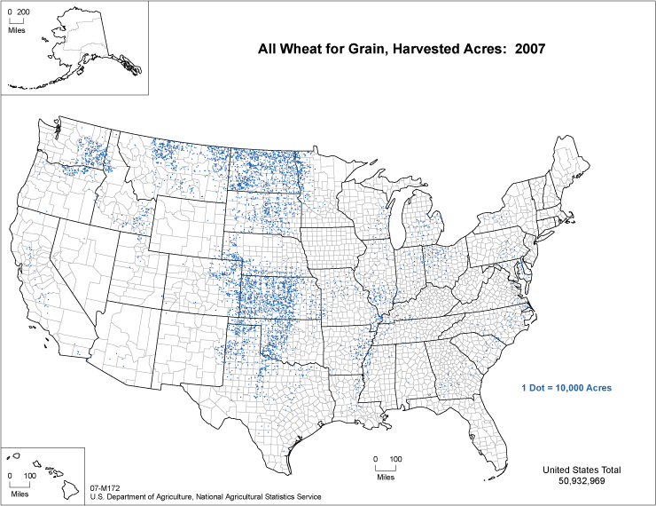

Slide 25
Northwest MN Planting Rate Studies Affect of Seeding Rate on HRS Yield. Seven Variety Average Wiersma. 1996-1998. Crookston, MInnesota
Optimum plants = also about 35 per sq. ft

Slide 26
Relationship between protein and yield
Northern locations 2009 - 2011: 20 environments

Slide 27
General recommendations with application of Post-anthesis Nitrogen
After flowering is completed through watery-ripe seed stage (main stem head)
30 lbs N/acre (10 gal UAN) provides an average increase of one-half percentage point of protein
Potential for significant leaf burning using UAN
dilute with water (e.g. 50:50)
apply evenings, early mornings, or cloudy days
Similar response among cultivars
No statistically-significant differences with response for grain yield, test weight and seed size

Slide 28
Protein increase with post anthesis UAN application (30 lb/acre N)

Slide 29
Effect of N treatment on Yield, Crookston

Slide 30
Effect of N treatment on protein average of varieties

Slide 31
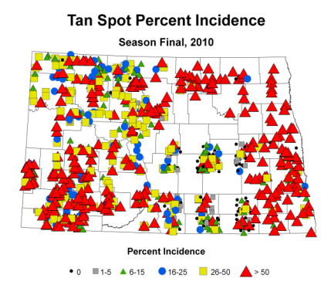
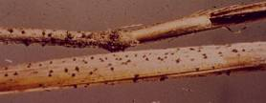
Tan spot the most common disease
Early season
tan spot
Overwintering Fruiting Bodies on Wheat Straw

Slide 32
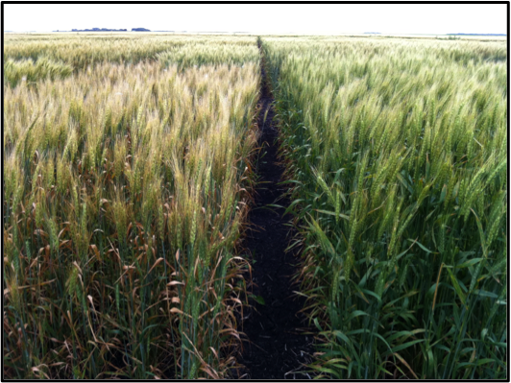
Bacterial Leaf Streak
No control options, but there are differences among variety responses
Good data in 2011, 1st complete set of ratings presented
Notes:
32

Slide 33
Crop Sequence Effects in Phase II Experiment
Units are percent
increase or decrease
in seed yield of
expected crop
caused by preceding
residue crop.
Residue (left side) and expected (top) crops are listed in order of increasing average water use.

Slide 34
Crop Sequence Effects in Phase III Experiment
Units are percent
increase or decrease
in seed yield of
expected crop
caused by preceding
residue crop.
Residue (left side) and expected (top) crops are listed in order of increasing
average water use.

Slide 35
Conclusions
ND is a key agricultural state
Land is mostly devoted to agriculture
Cropping is more important than animal production
ND leads in production of many commodities
Diversity of crops provides interesting challenges and opportunities
Short growing season and uncertainly of rainfall (western) are the main constraints

