Slide 1


2012 Optical Sensing Nitrogen Management Group
August 6-8 - Fargo, North Dakota

Slide 2

Results Using Optical Sensors in South Brazil
Agronomist Engineer, Dr. Fabrício Povh
Fundação ABC – Castro – Brazil

Slide 3
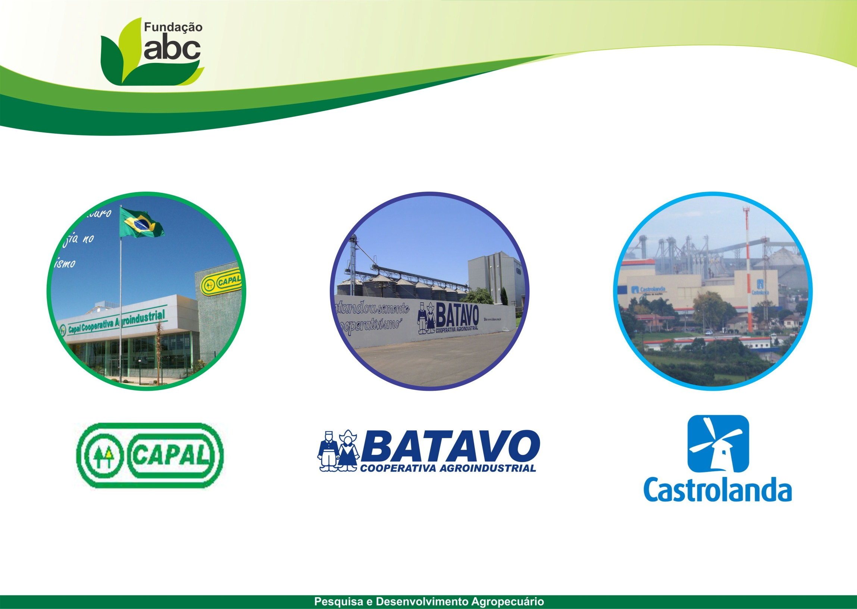
Three Dutch Cooperatives
ABC Foundation was created in October 23, 1984.
985 associates Arapoti - PR
601 associates
Carambeí - PR
718 associates
Castro - PR

Slide 4
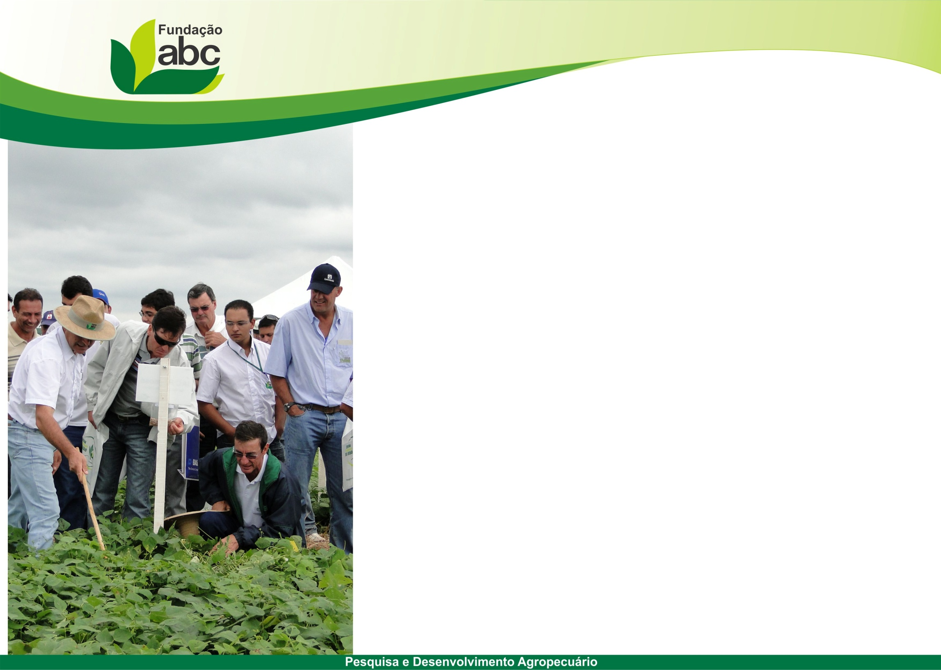


Recently more two Cooperatives
Coopagricola
Ponta Grossa – PR
Holambra
Paranapanema – SP

Slide 5
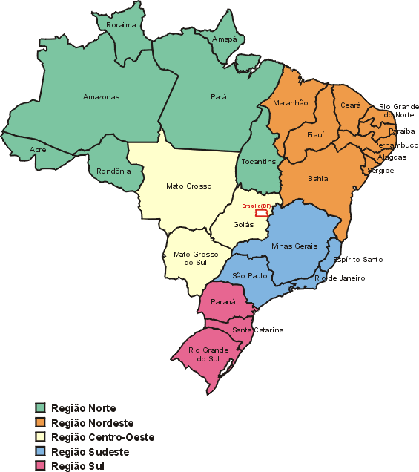

Slide 6
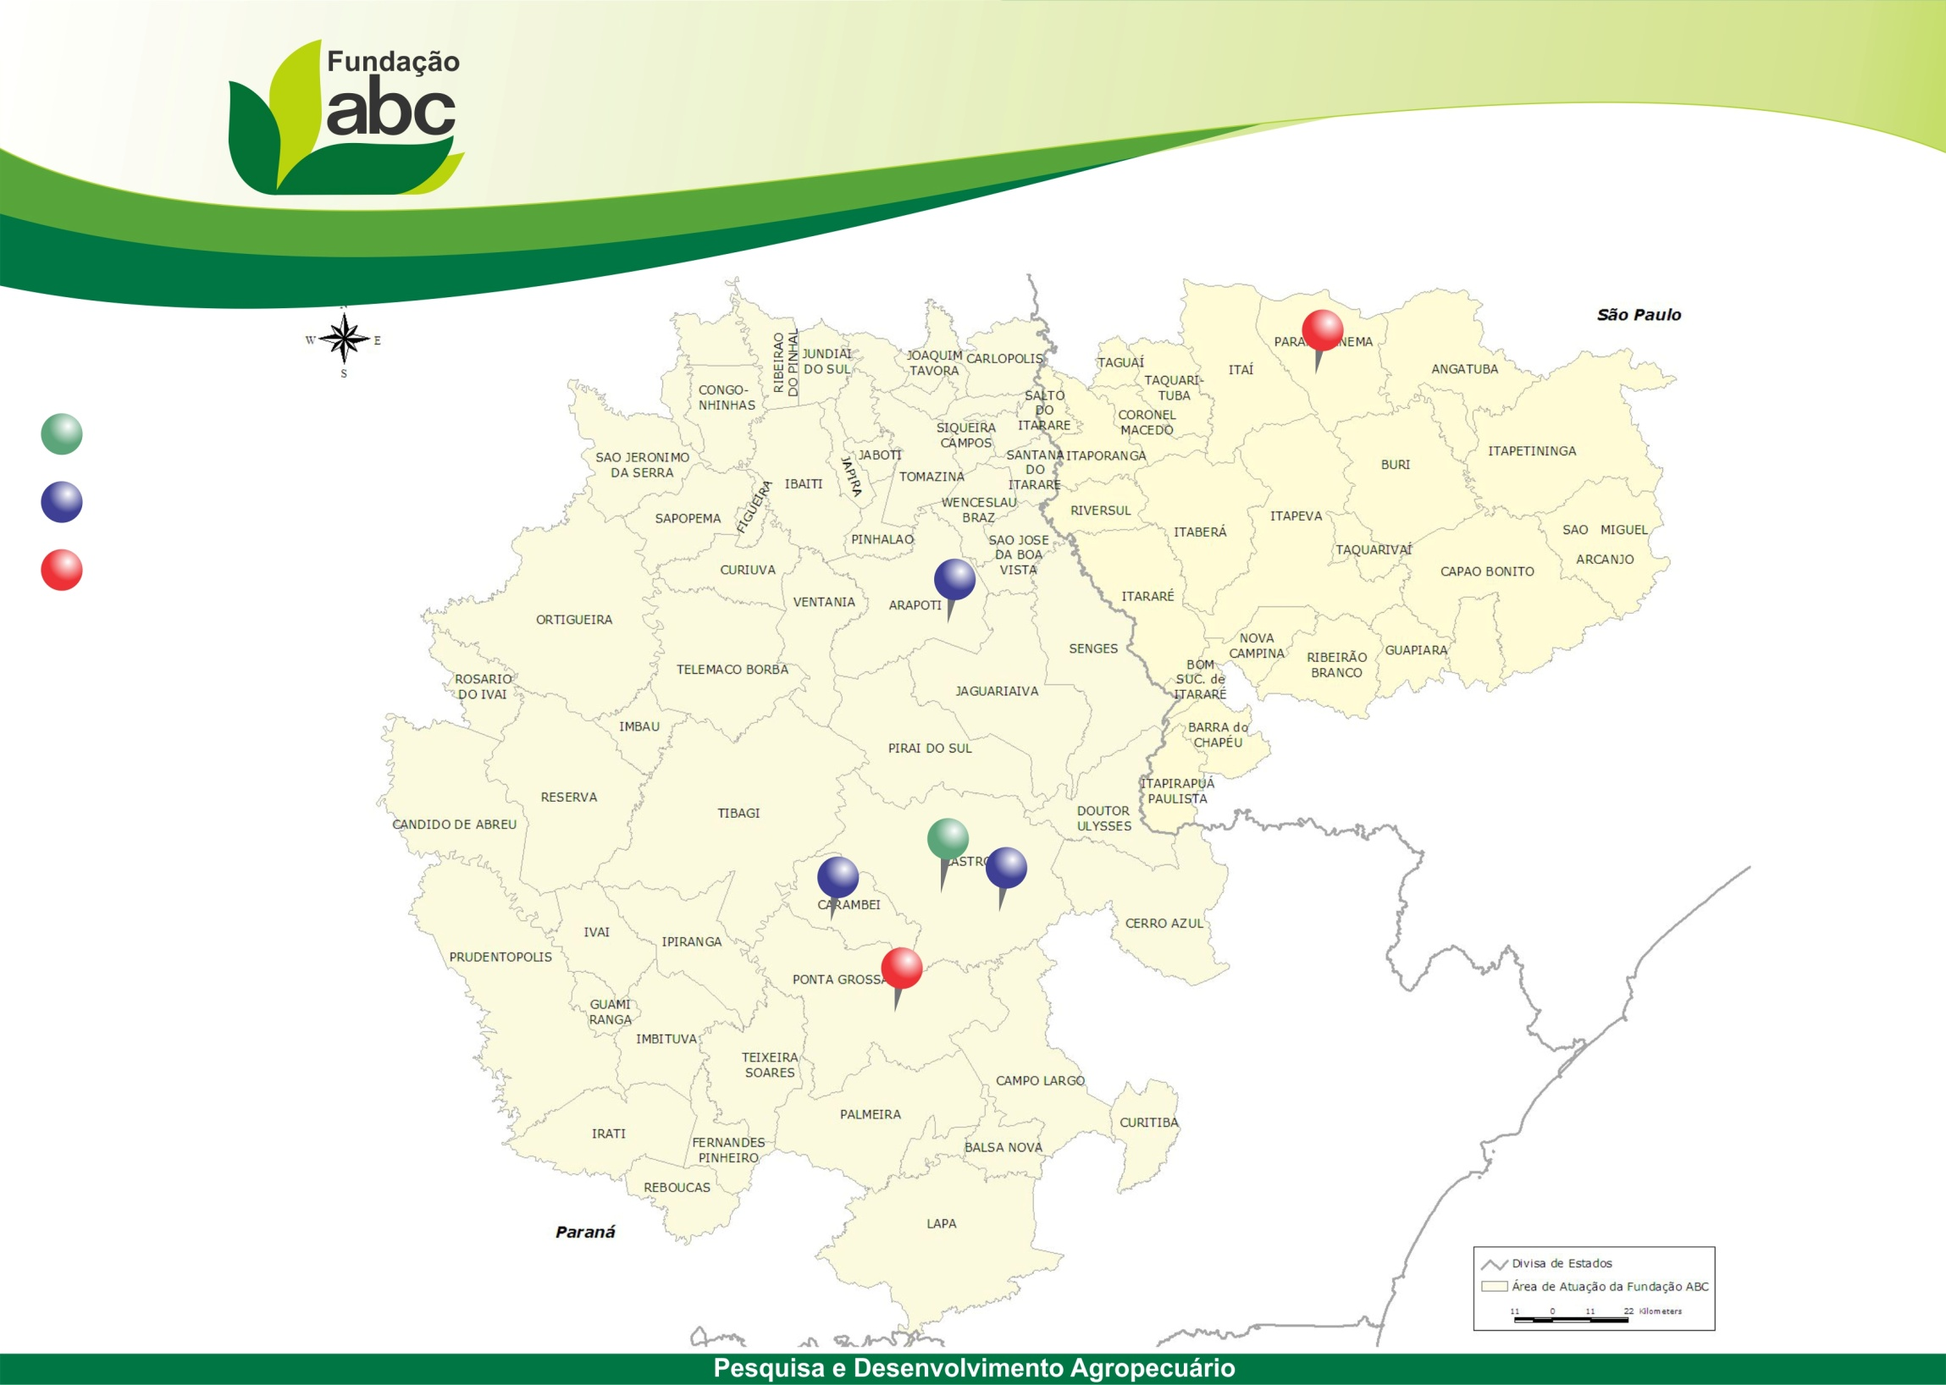
Área de atuação
Fundação ABC
Holambra
Main
Capal
Partners
Fundação ABC
Castrolanda
Batavo
Coopagrícola
67 municipals
360,000 hectares
1 million liters of milk/day

Slide 7
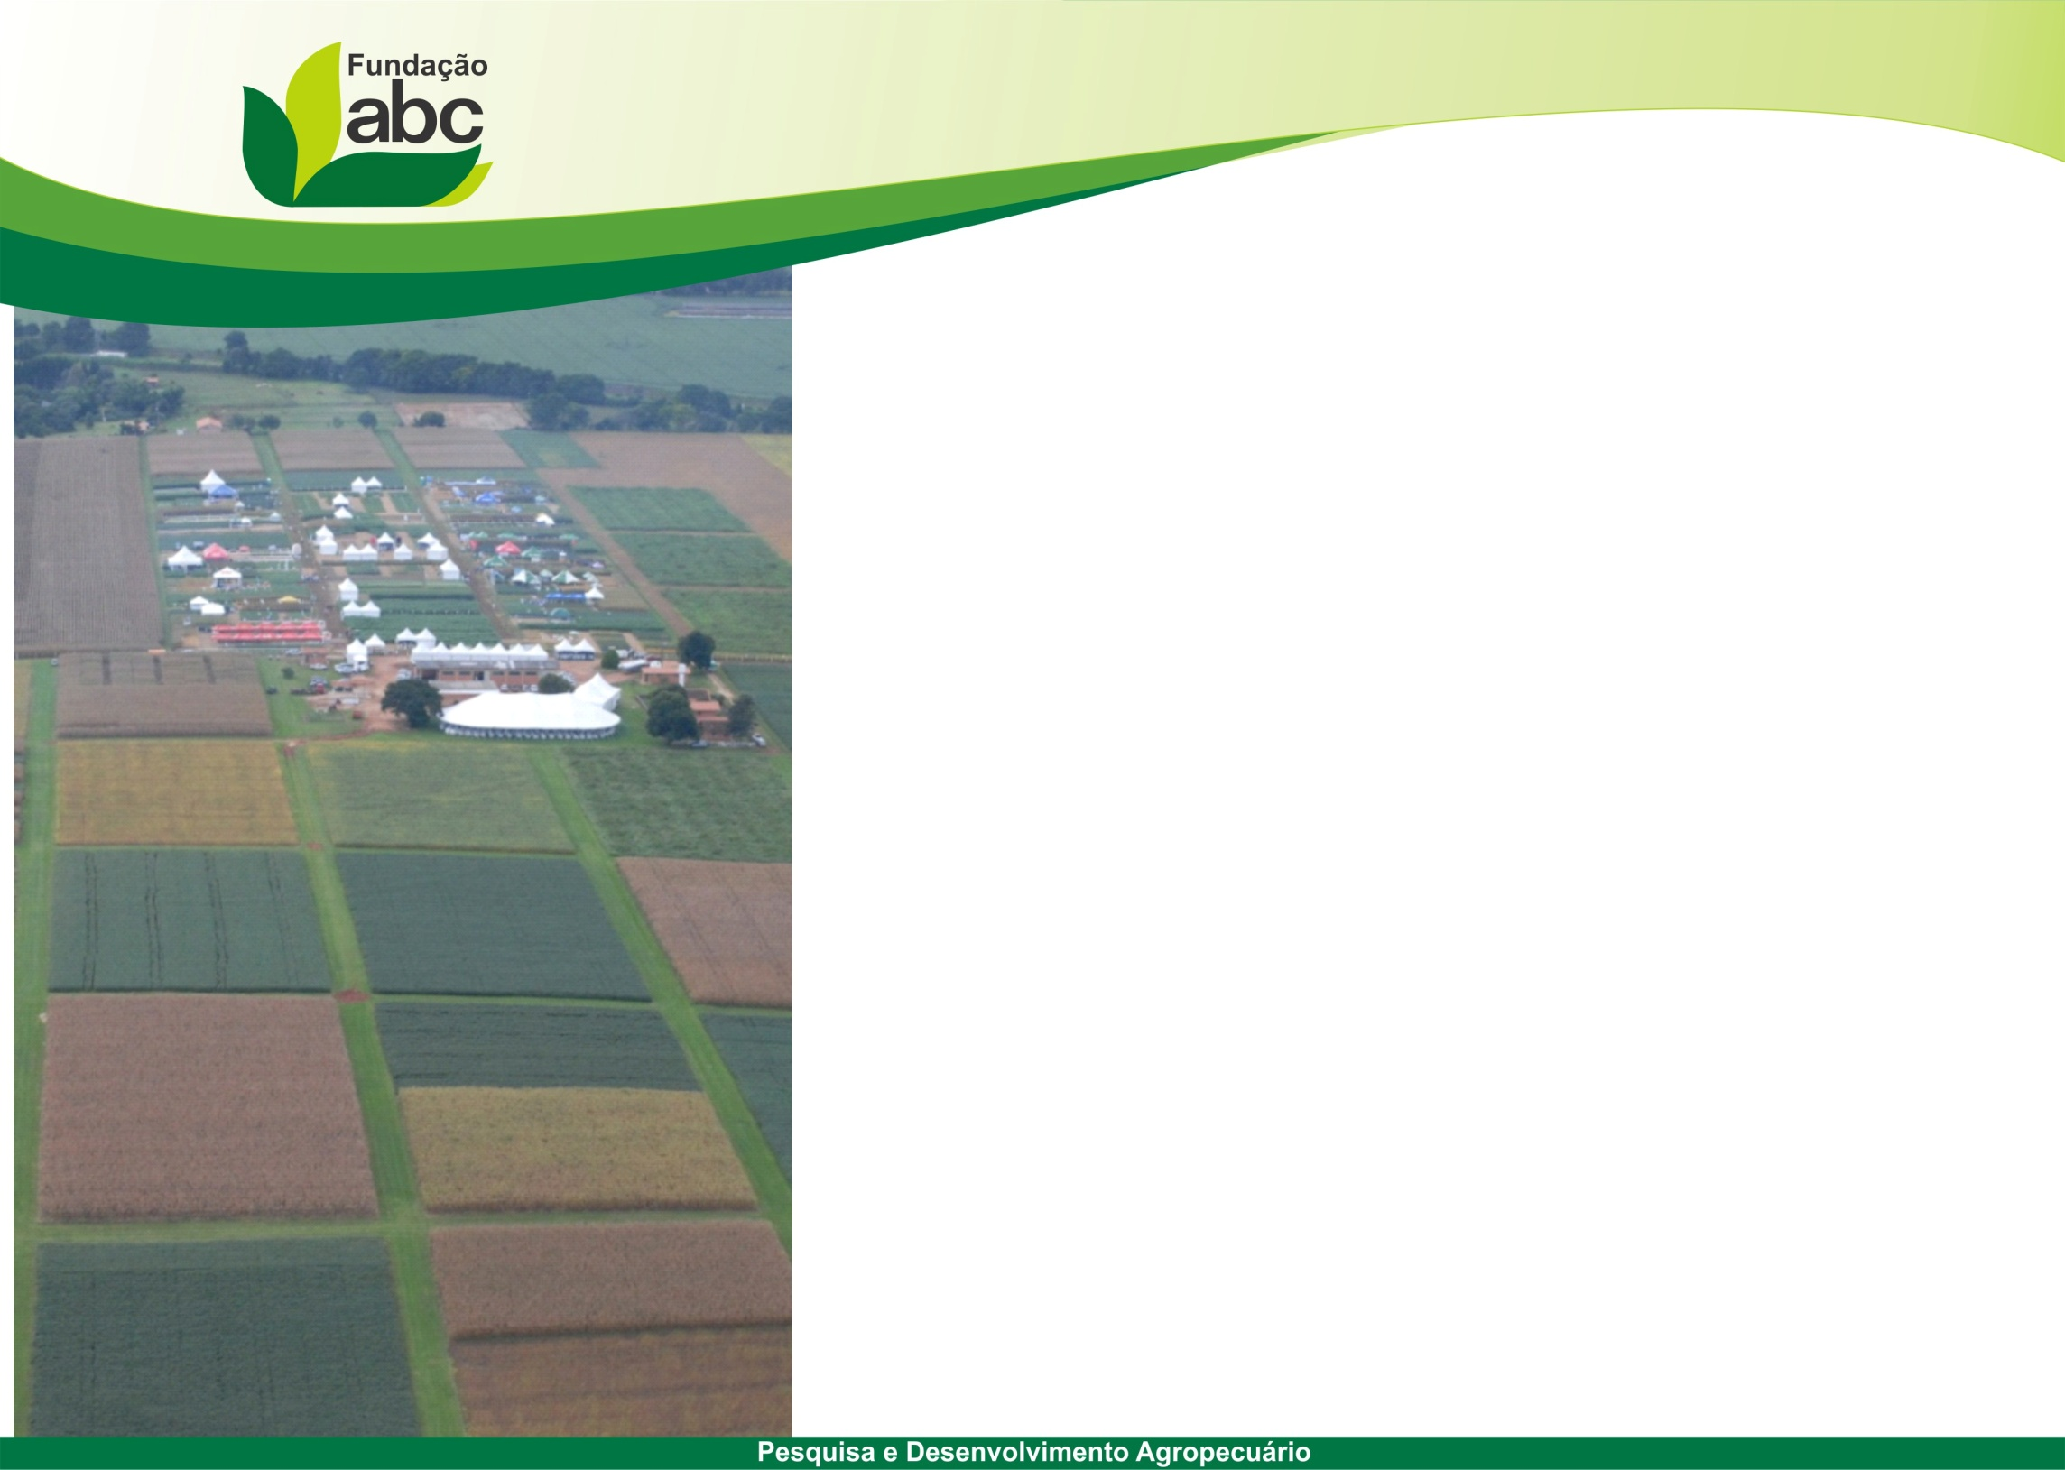
Experimental Fields
Ponta Grossa – 74.88 ha
Castro – 139.40 ha
Tibagi – 21.37 ha
Arapoti – 25.92 ha
Itaberá – 51.64 ha
Total: 313 hectares
- For each 8 hectares from farmers, the
ABC Foundation has 1 plot
- 45,000 plots / year (Summer/Winter)

Slide 8
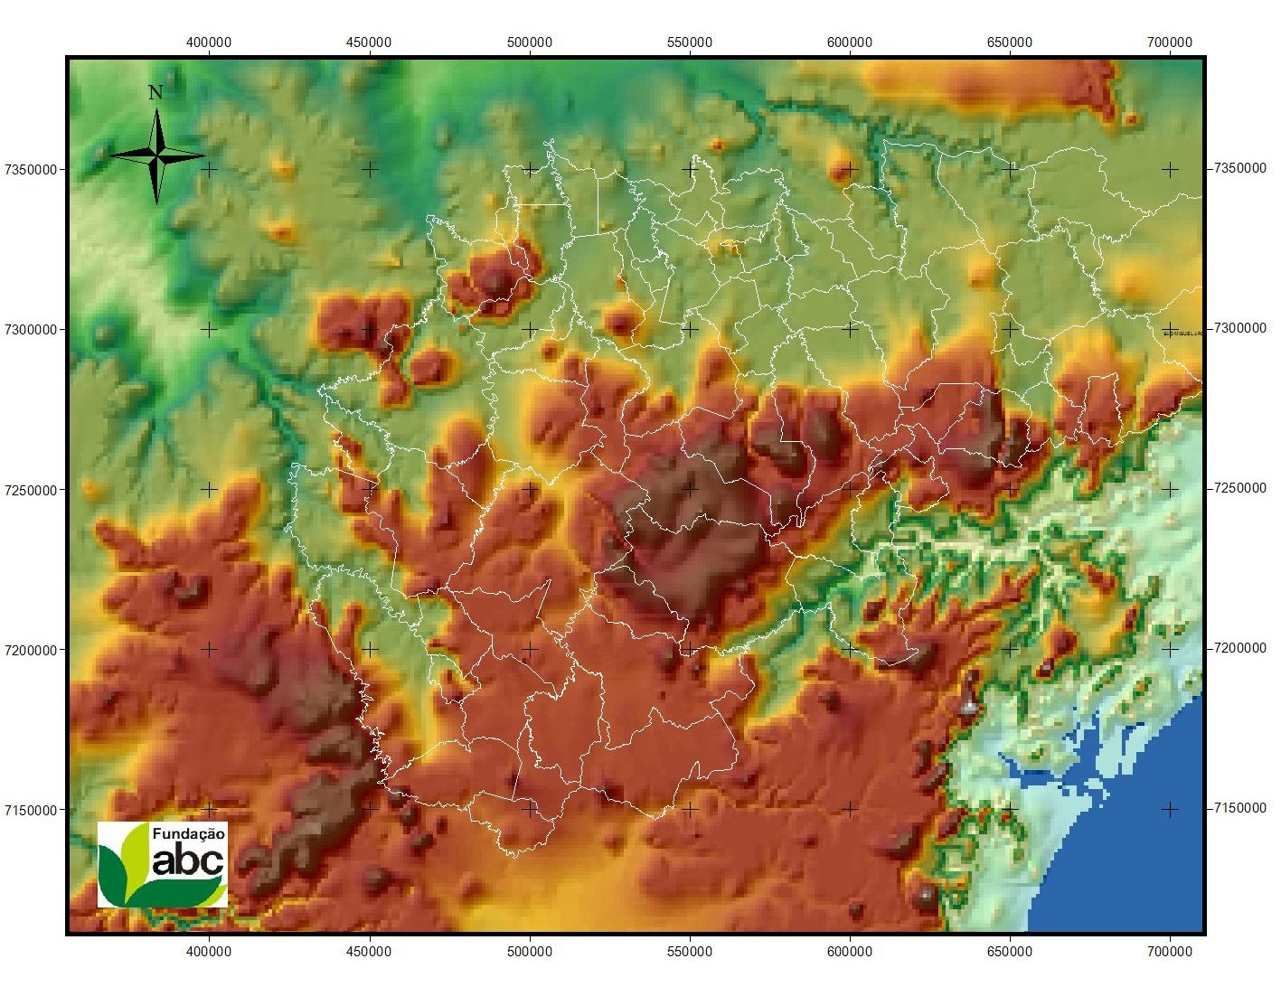
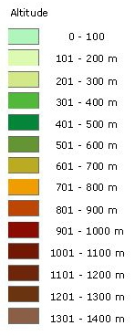
experimental fields

Slide 9
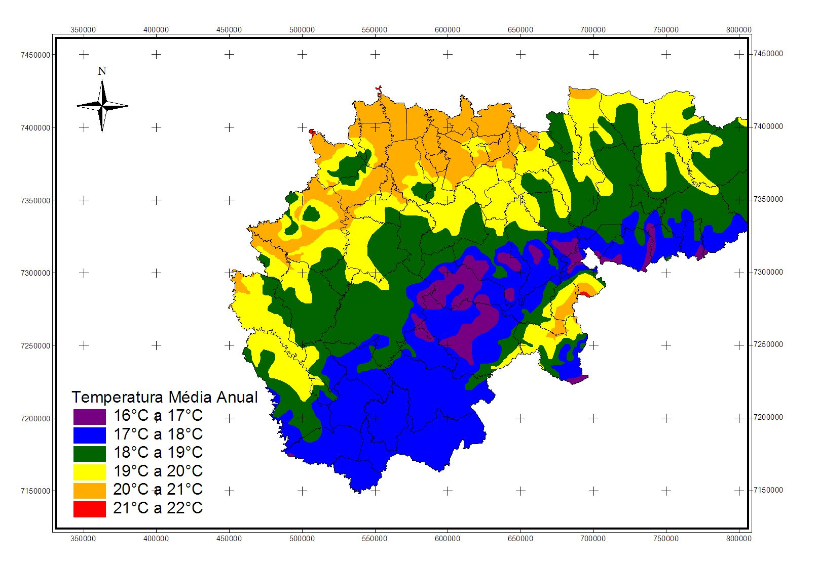
Annual average temperature

Slide 10
Crops in ABC group
Summer: Soybeans, Corn (grain and silage), Beans
Winter: Wheat, Oats (black and white), Rye Grass, Canola, Barley

Slide 11
Sensors in Brazil
  GreenSeeker – Trimble – Santiago&Cintra;
  N-sensor – Yara – Stara;
  OptRX – AgLeader – Jacto;
  Topcon – Massey Ferguson (AGCO Group).

Slide 12
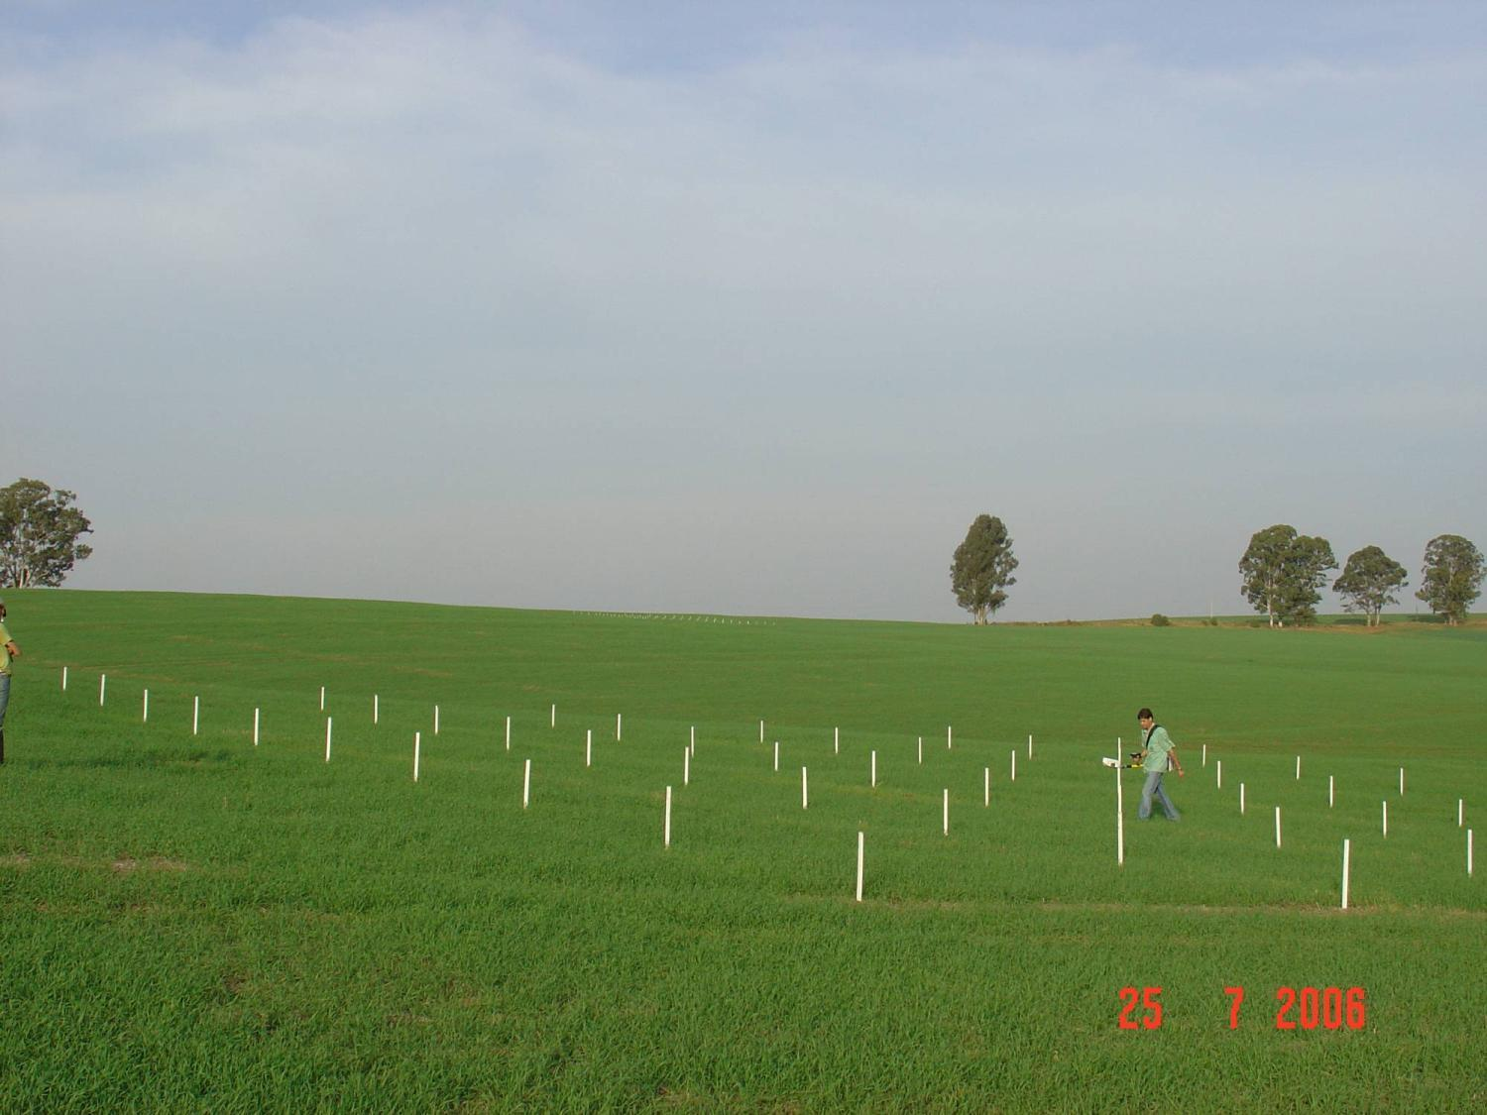

First Experiment (Nitrogen Rates in Wheat)

Slide 13
Feekes 10
N Rates
Inceptisol
Oxisol

Slide 14
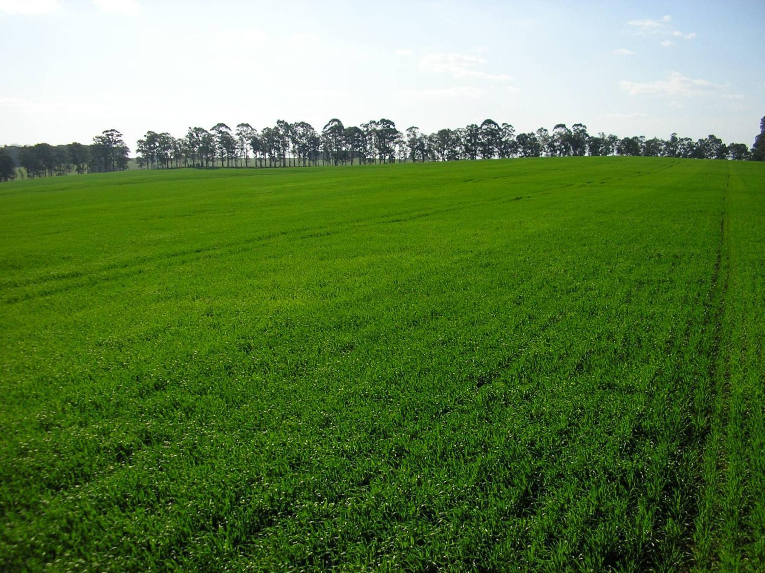

Slide 15
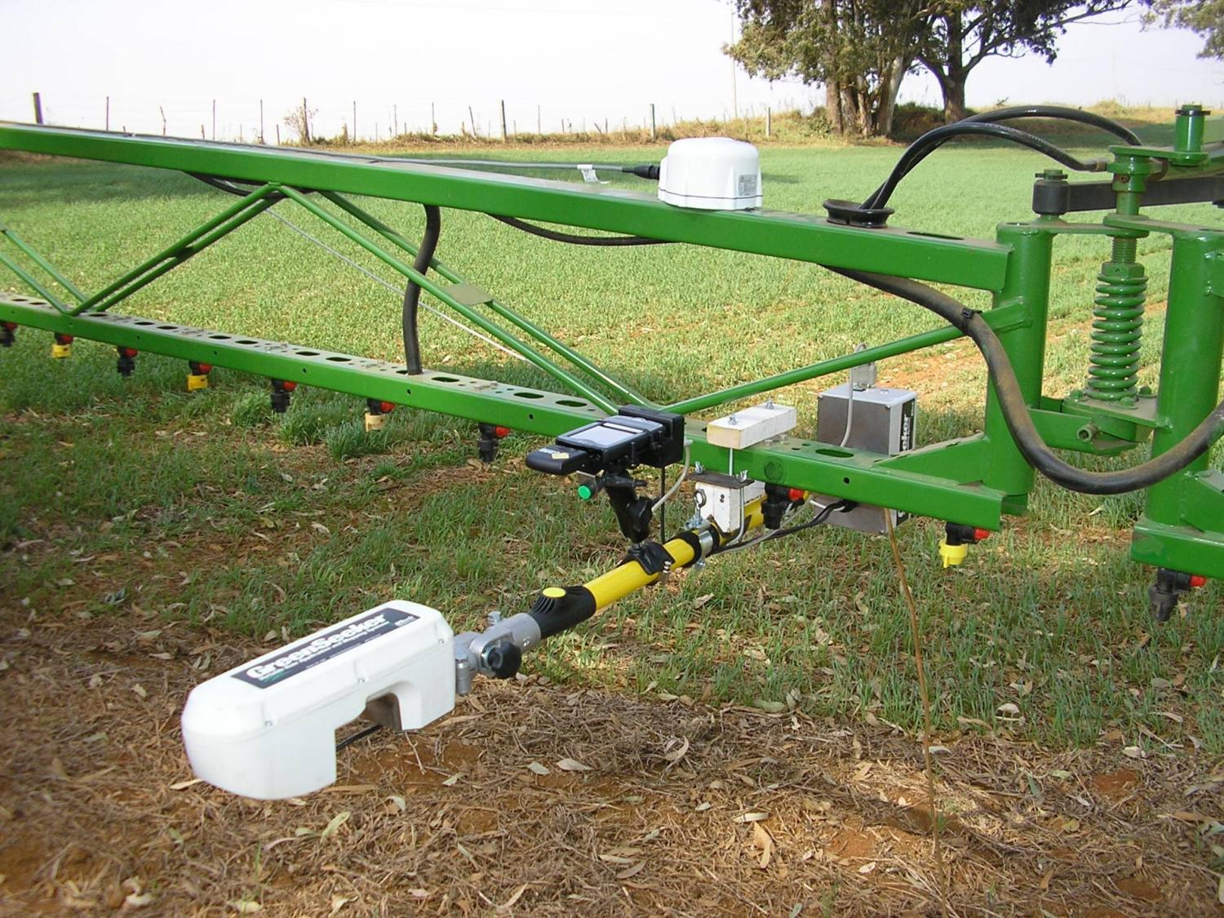

Slide 16
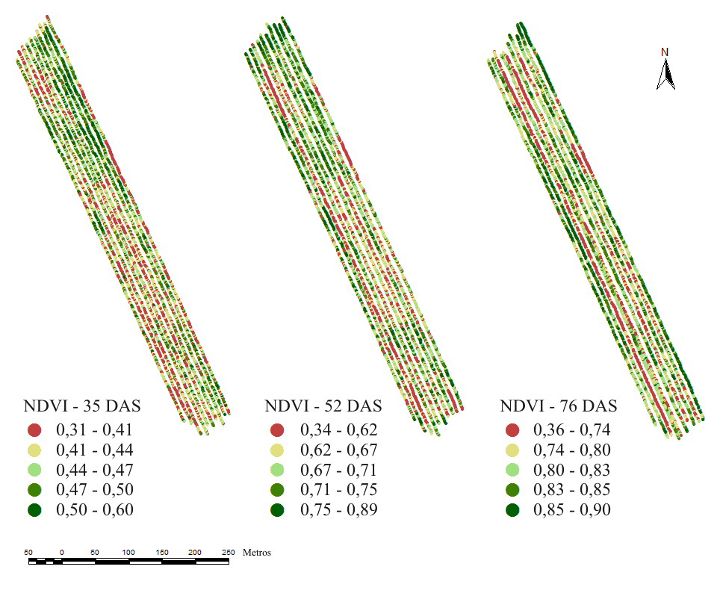
70 – 120 – 25 – 70 – 0 – 120 – 25 – 70 – 25 – 120
Nitrogen Rates

Slide 17
Wheat (2007)
Tibagi – PR – Brazil
Treatments | N (sowing) | N (pre-plant) | N (Feekes 3) | N (Feekes 10) | N (Total)
1 | 18 | 0 | 0 | Sensor | 18
2 | 18 | 34 | 0 | Sensor | 52
3 | 18 | 0 | 102 | 0 | 120
4 | 18 | 34 | 68 | 0 | 120

Slide 18
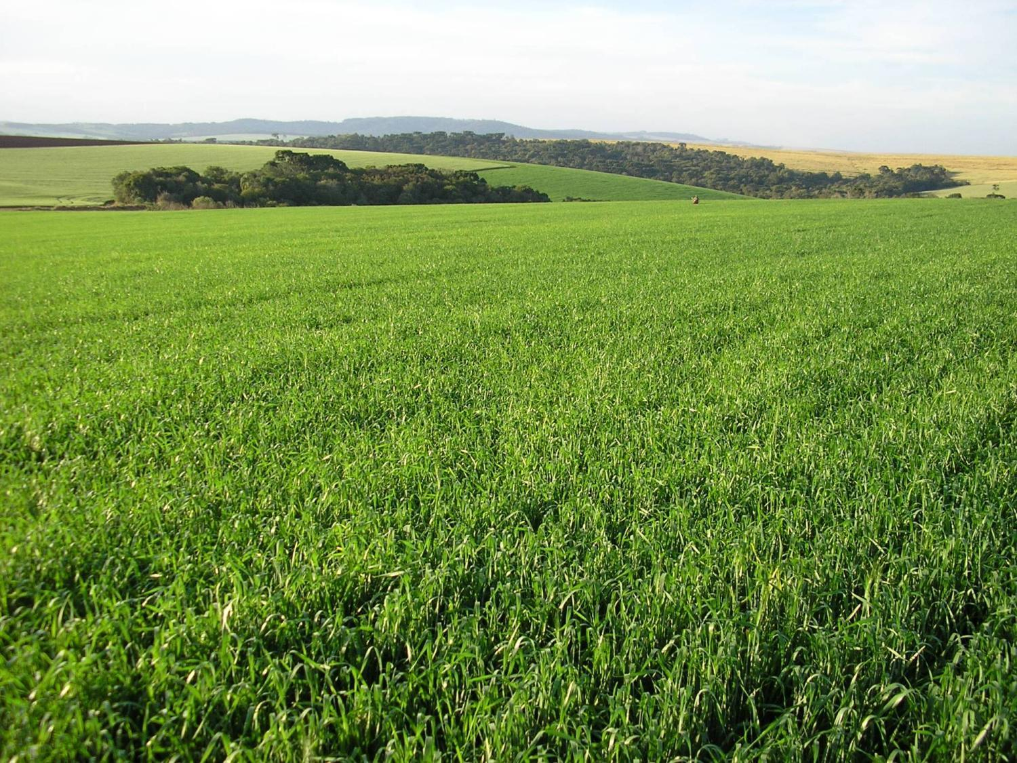

Slide 19
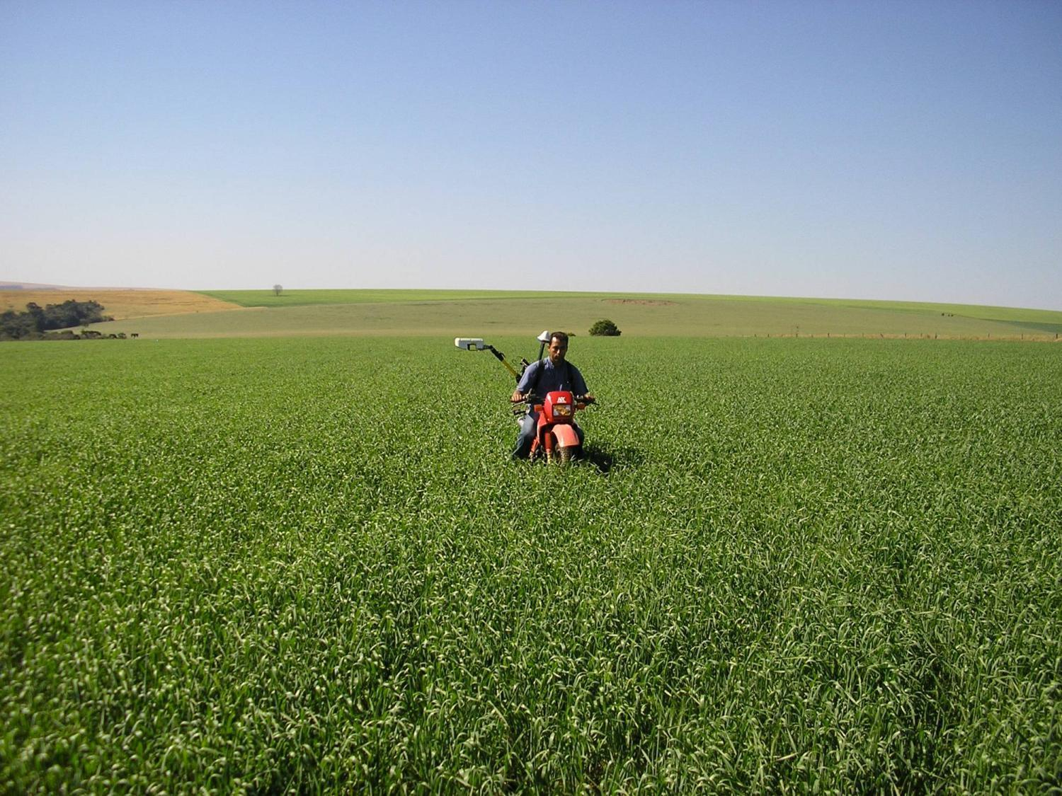

Slide 20
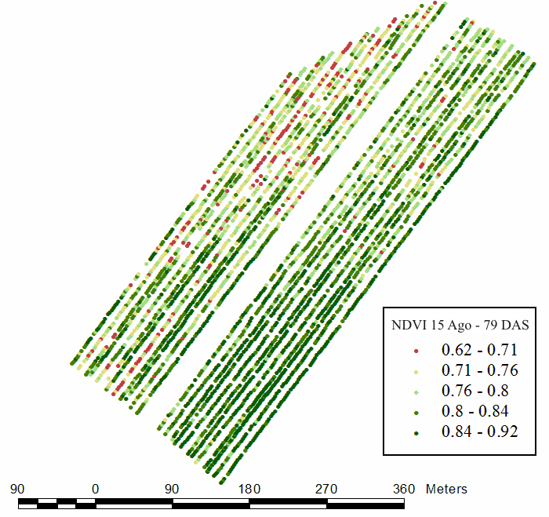

Slide 21
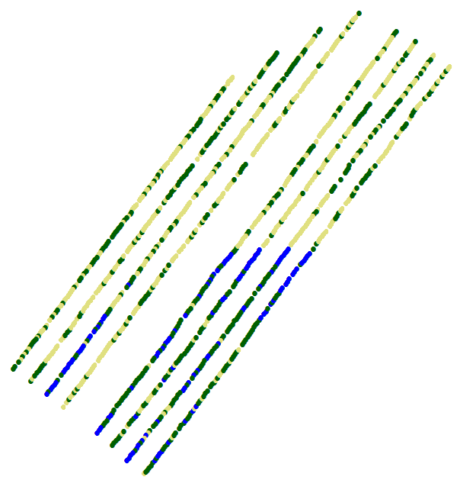
20 kg N/ha
40 kg N/ha
60 kg N/ha

Slide 22
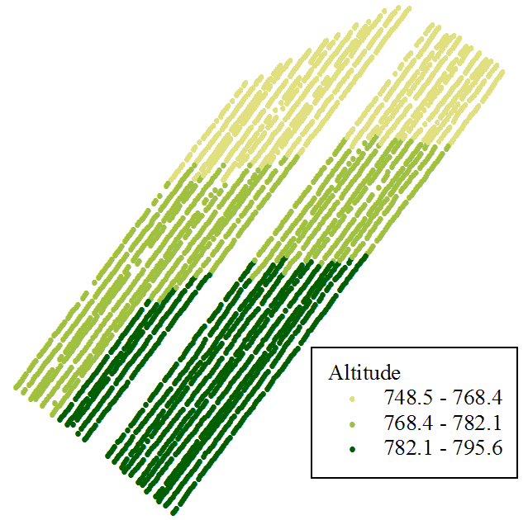
Elevation (m)
3
2
1

Slide 23
Speeds and Rates
20 kg N/ha – 9.0 km/h – 4ª II R
40 kg N/ha – 4.5 km/h – 2ª II R
60 kg N/ha – 3.0 km/h – 1ª II R
Nitro LL – 35% of N – 2:1 (water) – 2.5 bar
20 kg N/ha – 57.1 L – 171.4 L/ha
40 kg N/ha – 114.3 L – 342.9 L/ha
60 kg N/ha – 171.4 L/ha – 514.3 L/ha

Slide 24
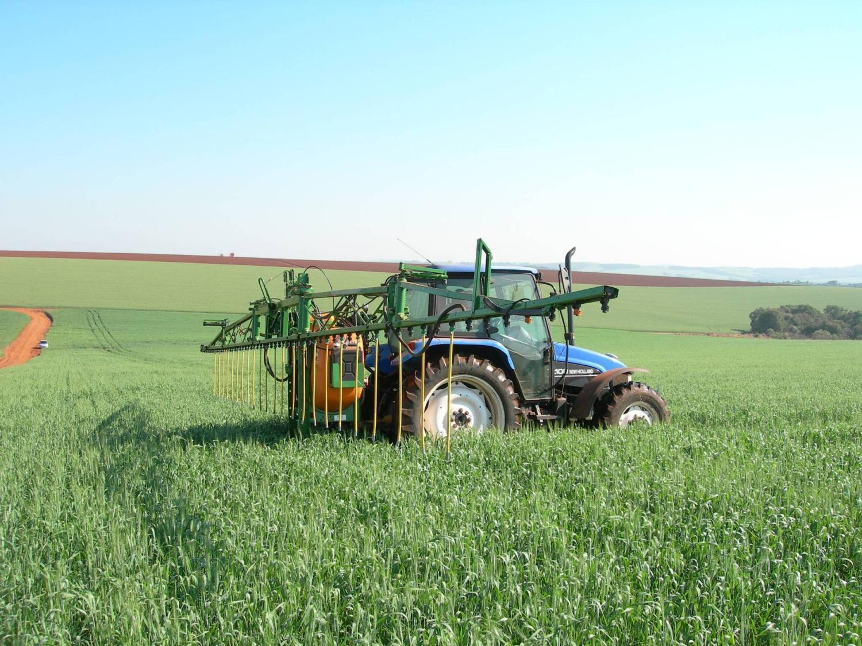

Slide 25
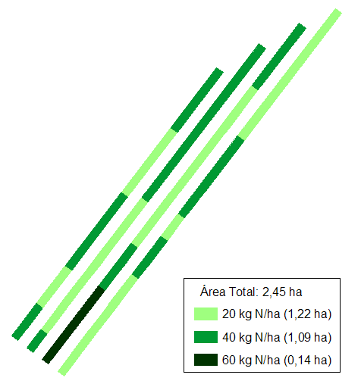
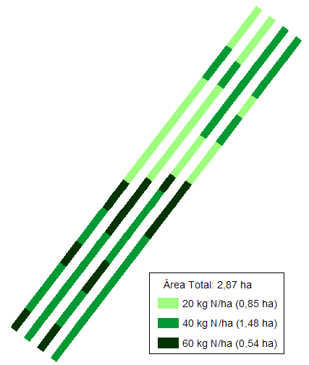
18 kg/ha
52 kg/ha
It would be applied: 195 kg N
It was applied: 109 kg N
Saving: 44%
It would be applied: 250 kg N
It was applied: 76 kg N
Saving: 70%

Slide 26
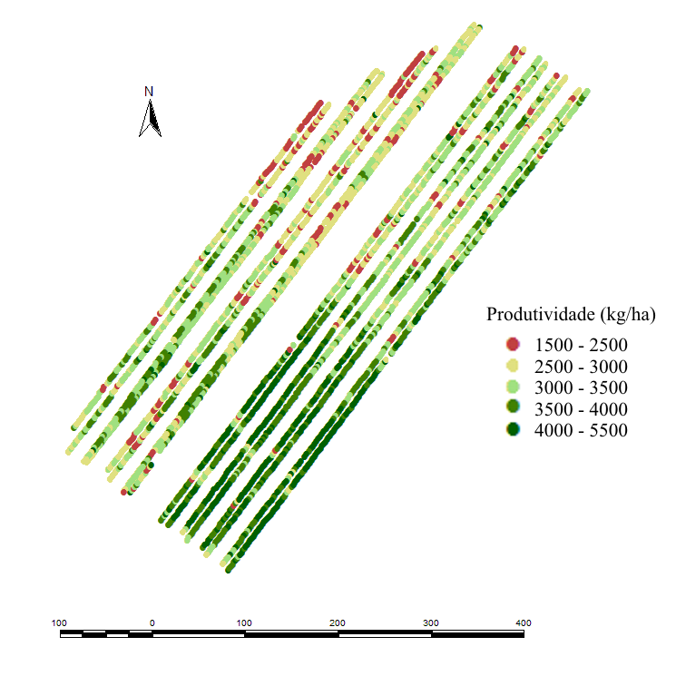
Yield Map
VR – 3053 kg/ha
FR – 3026 kg/ha
VR – 3568 kg/ha
FR – 3546 kg/ha

Slide 27
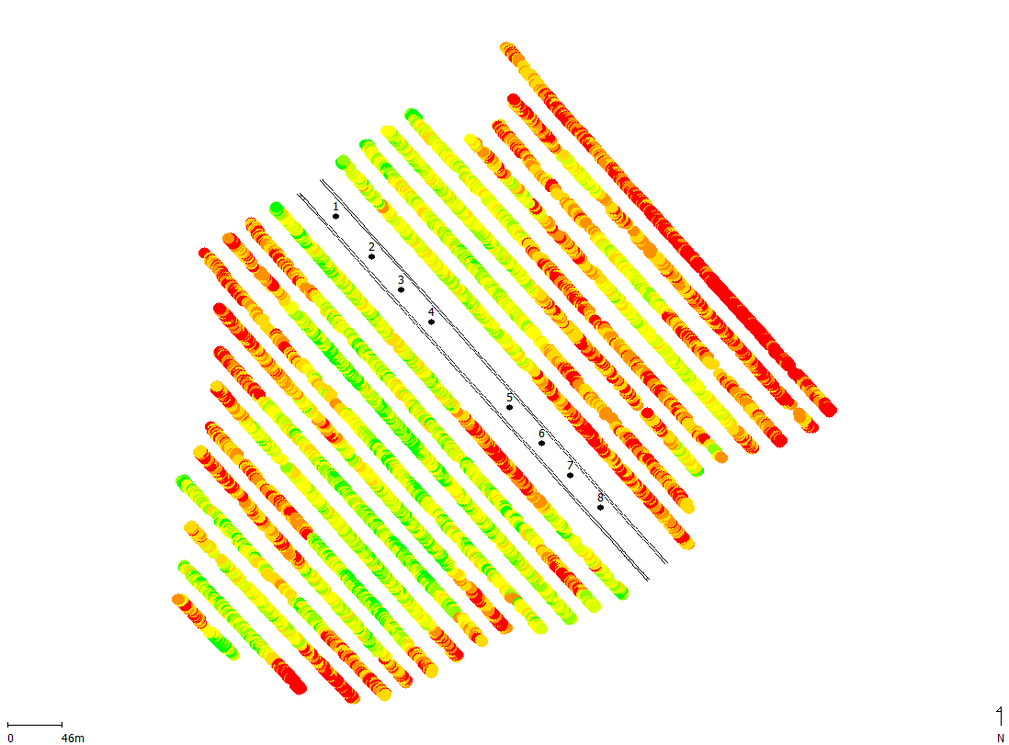
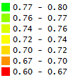
Wheat (2011)
Castro – PR – Brazil
Higher NDVI:
Plots 1 to 4
Lower NDVI:
Plots 5 to 8

Slide 28
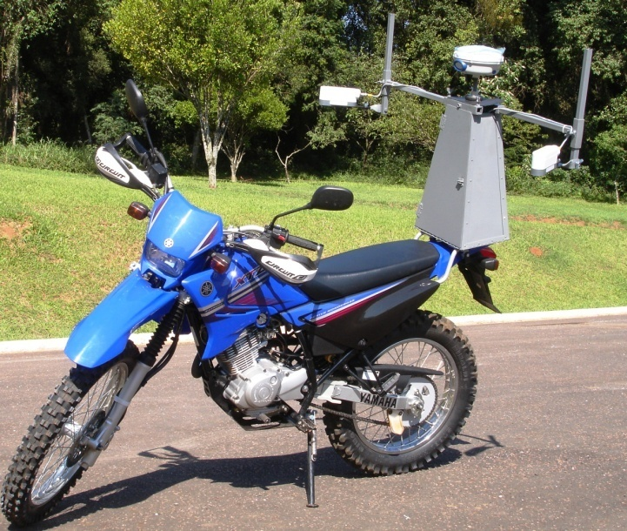


Slide 29
Sowing fertilizer: 300 kg/ha 14-34-00 = 42 kg of N
Top-dressing: 200 kg/ha 22-00-21 = 44 kg of N
N total = 86 kg/ha
Plots 1-4 – Higher response: RI = 1.07 – N Rate: 44 kg/ha
Higher NDVI Values
Plots 5-8 – Lower response: RI = 1.03 – N Rate: 18 kg/ha
Lower NDVI Values

Slide 31
Loss of yield with high N rates in low N response years

Slide 32
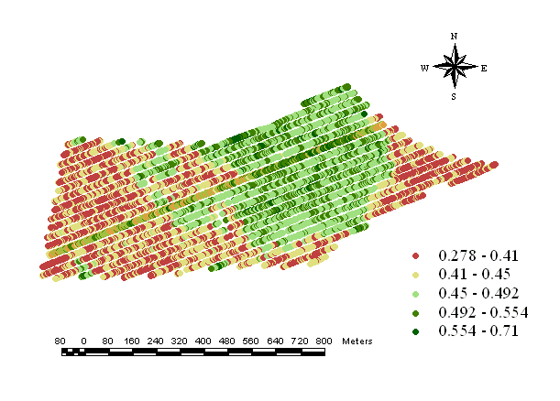
The opposite!!
Lower potential yield zone
RI = 1,29
Higher potential yield zone
RI = 1,15
N Rich Strip

Slide 33
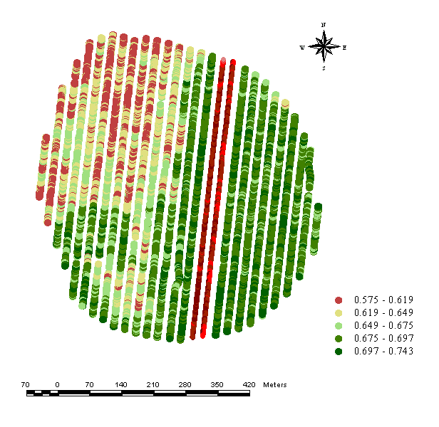
N Rich Strip at the wrong place!!!
Wheat (2012)
Lower NDVI zone
???
Higher NDVI zone
RI = 1.006 (Very Low Response)
SI = 0.994

Slide 34


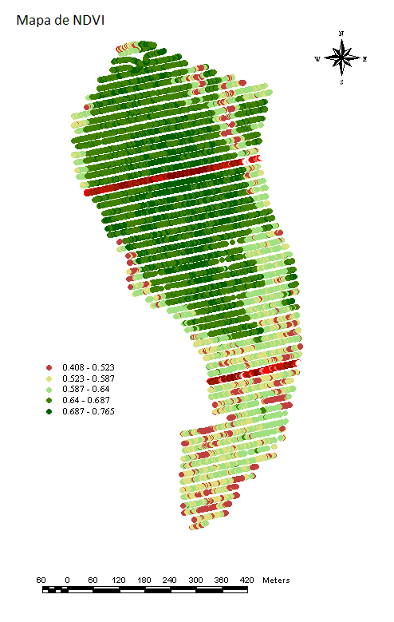

Slide 35
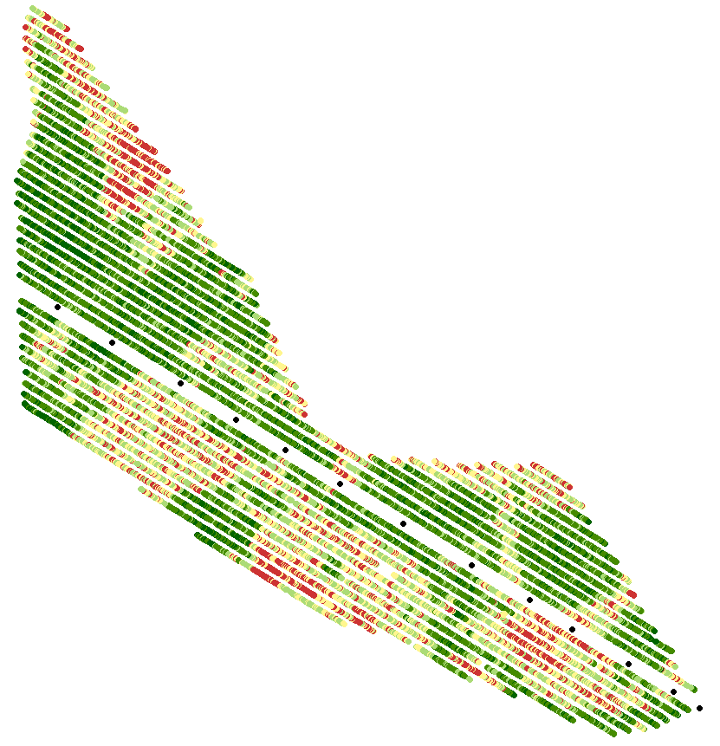
110 ha – Wheat (2011)
26 plots harvested
side-by-side (13 points)
N Rich Strip x Sensor

Slide 36
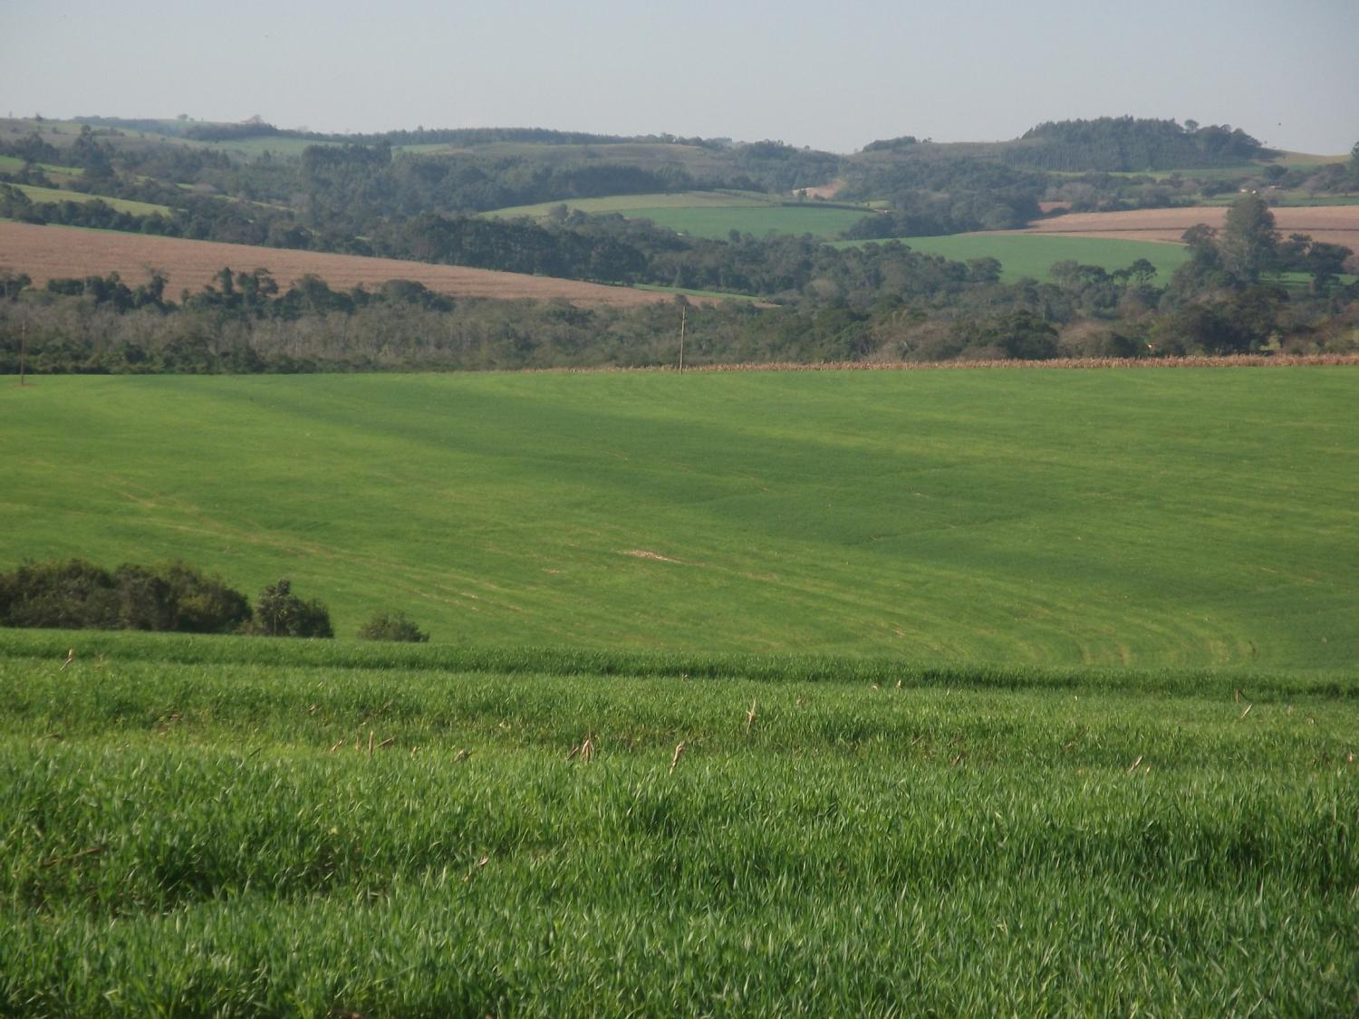

Slide 37
The use of optical sensors to map spatial variability

Slide 38
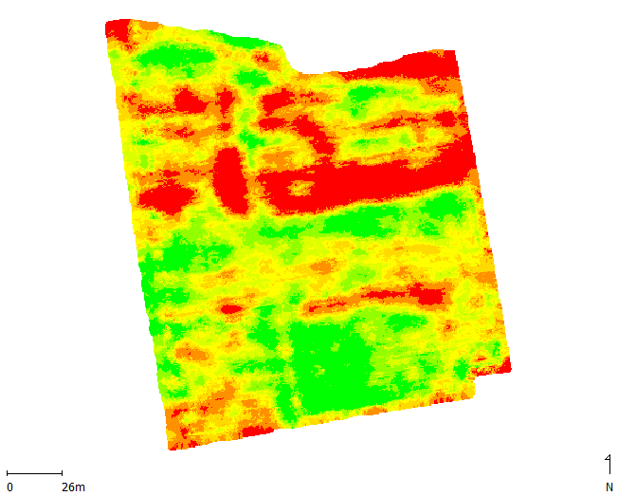
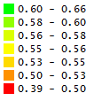
Corn – 2.86 ha – Ponta Grossa – PR
NDVI

Slide 39
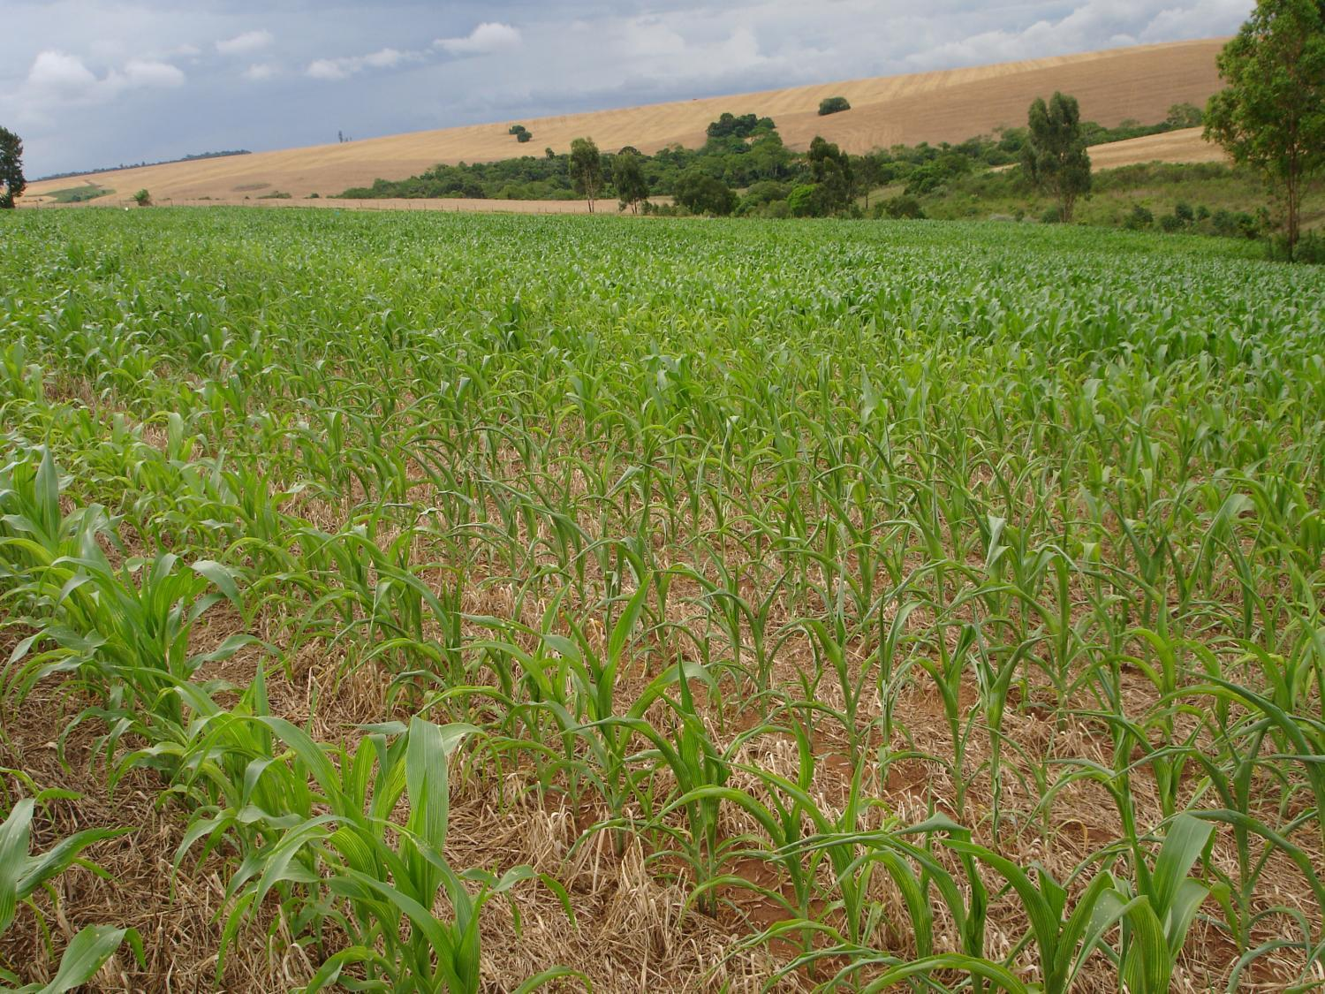

Slide 40
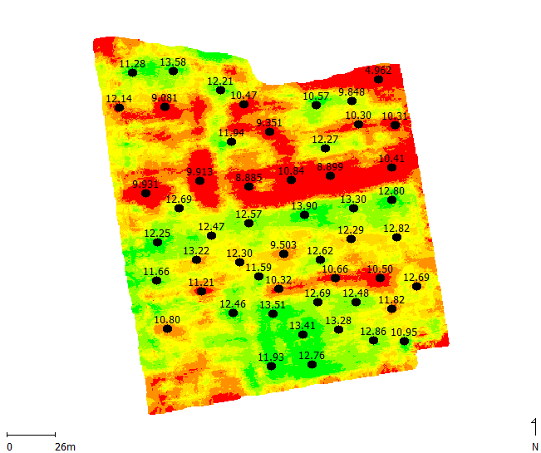
Corn Yield (kg/ha)

Slide 41
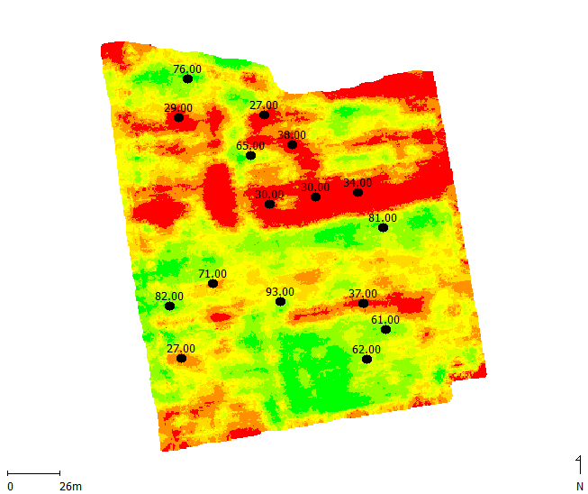
Soil Base Saturation (V%)

Slide 42
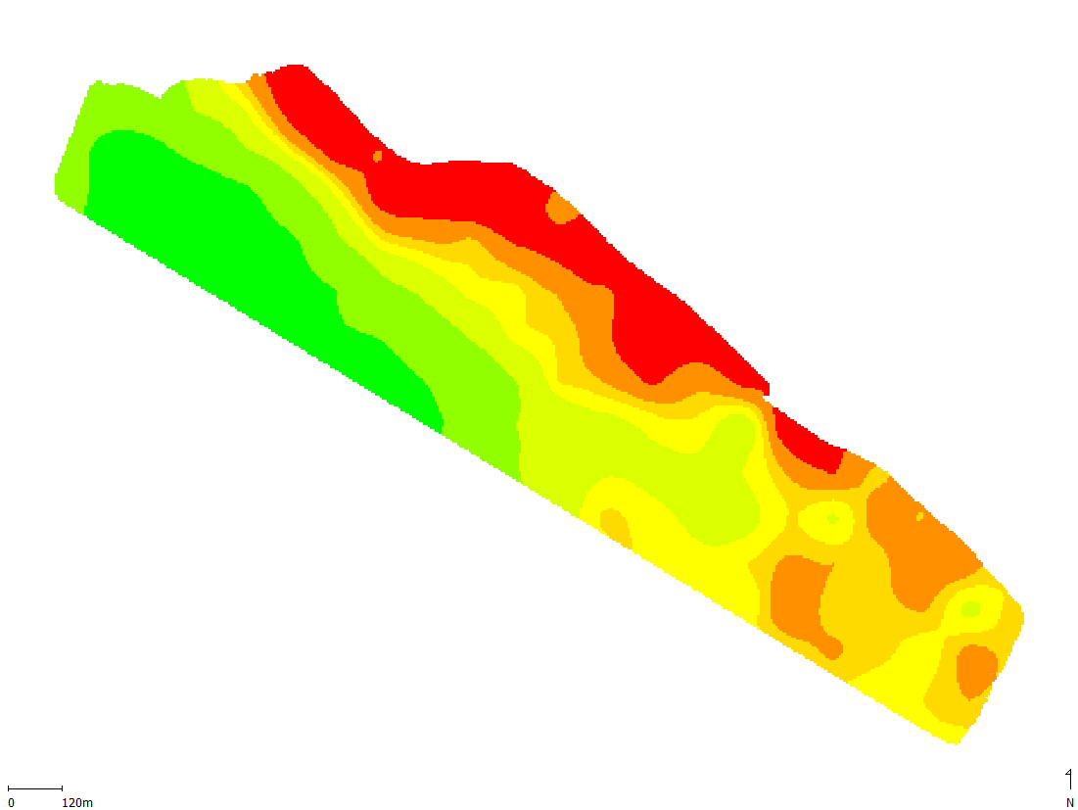
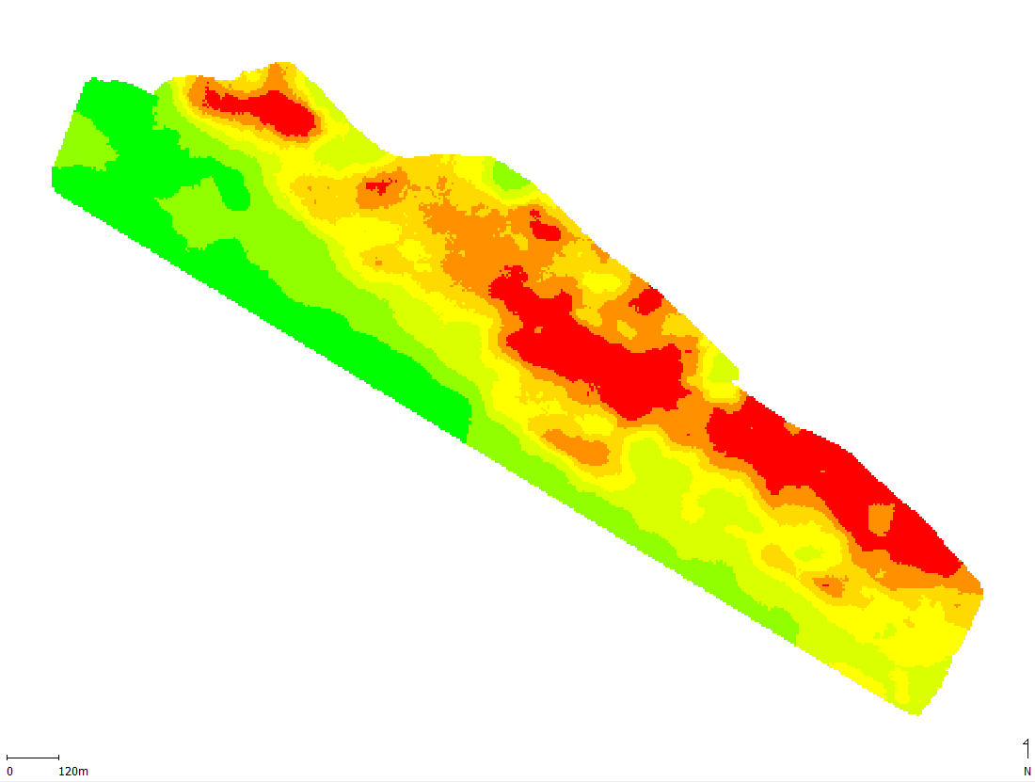
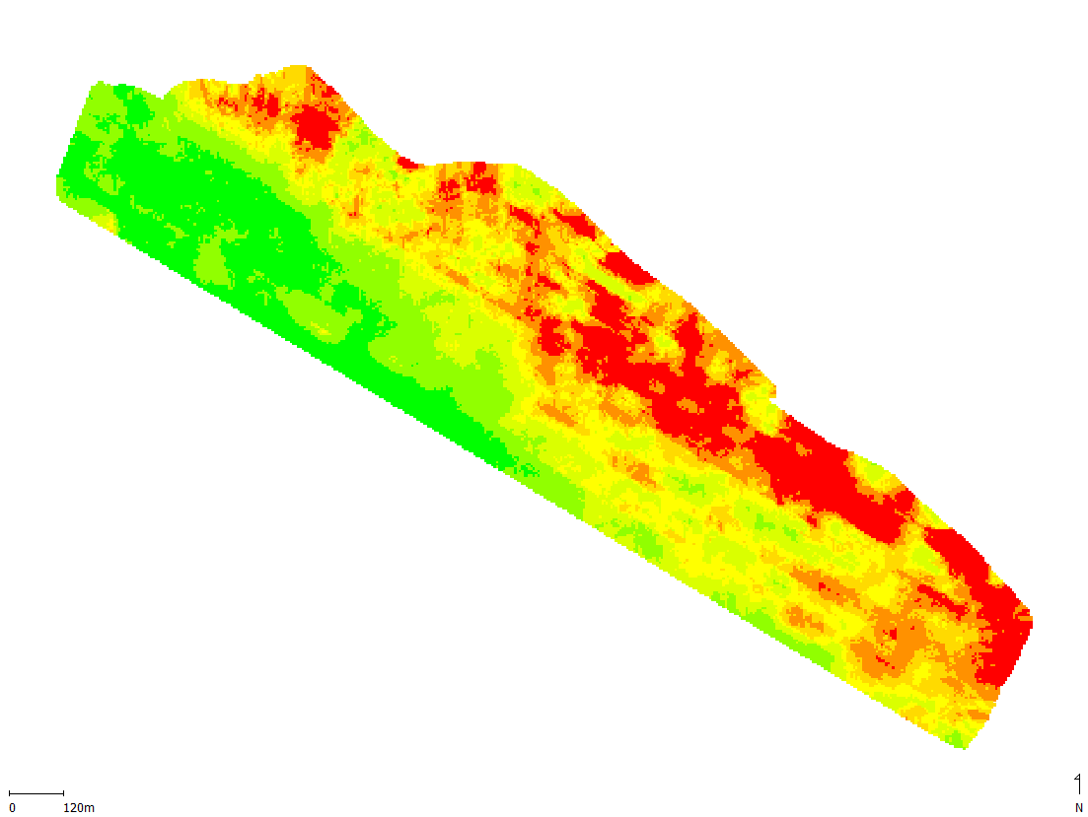
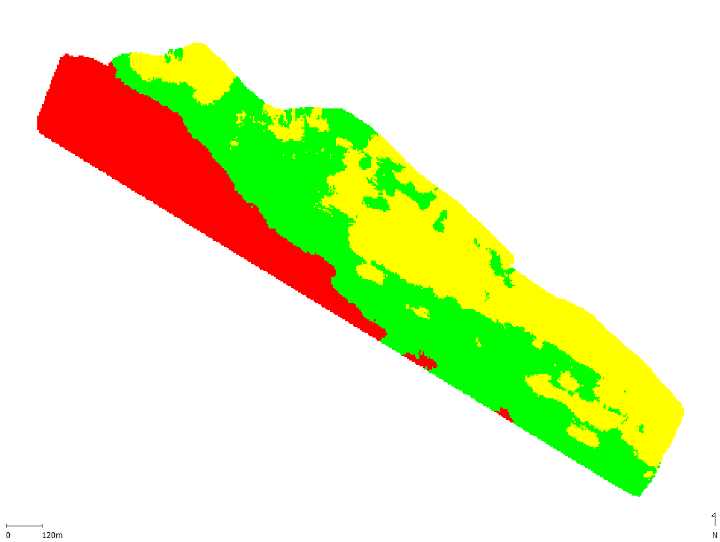
Clay
Soil EC
NDVI - Wheat
Management Zones

Slide 43
Other uses:
  Growth regulator in wheat and cotton;
  Desiccants for potatoes and beans;

Slide 44
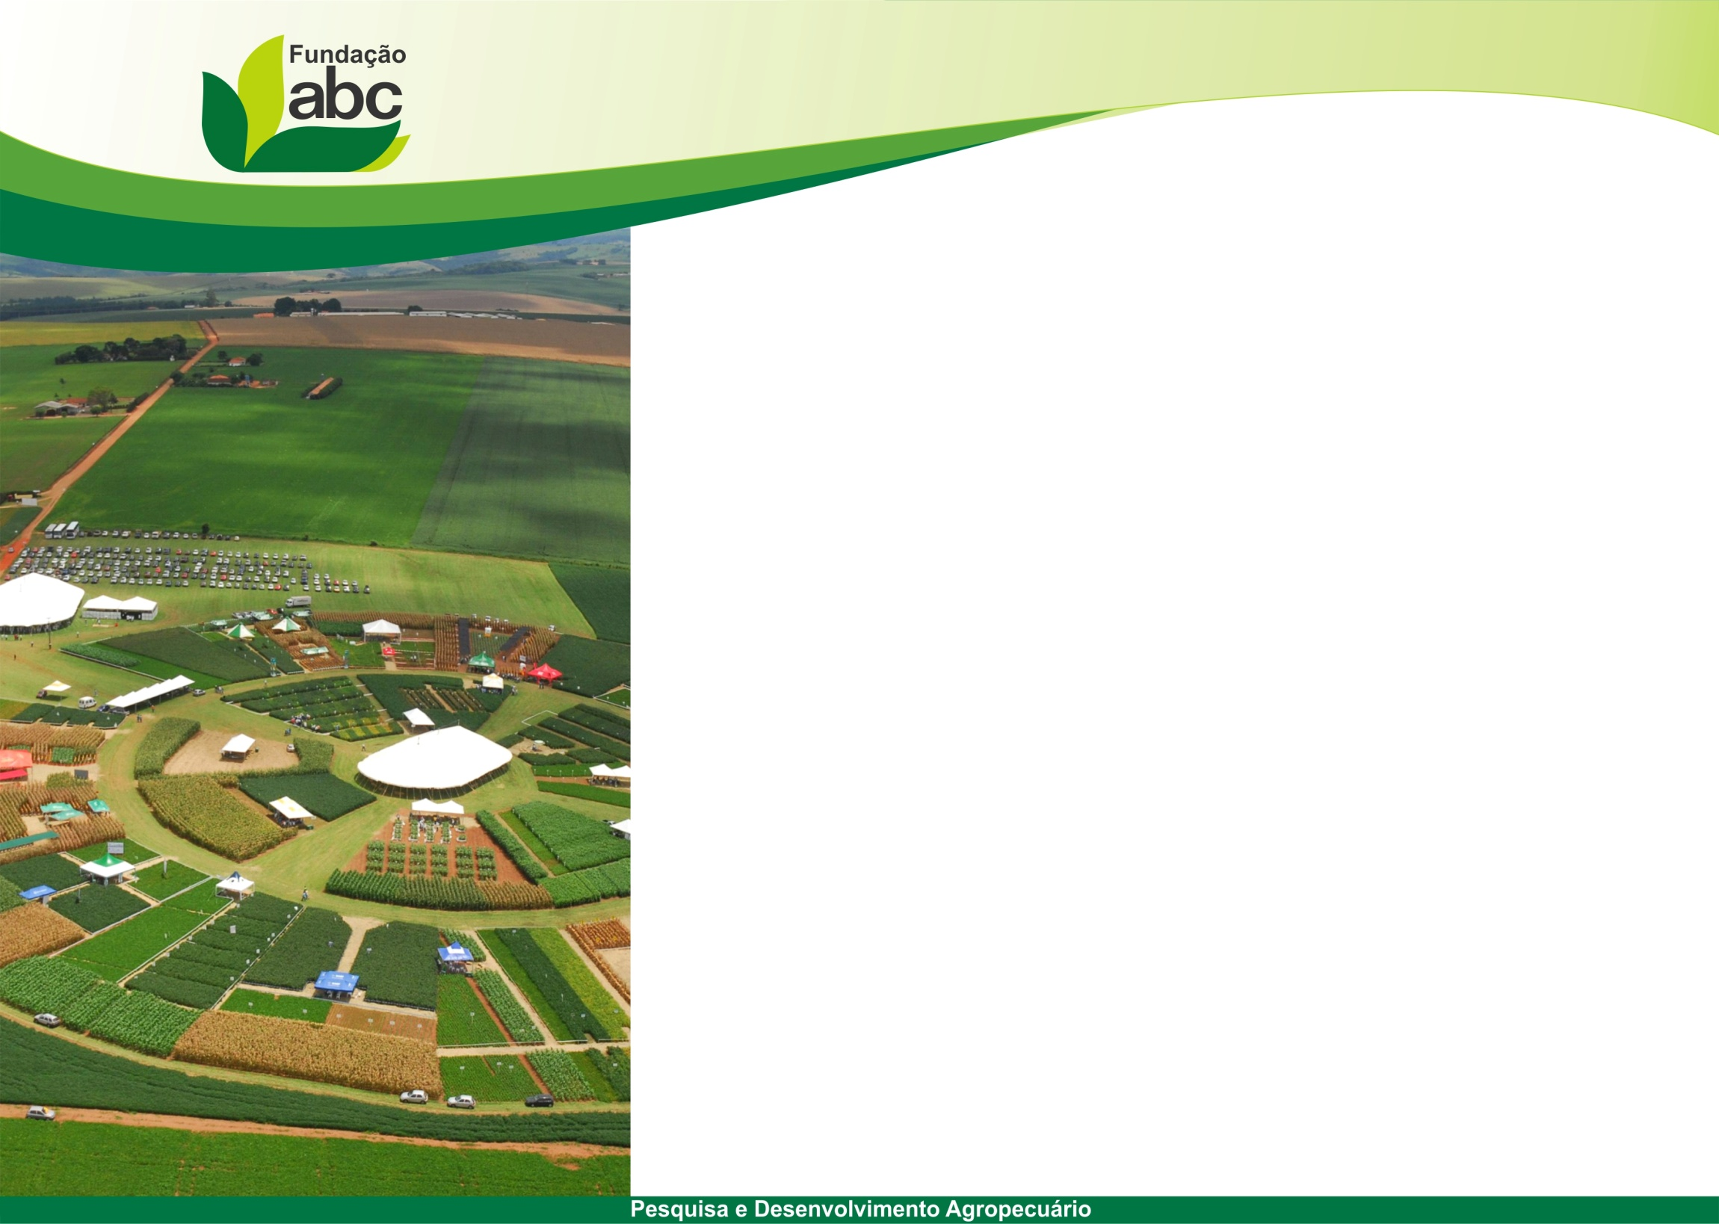
Thanks!!
Dr. Fabrício Povh
fabricio@fundacaoabc.org.br
Phone: +55 42 2322-2662
www.fundacaoabc.org.br
Castro – Paraná – Brazil

