Slide 1
Interactions of Nitrogen Management Strategy with Corn Hybrid and Population
Dave Franzen – North Dakota State University
Newell Kitchen – USDA-ARS, Columbia, MO
Laura Stevens, Richard Ferguson – University of Nebraska-Lincoln

Slide 2
Questions
Is the use of crop canopy sensors for in-season N management influenced by hybrid or plant population?
What are the interactions among N rate strategy, corn hybrid and population across this region?
How do two different N rate recommendation strategies (sensor vs. model) compare across a broad region?

Slide 3
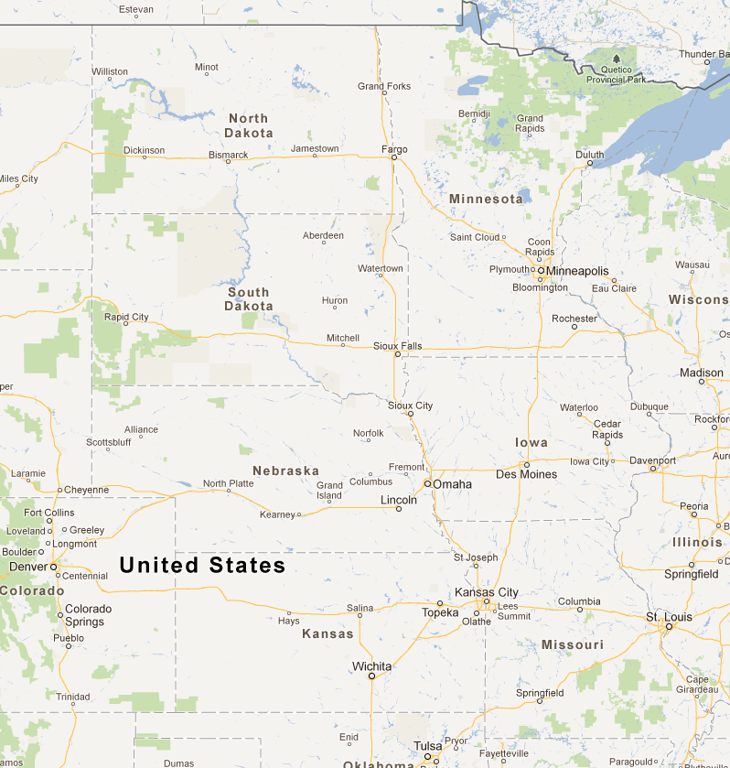
Locations
High yield potential and moderate yield potential sites in each state

Slide 4
Nitrogen Rate Strategies
Sensor: Holland Scientific RapidScan (3 band: red, red-edge, NIR); Schepers/Holland algorithm for N rate calculation (Holland & Schepers, Agronomy Journal 2010).
Model: Maize-N (Setiyano, et al., Agronomy Journal 2011); based on the Hybrid-Maize crop growth model; use of local, historic weather data.
Base N rate 0-75 lb/acre, depending on site (applied at or prior to planting).
In-season N applied immediately after sensing at V9-V10 growth stage.

Slide 5
Treatments
Hybrid: High drought tolerance, low drought tolerance.
Population: moderate (24-32,000 plants/acre) or high (31-42,000 plants/acre).
Nitrogen rate: unfertilized check, high N reference, Maize-N model rate, canopy sensor rate.
Location: Missouri, Nebraska and North Dakota, each state with high yield and moderate yield potential sites.

Slide 6
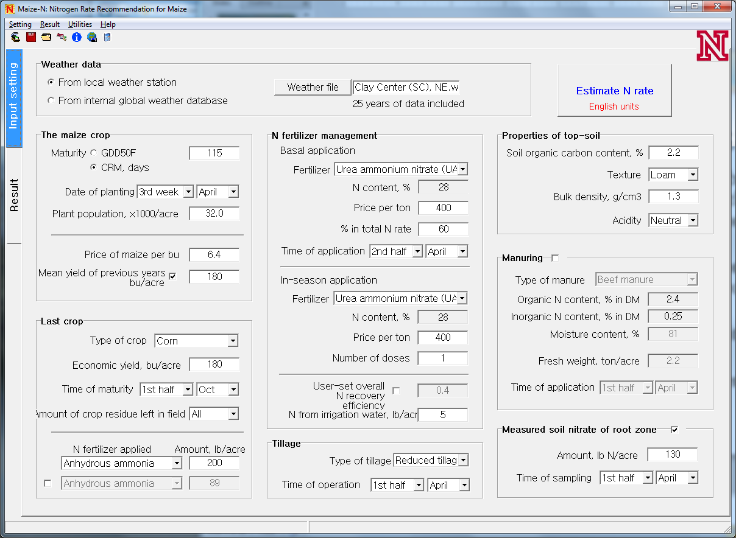

Slide 7
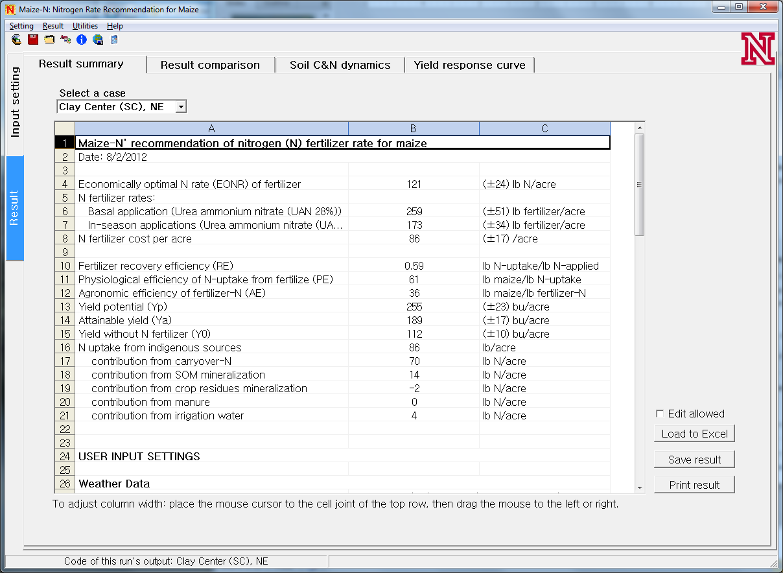

Slide 8
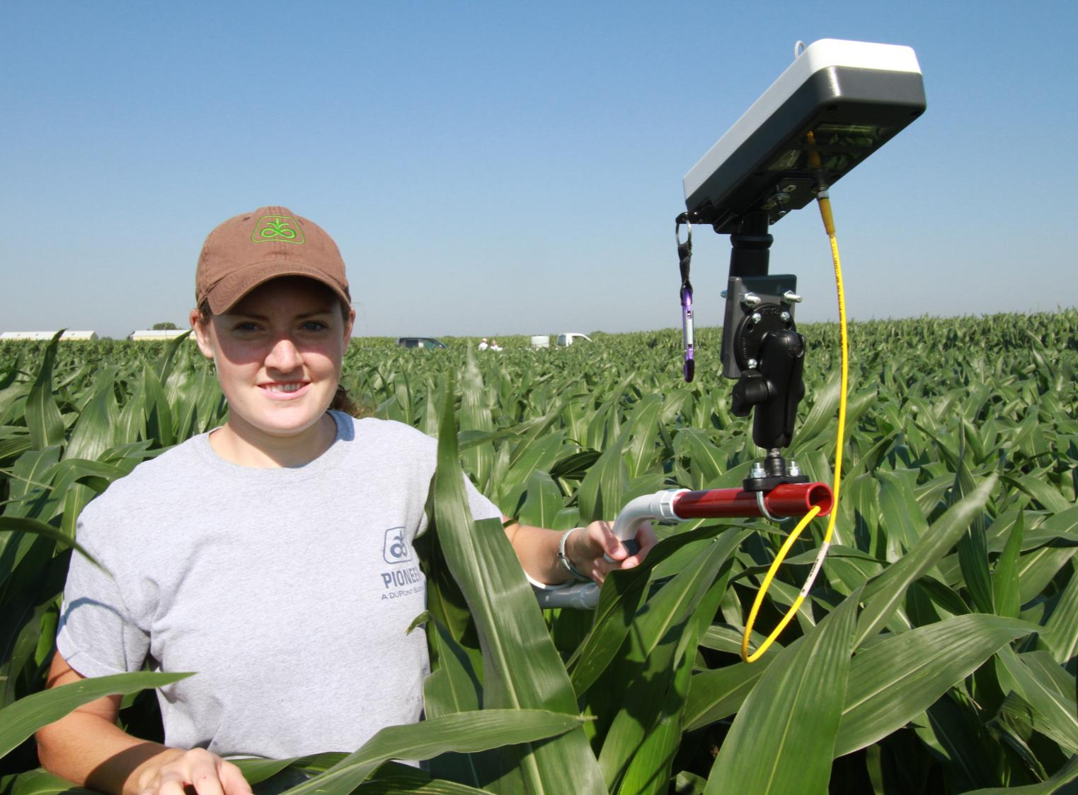

Slide 9
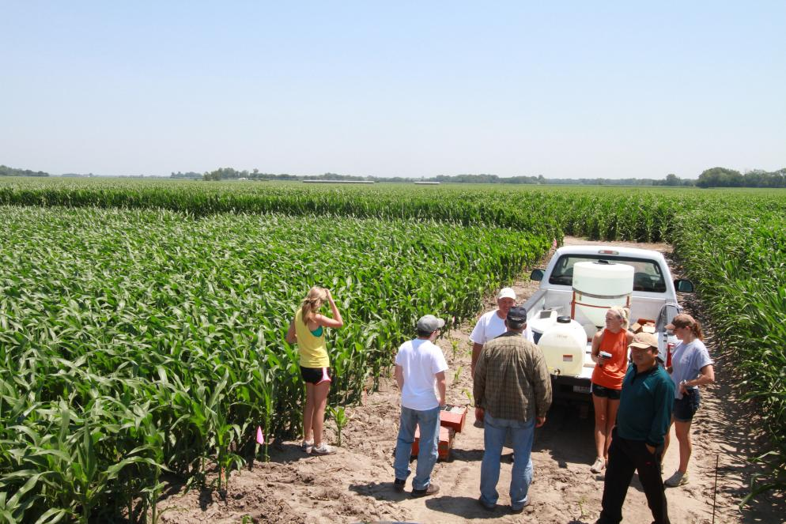
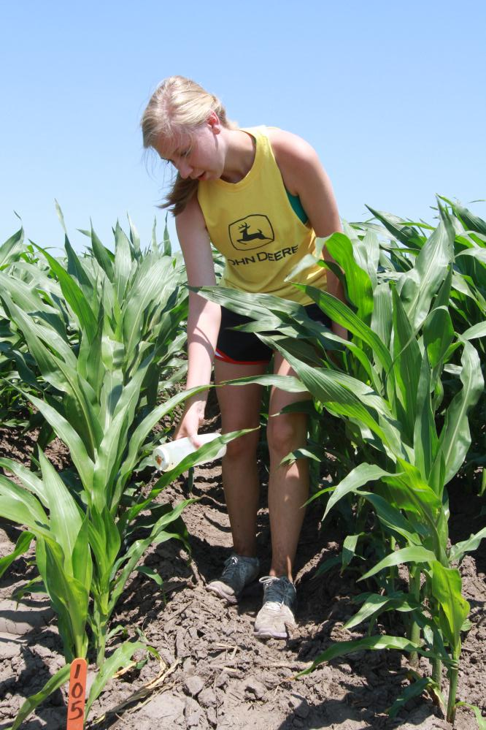

Slide 10
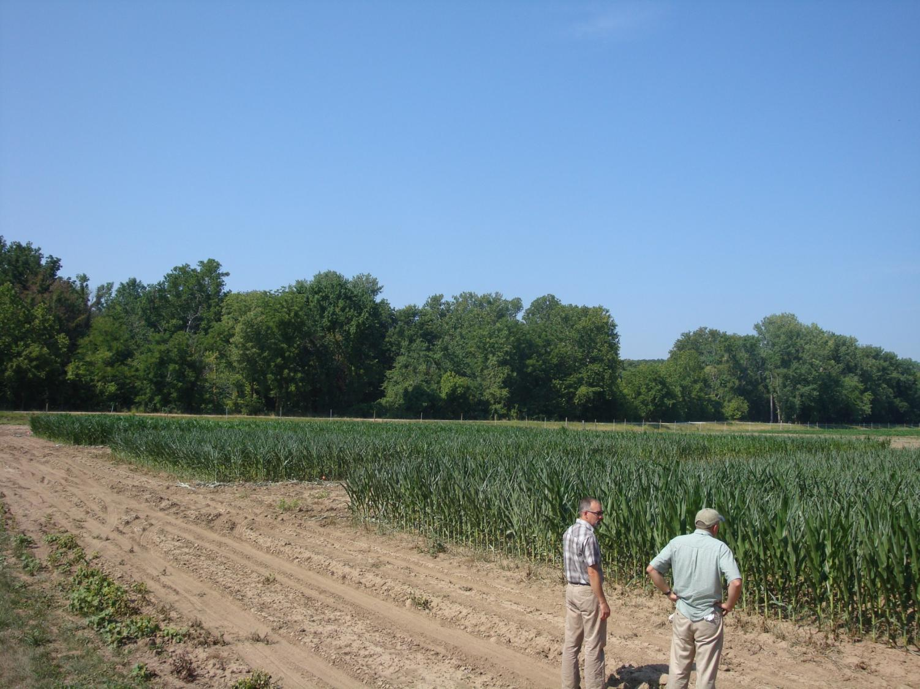

Slide 11
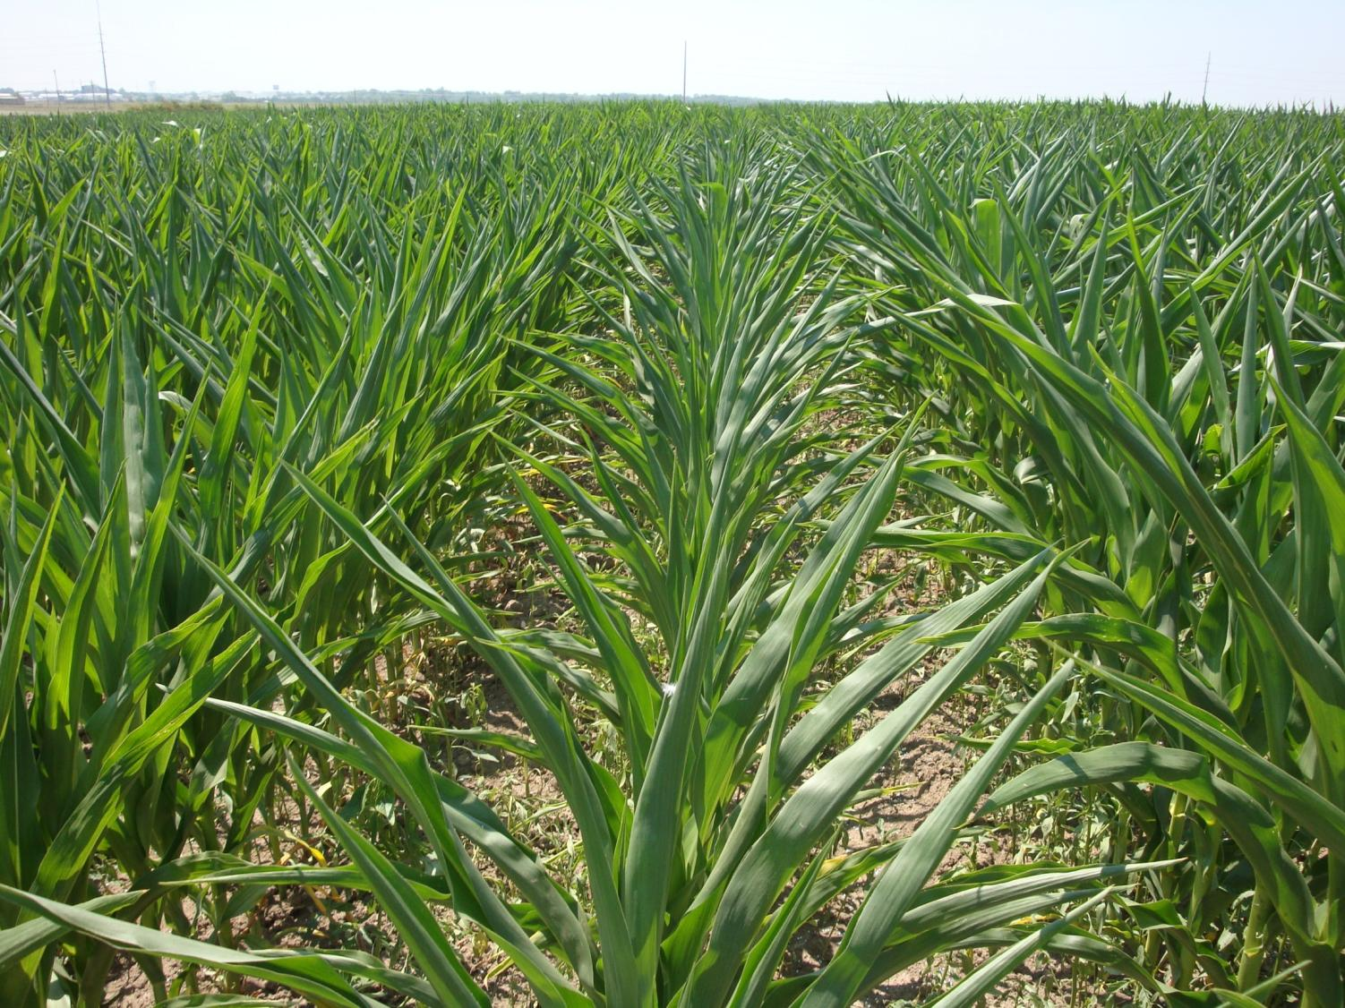

Slide 12
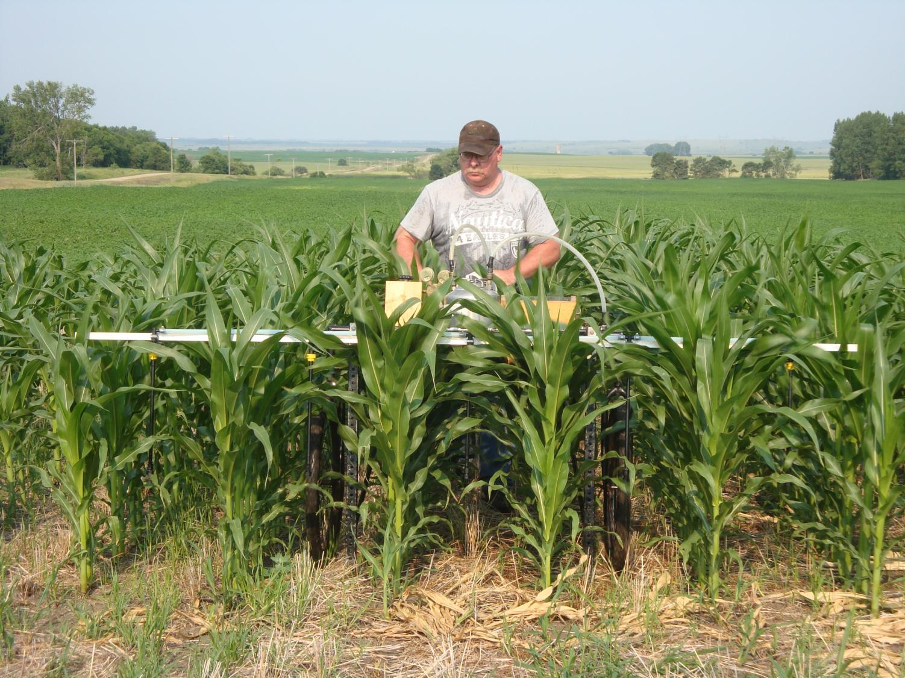

Slide 13
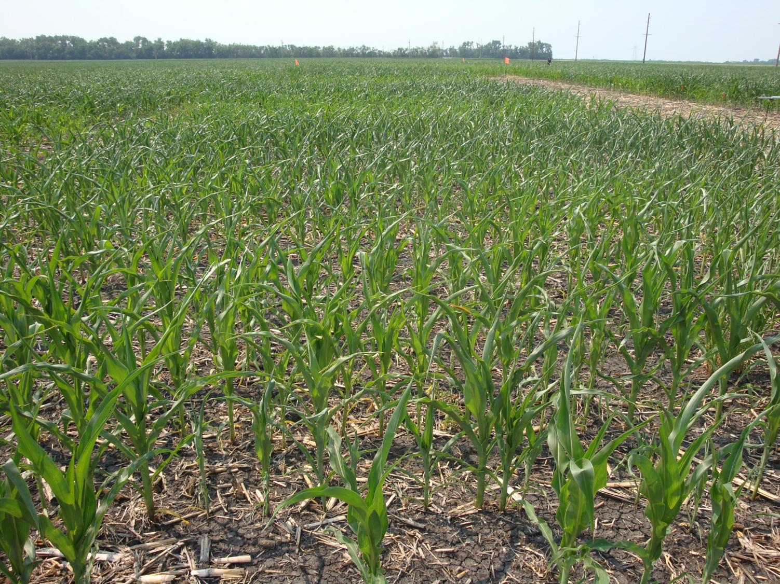

Slide 14
Vegetation Indices and Nitrogen Rate Missouri

Slide 15
Vegetation Indices and Nitrogen Rate Missouri

Slide 16
Vegetation Indices and Nitrogen Rate Nebraska

Slide 17
Vegetation Indices and Nitrogen Rate Nebraska

Slide 18
Vegetation Indices and Nitrogen Rate North Dakota

Slide 19
Vegetation Indices and Nitrogen Rate North Dakota

Slide 20
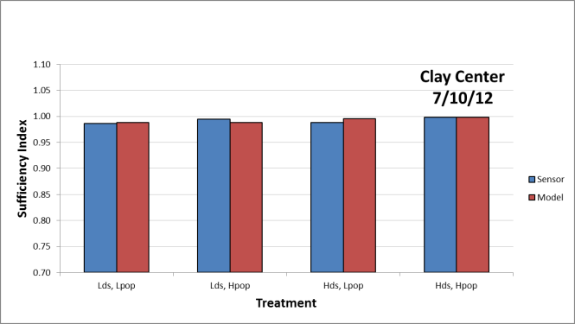
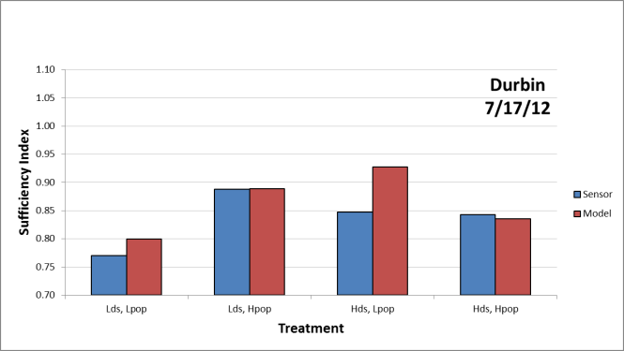
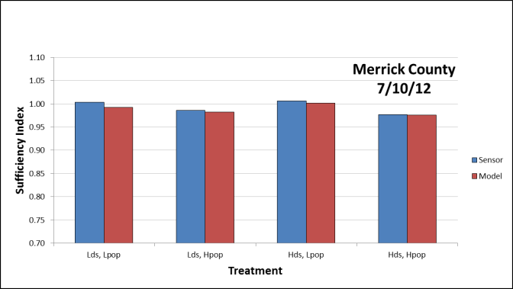
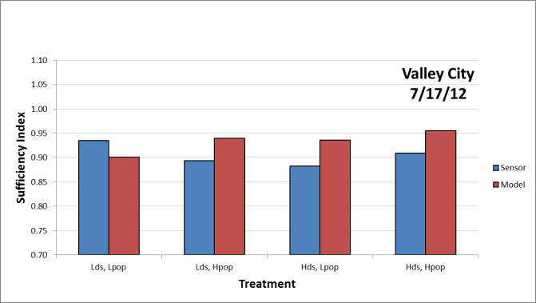
Sufficiency Index – Post-Fertilization

Slide 21
Change in NDRE Relative to N Applied
ΔNDRE/lb N

