Slide 1

CropSpec Update
2012 NUE Conference
Fargo ND
August 6-8
Joe W. Tevis, PhD
Director, Agronomic Products and Services
Topcon Precision Agriculture

Slide 2
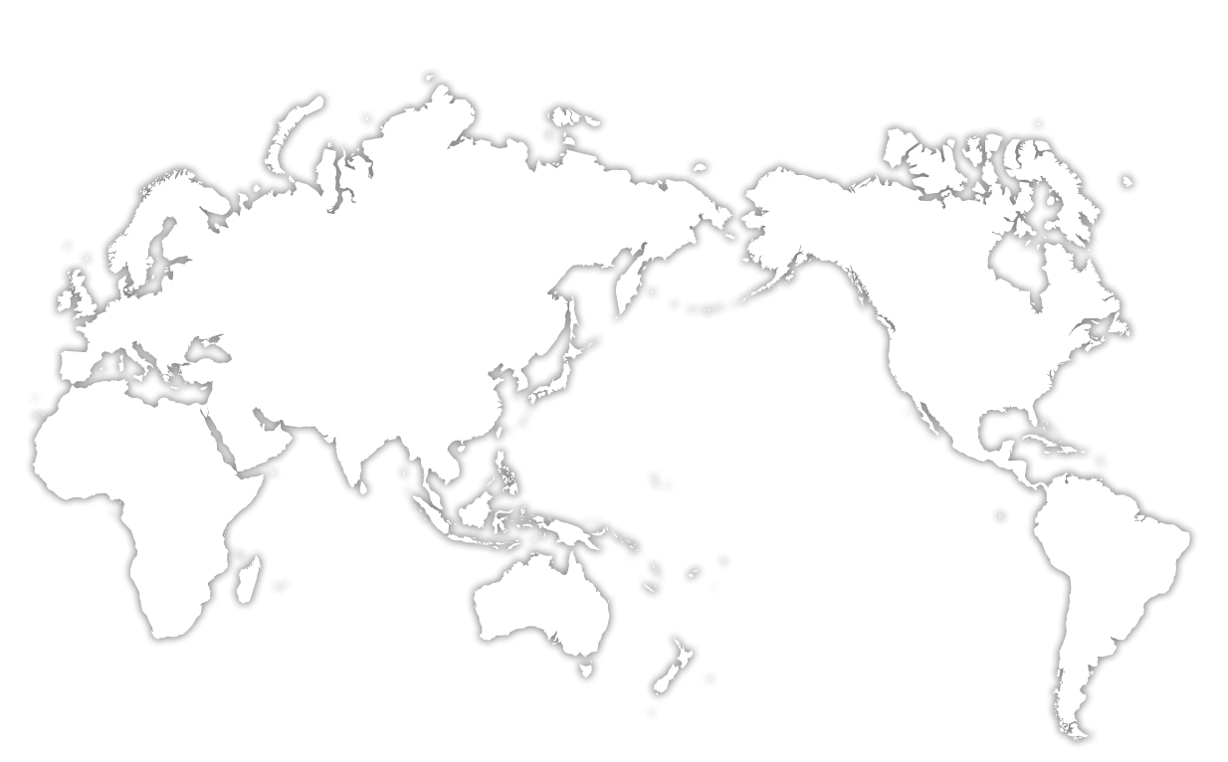
Topcon
The World’s Leading Supplier of Optical and Positioning Solutions

Slide 3

Topcon Statistics
Founded in 1932
Major shareholder: Toshiba
Topcon business units:
  Topcon Positioning
    Survey
    Construction
    Tierra
    Topcon Emerging Business Unit
    Precision Agriculture
  Topcon Medical
  Topcon Industrial & Optics
Developed many “World’s First” products and technology

Slide 4

Worlds First
  World’s first Coaxial Total Stations
  World’s first Green Beam Laser
  World’s first Sonic Tracker
  World’s first Automatic GPS+ Machine Positioning
  World’s first automatic excavator system
  World’s first wireless, dual constellation GPS+ survey system
  World’s first optical communicating total station
  World’s first mmGPS

Slide 5
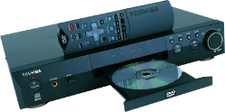
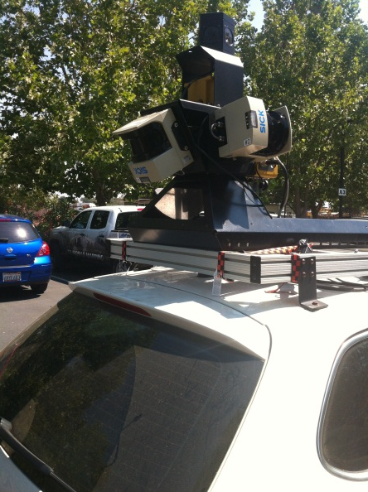
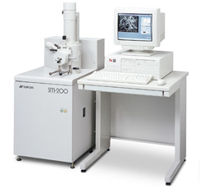
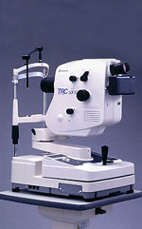
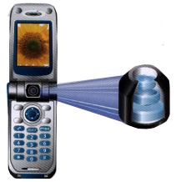
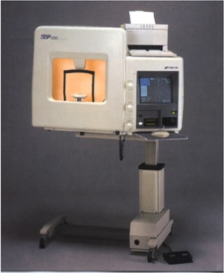
Topcon in the World Market Place
Major producer of vision testing, retinal cameras, surgical & electron beam microscopes.
One of the world’s leading suppliers of optical lenses used for reading CD’s and DVD’s.
Major supplier of lenses for camera phones.

Slide 6
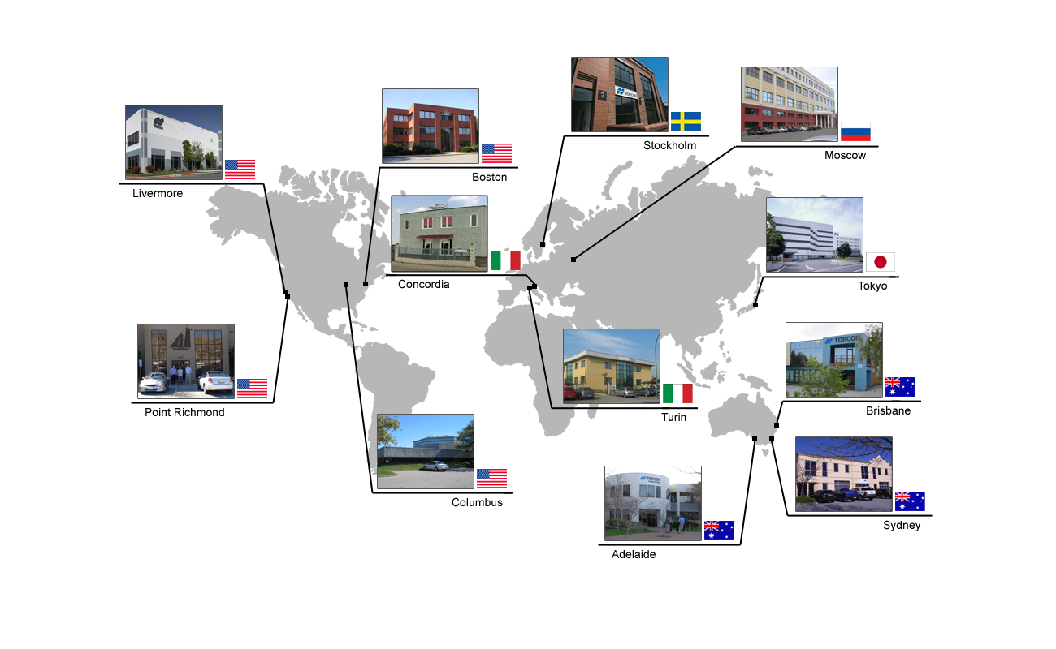
Who is Topcon?
Global Research and Development Facilities

Slide 7
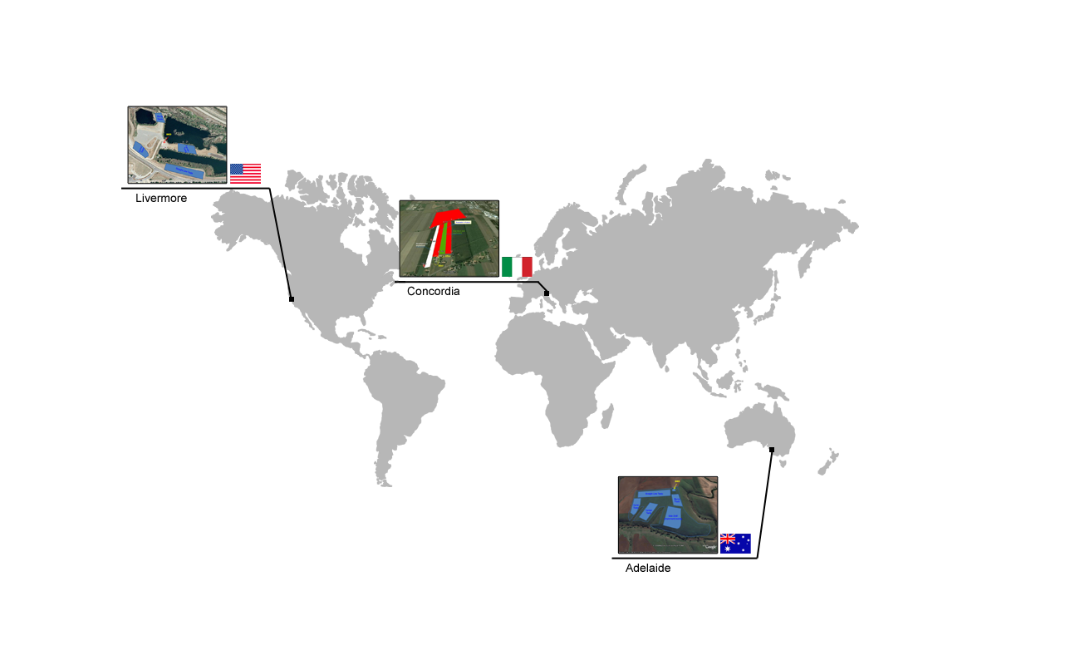
Who is Topcon?
Global Precision Ag Test Facilities

Slide 8
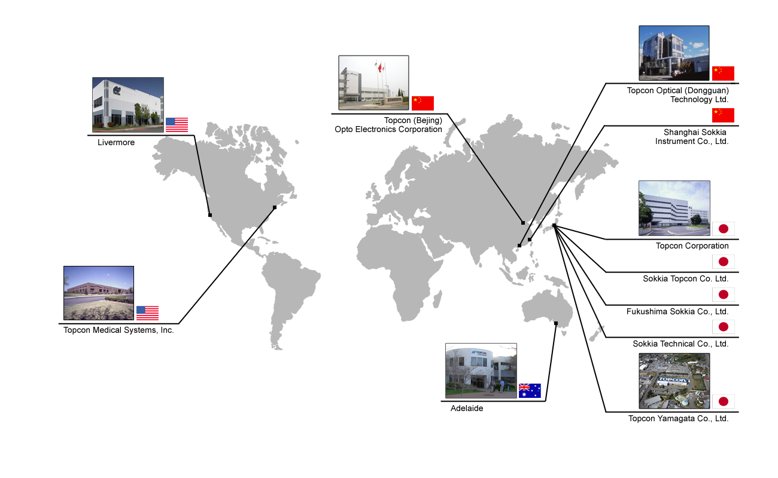
Who is Topcon?
Global Manufacturing

Slide 9
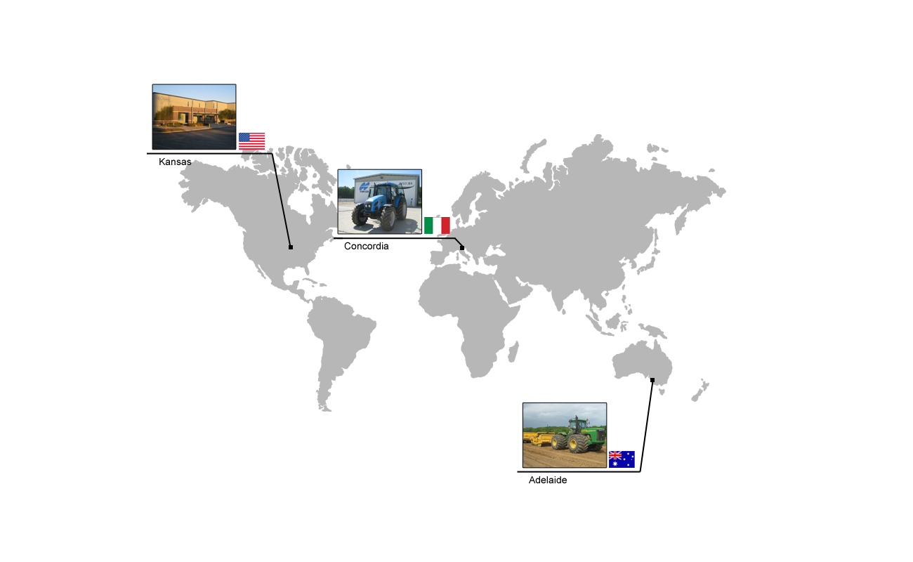
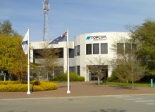
Who is Topcon?
Precision Ag Training, and Support Centers

Slide 10
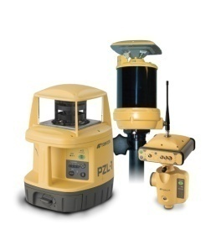

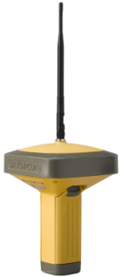
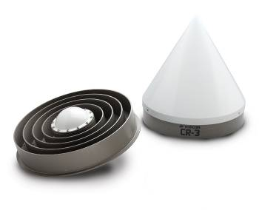
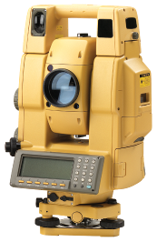
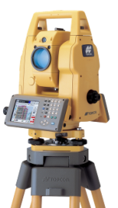
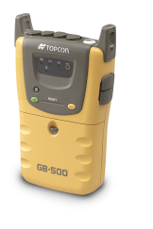
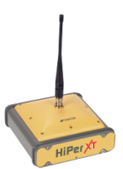
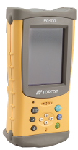
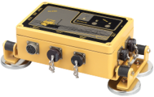
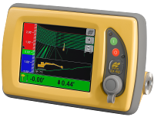
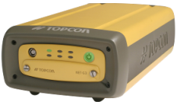

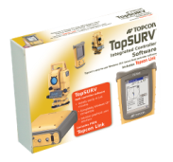
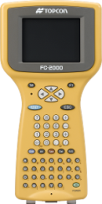
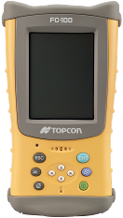
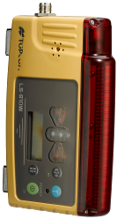
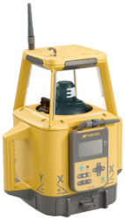
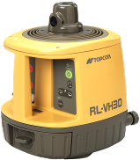
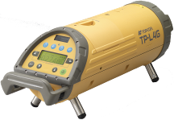
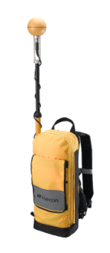
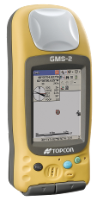
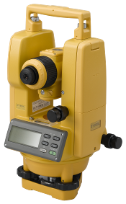
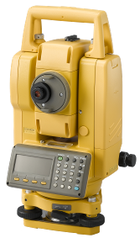
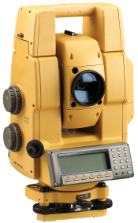
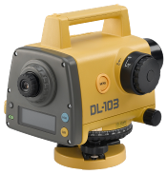
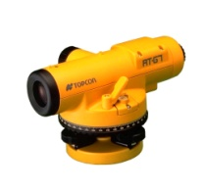
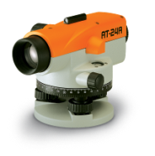
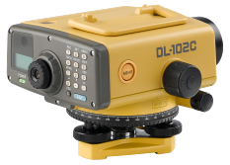
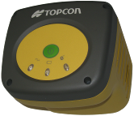
High-End Optical
GPS+ Products
Machine Control
Grade Management
System
Networks
Most Complete Positioning
Product Portfolio in the Industry
Data Collection
& Software
Laser Products
GIS Products
Digital Theodolites
Construction
Grade Optical
Automatic Levels
Digital Levels

Slide 11


Crop Spec,
A Collaborative Partnership
A real time integrated plant nutrient monitoring and application system for Agricultural equipment

Slide 12
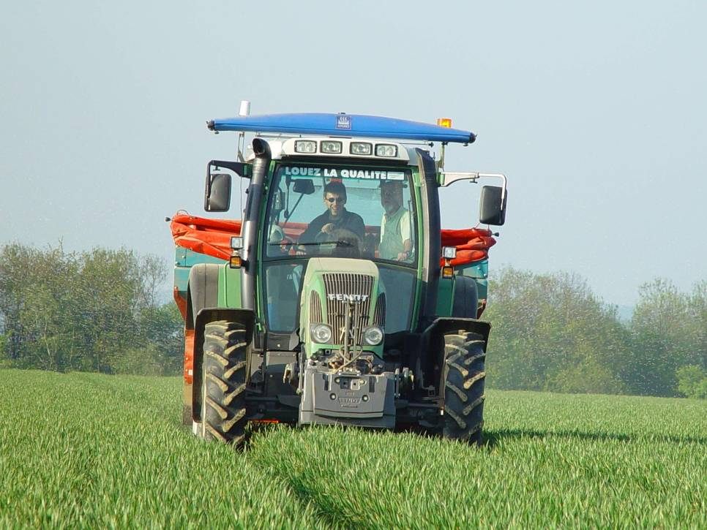
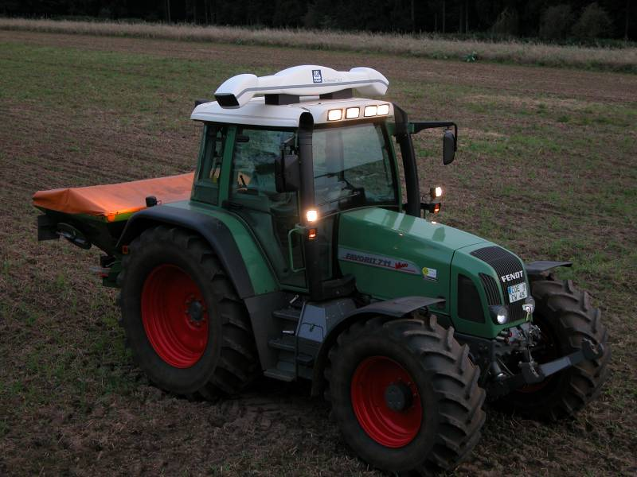
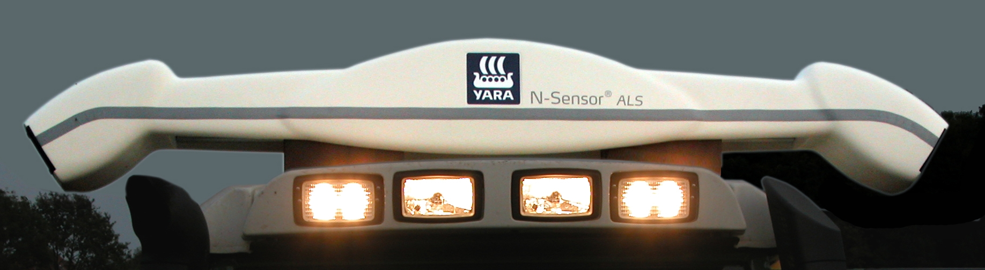
Yara Electronic Products ,1995 - Present

Slide 13
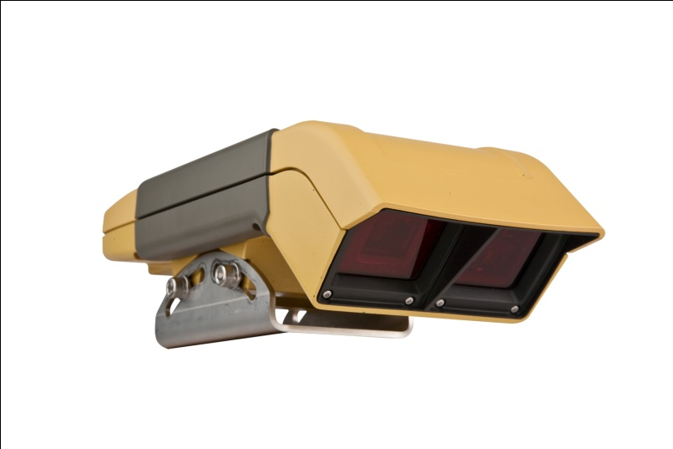
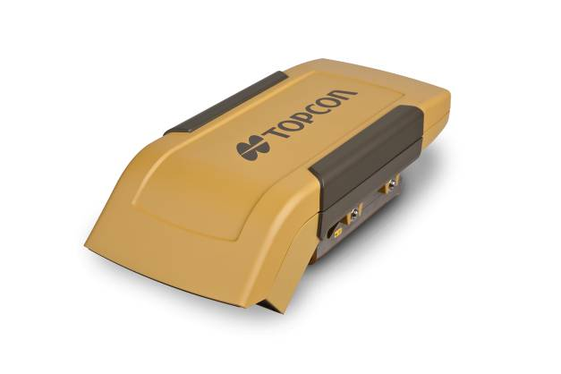
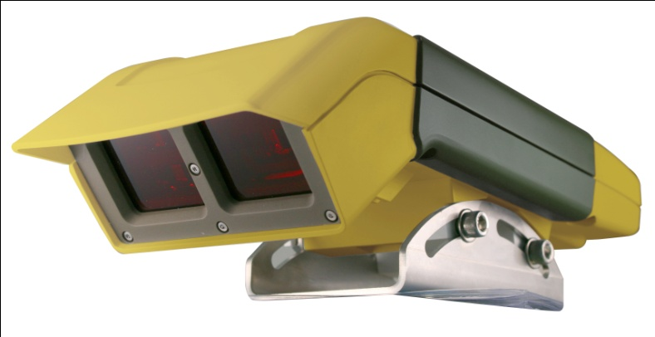
CropSpecTM – specifications
Environment | IP 67 compliant
Laser safety | Class 1 or Class 1M
Physical Dimensions | 200 mm x 80 mm x 80 mm
Mounting height | 2 - 4 meters
Viewing angle | 45°- 55°
Temperature | 0 - 60°Celsius
Operational wavebands | 730-740 nm and 800-810 nm
Supply voltage | 10-32 VDC
Supply current | 5 A

Slide 14
CropSpec Parameter Calculation
Define:
R = Simple ratio of NIR reflectance (808nm) to RedEdge (735nm)
R = NIR/ RedEdge
Define:
S1 = 100 * (R – 1) Compare NDVI = (R - 1) / (R + 1)
The CropSpec parameter is defined:
S1CAL = 47 * S1 / S1REF
S1REF is the S1 measured with the reference matching filter.
The 47 factor is used for matching with YARA.

Slide 15
Cab Mounted Sensors
Geometry provides largest footprint per sensor in the industry
Sensing Larger % of Area to be Applied
  Redundancy in Left and Right viewing areas
Safety and Stability of Sensors
  Less potential for damage
Viewing crop at an angle, rather than from 90 degrees directly above
  Minimize affects of shadowing, crop movement, etc.
Light Source and Detector at Uniform Angle to Crop
  Minimize affects of crop movement, weak crop stands.

Slide 16
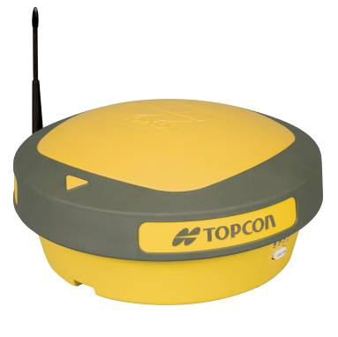


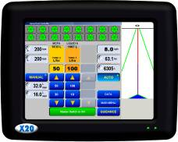
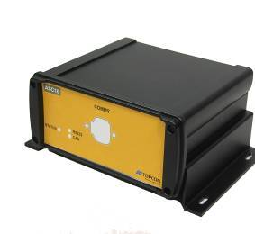
Crop Spec System Diagram
RS232
CANBUS
Topcon X20
Implement with Liquid or Granular Application

Slide 18
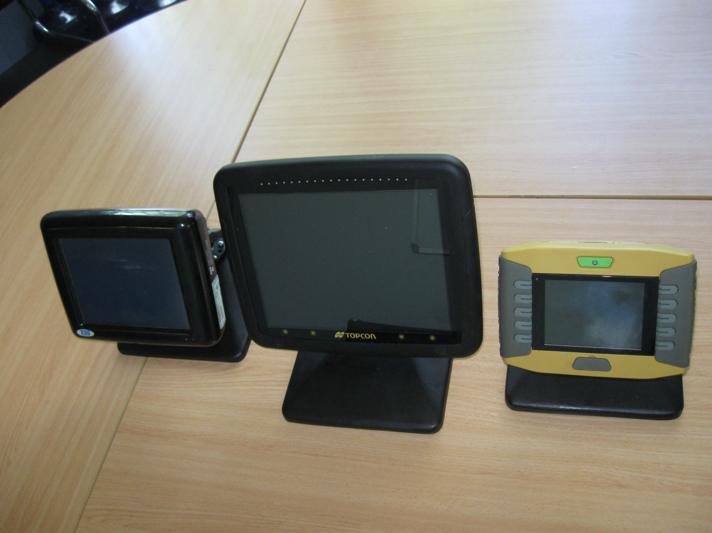
Topcon Console Family

Slide 19

Crop Spec X30 Sunrise Configuration
RS232
CANBUS
Topcon X30
Implement with Liquid or Granular Application

Slide 20


CropSpec – System 110 Configuration

Slide 21

CropSpec ISO VT Client

Slide 22
ISO 11783 – Crop Sensor Support
Sources of “Set Point” values for application rates
  User input
  VRT “Map”
  Crop Sensor (In draft stage)
Field historical data (proposed)
    Map of Yield Potential
      Relative yield potential
      Absolute yield goal

Slide 23

Yara ImageIT

Slide 24
Topcon CropSpec Contacts
Sales
  Marty Cook, North America Sales Manager
University Cooperation/ Education Partnership Program
  Hank Boudreau, Educational Partnership Manager
Agronomics
  Joe Tevis, Director Agronomic Products and Services
    jtevis@topcon.com
    Mobile: 612.325.3012

Slide 25




Educational Partnership Program
Topcon is proud to announce the launch of the enhanced Educational Partnership Program (EPP). Our mission has always been to supply educational institutions with special savings on products and training. Now, to further improve upon this goal, we have created additional enhancements to aid in your efforts of teaching the next generation of agricultural professionals. Topcon seeks to establish a partnership with you and your institution to help incorporate the latest techniques and technology into your curriculum. By emphasizing the “partnership” in our EPP program, Topcon offers a wide variety of additional enhancements including:
Access to your own portal on the Topcon TotalCare site
One-on-one instructor training with a Topcon University product expert
Classroom instruction through a Topcon University training professional
Access to online training materials including videos and course materials
Student internship opportunities and job posting board
Scholarship opportunities through Topcon sponsored contests
Topcon is committed to providing affordable pricing on the latest technology that now comes with added partner benefits. Want to learn more about these new enhancements? Contact Topcon’s Educational Partnership Program manager Hank Boudreau at hboudreau@topcon.com or 508-697-4047. Look for an updated catalogue and more information posted to Topcon’s websites.

Slide 26

Thank You

