Slide 1
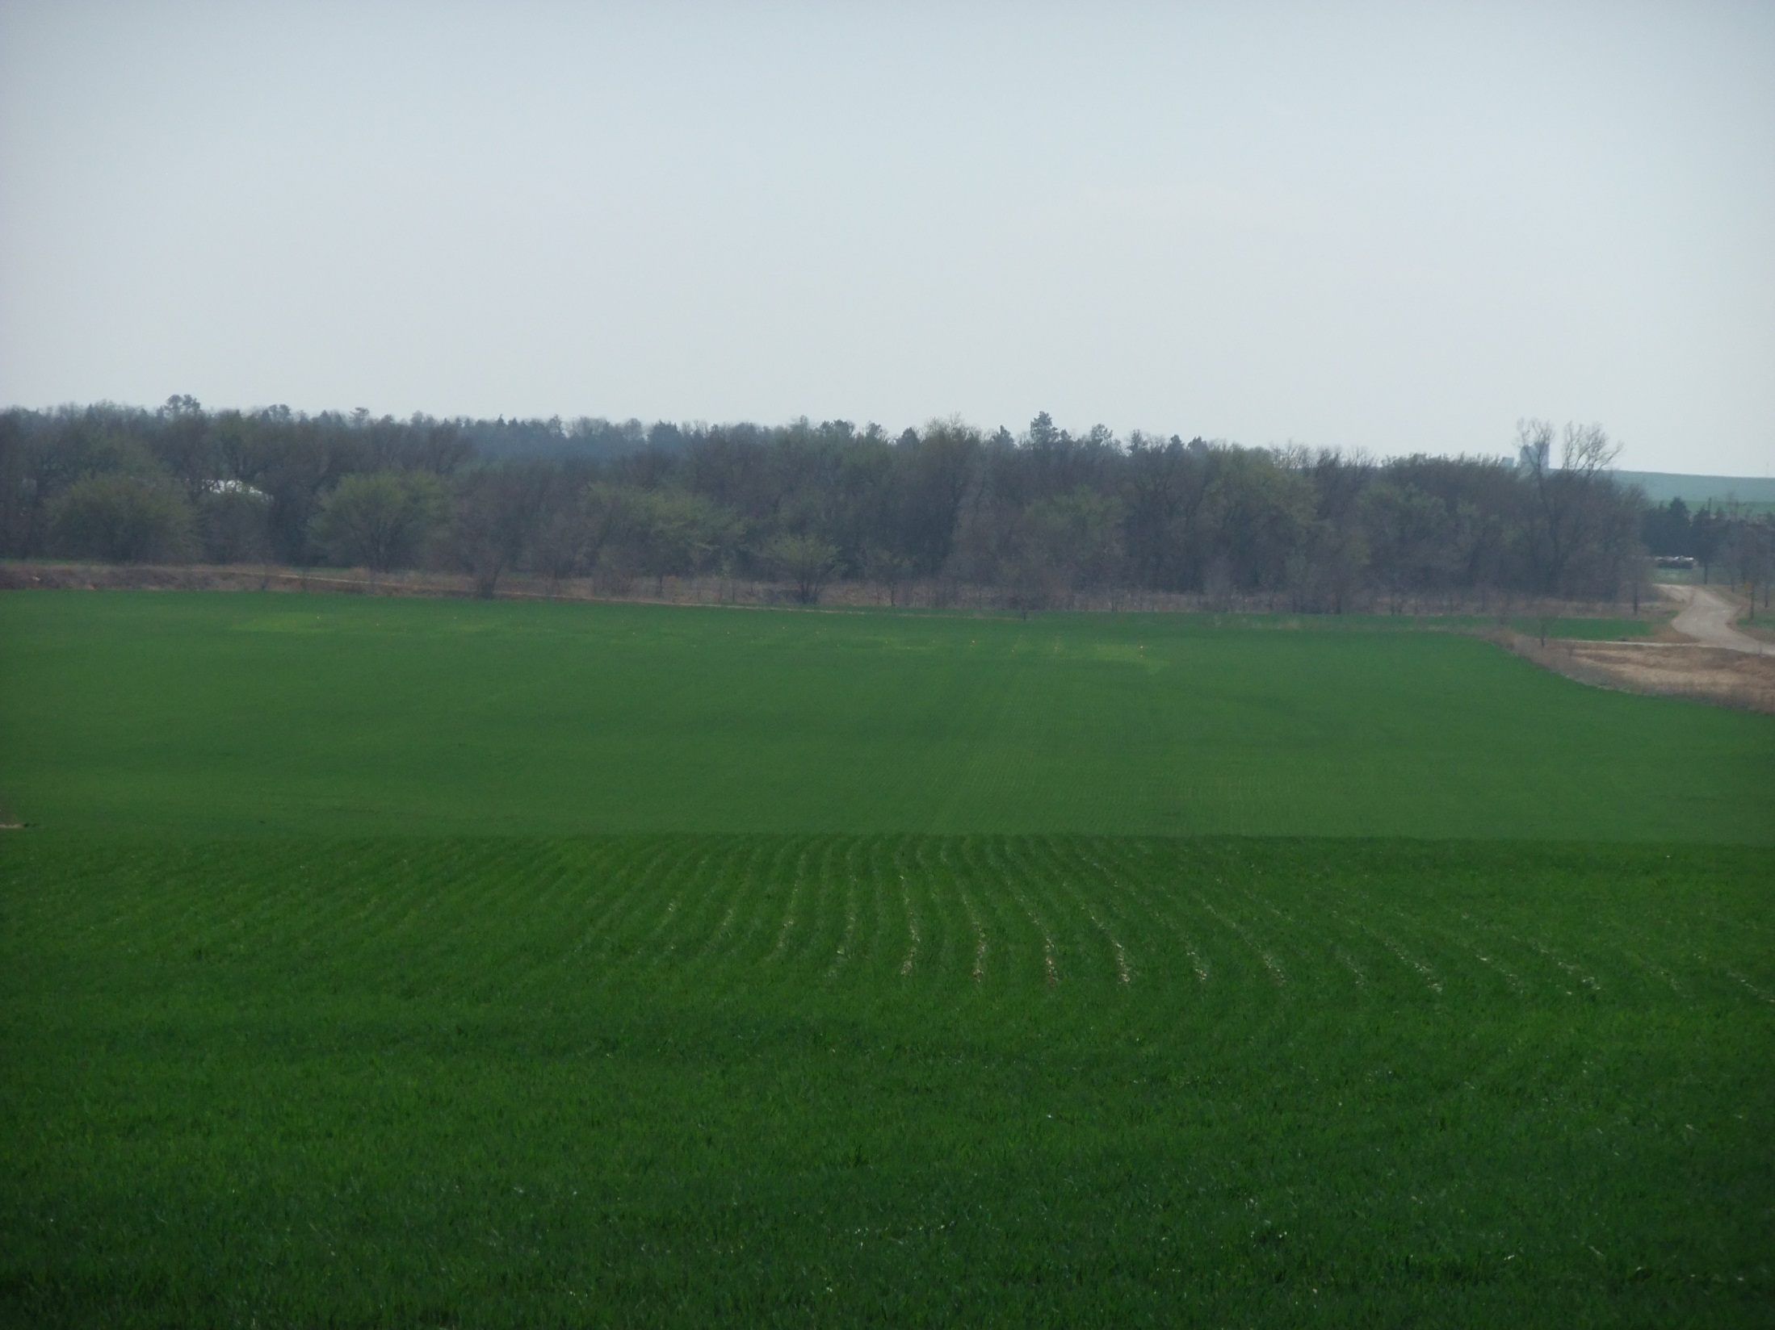
Using Optical Sensors to Direct In-Season Nitrogen Management of Wheat
Ray Asebedo and David Mengel
Kansas State University

Slide 2
Introduction
Wheat producers in Kansas commonly use two different approaches to nitrogen (N) management on wheat:
Full N application prior planting w/wo some N with the drill
Split application with some N in the fall, and the balance applied in the winter with herbicides or topdressed at Green-up (Feekes 3/4).
Producers rarely soil test for residual profile N before planting.
N mineralization varies dramatically from year to year following variation in rainfall and soil moisture.
Some producers recognize the short comings of not soil testing and would like an alternative method for evaluating the N status of their soil and wheat crop.
This has sparked interest in utilizing optical sensor technology for N management of wheat.
A study was initiated in 2006 to evaluate optical sensors as an N management tool, and develop strategies to maximize NUE.

Slide 3
Material and Methods
21 Experiments were conducted over 12 locations from 2006-2012
Manhattan, Randolph, Tribune, Johnson City, Scandia, McPherson, Partridge, Rossville, Yates Center, Gypsum, Pittsburg, Sterling
Crop rotations, tillage, cultural practices, and wheat varieties used were representative of the areas.
Soil Tests were taken from 0-6” and 0-24” at all sites.
N rates from 0 to 150 lbs N/acre were applied all pre plant or in split application.
Applications included: preplant, late winter, Feekes 4/5, Feekes 7, and Feekes 9.
Sensors used: Greenseeker, Cropcircle ACS-210, and Cropcircle ACS-470.
Sensor measurements were taken at Feekes 4/5, Feekes 7, and Feekes 9.
Flag Leaves samples were taken at Feekes 10.5.
Grain Yield was measured by harvesting an area of 5 feet by 50 feet with a plot combine at all locations.
Grain Yield was adjusted to 12.5 percent moisture.
Grain was analyzed for N content (protein).

Slide 4
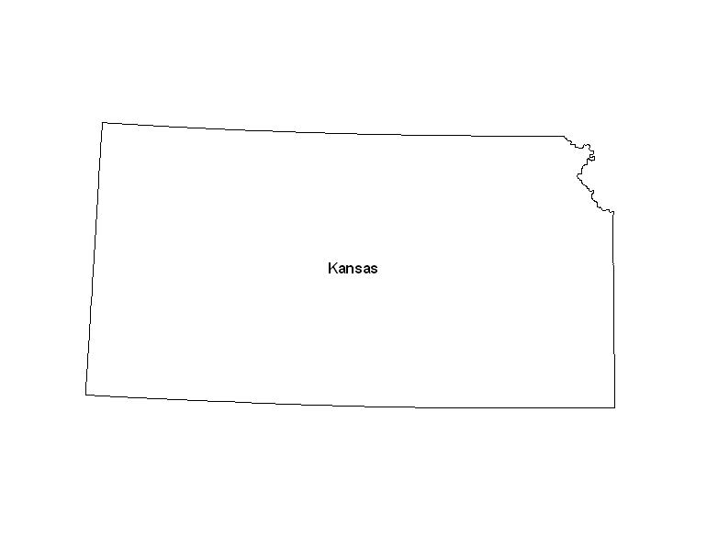
Locations
2006 – 2012
21 Site Years

Slide 5
Building the Model
Three algorithms were built, linked to Feekes 4-5, Feekes 6-7, and Feekes 8-9 growth stages
Why not use Growing Degree Days?
Issues with water stress slowing down the growth of wheat despite having adequate GDD. Increases error in model.
Inadequate weathernet, making calculation of GDD difficult for producers.

Slide 6
Building the Model
We use an N rich reference strip.
A separate, but similar, algorithm is used for different growth stages.
Adjust N recommendation for NUE.
Use NDVI of N reference strip to make a yield potential prediction.
A response index is calculated (Reference NDVI/ farmer practice NDVI) and is used to calculate percent recoverable yield.

Slide 7
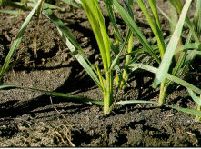
Significance of Feekes 2-3
Feekes 2-3 (Zadoks 21-29), Primary tillering stage
Most tillers are formed during Feekes 2-3.
Planting date, seeding rate and N rate all influence tiller numbers.
Normally starts in fall, but can extend after green-up
Image from “Growth stages of Wheat” TAMU publication SCS-1999-16, by Travis Miller.

Slide 8
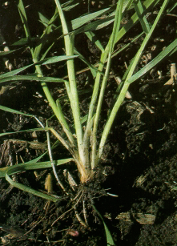
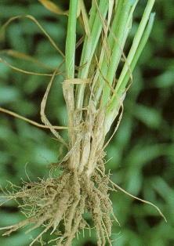
Significance of Feekes 4-5
Feekes 4 stage (Zadoks 30), this is the beginning of erect growth
Tiller formation is still occurring, but nearing the end
Feekes 5 stage (Zadoks 30), wheat plant is strongly erect
Significant tillers formation has stopped
Head size is determined, once the plant is vernalized
Feekes 4
Feekes 5
Images from “Growth stages of Wheat” TAMU publication SCS-1999-16, by Travis Miller.

Slide 9
Significance of N Management Around Feekes 4-5
It is important to ensure wheat is not N stressed during the Feekes 5 stage, due to head size determination. N applications during this stage can have positive effects on yield.
In split application strategies we need to apply enough N in the fall or make the second application early enough to support head development at Feekes 5.
Making applications at Feekes 4 will allow time for precipitation to move the N into the soil and root zone.
Downside to topdressing at Feekes 4 or earlier, is difficulty assessing N Mineralization. This may lead to over/under fertilization.

Slide 10
KSU Winter Wheat Algorithm

Slide 11
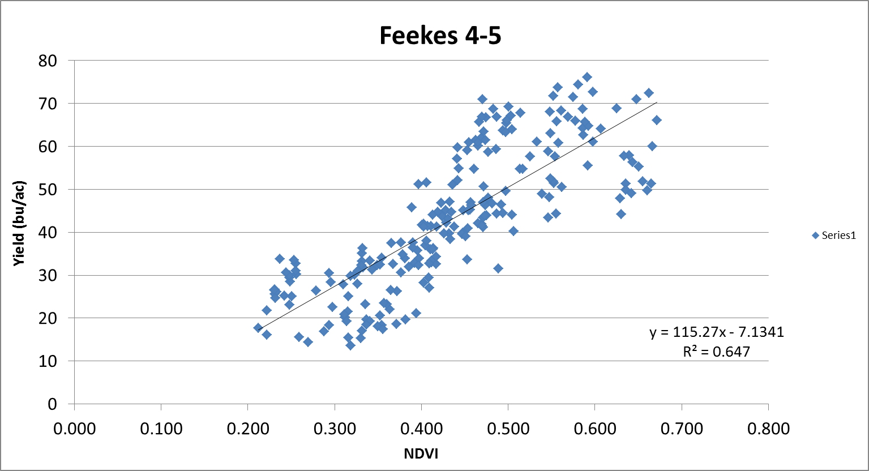
Feekes 4-5 Yield Potential

Slide 12
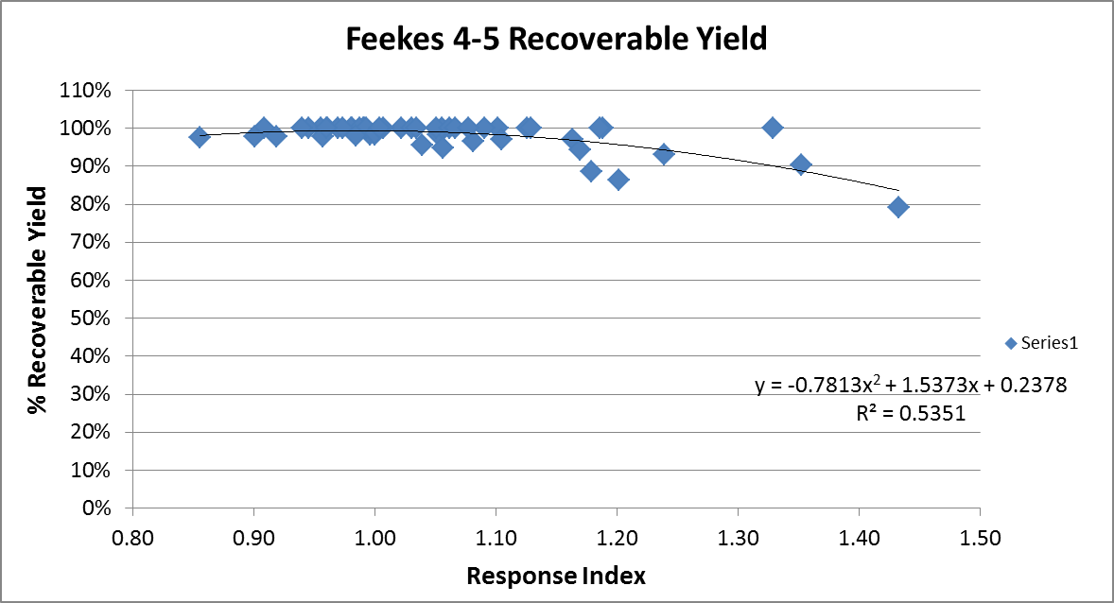
Feekes 4-5 Recoverable Yield

Slide 13
Feekes 4-5 Recoverable Yield
Response Index | % Recoverable Yield
< 1.30 | 100%
> 1.30 | 90%
> 1.50 | 80%

Slide 14
Five Yield Segments of N Coefficients
Feekes 4-9
Yield Potential | N Coefficient
>70 bu | 1.2 lbs
69-60 bu | 1.4 lbs
59-50 bu | 1.6 lbs
49-44 bu | 1.9 lbs
43-0 bu | 2.2 lbs

Slide 15
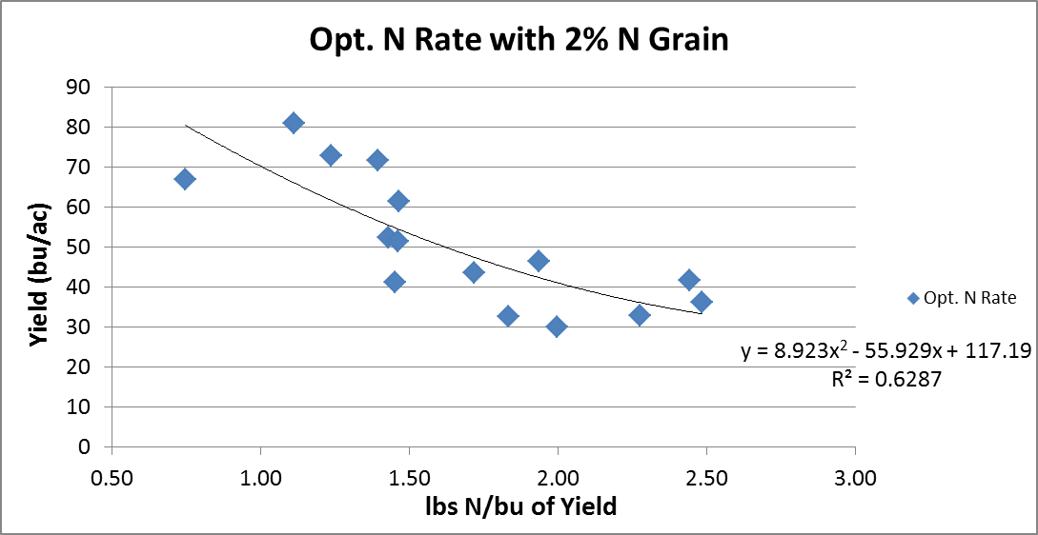
Efficiency of Yield

Slide 16
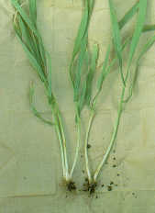
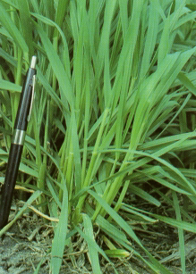
Feekes 6-7 Application Timing
Feekes 6 (Zadoks 31) – Jointing: One visible node above soil.
Feekes 7 (Zakoks 32-36) – Two visible nodes above soil with visible internode elongation.
Feekes 6
Feekes 7
Image from “Growth stages of Wheat” TAMU publication SCS-1999-16, by Travis Miller.

Slide 17
Significance of Feekes 6-7
Rapid growth and stem elongation.
Potential for tiller abortion due to N stress.
Occurs in April to May across Kansas in most years.
Later application allows more time to evaluate environmental conditions that may have a positive or negative effect on yield (ie. Precipitation and disease, mineralization of N)
Mineralization kicks in with Green-up, so the impact of mineralized N will be more apparent at Feekes 6-7.
Potential for N loss also begins to increase in March as precip rises during the spring.
Disease pressure generally begins to increase as crop canopy develops

Slide 18
KSU Winter Wheat Algorithm

Slide 19
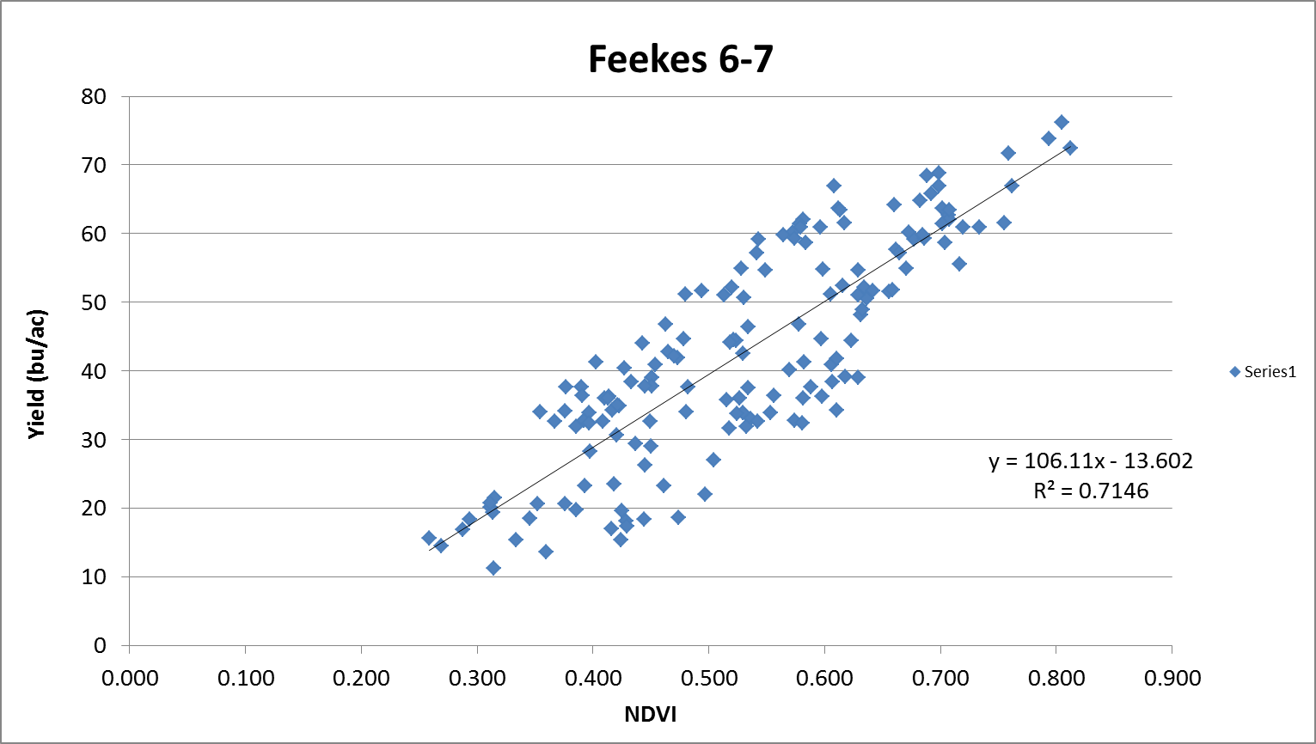
Feekes 6-7 Yield Potential

Slide 20
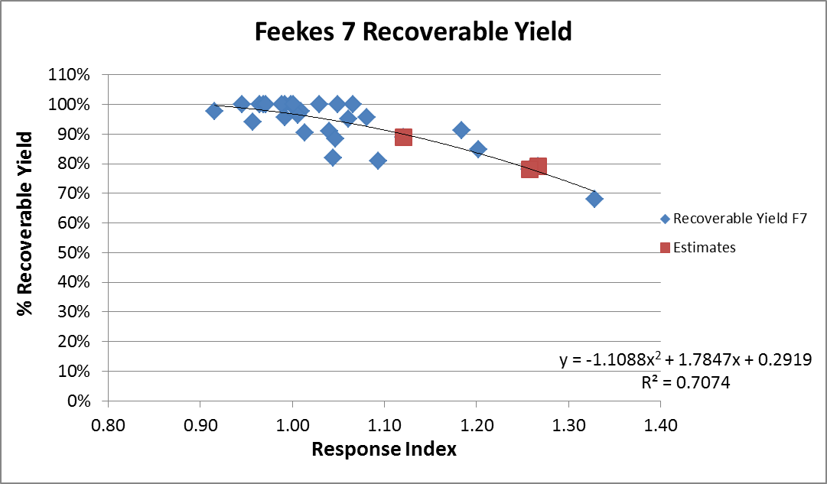
Feekes 7 Recoverable Yield

Slide 21
Feekes 7 Recoverable Yield
Response Index | % Recoverable Yield
< 1.10 | 100%
> 1.10 | 90%
> 1.15 | 85%
> 1.25 | 80%
> 1.30 | 75%
> 1.35 | 70%

Slide 22
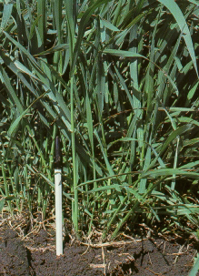
Feekes 8-9 Application Timing
Feekes 8 (Zadoks 37)– Flag leaf visible in whorl.
Feekes 9 (Zadoks 39)– Flag leaf fully emerged with ligule visible.
Feekes 8
Feekes 9
Image from “Growth stages of Wheat” TAMU publication SCS-1999-16, by Travis Miller.

Slide 23
Feekes 8-9 Application Timing
Significance:
Can’t fully recover yield loss from significant N deficiency at this stage.
Yield can be maintained from a late season N loss event.
Applications can also increase grain N/protein.

Slide 24
KSU Winter Wheat Algorithm

Slide 25
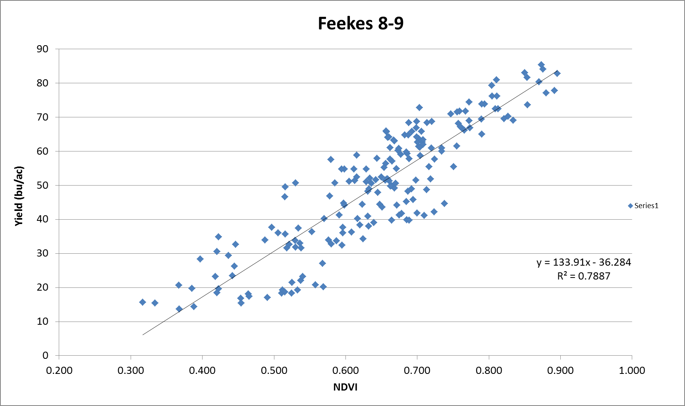
Feekes 8-9 Yield Potential

Slide 26
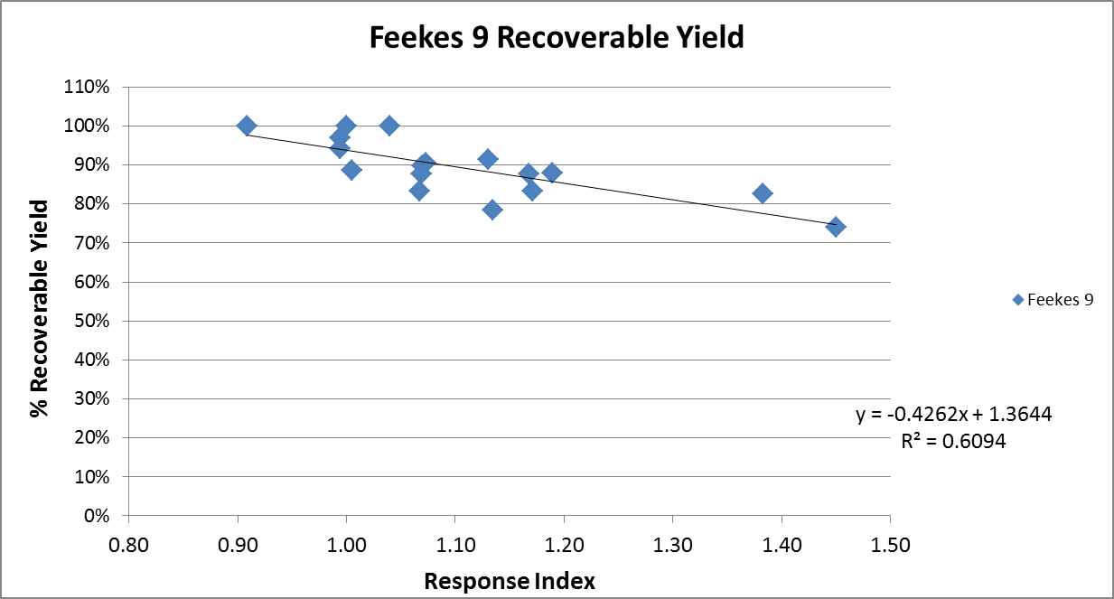
Recoverable yield showing decline at high RI at Feekes 8-9

Slide 27
Increasing Grain N and Protein
2011 Crop Year
All plots received 30 pounds N at seeding
N added Feekes 9 | Randolph Yield | Randolph Protein | Rossville Yield | Rossville Protein | Scandia Yield | Scandia Protein
0 | 39 | 12.2 | 52 | 12.2 | 20 | 13.9
25 | 38 | 11.9 | 58 | 12.6 | 23 | 15.3
50 | 40 | 12.1 | 55 | 13.1 | 23 | 16.3
2012 Crop Year
N added Feekes 9 | Gypsum Yield | Gypsum Protein | Nfarm F Yield | Nfarm F Protein
0 | 34 | 13.6 | 60 | 12.7
30 | 46 | 13.6 | 64 | 13.2
60 | 42 | 15.3 | 66 | 14.3
90 | 38 | 16.3 | 65 | 15.6
Notes:
Do we have data showing increase protein at F9?

Slide 28
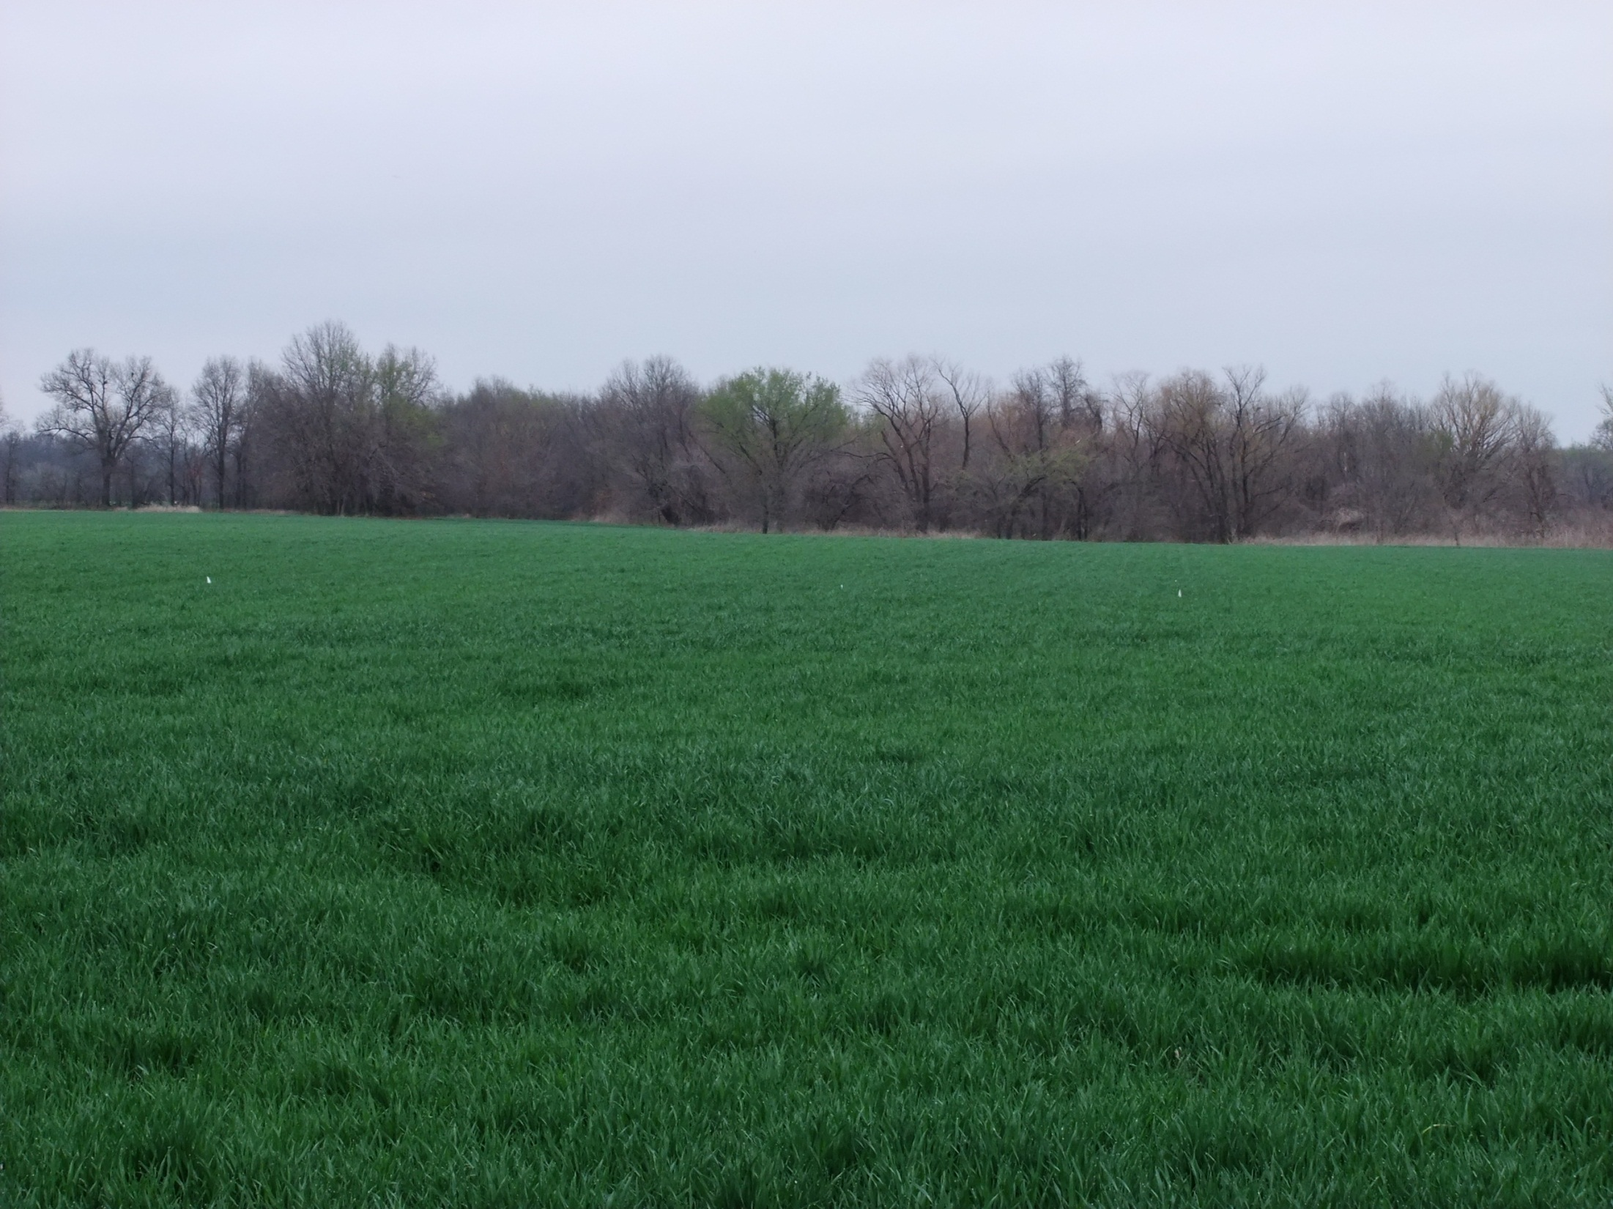
Initial Proofing of Algorithm Pittsburg, KS

Slide 29
Pittsburg, KS
Over 10 Sites visited
All sites were wheat following failed corn
6/5/2012 Harvest |  | 3/15/2012 Feekes 5-6 |  |  | 3/27/2012 Feekes 8
Treatment | Yield (bu/ac) | NDVI | Yield Pred. Feekes 4/5 Algorithm | Yield Pred. Feekes 6-7 Algorithm | NDVI | Yield Pred. Feekes 8/9 Algorithm
92lbs N as Urea | 68 | 0.73525 | 78 | 64 | 0.7763 | 68
Check | 63 | 0.7366 | 78 | 64 | 0.7616 | 66
52lbs N as AN | 71 | 0.76171 | 81 | 67 | 0.8149 | 73
92lbs N as Urea | 77 | 0.7855 | 83 | 70 | 0.8344 | 75
114lbs N as AN | 71 | 0.77315 | 82 | 68 | 0.8229 | 74

Slide 30
Pittsburg, KS
Over 10 Sites visited
All sites were wheat following failed corn
6/5/2012 Harvest |  | 3/15/2012 Feekes 5-6 |  |  | 3/27/2012 Feekes 8
Treatment | Yield (bu/ac) | NDVI | Yield Pred. Feekes 4/5 Algorithm | Yield Pred. Feekes 6-7 Algorithm | NDVI | Yield Pred. Feekes 8/9 Algorithm
92lbs N as Urea | 68 | 0.73525 | 78 | 64 | 0.7763 | 68
Check | 63 | 0.7366 | 78 | 64 | 0.7616 | 66
52lbs N as AN | 71 | 0.76171 | 81 | 67 | 0.8149 | 73
92lbs N as Urea | 77 | 0.7855 | 83 | 70 | 0.8344 | 75
114lbs N as AN | 71 | 0.77315 | 82 | 68 | 0.8229 | 74

Slide 31
Possible Improvements
Add more locations across Kansas
By Soil and Precipitation Region
Control Biomass Production

Slide 32
Directing Biomass
Wheat biomass production (fall and spring tillers) needs to be controlled in order to increase nutrient and water use efficiency, and reduce disease potential.
Tribune 2007 Drought, excess biomass resulted in yield reduction.
N Farm Field F 2012 heavy stripe rust due to high biomass, promoting a microclimate conducive to stripe rust, and severe yield reduction.

Slide 33
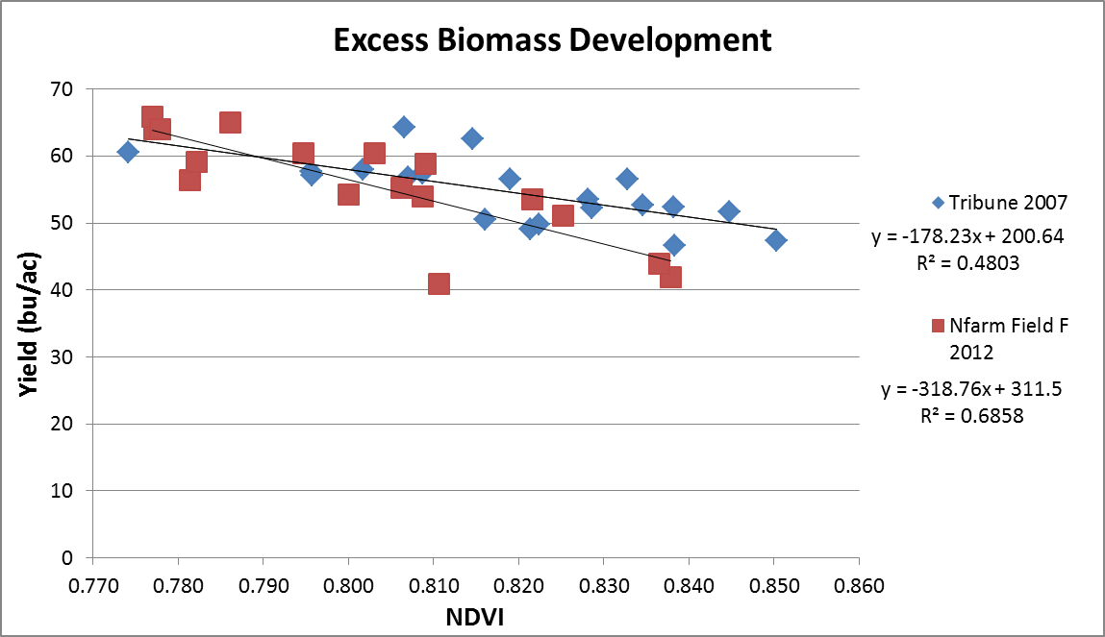
Directing Biomass Feekes 4

Slide 34
Research Plans
Continue proofing and improving algorithm by setting up N response studies and conducting observational trials throughout Kansas
Focus will be on amounts of fall or winter N needed to keep RI in the 1.1 to 1.2 range allowing high levels of recoverable yield and NUE utilizing late spring applications.
Start research on managing biomass using N timings and rate.
Avoid excess biomass production wasting water and creating conditions that favor disease development.
Other management factors to consider are planting date, seeding rate and row spacing.

Slide 35
References
Miller, T. , Growth stages of Wheat. TAMU publication SCS-1999-16. Retreived from http://varietytesting.tamu.edu/wheat/docs/mime-5.pdf
Herbek, J., Lee, C., (2009). A Comprehensive Guide to Wheat Management in Kentucky. Retrieved from http://www.uky.edu/Ag/GrainCrops/ID125Section2.html

Slide 36
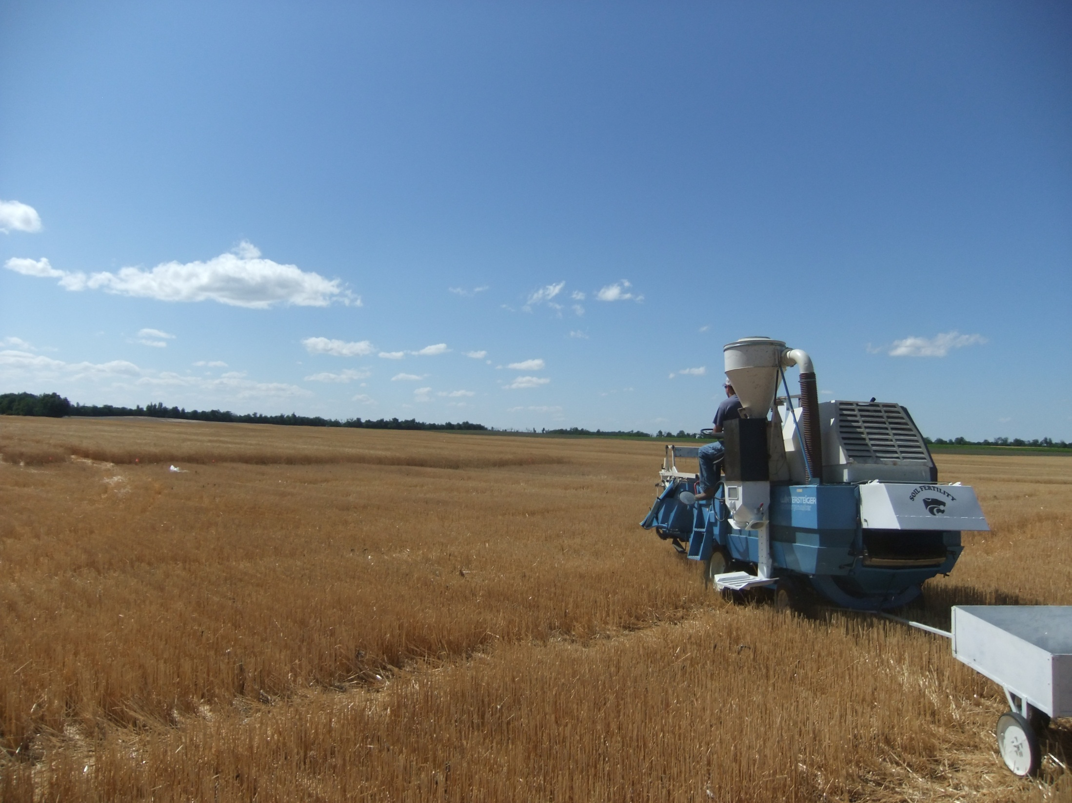
Questions???

