Slide 1
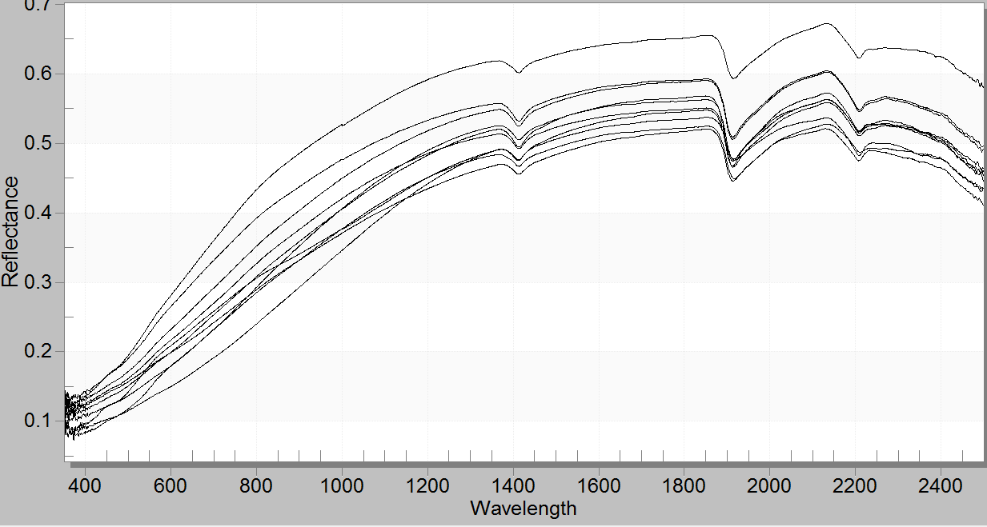
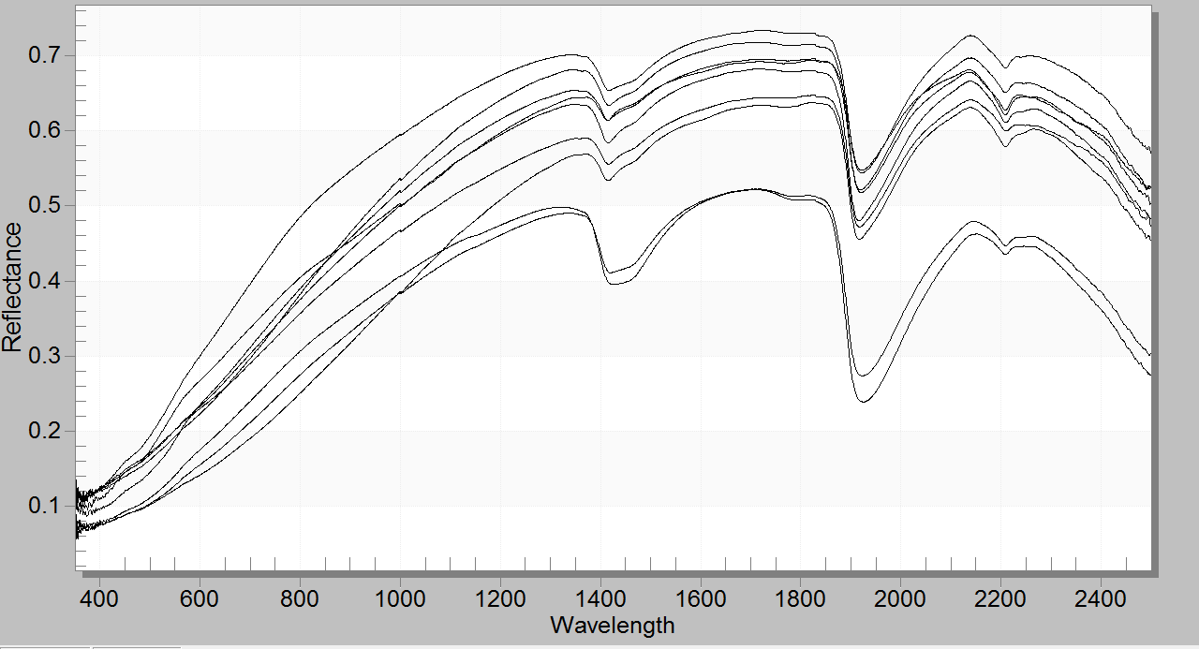
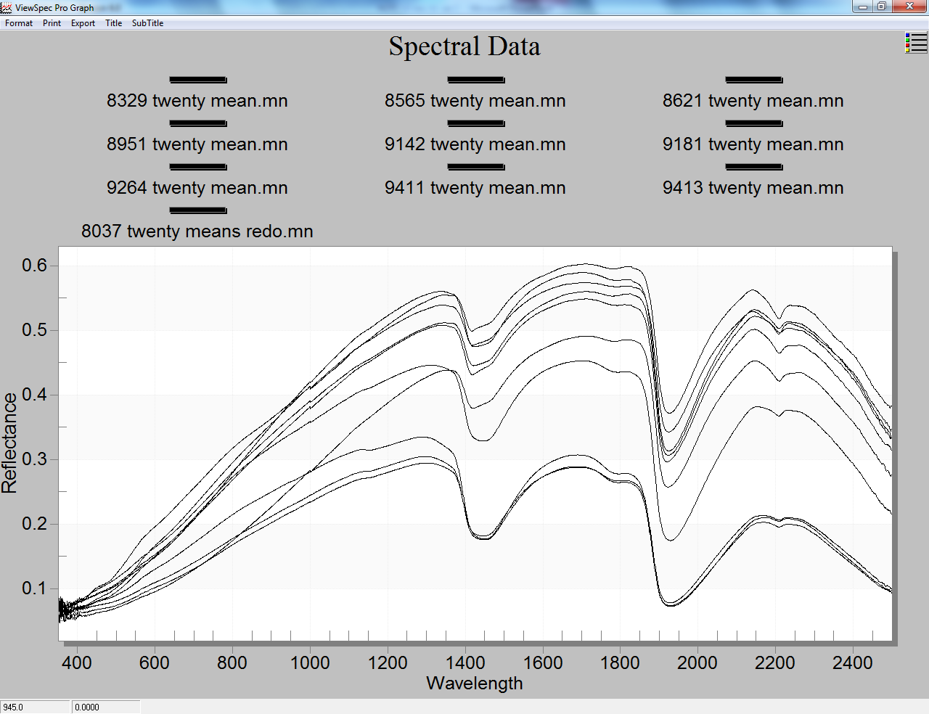
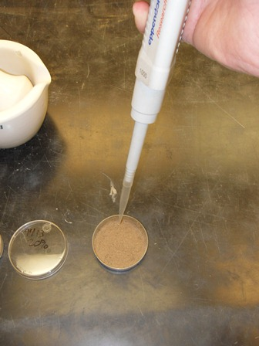
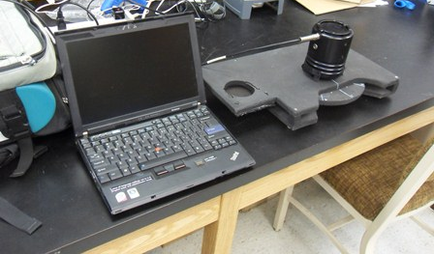
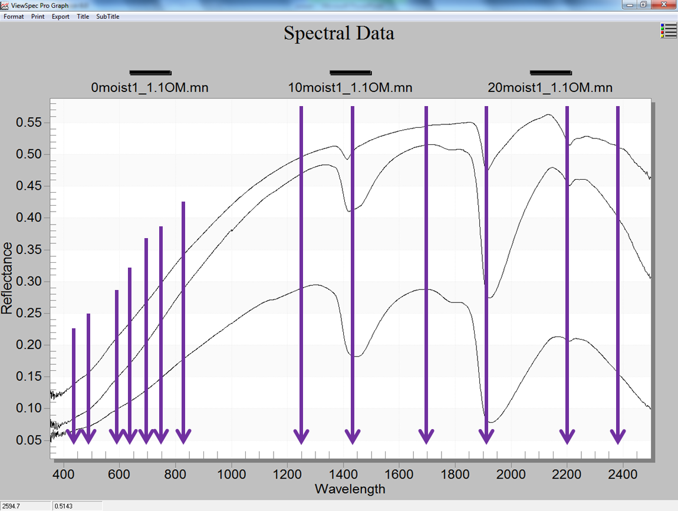
Using Sensors to Determine Organic Matter, Nitrogen and Phosphorus in Kansas Soils
Robert Florence, Ray Asebedo, Kevin Price, and David B. Mengel
Department of Agronomy at Kansas State University, Manhattan, KS
Email: florerj@ksu.edu
Introduction
Fertilizer nitrogen (N) and phosphorus (P) are important inputs used in crop production. Adequate levels of both N and P are important for achieving optimum crop yield. Unfortunately, over application of N and P can contribute to water quality issues.
Soil organic matter (SOM) contributes available nitrogen throughout the growing season. KSU fertilizer recommendations currently credit 10 and 20 lbs of N/Acre to Winter and Summer crops, respectively, for each percent Walkley–Black OM. Nitrogen present from a previously failed crop may still reside in a soil prior to a new planting which would reduce the amount of N fertilizer required.
Ability to measure OM, nitrate N, and available P in the field with a spectrometer would add another tool in the precise application of N fertilizer.
Results
Predicted versus measured values for 25 soils at 0% gravimetric moisture
Organic Matter
 | Intercept | P-Value
 | 10 | 0.026
Wavelength (nm) | Slope Coefficient | P-Value
550 | -83 | 0.02
975 | 205 | 0.011
1230 | -441 | 0.002
1402 | 235 | <0.0001
1675 | 560 | 0.01
2132 | -209 | <0.0001
Nitrate
 | Intercept | P-Value
 | 143 | 0.001
Wavelength (nm) | Slope Coefficient | P-Value
450 | 1186 | 0.0207
550 | -1327 | 0.0238
785 | 545 | 0.0226
1675 | -402 | 0.0006
Objectives
Total Nitrogen
 | Intercept | P value
 | .657 | 0.0001
Wavelength (nm) | Slope Coefficient | P-Value
975 | 2.84 | 0.0001
1230 | -14.34 | 0.0051
1402 | 17.67 | <0.0001
2331 | -6.56 | <0.0001
Phosphorus
 | Intercept | P-Value
 | 179 | 0.14
Wavelength (nm) | Slope Coefficient | P-Value
450 | 12496 | 0.0001
550 | -16389 | 0.0008
650 | 125697 | 0.0001
670 | -151041 | 0.0001
760 | 38603 | 0.0002
975 | -8496 | 0.0003
1402 | 8915 | 0.0077
1675 | -9900 | 0.0264
2132 | 11261 | 0.0213
2331 | -8805 | 0.0085
To determine if useable correlations could be developed between wet lab analyses and spectrometer readings for SOM, total N and available P in Kansas soils.
To establish the effect of soil moisture on the reflectance values of specific wavelengths and the measurement of the soil properties in question.
Soils – 25 Kansas soils were dried for 48 h at 60ºC, ground, sieved to 2 mm. After preparation, soils were analyzed for Walkley-Black SOM content, KCl extractable nitrate, Mehlich 3 available P, 1:1 soil to water pH, and total N using a LecoTruspec CN.
Example of linear equation format:
Predicted soil property
=
Intercept + (750 nm reflectance x 750 nm coefficient) + (975 nm reflectance x 975 nm coefficient) + …
Methods and Materials
Effect of moisture on reflectance for 10 soils
Water Content – Ten soils were prepared at 0, 10, and 20% gravimetric water content to determine the effect of soil water content on reflectance. Desired water content was created by placing 10 g of soil in a petri dish, and applying 0, 1, and 2 g of DI water with a micro pipette. Soil was mixed, allowed to equilibrate for 1d, and surface patted flat to reduce shadow effects.
Spectrometer readings – Soils were further ground in a mortar and pestle, and placed in a Petri dish. Ten readings of multiple wavelengths between 450 and 2400 nm were made from each sample with an ASD spectroradiometer. Reflectance data was processed with ViewSpec Pro V.6.0 software.
Statistical Analysis – Thirteen Wavelengths (450, 550, 650, 670, 760, 785, 975, 1230, 1402, 1675, 1905, 2132, and 2331 nm) were chosen from visual inspection of the spectra. Using SAS 9.2 (Cary, NC), backwards stepwise regression was performed on the soil properties to produce a linear equation using only wavelengths that showed significant reflectance at α = 0.05 level. Linear equations from stepwise regressions were used to predict soil properties. To evaluate the effect of soil moisture on reflectance, stepwise regression was performed on ten soils, each at three different moisture contents.
0% gravimetric moisture
10% gravimetric moisture
20% gravimetric moisture
Predicted versus measured values for 10 soils with 0, 10, and 20% gravimetric water content
 | Intercept | P-Value
 | 0 | 0.049
Wavelength (nm) | Slope Coefficient | P-Value
450 | 4 | 0.0003
650 | 91 | <0.0001
670 | -166 | <0.0001
760 | 222 | <0.0001
785 | -155 | <0.0001
975 | 6 | 0.0045
1230 | -8 | <0.0001
1675 | 10 | <0.0001
1905 | 5 | <0.0001
2331 | -9 | <0.0001
 | Intercept | P-Value
 | 3 | 0.0393
Wavelength (nm) | Slope Coefficient | P-Value
450 | 43 | 0.0406
650 | 1022 | 0.0021
670 | -2277 | <0.0001
760 | 4631 | <0.0001
785 | -3614 | <0.0001
975 | 197 | <0.0001
1230 | -112 | 0.0017
1402 | 108 | 0.0021
1675 | 63 | 0.0218
1905 | 56 | <0.0001
2331 | -147 | <0.0001
 | Intercept | P-Value
 | 71 | 0.1146
Wavelength (nm) | Slope Coefficient | P-Value
650 | 43 | <0.0001
670 | 1022 | <0.0001
760 | -2277 | <0.0001
975 | 4631 | 0.0014
1230 | -3614 | <0.0001
1675 | 197 | 0.0001
2132 | -112 | 0.0184
Many wavelengths can be utilized to construct a linear equation to predict OM, total N and P. Moisture greatly affects soil reflectance. Moisture can be accounted for by using certain wavelengths, allowing a prediction across soil moisture content. It is important to note that these readings were done on bare soil. Readings in the field may have residue blocking soil reflectance, and will likely only give similar readings if the soil under the residue surface is exposed or extracted. For similar equations to be useful across a broad range of Kansas soils, many more samples beyond the number of wavelengths used as predictors must be included.
Conclusion
The authors would like to thank Nan An for technical support with the spectroradiometer, along with Lynn Hargrave and Kathy Lowe for soil analysis.
Acknowledgments

